Slide 1
Beam Cooling – An Introduction
And Overview
Christoph Leemann
Slava Symposium
Jlab August 2, 2010

Slide 2
Overview
___________________________________________________________________________
Introduction
Physics at the Energy and “Particle” Frontier –”View from 20,000 m”
Beam cooling – Why so important?
Synchrotron radiation damping –an illustrative digression
For ionization cooling, electron cooling, and stochastic cooling:
Concept
Components and devices
Rudiments of theory
Summary and Conclusions

Slide 3
Introduction – Do I Need To Wear A Tie To A Symposium?

Slide 4
Physics at the Energy and “Particle” Frontier –A “View from 20,000 m”
_____________________________________________________________________________”
Our knowledge comes from a few large accelerator/collider facilities
Lepton colliders:
PEP, PETRA, KEK via the B-Factories to LEP (and maybe the ILC, CLIC, or a Muon Collider)
Hadron colliders
SPS to the Tevatron to the LHC
The “heavies”
RHIC (née CBA), FAIR, and (maybe the LHC)
All rely on processes that compress phase space occupied by beam
Critically, strongly, somewhat or for upgrades
For the leptons “nature” provides (at least the opportunity)
For all others “engineered approaches”, i.e. “beam cooling” is needed
Beam cooling has enabled much of the particle physics progress of the last thirty years

Slide 5
And Just Why Is That So?
Experimenters , users - are impatient people – they want their data fast
Their Holy Grail: integrated luminosity – lots of it and more if the can get it
Therefore:
Luminosity – achieve it!
Luminosity life time – keep it!
Luminosity:
L= NNf/A with A = ε_{n}β* /βγ
Beam-beam strength:
ξ = Nr/πε_{n} therefore L = (βγξπ /r )Nf/ β*
The key figures
ε
N/ε
And to some extent (via limits on β*) δp/p

Slide 6
And This Is How
Accumulation of particles produced in diluted form (antiprotons, muons) and “stuffing” them inside some useable emittance ε
Possibility of one – ring scenarios
Further reduction of stored beam’s emittance - ideally to the levels imposed by ξ
Maintaining emittance in presence of IBS and other “noisy” processes

Slide 7
Synchrotron Radiation –an illustrative Digression
Synopsis of process:
Energy loss due to radiation (momentum loss in all 3 dimensions)
Energy loss restored by rf system (restoration along longitudinal motion)
Leads to reduction of betatron and synchrotron amplitudes (“cooling”)
Random nature of photon emission leads to “heating”
Result: an equilibrium distribution shaped by lattice design characteristics
longitudinal
transverse

Slide 8
Synchrotron Radiation (Continued)_
A paradigm and inspiration for the inventors of electron and ionization cooling
Introduces many concepts encountered again in “human made” beam cooling:
A “coherent” decrement or cooling rate
A competing heating mechanism leading to an equilibrium distribution
For leptons:
Fast and efficient cooling process
A limitation on achievable energy in circular accelerators via RF power needed
Slow for hadrons up to tens of TeV: no pain, no gain – at best/worst a nuisance

Slide 9
What If You Can’t Wait? – Ionization Cooling
ΔE energy
gain from rf
ΔE energy
gain from rf
ΔE
energy loss
ΔE
energy loss
Transverse cooling is evident
Cooling rate straightforward to calculate
Ultimately limiting: multiple coulomb scattering
Longitudinal cooling compromised – energy straggling, weak energy dependence
of process, absence of rf bucket
Requires deliberate coupling with transverse phase planes – more
easily said than done but demonstrated on paper
More soon from MERIT, MICE, MANX, EMMA

Slide 10
Electron Cooling – Concept and History _____________________________________
Alternate ways to visualize the process:
Ionization (dE/dx) cooling without the annoying nuclei
Heat exchange between a hot and a cold gas –cold gas continually replenished
kT = 1/2mv² =1/2MV² → V/v=(m/m)^{1/2}
Key components: “cold” electron beam, ~ 1 A, γ_{e}=γ_{p} or E_{e}[keV] ≈ E_{p}[MeV]/2
Inventors and pioneers
Institute of Nuclear Physics, Novosibirsk, NAP-M, 1966, 1974
CERN, starting in 1970’s, Initial Cooling Experiment (ICE), LEAR, and AD
FNAL, Electron Cooling Ring
Contemporary operational installations
FNAL recycler
ESR at GSI, Darmstadt
Outlook: e-cooling at high energy (E_{ion} ~ 100 GeV/u)

Slide 11
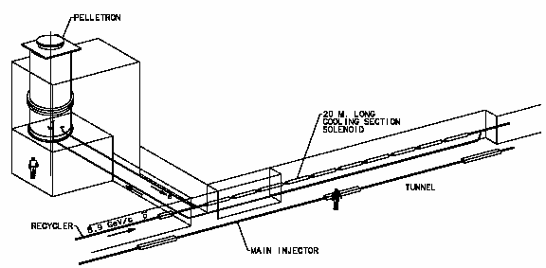
Electron Cooling – The Devices
Schematic of one of the CERN cooling installations
Schematic of Recycler e-cooling set-up
E_{e} = 4.34 MeV
I_{e} = 0.5 A
ΔE _{abs} < 0.3%
E _{ripple} < 10-4
E-angle < 200 μrad

Slide 12
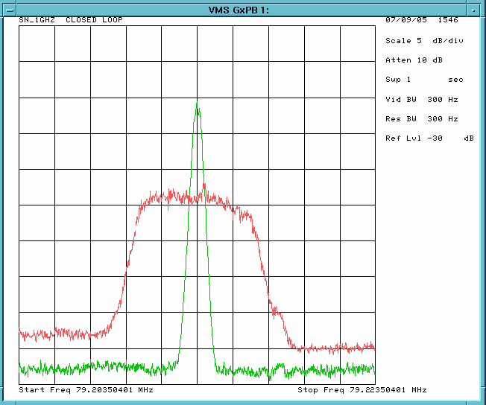
Electron Cooling – A Beauty from the Recycler

Slide 13
Electron Cooling – At its Best for Already Cool Beams of Moderately Low Energy
is the relative difference in angle between
ions and electrons (θ_{i} - θ_{e}), [θ_{i}=√(ε/β)]
The parameter η = L_{cooler}/L_{machine}
and I_{e} is the electron current.

Slide 14
Stochastic Cooling – Layout and Essential Components _______________________________
Shown is a single system – typically 3 or more are arranged around the ring
Pick-ups and kickers:
Δ or Σ devices
Arrays of multiple units (S/N and power concerns)
Broadband, 2-4 GHz, 4-8 GHz
Location and lattice requirements
Betatron phase advance (2n+1)π/2 (transverse cooling)
Presence or absence of dispersion
Long straights with optimized β
Amplifiers
100 to 200 db gain
Low noise
Harmonic filters for some types of momentum cooling
Kicker
Amplifiers & Transmission
Lines, Filters
Pick-Up

Slide 15
Stochastic Cooling – “Gedankenexperiment” Proof of Principle
_________________________________________
X_{i,k+1} = X_{i,k}-gX_{i,k}-gΣ^{n}X_{j,k} n=N/2WT
Δ(X_{i}²) = -2gx_{i}²+g²Σ^{n}x_{i}²-2gΣ^{n}x_{i}x_{j}+g2Σ^{n}Σ^{n}x_{j}x_{k}
With <x_{i}x_{j}>=0, i ≠ j
Δ<X²> = -2g<X²>+g2N<X²>
τ=W/2N
2gΣ^{n}x_{i}x_{j}+g2Σ^{n}Σ^{n}x_{j}x_{k}
represents correlations, not strictly 0, introduced by feedback system, full treatment best in frequency domain
N, T
g, W
Kicker
Amplifiers & Transmission
Lines, Filters
Pick-Up

Slide 16
Stochastic Cooling – Elements of a Theory
Needed: a “mixed” representation
Frequency domain for time scales of the order of the revolution time
Time domain for time scales of the order of the cooling time
Steps
Particle signal – Schottky spectrum
Proper representation of amplifier, transmission, signal - particle delays
Influence of other particles
Derive
Cooling rates: single particle, low order moments
Signal suppression
Fokker – Planck equation for more complex distributions

Slide 17
Real World Installations (Cooling H, V, DP) – An Overview ________________________________________________________
Institution Use Frequencies [MHz]
CERN pioneering experiments 50 to 2,000
“production “ HEP 150 to 3,000
FNAL pioneering experiments 20 to 400
“production” HEP 1,000 to 8,000
KFA Jülich user experiments 1,000 to 3,000
GSI user experiments 900 to 1,700
Significant high energy systems planned for RHIC II and FAIR at GSI

Slide 18
Real World Systems – An Overview ________________________________________________________
Vertical betatron cooling vertical Δ pickup, vertical kicker separated by(2n+1)π/2 phase advance
Horizontal betatron cooling horizontal Δ pickup, no dispersion
horizontal kicker, (2n+1)π/2 phase advance
Momentum cooling horizontal D pickup, large dispersion
longitudinal kicker, no dispersion
Momentum cooling (filter) Σ pickup, periodic notch filter
longitudinal kicker, no dispersion
Issues: bandwidth & power: 1 to 8 GHz
noise: overcome 1kT [W/Hz] thermal noise
Pickups and kickers are arrays of 100’s of units, occupying many meters of drift length

Slide 19
“Down In The Weeds” – Some Interesting EM ________________________________________________________
Some insight helps before turning on
the big codes!
V_{B}=0.5 Z_{c}/V_{T}∫dVE_{T}• J_{B}
In words: the output voltage (at frequency Ω) at a terminal plane S_{k} in the k_{th} output port generated by a current density J_{B} (at Ω) is given by the volume integral above, where E_{T} is the E-field generated by an input voltage V_{T} at the plane S_{k}!
S₁
S₂
S₅
S₆
beam
S₄
S₃

Slide 20
“Down In The Weeds” – Some Interesting EM (Continued) ________________________________________________________
x
+
Transverse deflection and transverse variation of longitudinal acceleration are related
The equations of motion and Maxwell’s equation quantify the relation
s
-
y
Δp_{x} = i/Ω ∂/∂x ΔE_{s}(x)
ΔE_{s}(x) = e∫dsE_{s}(x,s)exp(i(Ω/v)s)

Slide 21
Summary and Conclusions ________________________________________________________
Beam cooling is one of the great achievements of accelerator science and technology
Beam cooling techniques have been essential to the progress of particle physics over the last thirty plus years
Electron and stochastic cooling are mature technologies, regularly and reliably used in a demanding operational environment
Electron cooling at much higher energies and stochastic bunched beam cooling open up exciting possibilities
…and we can’t wait for a muon cooling demonstration!

