Slide 1
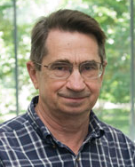
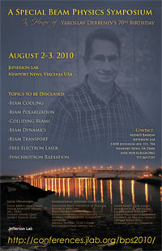
Slava and Coherent Electron Cooling or Cool side of Slava
Vladimir N. Litvinenko
C-AD, Brookhaven National Laboratory, Upton, NY, USA
Department of Physics and Astronomy, Stony Brook University
Center for Accelerator Science and Education

Slide 2
Content
Bits of memory from 36 years ago forward
Cool side of Slava
Few serious slides
Instead of conclusion
V.N. Litvinenko, Y.Derbenev's 70th Birthday Symposium, JLab, August 2, 2010

Slide 3
From Slava’s resume….
M.S., Moscow State University, 1963
Soviet Candidate Degree, Institute of Nuclear Physics, Novosibirsk, 1968
Soviet Doctoral Degree, Institute of Nuclear Physics, Novosibirsk, 1978 Doctoral Thesis "Theory of Electron Cooling”
Career:
Staff Scientist, JLab, 2001-present xxxxxxxx 2003-2010
Visiting Research Scientist and Adjunct Professor, Physics Dept., University of Michigan, 1990 - 2001
Chief Scientist, Accelerator Physics and Laser Technology Group, Institute of Complete Electric Drive, Novosibirsk, Russia, 1986-1990
Chief Scientist, Institute of Physics, Atomic Energy Committee, Yerevan, USSR, 1985-1986
Chief Scientist, Accelerator Theory Group, Institute of Nuclear Physics, Novosibirsk, Russia, 1969-1985 1977-1985
Junior Scientist, Theoretical laboratory of the Institute of Nuclear Physics, Novosibirsk ,Russia, 1963-1968
Teaching
1990-1993: Advanced Accelerator Physics Graduate Course (level 600), University of Michigan,
1965-1983 Graduate level seminars in general and quantum physics, Novosibirsk State University 1974

Slide 4
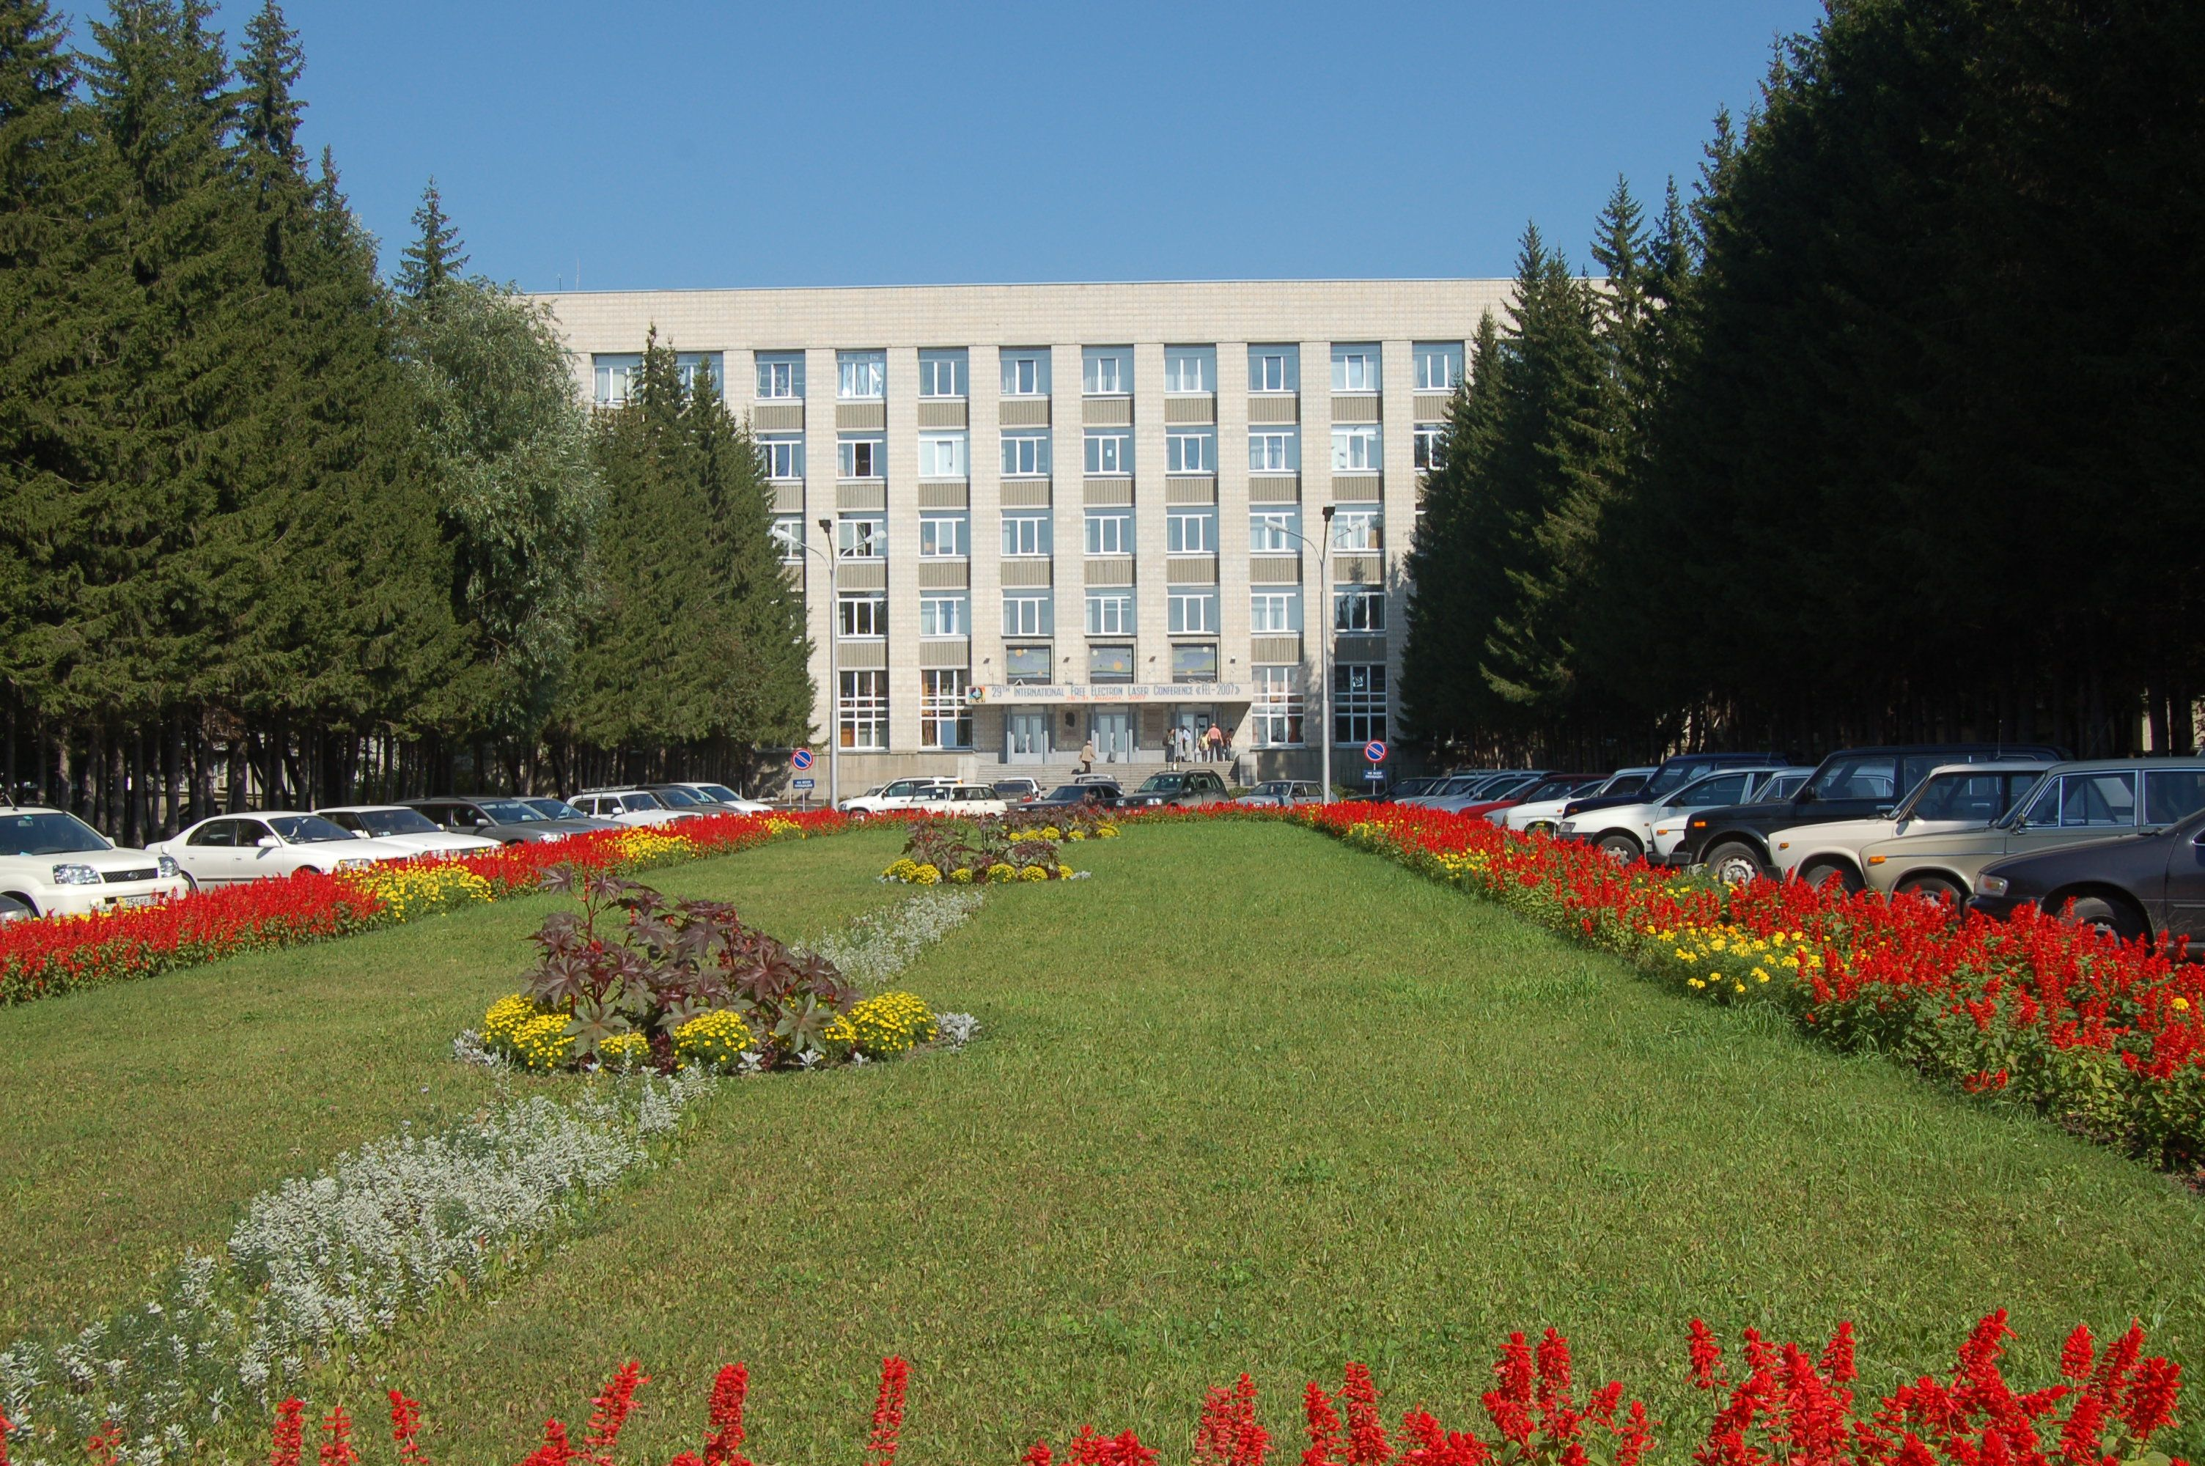
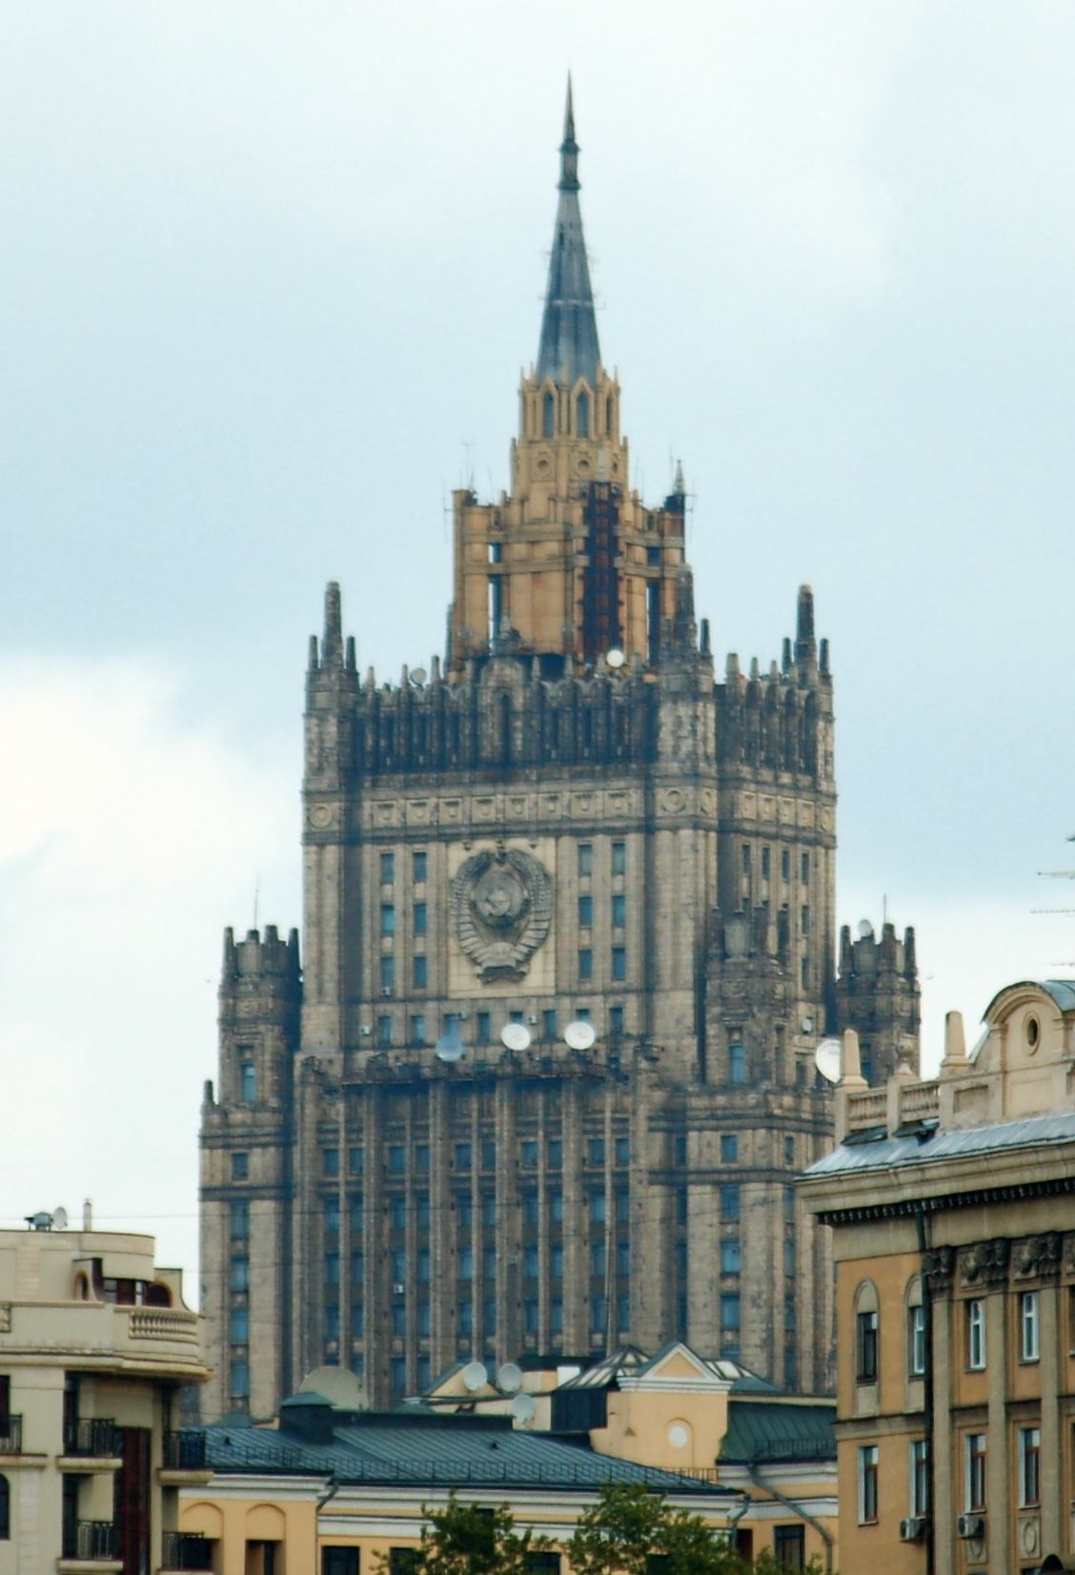
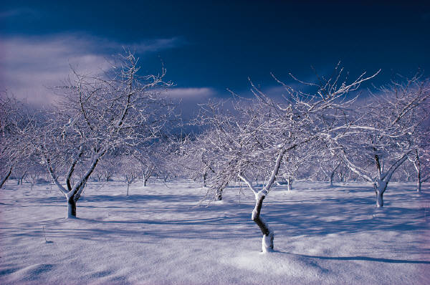
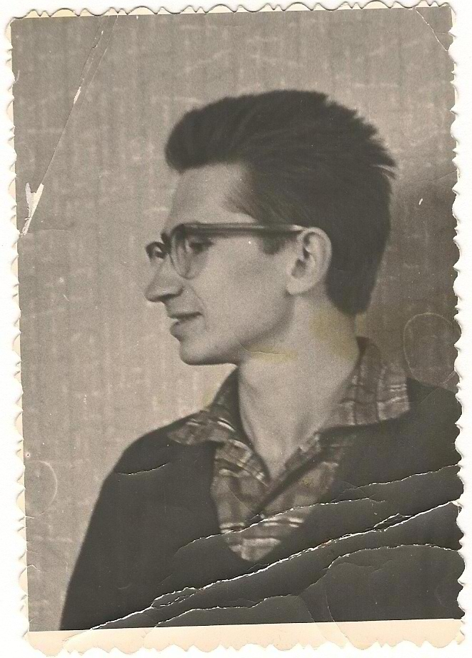
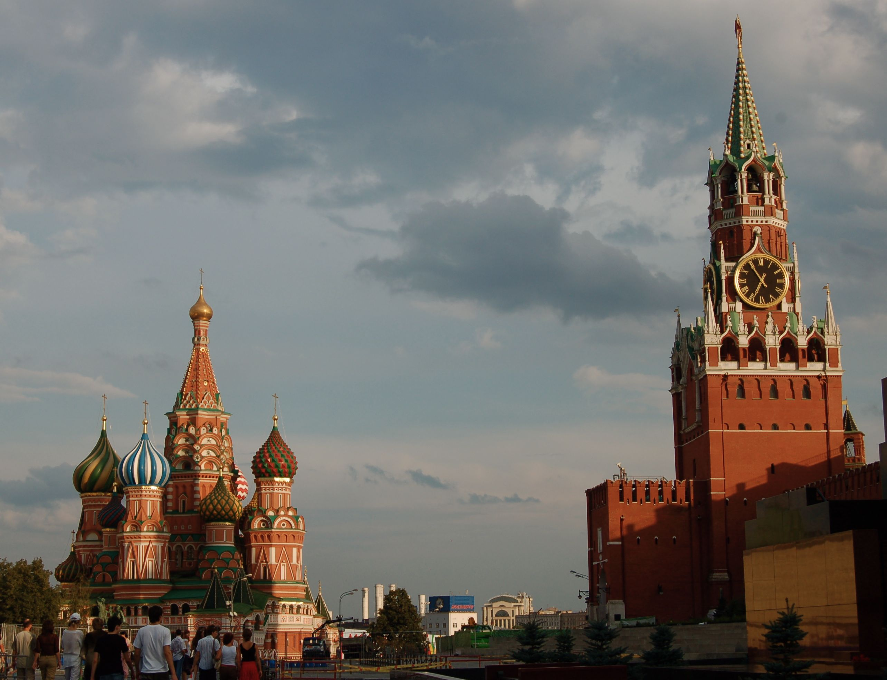
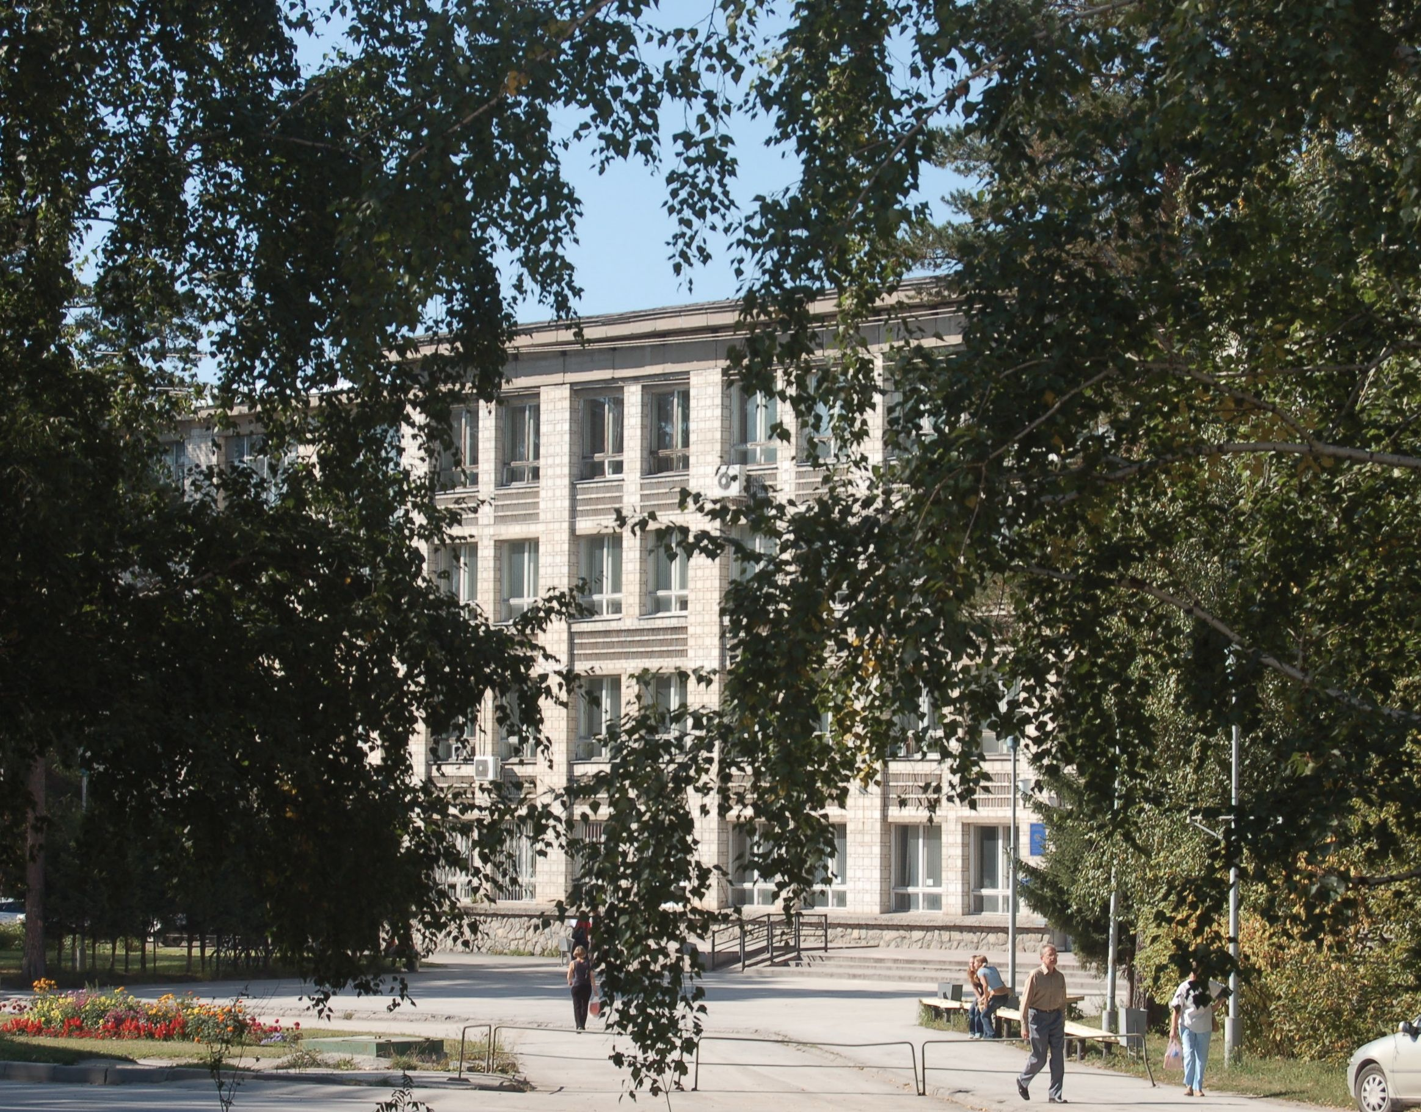
From Moscow to Siberia

Slide 5
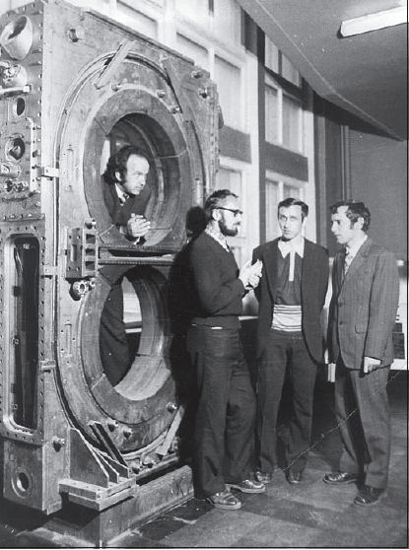
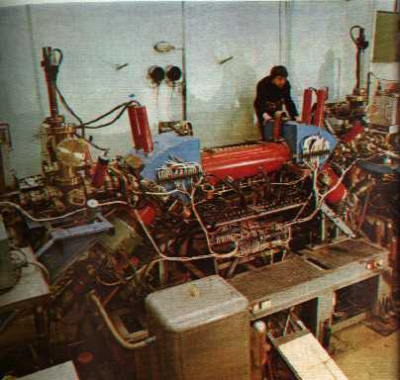
Novosibirsk Budker Institute of Nuclear Physics
Siberian snakes
Magnetized cooling
Beam-beam effects
Notes:
Innovative spirit at INP was perfect environment for Slava to develop many facets of his creativity: colliding-side, spin-side and the cool-side.
No problems were too tough to crack!
There was one more side of Slave– teaching.

Slide 6
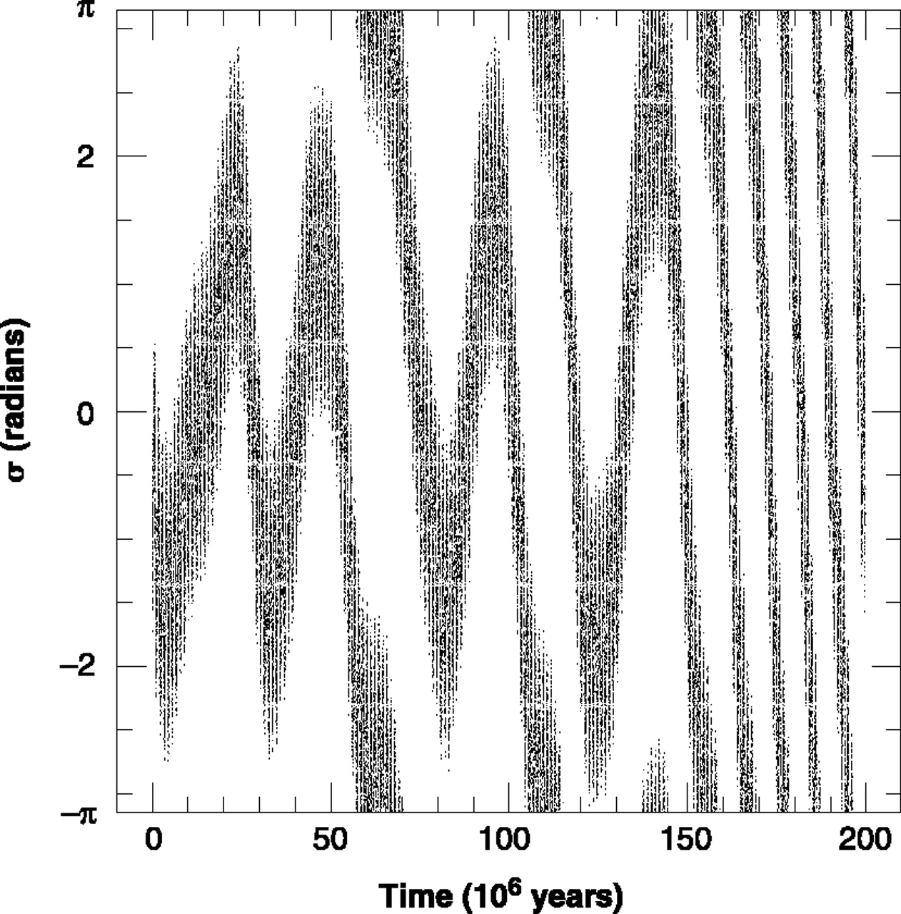
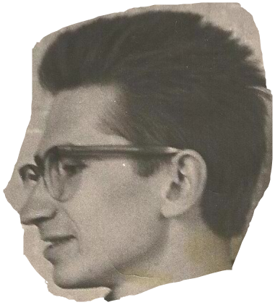
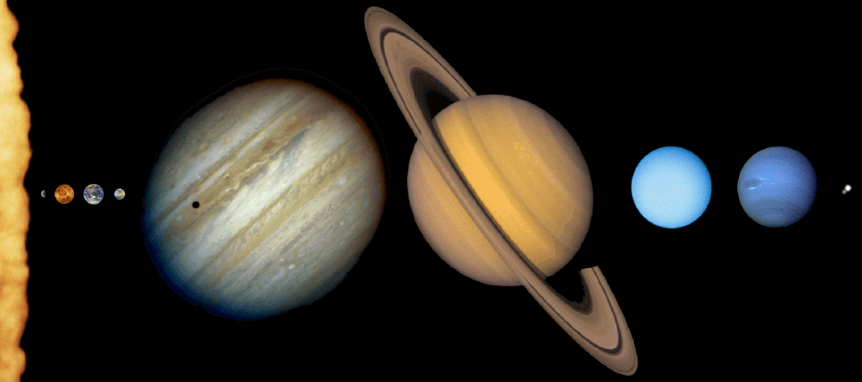
Slava as my teacher Analytical Mechanics 1974
Notes:
It was very interesting experience for our class – following the equation derivation done by Slava was the blast! Clear elegant logic,
Which defied words. Words were not necessary and and also not very helpful.

Slide 7
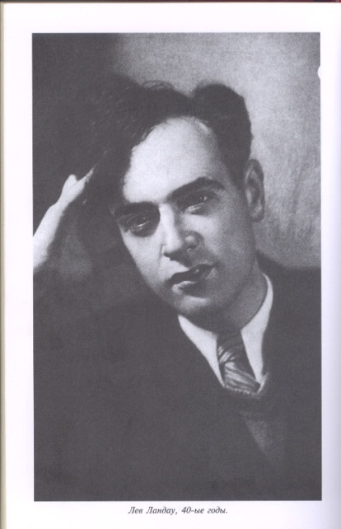
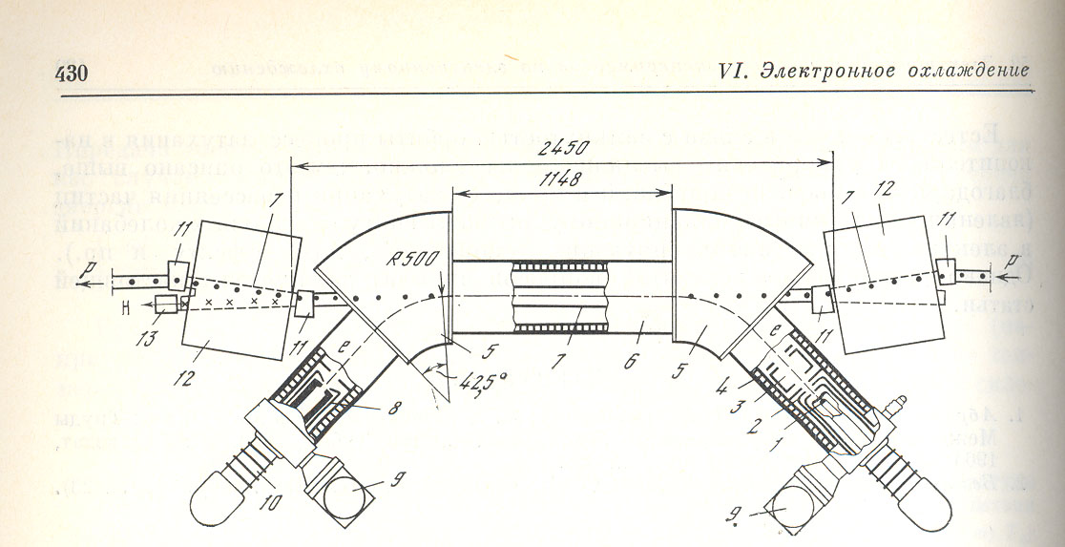
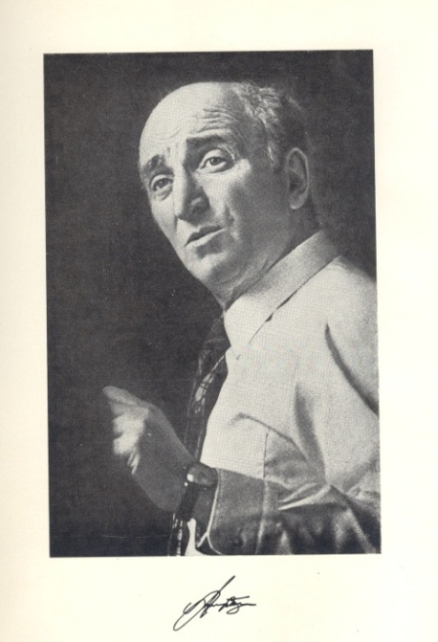
Electron Cooling
Budker’s idea – if we put hot hadron gas in contact with cold electron gas after a period of thermal relaxation they will have the same temperature in the c.m. frame
Was is too simple for Slava to get involved?
Kinetic equation (plasma relaxation) was derived by Landau in 1937. But… can it work for beams? It does! Yet very interesting and important phenomena have been discovered (magnetized cooling, super-deep cooling, christaline beams…) © Ya. Derbenev
Notes:
Kinetic equation (plasma relaxation) derived by Landay in 1937. But…can it work for beams? It does! Yet

Slide 8
1975 – NAP Surprise!
Rise to the cool side of Slava
The cooling time is much shorter than
Budker’s estimate!
Explained!
Magnetized Cooling
Just complex enough to get Slava interested !
e⁻
B
Interaction of an ion with “a Larmor circle”

Slide 9
Not cool enough for Slava?
Slava is on of the first who recognized direct connection between stochastic and electron cooling
Since 1980 he works on the ways to electron cooling by all means possible, including amplifying the media response on presence of a charged hadron.
Many e-Beam instabilities (including FEL) were tried to fit the task
Y.S. Derbenev, Proceedings of the 7th National Accelerator Conference, V. 1, p. 269, (Dubna, Oct. 1980)
Coherent electron cooling, Ya. S. Derbenev, Randall Laboratory of Physics, University of Michigan, MI, USA, UM HE 91-28, August 7, 1991
Ya.S.Derbenev, Electron-stochastic cooling, DESY , Hamburg, Germany, 1995
And many more…

Slide 10
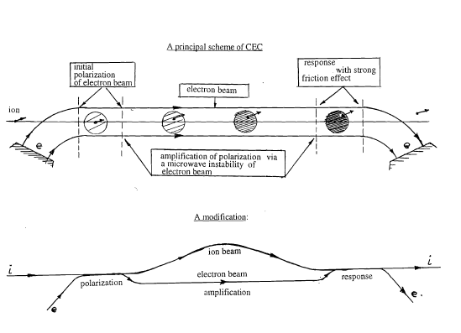
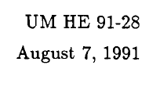
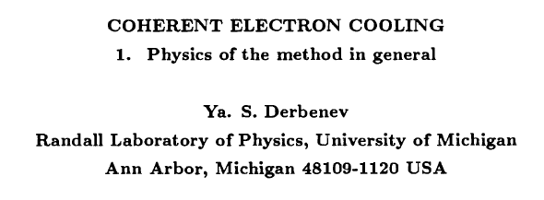
Coherent Electron Cooling

Slide 11
CeC - Equations

Slide 12
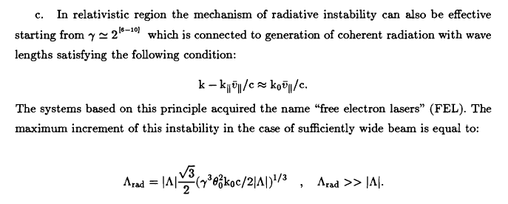
CeC - Equations

Slide 13
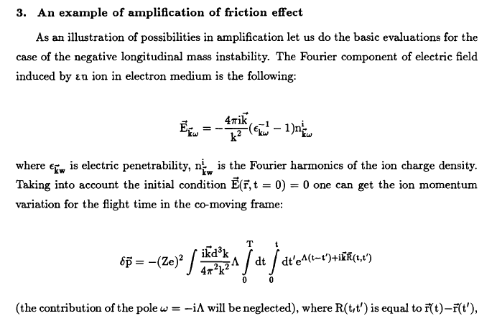
CeC - Equations

Slide 14
CeC - Equations

Slide 15
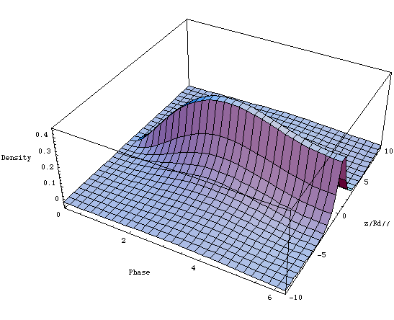
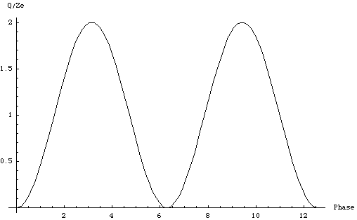
Coherent Electron Cooler
At a half of plasma oscillation
Dispersion
E < E_{h}
Dispersion section
( for hadrons)
E_{h}
Hadrons
Modulator
E > E_{h}
Kicker
l₁
High gain FEL (for electrons)
l₂
Electrons
λ_{FEL}
Amplifier of the e-beam modulation in an FEL with gain G_{FEL}~10²-10³
v_{h}
Debay radii
E < E₀
λ_{FEL}
2 R_{D⊥}
E₀
2 R_{D//}
E > E₀
E_{z}
λ_{FEL}
Density
V.N. Litvinenko, Y.Derbenev's 70th Birthday Symposium, JLab, August 2, 2010

Slide 16
Analytical formula for damping decrement which most of us can understand…
V.N. Litvinenko, Y.Derbenev's 70th Birthday Symposium, JLab, August 2, 2010

Slide 17
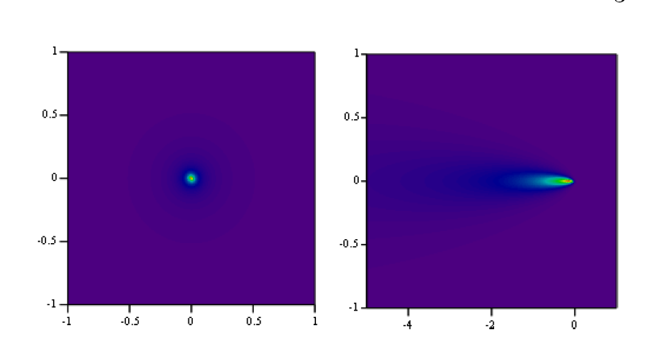
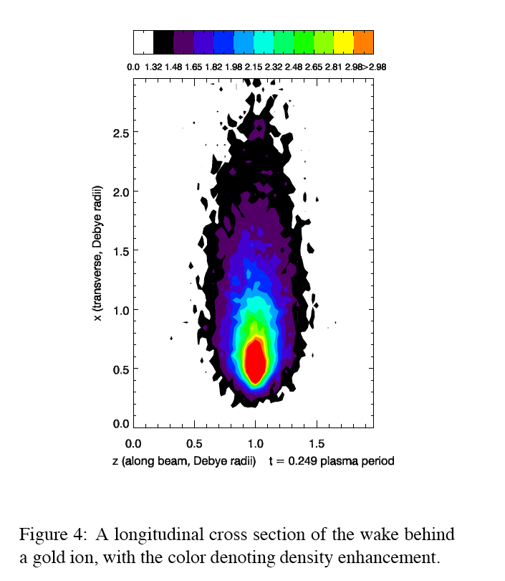
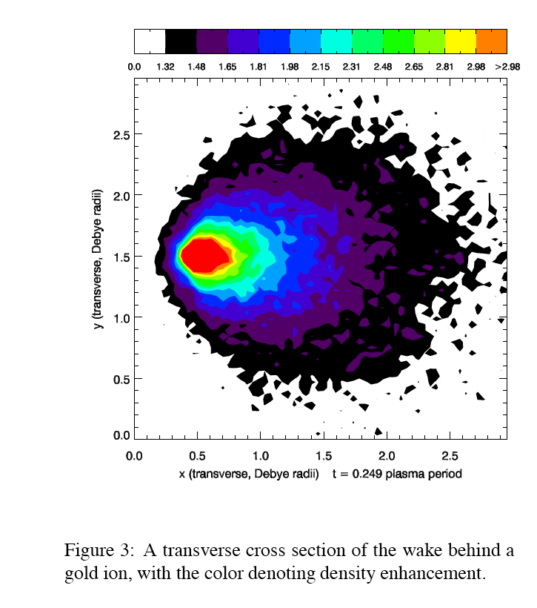
e-Density modulation caused by a hadron (co-moving frame)
Induces charge:
Analytical: for kappa-2 anisotropic electron plasma,
G. Wang and M. Blaskiewicz, Phys Rev E 78, 026413 (2008)
+Ze
Density plots for a quarter
of plasma oscillation
r/R_{D//}
r/R_{D//}
Ion moves in c.m. with
Ion rests in c.m.
(0,0) is the location of the ion
(0,0) is the location of the ion
z/R_{D//}
z/R_{D//}
Numerical: VORPAL @ TechX)
Parameters of the problem
V.N. Litvinenko, Y.Derbenev's 70th Birthday Symposium, JLab, August 2, 2010

Slide 18
3D FEL response calculated Genesis 1.3, confirmed by RON
The amplitude (blue line) and the phase (red line, in the units of π) of the FEL gain envelope after 7.5 gain-lengths (300 period). Total slippage in the FEL is 300λ, λ=0.5 μm. A clip shows the central part of the full gain function for the range of ζ={50λ, 60λ}.
V.N. Litvinenko, Y.Derbenev's 70th Birthday Symposium, JLab, August 2, 2010

Slide 19
Examples of hadron beams cooling
Machine | Species | Energy GeV/n | Trad. Stochastic Cooling, hrs | Synchrotron radiation, hrs | Trad. Electron cooling hrs | Coherent Electron Cooling, hrs 1D/3D
RHIC PoP | Au | 40 | - | - | ~ 1 | 0.02/0.06
eRHIC | Au | 130 | ~1 | 20,961 ∞ | ~ 1 | 0.015/0.05
eRHIC | p | 325 | ~100 | 40,246 ∞ | > 30 | 0.1/0.3
LHC | p | 7,000 | ~ 1,000 | 13/26 | ∞ ∞ | 0.3/<1
V.N. Litvinenko, Y.Derbenev's 70th Birthday Symposium, JLab, August 2, 2010

Slide 20
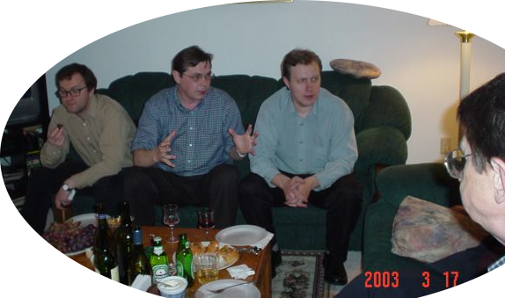
How to understand your ideas and concepts?
How get them into the limelight?
V.N. Litvinenko, Y.Derbenev's 70th Birthday Symposium, JLab, August 2, 2010

Slide 21
Instead of conclusion
Landau loved generating ideas and cracking problems - but he did not liked writing words between equations
He found Liftshitz to do the later and result was fantastic – many generation of physicists admire classics books by Landau and Liftshitz
Slava – where is your Lifshitz?
Question to the birthday boy to think while relaxing on a summer day..
Virginia beach
V.N. Litvinenko, Y.Derbenev's 70th Birthday Symposium, JLab, August 2, 2010

Slide 22
Main message to take home: Happy Birthday! 30 more productive years!
V.N. Litvinenko, Y.Derbenev's 70th Birthday Symposium, JLab, August 2, 2010

Slide 23
Effects of the surrounding particles
Each charged particle CUAses generation of an electric field wave-packet proportional to its charge and synchronized with its initial position in the bunch
Evolution of the RMS value resembles stochastic cooling! Best cooling rate achievable is ~ 1/N_{eff}, N_{eff} is effective number of hadrons in coherent sample (Λ_{k}=N_{c}λ)
Λ_{k} ~ 38 λ_{fel}
Fortunately, the bandwidth of FELs Δf ~ 10¹³-10¹⁵ Hz is so large that this limitation does not play any practical role in most HE cases
V.N. Litvinenko, Y.Derbenev's 70th Birthday Symposium, JLab, August 2, 2010

Slide 24
Numerical simulations (VORPAL @ TechX)
Provides for simulation with arbitrary distributions and
finite electron beam size
VORPAL Simulations Relevant to Coherent Electron Cooling, G.I. Bell et al., EPAC'08, (2008)
© TechX
V.N. Litvinenko, Y.Derbenev's 70th Birthday Symposium, JLab, August 2, 2010

Slide 25
Transverse cooling
Non-achromatic chicane installed at the
exit of the FEL before the kicker section
turns the wave-fronts of the charged planes
in electron beam
Transverse cooling can be obtained by using coupling with longitudinal motion via transverse dispersion
Sharing of cooling decrements is similar to sum of decrements theorem for synchrotron radiation damping, i.e. decrement of longitudinal cooling can be split into appropriate portions to cool both transversely and longitudinally: J_{s}+J_{h}+J_{v}=1
Vertical (better to say the second eigen mode) cooling is coming from transverse coupling
R₂₆≠0
V.N. Litvinenko, Y.Derbenev's 70th Birthday Symposium, JLab, August 2, 2010

Slide 26
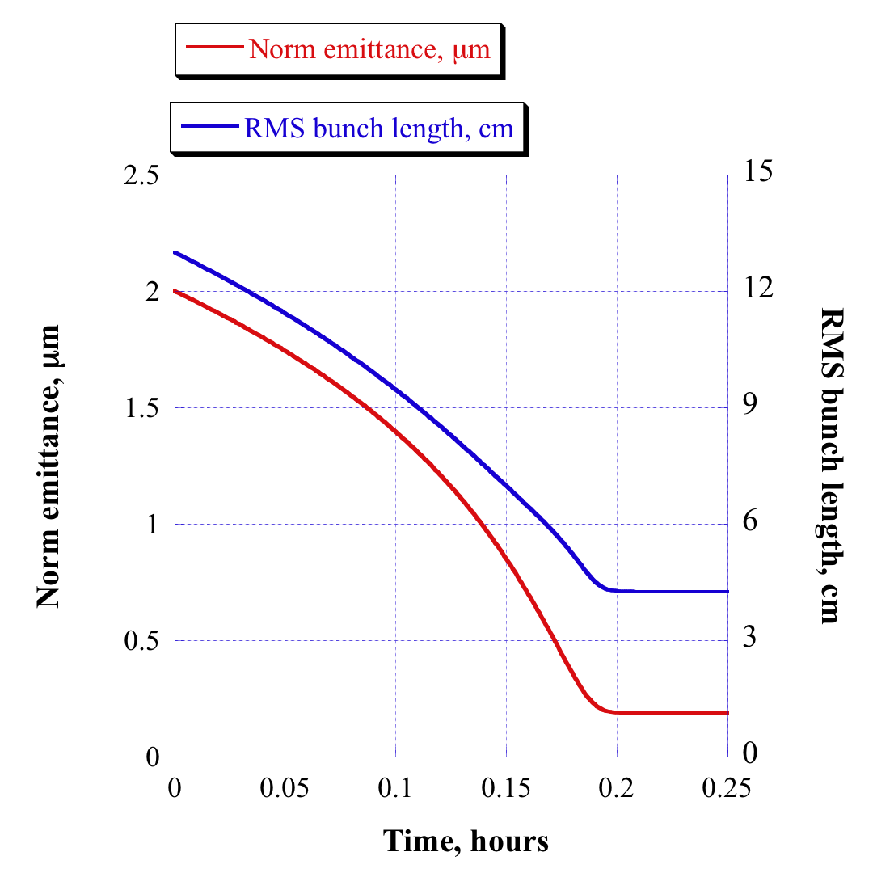
Gains from coherent e-cooling:
Coherent Electron Cooling vs. IBS
IBS in RHIC for
eRHIC, 250 GeV, N_{p}=2.10¹¹
Beta-cool, ©A.Fedotov
Dynamics:
Takes 12 mins
to reach
stationary
point
This allows
keep the luminosity as it is
reduce polarized beam current down to 50 mA (10 mA for e-I)
increase electron beam energy to 20 GeV (30 GeV for e-I)
increase luminosity by reducing β* from 25 cm down to 5 cm
V.N. Litvinenko, Y.Derbenev's 70th Birthday Symposium, JLab, August 2, 2010

Slide 27
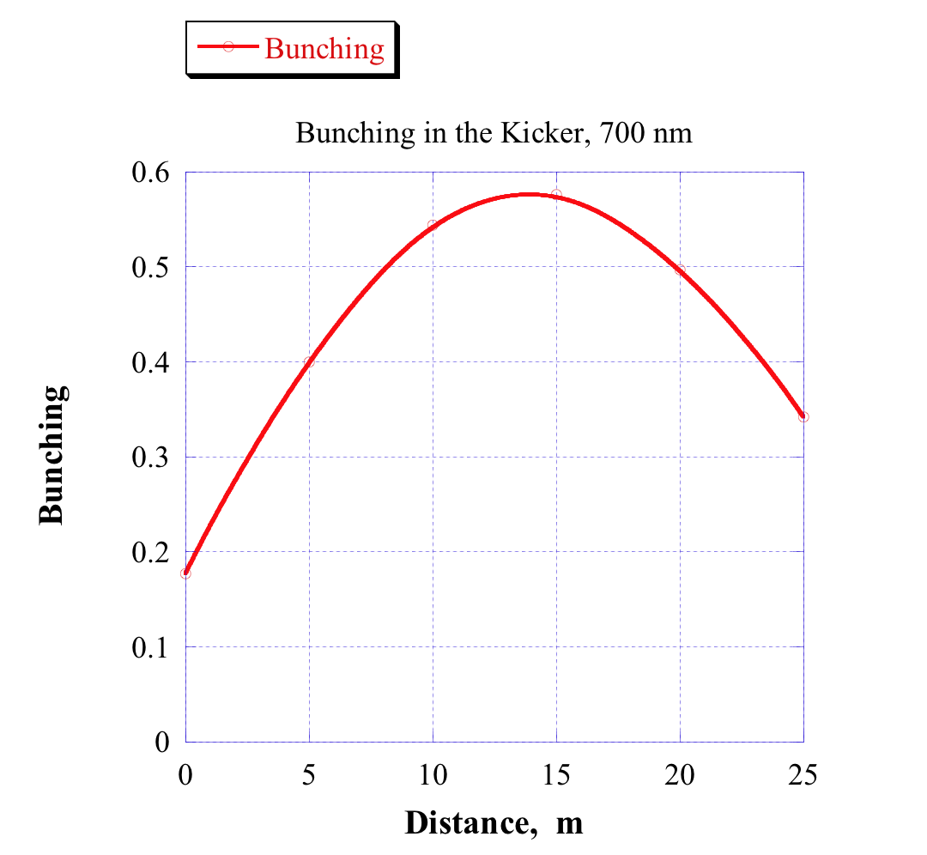
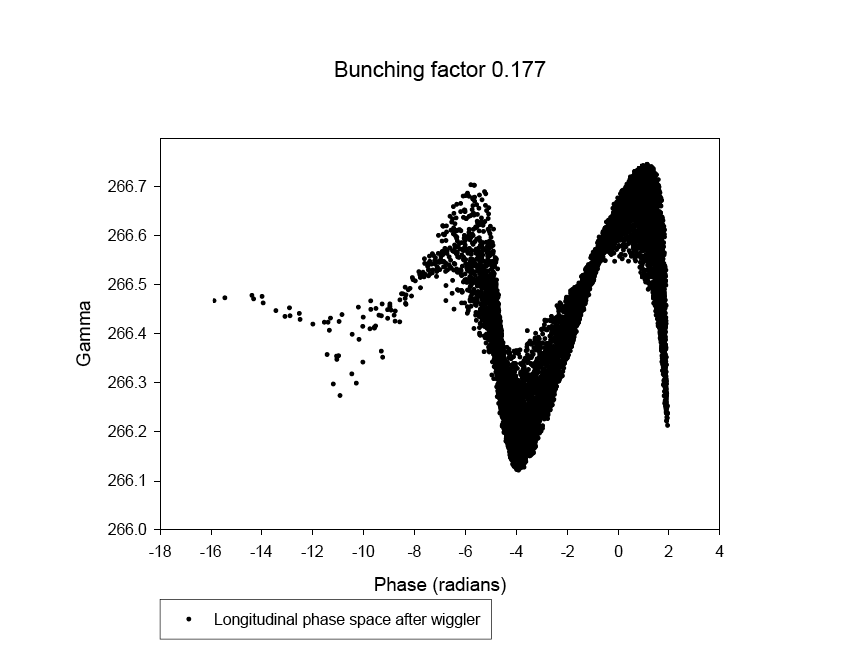
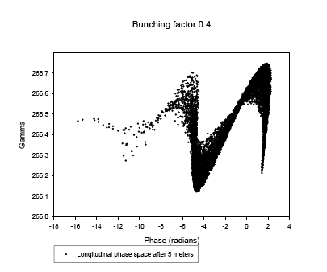
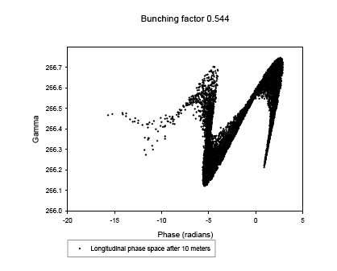
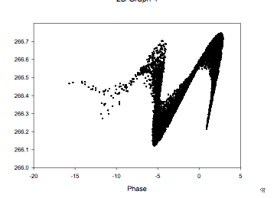
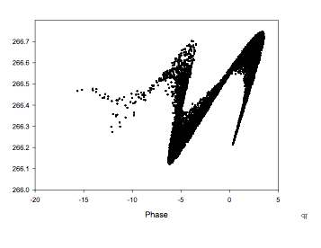
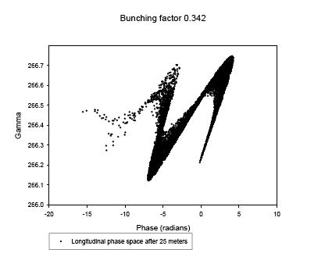
Output from Genesis propagated for 25 m
The Kicker
A hadron with central energy (E_{o}) phased with the hill where longitudinal electric field is zero, a hadron with higher energy (E > E_{o}) arrives earlier and is decelerated, while hadron with lower energy (E < E_{o}) arrives later and is accelerated by the collective field of electrons
Simulations: only started
Analytical estimation
Step 1: use 3D FEL code out output + tracking
First simulation indicate that equations on the left significantly underestimate the kick, i.e. the density modulation continues to grow after beam leaves the FEL
E < E₀
λ_{FEL}
E₀
E > E₀
©I.Ben Zvi
Periodical longitudinal electric field
0m
5m
10m
15m
20m
25m
Step 2:
use VORPAL with input from Genesis, in preparation
V.N. Litvinenko, Y.Derbenev's 70th Birthday Symposium, JLab, August 2, 2010

Slide 28
Polarizing Hadron Beams with Coherent Electron Cooling New LDRD proposal at BNL: VL & V.Ptitsyn
Hadrons
Modulator
Delay for hadrons
Kicker
λ
HW1
left helicity
HW2
right helicity
High gain FEL (for electrons)
l₂
Electrons
Modulation of the electron beam density around a hadron is CUAsed by value of spin component along the longitudinal axis, z. Hardons with spin projection onto z-axis will attract electrons while traveling through helical wiggler with left helicity and repel them in the helical wiggler with right helicity.
Hadrons with z-component of spin will have an energy kick proportional to the value and the sigh if the projection. Placing the kicker in spin dispersion will result in reduction of z-component of the spin and in the increase of the vertical one.
The high gain FEL amplify the imprinted modulation.
This process will polarize the hadron beam
V.N. Litvinenko, Y.Derbenev's 70th Birthday Symposium, JLab, August 2, 2010

Slide 29
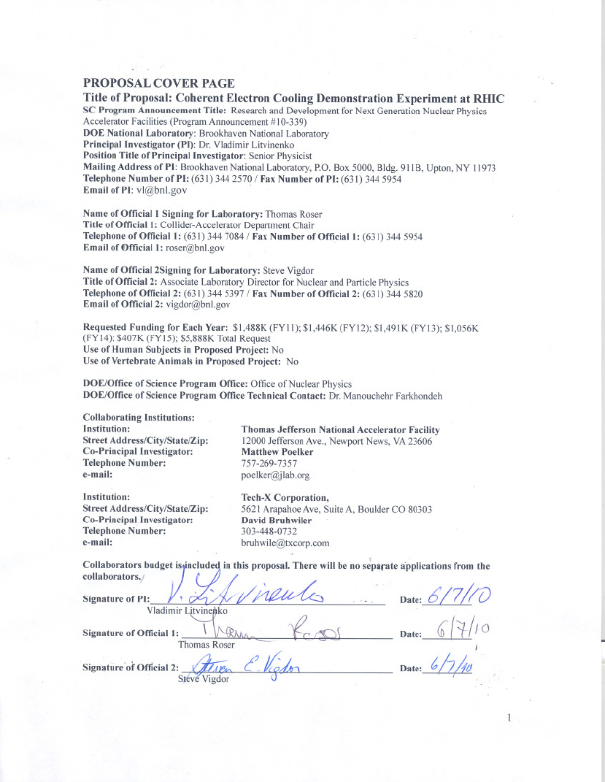
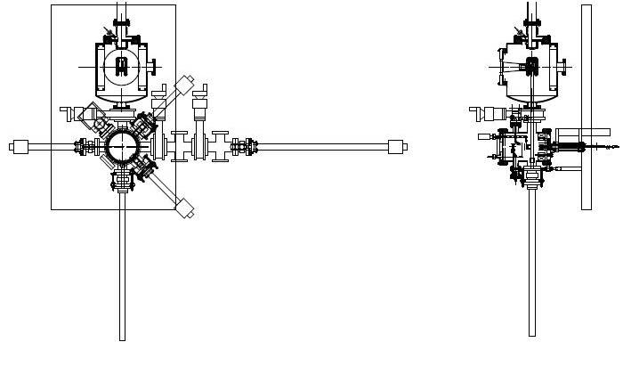
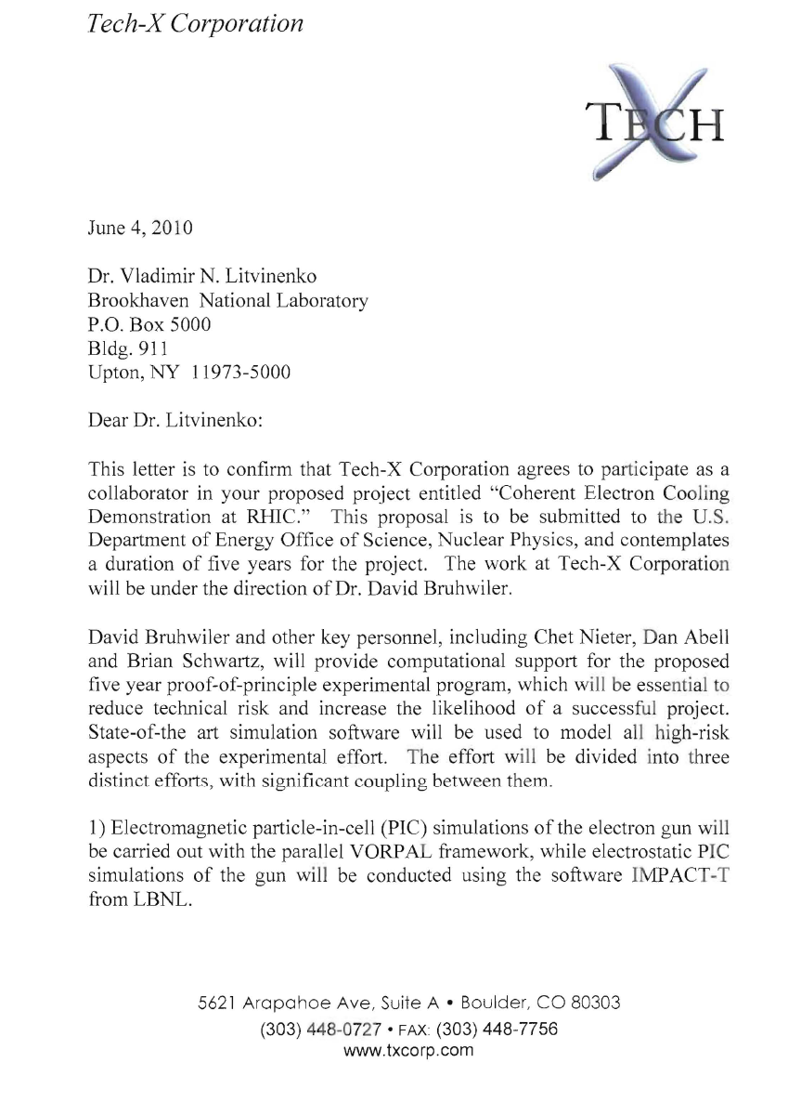
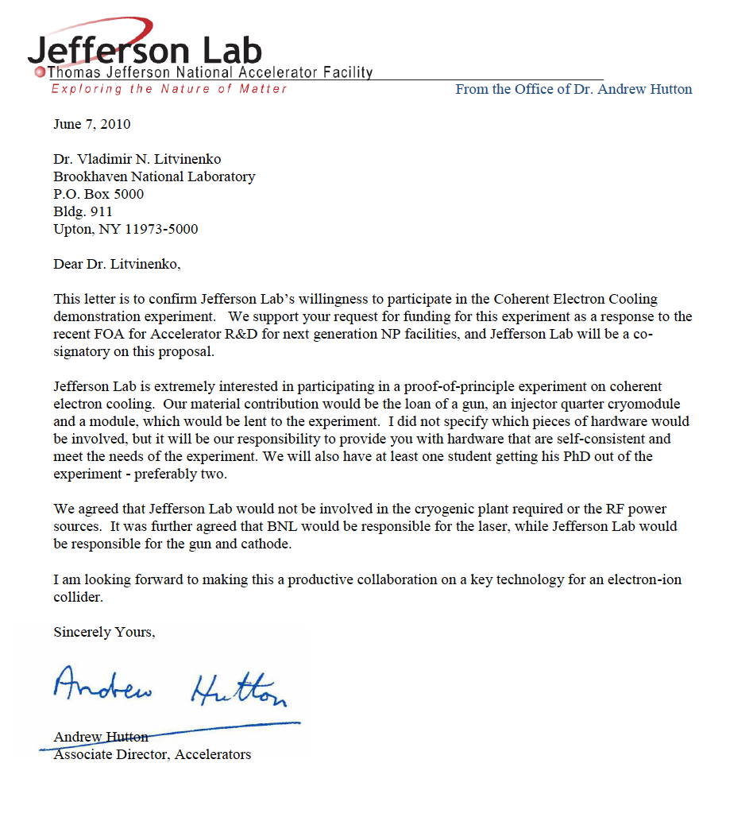
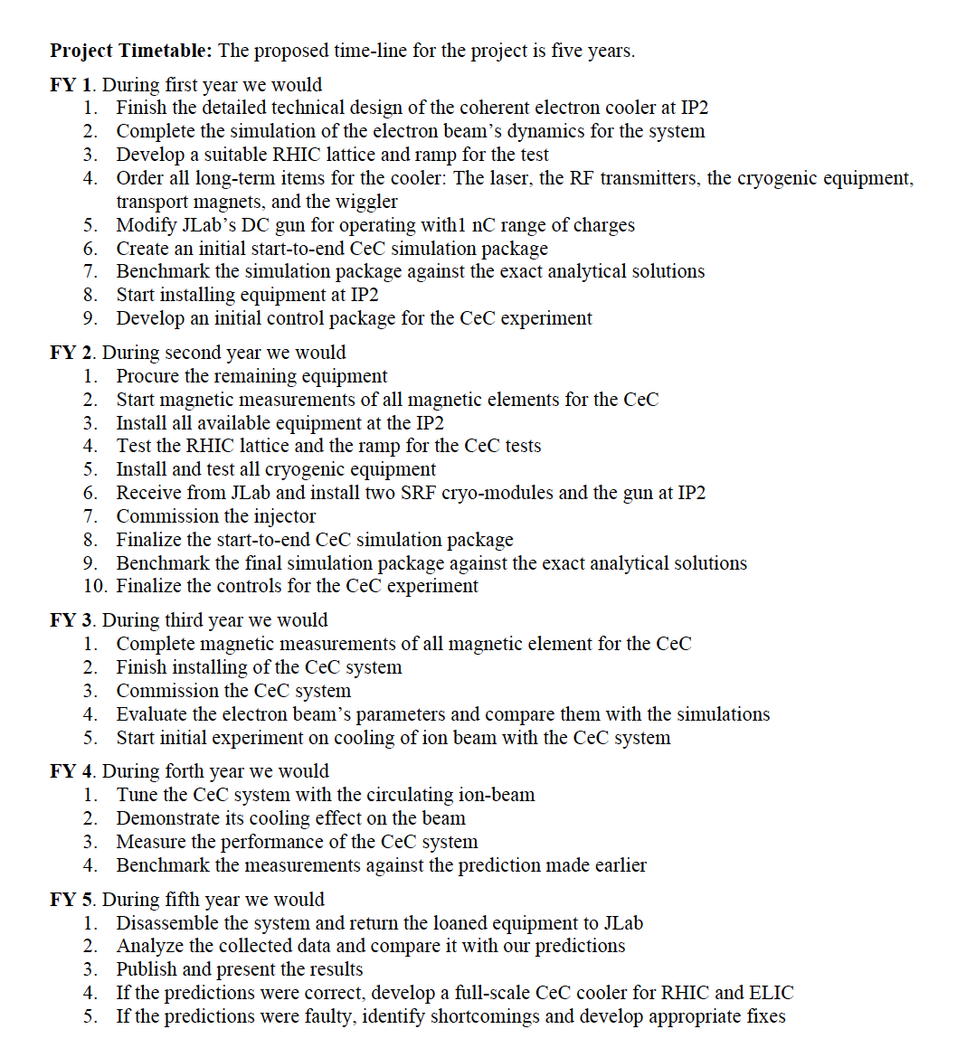
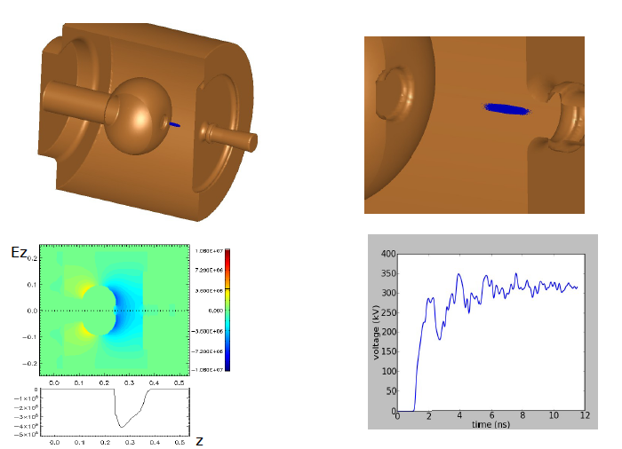
Proposal to NP DoE, 5 years, $5.9M
V.N. Litvinenko, Y.Derbenev's 70th Birthday Symposium, JLab, August 2, 2010

Slide 30
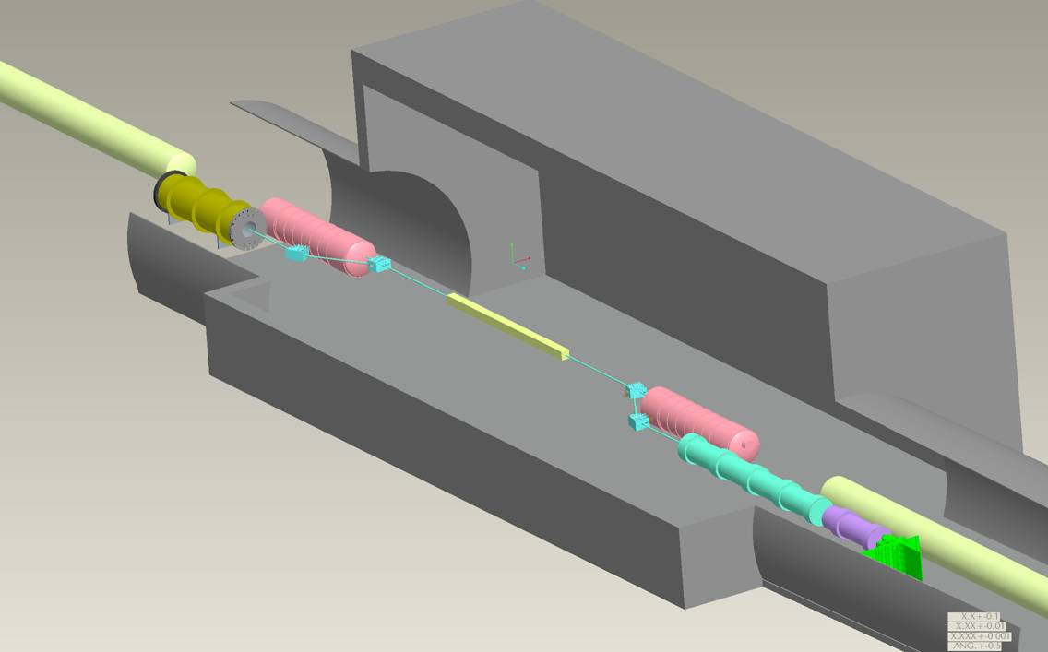
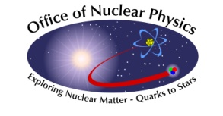
Layout for Coherent Electron Cooling
proof-of-principle experiment in RHIC IR 2
Collaboration between BNL & JLab
19.6 m
Kicker, 3 m
Modulator, 4 m
DX
DX
Wiggler 7m
Parameter
Species in RHIC | Au ions, 40 GeV/u
Electron energy | 21.8 MeV
Charge per bunch | 1 nC
Rep-rate | 78.3 kHz
e-beam current | 0.078 mA
e-beam power | 1.7 kW
Beam dump
20 MeV SRF linac
©G.Mahler
V.N. Litvinenko, IPAC’11, Kyoto, May 26, 2010
Notes:
This is our first three dimensional rendering of the layout using CEBAF DC gun and CEBAF SRF linac cryomodule for the acceleration.

Slide 31
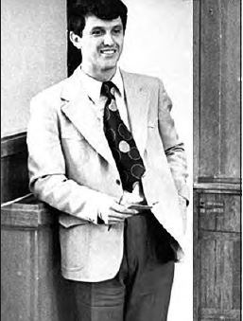
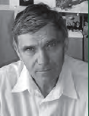
Novosibirsk Budker Institute of Nuclear Physics
Siberian snakes
Magnetized cooling
Beam-beam effects

