Slide 1
People andStimuli Sources and Resources Mathematics & Physics
Since 1957…
By Yaroslav Derbenev
Symposium because of 70 year old
Jefferson Lab, Newport News, Virginia
August 02, 2010
Notes:
By Yaroslav Derbenev
Symposium because of 70 year old
Jefferson Lab, virginia, August 02, 2010.

Slide 2
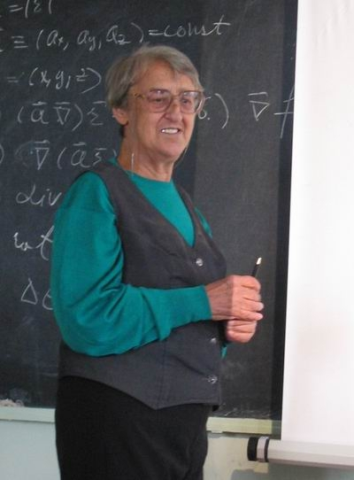
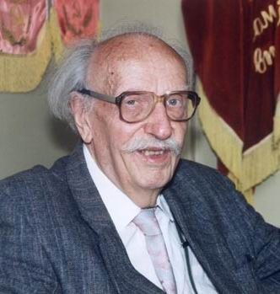
Mathematics-I: how much a physicist needs?
Calculus
Algebras
Differential equations
V.A.Ilyin
A.B. Vasilyeva
A.G.Sveshnikov
Not enough…
Notes:
Not enough…

Slide 3
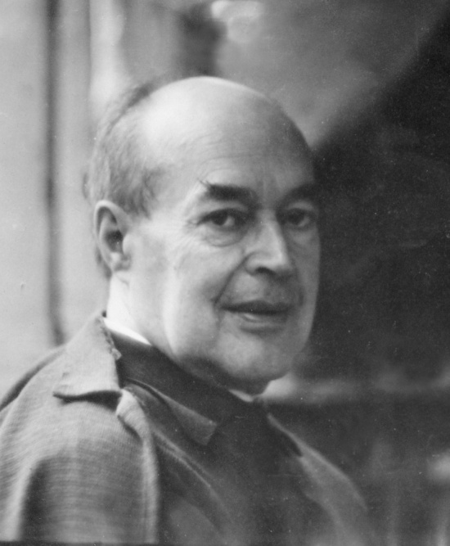
Mathematics-II
-affine and projective geometry-
-Spinors-
-differential geometry & Tensor Calculus-
-Riemannian geometry-
-Invariants & Groups-
P. K.Rashevsky
What is the background of everything? Vectors?... Numbers?... Matrices?... Transformations?...
Notes:
What is the background of everything? Vectors?...

Slide 4
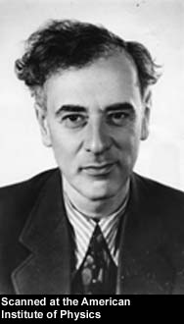
Physics
Lev D. Landau
Nikolai N. Bogolubov
Everything to learn…
in order to know and use
Methods to work with:
Non-linear mechanics
QFT
Statistical physics and kinetics
Quantum liquids theory
Notes:
Methods to work with:
Non-linear mechanics
QFT
Condense matter theory

Slide 5
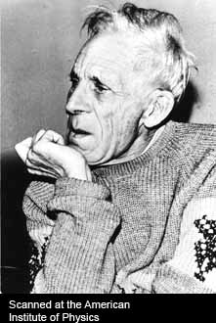
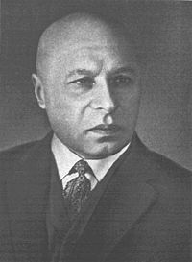
Physics
Mikhail Leontovich
Al exander Davydov
Classical electrodynamics
Leontovich’ boundary condition
Quantum mechanics
Excitons
Nuclear physics
Notes:
Quantum mechanics course
Nuclear physics

Slide 6
Anatoliy A. Vlasov
Course of the KineTic theory
Vlasov equation
Theory of cristals
Nuclear theory

Slide 7
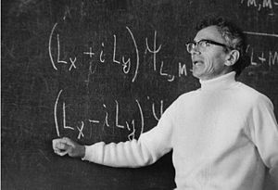
Quantum mechanics
Interpretation of Quantum Mechanics
According to Krivchenkov, the intents to "interpret" quantum mechanics in terms of classical mechanics nave no more sense than interpretation of heliocentric cosmological system in terms of geocentric system. Only the old tradition forced the physicists to discuss the so-called Copenhagen interpretation of quantum mechanics. Quantum mechanics is completely deterministic systems, where any event always has a cause and any cause always has an effect. However, some quantum mechanical systems are complicated, so we have to describe them classically (quasi-classically, semi-classically, pseudo-classically, ..). Then, immediately, probability appears, because classical mechanics cannot interpret events in a deterministic way. An intermediate step is provided by the formalism of the density matrix, that allows us to keep some quantum mechanical properties in the classical description; however, such a description is not complete and it is just a compromise between the deterministic description of too complicated a system and wishes to make any (at least probabilistic) predictions.
In such a way, it is classical mechanics that could in some sense be interpreted in terms of quantum mechanics (the correspondence principle). By itself, quantum mechanics is a self-consistent deterministic theory that does not need any interpretation.
Vladimir Krivchenkov
“You have to wear through many trousers before you start understanding of quantum mechanics…”
Interpretation of spin
“… Answer me, finally, what is spin?...”
“I said everything I know, I don’t know more…”
“Now, listening and remember for the rest of your life:
Spin is (1,0) and (0,1) , and nothing else!”
Notes:
“You have to wear through many panties before you start understand quantum mechanics…”

Slide 8
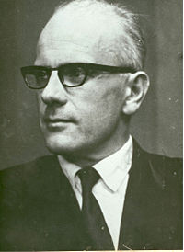
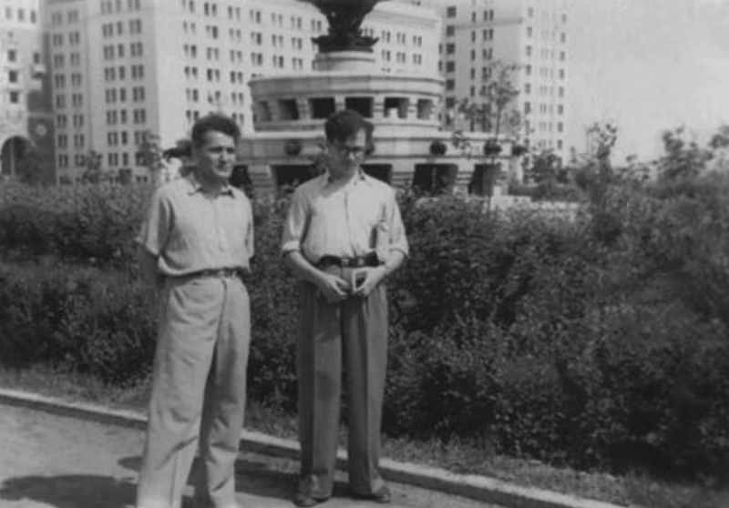
From QM to QFT
One of the colleagues of Krivchenkov, Yurii Shirokov tried to construct quantum field theory in terms of wave packets, without divergences, using the algebra of generalized functions, but even now this approach is not sufficiently developed.
Perturbation theory
Quantum field theory is a generalization of quantum mechanics. Krivchenkov believed that people need to understand at least the non–relativistic theory. He almost asked students to excuse him for the field theory, where only perturbation theory can be offered. Not only do the perturbation theory series diverge, but each perturbation term also in some sense is infinite, and a special renormalization of the interaction constant is required to give the result the physical sense.
Krivchenkov told students that they are supposed to build up a "true" theory, not just a perturbation, that always gives a divergent series. This statement (dogma) applies not only to Field Theory and quantum mechanics, but to any perturbation theory with respect to any distributed system; the perturbation series always diverges. Krivchenkov had realized this and brought this knowledge to students. Many problems in his books stress this property of perturbation theory.
Yuriy Shirokov
Nuclear Physics course
Group theory for physicists
Notes:
Nuclear Physics course
Groups theory for physicists

Slide 9
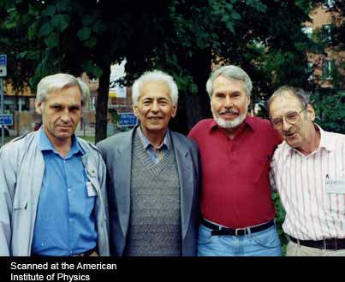
= Leonid Ponomarev = Classmate (msu) , friend …
Leonid Ponomarev; Semen Gershtein; J.D. Jackson;
Yuri Petrov at Workshop on Muon-catalyzed Fusion . Uppsala, Sweden, July 1992
Muon-catalized fusion
Resonance muon capture theory
New special functions
“the Quantum Dice”
Institute of Quantum Physics
at IAE (Moscow), Director
Notes:
Classmate at MSU

Slide 10
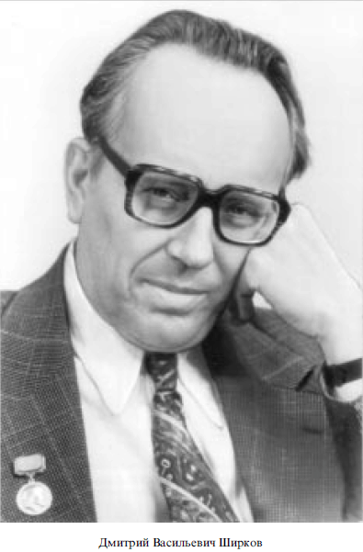
QED & QFT
“Introduction to Theory of Quantized Fields”
Nikolai Bogolubov
Dmitriy Shirkov
Introduction course of lectures by Vladimir Fainberg
Notes:
“Introduction to Theory of Quantum Fields”
Condense matter theory

Slide 11
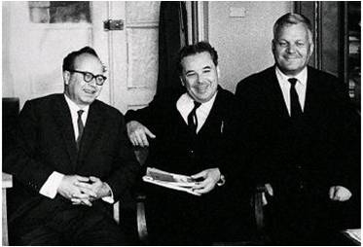
Accelerator physics
Introduction course by I. Ternov
Sokolov-Ternov effects in storage rings:
-Beam temperature due to quantum
synchrotron radiation
-Spin light
-Radiative spin-polarization
I.Ternov, D. Ivanenko, A. Sokolov
D. Ivanenko :
proton-neutron model of nuclei
Notes:
D. Ivanenko : proton-neutron model of nuclei

Slide 12
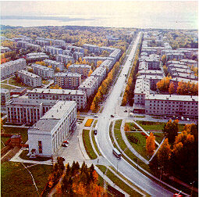
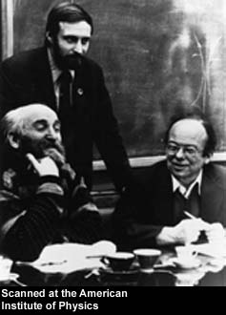
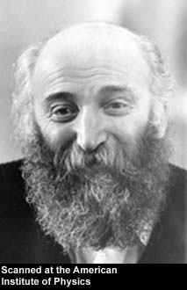
Best place for life and work after MSU… (Siberia,1963)
Gersh Budker
Institute of NP
Notes:
Institute of NP

Slide 13
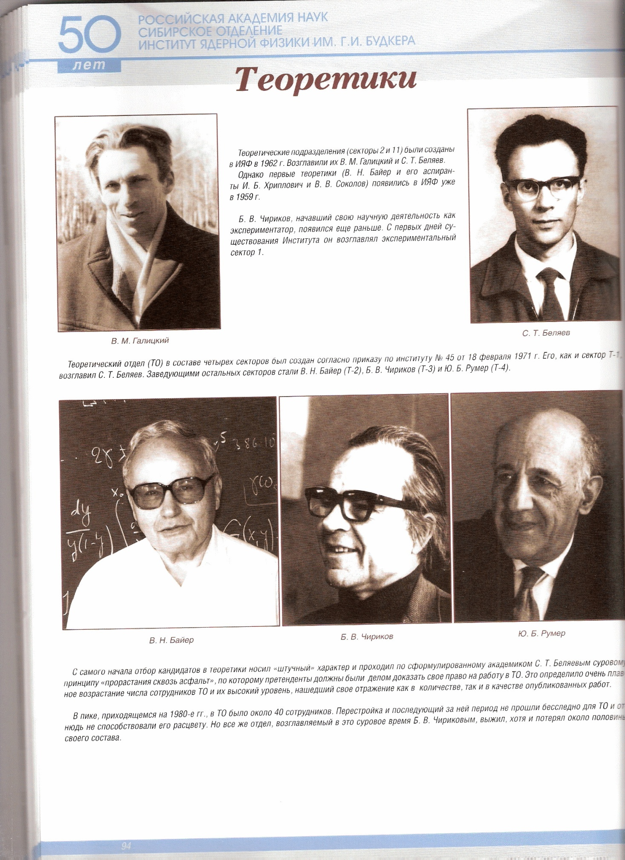
Theorists
Victor Galitsky
Spartak Belyaev
Victor Galitsky
(quantum and nuclear physics):
-As you have found me in old Arbat
under re-construction, you can
apply for job in theory…
Gersh Budker:
-Well, we don’t need more theorists…
But, if he agrees to work for
accelerators, we take him…
Vladimir Baier
Boris Chirikov
Yuriy Roumer
V. Baier: QED
Y. Roumer: Quantum Physics
Notes:
Theorists
B. Chirikov: origin of stochastics
Y. Roumer: Quantum Physics

Slide 14
Theorists of BINP
V. Zelevinskiy: Nuclear theory and quantum physics
I. Khriplovich: HEP and quantum mechanics
/P-violation in atomic transitions/
V. Sokolov: HEP
V. Zakharov: integrable systems, plasma theory
G. Zaslavskiy: origin of stochastics, models and applications
A. Vainstein: HEP and Field Theory /”gang of 4”/
S. Kheifets: HEP, Accelerator Physics
V. Fadin: QED and HEP

Slide 15
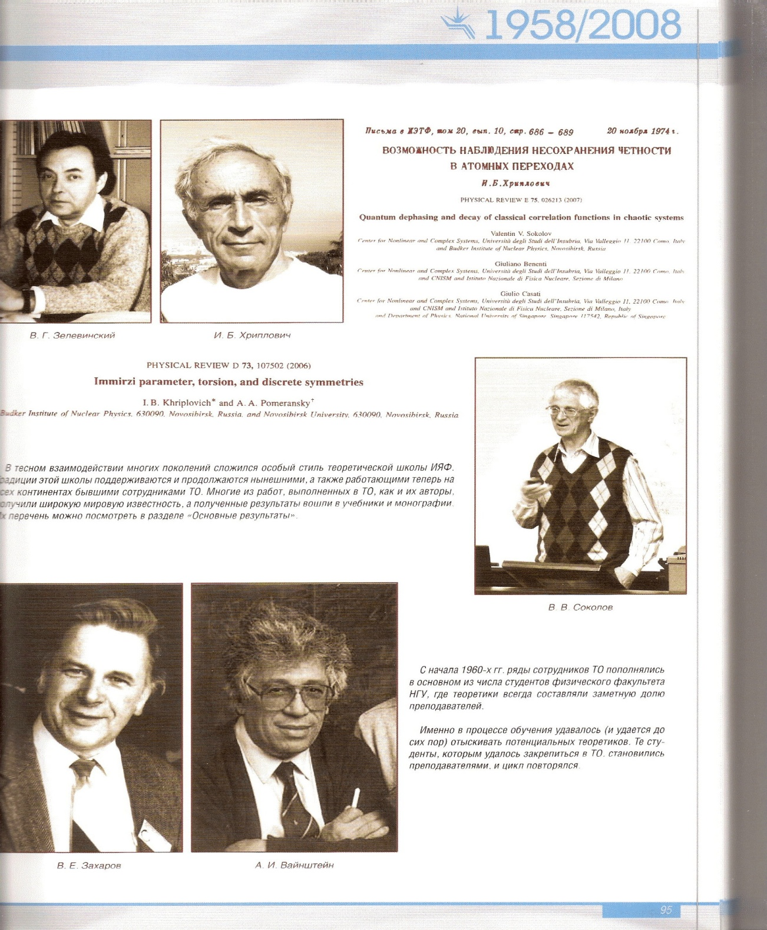
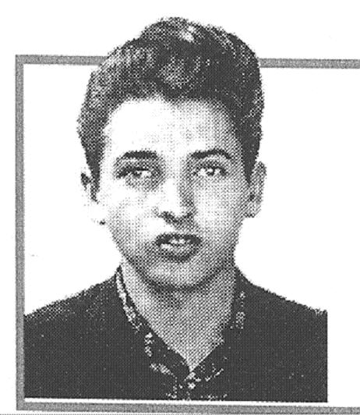
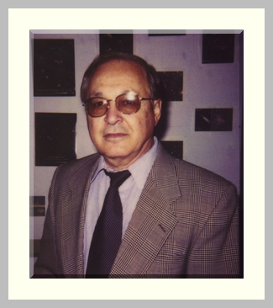
S. Kheifets
V. Zelevinskiy
I. Khriplovich
V. Sokolov
G. Zaslavskiy
V. Zakharov
A. Vainstein
Notes:
V. Zelevinskiy: Nuclear theory
and quantum physics
I. Khriplovich: HEP and quantum mechanics
/P-violation in atomic transitions/
V. Sokolov: HEP
V. Zakharov: integrible systems, plasma theory
G. Zaslavskiy: origin of stochastics
A. Vainstein: HEP and Field Theory

Slide 16
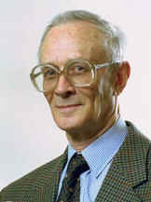
=Spartak Belyaev =
2004 FEENBERG MEDAL CITATION: Spartak T. Belyaev and Lev P. Gor'kov In the late fifties Russian theorists were among the first to use field theoretical methods borrowed from quantum electrodynamics in the field of Statistical Physics. A series of landmark papers applied them to a wide variety of problems. Some of them were also conceptual breakthroughs. The papers of Spartak Belyaev and Lev Gor'kov belong to that very special class. Spartak Belyaev was born in 1924. Just out of high school, he served in the Russian Army during World War II, from 1941 to 1946. Upon release, he went to Moscow State University and soon started research with G.E. Budker on relativistic kinetic equations in plasmas. In 1949, he realized that his interests were in theory and he joined the group of Arkady Migdal. The road was then wide open! He joined the Kurtchatov Institute in 1952, and received his Doctorate of Science in 1962. His fame spread quickly. He was invited to the Niels Bohr Institute in 1957-1958, and delivered two famous courses at the 1958 Les Houches school on many body problems. He left Moscow in 1962 for Novosibirsk, where a major research center was being built. He created an outstanding theory group at the Budker Institute of Nuclear Physics. He also served as rector of the University and was influential in making Novosibirsk a success. After 1978, he returned to the Kurtchatov Institute in Moscow, and eventually became the director of the Institute of General and Nuclear Physics. He is largely responsible for maintaining the high level of the Kurtchatov Institute throughout the difficult times of the 90's. Being a man of great civic, as well as scientific responsibility, he was deeply involved in the assessment of the Chernobyl disaster. He was elected to the Russian Academy of Sciences as a correspondent in 1964 and as a full member in 1968. He received the Landau gold medal in 1998.
Nuclear superfluids
Focker-Plank equation in a strong external field
Coulomb stoss-term in magnetic field (“magnetized collisions”)
Notes:
Nuclear superfluids
Focker-Plank equation in a strong external field
Coulomb stoss-term in magnetic field “magnetized collisions”

Slide 17
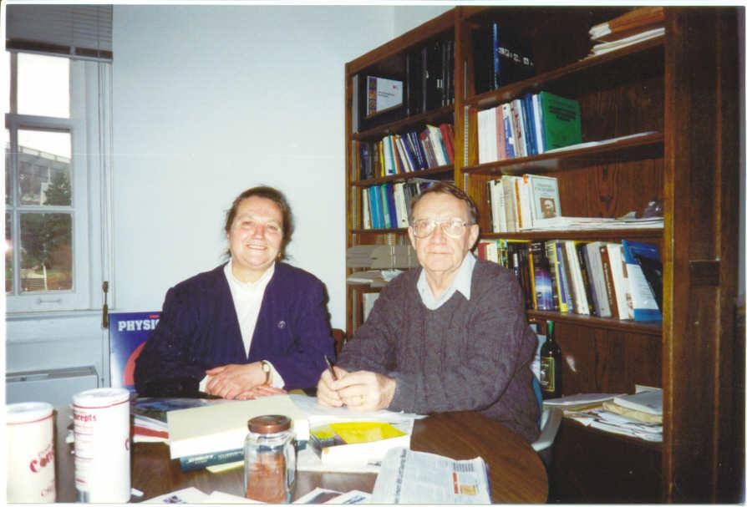
=Roald Sagdeev=
Plasmas theory (shock waves, neo-classical turbulence)
Thermonuclear fusion
Space plasmas
Astrophysics
Space programs…
USSR (Russia)-USA bridge…
Notes:
Plasmas theory (shock waves, neo-classical turbulence)
Fusion
Space plasmas
Astrophysics
Space programs…

Slide 18
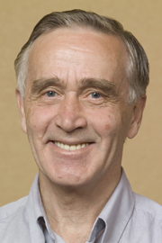
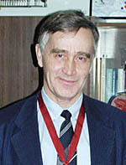
= Alexander Skrinsky =
Colliding beams
Electron cooling
Polarized beams
Ionization cooling (MC)
FEL
E-storage rings and linear colliders
Director of BINP since 1977
One of leaders of Academy of Sciences/HEP

Slide 19
-Colliding beams-
V. Galitsky: “ Check tune ¾…”
Van der Paul –Bogolubov method (Chebyshev’s expansion)
High order 1,2,and 3d non-linear resonances
Non-linear tune shift
Microwave stability thank to Landau damping
Chirikov’s stochasticity
Radiation damping for electrons helps…
4-beam compensated system: unstable…

Slide 20
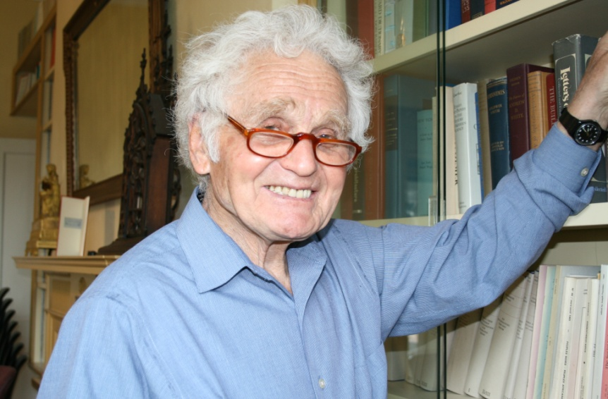
= Yuriy Orlov =
Non-linear dynamics in accelerators
Prediction and first theory of quantum depolarization
G-2 dynamics precision theory
EDM observation in storage ring (theory)
Quantum logic
Human Rights…
Notes:
Human Rights

Slide 21
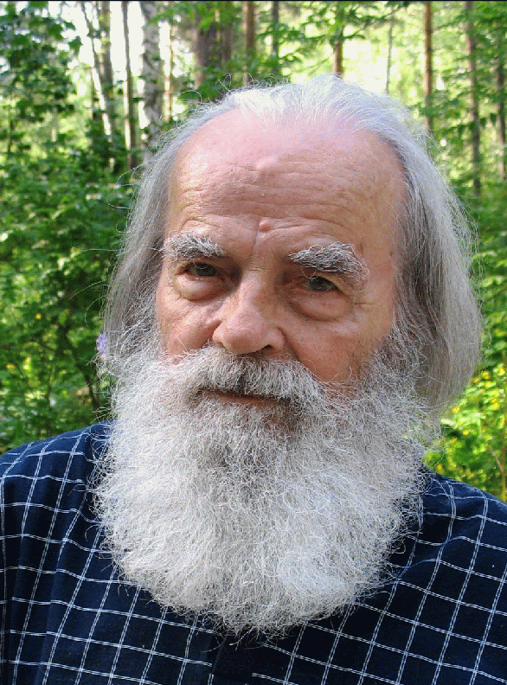
= Boris Chirikov =
Stochasticity criterion of
low-dimension systems:
Quantum stochasticity
Origins of statistical physics
…more …and Applications
Budker’s Stabilized e-beam theory
Teaching
overlapping resonances
Final conclusion about quantum stochastics: it does not exist in a conservative system! (rest is a quasi-stochastics…)
Explanation (?): solution of Schroedinger equation for a wave function can be complicate but cannot be irregular; thus, system is reversible-in-principle
Notes:
overlapping resonances
Final conclusion about quantum stochasticity: does not exist!

Slide 22
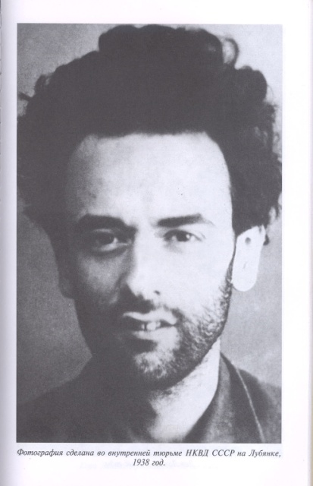
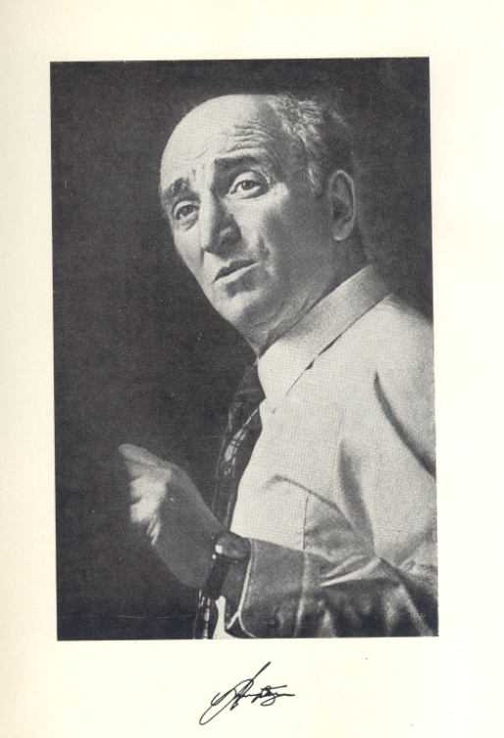
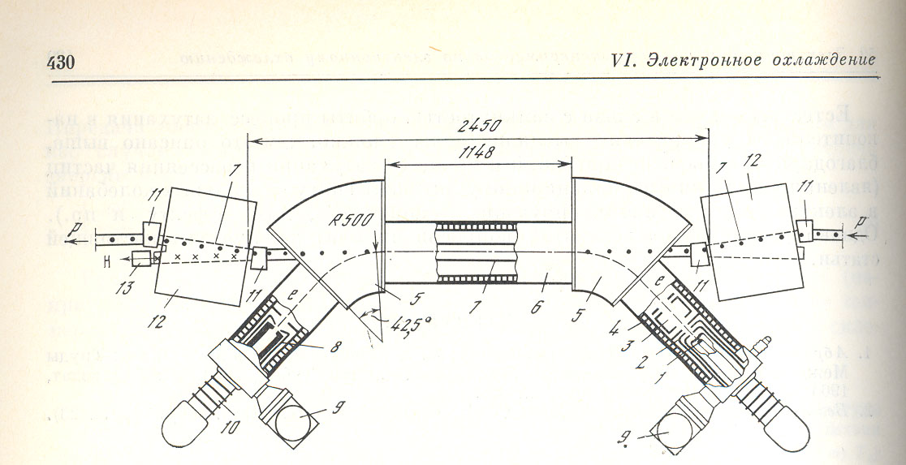
Electron Cooling:
The thermostat of a relativistic engineer
Do not renounce
from prison and
money bag…
Landau liked to call me
“The relativistic engineer”.
I am very proud of that.
Gersh Budker
Kinetic equation (plasma relaxation) was derived by Landau
in 1937. But… can it work for charged beams? It does! Yet very interesting and important phenomena have been discovered
(magnetized cooling, super-deep cooling, cristaline beams…)
EC and IBS: similar equations…
Notes:
Kinetic equation (plasma relaxation) derived by Landay in 1937. But…can it work for beams? It does! Yet

Slide 23
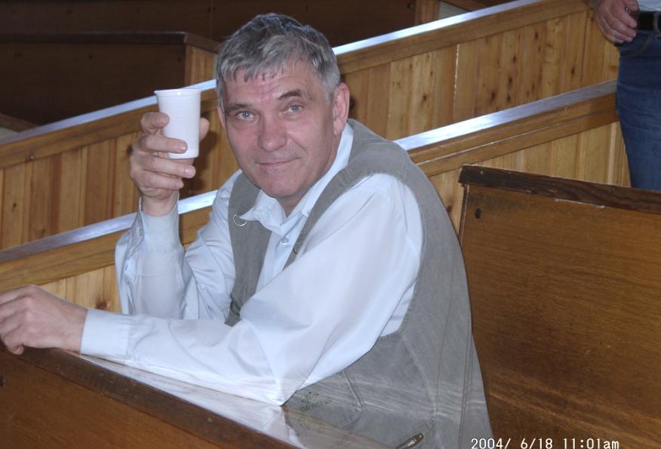
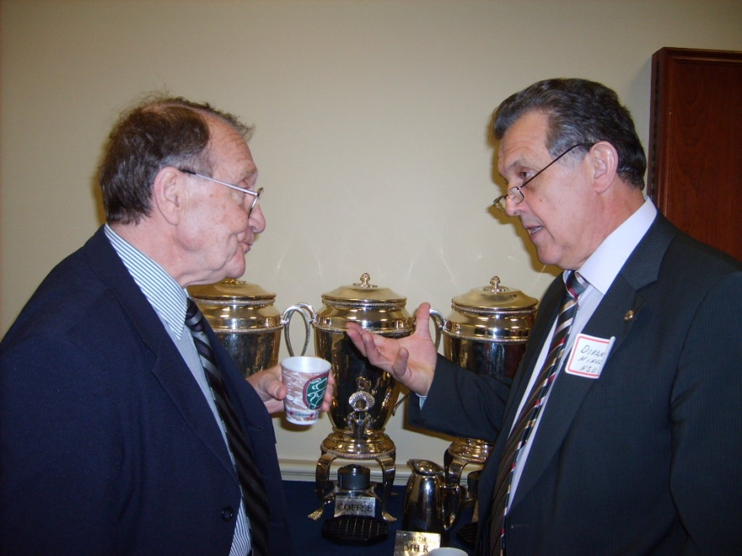
Masters of Electron cooling
Alexander Skrinsky Igor Meshkov Valeriy Lebedev
Vasiliy Parkhomchuk
Nikolai Dikansky
Relativistic EC: Sergei Nagaitsev
Notes:
Relativistic EC: Sergei Nagaitsev

Slide 24
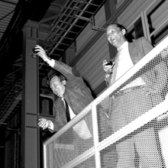
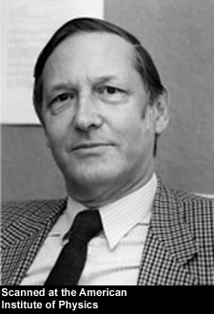
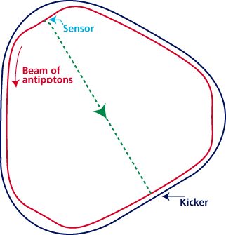
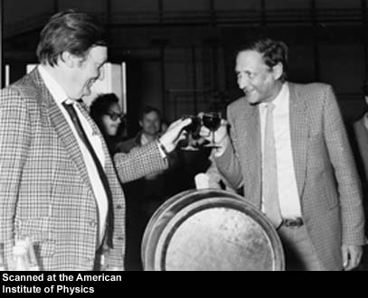
Stochastic cooling:
“Is n’t it the Maxwell’s demon?”
(G.Budker)
Meer’s demon
The van der
It works!!
Works well for coasted low current,
large emittance beams.
Can it work for bunched beams? Hardly… but
demonstrated by M.Blaskewitz for lead at RHIC!
May help EIC (stacking and pre-cooling)…
Notes:
Can it work for a bunched beam?

Slide 25
Samuel Kheifets
Stochastic model: irreversibility in an oscillator system with equidistant spectrum
Theory of stochastic cooling (Bogolubov’s method)
- Limitation on cooing rate due to
the collective modes (Landau damping criterion)
- Limitation on equilibrium temperatures due to amplified the quantum noise
Impedance theory
Microwave CSR instability (with Gennadiy Stupakov)

Slide 26
Electron cooling
-Past & Present-
-perspectives-
Super- perspective:
-Coherent EC-
Revived by V. Litvinenko !
Cooling of low energy beams
Relativistic cooling of p-bar
Magnetized cooling
Fast cooling
Super-deep cooling
Cooling of positrons (theory)
Cooling of positrons
Matched cooling
ERL based HEEC
Circulator-cooler ring

Slide 27
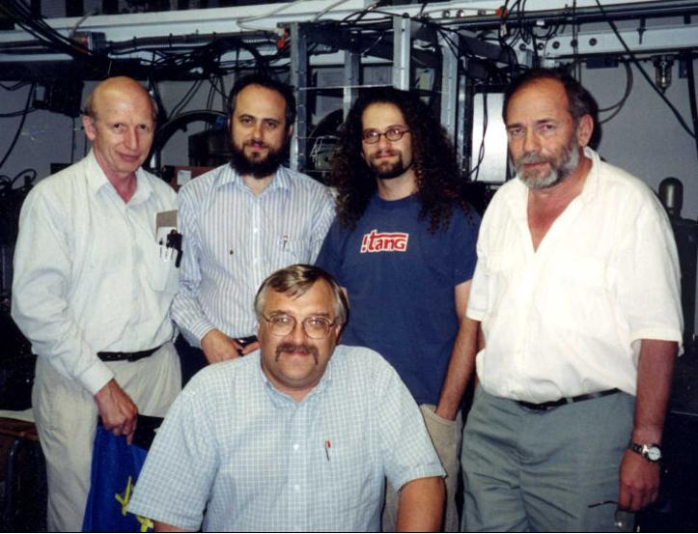
Max Zolotorev
parity violation in atomic transitions
(with L.Barkov and I. Khriplovich)
Idea of the Optical stochastic cooling
(incoherent feedback on amplified light
radiation in undulator)
Super-short e-bunches
More and more…
Clarifying discussions…
Max
Notes:
Max Zolotorev
Alexander Mikhailichenko
Alexander Zholents

Slide 28
Collective stability
Impedance instabilities (with N. Dikansky and D. Pestrikov)
EC: microwave instabilities of a magnetized e-beam
1. Ion - “freezed” electron beam wake instability
2. E-beam – ionized gas instability (Parkhomchuk-Burov)
3. Drift wake i-e instability (Parkhomchuk - Burov)
Microwave instabilities of magnetized relativistic e-beam (with A.Burov, for CEC)

Slide 29
Polarized beams
Mandates
A. Skrinsky:
“ …Do not answer me about spin and BMT. I give you the highest grade in advance. But you will work hard on it afterwards…”
S. Belyaev:
“…Work with Kondratenko. He is special…”
So…that was easy for power of three:
Spin rotators
Spin on closed orbit
Snakes and Spin Echo
Spin Resonances
Acceleration and maintenance
Spin diffusion
Radiative polarization
Notes:
Spin rotators

Slide 30
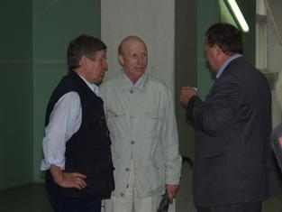
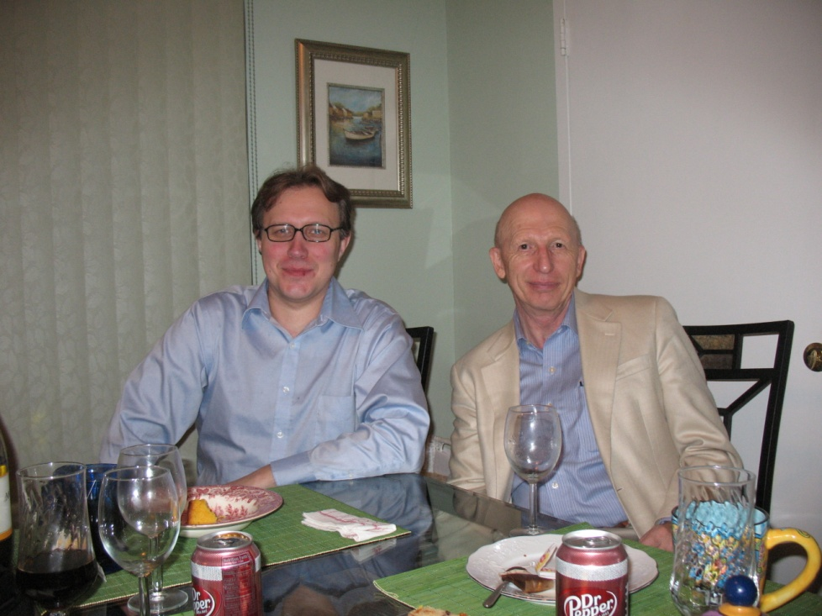
Masters of Polarized sources and beams
Yuriy Anatoliy
Shatunov Zelenskiy
Vadim Ptitsyn Vadim Ptitsyn
Vadim Ptitsyn Vadim Dudnikov

Slide 31
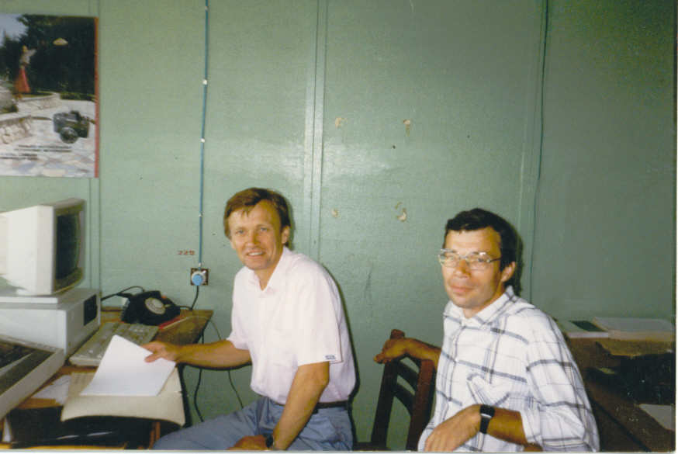
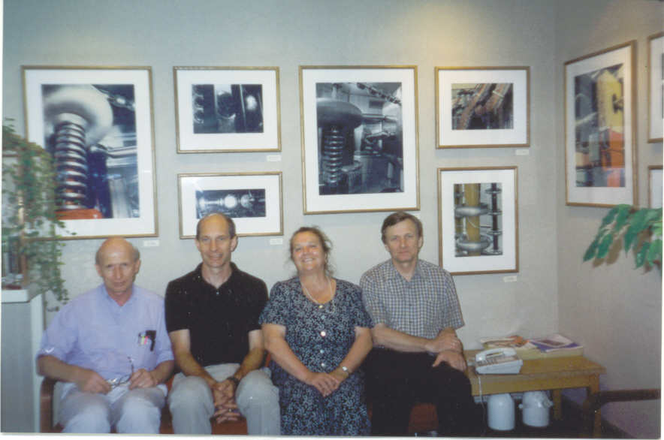
Masters of Polarized sources and beams
Alexander Belov
Vladimir Derenchuck
Notes:
Vladimir Derenchuck

Slide 32
Eye-witness/user of trends
Origins of stochasticity
Stripping injection/stacking
Of ions
High gain FEL theory
SASe & X-ray FEL concepts
Gamma-gamma collider idea/FEL-based concept
holography on SR Quantum theory
B. Chirikov
G. Budker, G. Dimov, V. Dudnikov
A. Kondratenko, E. Saldin,
E. Schneidmiller, M. Yurkov
A. Kondratenko and A. Skrinsky

Slide 33
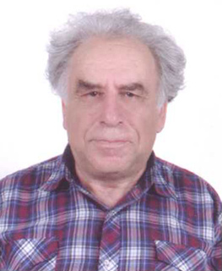
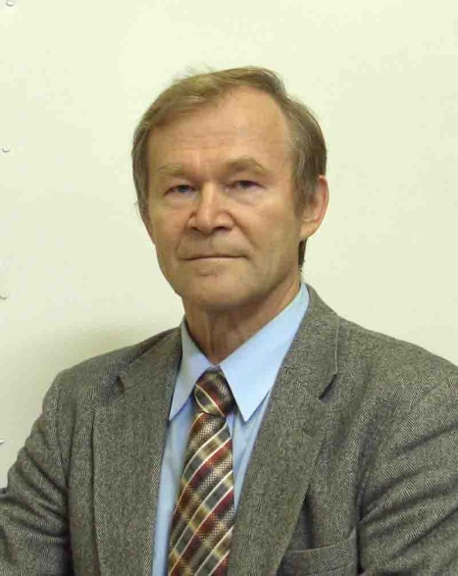
G-G Collider idea
Use back Compton on GeV’s e-beam
A.Kondratenko, E. Saldin, and E. Pakhtusova
FEL - based g-g collider Laser - based G-G
I. Ginzburg and V. Telnov
Notes:
Use back Compton on Gev’s e-beam

Slide 34
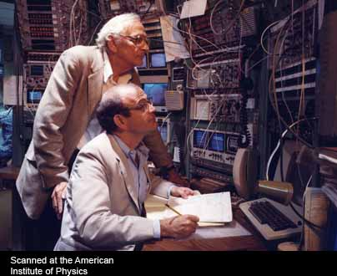
Friends and trends
Larry Ratner
Alan Krisch
Notes:
Alan Krisch

Slide 35
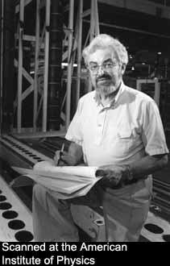
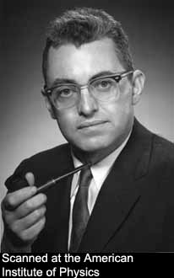
= Ernest Courant =
Invariant forever
How this can be possible:
an alternated field to focus a beam ?!...
Young but wise…
Super-wise…
AGF is a relative of the Kapitsa pendulum, but of more
general and fundamental nature…
Spin resonances and snakes…
Notes:
How it becomes possible that an alternated field may focus a beam ?!...

Slide 36
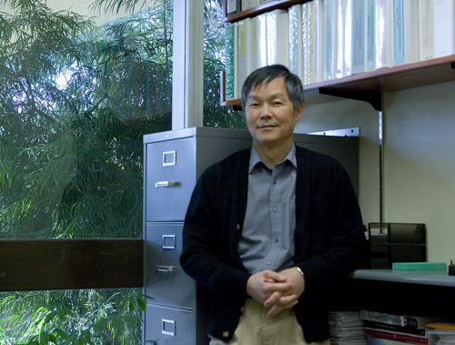
Alex Chao
Accelerator Encyclopedia
Slim program
Spin quads
Collective stability
More… and more
Handbook of accelerator
physicist
To galaxies…
to…?
Notes:
Accelerator Enciclodia

Slide 37
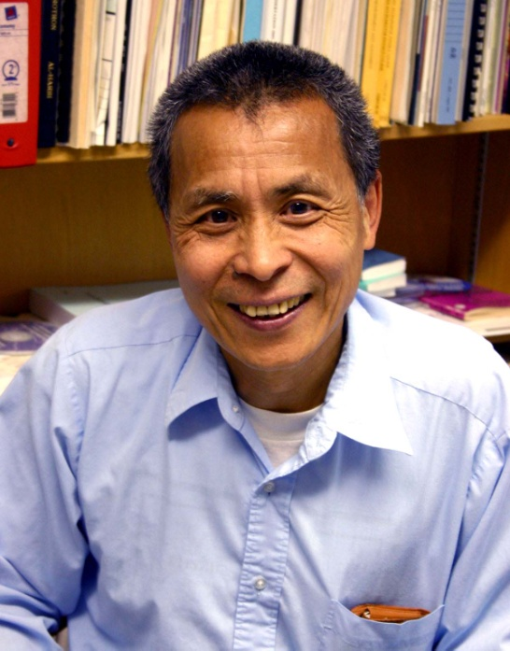
Iucf: Accelerator arboretum
Non-linear dynamics
Space charge studies
Spin: Snake resonances
More…
“Spin dynamics and snakes”
Lectures
S.Y. Lee

Slide 38
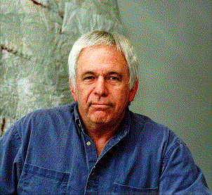
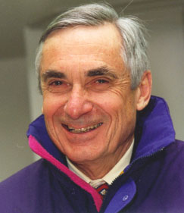
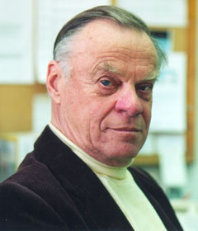
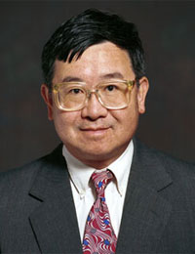
U of M, Ann Arbor
George Ford
Lawrence Jones
Gordon Kane
Ronald Gilgenbach
Y.Y. Lau
Notes:
George Ford

Slide 39
Masers and RF polarimetry
Daniel Kleppner
Norman Ramsey

Slide 40
CERN
CERN
DESY
D. Mohl
B. Montague
F. Sacherer
B. Zotter
E. Keil
L. Thorndal
I. Hoffman
F. Ruggiero
V. Scandale
G. Voss
R. Brinkmann
D. Trienes
K.Flottmann
J.Rossbach
D. Barber
P. Schuler
P. Wesolovski

Slide 41
Help & co-operation from HEP theory
James Bjorken
The Minimax experiment at the Fermilab Tevatron
J.Bjorken and R. Gustafson
IBS theory by Bjorken and Mtingva
“-James, Landau did this for plasmas in 1937…”
“-So I’ve got in a good company!”
Notes:
J.Bjorken and R. Gustafson

Slide 42
John + Mary Bell
Classics of quantum world
“Hidden parameters”
John:
-- Closing disputes on
hidden parameters --…
-- Unrue radiation ↔ Radiative
polarization --...
Mary:
-- Debay shielding
in Magnetized Electron Cooling --
Notes:
Unrue radiation ↔ Radiative polarization ?...

Slide 43
Classics of quantum world Gauge principle & problem
What is your gauge?...
MartinusVeltman
John and Tiny
Unification with gravity?
Is the gravity as fundamental as other “interactions”?
Notes:
John and Tiny

Slide 44
Classics of quantum world =Questions to the fundamentalists =
Gordon Kane
Origin of quantum description ?
Unification with gravity?
Is the gravity as fundamental as other “interactions”?
Space-time nature…
e.g. connection/relations to matter ?
Gordon Kane
------------------------------------------------------------------------------------------------------------------------
A question to explore:
Is the known background of math sufficient to build the UFT ?...
Let us assume so…
Notes:
----------------------------------------------------------------------------------------------------------------------------------------

Slide 45
Conclusion
"No wonder that my remembrance fails me, for
I shall complete my 70 years… — and during these 70 years I have had a happy life; which still remains happy because of hope and content.”
M. Faraday
Courtesy of Martha Harrell
Notes:
Courtesy of Martha Harrell

