Slide 1
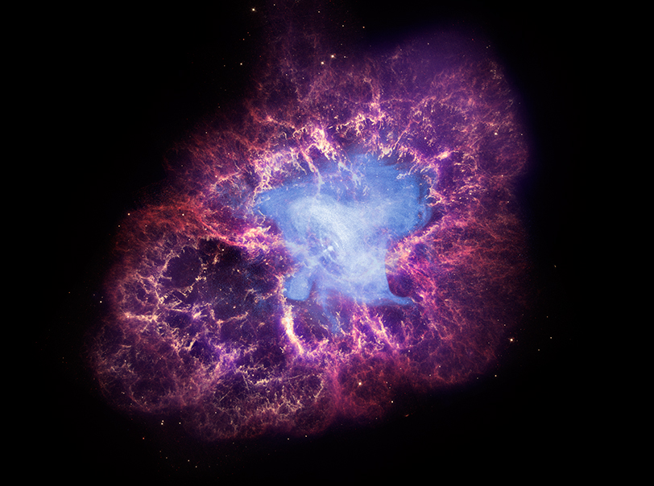



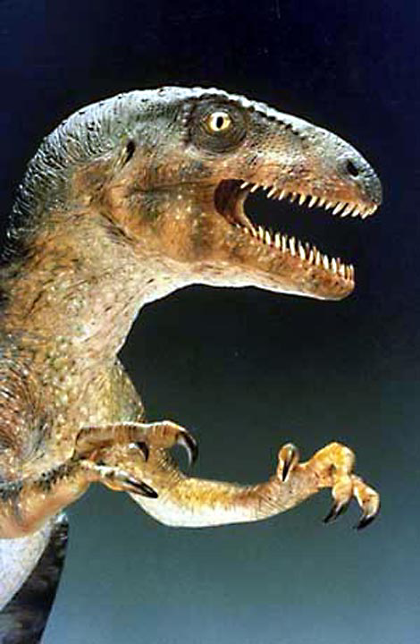
PREX II and CREX
NASA/CXC/SAO
Juliette Mammei
²⁰⁸Pb

Slide 2
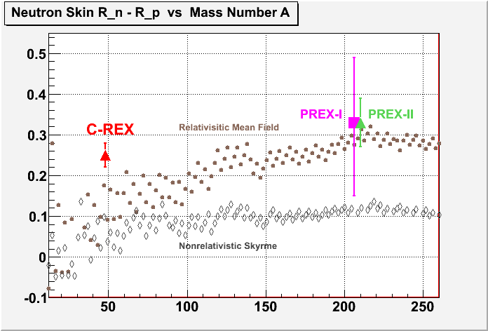
PREX II and CREX
²⁰⁸Pb more closely approximates infinite nuclear matter
The ⁴⁸Ca nucleus is smaller, so can be measured at a Q² where the figure of merit is higher
and are expected to be correlated, but the correlation depends on the correctness of the models
The structure of ⁴⁸Ca can be addressed in detailed microscopic models
Theory from P. Ring et al. Nucl. Phys. A 624 (1997) 349
Measure both and - test nuclear structure models over a large range of A
Notes:
Calcs. for rel. mean field theory vs. within Hartree-Fock with density-dependent Skyrme forces
Parameter sets NL-1 and skiii

Slide 3
Problems during PREX I
Repeated failures of scattering chamber attachment o-ring
  Solution: all metal seals
Damage to electronics from radiation in Hall
  Solution: More rad-hard electronics, better locations
  Improved shielding design
Eventual failures of the individual lead targets
  Solution: Run with 10 targets!

Slide 4
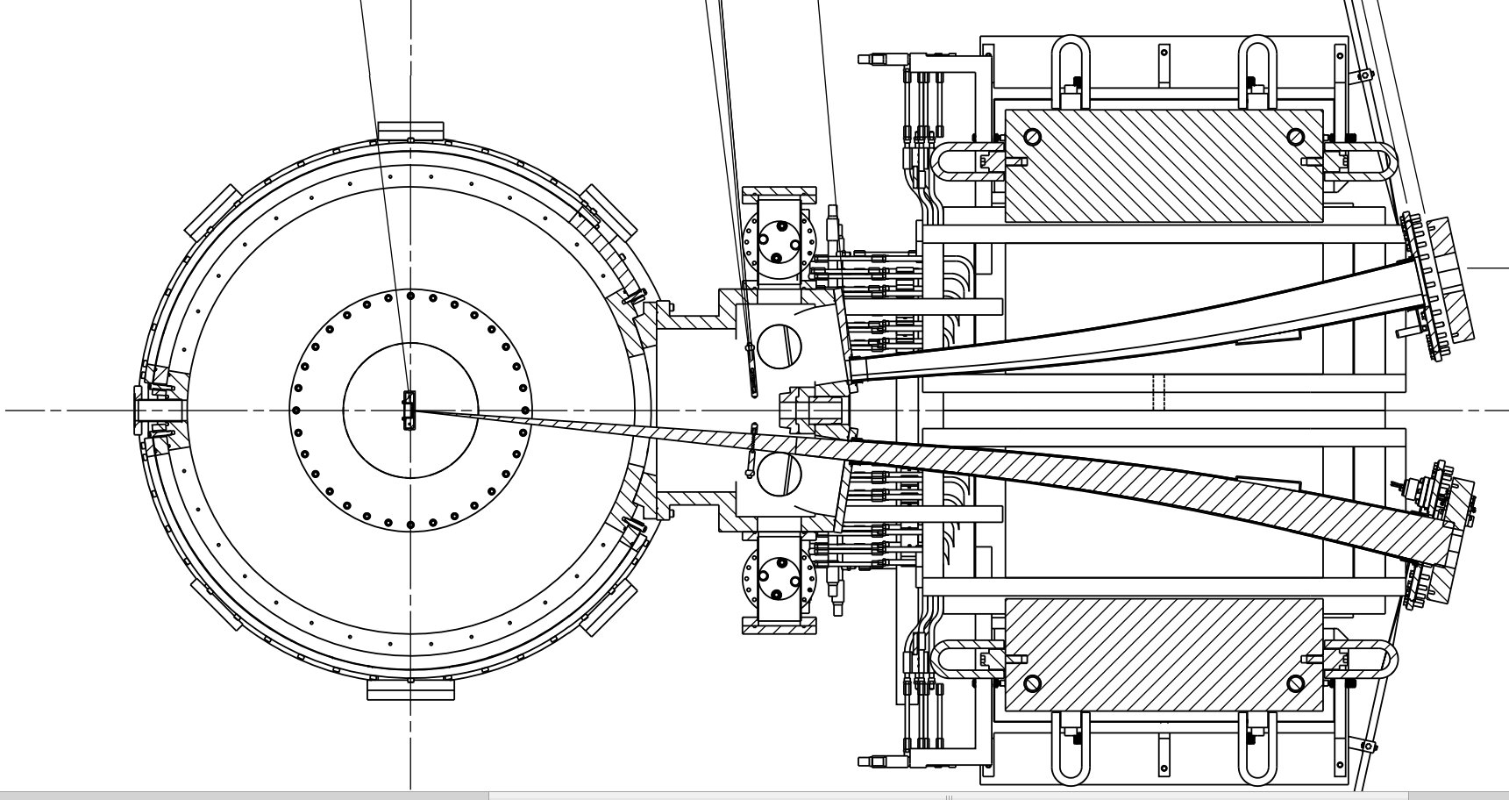
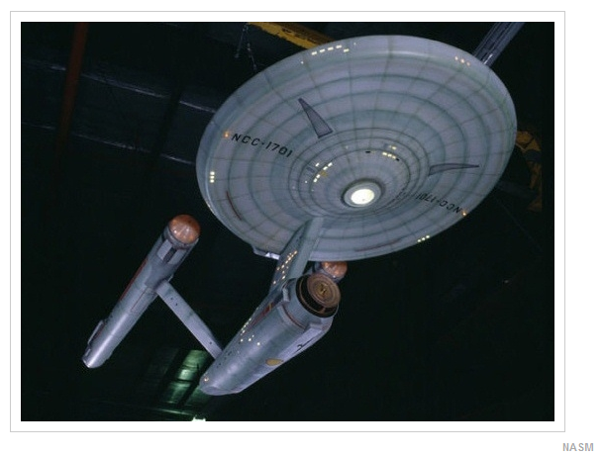
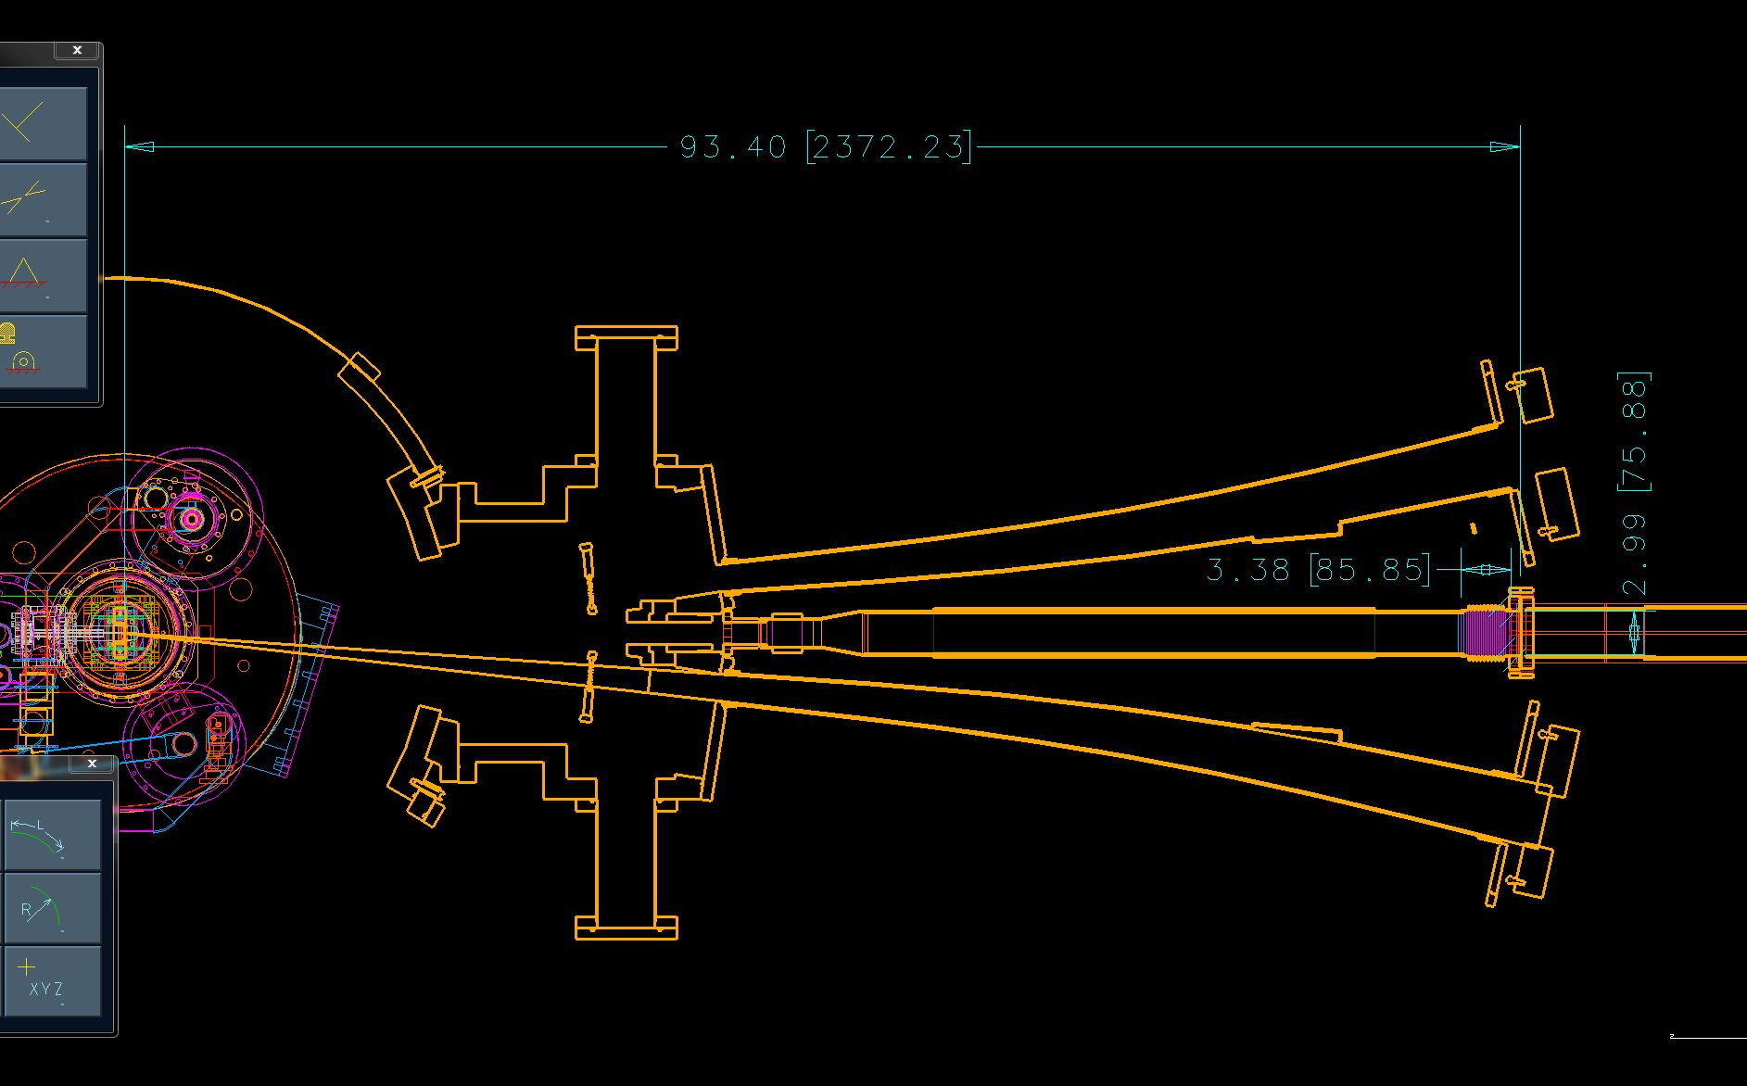
The Enterprise
Collimator region
collimator
Downstream face of scattering chamber attachment
Beam pipe through septum
Magnetic shield

Slide 5
Metal seals
Electronics throughout hall replaced and/or moved
Decrease the collimator inner diameter and water cool it
Extend magnetic shield as far upstream and downstream as we can

Slide 6
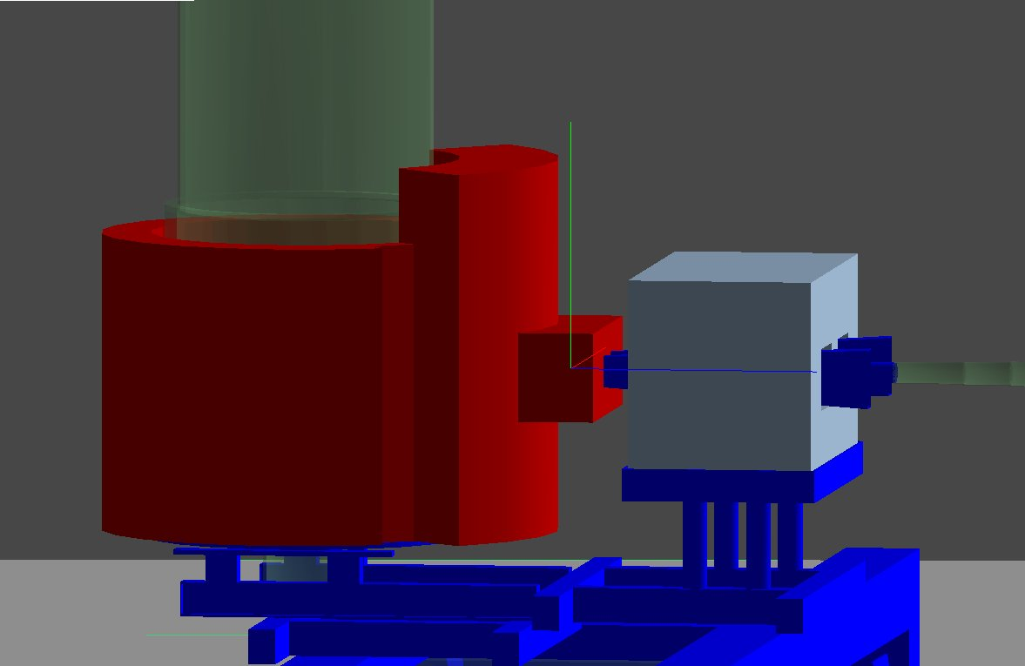
Background simulations
Geometry in modelled in GEANT4
Physics lists:
Standard EM Physics
photo- and electro-nuclear
(equivalent photon approximation for
the latter)
QGSP_BERT_HP
Bertini cascade model for protons, neutrons, pions and kaons (below 10 GeV)
Data driven high precision neutron package to transport neutrons below
20 MeV down to thermal energies
Notes:
electromagnetic (PhotoElectricEffect, ComptonScattering, MultipleScattering, Ionisation, Bremsstrahlung, etc.) neutron production (Photo- (parameterized cross-section data) and Electro-nuclear (EPA) processes) neutron transport (still trying to pin this down)
QGSP - quark gluon string model for high energy interactions of protons, neutrons, pions, and kaons and nuclei

Slide 7
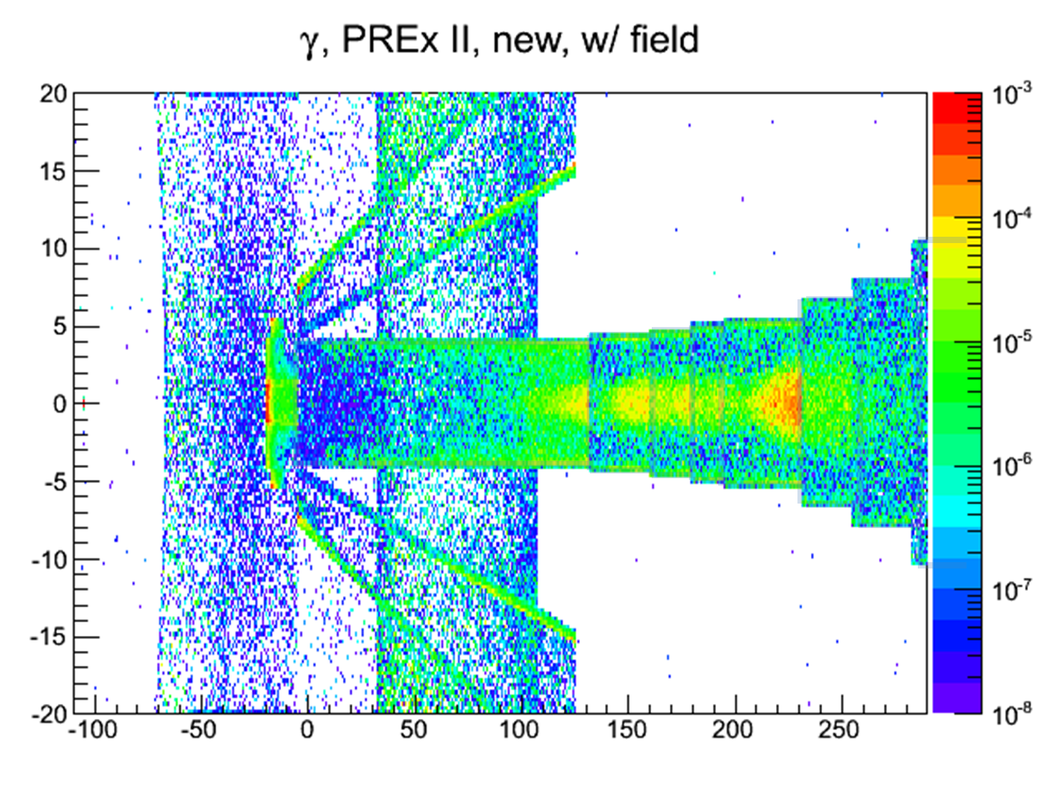
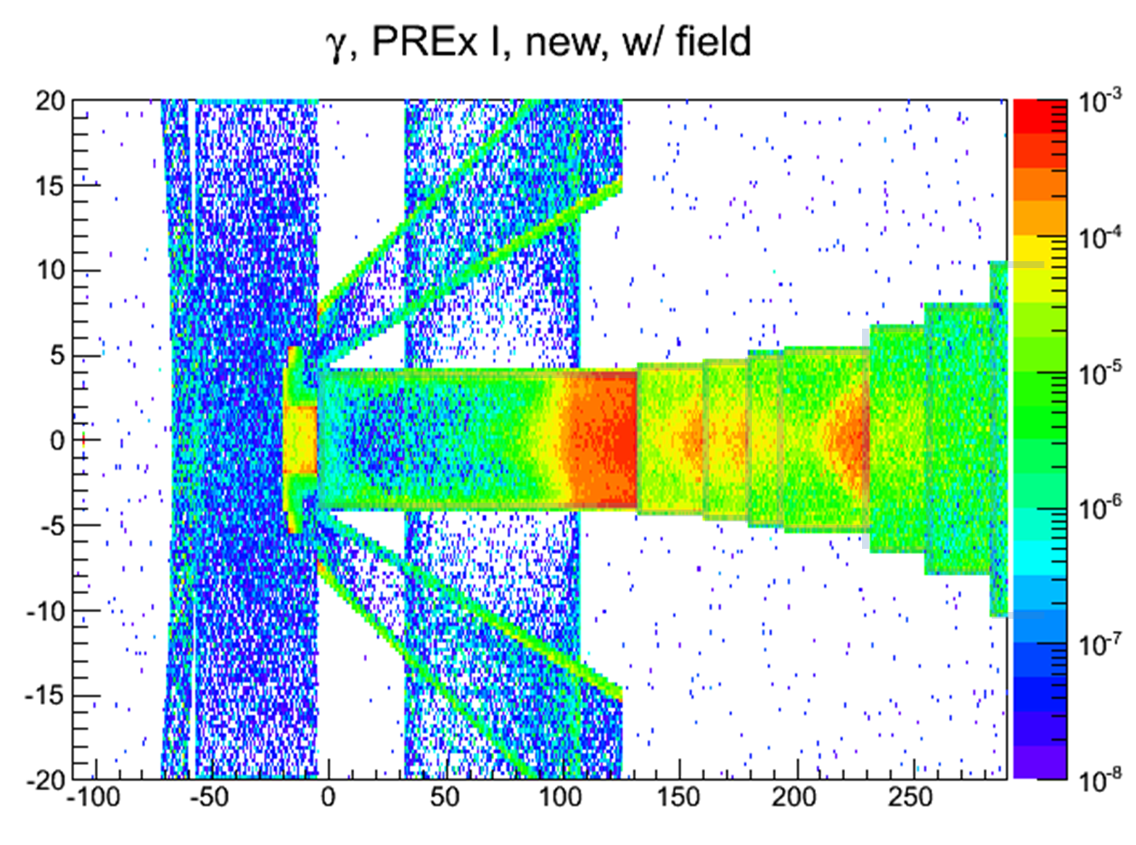
Qualitative improvement
Origin of photons hitting a “plane” detector downstream of the septum
PREX I
PREX II
Collimator bore was not small enough in PREX I to eliminate sources at the end of beampipes; quadrupole field in beampipe exacerbates the problem
decreasing the bore eliminates sources downstream

Slide 8
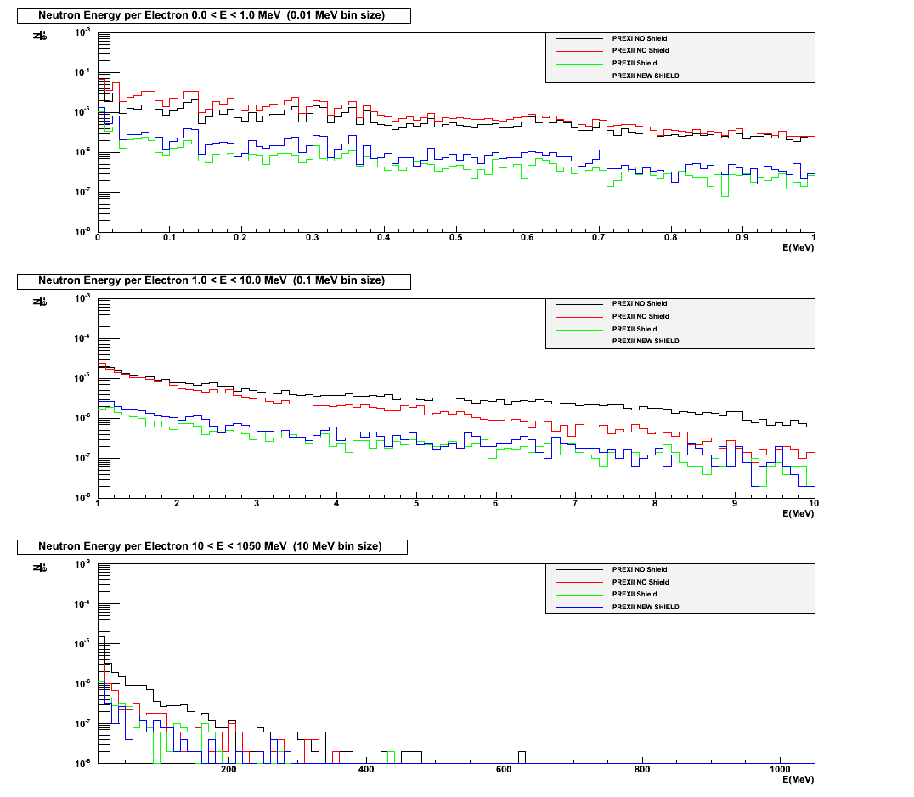
Neutron Energy Spectra
0<E<1 MeV
(0.01 MeV bins)
Neutrons per incident electron
1<E<10 MeV
(0.1 MeV bins)
“unshielded” neutron rates go up a bit with new bore
Source is localized …
Shield it!
PREX II neutron rates 10x smaller than PREX I
10<E<1050 MeV
(10 MeV bins)

Slide 9
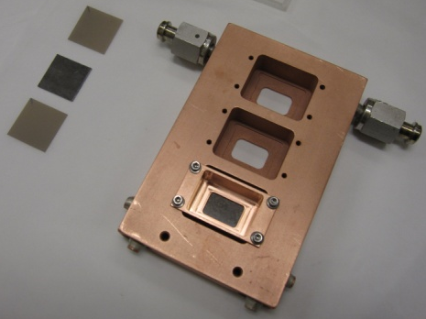
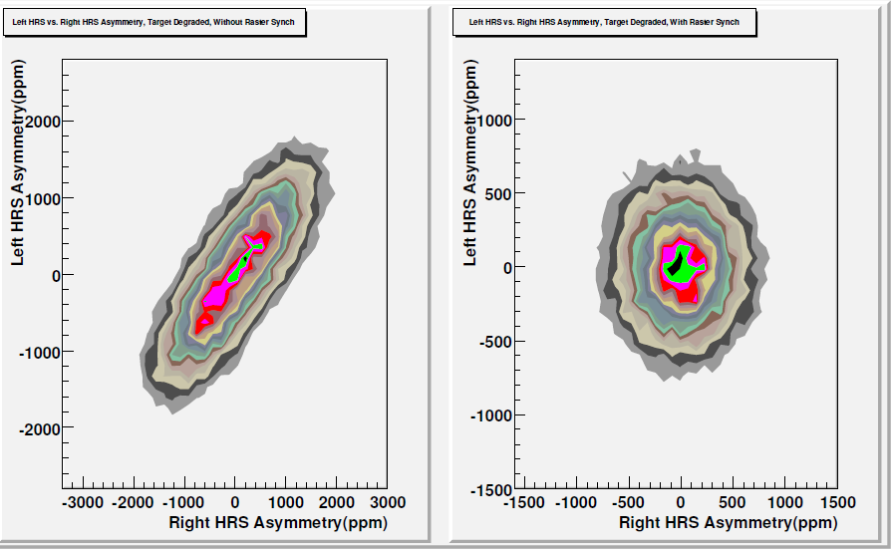
Target Performance
Three targets, with thin, medium and thick diamond (~0.15 mm) backing on a 0.5 mm thick Pb sheet
Cooled with liquid He (30 W)
Over time, the targets developed thickness non-uniformities which resulted in correlated noise between detectors
→ Synchronize raster
to the helicity
frequency!
Not synched
Synched

Slide 10
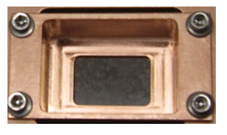
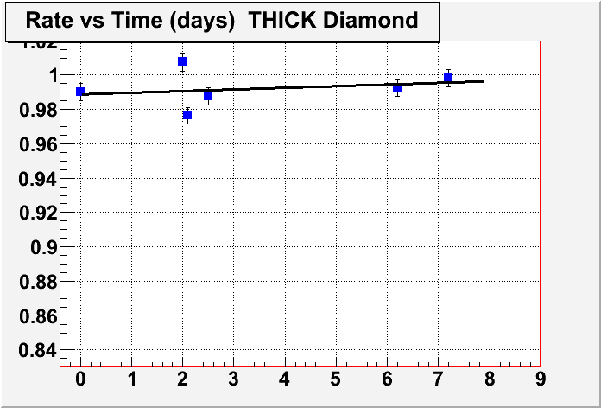
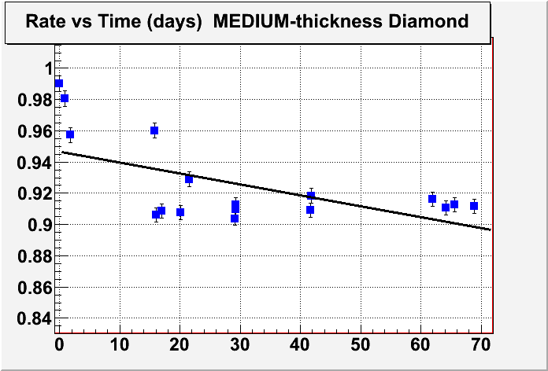
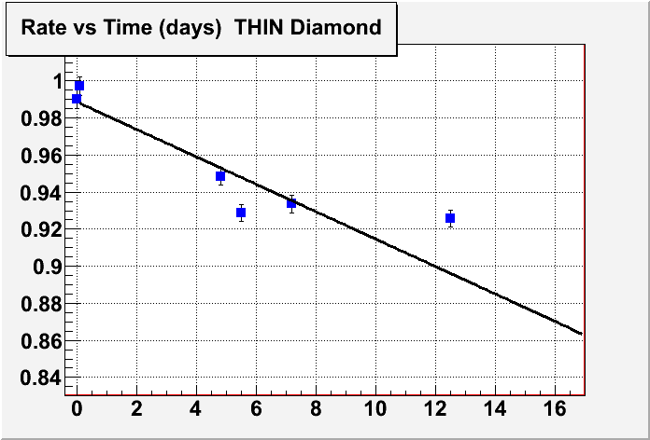
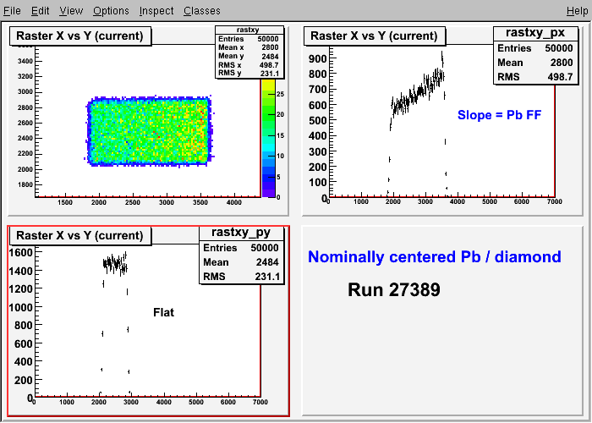
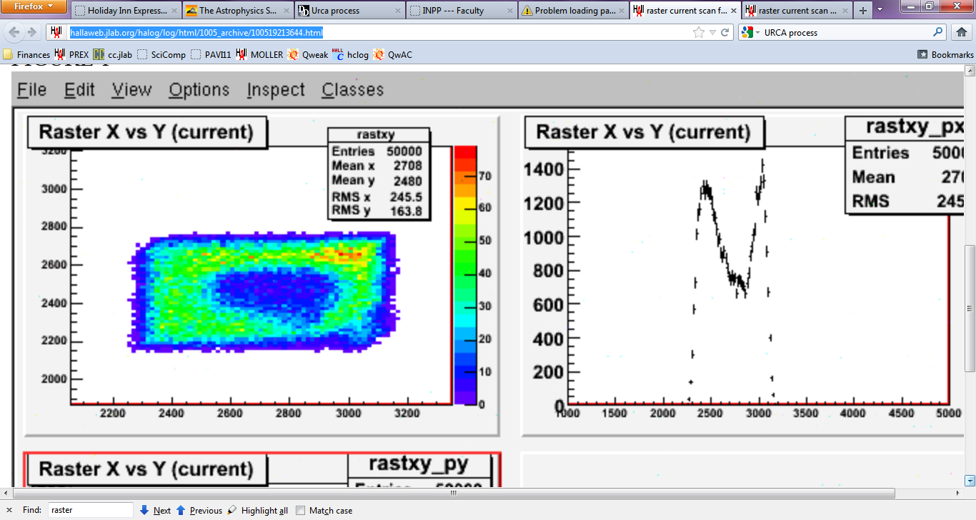
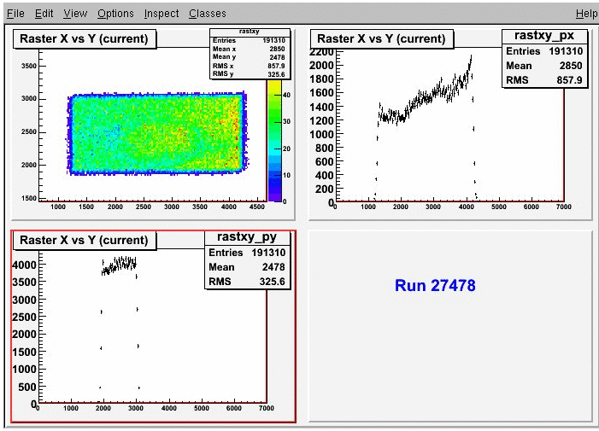
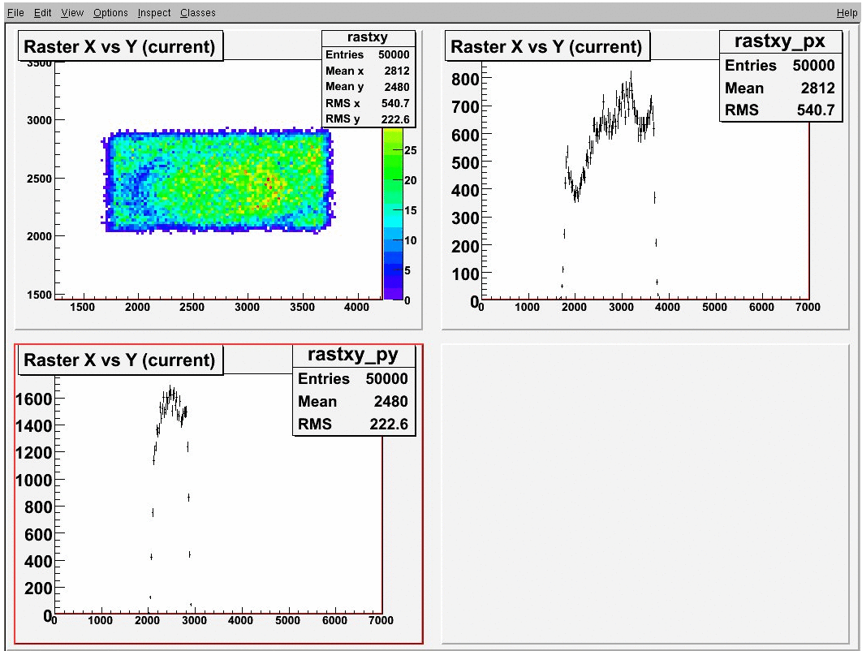
Target Performance
raster
Counts
X position of raster
Y position of raster
(slope from Pb FF)
Targets with thin diamond backing (4.5% bkgd) degraded fastest
Thick diamond (8% bkgd) ran well and did not melt – even at 70 uA!
Trade-off between length of time the target can be used and the amount of bkgd
MELT
Solution: Run with 10 targets

Slide 11
CREX
Target design (10x more power – 360 W)
Optimization of the kinematics
Septum design
Backgrounds from 1st excited state (tails larger than in PREX)
Radiation in Hall

Slide 12
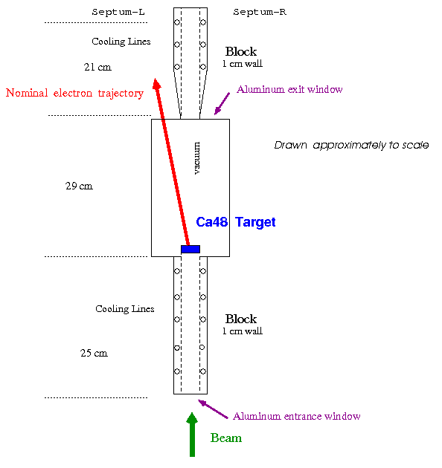
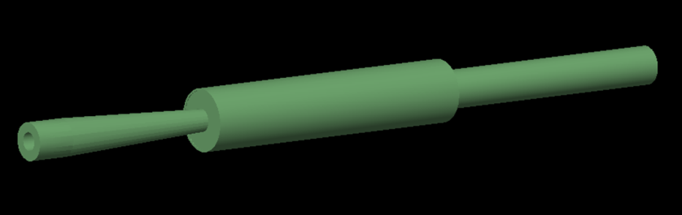
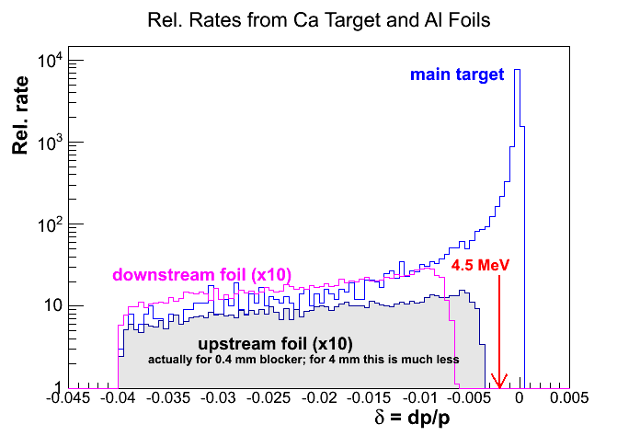
Target Design
Preliminary
Notes:
Target is 1g/cm2 isotopically pure 48-Ca - 5% radiator (PREX has ~10% radiator)
In vacuum so it can be recovered in the case of the target being destroyed so 48 Ca can be recovered (very expensive!) used in x>2 SRC (short range correlations) used up to 40 uA
Thermal calculations show that with a standard raster pattern to distribute the heat from the beam, the target temperature will not exceed 120C (the melting point is 842C) if we can keep the temperature on the border of the target fixed at room temperature. Need to carry away 360 W.

Slide 13
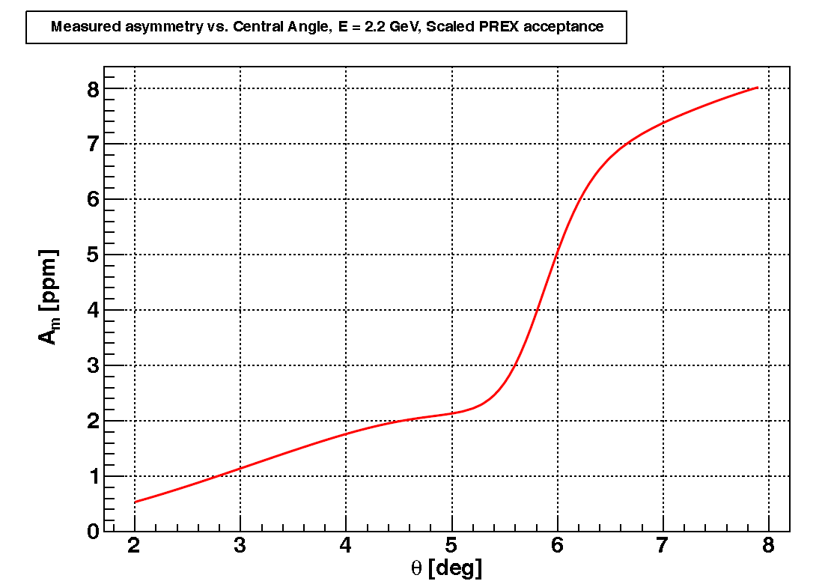
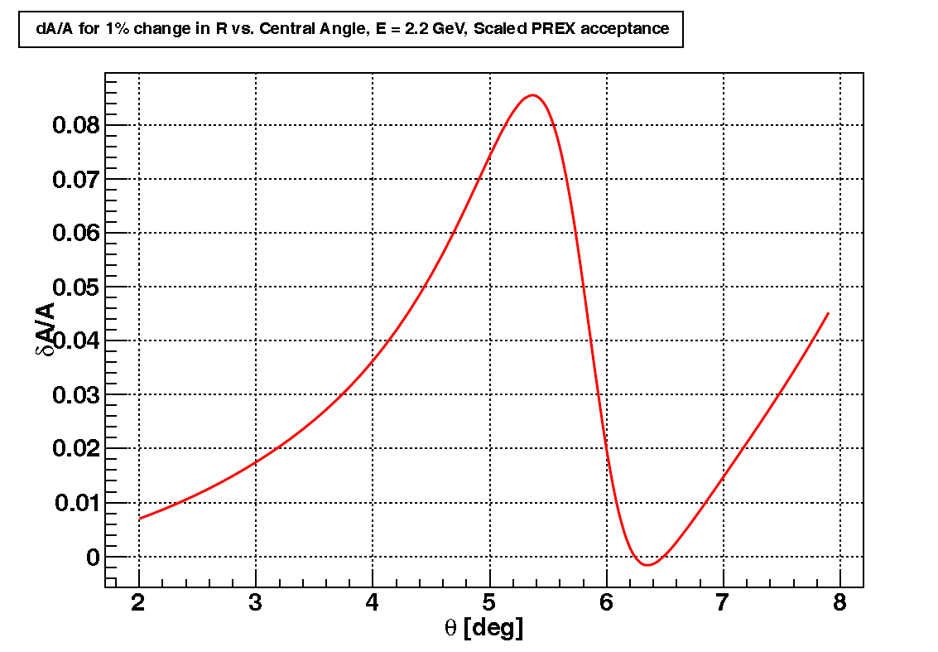
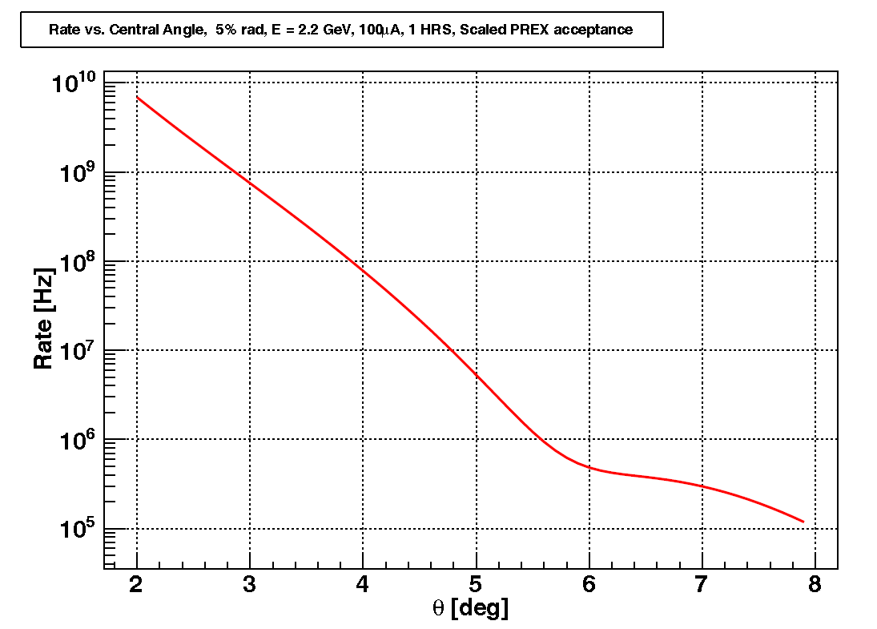
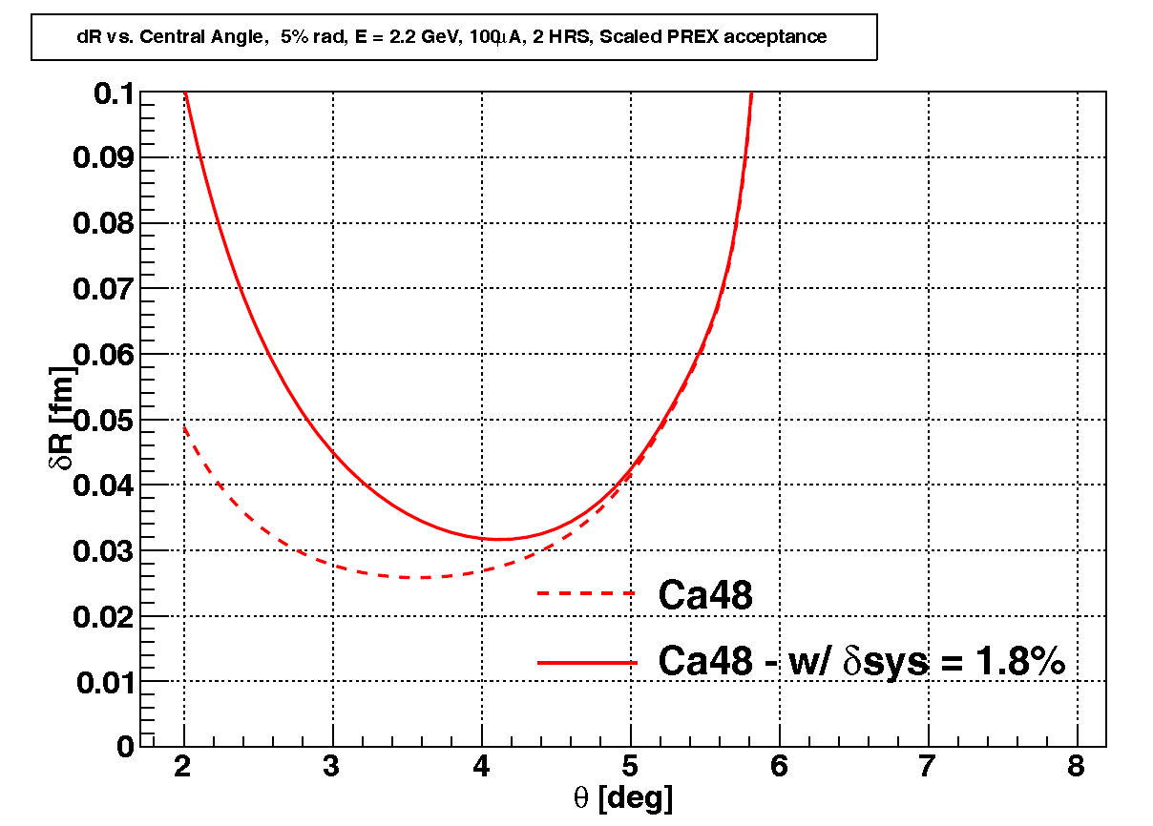
Kinematics
Plots vs. central angle
beam energy 2.2 GeV
(scaled PREX acceptance)
Asymmetry (ppm)
δA/A
(δR/R ~1%)
Rate (Hz)
δR (fm)
Notes:
In general smaller is better (higher momentum transfers so APV larger) but also more neutron rich is better (larger weak charges, so APV larger)

Slide 14
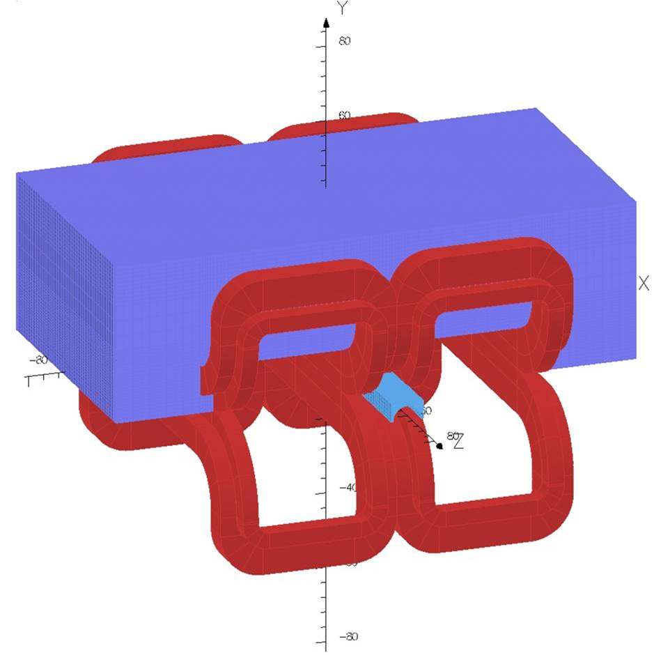
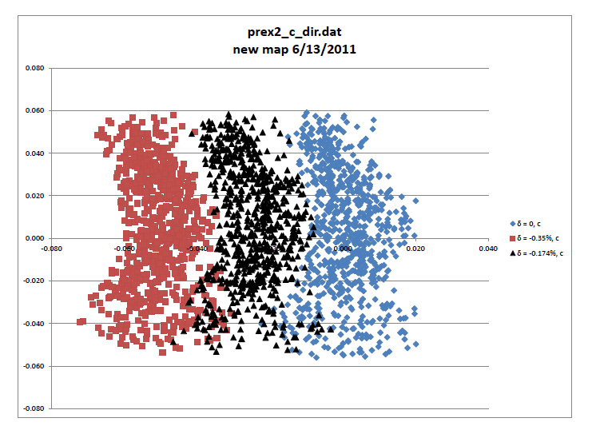
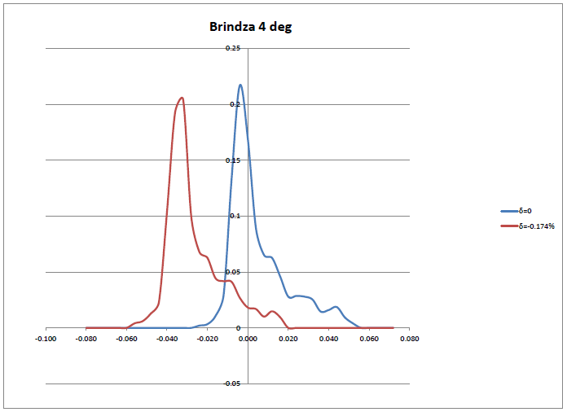
Septum
Same design as for PREX II, but at a higher current density - 1350 A/cm²
With proper cooling, this is not a problem
(coils can be run at least as high as 1430 A/cm²)
Notes:
Plot of x vs. y at the focal plane for elastic (blue) and first excited states of Pb (red) and Ca48 (black) with two coil configuration.
deltaP/P – resolution of spectrometer
1st excited state - 2.6 MeV for Pb – 2.45 delta
1st excited state – 3.8 MeV for Ca – 1.72 delta (3.5 if 1 GeV)

Slide 15
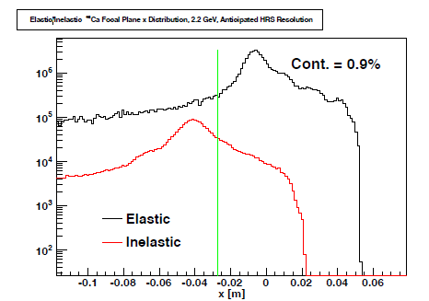
Backgrounds from excited states
We will have a 0.9% background from excited states
Improvement in the hardware optics resolutions will reduce this amount
Assuming calculated A_{ine}~ A_{ela} (with 50% error)
→ systematic error contribution = 0.5%
Notes:
Need to know the fraction of the background, but also its asymmetry
The first few inelastic excited states were simulated with the appropriate strengths by using fits to form factor measurements of electron scattering from 48Ca done at MIT-Bates [40]. These measurements covered the same momentum transfer range of interest here.
Calculation of the contributing asymmetries is underway, but they are not expected to be significantly different from the measured asymmetry.

Slide 16
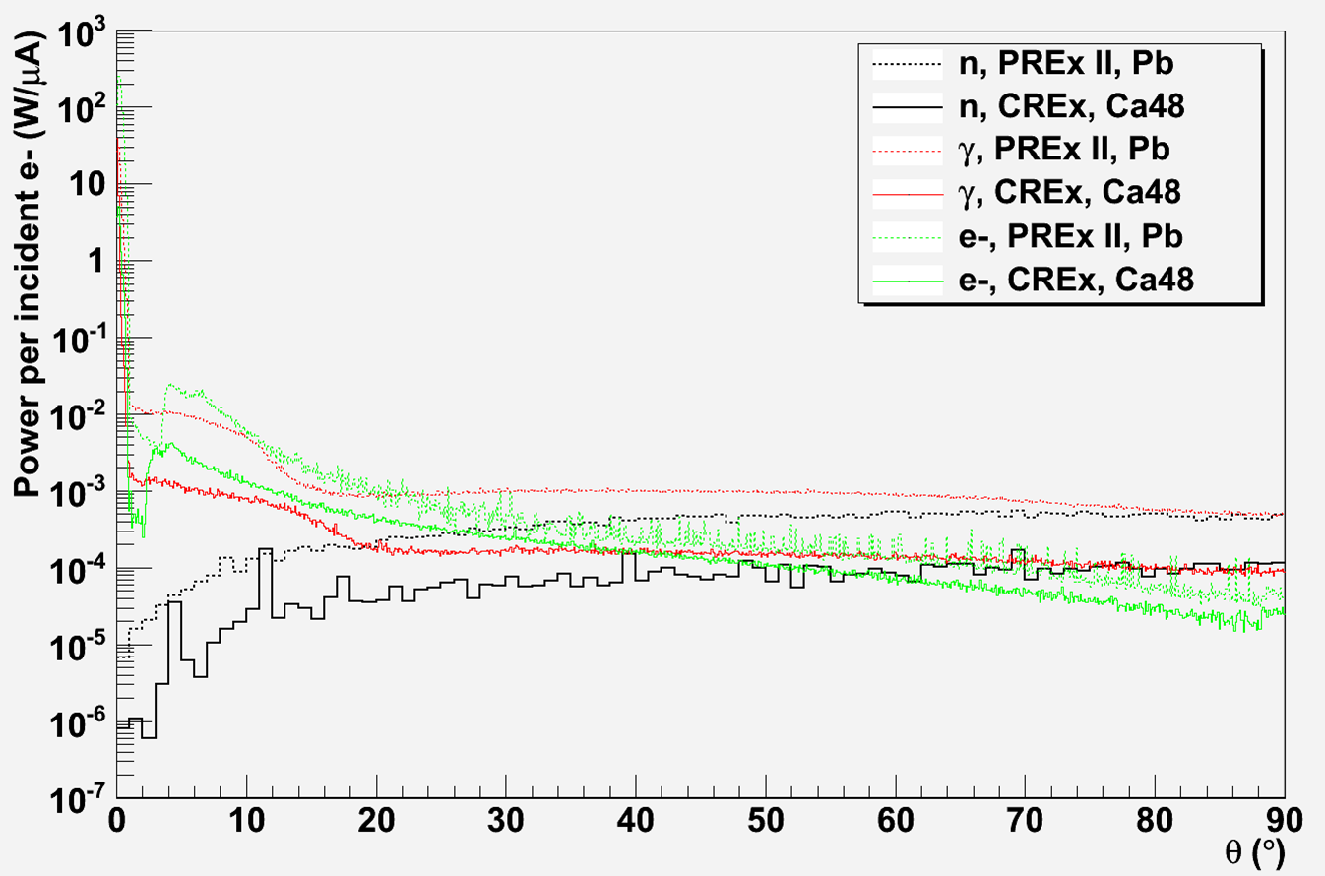
Radiation in the Hall
Backgrounds from radiation in hall are 10x smaller than PREX II
Power from all particles per incident electron for 5% Ca and 8.9% Pb targets.

Slide 17
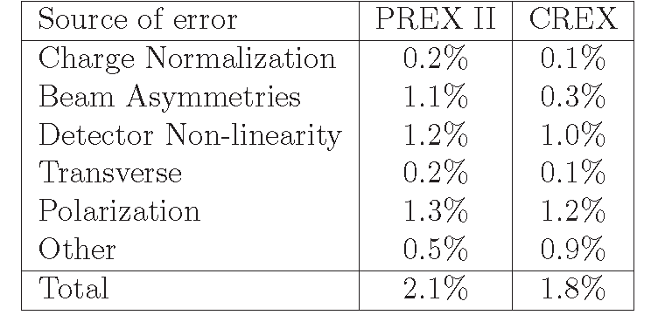
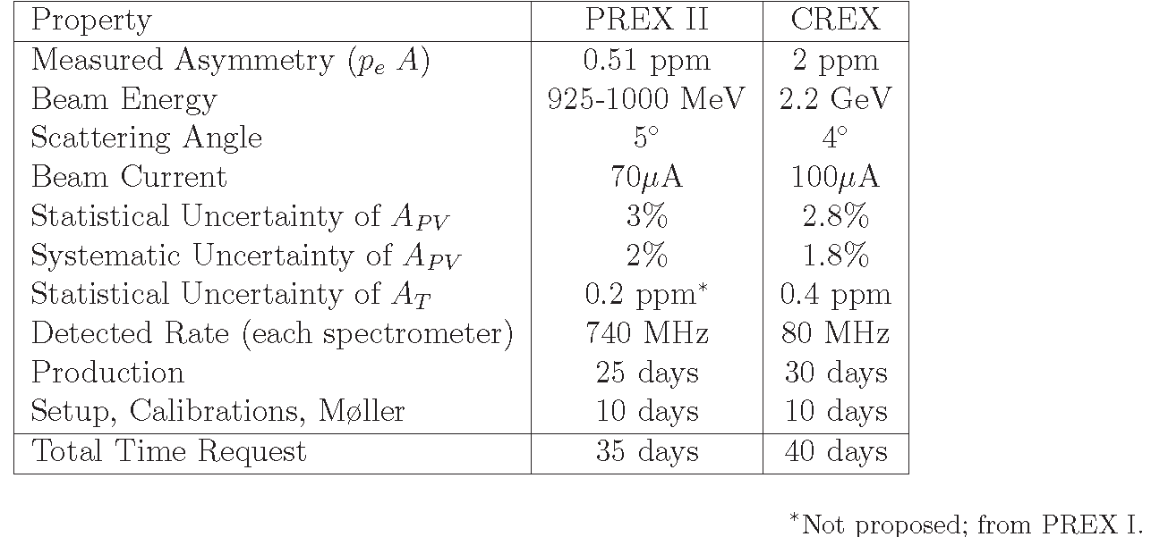
PREX II and CREX
These numbers are based on experience from PREX-I
Table 2 –Systematic errors for PREX II and CREX.
C-REX is a standard energy (2.2 GeV)
1-pass beam is easy to schedule –
standard equipment (HRS, etc.)
Table 1 –Proposed data for PREX II and CREX.
Uncertainty in:
±0.05 fm
± 0.03 fm

Slide 18
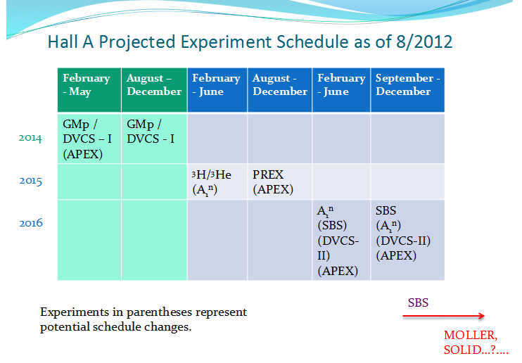

Slide 19
Spokespeople
PREX II
K. Kumar
R. Michaels
K. Paschke
P.A. Souder
G.M. Urciuoli
CREX
J. Mammei
R. Michaels
K. Paschke
S. Riordan
P.A.Souder
D. McNulty

Slide 20
Extra Slides

Slide 21
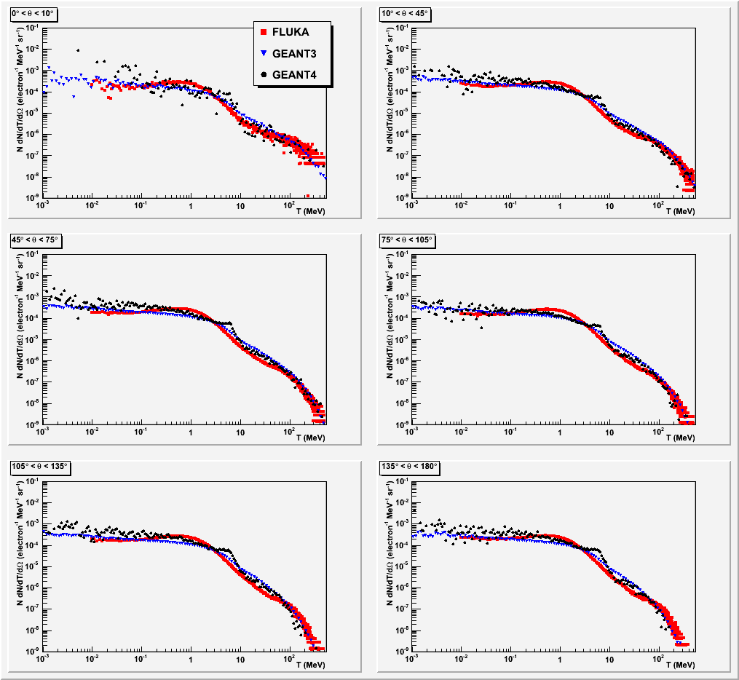

Slide 22
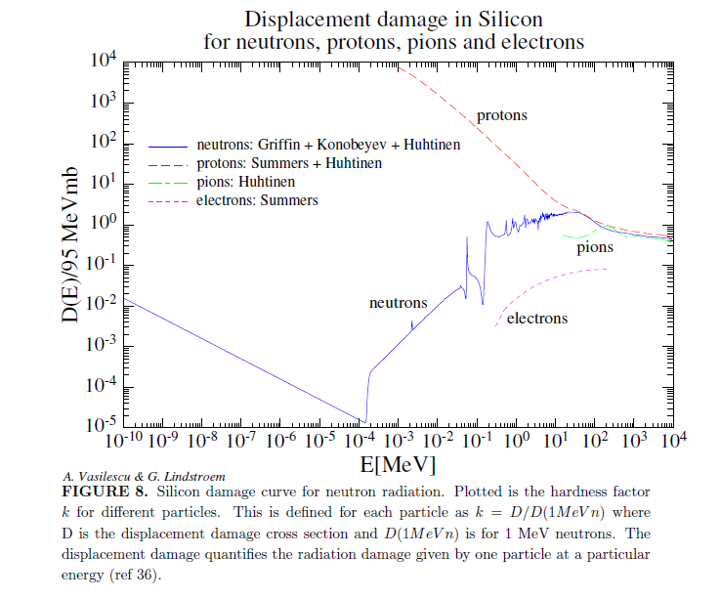

Slide 23
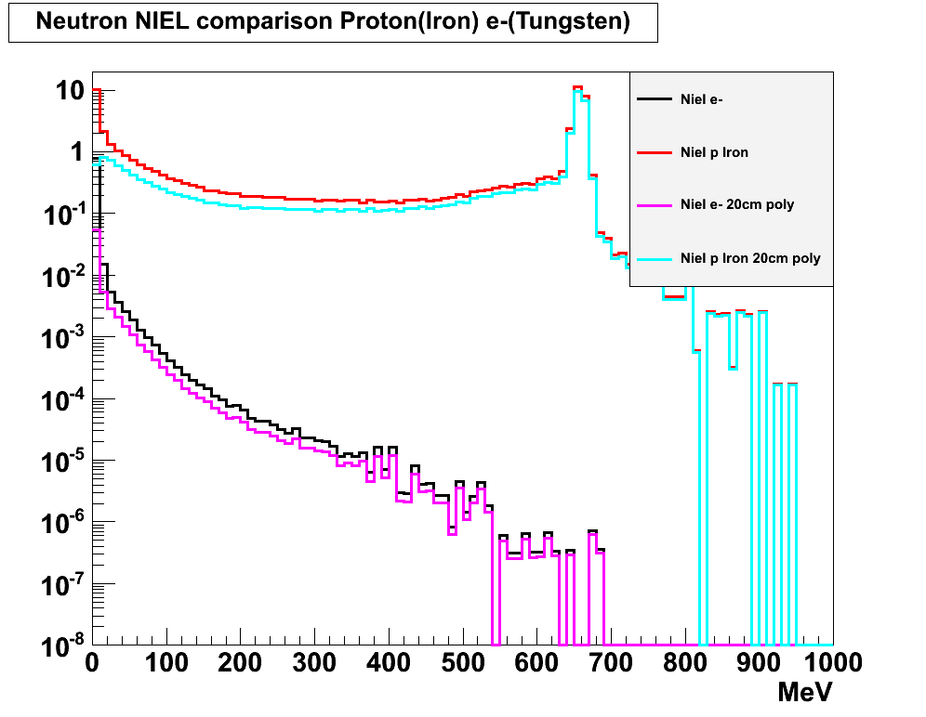
Incident particle:
1 GeV (p or e-)
Damage-weighted energy spectra

Slide 24
Physics Lists
QGSP is the basic physics list applying the quark gluon string model for high energy interactions of protons, neutrons, pions, and kaons and nuclei. The high energy interaction creates an exited nucleus, which is passed to the precompound model modeling the nuclear de-excitation.
"Like QGSP, but using Geant4 Bertini cascade for primary protons, neutrons, pions and kaons below ~10GeV. In comparison to experimental data we find improved agreement to data compared to QGSP which uses the low energy parameterised (LEP) model for all particles at these energies. The Bertini model produces more secondary neutrons and protons than the LEP model, yielding a better agreement to experimental data. "
data driven high precision neutron package (NeutronHP) to transport neutrons below 20 MeV down to thermal energies.
http://www.slac.stanford.edu/comp/physics/geant4/slac_physics_lists/ilc/LHEPlistdoc.html

Slide 25
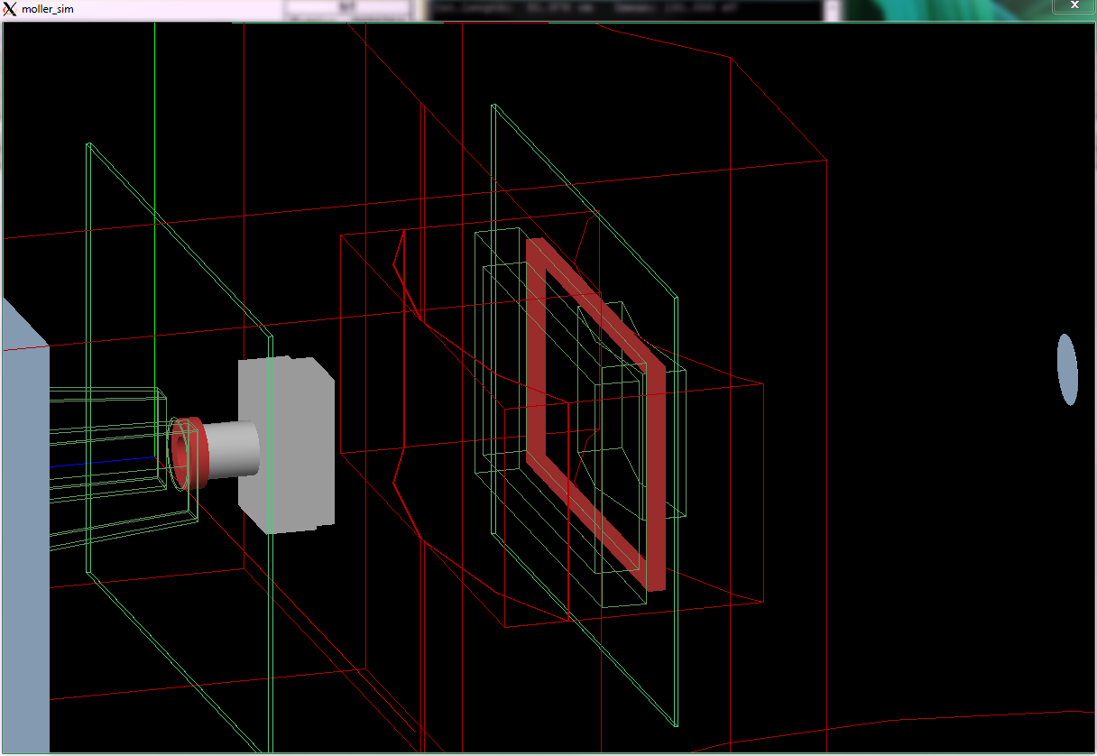
o-ring nominal dimensions shown; septum o-ring extends ±1 cm and sc o-ring extends ±0.5 cm around that in plane, and both are 2 cm thick in the z direction
46
R = 3.0
24.638
25
17.018

Slide 26
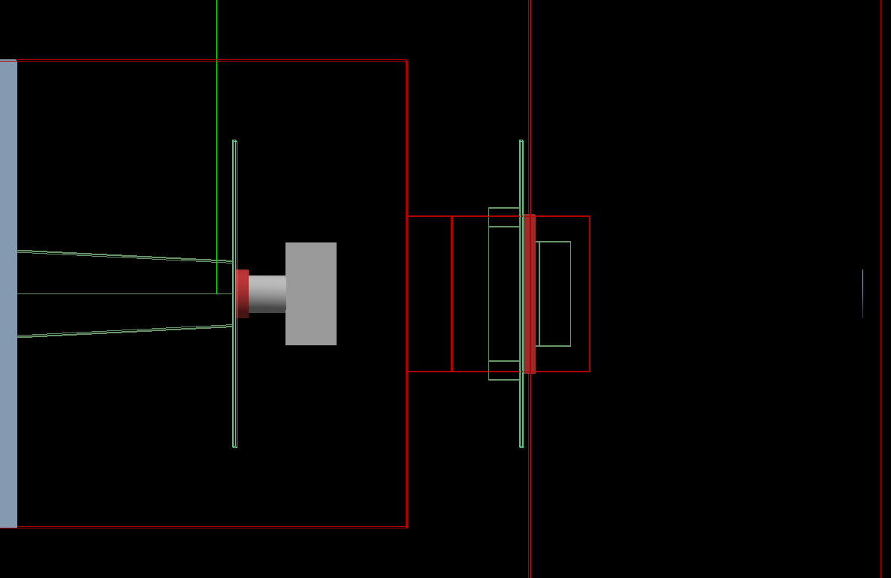
flange
(Al – PREX I, SS – PREX II )
septum
plane detector
plane detector
vacuum attachments
septum o-ring
scattering chamber o-ring
collimator
septum pipe
target
opening in scattering chamber
hut
(polyethylene)
cylinder
(polyethylene)
5.08
52.07
14.351
85.822

Slide 27
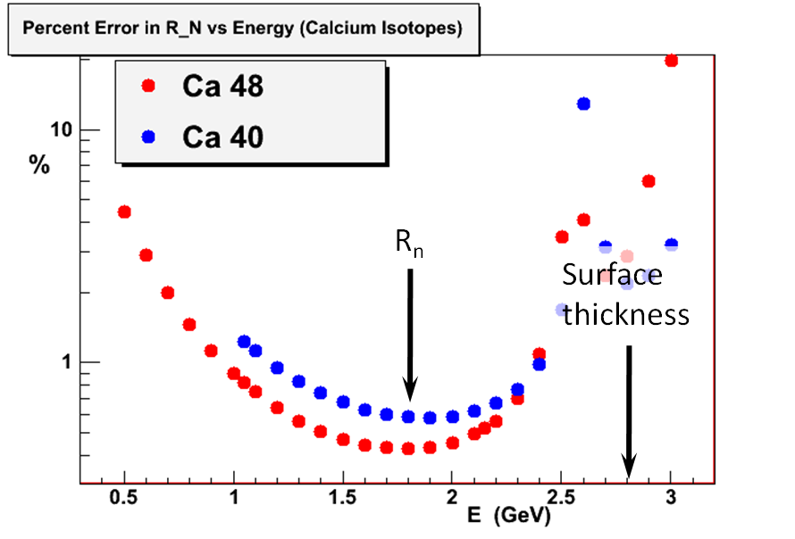
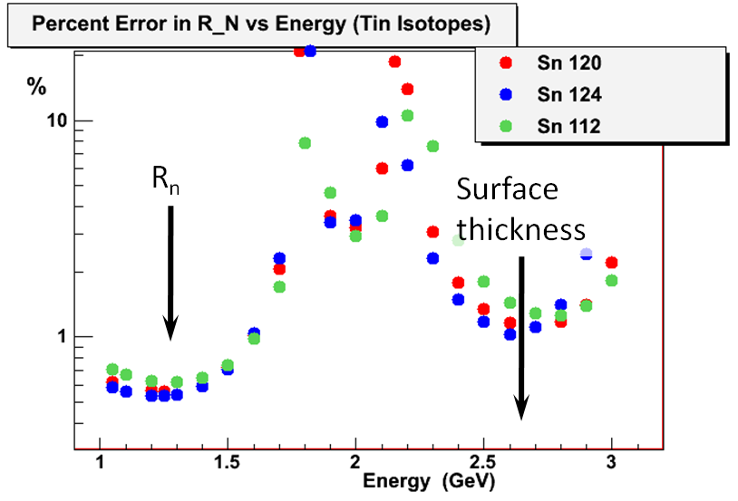
Possible Future Program
Additional measurements would allow us to:
relate the measurement to 3-nucleon forces
(other nuclei)
and constrain the surface thickness
(add’l higher energy point)
Nucleus | E (GeV) | dR_{N} / R_{N}
²⁰⁸Pb | 1 | 1 %
⁴⁸Ca | 2.2 (1-pass) | 0.4 %
⁴⁸Ca | 2.6 | 2 %
⁴⁰Ca | 2.2 (1-pass) | 0.6 %
tin isotope | 1.8 | 0.6 %
tin isotope | 2.6 | 1.6 %
Approved
To be proposed
Not yet proposed
Each point 30 days, statistical error only
Shufang Ban, C.J. Horowitz, R. Michaels J. Phys. G39 014104 (2012)
Notes:
48Ca at 2.2 GeV is a natural 12 GeV experiment… Ca is once of the lightest neutron rich closed shell nuclei.
In general smaller is better (higher momentum transfers so APV larger) but also more neutron rich is better (larger weak charges, so APV larger)

Slide 28
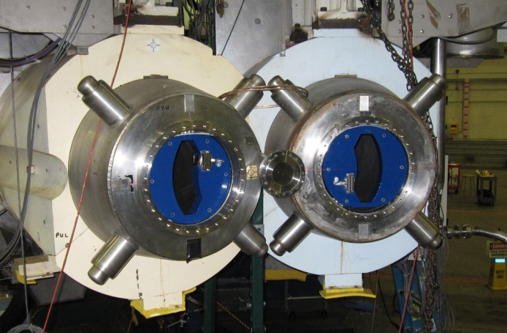
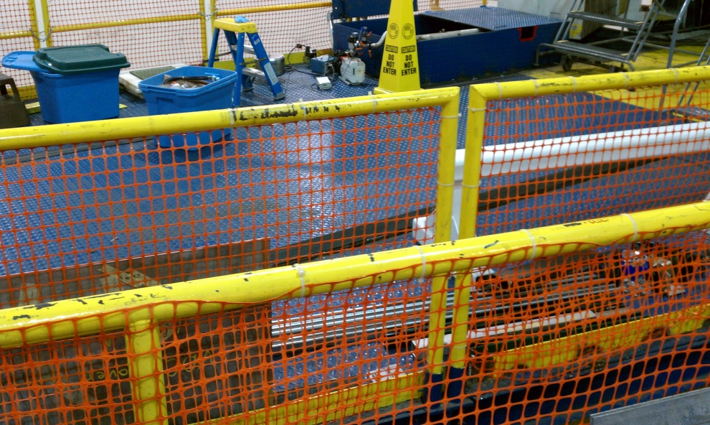
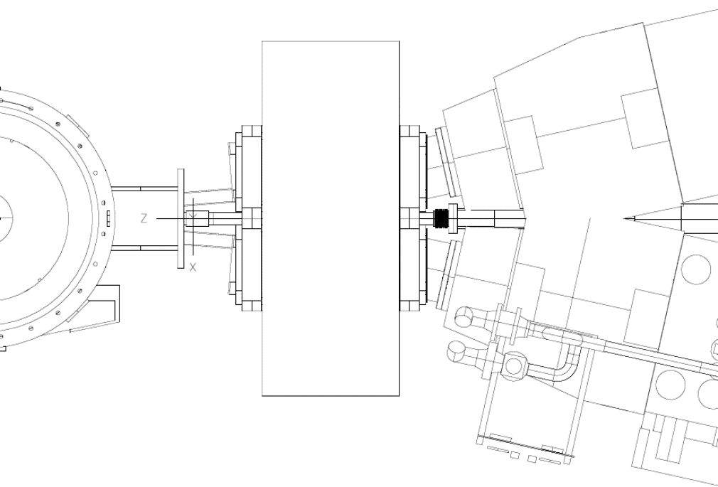
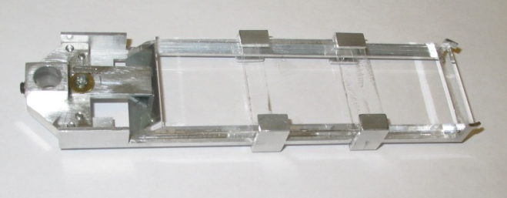
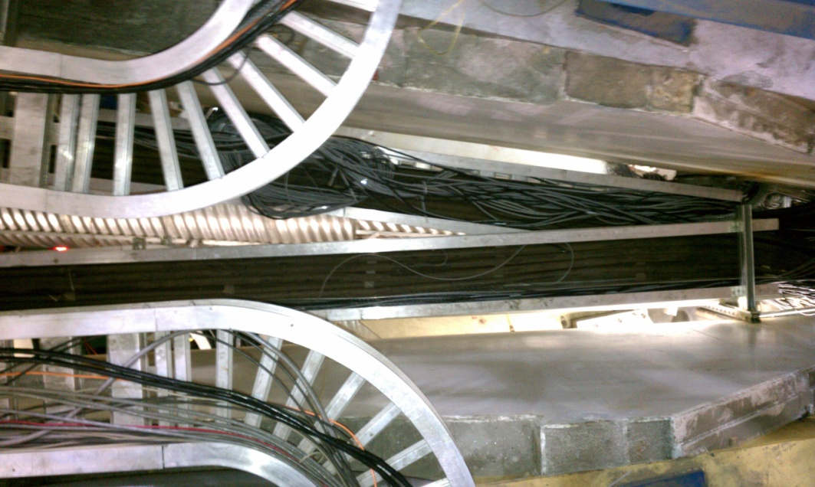
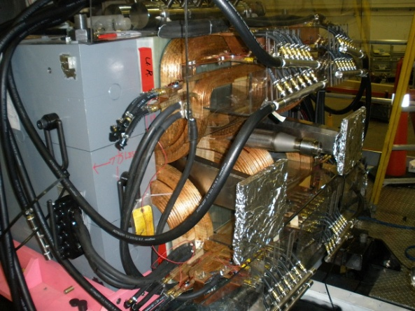
PREx Apparatus
Notes:
Digress to talk about how close the spectrometers were. Relevant because we need the septum, which cause problems with vacuum, etc.

