Slide 1
BE and charge radii well described (mostly isoscalar)
Isovector sector unconstrained by real data
Slope of asymmetry energy with density, L, is primarily isovector
The things we know the best are unaffected by wildly different values of L
You need neutron-rich matter (isovector)
  ²⁰⁸Pb is uniform nuclear matter – addresses L (but do we know everything we need from this?)
  ⁴⁸Ca interpolate to intermediate A (big lever arm)
  Anchor FRIB radioactive program
Need ⁴⁸Ca to address in ab initio and DFT (bridge between the two)
  ab initio calculations can’t be done in ²⁰⁸Pb
  3N forces

Slide 2
What are the fundamental parameters?
  F_{W}, α_{D}? Surface thickness? L?
  If surface thickness important, second Q² point?
What if central value of PREX holds up in PREX II? second Q² point?
Correlations between values in models – how do they change with 3N effects? (hard to do)
For example - L = 3ρ_{eq}a’_{sym} is unconstrained (isoscalar properties unaffected, even with L~180 – why is this “ridiculous”?)
  Ground state – doesn’t
  Excitations?
  α_{D}?
  R_{NS}?
What are the “real” errors on R_{NS}, or α_{D}, and the theory?
What is the model dependence of each of the measurements (or type of measurement)? How to compare?
What kind of plots would we like to be able to show?

Slide 3
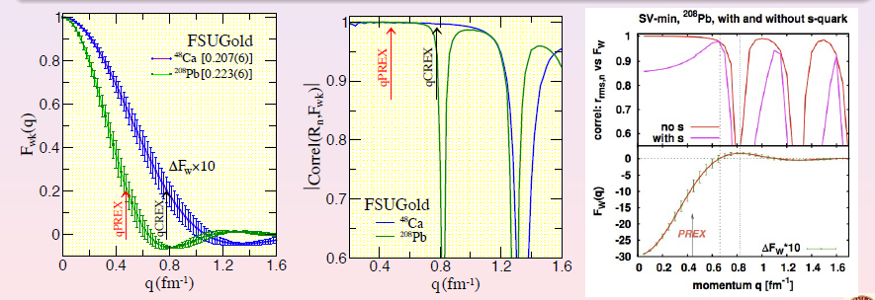
J. Piekarewizc
Bob liked these plots

Slide 4
Bigger axes
Fit our data point and our error bar
We are not trying to distinguish between models
There is no isovector data used in these fits
HW: if you take our data point, does it rule out other data
2013

Slide 5
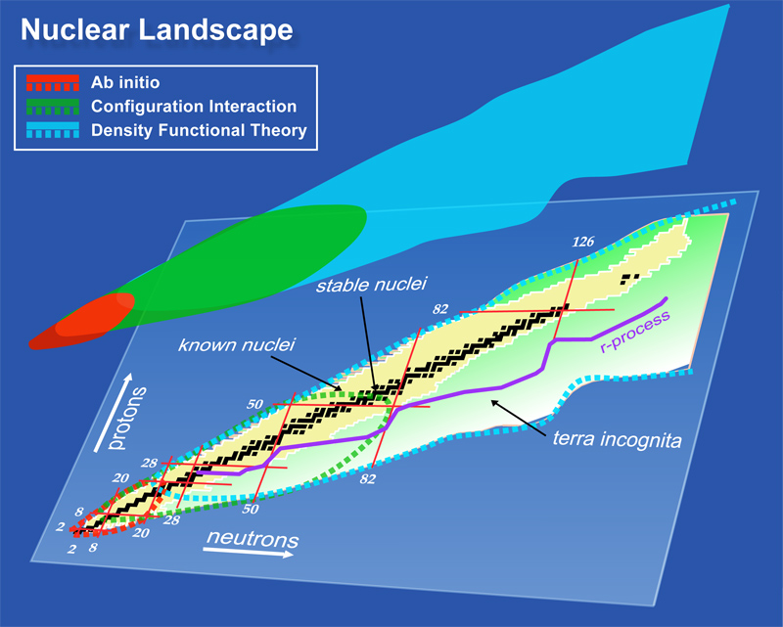

Slide 6
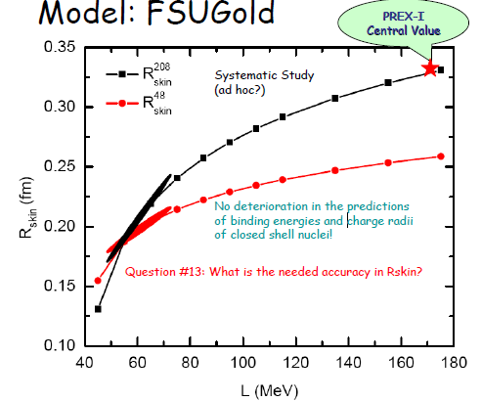
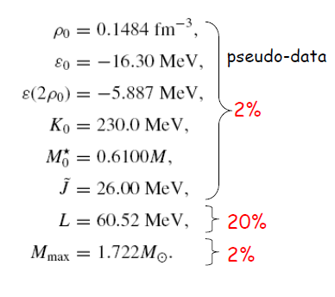
PREX I value gives large L value
EOS unreasonably stiff
OR – model not correct!
(Far from χ² minimum, but doesn’t affect BE or ρ_{ch} – what about α_{D} or R_{NS}?)
Fattoyev

Slide 7
Good isovector
indicators
Poor isovector
indicators
more in talk by Jorge Piekarewicz

Slide 8
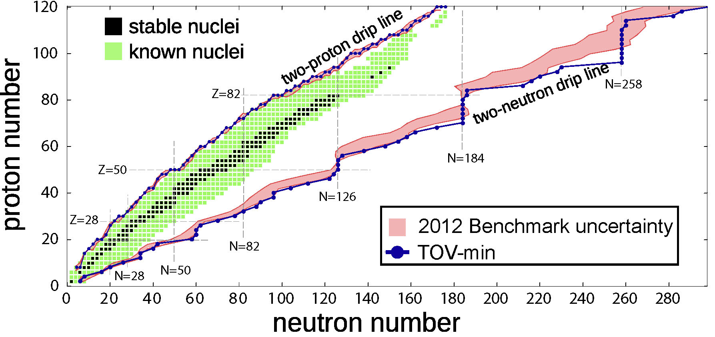
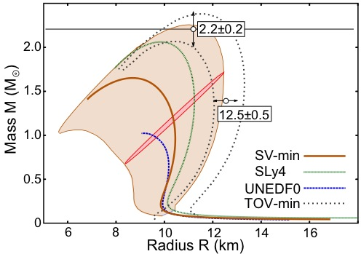

Slide 9
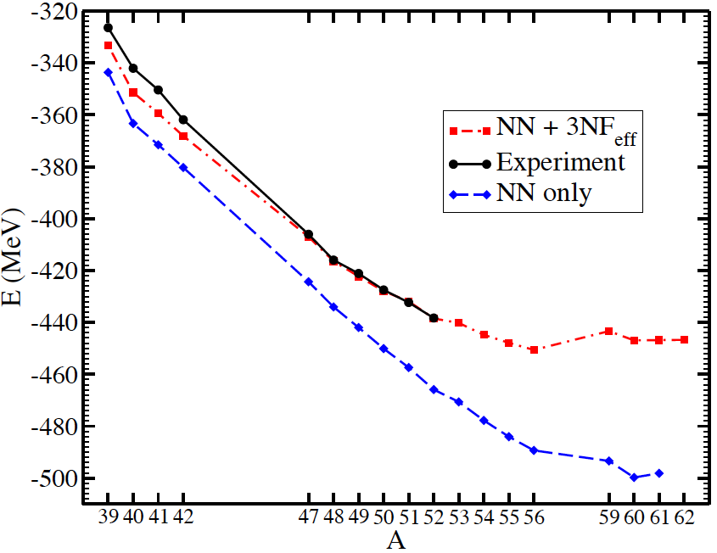
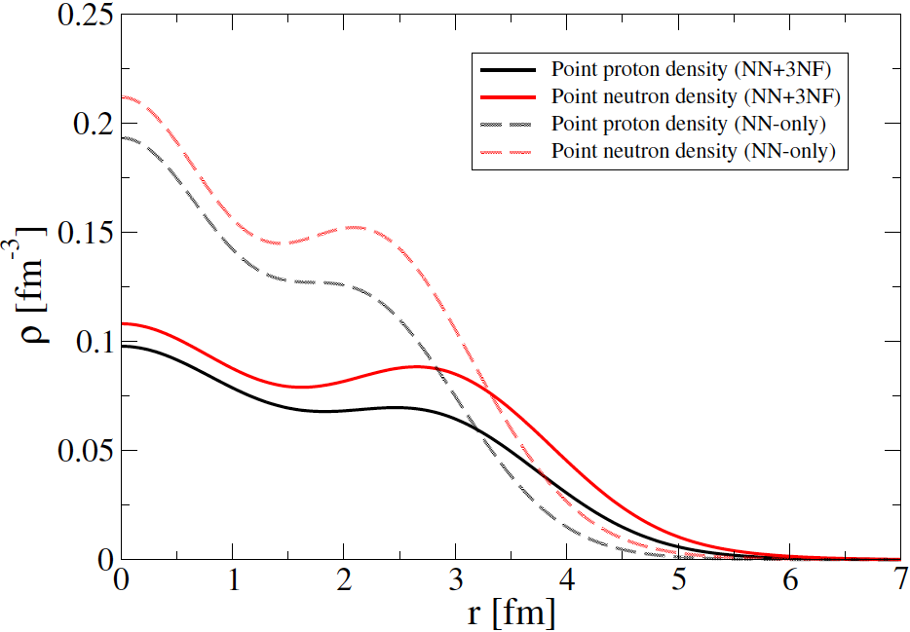
Preliminary
G. Hagen

Slide 10
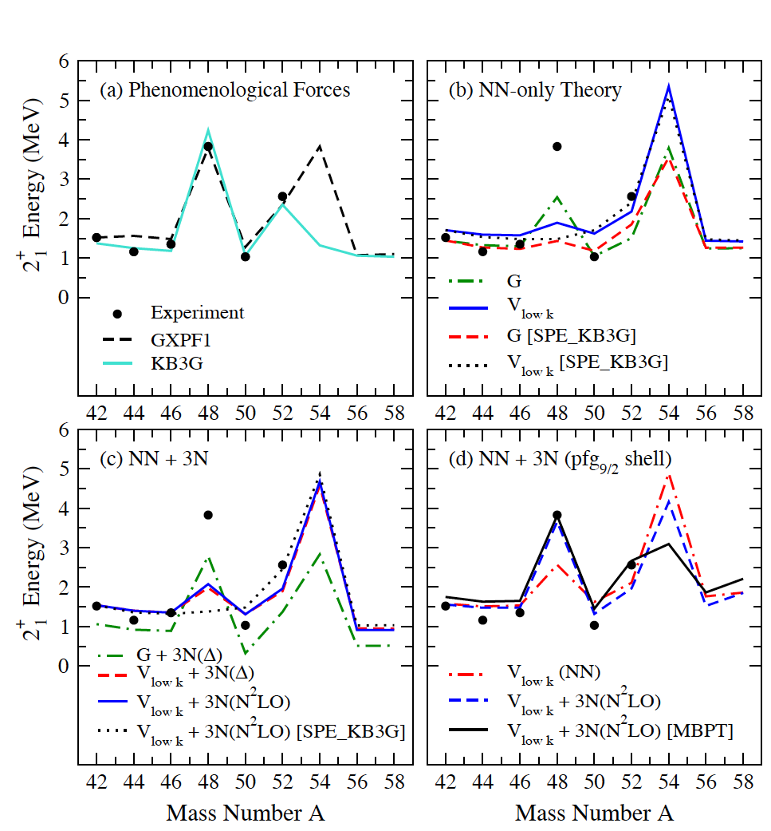
3N forces needed for Ca48 to be doubly-magic
Can do microscopic calculations for C48
G. Hagen

Slide 11
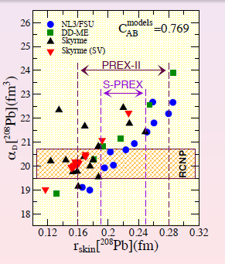
Other nuclei: DP, PDR, spin-M1 (data analysis in progress)
⁹⁶Mo (DCS and PT): Dirk Martin
⁴⁸Ca (DCS): Jonny Birkhan
⁹⁰Zr (DCS): C. Iwamoto
(PDR-region, published in PRL108, 262501 (2012))
¹²⁰Sn (DCS and PT): A.M. Krumbholtz, T. Hashimoto
¹⁵⁴Sm (DCS and PT): A. Krugmann
⁸⁸Sr, ⁹²Mo (DCS): C. Iwamoto
⁷⁰Zn (DCS):

Slide 12
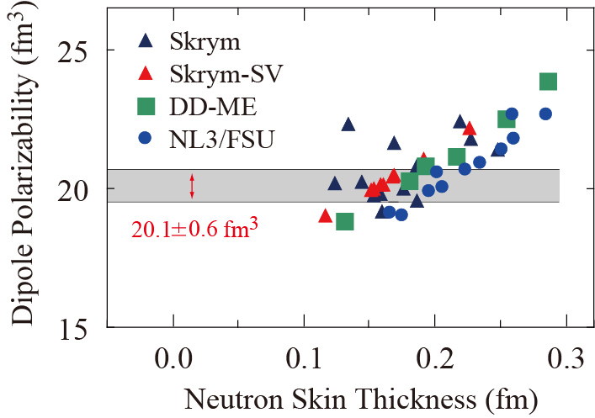
Other nuclei: DP, PDR, spin-M1 (data analysis in progress)
⁹⁶Mo (DCS and PT): Dirk Martin
⁴⁸Ca (DCS): Jonny Birkhan
⁹⁰Zr (DCS): C. Iwamoto
(PDR-region, published in PRL108, 262501 (2012))
¹²⁰Sn (DCS and PT): A.M. Krumbholtz, T. Hashimoto
¹⁵⁴Sm (DCS and PT): A. Krugmann
⁸⁸Sr, ⁹²Mo (DCS): C. Iwamoto
⁷⁰Zn (DCS):

Slide 13
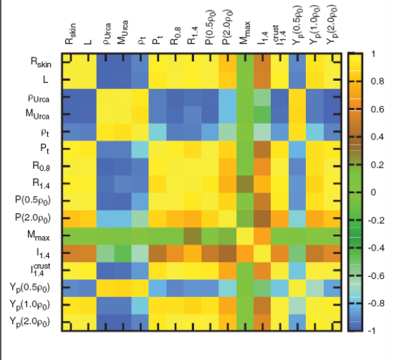

Slide 14
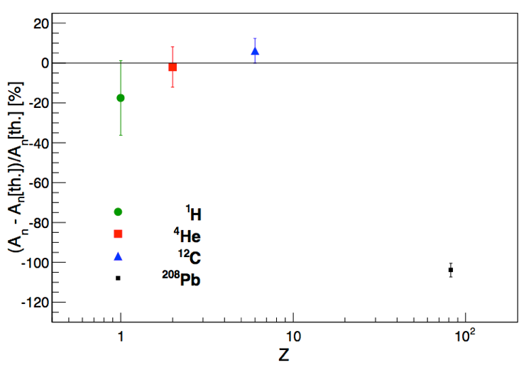
Al
BeO
Ca
Ta
Energy scan

Slide 15
Which nuclei?
Stable
Spin-0
Doubly magic
  Have first excited states far from elastic
  No deformations

Slide 16
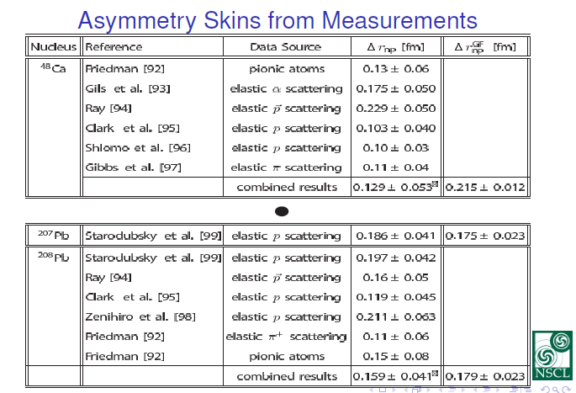
Do theorists believe this? NO! But why?
Claimed errors are too small
From re-normalized chi2?
Danielewicz

Slide 17
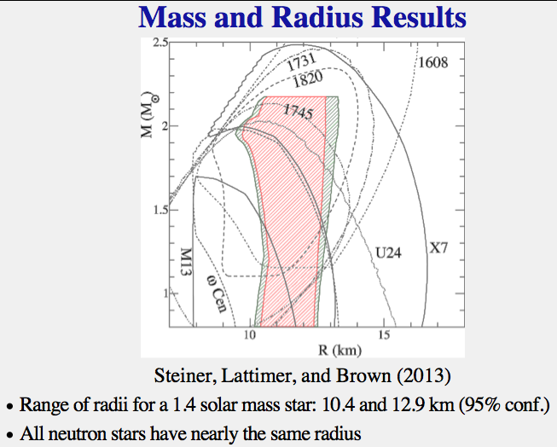
Gandolfi et al. PRC85, 032801 (2012)
What can PREX II and/or CREX say about neutrons stars?
“hard” to get mass and radius of same star
Nazarewicz
Steiner
Nazarewicz

Slide 18
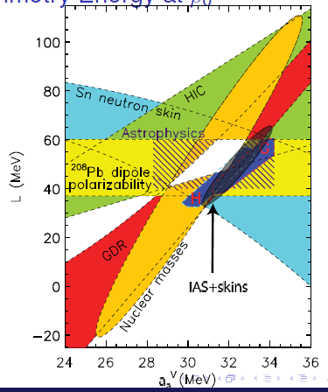
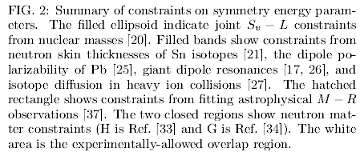
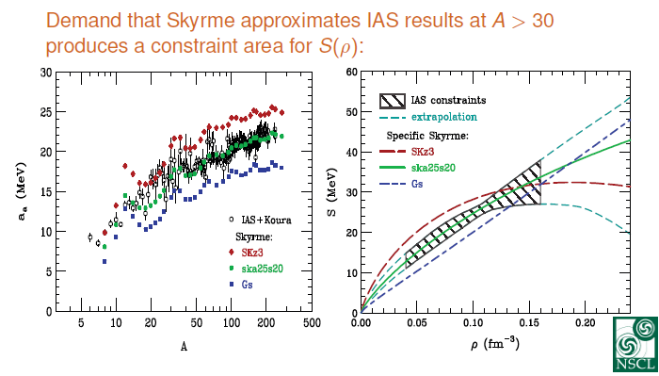
Danielewicz

Slide 19
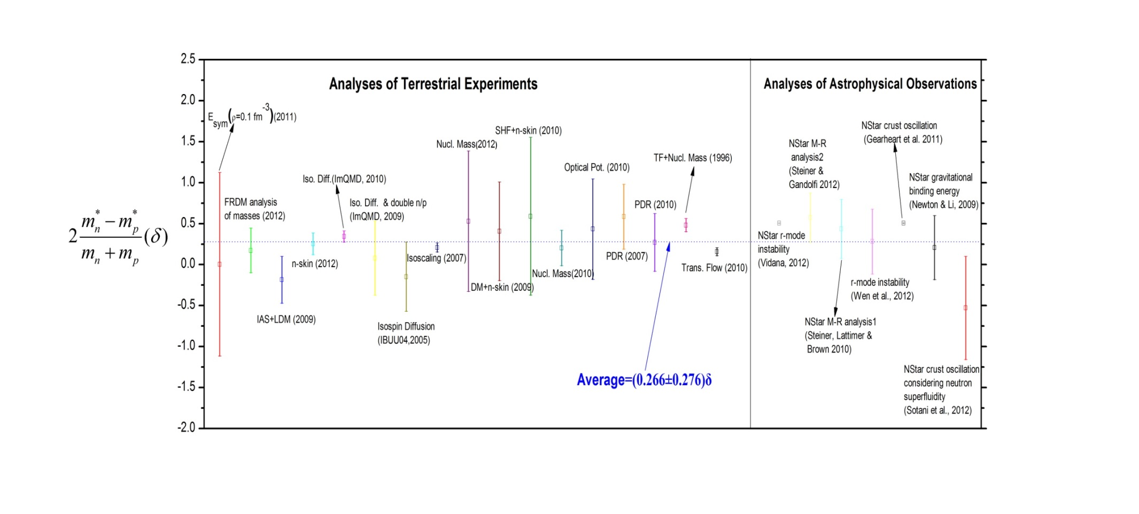
very model dependent
Isospin dependence of effective masses
Bao-An Li

