Slide 1
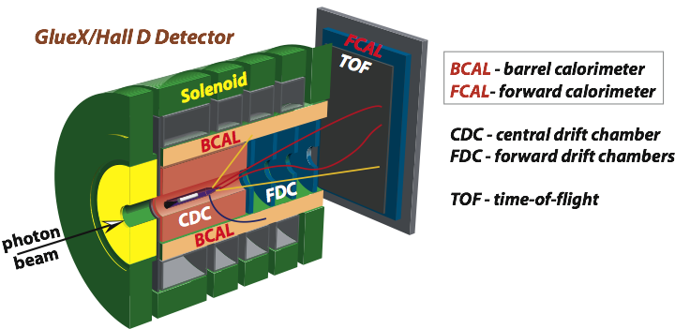
Photoproduction of vector mesons off nuclei
with the GlueX detector
A. Somov (Jefferson Lab)
Exploring Hadrons with Electromagnetic Probes: Structure, Excitations, Interactions
November 2 , 2017
GlueX detector and physics program
Photoproduction of vector mesons off nuclei
- Physics motivation
- Theoretical predictions
- Run conditions
- Reconstruction of vector mesons and projected errors

Slide 2
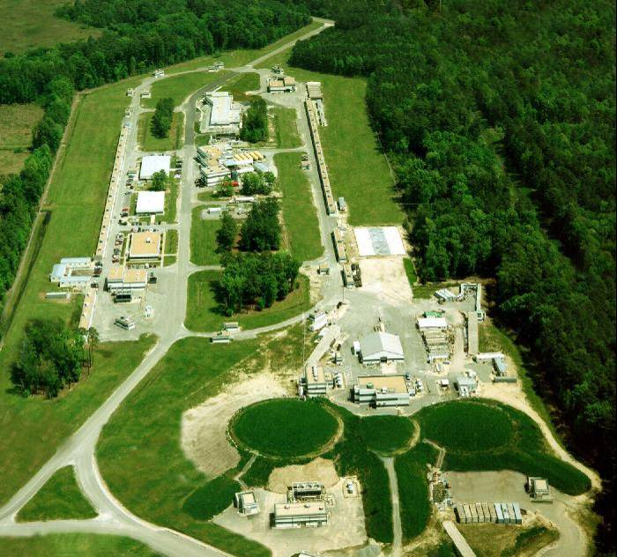
The GlueX Experiment in Hall D at JLab
Hall D
Newly constructed experimental Hall D
with the GlueX detector
- Photon beam produced by CEBAF 12 GeV
electrons in thin radiator via bremsstrahlung
process
- Linear polarization of beam photons
Collaboration of 100+ people from 26
institutions
A
B
C

Slide 3
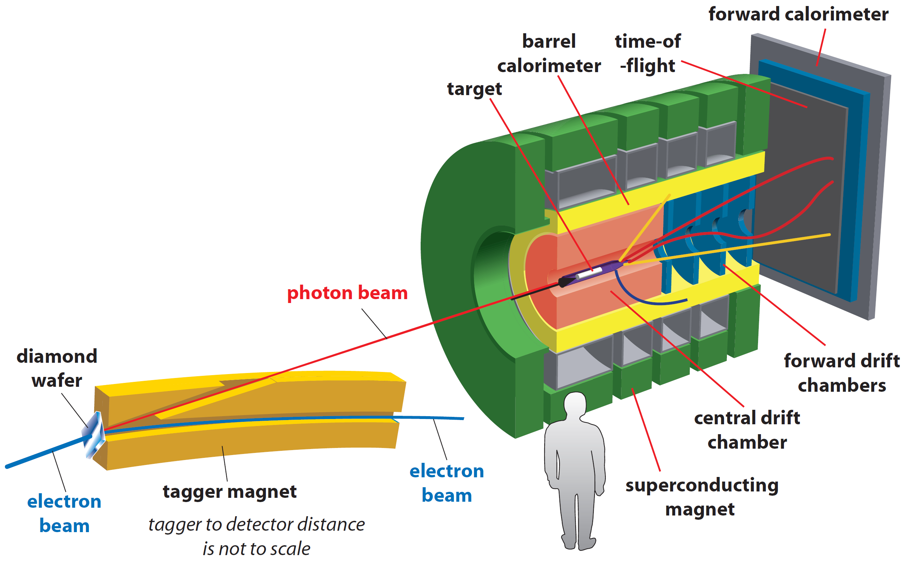
GlueX Detector
• Optimized to detect multi-particle final states
• Hermetic, large/uniform acceptance for
charged and neutral particles, good energy
and momentum resolution
Tracks: σ_{p} / p ~ 2 – 5 %
Photons: σ_{E} / E = 6 % /√E ⊕ 1.6 %
Acceptance: 1° < θ < 120°
Target: liquid hydrogen
new PID (k/π)
Newly proposed experiments:
- install nuclear targets
- no modifications to the
existing detector

Slide 4
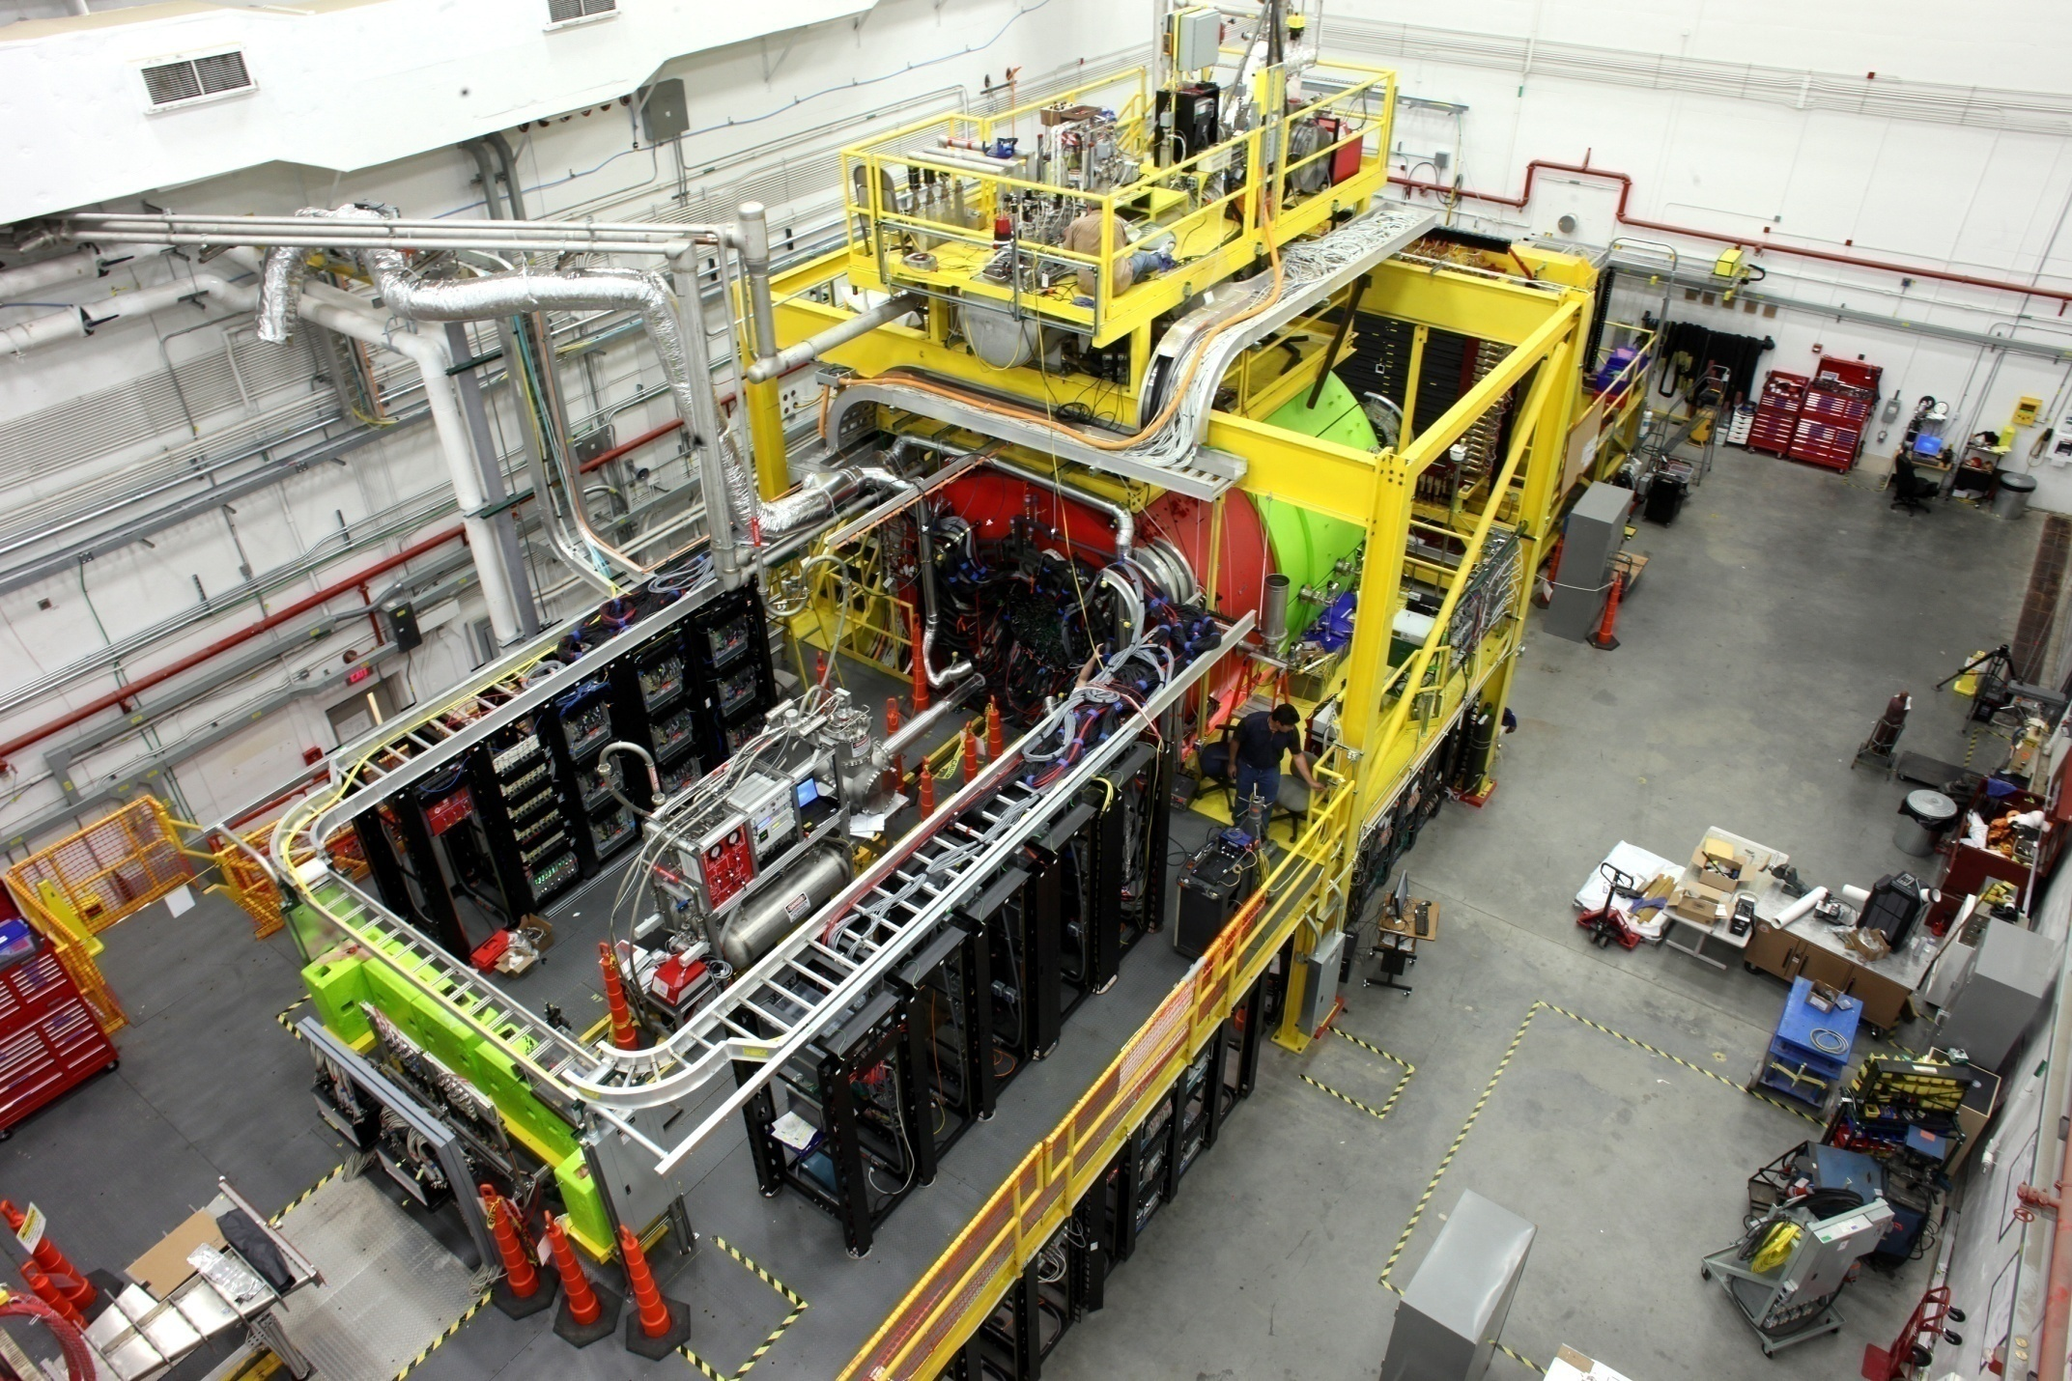
GlueX Detector

Slide 5
Hall D Physics Program: Approved Experiments
Experiment | Name | Days | Condition | Target
E12-06-102 | Mapping the spectrum of light quark mesons and gluonic excitations with Linearly polarized photons | 120 |  | LH₂
E12-12-002 E12-13-003 | A study of meson and baryon decays to strange final states with GlueX in Hall D | 220 (200) | PID | LH₂
E12-10-011 | A precision measurement of the η radiative decay width via the Primakoff effect | 79 |  | LH₂ LHe₄
E12-13-008 | Measuring the charged pion polarizability in the γγ → π⁺π⁻ reaction | 25 |  | Sn
C12-14-004 | Eta decays with emphasis on rare neutral modes: The JLab Eta Factory experiment (JEF) |  | Upgrade Forward calorim. | LH₂

Slide 6
Hall D Physics Program: New Proposals
Proposal | Name | Target
PR12-17-001 | Physics with secondary K_{L} beam | LH₂, A
PR12-17-007 | Probing QCD in the nuclear medium withreal photons and nuclear targets at GlueX (Color Transparency and SRC) | LH₂, A
PR12-17-010 | Production of vector mesons on nuclei with GlueX | A

Slide 7
Production of Vector Mesons of Nuclei:
Physics Goal
Measure cross section of longitudinally polarized omega mesons with
nuclei, σ_{L} (ω N)
Measure energy dependence of the nuclear transparency T = σ_{A} / A ⋅ σ _{N}
of vector mesons ω, ρ, and φ on different targets

Slide 8
Proposed Measurements with GlueX
Measure photoproduction cross sections of vector mesons ω, ρ, and φ
on C, Si, Sn and Pb targets in the energy range of 6 - 9 GeV with the
GlueX detector
Extract nuclear transparency at different energies
Extract spin density matrix elements
Extract cross section of longitudinally polarized omega mesons with
nuclei σ_{L} (ω N) with two methods
- nuclear transparency
- spin density matrix element ρ^{A}₀₀

Slide 9
Why is it Important ?
There are experimental indications that σ_{L} (VN) < σ_{T} (VN), but there
have been no direct measurements of σ_{L} (VN) so far. Measurements
of σ_{L} are important for the interpretation of the color transparency in
vector meson electroproduction and comparison between different
theoretical approaches
Disagreement between existing experimental data and theoretical
predictions for nuclear transparency

Slide 10
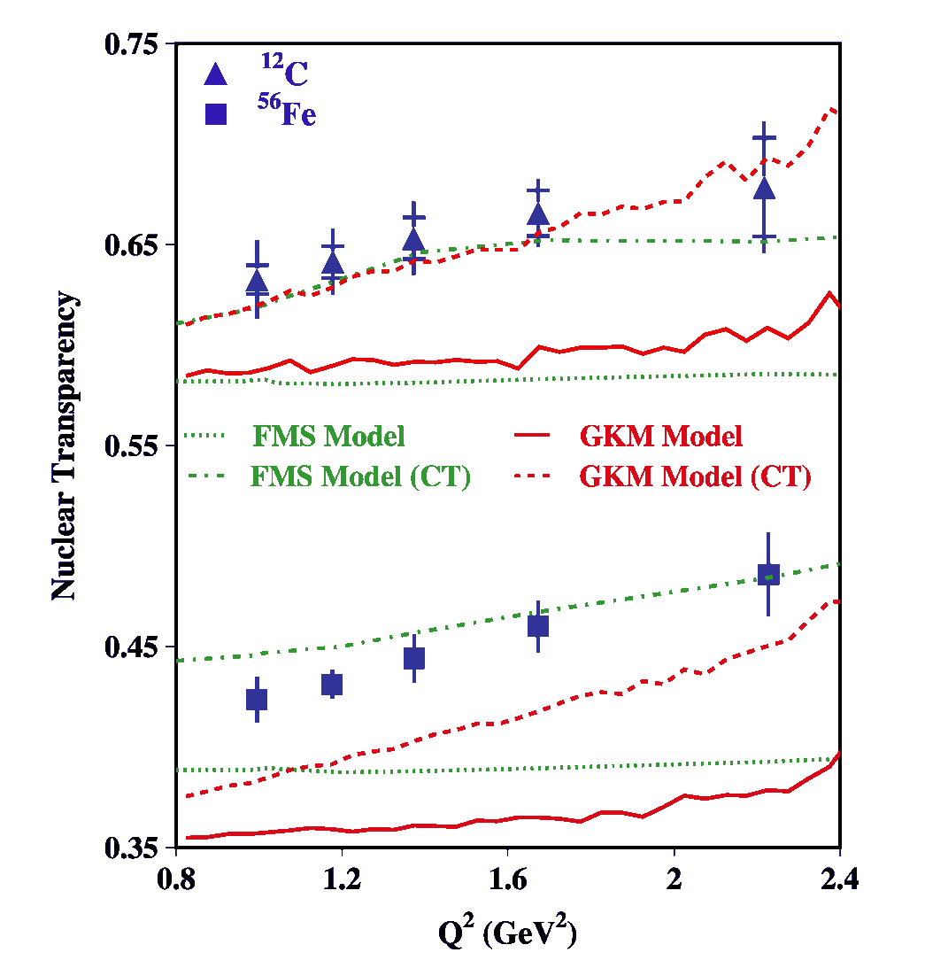
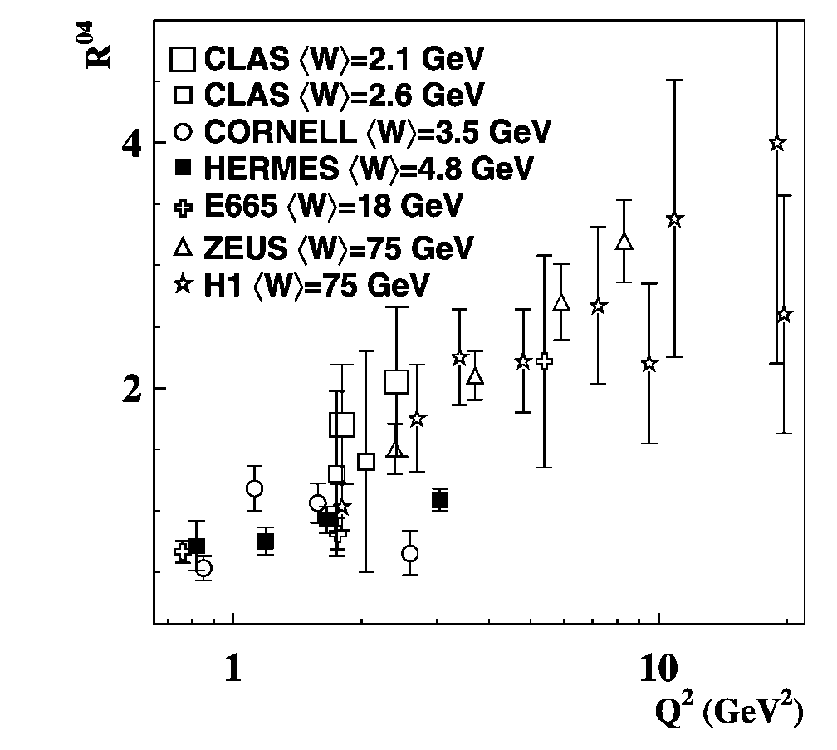
Effect of σ_{L} (VN) on Color Transparency
CT measurements at CLAS
Q² dependence of the longitudinal-to-
transverse cross section ratio for ρ mesons
- Larger fraction of longitudinally polarized
mesons produced at larger Q²
Nuclei become more transparent at large Q²
(color transparency effect)
screen CT if σ_{T} (VN) >> σ_{L} (VN)

Slide 11
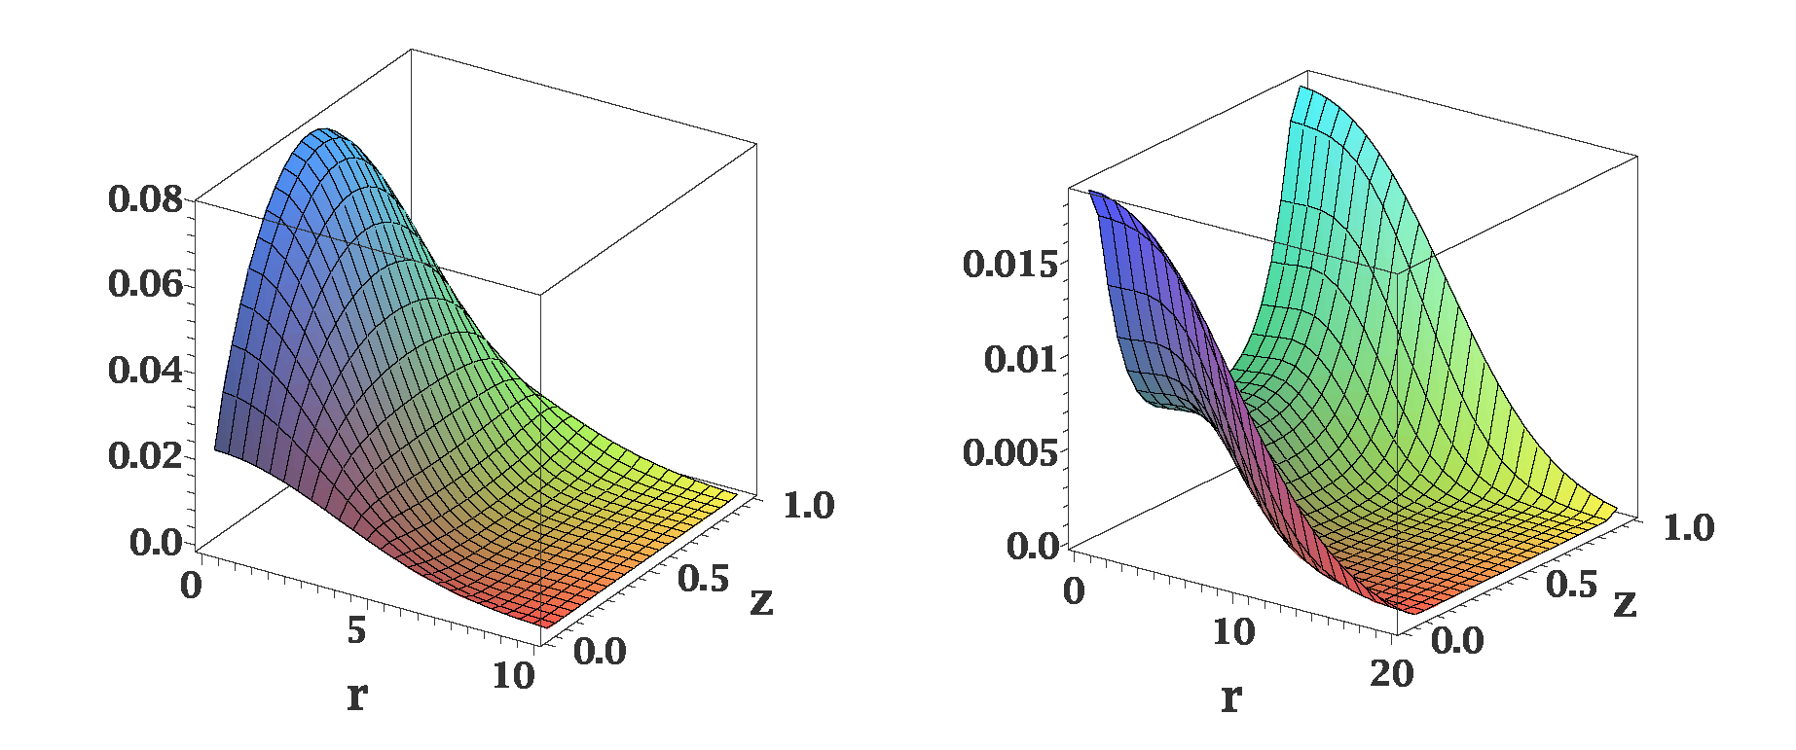
Distribution of Quarks in Vector Meson
Different distributions of quarks in the transversely and longitudinally polarized
mesons
ρ_{L}
ρ_{T}
In AdS/QCD (Brodsky & G.Teramond)
light-cone wave functions depend on
meson polarization
Light-cone wave functions for ρ mesons:
J.Forshaw and R.Sandapen
Phys.Rev. Lett. 109,081601,2012
Color dipole model of strong interaction
different cross sections for interactions of transversely and longitudinally
polarized mesons

Slide 12
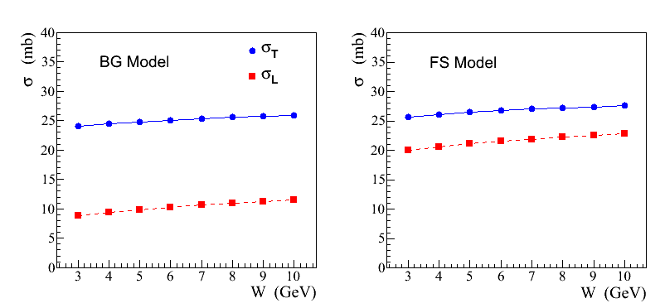
Recent Theoretical Calculations
S. Gevorkyan, paper in
preparation
σ_{L,T} (ρ N) cross sections predicted in a color dipole model using different
parameterizations of wave functions:
AdS / QCD holographic wave function (FS)
J.Forshaw and R. Sandopen,
Phys.Rev.Let. 109, 2012
Boosted Gaussian (BG) wave function
B.Kopeliovich et al., Phys.Rev. C65, 2002
FS model
BG model

Slide 13
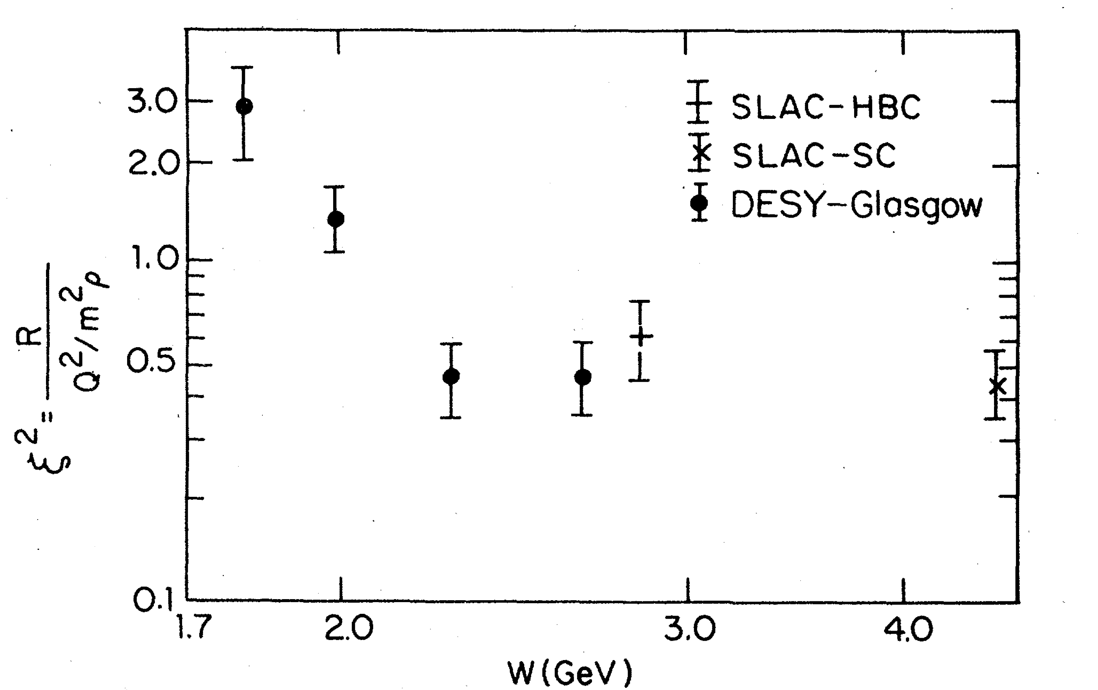
Polarization-Dependent Interactions: Experimental Observations
Hints from the electroproduction of vector mesons:
where
ρ mesons: ξ ~ 0.7 Nucl. Phys. B113, 53 (1976)
φ mesons: ξ² ~ 0.33 Phys. Rev. Let. 39, 516 (1977)
Similar observations of the polarization-dependent
interactions of deuterons with Carbon targer
- measured in Dubna and Juelich
Phys. Part. Nucl. Lett. 7, 27, 2010 Phys. Rev. Lett. 104, 2010
Measurements in the charge exchange process at Argonne:
π⁺ + Ne → ρ + Ne′
Nucl. Phys. B67, 333 (1973)
Propose to measure σ_{L} (VN) using photoproduction on nuclei

Slide 14
Photoproduction of ω Mesons
In the coherent γ + A → ω + A production at JLab energies the essential
contribution of pion exchange cancels out. From the absorption of ω’s one
can extract σ_{T} (ω N)
- it has been measured by several experiments (σ_{T} ~ 26 mb)
In the incoherent process γ + A → ω + A′ the cross section can be written as
- N (0, σ_{L}) and N (E, σ_{T}) are absorptions of the longitudinally and transversely
polarized mesons predicted by theoretical models
- ρ₀₀ is the spin density matrix element measured in γ p → ω p reaction
Why ω measons ?
- Some fraction of ω mesons is longitudinally polarized at GlueX energies,
ρ₀₀ measured by SLAC is 0.2 ± 0.07

Slide 15
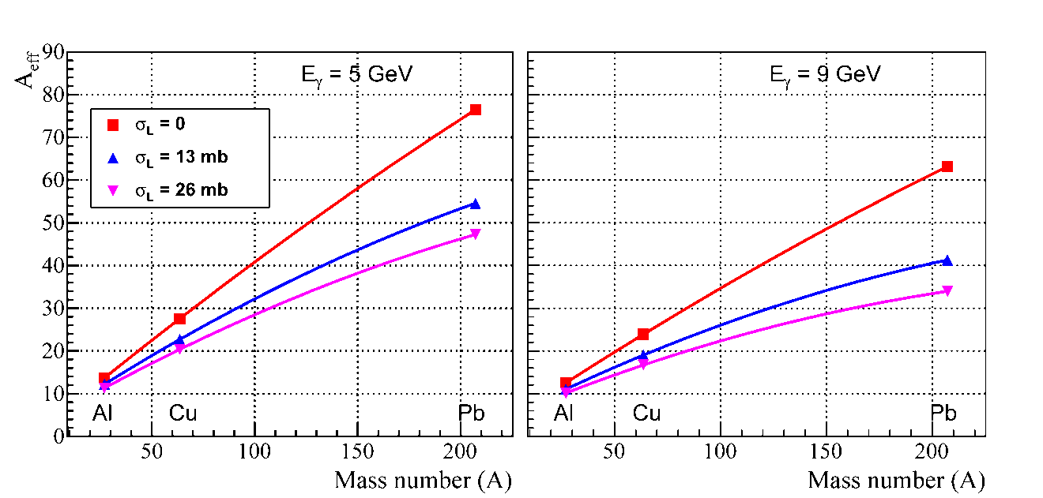
How to Extract σ_{L} (ωN) ?
σ_{L} (ωN) can be extracted from the measurements of:
Method 1: Nuclear transparency ( A_{eff} )
Method 2: Spin density matrix element (ρ^{A}₀₀ )
Method 1
Calculations by S. Gevorkyan for GlueX Phys. Rev. C 93, 015203 (2016)
Predictions for A_{eff}
Measure A_{eff} for each target
A_{eff} depends on σ_{L} (see plot)
N (0, σ_{L}) and N (E, σ_{T}) are
predicted by theoretical models.
N (E, σ_{T}) will be independently
measured for ρ mesons
A_{eff} will be normalized to Carbon data: some systematic uncertainties will cancel out
(σ_{N,} Br, some reconstruction efficiencies, )

Slide 16
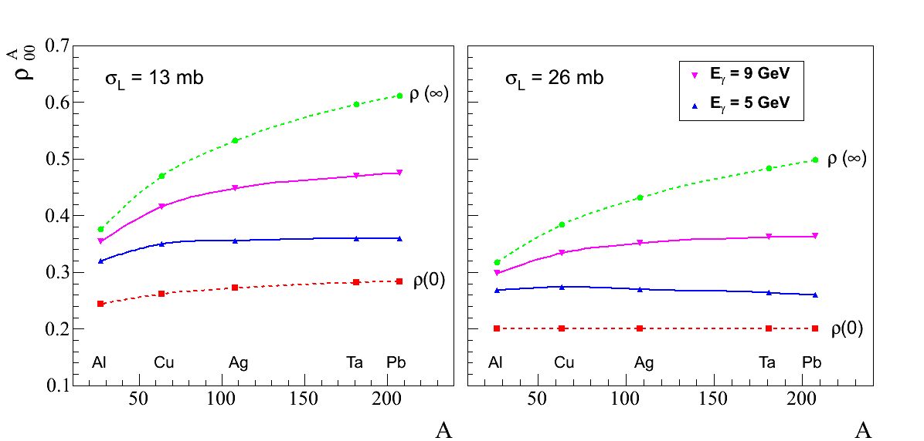
How to Extract σ_{L} (ωN) ?
Method 2
Measure ρ^{A}₀₀ for each target from the
fit to the ω decay angular distribution
ρ^{A}₀₀ depends on σ_{L}
- extract σ_{L}
ρ₀₀ is measured in the
γ p → ω p reaction
Predictions for ρ^{A}₀₀ Phys. Rev. C 93, 015203 (2016)
A-dependence of the spin
density matrix elements ρ^{A}₀₀

Slide 17
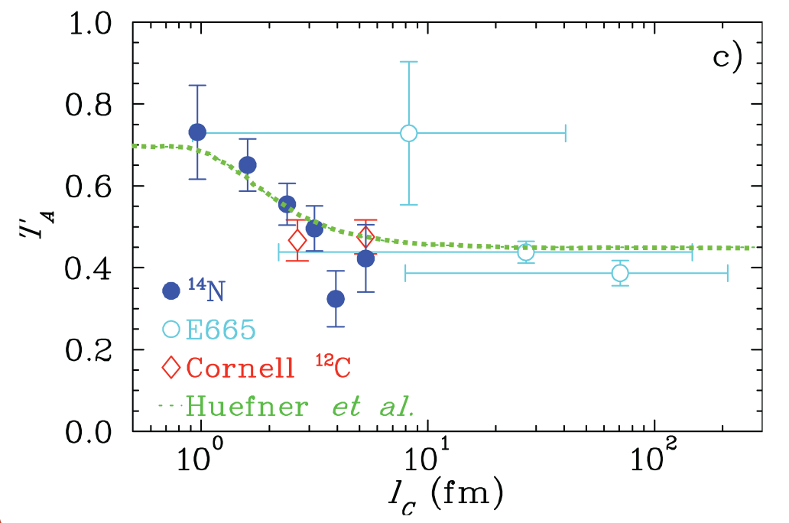
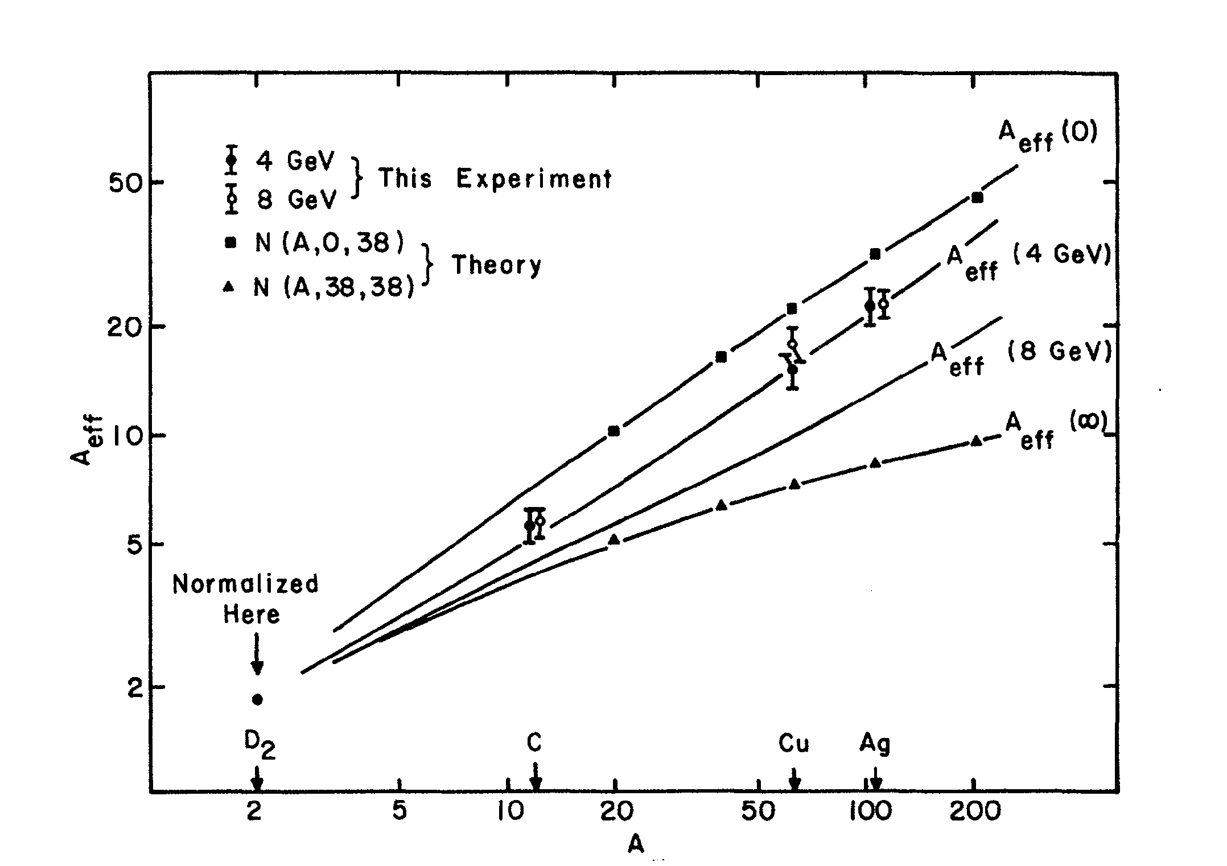
Energy Dependence of Nuclear Transparency
Energy dependence of the nuclear transparency due to the interference of amplitudes
in the production of mesons on nuclei
- dependence of the incoherent cross section on energy ν via the
coherence length
Predicted for both electroproduction and photoproduction
Measured in the electroptoduction
not observed in ρ photoproduction
A_{eff}
T_{A} = A_{eff} / A
G. McClellan, et al. Phys. Rev. Let. 23, 10, 1969

Slide 18
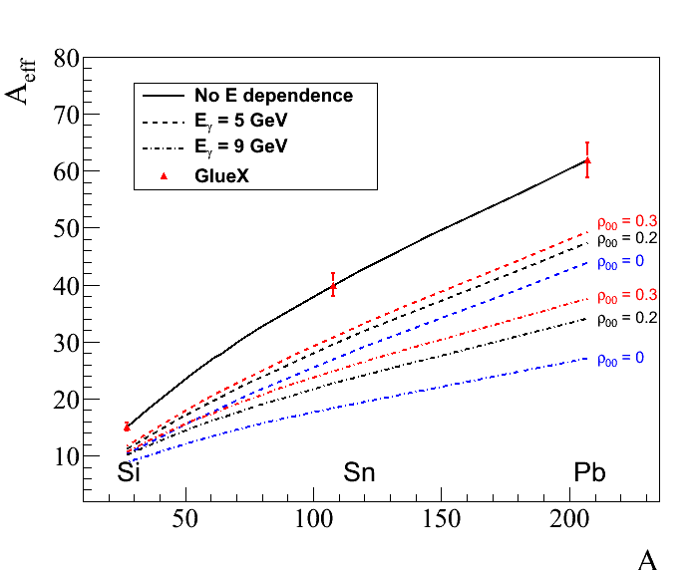
Energy Dependence Predicted for GlueX
Predicted energy dependence of the nuclear transparency for ω mesons
similar dependence for
ρ-mesons ( ρ₀₀ = 0 )
5 GeV
9 GeV

Slide 19
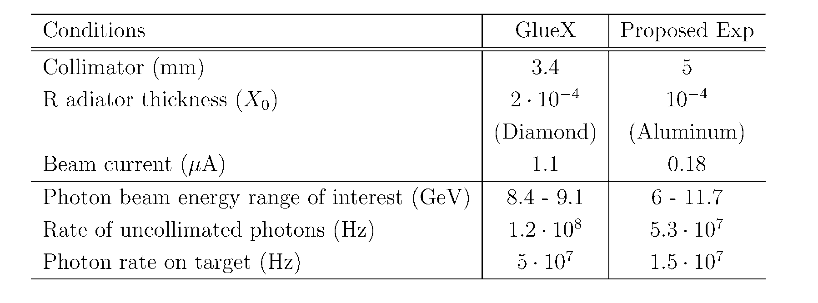
Run Conditions
Use amorphous radiator (incoherent bremsstrahlung)
Decrease the flux of uncollimated photons by a factor of 12 compared with GlueX
- rate of accidental hits in the tagging detectors is about 20 %
Beam request: 28 days in total
use four nuclear targets: C, SI, Sn, Pb with the thickness
of 7 % R.L.

Slide 20
Reconstruction of Vector Mesons: Monte Carlo Simulation
We studied reconstruction capabilities for ρ, ω, and φ mesons in the beam energy range
between 6 GeV – 12 GeV using detailed GlueX
Momentum transfer t
Δ t = 0.017
ω → π⁰ γ
 | π⁰ γ | π⁺π ⁻π⁰
M _{γγ} (MeV) | 7.7 | 8.2
M _{ω} (MeV) | 33 | 33
Δ t (GeV²) | 0.017 | 0.02
γ γ invariant mas
3γ invariant mas
σ (m) - 7.7 MeV
σ (m) - 33 MeV
σ (M_{mis}) ~ 190 MeV

Slide 21
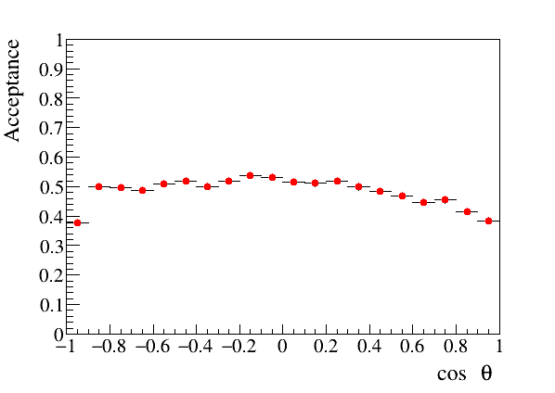
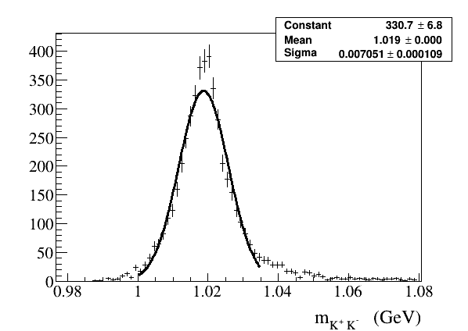
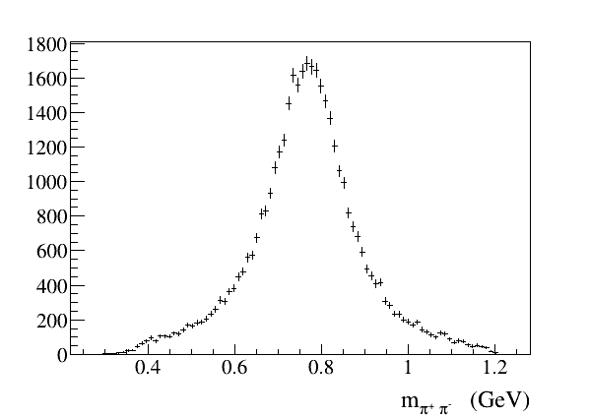
Reconstruction of Vector Mesons: Monte Carlo Simulation
Angular acceptance for ω → π⁰ γ decays
(helicity frame)
Uniform angular acceptance
- important for polarization
measurements
Reconstruction of ρ → π⁺π⁻ and φ→ K⁺ K⁻
σ (m) - 7 MeV
σ (t) ~ 0.02 GeV²
σ (M_{mis}) = 180-200 MeV

Slide 22
Reconstruction Efficiencies and Yields
 | ω → π⁰γ |  | ω → π⁺ π⁻ π⁰ | ρ → π⁺ π⁻ | φ → K⁺ K⁻
Efficiency (%) | 24.6 |  | 49.4 | 39.3 | 19.9
Incoherent cross section, Pb (μb)
6 GeV | 119 |  |  | 546 | 36.4
9 GeV | 67 |  |  | 325 | 33.6
Reconstructed events ( k ) 0.1 < t < 0.5
6 – 9 GeV | 10 | 50 |  | 500 | 10
9 – 12 GeV | 6 | 27 |  | 280 | 9

Slide 23
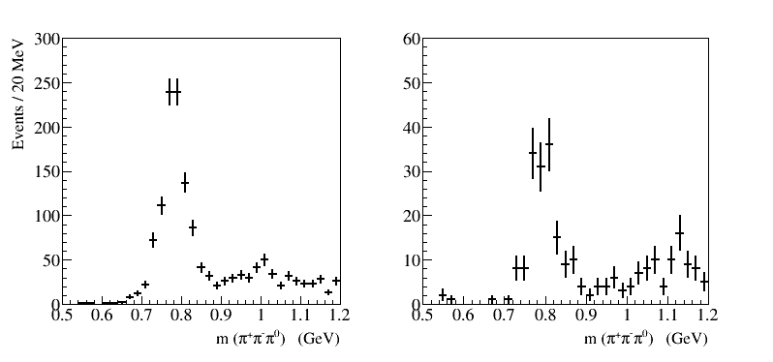
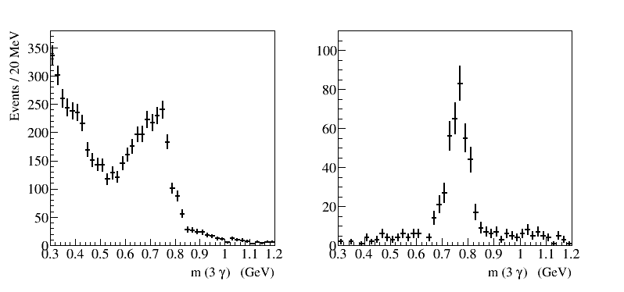
Runs with Empty Target: Data
γ (p, A) → ω (X)
(require to reconstruct only ω)
γ (p, A) → p ω
ω → π⁺ π⁻ π⁰
Z vertex is unknown
(no shift for real target)
ω → π⁰ γ
Relatively small BG for both
ω decay channels

Slide 24
Errors on Measurements of A_{eff} and Extraction of σ_{L} (ωN)
Systematic uncertainties dominate
- smallest data sample of ω → π⁰γ reconstructed decays (16 K per target)
- conservatively assume that S/B = 1
systematic uncertainties on A_{eff}
Statistical errors on A_{eff}
δ (A_{eff}) / A_{eff} = 1.4 % (6 – 9 GeV)
= 1.8 % (9 -12 GeV)
Target thickness | 1.0 %
Photon flux determination | 1.5 %
Signal yield (bg subtraction) and event selection | 3.0 %
Dependence on ρ₀₀ | 1.2 %
Reconstruction efficiencies | 3.0 %
Total | 4.7 %
σ_{L} is computed according to the
predicted dependence of A_{eff} on σ_{L}
Polarization of | Error on σ_{L} (26 mb) (mb)
ω mesons | 6 – 9 GeV | 9 – 12 GeV
ρ₀₀ = 0.2 | 1.1 (stat) 3.5 (syst) | 1.1(stat) 2.7 (syst)
ρ₀₀ = 0.1 | 2.1 (stat) 6.6 (syst) | 2.0 (stat) 5.0 (syst)
ρ₀₀ = 0.3 | 0.9 (stat) 2.5 (syst) | 0.8 (stat) 2.0 (syst)
Measued by
SLAC

Slide 25
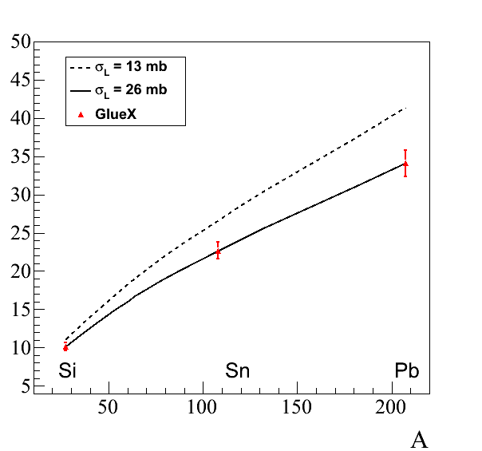
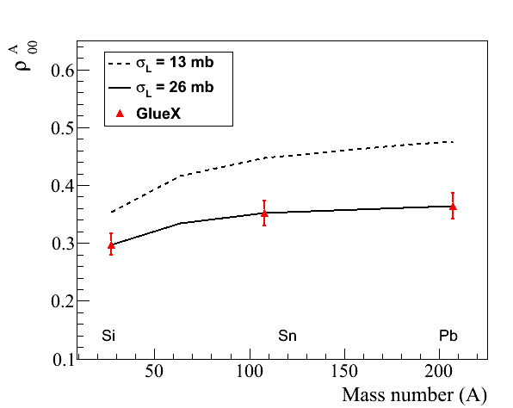
Projected Errors: A_{eff} and ρ^{A}₀₀
Projected errors on measurements of A_{eff} and ρ^{A}₀₀ for ω → π⁰ γ decays
(input values: σ_{T} = 26 mb, ρ₀₀ = 0.2)
A_{eff}
ρ^{A}₀₀
9 GeV
9 GeV

Slide 26
Projected errors on σ_{L} (ωN)
σ_{L} will be extracted for ω mesons using two measurements: A_{eff} and ρ^{A}₀₀
Expected errors on σ_{L} for ω→π⁰γ decays obtained from measurements on a Pb target:
σ ( σ_{L} ) = 3.7 mb (6 – 9 GeV) ; 2.9 mb (9 – 12 GeV) extracted from A_{eff}
σ ( σ_{L} ) = 2.6 mb (6 – 9 GeV) ; 2.8 mb (9 – 12 GeV) extracted from ρ^{A}₀₀ Combined: 2.3 mb 2.0 mb
FS Model
BG Model
proposed
experiment
σ_{L} will be independently measured using ω → π⁺π⁻π⁰ decays

Slide 27
Summary
We propose to use the GlueX detector to study photoproduction of light mesons
on nuclear targets: C, Si, Sn, and Pb in the large beam energy range between
6 GeV and 12 GeV. The primary goal is:
Measure nuclear transparency and the SDME for omega mesons in incoherent
photoproduction and extract the total cross section of the longitudinally
polarized ω mesons with nucleon. Measurements are important in interpreting
color transparency effects.
Measure nuclear transparency of light mesons such as ρ, ω, ϕ. Study the
dependency of the nuclear transparency on the beam energy, predicted by
theoretical models.
Data sample acquired on nuclear target will allow to study other physics topics,
like production of mesons at larger t, etc.
The expected length of the experiment is 28 days of taking data. The detector
will be operated at small luminosity. No modifications of the GlueX detector
is required

Slide 28
Backup Slides

Slide 29
Projected errors on σ_{L} (ωN)
σ_{L} will be extracted for ω mesons using two measurements: A_{eff} and ρ^{A}₀₀
Expected errors on σ_{L} for ω→π⁰γ decays obtained from measurements on a Pb target:
( Input values of ρ₀₀ = 0.14 )
σ ( σ_{L} ) = 5.0 mb (6 – 9 GeV) ; 4.6 mb (9 – 12 GeV)
FS Model
BG Model
proposed
experiment
σ_{L} will be independently measured using ω → π⁺π⁻π⁰ decays

Slide 30
Timeline
Nuclear Photoproduction with GlueX Workshop, Jefferson Lab, April 28 - 29, 2016
https://www.jlab.org/conferences/photoproduction16/
- interesting discussions, motivated further theoretical studies
Photoprodiction of ω mesons of nuclei and impact of polarization on the
meson-nucleon interactions, Phys. Rev. C93, 1, 015203, 2016
Topic presented at several conferences / workshops

Slide 31
Sensitivity of A_{eff} and ρ^{A}₀₀ to ρ₀₀
I )
uncertainties of ρ₀₀ of ± 4 % affect A_{eff} by ± 1.2 %
total systematic error on A_{eff} = 4.7 %
I I )
uncertainties of ρ₀₀ of ± 4 % affect A_{eff} by ± 3.7 %
total systematic error on A_{eff} = 5.6 %
Extract from A_{eff}
Extract from ρ^{A}₀₀
σ_{L} (26 mb) ±1.1 (stat) ±3.5 (syst) mb
σ_{L} (26 mb) ±1.4 (stat) ±2.1 (syst) mb

Slide 32
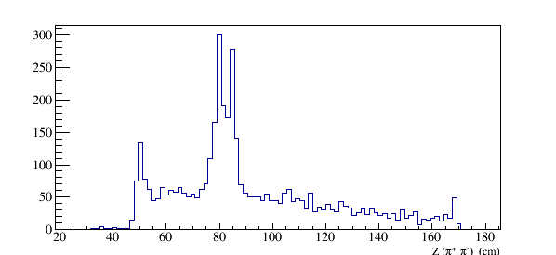
S/B Estimates
Estimate background using photoproduction on target walls
and air ( runs with empty target )
Production vertex for ω → π⁺ π⁻π⁰
Vacuum cell and window:
75 , 100 μm Kapton
Cold H₂ gas:
ρ = 1.8 ⋅10⁻³ g /cm³
Air:
ρ = 1.2 ⋅ 10⁻³ g /cm³
Target cell walls
Vacuum window
Air
Cold H₂ gas
Z (π⁺ π⁻) (cm)
Kapton
Kapton
Air

Slide 33
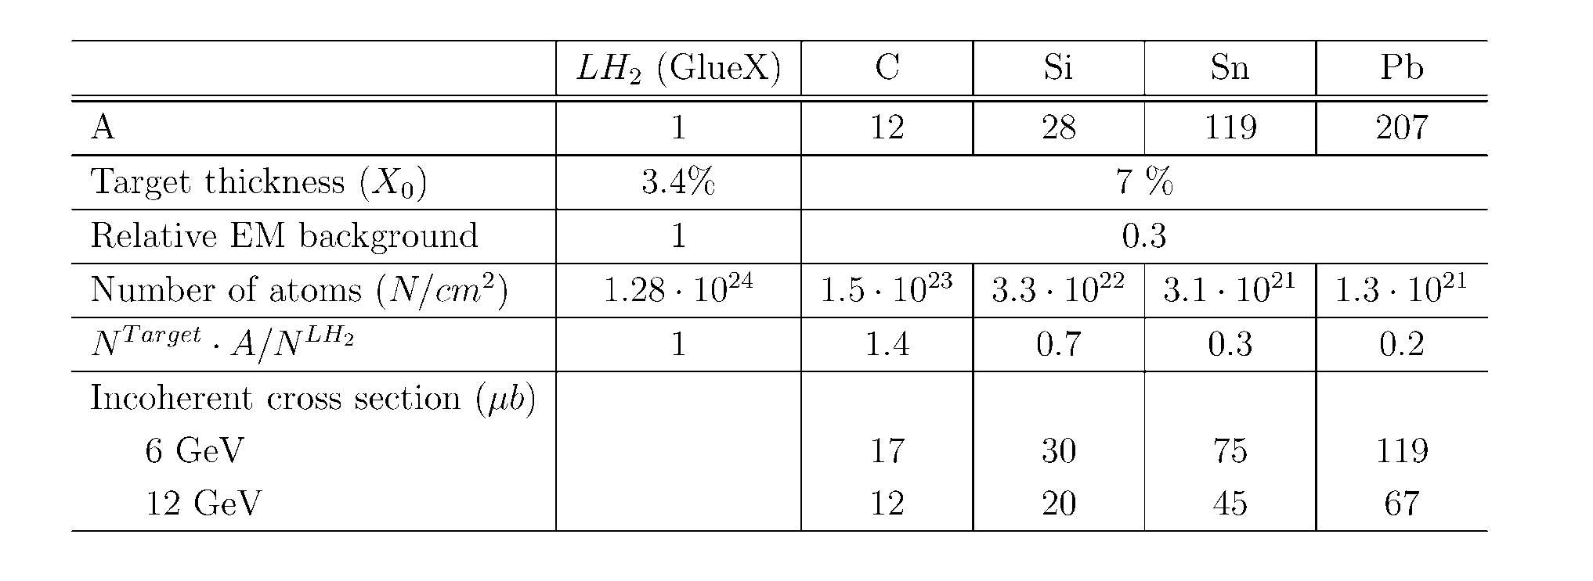
Nuclear Targets
Use four nuclear targets: C, SI, Sn, Pb with the thickness of 7 % R.L.
- small electromagnetic background compared with GlueX
- neutron background will not exceed the GlueX level
(JLAB-TN-11-005, 2011)

Slide 34
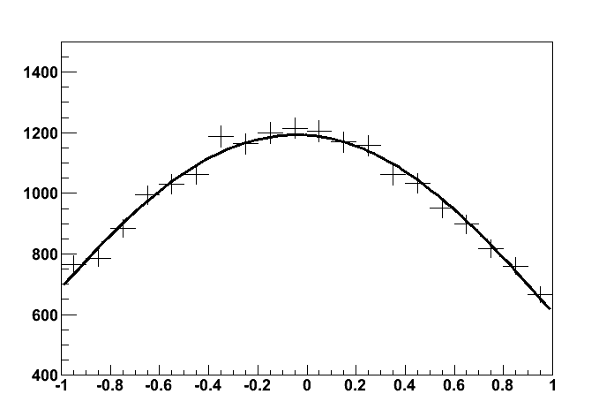
Errors on Measurements of ρ^{A}₀₀ and Extraction of σ_{L} (ωN)
Obtain ρ^{A}₀₀ from the fit to the decay angular distribution in the helicity frame
Statistical errors : σ(ρ^{A}₀₀ ) = 0.011 (6 – 9 GeV)
(from the fit) = 0.014 (9 -12 GeV)
→ π⁰ γ ( 6 – 9 GeV )
Signal + BG, realistic acceptance
(input ρ₀₀ = 0.2 )
cos θ
systematic uncertainties on ρ^{A}₀₀
σ_{L} is computed according to the predicted
dependence of ρ^{A}₀₀ on σ_{L}
Signal yield (bg subtraction) and event selection | 1.0 %
Dependence on ρ₀₀ | 3.7 %
Acceptance determination | 3.0 %
Total | 5.6 %
σ_{L} (26 mb) ±1.4 (stat) ±2.1 (syst) mb
6 – 9 GeV
σ_{L} (26 mb) ±1.6 (stat) ±2.3 (syst) mb
9 – 12 GeV

