Slide 1

Exclusive 𝜋⁰ & 𝜂 Electroproduction and Transversity - Observables
Gary R. Goldstein
Tufts University
Simonetta Liuti,
University of Virginia
Osvaldo Gonzalez-Hernandez
Torino
Presentation for Exclusive Meson Production Workshop
Jefferson Lab, Jan.22-24, 2015
King-Lincoln Park

Slide 2

Outline
How to measure transversity & tensor charge
Hadron Spin Structure from GPDs →
Our “Flexible” parameterization for Chiral Even GPDs
  Regge ✖ diquark spectator model: R✖Dq
  Constrainted by results for DVCS (transverse γ* → transverse γ)
  & EM Form factors
Extend to Chiral Odd GPDs via diquark spin relations
→ Transversity
  Model relations between Chiral even & odd helicity amps
  π⁰ & η production & flavor separation
  Tensor charge 𝛿_{q}
  Transverse spin-flavor dipole moments 𝞳_{T}^{q}
Observables: Cross sections & Asymmetries
  Beam helicity
  Target – longitudinal
  Target - transverse
Exclusives2015 GR.Goldstein

Slide 3
Why observables?
Long history of choosing observables in scattering processes to probe theoretical notions and vice versa
Resonances– how to isolate? Plethora of new hadrons – quantum numbers? Study partial waves – spin isolated in different polarization asymmetries
Strong Dynamics – exchange models & Regge – then Regge cuts - . . . (see e.g. 𝜋⁰ photoproduction GG & J. Owens PRD7, 865 (73) )
SSA & surprises (that continue!)
electroproduction – beautiful verification of scaling and scaling violation ala QCD! NLO, NNLO, . . . . f1, g1, add h1.
Double polarization asymmetry: g1(x) ? Began “spin crisis” → OAM? Transverse momenta, TMDs & GPDs.
How to isolate critical contributions? Need right observables. Then extracting theoretical structures is hard & sometimes reveals discrepancies. Back to the drawing board! Maybe seeing this now in DVMP!
Exclusives2015 GR.Goldstein

Slide 4
Why look for Chiral odd GPDs? →
Transversity → h₁(x) → tensor charges 𝛿_{q}
GG, Gonzalez, Liuti,
arXiv:1311.0483 [hep-ph]
Exclusives2015 GR.Goldstein

Slide 5
Chiral odd GPDs →
transverse spin-flavor “dipole moments” 𝞳_{T}^{q}
defined by M. Burkardt, PRD72,094020(2005)
GG, Gonzalez, Liuti,
arXiv:1311.0483 [hep-ph]
Exclusives2015 GR.Goldstein

Slide 6
Asymmetry sensitive to tensor charge
First in Ahmad, GG, Liuti,
PRD79, 054014, (2009)
Newer: GG, Gonzalez, Liuti,
arXiv:1311.0483 [hep-ph]
Exclusives2015 GR.Goldstein

Slide 7
𝜋 electroproduction amplitudes & observables
Exclusives2015 GR.Goldstein

Slide 8
𝜋 electroproduction
k´_{e}, h´
q'
k_{e}, h
T
p, Λ
p´, Λ´
Helicity amplitudes T _{h Λ; 0 Λ´}(k_{e}, k_{e}´, p, q´, p´)
How many independent? 2x2x2x2/2(parity)=8
& kinematic invariants ⊃ s, t, Q², s_{e´𝜋} , s_{𝜋p´}

Slide 9
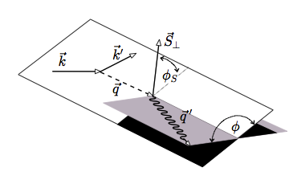
From outside into GPDs
k´_{e}, h
q,Λ_{γ}
q'
k_{e}, h
f
p, Λ
p´, Λ´
Exclusive 𝜋 production – in one photon approximation
Massless lepton helicity h is conserved
→ 2x2x2=8/2(parity)=4 helicity amps (vs. 8 in DVCS)
T _{h Λ; 0 Λ´}(k_{e}, k_{e}´, p, q´, p´) = ∑ _{Λγ} A_{h} ^{Λγ}(k_{e}, q, 𝜑) f _{Λγ Λ; 0 Λ´}(x,t,Q²)
f _{Λγ Λ; 0 Λ´}(x,t,Q²) virtual photoproduction
→ 3x2x2/2(parity)=6 helicity amps
A_{h} ^{Λγ}(k_{e}, q, 𝜑) →2x3/2(parity)=3 helicity amps
Exclusives2015 GR.Goldstein

Slide 10
Helicity amplitudes
f_{𝞚𝛾 ,𝞚N ; 0, 𝞚N’} are related to spin dependent observables
They are linear in convoluted GPDs or Compton form factors.
Observables are bilinear in helicity amps.
Are there enough measureable observables in order to
uniquely determine each GPD? Flavor separation?
Not within one reaction. SSA, double, triple polarization? KΛ?
Are the GPDs universal? factorization?
Exclusives2015 GR.Goldstein

Slide 11
quark GPDs
Exclusives2015 GR.Goldstein

Slide 12
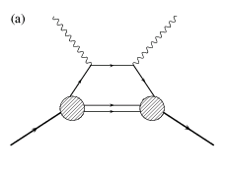
DVCS & DVMP γ*(Q²)+P→(γ or meson)+P’ partonic picture – leading twist
q
q+Δ
{
k_{T}
k'_{T}=k_{T}-Δ
}
k⁺=XP⁺
k'⁺=(X-ζ)P⁺
GPD
P⁺
P'⁺=(1-ζ)P⁺
P’_{T}=-Δ
}
Factorized
“handbag”
picture
ζ→0 Regge
t
Quark-spectator
quark+diquark
X>ζ DGLAP Δ_{T} -> b_{T} transverse spatial
X<ζ ERBL x=(X-ζ/2)/(1-ζ/2); ξ=ζ/(2-ζ)
see Ahmad, GG, Liuti, PRD79, 054014, (2009) for first chiral odd GPD
parameterization Gonzalez, GG, Liuti PRD84, 034007 (2011) chiral even
Exclusives2015 GR.Goldstein
12

Slide 13
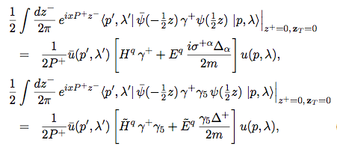
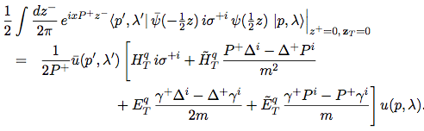
GPD definitions – 8 quark + 8 gluon
Momentum space nucleon matrix elements of quark field correlators
see, e.g. M. Diehl, Eur. Phys. J. C 19, 485 (2001).
Chiral even GPDs
-> Ji sum rule
Chiral odd GPDs
-> transversity
How to measure
and/or
parameterize them?
Exclusives2015 GR.Goldstein
13

Slide 14

Factorization in exclusive processes (DVCS, DVMP…)
t
q'=q+Δ, Λ_{γ}’
q,Λ_{γ}
g
k, λ
k’= k –Δ. λ’
k, λ
A
k’= k –Δ. λ’
P, Λ
P’= P-Δ, Λ’
Convolution of “hard part” with quark-proton Helicity amplitudes
most direct connection to observables
Exclusives2015 GR.Goldstein

Slide 15
Factorization in exclusive 𝜋,𝜂 (DVMP)
t
q'=q+Δ, Λ→0
q,Λ_{γ}
g
k, λ
k’= k –Δ. λ’
k, λ
A
k’= k –Δ. λ’
P, Λ
P’= P-Δ, Λ’
Convolution of “hard part” with quark-proton Helicity amplitudes
most direct connection to observables
0
0
Exclusives2015 GR.Goldstein

Slide 16
𝜋 electroproduction amps ⊃ DV𝜋P helicity amps ⊃ GPDs
0
0
Exclusives2015 GR.Goldstein

Slide 17
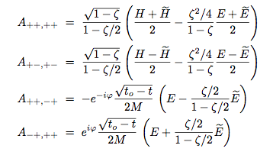
Helicity amps (q’+N->q+N’) are linear combinations of GPDs
~
Subtract to isolate H
~
Add to isolate E
T-reversal
at ξ =0
Chiral even helicity amps
See Diehl, Phys.Rept. 388, 41 (2003)
Exclusives2015 GR.Goldstein

Slide 18
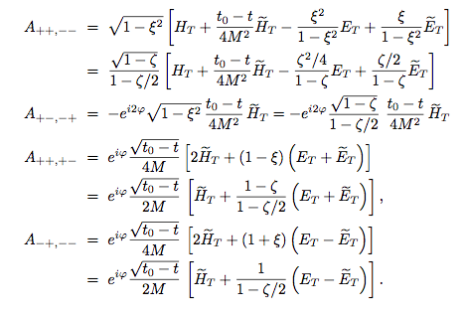
Helicity amps (q’+N->q+N’) are linear combinations of GPDs
H_{T}(x,ξ,t)
Transversity
H_{T}(x,0,0)=h₁(x)
T-reversal
at ξ =0
Chiral odd helicity amps
See Diehl, Phys.Rept. 388, 41 (2003)
In diquark spectator models A_{++;++}, etc. are calculated directly.
Inverted -> GPDs
Exclusives2015 GR.Goldstein

Slide 19
Observables are determined from helicty amps
Chiral Even
Chiral Odd
Compton Form Factors
Re H
Im H
Exclusives2015 GR.Goldstein

Slide 20

Relations between GPDs & TMDs ?
Model dependent relations with h₁⊥ requiring
final state interactions, but not l.h.s. GPDs.
Exclusives2015 GR.Goldstein

Slide 21
How to single out chiral odd GPDs?
Exclusive Lepto-production of πº or η, η’
to measure chiral odd GPDs & Transversity
πº
+1,0
+1/2
+1,0
q nos of C-odd
1⁻ ⁻ exchange
ρ & ω
1⁺⁻ exchange
b₁ & h₁
+1/2
-1/2
-1/2
N
+1/2
N
-1/2
+1/2
e.g. f_{+1+,0-}(s,t,Q²)
πº
g_{+1+,0-} A_{++,- -}
H_{T}
+1,0
b₁ & h₁
quark non-flip quark flip
-1/2
N
+1/2
N
t-channel J ^{PC} quantum numbers enhance chiral odd
see GG, Gonzalez Hernandez, Liuti, J.Phys.G39,115001(2012)
21
Exclusives2015 GR.Goldstein

Slide 22
Constructing observables
k´_{e}, h
q,Λ_{γ}
q'
k_{e}, h
f
p, Λ
p´, Λ
T _{h Λ; 0 Λ´}(k_{e}, k_{e}´, p, q´, p´) = ∑ _{Λγ} A_{h} ^{Λγ}(k_{e}, q, 𝜑) f _{Λγ Λ; 0 Λ´}(x,t)
d𝜎 ∝ ∑_{unmeasured spins} (T _{h Λ; 0 Λ´}* T _{h Λ´ ´; 0 Λ´} + c.c. ) 16 independent
Note: A_{h} ^{Λγ}(q, 𝜑) ∝ e ^{iΛγ 𝜑} so in summation there are terms
e ^{-iΛγ 𝜑} f _{Λγ Λ; 0 Λ´}* e ^{iΛγ´ 𝜑} f _{Λγ´ Λ ´ ´ ; 0 Λ´}
𝜑-azimuth helps discriminate
Exclusives2015 GR.Goldstein

Slide 23
d𝜎 ∝ ∑_{unmeasured spins} (T _{h Λ; 0 Λ´}* T _{h Λ´ ´; 0 Λ´} + c.c. )
For unpolarized d𝜎 ∝ ∑_{all spins} |T _{h Λ; 0 Λ´} |²
For beam polarization take h=+1/2 and subtract h=-1/2
d𝜎_{h=+1/2} - d𝜎_{h=+1/2} = P_{beam} d𝜎
For target polarization first select frame – rest frame –
then direction of polarization: longitudinal or transverse
First consider Deeply Virtual limit
Exclusives2015 GR.Goldstein

Slide 24
How to model GPDs? Normalizing GPDs – Chiral even
Form factor, Forward limit
Integrates to charge
Integrates to axial charge
Exclusives2015 GR.Goldstein

Slide 25
How do we normalize chiral-odd GPDs?
Only Physical constraints on the various chiral-odd GPDs are
Forward limit
Transversity
Integrates to tensor charge 𝛿_{q}
Form Factors
Integrates to “transverse
anomalous moment” 𝞳_{T}^{q}
~
No direct interpretation of E_{T} - separates single flip amps
Exclusives2015 GR.Goldstein

Slide 26
The Model – Reggeized Diquarks
Exclusives2015 GR.Goldstein

Slide 27
The Model – first for Chiral Even – Reggeized Diquarks
Exclusives2015 GR.Goldstein

Slide 28

Vertex Structures with Diquark Spectator
λ
λ’
k⁺=XP⁺
k’⁺=(X-ζ)P⁺
Λ
P⁺
P_{X}⁺=(1-X)P⁺
P_{X}⁺=(1-X)P⁺
P’⁺=(1- ζ)P⁺
Λ’
S=0 or 1
First focus on S=0 pure spectator – beginning
Vertex function
Exclusives2015 GR.Goldstein

Slide 29

Reggeization
q, Λ_{γ}
q'=q+Δ, Λ_{γ}’
k, λ
k’= p –Δ. λ’
M_{X}→ k_{X},λ’’
P’= P-Δ, Λ’
P, Λ
Landshoff, Polkinghorn, Short ‘71
Brodsky, Close, Gunion ’71 Regge
behavior required for Compton
Ahmad, Honkanen,Liuti,Taneja ’07, ’09
Gorshteyn & Szczepaniak (PRD, 2010)
Brodsky, Llanes-Estrada ‘07
Brodsky, Llanes, Szczepaniak ‘08
    Gonzalez, GG, Liuti, arXiv:1201.6088 [hep-ph] J. Phys. G: Nucl. Part. Phys. 39 115001 (2012)
Exclusives2015 GR.Goldstein

Slide 30

Parametric Form
R✖Dq
Fit via DVCS dσ & asymmetries
see GRG, Gonzalez Hernandez, Liuti,
PRD84, 034007 (2011)
Exclusives2015 GR.Goldstein

Slide 31
How to measure?
Helicity amps
are straightforwardly related to participating particle polarizations.
are directly constructed in QCD-based models
R✖Dq
Fit via DVCS dσ & asymmetries
see GRG, Gonzalez Hernandez, Liuti,
PRD84, 034007 (2011)
Exclusives2015 GR.Goldstein

Slide 32
RESULT: determined the chiral even GPDs
t
Exclusives2015 GR.Goldstein

Slide 33
RESULT: Chiral odd GPDs
Exclusives2015 GR.Goldstein

Slide 34
The Model for Chiral Odd – Reggeized Diquarks
Exclusives2015 GR.Goldstein

Slide 35
Vertex Structures with Diquark Spectator
λ
λ’
k⁺=XP⁺
k’⁺=(X-ζ)P⁺
Λ
P⁺
P_{X}⁺=(1-X)P⁺
P_{X}⁺=(1-X)P⁺
P’⁺=(1- ζ)P⁺
Λ’
S=0 or 1
First focus on S=0 pure spectator – beginning
Vertex function
Exclusives2015 GR.Goldstein

Slide 36
Vertex Structures with Diquark Spectator
λ
λ’
k⁺=XP⁺
k’⁺=(X-ζ)P⁺
Λ
P⁺
P_{X}⁺=(1-X)P⁺
P_{X}⁺=(1-X)P⁺
P’⁺=(1- ζ)P⁺
Λ’
S=0 or 1
First focus on S=0 pure spectator – beginning
Parity at vertices:
Note that by switching
λ➔- λ & Λ ➔ -Λ (Parity)
will have chiral evens
go to ± chiral odds
giving relations –
before k integrations
A(Λ’λ’;Λλ)➔
±A(Λ’,λ’;-Λ,-λ)*
but then (Λ’-λ’)-(Λ-λ)
≠(Λ’-λ’)+(Λ-λ) unless Λ=λ
Vertex function
Exclusives2015 GR.Goldstein

Slide 37
S=0 Chiral even <-> odd helicity amps
(+ S=1)
Invert to get GPDs – same helicity amp sets
Exclusives2015 GR.Goldstein

Slide 38
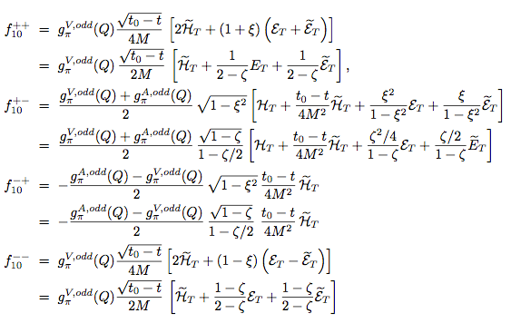
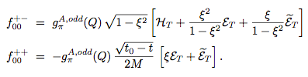
6 helicity amps for π⁰ with chiral odds
f₁
f₂
f₃
f₄
f₅
f₆
-
-
-
-
6 amps
& 8 quark
GPDs (flavor)
Also 8 gluon
GPDs
(at twist 2)
_
H_{T} & E_{T}
+
Exclusives2015 GR.Goldstein

Slide 39
Different notations
f_{𝜦𝛾,𝜦N ; 0 , 𝜦N´} = M _{0 , 𝜦N´ ;𝜦𝛾,𝜦N} =f_{𝜦𝛾,0} ^{𝜦N,𝜦N´}
= -(-1) ^{𝜦𝛾} ⁻ ^{𝜦N +} ^{𝜦N´}f_{-𝜦𝛾,-𝜦N ; 0 , -𝜦N}
f₁ = f _{1,+1/2; 0,+1/2} = f₁₀⁺⁺ = M _{0,+1/2; +1,+1/2} or M _{0 +, + +} : single helicity flip
f₂ = f _{1,+1/2; 0,-1/2} = f₁₀⁺ ⁻ = M _{0 -, + +} : non-flip
f₃ = f _{1,-1/2; 0,+1/2} = f₁₀⁻ ⁺ = M _{0 +, + -} : double flip
f₄ = f _{1,-1/2; 0,-1/2} = f₁₀⁻ ⁻ = M _{0 -, + -} : single flip
f₅ = f _{0,+1/2; 0,-1/2} = f₀₀⁺ ⁻ = M _{0 -, 0 +} : single flip
f₆ = f _{0,+1/2; 0,+1/2} = f₀₀⁺⁺ = M _{0 +, 0 +} : non-flip
n helicity flips get factor [√(t₀ – t) /2M]^{n} = Δ^{n}/(2M)^{n}
Exclusives2015 GR.Goldstein

Slide 40
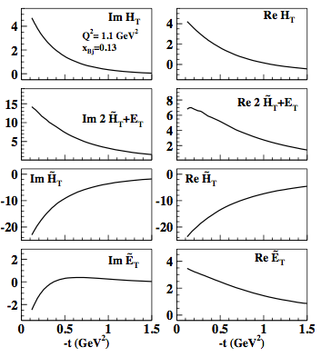
Chiral odd GPD Compton form factors
Exclusives2015 G.R.Goldstein

Slide 41
Observables: cross sections & asymmetries
Exclusives2015 GR.Goldstein

Slide 42
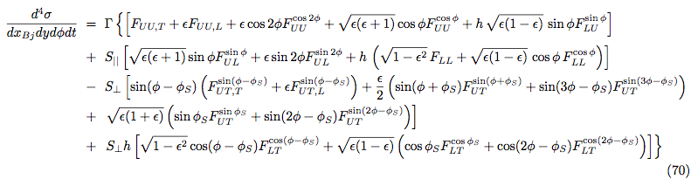
Cross sections for π ⁰
See: GG, Gonzalez Hernandez, Liuti 1311.0483.pdf;
J.Phys.G39,115001(2012); PRD84, 034007(2011).
Notation: Bacchetta, et al., JHEP 0702, 093 (2007);
angular form: Diehl & Sapeta, Eur. Phys. J. C 41, 515 (2005).
Exclusives2015 GR.Goldstein

Slide 43
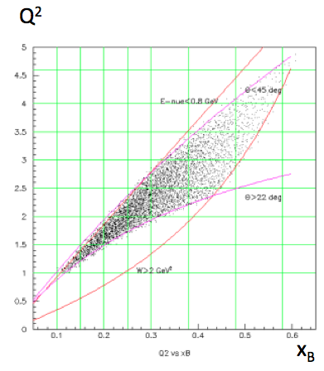
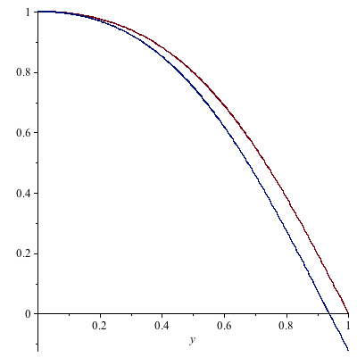
Experimental range of kinematics
Hall B kinematics 6 GeV
𝜺 long./trans.
y
Exclusives2015 GR.Goldstein

Slide 44
𝜖 is ratio of longitudinal virtual photon to transverse with unpolarized leptons
How are the individual “structure functions” related
to helicity amps and GPDs?
Exclusives2015 GR.Goldstein

Slide 45

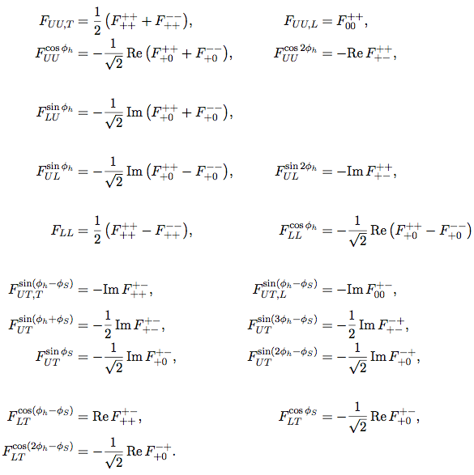
From d𝜎 to helicity bilinears
d𝜎_{𝜦𝛾 ,𝜦𝛾´}^{𝜦N, 𝜦N´}
∝ Σ_{𝜦}(f_{𝜦𝛾,0} ^{𝜦N,𝜦})* f_{𝜦𝛾´,0} ^{𝜦’N,𝜦}
See: Bacchetta, et al. JHEP0702, 093 (2007)
Diehl & Sapeta, EPJC41, 515 (2005)
Exclusives2015 GR.Goldstein

Slide 46
Unpolarized cross section components
Real bilinears
Exclusives2015 GR.Goldstein

Slide 47
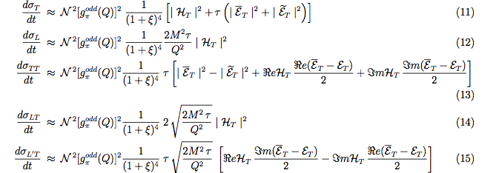
(t₀-t)/2M² =𝛕
Exclusives2015 GR.Goldstein
1/7/15

Slide 48
Chiral odd GPDs →
Transversity → pdf’s: h₁^{q}(x,Q²)
GG, Gonzalez, Liuti,
arXiv:1311.0483 [hep-ph]
Exclusives2015 GR.Goldstein

Slide 49
Extraction of transversity after using DVCS data via
chiral even←→odd
Anselmino, Boglione, et al.,
Phys.Rev. D87 (2013) 094019
δu = 0.31_{-0.12}^{+0.16} δd=-0.27_{-0.10}^{+0.10}
BCR=Bacchetta, Conte, Radici

Slide 50
Extraction of tensor charge
L.Gamberg & GG, PRL87, 24001 (2001)---→
Anselmino, Boglione, et al.,
Phys.Rev. D87 (2013) 094019
δu = 0.31_{-0.12}^{+0.16} δd=-0.27_{-0.10}^{+0.10}
From our Reggeized form
δu ≈ 1.2 δd ≈-0.08
Closer to QCD sum rule values

Slide 51
Chiral odd GPDs →
Transversity → tensor charges 𝛿_{q}
GG, Gonzalez, Liuti,
arXiv:1311.0483 [hep-ph]
Exclusives2015 GR.Goldstein

Slide 52
Observables - data
Cross sections
Asymmetries
Exclusives2015 GR.Goldstein

Slide 53
How well do the parameters fixed with DVCS data reproduce πº
electroproduction data?
Hall B data, Kubarovsky& Stoler, PoS ICHEP 2010 & PRL 109, 112001 (2012)

Slide 54
Same, separating the GPDs contribution

Slide 56
CLAS π⁰ arXiv:1206.6355v1 [hep-ex] PRL 109, 112001 (2012)
GGL vs. G&K
Exclusives2015 GR.Goldstein

Slide 57
Comparing d𝝈/dt to other models
The t-> 0 feature for us is that f₁₀⁺⁻ dominates & it is driven by H_{T.}
But f₁₀⁺⁺ & f₁₀⁻⁻ also contribute as ~√(t₀-t), however weaker. For ξ→0 they ⊃ CFFs
f₁₀⁺⁺ & f₁₀⁻⁻ are not equal in magnitude, particularly vs. ζ or ξ ⊃
mixes “natural & unnatural parity”
In A_{LL} ~ |f₁₀⁺⁺|² + |f₁₀⁺⁻|² - |f₁₀⁻⁺|² - |f₁₀⁻⁻|² sensitive to differences of f₁₀⁺⁺ & f₁₀⁻⁻
c.f. Goloskokov & Kroll – different dominant amps.
Exclusives2015 GR.Goldstein

Slide 58
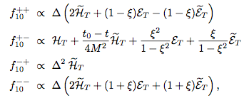

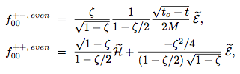
Selecting transversity
+
+
-
-
-
Compare also f _{long}^{odd} & with chiral even f_{long}^{even}
( )²
Exclusives2015 GR.Goldstein

Slide 59
Asymmetries:
Longitudinal polarizations
(note: single spin asymmetries ~ Im
double spin asymmetries ~ Re )
Exclusives2015 GR.Goldstein

Slide 60
Longitudinally polarized target
Look for tensor charge in f₁₀⁺⁻
From GG, Gonzalez Hernandez, Liuti
arXiv:hep-ph:1311.0483
Transverse dipole moment in f₁₀⁺⁺,f₁₀⁻⁻
Exclusives2015 GR.Goldstein

Slide 61
Longitudinally polarized beam and target
Look for tensor charge in f₁₀⁺⁻
From GG, Gonzalez Hernandez, Liuti
arXiv:hep-ph:1401.0438
Transverse dipole moment in f₁₀⁺⁺,f₁₀⁻⁻
Exclusives2015 GR.Goldstein

Slide 62
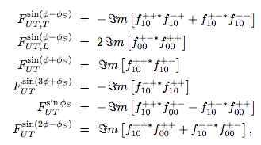

Asymmetries:
Transverse polarizations
₋
~Im(H_{T}* E_{T}) Δ¹
₋
~Im(H_{T}* E_{T}) Δ¹
~Δ²
~
~Im(H_{T}* H) Δ⁰
~Δ²
Exclusives2015 GR.Goldstein

Slide 63
Transverse target
Look for tensor charge in f₁₀⁺⁻
Transverse dipole moment in f₁₀⁺⁺,f₁₀⁻⁻
From GG, Gonzalez Hernandez, Liuti
arXiv:hep-ph:1401.0438
Exclusives2015 GR.Goldstein

Slide 64
Transverse target
FIG. 7: (Color online) The asymmetries Asin(φ−φS), Asin(φ+φS), and Acos(φ−φS), plotted vs. −t, at ^{x}_{Bj} ^{= 0.2, Q2 = 1.5.}
In the left panel γ∗p → πop′; in the right panel γ∗p → ηp′.
The long dashed and short dashed curves show the contributions proportional to the amplitudes,
Imf+− and Ref+−, which contain the GPD H_{T}, and are therefore sensitive to the tensor charge. The dotted curves show the sum of contributions from the remaining amplitudes, and the full curves show the total contribution.
Look for tensor charge in f₁₀⁺⁻
From GG, Gonzalez Hernandez, Liuti
arXiv:hep-ph:1401.0438
Transverse dipole moment in f₁₀⁺⁺,f₁₀⁻⁻
Exclusives2015 GR.Goldstein

Slide 65

Asymmetry sensitive to tensor charge
From GG, Gonzalez Hernandez, Liuti
arXiv:hep-ph:1401.0438
Exclusives2015 GR.Goldstein

Slide 66

Asymmetries:
Polarized beam & transversely polarized target
(note: single spin asymmetries ~ Im
double spin asymmetries ~ Re )
Exclusives2015 GR.Goldstein

Slide 67
Ratio of unpolarized η / π⁰
Q²=1.5 GeV²
x_{Bj}=0.2
η/πº
From GG, Gonzalez Hernandez, Liuti
arXiv:hep-ph:1401.0438
Exclusives2015 GR.Goldstein

Slide 68
Summarizing chiral odd for π⁰, η
& charged pseudoscalars
Exclusives2015 GR.Goldstein

Slide 69
Summary
Using Flexible parameterization for chiral even from form factors, pdfs & DVCS R✖Dq
Extended R✖Dq to chiral odd sector
DVMP – π⁰ many dσ ‘s & Asymmetries
measure Transversity
Exclusives2015 GR.Goldstein

