Slide 1
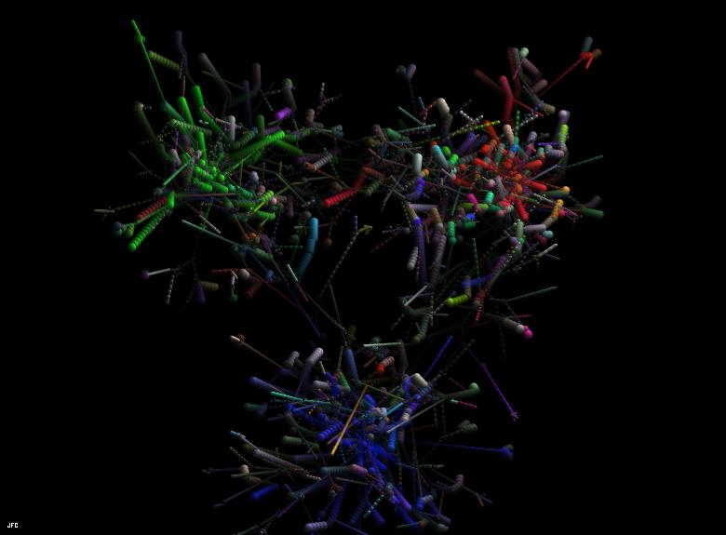
Accessing the Tensor Charge through Neutral Pseudocalar Meson Production
Simonetta Liuti
University of Virginia
Jefferson Lab, January 22nd, 2015

Slide 2
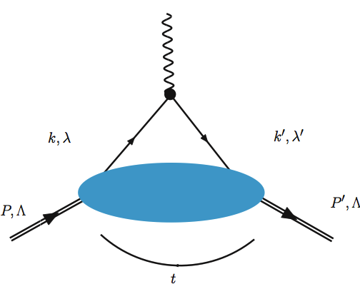
Nucleon Tensor Charge and Chiral Odd GPDs: Motivation and context
The most general form of gauge interactions with the exchange of a spin-1 particle is a linear
combination of VECTOR and AXIAL-VECTOR
The tensor charge is therefore not “fundamental”
➔ A “tensor form factor” cannot be measured in elastic scattering type processes

Slide 3

An accurate knowledge of the tensor charge/form factor is important in Beyond the Standard Model (BSM) searches
Bhattacharya et al., PHYSICAL REVIEW D 85, 054512 (2012)
Parameters in precision measurements of decays of (ultra)cold neutrons
Preliminary
S.Baessler, A. Courtoy, M. Gonzalez-Alonso, S.L.
Many candidate extensions of the SM at the TeV scale (supersymmetry, extra dimensions…)
However, no experimental guidance on what new interactions and particles exist at this scale.
Effective field theory approach: new interactions at the TeV scale produce effects in low-energy (few-GeV) physics
If these are known at the 10⁻³ level they can be used to improve the bounds on new scalar and tensor interactions at the TeV scale.
Notes:
There are many candidate extensions of the SM, such as supersymmetry and extra dimensions, but, so far, there is no
experimental guidance on what new interactions and particles exist at this scale.
A theoretical approach (effective field theory) is to postulate new interactions at the TeV scale (without necessarily specifying a model) and analyze the corrections they would give rise to in low-energy (few-GeV) physics.

Slide 4
We can access the tensor charge, in DIS type experiments
Chirally Even Quark-Proton Helicity Amplitudes
Net helicity of a quark in a longitudinally polarized proton:
(number of quarks with momentum fraction x and spin parallel to the proton’s) – (number of quarks with the same x and spin antiparallel )
Notes:
The tensor charge, the transverse magnetic moment, … are chiral-odd (quark helicity flip) objects, they can be measured in processes that allow for quark helicity flip (one has to go beyond inclusive DIS)

Slide 5
… in transverse basis:
In the helicity basis it is described in terms of non-diagonal/chirally-odd quark-proton helicity amplitudes.
Net transverse polarization of a quark in a transversely polarized proton:
(number of quarks with momentum fraction x and polarization parallel to the proton’s) – (number of quarks with the same x and polarization antiparallel)
Notes:
The tensor charge, the transverse magnetic moment, … are chiral-odd (quark helicity flip) objects, they can be measured in processes that allow for quark helicity flip (one has to go beyond inclusive DIS)

Slide 6
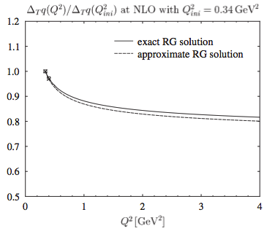
In a non-relativistic theory the transversity and longitudinal spin distributions would coincide.
In a partonic picture, because rotations involve interactions, transversity provides extra dynamical information.
A signature of dynamical effects is given by the fact that the tensor charge is Q² dependent
Wakamatsu (PRD, 2009)

Slide 7
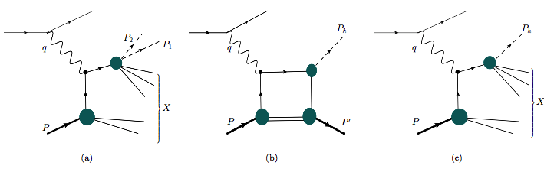
To detect chiral odd distributions we need another
distinct hadronic blob
dihadron
DVπºP, DVηP
SIDIS
collinear
Notes:
The tensor charge, the transverse magnetic moment, … are chiral-odd (quark helicity flip) objects, they can be measured in processes that allow for quark helicity flip (one has to go beyond inclusive DIS)

Slide 9
DVπºP, DVηP
Compton Form Factors
Helicity Amplitudes
A_{LU}
A_{UL,} A_{LL}
A_{UT}
Generalized Parton Distributions

Slide 10
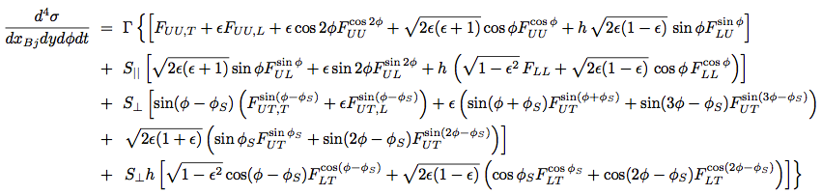


Cross section

Slide 11
General structure of structure function (for example a chiral odd term)
t
*
0
0
-1
+1
Λ’
+
Λ’
+

Slide 12
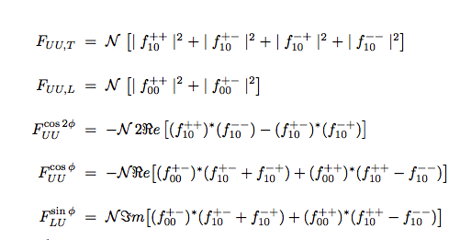
12
1/23/15

Slide 13

Factorization in exclusive processes (DVCS, DVMP…)
t
t
q'=q+Δ, Λ_{γ}’
q, Λ_{γ}
g
k, λ
k’= k –Δ. λ’
k, λ
A
k’= k –Δ. λ’
P, Λ
P’= P-Δ, Λ’
Convolution of “hard part” with quark-proton amplitudes

Slide 14

The type of amplitudes will depend on whether one has a chiral odd or even coupling
t
q, Λ_{γ}
q'=q+Δ, Λ_{γ}’
g
k, λ
k’= k –Δ. λ’

Slide 15
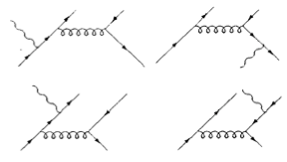
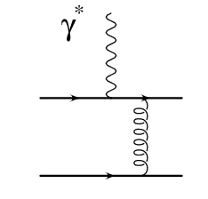
One gluon exchange at leading order
IMPORTANT: based on this picture Collins et al. predicted that pseudoscalar meson e⁻ production measures chiral even GPDs (PRD, 1997)
S.Ahmad, G. Goldstein, S.L., PRD79, 054014 (2009) suggested a model beyond the leading order
J^{PC}=1⁻⁻ (³S₁)
J^{PC}=0⁻⁺
J^{PC}=1⁺⁻(¹P₁)

Slide 16
Distinction between vector and axial-vector t-channel exchanges
J^{PC}=1⁻⁻
transition from (S=1 L=0) to (S=0 L=0) ΔL =0
J^{PC}=1⁺⁻
transition from (S=0 L=1) to (S=0 L=0) ΔL =1

Slide 17
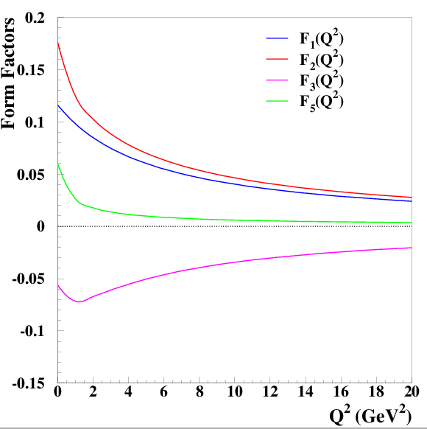
Our model affords increased flexibility in the Q² dependence

Slide 18
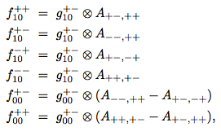

Quark-proton helicity amplitudes
t
k, λ
A
k’= k –Δ. λ’
P, Λ
P’= P-Δ, Λ’

Slide 19
DVπºP, DVηP
Compton Form Factors
Helicity Amplitudes
A_{LU}
A_{UL,} A_{LL}
A_{UT}
Generalized Parton Distributions

Slide 20
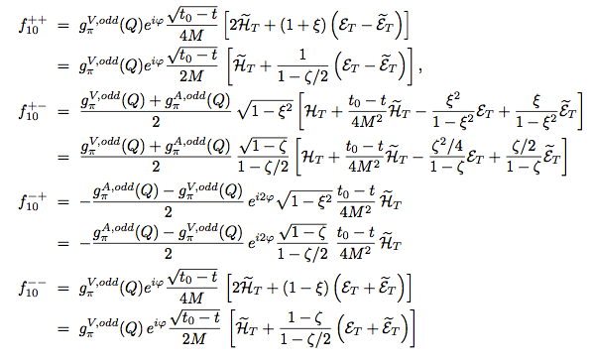
From helicity amplitudes to Compton Form Factors
Small ξ approximation

Slide 21
Observables
Chiral Even
Chiral Odd
Compton Form Factors
Re and Im parts of amps.!

Slide 22
Differently from the chiral even case where we have “ball park” estimates of the sizes of the various GPDs given by their normalization to the electroweak form facors, and to the forward limit (PDFs) in the chiral odd sector there are essentially no constraints!

Slide 23
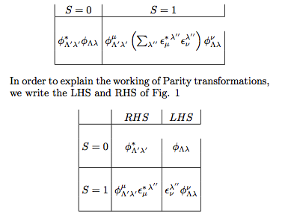
In the diquark model the chiral odd
helicity amps are related to the chiral even
ones through Parity
S=0,1

Slide 24
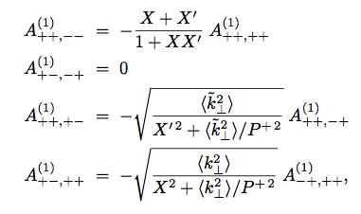
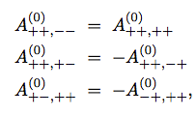

S=1
Odd
Even
S=0
Odd
Even

Slide 25
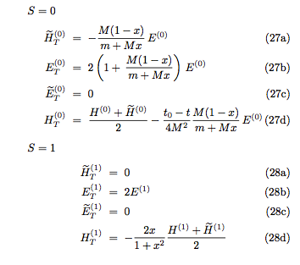
In terms of GPDs
Odd
Even

Slide 26
Final step: use SU(4)

Slide 27
DVπºP, DVηP
Compton Form Factors
Helicity Amplitudes
A_{LU}
A_{UL,} A_{LL}
A_{UT}
Generalized Parton Distributions

Slide 28
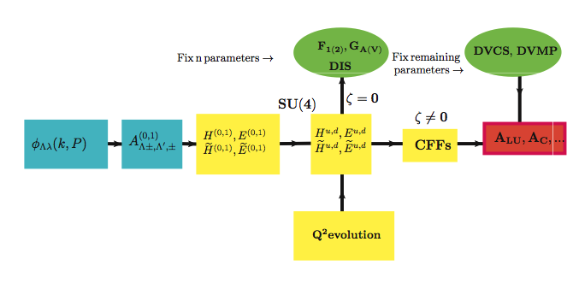
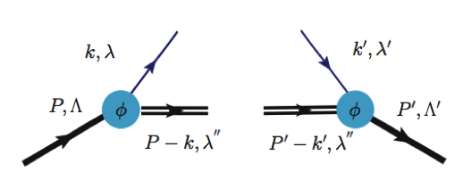
Summary so far
Reggeized diquark model
S=0,1

Slide 29
Given the enhanced complexity, how do we choose the “initial parameterization”?
We propose a “flexible” parameterization based on the reggeized quark-diquark model.
The number of parameters is optimized
From DIS
to DVCS, DVMP

Slide 30
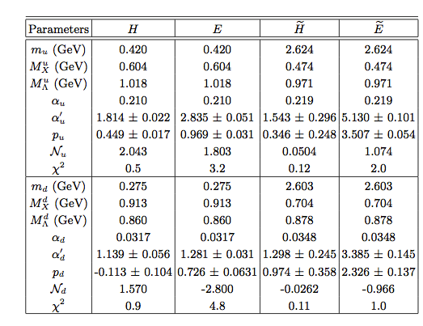
We asked the question: “What is the minimal number of parameters
necessary to fit X and t ?” It can be addressed with Recursive Fit
New set of parameters using Cates et al. (2012)

Slide 31
Not to forget: GPDs need to be perturbatively evolved to
compare with data

Slide 32
In essence there are two types of models:
Double distributions based
Partonic picture (not ensemble of free quarks!)
Double distribution based models aim at getting ξ dependence correctly (polynomiality is satisfied from scratch) but introduce t dependence empirically
Partonic picture based have to implement polynomiality order by order, but they predict the t-dependence

Slide 33
Polynomiality in the reggeized quark-diquark approach ➔arXiv:1012.3776
ξ⁰
ξ²
ξ⁴
ξ⁶
ξ⁸
x_{Bj}=0.7

Slide 34
Example
The extent to which baryon number is conserved by PDF parametrizations

Slide 35
Chiral even GPDs
t

Slide 36
Chiral odd GPDs

Slide 37
Compton form factors

Slide 38
Comparison with Hall B DVCS data (Girod et al.)
Before fitting
additional parameters
After fit

Slide 39
Unpolarized Helicity Amplitudes

Slide 40
Same, separating the GPDs contribution

Slide 41
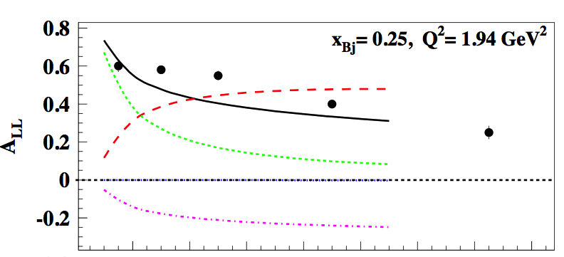
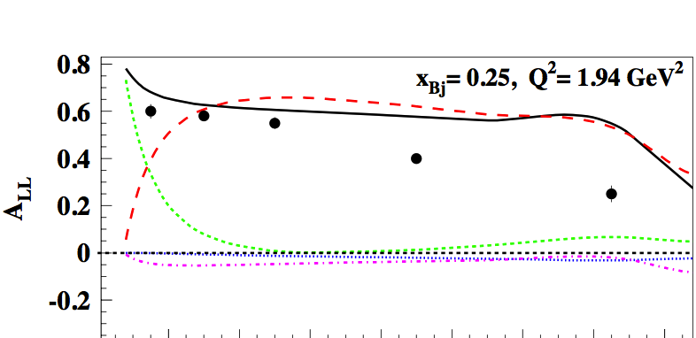


Sensitive to tensor charge
Role of parameters

Slide 44
Conclusions
We outlined an approach to extract the tensor charge from
pseudoscalar meson production data
There are several papers on arXiv…
sl4y@virginia.edu

Slide 45
Back up

Slide 46
Im Helicity Amps
Re Helicity Amps

