Slide 1
J/ψ @ SoLID
Zhiwen Zhao
Jlab/ODU
Exclusive Meson Production Workshop
2015/01/24

Slide 2
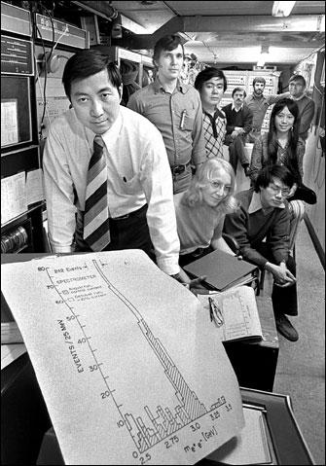
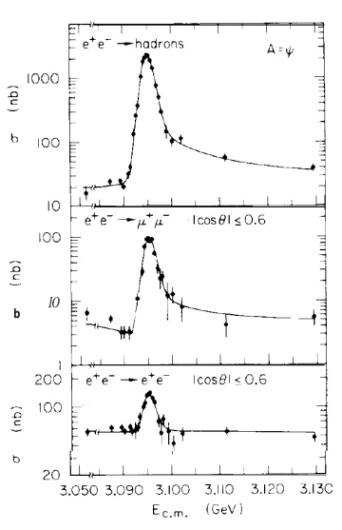
Discovery/Birth
J by Samuel C.C. Ting’s group
proton on fixed target
AGS@BNL
ψ by Burton Richter's group
e+e- annihilation
SPEAR@SLAC
1974 Nov 11

Slide 3
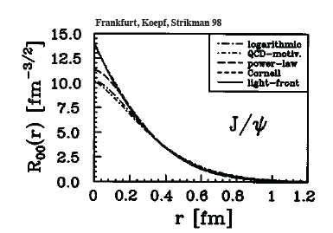
Gluon Study Using J/ψ
J/ψ is a charm-anticharm system
Little (if not zero) common valence quark between J/ψ and nucleon
Quark exchange interactions are strongly suppressed
Pure gluonic interactions are dominant
Charm quark is heavy (1.3GeV) (0.2GeV)
Typical size of J/ψ is 0.2-0.3 fm
J/ψ as probe of the strong color
field in the nucleon

Slide 4
Interaction between J/ψ-N
New scale provided by the charm quark mass and size of the J/ψ
OPE, Phenomenology, Lattice QCD …
High Energy region: Pomeron picture …
Medium/Low Energy: 2-gluon exchange
Very low energy: QCD color Van der Waals force
Prediction of J/ψ-Nuclei bound state
Brodsky et al. ….
Experimentally no free J/ψ are available
Challenging to produce close to threshold!
Photo/electro-production of J/ψ at JLab is an opportunity

Slide 5
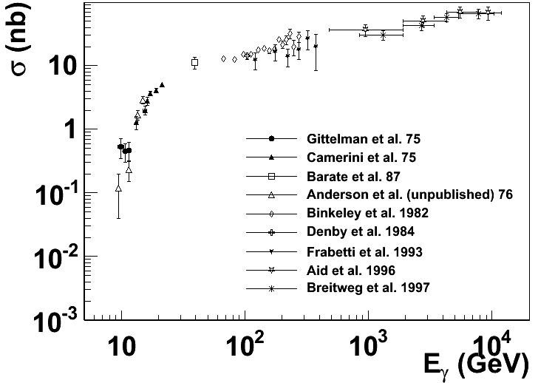
Experimental status
More data exist with inelastic scattering on nuclei, such as A-dependence.
Not included are the most recent results from HERA
H1/ZEUS at large momentum transfers and diffractive production with electro-production
SLAC, Cornell, Fermilab, HERA …
The physics focus is at threshold region

Slide 6
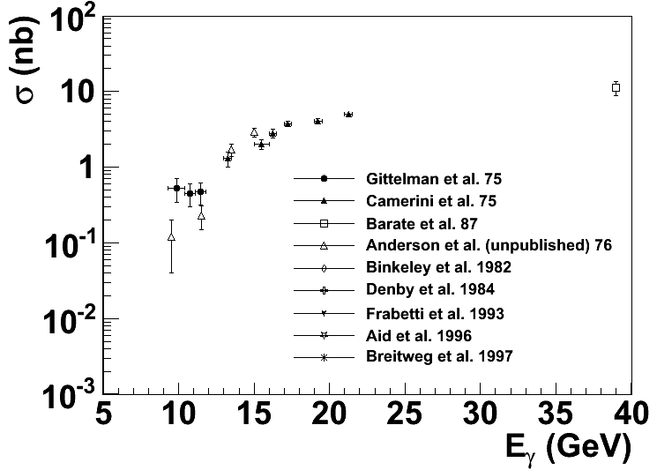
Near Threshold
Enhancement ?
?
Intense experimental effort (SLAC, Cornell … ) shortly after the discovery of J/ψ
But near threshold not much data since (~40 years till now)

Slide 7
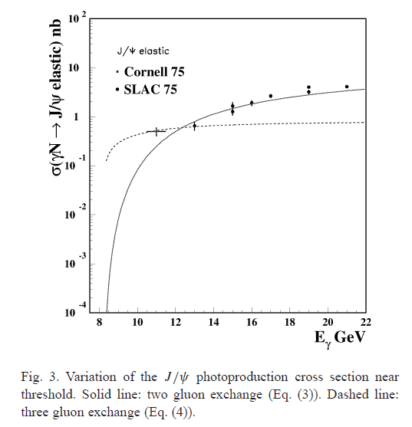
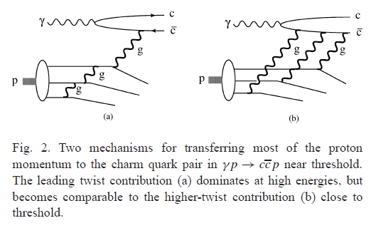
Reaction Mechanism
Hard scattering
(Brodsky, Chudakov, Hoyer, Laget 2001)
Add in 3-gluon scattering
Multiple gluon exchange and bound state?

Slide 8
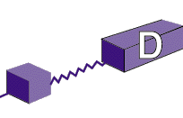
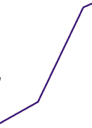
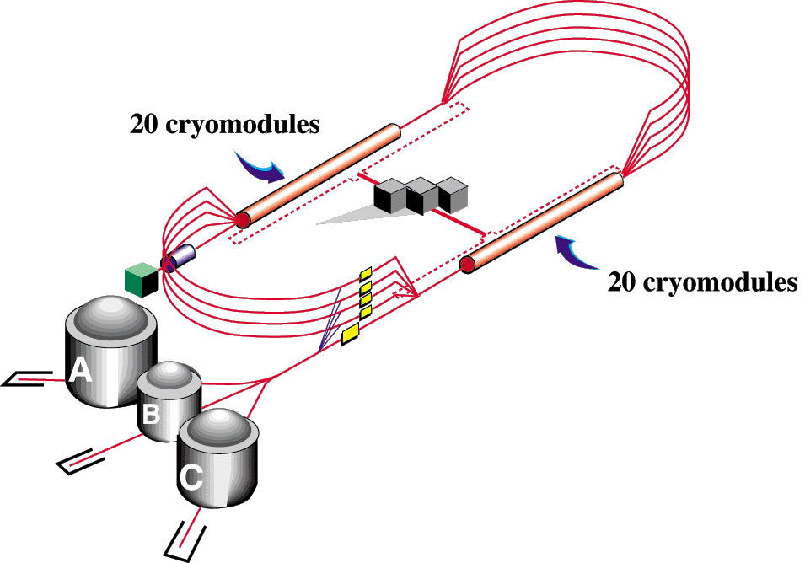
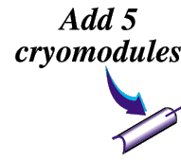
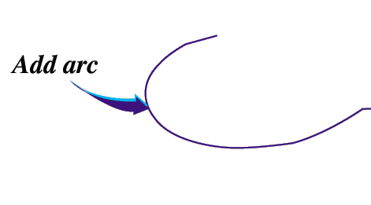
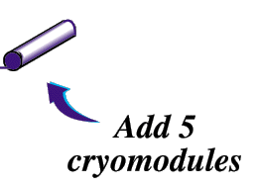
Opportunity at JLab 12GeV
Cross 8.2 GeV threshold and reach 12 GeV
New Hall-D
Max energy: 12 GeV
CHL-2
Enhanced capabilities in existing Halls A/B/C
Max energy: 11 GeV
Two 1.1 GeV LINACs, maintain capability to deliver lower pass beam energies: 2.2 – 8.8 GeV

Slide 9
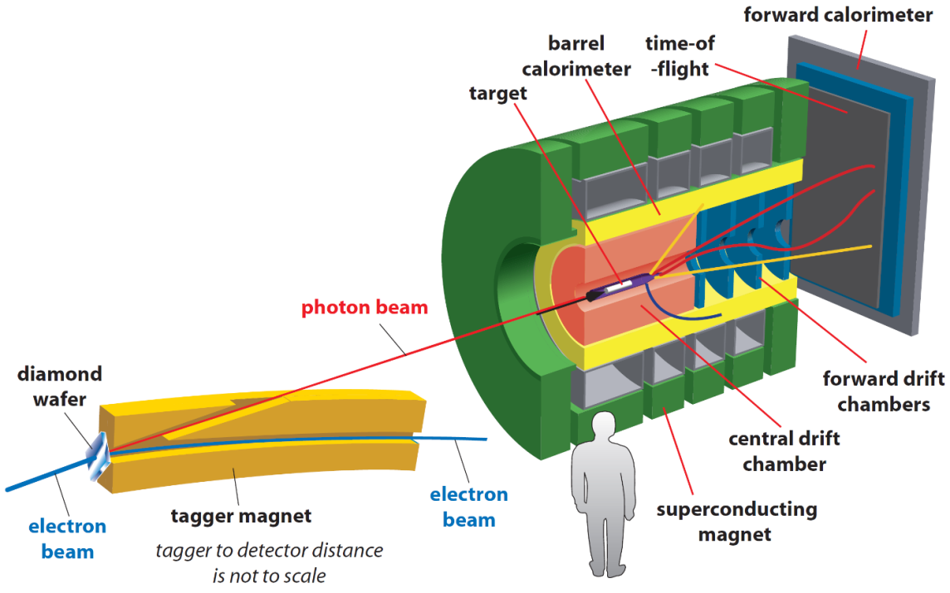
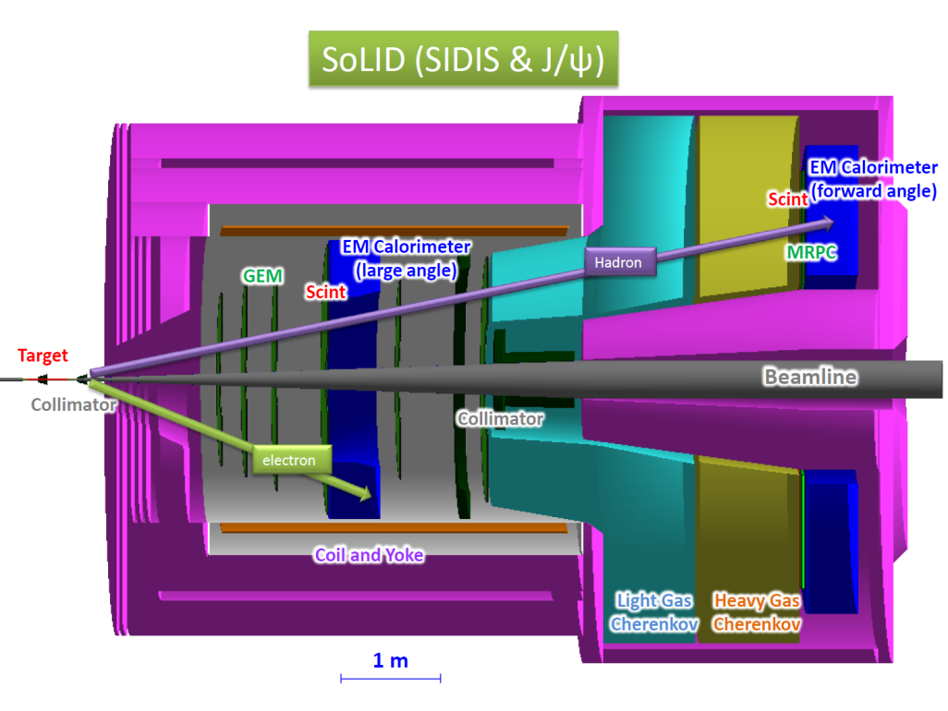
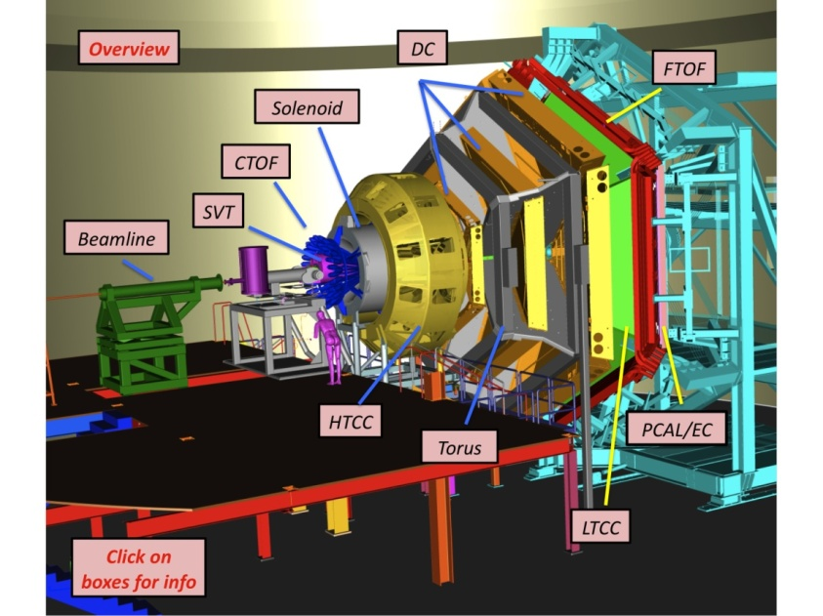
Opportunity at JLab 12GeV
Several new detectors
with
Large acceptance
High luminosity
GlueX
SoLID
CLAS12

Slide 10
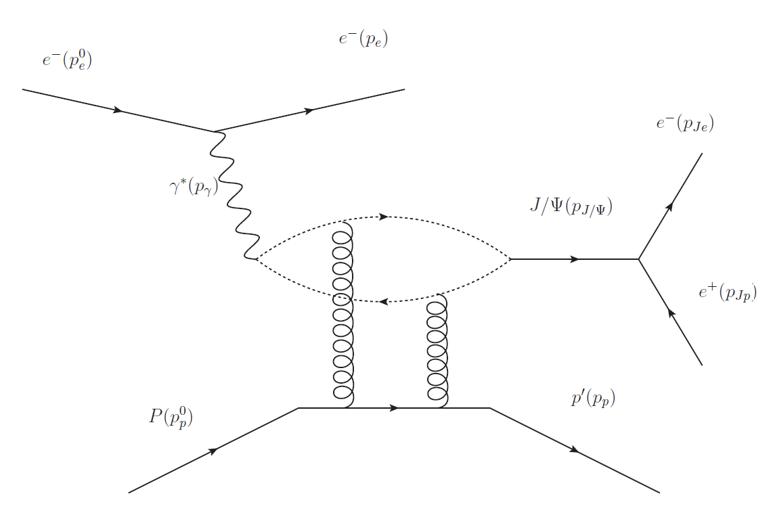
J/ψ @ SoLID
E12-12-006 approved
Spokespersons:
Kawtar Hafidi (ANL),Zein-Eddine Meziani (Temple)
Xin Qian (BNL), Nikos Sparveris (Temple)
Zhiwen Zhao (Jlab/ODU)
Detect decay e⁻ e⁺ pair
Detect scattered e⁻ for electroproduction or detect NO scattered e⁻ for photoproduction
Detect recoil p to be exclusive
e p → e′ p′ J/ψ(e⁻ e⁺)
γ p → p′ J/ψ(e⁻ e⁺)

Slide 11
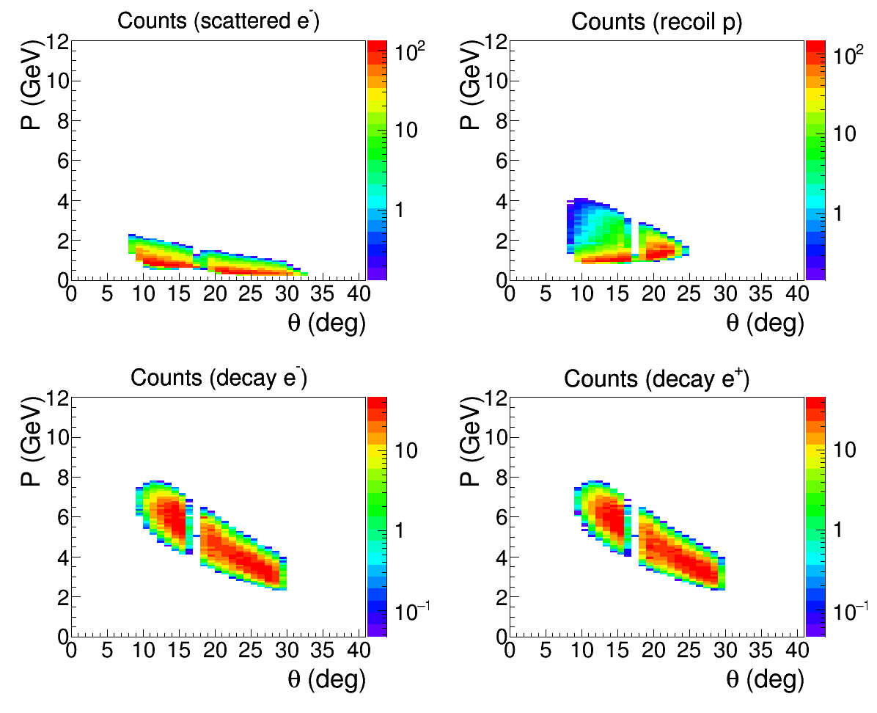
PID and Acceptance
Scattered e⁻ and Decay e⁻/e⁺:
EC + Scint + CC @ forward angle
EC + Scint @ large angle
Recoil p:
100 ps TOF(MRPC): 4 σ separation between p and K up to 4.5 GeV @ forward angle
150 ps TOF(Scint): 4 σ separation between p and K up to 2 GeV @ large angle
Electroproduction (fully exclusive)
Tracking at both forward and large angles

Slide 12
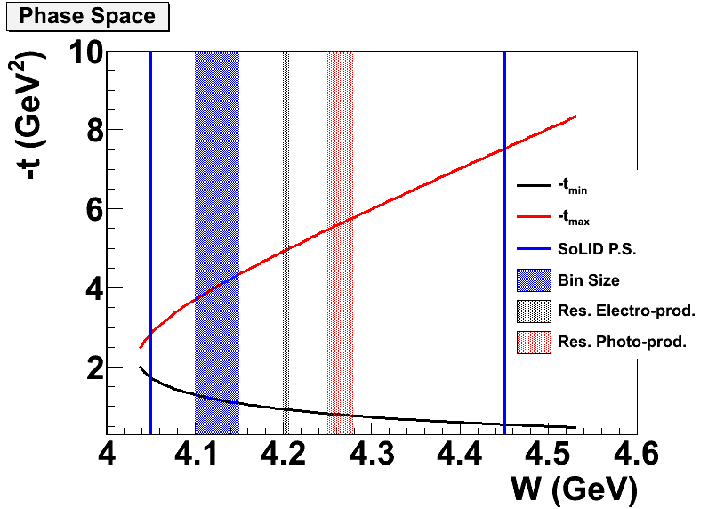
Electroproduction vs. Photoproduction
production | Energy resolution | W reach | Background | Statistics
Electro- | better | lower | less | less
Photo- | worse | higher | more | more
Electroproduction
virtual photon energy solely determined by detection of scattered e⁻, like a tagged virtual photon beam
non-zero Q2 gives lower W reach
More final particle detection can have less background
Photoproduction
photon energy derived from detection of recoil p, decay e-, decay e+
more statistics
Trigger on decay e⁻ and decay e⁺ to include both channels
Single electron trigger rate is ~1MHz
Coincidence trigger rate of two electron triggers within a 30ns time window is ~30kHz, comparing to 100 kHz design trigger rate limit

Slide 13
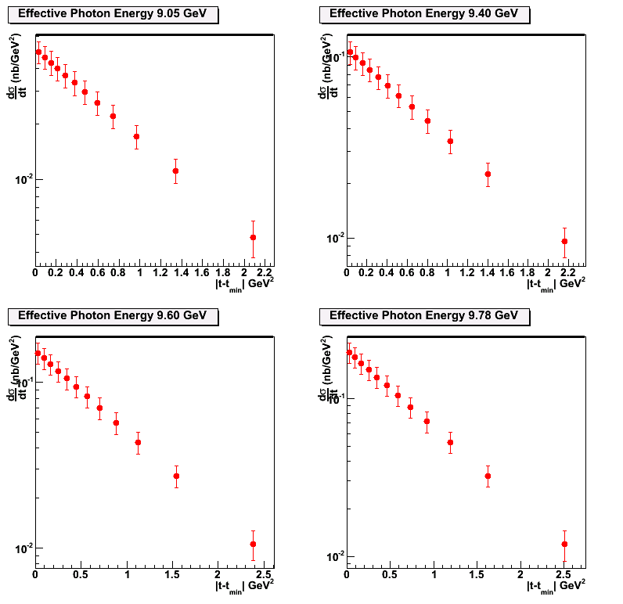
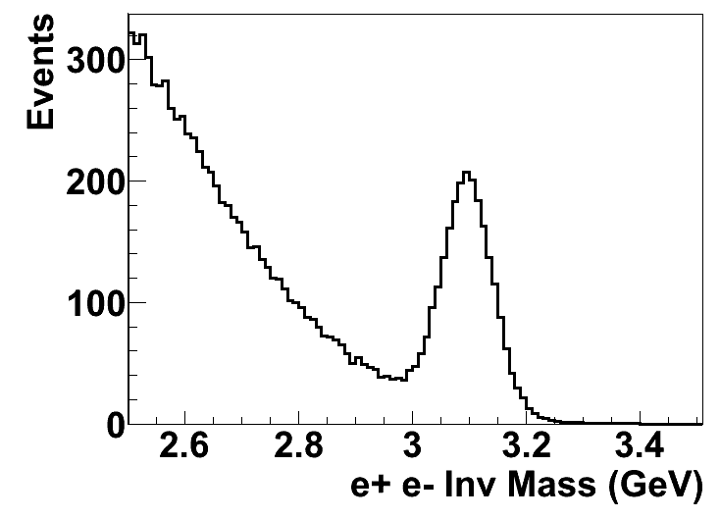
Projections of Differential Crosssection
Conservative estimation with 2-g model
Electroproduction (fully exclusive) channel
Main background from BH
50 Days

Slide 14
Projection of Total Crossection
Lumi 1.2e37/cm²/s
11GeV 3uA e- on 15cm LH2
50 Days
With < 0.01 GeV energy resolution and small binning to
study the threshold behavior of cross section

Slide 15
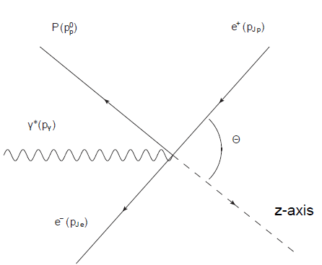
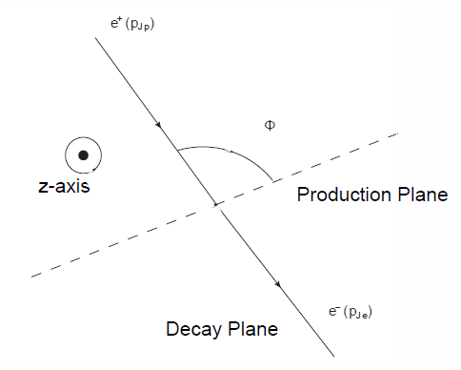
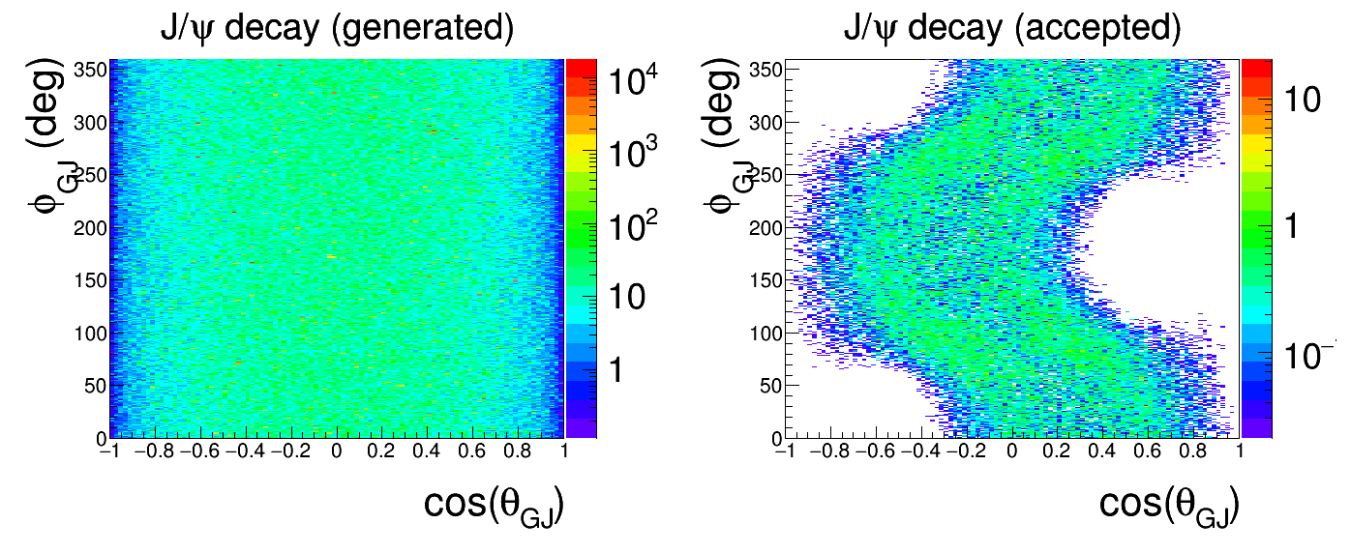
Decay
What we can learn from decay of J/ψ provide about its production?

Slide 16
Summary
JLab 12GeV upgrade and SoLID with high luminosity and large acceptance capability enables unique “precision” measurement near threshold for J/ψ
Search for possible enhancement
Study multiple gluons exchange
Shed light on the low energy J/ψ-nucleon interaction (color Van der Waals force)
Shed light on the trace anomaly, an important piece in the proton mass budget
Non-Perturbative Color Forces in QCD Workshop in Spring 2012 at Temple
http://quarks.temple.edu/~npcfiqcd
Proposal
http://www.jlab.org/exp_prog/proposals/12/PR12-12-006.pdf

Slide 17
backup

Slide 18
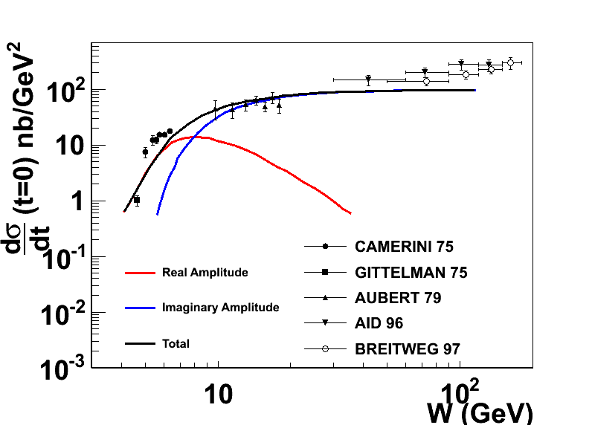
Reaction Mechanism
D. Kharzeev. Quarkonium interactions in QCD, 1995
D. Kharzeev, H. Satz, A. Syamtomov, and G. Zinovjev, Eur.Phys.J., C9:459–462, 1999
Imaginary part is related to the total cross section through optical theorem
Real part contains the conformal (trace) anomaly
Dominate the near threshold region
A measurement near threshold could shed light on the conformal anomaly
Notes:
Add the reference of the figure.

Slide 19
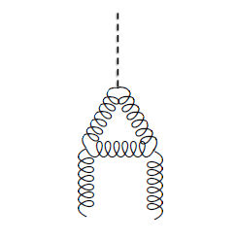
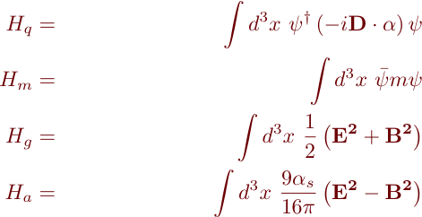
Conformal (Trace) Anomaly
Connecting
Trace of energy momentum tensor
“Beta” function energy evolution of strong
interaction coupling constant
Decomposition of Proton mass [X. Ji PRL 74 1071 (1995)]
CM frame
Quark energy
Trace Anomaly
Quark mass
Gluon Energy
Gluon energy
Quark Energy
Trace anomaly
Sets the scale for the Hadron mass!
Quark Mass
X. Ji PRL 74 1071 (1995)

Slide 20
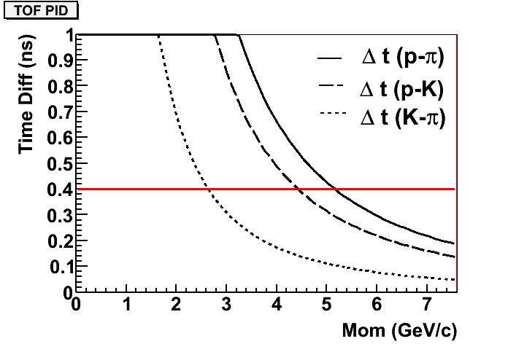
TOF
Recoil p:
100 ps TOF(MRPC): 4 σ separation between p and K up to 4.5 GeV @ forward angle
150 ps TOF(Scint): 4 σ separation between p and K up to 2 GeV @ large angle
SIDIS FA
Jpsi/TCS LA

Slide 21
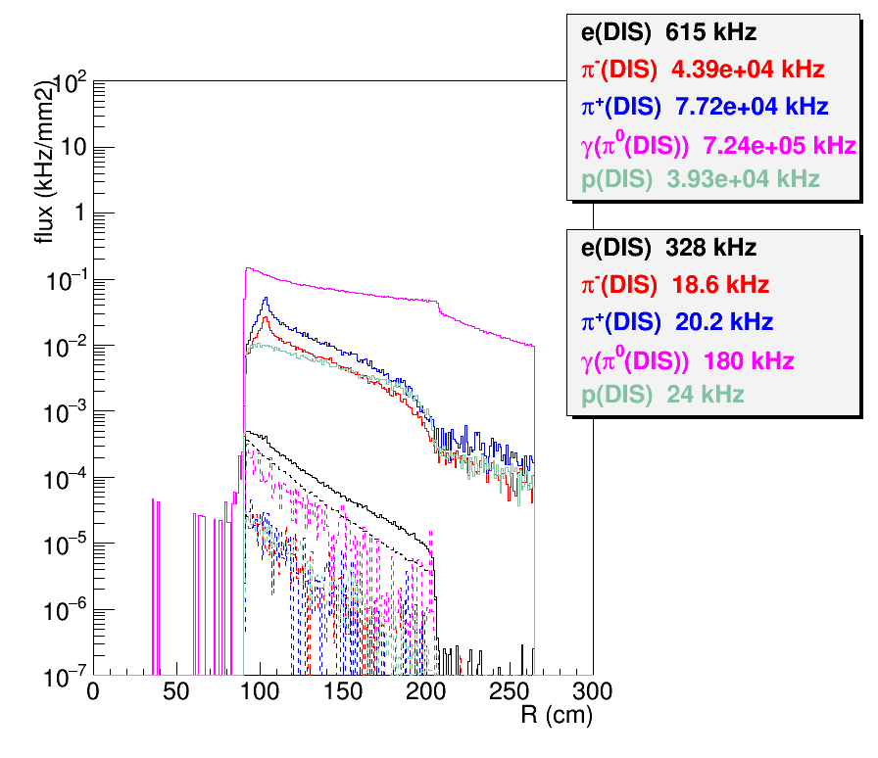
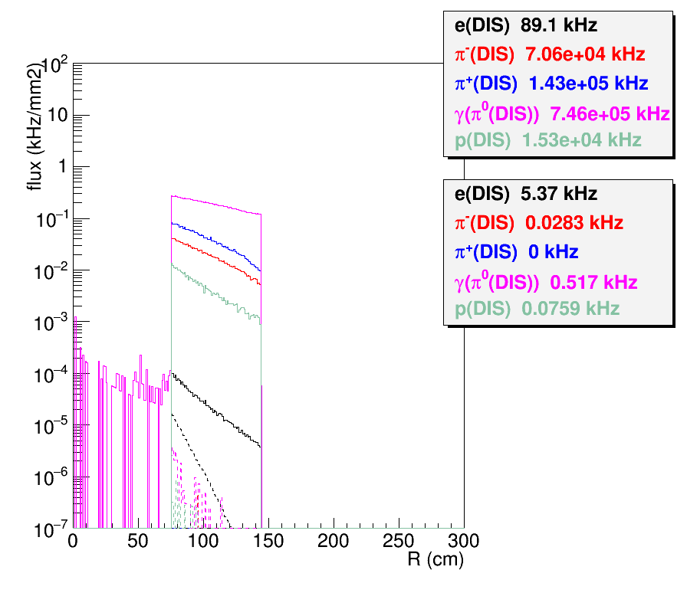
Trigger
Single electron trigger by EC with 2GeV threshold (this preserves decay leptons for both Jpsi and TCS)
Histograms showing rate before and after trigger cut
Done in the way similar to the trigger study for SIDIS_He3
Using SIDIS_He3 EC trigger response for now, but luminosity (1e37/cm2/s) are similar for both and background has no big effect on EC trigger for this level of luminosity)
Single electron trigger is below 1MHz
Coincidence of two electron trigger within 30ns time window is 1e6*1e6*30e-9 = 30kHz
FAEC
LAEC

Slide 22
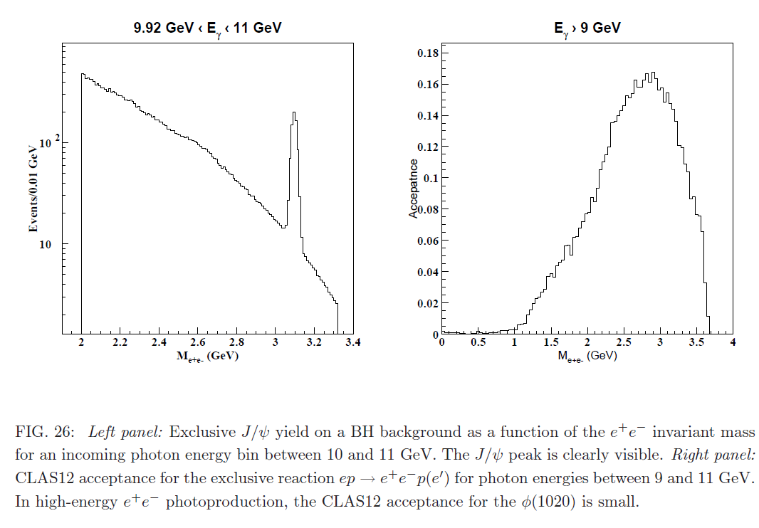
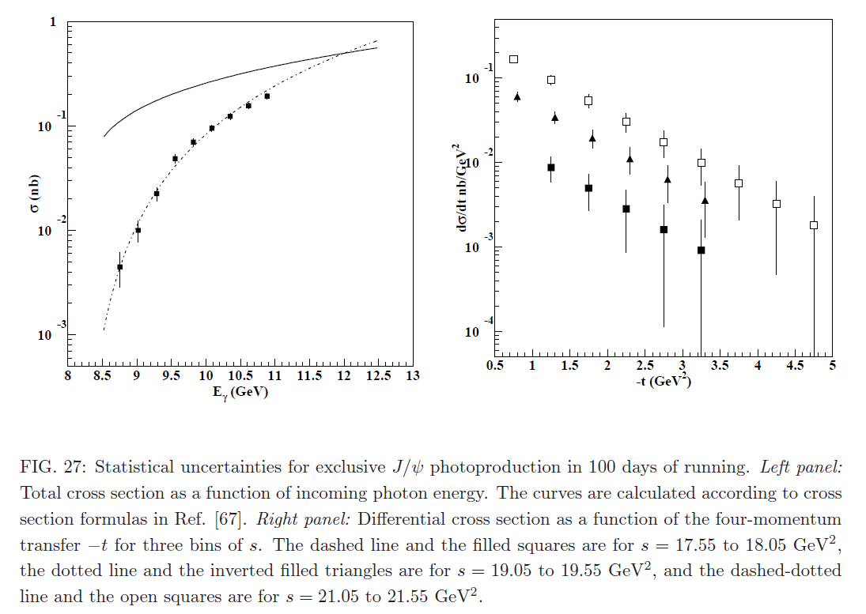
J/ψ @ CLAS12
E12-12-001 approved together with TCS
1e35 /cm2/s Lumi, 120 days on LH2, Single particle trigger
Photoproduction, photon energy not directly measured

