Slide 1
CLAS data and progress in the investigation of electroexcitation of nucleon resonances
A overview of CLAS results in our quest for understanding the nucleus and its excited states

Slide 2
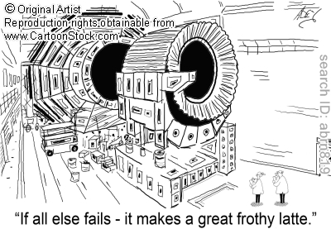
No need for latte, but champagne… CLAS is awesome for the investigation of nucleon resonances and our understanding of nature

Slide 3
A Quest for Understanding Nature
Even as we speak, we need to fully understand:
the essential nature of quark confinement.
the dynamics of quark-gluon interaction at low energy
Challenge:
Understanding the role of quarks and gluon in nuclei
How to address and solve this:
Step into the domain of relativistic quantum field theory where the key phenomena can only be understood with non-perturbative methods

Slide 4
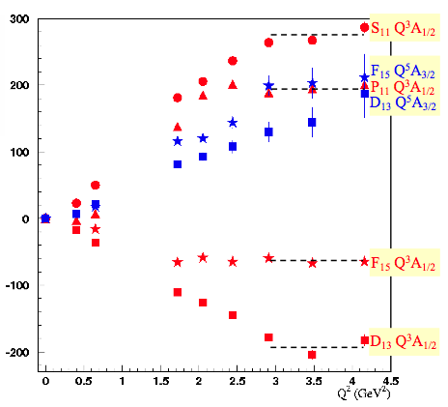
Beyond CQM, pQCD
The structure of the nucleon and its excited states is much more complex than CQM
Constituent Counting Rule tell us what will happen at high Q²
γ
g
g
but pQCD cannot:
produce mass in the chiral limit
explain dynamics of quark-gluon interaction at low energy
explain quark confinement

Slide 5
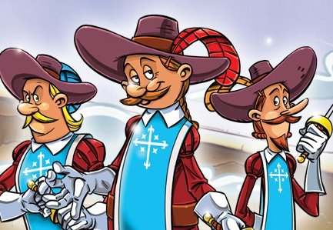
Beyond CQM, pQCD…
The Three Musketeers
Lattice QCD
Dynamical Chiral Symmetry Breaking
Light Cone Sum Rule
Understanding Nature using a non-perturbative approach is now becoming a reality… and measurements of nucleon resonances play a crucial role in all this. CLAS shares are up.

Slide 6
Lattice QCD
JLAB
Carnegie Mellon
Univ. of Maryland
Trinity College (Dublin)
Proton – P11 form factors
New Techniques:
Anisotropic Lattices
3 flavors of quarks
First time: baryon spectra for the excited states
Proton Roper Form Factors
Huey-Wen Lin: radial excitations to calculate form factors, and signal-to-noise extraction
M=578 MeV
M=416 MeV
Notes:
Lattice group at JLAB, Carnegie Mellon, Univ. of Maryland and Trinity College in Dublin: program to compute the high-lying baryon states and form factors.
New type of lattices (dynamical anisotropic lattice formulation and 3 flavor of quarks) are and will be generated using DOE, NSF and USQCD computing resources, including cluster at JLAB.
New techniques allow the calculation of baryon spectra not only in the ground state (proton, roper, S11) but also of the EXCITED states.At large quark mass, the excited states are stable… however as the mass become smaller, one can see decays channels opening up
Left: with mass=578 – right, mass=416. g=positive parity, u=negative parity
H,G are irriducible representation of the so called cubic group in the lattice calculation.
In the calculation on the right: 3 masses: 480 (pink) 720(purple) and 1100 (grey).
At low q2 the unphysical pion masses how large deviation from the experiment. This also might be due to coupling of the meson cloud with the resonances.
However at higher q2 results, given the limitation of these calculation, are promising.
Data are from H.W. Lin calculations that involves for the first time radial excitations in the calculation of the form factors, and a way to extract signal to noise that help the extraction at high Q2. Typical previous lattice calculation are up to 3 GeV.

Slide 7
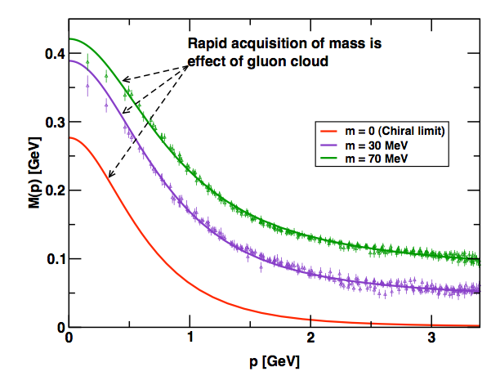
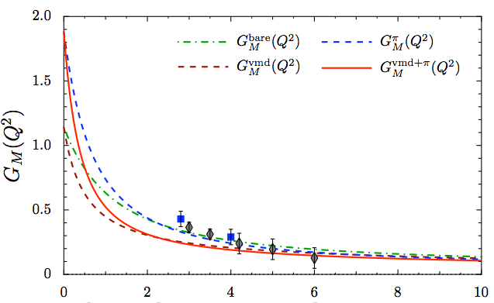
Dynamical Chiral Symmetry Breaking
data: unquenched LQCD
curves: DSE calculation
N → Δ transition form factor
We can use high precision measurement of nucleon-resonance transition form factors to chart the momentum evolution of the dressed-quark mass
Notes:
The framework of DSE is a framework that has marked success on DCSB study and hadron observables… and these guys are just getting started.
An extensive, international study of nucleon electromagnetic form factors has been recently completed by Cloet et al (argonne). In their calculations dressed quarks are the degrees of freedom and correlations are expressed with di-quarks. The diquark current depends on their charge radius.
Here’s the key: we can use high precision measurement of nucleon-resonance transition form factor to chart the momentum evolution of the dressed-quark mass. In particular, the transition between current and constituent quark domains. This is believed to happen between 5-10 GeV2
An example of the role of transition form factor is the N->Delta. The calculation reported here, by Cloet, Bentz and Thomas. The FF lacks significant strength at 0 (its value should be 3) but qualitatively it’s very promising. This calculation is done without the running of the dress quark mass with its momentum. Following this calculation, the framework of the Faddeev equation and the dressed-quark mass variation predicted by the DSE, will be performed.

Slide 8
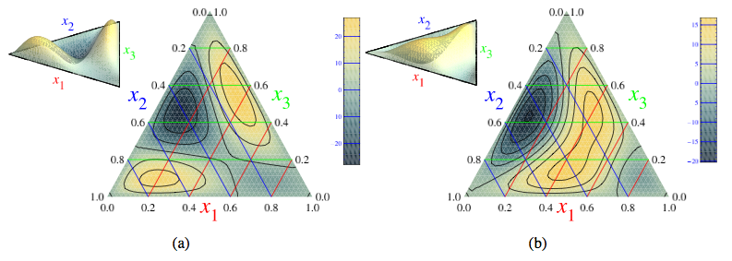
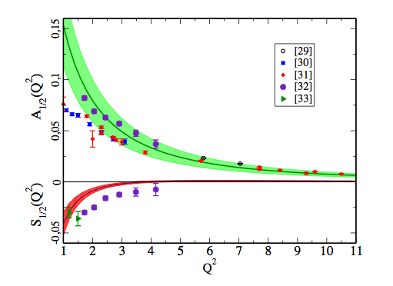
Light Cone Sum Rule
Transition Form Factor ⬅➔ Distribution Amplitudes
DA from Lattice QCD (Warkentin, Braun) :
29, 30: Dalton and Denizli
31: Brasse parameterization
32: Aznauryan analysys of e1-6 CLAS data
Proton
S₁₁
Notes:
One of the prediction of QCD is that the, at large momentum transferred, the form factor become dominated by the contribution of valence states with small transverse separation between them.
Such distributions are dubbed Distribution Amplitudes.
An approach that allows quantitative descriptions of form factor using soft non perturbative contribution is the LCSR.
One of the feature of LCSR that I’d like to emphasize here is the ability of connecting the DA to the transition form factors.
Where can we get the DA? Recent effort from Warkentin, Braun, of Theoretical Groups in Regensburg and others from the QCDSF collaboration calculated the DA for both the proton and the S11.
These are shown in the picture.
One can notice that the momentum fraction of the u quark for example is significantly higher in the S11 than in the proton. The line of constant X1 is parallel to x2.
The pion mass used in this calculation was of the order of the GeV and the calculation was done at the leading order of the DA. The group has plan in the next couple of years to 1) decrease the pion mass for more precise measurement and 2) to make this calculation for all the baryons in the octect and the decuplet.
The transition form factor from P -> S11 is of the form gamma5 Gamma, where Gamma contains the terms A1/2 and S1/2. The LCSR for the S11 form factor have the same functional form of the dirac and pauli form factors of the proton, but with the different DA. The results are shown in the picture.
29, 30: Dalton and Denizli
31: Brasse parameterization
32: Aznauryan analysys of e1-6 CLAS data
33: Old data by Tiator
The band represents uncertainties in the DA (that will be improved with improved calculations) and assumptions in the LCSR (quark hadron duality: quark-gluon degrees of freedom same as hadronic degrees of freedom)
The LCSR expect to converge at Q2>2… here the prediction looks to describe the data reasonably well. As the LQCD results are expected to improve, these results will have to improve – for example, include NLO radiative corrections.

Slide 9
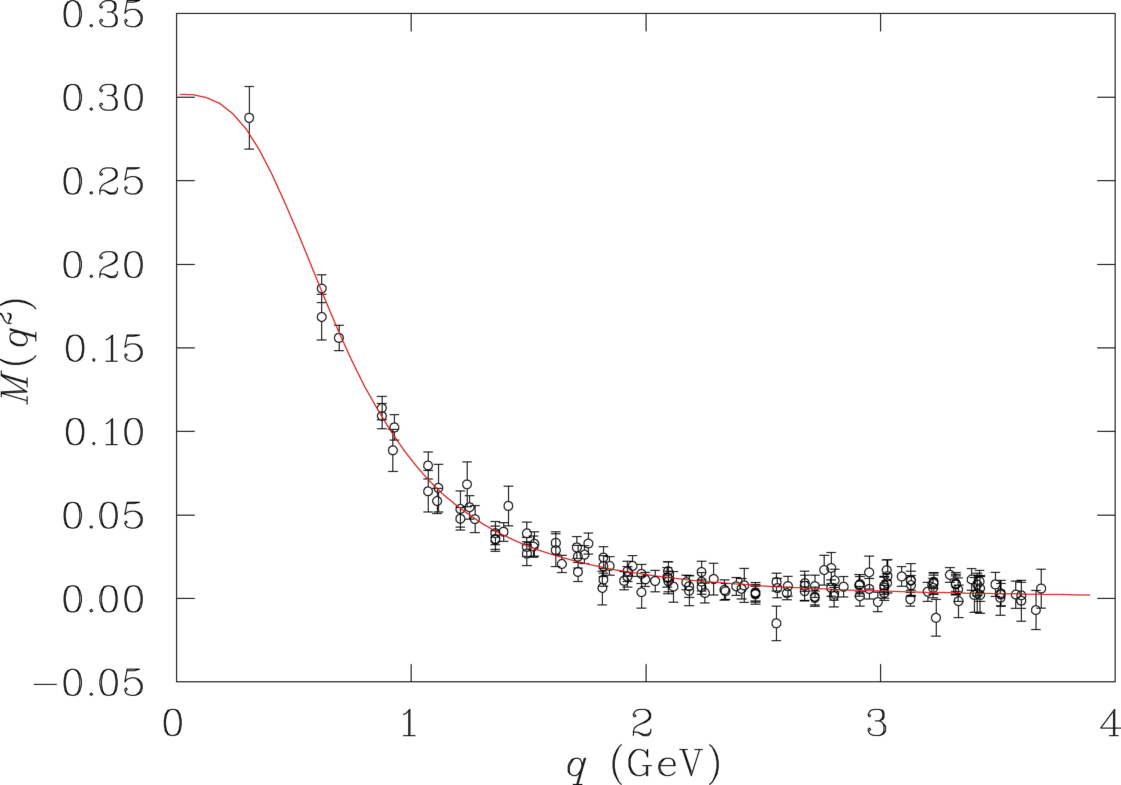
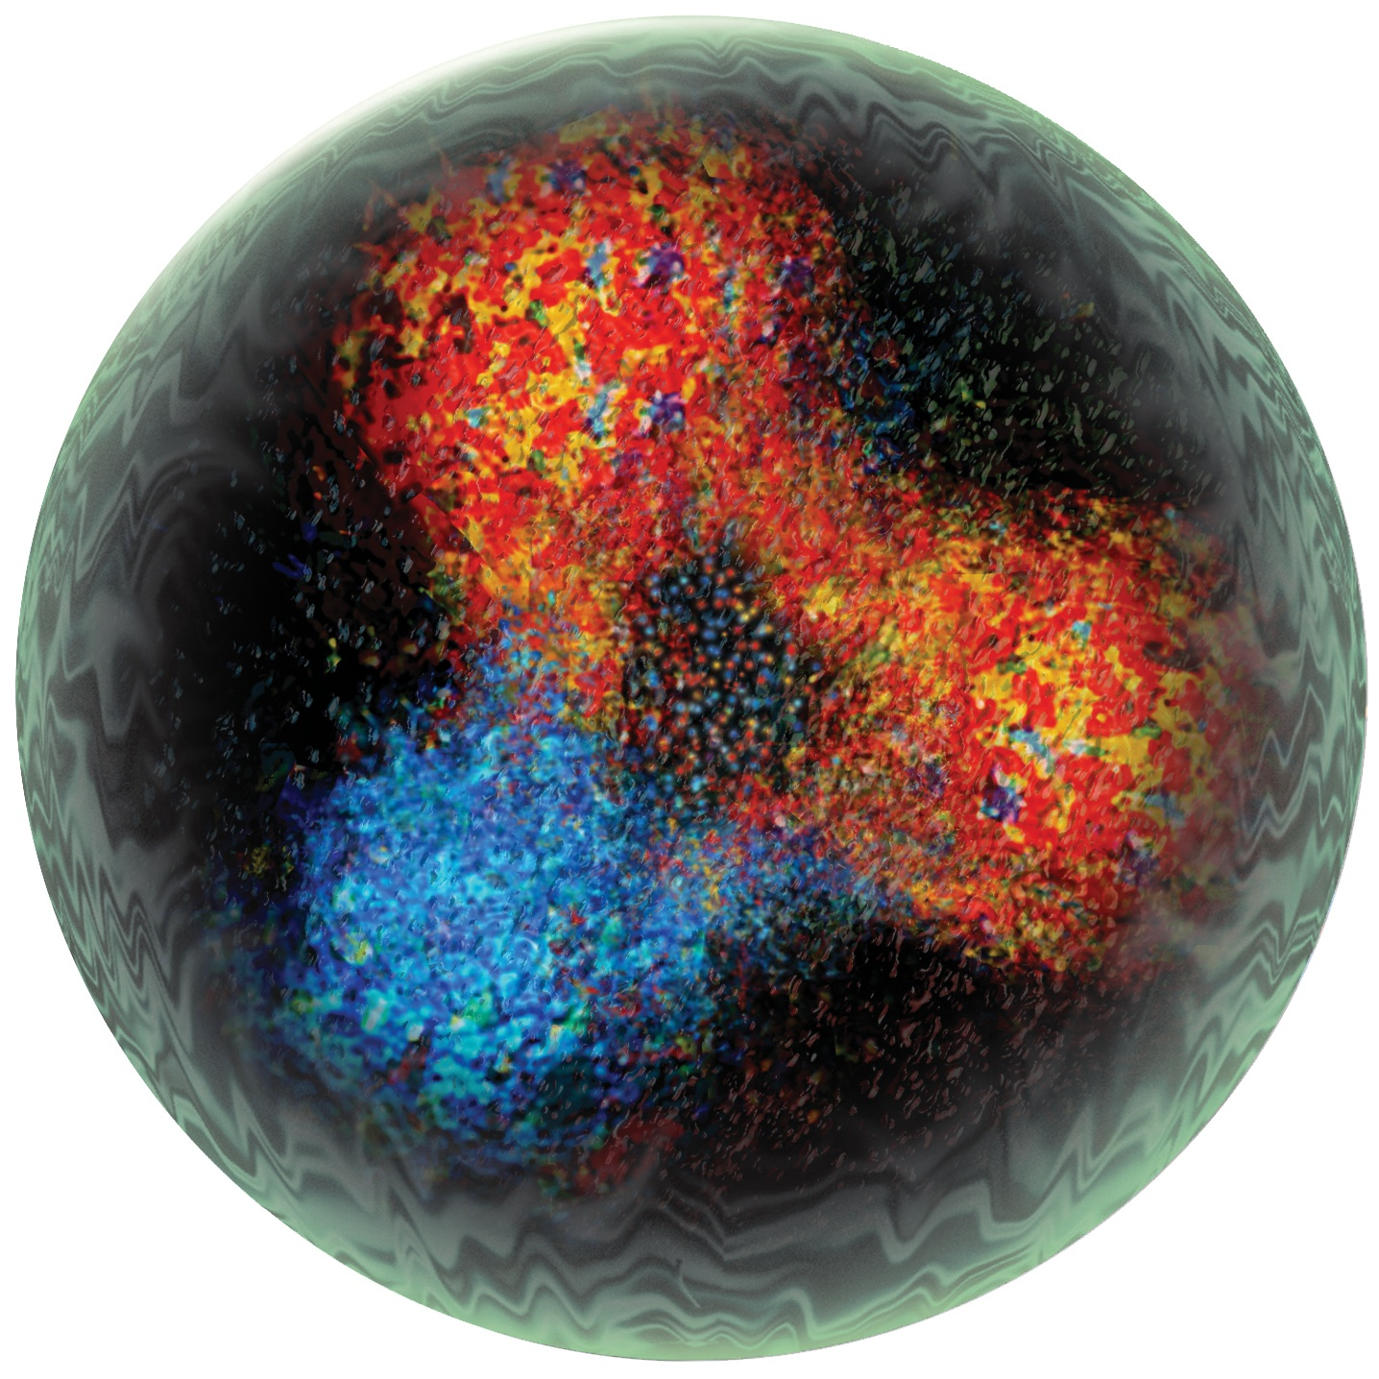
N* Program in CLAS
Map the γNN* electrocouplings as a function of photon virtuality with a combined analysis of electroproduction channels
Access active degrees of freedom at various distances
Explore the non-perturbative strong interactions responsible for nucleon formation and the origin of quark confinement
Investigate the origin of 98% of nucleon mass through DCSB
Notes:
With the 3 muskeeteer toolsjust presented…
This investigation , to have a clear picture

Slide 10
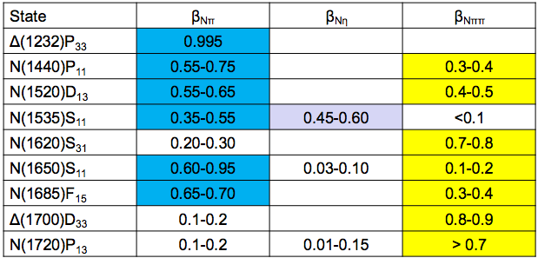
N* Program in CLAS
Map the γNN* electrocouplings as a function of photon virtuality with the combined analysis of the major electroproduction channels
Several channels with entirely different non-resonant amplitudes allow reliable determination of electrocouplings
Notes:
Notice overlap!
Overlap between Npi Neta and npi pi allow safe extraction of electrocouplings: the

Slide 11
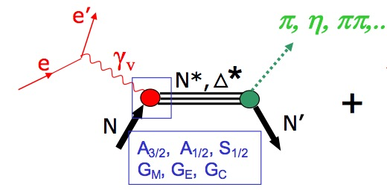
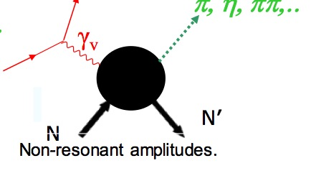
Analysis Tools
Single pseudoscalar meson production, e.g. Nπ, Nη
Unitary isobar model (UIM)
non-resonant amplitudes incorporate nucleon and meson Born terms, vector meson exchanges, Regge terms at high energy
resonant terms incorporate relativistic BW amplitude with energy-dependent widths
full amplitude unitarized in K-matrix approximation
Fixed-t dispersion relations (DR)
resonance amplitudes constructed in same way as in UIM
non-resonant amplitudes from Born terms and dispersion relation.
Double pion channels, e.g. pπ⁺π⁻
Isobar model (JM)
Includes leading contributions as observed in the data. Fit to 9 single-dimensional projections diff. cross sections.

Slide 12
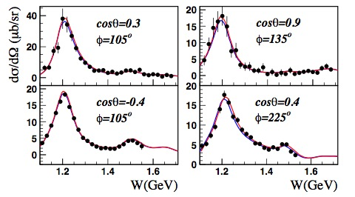
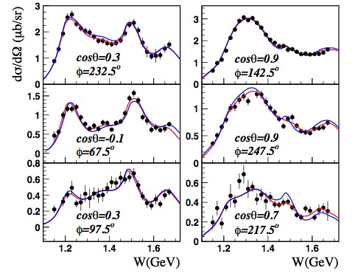
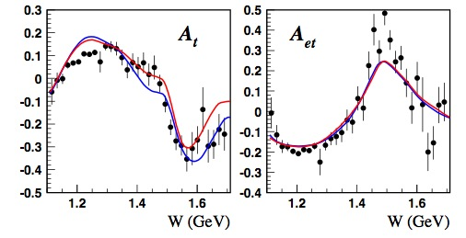
Examples of Fits To Single Meson Cross Sections
π⁺
π⁰
π⁺
π⁰
Q²=1.7, 2.4, 3.5 GeV²
Q²=~0.4 GeV²

Slide 13
CLAS Single Meson Data
nπ⁺: Q² > 1.7 GeV²
nπ⁺ & pπ⁰: Q² < 0.65 GeV²
pπ⁰: Q² > 0.75 GeV²

Slide 14
Single Meson Results
Delta
Roper
D₁₃(1520)
S₁₁(1535)
Transverse Charge Densities

Slide 15
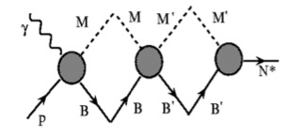
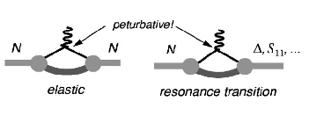
N → Δ Transition Form Factor
Meson-Baryon Dressing:
Dynamical Reaction Models show huge contribution of pion cloud to Magnetic Form Factor
CLAS
Hall A
Hall C
MAMI
Pion
cloud
QM
Pascalutsa,
Vanderhaeghen
Sato, Lee
Pascalutza: Large N_{C} links N to Delta to the e.m. properties of the nucleon!
N→Δ GPD H_{M} is related to isovector elastic GPD E(x,ξ, t)
Notes:
The N-Delta transition amplitudes have been measured up to Q2=6 GeV2 (here I’m not including the latest Hall-C result of 7 gev, which anyway follow same trend).
The magnetic form factor, which in the Constituent counting rule should scale as 1/Q4, continues to to drop faster with Q^2 than the elastic magnetic f.f. We expect GM* to start scaling at around 10 GeV2 (SLAC)
Pascalutza calculation: large NC relations link the N to Delta transition to in terms of the electromagnetic properties of the nucleon: GM can be expressed as a function of the nucleon form factors! And so are REM and RSM
Large N_{C} limit: N→Δ GPD H_{M} is related to isovector elastic GPD E(x,ξ, t)
On the right, the same data in linear scale, based on DSE calculation, w/o the running of the dress quark mass – which will be the next stem in Cloetz (Argonne), Bentz and Thomas calculation.

Slide 16
N → Δ Transition Form Factor
Meson-Baryon Dressing:
Dynamical Reaction Models show huge contribution of pion cloud to Magnetic Form Factor
Same data in linear scale, based on DSE calculation, w/o the running of the dress quark mass (next step in Cloetz Bentz and Thomas calculation)
Pascalutza: Large N_{C} links N to Delta to the e.m. properties of the nucleon!
N→Δ GPD H_{M} is related to isovector elastic GPD E(x,ξ, t)
Notes:
On the right, the same data in linear scale, based on DSE calculation, w/o the running of the dress quark mass – which will be the next stem in Cloetz (Argonne), Bentz and Thomas calculation.

Slide 17
N → Δ Transition Form Factor
CLAS
Hall A
Hall C
MAMI
Pascalutsa,
Vanderhaeghen
Sato, Lee
0.2
6.0
No sign for onset of asymptotic behavior, R_{EM}→+100%, R_{SM}→ const.
R_{EM} remains negative and small, R_{SM} becoming more negative with Q².
Meson-baryon contributions needed to describe multipoles.
LQCD shows same trend as data but discrepancies for R_{SM} at low Q²
Notes:
The electric quadrupole ratio E/M remains small and negative at -2%, while asymptotically +100% is expected both in pQCD and holographic QCD. S/M also remains negative and increases in magnitude. hQCD predicts -100% for this ratio. A description of these transition amplitudes requires the inclusion of meson-baryon contributions either in effective field theory or in dynamical models.
Blue curves: large NC limit

Slide 18
The Roper Resonance
I. Aznauryan et al., Phys.Rev.C78:045209,2008
Sign change of A_{1/2} observed in both channels at same Q²
Magnitudes of A_{1/2} and S_{1/2} consistent in the two channels.
High Q² behavior consistent with radial excitation of nucleon.
Rules out the Roper as a gluonic excitation
Meson, non resonant contributions necessary at low Q²?
Notes:
For the first time transition amplitudes for the Roper resonance have been extracted for the Roper resonance.
The transverse amplitude becomes positive and large, at Q^2=2GeV2 exceeding the value at the photon point. This behavior has been observed both in single pion and 2-pion production. The transverse amplitude becomes positive and large, at Q2=2 exceeding the value at the photon point. The sign change has been observed for both channels. The longitudinal amplitude drops smoothly with Q2. Both amplitudes are qualitatively consistent with LC quark models. However, meson contributions or non resonant maybe are required at low Q2 to explain behavior quantitatively.
First sign change of a nucleon transition amplitude, seen in
both Nπ and Nππ electro-production analysis.
Consistent with radial excitation of the nucleon in LCQM.
Excludes hybrid baryon assignment for the Roper
Shows sensitivity of transition amplitudes to the nucleon structure

Slide 19
D₁₃(1520) Transition Amplitudes
First data set that allows determination of S_{1/2}(Q²)
Very Accurate result for the Transverse Amplitudes
Clear evidence of helicity switch from helicity=3/2
dominance at Q²=0 to helicity=1/2 dominance at
high Q²
(A_{1/2})²- (A_{3/2})²
A_{hel}=
(A_{1/2})²+(A_{3/2})²
Notes:
The D13 as a spin 3/2 state has 3 transition amplitudes. The 3/2 amplitude is dominant at the photon point, but drops rapidly with Q2. We see a switch to ½ dominance at Q2>1GeV2. While quark models describe the features qualitatively, there is a discrepancy in the magnitude of A3/2. This might be related to the importance of meson contributions.
Curves:
Dashed: hypercentric quark model (Giannini)
solid:
Warns Schroder Phys C 45 (1990)

Slide 20
S₁₁(1535) Transition Amplitudes
CLAS pη
LC SR
CLAS nπ+
LCQM
HallC pη
Analysis of pη channel assumes S_{1/2}=0
Branching ratios: β_{Nπ} = β_{Nη} = 0.45
QCD based LQCD and LCSR
(Regensburg University) reproduce trend at Q²>2GeV²
A_{1/2} (Q²) from Nπ and pη are consistent
First extraction of S_{1/2}(Q²) amplitude.

Slide 21
Transverse Charge Densities: Roper
L. Tiator, D. Drechsel, S.S. Kamalov, M. Vanderhaeghen, 2008
Charge Density
Transverse charge densities are calculated from the transition form factors as seen from a light front moving toward the baryon.
The transition of p→N⁺(1440)P₁₁
in LF helicity +1/2 → +1/2
is dominated by up quarks in a central region of radius ~0.4 fm, and by down quarks in an outer band up to ~0.8 fm.
Light: positive
Dark: negative

Slide 22
Transverse Charge Densities: D₁₃
L. Tiator, D. Drechsel, S.S. Kamalov, M. Vanderhaeghen, 2008
P
transition dominated by d-quarks in radius 0.5 fm in center, and by u-quarks in region up to 1.3 fm.
proton and N(1520)D₁₃ polarized along x-axis with opposite spin projections, nearly full quark flavor separation.

Slide 23
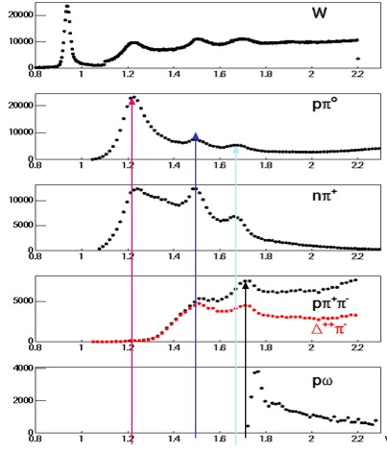
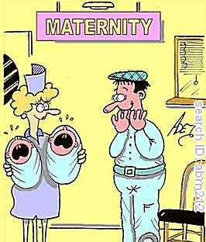
Double Meson Production
CLAS Data, Q²<4 GeV²

Slide 24
Double Meson Production
CLAS Data, Q²<4 GeV²
single, double meson channels are the main players in the resonance region: sensitive to almost all excited proton states
The combined analysis of Nπ, Nππ data is key in the entire N* program
Notice that structure in π⁺ channel absent in π⁰

Slide 25
JLAB-MSU meson baryon model for Nππ electroproduction
Channels included:
γ
π
all N*s with πΔ decays
Reggeized Born Terms
additional πΔ Contact Term
π
Δ⁺⁺⁽⁰⁾
P
P
π⁻
all N*s with ρP decays and 3/2+(1720)
candidate
Diffractive Ansatz for non-resonant part
ρ line shrinkage in N* region
γ
ρ
π⁺
P
P
Notes:
delta term is additional to born term

Slide 26
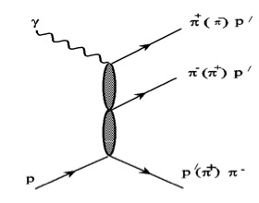
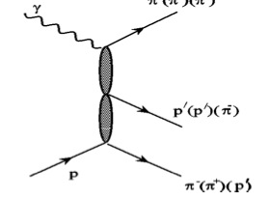
JLAB-MSU meson baryon model for Nππ electroproduction
Channels included:
γ
π
D13, F15, P33(1640)
π
Ν∗
P
P
π
Direct 2 pion production
(required by Unitarity and confirmed
by CLAS Pππ data)
γ
Notes:
creation of pi pi state w/o creation of unstable hadron in intermidiate state

Slide 27
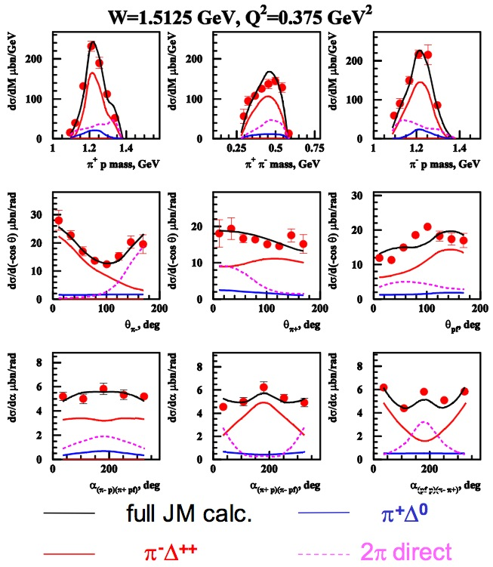
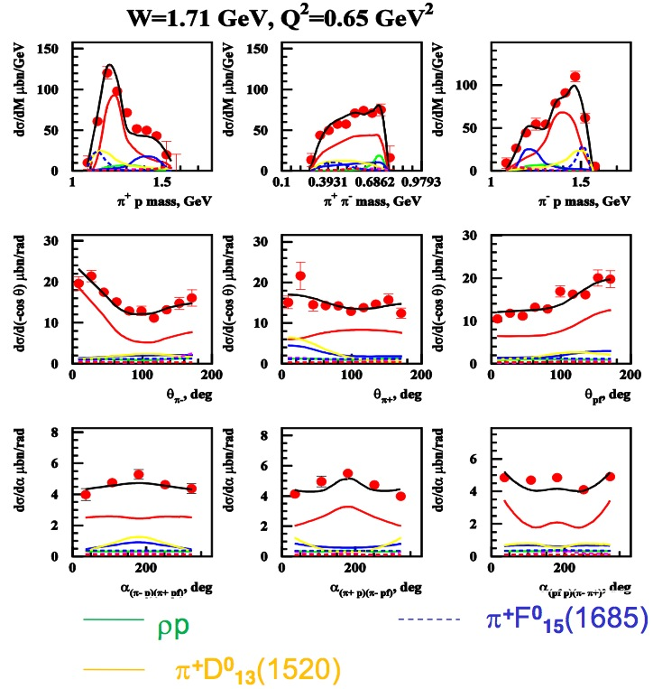
Pπ⁺π⁻ Production
Fedotov, PRC 79 (2009)
Ripani, PRL 91 (2003)
Notes:
various prod. mechanism has very different shape of cs in different observables
on other hand any given mechanism show different manifestation in various observable
combined analysis of all observable give us access to all relevant mechanism

Slide 28
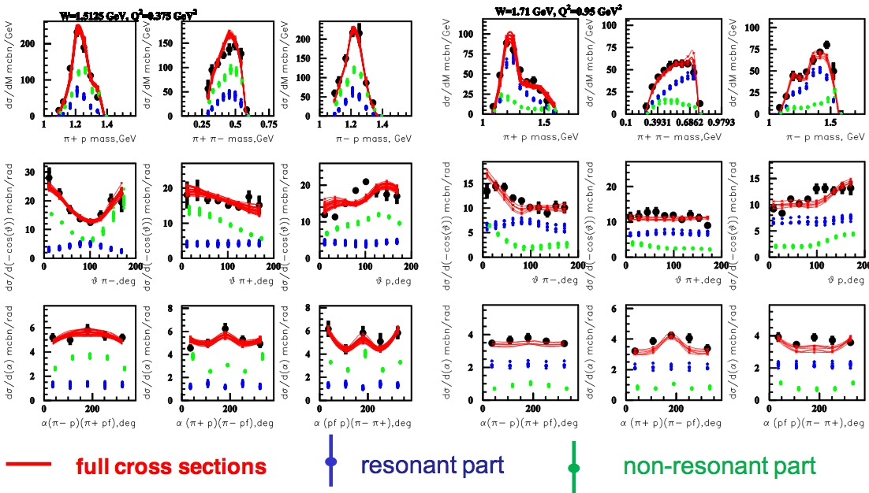
Resonant, non-resonant parts of Nππ
V. Mokeev
Notes:
"best" calculated cross section with minimal chi^2/d.p., but bunch of calculated cross sections closest to the data and calculated varying resonant and non-resonant parameters combined.
shave of cs is very different in res, non – res allow to separate
separation is Unambigous isolation of res non res: the errors on res, non res are comparible with the data error. If there was ambiguity, there would be bigger error
fundamental in determining the non resonant contribution to CS

Slide 29
Helicity amplitudes from Pπ⁺π⁻
Δ(1700)D₃₃
Obtain the first consistent results for Δ(1700)D₃₃ transition form factors.
First measurement of transition form factors
for N(1720)P₁₃.
N(1720)P₁₃
New data for Q² up to 5 GeV² under analysis.
Notes:
high lying resonance states really need 2 pion channels, data in progress extracted from ripani data, using the latest JM model
may substantially affect other channels with lower cross section (lambda k, sigma k)

Slide 30
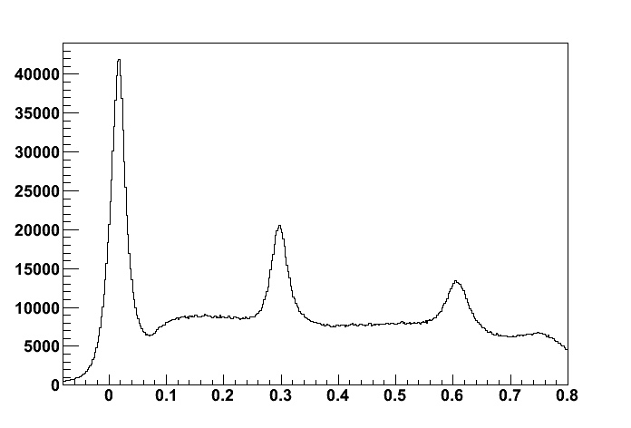
Coming Soon: π⁰, η
π⁰
η
eP missing mass² [GeV²]
Notes:
may asubstantially affect other channels with lower cross section (lambda k, sigma k)

Slide 31
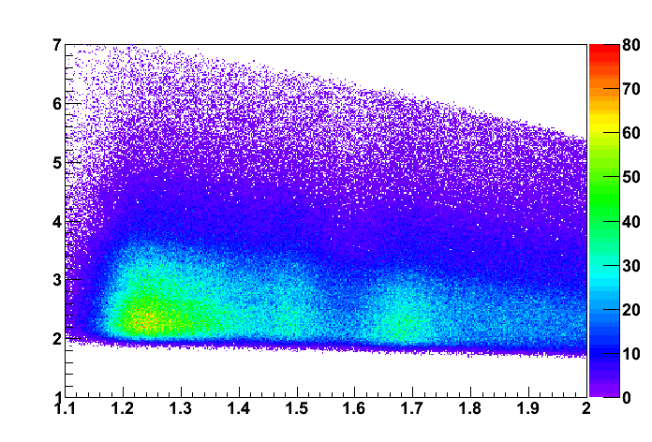
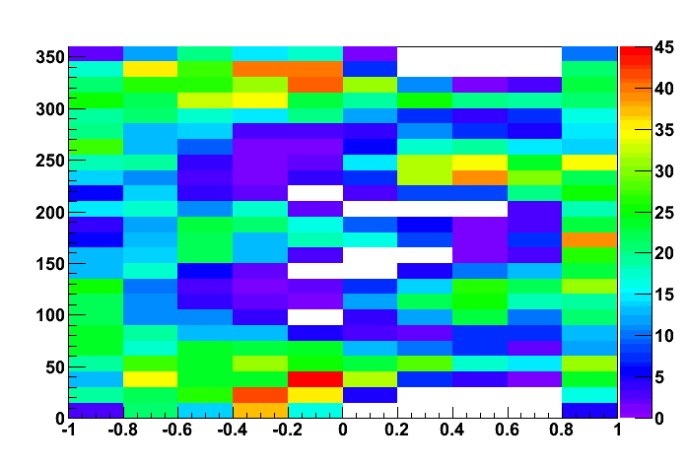
Coming Soon: π⁰, η
π⁰
W=1.59 Q²=3.5
Q² [GeV²]
W [GeV]
45 bins in W, ΔW=20 MeV
7 bins in Q² DQ²/Q² ~ 0.18
10 bins in cos(θ*)
24, 48, 96 bins in φ*
Total: 75600 CS points
Notes:
may asubstantially affect other channels with lower cross section (lambda k, sigma k)

Slide 32
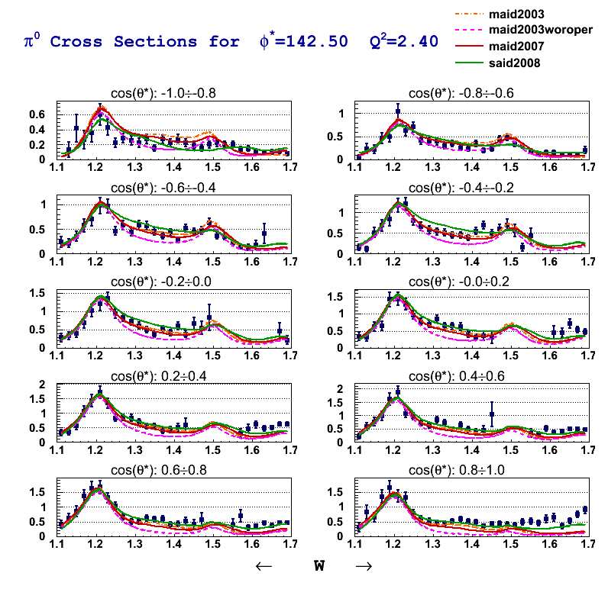
Coming Soon: π⁰, η
350 points
out of 75K
Notes:
may asubstantially affect other channels with lower cross section (lambda k, sigma k)

Slide 33
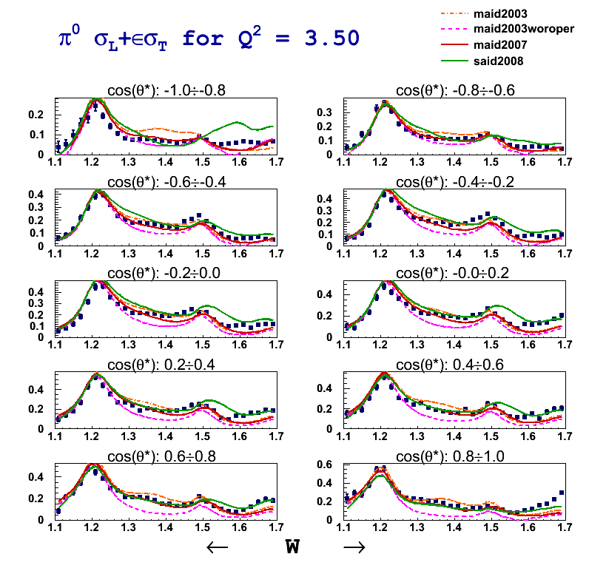
Coming Soon: π⁰, η
dσ/dΩ∗ = σ_{T} + εσ_{L} + εσ_{TT}cos2φ + √2ε(ε+1)σ_{LT}cosφ
Notes:
may asubstantially affect other channels with lower cross section (lambda k, sigma k)

Slide 34
Summary
CLAS provided (and will provide) high definition pictures of the nucleon.
The combined analysis of single and double meson channels is key to the N* program
Reliable, new tools are developed for the extraction of resonance parameters (UIM, DR, JM)
Advance program (EBAC) will also provide theoretical interpretation
Maping the γNN* electrocouplings as a function of photon virtuality will:
Access active degrees of freedom at various distances
Explore the non-perturbative strong interactions responsible for nucleon formation and the origin of quark confinement
Investigate the origin of 98% of nucleon mass through DCSB

