Slide 1

Thomas Jefferson National Accelerator Facility November 18-20 2014
Data analysis techniques in meson photoproduction
Annalisa D’ANGELO
University of Rome “Tor Vergata” and INFN Rome Tor Vergata

Slide 2
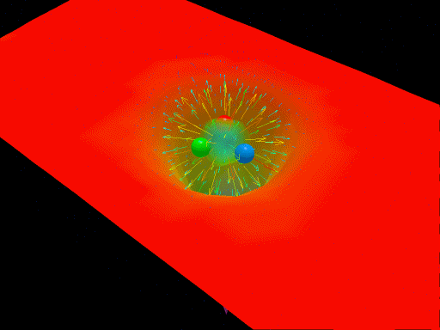
Baryon Spectroscopy
reveals the workings of QCD

Slide 3
Why do we study N*’s?
“Nucleons are the stuff of which our world is made. As such they must be at the center of any discussion of why the world we actually experience has the character it does. I am convinced that completing this chapter in the history of science is one of the most interesting and fruitful areas of physics for at least the next 30 years. “ Nathan Isgur, NStar2000, Newport News, Virginia.
Only now do we have experimental, phenomenological, and theoretical tools to fully explore baryon spectrum and structure.
The N* spectrum reflects the underlying degrees of freedom and the effective forces between them.
Baryon-meson
system
Notes:
… One of the experimental tool we employ is the study of the N* spectrum as a reflection of the underlying degrees of freedom, some of which are shown by these cartoons representing constituent quarks in a bag, held together by gluon strings that my also get excited and generate hybrid baryons, quarks model with di-quark clustering, and states generated dynamically by meson-baryon interaction. These configuration result in variations of the excitation spectrum which we study with hadron or electromagnetic beams. The second line of research is to measure the strength of resonance excitations versus the space-time resolution of the probe to see how the strength of the effective degrees of freedom change with the distance scale. Beyond these mostly experimental aspects, there has been significant progress in the theory sector , e.g. predictions from LQCD of the spectrum, the Dyson-Schwinger equations of QCD, holographic QCD, and others.

Slide 4
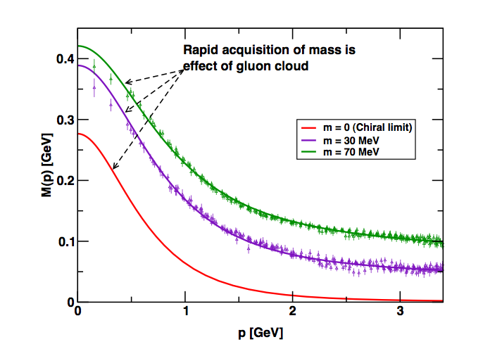
Motivation
Understanding the working of QCD: hadronic degrees of freedom.
Connection between constituent and current quarks
numerical simulations
of unquenched lattice QCD
(Bowman et al.)
Dyson-Swinger equation
(Bhagwat et al.)
Current-quarks of perturbative QCD evolve into constituent quarks at low momentum
Notes:
The main motivation is understanding the working of QCD: how do we

Slide 5
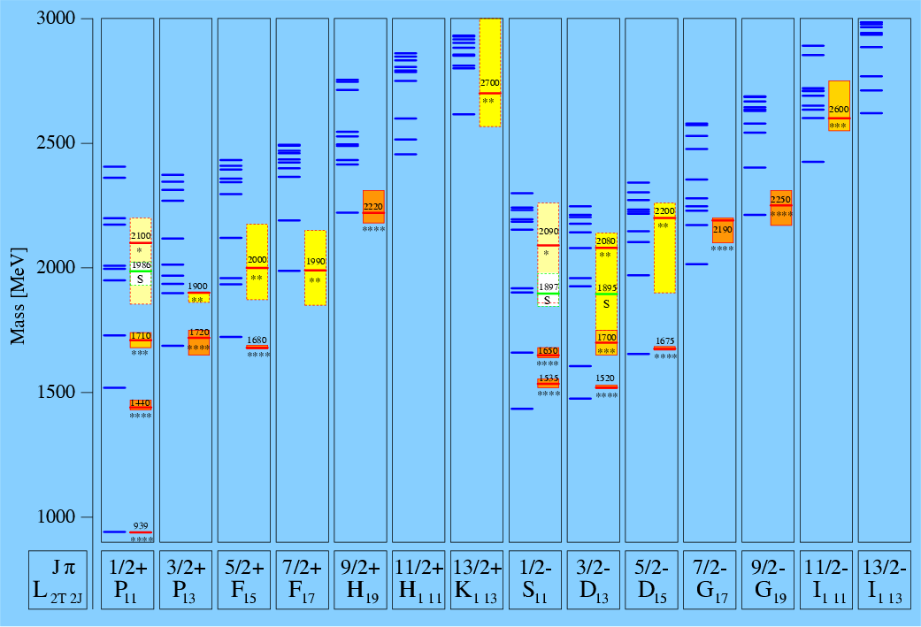
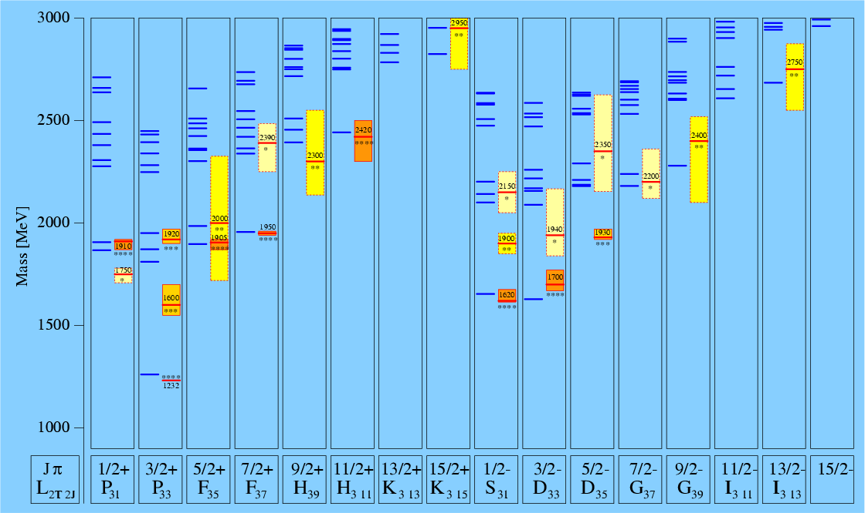
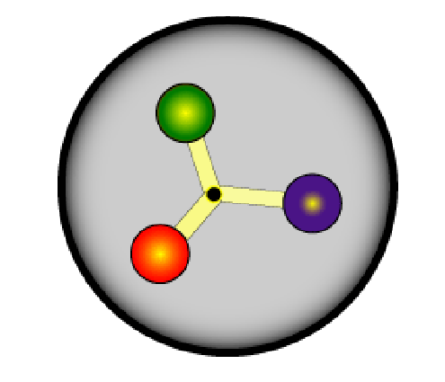
Nucleon model states (π N couplings)
QCD-inspired
Constituent Quark Models
States classified by isospin, parity and spin within each oscillator band.
Thick segments:
theoretical
predictions
N*
Shaded boxes:
experimental
results
Δ
U. L¨oring, B. Metsch, H. Petry, Eur. Phys. J. A 10, 395 (2001).

Slide 6
Nucleon model states (π N couplings)
QCD-inspired
Constituent Quark Models
Findings:
Linear Regge trajectories
Only lowest few in each band seen with 4★ or 3★ status
g(πN) couplings predicted to decrease rapidly with mass in each oscillator band
Higher levels predicted to have larger couplings to KΛ, KΣ, ππN, …
N*
Δ
U. L¨oring, B. Metsch, H. Petry, Eur. Phys. J. A 10, 395 (2001).

Slide 7
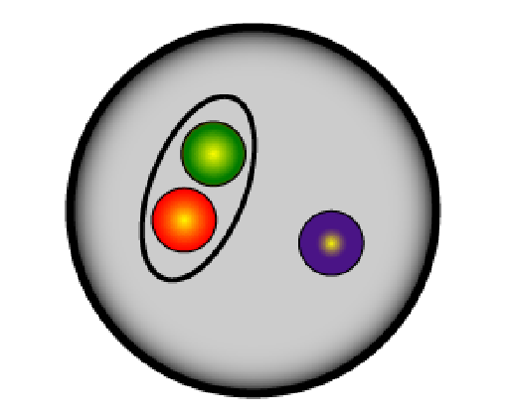
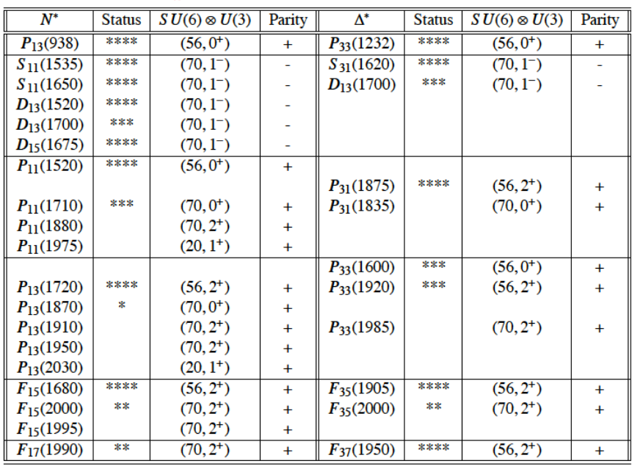
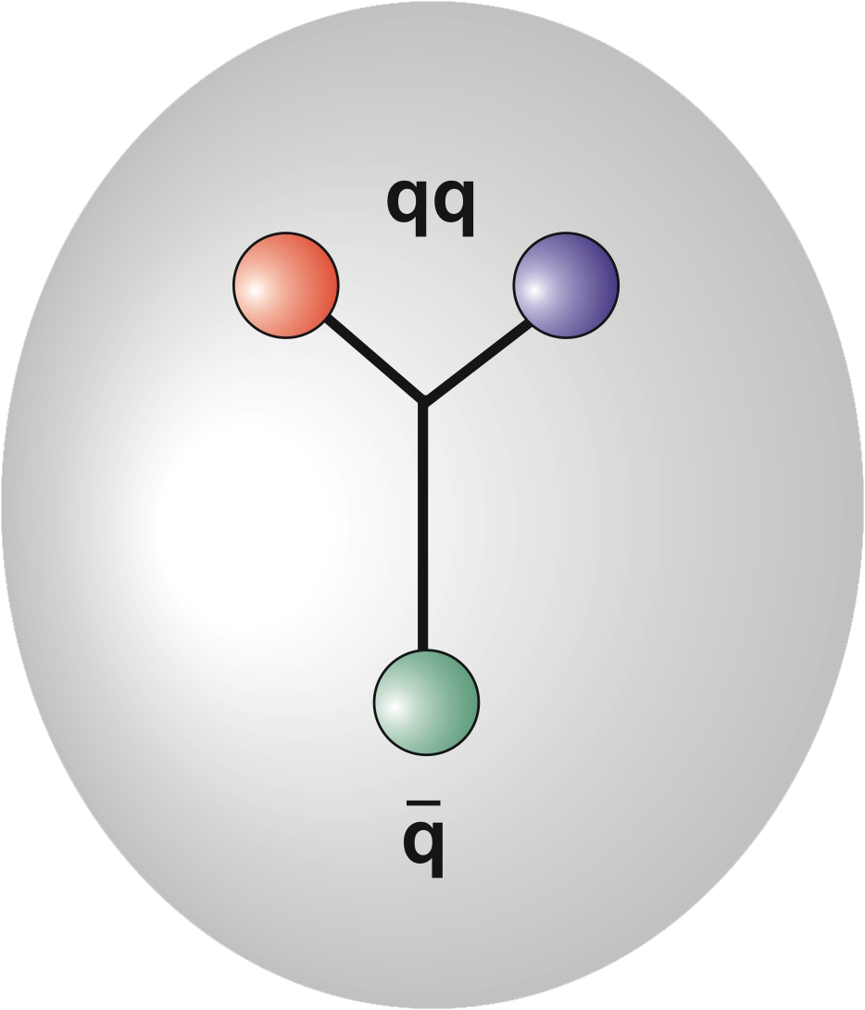
QCD-inspired di-Quark Models
3
q
3
2 quarks in nucleon assumed to be quasi-bound in a color isotriplet; diquark-quark is a net color isosinglet.
all possible internal di-quark excitations ⇔ full spectrum of CQM
the challenge: ⇔ unravel the N* spectrum
internal di-quark excitations are frozen out (spin 0; isospin 0) ⇔ large reduction in the number of degrees of freedom ⇔ predicts less N* states than seen in πN

Slide 8
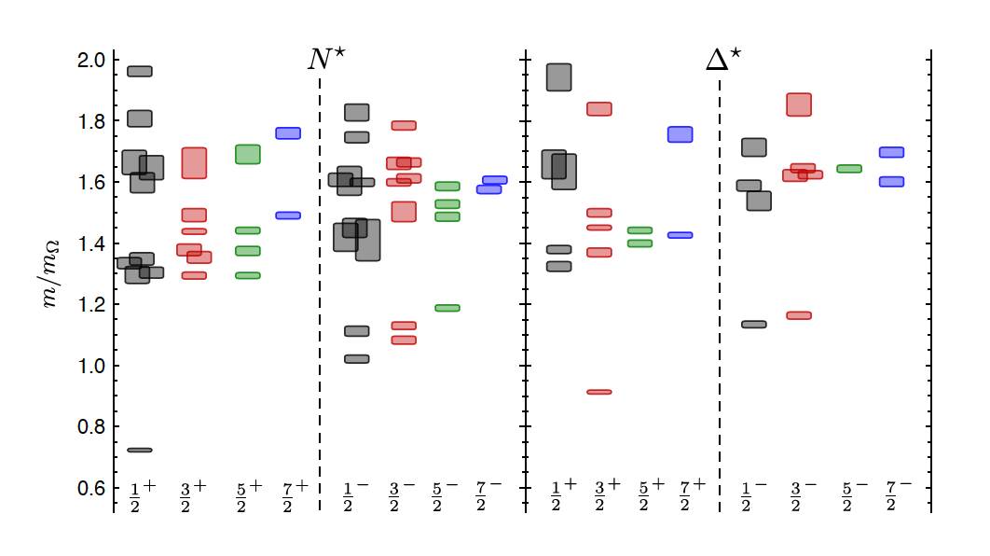
Excited Baryons from L QCD
Exhibits the SU(6)×O(3)-symmetry
features
Counting of levels consistent with non-rel. quark model
Striking similarity
with quark model
No parity doubling
m_{π}=396 MeV
4
5
3
1
2
3
2
1
1
1
2
2
1
Δ(1232)
N(938)
Robert G. Edwards, Jozef J. Dudek, David G. Richards, Stephen J. Wallace Phys.Rev. D84 (2011) 074508
Problems are not solved!
Notes:
As This fundamental problem is unique in physics history: the elementary excitation of the theory are not those of the degrees of freedom accessible directly by the experiment.
In the absence of direct QCD prediction the excited states of the nucleon have been predicted by constituent quark models but

Slide 9
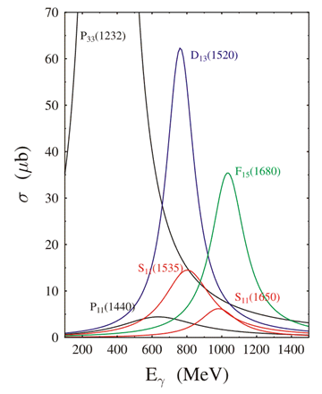
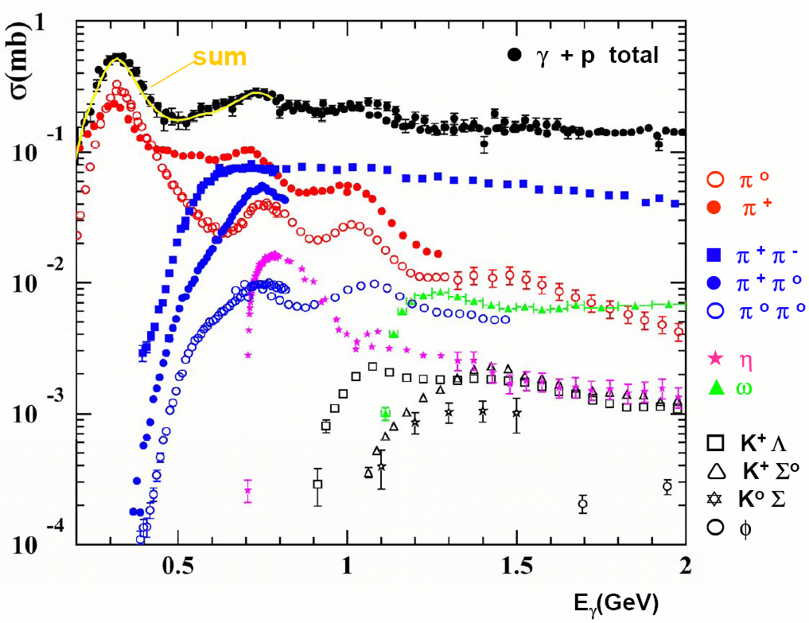
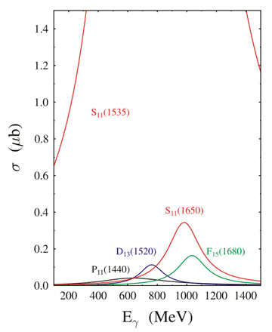
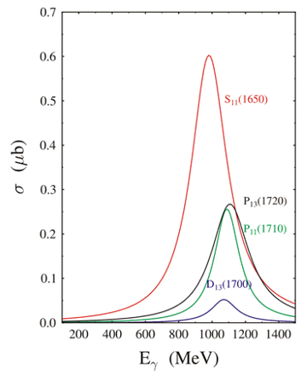
Photonucleon cross sections
Notes:
In the

Slide 10
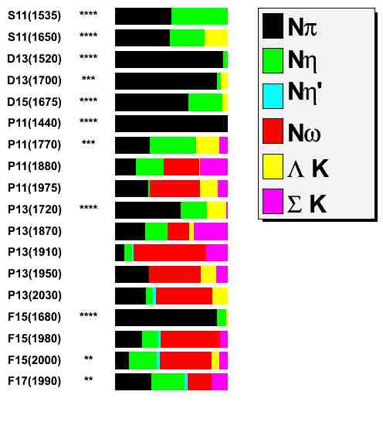
search all channels: not just πN
(1/2)⁻
(1/2)⁻
(3/2)⁻
(3/2)⁻
(5/2)⁻
(1/2)⁺
(1/2)⁺
(1/2)⁺
(1/2)⁺
(3/2)⁺
(3/2)⁺
(3/2)⁺
(3/2)⁺
(3/2)⁺
(5/2)⁺
(5/2)⁺
(5/2)⁺
(7/2)⁺
Nπ
Nη
Nη
Nω
ΛK
ΣK

Slide 11
Search for new N* and Δ* states
Precision measurements of photo-induced processes in wide kinematics, e.g. γp→πN, ηp, KY, .., γn→πN, K⁰Y⁰, ..
Polarization observables are essential
More complex reactions, e.g. γp → ωp, pφ, ππp, ηπN, K*Y, .. may be sensitive to high mass states through direct transition to ground state or through cascade decays
QCD
LQCD
N*, Δ*
Models
- I.G. Aznauryan, et al. (White Paper), Int. J. Mod. Phys. E, 22, 1330015 (2013)
- V. Crede, W. Roberts, arXiv:1302.7299 (2013)
- I.G. Aznauryan, V. D. Burkert, Prog. Part. Nucl. Phys. 67, 1 (2012)
- L. Tiator, D. Drechsel, S. Kamalov, M. Vanderhaeghen,
Eur. Phys. J. ST198 (2011)
- E. Klempt, J.M. Richard, Rev. Mod. Phys. 82, 1095 (2010)
Reaction
Theory
Amplitude
analysis
ANL-Osaka
Bonn-Gatchina
Engagement of groups to extract physics in theoretically sound analyses is essential.
Data
Hadronic
production
Electromagnetic
production
By Volker Burkert

Slide 12
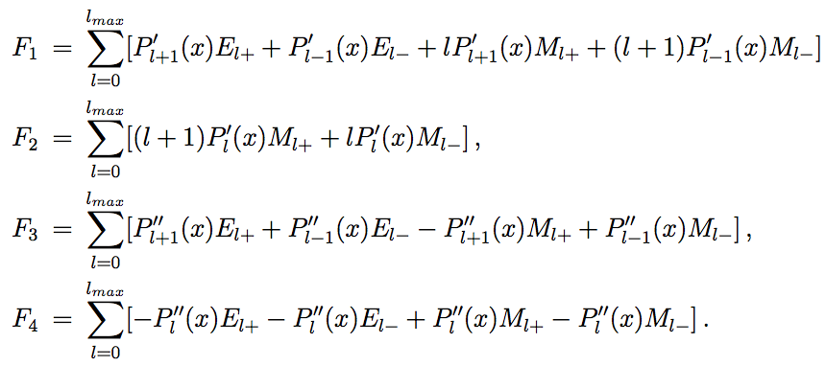
Complete experiments in pseudoscalar meson photoproduction
Spin states
2 x 2 x 2
8 possible spin states → 4 independent complex amplitudes
describe the transition matrix
CGLN amplitudes in terms of Pauli matrixes:
are conveniently expanded into multipoles

Slide 13
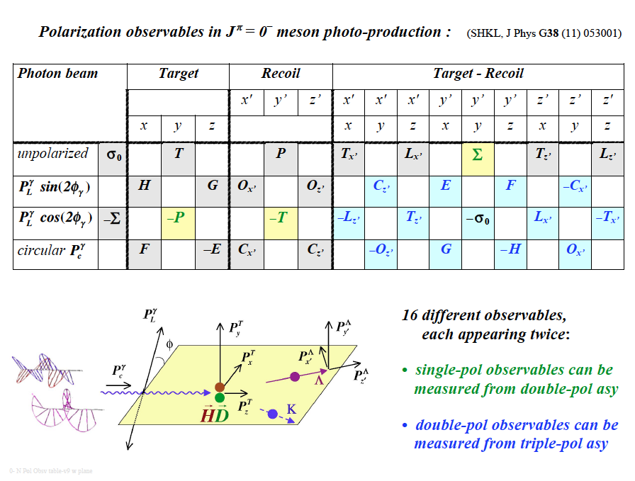
A. Sandorfi, S. Hoblit, H. Kamano, T.-S.H. Lee, J.Phys. 38 (2011) 053001
(Over)complete experiments
Notes:
As This fundamental problem is unique in physics history: the elementary excitation of the theory are not those of the degrees of freedom accessible directly by the experiment.
In the absence of direct QCD prediction the excited states of the nucleon have been predicted by constituent quark models but

Slide 14
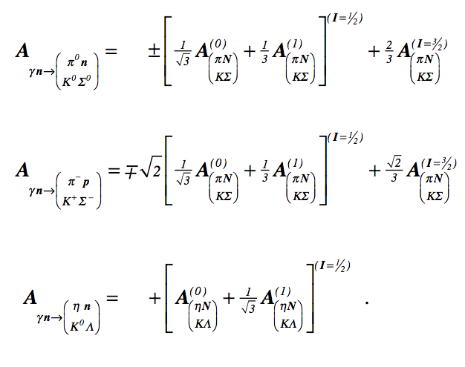
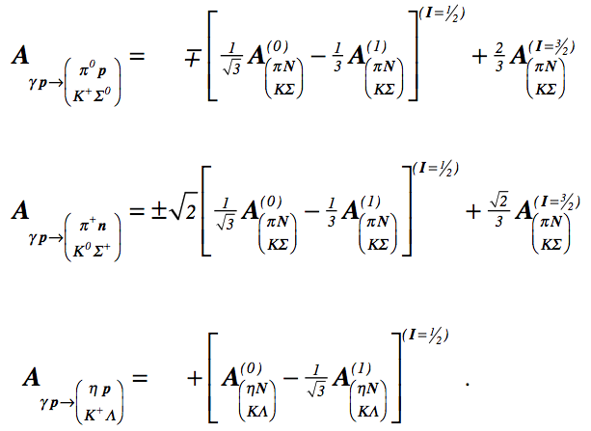
Isospin dependence of reaction amplitudes in pseudoscalar meson photoproduction
A⁰ and A¹ are the components results from coupling of I=1/2 with isoscalar and isovector components of the photon.
Their contributions appear in linear combinations that may be disentangled only by measurements on both the neutron and the proton.
I. S. Barker, A. Donnachie, J. K. Storrow, Nucl. Phys. B95, 347 (1975).

Slide 15
Experimental Requirements
    Tagged and polarized photon beam
    Large acceptance detector
    H and D polarized targets
Modern experiments are
constructed to meet all above requirements:
GRAAL CLAS in Hall-B
Eγ = ( 500 - 1500 )MeV Eγ = ( 500 - 6000 )MeV
BGO-OD&Crystal Barrel@BONN Crystal Ball@MAINZ
Eγ = ( 500 - 3000 )MeV Eγ = ( 100 - 1500 )MeV

Slide 16
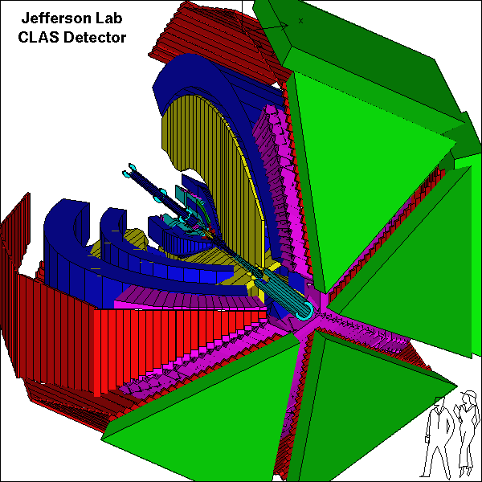
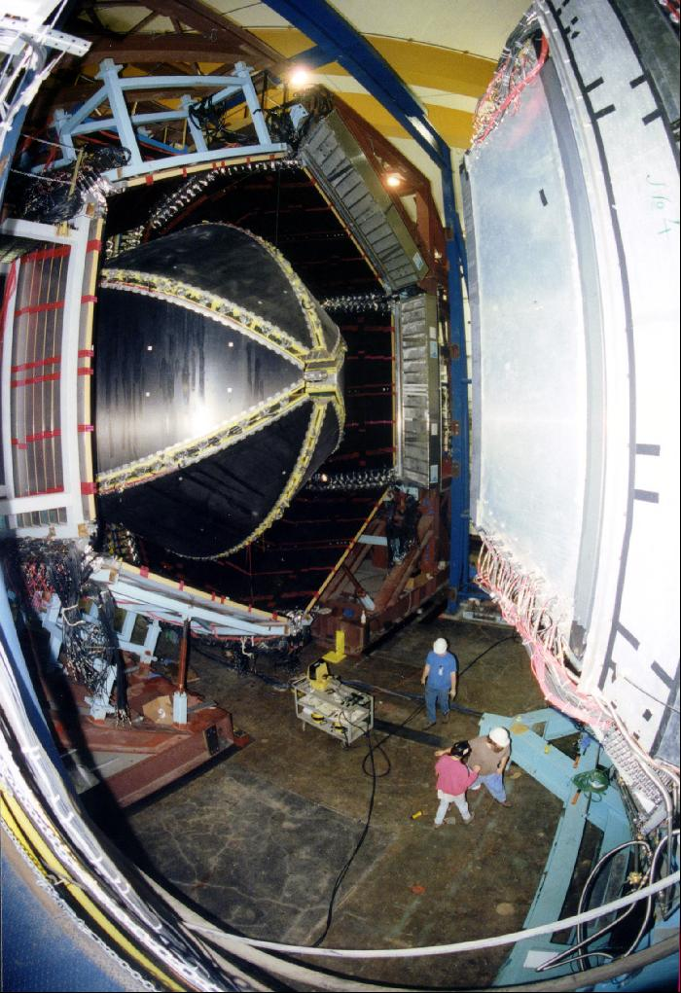
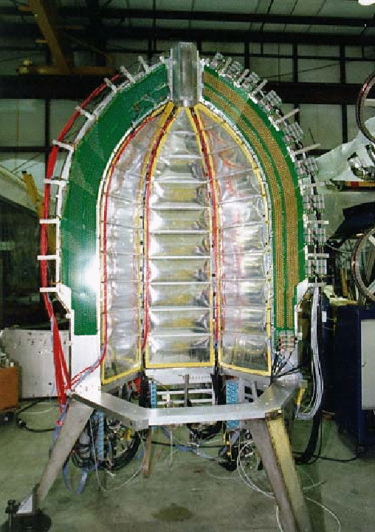
CEBAF Large Acceptance Spectrometer
Torus magnet
6 superconducting coils
Electromagnetic calorimeters
Lead/scintillator, 1296 photomultipliers
target + start counter
Drift chambers
35,000 cells
Time-of-flight counters
plastic scintillators, 684 photomultipliers
Gas Cherenkov counters
e/π separation, 256 PMTs

Slide 17
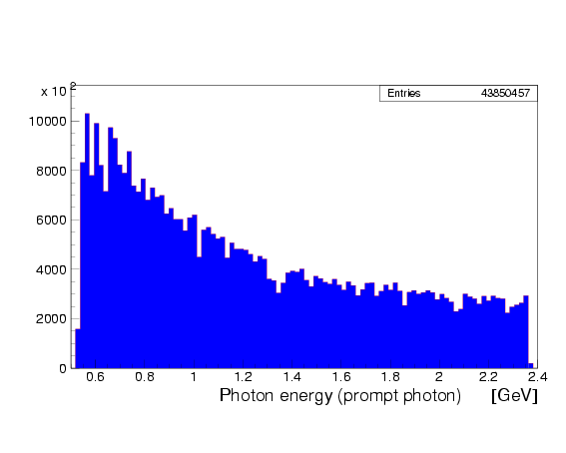
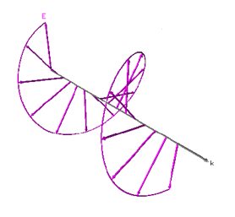
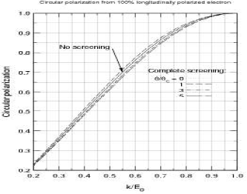
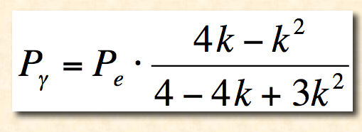
Circularly polarized photons
Circular polarization from 100% polarized electron beam
Circularly polarized beam produced by longitudinally polarized electrons
CEBAF electron beam polarization >85%
tagged flux ~ 50 - 100MHz for k>0.5 E₀
Circular polarization

Slide 18
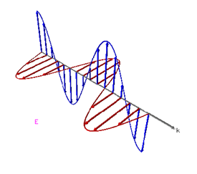
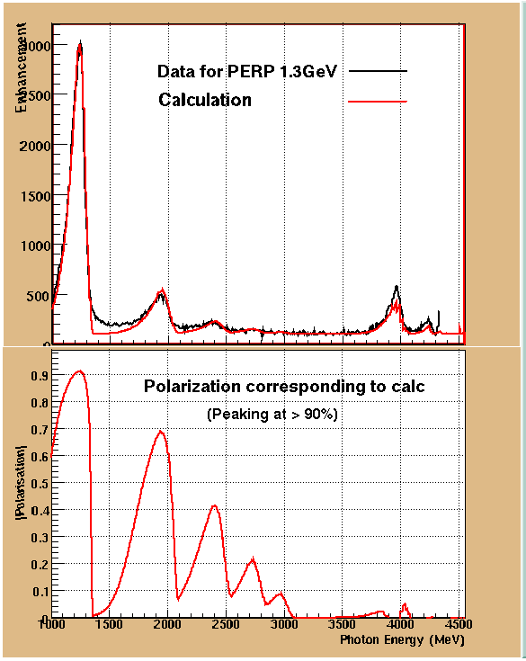
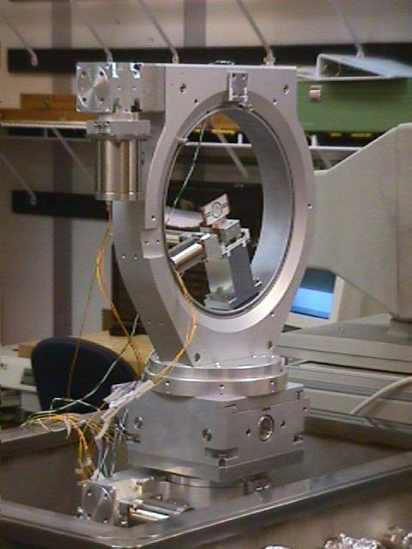
Linearly polarized photons
Linearly polarized photons: coherent bremsstrahlung on oriented diamond crystal

Slide 19
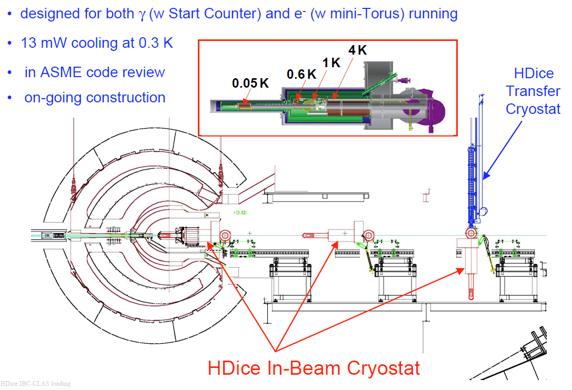
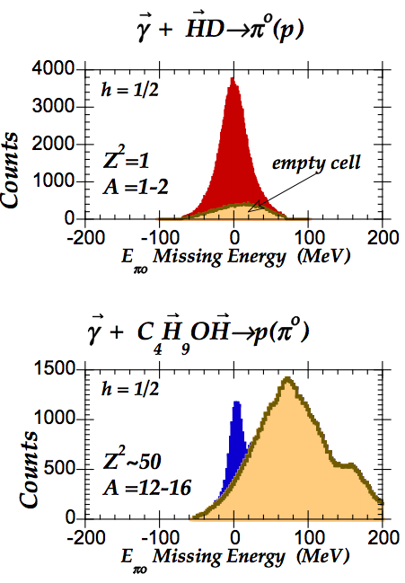
HDIce polarized target
HDIce Solid Deuterium-Hydride (HD) – a new class of polarized target
Spin can be moved between H and D with RF transitions
All material can be polarized with almost no background

Slide 20
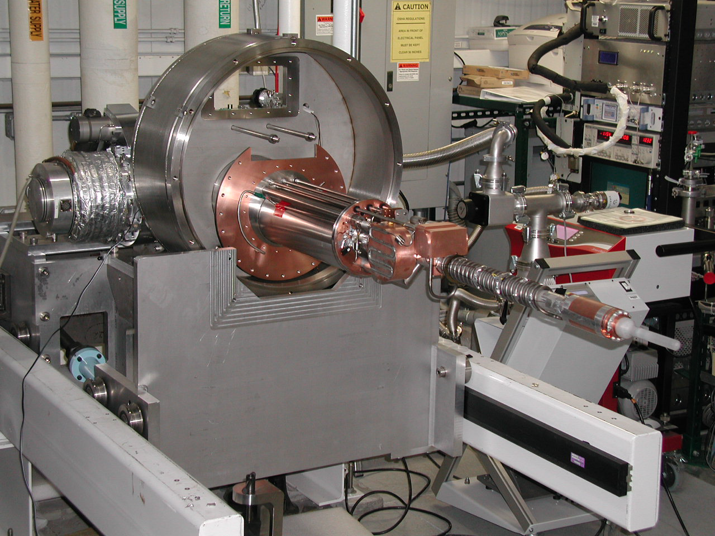
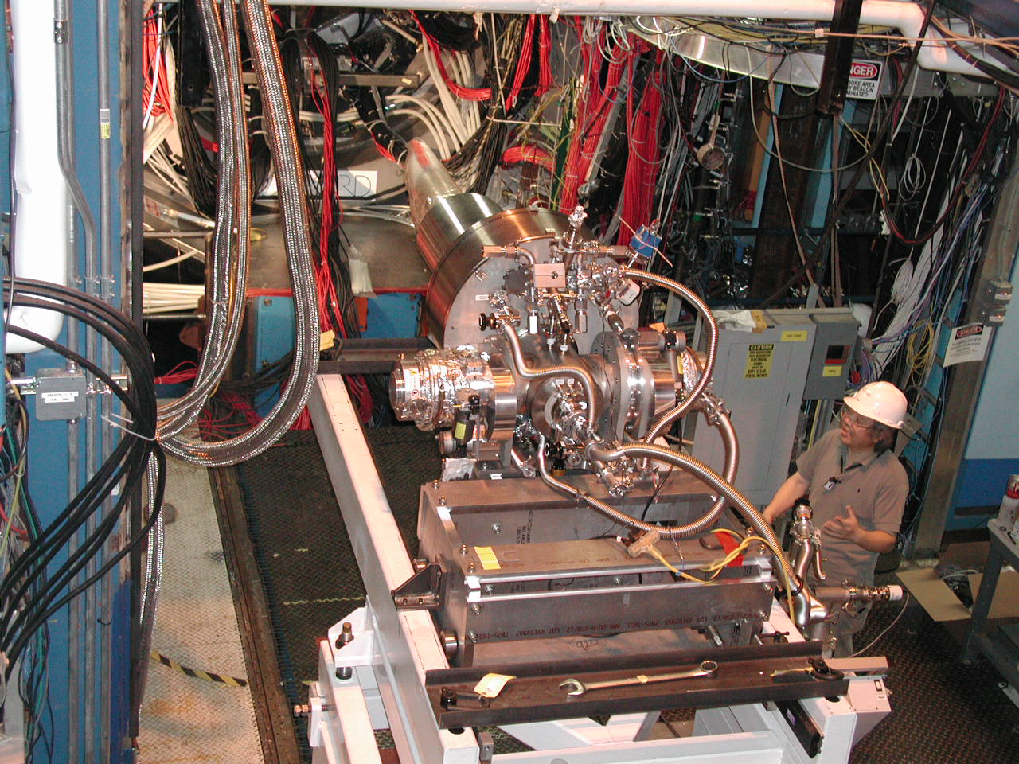
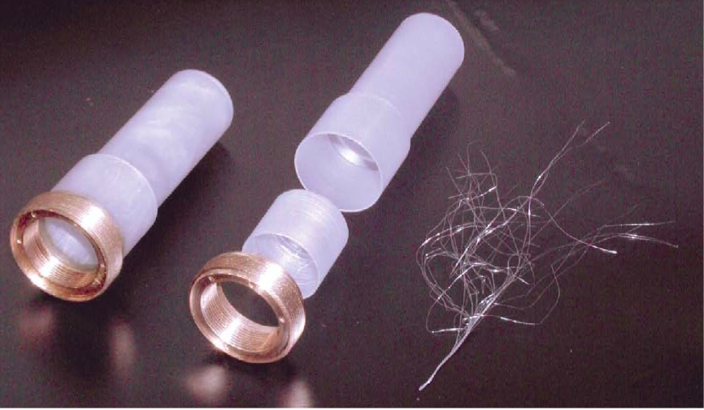
HD-Ice
Longitudinal and Transverse Polarizations: > 60%
Relaxation time: > 1 year
Polarization procedure ≈ 3 months
Data taking: ≈ months
Very complicated target transfer technology.

Slide 21
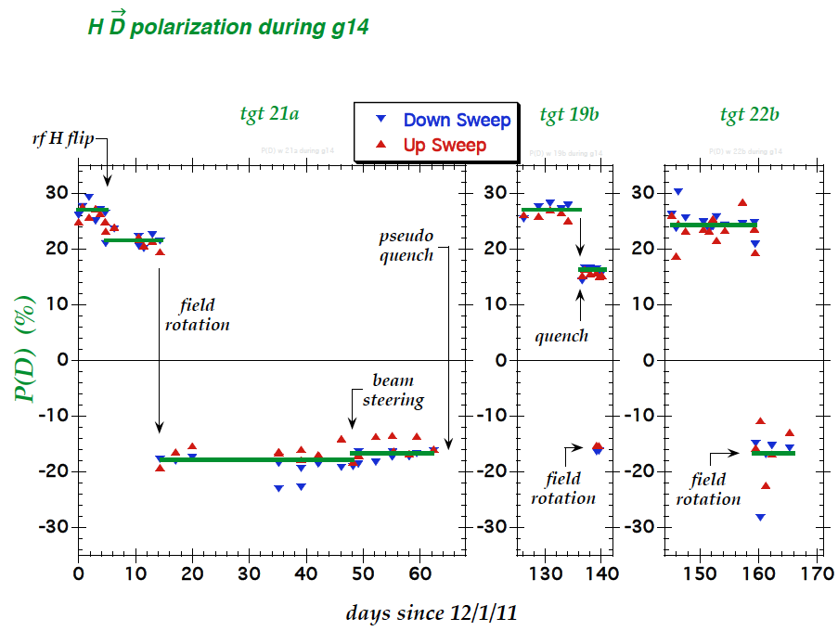
HD-Ice

Slide 22
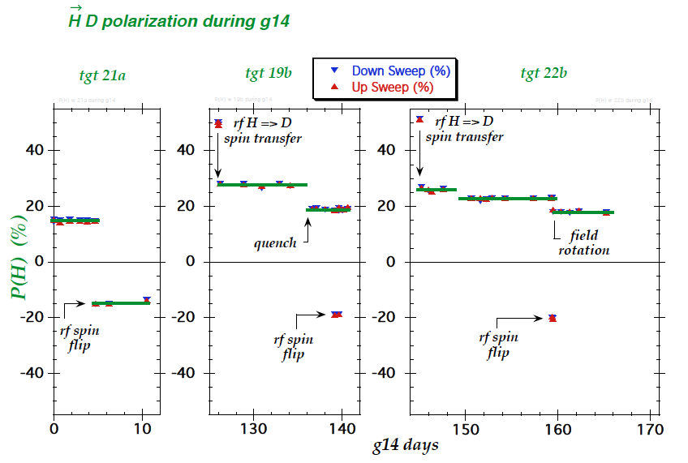
HD-Ice

Slide 23
 | σ | Σ | T | P | E | F | G | H | T_{x} | T_{z} | L_{x} | L_{z} | O_{x} | O_{z} | C_{x} | C_{z}
Proton target
pπ⁰ | ✔ | ✓ | ✓ |  | ✓ | ✓ | ✓ | ✓
nπ⁺ | ✔ | ✓ | ✓ |  | ✓ | ✓ | ✓ | ✓
pη | ✔ | ✓ | ✓ |  | ✓ | ✓ | ✓ | ✓
pη’ | ✔ | ✓ | ✓ |  | ✓ | ✓ | ✓ | ✓
pω | ✔ | ✓ | ✓ |  | ✓ | ✓ | ✓ | ✓
K⁺Λ | ✔ | ✓ | ✓ | ✔ | ✓ | ✓ | ✓ | ✓ | ✓ | ✓ | ✓ | ✓ | ✓ | ✓ | ✔ | ✔
K⁺Σ⁰ | ✔ | ✓ | ✓ | ✔ | ✓ | ✓ | ✓ | ✓ | ✓ | ✓ | ✓ | ✓ | ✓ | ✓ | ✔ | ✔
K^{0*}Σ⁺ | ✔ | ✓ |  |  |  |  |  |  |  |  | ✓ | ✓
Neutron target
pπ⁻ | ✔ | ✓ | ✓ |  | ✓ | ✓ | ✓ | ✓
nρ⁰ | ✓ | ✓ | ✓ |  | ✓ | ✓ | ✓ | ✓
K⁻Σ⁺ | ✓ | ✓ | ✓ |  | ✓ | ✓ | ✓ | ✓
K⁰Λ | ✓ | ✓ | ✓ | ✓ | ✓ | ✓ | ✓ | ✓ | ✓ | ✓ | ✓ | ✓ | ✓ | ✓ | ✓ | ✓
K⁰Σ⁰ | ✓ | ✓ | ✓ | ✓ | ✓ | ✓ | ✓ | ✓ | ✓ | ✓ | ✓ | ✓ | ✓ | ✓ | ✓ | ✓
K^{0*}Σ⁰ | ✓ | ✓

Slide 24
Assessing the past:
What did we learn up to now from meson photoproduction
published data ?

Slide 25
Strangeness production γp→K⁺Λ→K⁺pπ⁻
M. Mc Cracken et al.(CLAS), Phys.RevC81,025201,2010
A.V. Anisovich et al, EPJ A48, 15 (2012)

Slide 26
Strangeness production γp→K⁺Λ→K⁺pπ⁻
M. Mc Cracken et al.(CLAS), Phys.RevC81,025201,2010
A.V. Anisovich et al, EPJ A48, 15 (2012)
M. Mc Cracken et al. (CLAS), Phys. Rev. C 81, 025201, 2010
D. Bradford et al. (CLAS), Phys.Rev. C75, 035205, 2007

Slide 27
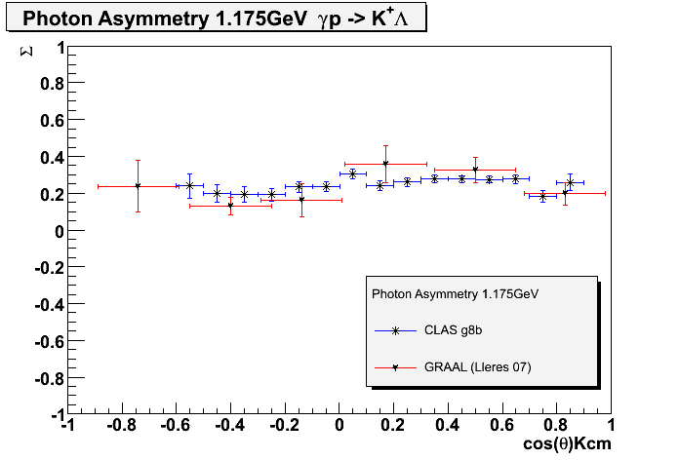
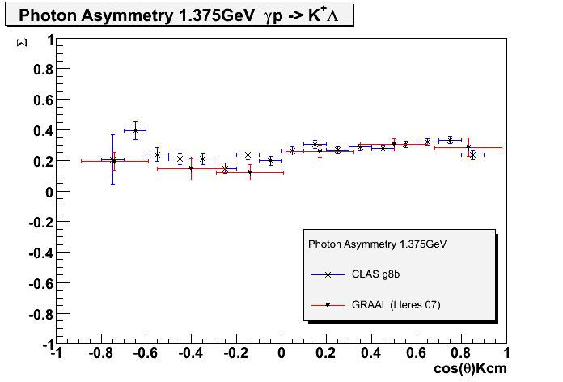
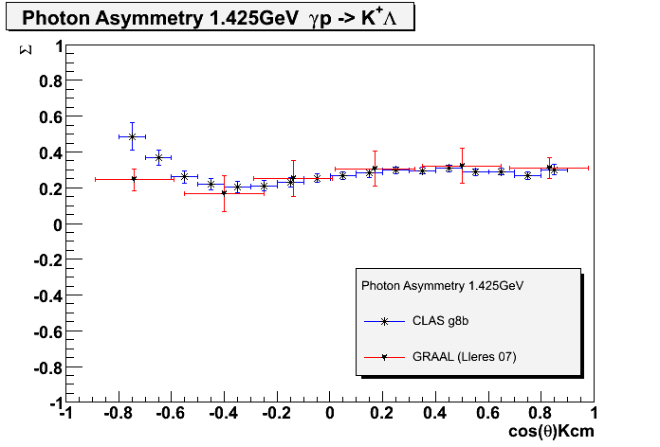
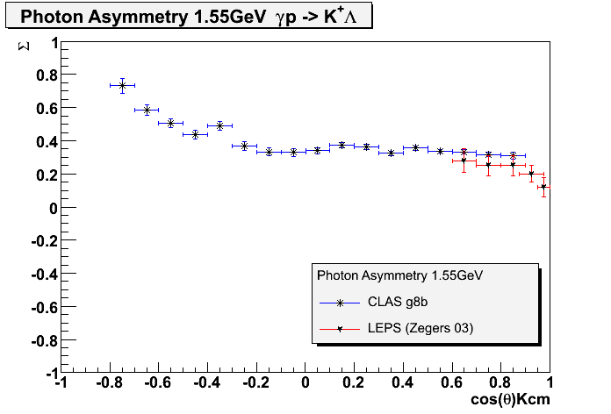
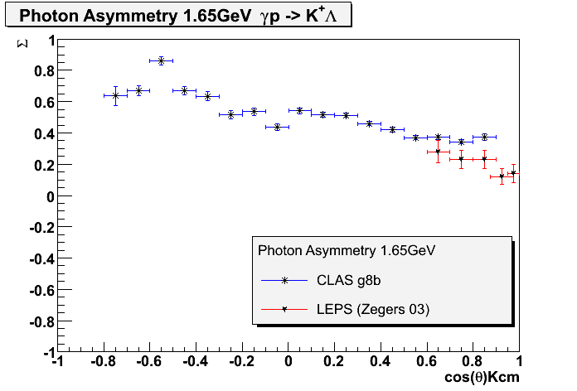
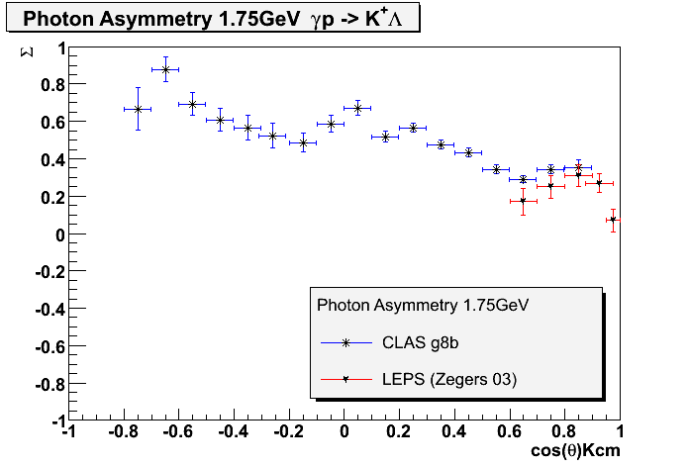
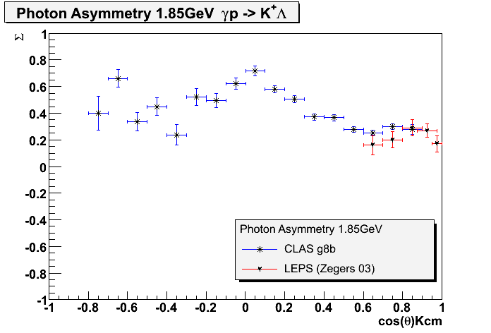
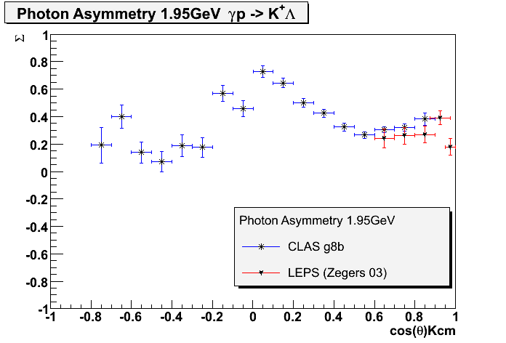
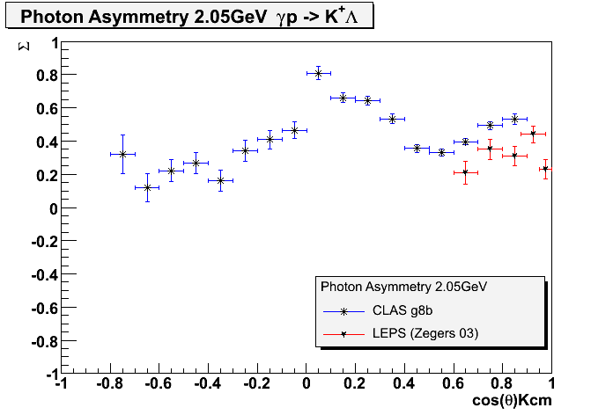
γp→K⁺Λ Photon Asymmetry Σ
preliminary
C. Patterson

Slide 28
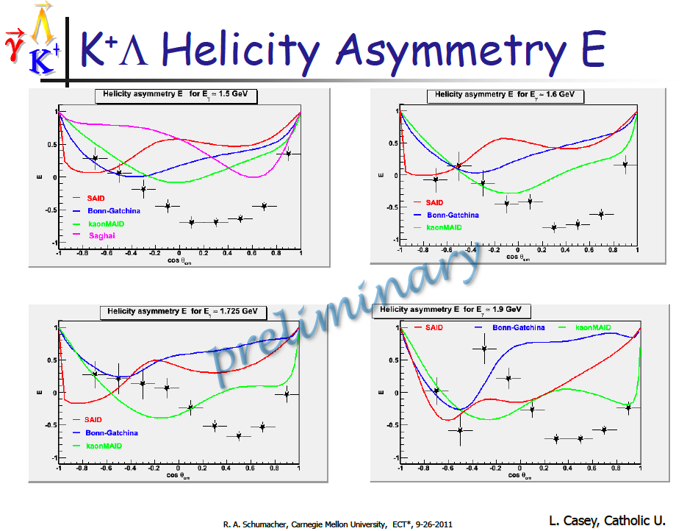

Slide 29


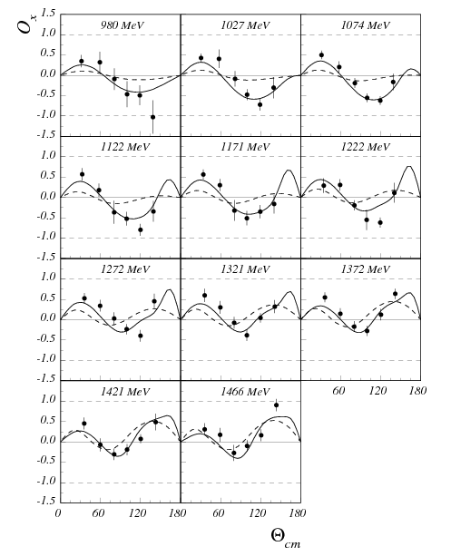
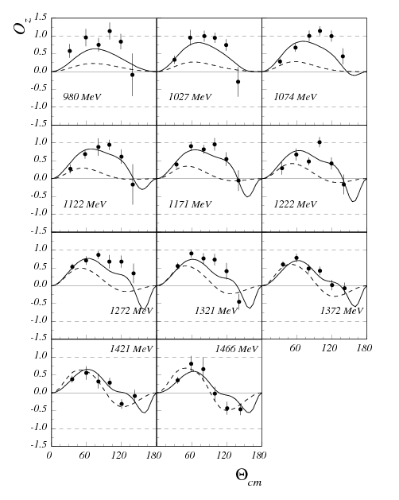
Double Polarization Observables in K+Λ Photoproduction
A.Lleres et al., EPJ A 39, 149-161 (2009)
GRAAL
GI RPR
GRAAL
Bonn Gatchina
GI RPR
Bonn Gatchina

Slide 30
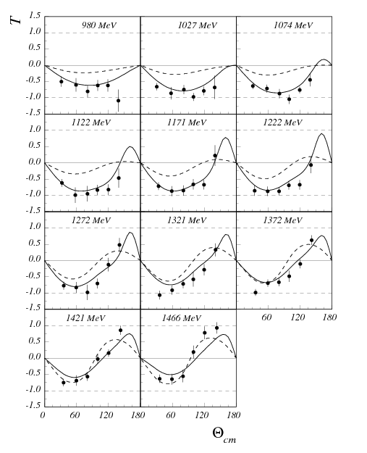
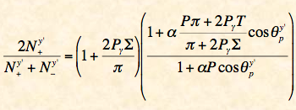
T in K⁺Λ Photoproduction
A.Lleres et al., EPJ A 39, 149-161 (2009)
From O_{x}, O_{z} and T results:
Ghent Isobar RPR Model:
GRAAL
Bonn Gatchina Model:
GI RPR
Bonn Gatchina

Slide 31
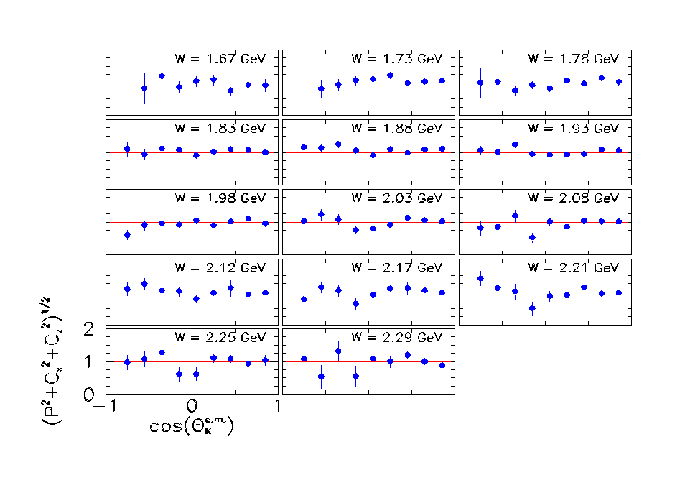

R Values for the Λ
The Λ appears 100% polarized when created with a fully polarized beam.

Slide 32


The P₁₃(1900)3/2⁺ State
Bonn-Gatchina
State solidly established in coupled-channel analysis making use of very precise KΛ data, resulting in *** assignment in PDG2012.
State was confirmed in covariant isobar model analysis (T. Mart & M. J. Kholili arXiv:1208.2780) of single channel analysis γp → K⁺Λ.
Confirmed in an effective Langrangian resonance model analysis (O. V. Maxwell, PRC85,034611, 2012) of photo- and electroproduction of single channel K⁺Λ data.
State may be ready for promotion to **** assignment and to become the first baryon resonance observed and confirmed in electromagnetic meson production.
P₁₃
T. Mart & M. Kholili
P₁₃

Slide 33


N/Δ spectrum in RPP 2012
J. Beringer et al. (Particle Data Group), Phys. Rev. D86, 010001 (2012)
Photoproduction data from JLAB, ELSA, GRAAL, LEPS
Naming scheme has changed:
L _{2I} _{2J}(E) J^{P}(E)
From Bonn-Gatchina coupled-channel analysis with precision photo-production of KΛ, KΣ and polarization observables.
V. Crede & W. Roberts, arXiv:1302.7299

Slide 34
N* spectrum in LQCD
Projected new states constrained largely from meson photoproduction
N(2060)5/2⁻
N(2120)3/2⁻
N(1875)3/2⁻
N(1895)1/2⁻
N(1900)3/2⁺
N(1880)1/2⁺
N(1675)5/2⁻
N(1700)3/2⁻
N(1520)3/2⁻
N(1650)1/2⁻
N(1535)1/2⁻
m_{π}=396MeV
New candidate states may be accommodated in LQCD projections

Slide 35
On going analyses : g14

Slide 36



Slide 37


Slide 38


Slide 39


Slide 40


Slide 41


Slide 42


Slide 43


Slide 44


Slide 45


Slide 46


Slide 47



E_{γ}=(0.8-2.2)GeV
Δ⁺
IM(π⁻n)
ρ⁰
Δ⁻
IM(π⁺n)
E_{γ}=(0.8-2.2)GeV
IM(π⁻n)
ρ⁰
Δ⁺
Δ⁻
IM(π⁺π⁻)

Slide 48




E_{γ}=(0.8-1.5)GeV
E_{γ}=(1.6-2.4)GeV
Δ⁺
Δ⁺
IM(π⁻n)
IM(π⁻n)
ρ⁰
ρ⁰
Δ⁻
Δ⁻
IM(π⁺n)
IM(π⁺n)
E_{γ}=(1.5-2.2)GeV
E_{γ}=(1.6-2.4)GeV
IM(π⁻n)
IM(π⁻n)
Δ⁺
ρ⁰
Δ⁺
ρ⁰
Δ⁻
Δ⁻
IM(π⁺π⁻)
IM(π⁺π⁻)

Slide 49


‘
Boosted Decision Tree and Q-value separation are being attempted to improve ρ⁰ separation.

Slide 50
Future?

Slide 51

Hybrid Baryons in LQCD
J.J. Dudek and R.G. Edwards, PRD85 (2012) 054016
T. Barnes and F.E. Close, PLB128, 277 (1983)
LQCD
regular states
clustered
in mass
hybrid states
1.3GeV
N
Hybrid states have same J^{P} values as Q³ baryons. How to identify them?
- Overpopulation of N1/2⁺ and N3/2⁺ states compared to QM projections?
- Transition form factors in electroproduction have different Q² dependence

Slide 52

Separating Q³G from Q³ states?
Z.P. Li, V.Burkert, Zh. Li, PRD46 (1992)70; C.E. Carlson, N. Mukhopadhyay, PRL 67, 3745, 1991
Lowest mass QQQG state N1/2⁺
q³G
q³G
A_{1/2} dominant amplitude at high Q² indicates radial QQQ excitation
Significant meson-baryon coupling at small Q²
For hybrid “Roper”, transverse amplitude A_{1/2}(Q²) drops off faster with Q², and S_{1/2}(Q²) ~ 0.

Slide 53
Conclusions
Thanks to precise new data, including double polarization data, the role of photoreaction data as been recognized for the first time by the PDG to impact the existing evidence of Nstar resonances, which seem to rule out di-quark models.
Community achieved important milestone in the search for new baryon states from photoproduction – 6 new candidates, 2 almost certain in RPP 2012. Two further confirmations for N(1900)3/2⁺.
New results are about to come and are expected to further improve our knowledge of the baryonic excited states.
I would like to thank the HD-Ice group and CLAS collaboration for letting me present preliminary data

