Slide 1


Charge-Changing Neutrino Scattering from the Deuteron
J. W. Van Orden
ODU/Jlab
Collaborators:
T. W. Donnelly and Oscar Morino
MIT
W. P. Ford
University of Tennessee

Slide 2
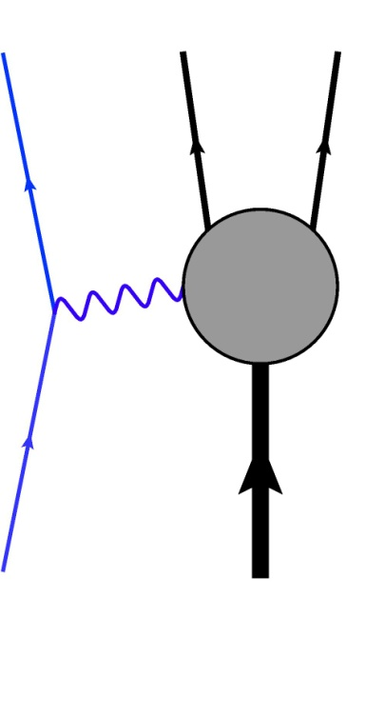

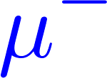
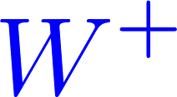

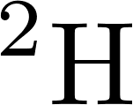
Introduction
Detection of the final-state particles can be used to determine the initial neutrino energy.
The deuteron is the simplest nucleus containing a neutron and can be calculated relatively easily.
This reaction can then be used to measure the incident neutrino flux.
This reaction can be used to study aspects of the weak interactions.
Calculation for deuterium can be used as a testbed for adding relativistic and pionic contributions to calculations for heavier nuclei.

Slide 3

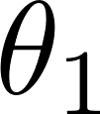
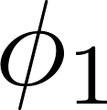
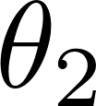

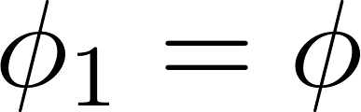
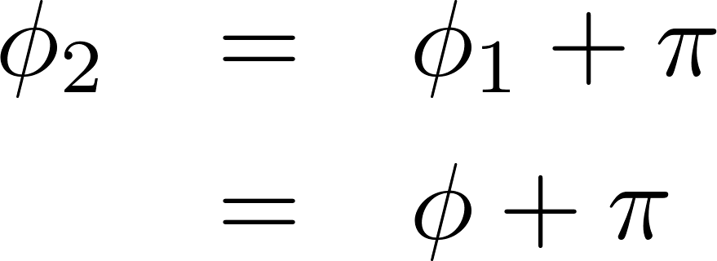
Kinematics
hadron plane
lepton plane
Since the final state includes two protons, double counting can be avoided by always choosing p₁ to be the proton with the largest momentum.

Slide 4
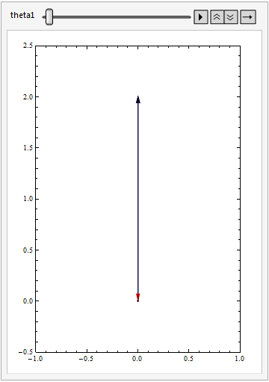




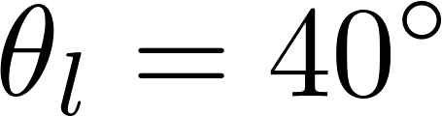

Slide 5
The Model
The model used for the calculations shown here is based on modifications to a model of deuteron electrodisintegration* developed for use at Q² of several GeV².
The model is based on the Bethe-Salpeter equation and is manifestly covariant.
Details of the electrodisintegration calculations can be found in the references below.
*S. Jeschonnek and J. W. Van Orden, Phys. Rev. C 78, 014007 (2008);
Phys. Rev. C 80, 054001 (2009); Phys. Rev. C 81, 014008 (2010).

Slide 6
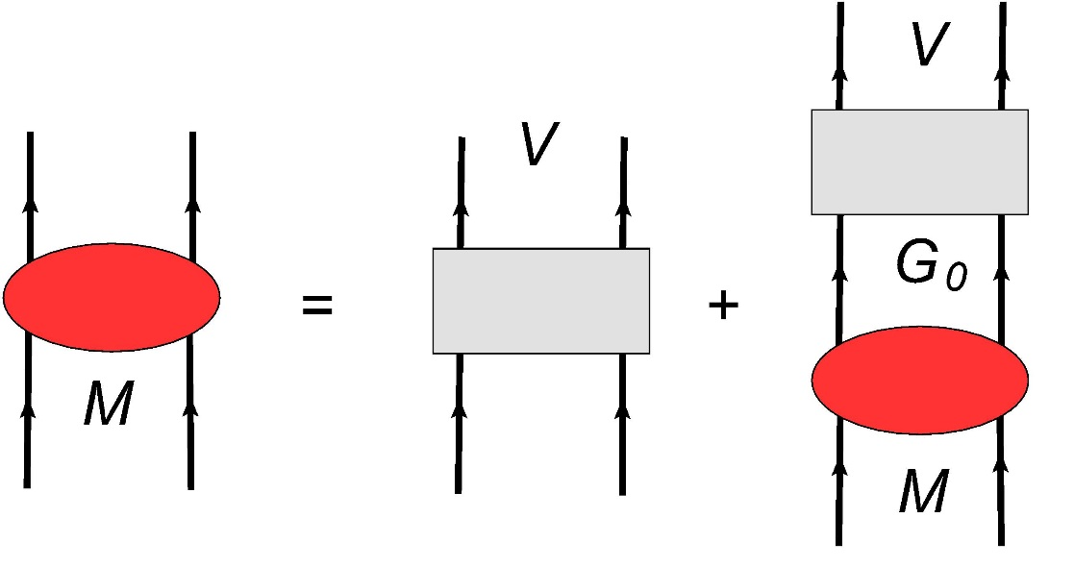

The Bethe-Salpeter Equation

Slide 7
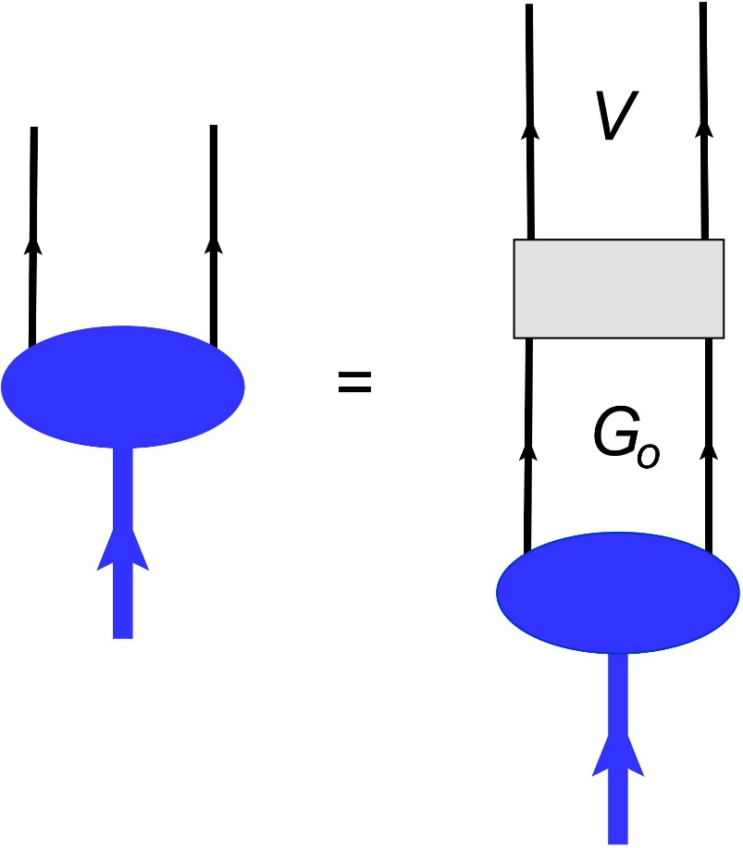
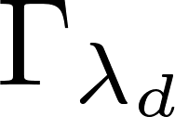
The Deuteron Vertex Function

Slide 8
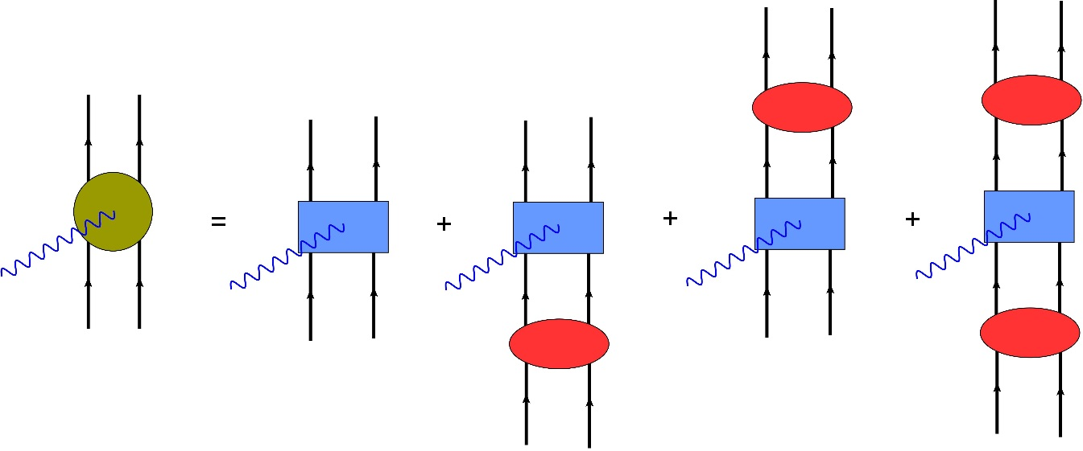

The Current Operator

Slide 9

The Impulse Approximation
The impulse approximation to CCν scattering from the deuteron is defined by the Feynman diagrams:
Antisymmetric scattering matrix
On Mass Shell
We will show three approximations:
Plane Wave Impulse Approximation (PWIA): diagram (a) only.
Plane Wave Born Approximation (PWBA): diagrams (a)+(b).
Distorted Wave Born Approximation (DWBA): diagrams (a)+(b)+(c).

Slide 10
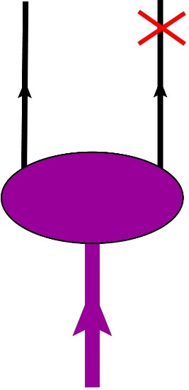
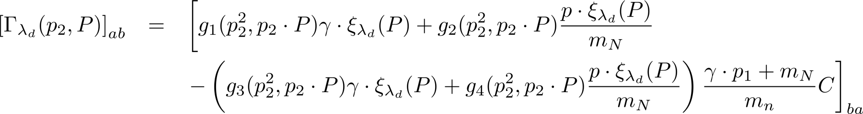
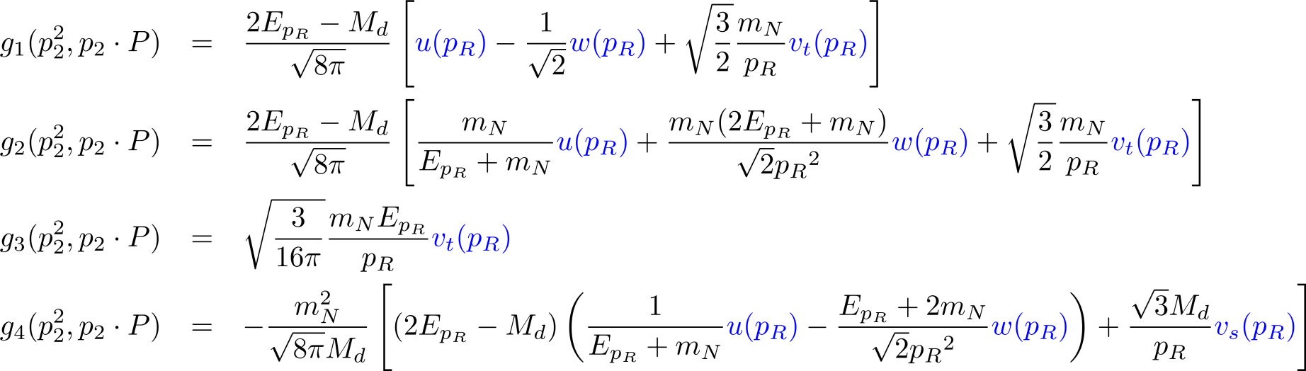
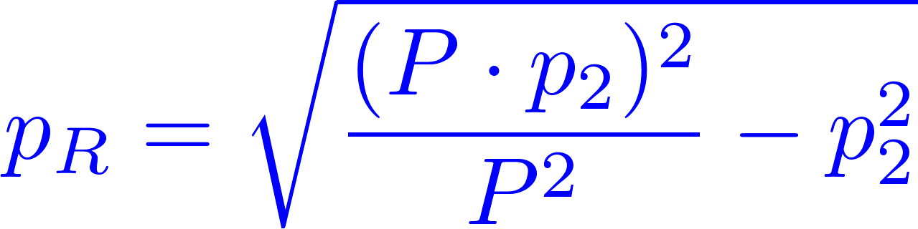
Deuteron Vertex Function
a
b
The invariant functions g_{i} are given by
Charge conjugation matrix
where
is the magnitude of the three-momentum in the deuteron rest frame.

Slide 11
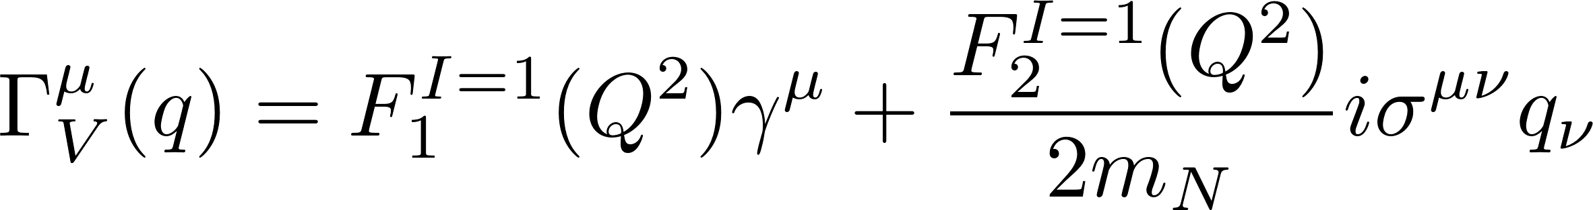
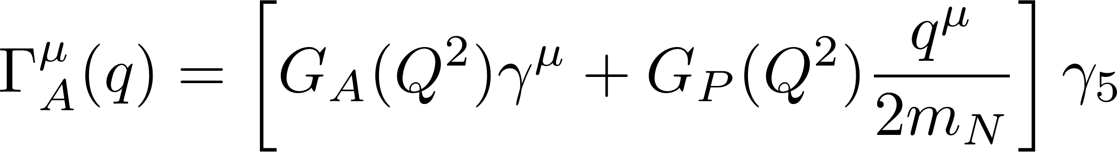
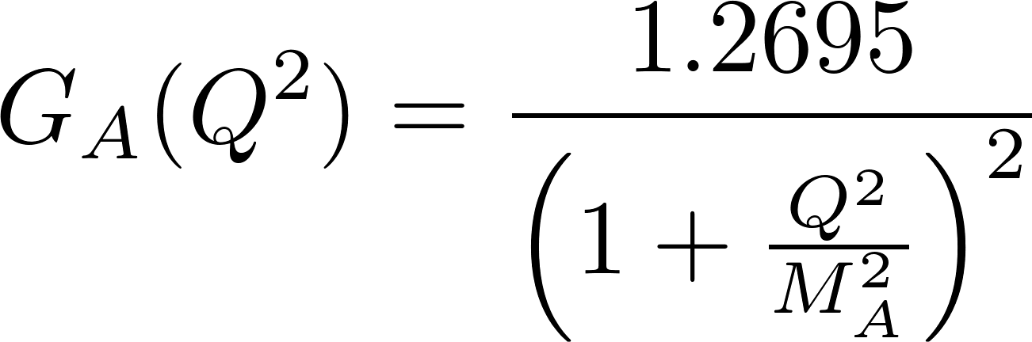
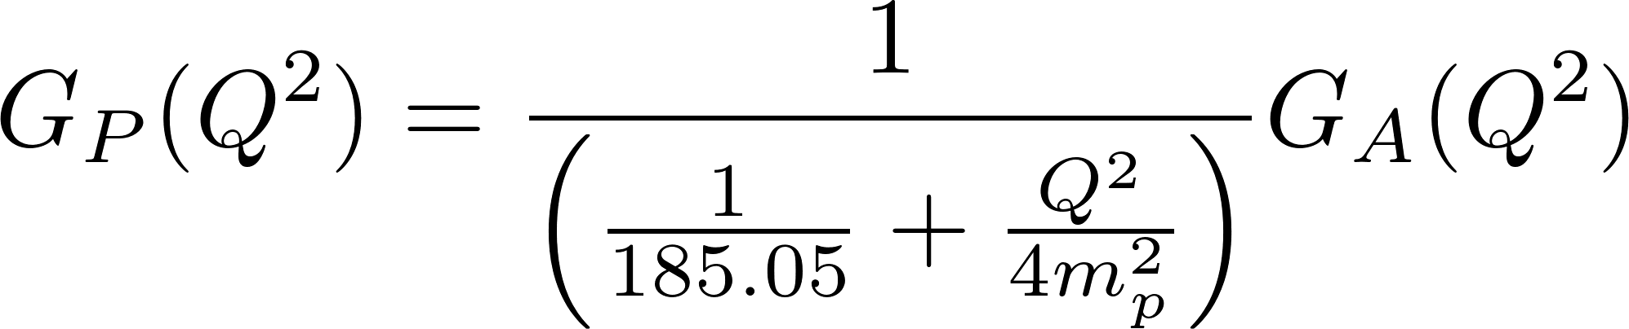
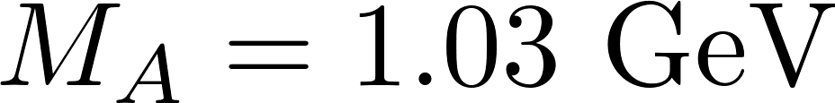
The Single-Nucleon Current Operator
where
and
The weak form factors used in the calculations shown here are:

Slide 12
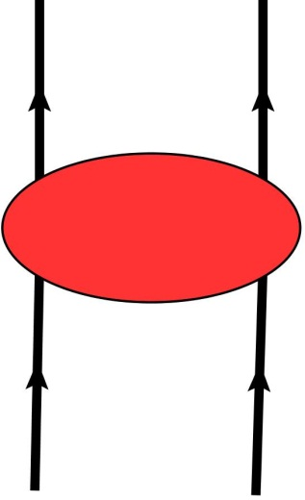
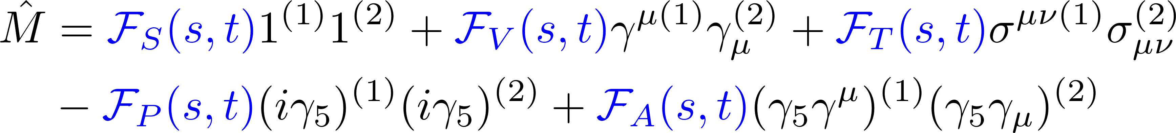
Final State Interactions
There are no reliable meson-exchange models of NN scattering for the invariant masses where pions production channels are open.
The scattering amplitudes must be obtained from data.
The scattering amplitudes are represented by a parameterization in terms of five Fermi invariants.
A complete description of on-shell NN scattering.
Lorentz invariant.
Has complete spin dependence.

Slide 13

We use two approaches:
The invariant functions are constucted from the SAID helicity amplitudes. pp amplitudes are available for s<9.16 GeV²
We have recently performed a fit of the available NN data from s=5.4 GeV² to s=4000 GeV² based on a Regge model.*
In the calculations shown here, only on-shell contributions from the pp amplitudes are used.
* W. P. Ford and J. W. Van Orden, Phys. Rev. C 87, 014004 (2013).
W. P. Ford, Ph.D. Dissertation, http://arxiv.org/abs/1310.0871

Slide 14
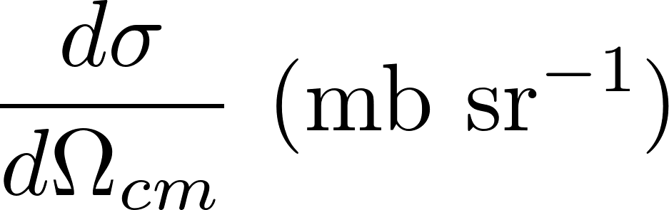
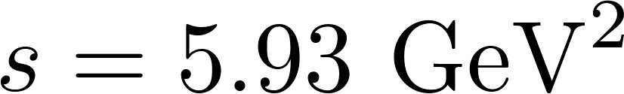
Elastic pp Scattering

Slide 15

Integrated Cross Section
For the purpose of initial study of this reaction, we assume kinematics such as are used in electron scattering. That is, the initial neutrino energy is assumed to be known and the muon and proton 1 are detected in the final state.
Maximum
10% of Maximum
Cross Section at Maximum

Slide 17
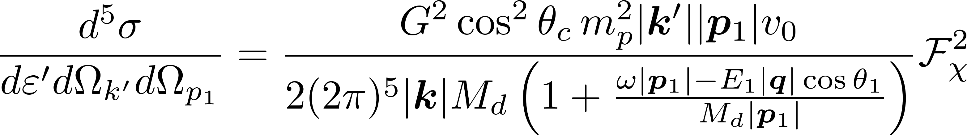
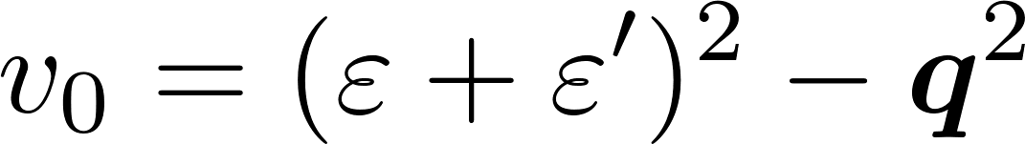
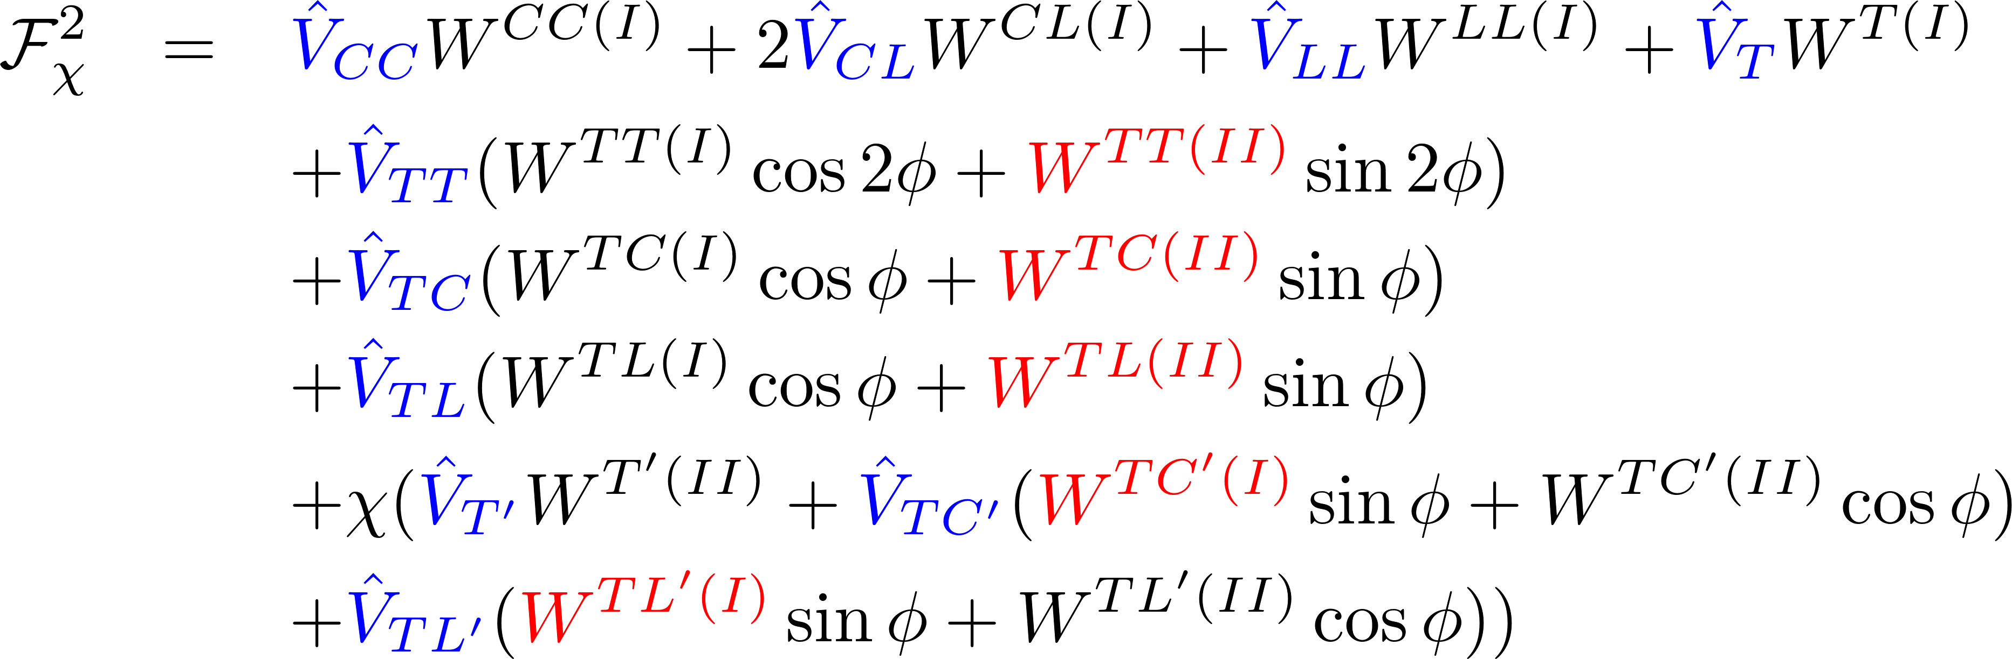
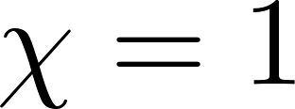
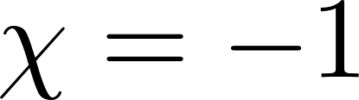
Exclusive Cross Section
where
and
for neutrino scattering
for anti-neutrino scattering
O. Moreno, T. W. Donnelly, W. P. Ford and J. W. Van Orden, Phys. Rev. D 90, 013014 (2014).

Slide 18
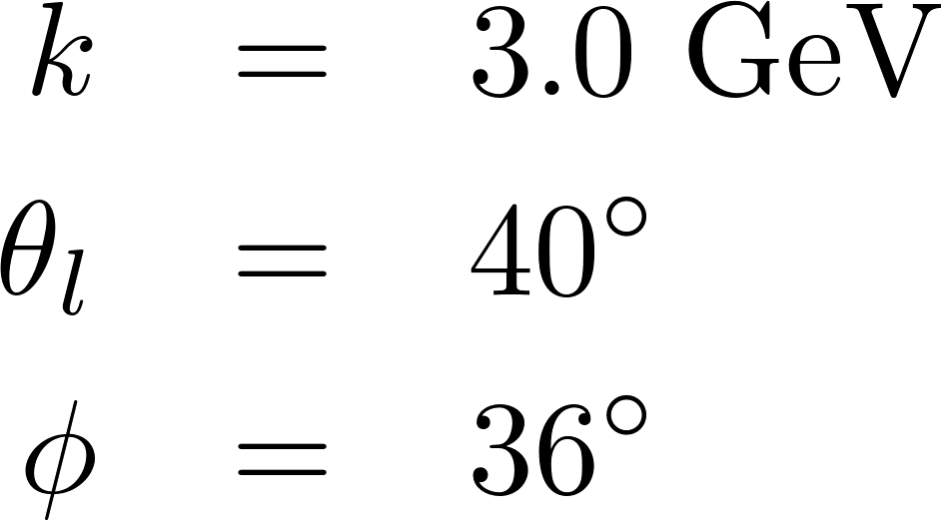
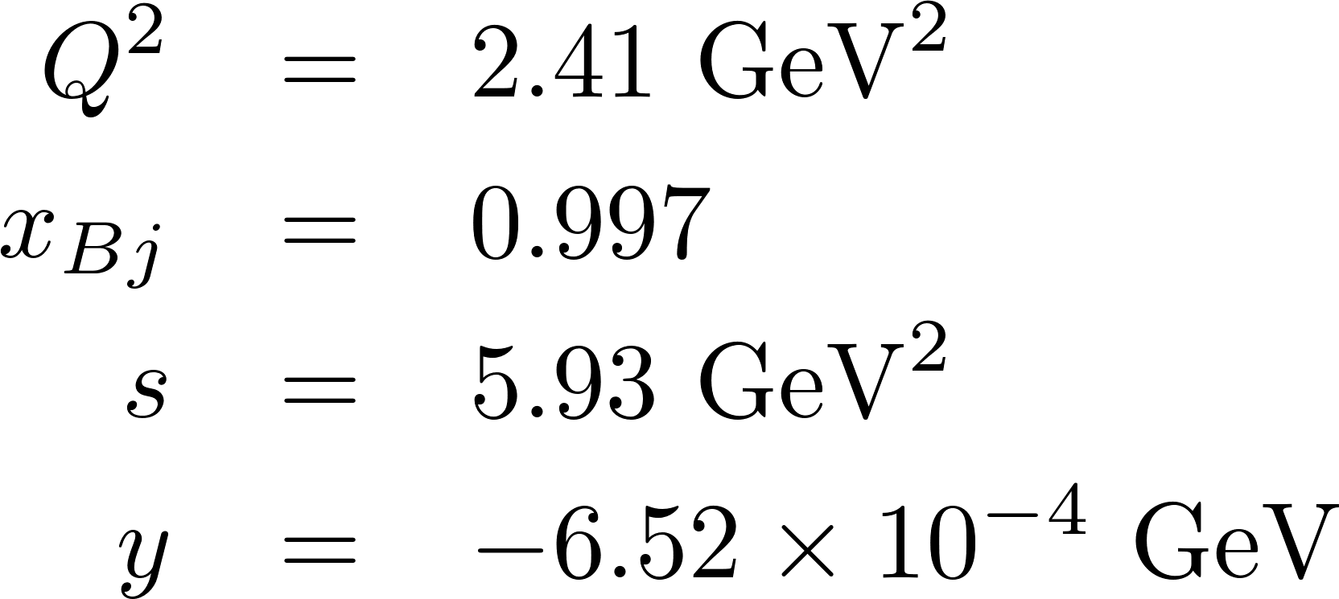
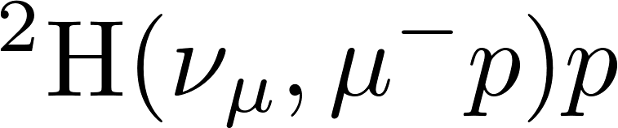
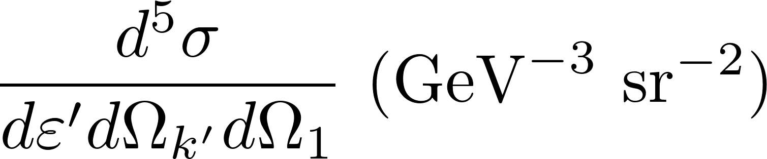
Exclusive Cross Section Calculations

Slide 19
Azimuthal Angular Dependence

Slide 20
Sensitivity to the Weak Form Factors

Slide 21
Summary
We have produced a working calculation of CCν for the deuteron in the DWBA designed for use at large energies.
We are just beginning to explore the results of this calculation.
The existing calculations indicate that the bulk of the cross section is produced at forward lepton scattering angles with small energy and momentum transfer.
The exclusive calculations indicate that the cross sections are dominated by high-momentum protons close to q.

Slide 22
The effects of final state interactions in this region are small but not necessarily neglegible.
The exclusive cross sections are sensitive to the axial form factor G_{A}(Q²).
Inclusion of Δ currents is underway.

Slide 23
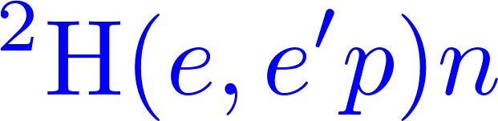
Comparison of Electron and Neutrino Scattering

