Slide 1

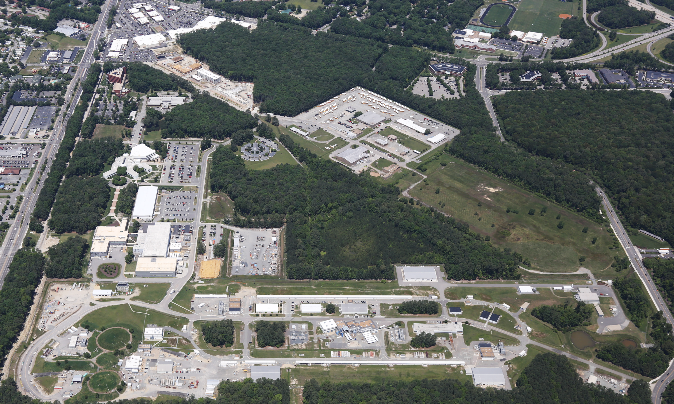
12 GeV Era at JLab
Bob McKeown
June 23, 2016

Slide 2
Outline
Development, PAC
The Science Program in the context of the NSAC Long Range Plan
Early results
Outlook

Slide 3
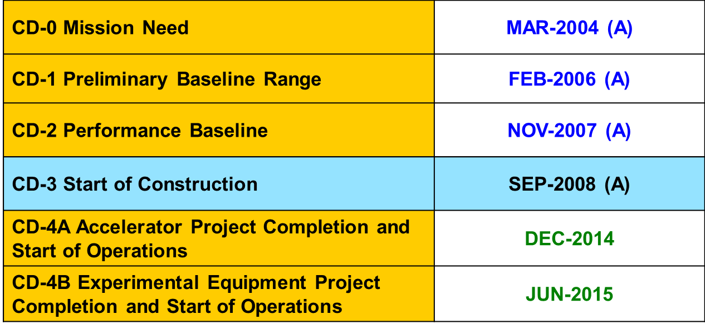
12 GeV History According to DOE

Slide 4

PAC History
PAC 29 - January 2006
Enter Mike Pennington as PAC member
PAC 30 – August 2006
Begin 12 GeV approvals
PAC 34-35 – 2009-2010
Mike Pennington  PAC Chair
More approved experiments – 25 total
2011 – Mike Pennington arrives as Theory Group Leader

Slide 5
12 GeV Approved Experiments by Physics Topics
Topic | Hall A | Hall B | Hall C | Hall D | Other | Total
The Hadron spectra as probes of QCD (GluEx and heavy baryon and meson spectroscopy) |  | 1 |  | 3 |  | 4
The transverse structure of the hadrons (Elastic and transition Form Factors) | 5 | 3 | 2 | 1 |  | 11
The longitudinal structure of the hadrons (Unpolarized and polarized parton distribution functions) | 2 | 3 | 6 |  |  | 11
The 3D structure of the hadrons (Generalized Parton Distributions and Transverse Momentum Distributions) | 5 | 9 | 7 |  |  | 21
Hadrons and cold nuclear matter (Medium modification of the nucleons, quark hadronization, N-N correlations, hypernuclear spectroscopy, few-body experiments) | 6 | 3 | 7 |  | 1 | 17
Low-energy tests of the Standard Model and Fundamental Symmetries | 3 | 1 |  | 1 | 1 | 6
TOTAL | 21 | 20 | 22 | 5 | 2 | 70

Slide 6
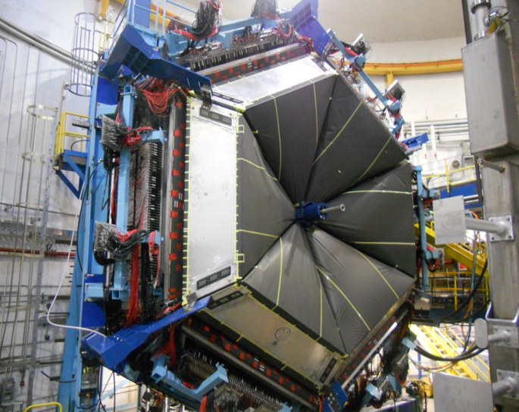
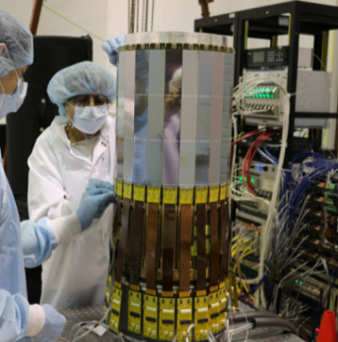
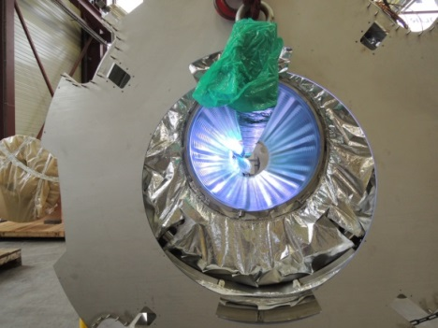
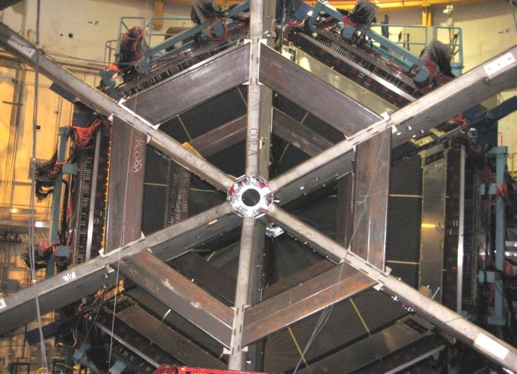
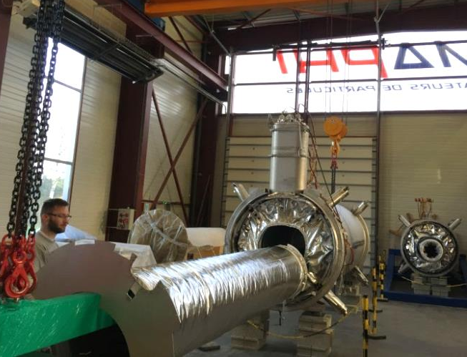
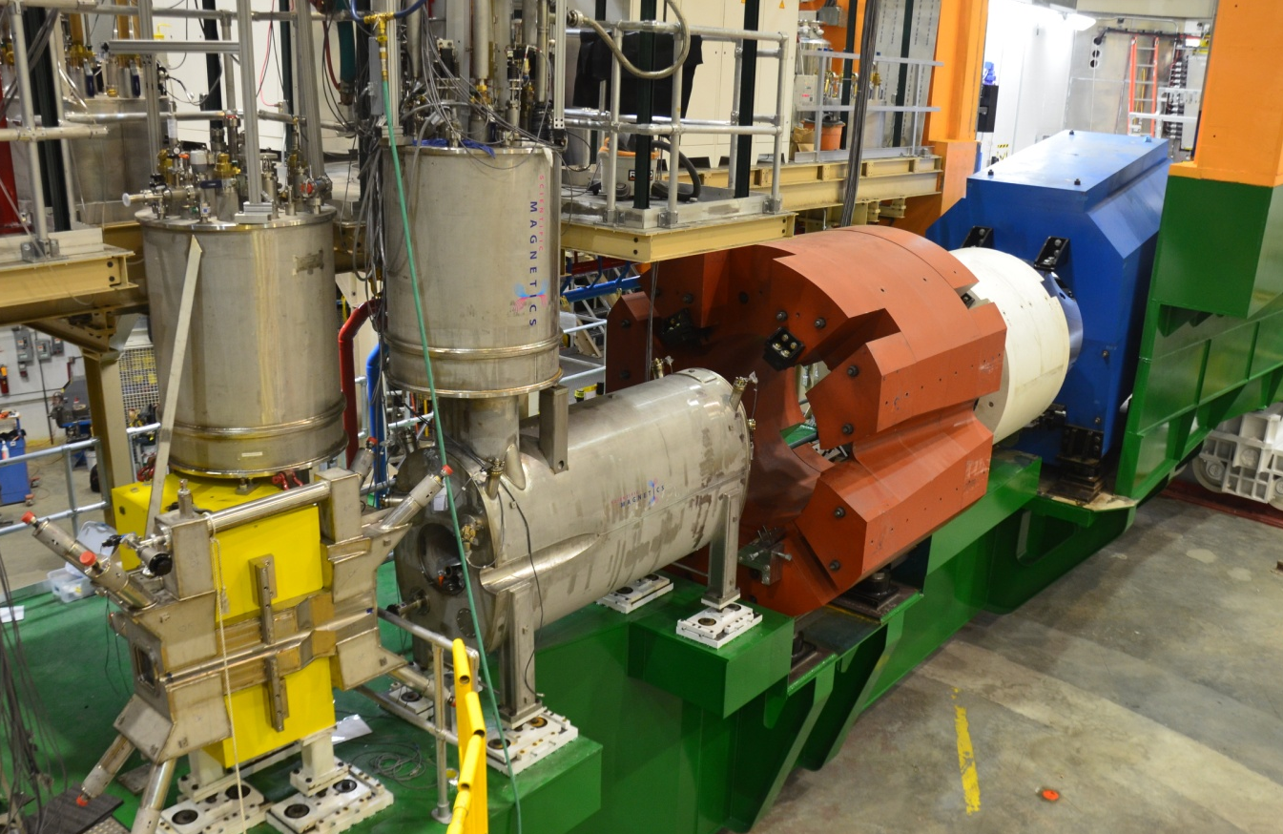
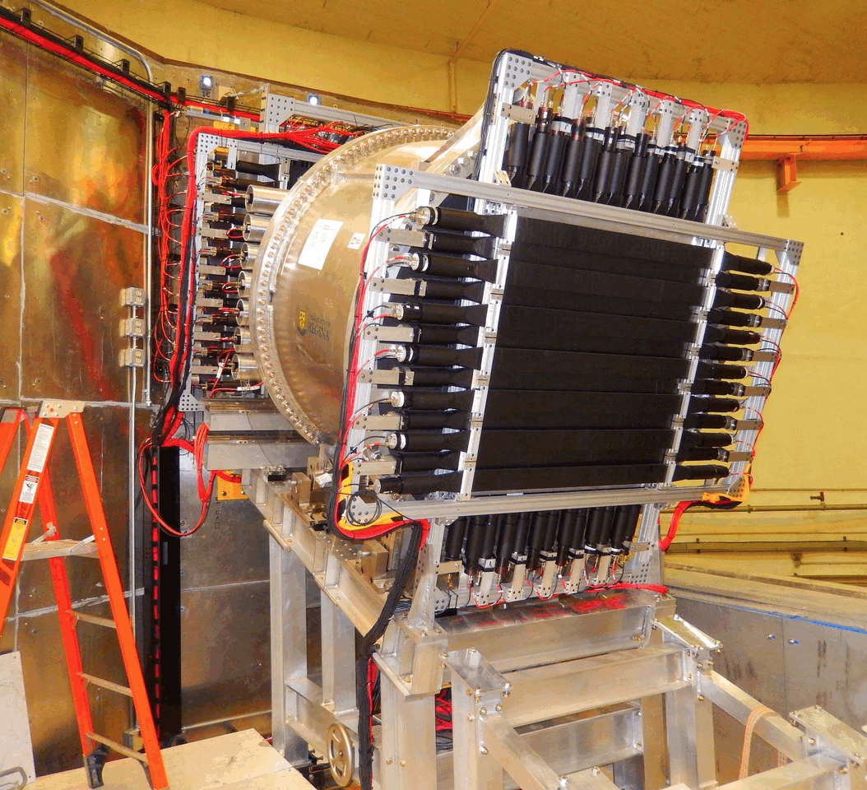
12 GeV Upgrade Project
TPC = $338M
ETC = ~$9M
Project Scope (~98% complete):
Doubling the accelerator beam energy – DONE
New experimental Hall D and beam line – DONE
Civil construction including utilities – DONE
Upgrades to Experimental Halls B & C – ~94%
  Halls B & C Detectors – DONE
Notes:
AL updated 01Apr w/Feb 28th data.

Slide 7

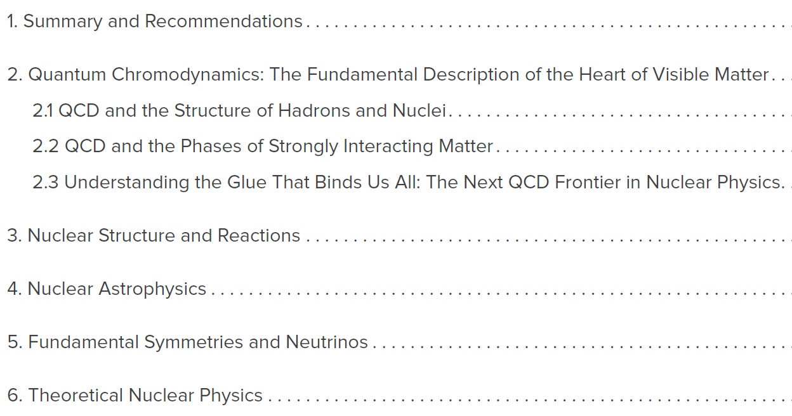
2015 NSAC LRP
Jefferson Lab has significant research activity in all 5 science chapters (2-6)

Slide 8
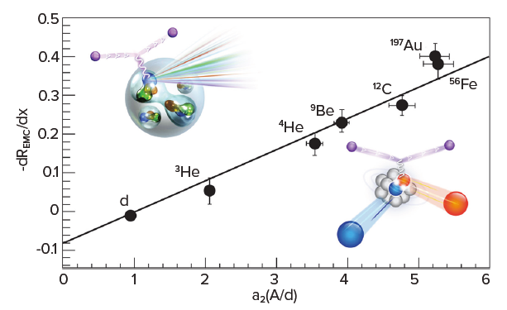
Chapter 2
Quantum Chromodynamics:
The Fundamental Description of the Heart of Visible Matter
CEBAF data showing how quark structure of nuclei is related to correlated pairs of nucleons

Slide 9
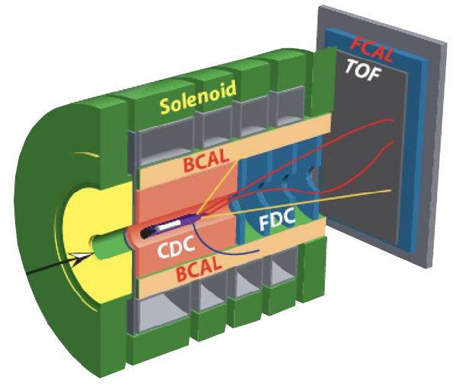

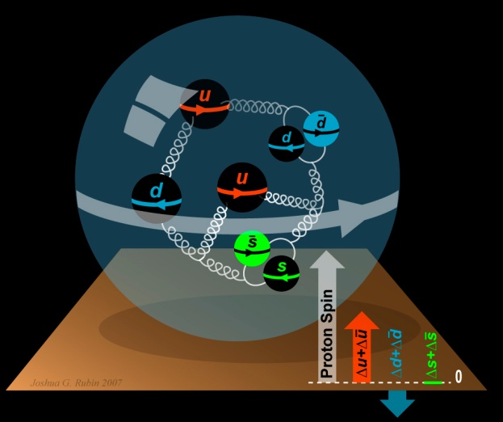
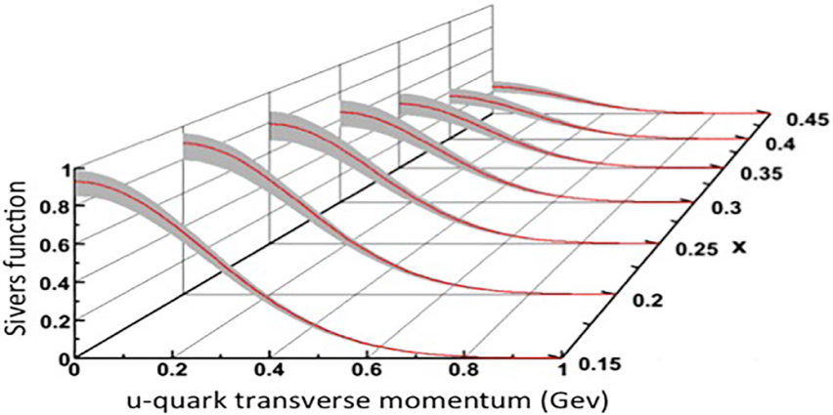
Quark Structure of Hadrons
What is the role of gluonic excitations in the spectroscopy of light mesons?
Where is the missing spin in the nucleon?
Role of orbital angular momentum?
Can we reveal a novel landscape of nucleon substructure through measurements of new multidimensional distribution functions?

Slide 10
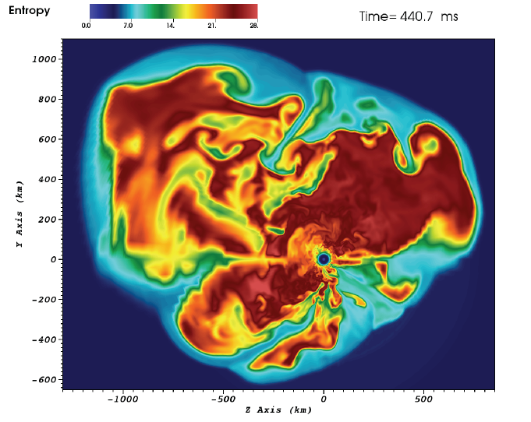
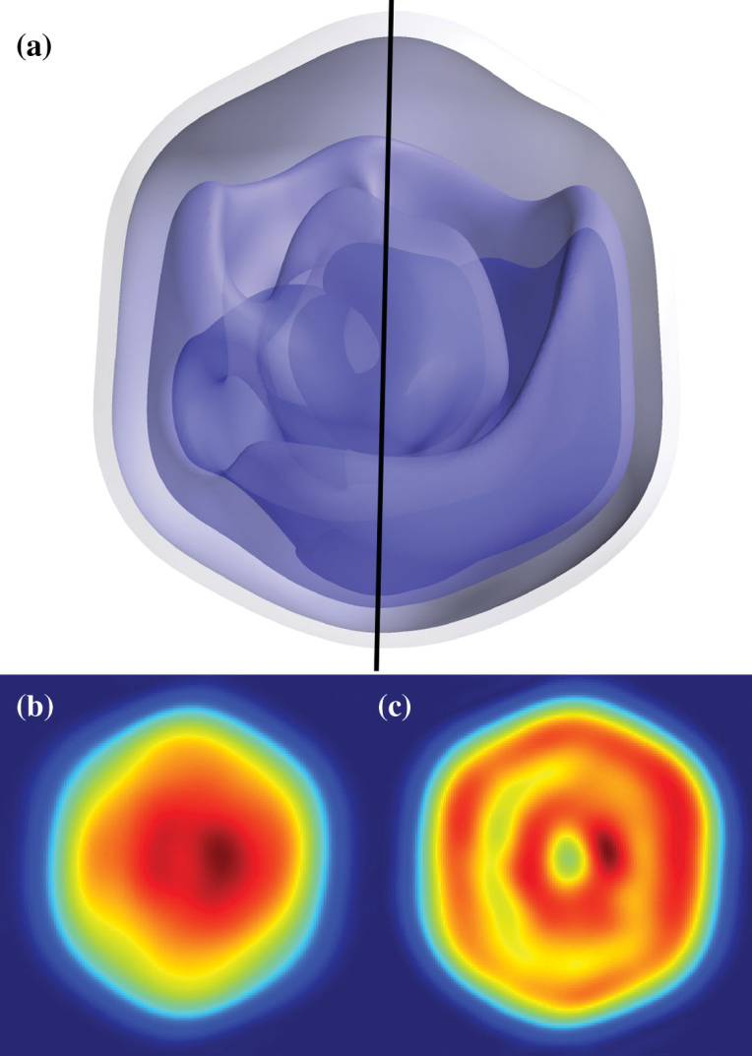
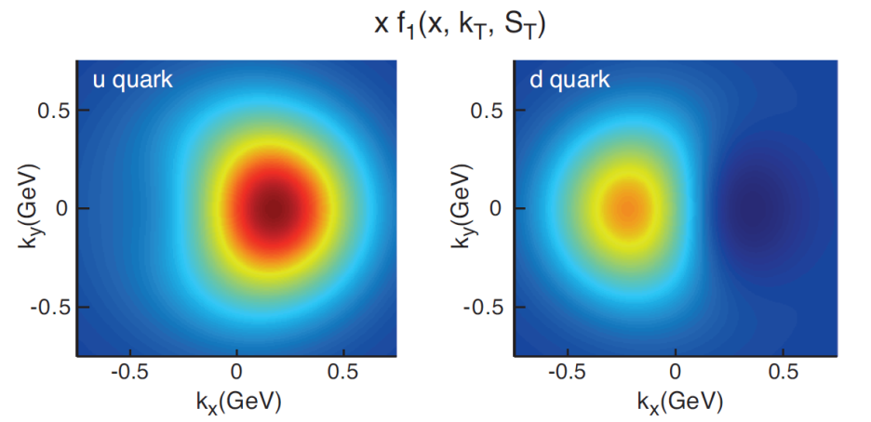
Science in 3-Dimensions
3D simulation of
15M supernova
(ORNL)
Predicted
quark
Transverse
Momentum
Distributions
for a
polarized
proton
(accessible with JLab @ 12 GeV)
Mimivirus imaged at LCLS (SLAC)
10

Slide 11

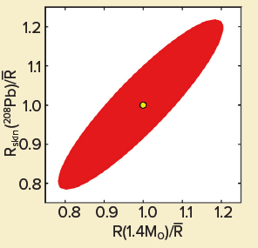
Chapter 3
Nuclear Structure and Reactions
Future CEBAF data will determine the thickness of the neutron skin in a Pb nucleus which is related to the radius of a neutron star

Slide 12
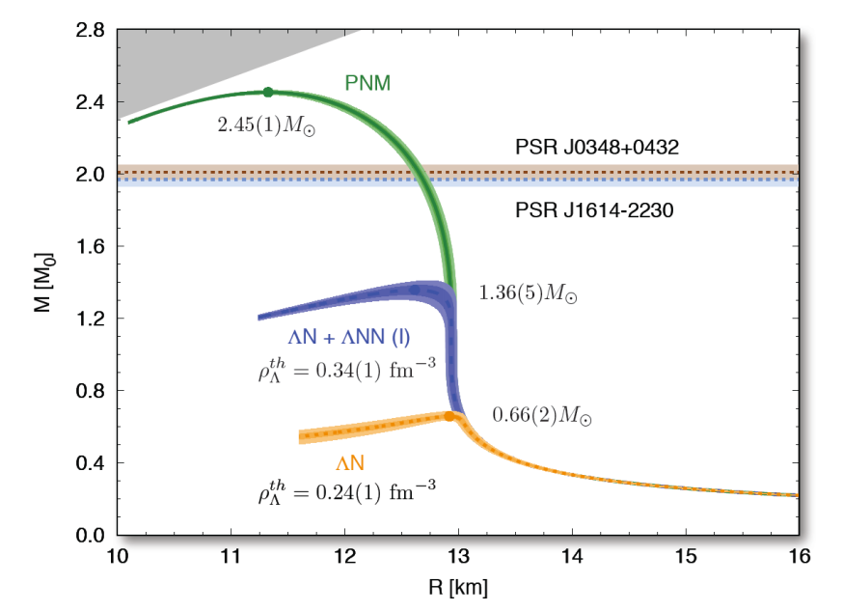
Chapter 3
Nuclear Structure and Reactions
Future CEBAF data on hypernuclei should test explanations of why neutron stars with masses twice that of our sun exist.

Slide 13
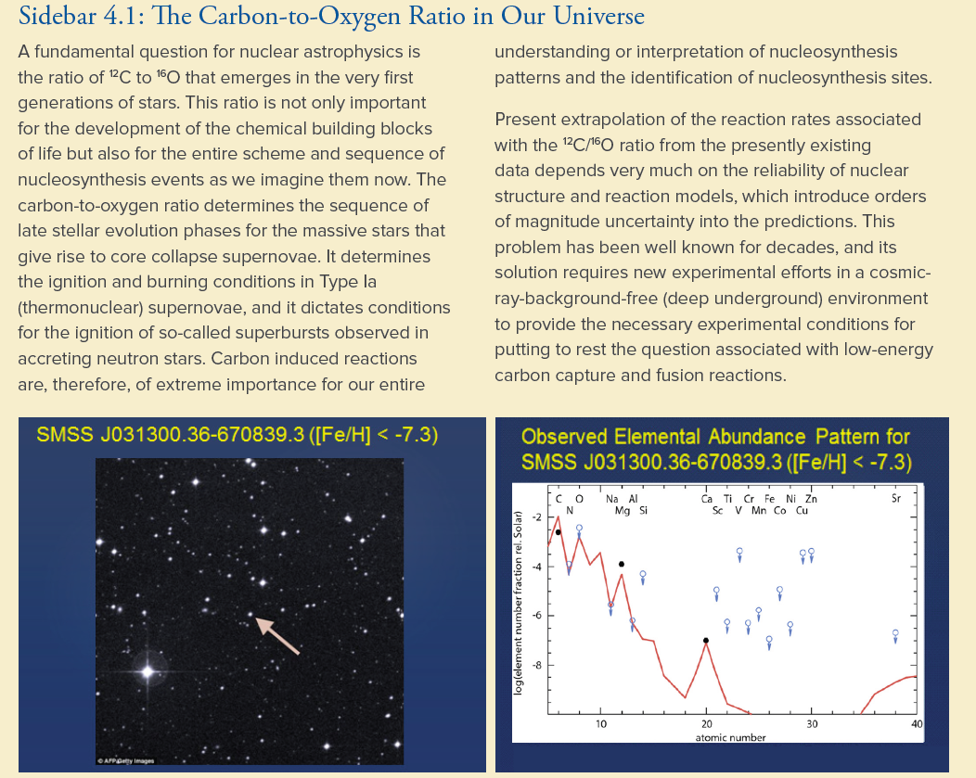
Chapter 4
Nuclear Astrophysics
Future CEBAF data on γ+¹⁶O  ¹²C +α will provide new information on the Carbon/Oxygen ratio in our universe.

Slide 14
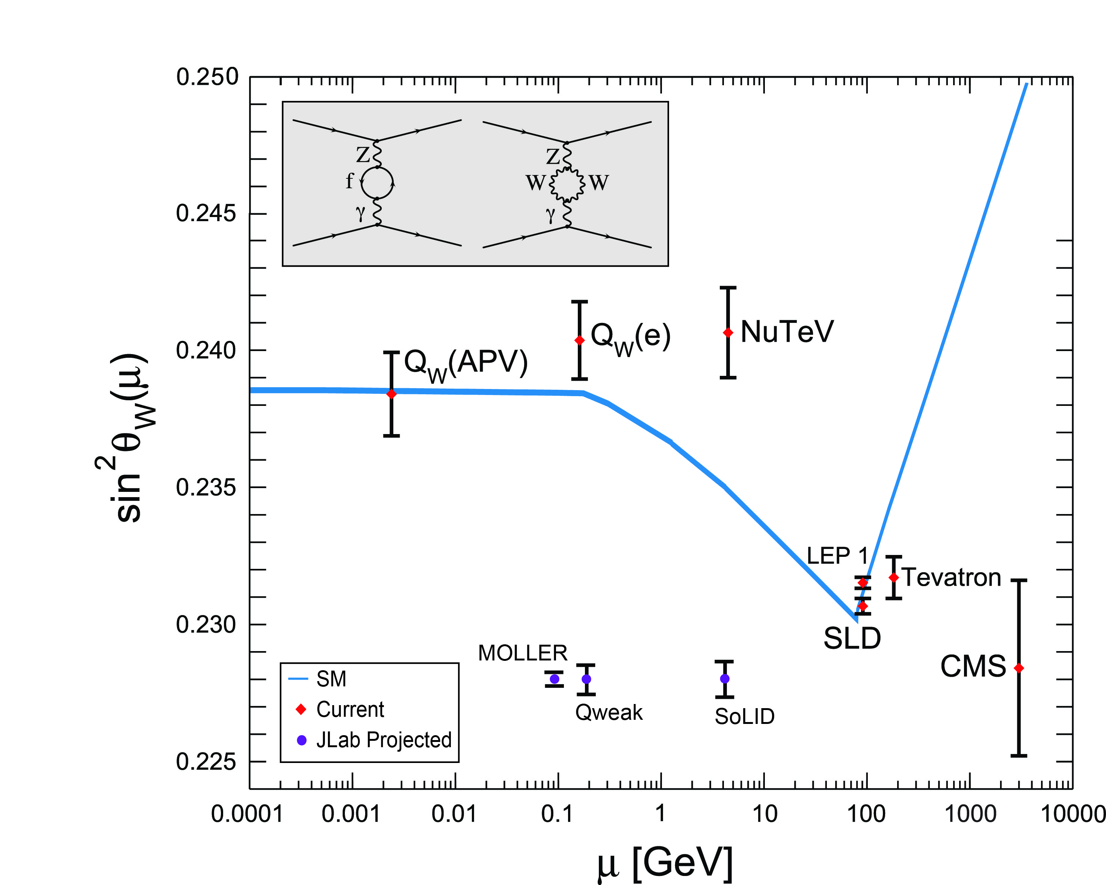
Chapter 5
Fundamental Symmetries and Neutrinos
JLab
Data
Projected
JLab data:
Future CEBAF data on parity violating electron scattering provides a high precision test of the standard model, complementary to measurements at LHC

Slide 15
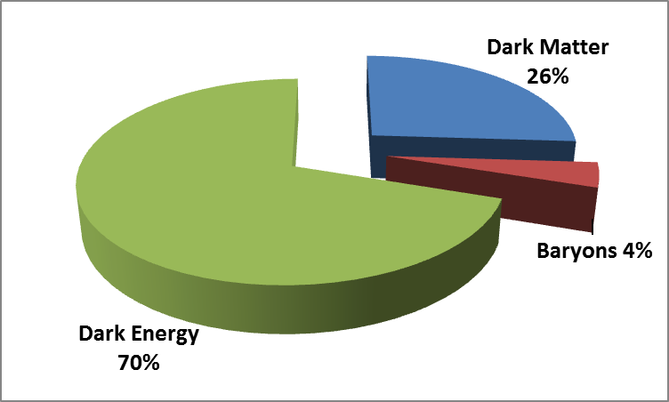
Chapter 5
Fundamental Symmetries and Neutrinos
CEBAF experiments will search for heavy photons, postulated particles that may communicate with dark matter.
HPS

Slide 16
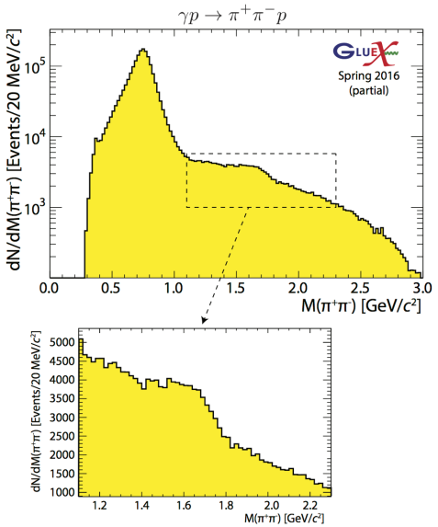
New Results from GlueX
ρ’
Study polarization observables!

Slide 17
More New Results from GlueX
Four photon final states
Clear signals for σ, f₀(980), f₂(1270),
a₀(980) and a₂(1320).

Slide 18

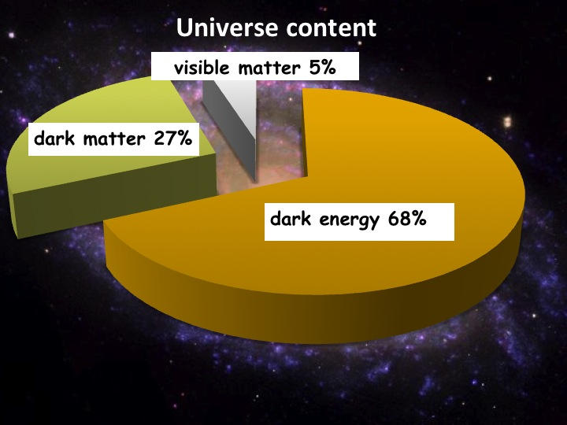
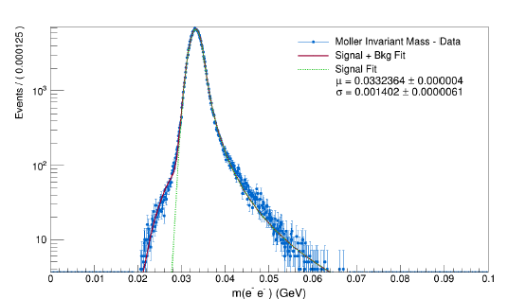
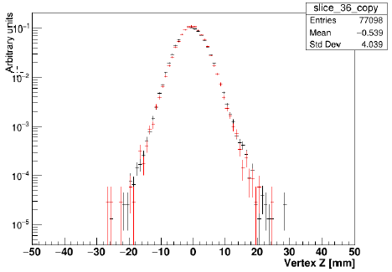
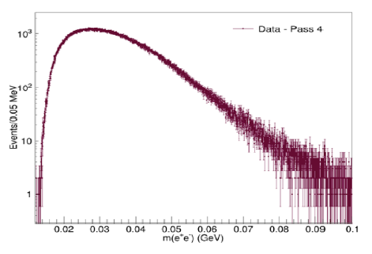
Heavy Photon Search
HPS searches for an electro-produced hidden sector photon (A’) which decays to e⁺e⁻ pairs
A’s could mediate dark matter annihilations and interactions with our matter
HPS identifies A’s with invariant mass and separated vertices
Successful 2015 Engineering Run at 1.05 GeV
HPS Works as Designed
JLAB has granted approval for full HPS run request
Mass Resolution ~ Design
Vertex Tails as Simulated
Measured e⁺e⁻ Masses

Slide 19
Search Underway. Results Soon!
First results at 1.05 GeV (~1.6 PAC days)
  Bump hunt due late summer will
  cross-check well trod region.
  Vertex search end of 2016 will cover virgin territory. New physics?
Results at 2.3 GeV (~ 5 PAC days)
  Both bump hunt and vertex search analyses cover a higher mass window
  More new territory!
  Hope for results in 2017
HPS Future
  Hope to install upgrade before 2018 which will boost reach considerably
  Extended run at 4.4 GeV (2018?)
  More runs at 1.1 and 2.3 GeV
2 PAC days at 1 GeV
Bump
Vertex
1 GeV
2.2 GeV
4.4 GeV
1 week 1.1 GeV
1 week 2.2 GeV
2 week 4.4 GeV

Slide 20
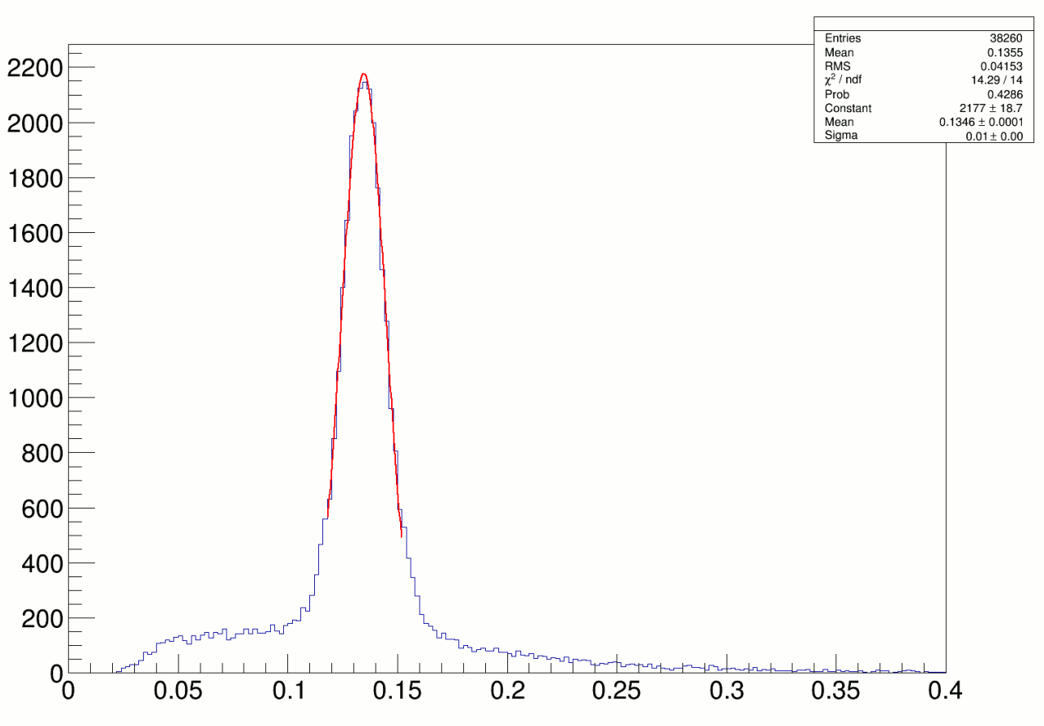
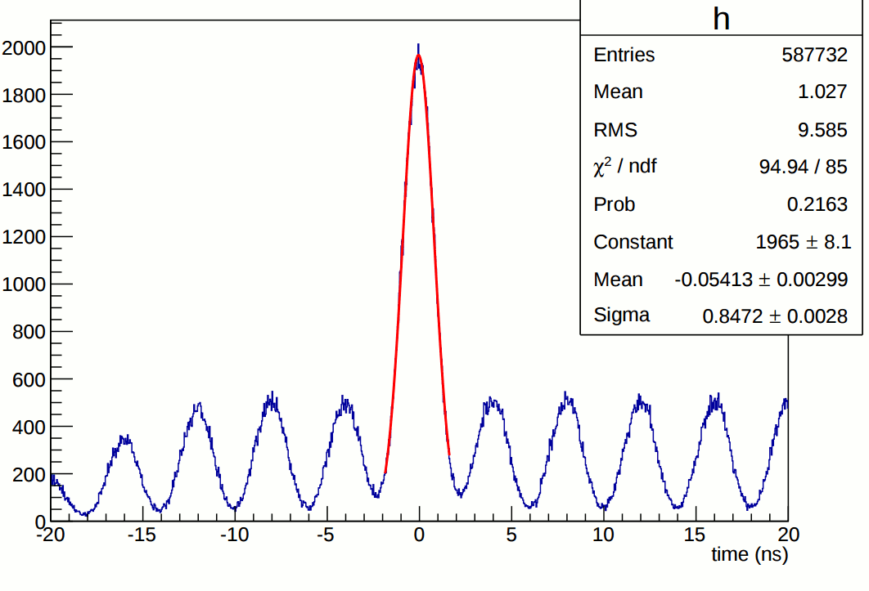
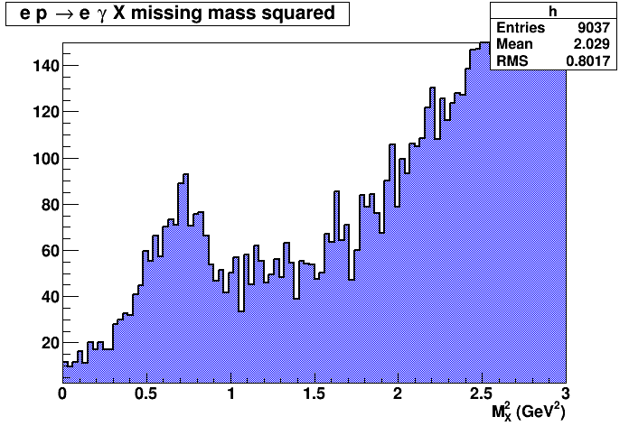
E12-06-114 DVCS/Hall A experiment at 11 GeV
Excellent coincident time resolution:
250 MHz beam structure
π⁰ ’s reconstructed in DVCS calorimeter
100 PAC days approved:
High impact experiment for nucleon 3D imaging program
High precision scaling tests of the DVCS cross section at constant x_{B}
CEBAF12 will allow to explore for the first time the high x_{B} region
DVCS events
(1.5 h of beamtime)
16% of experiment completed in 2014-2016
20

Slide 21
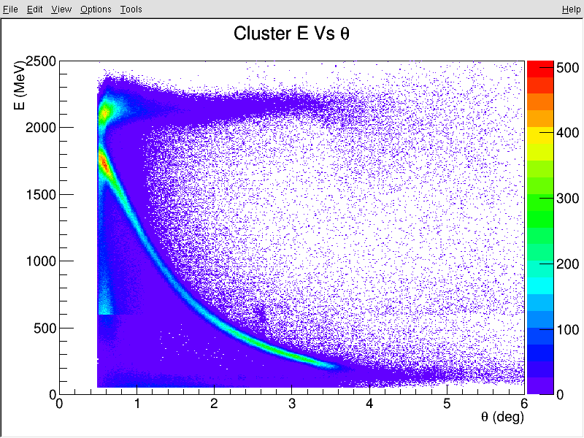
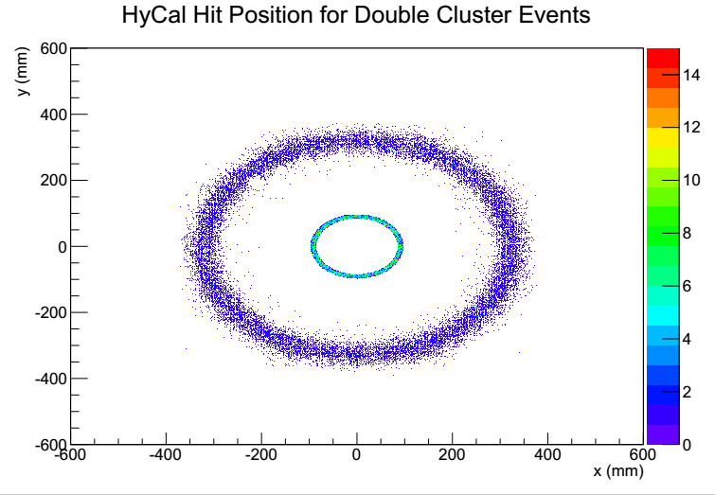
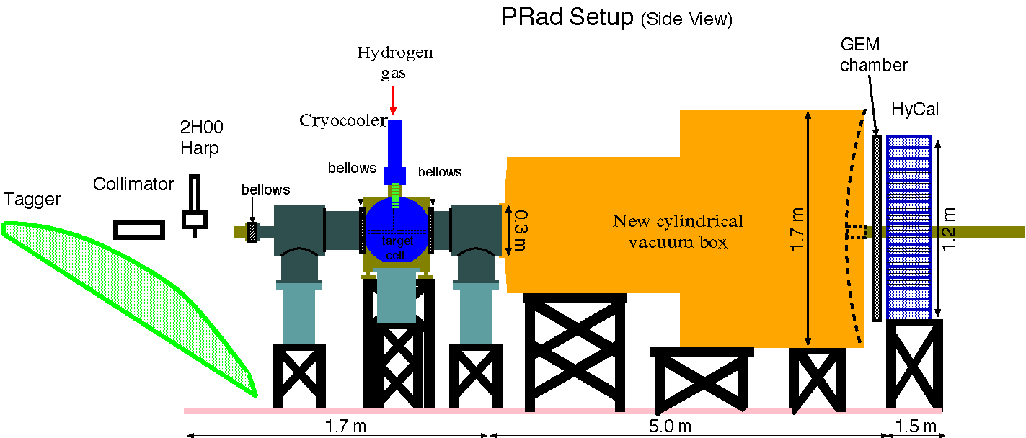
PRad
Experimental goals:
Reach very low Q2 range (~ 10 times less
than the Mainz experiment)
Reach sub-percent precision in rp extraction
Suggested solutions:
1) Non-magnetic-spectrometer method:
use high resolution high acceptance calorimeter
and high position resolution GEM detector
2) Simultaneous detection of ee → ee Moller scattering
(best known control of systematics)
3) Use high density windowless H2 gas flow target:
minimize experimental background
Two beam energies: 1.1, 2.2 GeV; Q² = (2x10⁻⁴ – 1x10⁻¹ ) GeV²
ep
Preliminary
e-e
Preliminary
21

Slide 22

Recommendations
RECOMMENDATION I
The progress achieved under the guidance of the 2007 Long Range Plan has reinforced U.S. world leadership in nuclear science. The highest priority in this 2015 Plan is to capitalize on the investments made.
Operate 12 GeV CEBAF
RECOMMENDATION II
We recommend the timely development and deployment of a U.S.-led ton-scale neutrinoless double beta decay experiment.
RECOMMENDATION III
We recommend a high-energy high-luminosity polarized EIC as the highest priority for new facility construction following the completion of FRIB.
· JLEIC development
RECOMMENDATION IV
We recommend increasing investment in small-scale and mid-scale projects and initiatives that enable forefront research at universities and laboratories.
· MOLLER, SoLID
22

Slide 23
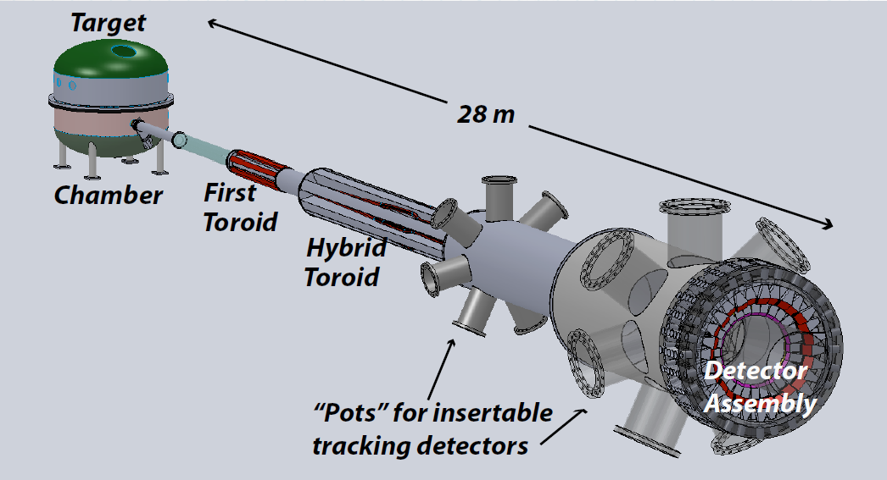

Future Projects
MOLLER experiment
(Possible MIE – FY17-20)
– Standard Model Test
– DOE science review (September 2014) – strong endorsement
– JLab technical, cost & schedule review this fall
– Now hope for FY18 start
SoLID
– CLEO Solenoid 
– Chinese collaboration
– Director’s review (Feb. 2015)
 lots of good feedback
– Collaboration briefing to DOE-NP
(Nov. 2015)

Slide 24

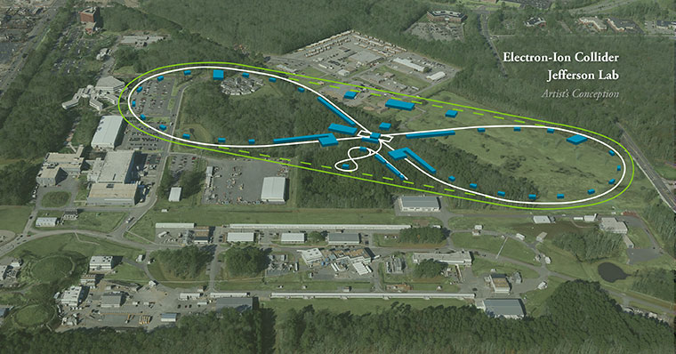
EIC at Jefferson Lab

Slide 25
Chapter 6
Theoretical Nuclear Physics
“We recommend new investments in computational
nuclear theory that exploit the U.S. leadership in
high-performance computing. These investments
include a timely enhancement of the nuclear physics
contribution to the Scientific Discovery through
Advanced Computing program and complementary
efforts as well as the deployment of the necessary
capacity computing.”
JLab hosts 1 of 2 NP Lattice QCD clusters
ASCR/SciDAC- supported software development continues to be critical
New appts – W&M joint and bridge in Lattice QCD
Helping lead NP into the Exascale arena
25

Slide 26

Experiment and Theory
Bright Future
High precision Lattice QCD calculations
enabled by exascale
High precision experimental studies of QCD
enabled by 12 GeV CEBAF
and future EIC
26

Slide 27


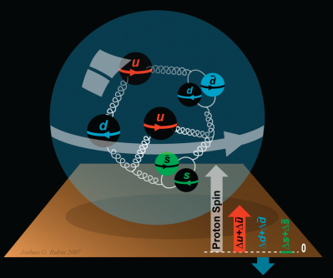
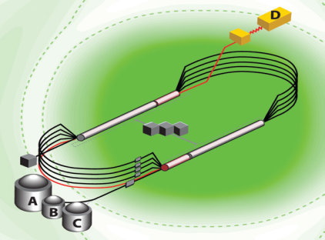
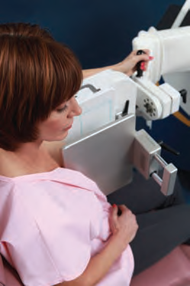
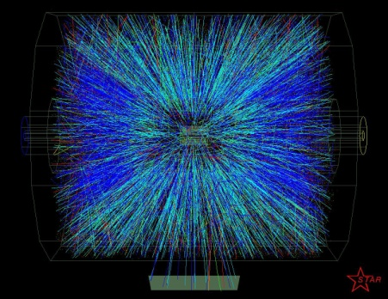


Summary and Outlook
12 GeV experimental program well developed
(Thanks Mike Pennington!)
Project construction mostly complete
Experiments on the floor have done well – hope for early results soon
MOLLER and SoLID moving along
EIC science and designs are making good progress
Mike Pennington has had a tremendous impact,
he will be sorely missed

