Slide 1
STUDY of Λ-Hypernuclei with Electromagnetic Probes at JLAB
Liguang Tang
Department of Physics, Hampton University
&
Jefferson National Laboratory (JLAB)
July 31 & Aug. 1, 2009, OCPA6 Satellite Meeting on Hadron Physics, Lanzhou University

Slide 2
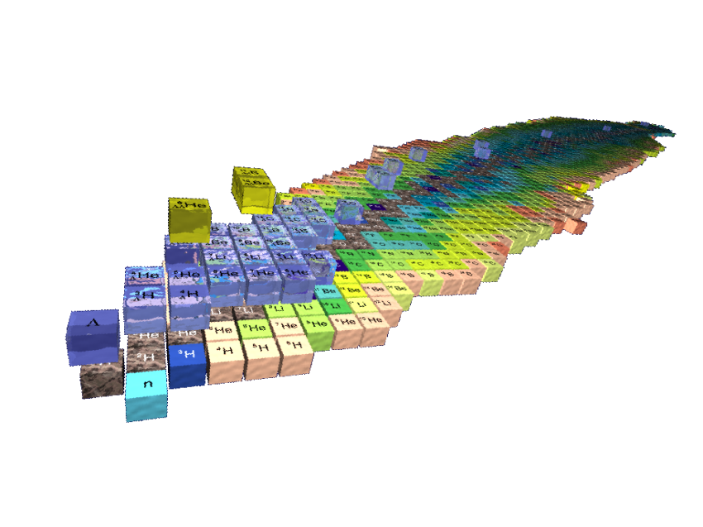
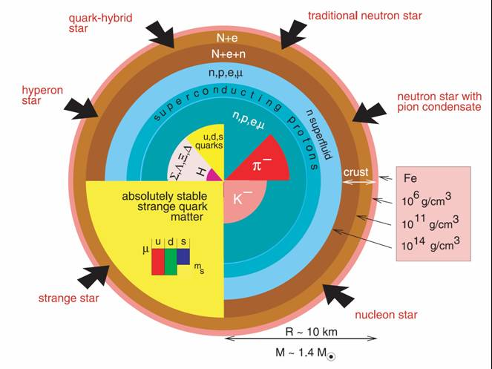
Introduction – Baryonic Interactions
Baryonic interaction B-B is the important nuclear force that builds the “foundation of world”;
H (1p)
C (3α )
Astronomical Scale - Neutron Stars -
He
(α - 2p, 2n)
Fully understand B-B beyond basic N-N (p and n) interaction is essential

Slide 3
Introduction – J^{p}=1/2⁺ Baryon Family
S - Strangeness
I₃ = -1/2
I₃ = +1/2
Nucleon (N)
I - Isospin
n
^{(udd)}
S = 0
p⁺
^{(uud)}
Hyperon (Y)
I₃ = -1
I₃ = 0
I₃ = +1
Σ⁻
^{(dds)}
Λ,Σ⁰
^{(uds)}
S = -1
Σ⁺
^{(uus)}
S
Q
Ξ⁻
^{(dss)}
S = -2
Ξ⁰
^{(uss)}
I

Slide 4
Introduction – J^{p}=1/2⁺ Baryon Family
Our current knowledge is limited at N-N level.
Study Y-N and Y-Y interactions is important for an unified description of B-B interaction and a gate way to include additional flavors
Λ-N interaction is the most fundamental one
The appearance of Y’s in the core of neutron stars is now believed important to stabilize the mass and density
Unfortunately, Y beam does not exist because of the short lifetime of hyperons, among which Λ has the longest lifetime because it decays via weak interactions only, τ = 2.6×10⁻¹⁰ sec. Direct scattering experiment is almost impossible.

Slide 5
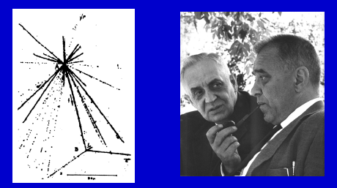
Introduction – Hypernuclei
A nucleus with one or more nucleons replaced by hyperon, Λ, Σ, …
A Λ-hypernucleus is the nucleus with either a neutron or proton being replaced by a Λ hyperon
Since first hypernucleus found 50 some years ago, hypernuclei have been used as rich laboratory to study YN and YY interactions
Discovery of the first hypernucleus by pionic decay in emulsion produced by cosmic rays, Marian Danysz and Jerzy Pniewski, 1952

Slide 6
Introduction – Λ-Hypernuclei
Sufficient long lifetime, g.s. Λ-hypernucleus decays only weakly via Λ → π N or ΛN→ NN, thus mass spectroscopy with narrow states (~100 keV) exists
Description of a Λ-hypernucleus within two-body frame work – Nuclear Core (Particle hole) ⊗ Λ (particle):
(Few example states)
(Example of the lowest mass states)
P
7/2⁺ & 5/2⁺
⊗ Λ
¹²_{Λ}C or ¹²_{Λ}B substitution states
5/2⁻ & 3/2⁻
S
1/2⁻
¹²_{Λ}C or ¹²_{Λ}B core excitations
⊗ Λ
3/2⁻
⊗ Λ
¹²_{Λ}C or ¹²_{Λ}B g.s. (deeply bound)
¹¹C or ¹¹B Core

Slide 7
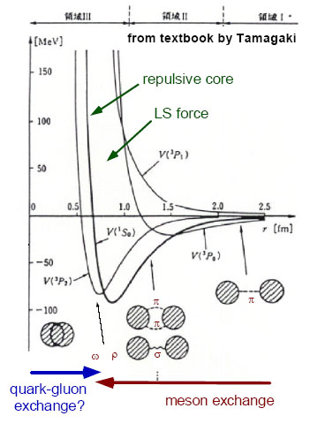
Introduction – Λ-Hypernuclei (cont.)
Two-body effective Λ-Nucleus potential (Effective theory):
V_{ΛN}(r) = V_{c}(r) + V_{s}(r)(S_{Λ}•S_{N}) + V_{Λ}(r)(L_{N}•S_{Λ}) + V_{N}(r)(L_{Λ}•S_{N}) + V_{T}(r)S₁₂
The right Λ-N and Λ-Nucleus models must correctly describe the mass spectroscopy (Λ binding energies, excitations, spin/parities, …)
A novel feature of Λ-hypernuclei
  Short range interactions
  Change of core structures
  (Isomerism?)
  Glue-like role of Λ
  (shrinkage of nuclear size)
  Drip line limit
No Pauli blocking to Λ
  Probe the nuclear interior
  Baryonic property change
Important for Λ−N
& Λ-Nucleus Int.
Λ N

Slide 8
Production of Λ-Hypernuclei
(K, π) Reaction
(π, K) Reaction
K⁻
π⁻
π⁺
K⁺
CERN → BNL → KEK & DAΦNE → J-PARC (Near Future)
n
Λ
n
Λ
A
_{Λ}A
A
_{Λ}A
Low momentum transfer
Higher production cross section
Substitutional, low spin, & natural parity states
Harder to produce deeply bound states
High momentum transfer
Lower production cross section
Deeply bound, high spin, & natural parity states
(e, e’K) Reaction
e
e’
γ
K⁺
CEBAF at JLAB
(MAMI-C Near Future)
p
Λ
A
_{Λ}A
High momentum transfer
Small production cross section
Deeply bound, highest possible spin, & unnatural parity states
Neutron rich hypernuclei

Slide 9
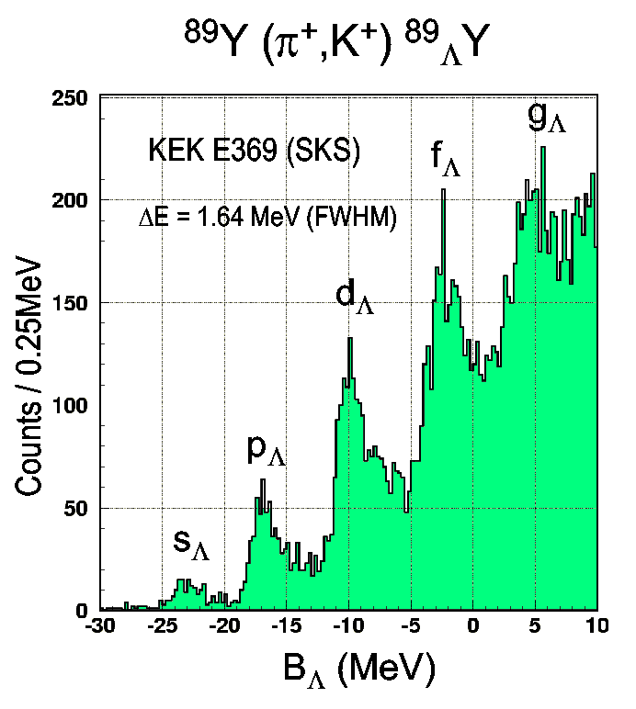
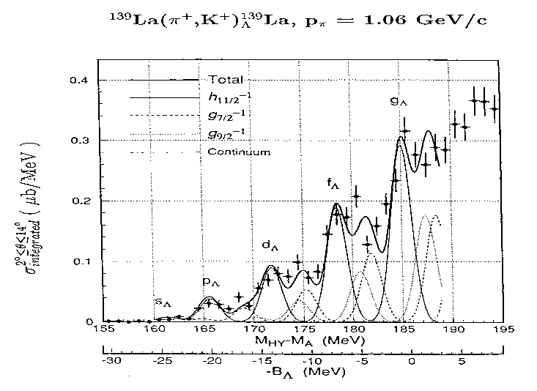
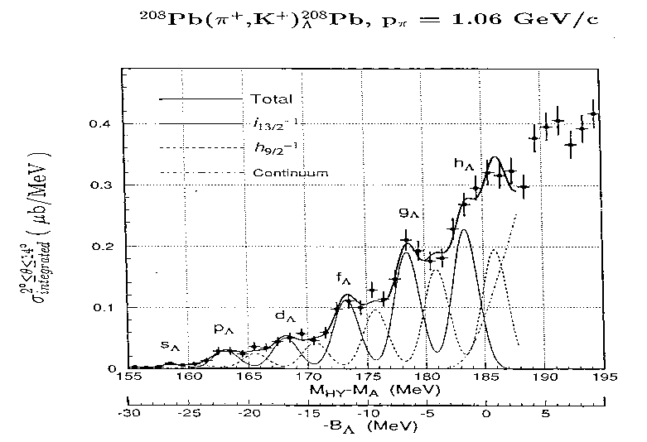
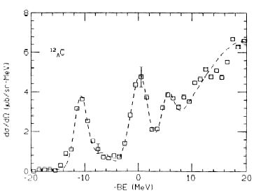
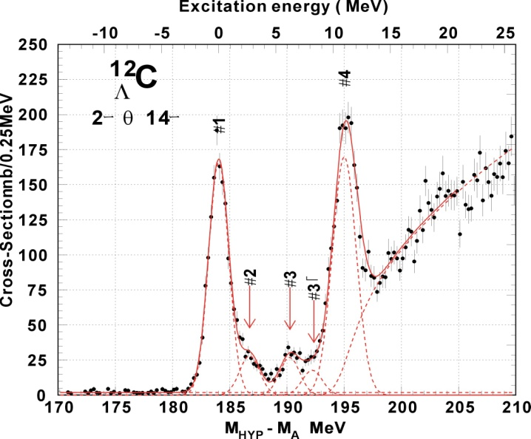
Keys to the Success on Λ-Hypernuclei
Textbook example of single-particle orbits in nucleus (limited resolution: ~1.5 MeV)
Energy Resolution
Hotchi et al., PRC 64 (2001) 044302
Precision on Mass
Hasegawa et. al., PRC 53 (1996)1210
Λ single particle states ⇒ Λ-nuclear potential depth = -30 MeV ⇒ V_{ΛN} < V_{NN}
KEK E140a
BNL: 3 MeV(FWHM)
KEK336: 2 MeV(FWHM)
KEK E369 : 1.45 MeV(FWHM)
¹²_{Λ}C
High Yield Rate

Slide 10
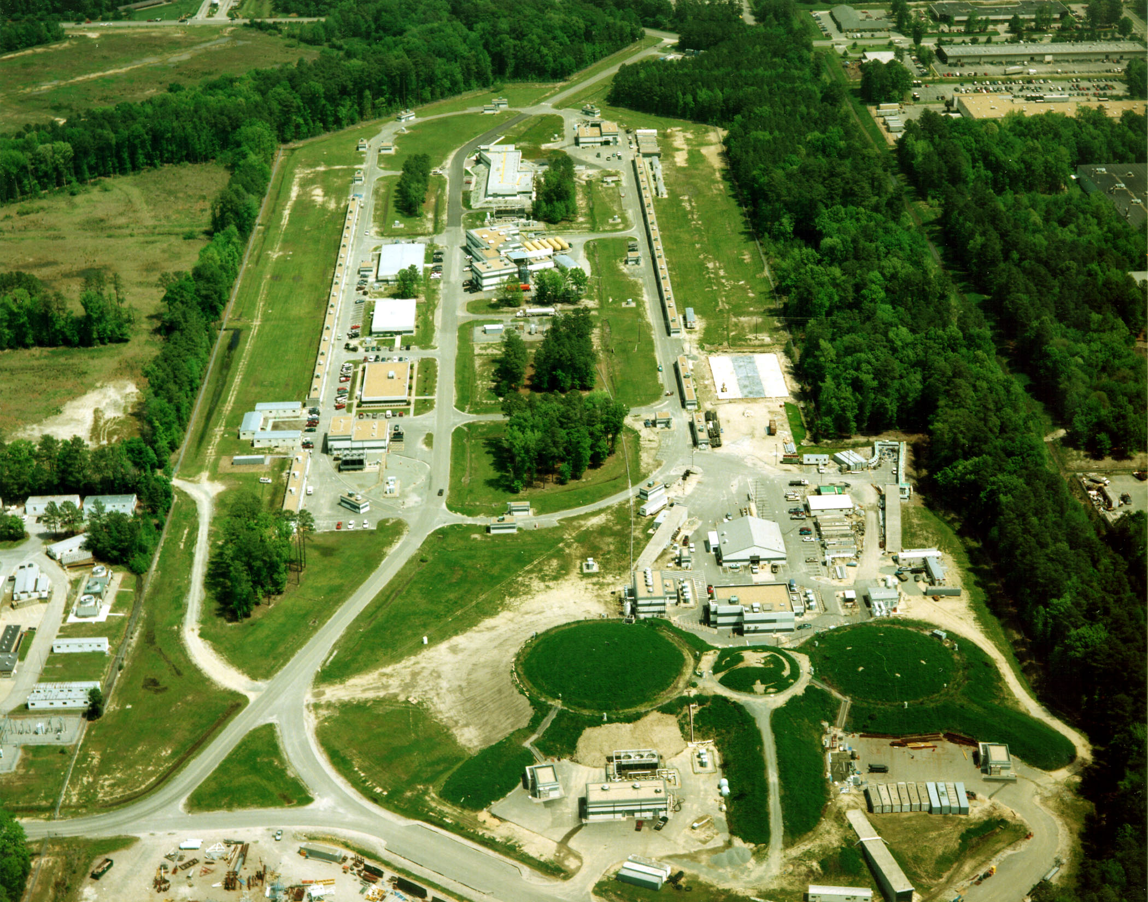
Continuous Electron Beam Accelerator Facility (CEBAF)
East Arc
CW Beam (1 – 5 passes)
2 ns pulse separation
1.67 ps pulse width
~10⁻⁷ emittance
I_{max} ≈ 100μA
FEL
North
Linac
+400MeV
South
Linac
+400MeV
MCC
Hyperon Physics
Electro- & photo-production
West Arc
Injector
A
C
B
Hypernuclear Physics
(e, e’ K⁺) reaction

Slide 11
Hypernuclear Physics Programs at JLAB
Established: High precision mass spectroscopy of Λ-hypernuclei with wide mass range. (Hall C program will be shown as an example)
Proposing: High precision decay pion spectroscopy for light and exotic Λ-hypernuclei

Slide 12
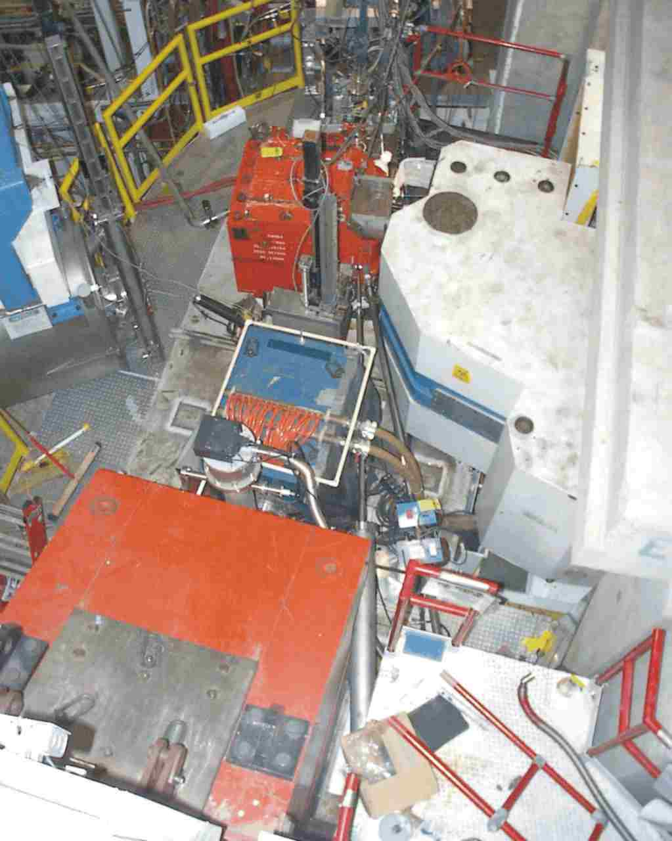
Hypernuclear Physics Programs in Hall C
E89-009 (Phase I, 2000) – Feasibility
Existing equipment
Common Splitter – Aims to high yield
Zero degree tagging on e’
Electron beam
  High accidental background → Low luminosity → Low yield
Side View
e’
K
+
  Sub-MeV resolution – 800 keV FWHM)
_
Target
D
D
Splitter
K⁺
Q
Top View
  First mass spectroscopy on ¹²_{Λ}B using the (e, e’K⁺) reaction
  T. Miyoshi, et al., Phys. Rev. Lett. Vol.90 , No.23, 232502 (2003)
  L. Yuan, et al., Phys. Rev. C, Vol. 73, 044607 (2006)
_
Q
Electron
K
+
D
D
Beam
(1.645 GeV)
Target
Focal Plane
( SSD + Hodoscope )
SOS spectrometer (K⁺)
Mom. resolution: 6×10⁻⁴ FWHM
Solid angle acceptance : 5msr
Central angle: 2 degrees
Beam Dump
0
1m
ENGE Spectrometer (e’)
Mom. resolution: 5×10⁻⁴ FWHM
Solid angle acceptance: 1.6msr

Slide 13
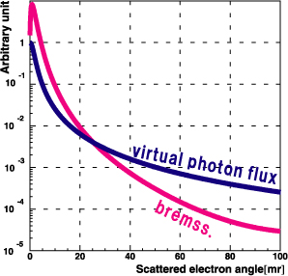
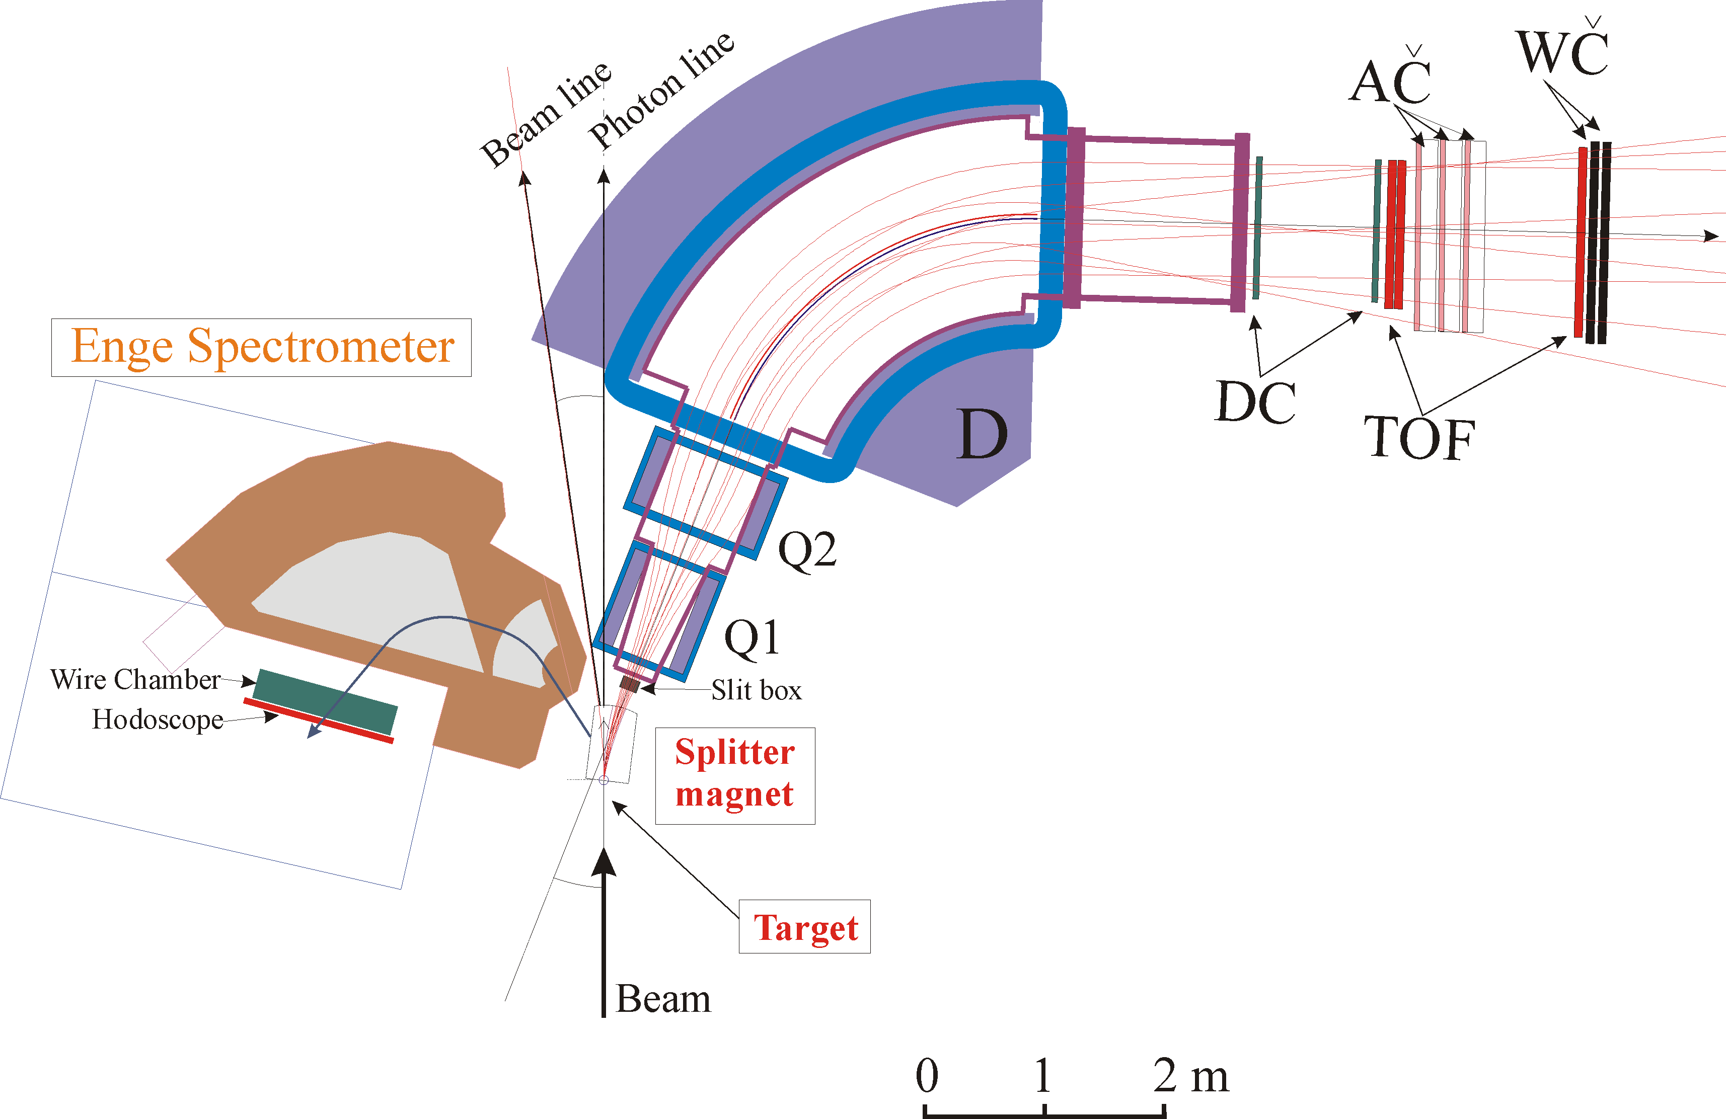
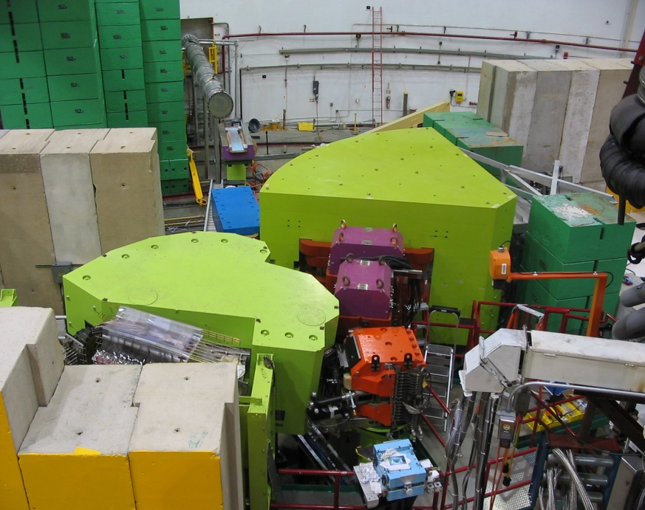
Hypernuclear Physics Programs in Hall C
E01-011/HKS (Phase II, 2005) – First upgrade
Replaced SOS by HKS w/ new KID system
Tilted Enge (7.5º) with a small vertical shift
HKS
Mom. Resolution: 2x10⁻⁴ FWHM
Solid angle acceptance: 15msr
E_{e}=1850 MeV
w=1494 MeV
  Electron single rate reduction factor – 0.7x10⁻⁵
  Allowed higher luminosity – 200 times higher
K⁺
  Physics yield rate increase – 10 times
e’
To beam dump
  Energy resolution improvement – ∼450 keV FWHM
  Hypernuclei: ⁷_{Λ}He, ¹²_{Λ}B, ²⁸_{Λ}Al, …
Tilted Enge
Mom. Resolution: 5x10⁻⁴ FWHM
Scattering angle: ∼4.5º
Electron beam

Slide 14
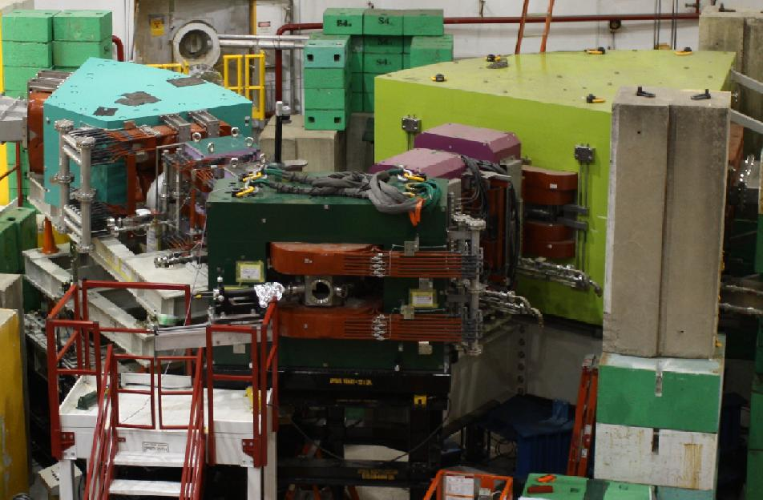
Hypernuclear Physics Programs in Hall C
E05-011/HKS-HES (Phase III, 2009) – Second upgrade
Replaced Enge by new HES spectrometer for the electron arm
Tilted HES
Mom. Resolution: 2x10⁻⁴ FWHM
Angular acceptance: ∼10msr
e’
  10 times more physics yield rate than HKS (100 HNSS)
e
γ
  Further improvement on resolution (~350 keV) and precision
  Hypernuclei: ^{6,7}_{Λ}He, ⁹_{Λ}Li, ^{10,11}_{Λ}Be, ¹²_{Λ}B, ²⁸_{Λ}Al, ⁵²_{Λ}V, ⁸⁹_{Λ}Sr
K⁺
Beam
2.4 GeV
HKS
Remain the same

Slide 15
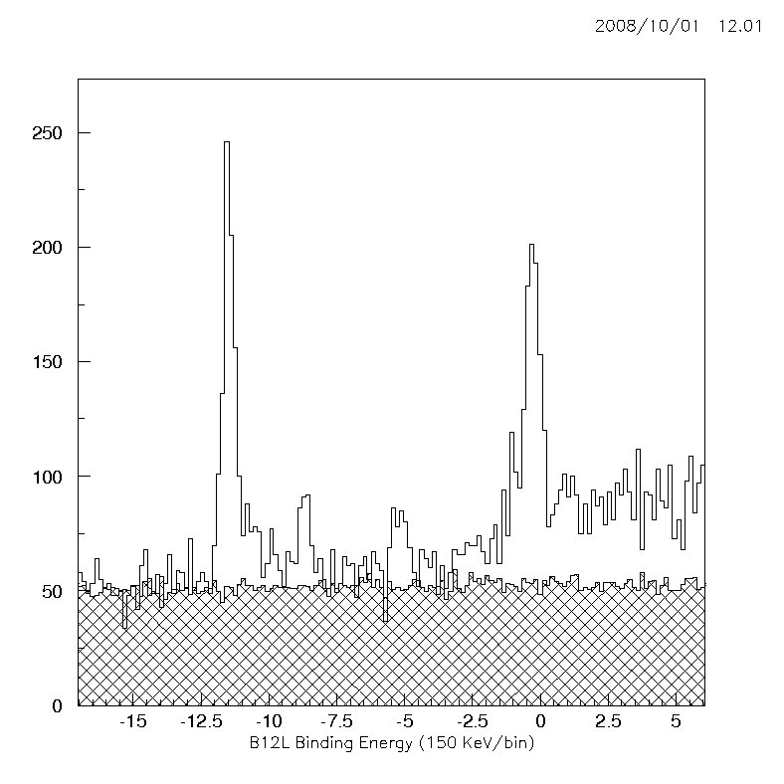
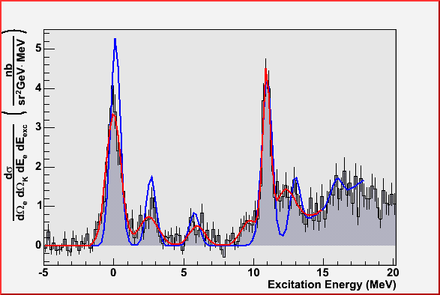
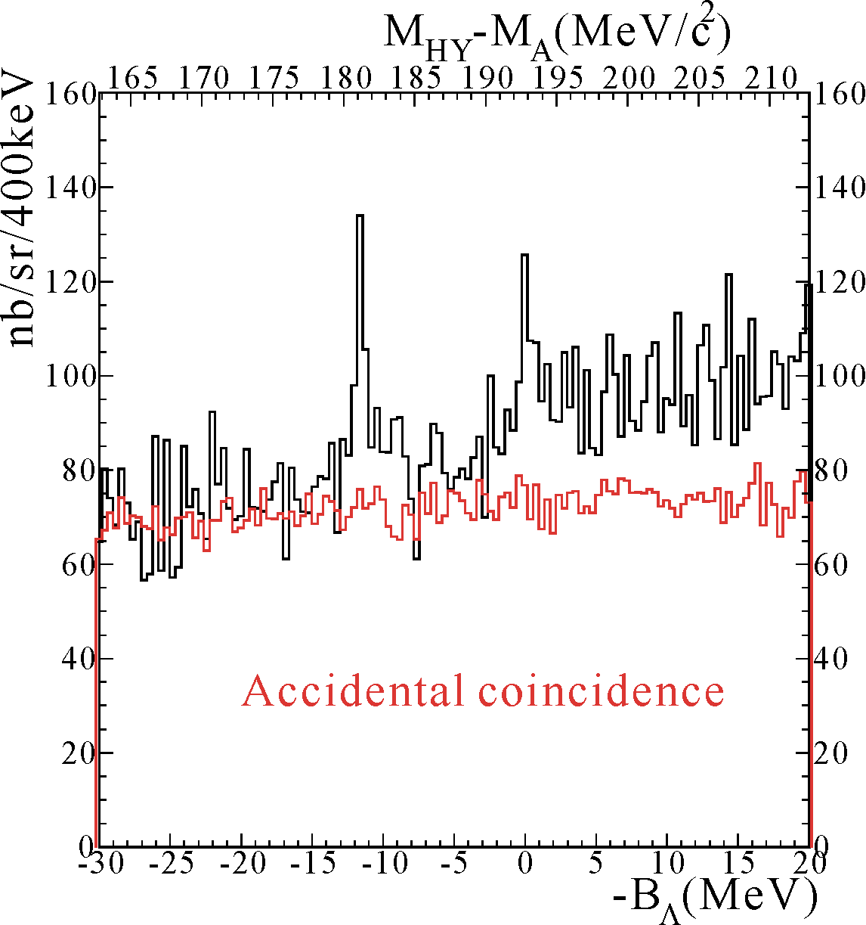
Highlights: Spectroscopy of ¹²_{Λ}B
¹²C(e, e’K⁺)¹²_{Λ}B, Phase II in Hall C
E94-107 in Hall A (2003 & 04)
Phase I in Hall C
HKS 2005
~450 keV
FWHM
~635 keV
FWHM
Λ_{s}
(2⁻/1⁻)
E89-009 ¹²_{Λ}B spectrum
HNSS in 2000
Λ_{p}
(3⁺/2⁺’s)
Λ_{s}
(2⁻/1⁻)
Λ_{p}
(3⁺/2⁺’s)
~800 keV
FWHM
Λ_{s}
Λ_{p}
Core Ex. States
K⁺
Core Ex. States
Counts (150 keV/bin)
(π⁺,K⁺)¹²_{Λ}C
K⁺
1.2GeV/c
_
D
Phase I in Hall C
Red line: Fit to the data
Blue line: Theoretical curve: Sagay Saclay-Lyon (SLA) used for the elementary K-Λ electroproduction on proton. (Hypernuclear wave function obtained by M.Sotona and J.Millener)
M.Iodice et al., Phys. Rev. Lett. E052501, 99 (2007)
Accidentals
E89-009 ¹²_{Λ}B spectrum
~800 keV
FWHM
Λ_{s}
Λ_{p}
HNSS in 2000
Local Beam Dump
K⁺
B_{Λ} (MeV)
K⁺
1.2GeV/c
_
D
Local Beam Dump

Slide 16
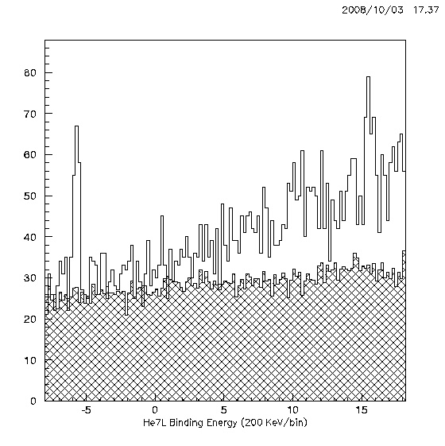
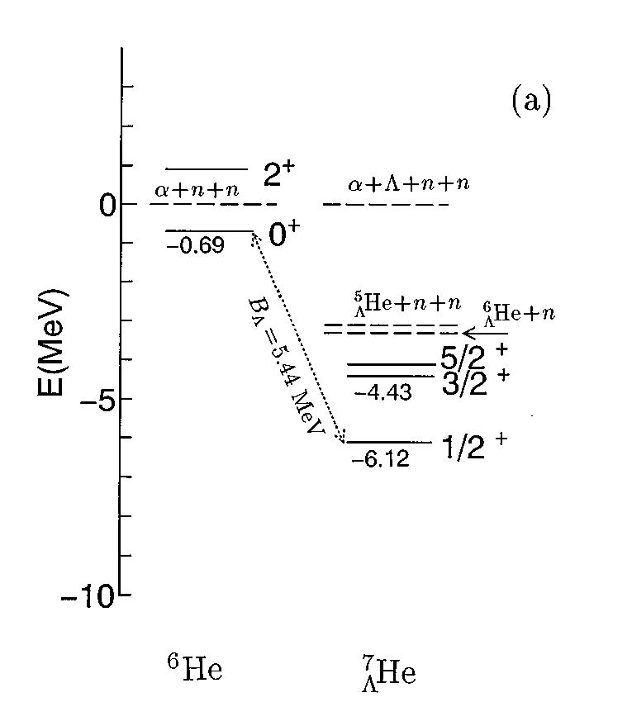
Highlights: Spectroscopy of ⁷_{Λ}He
⁷Li(e, e’K⁺)⁷_{Λ}He (n-rich)
1st observation of ⁷_{Λ}He G.S.
HKS
JLAB
HKS (Hall C) 2005
n
⁶He core
Λ_{s}
α
Λ
n
Counts (200 keV/bin)
Sotona
Accidentals
B_{Λ} (MeV)
E. Hiyama, et al., PRC53 2078 (1996)

Slide 17
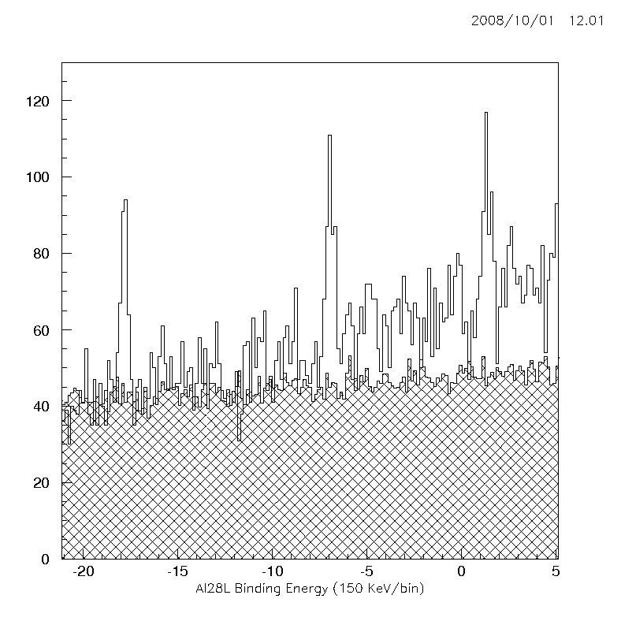
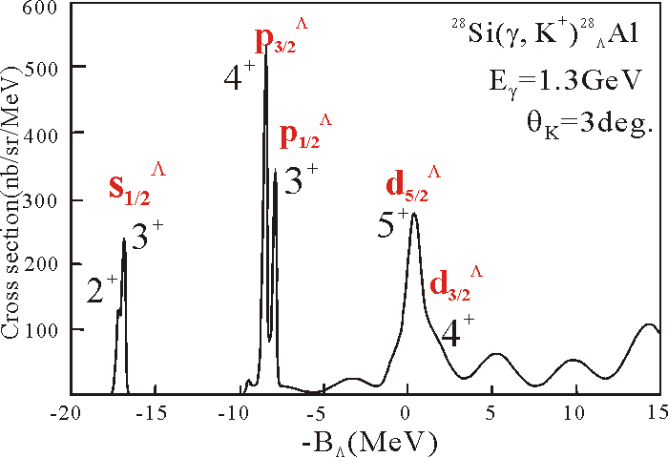
Highlights: Spectroscopy of ²⁸_{Λ}Al
²⁸_{Λ}Al
1st observation of ²⁸_{Λ}Al
~400 keV FWHM resol.
Clean observation of the shell structures
²⁸Si(e, e’K⁺)²⁸_{Λ}Al
HKS
JLAB
Λ_{d}
HKS (Hall C) 2005
Λ_{p}
Λ_{s}
Peak B_{Λ}(MeV) E_{x}(MeV) Errors (St. Sys.)
#1 -17.820 0.0 ± 0.027 ± 0.135
#2 -6.912 10.910 ± 0.033 ± 0.113
#3 1.360 19.180 ± 0.042 ± 0.105
Counts (150 keV/bin)
Accidentals
SKS
KEK E140a
²⁸Si(π⁺,K⁺)²⁸_{Λ}Si
Motoba with full (sd)^{n} wave function
B_{Λ} (MeV)

Slide 18
Decay Pion Spectroscopy for Light and Exotic Λ-Hypernuclei
e’
Example:
K⁺
Direct Production
¹²C
Ground state doublet of ¹²_{Λ}B
B_{Λ} and τ
e
p
¹²_{Λ}B_{g.s.}
2⁻
~150 keV
Λ
1⁻
0.0
¹²C_{g.s.}
π ⁻
Weak mesonic two body decay

Slide 19
Decay Pion Spectroscopy for Light and Exotic Λ-Hypernuclei
Fragmentation Process
e’
K⁺
Example:
Access to variety of light and exotic hypernuclei, some of which cannot be produced or measured precisely by other means
¹²C
e
p
¹²_{Λ}B*
Λ
α
⁴_{Λ}H
Λ
π ⁻
α
Weak mesonic two body decay (~10⁻¹⁰s)
Fragmentation (<10⁻¹⁶s)
⁴He

Slide 20
Electro-production of Hypernuclei and Hyperfragments from the Continuum
e
e’
e
e’
γ*
K⁺
γ*
K⁺
Background
p
Λ
p
Λ
A
_{Y}A
A
(A-1)
Direct production of Hypernuclei
Quasi-free Λ production (Continuum)
e
e’
e
e’
γ*
K⁺
γ*
K⁺
A rich source of a variety of light hypernuclei for new findings and discoveries
2B decay pion is used as the tool
N
Λ
N
p
Λ
p
A
_{Y}(A-1)
A_{a}
(A_{a}-1)
_{Y}(A_{b}-1)
A_{b}
Production of Hyperfragment (Continuum)
Production of Hyperfragment (Continuum)

Slide 21
Decay Pion Spectroscopy for Light and Exotic Λ-Hypernuclei
High precision on ground state light hypernuclei
  Resolution: ~130 keV FWHM; mass precision : < ±30 keV
  Precise Λ binding energy
  Charge symmetry breaking
Linkage between structures of hypernuclei and nuclei
  Determining ground state spin/parity
Search for Isomeric low lying states (Isomerism)
Study the drip line limit on Λ-hypernuclei, such as heavy hyper-hydrogen: ⁶_{Λ}H, ⁷_{Λ}H, and ⁸_{Λ}H
Medium modification of baryon property

Slide 22
Top View of the Experimental Layout
Figure 6. Schematic top view of the experimental configuration for the JLAB hypernuclear decay pion spectroscopy experiment (Hall A).
To Hall Dump
To a local photon dump
1.2 GeV/c
K⁺
HES
22mg/cm²
64mg/cm²
π⁻
94 – 140 MeV/c
2.3 GeV
Hall Z-axis

Slide 23
General Experimental Parameters
Beam energy | ~2.3 GeV
Luminosity (beam current × target thickness) | 60 μA × 64 mg/cm²
Target thickness toward HES | 22 mg/cm²
Target tilt angle | 20º
Average energy shift due to target straggling loss | ~40 keV
Momentum resolution due to target straggling | 61 keV/c (r.m.s.)
Experimental targets | Phase-I: ⁷Li; -II: ⁹Be; and -III: ¹²C
HKS central angle (horizontal) | 6º
HKS momentum and acceptance | P_{o} = 1.2 GeV/c and ±12.5%
HKS solid angle acceptance | 12 msr
HKS (K⁺) momentum resolution | 2 × 10⁻⁴ FWHM
HKS scattering angle resolution | 2.5 mr FWHM
HKS production time resolution | 130 ps (r.m.s.)
HES central angle (horizontal) | 110º
HES momentum and acceptance | P_{o} = 116 MeV/c and ±20%
HES solid angle acceptance | 20 msr
Detection efficiency | 80%
π⁻ survival rate | ~32%
Decay pion acceptance | 0.16%
HES (π⁻) mom. resolution w/ extended “beam spot” | 6 × 10⁻⁴ FWHM
HES scattering angle resolution | 6 mr FWHM
HES decay time resolution | 100 ps (r.m.s.)
Overall decay pion momentum resolution | 165 keV/c FWHM
Absolute energy scale precision | ~ ±20 keV

Slide 24
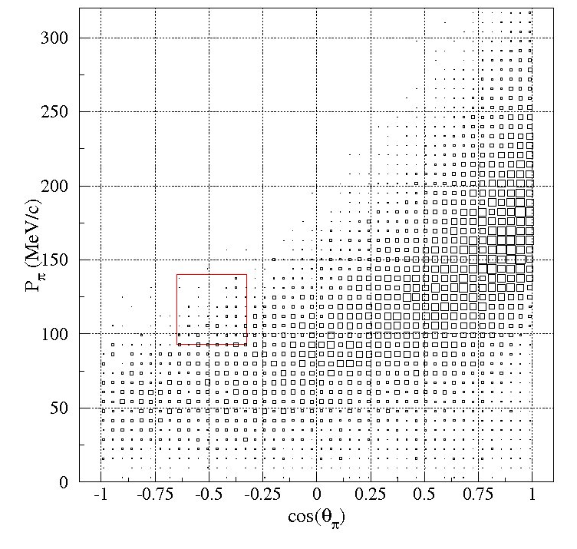
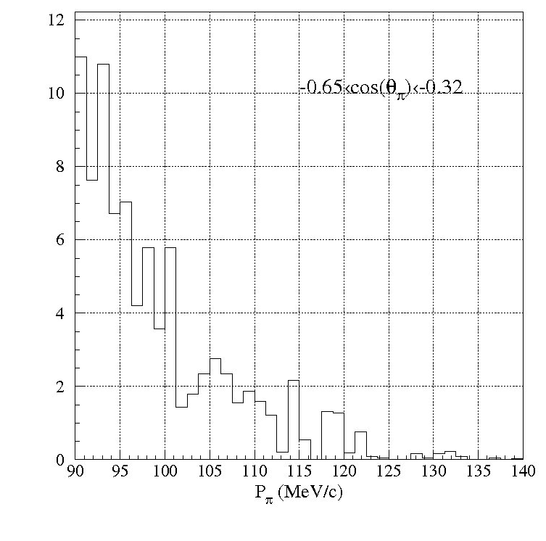
Free of Q.F. Λ Background
Quasi-free Λ → p + π⁻ (all)
Within the HES acceptances

Slide 25
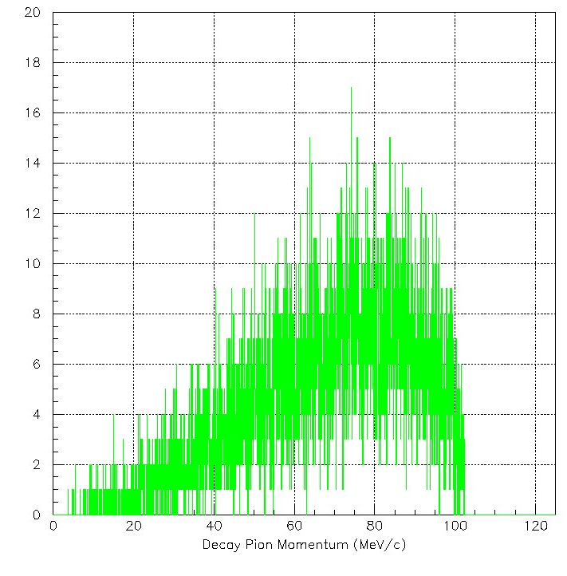
Three-Body Decay Background
Example: ⁴_{Λ}He → ³He + p + π⁻
P_{π} Acceptance

Slide 26
Hypernuclei from a ⁷Li Target
Two-Body decay – 6 possible hypernuclei
Breakup Mode | Q value (MeV) | π⁻ Decay | P_{π} (MeV/c) | Width (keV/c) FWHM
⁷_{Λ}He | - | ⁷Li + π⁻ | 114.61 | 165
p + ⁶_{Λ}H | -23.503 (B_{Λ}=5.1) | ⁶He + π⁻ | 133.47 | 165
n + ⁶_{Λ}He | -3.409 | ⁶Li + π⁻ | 108.39 | 165
d + ⁵_{Λ}H | -23.011 (B_{Λ}=4.1) | ⁵He + π⁻ | 133.42 | ~900*
³H + ⁴_{Λ}H | -16.995 | ⁴He + π⁻ | 132.95 | 165
⁴H + ³_{Λ}H | -26.981 | ³He + π⁻ | 114.29 | 165
Three-Body decay – Background
Breakup Mode | Q value (MeV) | π⁻ Decay | P_{π} max (MeV/c) – cut off
d + ⁵_{Λ}H | -23.011 (B_{Λ}=4.1) | ⁴He + n + π⁻ | 139.27*
2n + ⁵_{Λ}He | -3.567 | ⁴He + p + π⁻ | 102.42
3n + ⁴_{Λ}He | -24.868 | ³He + p + π⁻ | 103.15

Slide 27
Hypernuclei from a ⁹Be Target
Two-Body decay – 6 additional hypernuclei
Breakup Mode | Q value (MeV) | π⁻ Decay | P_{π} (MeV/c) | Width (keV/c) FWHM
⁹_{Λ}Li | - | ⁹Be + π⁻ | 121.18 | 165
p + ⁸_{Λ}He | -13.817 | ⁸Li + π⁻ | 116.40 | 165
n + ⁸_{Λ}Li | -3.756 | ⁸Be + π⁻ | 124.12 | 165
2p + ⁷_{Λ}H | -40.328 (B_{Λ}=6.1) | ⁷He + π⁻ | 135.17 | ~270*
d + ⁷_{Λ}He | -12.568 | ⁷Li + π⁻ | 114.61 | 165§
2n + ⁷_{Λ}Li | -12.218 | ⁷Be + π⁻ | 108.02 | 165
³He + ⁶_{Λ}H | -29.608 (B_{Λ}=5.1) | ⁶He + π⁻ | 133.47 | 165§
³H + ⁶_{Λ}He | -9.745 | ⁶Li + π⁻ | 108.39 | 165§
3n + ⁶_{Λ}Li | -18.957 | ⁶Be + π⁻ | 100.58 | ~220**
α + ⁵_{Λ}H | -11.749 (B_{Λ}=4.1) | ⁵He + π⁻ | 133.42 | ~900*§
n + α + ⁴_{Λ}H | -12.005 | ⁴He + π⁻ | 132.95 | 165§
⁶He + ³_{Λ}H | -18.183 | ³He + π⁻ | 114.29 | 165§

Slide 28
Hypernuclei from a ¹²C Target
Two-Body decay – 12 additional hypernuclei
Breakup Mode | Q value (MeV) | π⁻ Decay | P_{π} (MeV/c) | Width (keV/c) FWHM
¹²_{Λ}B | - | ¹²C + π⁻ | 115.49 | 165
p + ¹¹_{Λ}Be | -12.280 (B_{Λ}=10.5) | ¹¹B + π⁻ | 109.66 | 165
n + ¹¹_{Λ}B | -12.765 | ¹¹C + π⁻ | 105.99 | 165
2p + ¹⁰_{Λ}Li | -32.908 (B_{Λ}=12.3) | ¹⁰Be + π⁻ | 119.78 | 165
d + ¹⁰_{Λ}Be | -18.264 | ¹⁰B + π⁻ | 104.31 | 165
2n + ¹⁰_{Λ}B | -22.544 | ¹⁰C + π⁻ | 95.84 | 165
3p + ⁹_{Λ}He | -48.534 (B_{Λ}=7.8) | ⁹Li + π⁻ | 117.83 | 165
³He + ⁹_{Λ}Li | -30.237 | ⁹Be + π⁻ | 121.18 | 165§
³H + ⁹_{Λ}Be | -16.072 | ⁹B + π⁻ | 96.88 | 165*
3n + ⁹_{Λ}B | -41.713 | ⁹C + π⁻ | 96.71 | 165
4p + ⁸_{Λ}H | -68.937 (B_{Λ}=7.1) | ⁸He + π⁻ | 137.15 | 165
⁴Li + ⁸_{Λ}He | -46.961 | ⁸Li + π⁻ | 116.40 | 165§
α + ⁸_{Λ}Li | -14.444 | ⁸Be + π⁻ | 124.12 | 165§
⁴H + ⁸_{Λ}Be | -37.659 | ⁸B + π⁻ | 97.09 | 165
4n + ⁸_{Λ}B | -56.317 (B_{Λ}=6.7) | ⁸C + π⁻ | 97.21 | 365**
p + ⁴Li + ⁷_{Λ}H | -73.473 (B_{Λ}=6.1) | ⁷He + π⁻ | 135.17 | ~270*§
⁵Li + ⁷_{Λ}He | -26.436 | ⁷Li + π⁻ | 114.61 | 165§
⁵He + ⁷_{Λ}Li | -25.782 | ⁷Be + π⁻ | 108.02 | 165§
⁶Be + ⁶_{Λ}H | -48.317 (B_{Λ}=5.1) | ⁶He + π⁻ | 133.47 | 165§
⁶Li + ⁶_{Λ}He | -24.186 | ⁶Li + π⁻ | 108.39 | 165§
⁶He + ⁶_{Λ}Li | -27.663 | ⁶Be + π⁻ | 100.58 | ~220**§
⁷Be + ⁵_{Λ}H | -44.499 (B_{Λ}=4.1) | ⁵He + π⁻ | 133.42 | ~900*§
2α + ⁴_{Λ}H | -22.693 | ⁴He + π⁻ | 132.95 | 165§
⁹Be + ³_{Λ}H | -27.244 | ³He + π⁻ | 114.29 | 165§

Slide 29
Illustration of Decay Pion Spectroscopy
(c)
1⁻
¹²_{Λ}B
Additions from ¹²_{Λ}B and its continuum
(Phase III: ¹²C target)
⁹_{Λ}Be 1/2⁺
Light Hypernuclei to Be Investigated
⁹_{Λ}B J^{p}=?
¹⁰_{Λ}Be
p
⁹_{Λ}He
⁸_{Λ}Be
¹¹_{Λ}B
¹¹_{Λ}Be
¹⁰_{Λ}Li
¹⁰_{Λ}B
J^{p}=?
J^{p}=?
⁸_{Λ}H
J^{p}=?
J^{p}=?
5/2⁺
J^{p}=?
J^{p}=?
3B background
Previously measured
6
⁸_{Λ}B
(b)
Mirror pairs
Additions from ⁹_{Λ}Li and its continuum
(Phase II: ⁹Be target)
3/2⁺
¹⁰_{Λ}B
¹¹_{Λ}B
¹²_{Λ}B
5
1/2⁺
J^{p}=?
⁸_{Λ}B
⁹_{Λ}B
⁷_{Λ}Li
1⁻
⁸_{Λ}He
⁹_{Λ}Li
⁸_{Λ}Li
4
⁶_{Λ}Li
⁸_{Λ}Be
⁹_{Λ}Be
¹⁰_{Λ}Be
¹¹_{Λ}Be
3B background
1/2⁺
⁷_{Λ}H
1⁻ ?
3/2⁺
5/2⁺
⁸_{Λ}Li
2⁻
3
⁶_{Λ}Li
⁷_{Λ}Li
⁹_{Λ}Li
¹⁰_{Λ}Li
(a)
0
1
E_{x}
0
1
E_{x}
0
1
E_{x}
2
⁶_{Λ}He
⁷_{Λ}He
⁸_{Λ}He
⁹_{Λ}He
2-B decay from ⁷_{Λ}He and its continuum
(Phase I: ⁷Li target)
0
2
E_{x}
1⁻ ?
³_{Λ}H
1/2⁺
0⁺
³_{Λ}H
⁴_{Λ}H
⁵_{Λ}H
⁶_{Λ}H
⁷_{Λ}H
⁸_{Λ}H
1
⁶_{Λ}He
1/2⁺
⁴_{Λ}H
⁶_{Λ}H
⁷_{Λ}He
A
3B background
1
2
3
4
5
6
7
8
9
10
11
12
3/2⁺
⁵_{Λ}H
5/2⁺
HES P_{Min}
0
2
E_{x}
E_{x}
HES P_{Max}
0
2
90.0
100.0
110.0
120.0
130.0
140.0
π⁻ Momentum (MeV/c)

Slide 30
Summary
High quality and high intensity CW CEBAF beam at JLAB made high precision hypernuclear programs possible
Electroproduced hypernuclei are neutron rich and have complementary features to those produced by mesonic beams. Together with J-PARC’s new programs, as well as those at other facilities around world, the hypernuclear physics will have great achievement in the next couple of decades
The mass spectroscopy program will continue beyond JLAB 12 GeV upgrade
The new decay pion spectroscopy program will start a new frontier

