Slide 1
Daniel S. Carman
Jefferson Laboratory
N* Spectrum & Structure
Analysis of CLAS Data
CLAS12 N* Program

Slide 2
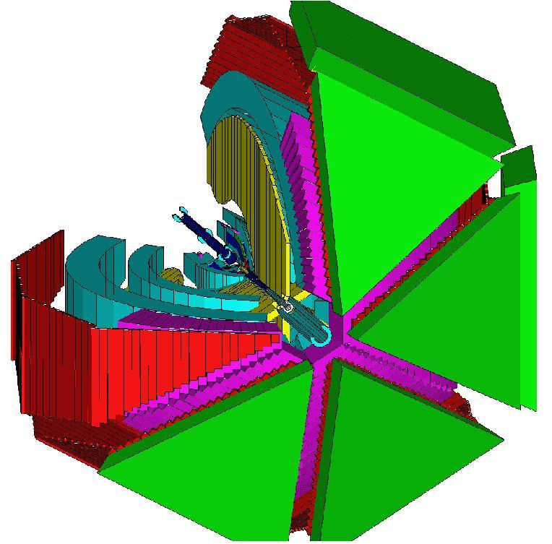
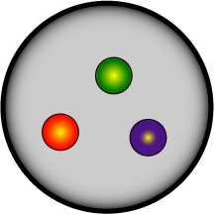
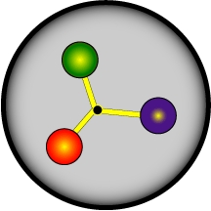
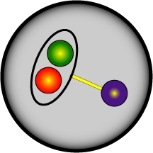
CLAS N* Program
The N* program is one of the key physics foundations of Hall B
CLAS was designed to measure γN and γ_{v}N cross sections and spin observables over a broad kinematic range for exclusive reaction channels
πN, ωN, φN, ηN, η’N, ππN
KY, K*Y, KY*
- Consistent interpretation of N* properties from different exclusive channels with different couplings and backgrounds offers model independent support for findings
The program goal is to study the spectrum of states and their associated structure vs. distance scale through studies of the Q² evolution of the γ_{v}NN* electrocouplings
- Probe the underlying degrees of freedom of the nucleon
- Study non-perturbative strong interaction that generates N* of different quantum numbers from quark and gluons
?
Notes:
Modify second bullet to focus on spectrum and structure

Slide 3
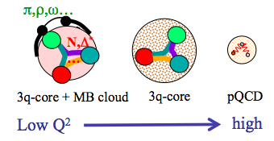
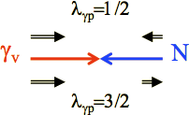
Nucleon Structure
Nucleon structure is more complex than what can be described accounting for quark degrees of freedom only
- Low Q²:
High Q²:
structure well described by adding an external MB cloud to inner quark core
quark core dominates; transition from confinement to pQCD regime
(Q² < 5 GeV²)
(Q² > 5 GeV²)
Electroproduction at high Q² probes the quark core of the excited N* resonances through the γ_{v}NN* electrocoupling amplitudes
- The electrocouplings probe the mass function and structure of the dressed quarks vs. distance scale
Comparison of theory predictions to data test our understanding of the strong interaction dynamics vs. distance scale
e’
M
γ_{v}
e
N*,△*
Q²
N
B
A_{1/2}, A_{3/2}, S_{1/2}
helicity amplitudes
A_{1/2} , A_{3/2} – transverse
S_{1/2} - longitudinal

Slide 4
Electroproduction Data
Photoproduction data sets have been used extensively in coupled-channel fits and “advanced” single-channel models
Photoproduction allows us to identify new states but tells us little about their nature
Electroproduction data allows for:
The Q² dependence of the data gives access to the γ_{v}NN* transition form factors - our source of information on N* structure
Promising in the search for new baryon states, since ratio of resonant to non-resonant contributions increases with Q²
Effective tool to explore the existence of new N* states examining the data description with Q²-independent resonance masses and hadronic decay widths
The electroproduction data provide constraints on the production amplitudes complementary to the photoproduction data

Slide 5
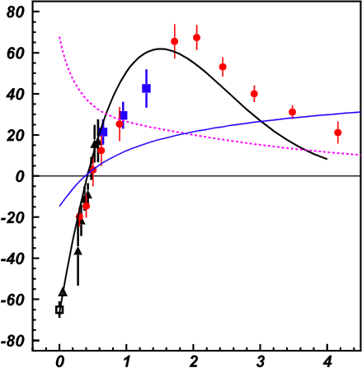
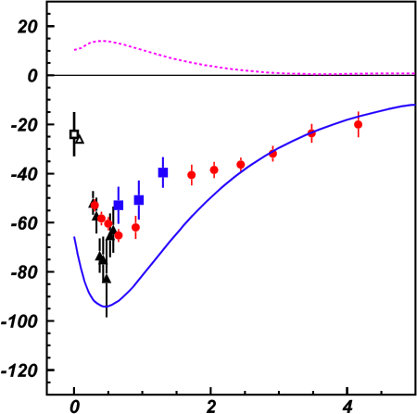
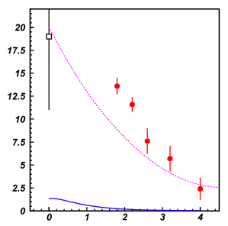
Lower-Lying N* States
A_{1/2}
A_{1/2}
A_{1/2}
P₁₁(1440)
D₁₃(1520)
D₁₅(1675)
Q² (GeV²)
Q² (GeV²)
Q² (GeV²)
Studies of γ_{v}NN* electrocouplings for different N* states at lower Q² reveals different interplay between quark core and MB cloud
- Important to study states of different quantum numbers vs. distance scale
Nπ
Nππ
MB cloud + quark core
MB cloud only
Quark core only
[Aznauryan et al., PRC 80, 055203 (2009)]
[Mokeev et al., PRC 86, 035203 (2012)]
[Park et al., PRC 91, 045203 (2015)]

Slide 6
Lower-Lying N* States
A_{1/2}
A_{1/2}
A_{1/2}
P₁₁(1440)
D₁₃(1520)
D₁₅(1675)
Q² (GeV²)
Q² (GeV²)
Q² (GeV²)
Good agreement of the extracted N* electro- couplings from both the Nπ and Nππ exclusive channels:
Compelling evidence for the reliability of the results
Channels have very different mechanisms for the non-resonant background
Structure studies of low-lying N* states (M < 1.7 GeV) have advanced due to agreement of results from independent analysis of the Nπ and Nππ final states

Slide 7
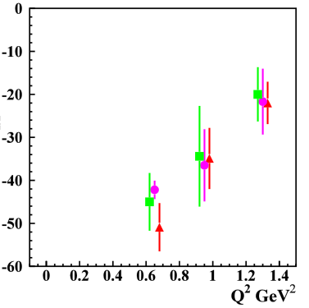
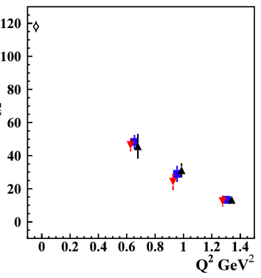
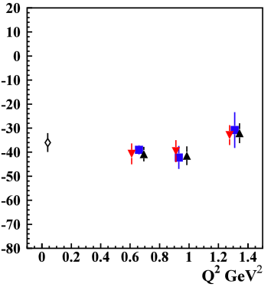
Higher-Lying N* States
Nππ channel provided the first results on S₃₁(1620), S₁₁(1650), F₁₅(1680), D₃₃(1700), P₃₃(1720) electrocouplings
S₃₁(1620)
D₃₃(1700)
P₁₃(1720)
1.61-1.71 GeV
1.66-1.76 GeV
1.71-1.81 GeV
1.46-1.56 GeV
1.56-1.66 GeV
1.61-1.71 GeV
S_{1/2}
A_{1/2}
A_{3/2}
preliminary
preliminary
preliminary
[Mokeev, Few Body Problems in Physics 21, to be published (2015)]
Many high-lying N* states (M > 1.6 GeV) decay mainly to Nππ with much smaller strength to Nπ
Data from the KY channels is critical to provide an independent
extraction of the electrocoupling amplitudes for the high-lying N* states

Slide 8
New N’(1720) State from Nππ Analysis
N(1720)3/2⁺ hadronic decays from the CLAS data fit with only conventional N* states
N* hadronic decays from the data fit that
incorporates the new N’(1720)3/2⁺ state
 | BF(πΔ), % | BF(ρp), %
electroproduction | 64-100 | <5
photoproduction | 14-60 | 19-69
Resonance | BF(πΔ), % | BF(ρp), %
N’(1720)3/2⁺ electroproduction photoproduction | 47-64 46-62 | 3-10 4-13
N(1720)3/2⁺ electroproduction photoproduction | 39-55 38-53 | 23-49 31-46
Δ(1700)3/2⁻ electroproduction photoproduction | 77-95 78-93 | 3-5 3-6
Contradictory BF values determined for N(1720)3/2⁺ decays to the πΔ and ρp final states deduced from γp and γ_{v}p data
- impossible to describe the data with conventional N* states only
Good description of both Nππ γp and γ_{v}p data achieved only by including new N’(1720)3/2⁺ state
[V. Mokeev et al., arXiv:1508.04088]
[M. Ripani et al, PRL 91, 022002 (2003)]
Another example of why both photo- and electroproduction data are essential for full understanding of the N* spectrum

Slide 9
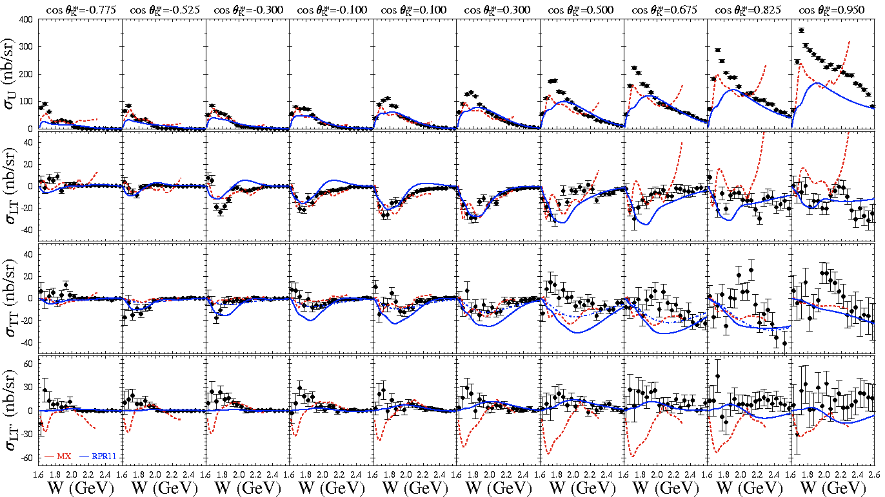
K⁺Λ Structure Functions
E = 5.5 GeV, W: thr – 2.6 GeV, Q² = 1.80, 2.60, 3.45 GeV²
[Carman et al., PRC 87, 025204 (2013)]

Slide 10
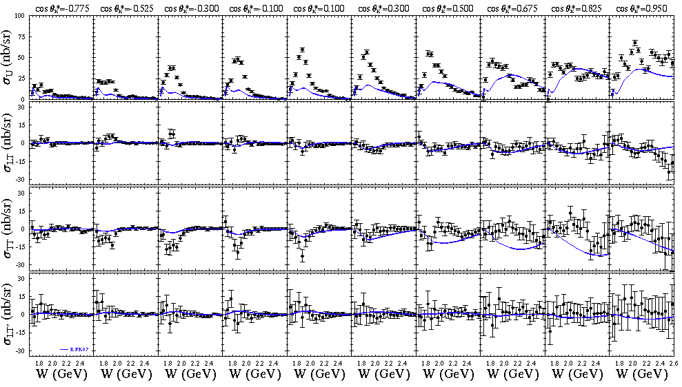
K⁺Σ⁰ Structure Functions
E = 5.5 GeV, W: thr – 2.6 GeV, Q² = 1.80, 2.60, 3.45 GeV²
[Carman et al., PRC 87, 025204 (2013)]

Slide 11
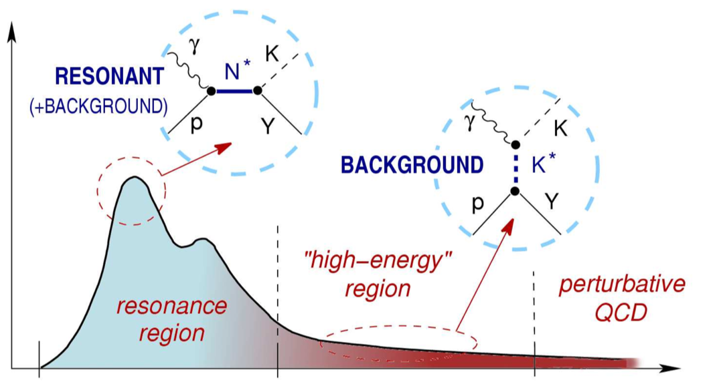
KY Reaction Model
At present there is no reaction model capable of extracting N* resonance parameters from the KY electroproduction data
This is necessary in to extract the electrocoupling parameters from the existing lower Q² CLAS data and the expected higher Q² CLAS12 data
Work is underway to develop the RPR model
cross section
Update RPR electrocoupling parameters
Refit model to CLAS γp and γ_{v}p data:
W → 2.6 GeV, Q² → 4 GeV²
Extend model to CLAS12 kinematics:
W → 3 GeV, Q² → 12 GeV²
[DeCruz et al., PRC 86, 015212 (2012)]
W
Background:
Exchange of K(494) and K*(892) Regge trajectories in t-channel
Parameterized by 3 coupling strengths
and 2 phases
Background tuned to high-energy data and CLAS data in resonance region
Resonances:
Standard isobar model N* states with J=1/2, 3/2, 5/2
EM form factors from Bonn CQM
11 s-channel resonance candidates with W < 2 GeV
Fit model to world γp data over full angular range
Model not constrained by CLAS electroproduction data

Slide 12
CLAS12 N* Program
E12-09-003
Nucleon Resonance Studies with CLAS12
Burkert, Mokeev, Stoler, Joo, Gothe, Cole
E12-06-108A
KY Electroproduction with CLAS12
Carman, Mokeev, Gothe
Measure exclusive electroproduction cross sections from an unpolarized proton target with polarized electron beam for Nπ, Nη, Nππ, KY:
E_{b} = 11 GeV, Q² = 3 → 12 GeV², W → 3.0 GeV, cos θ_{m}* = [-1:1]
Key Motivations:
Study spectrum and structure of all prominent N* states vs. Q² up to 12 GeV².
A unique opportunity to explore the nature of confinement that is responsible for >98% of resonance masses and the emergence of N* states from QCD
KY data complement the Nππ data as independent information for high-mass states inaccessible with Nπ final states
Urgent need: Develop reaction models to extract electrocouplings that incorporate the transition from M-B to q-G degrees of freedom

Slide 13
Concluding Remarks
The study of N* states is one of the key foundations of the Hall B physics program with CLAS:
CLAS has provided a dominant amount of precision data (cross sections and pol. observables) for the Nπ, Nη, KY, and Nππ channels Q² from 0 to 4.5 GeV²
Electrocouplings of most N* states < 1.7 GeV were extracted from these data for the first time
The CLAS12 N* program will extend these studies to Q² up to 12 GeV²:
These studies will allow for insight into the strong interaction dynamics of dressed quarks and their confinement in baryons over a broad Q² range
These data will address the most challenging and open problems of the Standard Model on the nature of hadron mass, quark-gluon confinement, and the emergence of the N* states from QCD
Exciting time as CLAS12 begins its physics program in early 2017

