Slide 1

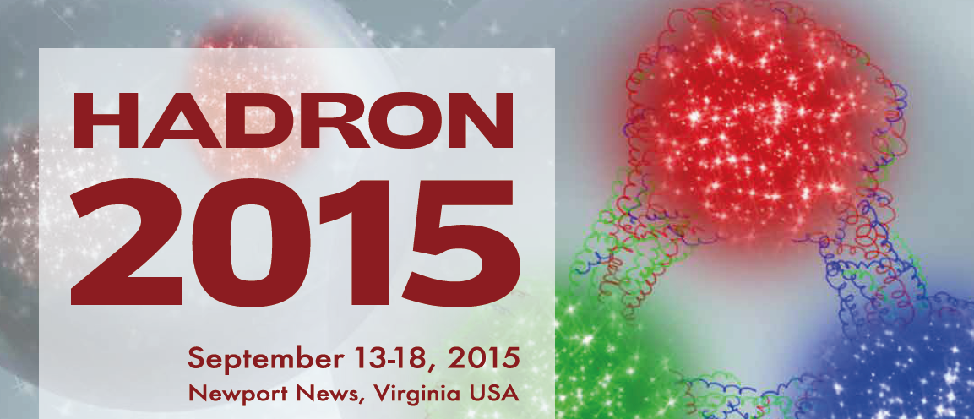



SIDDHARTA results and implications of the results on antikaon-nucleon interaction
J. Marton on behalf SIDDHARTA/SIDDHARTA2
Stefan Meyer Institute, Vienna
P24756-N20

Slide 2

Content
Hadronic atoms as probes for strong interaction at threshold
Results of K⁻p, (K^{3,4}He) experiments
Highest priority issue: K⁻D measurement → K⁻n interaction
Experimental challenges (yield, background)
Target and Instrumentation
Summary and Outlook

Slide 3
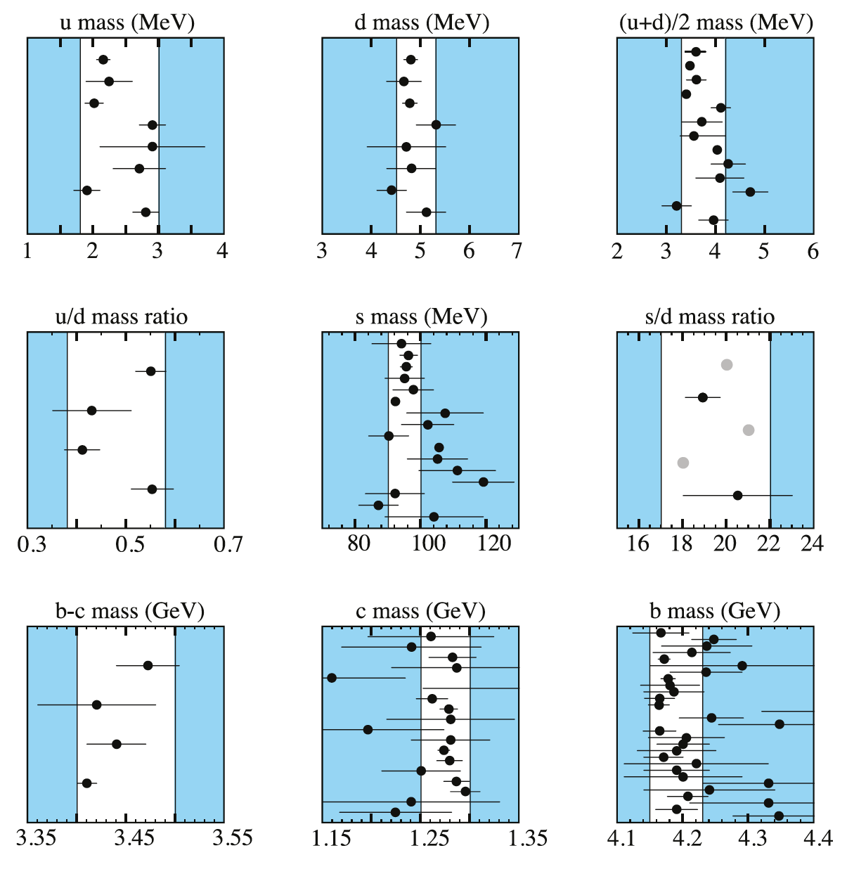
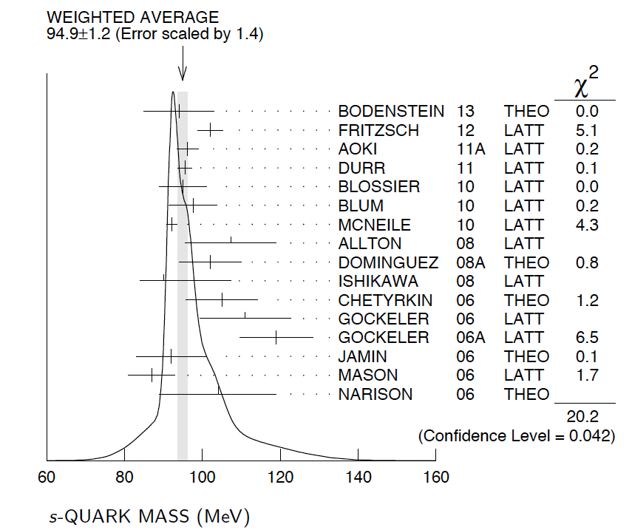
Strangeness
Strange quark – not light but not heavy
Kaonic atoms →
Spontaneous and explicit
Chiral symmetry breaking in
low-energy QCD

Slide 4
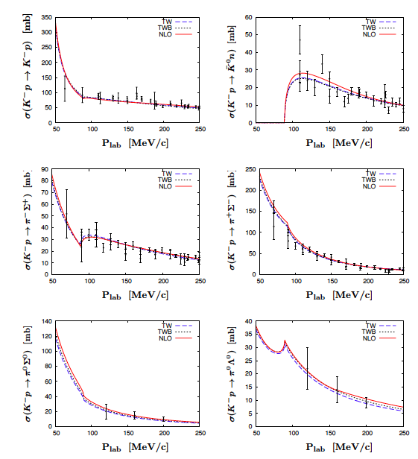
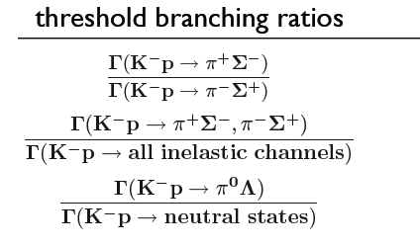
Sources of experimental information on K_{bar}N interaction
K-p scattering data
for threshold data extrapolation
necessary
Threshold branching ratios
Kaonic atom data
Kaonic hydrogen
Kaonic Deuterium
1s state shift
1s state width
→ x-ray spectroscopy
Constraints from precise kaonic hydrogen measurements → sub-threshold extrapolations of the KbarN amplitude with
strongly reduced uncertainties

Slide 5
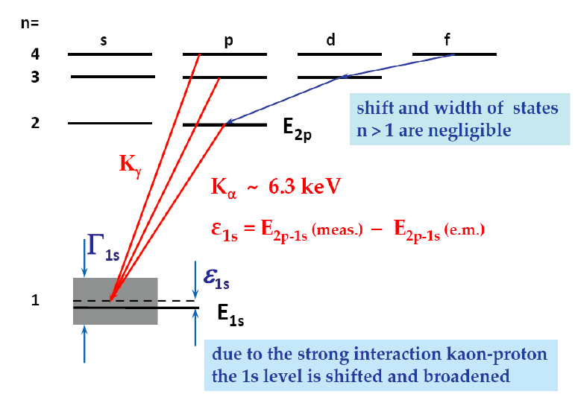
Cascade in hadronic atoms (KH,KD)
n
~ 25
3
2
1
Stark-mixing
l=0 1 2 n-1
external Auger effect
chem. de-excitation
nuclear
absorption
Coulomb de-excitation
X-ray radiation
K_{α}
Probing strong interaction at threshold
Γ_{1s}
observable hadronic
shift and broadening
ε_{1s}

Slide 6
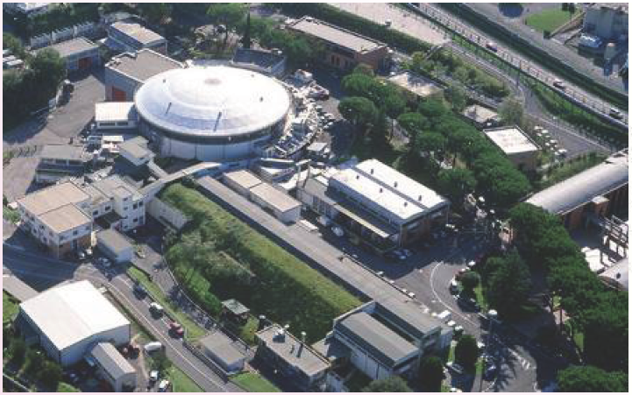
Kaonic atoms at DAΦNE/Frascati
e⁺-e⁻
collider
Accu.
LINAC

Slide 7
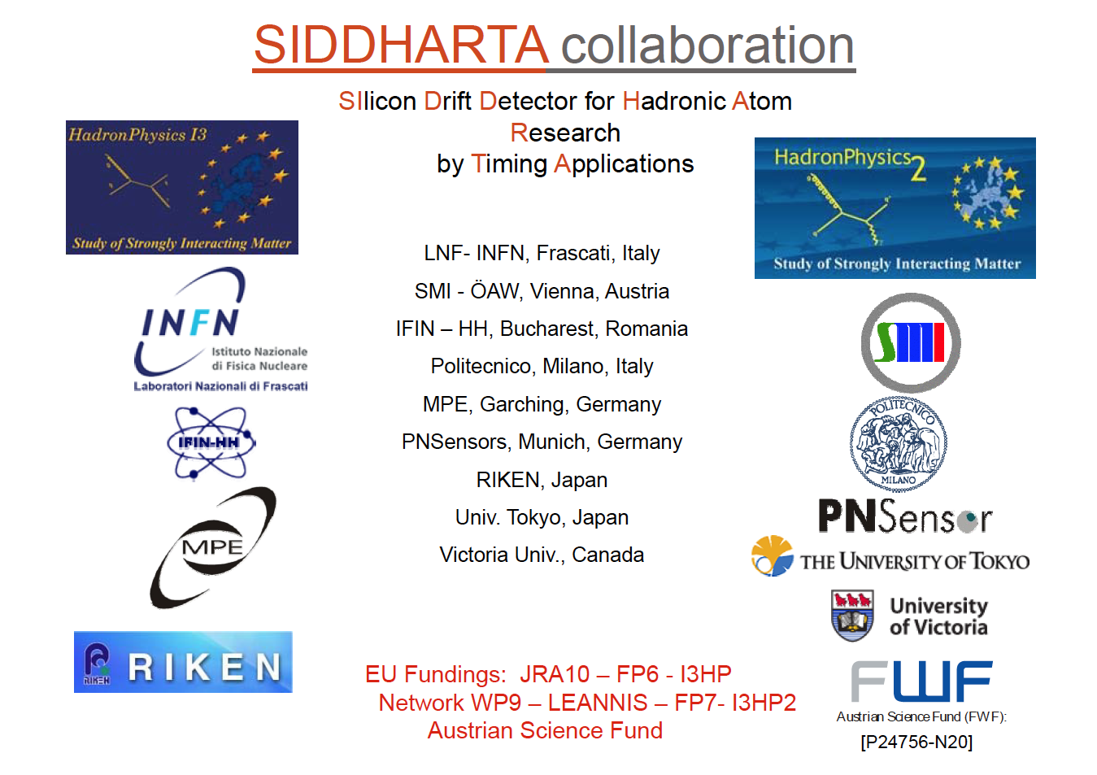


Slide 8
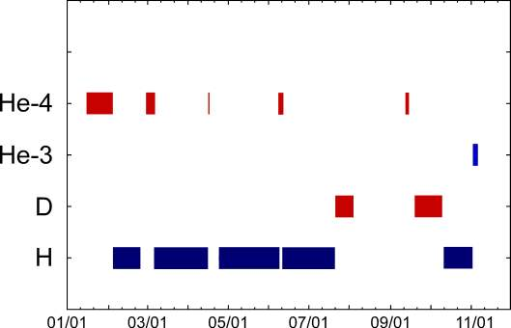
SIDDHARTA data overview

Slide 9
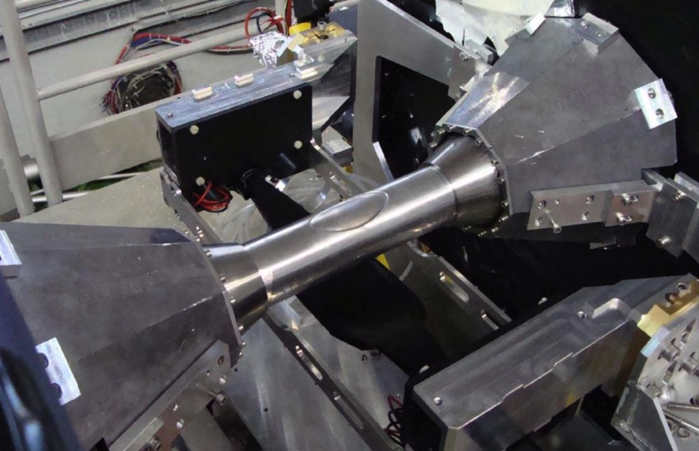
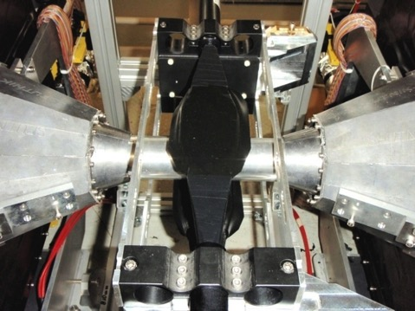
Beam pipe in e⁺e⁻ intersection of SIDDHARTA
SIDDHARTA used the KLOE intersection of DAFNE
Luminosity increased with new system providing a large crossing angle (crab waist system)
Kaon window
Kaon detectors sitting below
and above the intersection

Slide 10
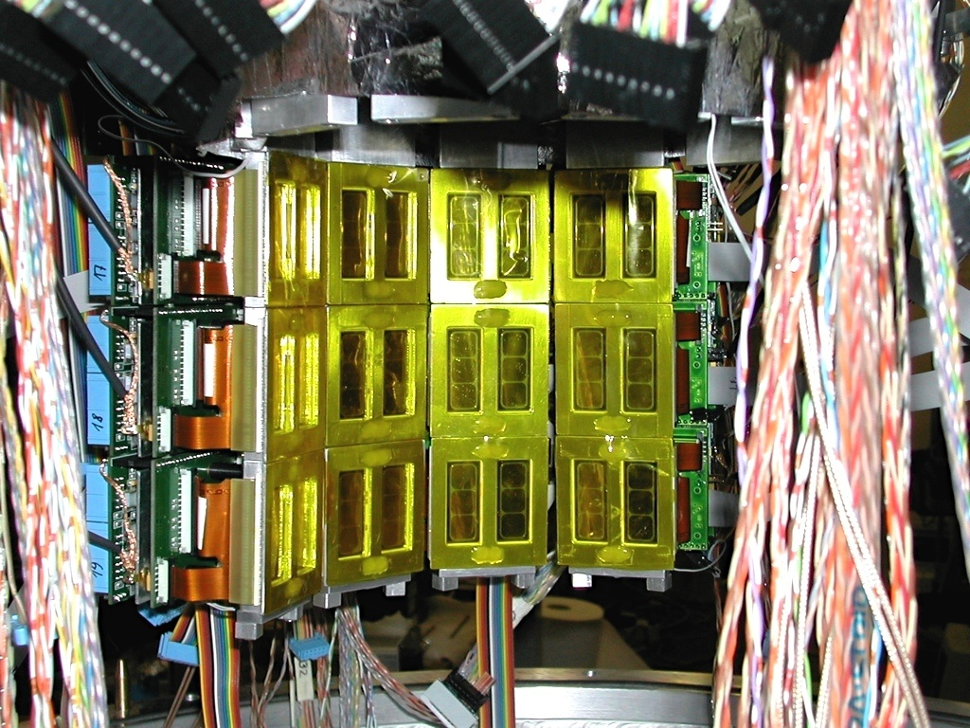
SIDDHARTA SDD Array
144 SDDs =144 cm² active area

Slide 11
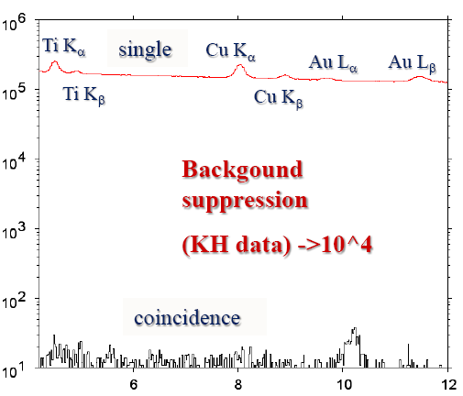
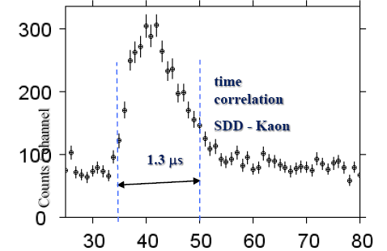
Background suppression in SIDDHARTA
Efficient background suppression by using the kaon - x-ray correlation
X-ray energy [keV]
time [83 ns/ch]

Slide 12
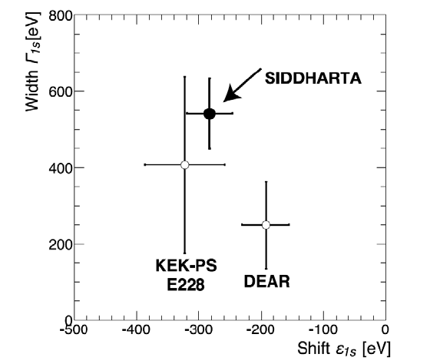
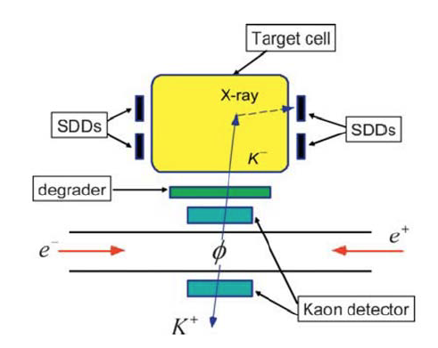
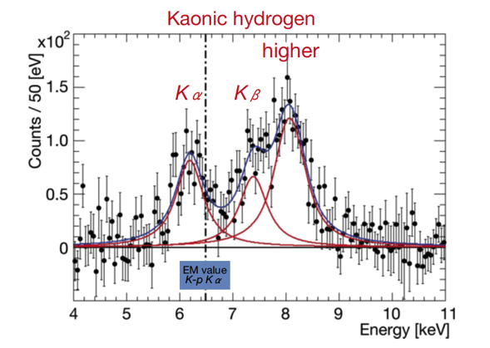
K⁻p result SIDDHARTA
ε_{1S}= −283 ± 36(stat) ± 6(syst) eV
Γ_{1S}= 541 ± 89(stat) ± 22(syst) eV
Physics Letters B704 (2011) 113

Slide 13
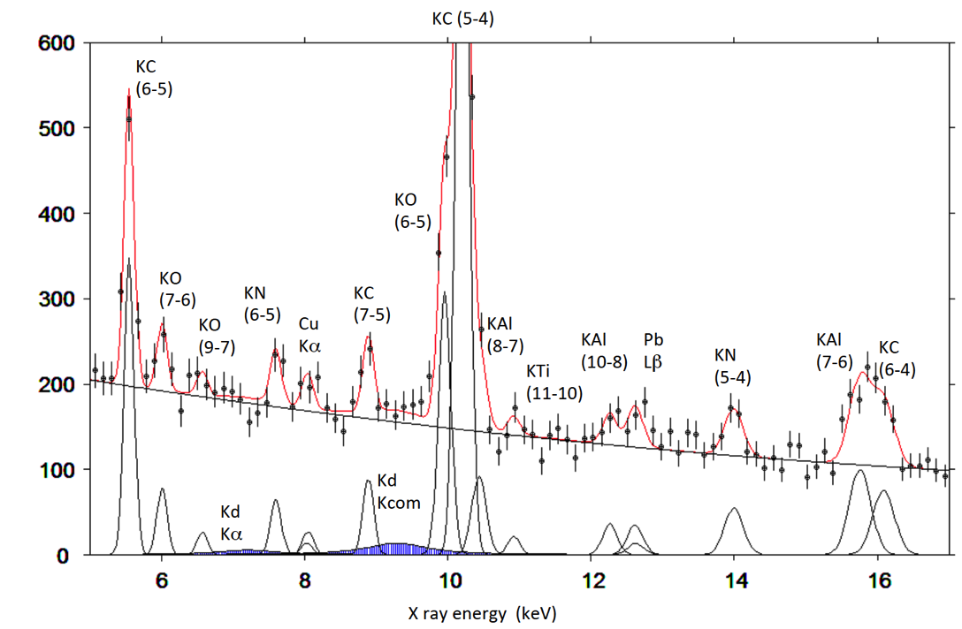
Kaonic atoms with deuterium gas (SIDDHARTA)
fit for shift about 500 eV, width about 1000eV, Kα / Kcomplex = 0.4
First exploratory K⁻d
x-ray experiment
2p-1s
3p-1s and higher

Slide 14
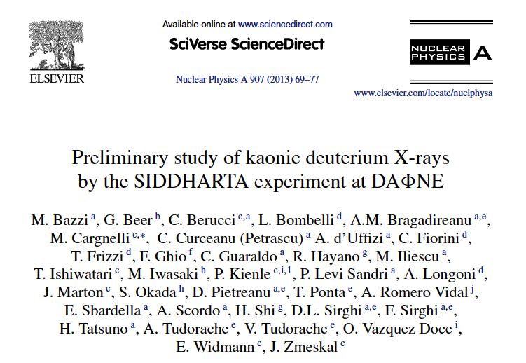

Yield of K-series in KD
Upper limits (90 C.L.)
for the x-ray yield
(SIDDHARTA)

Slide 15
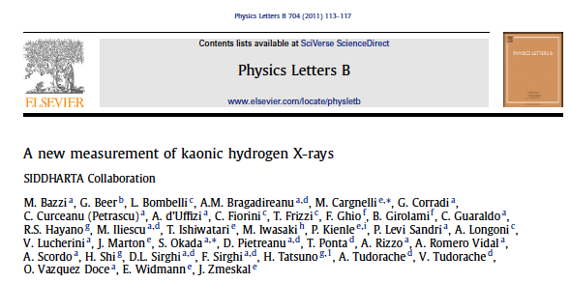
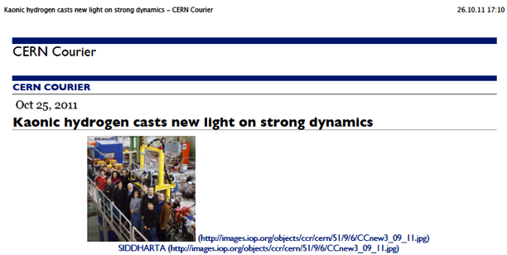
Kaonic Hydrogen: 400pb⁻¹, most precise measurement, Physics Letters B704 (2011) 113
Kaonic deuterium: 100 pb⁻¹, exploratory
first measurement ever, Nucl. Phys.A907 (2013)69
- Kaonic helium 4: first measurement ever in gaseous target; published in Phys. Lett. B 681 (2009) 310; NIM A628 (2011) 264 and
Phys. Lett. B 697 (2011)
- Kaonic helium 3: 10 pb⁻¹, first measurement, published in Phys. Lett. B 697 (2011) 199
Results of SIDDHARTA

Slide 16
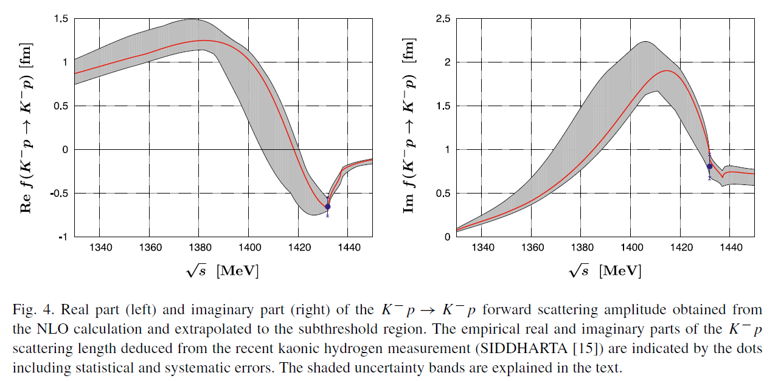
Chiral SU(3) theory of antikaon-nucleon interactions with improved threshold constraints
Y. Ikeda, T. Hyodo and W. Weise, Nucl. Phys. A881 (2012) 98-114.

Slide 17
Motivation for new experiments
SIDDHARTA – K-p strong interaction observables
SIDDHARTA – First exploratory experiment on K⁻D
But: No data on hadronic shift and width of 1s state of kaonic deuterium
→ still to be measured
Study of K-n interaction: Isospin-dependent scattering lengths from KH and KD → K⁻p interaction at low energy is well understood, but the case of K⁻d represents the most important missing information
High resolution studies of kaonic atoms (e.g. K-He, heavier kaonic atoms)

Slide 18

Expected shift and width
a_{d} [fm] | ε_{1s} [eV] | Γ_{1s} [eV] | Reference
-1.58 + i 1.37 | - 887 | 757 | Mizutani 2013 [4]
-1.48 + i 1.22 | - 787 | 1011 | Shevchenko 2012 [5]
-1.46 + i 1.08 | - 779 | 650 | Meißner 2011 [1]
-1.42 + i 1.09 | - 769 | 674 | Gal 2007 [6]
-1.66 + i 1.28 | - 884 | 665 | Meißner 2006 [7]
=>
shift = -800 eV
width = 800 eV
used in simulation
Modified Deser formula next-to-leading order in isospin breaking (Meißner, Raha, Rusetsky 2004 [3])
(μ_{c} reduced mass of K⁻d, α finestructure constant )
[1] M. Döring, U.-G. Meißner, Phys. Lett. B 704 (2011) 663.
[3] U.-G. Meißner, U.Raha, A.Rusetsky, Eur. phys. J. C35 (2004) 349.
[4] T. Mizutani, C. Fayard, B. Saghai, K. Tsushima, arXiv:1211.5824[hep-ph] (2013).
[5] N.V. Shevchenko, Nucl. Phys. A 890-891 (2012) 50-61.
[6] A. Gal, Int. J. Mod. Phys. A22 (2007) 226
[7] U.-G. Meißner, U. Raha, A. Rusetsky, Eur. phys. J. C47 (2006) 473

Slide 19

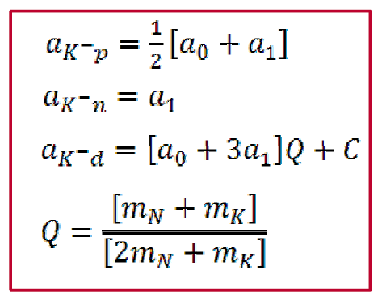
Isospin scattering lengths
The isospin scattering lengths a₀ and a₁ for I=0,1 cannot be determined from ε_{1s} and Γ_{1s} from kaonic hydrogen.
The (modified) Deser-type formula U.G.Meißner,U.Raha,A.Rusetsky,Eur.Phys.J.C35(2004)349,arXiv:hep-ph/0402261.
Kaonic deuterium provides
the lacking information
a_{p} = ½(a₀+a₁)
a_{n} = a₁

Slide 20
Kaonic deuterium Experiment: new instrumentation

Slide 21
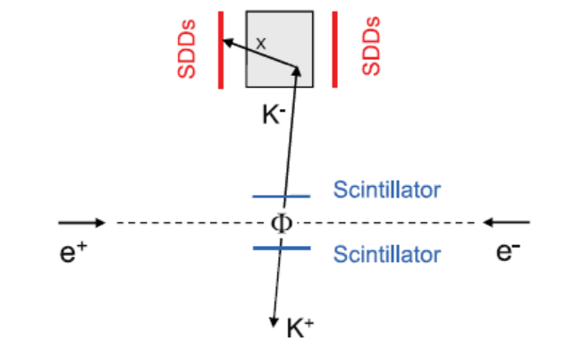
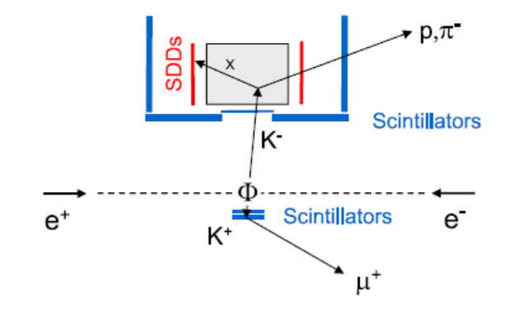
From SIDDHARTA to SIDDHARTA2
  Factor 2 in density of deuterium gas
  Kaon trigger geometry and arrangement
  Discrimination K⁺/K⁻ by lifetime detector
  Active shielding of apparatus
  Higher timing resolution of SDDs by cooling
SIDDHARTA
SIDDHARTA2

Slide 22
Lightweight cryogenic target (used for KH)
working T 22 K
working P 1.5 bar
Alu-grid
Side wall:
Kapton 50 µm
Kaon entrance
Window:
Kapton 75 µm

Slide 23
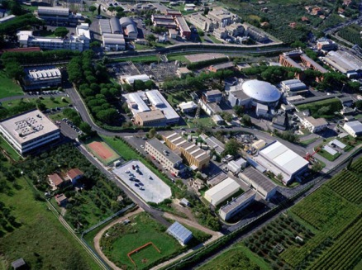
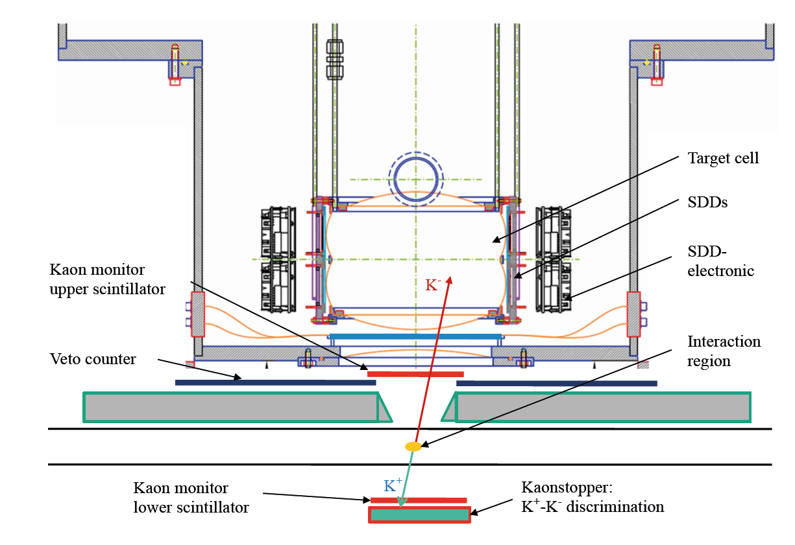
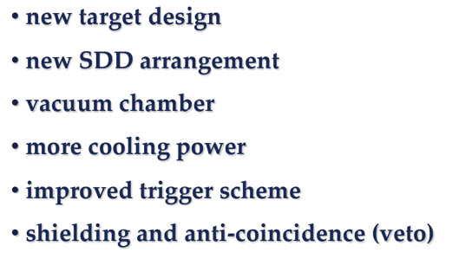
Plans for SIDDHARTA2 at DAFNE

Slide 24
SDD Characterization
Extremely important for precision x-ray spectroscopy
  Stability
    Long term monitoring gain and offset
    Stability under small temperature variations
    Gain stability at different x-ray rates
  Linearity
  SDD time response at various temperatures
  SDD operation at low temperatures
  Radiation hardness

Slide 25
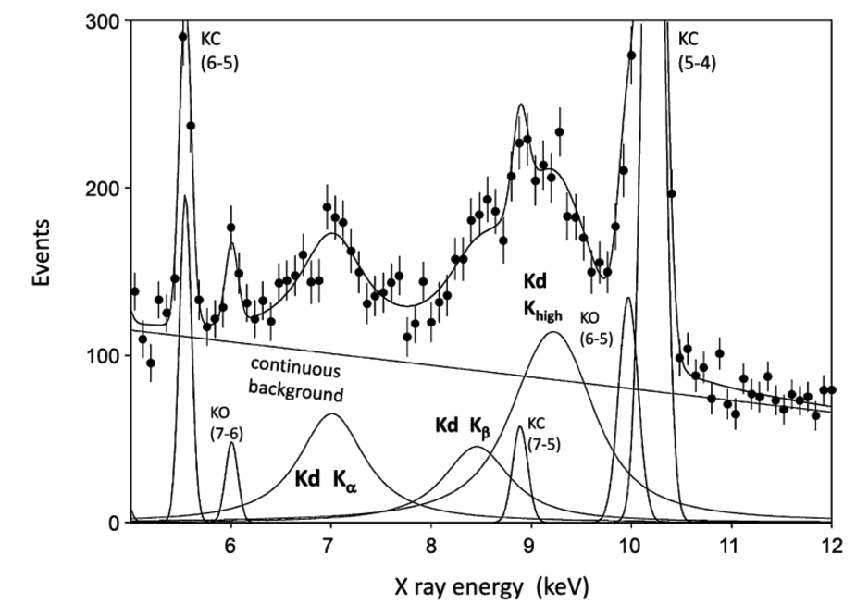
Kaonic deuterium with SIDDHARTA2 at DAFNE
Monte Carlo Simulation for KD in SIDDHARTA2:
Shift: -805 eV
Width: 750 eV
Yield (Kα)=0.001
Luminosity: 800 pb-1
Precision from MC
Shift: 70 eV
Width 150 eV
M. Bazzi et al. (SIDDHARTA Coll.), Nucl.Phys. A907 (2013) 69.
We expect to measure shift and width of kaonic deuterium
with a similar relative precision like kaonic hydrogen

Slide 26
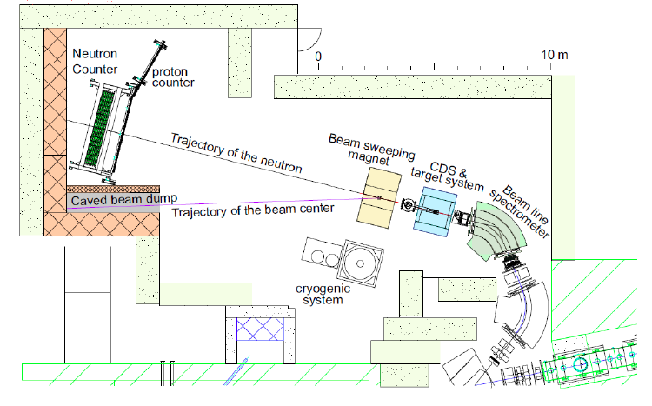
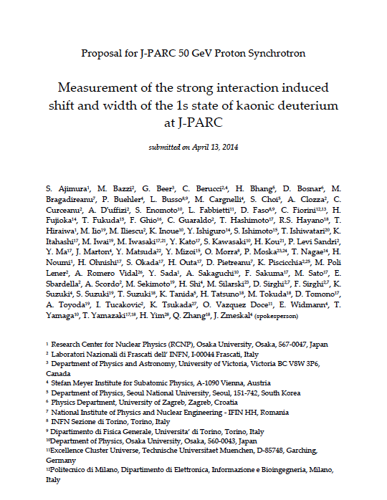
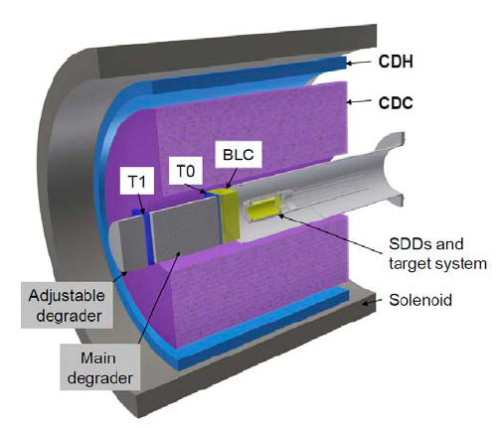
Option:
kaonic deuterium @ J-PARC
J-PARC K1.8BR spectrometer,
for E15, E17
Proposal for J-PARC
Submitted and presented 2014

Slide 27
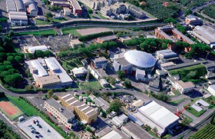
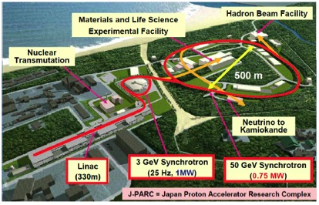
SIDDHARTA2 @DAFNE
DAFNE – ideal for kaonic atoms
Kaon source (Φ decay in K⁻K⁺)
Low-energy kaons (127 MeV/c) ideal for stopping
No tracking
With 10 pb⁻¹ per day
1.5 10⁷ K- per day isotropically
2% per kaon pair stopping in gas
144 SDDs from SIDDHARTA
Kaonic deuterium @J-PARC ?
Kaon beam
Kaons at higher momentum (660-1000 MeV/c)
needs degrader
Tracking
With 30 kW beam power
430 10⁷ K⁻ per day
0.03% per kaon pair stopping in gas (660 MeV/c)
340 SDDs

Slide 28
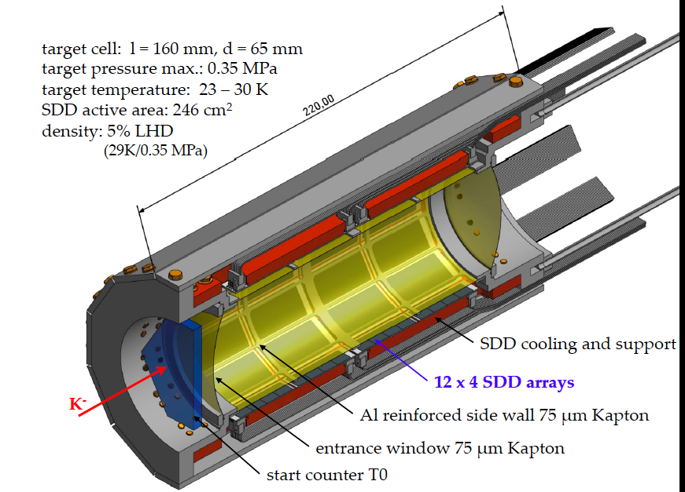
Cryogenic target and SDDs

Slide 29
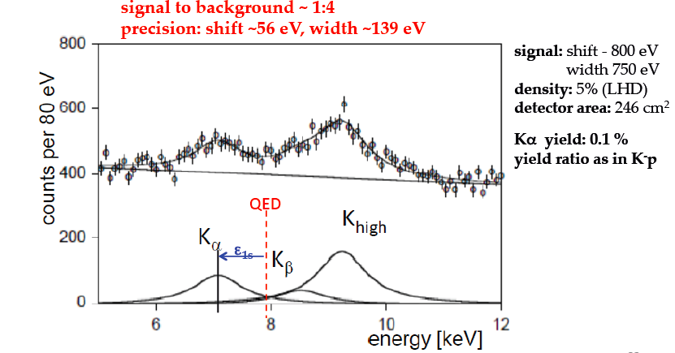
Monte Carlo results Kd@J-PARC

Slide 30
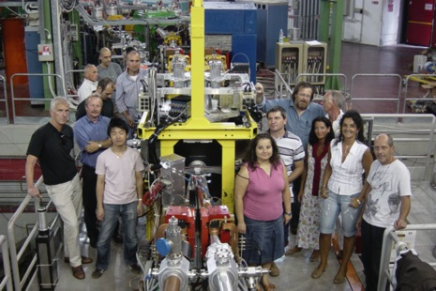


Summary
SIDDHARTA – important results on
light kaonic atoms
Strong impact for K_{bar}N theory
SIDDHARTA – first exploratory experiment on K⁻d
SIDDHARTA2 with improved apparatus aiming at a first extraction of 1s state shift and width in kaonic deuterium
SIDDHARTA2 at DAFNE/J-PARC
P24756-N20

Slide 31
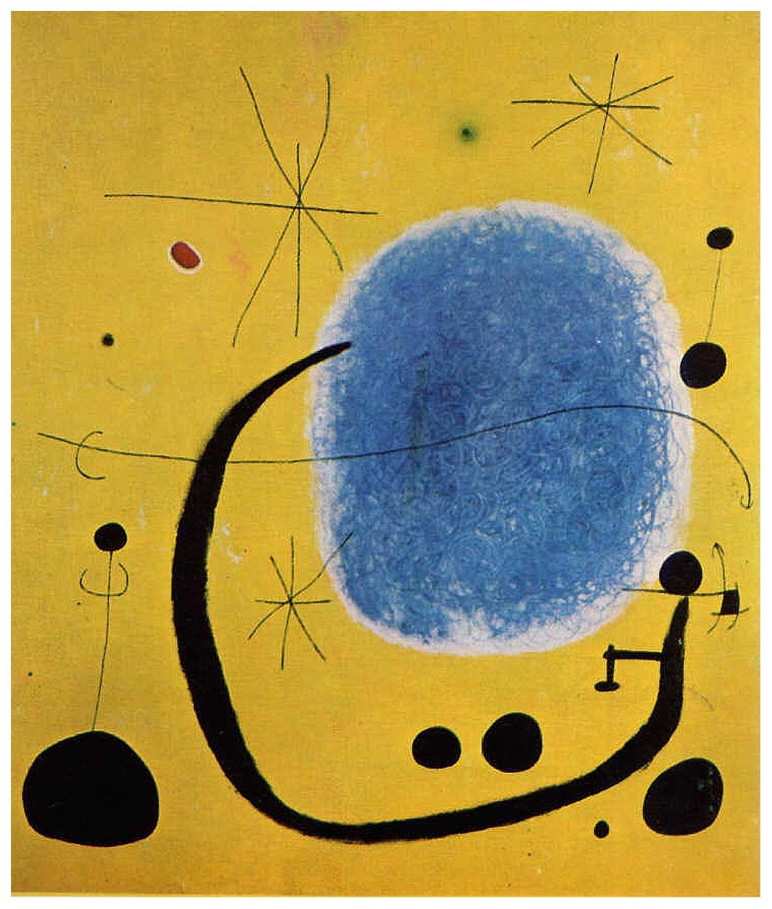
Thank you for your attention

Slide 32
Spare

Slide 33
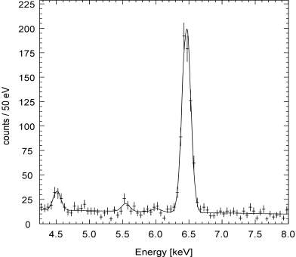
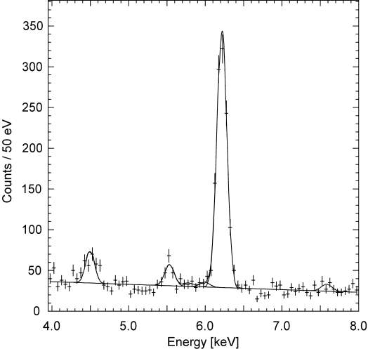
Comparison kaonic ³He and ⁴He
K-4He (3d-2p)
K-3He (3d-2p)
PLB697(2011)199

Slide 34
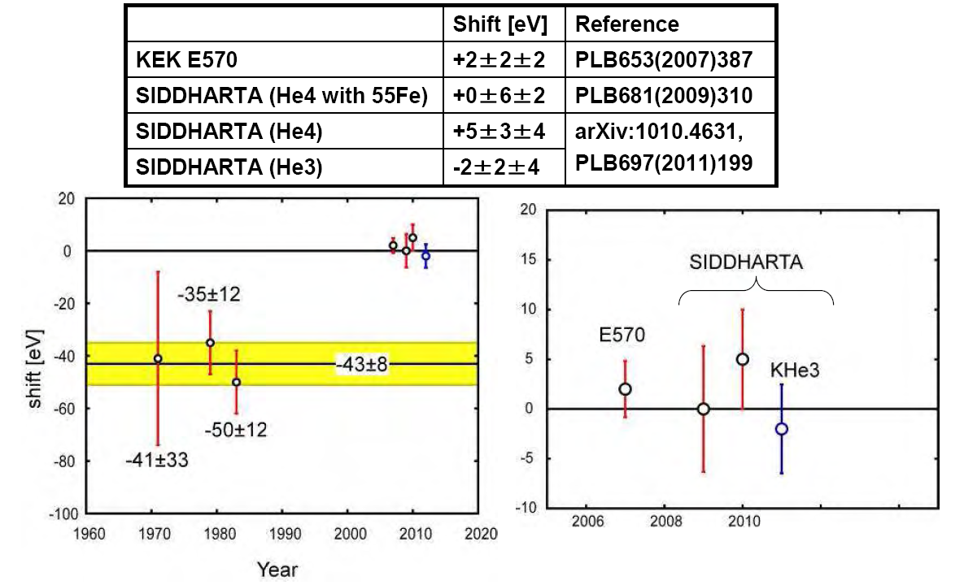
Kaonic helium results
calibration under control within several eV

Slide 35
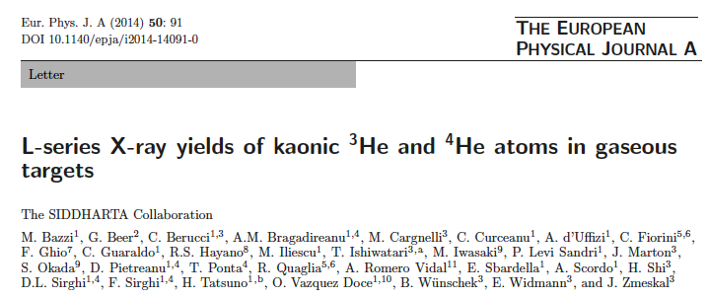
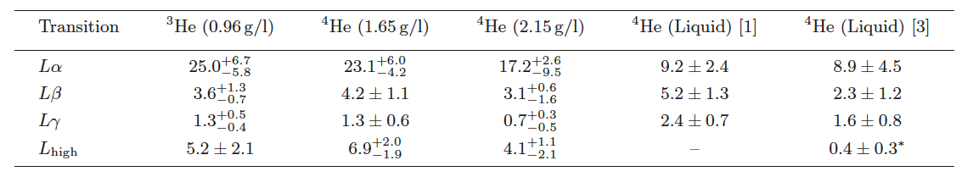
Yields in kaonic helium atoms
Study of the x-ray pattern in kaonic helium atoms (transitions to the 2p state)
First determination of the absolute yields
Indications of weak molecular Stark mixing
Data are calling for improved cascade calulations

Slide 36
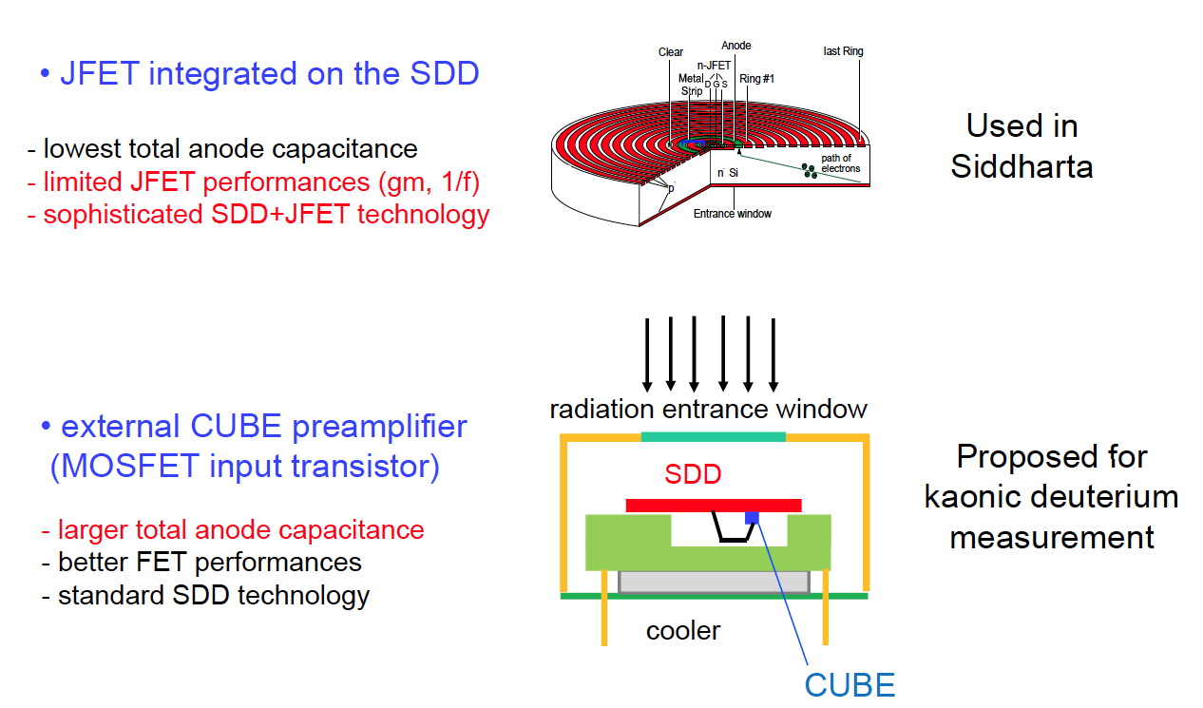
New x-ray detectors

Slide 37
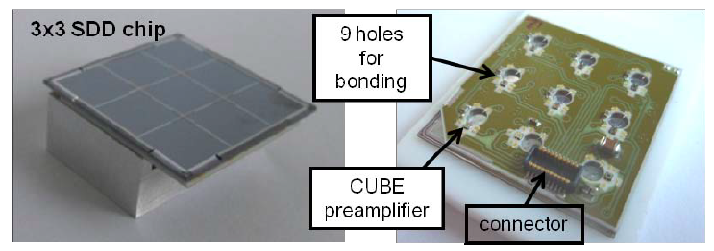
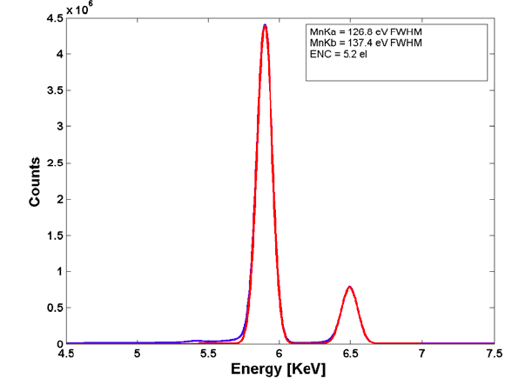
New SDDs for x-ray detection
(FBK and Politecnico Milano)
Excellent active to total area 85%
Large solid angle
Very good energy resolution
Very good timing at low T
Test with Fe-55
Source
Mn Kα
127 eV (FWHM)

Slide 38
Outlook: New precision studies with new technologies
Kaonic helium 2p state shift/width
2 level studies in kaonic atoms

Slide 39
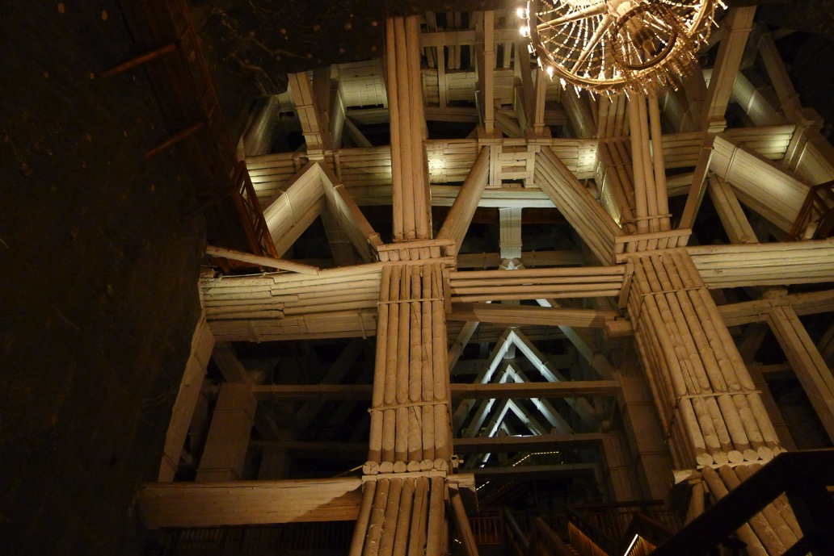
Thank you

Slide 40
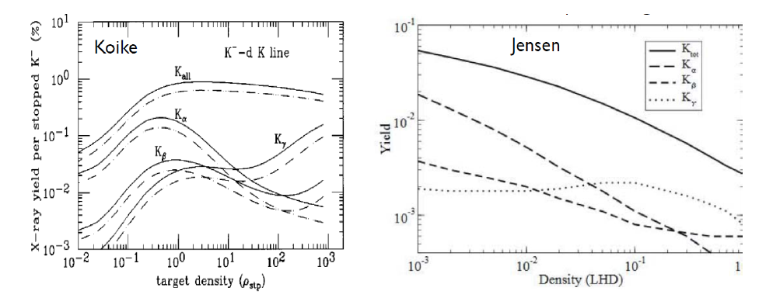
X-ray yields in K⁻D
T.Koike, T. Harada, "calculation of K-p and K-d atoms", Phys. Rev. C 53 (1996) 79
T. S. Jensen, “Atomic Cascade in Kaonic Hydrogen and Deuterium”, Proceedings of DAFNE 2004: Physics at meson factories, June 2004.

Slide 41
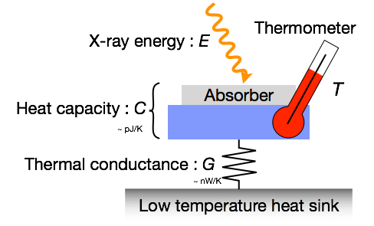
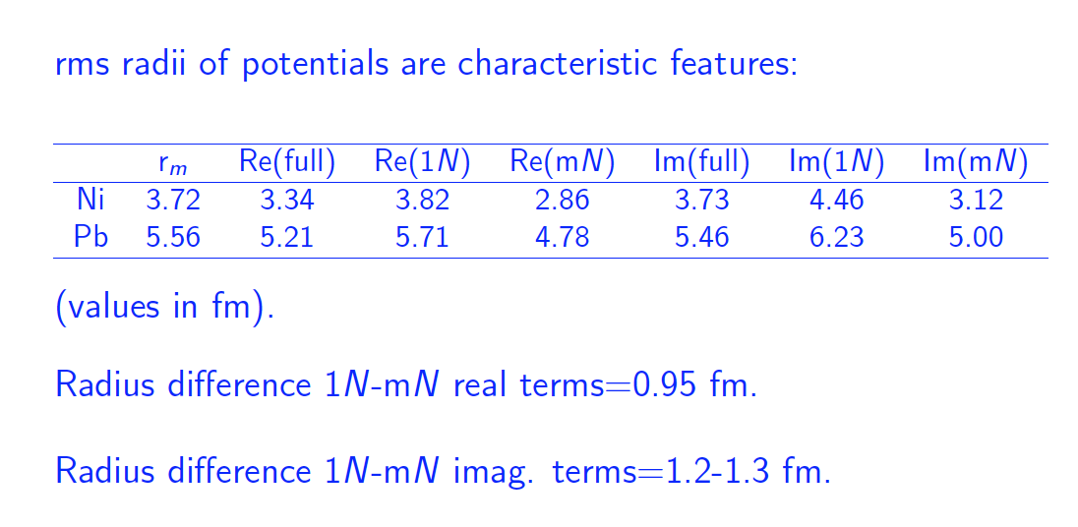

New experiments - microcalorimeter
Study of 2 transitions in the same kaonic atom for separating
one-nucleon 1N) from multi-nucleon (mN) processes
using micro-calorimeters
Further applications of
microcalorimeters for precision x-ray studies:
K-He-3,4 2p-shift/width
Charged kaon mass

Slide 42

What is a exotic (kaonic) atom?

Slide 43

Exotic atoms
Studies of fundamental interactions and symmetries
with exotic atomic bound systems
K⁻p, K⁻d
π-p, π-d
….
Hadronic atoms are
sensitive probes for
the strong interaction
at lowest energy
(direct study of strong
interaction at threshold)
Lamb-shift
muonic hydrogen
→ Proton radius

Slide 44


Kaonic hydrogen and deuterium
Principal interaction = electromagnetic.
Strong interaction manifests in hadronic shift and width of the 1s state → energy displacement from the electromagnetic value of the 1s state and broadening due to K⁻ absorption
calculated solving the Klein-Gordon (KG) equation and taking into account vacuum polarization (VP) and final size (FS) effect (accuracy ~1eV).
Strong interaction effect on 2p state is weak (meV) and experimentally undetermined, nevertheless has severe consequences for the x-ray yield.

Slide 45

Goal
Measurement of the shift ε_{1s} and width (broadening)
Γ_{1s} of the ground state 1s
Since only the 1s state is measurably affected by strong interaction → measured K line energies compared to calculated e.m transition energies yield ε_{1s} and Γ_{1s}
Transition | e.m. energy (keV) (calculated, without strong interaction)
KD (2-1) | 7.808
KD (3-1) | 9.255
KD (4-1) | 9.765
KD (5-1) | 9.994
KD (6-1) | 10.119
.. | ..
KD (∞) | 10.41

Slide 46

Setup at J-PARC K1.8BR

Slide 47



Experiments on kaonic hydrogen
Older experiments used liquid targets
which have the disadvantage of
lower yields (Stark effect)
KpX, PRL1997
KEK (K beam)
Gas target
Si(Li) detectors
DEAR, PRL2005
DAFNE (e⁺ e⁻ collider)
Gas target
CCD detectors
SIDDHARTA, PLB 2011
DAFNE (e⁺ e⁻ collider)
Gas target
SDD detectors

Slide 48


Predictions
Real and imaginary part of the K⁻n → K⁻n forward scattering amplitude in the sub-threshold region
Imaginary part of the I=0
KbarN and Σπ amplidudes
Error bands due to constraints by SIDDHARTA

Slide 49

Comparison KH-KD
 | Kaonic hydrogen | Kaonic deuterium
Yield (Kα) estimates | 3% | 0.3% (depending on 2p state width)
Energy (Kα) e.m. | 6.5 keV | 7.8 keV
Shift (1s) | -283±36(stat)±6(syst) | -800 ? (estimate)
Width (1s) | 541±89(stat)±22(syst) | 800 ? (estimate)
KH
????
KD

