Slide 1
Baryon Spectroscopy and Decays using the Belle Detector
John Yelton
University of Florida
yelton@ufl.edu
I review recent results on charmed baryon decay, mass and width measurements using the world’s largest data set of e⁺e⁻ annihilation events taken in the Upsilon energy range.

Slide 2
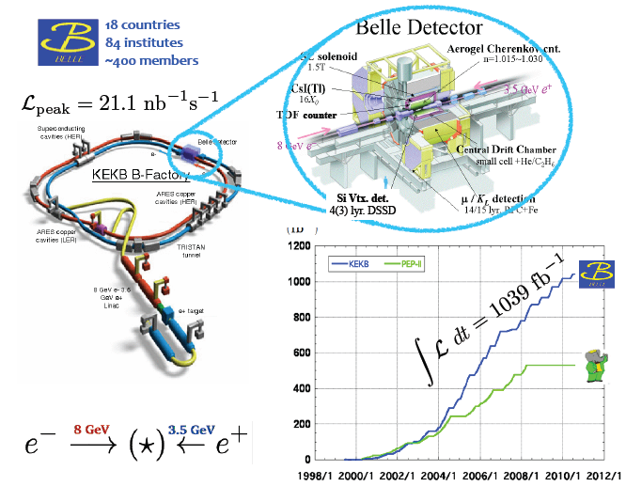
Most of the data was taken at the Upsilon(4S) energy, but most charmed baryon studies are made using particles produced in the charm continuum. These charmed baryons are generally easier to detect, and have better signal:noise than those in B decays.

Slide 3
Why study charmed baryons?
In the Heavy Quark Effective Theory charmed baryons are considered to be a combination of a heavy c quark, rather loosely bound to a light di-quark.
All the couplings and masses we measure can be extrapolated using HQET, up to the B-baryons system (substitute c->b), and also (though not so precisely), the strange system (c->s) .
H
L
L
H
is c quark for us, but can be b or s
L
is u, d, or s quark
The charmed baryons offer us a fascinating quantum mechanical system, with more experimentally accessible states than the b-system, narrower and better defined states than the hyperon system, and more variety of possible states than the meson system.
We would like to identify the states, and measure their widths and masses and branching fractions as accurately as possible in order to understand the underlying structure of baryons.

Slide 4
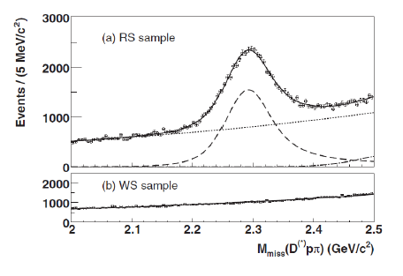
ABSOLUTE branching fraction measurement of Λ_{c} →pK⁻π⁺
The PDG lists around 40 branching ratios for Λ_{c} decays, but to get the branching fraction
you need to know the absolute branching fraction for one of them – this has been a problem
for 30 years! Nothing special about pK⁻π⁺
Number of Λ_{c} →pK⁻π⁺ detected
Total number of Λ_{c} produced
Easy!
BF=
How can we know this?
Belle noted that there is a large signal in:
e⁺e⁻ →cc →D^{(*)-} p π⁺ Λ_{c}⁺
- -
-
Detect the D^{(*)-}p π⁺ with no Λ_{c}⁺
and look for peak in the missing mass plot.
Number of Λ_{c} produced 36,447±432

Slide 5
N=1457±44 fully reconstructed
PRL 113, 042002 (2014)
PDB has 5.0±1.3% based on several measurements
BESIII preliminary 5.77±0.27 (statistical)%, using double-tagged method.

Slide 6
Precision Measurement of the Σ_{c}^{++/0} (2455) and Σ_{c}^{++/0} (2520) Masses and Widths
Reconstruct large sample of Λ_{c}→pK⁻π⁺
Add another charged pion and take the mass difference
Cut at high momentum (continuum production)
Take away contribution from feed-down from excited Λ_{c} states
Plot the mass differences M(Λ_{c}⁺π⁺) –M(Λ_{c}⁺) and M(Λ_{c}⁺π⁻)-M(Λ_{c}⁺)
and carefully fit to Breit-Wigners convolved with multi-Gaussian resolution functions.
Ref. Phys. Rev. D89, 091102 (2014)

Slide 7
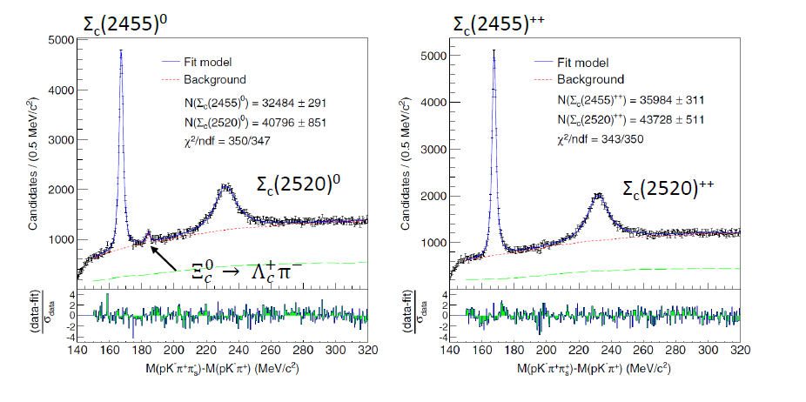
Particle | ΔM (BELLE) | ΔM(PDG) | Γ(BELLE) | Γ(PDG)
Σ_{c}(2455)⁺⁺ | 167.51±0.01±0.02 | 167.52±0.08 | 1.76±0.04 | 2.26±0.25
Σ_{c}(2455)⁰ | 167.29±0.01±0.02 | 167.27±0.08 | 1.84±0.04 | 2.16±0.26
Σ_{c}(2520)⁺⁺ | 231.98±0.11±0.04 | 231.4±0.6 | 15.41±0.41 | 14.9±1.5
Σ_{c}(2520)⁰ | 231.99±0.10±0.02 | 232.3±0.5 | 14.77±0.25 | 14.5±1.5
+0.09
-0.21
+0.07
-0.20
+0.20
-0.32
+0.18
-0.30
Units are all MeV

Slide 8
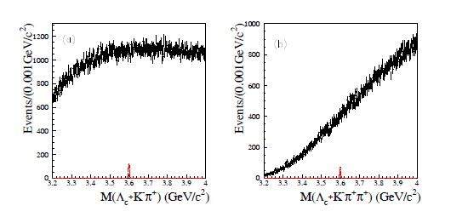
Search for the Doubly-Charmed Baryons, Ξ_{cc}⁺ and Ξ _{cc}⁺⁺
Many experiments, over 20+ years, have searched for them, only SELEX have claimed an observation.
Here we show Ξ_{cc}⁺⁽⁺⁾ →Λ_{c}⁺K⁻π⁺(π⁺)
Ξ_{cc}⁺
Ξ_{cc}⁺⁺

Slide 9
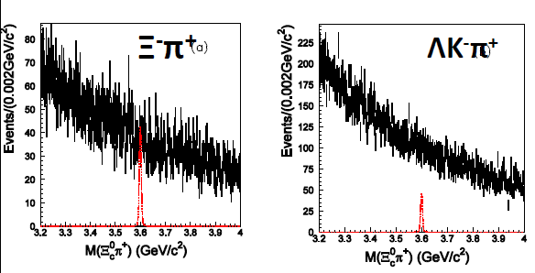
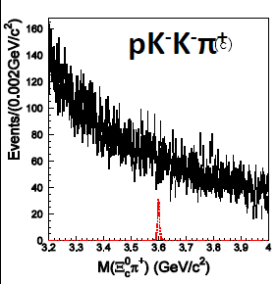
Similarly, we find nothing in Ξ_{cc}⁺→Ξ_{c}⁰π⁺(π⁺)
No Signals!
Tight upper limits are placed as a function of mass for the various decay modes.
Maybe we are looking in the wrong place?

Slide 10
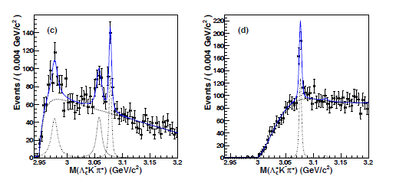
M[Σ_{c}(2455)⁺⁺K⁻] M[Σ_{c}(2520)⁺⁺K⁻]
_{c}(2980)⁺
(well-known in Ξππ)
Ξ_{c}(3055)⁺
Ξ_{c}(3080)⁺
NOTHING at 3123
Limit much tighter than observation reported by BaBar
Phys. Rev. D 89. 052003

Slide 11
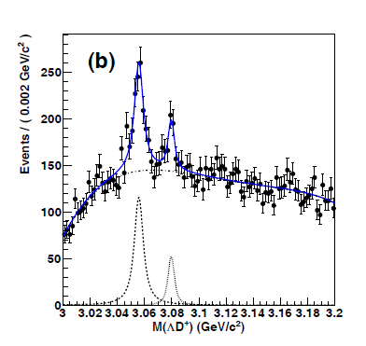
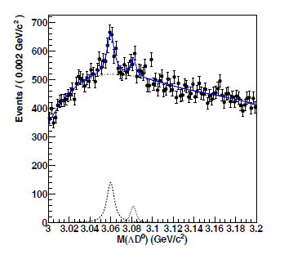
PRELIMINARY search for Ξ_{c}→ΛD
ΛD⁺
ΛD⁰
Ξ_{c}(3055)^{+/0}
Ξ_{c}(3080)^{+/0}
PRELIMINARY! 7.6σ for
Ξ_{c}(3055)⁰ (first observation)
PRELIMINARY
Units are MeV | Mass (BELLE) | Mass(PDG) | Width(BELLE) | Width(PDG)
Ξ_{c}(3055)⁰ | 3059.7±0.6±0.5 |  | 9.7±3.4±3.3
Ξ_{c}(3055)⁺ | 3055.7±0.4±0.4 3058.1±1.0±2.1 | 3054.2±0.4±0.4 | 7.7±1.2±1.8 9.7±3.4±3.3 | 17±6±11
Ξ_{c}(3080)⁰ | 3081.6±1.1±0.2 | 3079.9±1.4 | 4.4±1.8±1.9 | 5.8±1.1
Ξ_{c}(3080)⁺ | 3079.6±0.6±0.7 3077.9±0.4±0.7 3076.9±0.3±0.2 | 3077±0.4 | 4.0±1.5±1.0 3.2±1.3±1.3 2.4±0.9±1.6 | 5.6±2.2

Slide 12
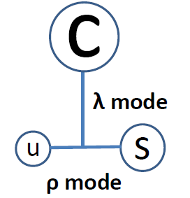
What are these states?
In d-wave Ξ_{c} baryons (i.e. 2 units of orbital angular momentum), the two units can be in two very different places.
Between the heavy quark and light di-quark (λ-modes, low mass excitation) Between the two lighter quarks (ρ-mode, higher mass excitation). In principle, 2 units can be 2 of either or 1 of each. Each can then combine with the light quark spin (0, or 1) and the charm quark spin to make many (34) different states!
Clearly the Ξ_{c}(3055) likes to decay to ΛD
The Ξ_{c}(3080) likes to decay Λ_{c}K π
This is a challenge to theory!

Slide 13
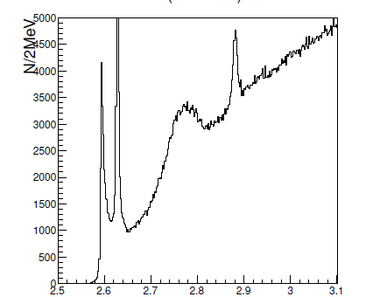
Ongoing Analysis Λ_{c}/Σ_{c}(2765)→Λ_{c}π⁺π⁻
(Off scale!)
Λ_{c}(2880)
Λ_{c}/Σ_{c}(2765)
PRELIMINARY
Λ_{c}(2625)
Λ_{c}(2593)
M(Λ_{c}π⁺π⁻ )
The (2765) is a big, wide, enhancement found by CLEO in 2000. Until now, there have not been any further studies of its properties, and neither its mass or width is well measured.
We don’t even know if it is a Λ_{c} or a Σ_{c}!

Slide 14
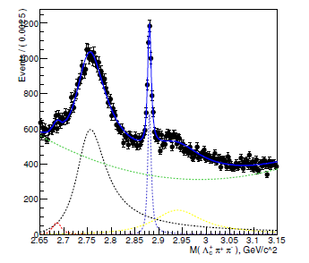
We DO know that the (2765) state resonates through an intermediate Σ_{c}(2455)
M(Σ_{c}⁺⁺π⁻) +M(Σ_{c}⁰π⁺)
PDG M =2766.6 ± 2.4 (stat)
Γ ~50 MeV
BELLE
Preliminary
Data
Belle is working on an exhaustive analysis of this state, with a view to measuring its mass and width and knowing its quantum numbers.
What is this particle that is so copiously produced? Could it be a radial excitation?

Slide 15
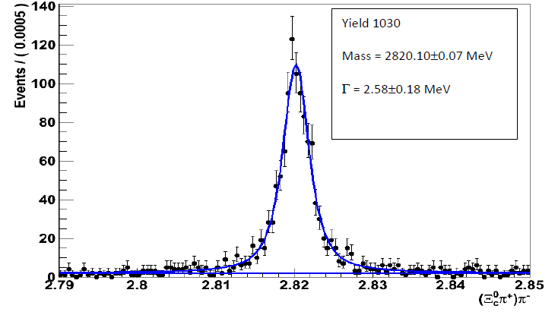
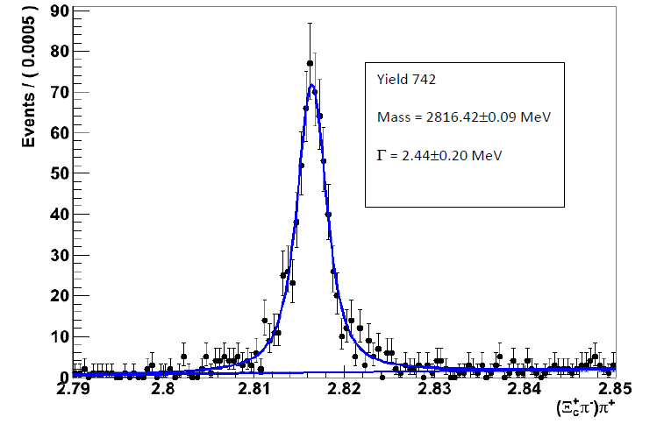
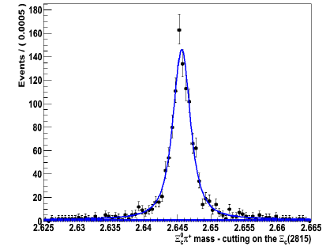
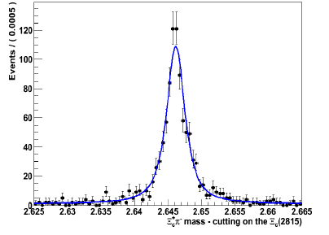
Ongoing analyses – preliminary plots – use many Ξ_{c} decay modes to
investigate the excited Ξ_{c} baryons
Ξ_{c}(2815)⁰→
Ξ_{c}(2645)⁺π⁻
Ξ_{c}(2815)⁺→
Ξ_{c}(2645)⁰π⁺
PRELIMINARY
Cut on Ξ_{c}(2815)⁰
Plot Ξ_{c}⁰π⁺ to see Ξ_{c}(2645)⁺
Cut on Ξ_{c}(2815)⁺
Plot Ξ_{c}⁺π⁻ to see Ξ_{c}(2645)⁰
15

Slide 16
Summary and Conclusions
The charmed baryon system remains a fertile ground of research
Belle has long history of discoveries and measurements on the charmed baryon system
I have shown results on:
Measurement of the absolute Λ_{c} branching fraction
Precise measurement of Σ_{c}^{++/0} (2455) and Σ_{c}^{++/0} (2520) masses and widths
Non-observation of doubly charmed baryons
Investigation of excited Ξ_{c} states, including preliminary observation of ΛD states
Plenty of new results will come, including analysis of the Λ_{c} (2765) and further analysis of excited Ξ_{c} states decaying into Ξ_{c} states
Many results still to come using the 1ab⁻¹ of Belle data. Other results will emerge once Belle II start to take data. There will be many talks with the same title in the next decade.

