Slide 1



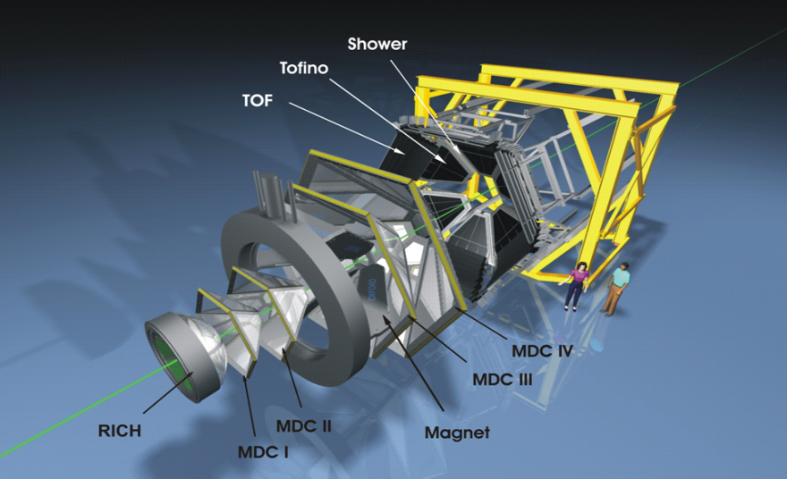
Studying Time-like Baryonic Transitions with HADES
Béatrice Ramstein, IPN Orsay, France
for the HADES collaboration
HADRON 2015, Newport News
N
R
e⁺
γ∗
e⁻

Slide 2
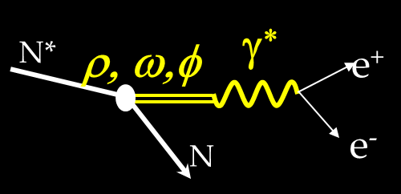
Outline
Introduction:
Motivations of measuring e⁺e⁻ emission with HADES at GSI
Results from pp reactions
Sensitivity of e⁺e⁻ emission to the electromagnetic structure
of baryonic resonances
Preliminary results with the GSI pion beam
(summer 2014)
e⁺e⁻ , π⁺π⁻ production
Conclusions

Slide 3
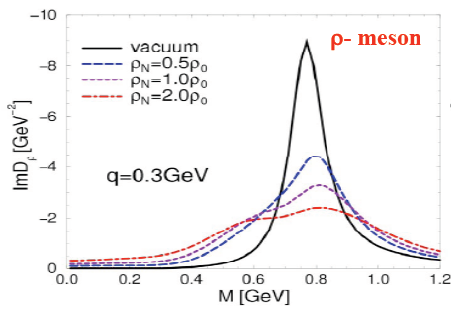

HADES experimental program: e⁺e⁻ production
Constrain interpretation of in-medium dilepton spectra by elementary processes
hadronic matter studies:
A+A (E/A<2 GeV), p+A (E<3.5 GeV), π+A (0.5<E<1.6 GeV) (SIS18)
Study modifications of in-medium vector meson spectral functions
depends on ρNN* coupling - main players: N(1520), Δ (1620),
N(1720)
Elementary reactions: p+p, d(n)+p, π+p
Dilepton exclusive channels e.g. pp→ppe⁺e⁻, π⁻p→ne⁺e⁻
Dalitz decay of baryonic resonances R→Ne⁺e⁻
Sensitivity to Time-like electromagnetic structure
Role of Vector Meson Dominance
Hadronic exclusive channels e.g. p/n+p→NNπ, NNππ, πp→πN, Nππ
constraint on resonance production mechanism
Partial Wave Analysis
Notes:
Complementary to DLS (Berkeley, 90’s), LHC, RHIC
(ultrarelativistic energies), KEK ( 20 GeV p beams),
G7/Jlab, γ beams)
So, the goal of HADES experiments can be summarized as:
Constrain interpretation of in-medium dilpeton spectra by elementary processes.
This coherent program has already quite a long history since first experiments started 15 years ago with reduced detector capcity. The detector has been up-graded several times.

Slide 4
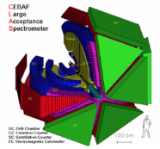
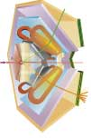
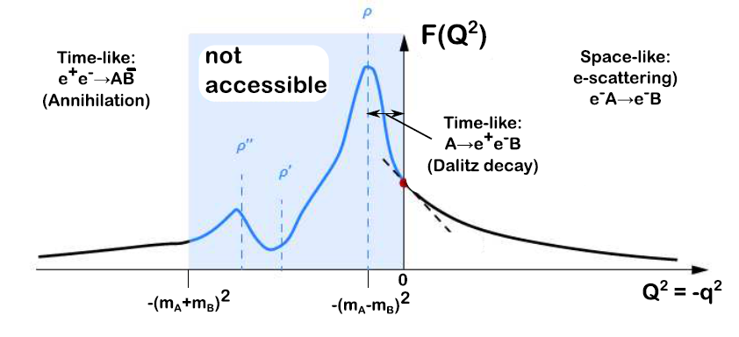
Electromagnetic baryonic transitions in Time-Like and Space-Like region: towards a global picture ?
Time-Like electromagnetic form factors
Space-Like electromagnetic form factors
Precise data from JLab/CLAS up to -q²=4 GeV²
No data
Inverse pion electroproduction
e⁺
q² <0 fixed
F(q²)
n
π ⁻
R
γ*
p
γ*
e⁺
R
e⁻
p
e⁻
F(q²)
π⁻
q² =(M _{ee} )²> 0
variable
p
e⁻⁻
Theoretical tools: Dispersion Relations, Dyson-Schwinger, Vector Dominance, Constituent Quarks ?

Slide 5
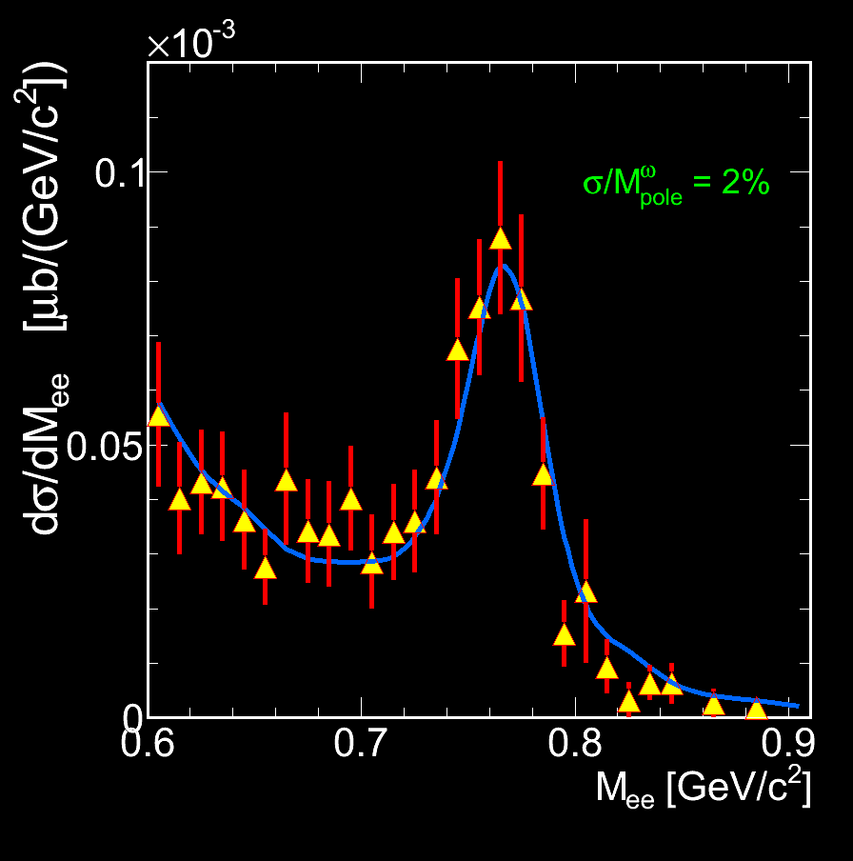
HADES
High Acceptance DiElectron
Spectrometer at GSI, Darmstadt
Acceptance: Full azimuth, polar angles 18º - 85º
Pair acceptance ≈ 0.35
Particle identification:
RICH, Time Of Flight, Pre-Shower (pad chambers & lead converter) ( also MDC (K±))
Trigger:
~ 50 kHz
Momentum measurement
  Magnet: ∫Bdl = 0.1- 0.34 Tm
  MDC: 24 Mini Drift Chambers
  Leptons: Δx~ 140 μ per cell, Δp/p ~ 1-2 %
  ΔM/M ~ 2% at ω peak
Electromagnetic Calorimeter to be ready in 2017
5
Notes:
5
Consists of 6 sectors,

Slide 6



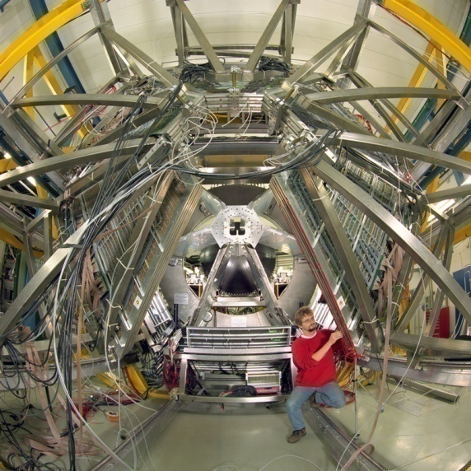
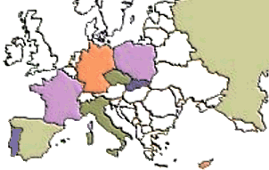
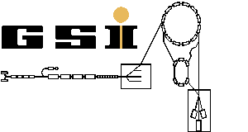
The Collaboration
Catania (INFN - LNS), Italy
  Cracow (Univ.), Poland
    Darmstadt (GSI), Germany
      Dresden (FZD), Germany
        Dubna (JINR), Russia
        Frankfurt (Univ.), Germany
        Giessen (Univ.), Germany
        Milano (INFN, Univ.), Italy
        München (TUM), Germany
        Moscow (ITEP,MEPhI,RAS), Russia
        Nicosia (Univ.), Cyprus
        Orsay (IPN), France
      Rez (CAS, NPI), Czech Rep.
    Sant. de Compostela (Univ.), Spain
  Valencia (Univ.), Spain
Coimbra (Univ.), LIP, Portugal
GSI
SIS
6
Notes:
6
The HADES detector is installed on the GSI facility, but HADES is a european collaboration. Actually 150 persons working in about 156institutions all over Europe. 15” tot 45”

Slide 7

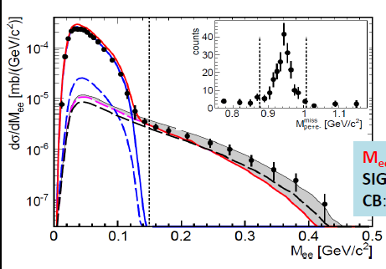

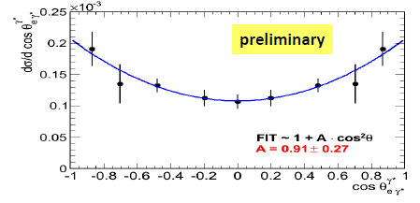
Δ(1232) Dalitz decay : pp→ppe⁺e⁻ at 1.25 GeV
π° Dalitz
Δ Dalitz with different FF
fixed G_{M}=3, G_{E}=G_{C}=0
----- Ramalho/Pena model
Phys.Rev. D85 (2012) 113014
Iachello,Wan model
Int. J Mod. Phys. A20 (2005) 1846
Helicity distributions γ* → e⁺e⁻
dσ/dΩ_{e}~ 1+cos²α
α
Supported by the analysis of
1π production channels
E.P.J. A48 (2012) 74
recent PWA analysis
submitted to EPJA
e⁻
γ*
e⁺
Δ
cosα
N
First measurement !
Dalitz decay branching ratio BR= 4.42 10⁻⁵ ±20% ( syst.) ± 9% (stat)

Slide 8
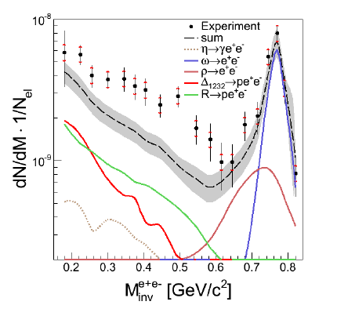
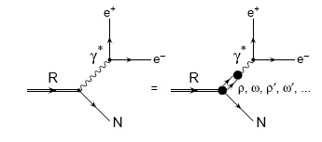
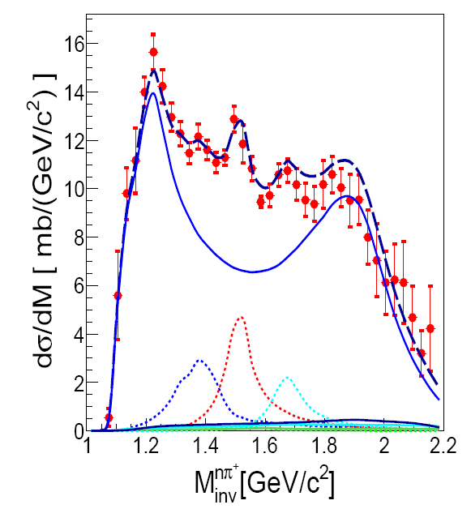
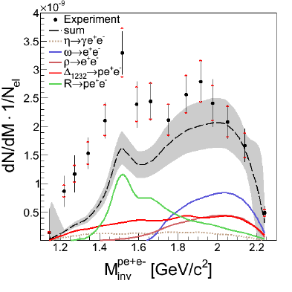
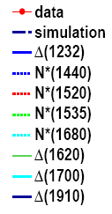
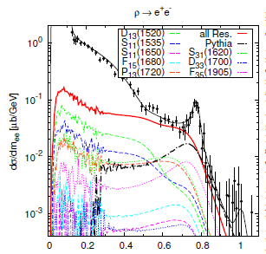
Higher lying resonances
p+p →pp e⁺e ⁻ 3.5 GeV
ppe⁺e⁻
Effect of electromagnetic
transition FF/coupling to
ρ meson of light baryonic
resonances (N(1520),…)
Dalitz decays of point-like
baryonic resonances
+ “direct” ρ and ω
R
ω
Cocktail of baryonic resonances
constrained by ppπ⁰ and pnπ⁺
channels
Δ
ρ
Inclusive e⁺e⁻ production
reproduced by resonnace
model with ρNN* couplings
pnπ⁺
ppe⁺e⁻
R
Δ
ω
G. Agakishiev et al.
Eur.Phys.J. A50 (2014) 8
J. Weil, et al., EPJA 48, 111 (2012)

Slide 9
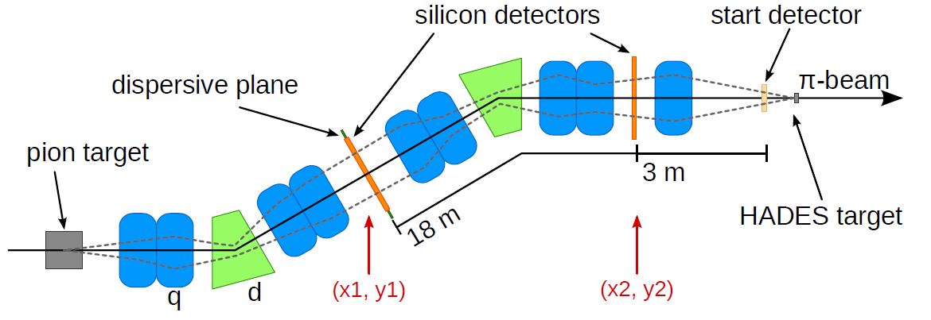
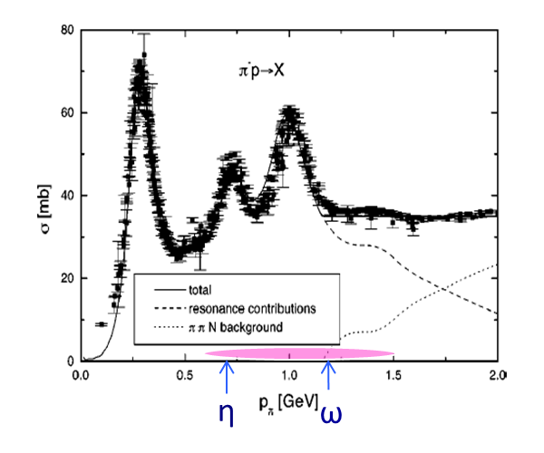
Pion beam experiments
GSI pion beam
momentum 0.6 < p <1.5 GeV/c
pion flux ~ 10⁶/s at 1 GeV/c
Pion beam tracker
Diamond detectors
HADES
2 Double-Sided Silicon sensors
100 x100mm², 300μm thick
2 x128 channels
Δp/p<0.3%
Unique tool for improving the very poor πp and πA
reaction data base:
detection of e⁺, e⁻, p, π⁺, π⁻ , K⁺, K⁻ and soon γ (>2016)
2014 experiment: Limited beam time +intensity
Use of Polyethylene (CH₂)_{n} and Carbon targets
Motivations:
π+A studies at p=1.7 GeV/c
investigate the N(1520) region both in e⁺e⁻ (Time-Like form factors)
and in π⁺π⁻ channels (PWA analysis for ρNN(1520) couplings)
Notes:
1’25

Slide 10
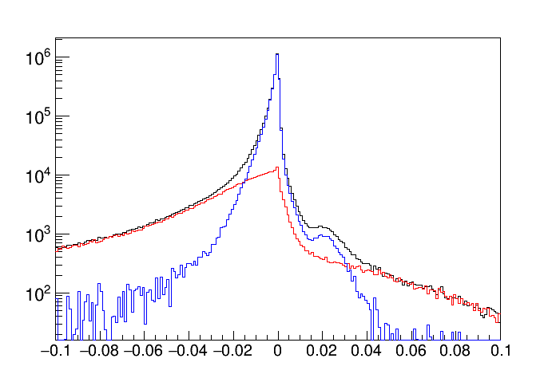
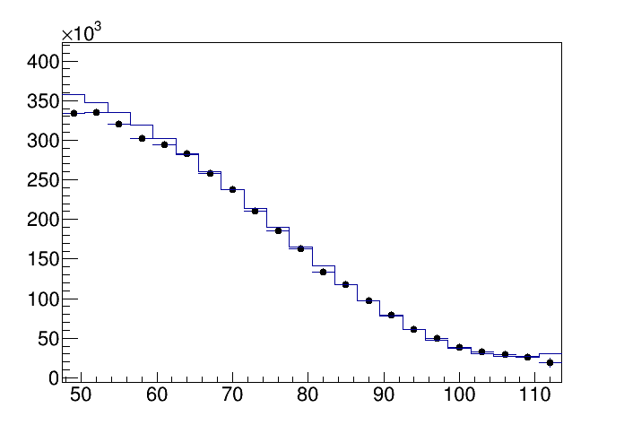
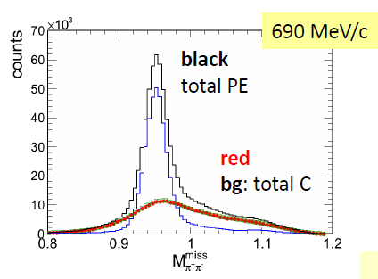
π⁻+p→ π⁻p, π π N: data analysis
Measurement at four center of mass energies around N(1520)
√s=1.469,1.490,1.526,1.557 GeV/c²
Subtraction of C contribution
Normalisation to SAID data base
√s=1.526 GeV/c²
√s=1.469 GeV/c²
(CH₂)_{n} target
. HADES
SAID
H
C
π⁻+p elastic
M_{miss} ² (π⁻p) ( GeV/c²)
θ_{CM} (deg)
√s=1.490 GeV/c²
« tagging » of interactions with C
nuclei based on correlations with C
target events
π⁻p→π⁺π⁻ n
π⁻p→π⁺π⁻ n
total
H
π⁻p→π⁻π⁰ p
Statistics of existing data base
increased by more than
2 orders of magnitude
(>4 10⁷ events for each √s)
C
Notes:
Section efficace elastique ?

Slide 11
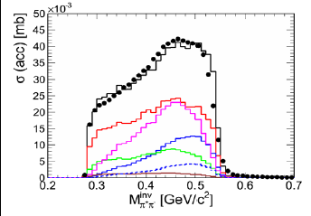
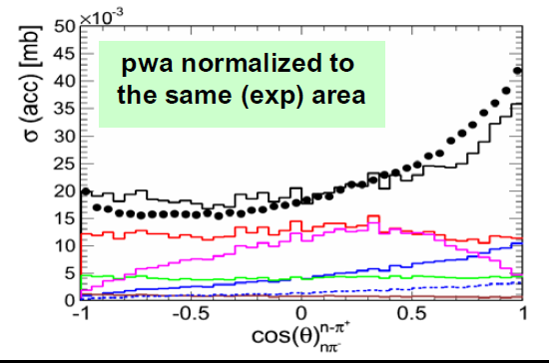
Towards a new extraction of N(1520) couplings in the 2π channel
Partial Wave Analysis with Bonn-Gatchina model (collaboration with A. Sarantsev)
4 data samples from HADES (π⁻p→ nπ⁺π⁻) + photon and pion data base
π⁻p→π⁺π⁻ n
Δ (1232)π
N(1440)π
ρN
σN
N(1520)
---N(1520) →ρN
In HADES
Very preliminary
Very preliminary
Goal: extract N(1520) branching ratio to Δπ, ρN ,σN
Impact on:
medium effects predictions ?
Space-Like transition form factors extracted from ep→e’Nππ ?

Slide 12
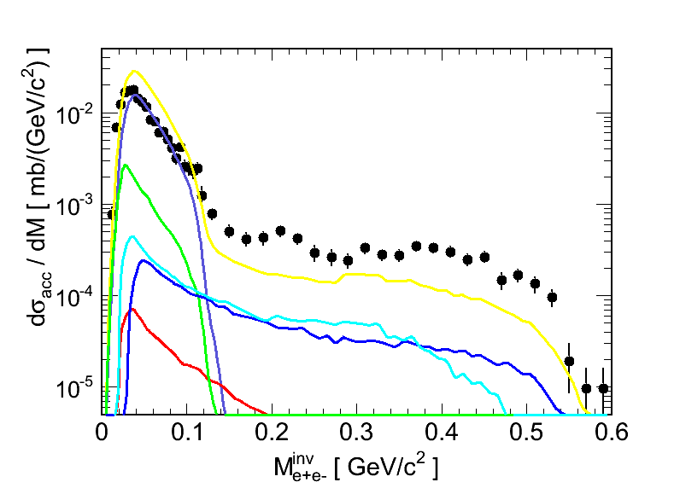

Inclusive e⁺e⁻ production with pion beams
PLUTO event generator
Fröhlich et al, POS (2007) 076
π⁻p:
Meson production: Landolt-Börnstein
Resonance contribution: Bonn-Gatchina PWA
π⁻C:
quasi-free process (momentum distr. of
nucleons taken into account) scaled to C/p
event number
acceptance and efficiency filters
Very preliminary
Θ_{ee} > 9⁰
Total
π⁰ (π⁰ →e⁺e⁻γ)
π⁰ π⁰ (π⁰ →e⁺e⁻γ)
η→e⁺e⁻γ
N(1520)→ne⁺e⁻
Δ(1232)→ne⁺e⁻
Constant covariant
form factors
(no em structure effect)
N
R
e⁺
Cocktail of point-like sources
underestimates the e⁺e⁻ yield at high invariant mass
Strong η contribution
γ∗
e⁻

Slide 13
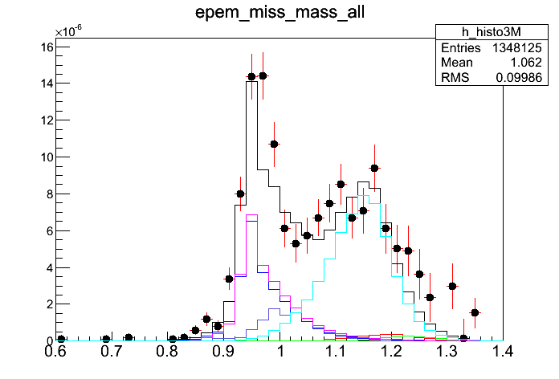
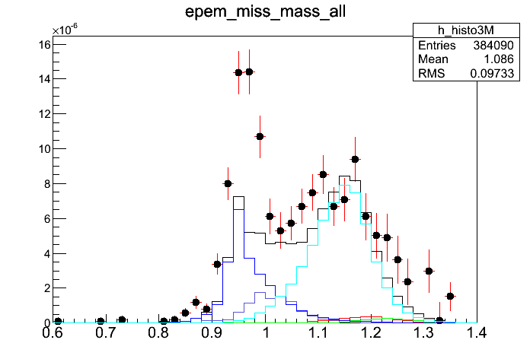
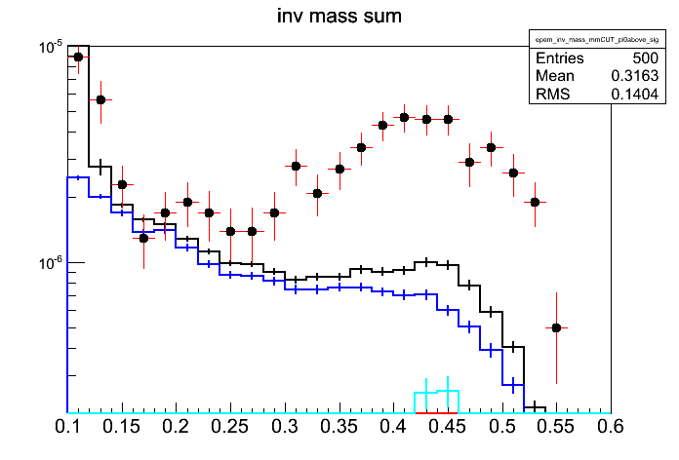
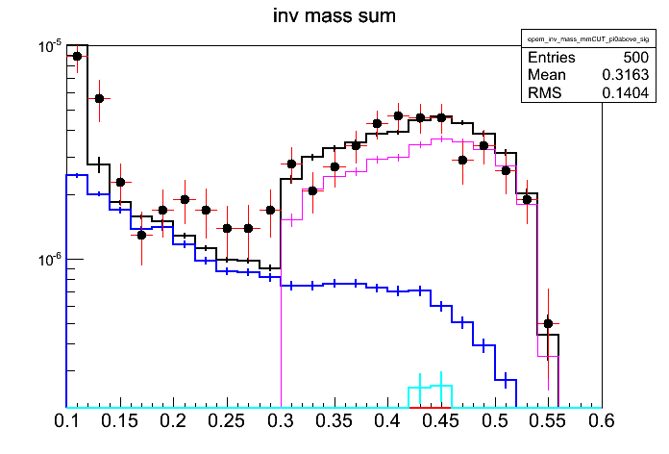
Exclusive ne⁺e⁻ channel with pion beams:
M^{inv}_{ee} > 0.12 GeV/c²
0.9 <M^{miss}_{ee} < 1.03 GeV/c²
Total
π⁰ →e⁺e⁻γ
η→e⁺e⁻γ
N(1520)→ne⁺e⁻
Δ(1232)→ne⁺e⁻
M^{inv}_{ee} > 0.12 GeV/c²
0.9 <M^{miss}_{ee} < 1.03 GeV/c²
π⁻p→ne⁺e⁻
π⁻p→ne⁺e⁻
π⁻p→ne⁺e⁻
M^{miss}_{ee} ( GeV/c²)
Very preliminary
ρ→e⁺e⁻ (~1/M³)
Very preliminary
PWA
M^{miss}_{ee} ( GeV/c²)
M^{inv}_{ee} ( GeV/c²)
ρ→π⁺π⁻
M^{inv}_{ππ} ( GeV/c²)
Excess consistent with ρ → e⁺e⁻
ρ cross section and mass shape derived from π⁻p→π⁺π⁻ n measured in the same experiment !
Empirical way of taking into account VDM form factors for electromagnetic decays

Slide 14

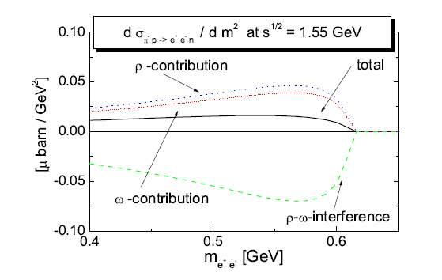
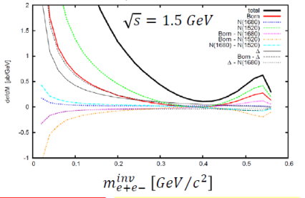

Theoretical tools
Cocktails from resonance models
s channel model based on ρ/ωNN* couplings
Destructive
interference
B. Kaempfer , A Titov , R.Reznik NPA 721(2003)583
M. Lutz , B. Friman, M. Soyeur NPA 713 (2003) 97–118
Lagrangian model : real γ + VDM coupling
Large Born term
Zetenyi and Wolf
Phys. Rev. C 86 (2012) 065209
Time-Like form factor models in const.
quark models only existing for N-Δ(1232)
G. Ramalho, T. Pena Phys.Rev. D85 (2012) 113014
F. Iachello, Wan Int. J Mod. Phys. A20 (2005) 1846
Update of e-VDM model
M. Krivoruchenko, Ann. Phys. 296 (2002) 299
to recent - SL transition FF data (CLAS)
- ρ/ωNN* couplings (PWA)
work in progress
consistent description of - π⁻p→ne⁺e⁻ and ep→ep π⁰ reaction mechanisms
- Time-Like / Space-like form factors
still needs to be developed

Slide 15
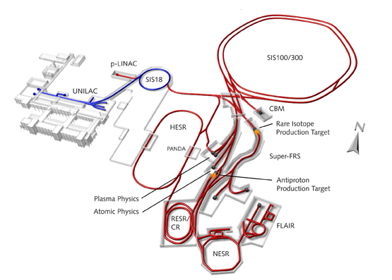
Future plans for HADES
> 2018: 2-3 year time slot for pion beam experiments at SIS 18 before the start of FAIR
Higher statistics measurements
Investigate heavier resonances Δ(1620), N(1720),…
liquid hydrogen target
Electromagnetic Calorimeter (better electron identification, access to
radiative decays, π⁰, η, ω reconstruction for PWA and in-medium studies)
> 2021: HADES experiments at FAIR (p and ion beams, possibly pions in the future….)
Pave the way for future meson facilities
see W. J. Briscoe et al., arXiv:1503.07763

Slide 16
Conclusion
HADES results (focus on pp/pn reactions)
selective study of e⁺e⁻ production from Dalitz decay of
baryonic resonances
→ sensitivity to Baryonic resonances
Time-Like electromagnetic structure/coupling to ρN
Indispensible complement for in medium studies
Recent pion beam experiment
New determination of N(1520) coupling to ρN from PWA
Large e⁺e⁻ yield : constraint for models
Continuation at SIS18 in 2018 with much more statistics
and new ECAL
Pave the way for future meson facilities
HADES at FAIR : pp, pA

Slide 17
Thank you

Slide 18

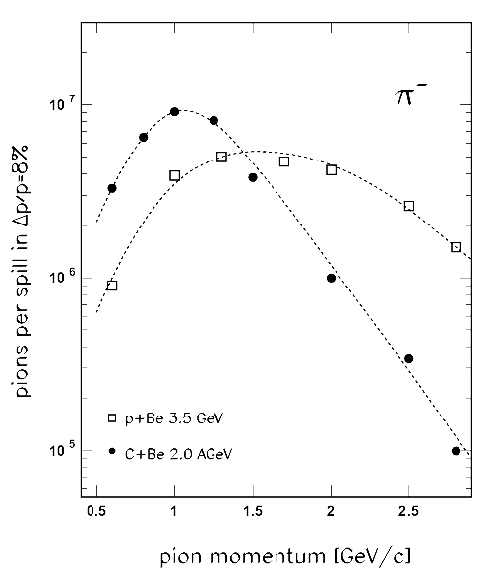
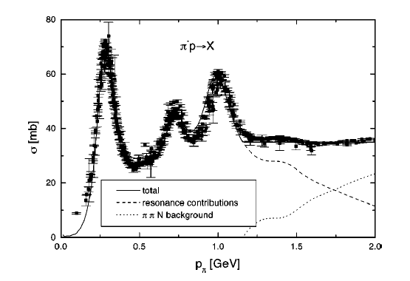
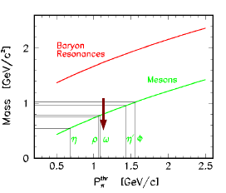
GSI pion beam
Expected Intensities for Space Charge Limit
and 100% extraction efficiency
I ~ 10⁶/s
Pion momentum 0.6 < p <1.5 GeV/c
√s
1.21
1.52
1.68
η
ω
Béatrice Ramstein
18
Notes:
18
18

Slide 19
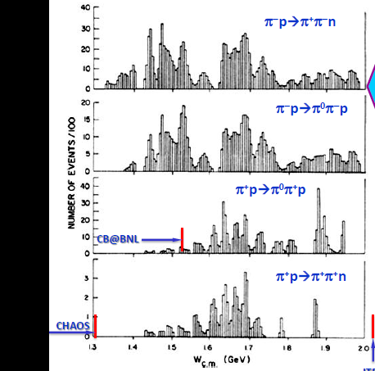
πN→ππN: present status
SAID, data base, CNS, GWU http://gwdac.phys.gwu.edu
All what we know about N* couplings to ρN, Δπ, σN is based on the analysis of 240000 events (bubble chamber < 1980)
114 kevents
72 kevents
1.4
1.6
1.8
2.
√s (GeV)
Very precise photoproduction data
Dynamical models are now available → a new combined PWA analysis of all pion and photoproduction channels will be possible.
Important for baryonic structure issues (Constituent Quark Models, Lattice QCD)
Very strong demand for new πN→ππN data !

Slide 20
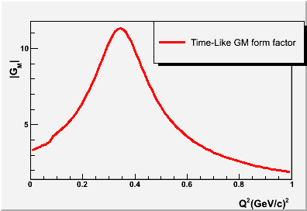
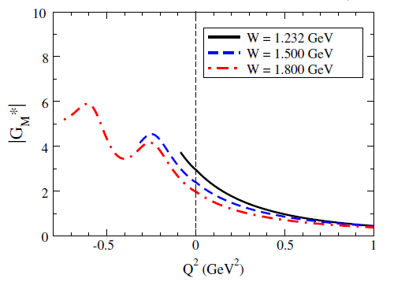
Models for N-Δ magnetic transition form factor in Time-Like region
Two component models
Wan & Iachello, int. J. Mod. Phys. A20(2005) 1846
B’
B’
Emilie Moriniere PHD, Orsay
F. Dorhmann et al , EPJA 45,401(2001)
B
B
V= ρ, ω, ϕ
G_{M}^{N-Δ}/3G_{D}
Space-like
Time-like
derivation of form factor
starting from wave functions
analytical continuation to
Time-Like region
→ to be tested with HADES
G^{N-Δ}_{M}(q²)
0.6m_{ρ}²
G.Ramalho and T. Pena Phys. ReV. D85,113014 (2012)
Extension to Time-Like region
exists for elastic nucleon
form factors
( to be measured with PANDA)
In progress for higher resonances
Coupling to the bare quarks
Time Like
m²_{ρ}
0.6m²_{ρ}
Space Like
Coupling to the meson cloud

Slide 21
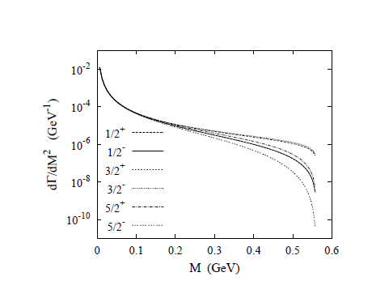
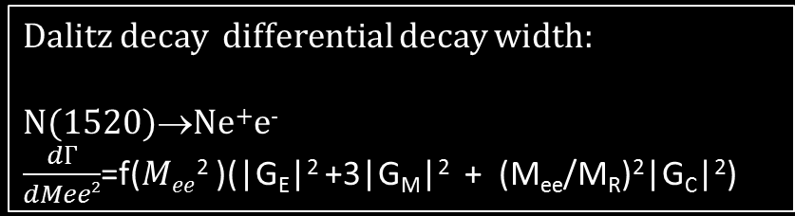
Dalitz decay differential decay width:
N(1520)→Ne⁺e⁻
$\frac{dГ}{dMee2}$=f($Mee$² )(|G_{E}|² +3|G_{M}|² + (M_{ee}/M_{R})²|G_{C}|²)
M_{R}=1.520 GeV/c²

Slide 22
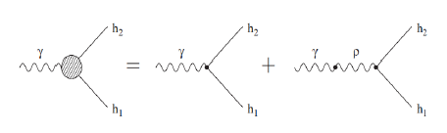

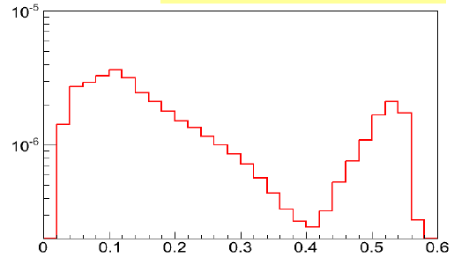
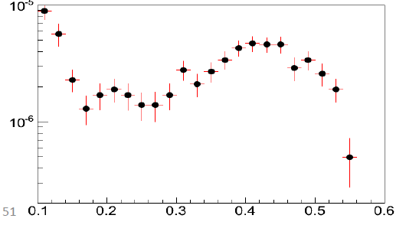
Exclusive e⁺e⁻ production with pion beams: theoretical predictions
destructive interference between I=0 (ω) and I=1 (ρ) contributions
B. Kaempfer , A Titov , R.Reznik NPA 721(2003)583
M.F.M. Lutz , B. Friman, M. Soyeur Nuclear Physics A 713 (2003) 97–118
Lagrangian model inclusing s,t and u processes
two-component form factors: real γ + VDM coupling
Strong non-resonant
contribution
Simulations based on the model
including acc*eff
Zetenyi and Wolf model
data

Slide 23
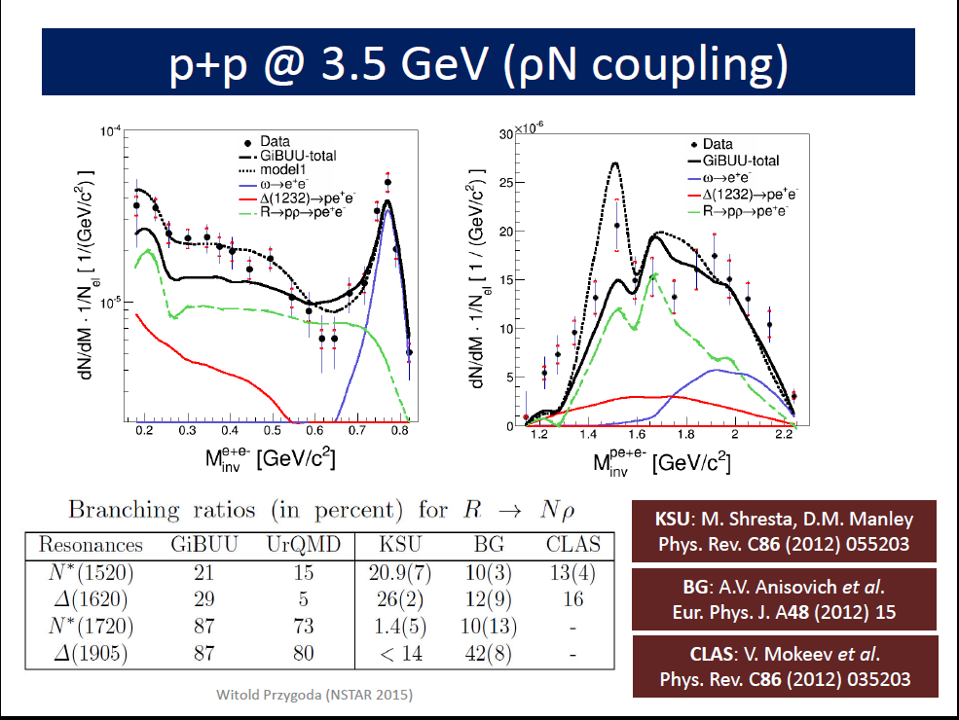

Slide 24
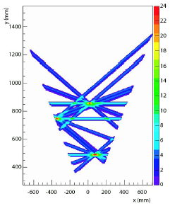
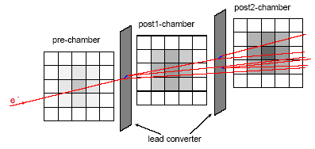
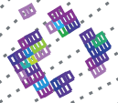
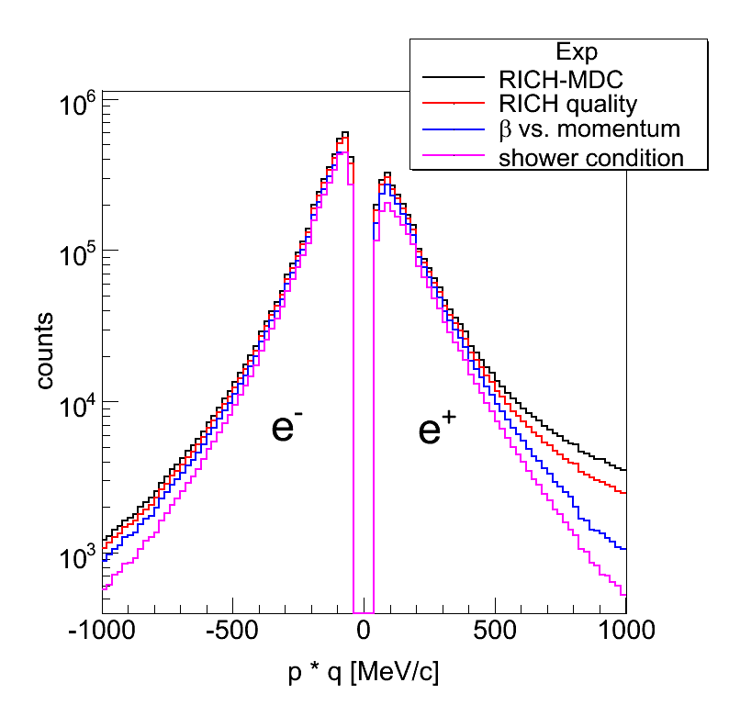
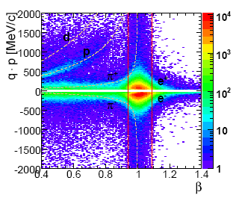
Lepton Identification with HADES
Drift Chamber:
Track reconstruction
RICH pattern
Pre-Shower condition
e⁻
+
+
+
momentum % velocity
momentum ∙ charge
C+C 2 AGeV

Slide 25




Studying cold nuclear matter
p+p/p+Nb
3.5 GeV
Phys.Lett. B715 (2012) 304
HADES added value
p_{e+e-} measured
down to 0.2 GeV/c
« ρ-like» contribution strongly distorted
Δ (1720),N* (1520),.. →Nρ→Ne⁺e⁻
From primary NN and secondary πN reactions .

