Slide 1
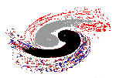
Institute of High Energy Physics
The role of anomalous triangle singularity in the understanding of threshold phenomena
Qiang Zhao
Institute of High Energy Physics, CAS
and Theoretical Physics Center for Science Facilities (TPCSF), CAS
zhaoq@ihep.ac.cn
XVI International Conference on Hadron Spectroscopy September 13-18, 2015, Newport News

Slide 2
Outline
1. Motivation: kinematic effects or genuine states?
2. Anomalous triangle singularity
3. Cases to recognize anomalous triangle singularity: Heavy pentaquark production at LHCb
4. Summary

Slide 3
1. Motivation: kinematic effects or genuine states?

Slide 4
Multi-faces of QCD: Exotic hadrons
Hybrid
Glueball
Tetraquark
Pentaquark
Hadronic molecule
Proton
u
d
u
π
d
Neutron
d
u
Deuteron: p-n molecule
Evidence for QCD exotic states is a missing piece of knowledge about the Nature of strong QCD.

Slide 5
Brief summary of the exp. progress
New quarkonium-like states, i.e. X, Y, Z’s, are observed in experiment
Do not fit in the conventional quarkonium spectrum as quark-antiquark states, e.g. X(3872), Y(4260), X(3900) etc.
Most of these new states, such as X(3872), are located close to a two-particle threshold.
Evidence for charged quarkonium states, e.g. Zb(10610), Zb(10650) , Zc(3900), Zc(4020), Z(4430), etc.
In some cases, isospin or heavy quark symm. are violated.
Good candidates for hadronic molecules or other non-standard configurations, e.g. tetraquarks, hybrids, etc.
Evidence for heavy pentaquarks, i.e. Pc(4380) and Pc(4430), reported by LHCb.

Slide 6
2. Anomalous triangle singularity

Slide 7
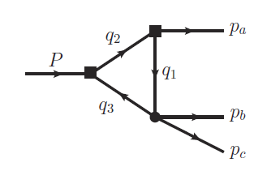
Anomalous triangle singularity
The ATS occurs when all the three internal particles can be simultaneously on shell. It corresponds to
for all j=1,2,3.
L. D. Landau, Nucl. Phys. 13, 181 (1959).
G. Bonnevay, I. J. R. Aitchison and J. S. Dowker, Nuovo Cim. 21, 3569 (1961).

Slide 8
Kinematics :
The ATS condition for fixed s₁, m_{j}, and s₃ is:
Or for fixed s₁, m_{j}, and s₂ :
X.-H. Liu and Q. Zhao, arXiv:1507.01674 [hep-ph]

Slide 9
Single dispersion relation in s₂:
The spectral function σ(s₁, s₂, s₃) can be obtained by means of the Cutkosky’s rules (absorptive part of the loop amplitude) or the formula
which reads

Slide 10
For fixed s₁, s₃ and m_{i}, the spectral function σ(s₁, s₂, s₃) has logarithmic branch points s±₂ , which correspond to the anomalous thresholds by solving the Landau equation.
How the logarithmic branch points s±₂ move as s₁ increases from the threshold of (m₂ + m₃)², with s₃ and m_{i} fixed?
Substituting s₁→s₁+iε, s±₂ in the s′-plane are then located at
The normal thresholds and critical values for s₁ and s₂ as follows,
With

Slide 11
Trajectory of s±₂ in the complex s′₂-plane with s₁ increasing from s_{1N} to ∞.
P:

Slide 12
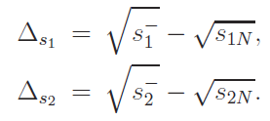
The difference between the normal and anomalous thresholds:
When s₂=s_{2N} (s₁=s_{1N}), we will obtain the maximum value of Δs₁ (Δs₂ ),

Slide 13
3. Cases to recognize anomalous triangle singularity: Heavy pentaquark production at LHCb
Many other cases:
J.-J. Wu, X.-H. Liu, and Q. Zhao, B.-S. Zou, PRL108, 081003 (2012)
X.-G. Wu, J.-J. Wu, Q. Zhao, B.-S. Zou, PRD 87, 014023 (2013)
Q. Wang, C. Hanhart, Q. Zhao, PRL111, 132003 (2013)
Q. Wang, C. Hanhart, Q. Zhao, PLB725, 106 (2013)
X.-H. Liu, Q. Zhao, arXiv:1507.01674 [hep-ph]
A. P. Szczepaniak, PLB747, 410 (2015) [arXiv:1501.01691 [hep-ph]]
M.Mikhasenko, B. Ketzer and A. Sarantsev, PRD 094015 (2015) [arXiv:1501.07023 [hep-ph]]

Slide 14
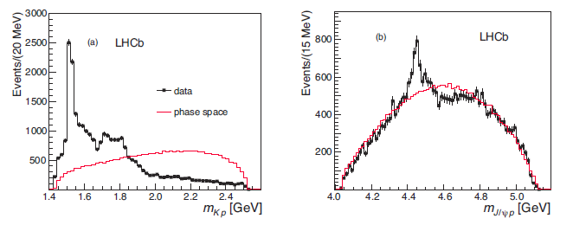
arXiv:1507.03414v2 [hep-ex], PRL(2015)
Pc⁺(4380)
Pc⁺(4450)

Slide 15
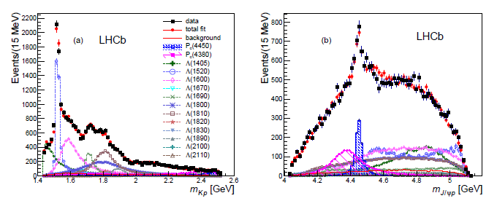
Data analysis including Λ* and pentaquark states
M[Pc⁺(4380)] = (4380±8±29) MeV, Γ= (205±18±86) MeV
M[Pc⁺(4450)] = (4449.8±1.7±2.5) MeV, Γ=(39±5±19) MeV
J^{P} = (3/2⁻, 5/2⁺) or (3/2⁺, 5/2⁻)

Slide 16
Immediate theoretical studies:
1) Molecular states:
R. Chen, X. Liu, X.-Q. Li, S.-L. Zhu, arXiv:1507.03704[hep-ph]
L. Roca, J. Nieves and E. Oset, arXiv:1507.04249 [hep-ph].
A. Feijoo, V. K. Magas, A. Ramos and E. Oset, arXiv:1507.04640 [hep-ph]
J. He, arXiv:1507.05200 [hep-ph]
U.-G. Meissner, J.A. Oller, arXiv:1507.07478v1 [hep-ph]
2) Multiquark state as an overall color singlet
L. Maiani, A.D. Polosa, and V. Riquer, arXiv:1507.04980 [hep-ph]
R.L. Lebed, arXiv:1507.05867 [hep-ph]
V.V. Anisovich et al., arXiv:1507.07652[hep-ph]
G.-N. Li, X.-G. He, M. He, arXiv:1507.08252 [hep-ph]
3) Soliton model
N.N. Scoccolaa, D.O. Riska, Mannque Rho, arXiv:1508.01172 [hep-ph]
4) Sum rules study
H. X. Chen, W. Chen, X. Liu, T.G. Steele and S. L. Zhu, arXiv:1507.03717
Z.-G. Wang, arXiv:1508.01468.

Slide 17
Some early studies:
J. J. Wu, R. Molina, E. Oset and B. S. Zou, Phys. Rev. Lett. 105, 232001 (2010) [arXiv:1007.0573 [nucl-th]].
J. J. Wu, R. Molina, E. Oset and B. S. Zou, Phys. Rev. C 84, 015202 (2011) [arXiv:1011.2399 [nucl-th]].
J. J. Wu, T.-S. H. Lee and B. S. Zou, Phys. Rev. C 85, 044002 (2012) [arXiv:1202.1036 [nucl-th]].
Z. C. Yang, Z. F. Sun, J. He, X. Liu and S. L. Zhu, Chin. Phys. C 36, 6 (2012) [arXiv:1105.2901 [hep-ph]].
Alternative solutions? Or some further concerns?
Threshold enhancement produced by anomalous triangle singularity:
F.-K. Guo, U.-G. Meissner, W. Wang, and Z. Yang, arXiv:1507.04950 [hep-ph]
X.-H. Liu, Q. Wang, and Q. Zhao, arXiv:1507.05359 [hep-ph]
M. Mikhasenko, arXiv:1507.06552v1 [hep-ph]

Slide 18
Challenges for difference scenarios:
1) The narrow Pc(4450), if has JP=5/2+, would require a P-wave coupling between e.g. Σc*(2520)‾D*. A strong attractive force is required to bring the mass below threshold in a P wave. Then, how about the S wave? Similar questions for the lower one.
2) Why the lower one is much broader than the higher one?
3) How about other channels with Σc*‾D(*) and Λc*‾D(*) interactions? How many states we would expect and why only two states are seen?
4) Pentaquarks with hidden b‾b ?
5) If the threshold interaction plays a role, how to distinguish the threshold kinematic effects from genuine states?
……

Slide 19
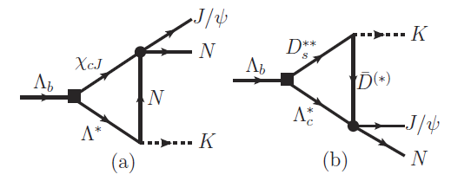
Production mechanism in Λ_{b} decay
Rescattering via triangle diagrams

Slide 20
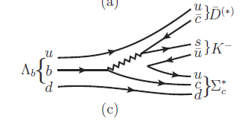
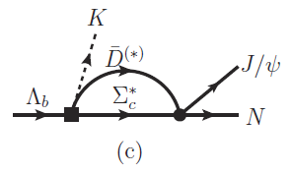
A new leading order mechanism
Rescattering to generate a pole?
Favored by the molecular picture

Slide 21
The anomalous triangle singularity can be recognized
F.-K. Guo, U.-G. Meissner, W. Wang, and Z. Yang, arXiv:1507.04950 [hep-ph]
X.-H. Liu, Q. Wang, and Q. Zhao, arXiv:1507.05359 [hep-ph]
M. Mikhasenko, arXiv:1507.06552v1 [hep-ph]

Slide 22
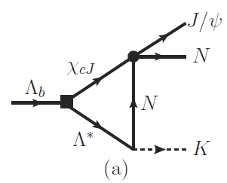
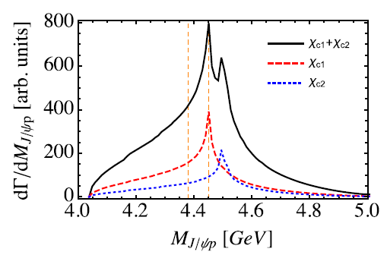
Thresholds for χ_{cJ} p
X.-H. Liu, Q. Wang, and Q. Zhao, arXiv:1507.05359 [hep-ph]

Slide 23
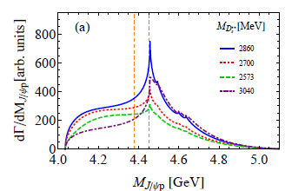
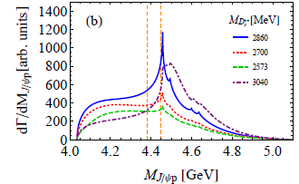
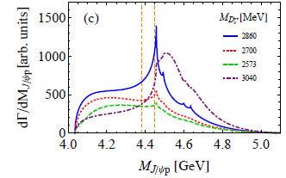
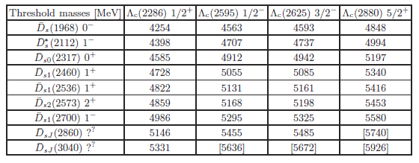
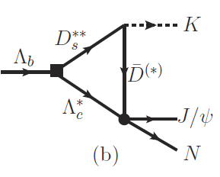

Slide 24
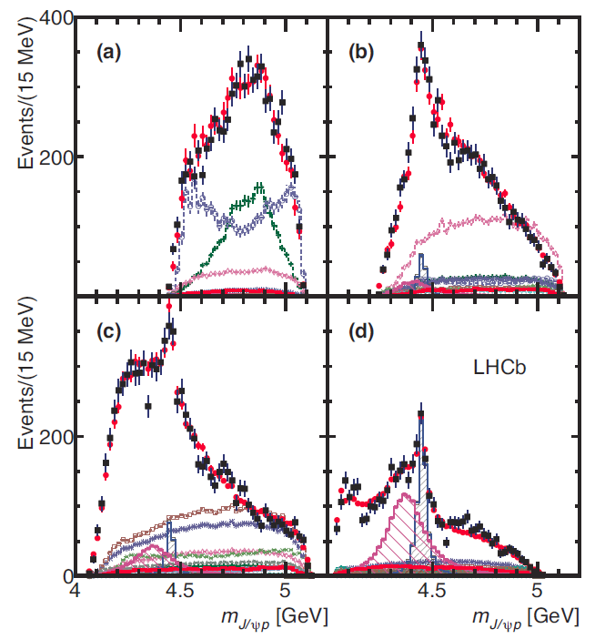
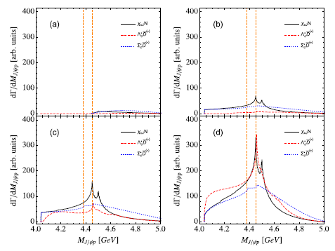
Invariant mass distribution of J/ψ p with different K⁻p momentum cuts

Slide 25
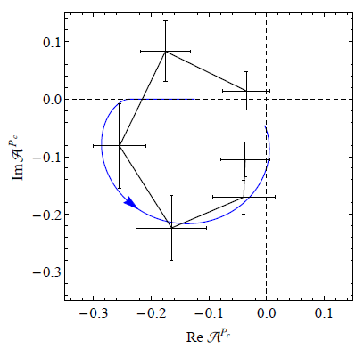
The ATS can mimic a resonance behavior in certain cases
F.-K. Guo, U.-G. Meissner, W. Wang, and Z. Yang, arXiv:1507.04950 [hep-ph]

Slide 26
How to distinguish an ATS enhancment from a genuine state?
If it is a genuine states, the signal in the invariant mass distribution of J/ψ p should be process independent.
The signal should still be present in a process where the ATS does not contribute, e.g. J/ψ photoproduction off nucleon.
Q. Wang, X.-H. Liu, and Q. Zhao, PRD(2015); arXiv:1508.00339 [hep-ph]
V. Kubarovsky and M.B. Voloshin, arXiv:1508.00888 [hep-ph]
M. Karliner and J. Rosner, arXiv:1508.01496 [hep-ph]
J. J. Wu and T.-S. H. Lee, arXiv:1212.2440 [nucl-th]
Y. Huang, J. He, H. F. Zhang and X. R. Chen, J. Phys. G 41, 115004 (2014)

Slide 27
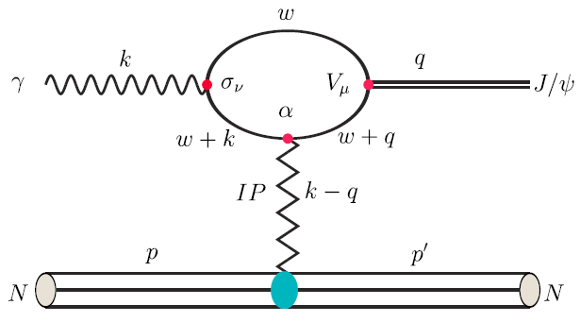
J/ψ photoproduction near threshold:
Diffractive dominant at forward angle: Pomeron exchange model
Q. Wang, X.-H. Liu, and Q. Zhao, PRD(2015); arXiv:1508.00339 [hep-ph]

Slide 28
Kinematic features of the production mechanism
Forward angle peaking is predominant due to the diffractive process, i.e. Pomeron exchanges.
S-channel resonance excitations contribute to the cross sections at middle and backward angles.
U-channel contributes to backward angles.
dσ/dΩ
t-channel:
Pomeron exchange
s-channel
u-channel
Interferences from different transition mechanisms
0
90
180
Scattering angle

Slide 29
s and u-channel pentaquark production
Coupling vertices for γNP_{c}:
S. H. Kim, S. i. Nam, Y. Oh and H. C. Kim, PRD 84, 114023 (2011)
Q. Wang, X.-H. Liu, and Q. Zhao, arXiv:1508.00339 [hep-ph]

Slide 30
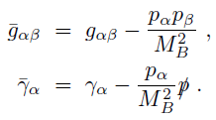
Coupling vertices for J/ψNP_{c}:
Leading transition matrix elements:
Rarita-Schwinger spin projections:
with

Slide 31
Vector meson dominance
γ
γ
eh₁
J/ψ
J/ψ
g₁
J/ψ
P_{c}
P_{c}
p
p
p
p
J/ψ
e⁺
e⁻
By assuming that the J/ψ p saturate the decay widths of the Pc states, we have
A form factor is included:

Slide 32
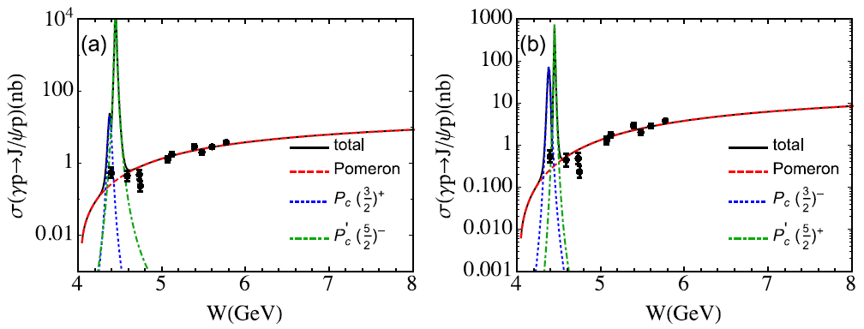
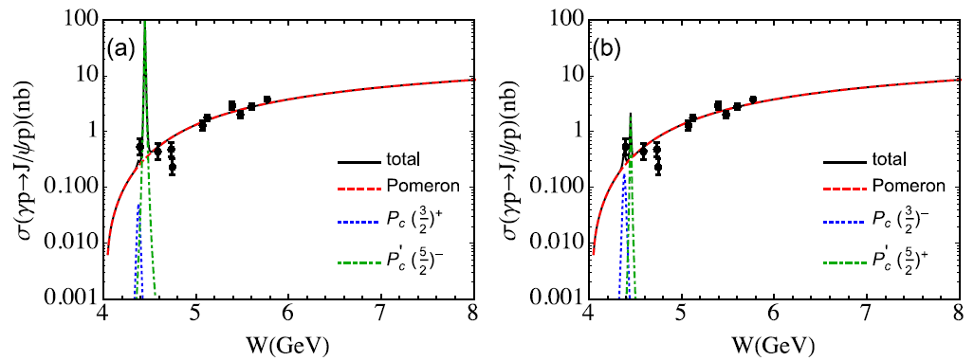
Total cross sections predicted:
Full width prediction
Prediction with 5% of b.r. to J/ψ p:

Slide 33
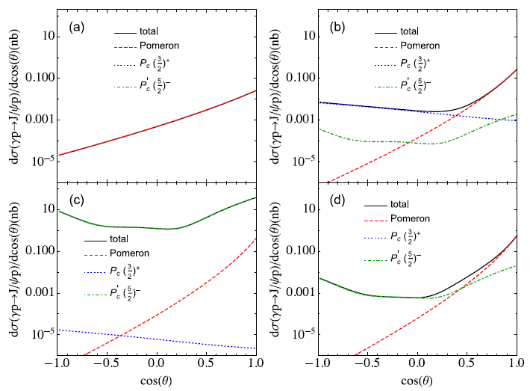
Predicted differential cross sections at different energies:
W= 4.15 GeV
W= 4.38 GeV
W= 4.45 GeV
W= 4.50 GeV

Slide 34
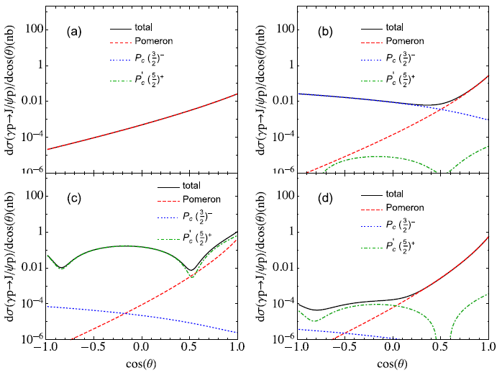
Predicted differential cross sections at different energies:
W= 4.15 GeV
W= 4.38 GeV
W= 4.45 GeV
W= 4.50 GeV

Slide 35
4. Summary
The anomalous triangle singularity is strongly correlated with threshold phenomena for which the physical consequences also need to be understood. Many cases seem to be indicating the ATS effects.
The pentaquark candidates observed by LHCb may have filled a missing piece of the strong QCD jigsaw puzzle. However, there are still many things to be understood.
The J/ψ photoproduction serves as an ideal process to distinguish the ATS enhancement from a genuine state which can be studied at JLab in the near future.

Slide 36
Institute of High Energy Physics
Thanks for your attention!

