Slide 1





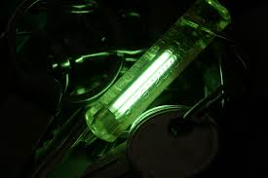
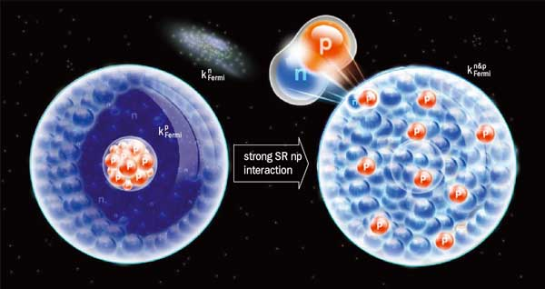
Proton and Neutron Momentum Distributions in A=3 Asymmetric Nuclei
Proposal PR12-13-012
Spokespersons:
O. Hen (TAU), L. B. Weinstein (ODU), S. Gilad (MIT), W. Boeglin (FIU)
PAC-42, July 30th, 2014.

Slide 2
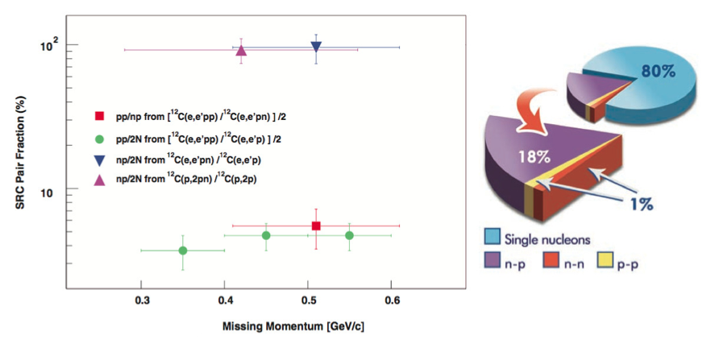
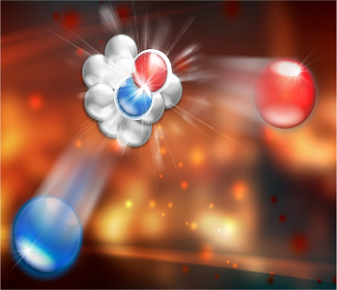
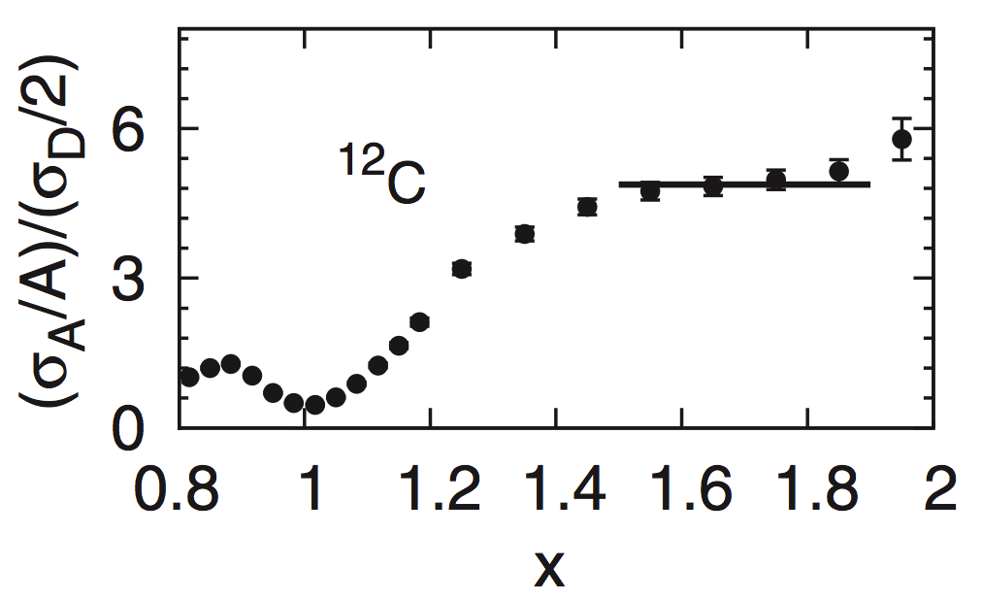
Momentum Distribution and Short-Range Structure of Nuclei
A large (and successful) part of the JLab 6 GeV program.
Short Range Correlations (SRC):
  ~25 % of nucleons in nuclei (A>12) have high-momentum (k > k_{F} ~ 250 MeV/c).
  High-momentum nucleons predominantly belong to 2N-SRC pairs.
  2N-SRC are dominated by np pairs (tensor interaction).
JLab experimental SRC results: 2 Science, 6 PRLs, …
+ LOTS of theoretical / phenomenological work inspired by the experimental results.

Slide 3
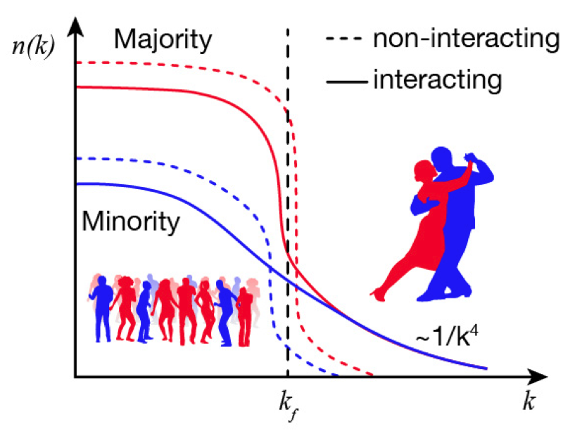
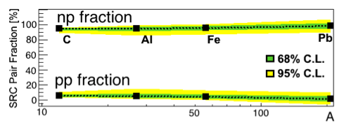
New Results on Heavy Asymmetric Nuclei
np-pairs also dominate SRC in heavy asymmetric nuclei (CLAS Data-Mining).
P(k>k_{F}) for Minority
larger than
P(k>k_{F}) for Majority
O. Hen et al. (CLAS Collaboration), Science 346 614 (2014)

Slide 4
For Light Nuclei Correlations are Predicted to Win
<T_{p}>
<T_{n}>
<T_{p}> − <T_{n}>
n
  <T>(Minority)
  <T>(Majority)
  >
VMC Calculations by R. Wiringa et al. (Phys. Rev. C 89, 024305 (2013))
Can we test this prediction ?
What are the implications ?

Slide 5
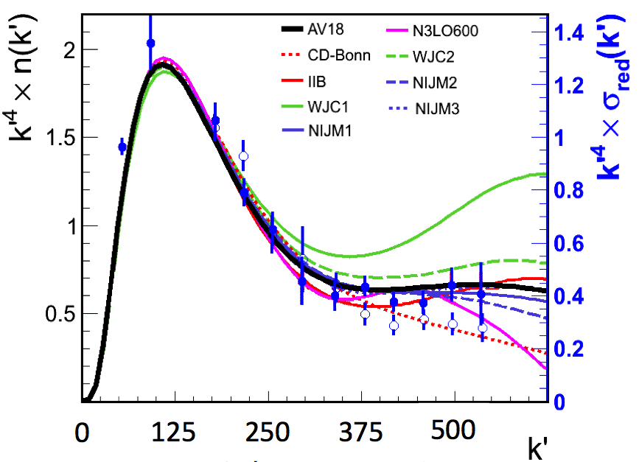
Nuclear Momentum Distributions
Fundamental quantity - sensitive to the full complexity of the nuclear interaction
Calculated from potentials fit to NN scattering.
High-momentum poorly constrained.
Not an observable.
Never precisely extracted.
d(e,e’p) data
30-40% Model Dependent Corrections
Hen, Weinstein, Piasetzky, Miller, Sargsian,
and Sagi, submitted to PRL
W. Boeglin et al. (Hall-A), PRL 107, 262501 (2011)

Slide 6
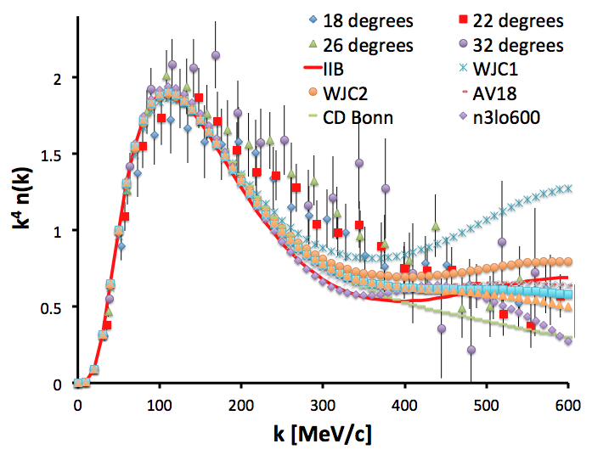
Nuclear Momentum Distributions
Fundamental quantity - sensitive to the full complexity of the nuclear interaction
Calculated from potentials fit to NN scattering.
High-momentum poorly constrained.
Not an observable.
Never precisely extracted.
d(e,e’)
y-scaling data
N. Fomin et al. (Hall-C), PRL 108, 092502 (2012)
30-40% finite Q² effects
6

Slide 7
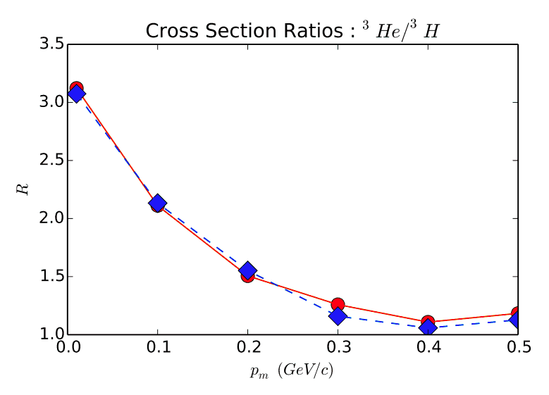
Nuclear Momentum Distributions
Fundamental quantity - sensitive to the full complexity of the nuclear interaction
Calculated from potentials fit to NN scattering.
High-momentum poorly constrained.
Not an observable.
Ratio can be precisely extracted
Plain Wave Calculation
Full Calculation
Insensitive to theoretical uncertainties

Slide 8
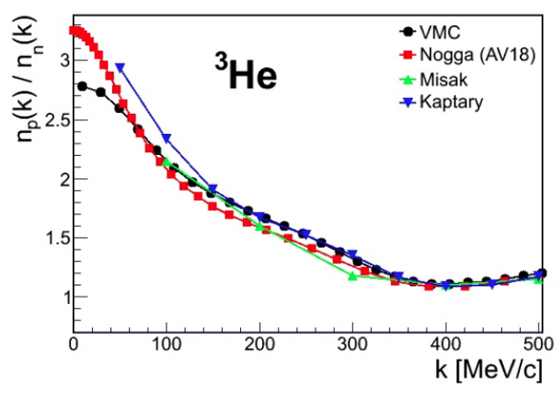
A=3 Nuclei: A Lab for Energy Sharing in Asymmetric Systems
³He
³He
Simple Nucleon Counting
n
P
n(k) proton / neutron ratio
p

Slide 9
A=3 Nuclei: A Lab for Energy Sharing in Asymmetric Systems
³He
³He
R=2
Simple Nucleon Counting
n
P
n(k) proton / neutron ratio
p
np-SRC:
R=1
Transition Region

Slide 10
A=3 Nuclei: A Lab for Energy Sharing in Asymmetric Systems
³He
R>2
n
P
n(k) proton / neutron ratio
p
Transition Region
R=1
Tensor correlations shift more neutrons than protons to the high-momentum tail.

Slide 11
Implication I: IsoSpin Dependent EMC Effect
IsoSpin dependent EMC effect (u quark distribution more modified than d) can explain the NuTeV anomaly.
Many models relate medium modification to nucleon virtuality.
If <T_{p}> > <T_{n}> :
➔protons more-modified than neutrons
➔ u modification > d
(Consistent with the EMC-SRC correlation)

Slide 12
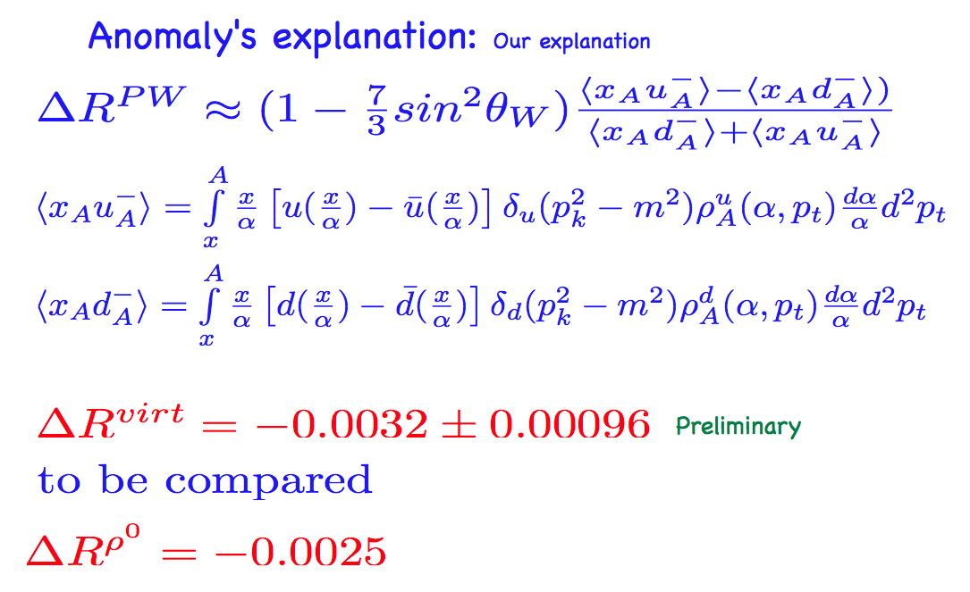
Implication I: IsoSpin Dependent EMC Effect
IsoSpin dependent EMC effect (u quark distribution more modified than d) can explain the NuTeV anomaly.
Many models relate medium modification to nucleon virtuality.
If <T_{p}> > <T_{n}> :
➔protons more-modified than neutrons
➔ u modification > d
(Consistent with the EMC-SRC correlation)
Also important for possible ‘off-shell’ corrections for MARATHON
(bound proton in ³He ≠ ³H)
From M. Sargsian talk at the APS meeting

Slide 13
Implication II: Symmetry Energy
Relates to the energy change when replacing n with p.
equation-of-state of neutron stars,
heavy-ion collisions,
r-process nucleosynthesis,
core-collapse supernovae,
more…
np-SRC pairs increase the kinetic energy of SNM with almost no effect on PNM
=> E_{sym} = E_{PNM} − E_{SNM} Reduced Dramatically
(symmetric,
#n=#p)
(pure neutron)
Hen et al, PRC in press, nucl-ex:1409.0772
Our measurement will complement the PREX results

Slide 14
Implication III: Neutron Stars
Neutron stars
k
F
n
p
e
np-SRC pairs
Create large high-momentum proton tail.
Open ‘holes’ in the neutron Fermi sphere.
Change the cooling rate via the direct URCA process.
Change the spatial distribution.
L. Frankfurt, M. Sargsian and M. Strikman, Int. J. Mod. Phys. A 23, 2991 (2008).

Slide 15
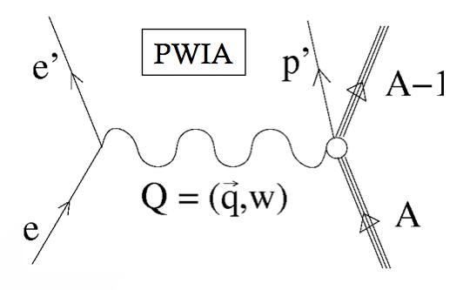
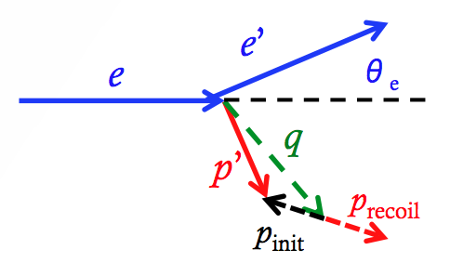
Extracting the nuclear momentum distributions: A(e,e’p)
Kinematical
Factor
e-p
Cross
Section
Spectral
Function
Complications:
Rescattering of the outgoing proton.
Off-shell proton cross-section.
Meson Exchange Currents (MEC).
Delta production (i.e. IC).

Slide 16
The A=3 System: A Lab for Energy Sharing in Asymmetric Systems
³He and ³H are mirror nuclei
  Neutron in ³He = Proton in ³H
Two-ways to study the proton-to-neutron momentum distribution ratio in ³He:
  Measure the ³He(e,e’p) / ³He(e,e’n) ratio.
  [Need to measure neutrons.]
  Measure the ³He(e,e’p) / ³H(e,e’p) ratio.
  [Need a Tritium target.]
³H
n
P
n
³He
n
P
p

Slide 17
The A=3 System: A Lab for Energy Sharing in Asymmetric Systems
³He and ³H are mirror nuclei
  Neutron in ³He = Proton in ³H
Two-ways to study the proton-to-neutron momentum distribution ratio in ³He:
  Measure the ³He(e,e’p) / ³He(e,e’n) ratio.
  [Low accuracy due to the neutron measurement]
  Measure the ³He(e,e’p) / ³H(e,e’p) ratio.
  [Complicated due to the need for a Tritium target.
  Luckily, JLab will have one ☺ ]
³H
How accurately can we do it?
n
P
n
³He
n
P
p

Slide 18
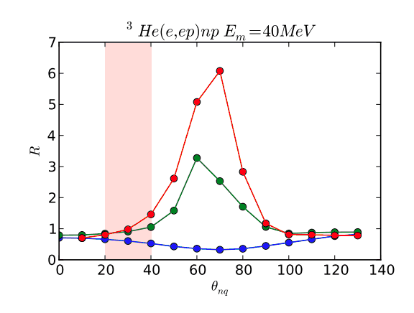
Accessing the momentum distribution - FSI
Rescattering minimized at small angles (verified for deuterium).
Small angles => x_{B}>1 => suppress MEC and IC effects.
R = σ_{Full} / σ_{PWIA}
500 MeV/c
400 MeV/c
200 MeV/c
Rescattering effects as a function of the angle between P_{miss} and q.
PWIA Calculation
Rescattering effects cancel in the ³He/³H ratio
Full Calculation
P_{miss} [GeV/c]

Slide 19
The proposed measurement
³He(e,e’p) and ³H(e,e’p) cross-sections and ratio:
Q² ≈ 2 GeV²
  Reduces non-nucleonic currents (MEC, IC)
  Proton energies high enough for eikonal FSI calculations
x = Q2/2mω > 1 to minimize non-nucleonic currents
θrq < 40º to minimize FSI
E_{beam} = 4.4 GeV
  Maximum beam energy for HRSe
  Maximizes the cross section
0 < pmiss < 450 MeV/c
  Covers the region from mean field to SRC
HRS with standard electron and proton detection packages
MARATHON ³H target. Low-luminosity.

Slide 20
The proposed measurement
E_{beam} = 4.4 GeV
Q² = 2.0 GeV²
I_{beam} = 20 μA
L (³H) = 8×10³⁶ nucleons cm⁻² s⁻¹
<p_{m}> (MeV/c) | x | E_{e} (GeV) | θ_{e} | p_{p} | θ_{p} | Time (days)
100 | 1.15 | 3.47 | 20.9º | 1.61 | 48.7º | 1
300 | 1.41 | 3.64 | 20.4º | 1.35 | 58.6º | 10
Hall A has done many (e,e’p) measurements at similar kinematics and much higher luminosities.
Very low luminosity:
  Negligible coincidence backgrounds.
  Low singles rates.

Slide 21
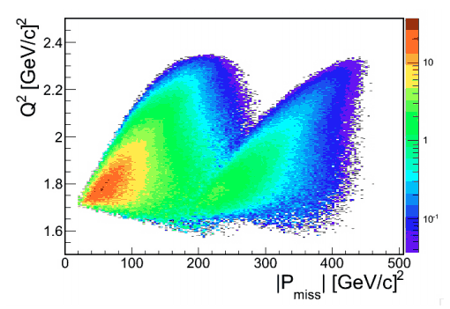
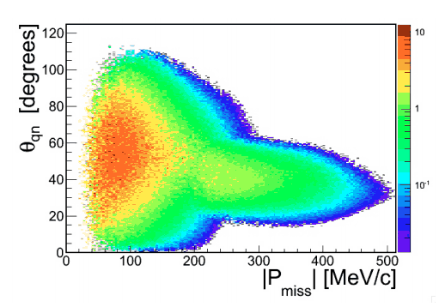
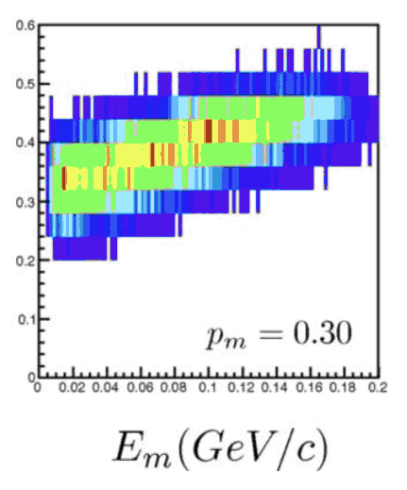
MCEEP Acceptance Simulations

Slide 22
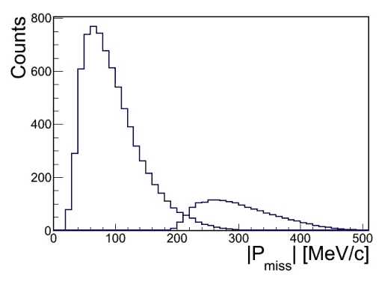
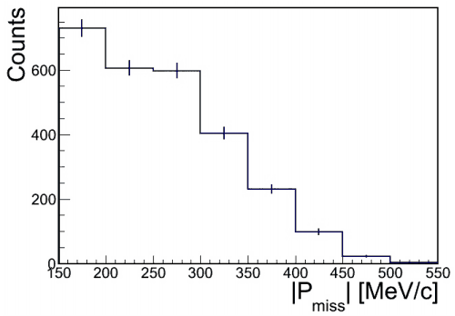
MCEEP Count Rate Estimations

Slide 23
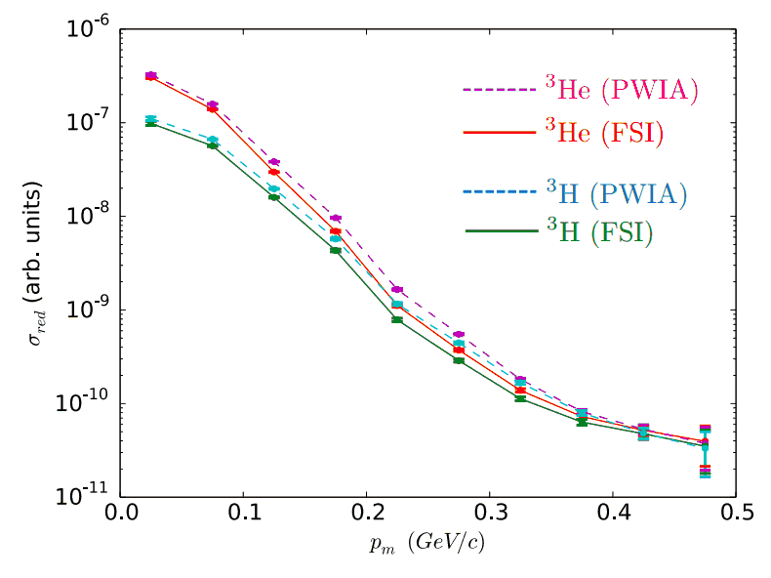
Expected Results I: Reduced cross-sections
Extract ³He and ³H reduced cross-sections.
Compare to detailed calculations.

Slide 24
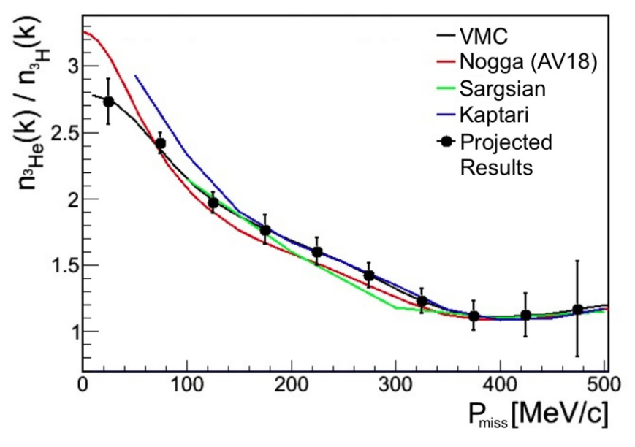
Expected Results II: proton-to-neutron momentum distribution ratio
First high-precision model-independent extraction of nuclear momentum distribution ratio
First direct test of calculated distributions

Slide 25
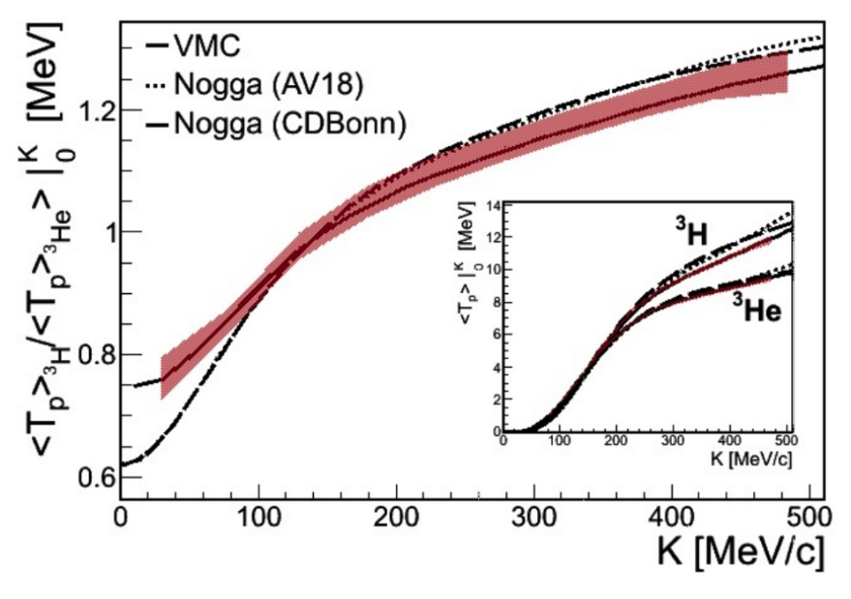
Expected Results III: Kinetic Energy Sharing
Mapping
the Inversion in the Kinetic Energy Sharing

Slide 26
Summary
Unique opportunity to study energy sharing in asymmetric systems
Implications on the EMC Effect, NuTeV anomaly, Symmetry energy, Neutron Stars, test of nuclear models, and more…

Slide 27
Backup Slides

Slide 28
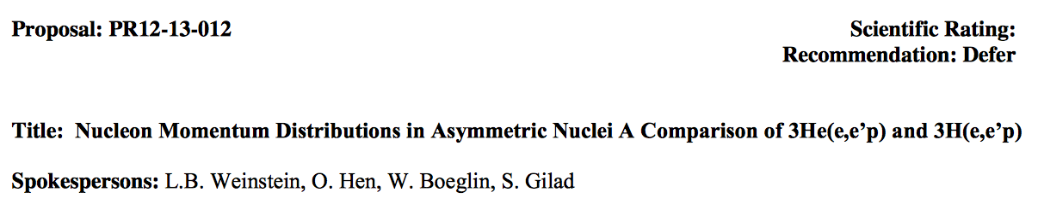
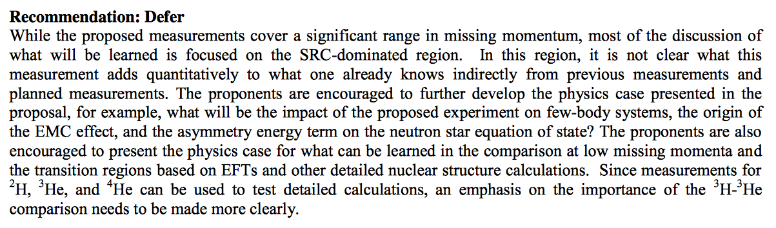
PAC40
See our response in the next transparency

Slide 29
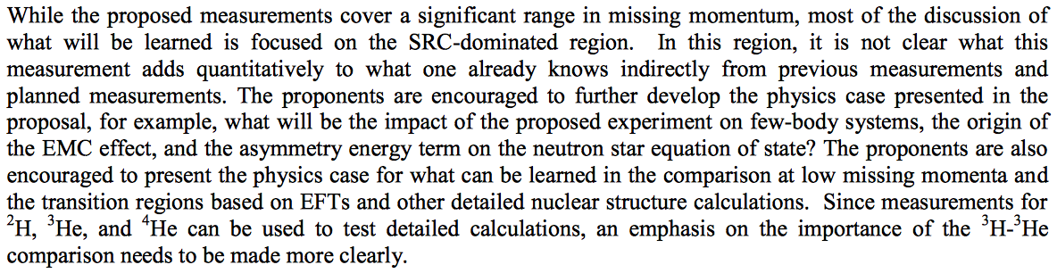
Response to PAC40
Few-Body Systems
  Transparencies: 7 - 15.
EMC Effect
  Transparencies: 16 - 18.
Asymmetry Energy and Neutron Stars
  Transparencies: 19 - 21.
Comparison of low-and-high missing momenta
  Transparencies: 12 - 15.
Importance of ³H-³He comparison
  Transparencies: 7 - 11, 23 - 27.

Slide 30
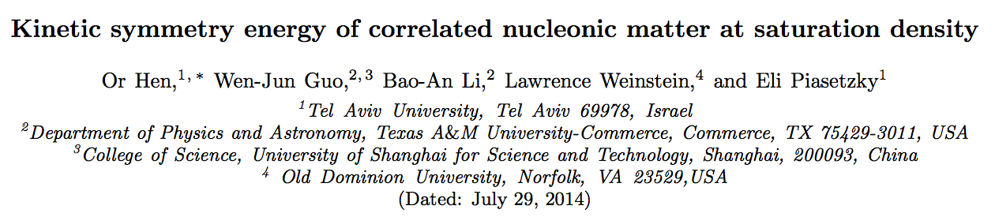
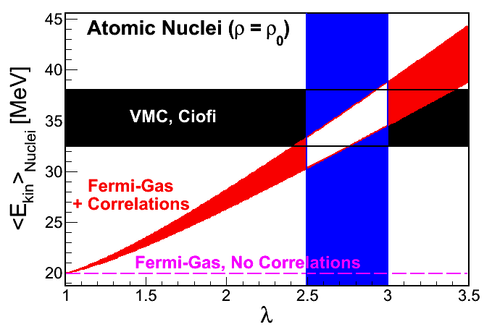
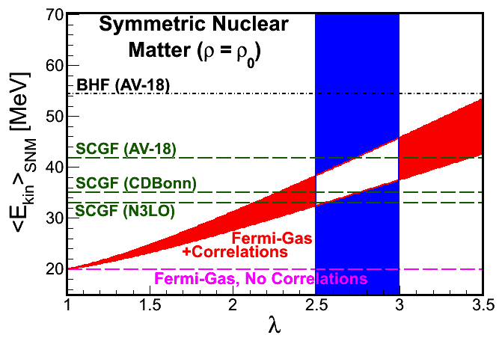
Phenomenological model for the effect of np-SRC on the kinetic part of the nuclear symmetry energy
Large impact on analysis of new Sn+Sn collisions data from MSU
(See next transparency)

Slide 31
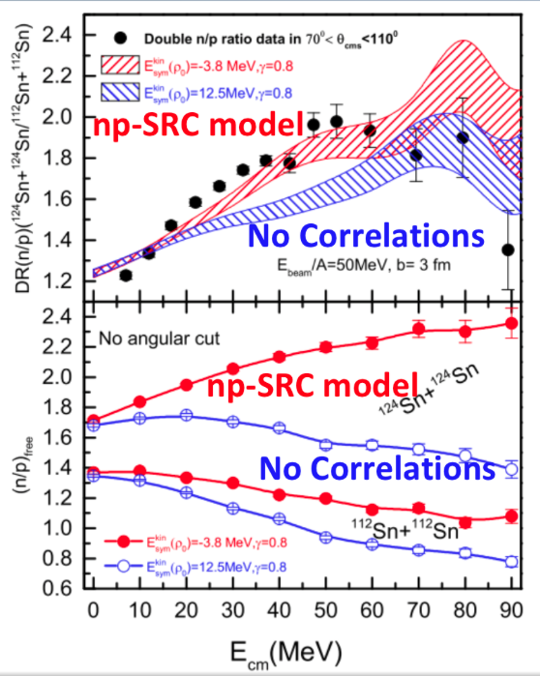
np-SRC has large impact on analysis of new Sn+Sn collisions data from MSU.
O. Hen, W. J. Gao, B. A. Li, E. Piasetzy, and L. B. Weinstein, in preparation.

Slide 32
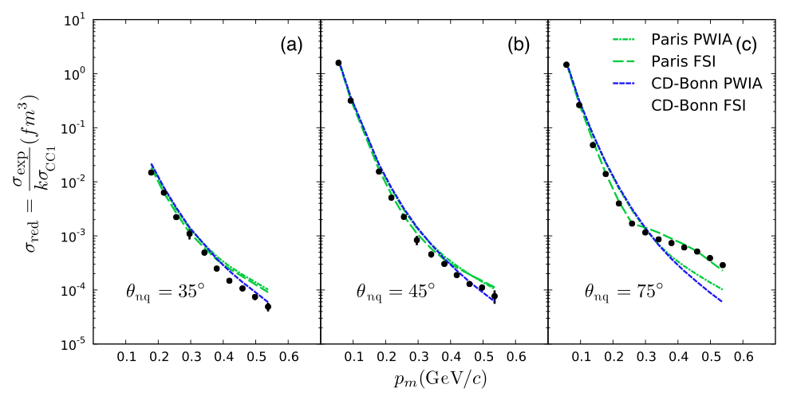
Minimizing d(e,e’p) Final State Interactions (FSI): choosing kinematics
θ_{nq}= 35º
θ_{nq}= 45º
θ_{nq}= 75º
Full
PWIA
0.1
0.5
0.1
0.5
0.1
0.5
P_{miss} (GeV/c)
Boeglin et al. (Hall-A Collaboration), PRL 107 (2011) 262501

Slide 33
Previously Measured d(e,e’p) Backgrounds and Rates
E_{in} = 4.7 GeV,
θ_{nq} = 40º,
p_{miss} = 0.5 GeV/c
Q² = 2.1 (GeV/c)²,
θ_{e} = 19.3º
θ_{p} = 66.3º
p_{e} = 3.97 GeV/c
p_{p} = 1.23 GeV/c
Similar kinematics,
pmiss = 0.5 GeV/c
L = 4×10³⁸ cm⁻² s⁻¹
Negligible Random coincidence background
Note: We have
L = 8×10³⁶ cm⁻² s⁻¹
Corrected e-p Time of Flight
From the 6 GeV d(e,e’p) measurement
Proton rates (T1): 1.6 kHz
Electron rates (T3): 4.6 kHz
Coincidence rate (T5): 4.3 Hz
Boeglin et al. (Hall-A), PRL 107 (2011) 262501

Slide 34
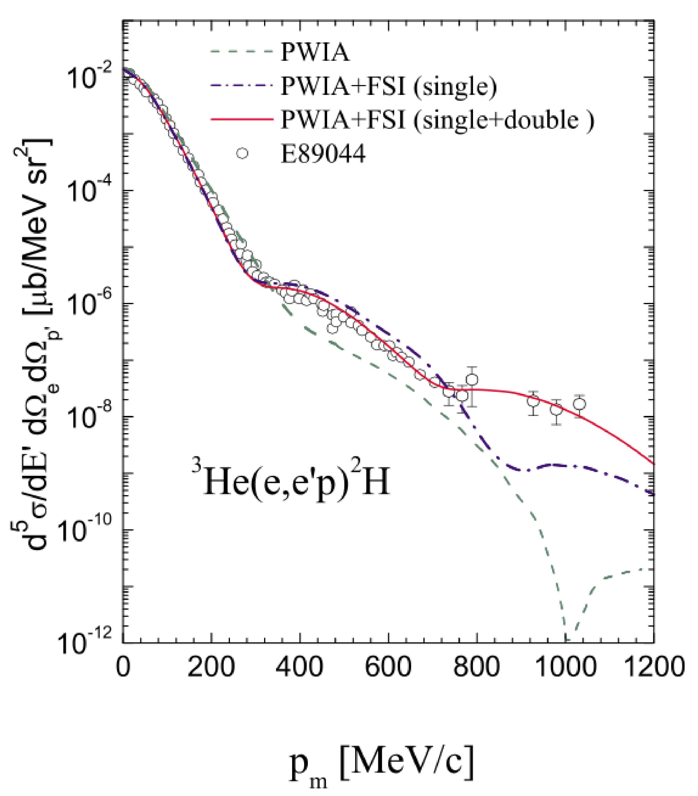
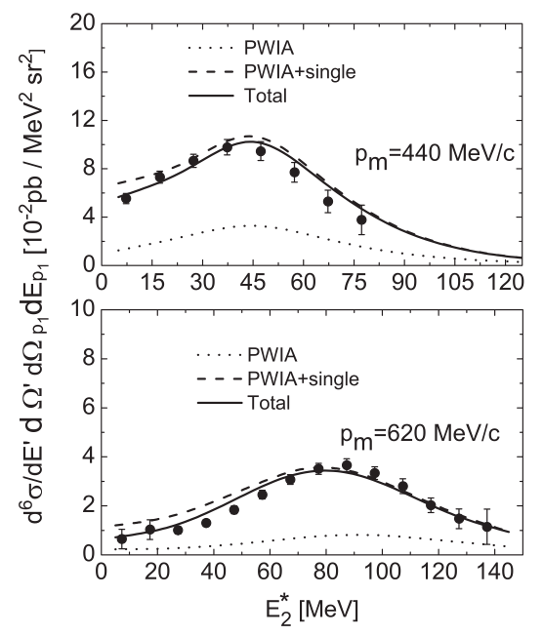
Previous Hall-A ³He (e,e’p) measurements
³He(e,e’p)d
³He(e,e’p)np
Full
p_{m} = 440 MeV/c
FSI dominant
PWIA
p_{m} = 620 MeV/c
PWIA
p_{m} [MeV/c]
E_{m} [MeV]
Dominated by FSI at large missing momentum
Well described by calculation
Data: Rvachev et al., PRL94 192302 ; Benmokhtar et al., PRL94 082305
Theory: Ciofi degli Atti and Kaptari, PRL95 052502 ; Alvioli et al., PRC81 021001 ; Laget, PLB609 49 (not shown)

Slide 35
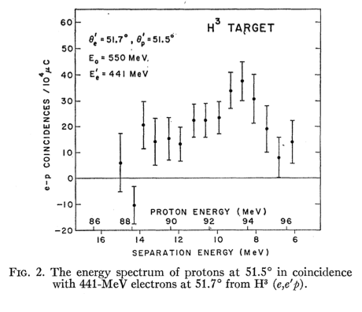
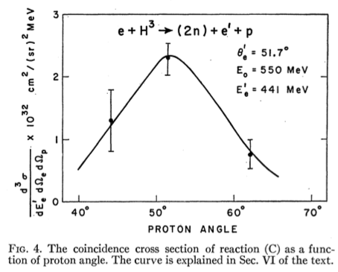
Previous ³H(e,e’p) measurements
A. Johansson (by himself!), PR136 (1964) 1030B.
Low-Energy Measurement.
No access to the momentum distribution

Slide 36
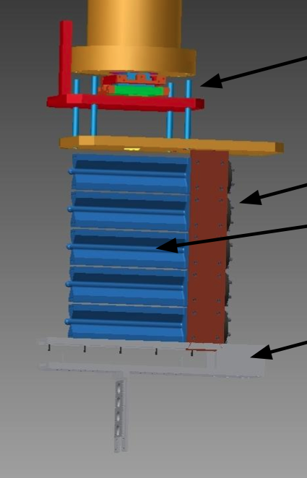
The Marathon Target
Identical 25-cm sealed-cell gas target cells for H₂, D₂, T₂, ³He
I_{beam} ≤ 20 μA
Cell | Thickness (mg/cm²) | Pressure (psi) | Number density
H₂ | 55 | 400 | 2
D₂ | 111 | 400 | 2
T₂ | ~90 | 200 | 2
³He | 82 | 400 | 1
Target cells
Solid targets
Adopted From David Meekins

Slide 37
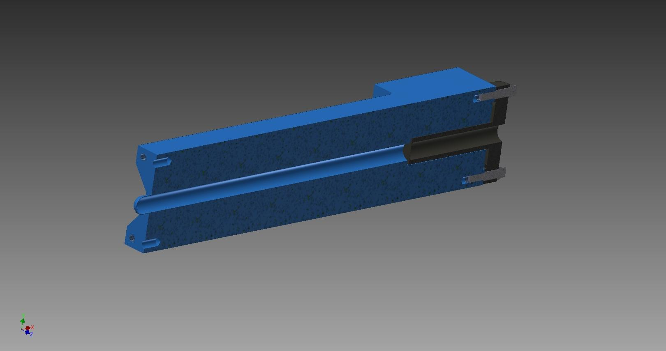
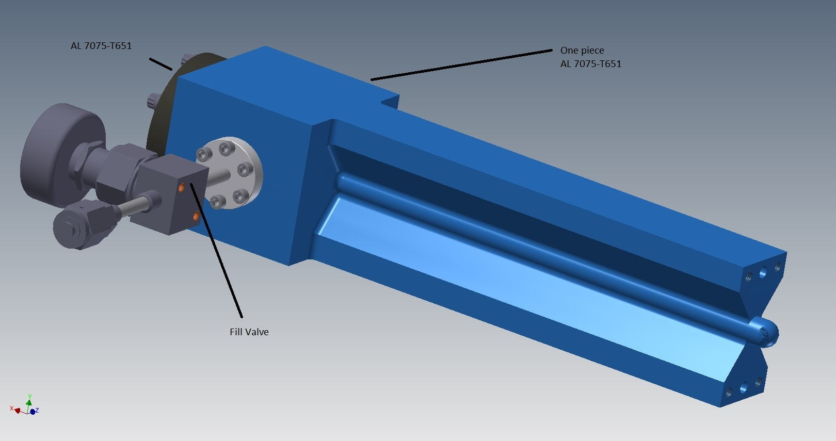
The Marathon Target
Entrance window
Open cell design allows a wide range of scattering angles
Wall thickness 0.018” Al (120 mg/cm²)
Entrance and exit windows: 0.010” Al (65 mg/cm²)
The proton HRS will not see the cell windows
Adopted From David Meekins

Slide 38
The MARATHON Target
Target to be fabricated at JLAB
Savanah River Site (SRS/SRNL)
  Fill and recover T2 gas
  Ship filled cell to JLAB
  Formal statement of work (SOW) has been drafted
  JLAB and SRS to perform additional studies on effects of T2 gas on Al 7075 alloy. SOW not complete.
Design/Operation Plan
  To be reviewed by both JLAB and SRS
Adopted From David Meekins

Slide 39
The Target Cell
Design is complete
  Made from Al 7075-7651
  Swagelok all metal valves and fittings
  Extensive service in H2 at JLAB
  All metal seals
Specs:
  T2 at ~200 psi fill pressure (1.1 kCi)
  Max beam current 20 μA
  Length 25 cm (~90 mg/cm²)
  Entrance window 0.254 mm thick
  Exit window 0.279 mm thick
  Side wall 0.45 mm thick
Adopted From David Meekins

Slide 40
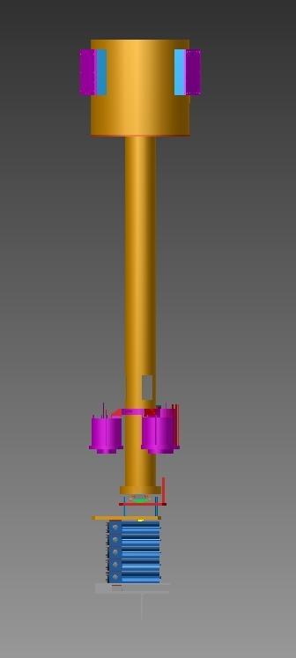
Complete Target Assembly
Cryostat
Use 15K He from ESR to stabilize and cool the cells.
Use the standard cryotarget cryostat for this
Positioning system
Target
Stack
Adopted From David Meekins

Slide 41
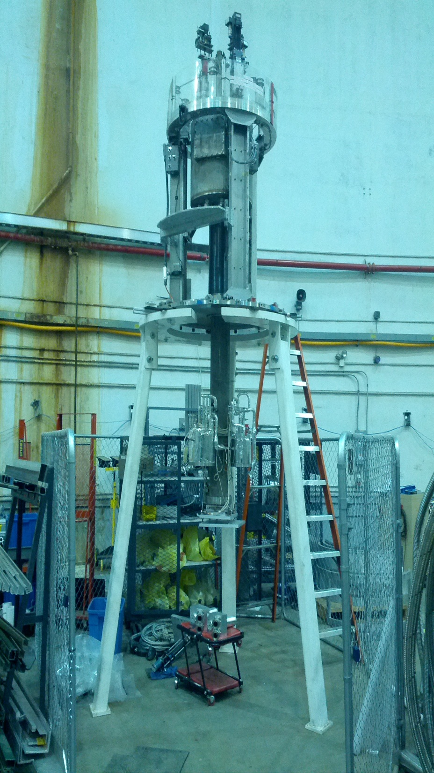
Modify the Current Hall A Target
Mount target stack where normal cryotarget cells go
Lift system remains the same
Mounts in current scattering chamber
Controls nearly identical to cryotarget
Mount cells here
Adopted From David Meekins

Slide 42
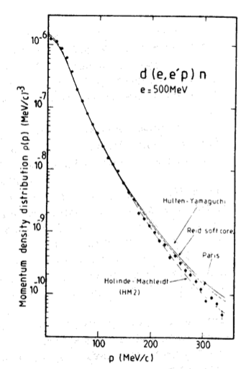
D(e,e’p) from Saclay (1981)
Large discrepancies at high-momentum
(> 150 – 200 MeV/c)
M. Bernheim et al., Nuclear Physics A 365, 349 (1981)

Slide 43
Systematic Uncertainties
Based on previous Hall-A d(e,e’p) measurements at almost identical kinematics:
[Boeglin et al. (Hall-A Collaboration), PRL 107, 262501 (2011)]
Overall systematics uncertainties (~4%):
  H(e,e’) cross-section (~2%)
  Beam Charge (~1%)
  Target Thickness (~1-2%)
  Detection Efficiencies (~1%)
  [Only run-to-run variations do no cancel in the ³He/³H ratio]
  Beam Energy (~1-2%, cancel in the ³He/³H ratio)
  Note: 2% target boiling effect is negligible for our beam current (20 uA vs. 100 uA) and gas target.
Point-to-point systematic uncertainties (~2-3%):
  Measured Kinematical variables for each bin.
Note: ³H/³He (e,e’) ratios (MARATHON and x>2) are assumed to have a ~2% systematic uncertainty.

