Slide 1
Hall A beamline and accelerator status

Slide 2
Hall A beamline configuration
Most significant changes for 12GeV:
The slow raster was removed
The fast raster was upgraded by doubling the coils
Some quadrupoles were added (one in front of compton), some were upgraded with stronger power supplies
Hall A dipoles were refurbished and measured but no change in the steel (unlike elsewhere in the accelerator).

Slide 3
Setting up the machine for hall a
Establish beam in main machine, pass by pass.
Adjust the main machine optics for optimal transport (transport matching)
Make the machine achromatic (dispersion correction)
Setup the extraction
Perform beam envelope measurements at 1C05 and match the beam to the hall (partially done by hand)
Notes:
Machine is now set from design instead of scaled from previous setups.

Slide 4
Setting up the machine for halla (cont)
Establish tune mode beam to dump
Test and calibrate the ion chambers
Test and commission the new fast raster
Establish beam envelope and CW beam

Slide 5
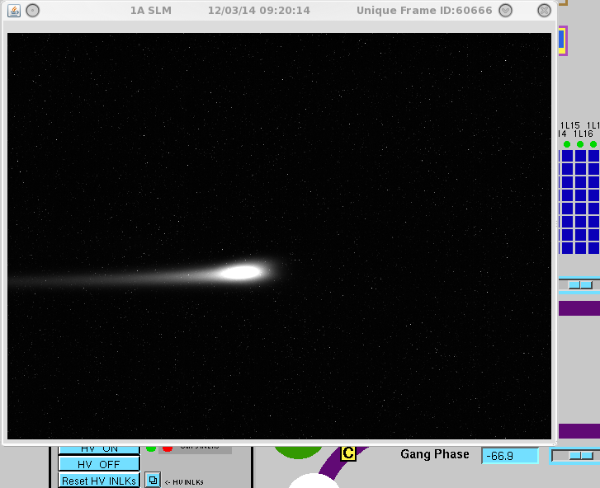
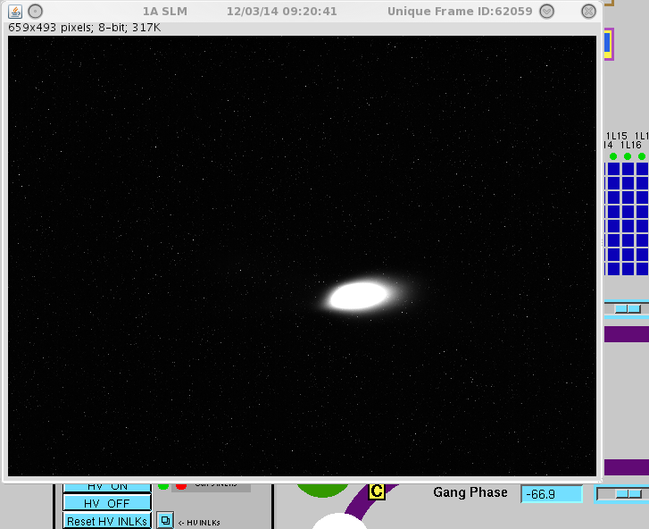
Longitudinal optics
In order to be optimal, optical beam path has to be the same for all lasers (A,B,C) and synchronization such that all electron beams travel the same path.
Hall A beam in ARC1
Hall D beam in ARC1

Slide 6
Extraction Configuration
The extraction lines were redesigned for the 12GeV era and significant upgrades were made (first two passes were not changed from 6GeV)
We commissioned third, first and fourth pass so far. Fourth pass was troublesome for a few days.

Slide 7
Extraction region
New
Relocated
Modified
12 GeV Upgrade Elevation View
L
C
R
R
Pass 1
Pass 2
Pass 3
Pass 4
Pass 5
12 GeV Upgrade Plan View
Recirculation ARCS
Horizontally deflecting septa
Horizontally deflecting Lambertson
Horizontally deflecting RF cavities (499MHz, copper)
Horizontally deflecting dipoles
recirculated
extracted
Notes:
B at 30, D at 150, A at 270 degrees. At E03 beams are roughly 3cm apart. This quad has an elliptical chamber. The bpm has an offset to make beam look like they are at +/- 15mm

Slide 8
Matching strategy
In a recirculating linac machine, we have to distinguish two types of matching:
Transport matching
where one “adapts” the maching transport (i.e quadrupole magnets settings) in order to optimally transport a beam with a specific phase space described by twiss parameters and emittance one measures with a harp scan.

Slide 9
Matching strategy (cont)
Envelope Matching
This is the action of adjusting quadrupole settings to give a specific beam size at a given point in the beamline. Typically done in the halls to adjust the spot at the compton, at the target etc..
Broadly speaking, in a ring these two actions are the same since the equilibrium twiss parameters are periodic and solely determined by the structure of the lattice (for electron beams anyway, not true for hadrons)

Slide 10
Transport matching
Why is it necessary?
We do not know the initial twiss parameters of the beam phase space (varies with laser on cathode, injector settings, etc..)
Imperfect model in the machine, especially the linacs where we do not account for the focusing dynamics and gradient distribution
Small error accumulations, i.e the components such as quads are stable to a few 10^-4 but vary a 1% in the family.
Field homogeneities in the S/R magnet is orbit dependent.

Slide 11
CEBAF matching strategy
Current method:
Adjust the transport matching by touching up quadrupoles in each recombiner corner.
Implications:
We let the errors accumulate through linacs and arcs
We do it empirically by making the courant-snyder invariant stays invariant using a small cross-section of the phase space (two correctors/plane)

Slide 12
CEBAF matching strategy (cont)
More rigorous method:
Measure the phase space parameters (twiss,emittance) at a given location and use that as an input to compute a match to the transport rather than empirically adjust the quads via courant-snyder.
We have the tools and methods. It is more time consuming so the faster method has been prevalent in the past.

Slide 13
CEBAF matching strategy for HALLS
Measure the phase space parameters (twiss,emittance) at a given location and use that as an input to compute a match to the transport rather than empirically adjust the quads via courant-snyder.
Worked successfully as demonstrated in the past in Hall A/C and recently in Hall D.

Slide 14
Hall A twiss parameters measurement
For Hall A, we measure the twiss parameters via scanning at harp IHA1C05. This is done by varying the focal length of quadrupole MQK1C04, with a customized Optics to enhance measurement quality.
The beam envelope transport is described by :
$$σ^{2}\left(\frac{1}{f}\right)=a{\left(1/f\right)}^{2}+b\left(1/f\right)+c$$
So varying focal length determines a,b,c which in turn give twiss parameters and emittance and allows us to calculate the quadrupole settings to correct for accumulated transport errors.

Slide 15
Nov 08 Measurements

Slide 16
Nov 08 Measurements

Slide 17
Nov 15 Measurements

Slide 18
Nov 15 Measurements

Slide 19
Machine reproducibility
Emittance seems reproducible in the horizontal plane (for Hall D, in both planes). Emittance always ends up around the same numbers within a few percents. Having difficulties in the vertical plane due to unfavorable optics for this measurement.
Date | Emit X (geom) | Emit Y(geom)
11/08 | 1.08e-9 | 3.79e-9*
11/15 | 1.17e-9 | 3.58e-9*+
* Suspiciously high emittance with small beta_y
+ dispersion corrected from arc swipe

Slide 20
Machine achromaticity
Response at 1C05 for an energy shift of 2.3e-4 when the
Machine is not achromatically compensated.
Notes:
Note that peak moves but I can not use that to get the dispersion since there is also eta’ which I can not measure unless I have two harps.
Instead, use the width.

Slide 21
Using the 30Hz RF kicks to characterize dispersion
Starting from ARC7, we have energy dependent vertical orbit

Slide 22
Using the 30Hz RF kicks to characterize dispersion(cont)
Horizontal also shows up in the transport line to Hall A

Slide 23
Using the 30Hz RF kicks to characterize dispersion(cont)
Once it gets to Hall A, there are huge energy dependent orbits

Slide 24
Using the 30Hz RF kicks to characterize dispersion(cont)
After adjusting quads in ARC7, we are back to nominal in Hall A

Slide 25
Lessons learned so far
Measurements very dependent on leakage dispersion. Ensure that there is none at the harp and quad.
Ensure that the beam does not move during quad scans
Check that answer is the same regardless of laser used.

Slide 26
Dispersion leakage (cont)
Notes:
From width, (0.45^2-0.38^2)/2.3e-4 = 1m dispersion eta. 1e-3 in arc2 is (909*2+105)*1e-3=1.7MeV which is 2.3e-4 in HALLA at 736

Slide 27
Absolute energy determination and machine setup
Cavity calibration in the linacs is known to a few percents at best (2-3 %)
ARC1 and ARC2 dipoles are used as spectrometers to set the energy. We adjust RF to make the beam go through the center of ARC1 and ARC2. Since $\frac{BL}{θ}=\frac{P_{0}}{q}$ we rely on the field map calibration (BL)
Subsequent arcs are adjusted likewise. We observed calibration issues of a few parts per thousands between them.

Slide 28
Absolute energy determination(cont)
BEM (what you call Tiefenback energy) performs a fit of the trajectory and compute the deviation from that $P_{0}$. It takes into account correctors powering and BPM offsets.
Most reliable methods are to use HALL A (our only remaining energy reference!) and do either an elastic measurement with HRS or an ARC energy mesurement.

Slide 29
The Energy puzzle ?
We are currently observing that the Hall A dipole string is indicated a $P_{0}$ of 0.8 % below nominal.
Lift the discrepancy with HRS elastic runs and NMR probe.
Field map measurement looks abnormal in the fringe field region. Bigger contributions from fringe field that expected and asymmetric behavior.
Notes:
Doug is working on setting this up. Should we do a 1 pass ?
The field map stuff may be a red herring or it could be that the refurbishing changed the dipole behavior even thought no extra steel was added.

Slide 30
Still a success for far
We established 7.4 GeV/c with CW beam for the first time in Hall A.
Still a few problems to shake (raster behavior, beam quality, ion chamber reliability, etc..)
Working on reproducibility, procedural issues and so on

