Slide 1
Tritium Experiment Summary
Marathon: E12-10-103 (DIS)
x < 3: E12-11-112 (QE/SRC)
(e,e’p): E12-13-012 (QE/SRC)
FF difference: E12-14-009 (elastic)
Larry Weinstein
For the Tritium Experiments
Hall A Collaboration Meeting
JLab, January 19, 2016

Slide 2
MeAsurement of F₂^{n}/F₂^{p}, d/u RAtios and A=3 EMC Effect in Deep Inelastic Electron Scattering Off the Tritium and Helium MirrOr Nuclei
JLab Experiment E12-10-103 - Update
Makis Petratos
For the JLab MARATHON Collaboration
Tritium Collaboration Meeting
JLab, December 7, 2015

Slide 3
3He, 3H and 2H Deep Inelastic Scattering
Measure DIS from ³He, ³H and ²H.
construct EMC cross section ratios of ³He and ³H to ²H.
Extract
  the nucleon F₂^{n}/F₂^{p} structure function ratio
  the d/u quark distribution ratio.
Electron-nucleus cross section formalism:

Slide 4
F₂^{n}/F₂^{p} Ratio Uncertainties
SU(6)
pQCD
Scalar
diquark

Slide 5
Nucleon F₂ Ratio Extraction from ³He/³H
Measure ³He and ³H DIS.
  Same nucleon binding.
  Ratio of differences between bound and free nucleons in the two nuclei is calculable, R*≈1 (W. Melnitchouk et al.).
If R=σ_{L}/ σ_{T} is the same for ³He and ³H, then
Determine nucleon F₂ ratio

Slide 6
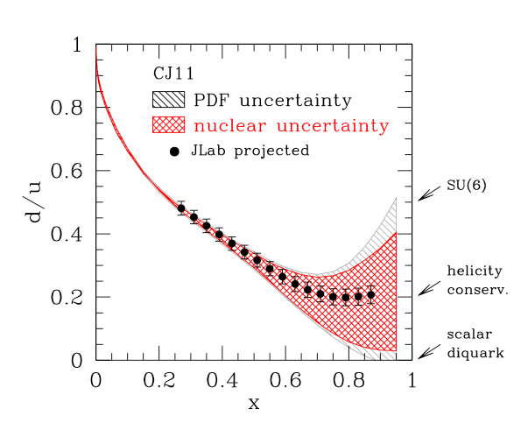
MARATHON Projected Data

Slide 7
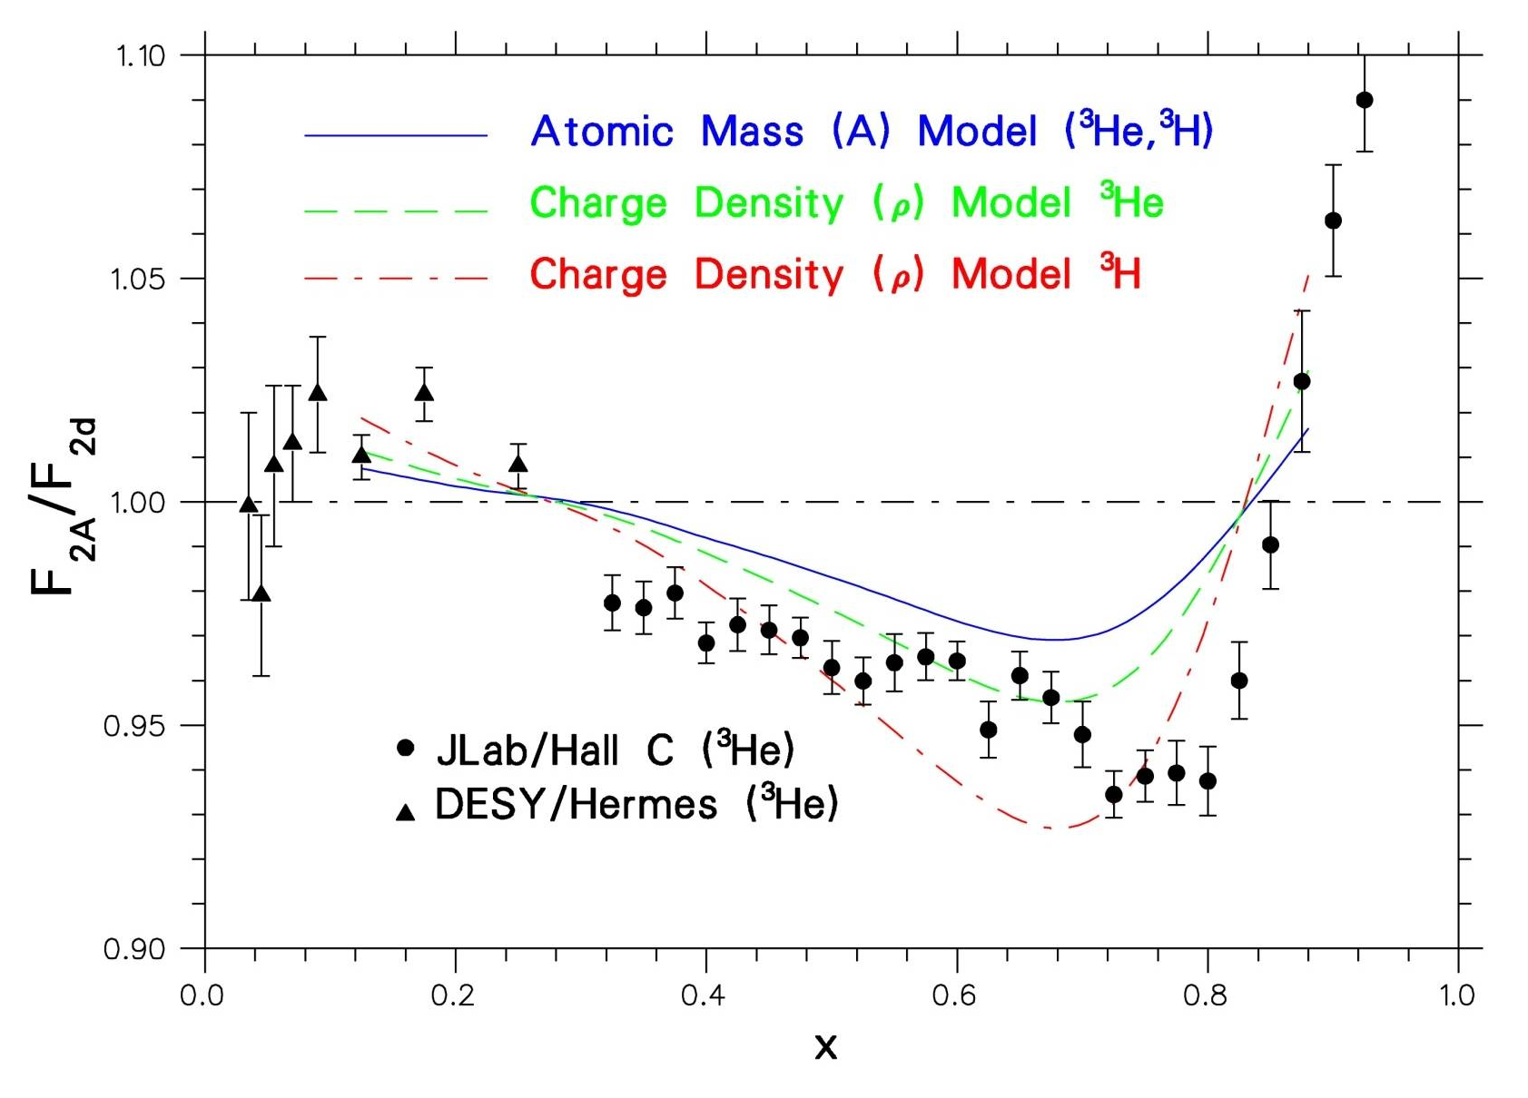
EMC Data for ³He
Jlab Hall C
DESY
Hall A data on ³H, ³He will be of similar precision to Hall C data

Slide 8
Experimental Plan and Requirements
³He/³H DIS:
  11.0 GeV
  20 µA
  HRS² (no longer using BB)
Want to check that R=σ_{L}/σ_{T} is the same for ³He and ³H:
    Rosenbluth separation of DIS cross sections at 6.6 and 8.8 GeV
    Want nonstandard 5.5 and 7.7 GeV too
    ~250 hours for R=σ_{L}/σ_{T} measurement (@ 50% efficiency)
Tritium Target System: see Meekins talk next

Slide 9
Precision measurement of the isospin dependence in the 2N and 3N Short Range Correlation Region
E12-11-112
Solvignon, Arrington, Higinbotham
Isospin dependence
  Better precision: extract ratio R(T=1/T=0)
  Much smaller FSI (inclusive)
Determine isospin dependence for A>3 nuclear corrections
Absolute cross sections and ratios
  Test calculations

Slide 10
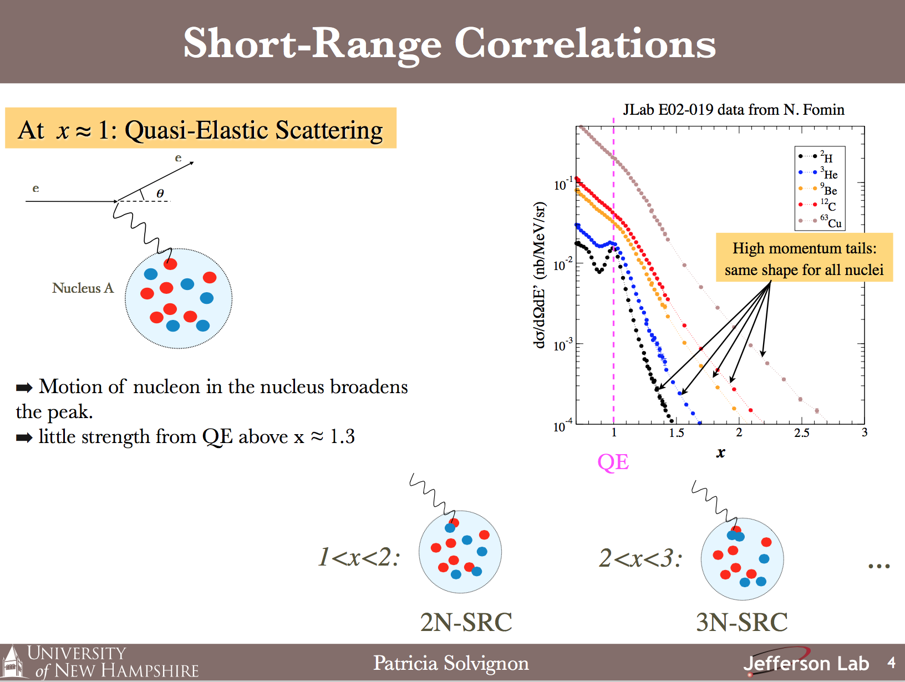

Slide 11
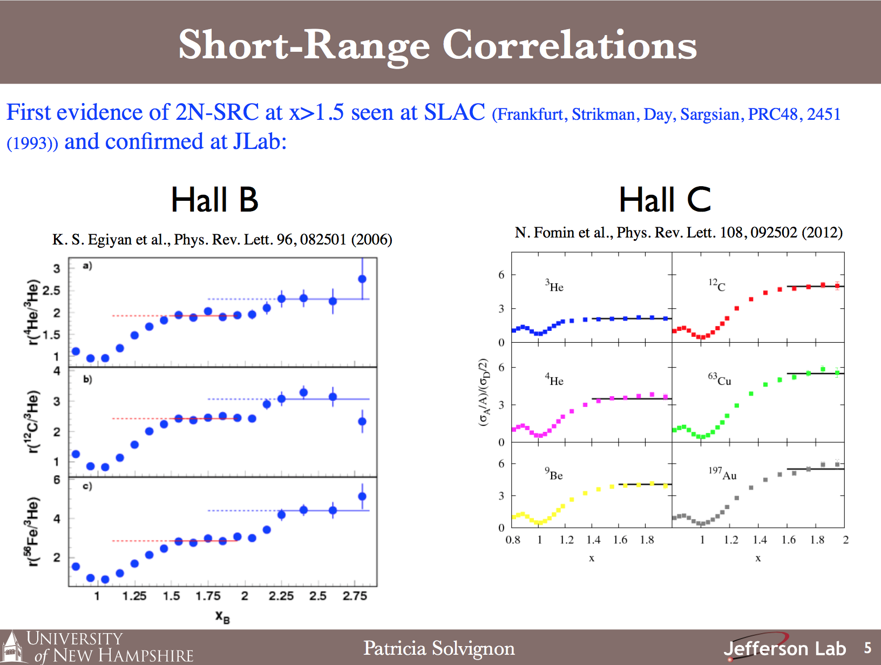

Slide 12
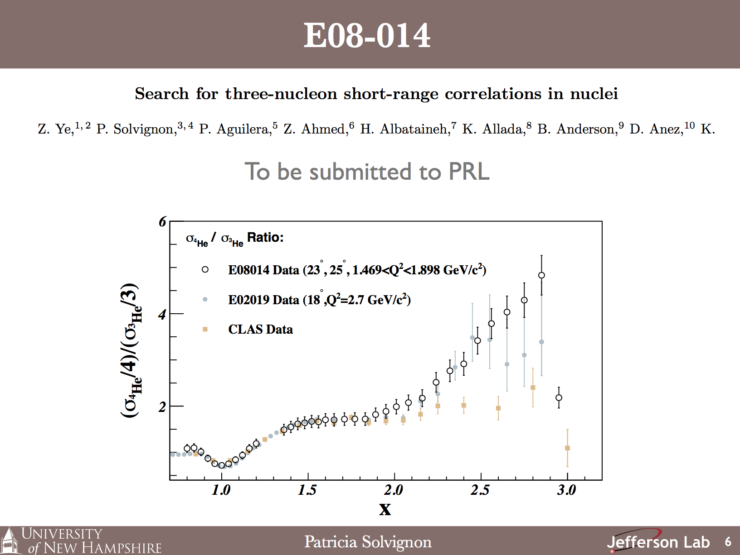

Slide 13
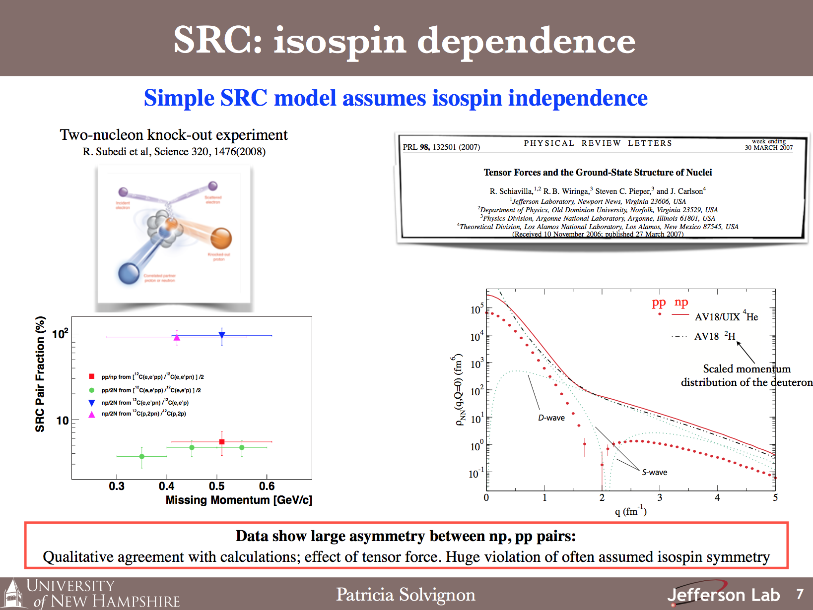

Slide 14
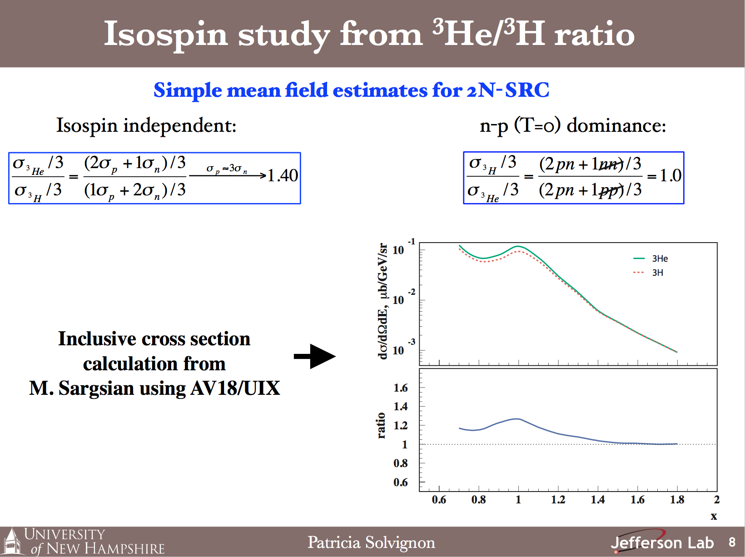

Slide 15
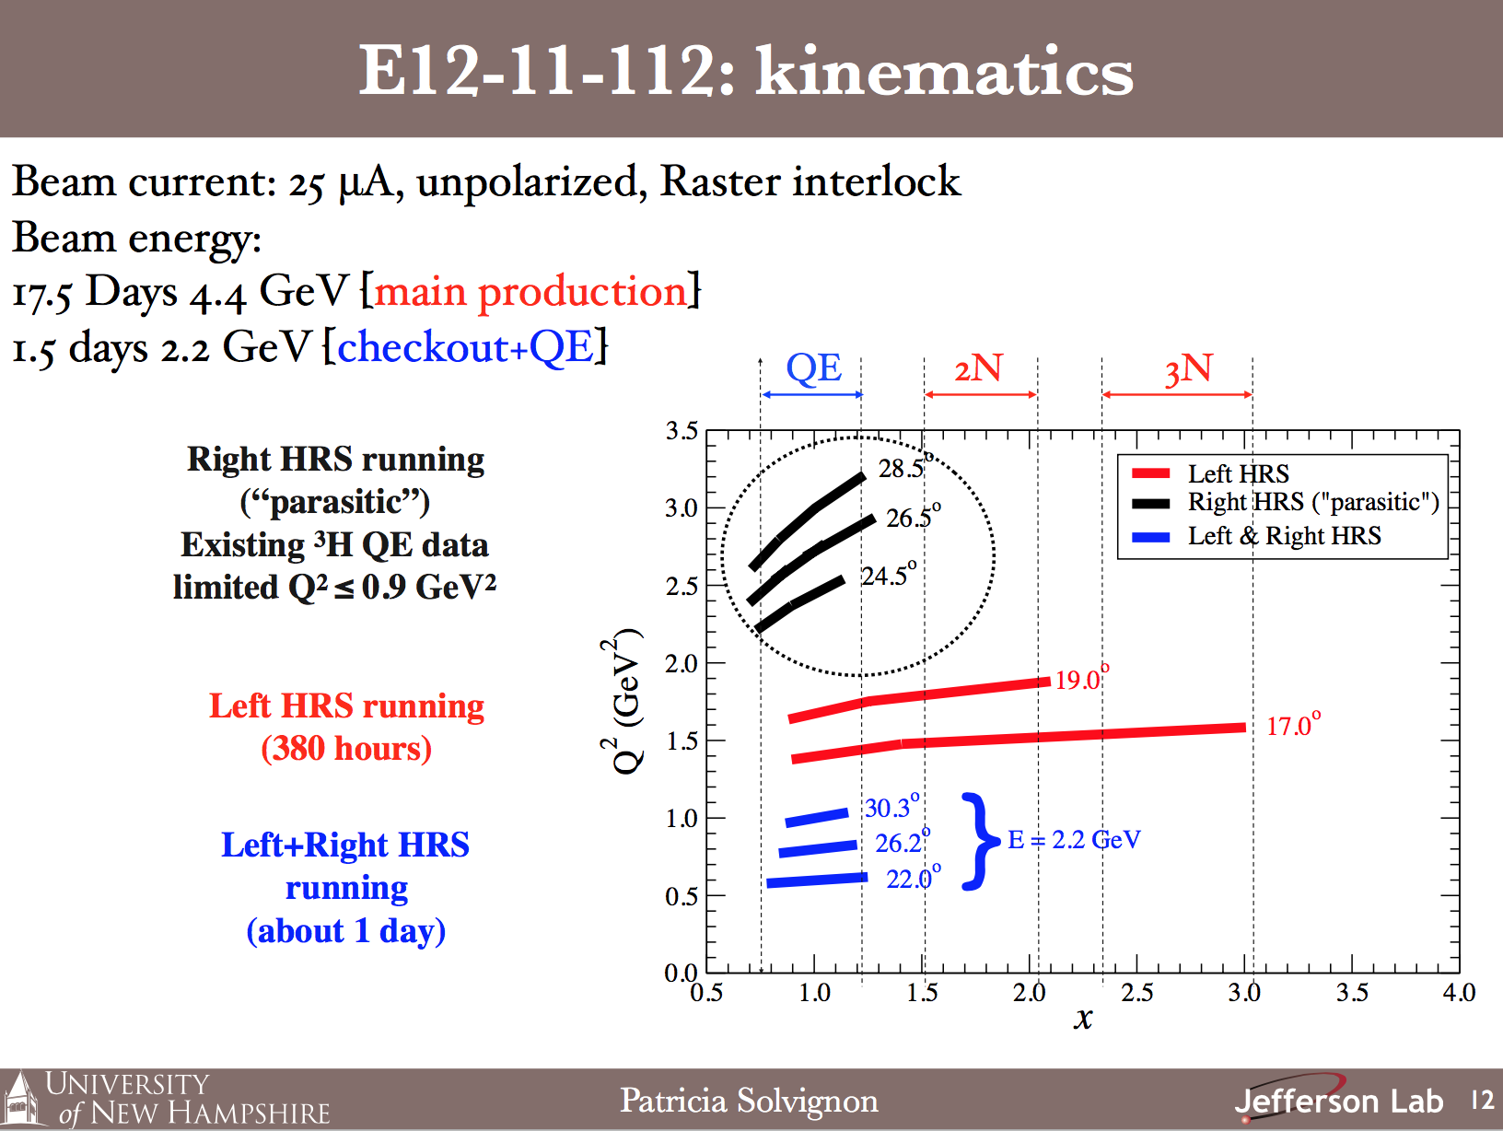

Slide 16
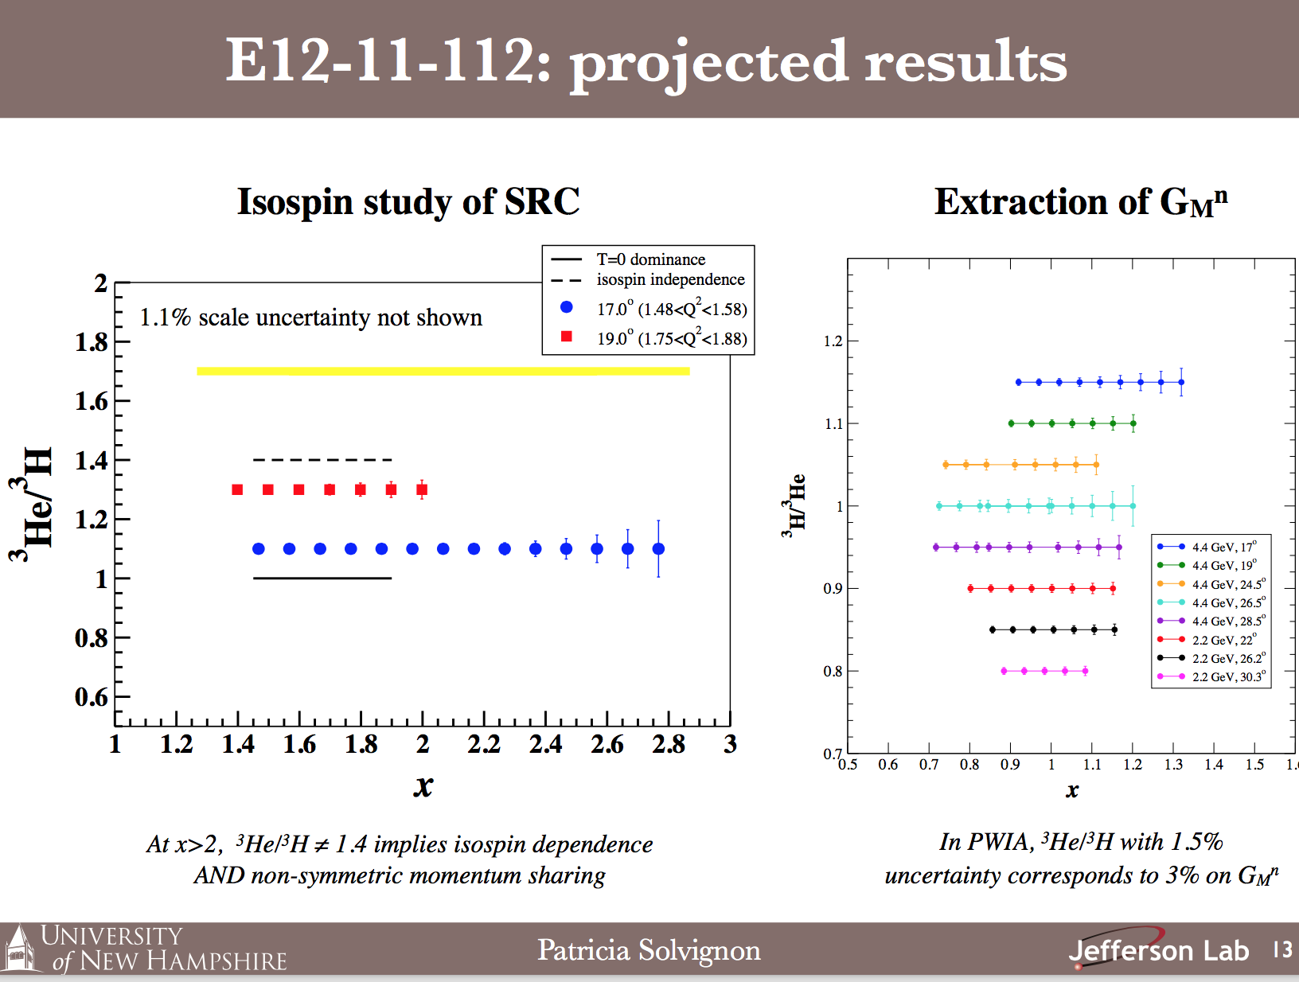

Slide 17
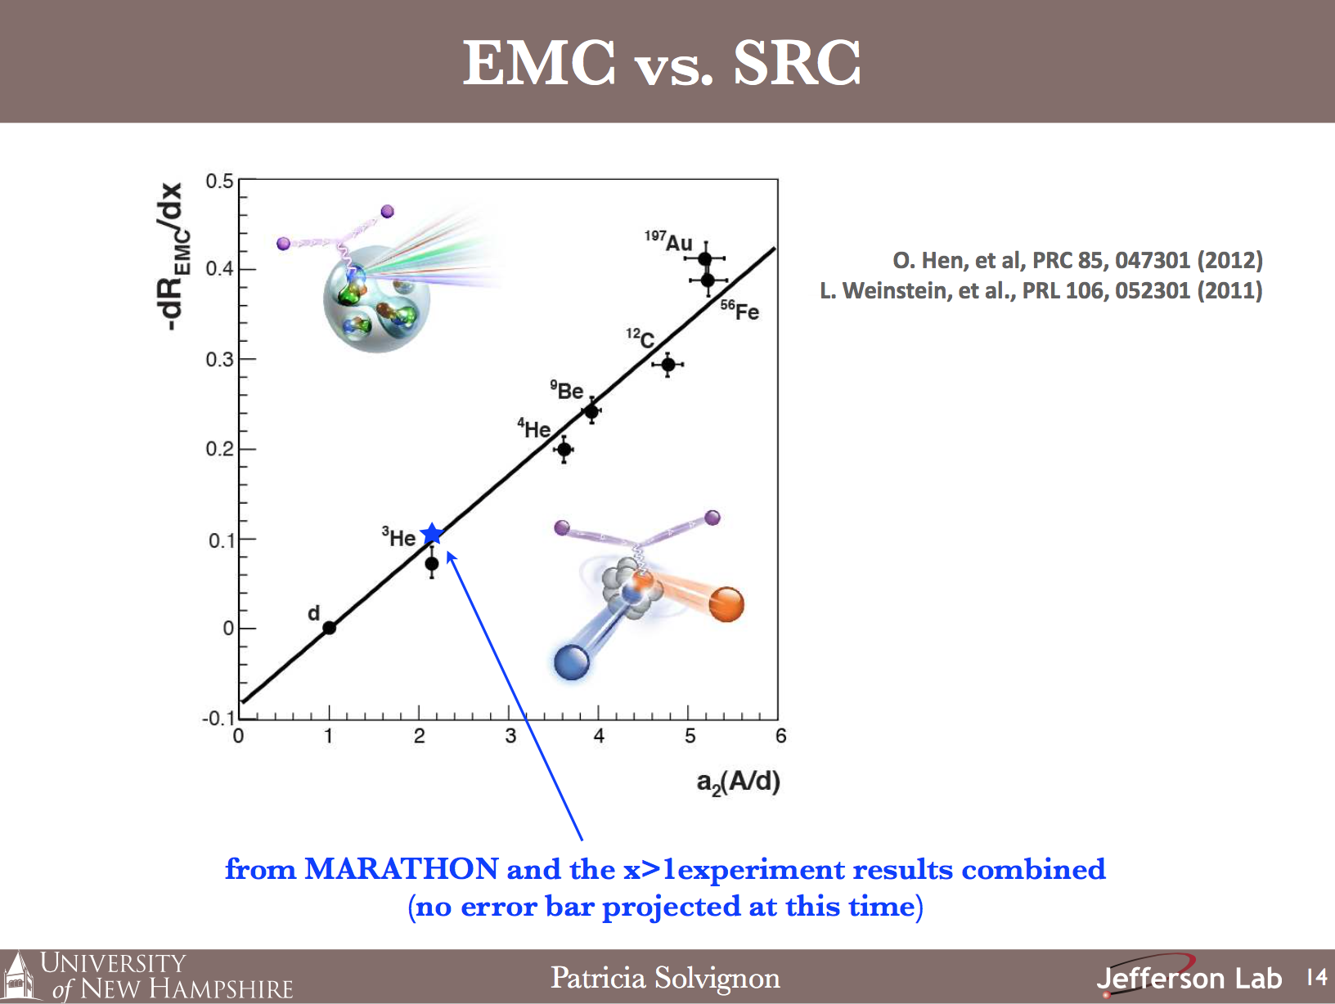

Slide 18
Nucleon Momentum Distributions in Asymmetric Nuclei
A Comparison of ³He(e,e’p) and ³H(e,e’p)
PR12-13-012
Lawrence Weinstein
Old Dominion University
Co-Spokespersons: Shalev Gilad (MIT),
Or Hen (MIT), Werner Boeglin (FIU)

Slide 19
Experiment Overview
Measure the quasielastic (e,e’p) reaction
on ³H, and ³He
  First measurement of ³H(e,e’p)
  Choose kinematics where FSI are small
  Measure cross sections sensitive to ground
  state momentum distributions
  Measure ratios of cross sections so residual
  FSI cancel
Simple picture: Map the transition as σ(³He)/σ(³H) changes from 2 at small p_{miss} due to proton counting to 1 at large p_{miss} due to np pair counting
Quantitative picture: compare to calculations with exact ground states and eikonal approximation FSI
k_{f}
k

Slide 20
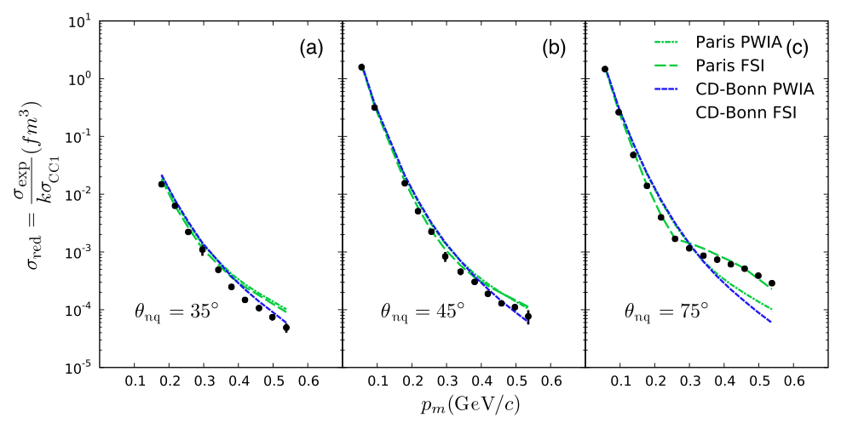
Minimizing FSI:
d(e,e’p)
θ_{nq}= 35º
θ_{nq}= 45º
d(e,e’p)
Full
FSI
75º
³He(e,e’p)np
PWIA
Ratio of FSI to PWIA calculations
0.1
0.5
0.1
0.5
0.1
0.5
p_{miss} = 0.5 GeV/c
P_{miss} (GeV/c)
0.4 GeV/c
➔Choose θ_{rq}< 40º
0.2 GeV/c
θ_{rq}

Slide 21
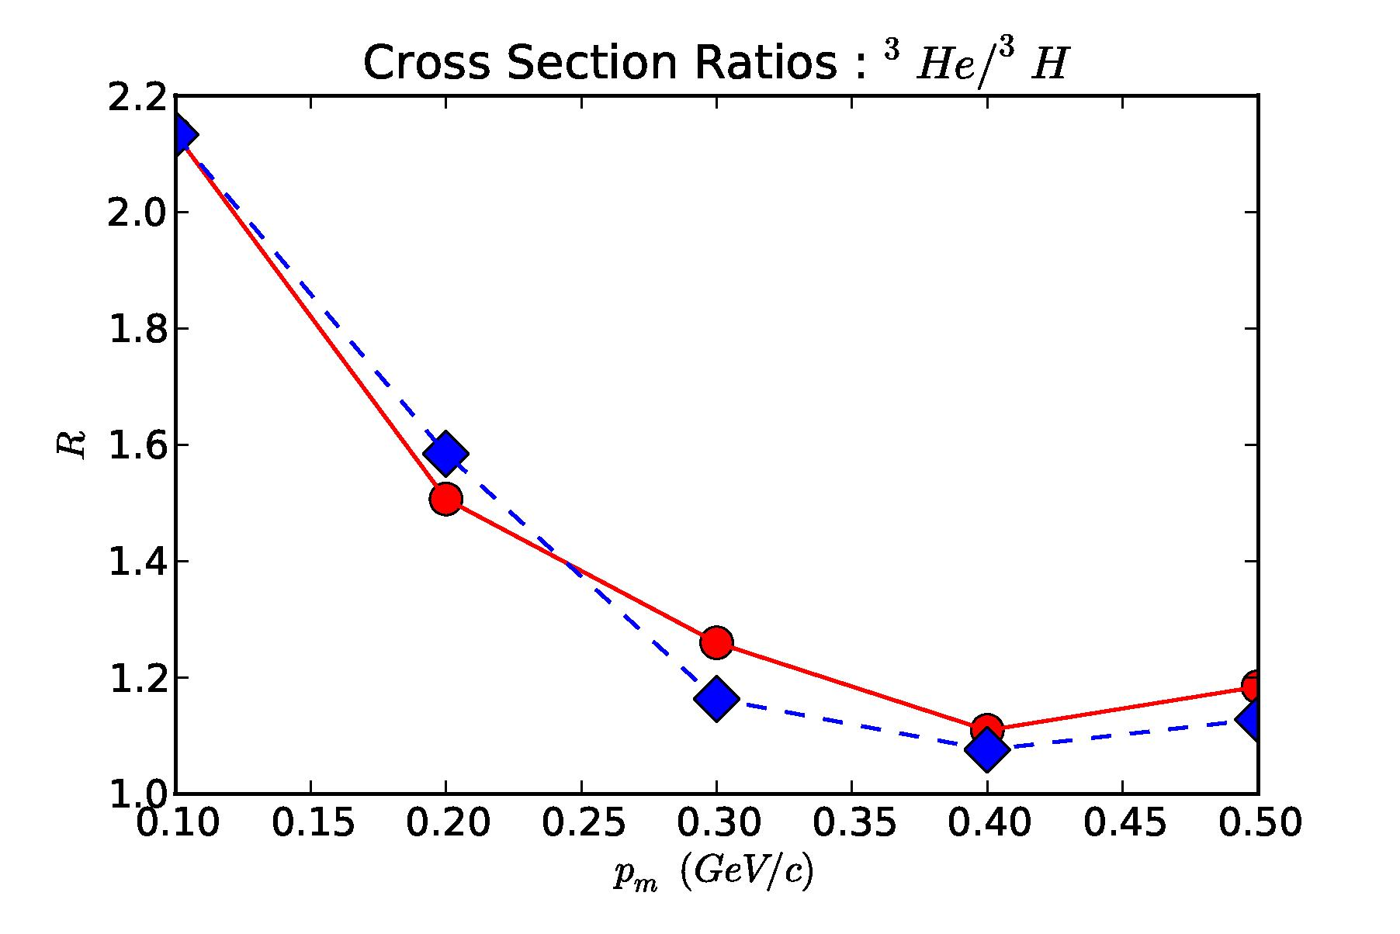
Minimizing FSI: taking ratios
Experimentalkinematics
PWIA
FULL
P_{m} (GeV/c)
Sargsian
Choose θ_{rq} < 40º
Take ratios to cancel residual FSI

Slide 22
Kinematics
E_{beam} = 4.4 GeV
Q² = 2.0 GeV²
I_{beam} = 20 μA
Both HRS
<p_{m}> (MeV/c) | x | E_{e} (GeV) | θ_{e} | p_{p} | θ_{p} | Time (days)
100 | 1.15 | 3.47 | 20.9º | 1.6 | 48.7º | 0.5/0.5
300 | 1.41 | 3.64 | 20.4º | 1.4 | 58.6º | 5/5
Calibrations: 1 day

Slide 23
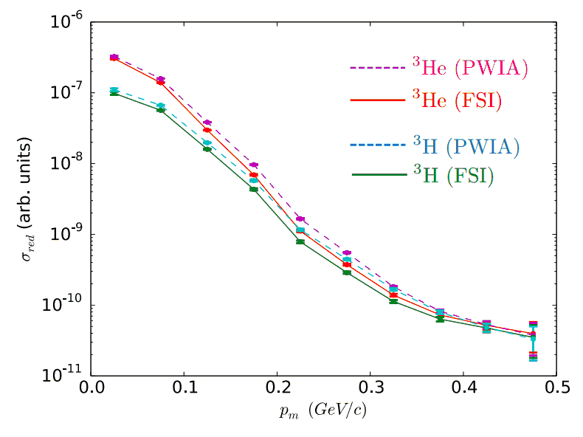
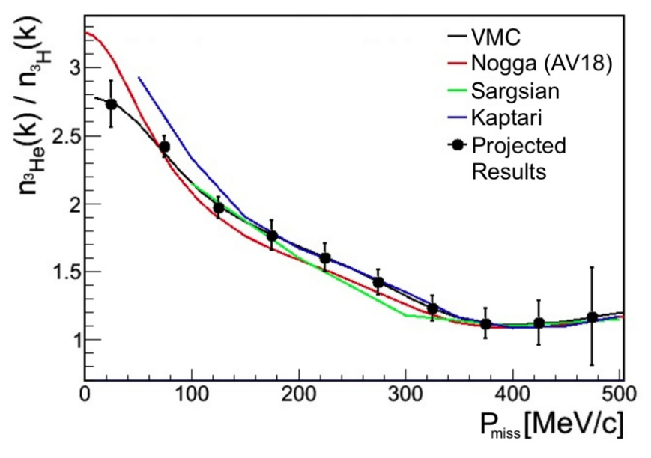
Results
Reduced cross sections
Cross section ratios
P_{miss}
Compare to exact calculations.
First high precision model independent extraction of nuclear momentum distribution ratio

Slide 24
E12–14–009: Ratio of the electric form factor in the mirror nuclei ³He and ³H
Luke Myers, John Arrington, and Doug Higinbotham Spokespersons

Slide 25
Motivation
One-time opportunity for ³H at JLab
Precise theoretical calculations of <r²_{rms}>_{3H}, <r²_{rms}>_{3He}
Experimental results: large uncertainties, discrepancies
³H
³He
 | <r²_{rms}>_{3H} | <r²_{rms}>_{3He}
GFMC | 1.77(1) | 1.97(1)
χEFT | 1.756(6) | 1.962(4)
SACLAY | 1.76(9) | 1.96(3)
BATES | 1.68(3) | 1.97(3)
Atomic | -------- | 1.959(4)

Slide 26
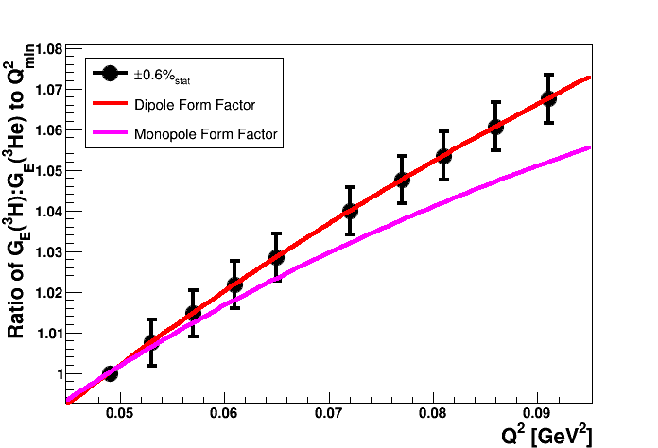
Expected Results

Slide 27
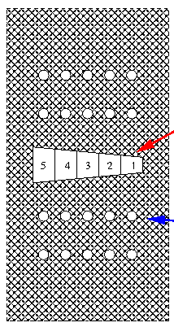
Kinematics with LHRS
Collimator
Plate
θ_{HRS} | p_{HRS} | Q² | ³H Rate | ³He Rate
[deg] | [GeV/c] | [GeV²] | [Hz/bin] | [Hz/bin]
12.5 | 1.07 | 0.049-0.065 | 210 | 510
15.0 | 1.07 | 0.072-0.091 | 60 | 125
Only one momentum setting
Huge count rates!
  I_{beam} ~ 5 μA
  10⁵ counts/bin/hr

Slide 28
Conclusions
Currently, <r²_{rms}>_{3He} – <r²_{rms}>_{3H} = (0.20 ± 0.10) fm
A 2% measurement of the form factor ratio
  <r²_{rms}>_{3He} – <r²_{rms}>_{3H} ≈ (0.20 ± 0.03) fm
Only 1.5 days of beamtime requested for experiment
  ¹H, ²H, ³H, ³He and ¹²C
Our best chance to measure the ³H radius!

Slide 29
Summary of the summaries
Four great experiments
Varied physics
Elastic to Deep Inelastic
Once in a lab-time opportunity

