Slide 1
Beam Background and the SVT Protection Collimator
HPS Collaboration Meeting, Jefferson Lab, June 4-6 2013
Takashi Maruyama
SLAC

Slide 2
Beam Background
HPS is the first experiment to place silicon sensors at 500 μm and trigger detector at a few cm from the beam.
Successful running is critically dependent on understanding and controlling the beam background.
We have made exhaustive studies of the background, but we may have missed important background.
I would encourage everyone to find possibly serious background.

Slide 3
Beam background
Souce | Effect on Detector | Simulation/Estimation
Multiple Coulomb Scattering beam energy e- | SVT occupancy Ecal occupancy Ecal trigger | EGS5/Geant4
Bremsstrahlung γ, degraded energy e- | Ecal occupancy Ecal trigger Neutron production | EGS5/Fluka
Moller scattering low energy e- | SVT occupancy | EGS5
Hadron production | SVT occupancy Ecal trigger | Geant4/Fluka Mostly inclusive production
X-ray generation | SVT occupancy | EGS5/Geant4
Beam Halo | SVT occupancy Ecal trigger | HARP measurement shows halo is not a problem.
Synchrotron radiation |  | Negligible
Beam induced EM Beam field, wake field, transition radiation | Electronics noise | Negligible because bunch charge in CW machine is small.

Slide 4
SVT Protection Collimator
Protect SVT from direct beam
  When the beam moves away from the nominal position by ∼mm, the halo counter/beam offset monitor system will shut off the beam in 40 μs.
  SVT may not be able to take the 40 μs direct beam exposure.
    1.1×10⁸ e-’s with σ(y) ∼ 50 μm at 6.6 GeV
Beam halo suppression
  Beam halo was < 10⁻⁵ in the 6 GeV era.
  We are getting a brand new beam in 2014. Due to outgassing from new vacuum components, beam halo from beam-gas scattering could be still high.
  What if the halo is 10⁻⁴?
Absorb synchrotron radiations from the last vertical bend

Slide 5
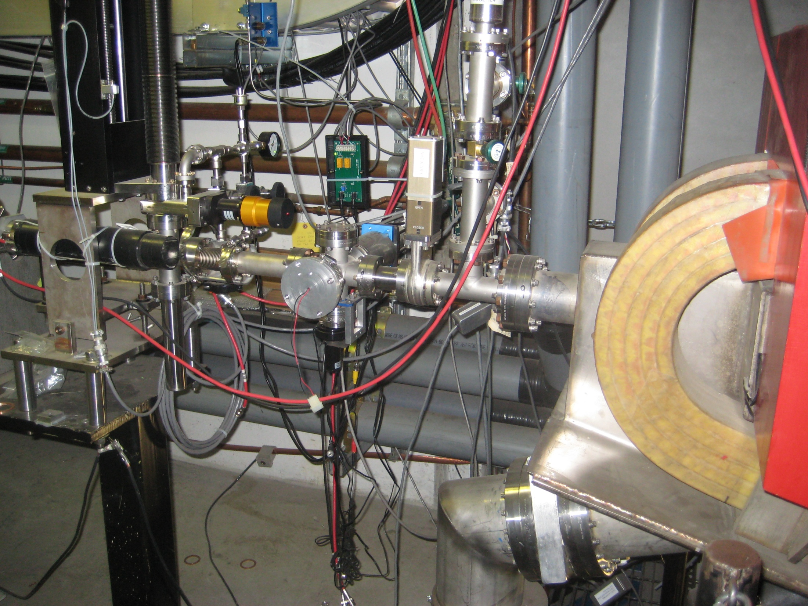
SVT Protection Collimator
Protection Collimator in vertical bellows
1 cm
1 mm
Tagger Magnet

Slide 6
Collimator
Frascati Magnet
SVT Layer 1
Tagger
2” beam pipe
Z = -800 cm
Z= -172 cm
Z = 10 cm
Low energy e+/e-’s are produced from the collimator. But Frascati magnet is very effective in sweeping away these particles. Only particles above ~1 GeV will become potential background in SVT Layer 1.
Additional particles above ~1 GeV could be produced from interactions in the beam pipe.

Slide 7
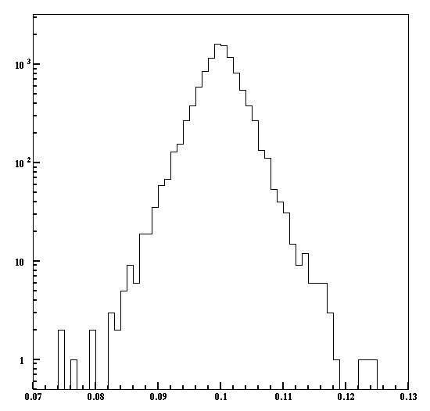
Collimator Scattering
600 cm long beam pipe (OD=2”, 65 mil thick)
6.6 GeV e-
4 mrad
1 mm
2 cm thick W
Energy > 1 GeV
θ < 4 mrad
rms ∼ 36 μm
Energy > 1 GeV
θ < 4 mrad
Y (cm)
Secondary production in the beam pipe is negligible.

Slide 8
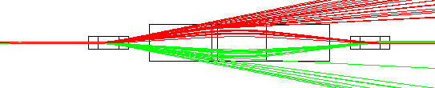
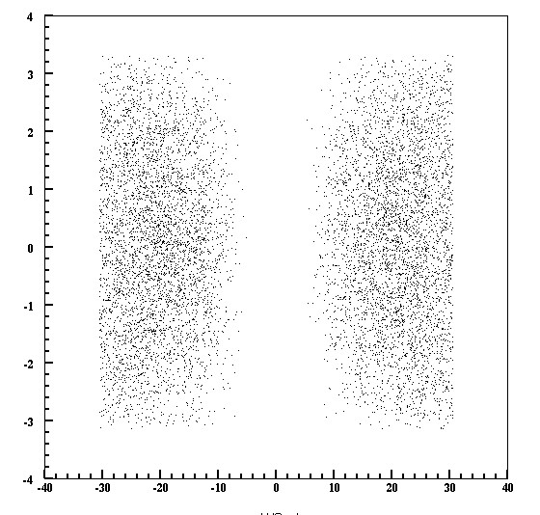
Hit density in 40 μs at Layer 1
e-
e+
2 cm thick W
At SVT Layer 1
6.6 GeV 450 nA: 2.8 × 10¹² e-’s /sec
1.1 × 10⁸ e-’s/40 μs
Y (cm)
•
Hit density will be ~3000 e-’s /cm² in 40 μs
e+
e-
X (cm)

Slide 9
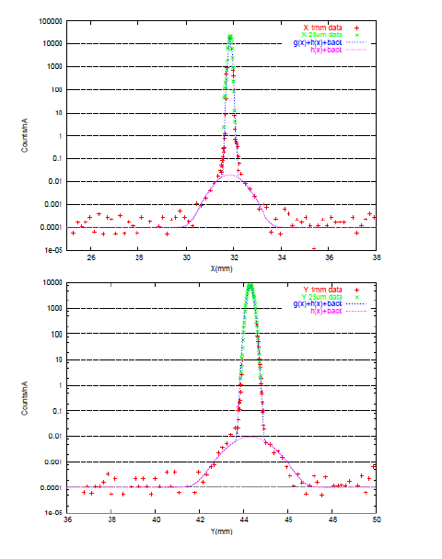
What if the halo is > 10⁻⁴
Halo << 10⁻⁵
Halo will dominate the SVT hits and possibly the trigger rate at > 10⁻⁴.
Protection collimator can clean up the halo.

Slide 10
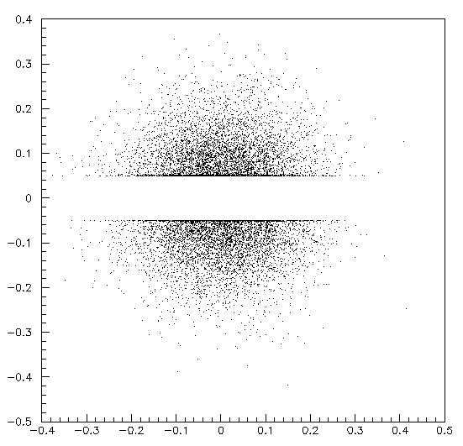
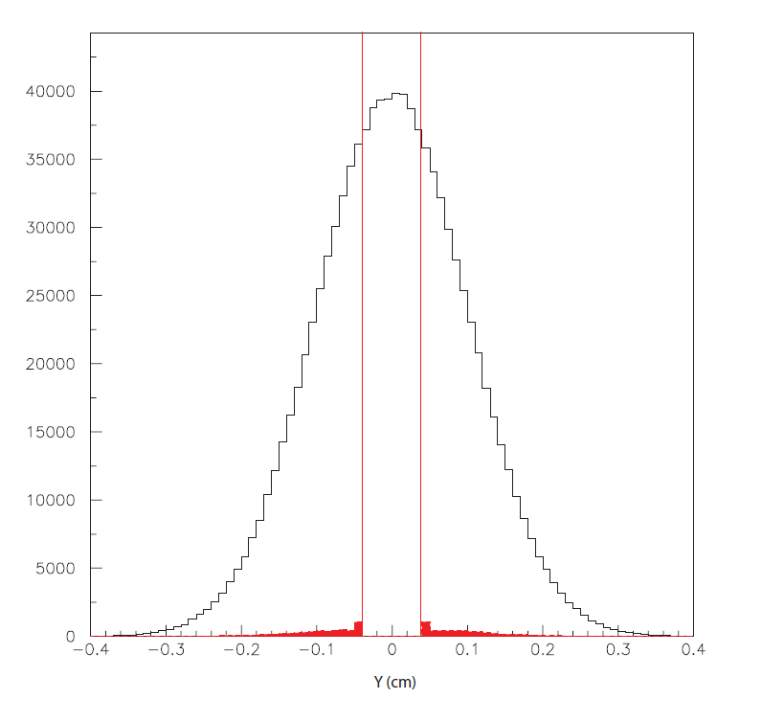
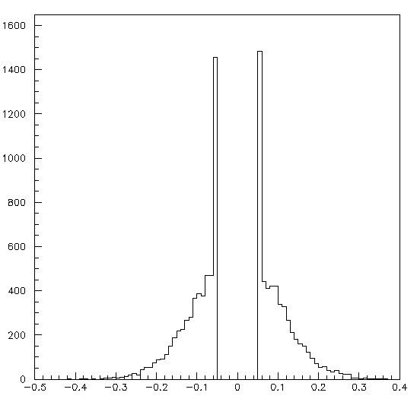
Halo Suppression
σ=1 mm beam into 2 cm thick collimator
10⁻⁴ halo in |Y| > 0.5 mm
can be reduced to 2×10⁻⁶
Y (cm)
X (cm)
Y (cm)

Slide 11
Summary
Beam background studies will continue.
Protection collimator is essential for
  Protecting the SVT from direct beam hit
  Suppressing the beam halo.
Issues:
How much area do we need to protect?
  Only active area or guard ring too?
Sensitivity of the beam offset monitor.
  Δy ∼ 500 μm at SVT layer 1
Collimator vertical alignment.

