Slide 1
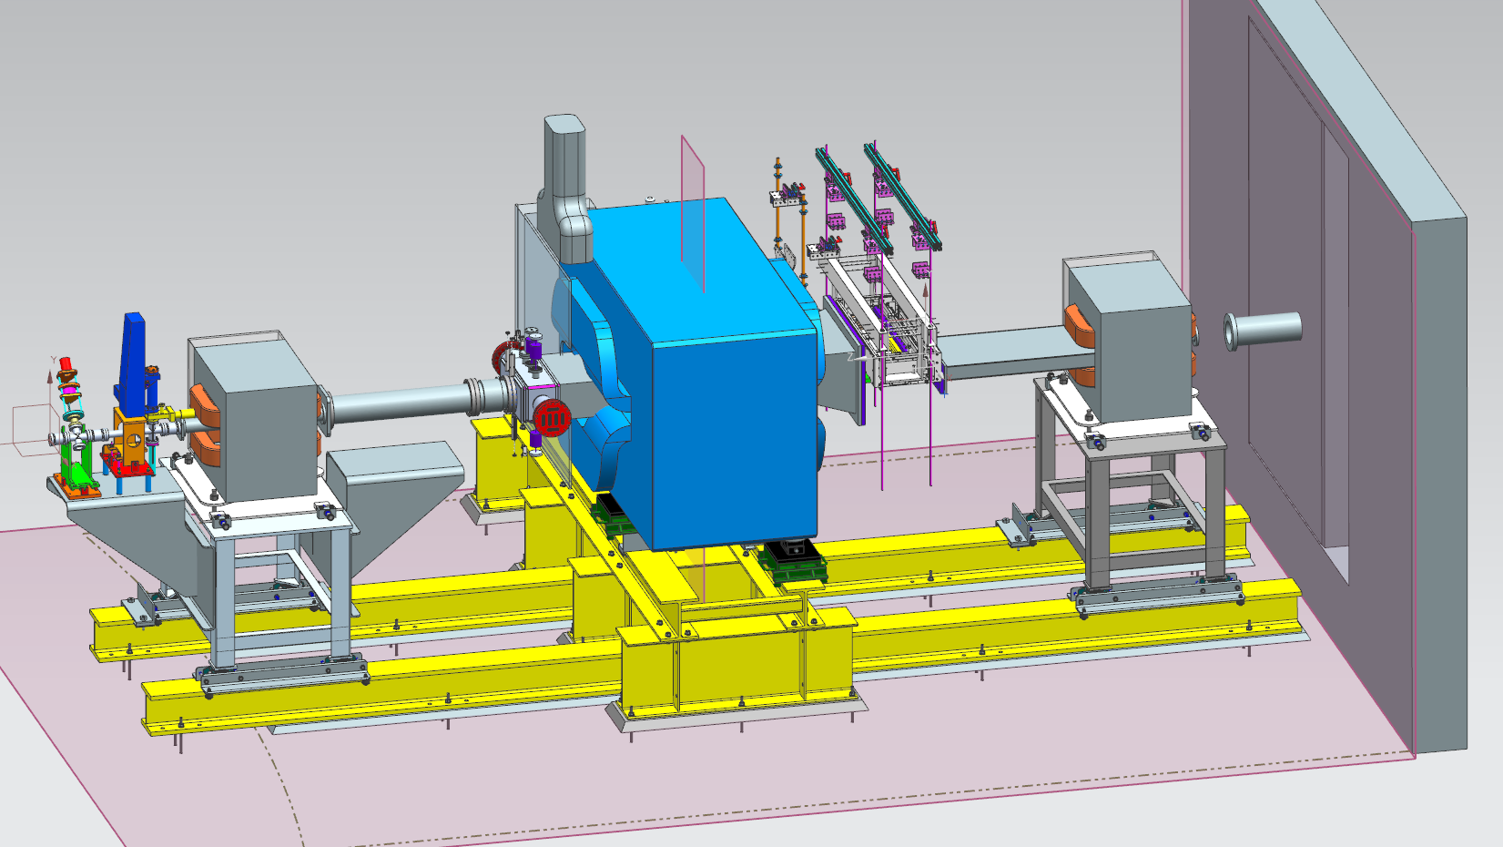

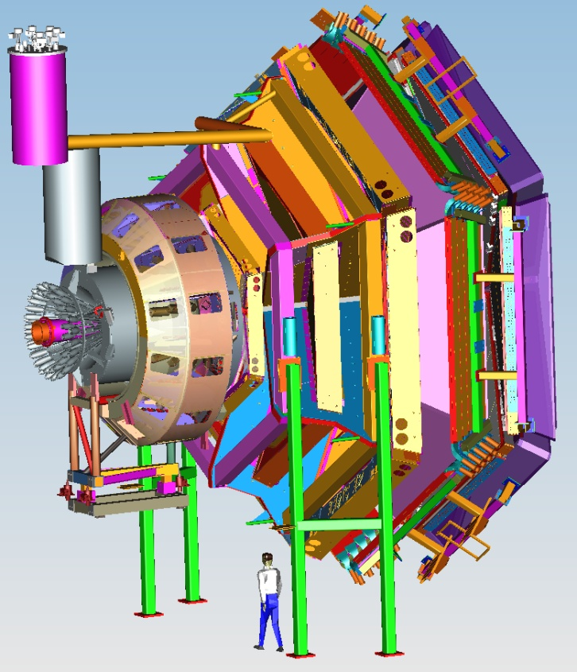
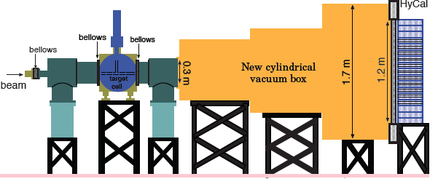



Progress in Hall B for early running
PRad
Volker D. Burkert
Jefferson Lab
Outline:
- Status of Hall B and HPS preparations
- Update on tentative run schedule
- 12 GeV construction in Hall B
- Torus assembly and impact on Fall / Spring run

Slide 2
Introduction
HPS received approval for installation of HPS hardware:
- Successful test measurement in 2012
- DOE HEP funding
- Progress in preparation of equipment
- Receive High Impact Status by PAC41
Conditions for running first experiment prior to 12 GeV:
- Non-interference with CLAS12 installation and other 12GeV project related work
- Successful NP Division Readiness Review (Technical & Safety)
- Successful Hall B review for readiness (Operation and Data analysis)
- Readiness of infrastructure in Hall B
- Availability of beam to Hall B in 2014/2015

Slide 3
Hall B work prior to TORUS assembly
Activity | Begin | End
FWD carriage modifications | 7/2013 | 11/2013 | ✔
PCAL Installation | 11/2013 | 12/03/2013 | ✔
FTOF 1a Installation | 12/10/2013 | 01/14/2014 | ✔
FTOF 1b Installation | 1/27/2014 | 2/13/2014 | ✔
Move FWD carriage | 3/14/2014 | 3/14/2014 | ✔
HPS hardware installation | 3/17/2014 | 6/05/2014 | ✔
Survey & Align HPS magnets | 6/12/2014 | 6/13/2014 | ✔
Preparation of Hall infrastructure | 6/2014 | 9/15/2014
NP Div Readiness (tech+safety) | 7/10/2014 | 7/10/2014
TORUS assembly in Hall B | 7/28/2014 | 01/2016

Slide 4
Preparing Hall-B for Fall Run
Beam delivery to Hall-B may be possible some time in mid October
The Hall-B beamline equipment, beamline controls, and online computing resources must be ready for initial checkout well before the beam delivery date
Besides work in Hall-B (see next pages)
Item | Ready | Comments
Run web page and documentation | July 1 | HPS collab.
Online computing clusters (clones) | July 1 | Hall-B
Online logbook | July 1 | Hall-B
Counting room occupancy | August 1 | Hall-B
Assembly of HPS Ecal | July 15 | HPS collab.
Install and connect HPS ECal | August 1 | HPS collab./Hall-B
Restore all IOCs | August 15 | HPS collab./Hall-B
HPS ECal cosmic calibration | September | HPS collab./Hall-B

Slide 5
Hall B Downstream Beamline
Item | Completion date | Comments
Align HPS chicane magnets | June 13 | Survey/Hall-B
Complete beamline design | July 1 | Hall-B
Install and connect vacuum chambers | July 15 | Hall-B
Connect and test magnet power supplies | August 1 | Hall-B
Install and connect harp and halo counters | August 15 | Hall-B
Install and connect new beam viewer | August 15 | Hall-B
Connect and test Faraday cup | September 1 | Hall-B
Install and connect 2H02 girder and BLMs | September 15 | Acc.Eng./Hall-B
Install and connect beam pipe through hall | September 15 | Hall-B
Connect and pump-down downstream beamline | September 15 | Hall-B

Slide 6
Hall B Upstream Beamline
Item | Completion date | Comments
Install Moller target | July 15 | Hall-B
Install beam pipe through the Moller quads | July 15 | Hall-B
Align and connect upstream beamline (up to the tagger) | September 1 | Acc.Eng./Hall-B
Install (including shielding) and connect Moller counters | September 1 | Hall-B
Installation and connect 2H01 nA BPM | September 1 | Acc.Eng./Hall-B
Install and connect 2H00 girder | September 15 | Acc.Eng.
Install and connect beamline devices (motors, halo counters) | September 15 | Hall-B
Pump-down upstream beamline | September 15 | Acc.Eng./Hall-B
Connect and check MPS/FSD signals | September 15 | Acc.Eng./Hall-B
Hot checkout of the whole system | October 1 | Acc.Eng./Hall-B

Slide 8
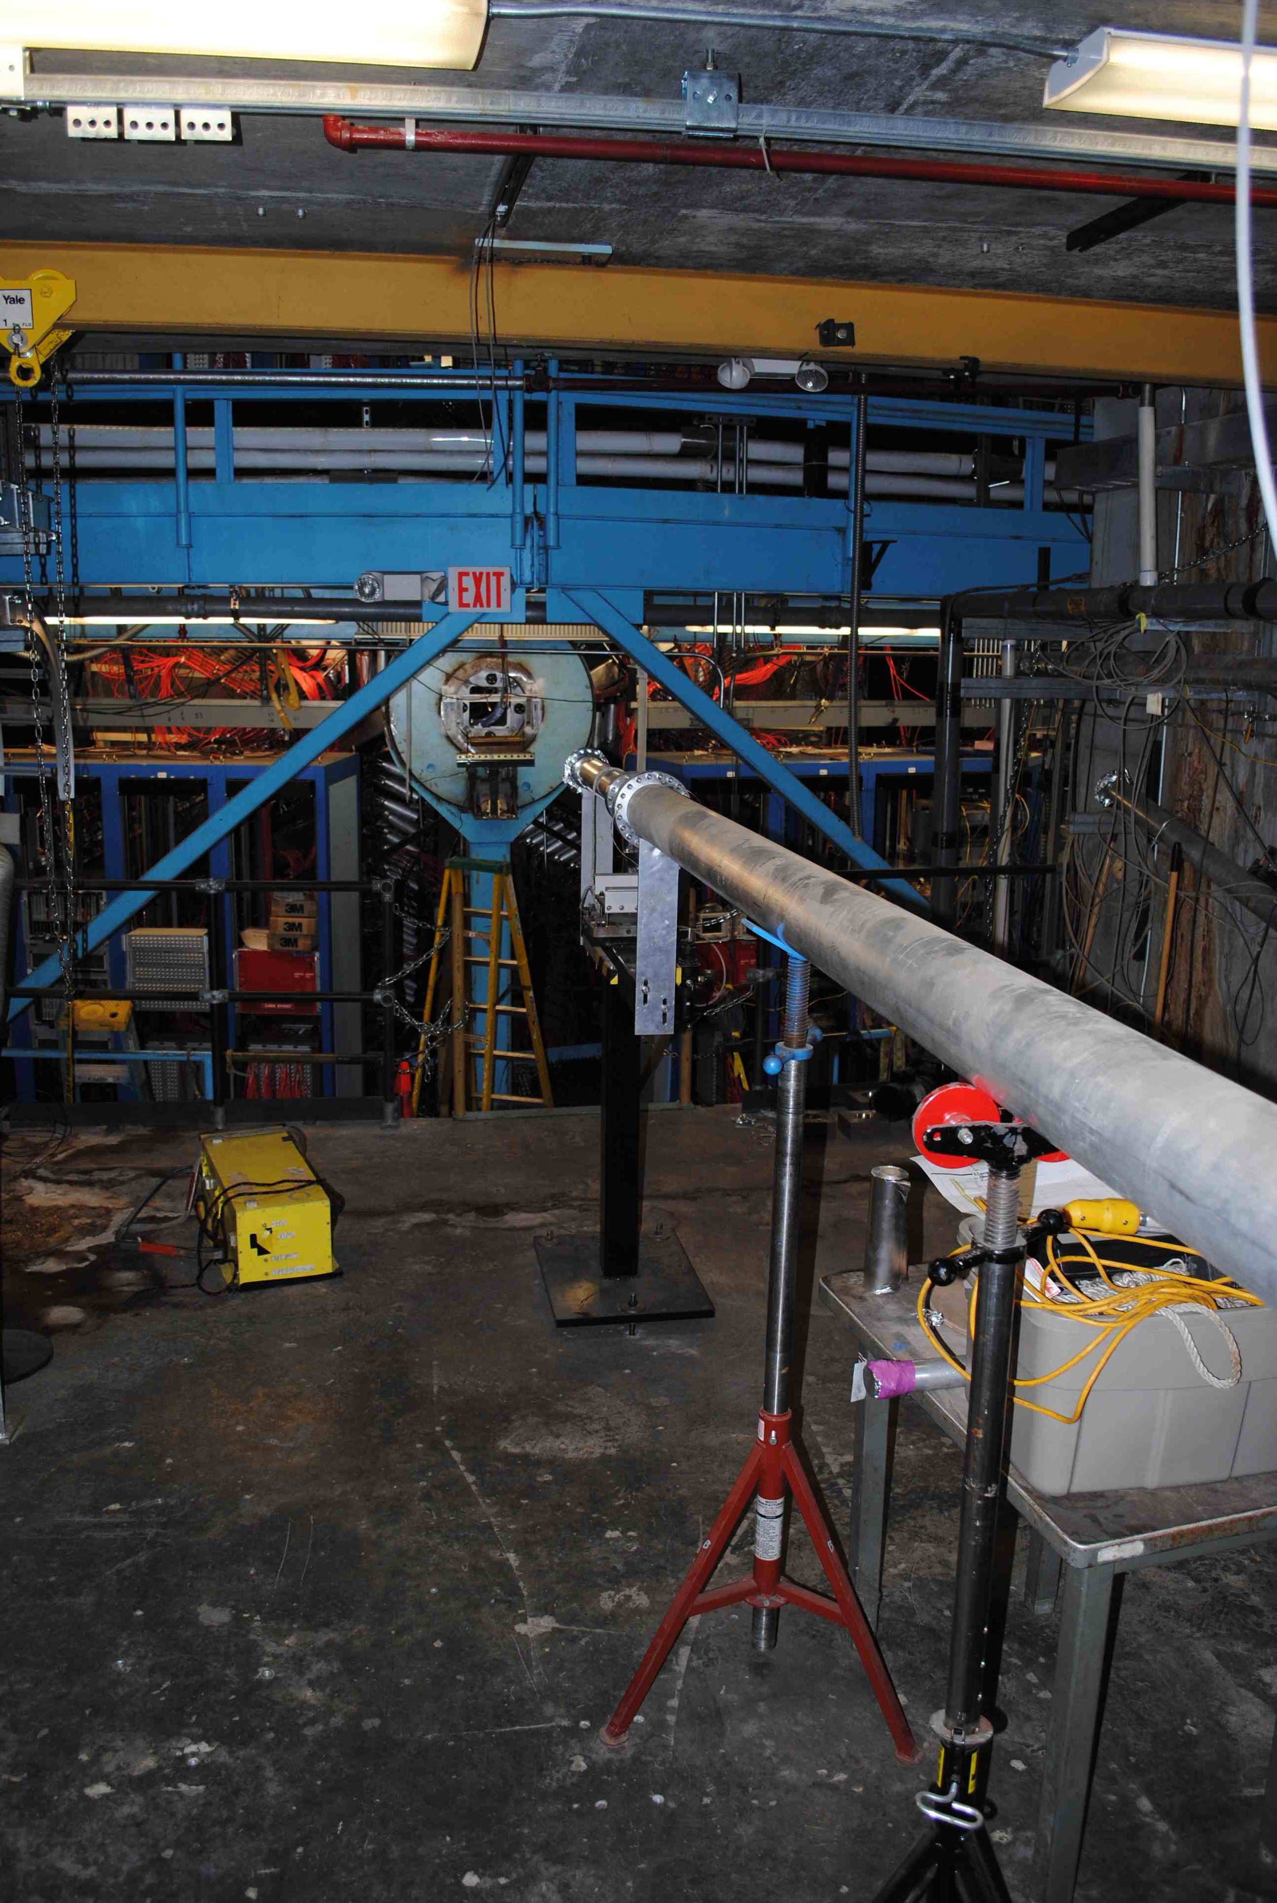
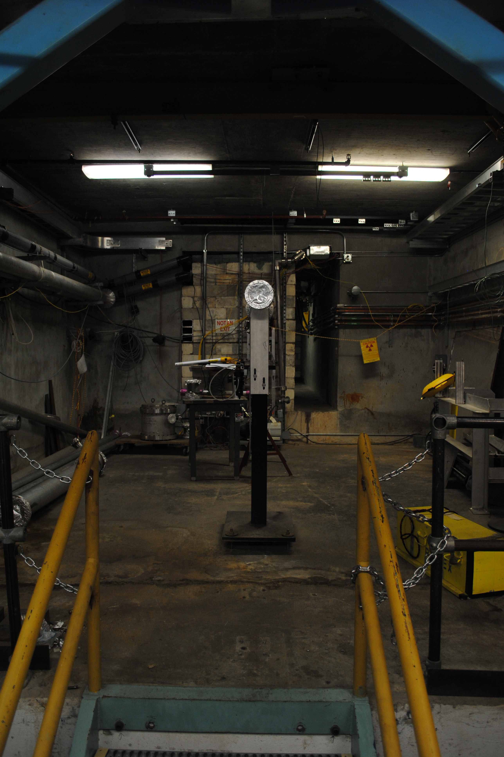
HPS installation area January 2014

Slide 9
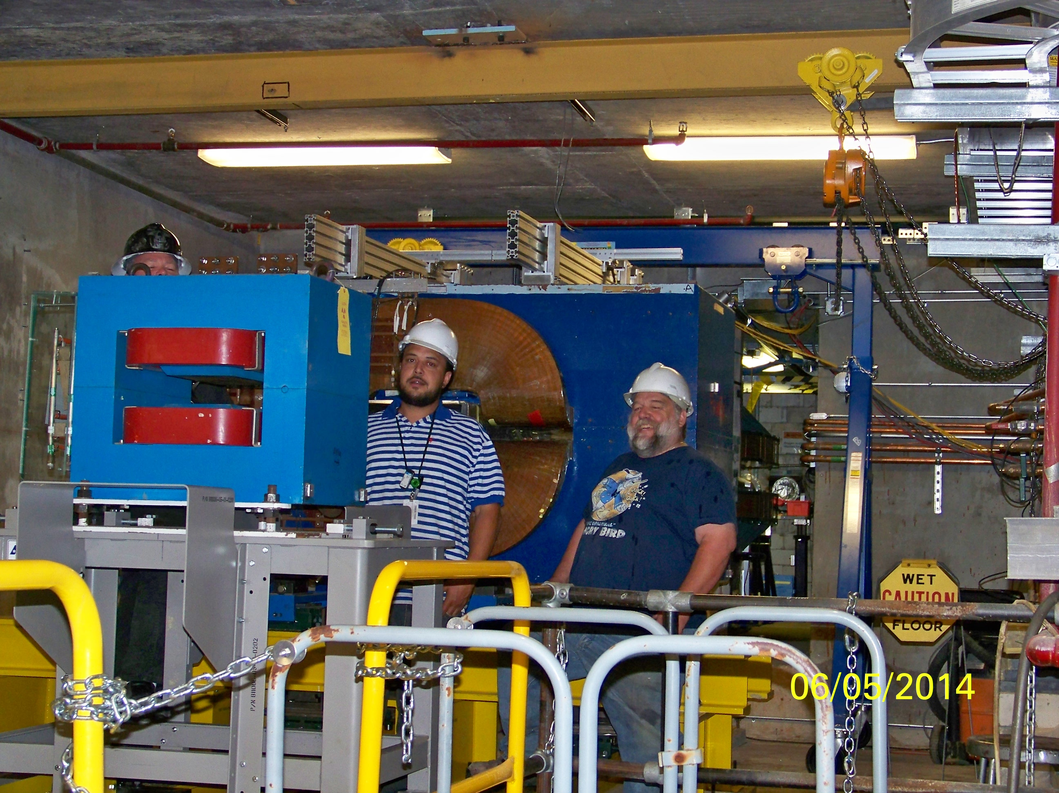
Views of HPS area 6/05/2014

Slide 10
Hall B CLAS12 experiments – run groups
Proposal | Physics | Contact | Rating | Days | Group | New equipment | Energy | Run Group | Target
E12-06-108 | Hard exclusive electro-production of π⁰, η | Stoler | B | 80 | 139 | RICH (1 sector) Forward tagger | 11 | A* F. Sabatié | liquid H₂
E12-06-112 | Proton’s quark dynamics in SIDIS pion production | Avakian | A | 60
E12-06-119 | Deeply Virtual Compton Scattering | Sabatie | A | 80
E12-09-003 | Excitation of nucleon resonances at high Q² | Gothe | B+ | 40
E12-11-005 | Hadron spectroscopy with forward tagger | Battaglieri | A- | 119
E12-12-001 | Timelike Compton Scatt. & J/ψ production in e+e- | Nadel-Turonski | A- | 120
E12-12-007 | Exclusive φ meson electroproduction with CLAS12 | Stoler, Weiss | B+ | 60
E12-11-005a | Photoproduction of the very strangest baryon | Guo | NR | (120)
E12-07-104 | Neutron magnetic form factor | Gilfoyle | A- | 30 | 90 | Neutron detector RICH (1 sector) Forward tagger | 11 | B* K. Hafidi | liquid D₂ target
PR12-11-109 (a) | Dihadron DIS production | Avakian
E12-09-007a | Study of partonic distributions in SIDIS kaon production | Hafidi | A- | 30
E12-09-008 | Boer-Mulders asymmetry in K SIDIS w/ H and D targets | Contalbrigo | A- | 56
E12-11-003 | DVCS on neutron target | Niccolai | A | 90
E12-06-109 | Longitudinal Spin Structure of the Nucleon | Kuhn | A | 80 | 170 | Polarized target RICH (1 sector) Forward tagger | 11 | C S. Kuhn | NH₃ ND₃
E12-06- 119(b) | DVCS on longitudinally polarized proton target | Sabatie | A | 120
E12-07-107 | Spin-Orbit Correl. with Longitudinally polarized target | Avakian | A- | 103
PR12-11-109 (b) | Dihadron studies on long. polarized target | Avakian
E12-09-007(b) | Study of partonic distributions using SIDIS K production | Hafidi | A- | 80
E12-09-009 | Spin-Orbit correlations in K production w/ pol. targets | Avakian | B+ | 103
E12-06-106 | Color transparency in exclusive vector meson production | Hafidi | B+ | 60 | 60 |  | 11 | D | Nuclear
E12-06-117 | Quark propagation and hadron formation | Brooks | A- | 60 | 60 |  | 11 | E | Nuclear
E12-10-102 | Free Neutron structure at large x | Bueltman | A | 40 | 40 | Radial TPC | 11 | F* | Gas D₂
TOTAL run time |  |  |  | 1412 (1532) | 559

Slide 11
Approved and C1 approved Hall B proposals
Proposal | Physics | Contact | Rating | Days | Group | Equipment | Energy |  | Group | Target
C12-11-111 | SIDIS on transverse polarized target | Contalbrigo | A | 110 | 110 | Transverse target | 11 |  | G* | HD
C12-12-009 | Transversity w/ di-hadron on transvere target | Avakian | A | 110
C12-12-010 | DVCS with transverse polarized target in CLAS12 | Elouadrhriri | A | 110
All transverse target proposals |  |  |  | 330 | 110
C12-11-006 | Heavy Photon Search at Jefferson Lab (HPS) | Jaros | A | 180 | 180 | New setup in alcove |  | 2.2, 6.6 | H* | Nuclear
E12-11-106 | High Precision Measurement of the Proton Charge Radius (PRAD) | Gasparian | A | 15 | 15 | Primex |  | 1.1, 2.2 | I* | H2 gas
TOTAL PAC39 beam time request |  |  |  | 525 | 305
Proposal approved & C1 cond. approved | PAC proposal days | PAC group days | Experiment on the floor
All CLAS12 proposals | 1742 | 669 | 6.8 yrs
PAC39 beam time request for HPS | 180 | 180 | 1.84 yrs
PAC39 approved beam time for PRAD | 15 | 15 | 0.16 yrs
All non-CLAS12 proposal | 195 | 195 | 2.0 yrs
All CLAS12 + all non-CLAS12 | 1937 | 864
Time needed to run the program either as individual experiments or as run groups (55% efficiency, 35 weeks/year, multiplicity=2.9, 4 Halls) => 98 PAC days/year (optimistic) | 20.6 yrs | 8.8 yrs

Slide 12
Run Group Schedule – Tentative
Run Group | PAC Days | 2015 | 2016 | 2017 | 2018 | 2019 | 2020 | remaining
Non-Clas12 equipment | 926 | CND | MM FT | RICH BONUS | LPT | TPT |  | 569
RG-H (HPS) | 180 | 25* |  | 30* |  |  |  | 125
RG-I (PRad) | 15* | 15 |  |  |  |  |  | ---
CLAS12 commissioning |  |  | 30
RG-A (proton) | 80 |  | 30* |  |  |  |  | 50
RG-A (FT) | 119 |  |  | 30 |  | 50 |  | 39
RG-F (BoNuS) | 42* |  |  | 30* |  |  |  | 12*
RG-B (deut.) | 90* |  |  |  | 35* |  |  | 55*
RG-C (NH₃) | 120 |  |  |  | 40 |  |  | 80
RG-C-b (ND₃) | 50 |  |  |  | 15 | 15 |  | 20
RG-G (TT) | 110* |  |  |  |  | 25* | 30* | 55
RG-E (Hadr.) | 60 |  |  |  |  |  | 30 | 30
RG-D (CT) | 60 |  |  |  |  |  | 30 | 30

Slide 13
CLAS12 Major Events
Hall | Key Event | Original Date | Planned Date
B | Torus 6th Cryostat Done | April 2015 | April 2015
B | Torus Installation | Jun 2014 – Oct 2015 | Aug 2014 – Jan 2016
B | Solenoid Practice Coil Wound | N/A | Jun – Jul 2014
B | Solenoid Coil Winding | N/A | Aug 2014 – Mar 2015
B | Solenoid Cryostated Coil Delivered | N/A | Sep 2015
B | Detector Commission w/ Beam | Feb 2016 | Jun 2016

Slide 14
Early Running of HPS & PRad?
Date | Accelerator | # weeks | Hall B | contingent
Fall 2014 | 12 GeV (5.5 pass) | 0 | beamline commissioning | 12 GeV program
Spring 2015 |  | 0 ≤ N ≤ 10 | Physics | ops funding
Summer 2015 | Shutdown
Fall 2015 Spring 2016 | Firm basis for 12 GeV operation for physics | 7 weeks | ---
Spring 2016 | 12 GeV, multi-pass | 3 weeks | CLAS12 commission | Project
Spring 2016 | 12 GeV, multi-pass | 0 ≤ N ≤ 10 | Physics | ops funding
Breaking News
25 HPS PAC days need 25 / 1.83 = 13.7 + weeks
15 PRad PAC days need 8.2 + weeks
House Energy and Water Committee shows increase of $4M for JLab 27 weeks of accelerator operation in FY2015.

Slide 15
Criteria for Scheduling Run Group
PAC/JLAB approval for first 5 years of running
No conflict with energies in other Halls, e.g. not any 2 Halls may run at same pass other than at 5 pass. Other than standard energy/pass difficult for first 5 years at 12 GeV.
New hardware ready for installation (NP Division readiness/safety review)
Preparedness for efficient data taking and online analysis (Hall B operational readiness review)
  Full simulation of experiment setup with realistic run conditions
  Commissioning plan if new equipment is involved
  Software in place for on-line calibration and analysis
  Availability of manpower for online analysis
Preparedness for efficient offline analysis
  Demonstrated readiness for offline analysis on background loaded simulated data
  Plan showing responsibilities of participating institution and individuals

Slide 16
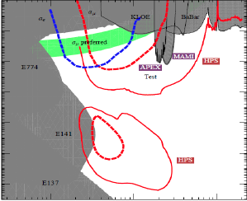
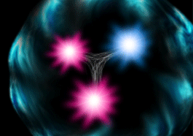
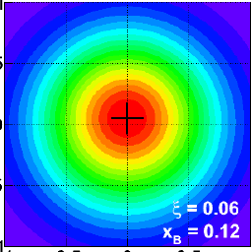
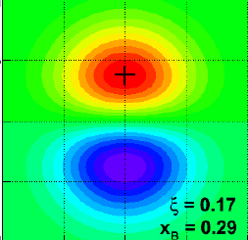
Plans for first years of Beam in Hall B
CLAS12
7 A-rated experiments in first 4 years: HPS, PRad, pDVCS, nDVCS, pSIDIS, g₁^{p}/g₁^{n}, exotic mesons
HPS
PRad
Construction & Installation
Commissioning & early 11 GeV Experiments
< 6 GeV beam
pDVCS
& GPDs
pSIDIS &
TMDs
nDVCS
& GPDs
nSIDIS
& TMDs
g₁^{p} , g₁^{n}
large x
spin str.
Nucleon Transverse spin structure
HPS
Heavy Photon Search
Proton
Charge Radius
d/u
hm*
Installation
11 GeV
1st beam
CY 2014
CY 2015
CY 2016
CY 2017
CY 2018

