Slide 1
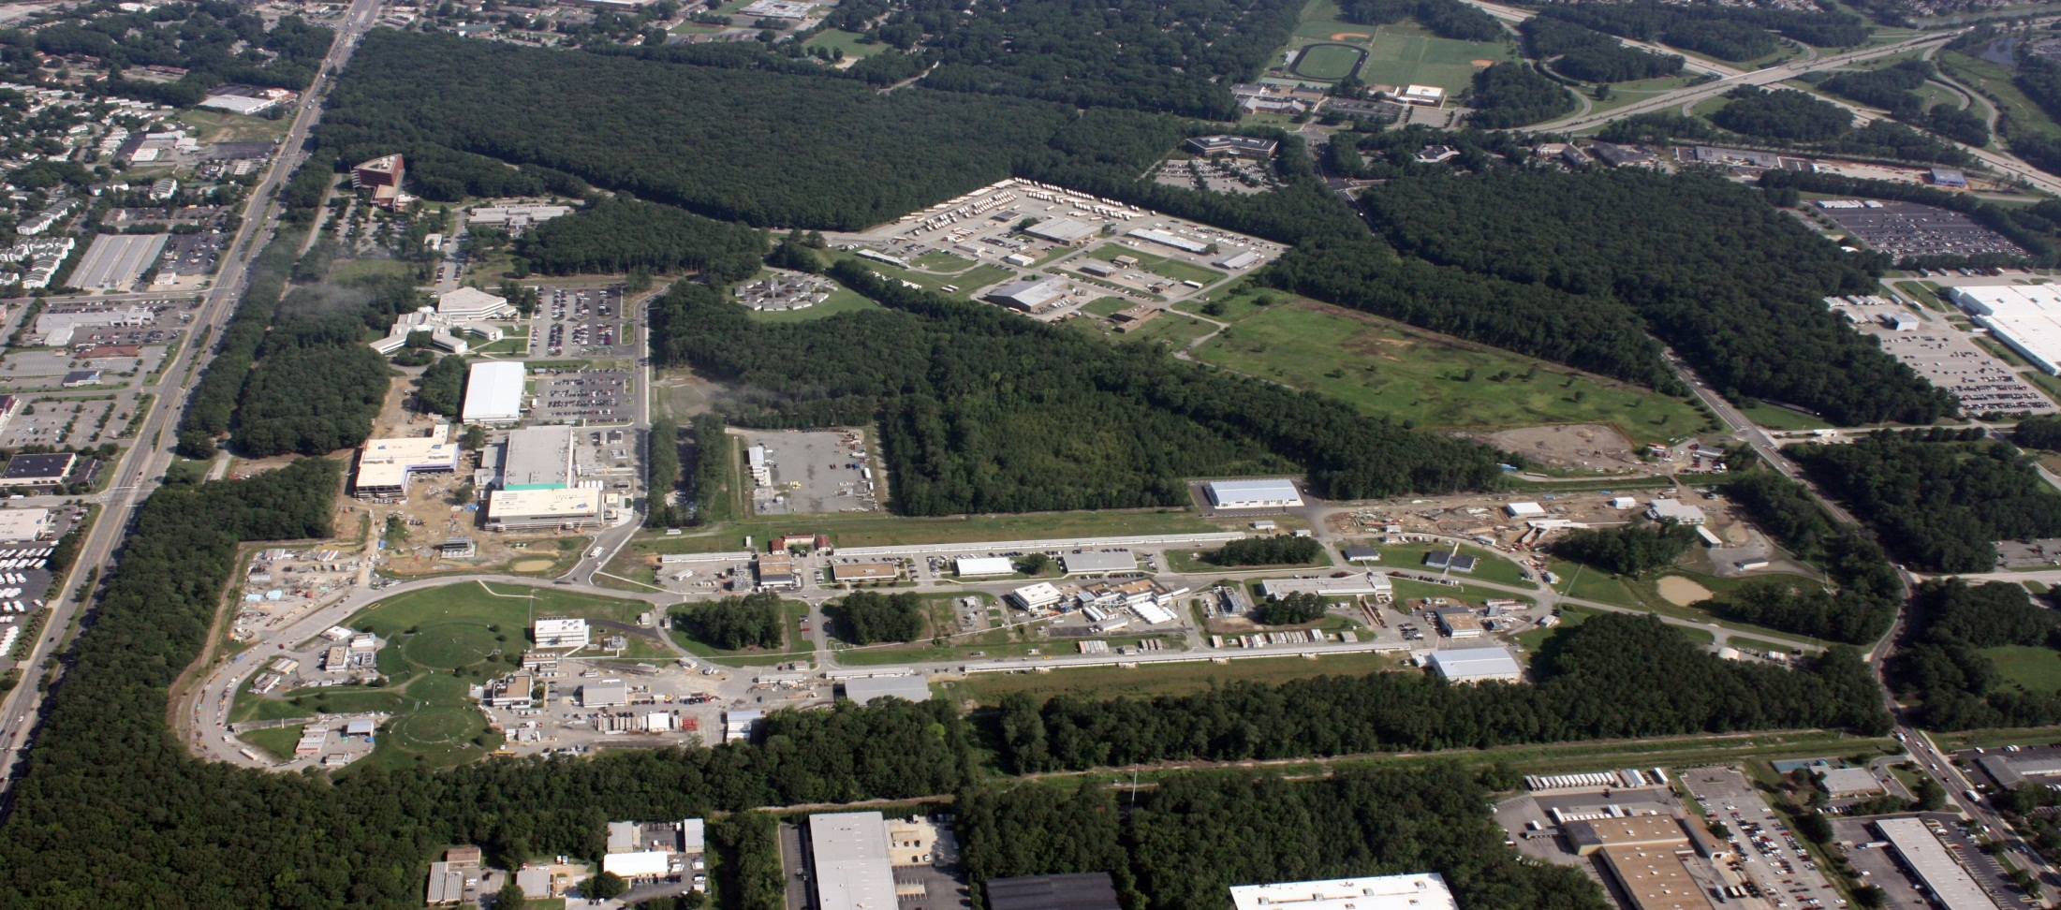
Jefferson Lab Update
R. D. McKeown
Jefferson Lab
HPS Meeting
June 16, 2014

Slide 2
Outline
PAC and science program
NSAC Long Range Plan
Outlook
Notes:
Like to give an overview of Jefferson Lab.
I can’t get going without saying something of the current status of the lab.
The dominant part of the talk will concern our 12 GeV Upgrade Project, the physics and the project status.
However, the technology which enables our nuclear physics and its enhancement also provides opportunities in the future
Photon Science
Accelerator Driven Systems
Nuclear Physics
Conclude

Slide 3
12 GeV Approved Experiments by Physics Topics
Topic | Hall A | Hall B | Hall C | Hall D | Other | Total
The Hadron spectra as probes of QCD (GluEx and heavy baryon and meson spectroscopy) |  | 1 |  | 2 |  | 3
The transverse structure of the hadrons (Elastic and transition Form Factors) | 4 | 3 | 2 | 1 |  | 10
The longitudinal structure of the hadrons (Unpolarized and polarized parton distribution functions) | 2 | 3 | 6 |  |  | 11
The 3D structure of the hadrons (Generalized Parton Distributions and Transverse Momentum Distributions) | 5 | 9 | 4 |  |  | 18
Hadrons and cold nuclear matter (Medium modification of the nucleons, quark hadronization, N-N correlations, hypernuclear spectroscopy, few-body experiments) | 4 | 2 | 6 |  | 1 | 13
Low-energy tests of the Standard Model and Fundamental Symmetries | 3 | 1 |  | 1 | 1 | 6
TOTAL | 18 | 19 | 18 | 4 | 2 | 61

Slide 4
12 GeV Approved Experiments by PAC Days
Topic | Hall A | Hall B | Hall C | Hall D | Other | Total
The Hadron spectra as probes of QCD (GluEx and heavy baryon and meson spectroscopy) |  | 119 |  | 320 |  | 439
The transverse structure of the hadrons (Elastic and transition Form Factors) | 144 | 85 | 102 | 25 |  | 356
The longitudinal structure of the hadrons (Unpolarized and polarized parton distribution functions) | 65 | 230 | 165 |  |  | 460
The 3D structure of the hadrons (Generalized Parton Distributions and Transverse Momentum Distributions) | 409 | 872 | 161 |  |  | 1442
Hadrons and cold nuclear matter (Medium modification of the nucleons, quark hadronization, N-N correlations, hypernuclear spectroscopy, few-body experiments) | 159 | 120 | 179 |  | 14 | 472
Low-energy tests of the Standard Model and Fundamental Symmetries | 547 | 205 |  | 79 | 60 | 891
TOTAL | 1324 | 1631 | 607 | 424 | 74 | 4060
More than 7 years of approved experiments

Slide 5
PAC41
PAC41 was held during the week of May 19, 2014. This was a special meeting to discuss the priority of already approved proposals for scheduling during the first 3-5 years of production running (beyond commissioning) in the 12 GeV era of CEBAF. The goal of this meeting is to provide input to the Lab scheduling process from the PAC in order to realize the highest impact program early in the 12 GeV running period.

Slide 6
PAC41
The PAC will consider all such approved and conditionally approved Stage II proposals in each of the six physics categories, and discuss the relative priority of the proposals in each category. Stage II proposals are those expected to be ready, based on equipment and beam availability, for scheduling of production running (beyond commissioning) during the first 3-5 years in the 12 GeV era of CEBAF. The PAC should identify a subset of these proposals that it considers to be "High Impact" for scheduling priority during this time frame.
Please note that the present status (grades and approved running time) of all previously approved proposals will not be changed by this procedure. It is not anticipated that the PAC will need additional input from the proposal collaborations for this meeting. Hall Leaders and JLab management may be consulted by the PAC during their deliberations if necessary.

Slide 7
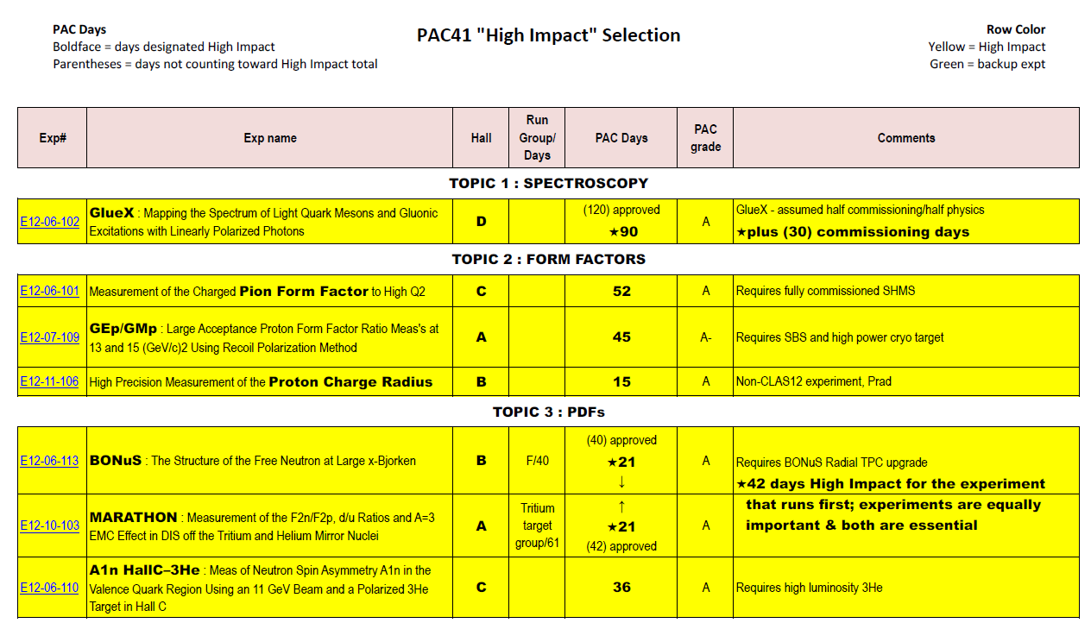
PAC41 Results

Slide 8
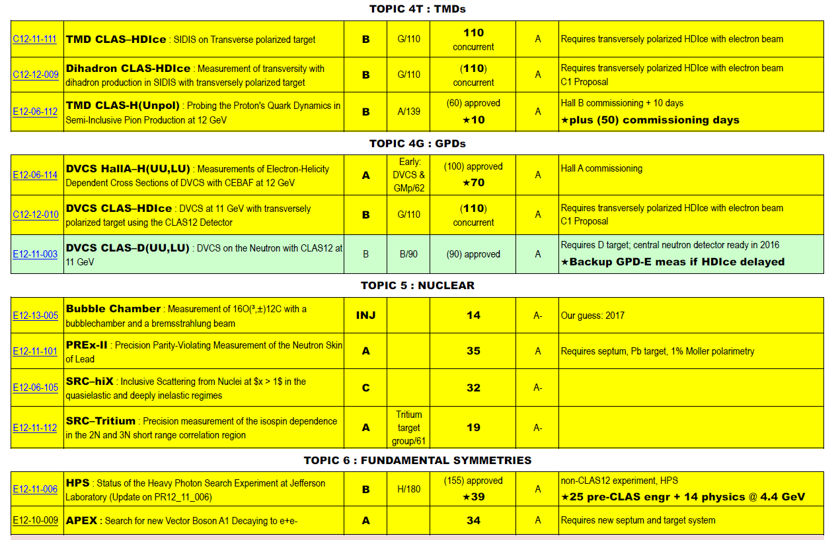
PAC41 Results (cont’d)

Slide 9
PAC41 Results (cont’d)

Slide 10
PAC41 Results
PAC41 identified 643 PAC-days of “High Impact” experiments
These will receive priority for scheduling in the first 5 years of 12 GeV running
These represent less than half of the anticipated running time
Lab management agrees with the PAC that this represents input to the scheduling process

Slide 11
PAC41 Results
Please read the report carefully, and keep in mind that this is guidance for scheduling. Nothing really new here, only additional PAC input.
It is extremely important for the Lab to realize a very high impact program early in the 12 GeV program. The PAC has done an admirable job of helping us to identify such potential components of this program.
This will help us to optimize our resources for realizing scientific excellence at Jefferson Lab in both the shorter and longer terms.

Slide 12
PAC42
Scheduled for July 28-August 1
Proposals were due June 2
Charge:
Review new proposals, previously conditionally approved proposals, and letters of intent for experiments that will utilize the 12 GeV upgrade of CEBAF and provide advice on their scientific merit, technical feasibility and resource requirements.
Identify proposals with high-quality physics that, represent high quality physics within the range of scientific importance represented by the previously approved 12 GeV proposals and recommend for approval.
Also provide a recommendation on scientific rating and beamtime allocation for proposals newly recommended for approval.
Identify other proposals with physics that have the potential for falling into this category pending clarification of scientific and/or technical issues and recommend for conditional approval. Provide comments on technical and scientific issues that should be addressed by the proponents prior to review at a future PAC.

Slide 13
Other Recent Developments
HPS funded by DOE HEP in FY15
- Install in FY14
- Hope for Scheduling in Hall B in FY15
PRad MRI funded.
- Request for install in FY14/15
- Hope for Scheduling in Hall B in FY15
CLEO solenoid committed for SoLID project, final negotiations
Decision by DOE-HEP re Babar DIRC for GlueX
Hall B RICH detector reviewed September 5-6, 2013
- DOE participation
- very positive

Slide 16
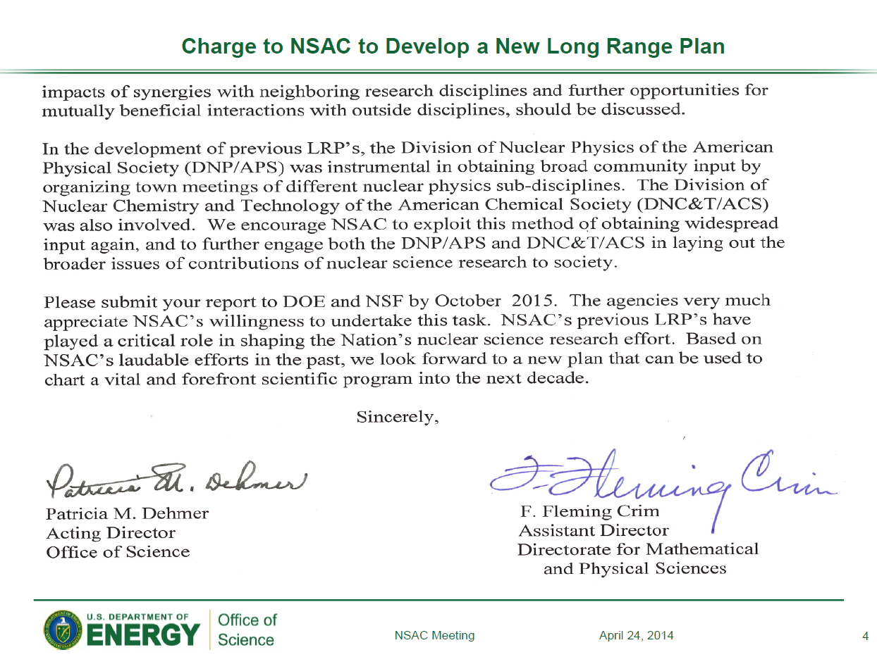

Slide 17
2015 LRP Plans
Town meetings – joint RHI/Hadronic meeting as for 2007
DNP Executive Committee has appointed conveners (QCD: H. Gao and C. Roberts)
Schedule and venue – TBA, likely early fall, east coast
Town meeting white papers due in Dec. 2014
Resolution meeting Jan-Feb 2015
Preliminary report to NSAC - March 2015

Slide 18
JLab LRP issues
12 GeV white paper from 2011 served us well, not seriously outdated – let’s not rewrite it! Perhaps a short update for PAC totals.
EIC white paper being updated by writing group (mostly input from LHC program)
Town meeting output can include both white papers, others from the rest of the community, and perhaps a short cover document.
JLab community should support/contribute to
- Nuclear Structure/Astrophysics
- Fundamental Symmetries and Neutrinos
LRP should recommend complete construction and begin full operations for new facilities – JLab12 and FRIB
LRP should support MIE projects – MOLLER and SoLID
LRP should recommendation construction of EIC

Slide 19
Summary & Outlook
PAC
- 2 meetings in 2014
- Special prioritization meeting
NSAC LRP imminent – unified JLab community is essential for success.

