Slide 1
SVT Stepper Motor Test
Takashi Maruyama, SLAC
HPS Collaboration Meeting
June 16-18, 2014

Slide 2
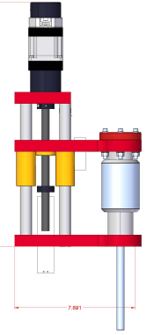
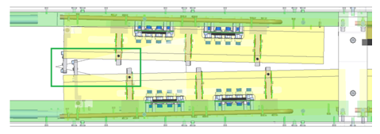
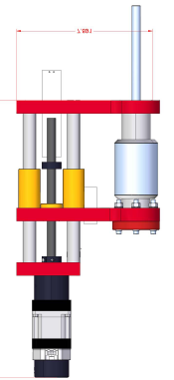
SVT and Linear Stage
Linear Stage is used to
Move SVT layers 1-3
Do wire scan to find the beam
Wire Frame
L1
L2
L3
Tests:
Positioning error
Backlash
Vacuum effect
Long term stability
Test in magnetic field
As we want to place the layer 1 physical edge at only 500 μm from the beam, we aim for less than 50 μm of positioning error and reproducibility.

Slide 3
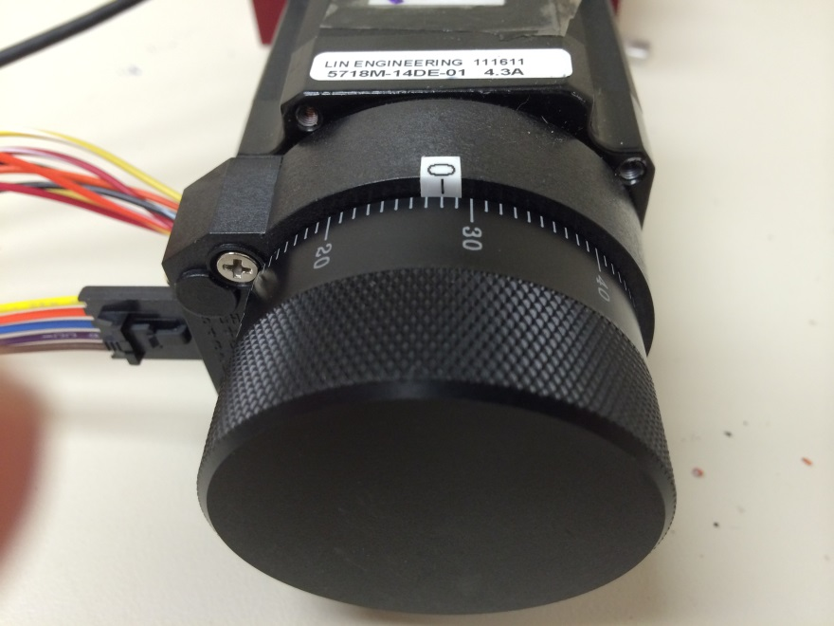
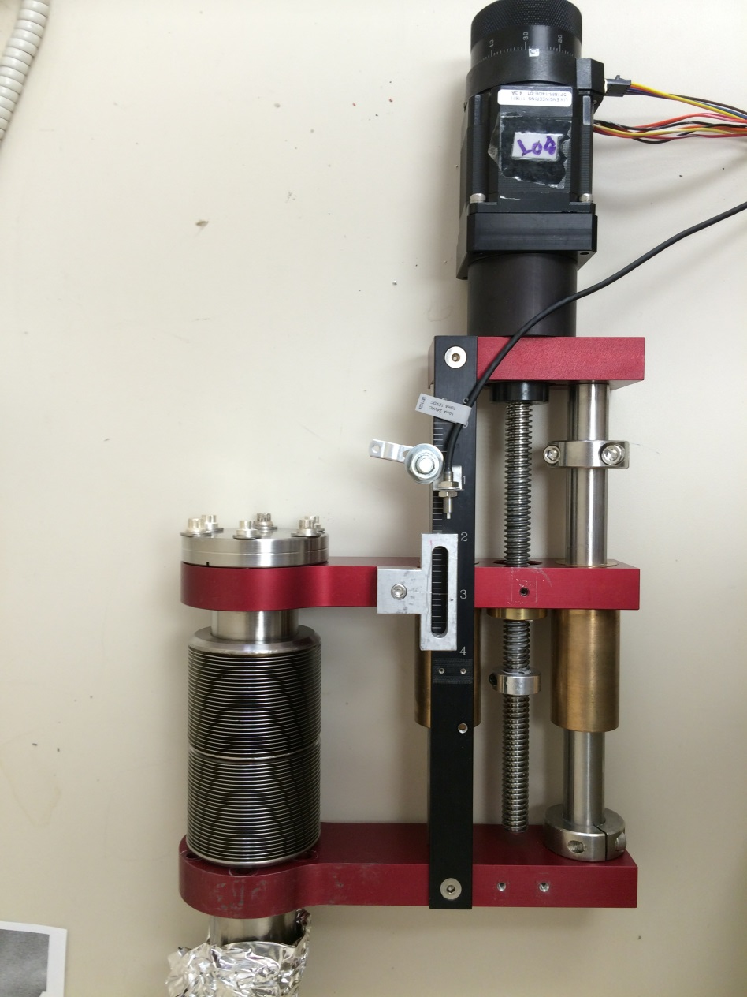
Linear Stage and Stepper Motor
“Home” is at the out
position.
Encoder
0.1” per turn
1 mil per unit
10 teeth / 1”
0.100” per revolution
400 encoder pulses per revolution
6.35 μm / pulse
Newport XPS Controller
Hovanes provided the stepper motor
parameters.

Slide 4
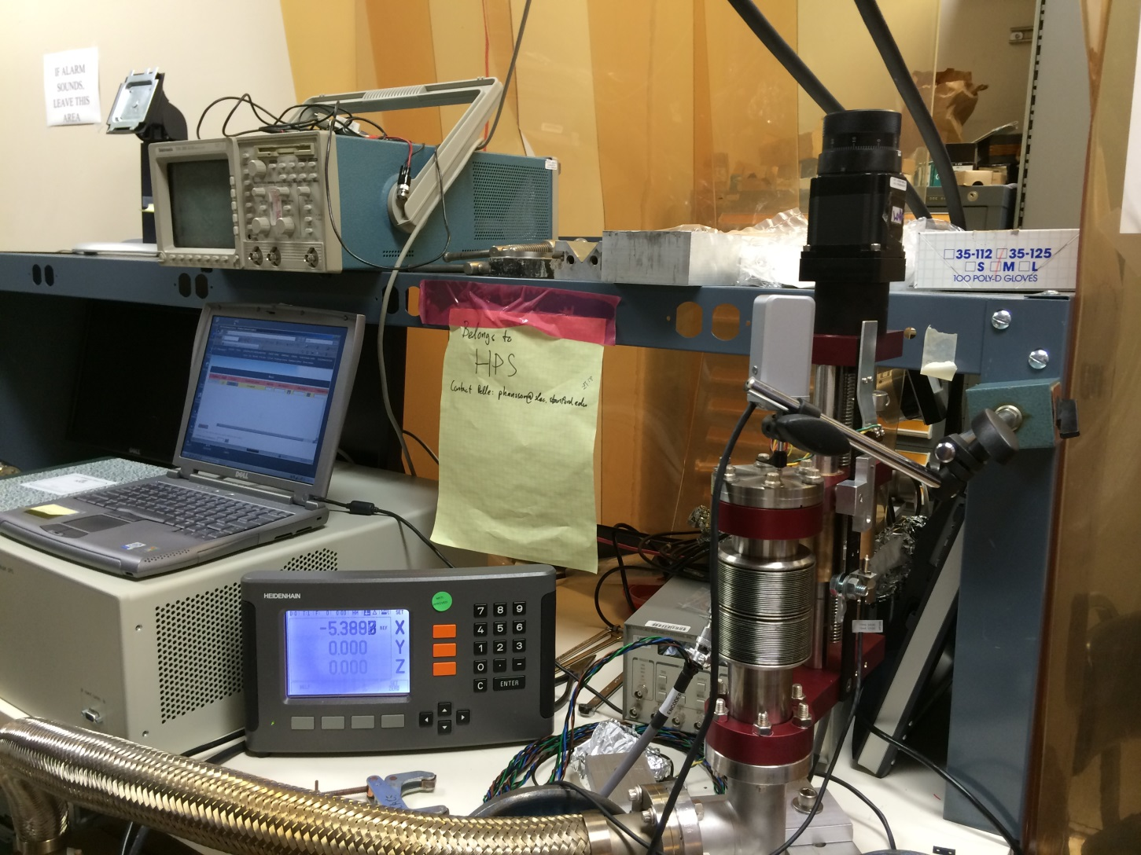
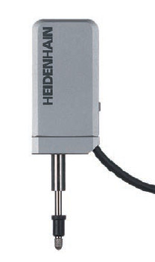
Positioning error measurement using Heidenhain MT1200
Heidenhain MT1200
±0.2 μm accuracy

Slide 5
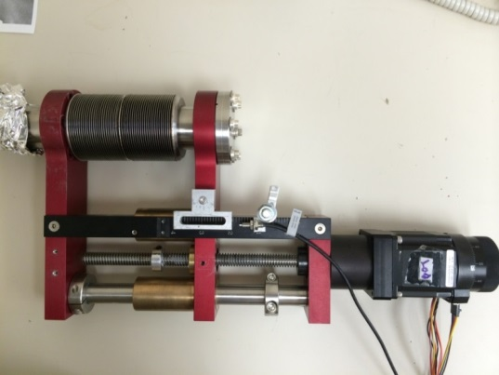
25 μm backlash
Under vacuum
0 mm
350 μm from vacuum
5
No vacuum
10
120 μm backlash
Positioning error is ≤ 10 μm.
Directional backlash is 120 μm w/o vacuum and 25 μm w/ vacuum.
Vacuum distorts the stage as much as 350 μm.

Slide 6
Vacuum Effect
W=0
W=3.2 lbs
W=0
W=3.2 lbs
380 μm
W=5.4 lbs
W=5.4 lbs
367 μm
W=7.4 lbs
310 μm
313 μm
Weight
Heidenhain

Slide 7
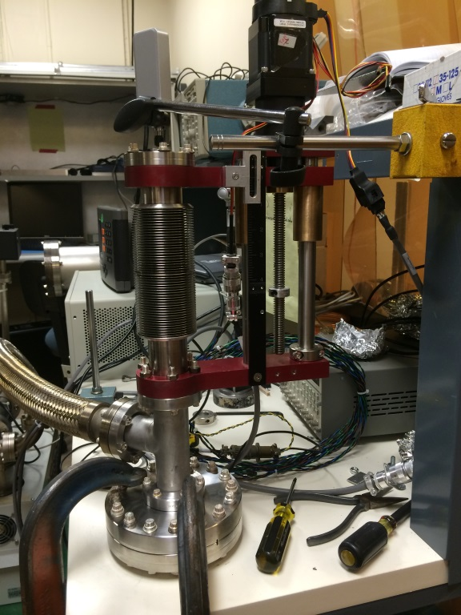
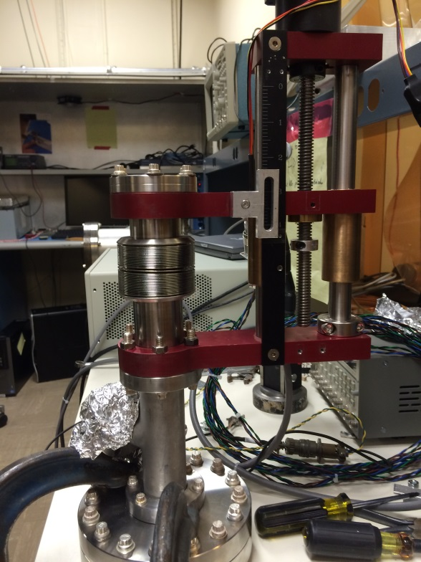
Bellows stretched
Bellows compressed
Bottom Stage
Vacuum
SVT weight
Larger vacuum effect
Smaller vacuum effect
Larger vacuum effect

Slide 8

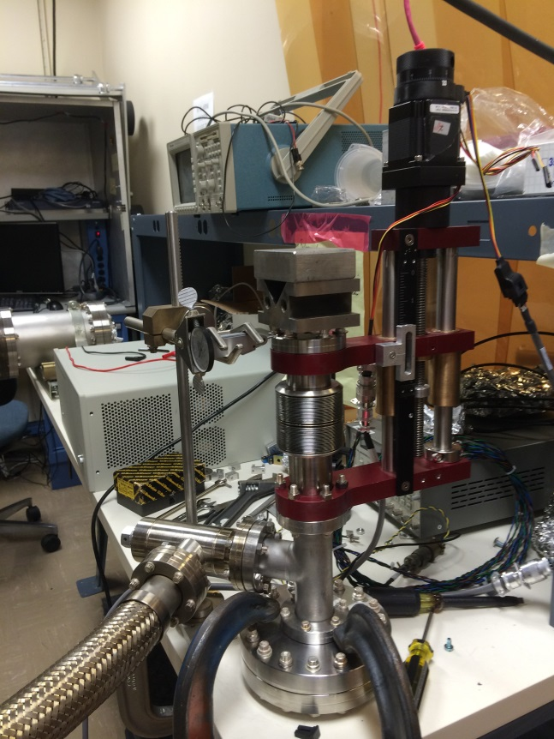
Flange stability
Brown&Sharpe
4.2 lbs weight
0.5 mil initial settlement
Stable within 0.5 mil
Pumped to 2×10⁻⁵ Torr and valved off

Slide 9
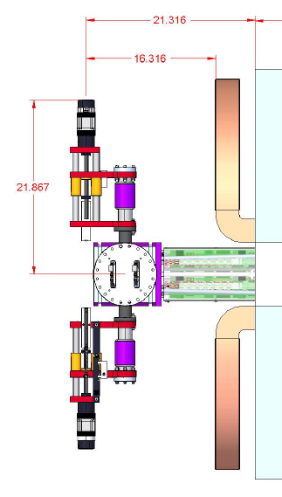
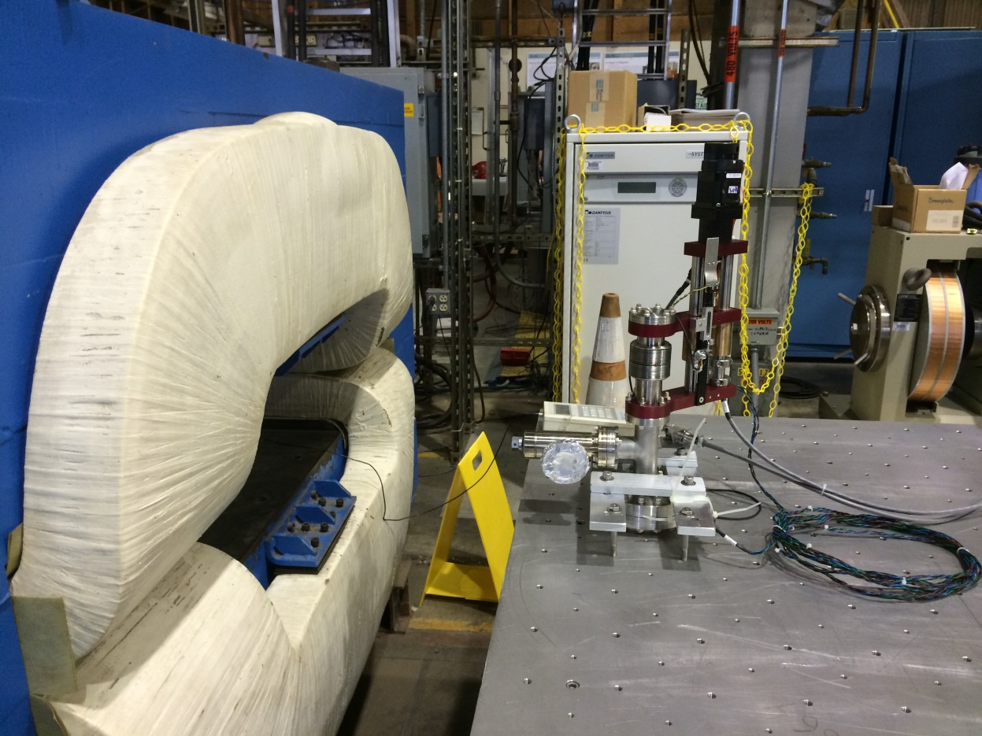
Stepper motor in B-field
15” , 24”
18”
90° valve
The stage was pumped down in the lab, and was valved off.

Slide 10
Distance from magnet | Central Field | Field at Stepper Motor
15” | 0.3 Tesla | 100 Gauss
15” | 0.6 | 200
15” | 1.0 | 310
24” | 1.0 | 120
Repeat stage move 5x: 0 → 20 mm → 0

Slide 11
Conclusions
Positioning error is ∼10 μm.
Directional backlash is 25 μm.
  Always move the stage towards the beam.
Stage is stable within 0.5 mil.
No problem in operating in B-field.
Vacuum causes as much as 500 μm of stage movement.
  This is not a problem as we have to find the beam using SVT wire scan.
  But we have to remember this effect when we set the limit switch on the linear stage.

