Slide 1
SVT Installation and Commissioning
Takashi Maruyama, SLAC
HPS Collaboration Meeting
June 16-18, 2014

Slide 2
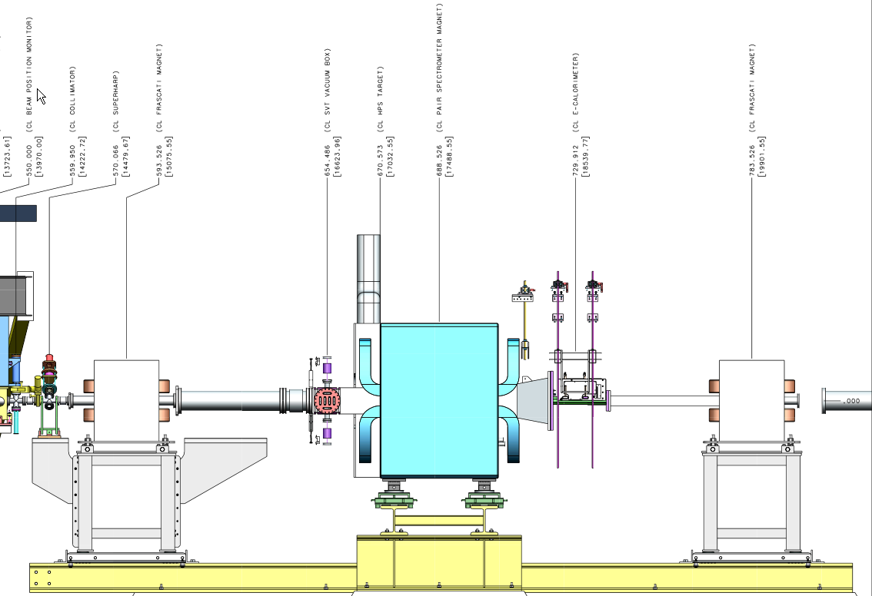
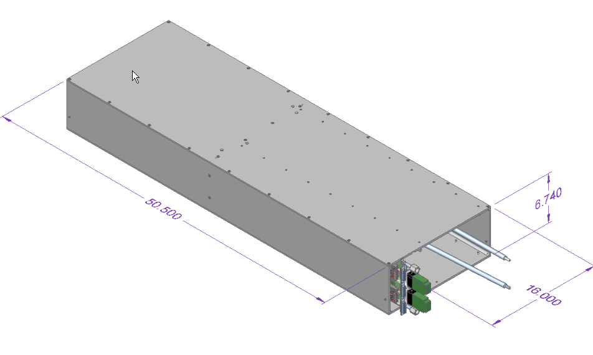
SVT Installation
SVT
58”
Now 85.00”
Now 85.00”
50.1 “

Slide 3
SVT Installation Steps:
Separate top/bottom ECal and move downstream
Remove ECal vacuum chamber
45 cm
2. Remove upstream beam pipe, PS vac flange; move Frascati upstream
3. Set up survey instruments upstream and downstream of PS vac chamber
Does the instrument fit in 45 cm?

Slide 4
SVT Installation Steps:
4. Put SVT box on table and slide into PS vac chamber and bring to correct Z
SVT
5. With surveyors, position SVT horizontally and vertically at downstream end; ditto upstream end.
6. Lock SVT Box in place
7. Survey location of PS vac inner surfaces, SVT box outer surfaces, SVT fiducials, check points.

Slide 5
SVT Installation Steps:
8. Install SVT vac box
9. Connect mover and target rods. Set hard stops and limit switches. Verify movers work. Check alignment with survey.
10. Connect cooling lines and test
11. Connect data/power cables and test 12. Remove upstream table; restore upstream Frascati position.
13. Restore vac connections: Upstream Beampipe, Ecal Vac chamber. 14. Pump down and Test Vacuum
15. Leave the SVT L1-3 at fully retracted position
16. Test cooling and data/power in vac
17. Replace Ecal and test
As the linear stage moves, the limit switches may need adjustments.

Slide 6
Survey Information on the vacuum chamber
Survey information wrt the straight-through beamline.
X position of vac chamber wall on beam’s right at upstream and downstream ends
Y position of vac chamber wall on bottom surface at upstream and downstream ends
Z position of the upstream flange mating surface at 4 corners.
Vac chamber
z
z
×
y
z
y
z
×
8.85 cm
Straight-through beam line

Slide 7
SVT Alignment
Alignment spheres:
Two at the top and one at the bottom of the base plate upstream and downstream.
End of the top and bottom rods.
Adjustment screws:

Slide 8
SVT Commissioning
SVT Commissioning will be performed under the following conditions,
SVT Protection Collimator is in the 3 mm gap and the FSD system is working.
SVT Layer 1 is retracted to 3 mm from the beam.
SVT bias voltage is set to 60 V.
Efficiency is nearly 100% and high voltage punch-through damage to the front-end electronics can be avoided.
SVT Chiller is running and temperature interlock is working.

Slide 9
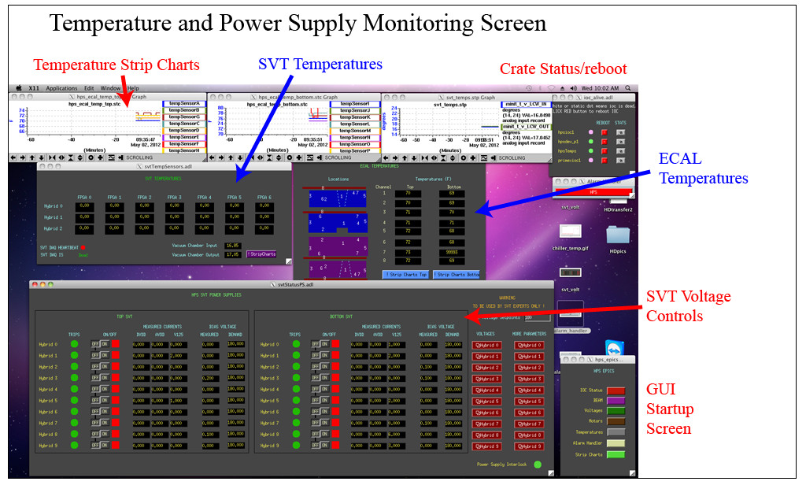
Slow Control
Power to the front end and flange boards
High voltage bias
Hybrid power
Hybrid and front end board temperatures
Chiller temperature

Slide 10
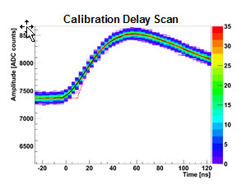
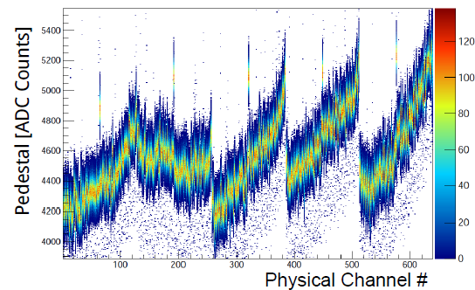
SVT Calibration
Extraction of the pedestals and noise for each of the 23004 channels
Extraction of the gains and offsets
Runs at different t0 values to study the pulse shape
SVT calibration can be done without beam, but it will be repeated with beam to make sure there is no beam-related anomalies.

Slide 11
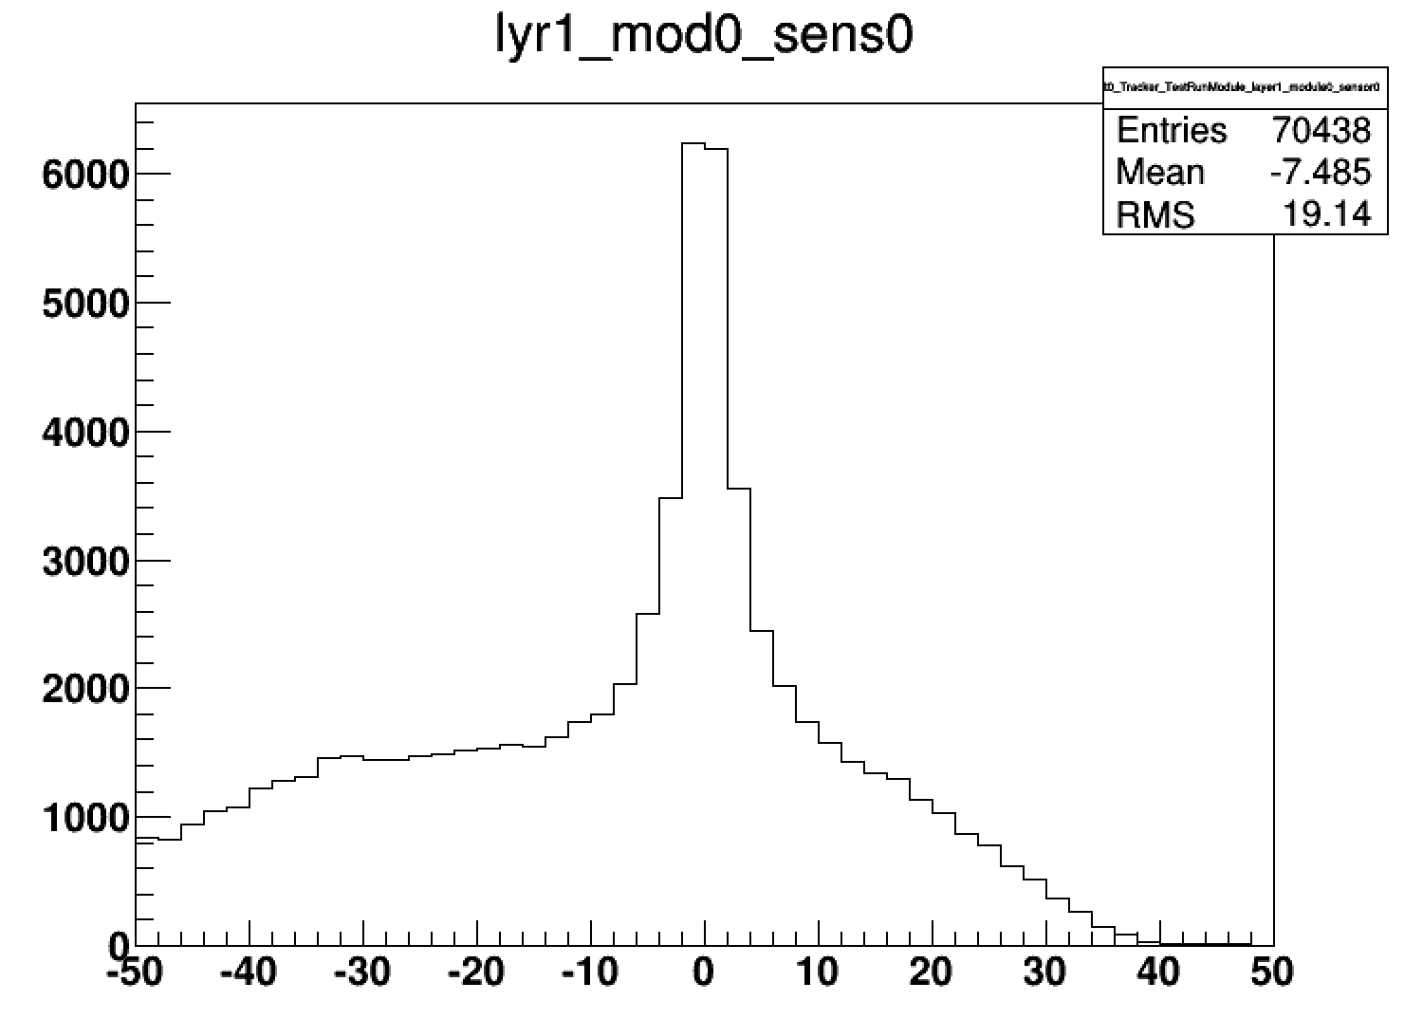
Timing in the SVT
Correctly timed in hits
Well controlled latency scan
Single cluster trigger (or an OR of top & bottom)
Low beam current to get single Ecal clusters for good reference time and no background
No pile-up pulse shape cuts in SVT (noise hits should be few)
Take runs with latency at 50-75ns steps
Background
ECal – SVT hit time
Observable | Effect from latency scan
ECal vs SVT hit time
Fitted amplitude (vs t0) | Amplitude lower when fitting tail.
Count samples (among the six) above some threshold | Rudimentary way of seeing increased occupancy.
Strip/3D hits per event | Broad peak around correct latency
Tracks per event | Broad peak around correct latency (probably using non-bend plane view as well)
(Ecal time above uses MC truth time )
We are producing these scans with MC to check
(Omar)

Slide 12
Online monitor
Occupancy
Shaper signal samples
Data rate
DAQ Errors
Occupancies from Test Run

Slide 13
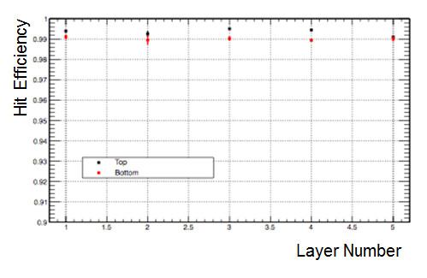
Event display and hit efficiency
Find tracks
Efficiency for finding hits on tracks should be >99%

Slide 14
Conclusions
SVT installation procedure is being developed.
Details still need more work.
If we have to extract L1-3 for repair, how can we do that?
If we have to extract L4-6, is it possible to extract from downstream?
SVT alignment and survey need more attention.
Software for SVT commissioning are being developed.
Slow control
Software for Timing-in
On-line monitor
Event display

