Slide 1
Beamline Overview
Collaboration Meeting
16 June 2014
Ken Moffeit
1:30pm - 3:00pm Beamline overview (15’+5’) Ken Moffeit
Status of the beamline construction (30’+5’) F-X. Girod
MPS/FSD systems for HPS (15'+5') Daniel Sexton
Radiation safety in Hall B (15'+5') Pavel and Vashek
Silicon detector stepping motor test (15'+5') Takashi Maruyama

Slide 2
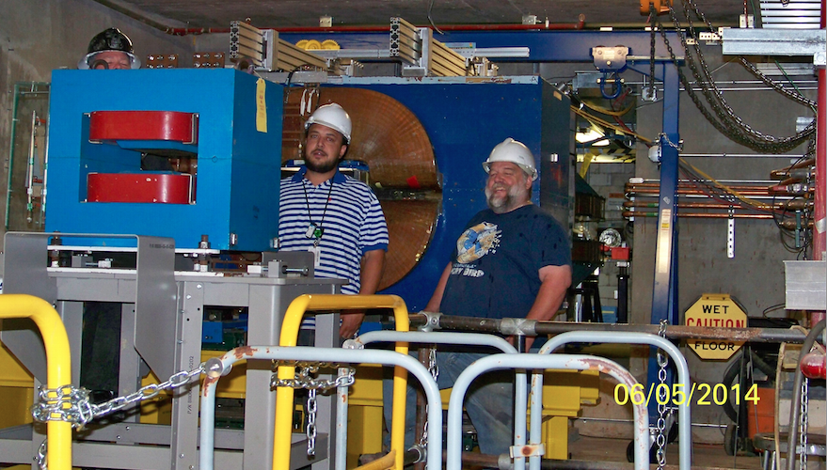
Dear all,
I am happy to inform that HPS chicane magnets are now installed in the Hall-B downstream alcove. Many thanks to the Hall-B engineering-technical team for the excellent work. Great work!
Best, Stepan 5 June 2014

Slide 3
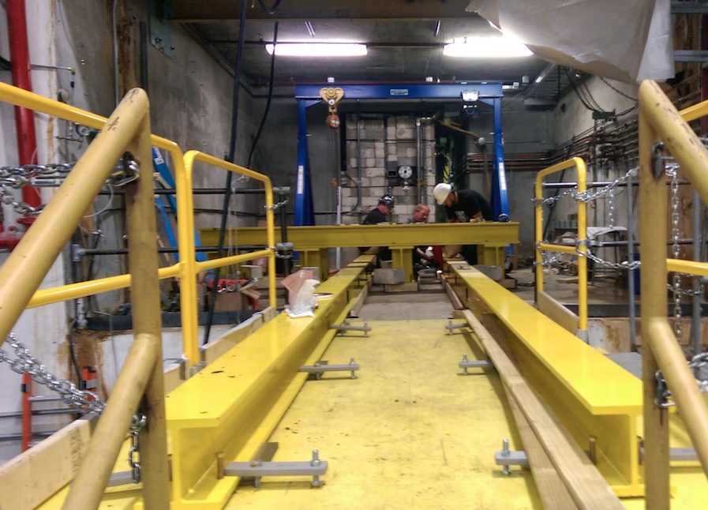
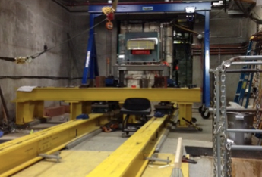
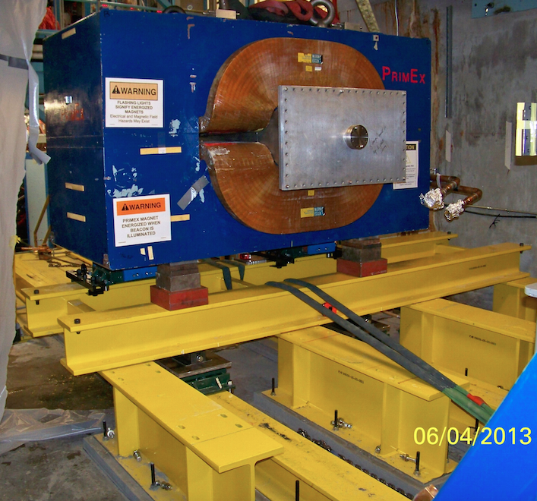
First Magnet Installed in Alcove – 3 June 2014
Frascati magnet
Spectrometer magnet installed in alcove
4 June 2014
More in next talk “Status of the beamline construction” - F-X. Girod

Slide 4
Heavy Photon Search (HPS) Experiment Readiness Review
Charge to the committee:
Are the HPS specific equipment, documentation and procedures to run the experiment in place and adequate? This includes demonstrated readiness for full rate capability and expedient analysis of the data.
Are the formal documentation requirements and reporting (run coordinator → shift leaders) procedures for running the experiment adequate, appropriate and complete (COO, ESAD, RSAD, ERG, OSP’s, general equipment operation manuals, etc.)?
Has the entire beamline, target, detector configuration been defined (including ownership, maintenance and control during beam operations)? Is all the necessary equipment installed and operable? If not, what are the completion/commissioning schedule and procedures?
Are the anticipated beam emittance, halo characteristics and general stability likely to be within the required specification to perform this measurement?
Has transmission of the primary beam and generated secondaries been evaluated for unexpected beam restrictions (e.g. too small of a beam pipe acting as a secondary target), background sources (e.g. large number of produced photons hitting the beam line) or paths (e.g. primary and/or secondary steering from a magnet fringe field)?
Are the radiation levels expected to be generated in the hall acceptable? Is any local shielding required to minimize the effects of radiation in the hall equipment?
Are the local shielding and the machine protection system required to minimize the effects of radiation in the HPS detector in place?
Have all the jobs that need to be done to mount the experiment/s been identified and defined adequately?
Have conflicts with the 12 GeV Upgrade in Hall B been examined and resolved?
Are the responsibilities for carrying out each job identified, and are the manpower and other resources necessary to complete them on time in place?
Agenda II. Beamline and detectors (Stepan Stepanyan), will cover charge items #3, #4, and #6
A. Status and plans to complete
B. Commissioning schedule and procedures (#3)
C. Safety: evaluation of background sources (#4)
D. Detector Protection: protection collimator, beam halo monitors and FSD , silicon positioning, local shielding (#6)

Slide 5
Documents and Procedures
Beamline Installation document – this is a long list of things that has to be done, people and groups are identified, several weekly meetings are held with the people and groups doing the work.
MPS/FSD – see presentation “MPS/FSD systems for HPS” by Daniel Sexton
Beamline design
https://confluence.slac.stanford.edu/download/attachments/170762148/HPSRUN_13JUN.pdf?version=1&modificationDate=1402700803000&api=v2

Slide 6
Experimental Hall-B and HPS Run Page
http://www.jlab.org/Hall-B/run-web/
CCO – HPS Conduct of Operations for Hall B Heavy Photon Search - June 11, 2014
http://www.jlab.org/Hall-B/run-web/hps/COO_HallB-HPS.pdf
(page 9 gives your responsibilities as a shift member)
ESAD - HPS Experiment Safety Assessment Document
http://www.jlab.org/Hall-B/run-web/hps/ESAD_HallB-HPS.pdf
(General Hazards, Hall B specific hazards)
ERG - Hall-B Emergency Response Guidelines
HALL B WORKER SAFETY AWARENESS TRAINING (SAF111)
http://www.jlab.org/Hall-B/run-web/hps/Hall-B_ERG.pdf
(Familiarize users with safety hazards and protection systems in the Counting House and Hall + maps)
HPS Run Page – (documentation, including operational manuals for detectors, and safety documents - each detector should have description of its own controls in its own operational manual )
Silicon Detector (Tim Nelson – Silicon detector group)
Ecal (work in progress – (Raphaël Dupré - Ecal detector group)

Slide 7
RSAD – HPS Radiation Safety Assessment Document
http://www.jlab.org/Hall-B/run-web/hps/RSAD_HallB-HPS.pdf
Page doesn’t exist at the moment.
I
ncludes section specific to HPS written by Takashi (see below)
Radiation damage to electronics
Neutron production sources
0.1 Radiation damage to electronics
While most of the HPS electronics are located away from the beam line, the front-end electronics boards (FE boards) are inside the vacuum chamber of the PS magnet at 20 cm from the HPS target. There are ten FE boards and each FE board has one Xilinx Artix 100T FPGA and 25 voltage reg- ulator MOSFETs, which are potentially vulnerable to radiations, especially neutrons. While the radiation damage from Total Ionizing Dose (TID) and Non Ionizing Energy Loss (NIEL) are negligible, Single Event Upset (SEU) may cause data corruption in FPGA and Single Event Gate Rupture (SEGR) may permanently damage MOSFET.
BaBar detector at SLAC had 47 FPGAs near the interaction point and observed many SEUs. Based on the BaBar experience and taking the ge- ometry difference into consideration, we estimate 1 SEU/day at the neutron flux of 8000 neutrons/cm2/sec.
Since all the MOSFETs are operated at less than 5 V gate voltage, SEGR is verly unlikely to take place.
0.1.1 Neutron production calculation
Neutron production calculations were made using the particle interaction simulation code FLUKA and Geant4. Following neutron production sources have been studied,
1. SVT Protection Collimator (1 cm Tungsten) 3 m upstream of the HPS target
^{2. HPS Target (4 μm Tungsten)}
3. PS Magnet Coil/Body at the beam’s right
4. ECal vacuum chamber and downstream beam pipe
^{5. Beam dump}
Among these sources, the HPS target is by far the dominant neutron source for the FE boards and the neutron production rate is 2×10−6 neutrons per 2.2 GeV e-. The neutron flux at the FE boards is estimated to be 700 neutrons/cm2/sec at the beam current of 200 nA. This neutron flux is at least a factor of ten lower than the neutron flux expected to cause 1 SEU/day.
See also talk in this session “Radiation safety in Hall B” Pavel and Vashek

Slide 8
Installation Procedures
Silicon Detector (John Jaros)
https://confluence.slac.stanford.edu/download/attachments/170757893/Draft%20SVT%20Installation.pptx?version=2&modificationDate=1402427179154&api=v2
Ecal Detector(Raphaël Dupré)
https://confluence.slac.stanford.edu/download/attachments/170760432/14-04-02_ECalInstall.pdf?version=1&modificationDate=1402424087000&api=v2
Procedures to follow for HPS Beam Recovery from beam trip – work in progress
Operation Procedures:
HPS Protection Collimator Operation Procedures (see below)
HPS Target Operation Procedures (see below)
HPS Wires Operation (in progress)

Slide 9
HPS Beamline Commission document
A) Beam to Hall-B tagger dump – Accelerator Operations
B) HPS Pre-setup before bringing beam to alcove and dump
C) Beam to alcove and dump – Accelerator Operations and HPS
D) HPS and Accelerator Operations – center beam in Ecal vacuum chamber
Vertical centering in Ecal vacuum chamber
Horizontal centering in Ecal vacuum chamber
E) HPS and Accelerator Operations – center beam in HPS silicon detector.
F) Position HPS Protection Collimator
G) Tests after beam through HPS is established, chicane currents are set and rates on halo counters are as expected.

Slide 10
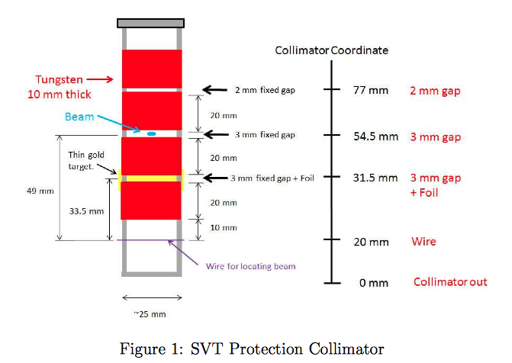
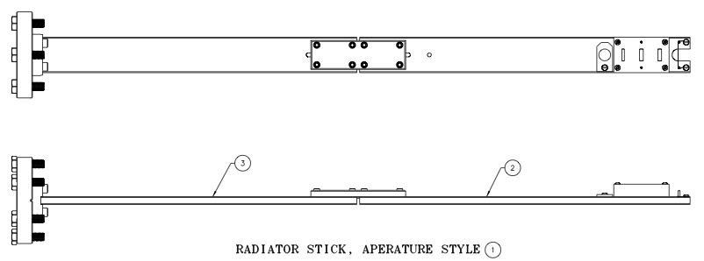
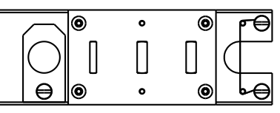
HPS Protection Collimator (Radiator Stick)
Drawings done
Need decision on thickness of thin gold target used for no-field calibration source.
Fabrication at JLAB
MPS/FSD system must be operational when HPS PC in.

Slide 11
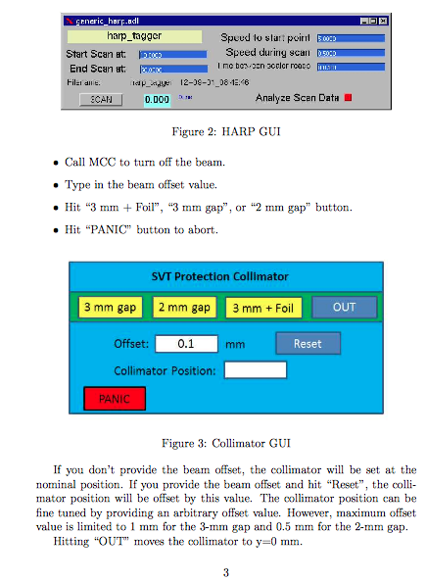
Protection Collimator Operation Manual – Takashi
https://confluence.slac.stanford.edu/download/attachments/170762148/collimator.pdf?version=1&modificationDate=1402700803000&api=v2

Slide 12
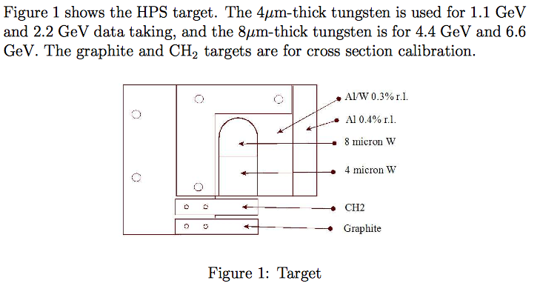
HPS Target (Clive and Marco)
Need decision on C12 and CH2 calibration targets.
Drawing in progress
Target Operation Manual - Takashi
https://confluence.slac.stanford.edu/download/attachments/170762148/target.pdf?version=1&modificationDate=1402701820794&api=v2

Slide 13
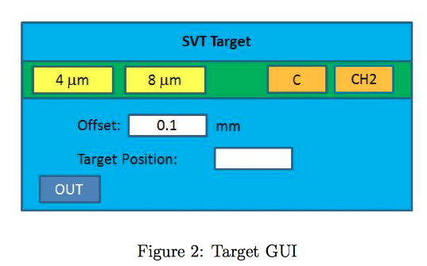
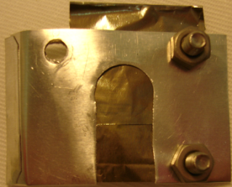
Target cartoon
Target stepping motor
Thin Tungsten
Targets
Silicon layer 1
Beam
10 cm
Calibration targets: C12 and CH2
Thin Gold Targets:
4 microns at bottom and 8 microns above
Beam
Thin Tungsten Targets:
4 microns at bottom and 8 microns above

Slide 14
HPS Slow Controls (Update 4 June 2014: Hovanes Egiyan)
Magnets: Krister Bruhwell is working on the main dipole and on the Frascati magnet power supplies. Controls for Frascati magnets are all serial, Krister is in process restoring the hardware connections.
Motors: Krister is working on installation of the downstream beamline motors. So far only beam stopper is working. Regular Hall B harp scans do not need significant changes. Ani Simonyan is working on 3-wire analysis for the scans.
Vacuum: Accelerator division who will provide EPICS support for the beamline vacuum
equipment for HPS.
MSP/FSD: See talk in the beamline session.
Beamline scalers: Same hardware for scalers (Struck and Joerger) for the HPS beamline. The scaler readout software needs to be transferred to new EPICS.
SVT Motors: Takashi has the XPS controller to be used for target and SVT support, he is learning how to use for HPS SVT applications. So far XPS works well for Takashi. Takashi will send XPS controller to Hovanes once finished with testing and calibrating the SVT stages. Hall D uses XPS controllers for all motors, EPICS support is not a problem. The SVT scans will need to use Hall D scan procedure using XPS controller still under active development in Hall D.

Slide 15
Beamline Costs Change
 | M&S/Labor | Actual | Budgeted | Difference
Beamline Elements | $51.7k / $137.6k | $189.4k | $134.6k | - $54.8
Alcove Installation | $62.9k / $76.0k | $138.9k | $84.5k | - $54.4
Magnet | $33.3k / $7.5k | $40.8k | $26.6k | - $14.2k
TOTAL | $147.9k / $221.1k | $369.1k | $245.7k | - $123.4k
The missing $125k were requested and agreed by Alan Stone on 4/25, as part of the contingency held by DOE.

Slide 16
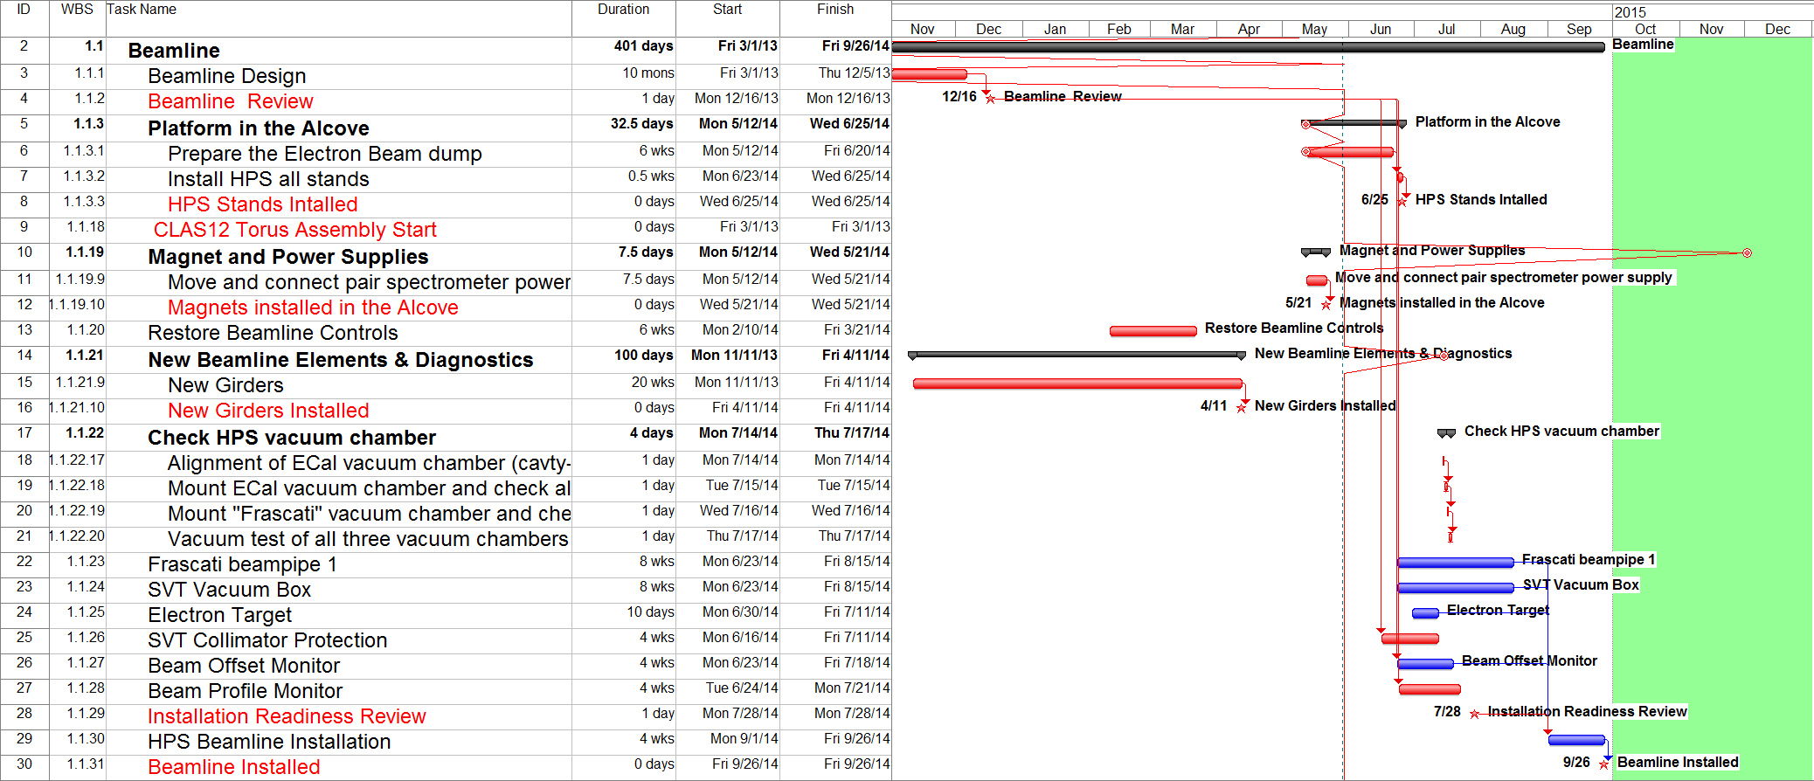
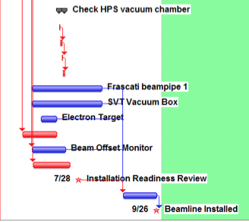
Beamline Schedule
2014
Beamline Review
Beamline Review

Slide 17
First beam into Hall-B may come some time
between mid-October to mid-November.
Beam through the HPS may be available some time
beginning of November to December.

