Slide 1

HPS MPS OVERVIEW
Dan Sexton
& the Safety Systems Group
JLAB

Slide 2
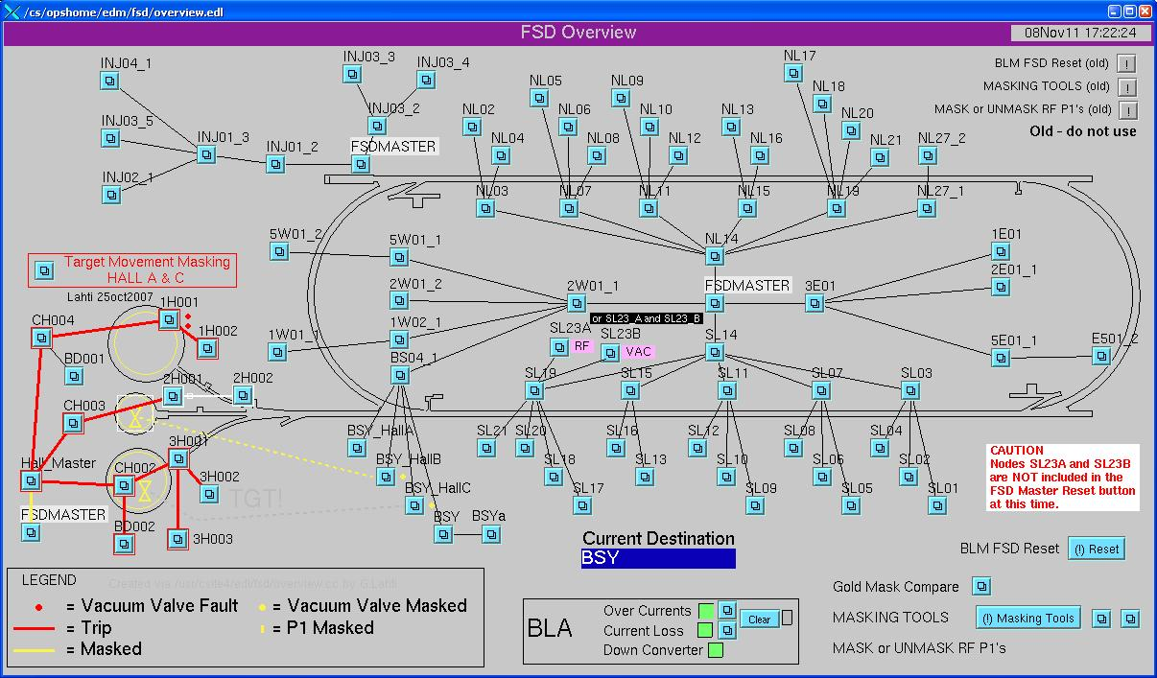
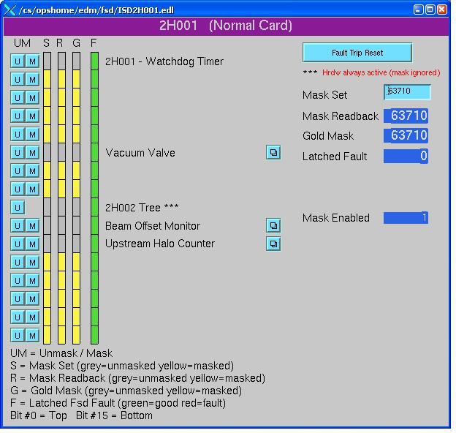
HPS MPS OVERVIEW
HPS MPS Elements
Beam Loss Monitors
Analog Monitoring
Limit Switches
Halo Counters
New Vacuum Valves
MPS Electronics
BLM Card
Analog Card
Electrical Card
Hall Master
New FSD Master
The MPS System for the HPS Experiment will make use of the same infrastructure and hardware that is utilized in CEBAF and the other experimental halls.

Slide 3
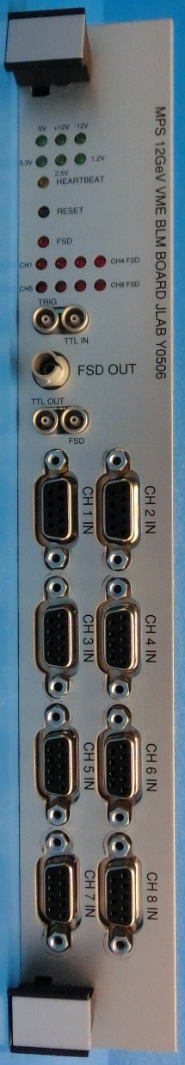
Beam Loss Monitors
Provide early detection of beam loss in critical areas to prevent the loss from becoming a catastrophic event.
The BLMs are mounted near the beam line in areas where loss is expected or of critical concern.
The HVPS channel for each BLM acts as the gain control which is calibrated during initial setup.
Current from the BLM is proportional to the loss detected.
Once the current goes above the set threshold the 5MHz FSD output will be removed causing beam termination.
EPICS status of these channels are available for diagnostic and other uses.
Locations
Previously located will be moved over to the VME controls from the present CAMAC system.
New BLMs are planned for the additional Girders and HPS apparatus
HV Power Supply
……….
BLM
5 MHz = OK
BLM
MPS HALL MASTER
BLM
.
.
.
BLM
The new VME card is tested, commissioned, and installed in CEBAF as part of the 12 GeV effort. This will allow us the opportunity to replace the legacy CAMAC controls since we need to install additional channels anyway. The existing cabling will be used and this will reduce an additional CAMAC crate from the system.

Slide 4
Analog Monitoring
Provide analog monitoring circuitry for windows of acceptable ranges. 0-5V, +/- 5V, 0-10V, or +/- 10V Input Ranges
Monitors Analog input channels and provides FSD permit within in the acceptable window.
Uses and Locations
Magnet Power Supply Current – This monitors the box supply currents and ensures that the energy of the magnets is properly set.
Temperature – Connected to the analog output of temperature monitoring components for over temperature protection
Spares available
5 MHz = OK
MAGNET P.S.
MPS HALL MASTER
TEMP. UNIT
MAGNET P.S.
Currently there are two of these cards installed in the Hall that will be either relocated to the new MPS rack closer to the HPS experiment or cabled to this location. The cables will be routed from the relocated power supplies to the determined location of this MPS Card.

Slide 5
MPS Electrical Card
Designed to interface with external signal of 5MHz, 24VDC, or 5VDC.
Summation of 12 available channels for FSD OK
Maskable channels for unused or tune up beam
Channel faults when external signal isn’t present
Input selection type can be changed via on board selection
Uses and Locations
PLC handshake between Hall B Controls and MPS
DC Power Supply interface.
Additional Channels for spares and “oh it would be nice if….”
5 MHz = OK
MAGNET P.S.
MPS HALL MASTER
LIMIT SWITCHES
HALL B PLC
ETC…..
This is a new VME based design that will be operationally commissioned during the hot checkout of the MPS. All hardware checks and operations have been completed and software group is developing drivers presently.

Slide 6
Hall B Beam Line MPS
Nothing will change in terms of existing MPS (all vacuum valves are the same, tagger magnet, beam lost monitors …). The additional components will be added as needed.
NEW COMPONENTS
Vacuum Valves
Others?

Slide 7
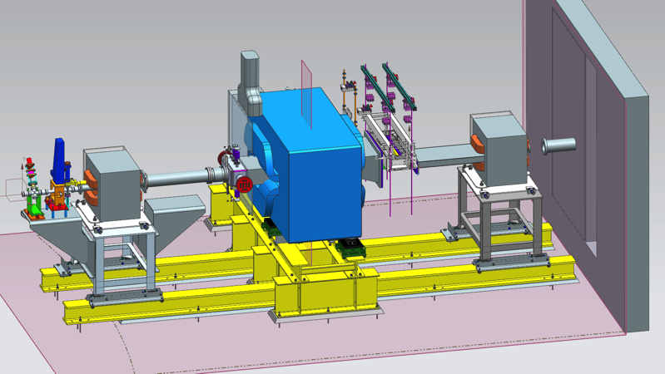
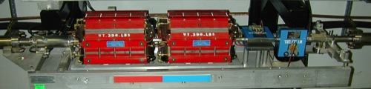


HPS Beam line in the Hall
Two new girders with MPS requirements
HPS Apparatus with MPS requirements
BPM, 2-QA, and H-V-correctors
HPS
2H01 nA BPM
Shield wall
YAG viewer
H-V-correctors and BPMs
Vacuum valves
Slide Courtesy of Stepan Stepanyan

Slide 8
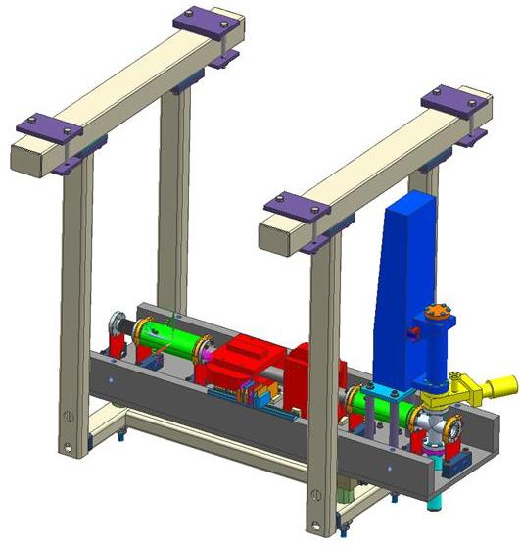
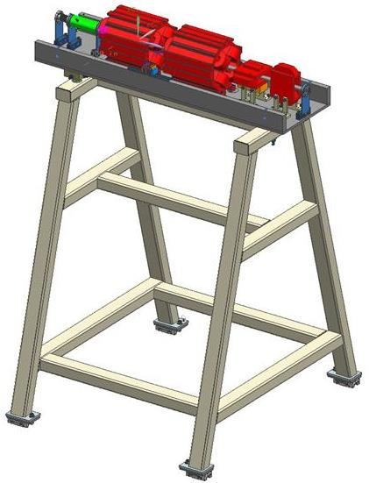
New girders – MPS Additions
Halo Counter
Girder-II
ETA2H03
LIMIT SWITCHES
Possible BLM
Girder-I
Beam Loss Monitors will be added in these specific locations:
Exit of Girder 2 after collimater
Two additional BLMs will be located at the front side of the Girder for Diagnostics and Spare.
Provisions for Limit Switches to protect from beam exposure
D. Sexton, Overview of the MPS for the HPS experiment

Slide 9
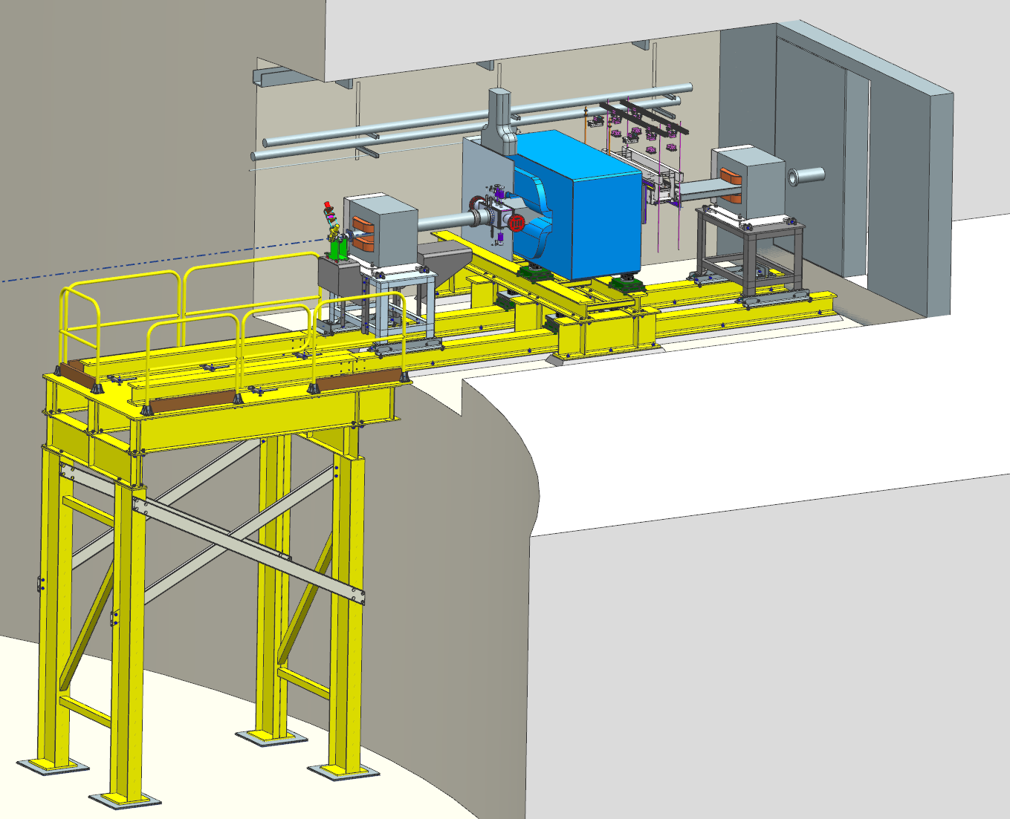
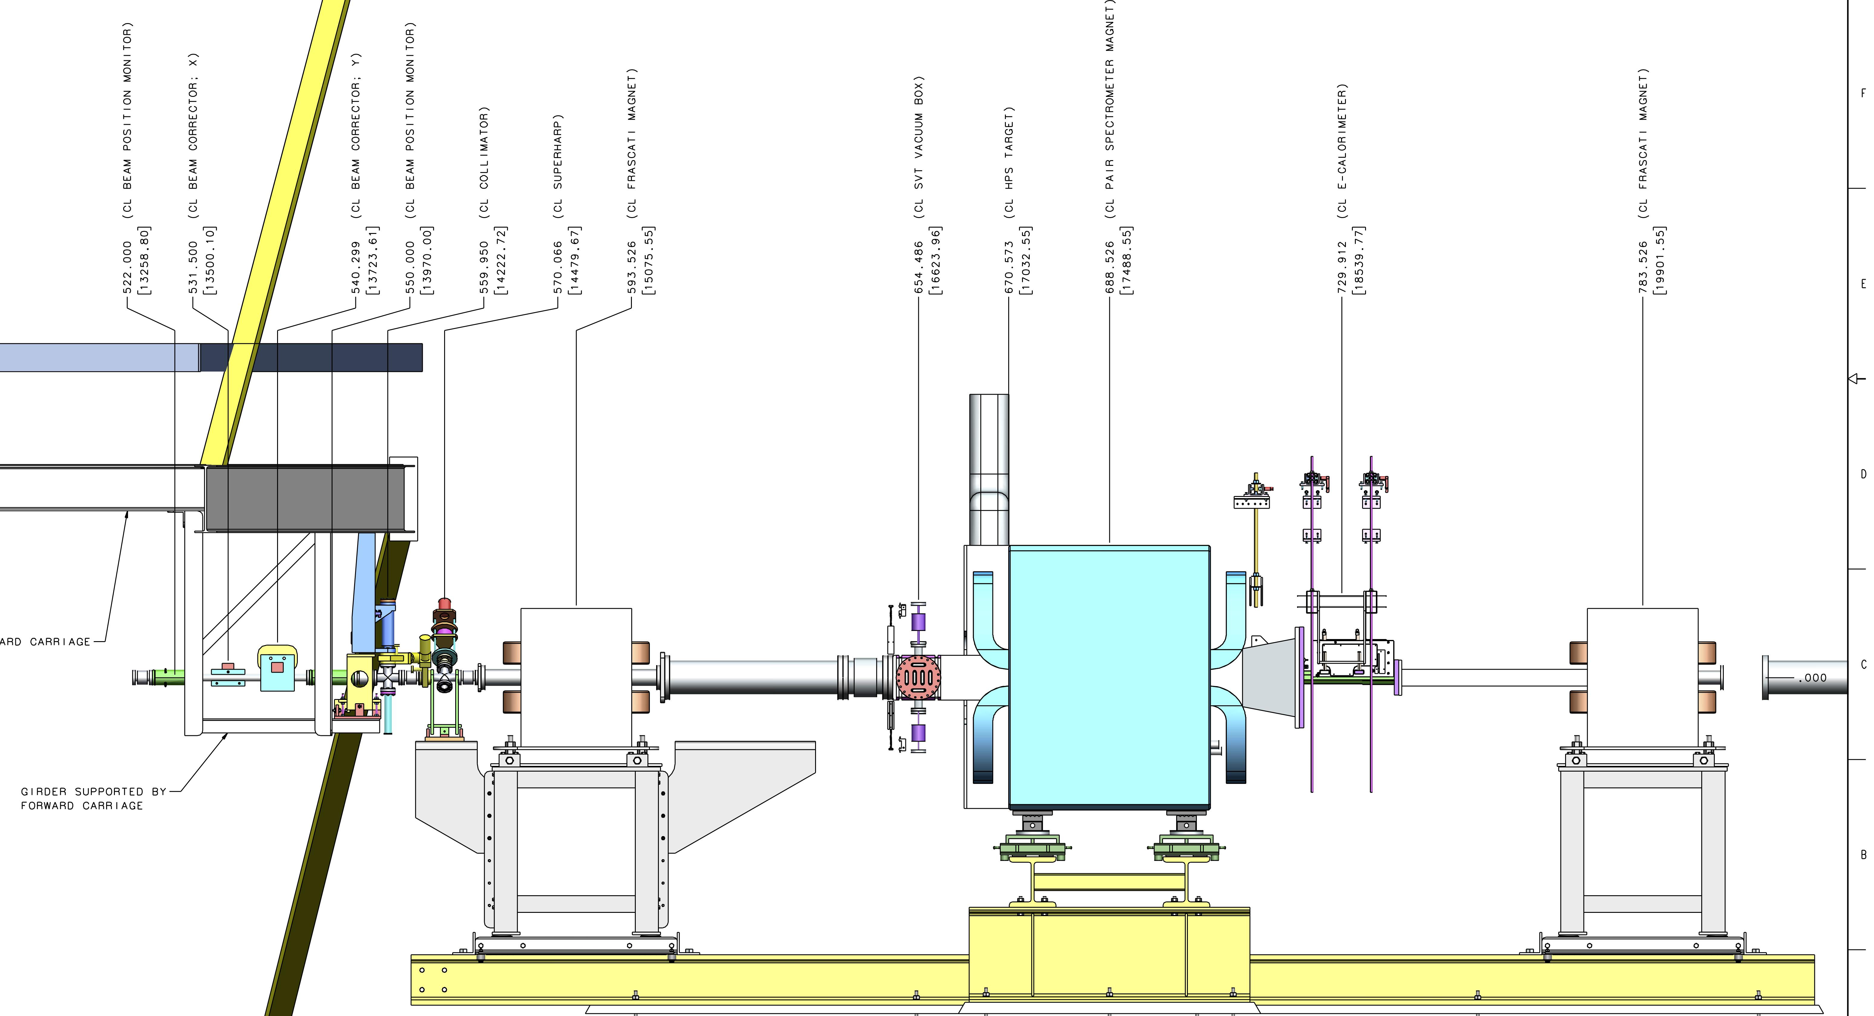
HPS chicane design status
HALL B HALO COUNTERS
5 MHz = OK
FIBER FSD NODE
Halo Counters located on 1st Girder and on HPS Chicane.
  EPICS Adjustable Count Limits
  Excessive counts will cause an FSD fault
Halo Counters

Slide 10
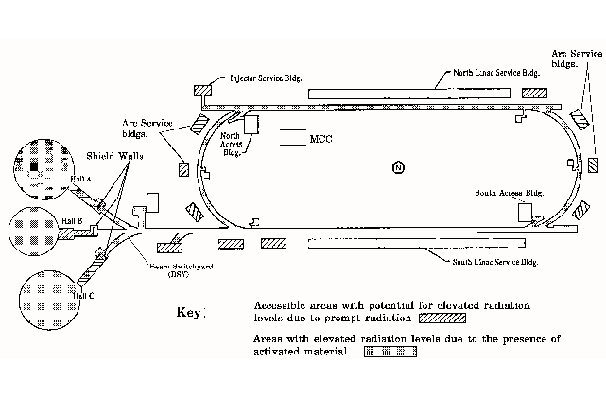
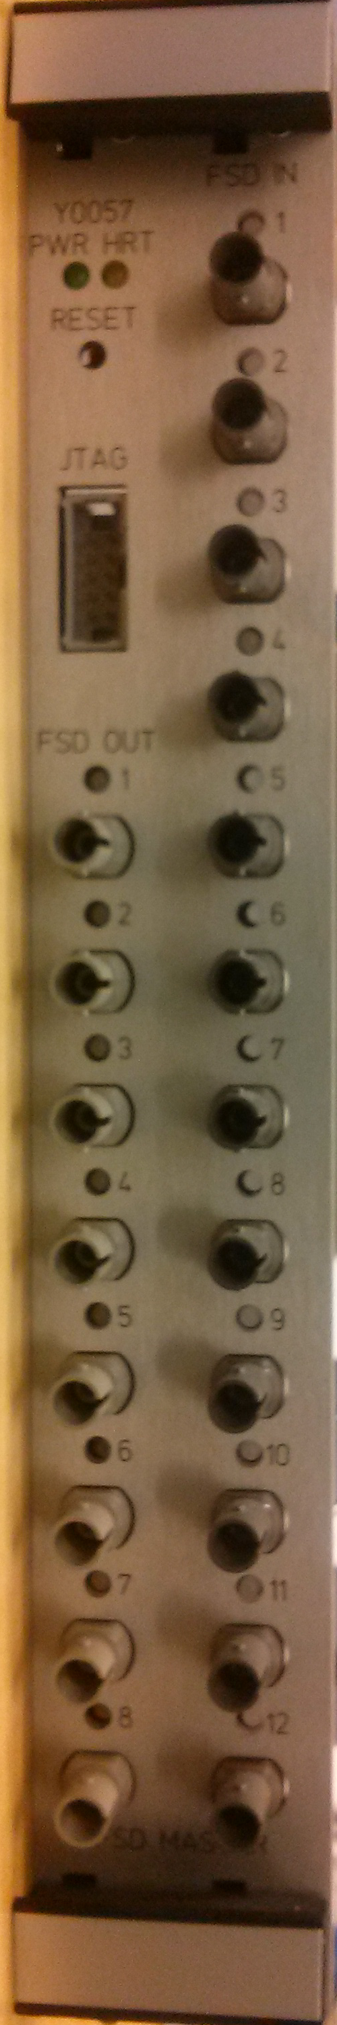
FSD Master Interface
HPS has requested status of the FSD signal for specific startup sequence
This will be a 5MHz signal coming back from the Injector which will be converted to a set of contacts that can be interfaced to the HPS Controls PLC
FSD MASTER
5 MHz = OK
HALL MASTER
5MHz to CONTACT CLOSURE
HALL B MPS NODES
NC NO
BLM
ANALOG
ELECTRICAL
ETC.
In Hall B the 5MHz return from the Injector will be a summation of all of the MPS needed for Hall B operations: Injector, NL, SL, BSY, and HB.
HALL B CONTROLS

Slide 11
HPS MPS Summary and Goals
Hall specific elements that require MPS interface are being solved with standard MPS Hardware
Additional Channels will be made available and can be added in as needed
Provides an opportunity to upgrade the Hall B MPS hardware with latest revisions.
First steps towards segmented MPS System
Status Feedback from FSD for Hall B controls knowledge of beam availability
Questions???

