Slide 1
ECal: New APDs testing and gluing
Work performed at JLab by
Emma, Holly, Kyle, Volodymyr
with the participation and/or input from
Alessandro, Andrea, Annie, Gabriel, M., Raphaël, Stepan & INFN
Michel Garçon HPS collaboration meeting, June 2014

Slide 2
Phases of work
Old APDs & fiber connectors ungluing
Crystal cleaning + (re)wrapping
Frame cleaning
APDs testing and grouping
APDs gluing
Crystal + APD test
Preparing and gluing LED holders
Mounting crystals in frames
Feb. - March
Feb. – June
April
April – May
April – May
May – June
June
June - July

Slide 3
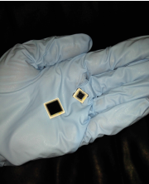
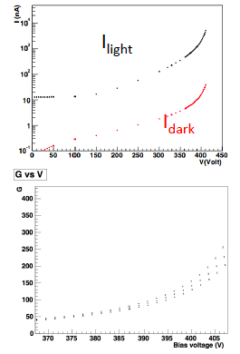
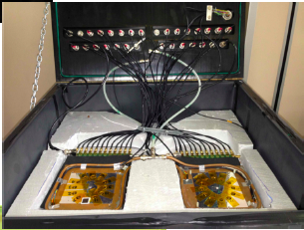
APD testing
Dark and Light current (LED off, on)
3 Temperatures: 20°C, 18°C, 16°C
Voltage (from 0 to breakdown)
Test bench built in Genova,
Analysis method developed in Roma
(A. Rizzo et al., Report on (CLAS12) Forward Tagger LAAPD Benchmarking)
Present analysis performed by Holly (cross-check Andrea)

Slide 4
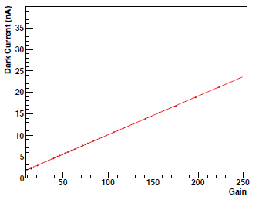
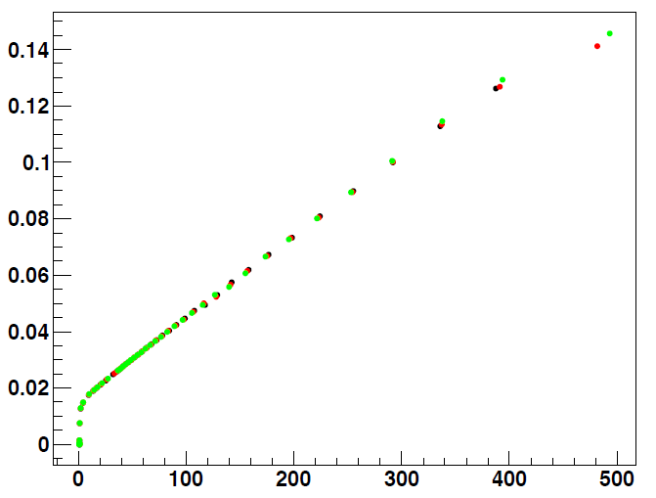
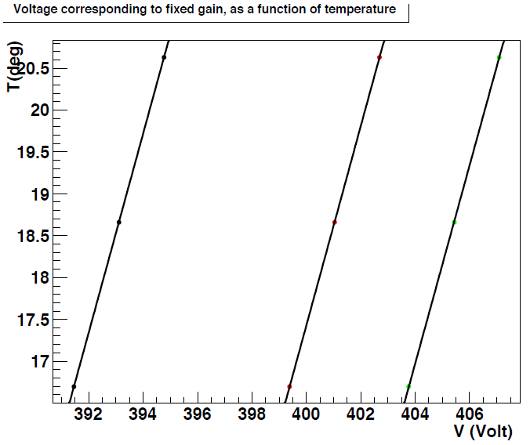
APD quality control
I_{dark} vs Gain linear at all T.
1/G·dG/dV linear f^{n} of G,
ind^{t} of T (~ 6%/V).
Gain = G(αV – βT).

Slide 5
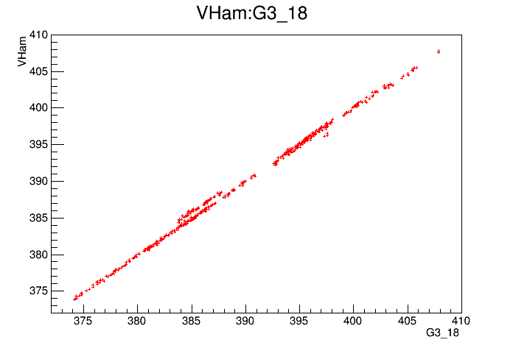
Comparison with Hamamatsu’s numbers
V_{bias_Hamamatsu} vs V_{bias_measured}
VMeasured
A few batches of 12 are off by exactly 1 V compared to Hamamatsu’s delivery sheets.
We have no knowledge of the uncertainty in their measurements,
but ours repeatedly gave the same values (within 0.2 V).
Knowing our uncertainty,
we grouped using the voltages and gains that we measured.

Slide 6
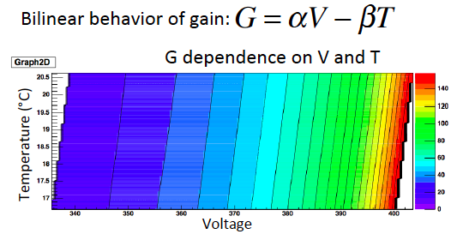
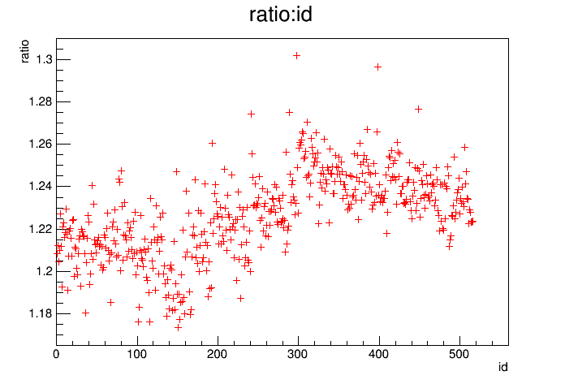
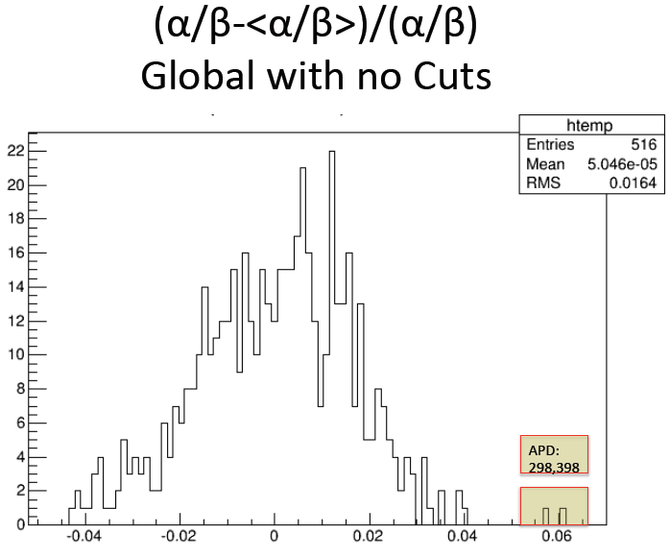
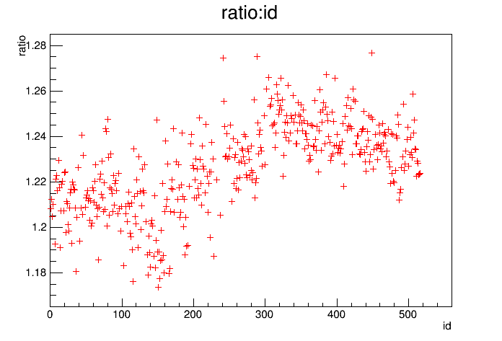
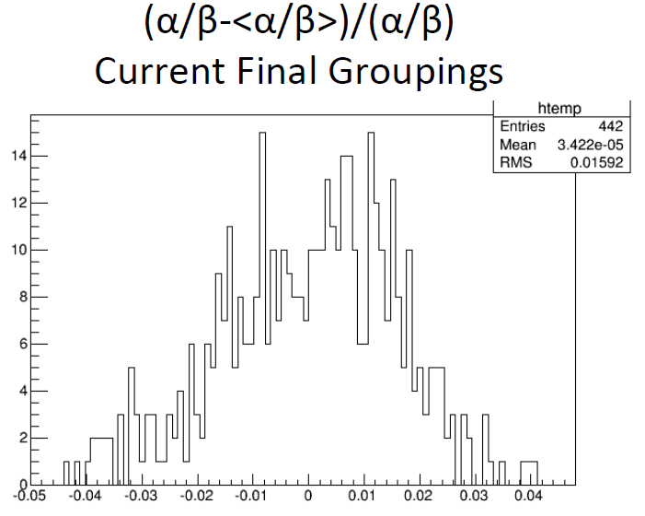
APD selection and grouping criteria
Fit Gain = G(αV – βT)
→ each APD characterized
by the ratio α/β (~ 1.25).
APDs are then grouped by minimizing the spread of voltages V(G=150, T=18°C) of the resulting group

Slide 7
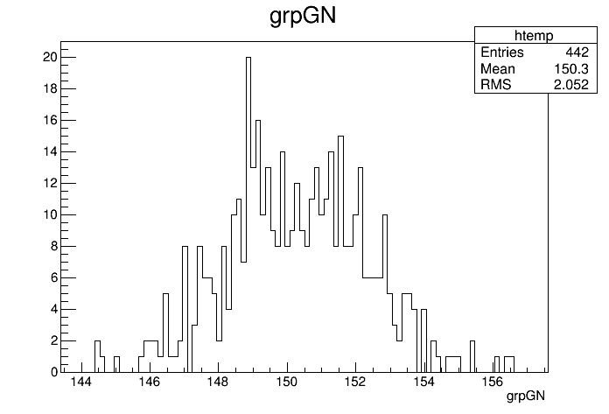
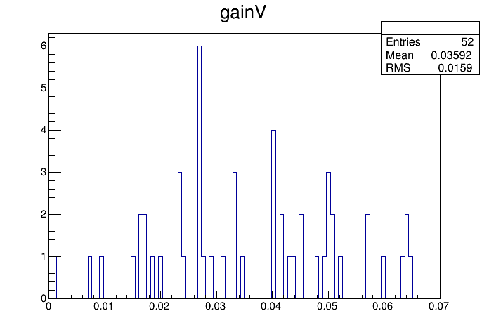
APD grouping
Gain of the 442 APDs,
each at its group average voltage:
Spread of gain (max-min)
in the 52 groups:

Slide 8
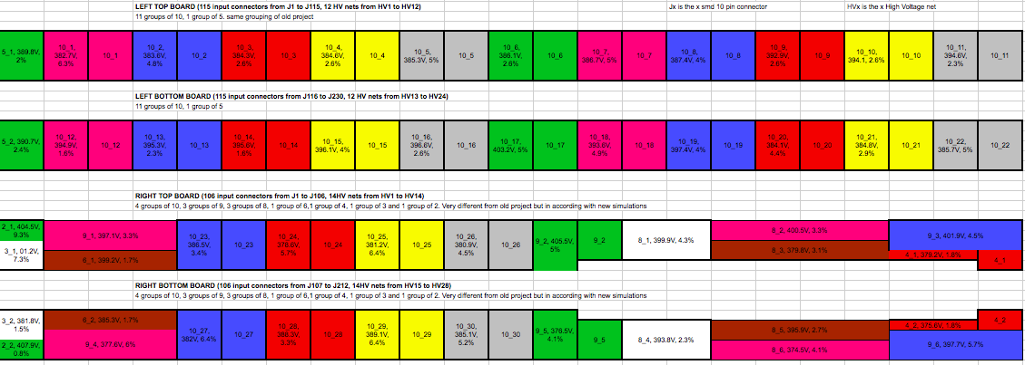
APD grouping
Grouping based on voltage measured for each APD at Gain = 150, T=18°C.
Groups below show the assigned group number, average voltage for the group, and gain variation of the group at this voltage:

Slide 9
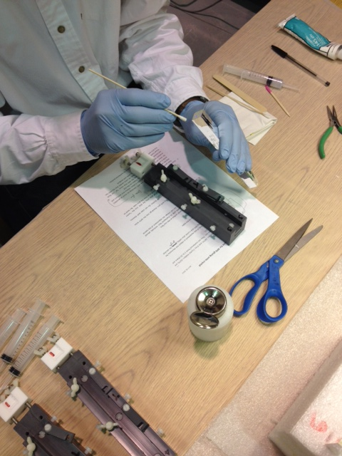
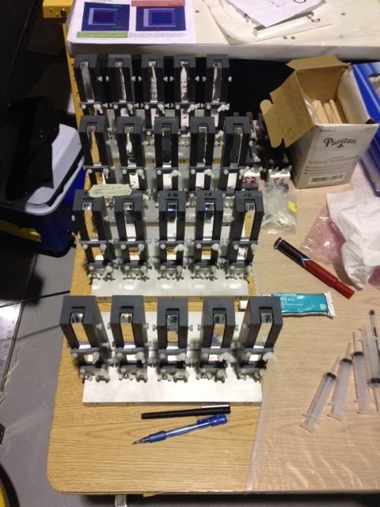
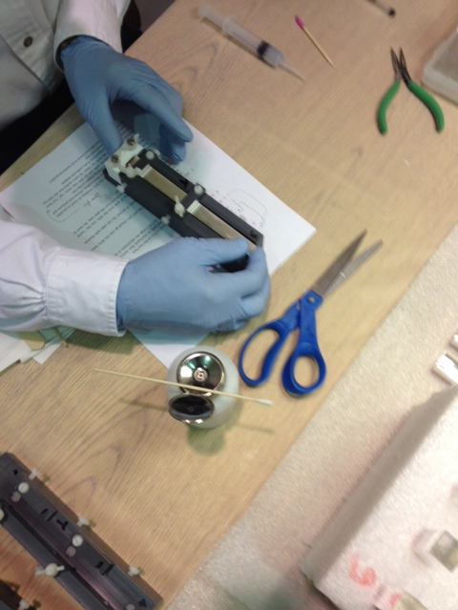
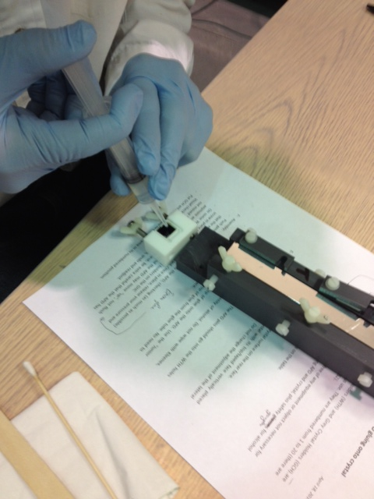
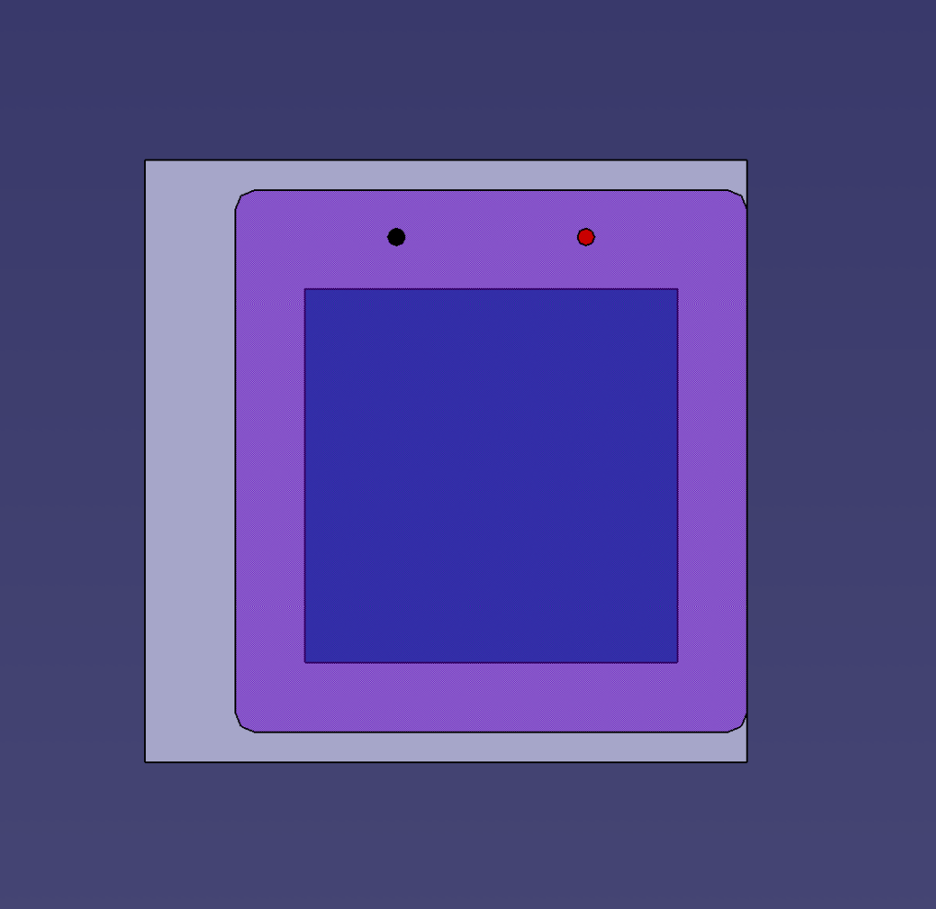
APD gluing
Cleaning crystal
Glue curing overnight
(batch of 20)
Pressing crystal onto the APD
Putting glue on the APD

Slide 10
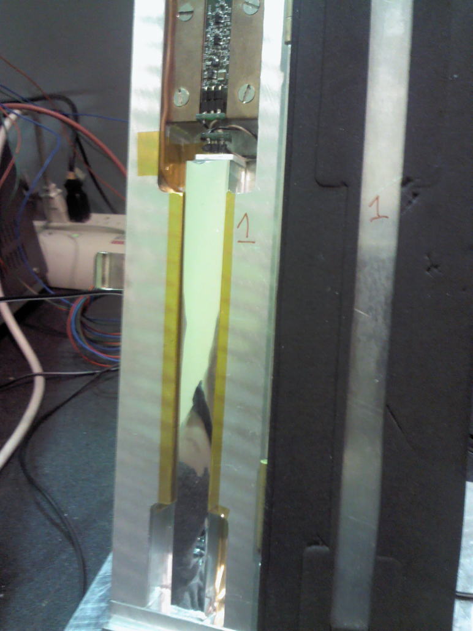
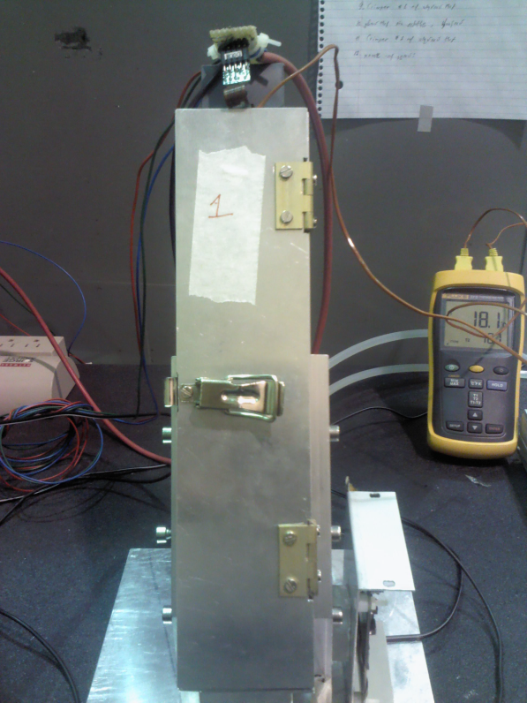
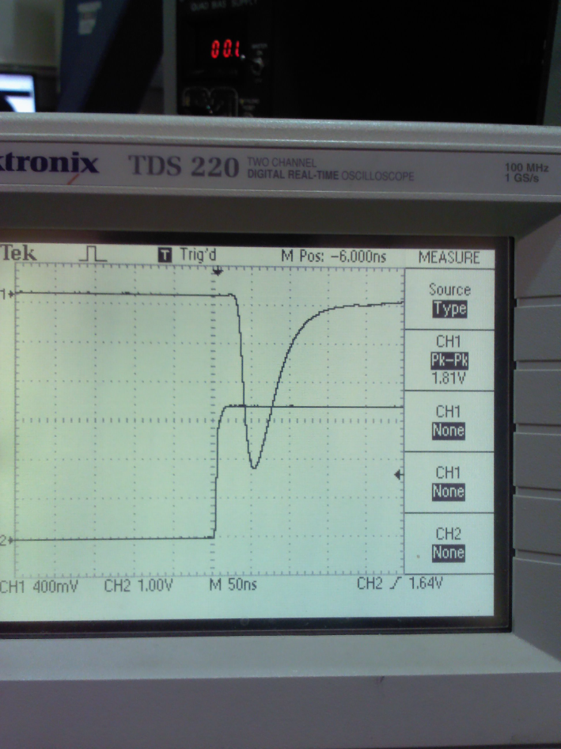
Crystal + APD post-gluing test
Crystal in thermalized box with light injection at the bottom
and preamp on top
Signal amplitude measurement
at set group voltage
Box closed (18°C)

Slide 11
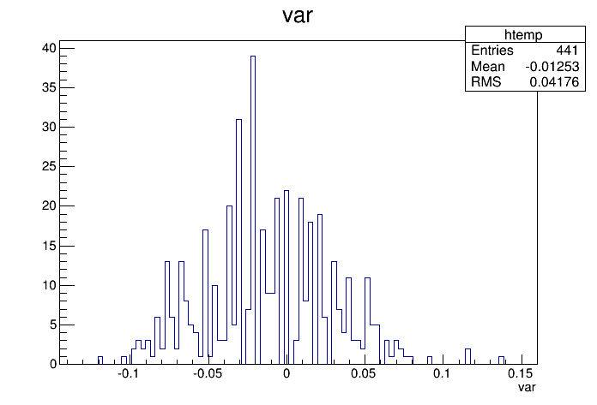
Glue check
Histogram of
(APD_{testing} - APD180)/APD180
Limitations:
HV set within +/- 0.5 V, due to integer read-out.
1V difference on HV corresponds to ~0.06 variation this plot.

Slide 12
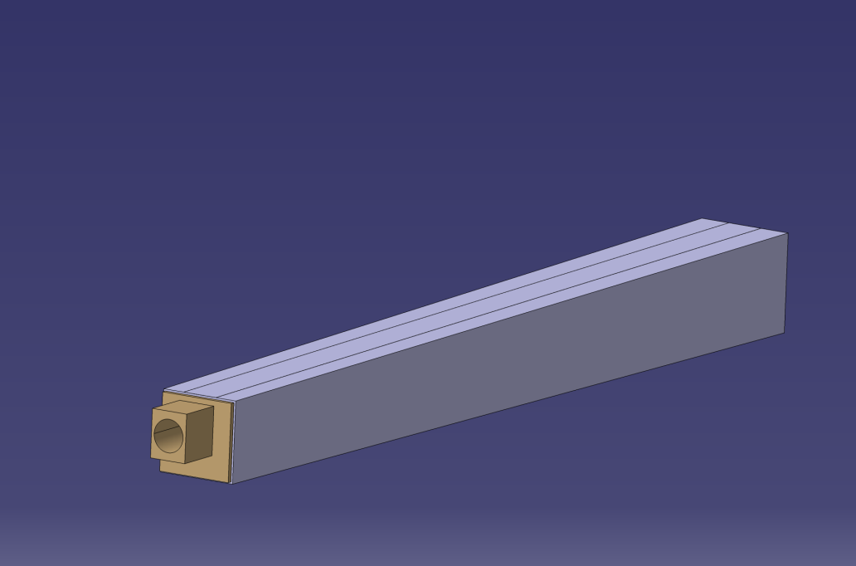
LED holders

Slide 13
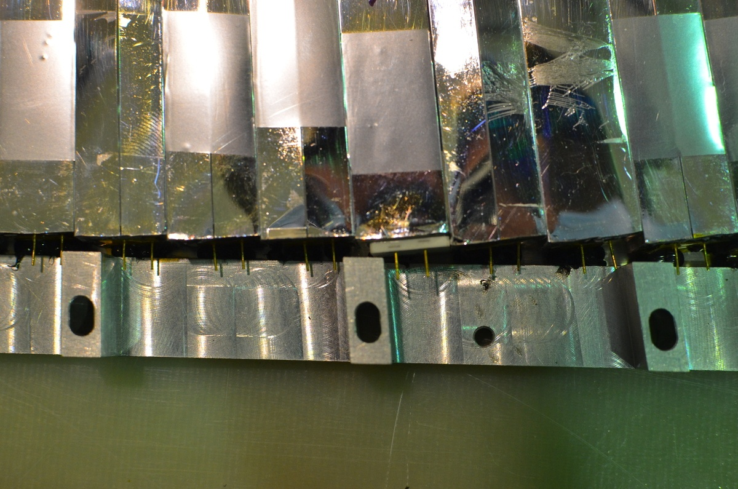
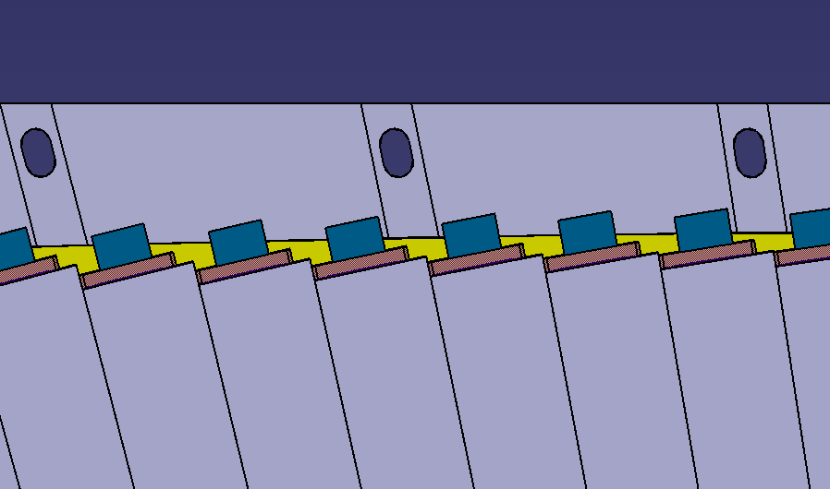
Mounting crystals in frames

Slide 14
Current status
APDs testing – completed (516 tested, 442 selected, 1 broken)
APD grouping for motherboards – completed
Glue new APDs to crystals – completed
Glue check – completed
All crystal wrappings inspected and re-wrapped if needed.
Left to do (this week ??):
Punch holes in VM2002 on LED holders – started, ~ 15% done
Glue LED holders to crystals

