Slide 1
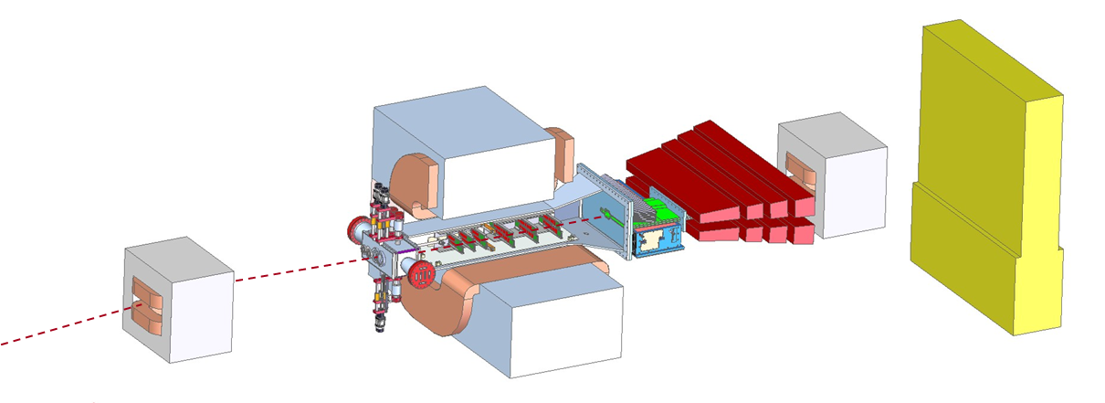
HPS Budget and Schedule
Marco Oriunno, June 18, 2014

Slide 2
Schedule and Manpower

Slide 3
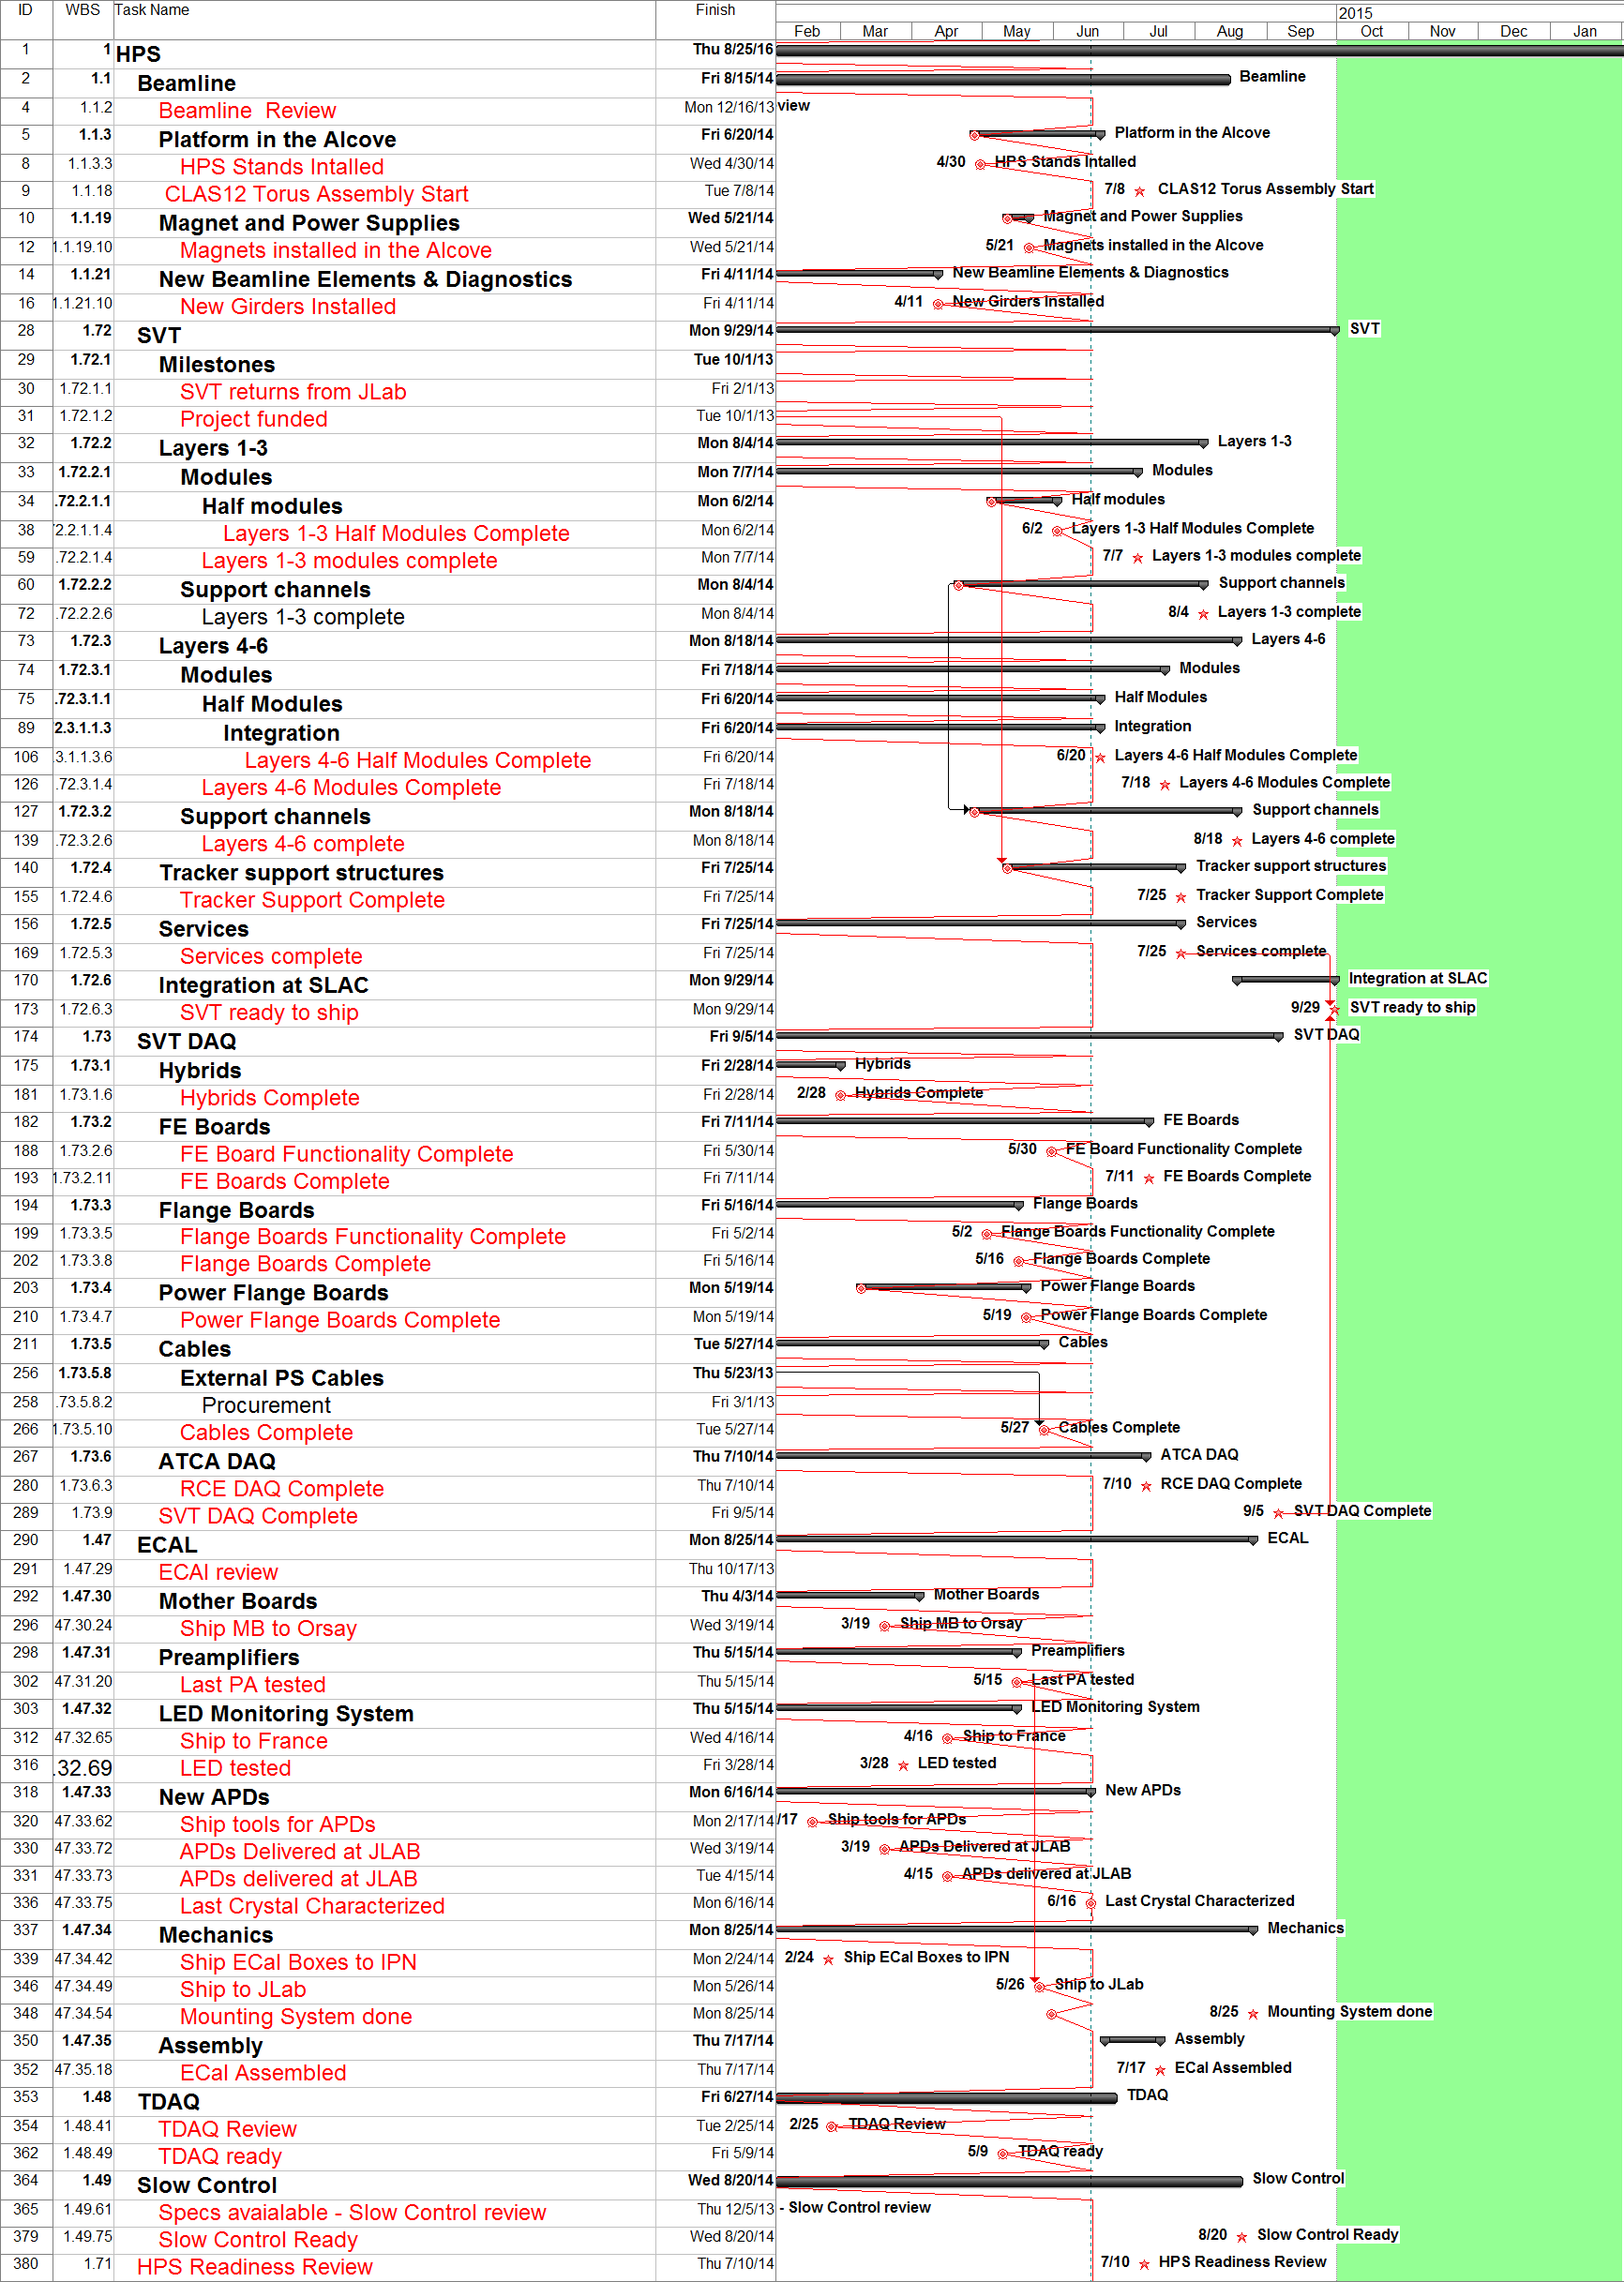
HPS Master Planning V810
Alcove ready: 5/30/2014
On Schedule
SVT Ready to Ship: 9/25/2014
6 weeks delay
ECAL Assembled: 9/22/2014
6 weeks delay
Slow Control ready: 9/30
4 weeks delay
Installation & Commissioning:
From September to November 2014

Slide 4
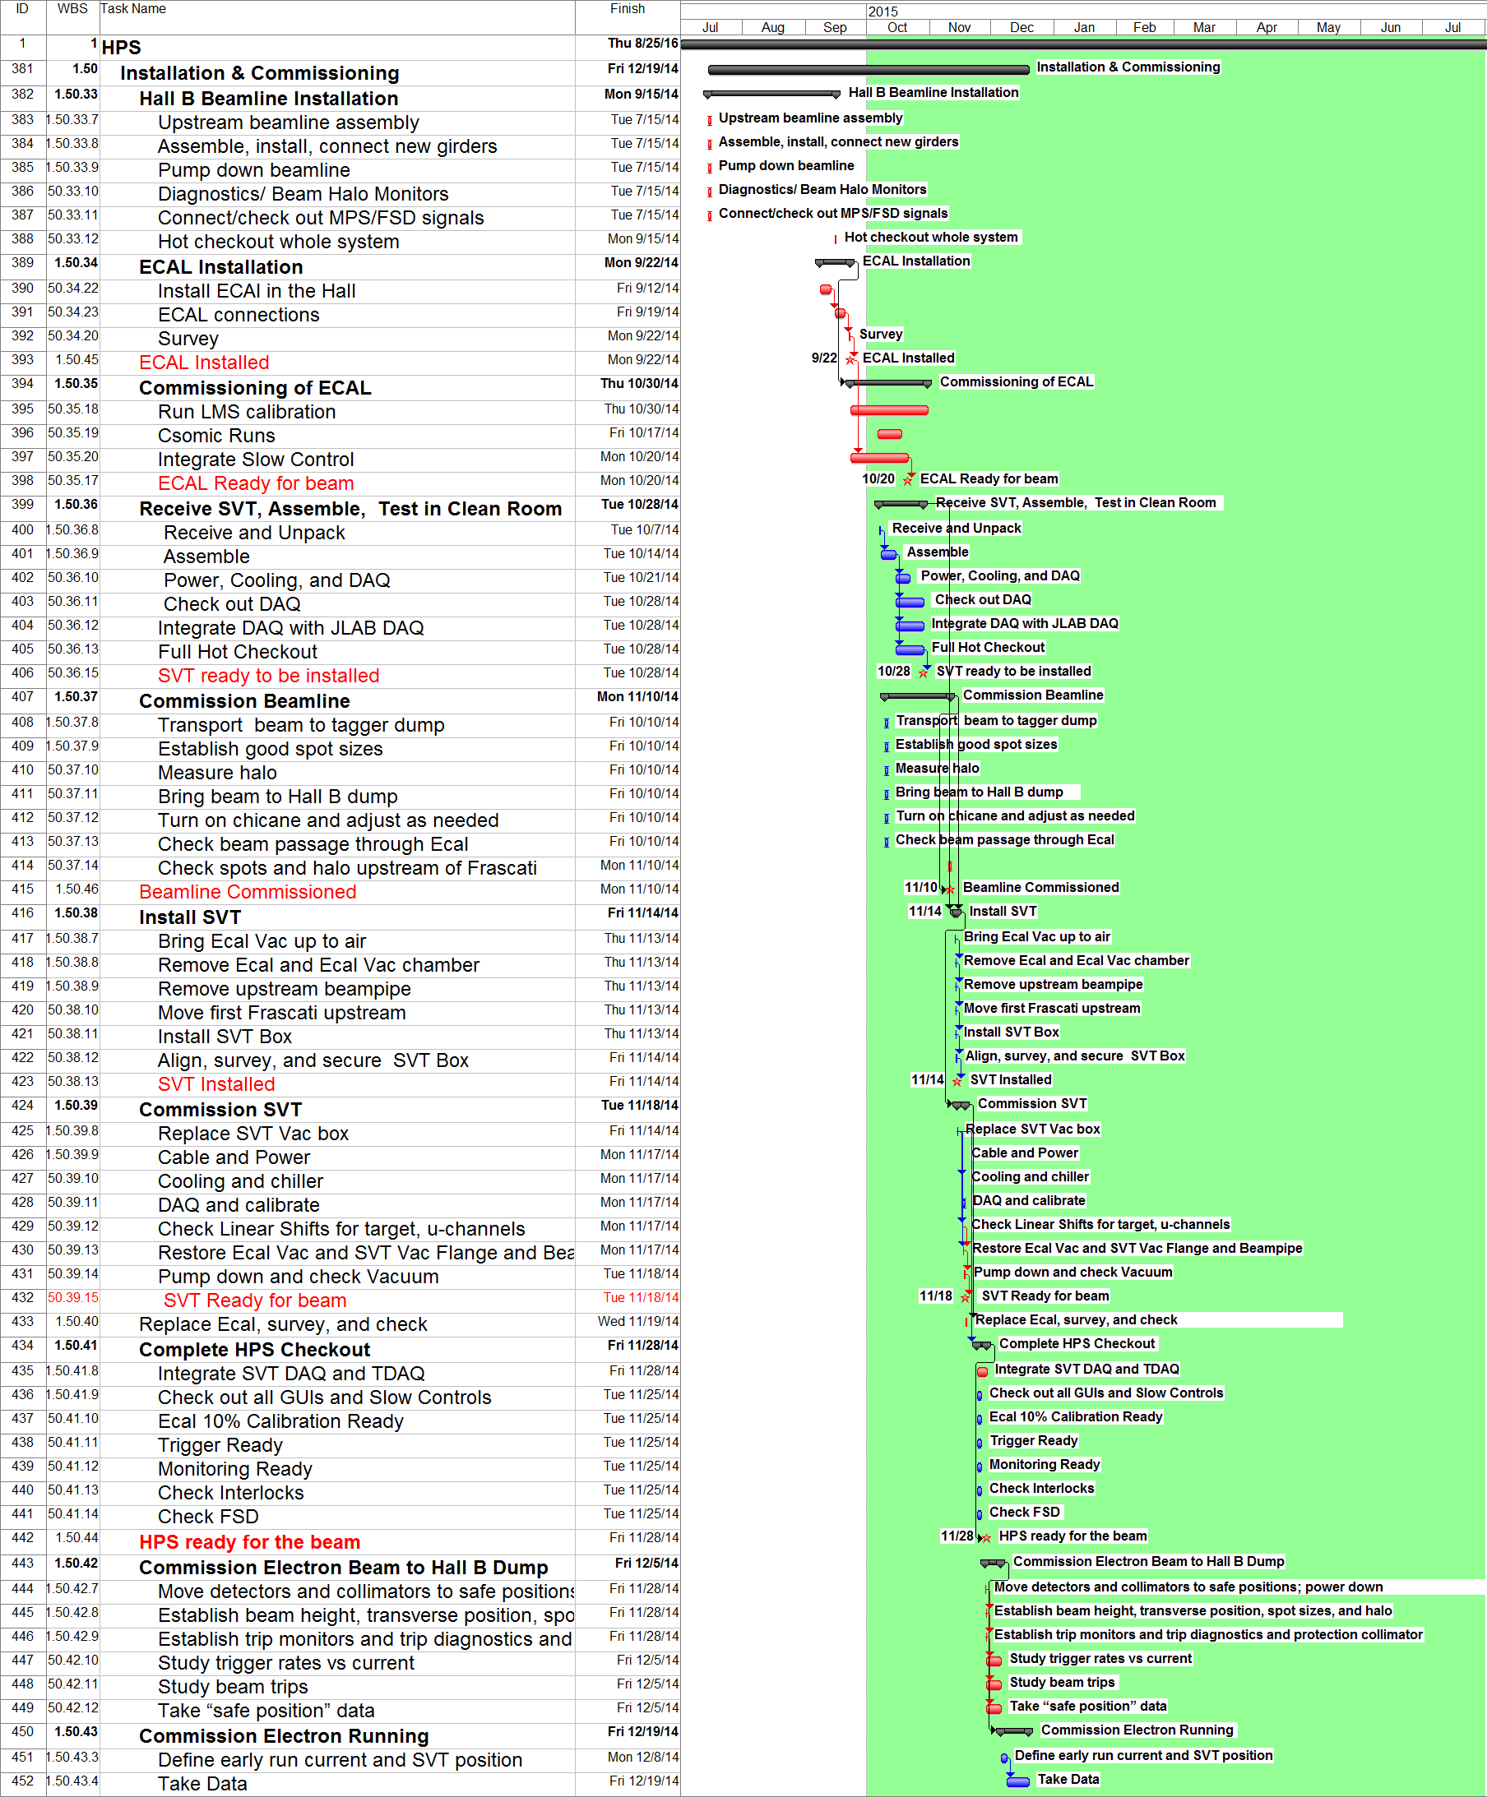
Installation and Commissioning
Complete Beamline
9/15/2014
ECAL Ready for the Beam
10/20/2014
SVT Installed
< 11/14/2014
SVT Ready for the Beam
< 11/18/2014
Engineering Runs
> 12/19/2014

Slide 5
Manpower (Scientific)
 |  | PM | Beamline | SVT | SVT DAQ | ECAL | TDAQ | Slow Control | Software | I&C | FTE
M. Battaglieri | INFN |  |  |  |  | 0.21 |  |  |  | 0.02 | 0.23
A. Celentano | INFN |  |  |  |  | 0.21 |  |  | 0.12 |  | 0.33
Stuart Fegan | INFN |  |  |  |  |  |  |  | 0.3 |  | 0.30
A.D'Angelo | INFN |  |  |  |  | 0.21 |  |  |  |  | 0.21
A.Rizzo | INFN |  |  |  |  | 0.21 |  |  | 0.12 |  | 0.33
L.Colaneri | INFN |  |  |  |  | 0.21 |  |  | 0.52 |  | 0.73
G.Simi | INFN |  |  |  |  |  |  |  | 0.3 |  | 0.30
N.Randazzo | INFN |  |  |  |  | 0.2 |  |  |  |  | 0.20
M.DeNapoli | INFN |  |  |  |  | 0.2 |  |  |  |  | 0.20
R.Devita | INFN |  |  |  |  | 0.1 |  |  | 0.12 |  | 0.22
M.Carpinelli | INFN |  |  |  |  | 0.4 |  |  | 0.1 |  | 0.50
V.Sipala | INFN |  |  |  |  | 0.3 |  |  |  |  | 0.30
M.Osipenko | INFN |  |  |  |  |  |  |  | 0.2 |  | 0.20
S.Aiello | INFN |  |  |  |  | 0.2 |  |  |  |  | 0.20
E.Leonora | INFN |  |  |  |  | 0.2 |  |  |  |  | 0.20
D.Calvo | INFN |  |  |  |  | 0.2 |  |  |  |  | 0.20
A.Filippi | INFN |  |  |  |  |  |  |  | 0.3 |  | 0.30
C.Ventura | INFN |  |  |  |  | 0.2 |  |  |  |  | 0.20
Raphael Dupre | IPNO |  |  |  |  | 0.63 |  |  | 0.08 | 0.02 | 0.74
Gabriel Charles | IPNO |  |  |  |  | 0.50 |  |  | 0.50 |  | 1.00
Stepan Stepanian | JLAB | 0.05 | 0.10 |  |  | 0.10 |  |  |  | 0.10 | 0.35
Arne Freyberg | JLAB |  | 0.05 |  |  |  |  |  |  |  | 0.05
Hovanes Hegiyan | JLAB |  |  |  |  |  |  | 0.21 |  | 0.02 | 0.23
Serguei Boyarinov | JLAB |  |  |  |  |  | 0.25 |  |  |  | 0.25
Maurizio Ungaro | JLAB |  |  |  |  |  |  |  | 0.10 |  | 0.10
FX Girod | JLAB |  | 0.40 |  |  |  |  |  |  |  | 0.40
Yuri Gernstein | Rutgers |  |  |  |  |  |  |  | 0.21 |  | 0.21
Tim Nelson | SLAC |  |  | 0.70 | 0.25 |  |  |  |  | 0.05 | 1.00
Per Hansson | SLAC |  |  | 0.35 | 0.40 |  |  |  | 0.20 | 0.05 | 1.00
Sho Uemura | SLAC |  |  | 0.20 | 0.20 |  |  |  | 0.20 | 0.02 | 0.62
Matt Graham | SLAC |  |  |  |  |  |  |  | 0.50 |  | 0.50
Jeremy McCormick | SLAC |  |  |  |  |  |  |  | 0.20 |  | 0.20
Norman Graf | SLAC |  |  |  |  |  |  |  | 0.50 |  | 0.50
John Jaros | SLAC | 1 |  |  |  |  |  |  |  |  | 1.00
Homer Neal | SLAC |  |  |  |  |  |  |  | 0.08 |  | 0.08
Takashi Maruyama | SLAC |  | 0.40 | 0.35 |  |  |  |  | 0.20 | 0.05 | 1.00
Ken Moffeit | SLAC |  | 1.00 |  |  |  |  |  |  |  | 1.00
Clive Field | SLAC |  | 0.17 |  |  |  |  |  |  |  | 0.17
Vitaliy Fadeyev | UCSC |  |  | 0.12 | 0.04 |  |  |  |  |  | 0.15
Forest McKinney | UCSC |  |  | 0.18 |  |  |  |  |  |  | 0.18
Omar Moreno | UCSC |  |  | 0.13 | 0.15 |  |  |  | 0.21 | 0.02 | 0.51
Kyle McCarthy | UNH |  |  |  |  | 0.25 |  |  | 0.25 |  | 0.50
Maurik Holtrop | UNH |  |  |  |  |  |  |  | 0.21 | 0.02 | 0.23
Annie Simonyan | Yerevan |  |  |  |  |  |  | 0.50 |  |  | 0.50
Nerses Gevorgyan | Yerevan |  |  |  |  |  |  | 0.50 |  |  | 0.50
Holly Szumila-Vance | W&M |  | 0.25 |  |  | 0.50 |  |  | 0.25 |  | 1.00
Total FTE by Subsytem |  | 1.05 | 2.37 | 2.02 | 1.04 | 5.04 | 0.25 | 1.21 | 5.78 | 0.37 | 19.13

Slide 6
New Manpower (Engineering)
Mechanical Engineering |  | PM | Beamline | SVT | SVT DAQ | ECAL | TDAQ | Slow Control | Software | I&C | Total
Marco Oriunno | SLAC | 0.40 | 0.10 | 0.40 |  |  |  |  |  | 0.12 | 1.02
Shawn Osier | SLAC |  |  | 0.71 |  |  |  |  |  |  | 0.71
Matt McCulloch | SLAC |  | 0.02 | 0.60 |  |  |  |  |  |  | 0.62
Bob Connelly | SLAC |  |  | 0.15 |  |  |  |  |  |  | 0.15
Reggie Rogers | SLAC |  |  | 0.15 |  |  |  |  |  |  | 0.15
MD | JLAB |  | 0.46 |  |  |  |  |  |  |  | 0.46
ME | JLAB |  | 0.09 |  |  |  |  |  |  |  | 0.09
ME Accelerator JLAB | JLAB |  | 0.10 |  |  |  |  |  |  |  | 0.10
MT Accelerator JLAB | JLAB |  | 0.70 |  |  |  |  |  |  |  | 0.70
P. Rosier | IPNO |  |  |  |  | 0.04 |  |  |  | 0.02 | 0.06
E. Rindel | IPNO |  |  |  |  | 0.17 |  |  |  | 0.02 | 0.19
F. Pratolongo | INFN |  |  |  |  | 0.13 |  |  |  |  | 0.13
G. Mini | INFN |  |  |  |  | 0.13 |  |  |  |  | 0.13
MT Hall-B | JLAB |  |  |  |  | 0.06 |  |  |  |  | 0.06
Electrical Engineering
Ryan Herbst | SLAC |  |  |  | 0.56 |  |  |  |  | 0.13 | 0.69
Ben Reese | SLAC |  |  |  | 0.85 |  |  |  |  |  | 0.85
Dave Nelson | SLAC |  |  |  | 0.15 |  |  |  |  |  | 0.15
ET SLAC | SLAC |  |  | 0.30 |  |  |  |  |  |  | 0.30
Ben Raydo (EE) | JLAB |  |  |  |  |  | 0.50 |  |  |  | 0.50
EE Hall-B JLAB | JLAB |  | 0.16 |  |  |  |  |  |  | 0.04 | 0.20
ET Hall-B JLAB | JLAB |  | 0.28 |  |  |  |  |  |  | 0.04 | 0.32
CS JLAB |  |  | 0.25 |  |  |  |  |  |  |  | 0.25
EE Accelerator JLAB | JLAB |  |  |  |  |  |  | 0.23 |  |  | 0.23
Emmanuel Rauly | IPNO |  |  |  |  |  |  |  |  | 0.02 | 0.02
 |  |  |  |  |  | 0.13 |  |  |  |  | 0.13
Total FTE by Subsytem |  | 0.40 | 2.16 | 2.31 | 1.56 | 0.52 | 0.50 | 0.23 |  | 0.38 | 8.07
Baseline Manpower, 4.78 FTE

Slide 7
Budget

Slide 8
Beamline Supplemental Funding
 | M&S/Labor | Actual | Budgeted | Difference
Beamline Elements | $51.7k / $137.6k | $189.4k | $134.6k | - $54.8
Alcove Installation | $62.9k / $76.0k | $138.9k | $84.5k | - $54.4
Magnet | $33.3k / $7.5k | $40.8k | $26.6k | - $14.2k
TOTAL | $147.9k / $221.1k | $369.1k | $245.7k | - $123.4k
The missing $125k were requested and agreed by DOEon 4/25, as part of the contingency held by DOE.

Slide 9
JLAB Budget (May 2014)
$271k
$393k

Slide 10
SVT Supplemental Funding
Some delays required an increased Engineering Manpower efforts in order to maintain our ability to install HPS this fall at JLAB.
Discussion started with DOE on 6/12.
Funds Required to Complete Project
Projected Costs | $ 676.6
Balance thru May 31, 2014 | $ 143.3
Net Funds Required | $ 533.2
Funds Requested
Total Contingency Available | $ 384.1

Slide 11
SLAC Budget (May 2014)
$1.17M
$143k

Slide 12
TOTAL (SLAC+JLAB) Budget (May 2014)
$1.44M
$510k

Slide 13
Readiness Review

Slide 14
Readiness Review, Charge
Are the HPS specific equipment, documentation and procedures to run the experiment in place and adequate? This includes demonstrated readiness for full rate capability and expedient analysis of the data.
Are the formal documentation requirements and reporting (run coordinator → shift leaders) procedures for running the experiment adequate, appropriate and complete (COO, ESAD, RSAD, ERG, OSP’s, general equipment operation manuals, etc.)?
Has the entire beamline, target, detector configuration been defined (including ownership, maintenance and control during beam operations)? Is all the necessary equipment installed and operable? If not, what are the completion/commissioning schedule and procedures?
Has transmission of the primary beam and generated secondaries been evaluated for unexpected beam restrictions (e.g. too small of a beam pipe acting as a secondary target), background sources (e.g. large number of produced photons hitting the beam line) or paths (e.g. primary and/or secondary steering from a magnet fringe field)?
Are the radiation levels expected to be generated in the hall acceptable? Is any local shielding required to minimize the effects of radiation in the hall equipment?
Are the local shielding and the machine protection system required to minimize the effects of radiation in the HPS detector in place?
Have all the jobs that need to be done to mount the experiment/s been identified and defined adequately?
Have conflicts with the 12 GeV Upgrade in Hall B been examined and resolved?
Are the responsibilities for carrying out each job identified, and are the manpower and other resources necessary to complete them on time in place?

Slide 15
Installation and Commissioning Schedule at JLAB, Summary Tasks

Slide 16
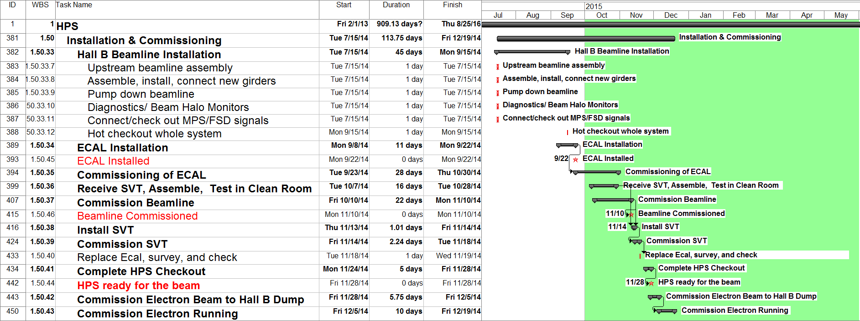
Hall B beamline Installation, 7/15 through 9/15

Slide 17
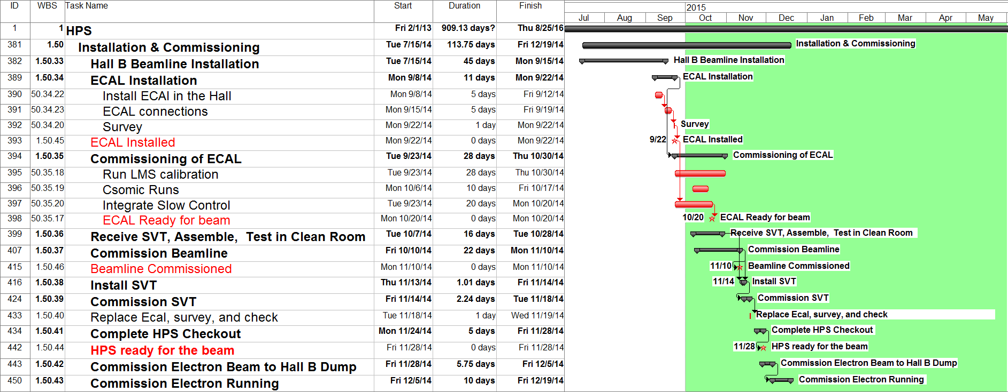
ECAL Installation and Commissioning, 9/8 through 9/22

Slide 18
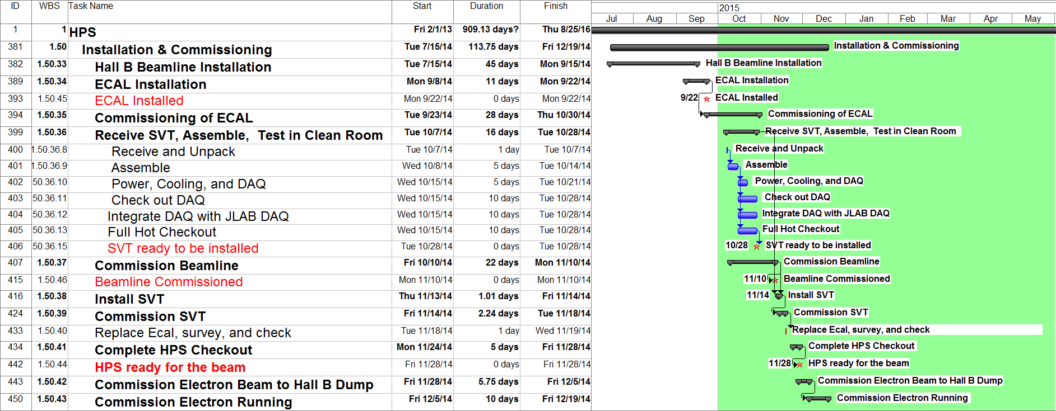
Receive SVT at JLAB, 10/7 through 10/28

Slide 19
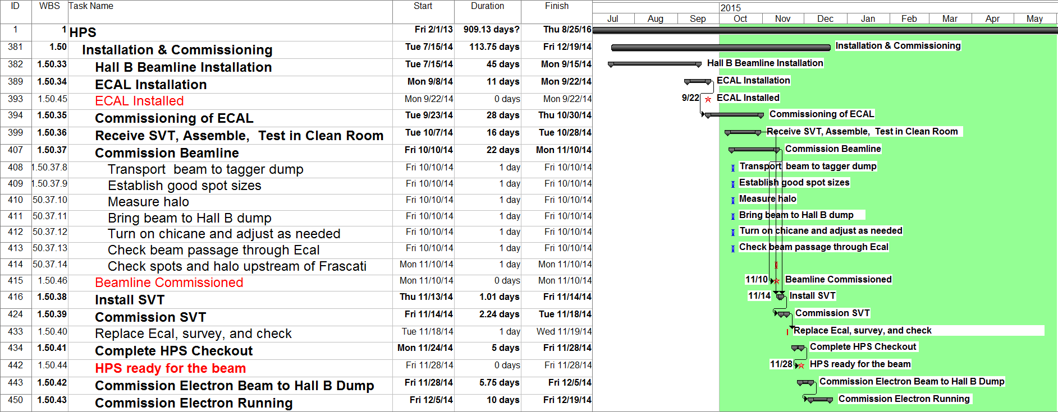
Beamline Commissioning, 10/10 through 11/10

Slide 20
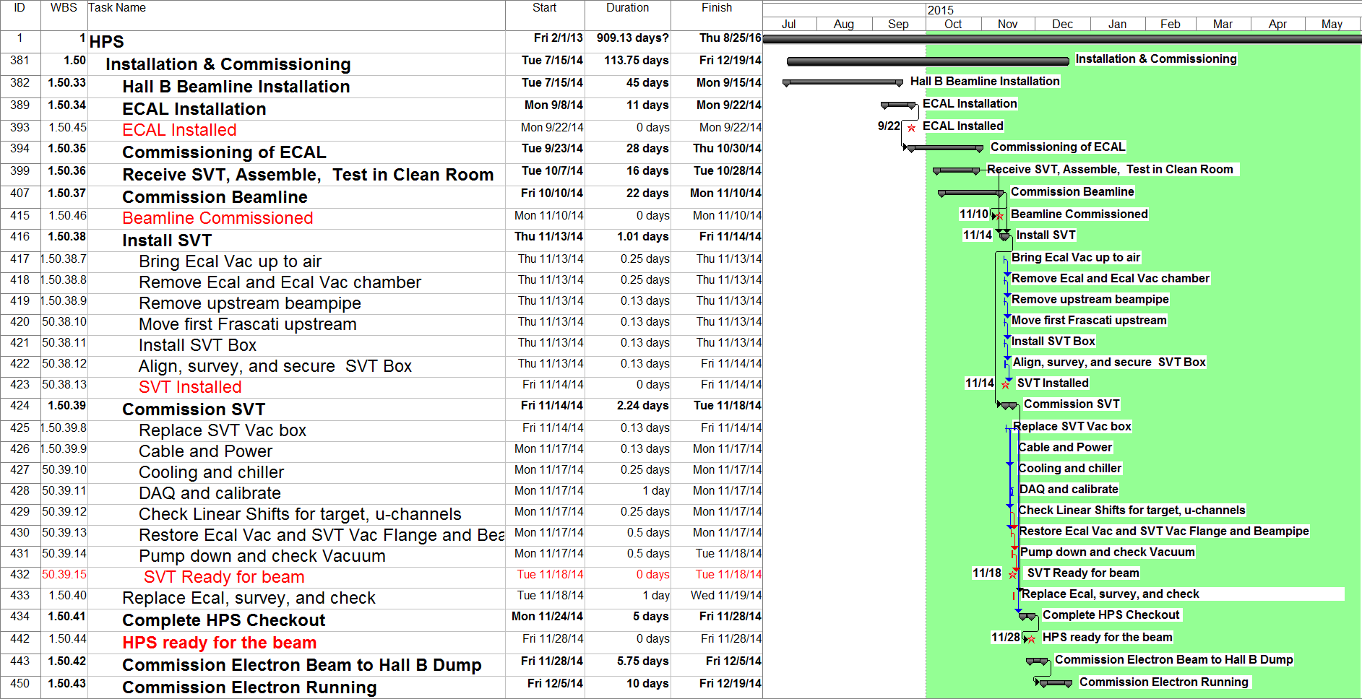
SVT Installation and Commissioning, 11/13 through 11/18

Slide 21
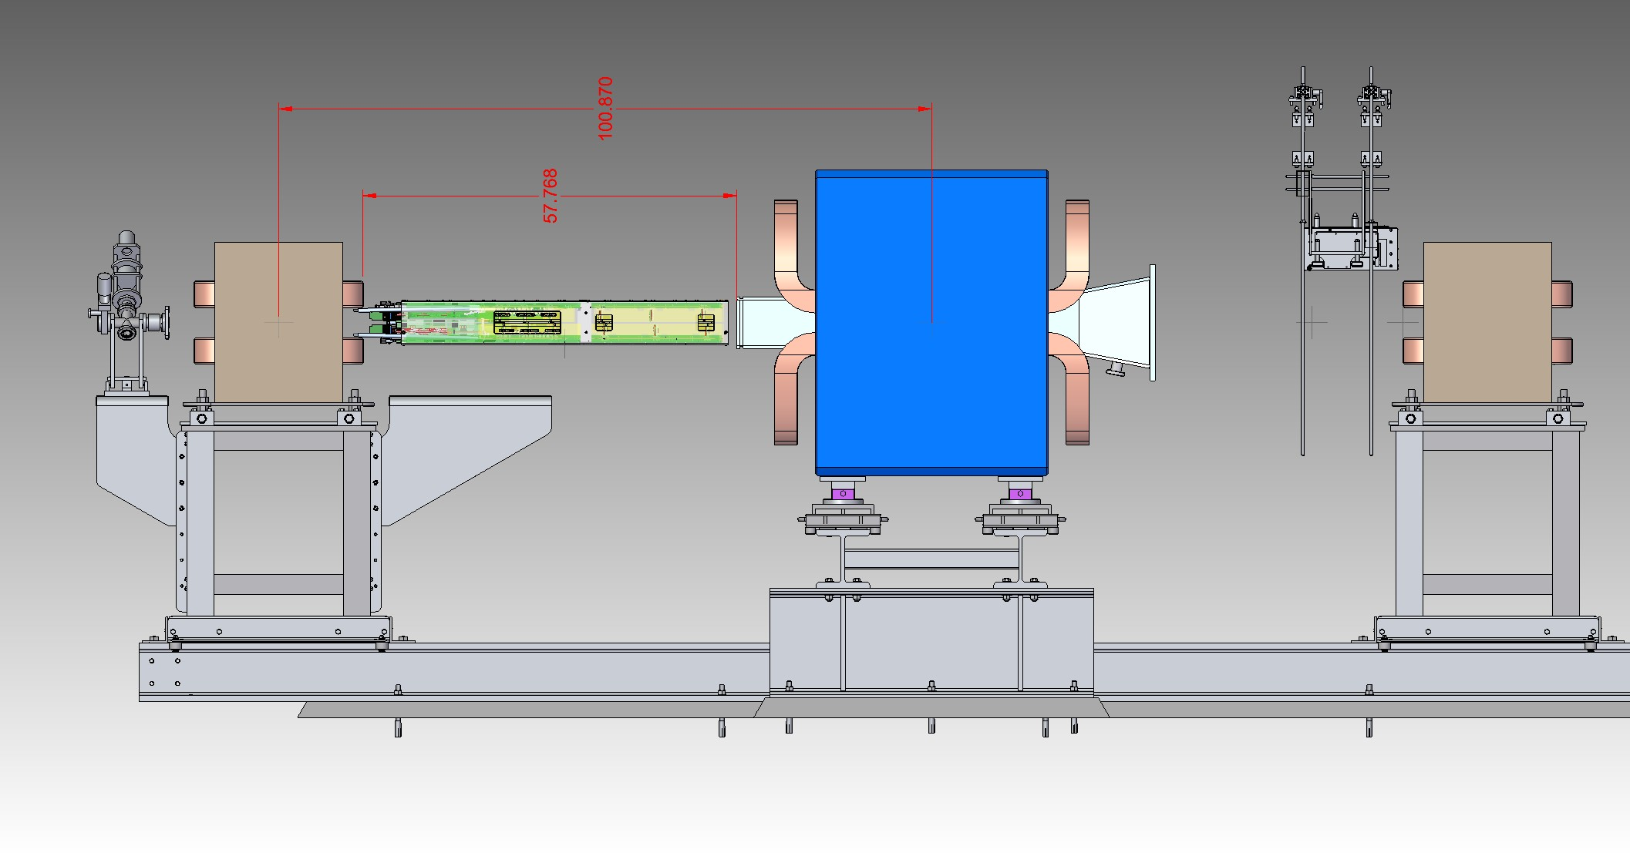
SVT Installation
Move 15” upstream
Run Position: 85”

Slide 22
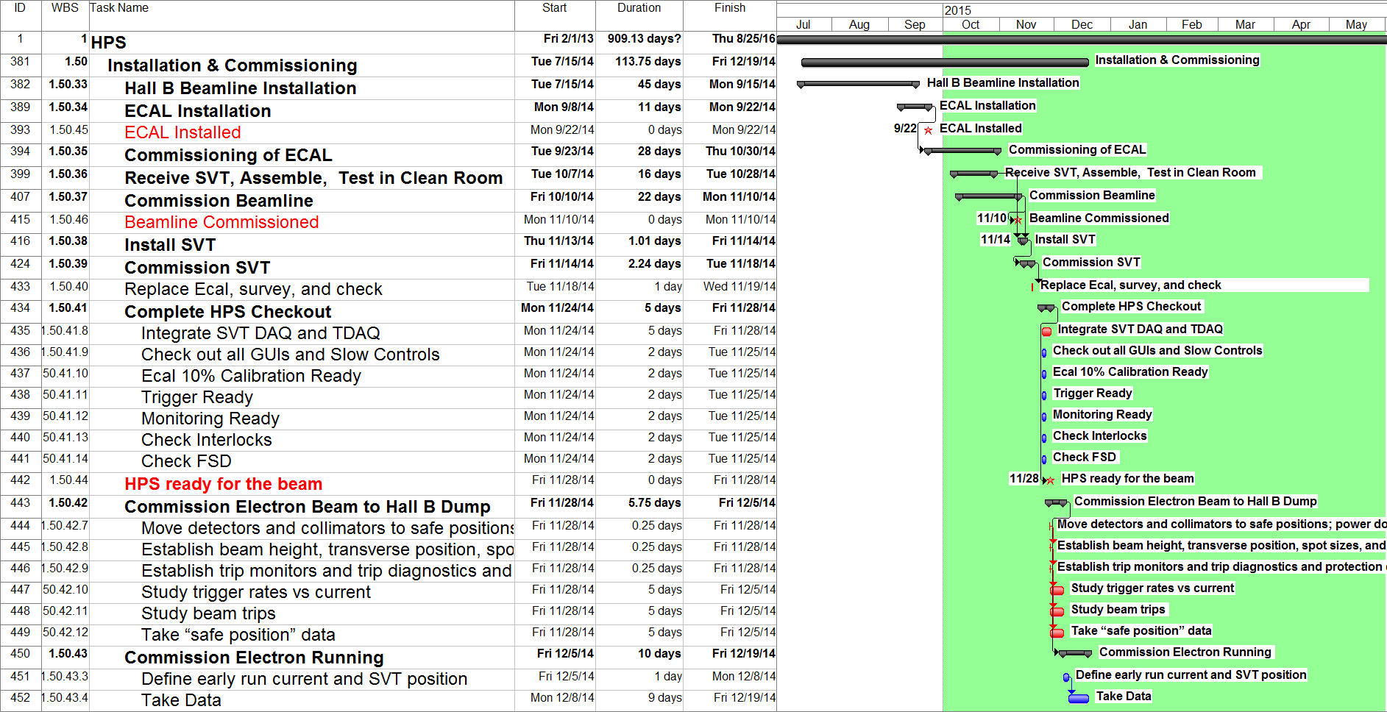
Complete HPS Checkout – Electron Beam commissioning and Running, 11/24 through 12/19

Slide 23
HPS in the Alcove

Slide 24
Potential sonflicts with the 12 GeV Upgrade in Hall B

Slide 25
Manpower (Preliminary)
Mechanical Engineering |  | I&C
Marco Oriunno | SLAC | 0.12 | SVT
Shawn Osier | SLAC
Matt McCulloch | SLAC
Bob Connelly | SLAC
Reggie Rogers | SLAC
MD | JLAB
ME | JLAB
ME Accelerator JLAB | JLAB
MT Accelerator JLAB | JLAB
P. Rosier | IPNO | 0.02 | ECAL
E. Rindel | IPNO | 0.02 | ECAL
Emmanuel Rauly | IPNO |  | 0.02
F. Pratolongo | INFN
G. Mini | INFN
MT Hall-B | JLAB
Electrical Engineering
Ryan Herbst | SLAC | 0.13 | SVT
Ben Reese | SLAC
Dave Nelson | SLAC
ET SLAC | SLAC
Ben Raydo (EE) | JLAB
EE Hall-B JLAB | JLAB | 0.04 | TDAQ, Slow Control
ET Hall-B JLAB | JLAB | 0.04 | TDAQ, Slow Control
CS JLAB
EE Accelerator JLAB | JLAB
Total FTE by Subsytem |  | 0.38
 |  | I&C
M. Battaglieri | INFN | 0.02 | ECAL
A. Celentano | INFN
Stuart Fegan | INFN
A.D'Angelo | INFN
A.Rizzo | INFN
L.Colaneri | INFN
G.Simi | INFN
N.Randazzo | INFN
M.DeNapoli | INFN
R.Devita | INFN
M.Carpinelli | INFN
V.Sipala | INFN
M.Osipenko | INFN
S.Aiello | INFN
E.Leonora | INFN
D.Calvo | INFN
A.Filippi | INFN
C.Ventura | INFN
Raphael Dupre | IPNO | 0.02 | ECAL
Gabriel Charles | IPNO
Michel Garcon | CEA
Stepan Stepanian | JLAB | 0.10 | ECAL
Arne Freyberg | JLAB
Hovanes Hegiyan | JLAB | 0.02 | Slow Control
Serguei Boyarinov | JLAB
Maurizio Ungaro | JLAB
FX Girod | JLAB
Yuri Gernstein | Rutgers
Tim Nelson | SLAC | 0.05 | SVT
Per Hansson | SLAC | 0.05 | SVT
Sho Uemura | SLAC | 0.02 | SVT
Matt Graham | SLAC
Jeremy McCormick | SLAC
Norman Graf | SLAC
John Jaros | SLAC
Homer Neal | SLAC
Takashi Maruyama | SLAC | 0.05 | SVT, Beamline
Ken Moffeit | SLAC
Clive Field | SLAC
Vitaliy Fadeyev | UCSC
Forest McKinney | UCSC
Omar Moreno | UCSC | 0.02 | SVT
Kyle McCarthy | UNH
Maurik Holtrop | UNH | 0.02 | Software
Annie Simonyan | Yerevan
Nerses Gevorgyan | Yerevan
Holly Szumila-Vance | W&M
Total FTE by Subsytem |  | 0.37

Slide 26
Summary
Average delay of 4 weeks for SVT and ECAL
SVT on the Critical Path
Requested in April contingency for Beamline (more labor intensive than expected). Full funded
Started last week discussion with DOE to release contingency fro the SVT (delay and design changes require more Labor)
Refined Installation and Commissioning Schedule, probably sufficient for the Readiness Review.
Need to better estimate the manpower for the Installation and commissioning.

