Slide 1

HPS Experiment Overview
John Jaros
HPS Collaboration Meeting at JLAB
October 26, 2015

Slide 2
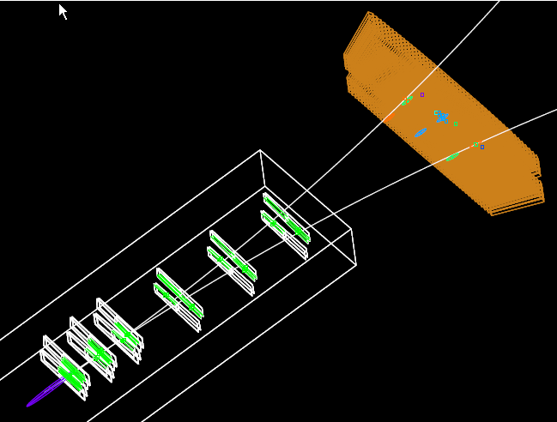
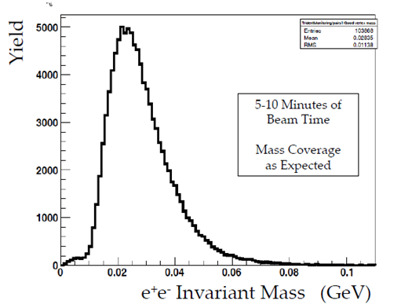
Following Success
HPS Spring Engineering Run was a certifiable success!
* CEBAF delivered stable, small beam
spots with little halo
* all detector systems, trigger and DAQ
worked as designed
* took 1/3 PAC week of data with SVT
at 0.5 mm
Post Engineering Run, a change of focus for HPS:
* Analyze the data! Publish results!
* Prepare for running in FY2016

Slide 3
Outline
Steps to the First HPS Physics Result
Preparing for FY2016 Running
HPS Physics Readiness and Approval
HPS Upgrades
Publishing HPS results
Conclusions

Slide 4
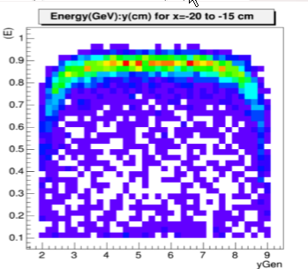
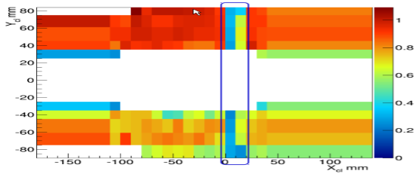
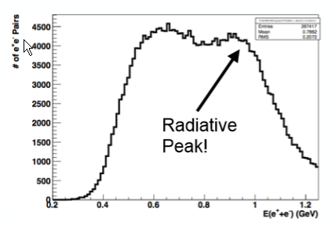
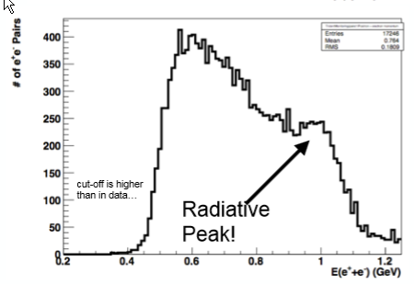
Steps to a Physics Result
Homework was outlined at ORSAY
* Ecal: Survey, Calibrations, Sampling Fraction
* SVT: Tracking Efficiency, Alignment
* Trident Data/MC Shape and Normalization Discrepancies
data
mc

Slide 5
Progress on Many Fronts Since
ECal Calibration
SVT Precision Alignment
Tracking Efficiency Improvements
New Ecal and SVT Reconstruction Code
Processing of Spring Run data

Slide 6
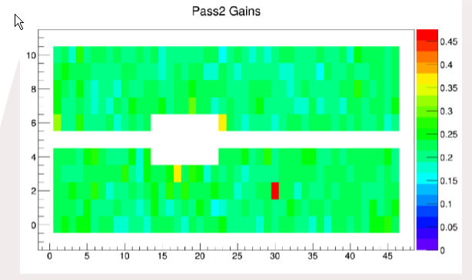
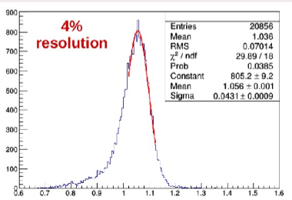
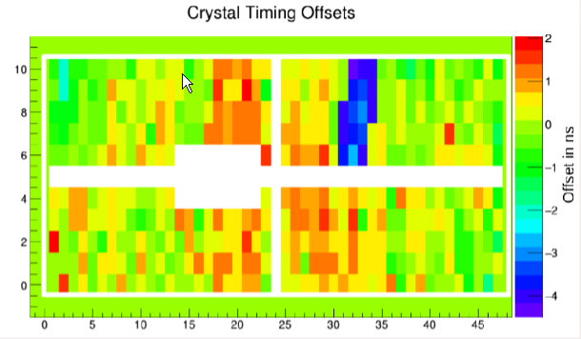
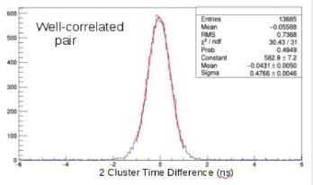
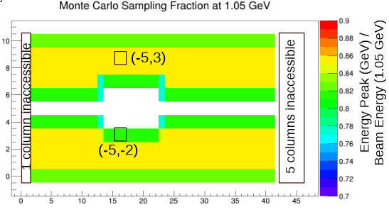
ECal Progress
ECal Calibrated with FEE
Ecal Timing Corrections Implemented
Sampling Fractions Determined
Holly, Luca
Holly, Annie
σ_{t} ~400ps
Holly

Slide 7
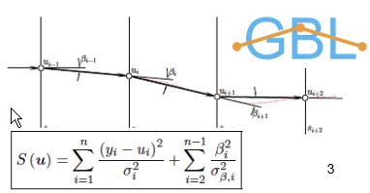
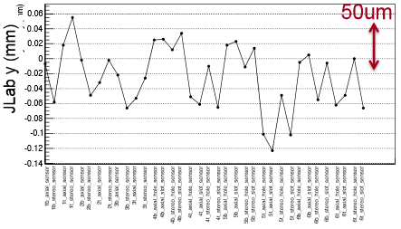
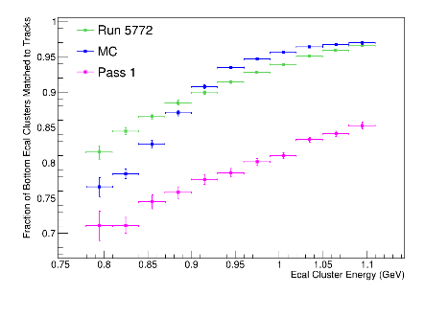
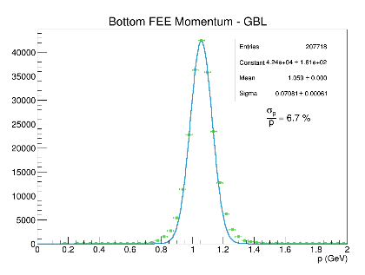
Tracking Progress
GBL Fits improve momentum
resolution and scale
MillePede Alignment has
reduced residuals, improved
χ²’s, and improved resolution
Multi-seed Tracking Strategies and Improved Alignment
give high tracking efficiency and excellent resolution
Pelle
Pelle,
Alesandra
Omar
et al.
FEE track matching
data~MC
⇒ good ε
ε ~ 95%
Δp/p = 6.7%

Slide 8
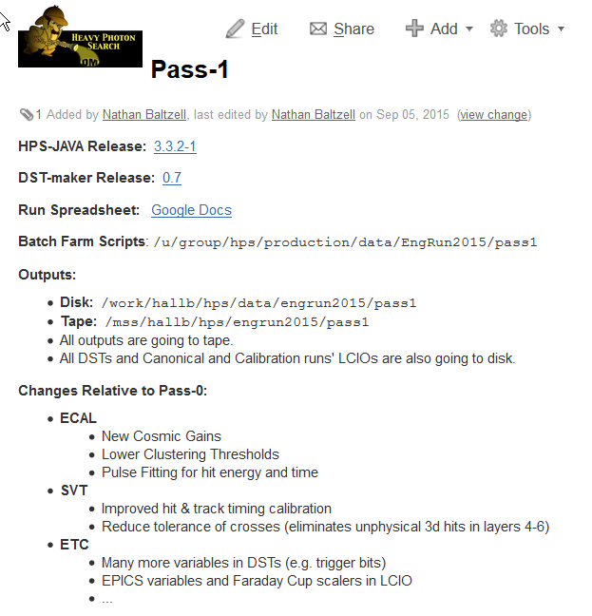
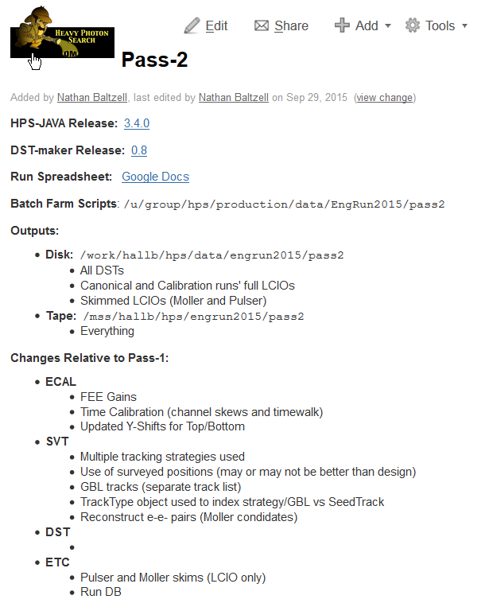
Data Reconstruction and Processing
Matt, Sho, Omar, Nathan,
Holly, Jeremy,…

Slide 9
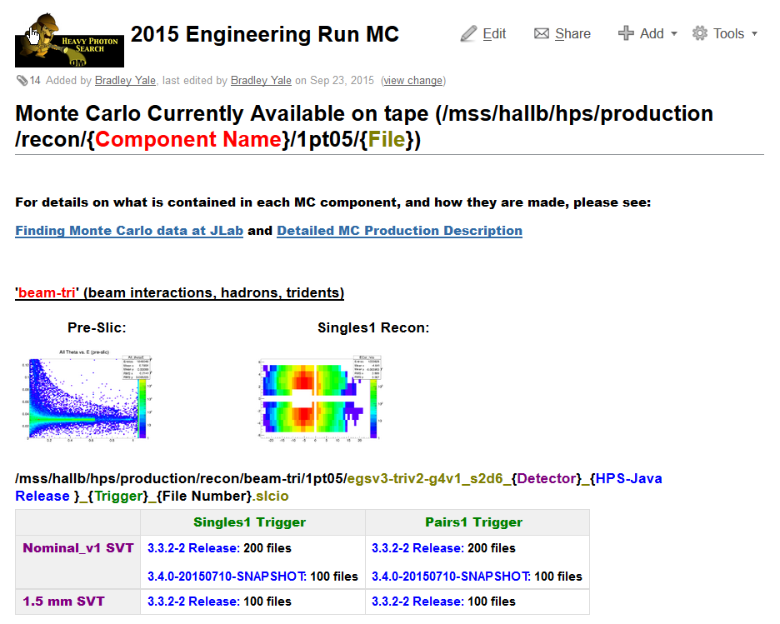
MC Processing
Bradley

Slide 10
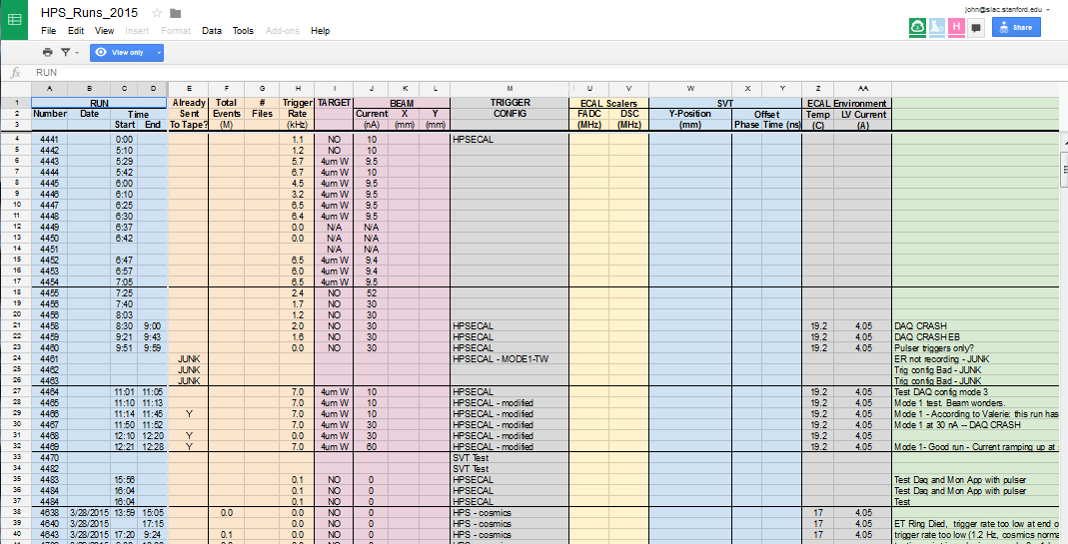
Analysis Aids
Updated DSTs
Skims: FEE, Moller, Pulser, V0
Conditions Data Base
Run Spreadsheet
Software and
Analysis Groups

Slide 11
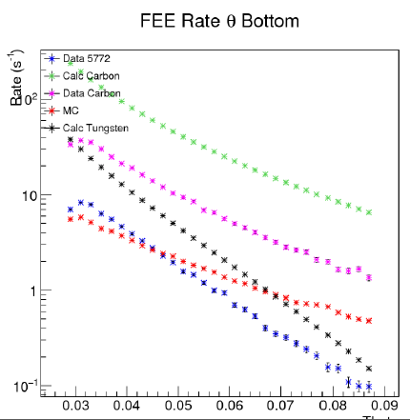
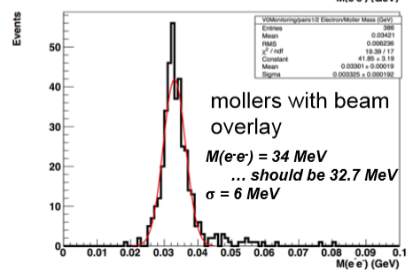
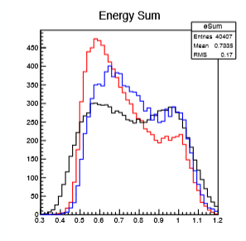
Physics Analyses Under Development
Puzzles Uncovered; Solutions at this Meeting?
Full Energy Electrons
* Cross section?
* Angular distribution?
Mollers
* How do we catch them in the first place?
* Will we still at higher energies?
* How to use them for mass, angle, and energy
calibrations?
Tridents
* Rates agree with MC?
With earlier reach estimates?
* Mass and energy acceptance understood?
* Is Madgraph right? Is our trigger understood?

Slide 12
Preparing for 2016 Running
No Fall 2016 running. No beamline commissioning.
CEBAF 12 schedule has shifted, their worklist is long (including multi-hall running and other Hall B items), and priority rests with the machine.
Experience has taught us that we need a stable machine,
calibrated Hall B diagnostics, and help from the experts to
establish good beams, so this work is prerequisite.
Spring Running Schedule?
Hope to hear from Patrizia…(next)
Once the schedule is finalized…
* EC will work out a detailed commissioning and shift plan
* Shift assignments can begin
* Thesis planning (who will use 2016 data, who will wait)
can proceed

Slide 13
Preparing for 2016 Running
Subgroup Reports will highlight preparations
* Fixes and minor upgrades to software and hardware
* Improving/updating procedures and manuals
* System documentation
* Ideas for further upgrades?
See Stepan’s talk Wednesday:
“Preparation for the Next Run”

Slide 14
HPS Run and Approval Status
Approved on 4/10/14 for 25 PAC day engineering run.
Bob: “… we agree that HPS has sufficiently satisfied the requirements to
remove the C1 conditional approval. With the concurrence of the Lab
Director, Hugh Montgomery, (see below) we will grant HPS full approval for
the engineering run currently envisioned for FY15.”
HPS was not required to submit a Beam Time Request for Jan 2016- June 2017 time period.
Still covered by Engineering Run approval.
We have ~15 PAC days left, enough for Spring 2016
Remember Bob’s Requirement:
“Approval for future running beyond this engineering run will be contingent
on successful demonstrated performance of the HPS apparatus during the
engineering run.”

Slide 15

Physics Readiness Document
Purposes of Document
* Demonstrate that HPS is fully ready to take,
process, and analyze high quality physics data
* Based on demonstrated performance, request
full and unconditional approval for the remainder
of PAC approved request of 180 days.
Outline
* Beamline Performance
* Ecal and Trigger Performance
* SVT and SVT DAQ Status
* Data Taking and Processing
* Tridents

Slide 16
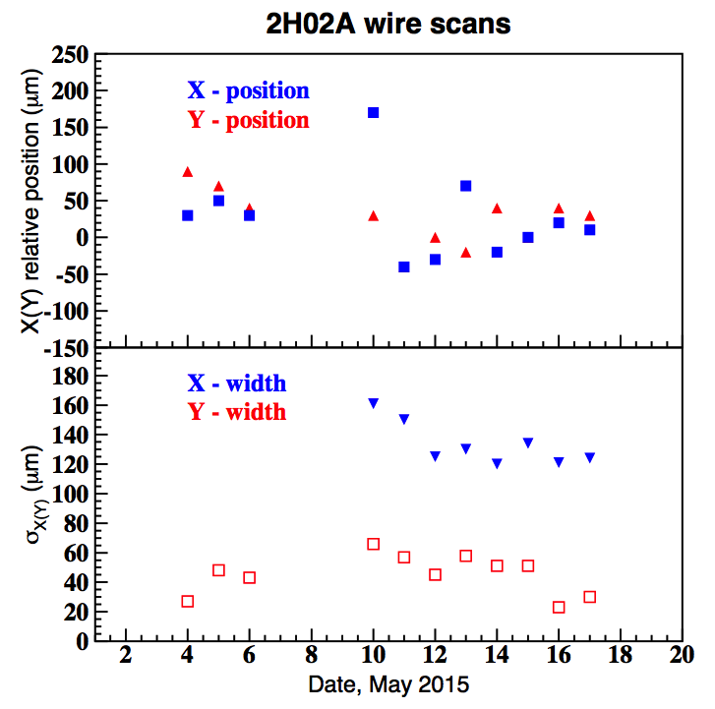
Physics Readiness: Beamline
Small, stable beams with minimal halo delivered to HPS
Beams delivered in < half shift for successful nights/weekends running
Fast Feedback, protection collimator, and Fast Shutdown all worked
Stable running with SVT ½ mm from beams achieved.

Slide 17
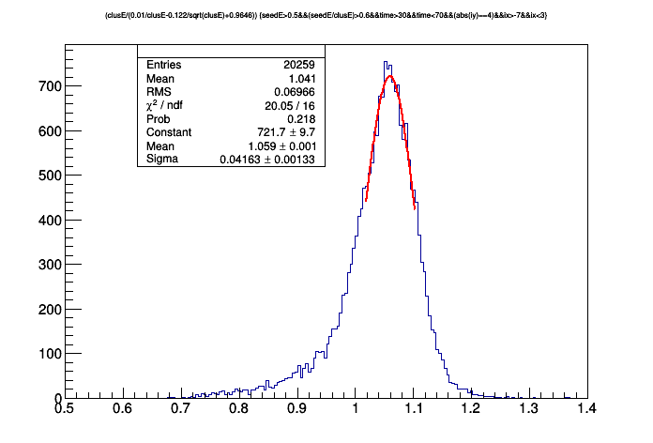
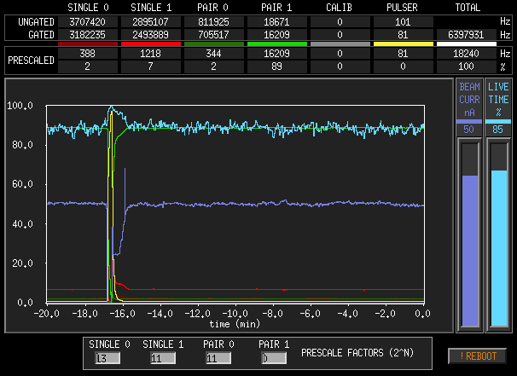
Physics Readiness: Ecal and Trigger
Cosmics calibration provided reliable trigger on day 1
Calibration with FEE gives excellent energy resolution (4%) and timing resolution (<400 ps)
Physics and diagnostic triggers worked. Trigger rates and backgrounds were as expected and manageable

Slide 18
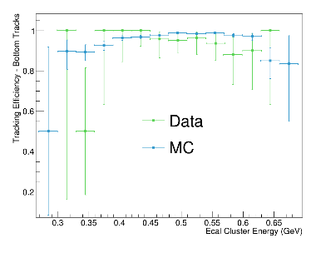
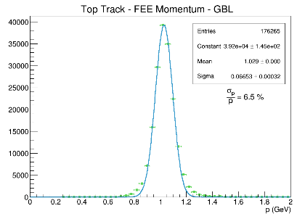
Physics Readiness: SVT and SVT DAQ
One more time:
Stable running ½ mm from beams!
Occupancies and S/N as expected
Tracking is ~ 95% efficient
Hit time resolution ~ 2ns
Momentum resolution and momentum
scale ~ design.
SVT DAQ good to 20 kHz with
10-15% deadtime; improvements coming

Slide 19
Physics Readiness:
Data Taking and Processing
CODA worked well
18 kHz trigger rate
200 MB/s to disk; then 150 MB/s to tape.
10-15% dead time
Detailed online monitoring available in counting house
Experienced shift takers and detector subsystem experts
guaranteed good detector uptime.
Full reconstruction of 10% of data now at Pass 3
Detailed performance studies and physics analysis underway

Slide 20
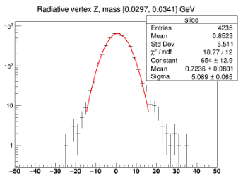
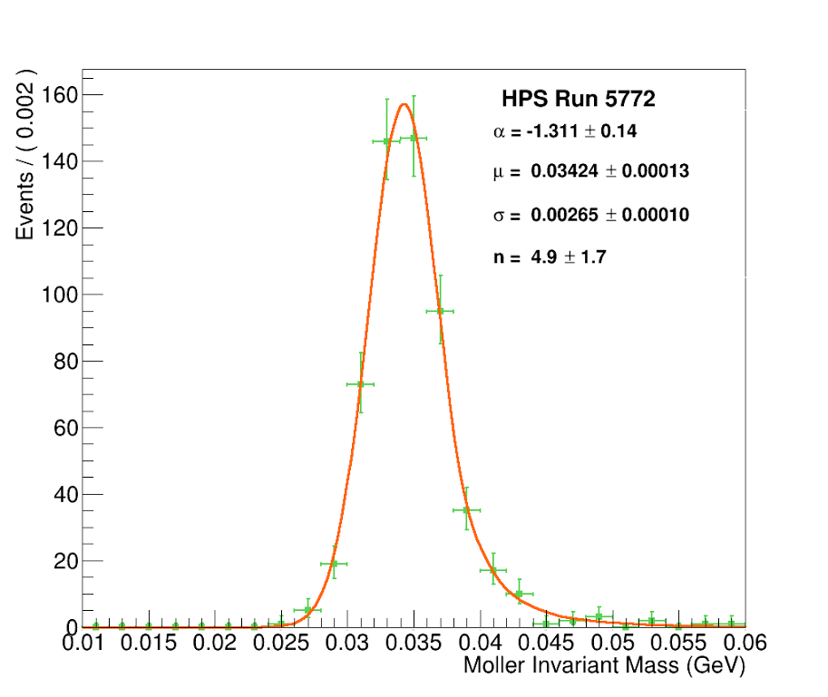
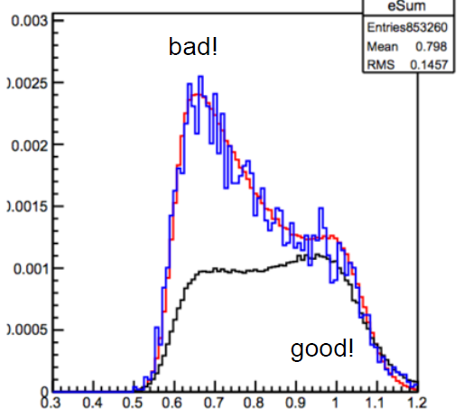
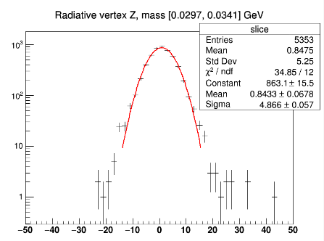
Ready for Physics! Ready for full Approval!
Within
Trident Data >.8 GeV ~ MC Mass Resolution ~ Design Vertex Tails ~ Striking Distance
data
MC
Data
MC

Slide 21
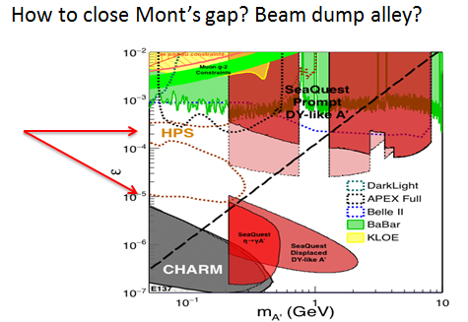
HPS Upgrades
Why consider Upgrades?
* Improve HPS Physics Reach
* There is a Window of Opportunity for funding/construction
during CLAS completion and commissioning in FY2017
* Good training for new graduate students (and the rest of us)
Standing Offer
* Free pizza and beer
for good proposals!
Discuss on Wednesday

Slide 22
HPS Publishing Goals
Top priority: Physics Results from the Engineering Run ASAP
Ready for APS April Meeting in Salt Lake City, April 16-19, 2016?
Hot seat: Analysis Group Leaders
Next: Technical description of HPS subsystems SOON
Ready for Spring HPS Meeting, April 25-27, 2016 ?
Hot seats: Beamline, Ecal, SVT/SVT DAQ, Trigger/DAQ
Sub-Group Leaders
Technical description of HPS Engineering Run Detector
Ready by Summer 2016?
Hot seat: Who will be Pelle’?
HPS has done a remarkable job, and promises more of the same.
But it doesn’t count until it’s in print!

Slide 23
HPS Publishing Prerequisites
Ensure latest HPS results are visible to Collaboration Members only.
HPS must discuss and develop the rules for unblinding.
This policy must be approved by the EC and made known to the Collaboration well in advance of actual unblinding.
Abide by Collaboration Bylaws on presentation of new results.
PPC must approve 2 weeks in advance of talk.

Slide 24
Conclusions
HPS has moved from commissioning and data taking to data analysis.
Great progress in calibration, alignment, reconstruction, and data processing have HPS on track for its first physics result.
With input from the lab, HPS is ready to prepare for 2016 running.
HPS has demonstrated physics readiness. Once documented, HPS should be granted unconditional approval for its full PAC allotment.
The future HPS running schedule provides us an opportunity to upgrade our experiment, and cover even more parameter space.
Worthy Goal: First HPS Physics Paper Next Spring!

