Slide 1

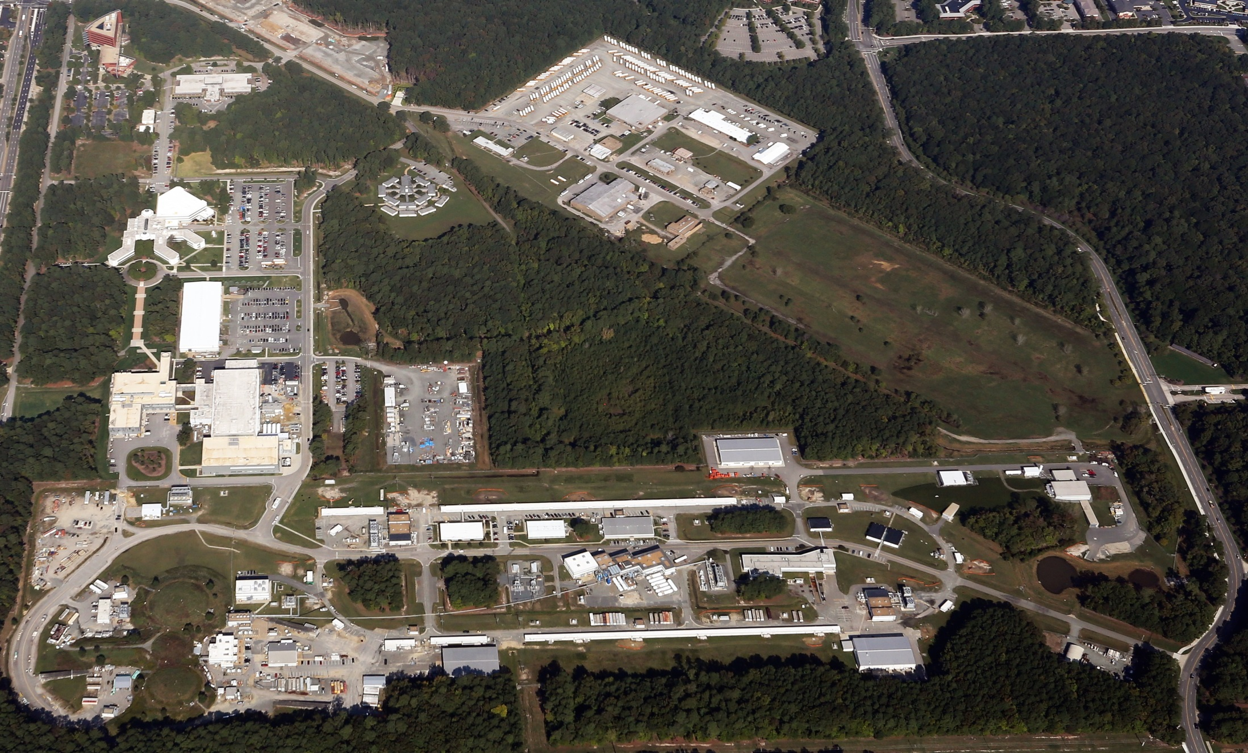
Update from JLab
Patrizia Rossi
October 26, 2015

Slide 2
Outline
12 GeV Upgrade: where we are
PAC
Budget
Experimental Schedule FY16-17
NSAC Long Range Plan
Jefferson Lab EIC (JLEIC)
Outlook

Slide 3
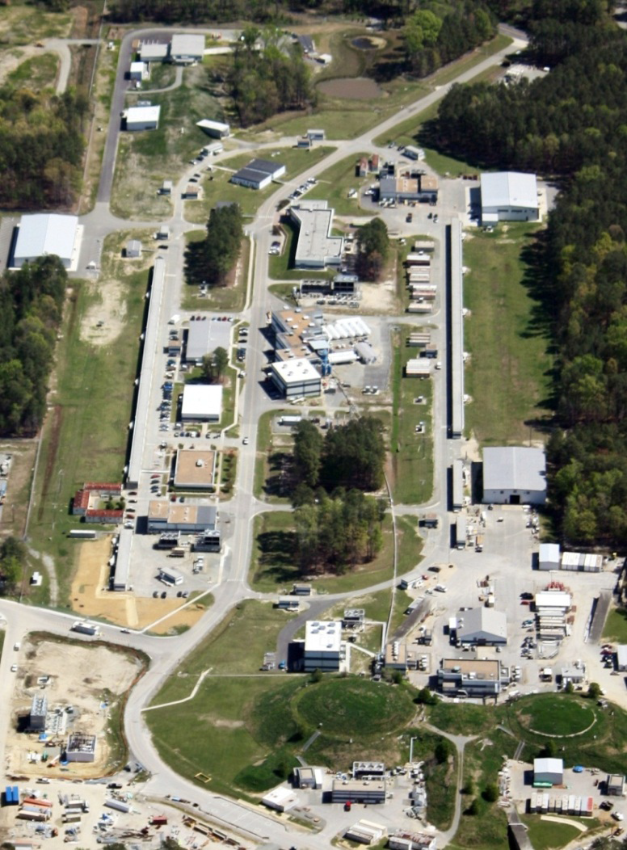
12 GeV Upgrade Project
Upgrade is designed to build on existing facility: vast majority of accelerator and experimental equipment have continued use.
Maintain capability to deliver lower pass beam energies: 2.2, 4.4, 6.6….
New Hall
D
Upgrade arc magnets
& supplies
Add 5 cryomodules
20 cryomodules
CHL upgrade
Add arc
20 cryomodules
Add 5 cryomodules
TPC = $338M
ETC = ~$15M
Enhanced capabilities
in existing Halls
Project Scope (~96% complete):
Doubling the accelerator beam energy - DONE
New experimental Hall D and beam line - DONE
Civil construction including Utilities - 99.9%
Upgrades to Experimental Halls B & C - ~91%
A
B
C

Slide 4
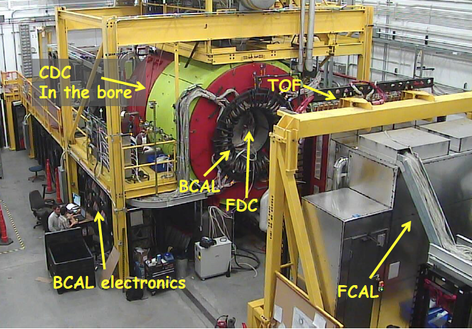
Hall D Status
  Fall 2014
  (~19 days)
  10.1 GeV
  amorphouse radiator
  CH₂ target
KPP achieved – December 2014
  Spring 2015
  (~10 days)
  5.5 GeV
  Diamond
  CH₂ target
  Finishing calibrations
  Physics signals
  GlueX Solenoid: Operational Review in July 2015
  Finding (credit to S. St.Lorant): difference between the SLAC and JLab cooling schemes
Modification to the cooling system (plan discussed with local experts & the reviewers
Decision to do the modifications now, to be finished before the Spring 2016 run
Work is in progress

Slide 5
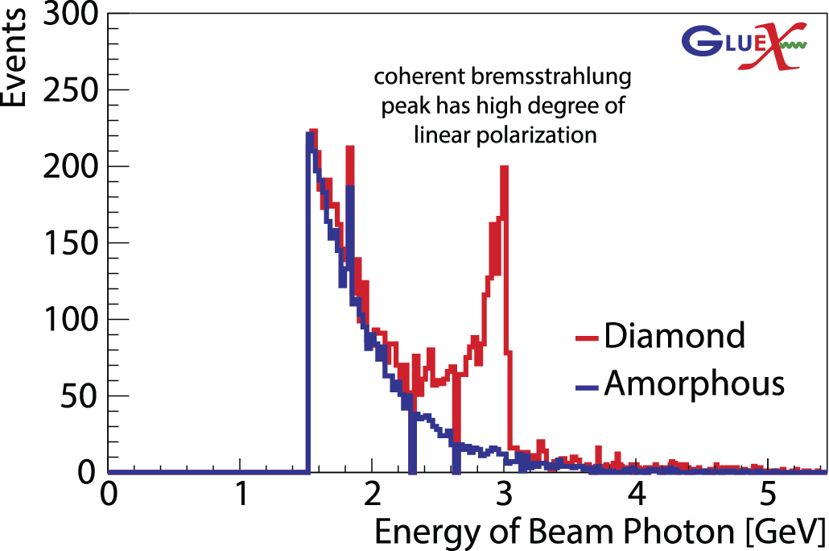
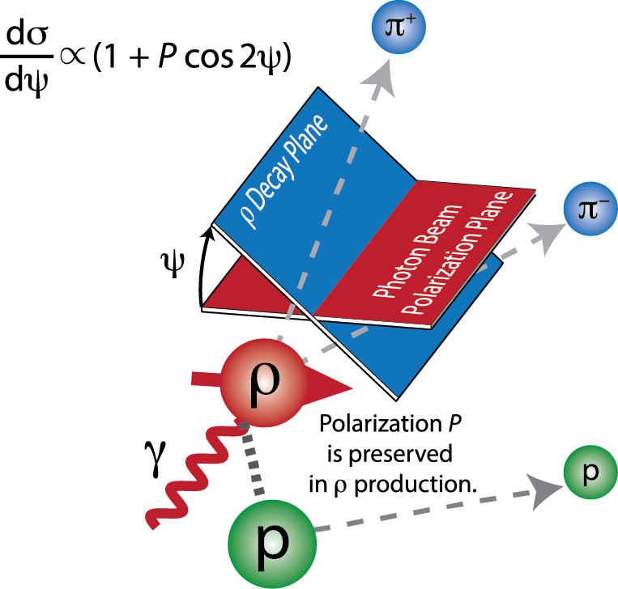
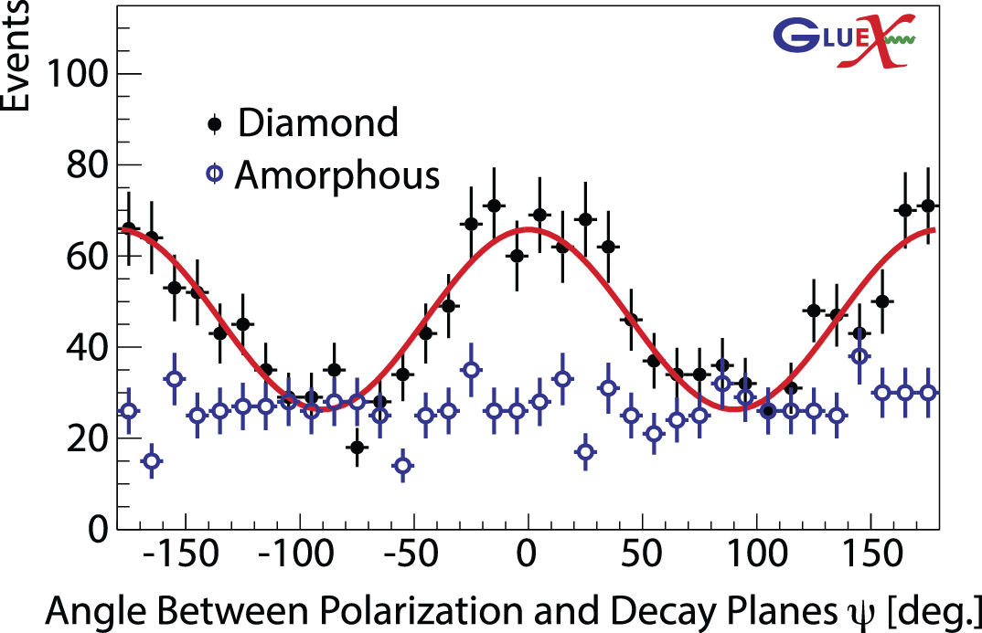
Polarization Transfer to the ρ
P=Linear Polarization
Σ=Beam Asymmetry~1.0
Only a few hours of beamtime
Fast turnaround: 2 days after run!
Comparable to previous world data
Preparing analysis towards paper

Slide 6
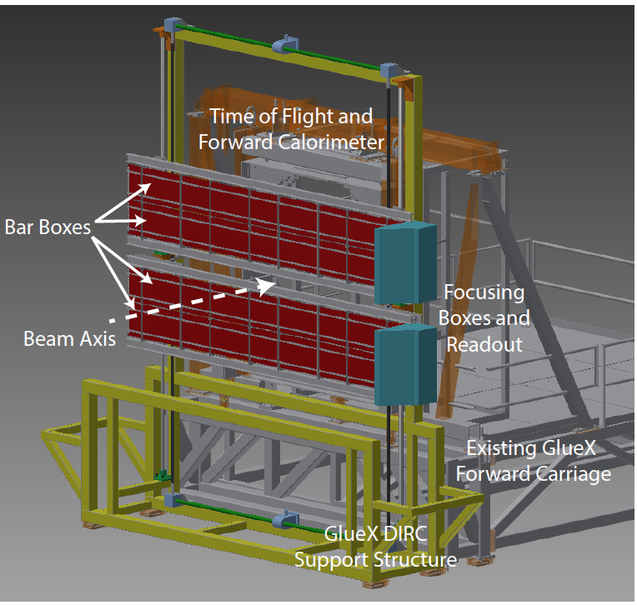
Hall D: Forward Kaon Identification
Four of the BaBar DIRC bar boxes will be installed in front of the TOF wall.
This combined with the other PID systems in GlueX will allow us to fully study final states with strange quarks.
Strangeonium mesons and hybrids can be studied.
Hyperon and cascade baryons can be studied.
Expected late 2017/ 2018
Physics Division-led Review with DOE in attendance on 10/14
Very positive response from the committee
The Project Management Plan is being finalized (cost, schedule, milestones,..)

Slide 7
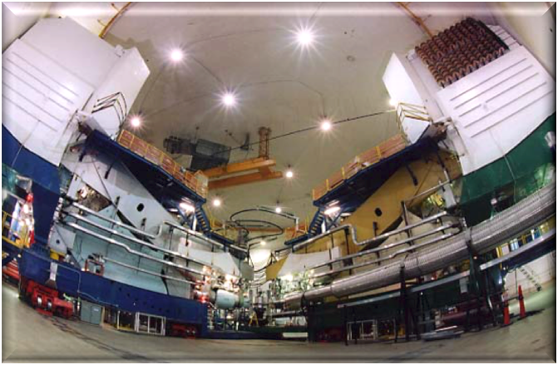
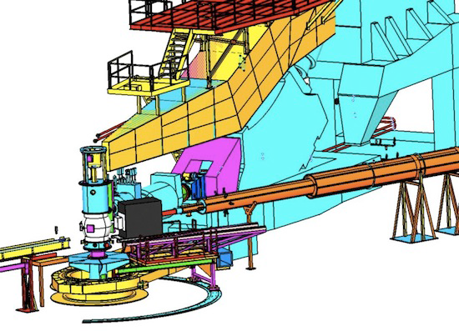
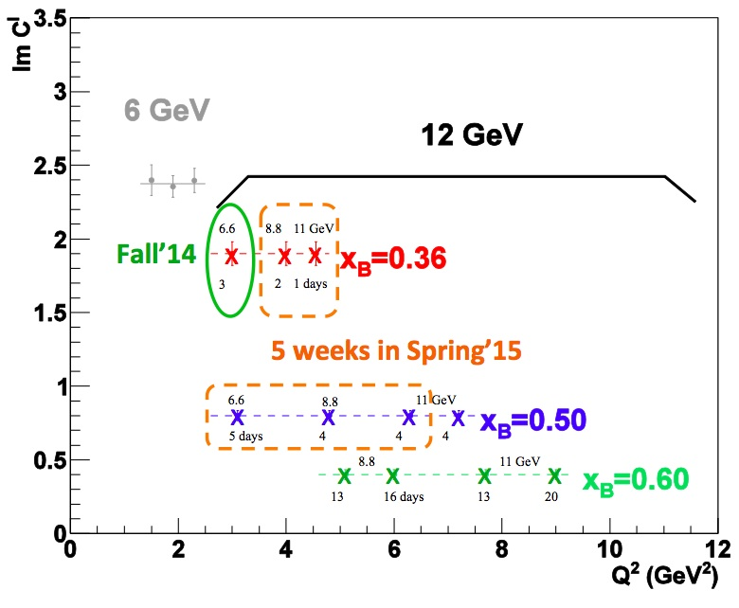
DVCS in Hall A at 11 GeV
HRS_{L}
  Scaling test of the DVCS cross section
208 PbF2 blocks
now ’16
7

Slide 8
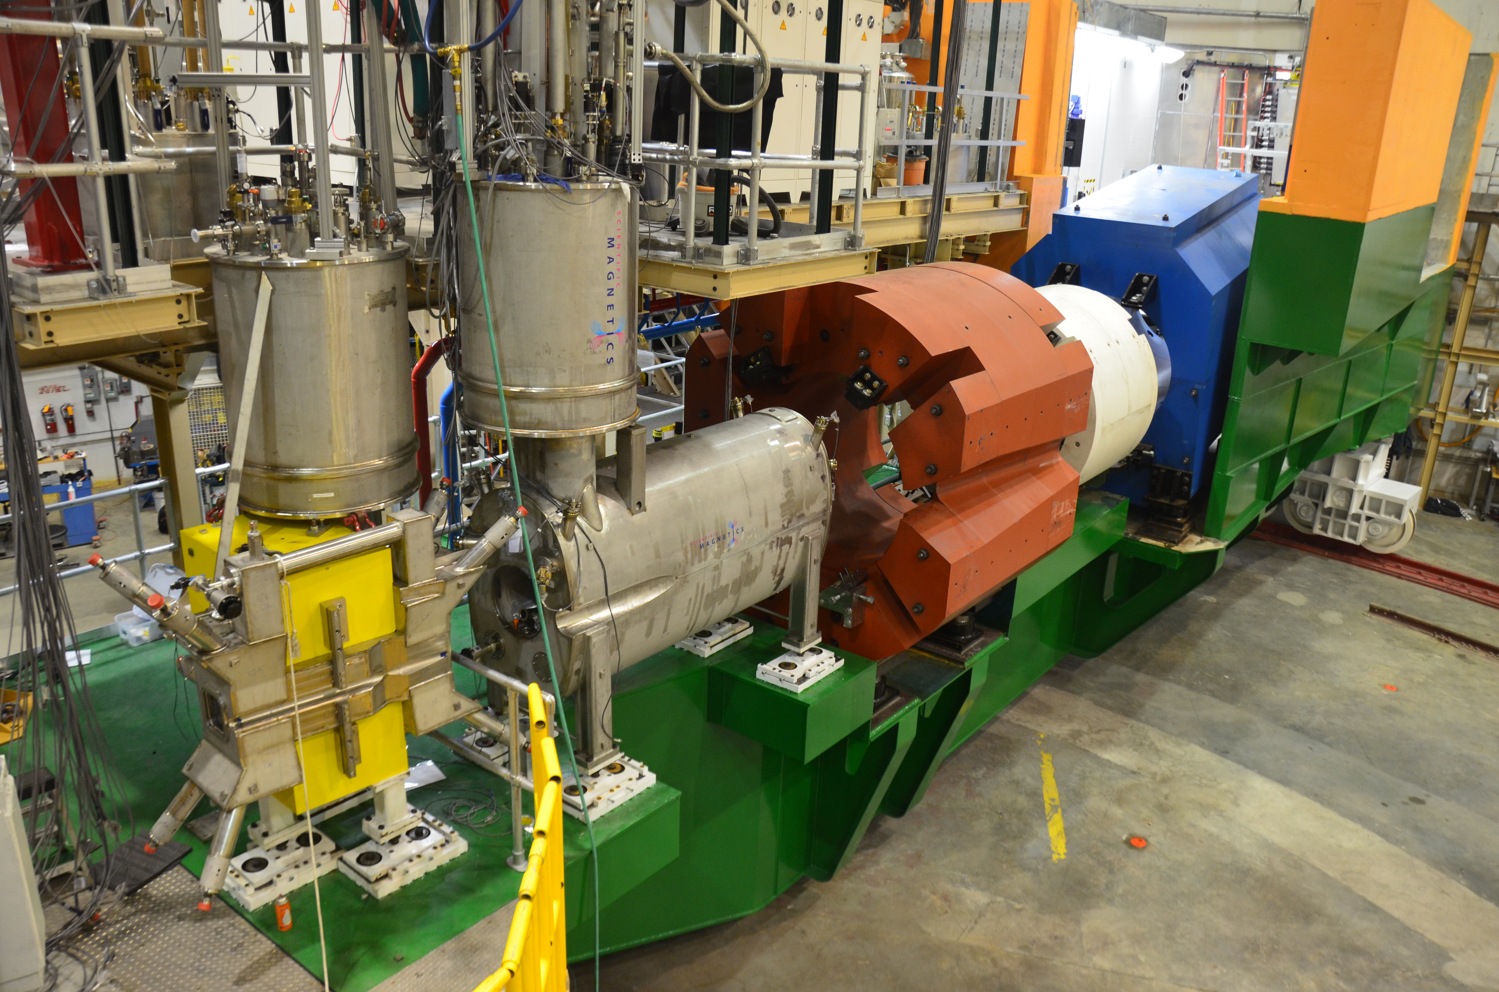
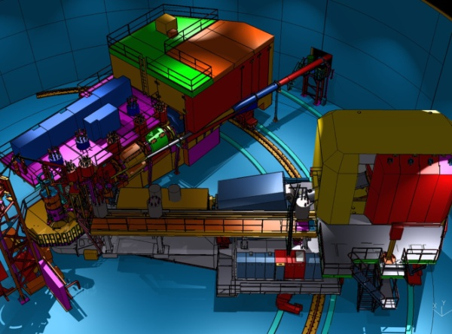
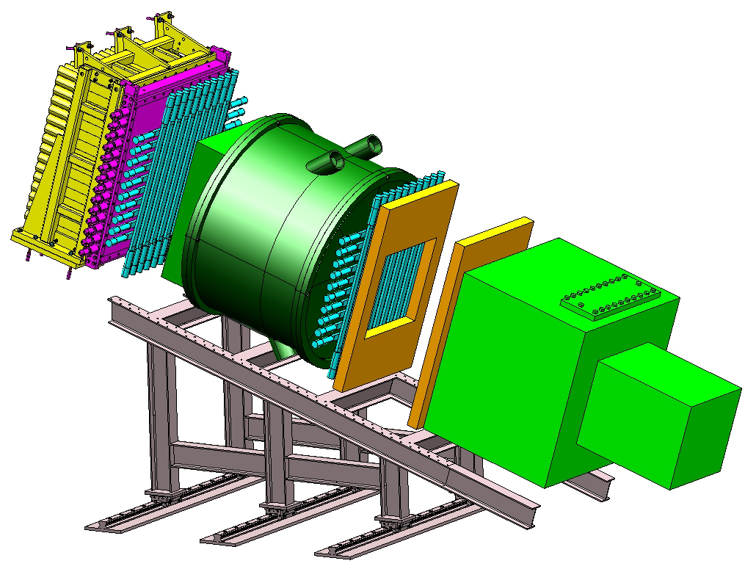
PreShower Counter
S2 Hodoscope
SHMS (New)
S1 Hodoscope
Heavy Gas Cerenkov
HMS (Exists)
Shower Counter
Drift Chambers
Noble-Gas Cerenkov
Hall C : SHMS + HMS

Slide 9
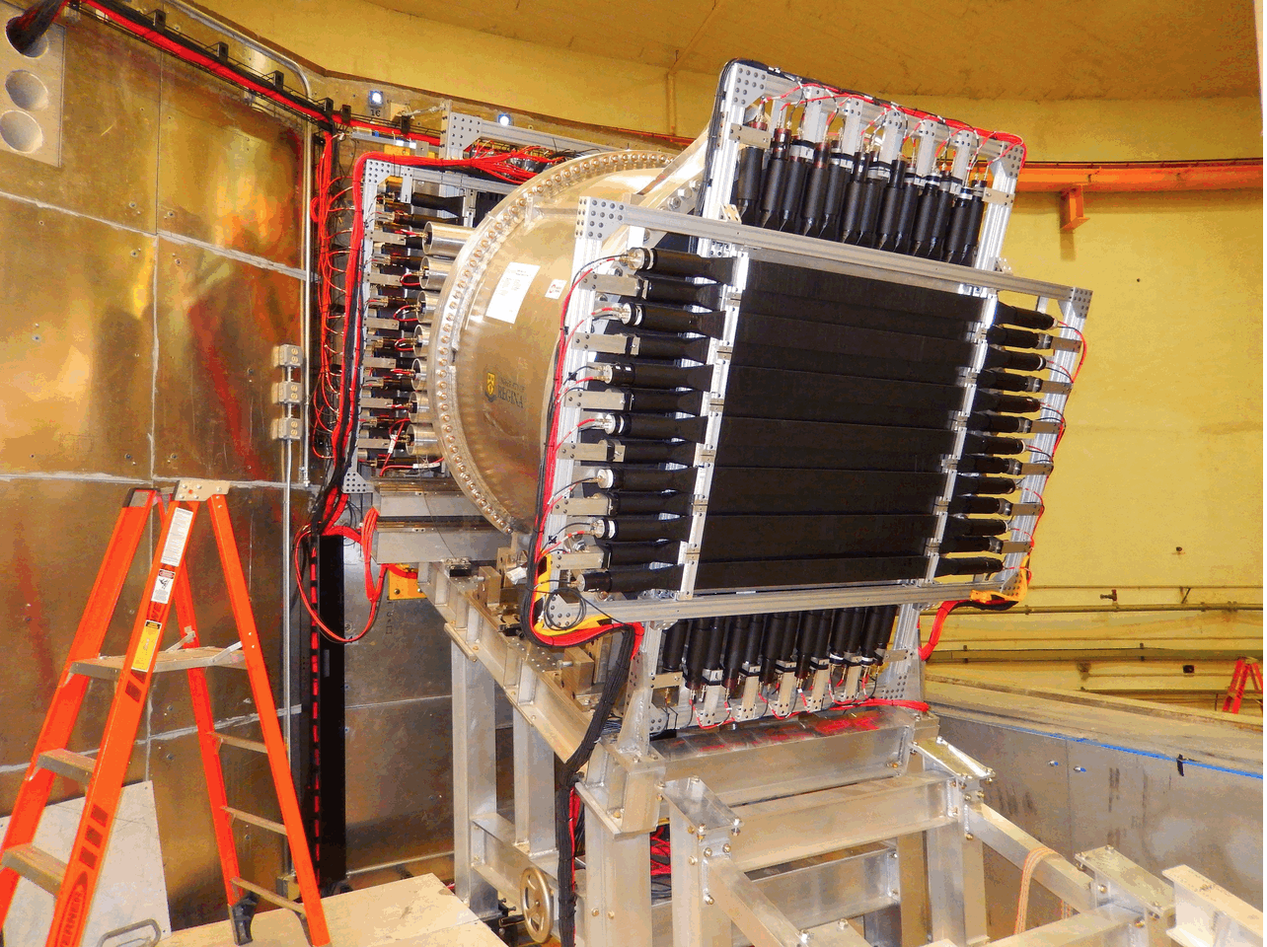
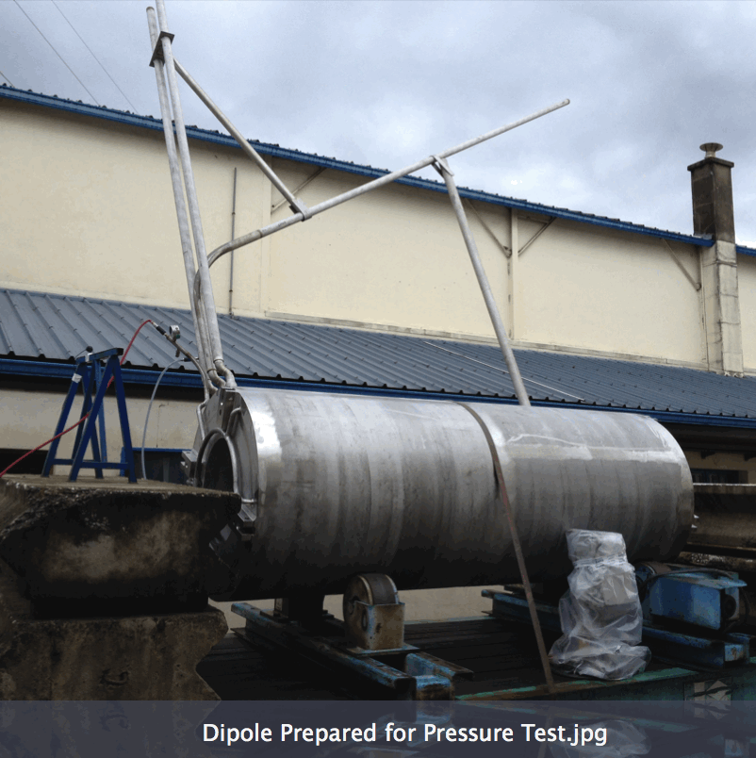
Hall C Status
All Detector Construction is Complete
  “Rear” Detectors have been installed.
  “Front” Detectors are in Experiment Staging Building.
  Remaining detector installations follow final magnet installation.
  Only the Noble-Gas Cerenkov construction is 12-GeV scope. Other detector construction is primarily contributed (significant involvement of universities and outside institutions)
Beamline at 84%
  Upstream Beamline: Done: (Compton, Møller, Magnet-mapping)
Q1 and HB Magnets are Installed
  Q1: Accepted. HB: Testing
The Only Significant Fabrications Remaining are Q2, Dipole, Q3
  Arrivals: early 2016

Slide 10
Enhancements beyond 12-GeV Upgrade
• Hall A DVCS Calorimeter (France - Orsay) installed
• Hall A SBS – ongoing (Capital Equipment (CE))
• Hall A SBS GEMs (Italy INFN, UK), Hadron Cal. (CMU+INFN) ongoing (ops)
• Hall A pre-R&D toward PV (MOLLER magnet concept, with MIT) ongoing (ops)
• Hall A SOLID (China, Temple, Duke, ANL, …) ongoing (magnet - CE)
• Hall A APEX septum magnet (Canada, Stony Brook) complete
• Hall B longitudinally polarized target (ODU …, NSF/MRI) ongoing (infrastr. - CE)
• Hall B forward tagger (Italy INFN & NSF/MRI) near-complete
• Hall B RICH sector(s) (Italy INFN, Chile) ongoing (PMTs, materials - CE)
• Hall B MicroMegas (France - Saclay) ongoing
• Hall B Central Neutron Detector (France - Orsay) complete
• Hall B Heavy Photon Search (HPS) (DOE HEP, France, INFN) installed/used for run
• Hall B H Gas Target for Proton Charge Radius (NSF/MRI) near-complete
• Hall C Kaon Detection System (CUA …, NSF/MRI) complete
• Hall C Backward nucleon detection system (Israel/ODU) ongoing
• Hall C Neutral-Particle Spectrometer (US/France/UK/Armenia & NSF/MRI) started
• Hall D PID/Cherenkov system (US) pre-R&D/planning (CE)
• Hall D Discussions with China on calorimeter upgrades (UNCW, NCAT) planning
• LERF: DarkLight Phase-I Equipment (MIT …, NSF/MRI) ongoing
• Injector: Bubble Chamber for ¹⁶O(γ,α)¹²C inverse kinematics (ANL) ongoing
Very active and engaged (international) user community showing large interest in JLab-12 GeV science program
10

Slide 11
12 GeV Approved Experiments
Topic | Hall A | Hall B | Hall C | Hall D | Other | Total
The Hadron spectra as probes of QCD (GlueX and heavy baryon and meson spectroscopy) |  | 1 |  | 3 |  | 4
The transverse structure of the hadrons (Elastic and transition Form Factors) | 5 | 3 | 2 | 1 |  | 11
The longitudinal structure of the hadrons (Unpolarized and polarized parton distribution functions) | 2 | 3 | 6 |  |  | 11
The 3D structure of the hadrons (Generalized Parton Distributions and Transverse Momentum Distributions) | 5 | 9 | 7 |  |  | 21
Hadrons and cold nuclear matter (Medium modification of the nucleons, quark hadronization, N-N correlations, hypernuclear spectroscopy, few-body experiments) | 6 | 3 | 7 |  | 1 | 17
Low-energy tests of the Standard Model and Fundamental Symmetries | 3 | 1 |  | 1 | 1 | 6
TOTAL APPROVED EXPs | 21 | 20 | 22 | 5 | 2 | 70
TOTAL APPROVED RUN GROUP PAC DAYS | 1346.5 | 671 | 667 | 644 | 74 | 3402.5
A Decade of Experiments
PAC41 (May 2014): Select ~ 600 PAC days for “High Impact”
to provide a strategic core program
Those experiments will receive priority for scheduling in the first 5 years of 12 GeV running

Slide 12
PAC Guidance
The Hall B collaboration should submit proposals for complete run groups at one PAC meeting, where all of the anticipated physics associated with the proposed run group will be considered. Each run group can submit up to 4 individual proposals (up to 3 physics topics plus 1 summary of additional topics) and will be granted a maximum of 4 presentations corresponding to these proposals. The PAC may consider each of these for grading, but will attempt to provide an common assessment of the whole run group. New experimental proposals that run in parallel with previously approved run groups should be considered internally by the CLAS collaboration. It is also requested that documentation (e.g., proposal and report) from the internal review be submitted to the PAC for their information. A CLAS representative will have the opportunity to report on these to the PAC, and the PAC will then provide comments on them in its report. Proposed parallel running in other halls should be handled in a similar fashion.
Next PAC meeting : July 25 – 29, 2016

Slide 13
FY2016 Budget
ONP Guidance / FY16 President’s Budget Request supports ~ 16 weeks running
  This matched somewhat with some infrastructure work in CHL and UIM which happened during the summer shutdown
  But we would have liked more running in FY16 and tried with Senate and House
Current Expectations
  No immediate lapse of Government Funding
  A short-term Continuing Resolution
    Impacts on ability to mount experiments & UITF …
    Partial mitigation coming from NP
  Potential for a Year Long CR
    Protect the workforce, operating weeks

Slide 14
Experiment Scheduling
Plan to have 1 scheduling request per year
Experiments can only submit requests when floor layouts frozen and construction near-final
Schedule will remain “tentative” to fold in:
  12 GeV Project Installation + pre-ops
  establishing robust accelerator operations
  budget uncertainties
Setting priorities amongst Halls/experiments will still be important to avoid conflicts
Nominal Dates for Scheduling Process
June 1 Call for Scheduling (Beam Time) Request
June 30 Deadline for Scheduling Request Submissions
September 1 Draft 18-Month Schedule Released
September 15 Deadline for Input of User Community on Draft Schedule
October 1 18-Month Schedule Released
Year 1 January – June Schedule Reaffirmed
Year 1 July – December Firm Schedule
Year 2 January – June Tentative Schedule
March 1 Draft 18-Month Schedule Released
March 15 Deadline for Input of User Community on Draft Schedule
April 1 18-Month Schedule Released
Year 1 July – December Schedule Reaffirmed
Year 2 January – June Firm Schedule
Year 2 July – December Tentative Schedule

Slide 15
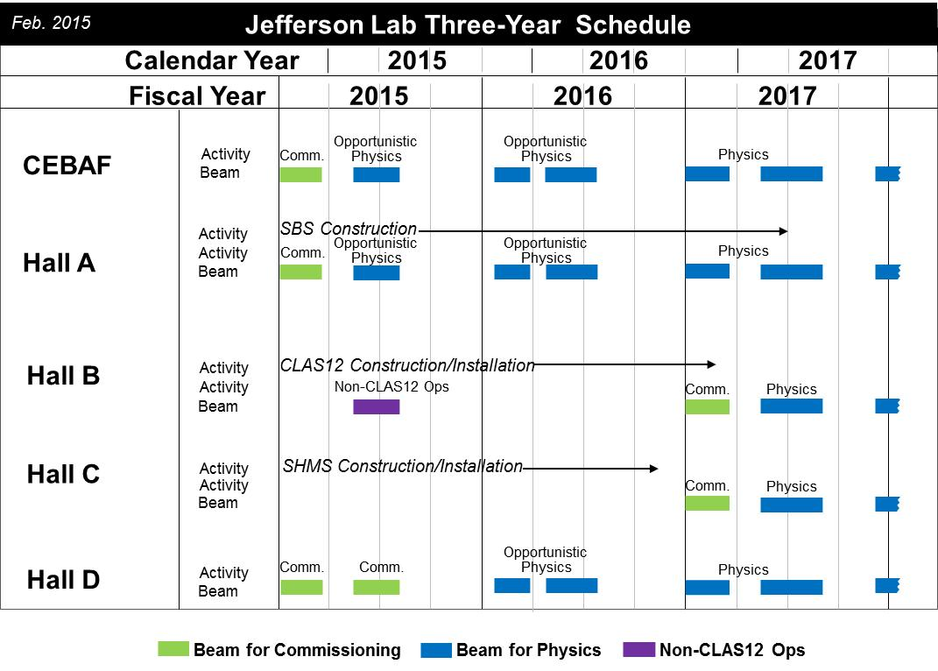
Three – Year Schedule
This has moved to Q1-FY17

Slide 16
Schedule
New schedule covering up to June, 30 2017 will be issued early November.
FY16: 16 weeks of operations
    Fall 2015 period aimed at achieving robust operations at full gradient (2.2 GeV/pass)
    Spring 2016 period has only one official week of physics operations, further weeks of operations is for machine development.
    Opportunistic physics in Halls A and D
Took more time for helium processing to optimize chances to achieve robust operations at full gradient
Beam restoration is Nov. 9, and only 5 weeks of accelerator operations planned for Fall 2015 (from 7), and no physics operations planned (beyond as needed for accelerator).

Slide 17
Schedule - Continued
Now 11 weeks of accelerator operations planned for the Spring of 2016
      This includes 1 week of restoration
      Schedule roughly from early February to mid April
Opportunistic Physics in FY16
Hall A: DVCS/GMp
Hall D: GlueX Commission Run
Hall C: Perhaps a few days of beam line checkout if beam dump maintenance completed
Hall B: complicated, see next slide

Slide 18
Hall B Schedule
  On the critical path for 12-GeV Project ➔ 12 GeV Project has priority
  Need to avoid even the appearance that 12 GeV Project does not get full priority under every circumstance
  Best effort to recover some running of HPS and also provide planned running for PRAD
  Hope to run HPS in February
  (but only weekends will be possible this time)
  Hope to install PRad in March
  (if not in conflict with the 12 GeV Project)
  Hope to run PRad in April/May
  (we are considering a potential few-week extension as low-energy, single-Hall operation only, similar in scope as this year in May 2015)

Slide 19
NSAC 2015 LRP
RECOMMENDATION I
The progress achieved under the guidance of the 2007 Long Range Plan has reinforced U.S. world leadership in nuclear science. The highest priority in this 2015 Plan is to capitalize on the investments made.
With the imminent completion of the CEBAF 12-GeV Upgrade, its forefront program of using electrons to unfold the quark and gluon structure of hadrons and nuclei and to probe the Standard Model must be realized.
Expeditiously completing the Facility for Rare Isotope Beams (FRIB) construction is essential. Initiating its scientific program will revolutionize our understanding of nuclei and their role in the cosmos.
The targeted program of fundamental symmetries and neutrino research that opens new doors to physics beyond the Standard Model must be sustained.
The upgraded RHIC facility provides unique capabilities that must be utilized to explore the properties and phases of quark and gluon matter in the high temperatures of the early universe and to explore the spin structure of the proton.

Slide 20
NSAC 2015 LRP
RECOMMENDATION II
The excess of matter over antimatter in the universe is one of the most compelling mysteries in all of science. The observation of neutrinoless double beta decay in nuclei would immediately demonstrate that neutrinos are their own antiparticles and would have profound implications for our understanding of the matter-antimatter mystery.
We recommend the timely development and deployment of a U.S.-led ton-scale neutrinoless double beta decay experiment.

Slide 21

NSAC 2015 LRP
1. The Washington Post (Associated Press)
Virginia lab to compete for bid to build atomic collider
Oct. 16, 2015
https://www.washingtonpost.com/local/virginia-lab-to-compete-for-bid-to-build-atomic-collider/2015/10/16/0906dcea-73f6-11e5-ba14-318f8e87a2fc_story.html
2. The Richmond Times-Dispatch
16 Oct. 2015
Nuclear advisory board recommends building collider
http://www.richmond.com/news/virginia/government-politics/article_ffebc211-30b2-5b78-ae61-7866aa2a9ed5.html
3. The Virginian Pilot
Atomic collider gets OK. Now Jefferson Lab will compete for it
http://hamptonroads.com/2015/10/atomic-collider-gets-ok-now-jefferson-lab-will-compete-it
Oct. 16, 2015
4. The Daily Press
16 Oct. 2015
Competition between Jefferson Lab, Brookhaven National Lab heats up for ion collider
http://www.dailypress.com/news/newport-news/dp-nws-nn-ion-collider-tech-center-20151015-story.html
5. Science Magazine: http://news.sciencemag.org/physics/2015/10/u-s-nuclear-physicists-push-new-neutrino-experiment?rss=1
6. Nature: http://www.nature.com/news/billion-dollar-particle-collider-gets-thumbs-up-1.17579
7. International Business News: http://www.ibtimes.co.uk/new-particle-collider-more-precise-lhc-awaits-approval-1502098
8. (AP) SFGate: http://www.sfgate.com/news/article/Virginia-lab-to-compete-for-bid-to-build-atomic-6573780.php
1. The Washington Post (Associated Press)
Virginia lab to compete for bid to build atomic collider
Oct. 16, 2015
https://www.washingtonpost.com/local/virginia-lab-to-compete-for-bid-to-build-atomic-collider/2015/10/16/0906dcea-73f6-11e5-ba14-318f8e87a2fc_story.html
2. The Richmond Times-Dispatch
16 Oct. 2015
Nuclear advisory board recommends building collider
http://www.richmond.com/news/virginia/government-politics/article_ffebc211-30b2-5b78-ae61-7866aa2a9ed5.html
3. The Virginian Pilot
Atomic collider gets OK. Now Jefferson Lab will compete for it
http://hamptonroads.com/2015/10/atomic-collider-gets-ok-now-jefferson-lab-will-compete-it
Oct. 16, 2015
4. The Daily Press
16 Oct. 2015
Competition between Jefferson Lab, Brookhaven National Lab heats up for ion collider
http://www.dailypress.com/news/newport-news/dp-nws-nn-ion-collider-tech-center-20151015-story.html
5. Science Magazine: http://news.sciencemag.org/physics/2015/10/u-s-nuclear-physicists-push-new-neutrino-experiment?rss=1
6. Nature: http://www.nature.com/news/billion-dollar-particle-collider-gets-thumbs-up-1.17579
7. International Business News: http://www.ibtimes.co.uk/new-particle-collider-more-precise-lhc-awaits-approval-1502098
8. (AP) SFGate: http://www.sfgate.com/news/article/Virginia-lab-to-compete-for-bid-to-build-atomic-6573780.php
RECOMMENDATION III
Gluons, the carriers of the strong force, bind the quarks together inside nucleons and nuclei and generate nearly all of the visible mass in the universe. Despite their importance, fundamental questions remain about the role of gluons in nucleons and nuclei. These questions can only be answered with a powerful new electron ion collider (EIC), providing unprecedented precision and versatility. The realization of this instrument is enabled by recent advances in accelerator technology.
We recommend a high-energy high-luminosity polarized EIC as the highest priority for new facility construction following the completion of FRIB.
Response of the city of Newport News

Slide 22
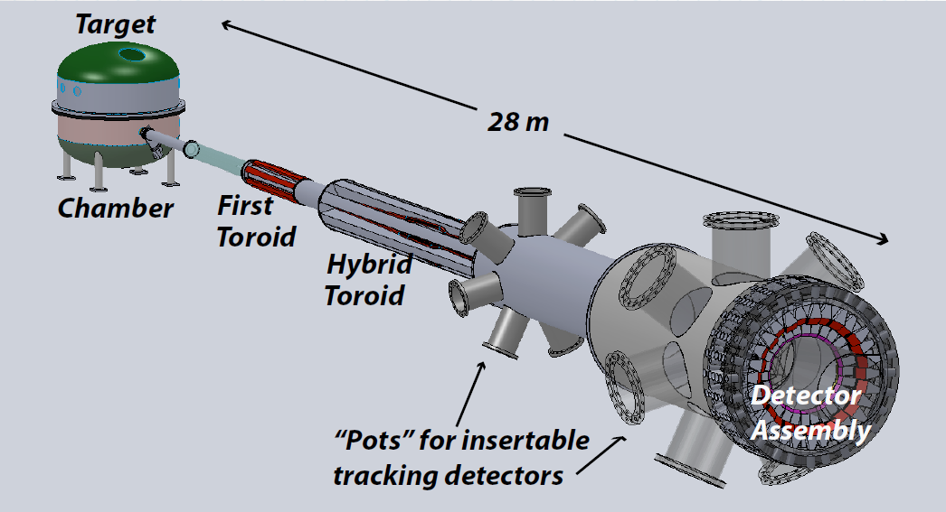

NSAC 2015 LRP
RECOMMENDATION IV
We recommend increasing investment in small-scale and mid-scale projects and initiatives that enable forefront research at universities and laboratories.
MOLLER
SoLID

Slide 23
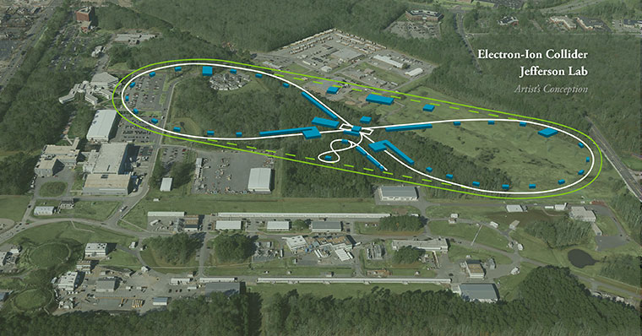
Jefferson Lab Future: JLEIC

Slide 24
JLEIC Concept
JLab EIC Figure 8 Concept
12 GeV CEBAF is electron injector
  e-p/A : A > 200 (Au, Pb) - p, d, ³He pol.
low x: x ◻ 0.0001
high polarization: > 70%
high luminosity: 10³⁴ cm⁻²s⁻¹
Initial configuration (MEIC):
  3-12 GeV on 20-100 GeV ep/eA collider
    Upgradable to higher energies (20x250)
    Low technical risk
    Flexible timeframe for Construction consistent w/running 12 GeV CEBAF
    Thorough cost estimate completed & presented to NSAC EIC Review
Current Activities
Site evaluation (VA funds)
Accelerator, detector R&D
Design optimization/Cost reduction

Slide 25
Summary and Outlook
12 GeV Upgrade making good progress – challenges remain
PAC process revised for parallel running
CR budget – we plan to run 16 weeks, but…
New schedule covering up to June, 30 2017 will be issued early November.
NSAC LRP released
- good for JLab
- requires modest budget growth
- recommends future EIC construction

