Slide 1
FEE studies of Carbon and CH2 using Ecal only
Sebouh Paul
10/27/15

Slide 2
Background
~30 minutes of data were taken with CH2 and carbon targets
Goal was to test if it would be feasible to do a pair of longer future runs with same targets and measure proton radius via subtraction.
CH2 is delicate, so it required low current (2 nA) and moving the target periodically during the run.
A hole was burned in the target.
Carbon can handle moderate amounts of current
30 nA used.

Slide 3
Questions
How well can we compare runs with very different beam currents?
Is the proton radius subtraction feasible using similar conditions on longer runs? How many times longer will we need to run the experiment in order to get 1% accuracy on the proton radius?

Slide 4
Data set used
Tungsten (Control group):
Run 5749 @ 30 nA
Run 5772 @ 50 nA.
Carbon: run 5779
30 nA
CH2 run 5781
2 nA
Include only files 5-34 to account for hole burned in target.
All of these are from pass3

Slide 5
Cuts
Single1 Trigger
Cluster energy is > .8 GeV and less than 1.2
Time is in [40, 48] ns
Cluster position within fiducial region
Use only the first cluster in the event
Sort the clusters by energy descendingly (The first cluster in the event is not necessarily the trigger event.)
Loop through clusters in the sorted list until reaching one that fulfills all the cuts and then break loop.

Slide 6
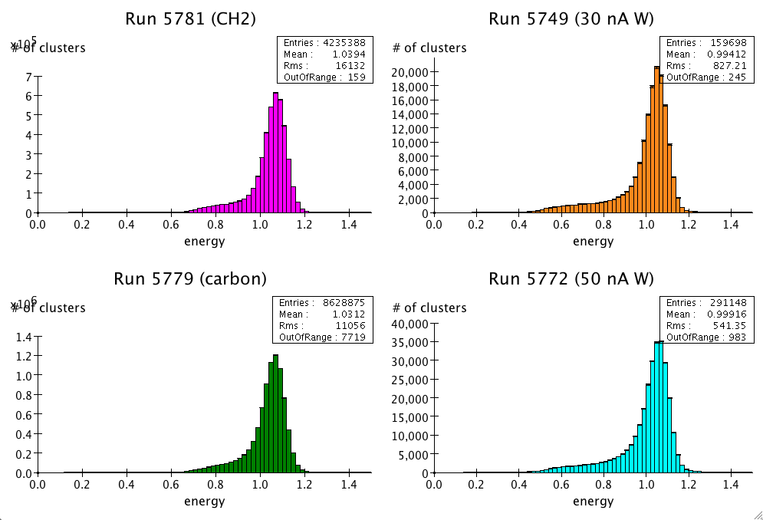
Energy Spectrum

Slide 7
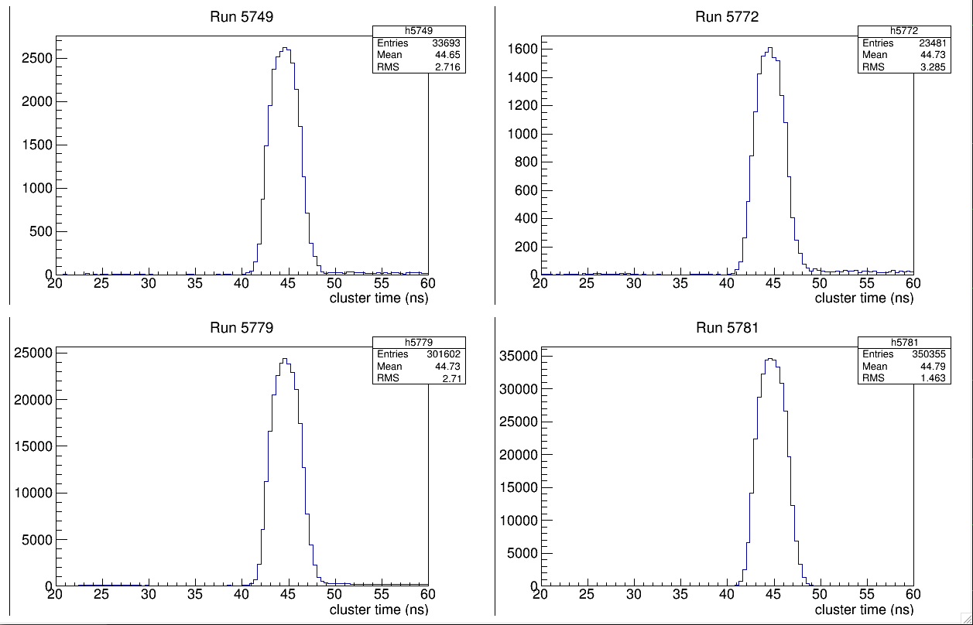
Timing Cuts

Slide 8
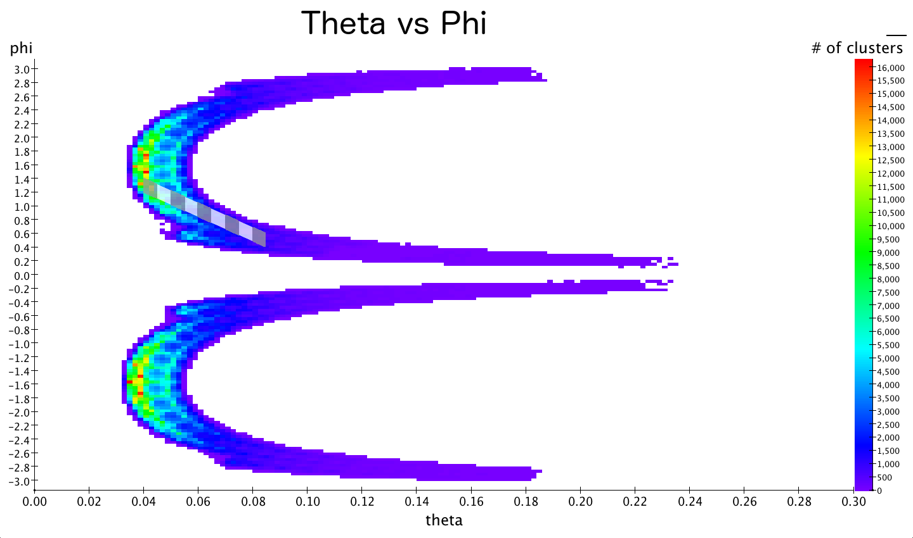
Binning

Slide 9
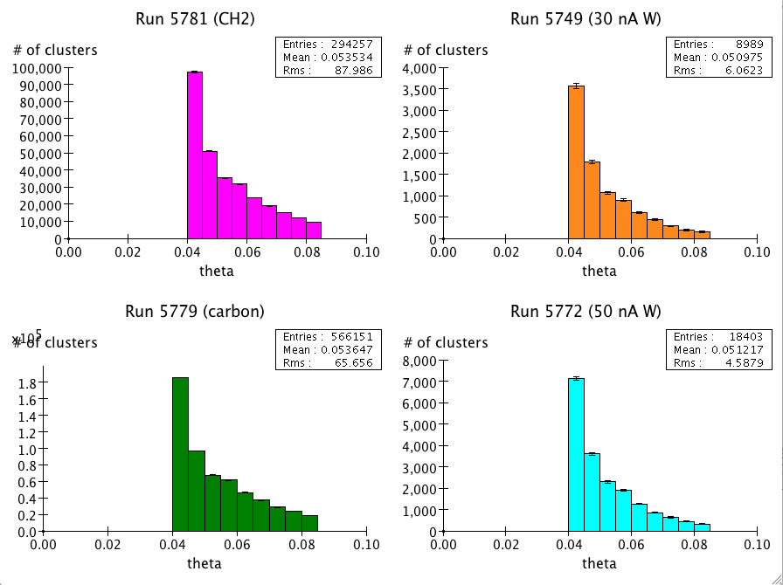
Theta Histograms

Slide 10
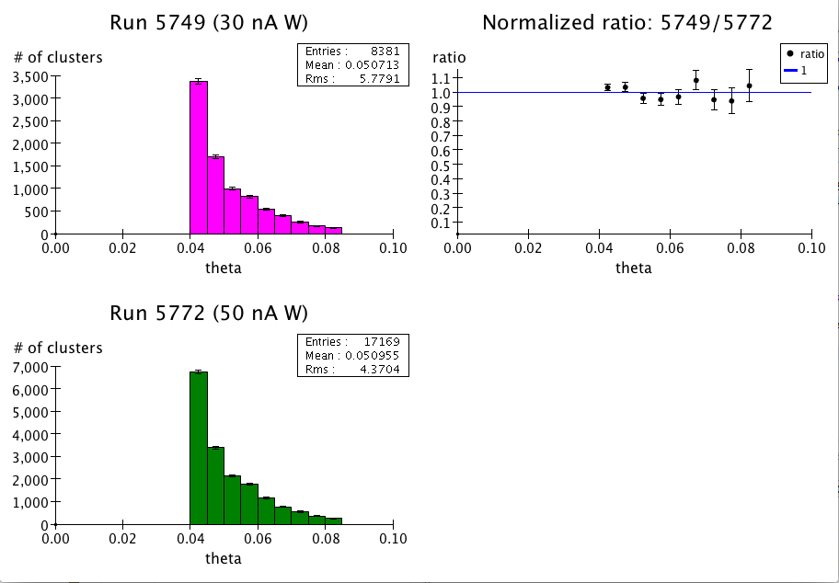
Comparison of Tungsten Runs
Ratio of cluster counts
Normalize with gated beam charge
Sho’s calculation from scalers
Overall ratio:
1.007± .013

Slide 11
Comparison of Carbon to CH2
Normalization factors:
*Prescale: 2^-7/2^-4 = 0.125
*Target areal density .0441/.0706 = 0.624
/Molar mass 12.01/14.02 = 0.856
*Beam charge 51378/2322 = 22.12

Slide 12
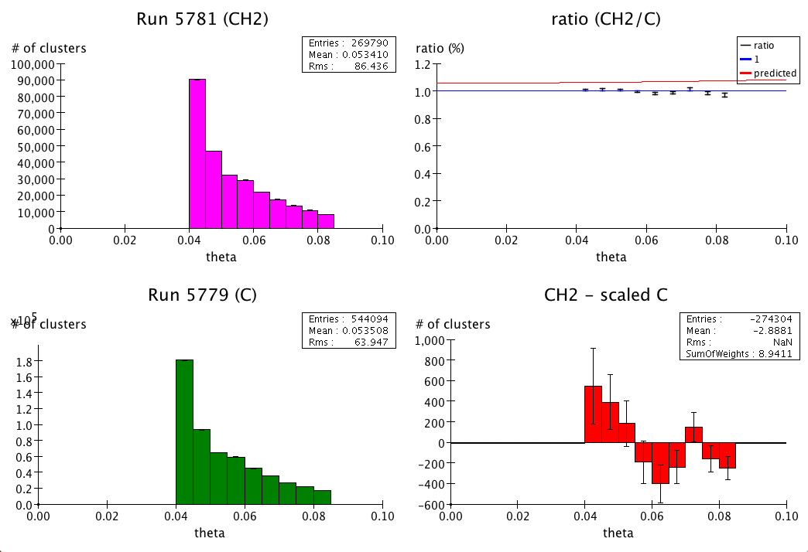
Comparison of Carbon to CH2

Slide 13
Comparison of Carbon to CH2:
Expected ratio:
1.056 + 2.87 θ^2
Measured ratio (linearly fit in θ^2)
(1.016 +- 0.007) + (-6.00 +- 1.78) θ^2
Problems:
Normalization is off by about 4%
Large statistical error bar in slope
This is to be expected: we have only a small amount of statistics

Slide 14
Possible Causes of Normalization Issues
How well do we know the areal densities of the targets?
Are the beam charges reliably known?
Both the mya scaler and faraday cup are in good agreement with one another.
Was there further radiation damage to the CH2 target not accounted for in our analysis?
Much work remains to be done on this.

Slide 15
Conclusion: Proton radius feasible?
We need the error bar on the slope down to about .003 to get 1% error on proton radius measurement.
Currently the error on slope is 1.78
Using larger solid angle may increase statistics up to about 10 fold.
Need about 40k times more data to get the slope resolution we need.

Slide 16
Future studies
Can we reconcile carbon data with Monte-Carlo?

Slide 17
Backup Slides

Slide 18
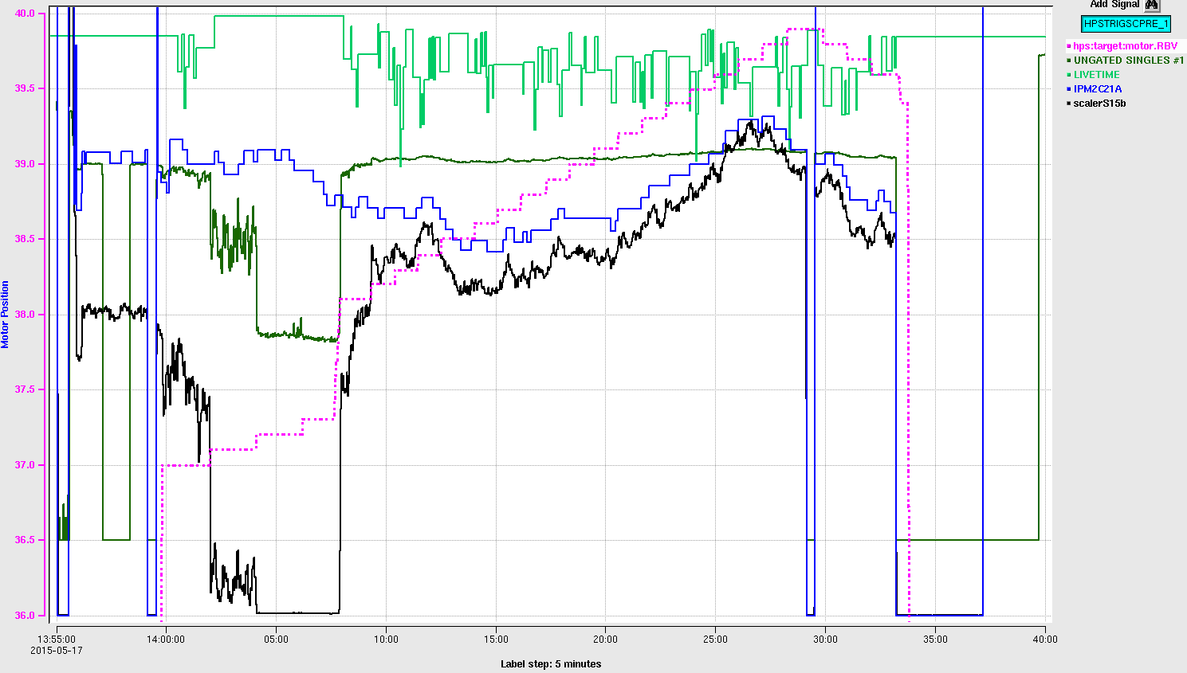
Hole in CH2?

