Slide 1
Moller Event Selection
Bradley Yale
UNH
HPS Collaboration Meeting
10/27/2015

Slide 2
Why Mollers?
Elastic e- e- scattering has very well-known kinematics with a highly correlated energy and angle between the electrons
MC follows these models extremely well; interdependent kinematics can be exploited for calibrations across fiducial and edge regions if these electron pairs can be identified
Moller energy peaks at half the beam energy, also bridging high-energy FEE and low-energy cosmic calibration regions

Slide 3
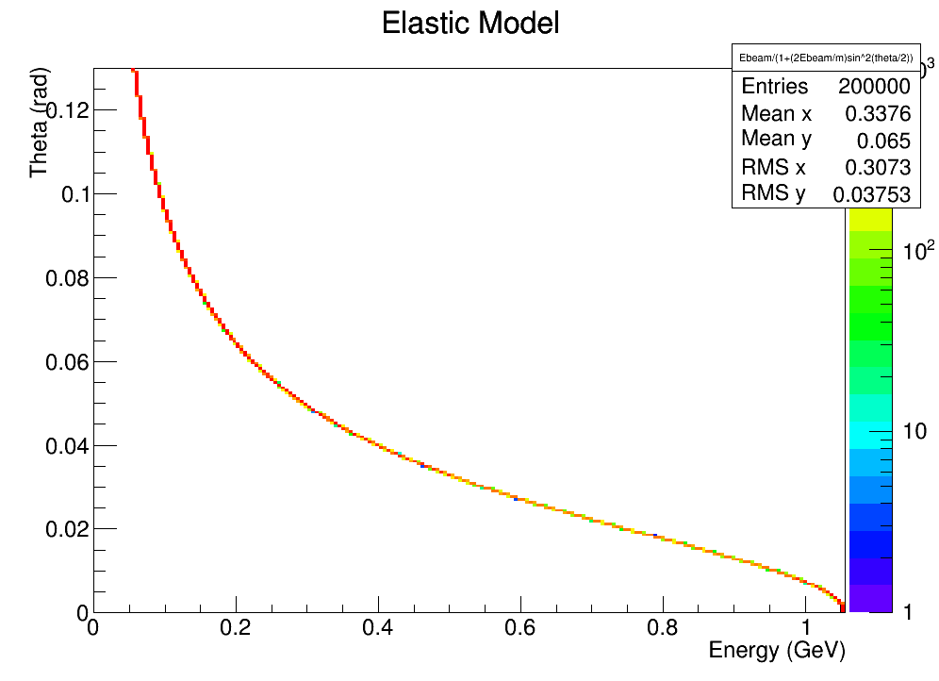
Elastic Scattering Model
Moller electrons should obey this
$$E\left(θ\right)=\frac{E_{beam}}{1+\frac{2E_{beam}}{m_{e}}\sin^{2}\left(θ/2\right)}$$

Slide 4
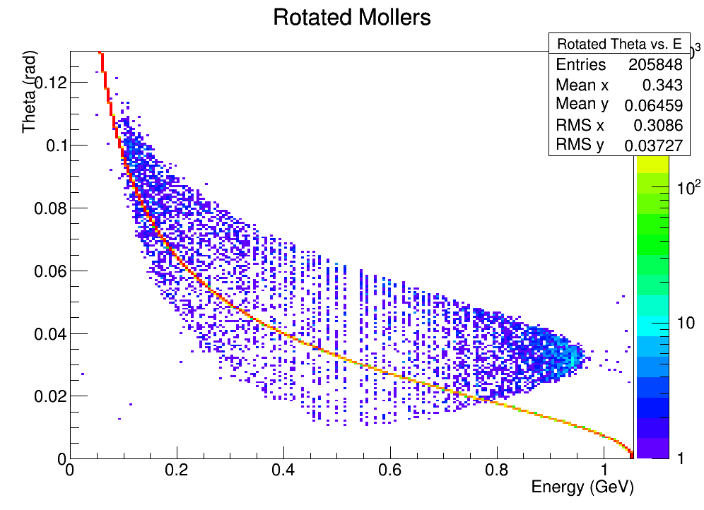
Pre-Slic PureMollers MC
…after the 30.5 mrad offset
(what SLIC actually sees):
$$\left.px′ = px∗cos(0.0305) + pz∗sin(0.0305\right)$$
$$\left.pz′ = pz∗cos(0.0305) − px∗sin(0.0305\right)$$
Idea: ‘Un-rotate’ track momentum and re-calculate theta
=>
$$\left.pz′ = pz∗cos(−0.0305) − px∗sin(−0.0305\right)$$
$$\left.px′ = px∗cos(−0.0305) + pz∗sin(−0.0305\right)$$

Slide 5
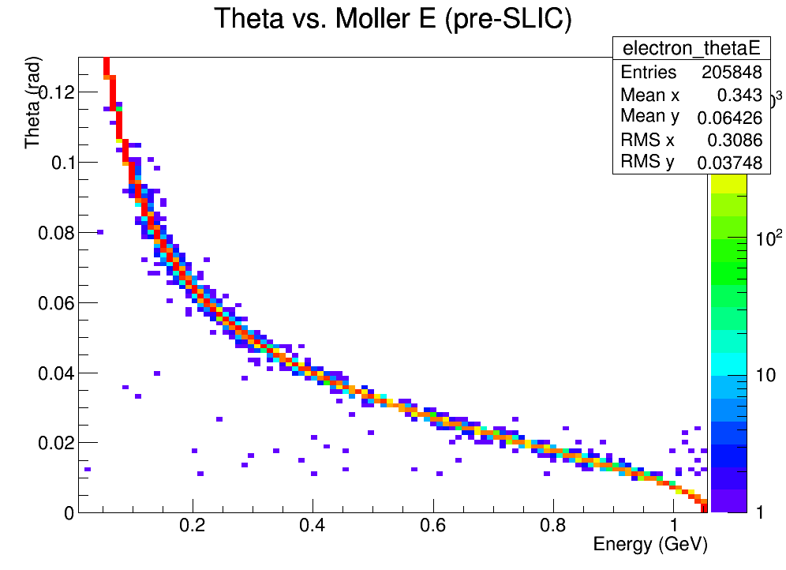
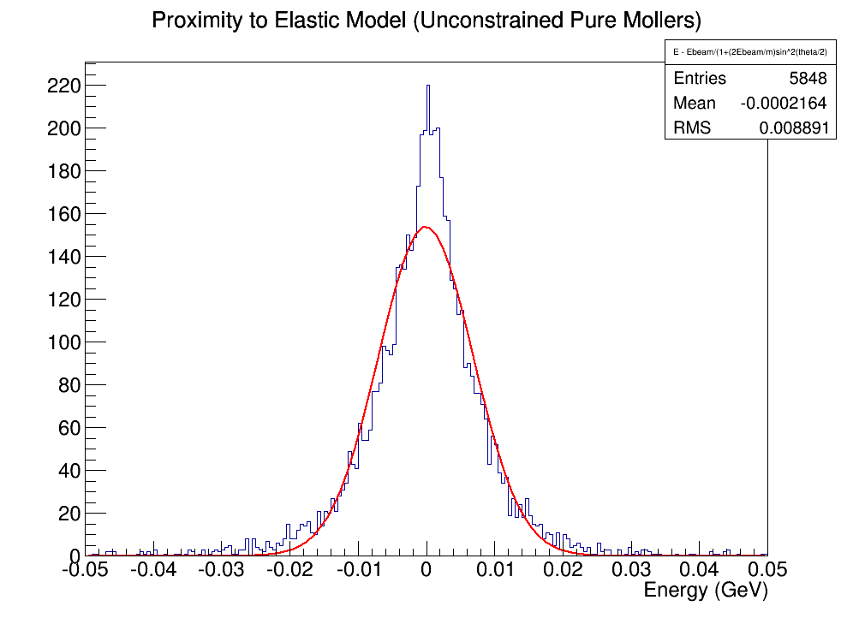
Pre-Slic PureMollers MC
Un-doing the beam offset:
Some MS and other secondary
processes in the target are included,
but 86% of generated e- fall within 5% of elastic model after target

Slide 6
Moller Kinematics
Energy-Theta:
$E\left(θ\right)=\frac{E_{beam}}{1+\frac{2E_{beam}}{m_{e}}\sin^{2}\left(θ/2\right)}$
Energy1-Energy2:
$E_{2}(E_{1})=E_{beam}−E_{1}$
Theta1-Theta2:
$θ_{2}(θ_{1}) =2\sin^{−1}\left(\frac{m_{e}}{2E_{beam}}\csc{\frac{θ_{1}}{2}}\right)$
Idea:
Select vertexed electrons using inter-electron kinematics

Slide 7
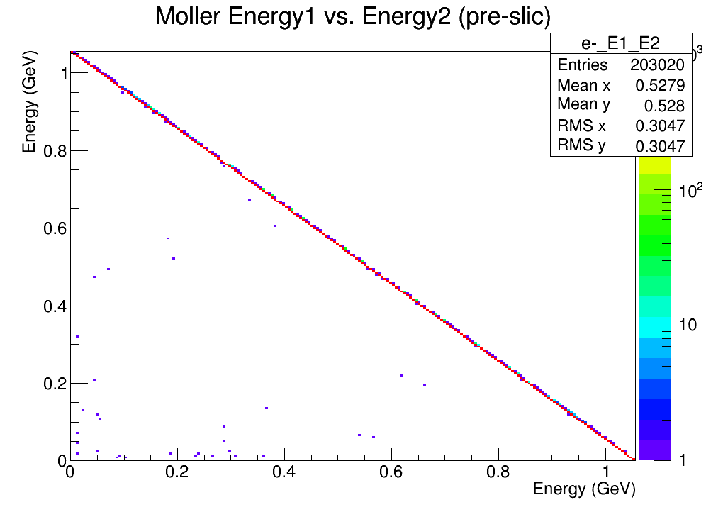
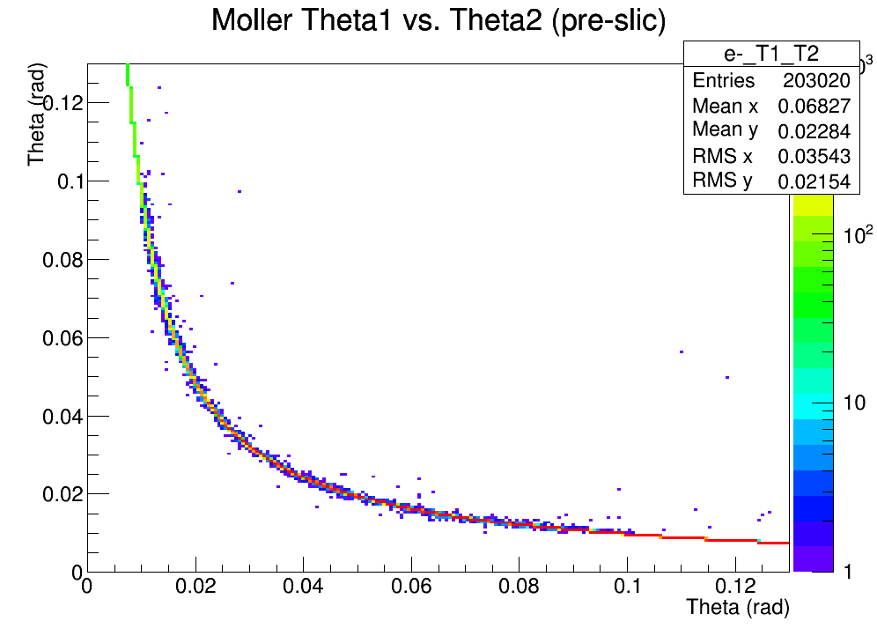
Pre-SLIC MC Agreement

Slide 8
Moller Selection Procedure
First, look at PureMoller MC recon to see what resolutions to expect in Moller kinematics
Select primary cuts using both electrons and the elastic model, such that minimal PureMoller MC events are lost
Refine cuts based on individual energy distributions, coincidence, etc.

Slide 9
Common to Everything:
Pass3 unconstrained MollerCandidates
Each particle has 1 cluster & 1 track
GBL Tracks (type>32), $χ^{2}<15$
HPS-EngRun2015-Nominal-v3-fieldmap detector
Singles1 trigger
Run 5772

Slide 10
MollerCandidates
MollerCandidates are vertexed particles
‘uc_moller_candidates’, ‘bsc_’, ‘tc_’
tan(lambda1)*tan(lambda2)< 0
1.6 ns coincidence
Both tracks found using the same strategy
Work just like other vertexed particles
Mollers act as ‘daughters’
Easy to identify individual Mollers in pairs
Current Moller filter has plenty of room for refinement…

Slide 11
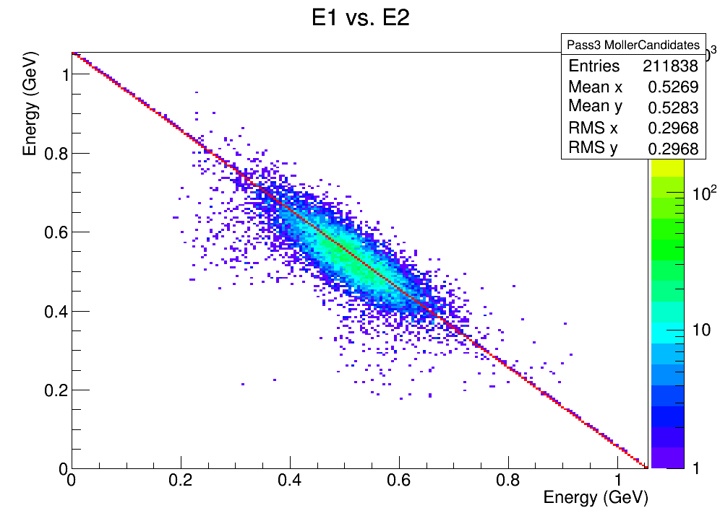
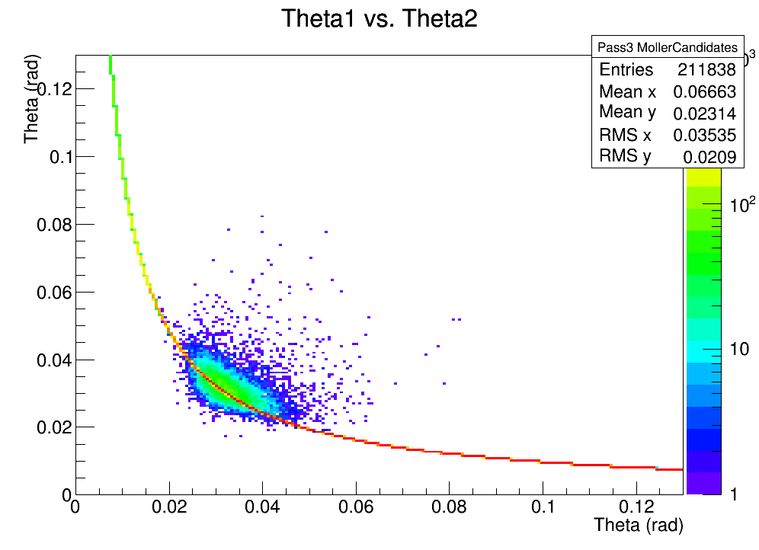
PureMoller MC (singles1) GBL Track Energy $(χ^{2}<15)$
This is the
‘best’ agreement
with the model to
expect after recon->

Slide 12
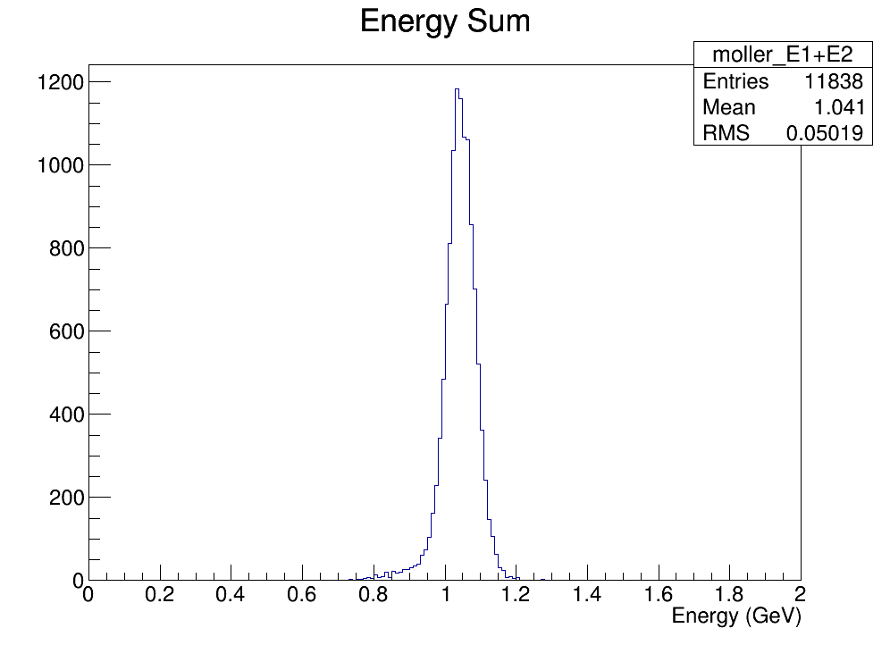
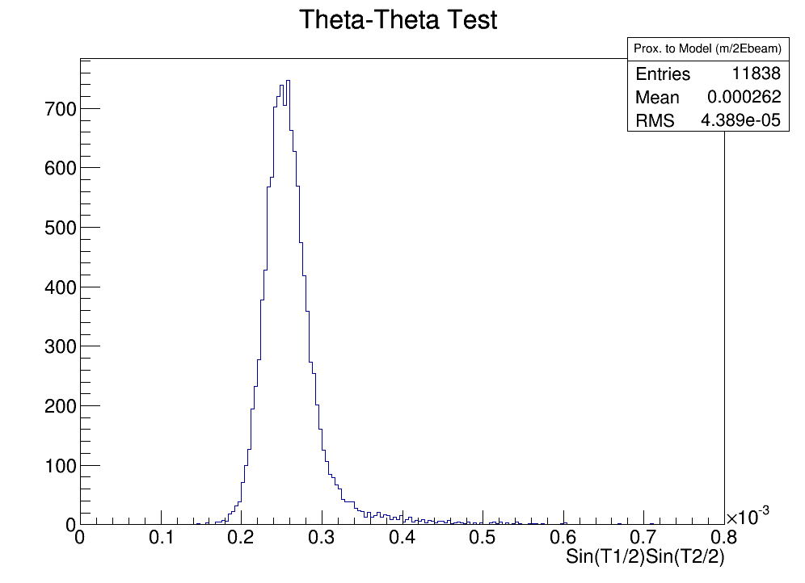
PureMoller MC (singles1) GBL Track Energy $(χ^{2}<15)$
Cut
Around
These
Expected resolution
wrt the model ->

Slide 13
Primary Moller Cuts
Based on the model distributions for PureMoller MC:
TrackE1+TrackE2 within 15% of Ebeam
Sin($θ_{1}$/2)*Sin($θ_{2}$/2) within 40% of $\frac{m_{e}}{2E_{beam}}$
This selects Mollers based primarily on inter-electron dependence, and keeps virtually all PureMoller MC

Slide 14
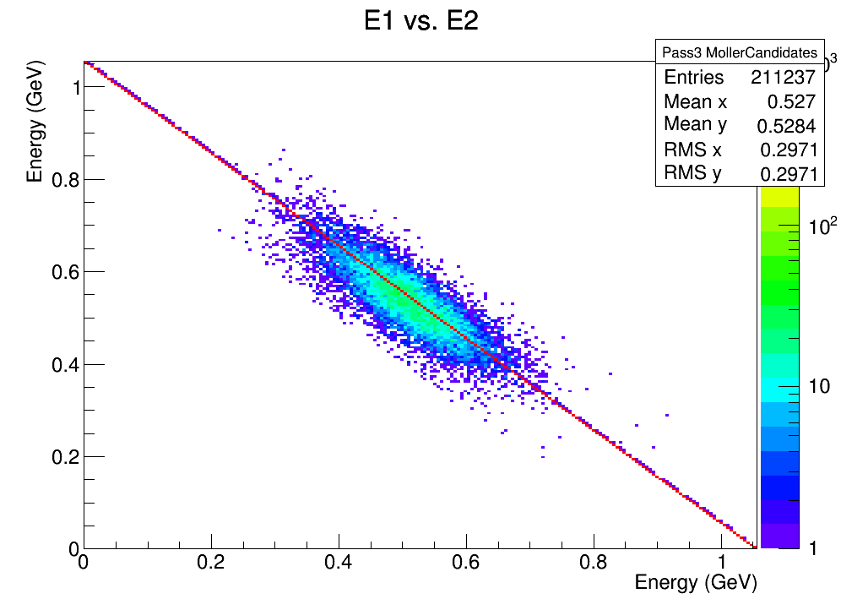
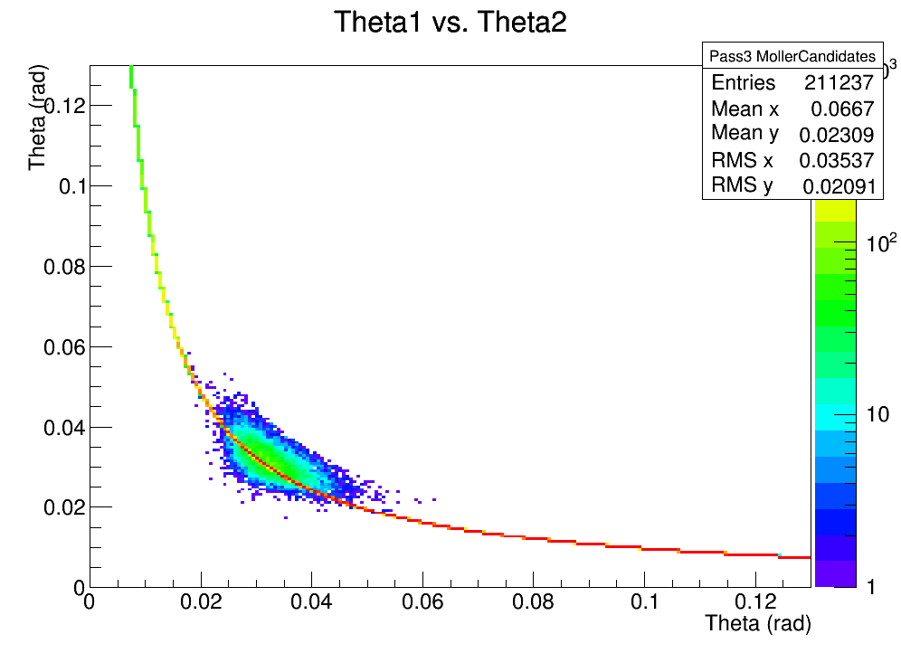
PureMoller MC After Primary Cuts
95% of
PureMollers pass ->

Slide 15
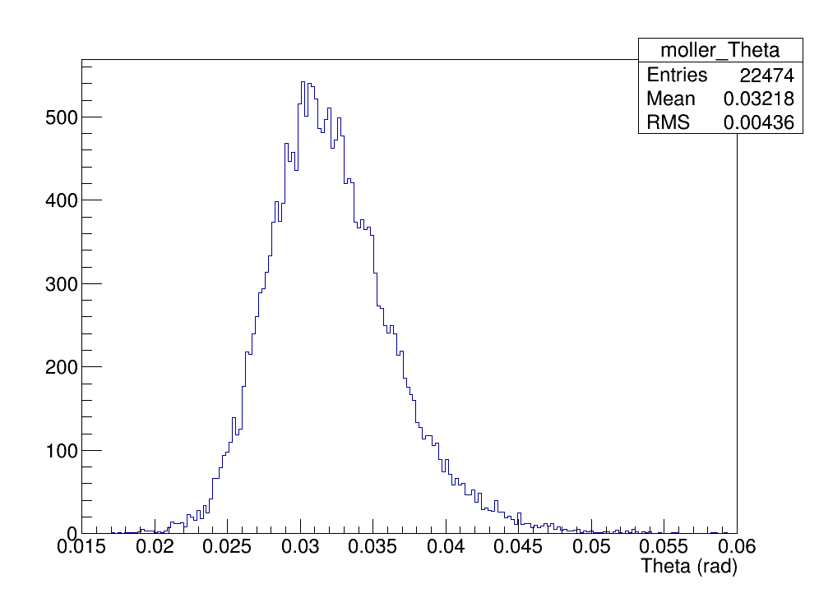
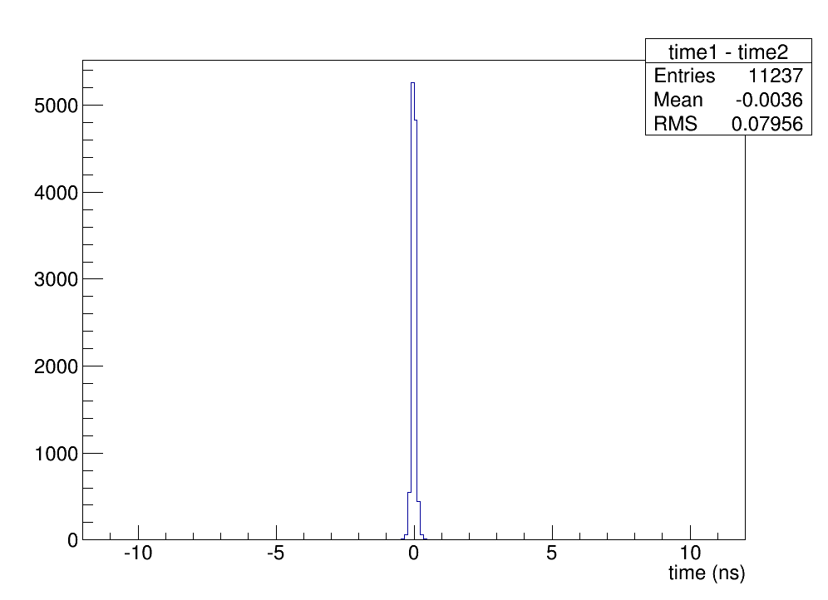
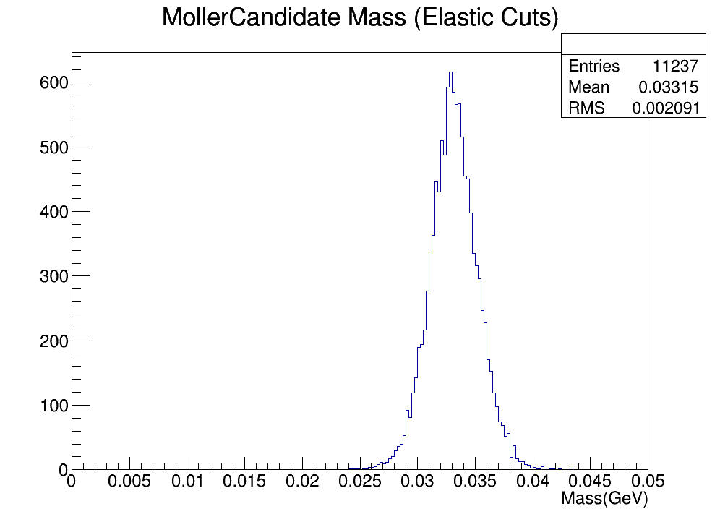
PureMoller MC After Primary Cuts
Now find secondary cuts to leave these distributions unchanged…

Slide 16
Secondary Moller Cuts
Based on the model distributions for PureMoller MC after primary e-e- cuts:
Individual E between 0.15 and 0.85 GeV
Individual θ between 0.02 and 0.05 rad
Coincidence <= 1ns
This keeps 95% of the cut PureMoller MC
Let’s try it with data and beam-tri MC…

Slide 17
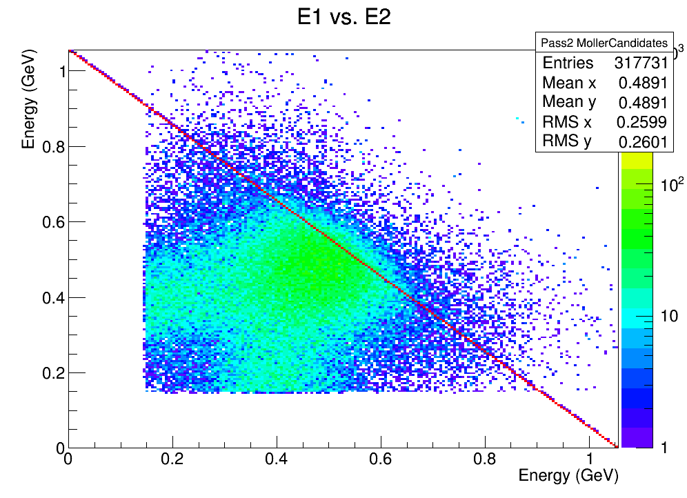
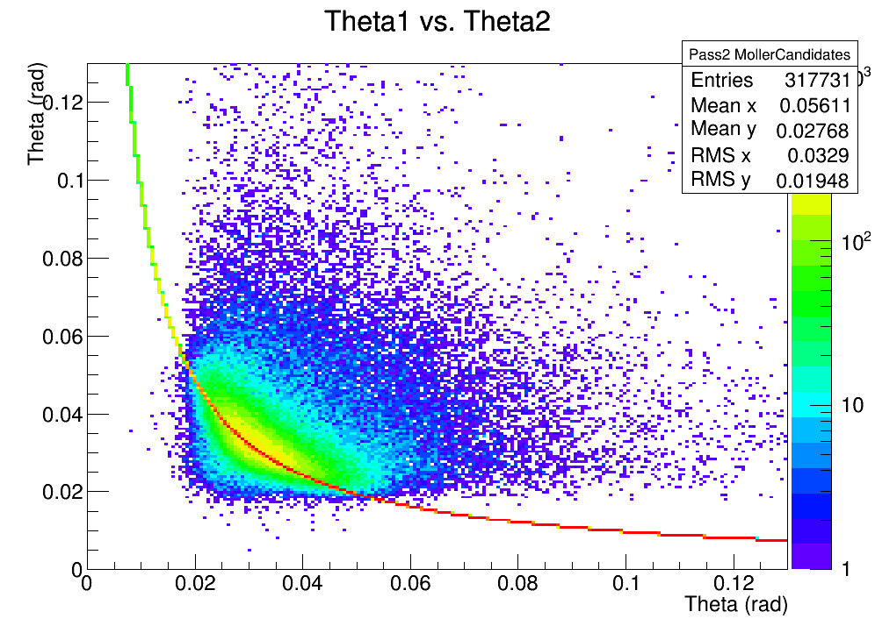
MollerCandidates from Skim before cuts (ECal Cluster E)
Using cluster E
may not be
optimal ->

Slide 18
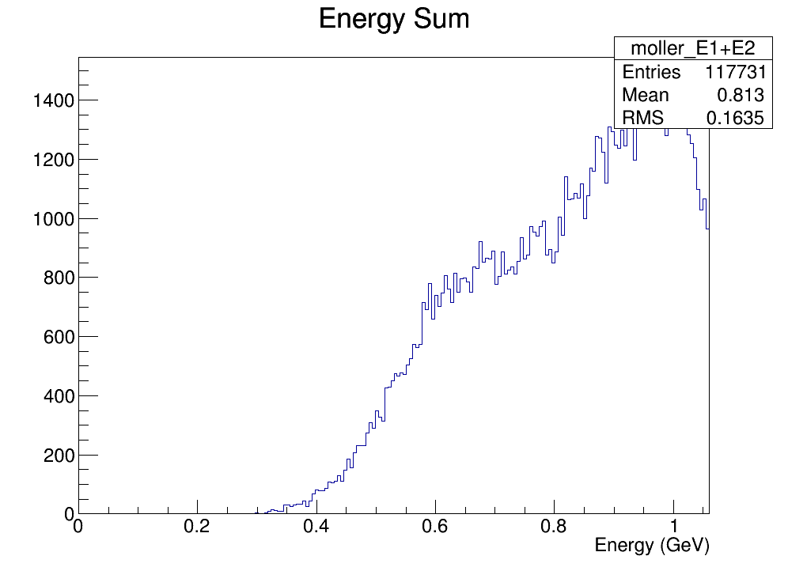
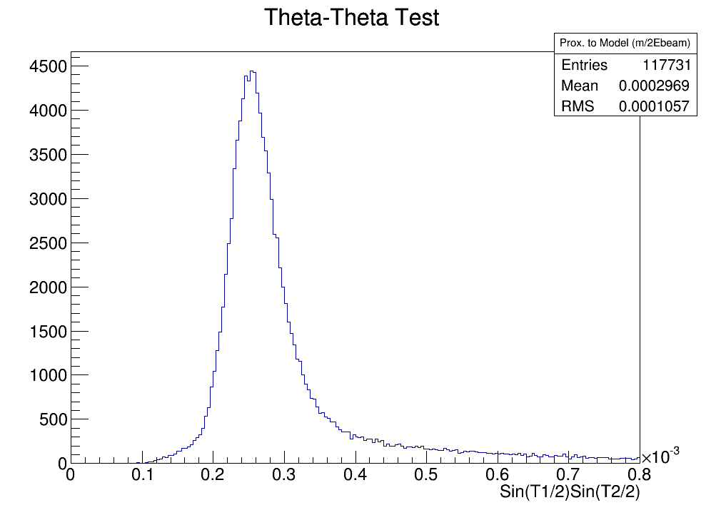
MollerCandidates from Skim before cuts (ECal Cluster E)

Slide 19
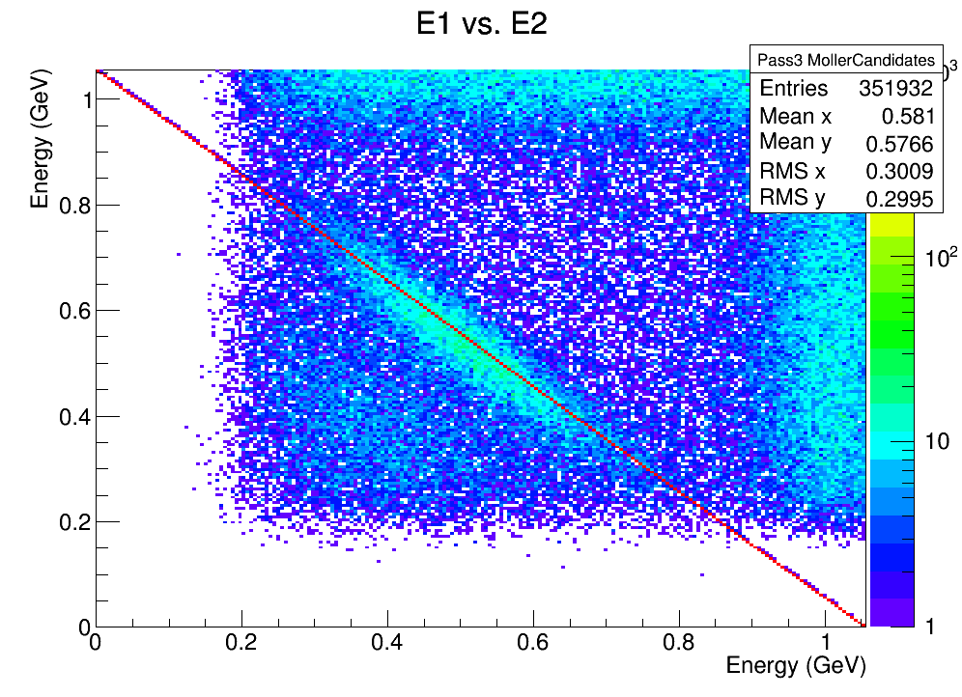
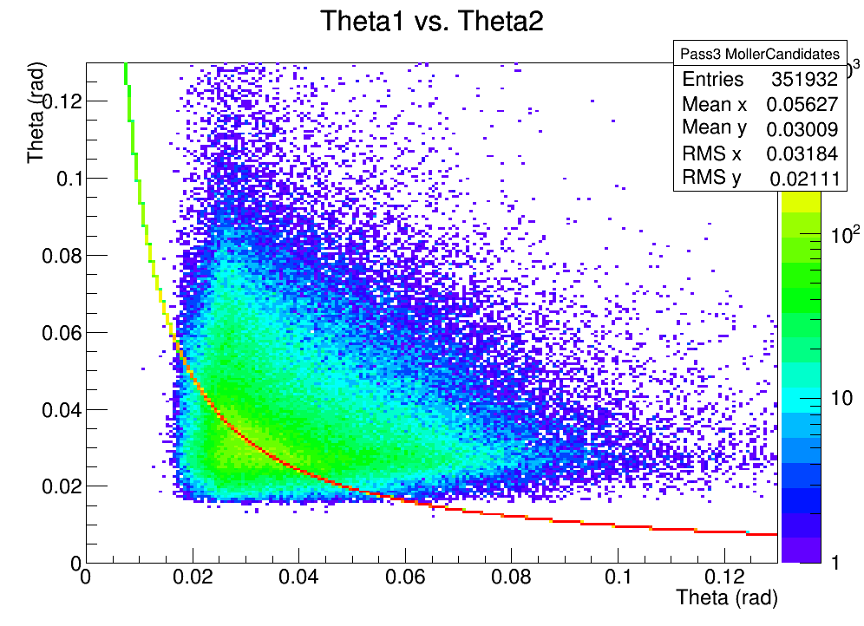
Pass3 “MollerCandidates” before cuts (GBL track E):
<- Lots of FEE…

Slide 20
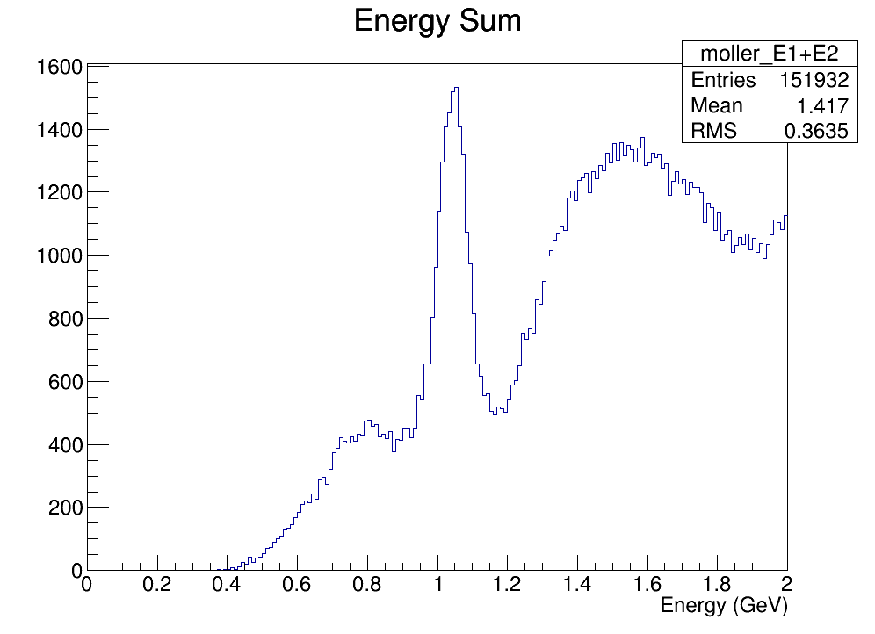
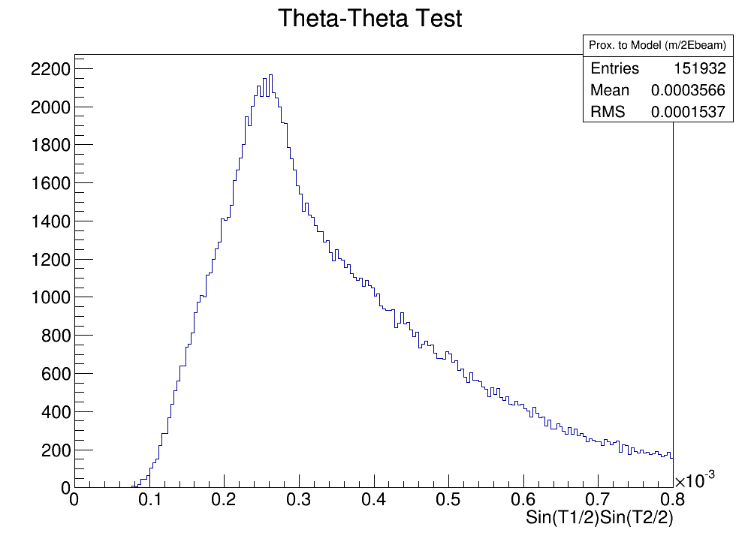
Pass3 “MollerCandidates” before cuts (GBL track E):

Slide 21
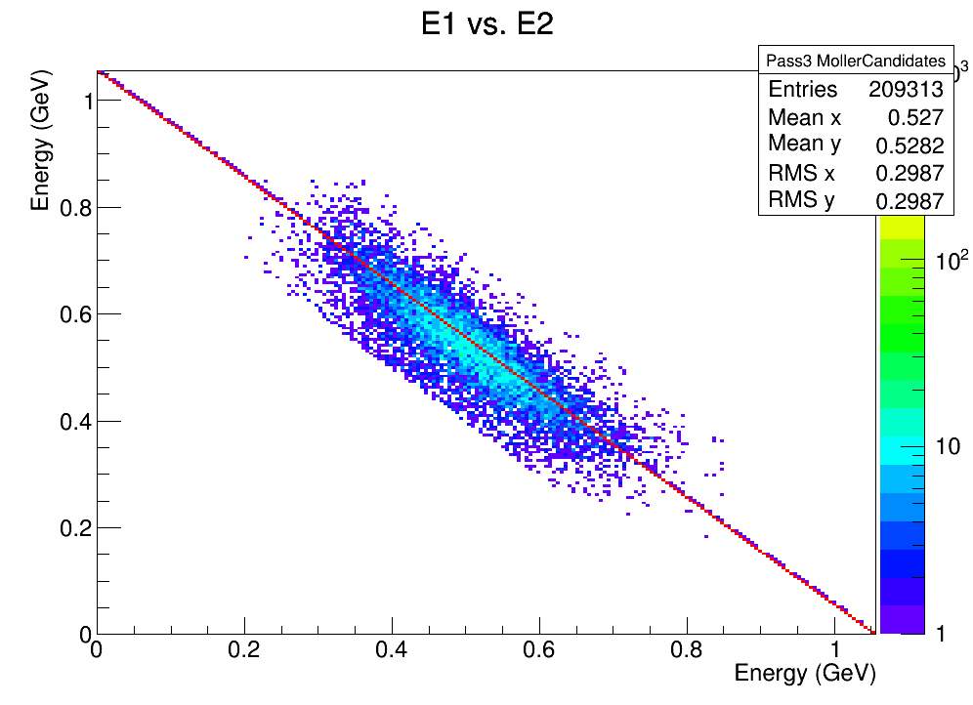
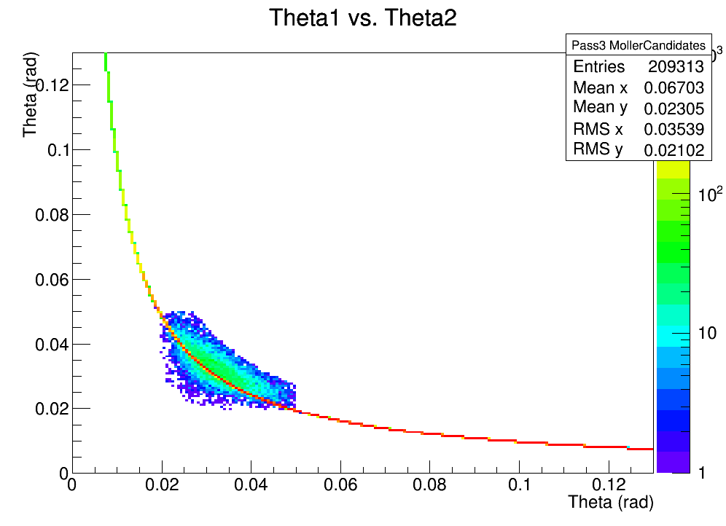
Pass3 “MollerCandidates” after cuts:

Slide 22
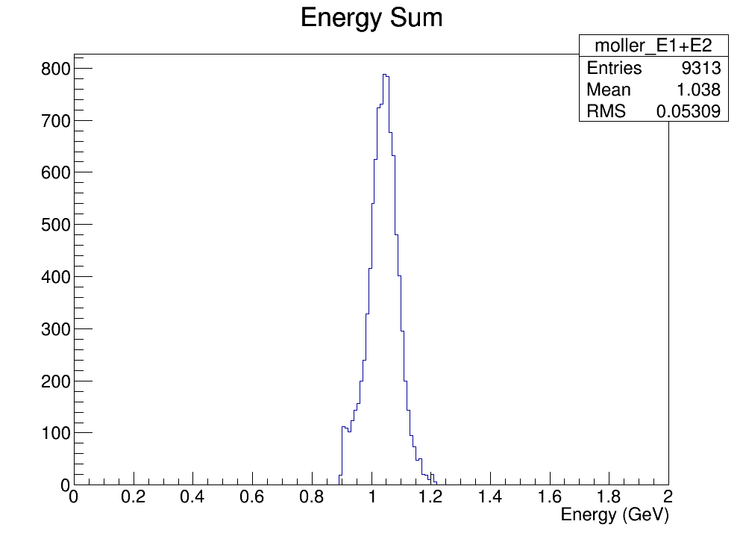
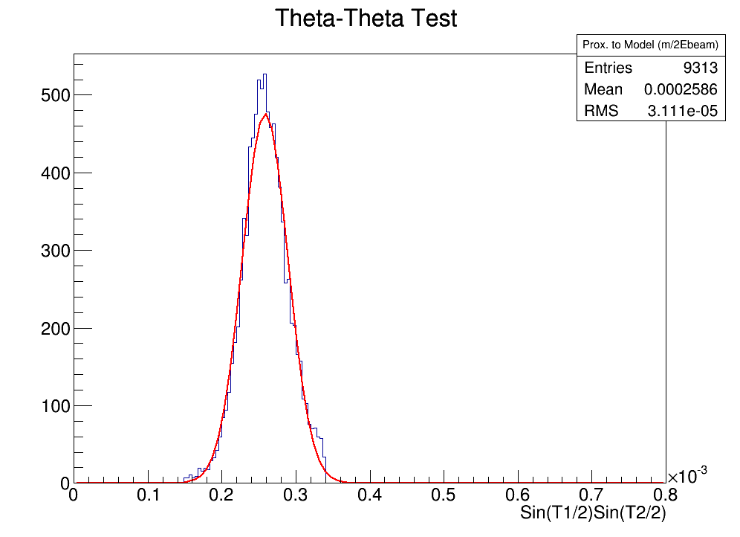
Pass3 “MollerCandidates” after cuts:
<- 15% resolution
difference
from pure MC

Slide 23
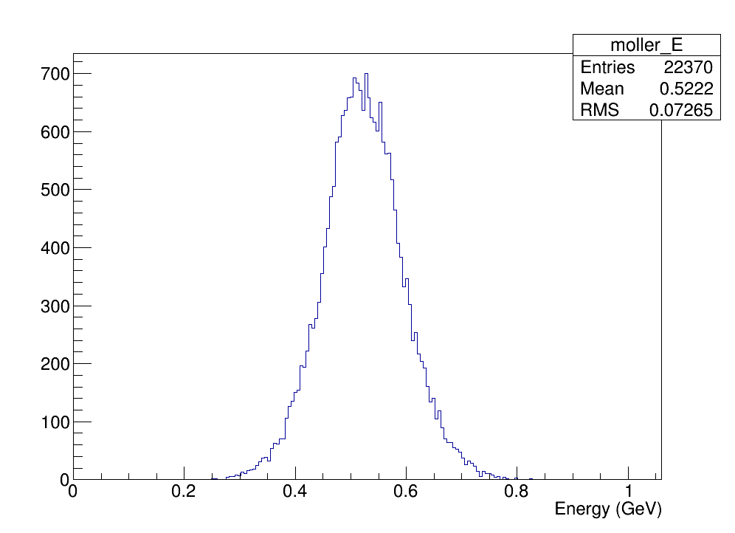
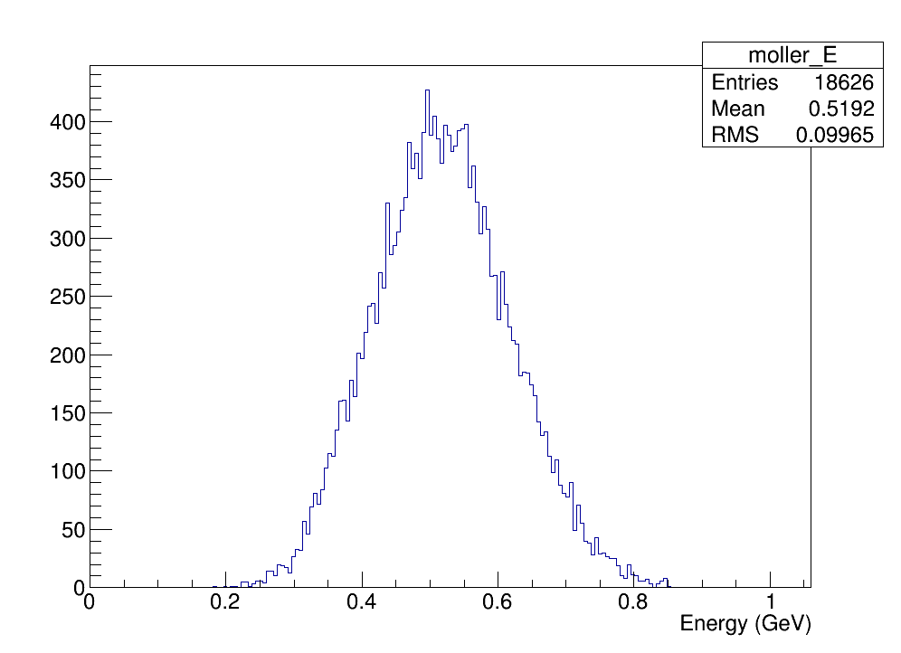
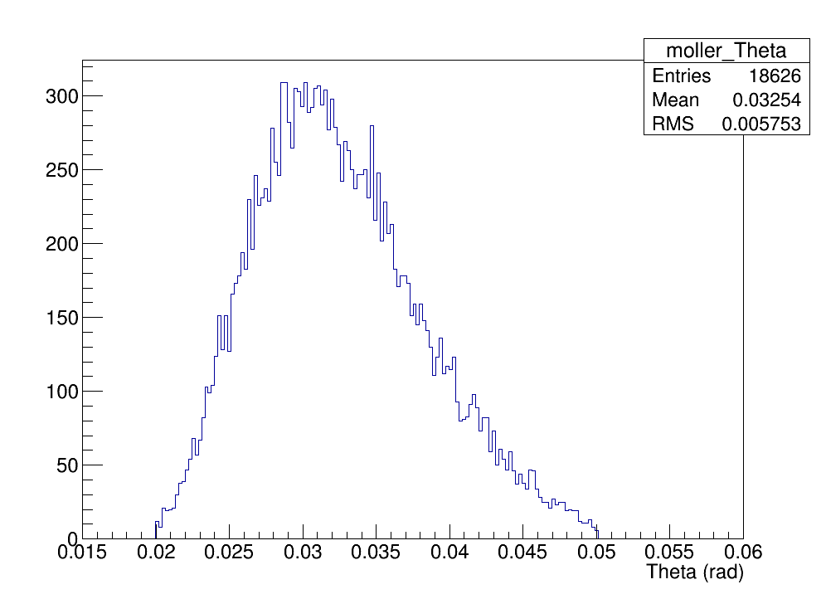
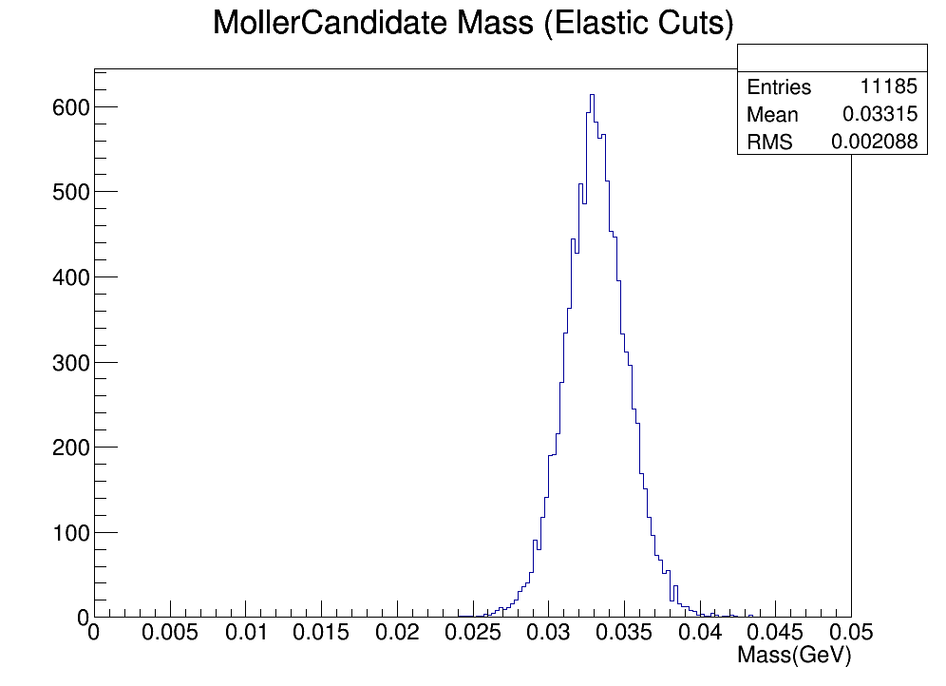
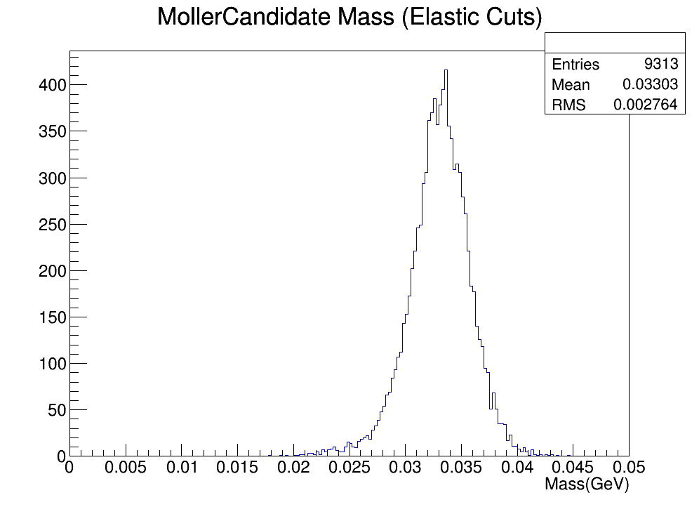
Pass3 PureMoller MC vs. Data

Slide 24
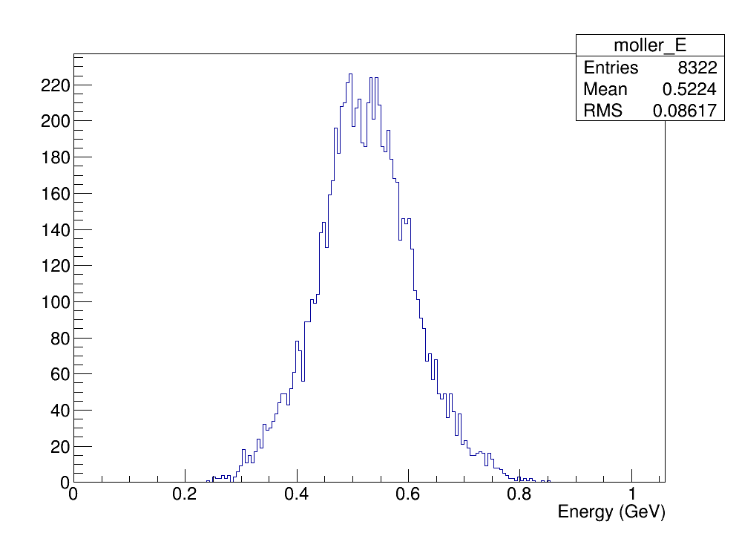
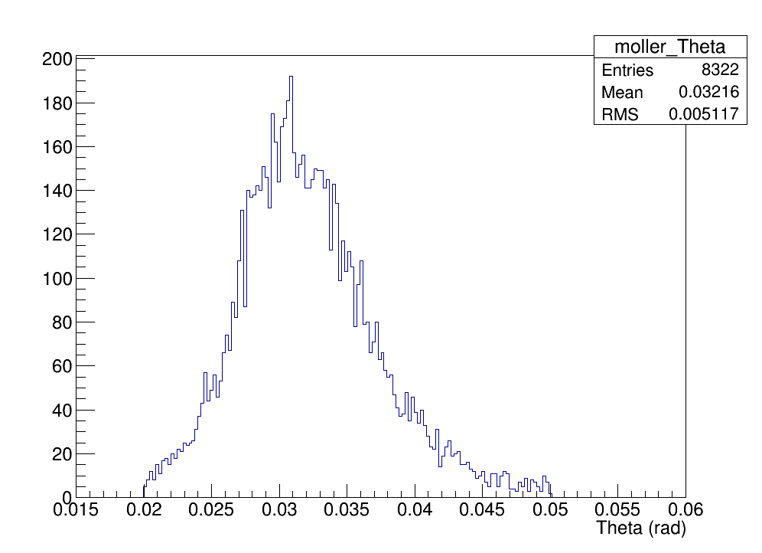
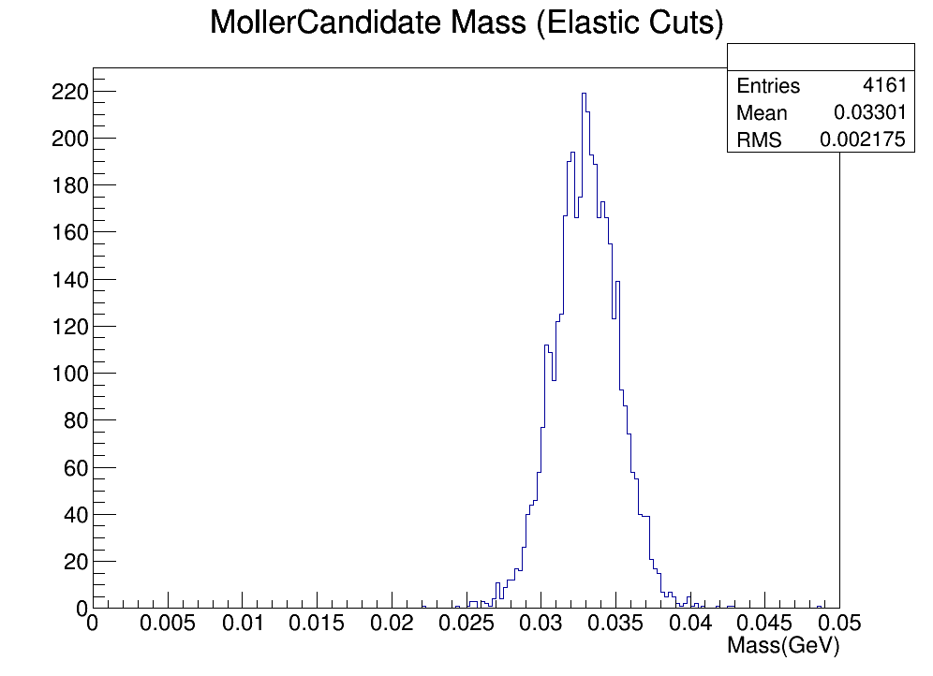
Pass3 Beam-Tri MC vs. Data

Slide 25
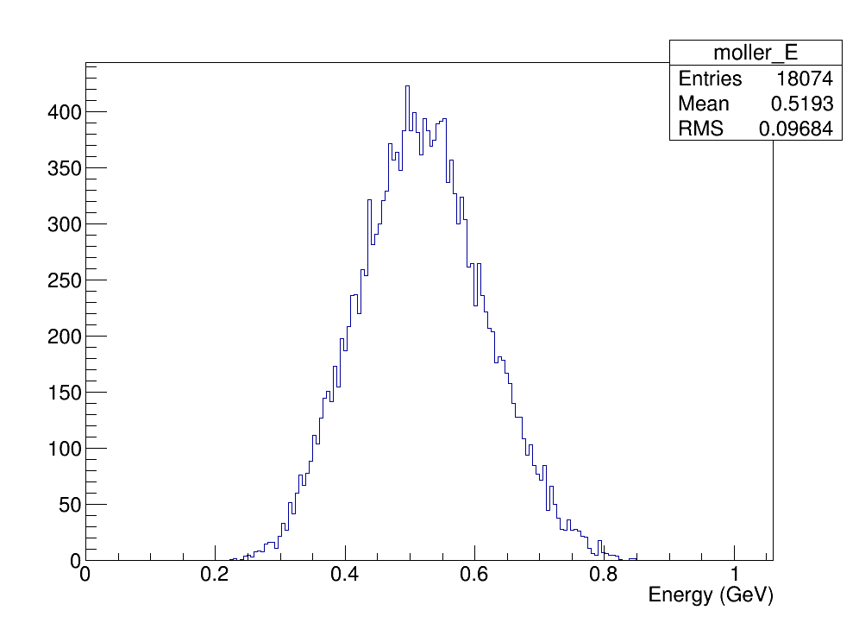
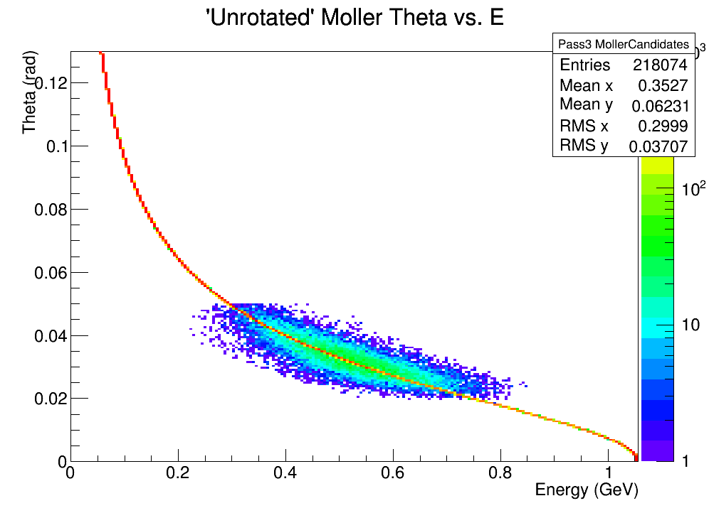
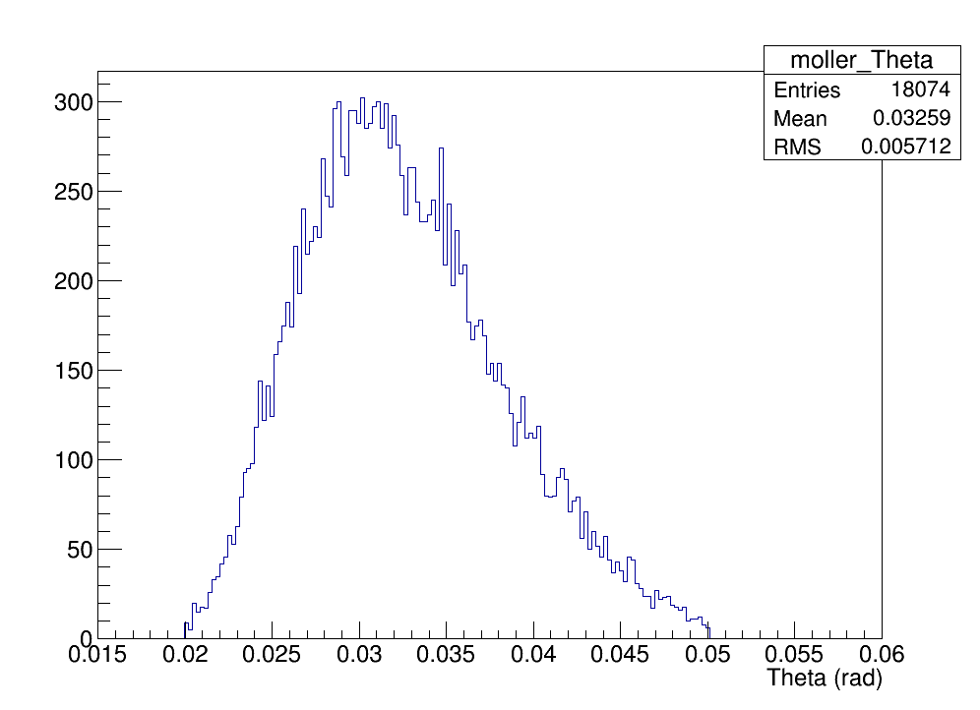
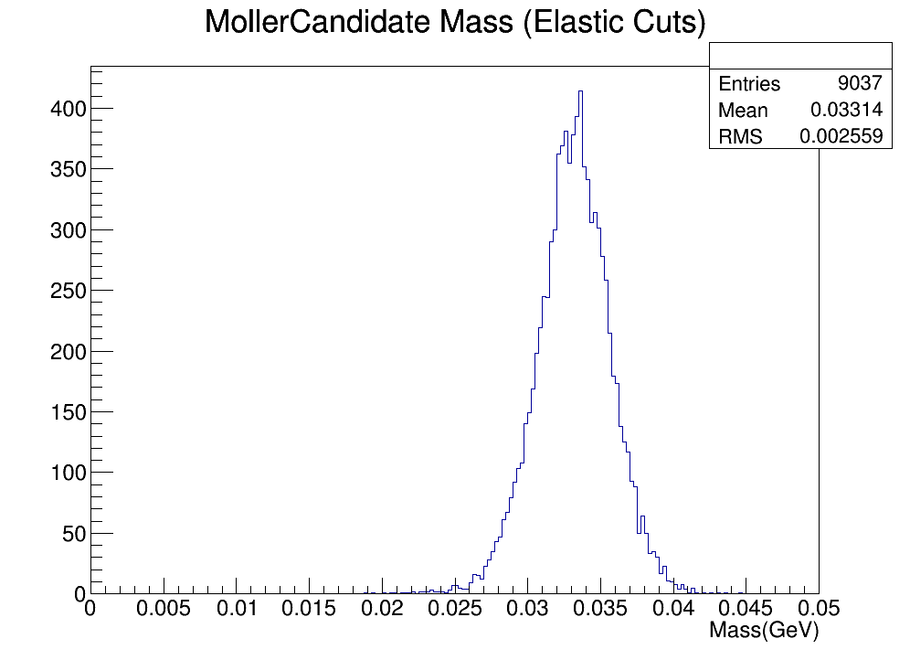
After additional E-Theta cut (E-Model <= 0.2)
MC
Data

Slide 26
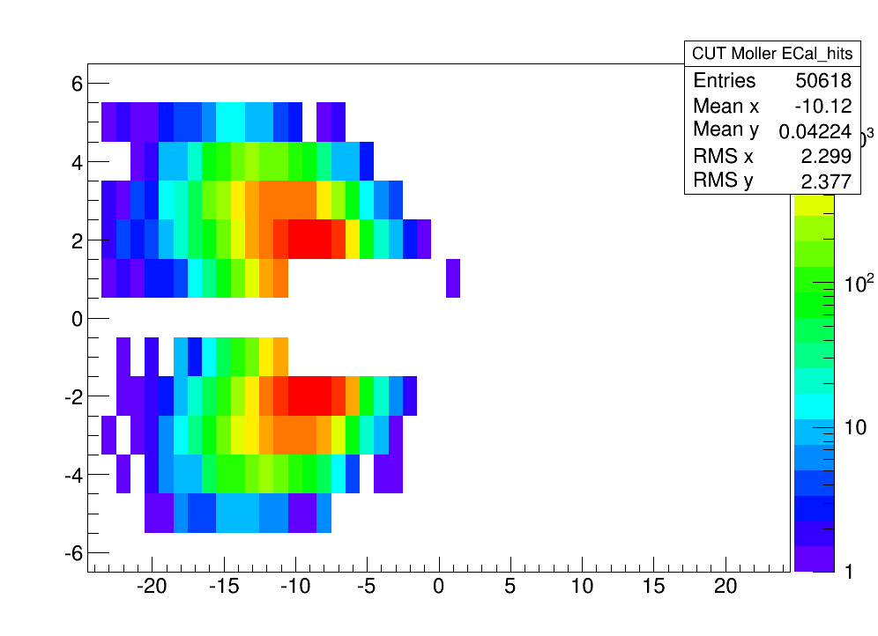
After additional E-Theta cut (E-Model <= 0.2)
Cut Data
Before
E-Theta cut
Cut Data
After
E-Theta cut
Still 27%-35% resolution difference from MC
in energy, theta, and mass
More cuts could be made,
but…

Slide 27
Moller Yields in MC
From PureMoller MC:
$$\frac{\# Moller Events}{\# Incident e^{−}}=\frac{34761}{10 SLIC∗1250000000}\sim 2.78∗{10}^{−6}$$
$$⇒(869 kHz, 100 mb)$$
$$\frac{\# Accepted Cut Mollers}{\# Scattered Mollers}=\frac{22370}{50 recon∗2∗34761}\sim 0.64\%$$
From Pass2 Beam-Tri MC:
$$\frac{Estimated \# Moller Events}{\# Incident e^{−}}\sim \frac{25640∗{\text{0.}95}^{−1}\text{∗}{\text{0.0}064}^{−1}}{50 recon∗100 SLIC∗\text{312500000}}\sim 2.69∗{10}^{−6}$$
$$⇒(843 kHz, 97 mb)$$
From Pass3 Beam-Tri MC:
$$\frac{Estimated \# Moller Events}{\# Incident e^{−}}\sim \frac{8322∗{\text{0.}95}^{−1}\text{∗}{\text{0.0}064}^{−1}}{19 recon∗100 SLIC∗\text{312500000}}\sim 2.19∗{10}^{−6}$$
$$⇒(720 kHz, 83 mb)$$
From cuts
Further cuts might worsen this
Files had inconsistent readout;
need to re-check once correct

Slide 28
Potential for Ecal Calibration
If Moller pairs can be confidently identified, then their related kinematics can be used as a calibration tool
In particular, if one Moller hits the fiducial region, and the other on the edge, then the correction for the edge crystals can be calculated

Slide 29
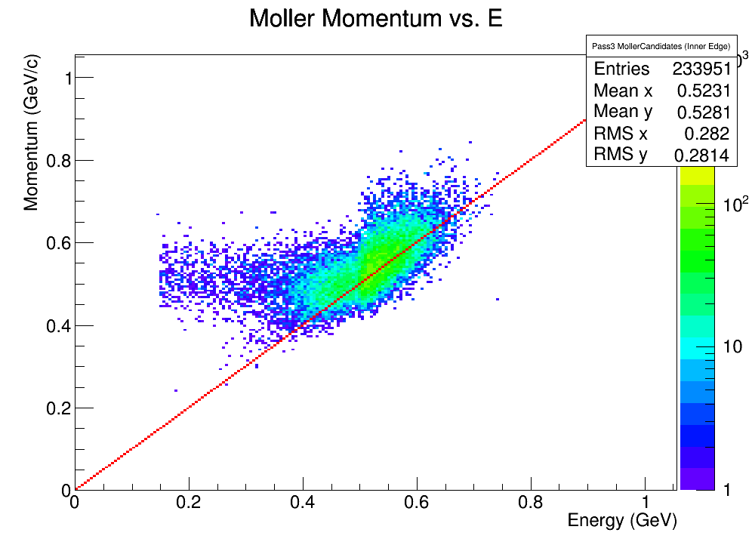
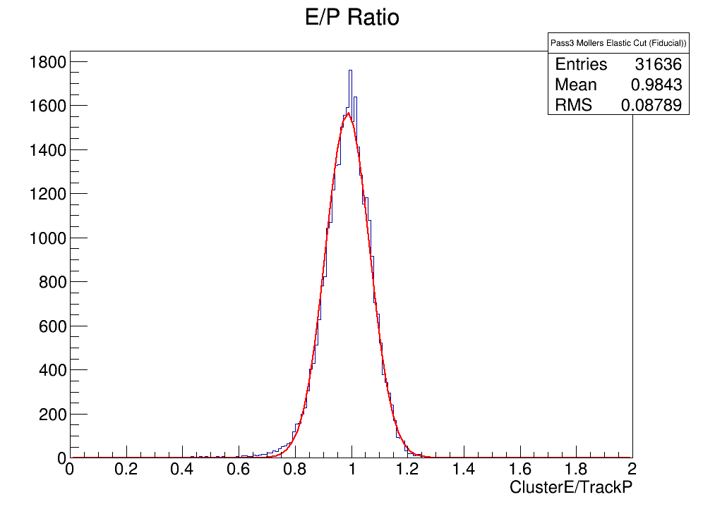
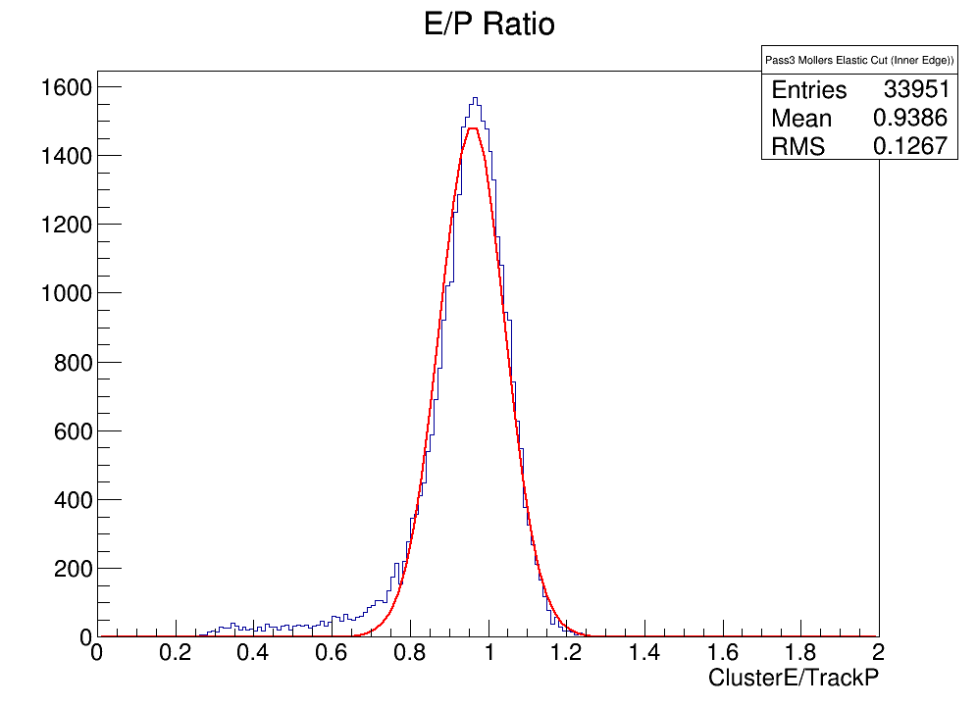
Potential for Ecal Calibration

Slide 30
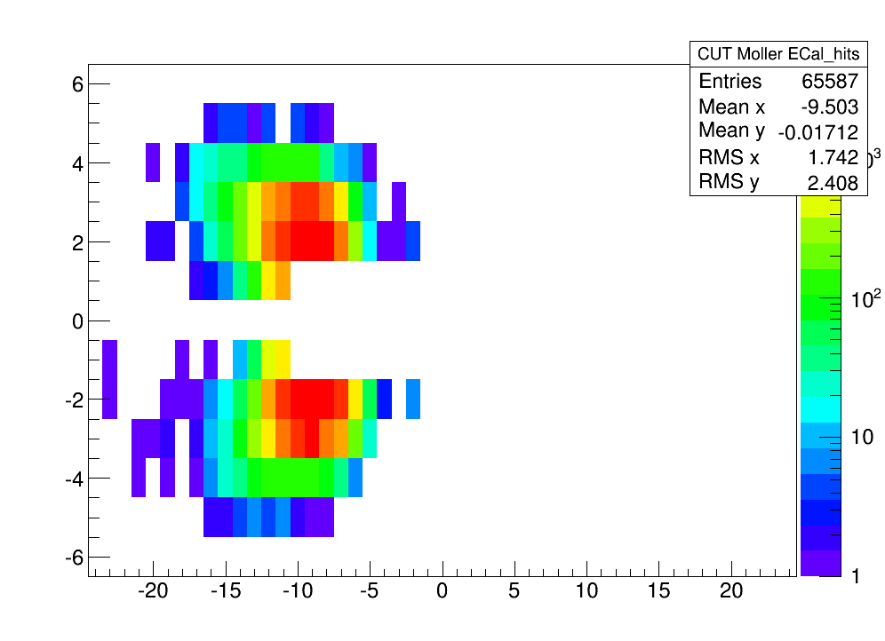
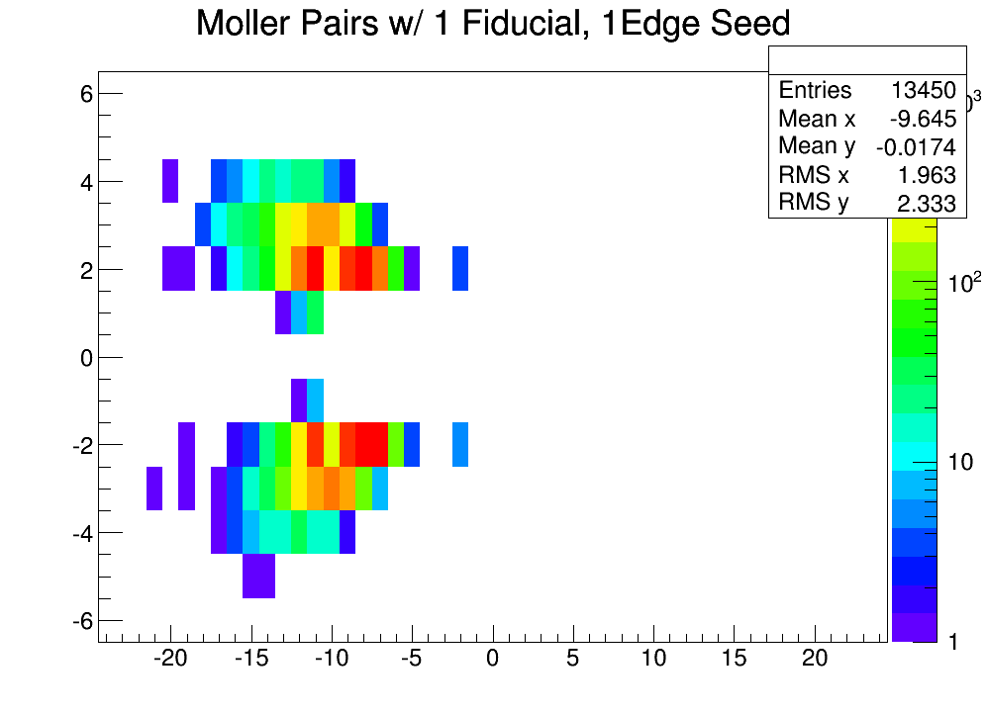
Potential for Ecal Calibration
Moller Seed Hits (Pure MC)
20% of cut singles1 recon Mollers can be used this way; more if the $χ^{2}$ cut is loosened

Slide 31
Summary
Virtually all Mollers can be captured by using elastic cuts and a pure MC ‘stencil’.
Kinematic distributions and rates appear to be in agreement
Data distributions (E, theta, mass) have worse resolution than pure Moller MC, but are similar to beam-tri
These cuts should be incorporated into the Moller filter, if similar yields can be verified when using them in data
Mollers would be ideal for finding energy corrections to the edge crystals, which are currently less reliable than the fiducial region

Slide 32
Extra Slides

Slide 33
Moller Yield
Moller Cross Section:
$$σ=$$
$$\left(\frac{\# Moller Events}{\# Incident e^{−}}\right){\left(\frac{N_{A}∗Density∗Thickness}{Z}\right)}^{−1}$$
Production Rate:
$$\# MollerEvents/sec=\frac{\# Moller Events}{\# Beam Bunches∗2ns}$$

Slide 34
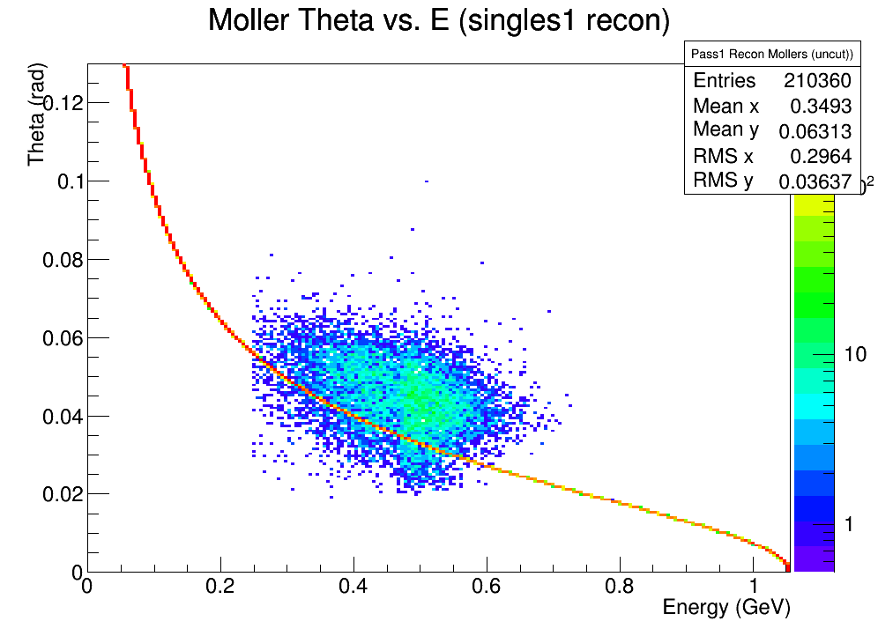
PureMoller Singles1 Recon
Idea: ‘Un-rotate’ track momentum
and re-calculate theta
=>
Additional Restriction:
Two e- with the same vertex
On opposite halves of the ECal
$$\left.pz′ = pz∗cos(−0.0305) − px∗sin(−0.0305\right)$$
$$\left.px′ = px∗cos(−0.0305) + pz∗sin(−0.0305\right)$$

Slide 35
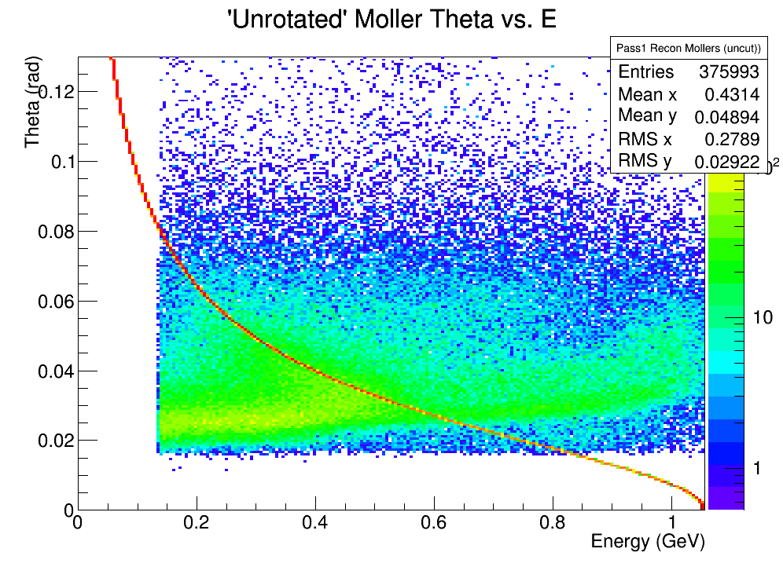
Electrons in data

