Slide 1
Recoil e- detection in Radiative tridents
5 SVT-hit detection efficiency for recoil e- in the current HPS is less than 5%.
Additional detector at the side was considered before, but such a detector is expensive and the recoil electron detection is limited.
Consider a SVT layer at Z=5 cm.

Slide 2
Pre-select Radiative tridents
Tridents at 6.6 GeV
E(e±) > 500 MeV
|θy (e±)| > 10 mrad
E(e⁺)+E(e⁻) > 0.8 × Ebeam
Mass(e⁺e⁻) > 20 MeV
No cuts on recoil e-

Slide 3
Run recoil e-
SVT 5-hit and Ecal acceptance for (e+,e-)
24,442 events / 100,000 events
For these (e+,e-) accepted events, run only recoil e- through the HPS.

Slide 4
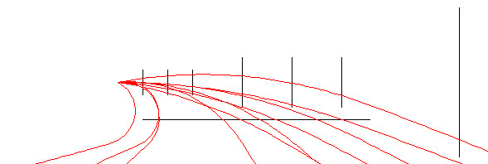
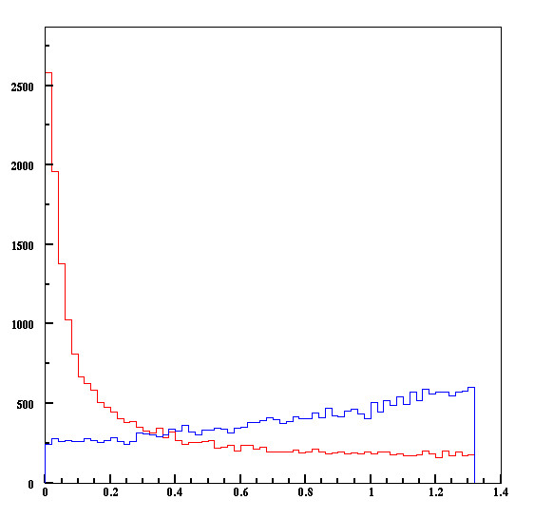
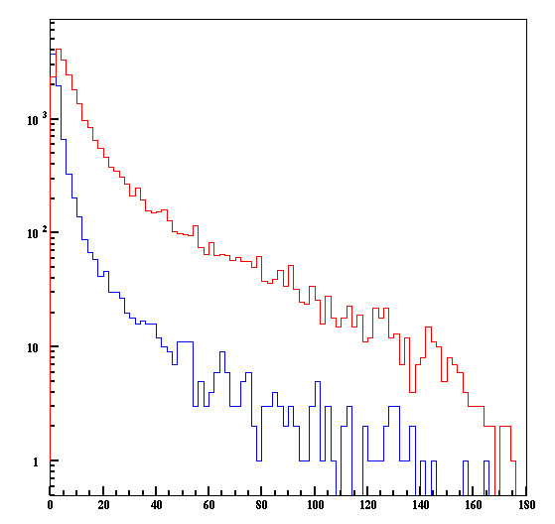
Layer 0 at Z=5 cm
ECal
SVT
Radiative Tridents
Possible detector at the electron side
Rad
Recoil e- in Radiative tridents are more spread.
BH
E (e-_{R}) (GeV)
θ (e-_{R}) (deg.)

Slide 5
Recoil electron acceptance
14%
9%

Slide 6
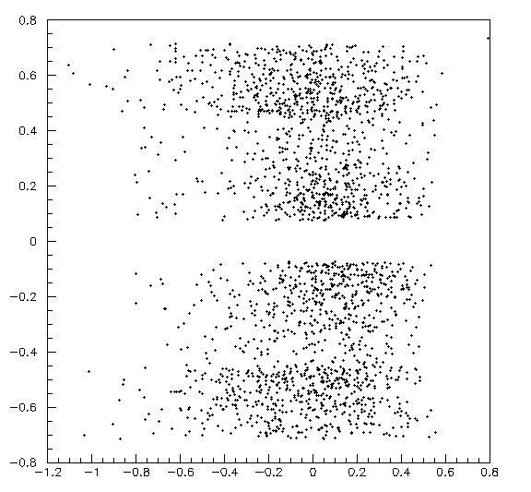
Layer 1, 2, 3 Hits
Layer 0 at Z = 5 cm
2175 events (8.9%)
Miss L4 at the top.
Y (cm)
Swept out at side between L3 and L4
Miss L4 at the bottom.
X (cm)

Slide 7
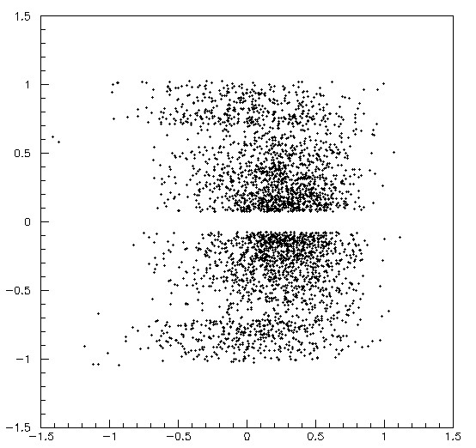
Layer 1 and 2 Hits
Layer 0 at Z = 5 cm
3426 events (14%)
Miss L3 at the top.
Swept out at side between L2 and L3
Y (cm)
Miss L3 at the bottom.
X (cm)

Slide 8
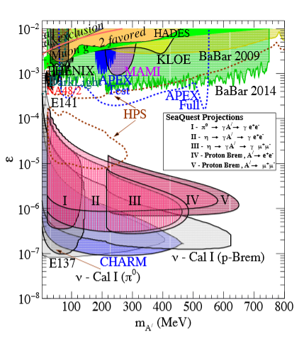
HPS Upgrade Discussions
SeaQuest Reach du jour
John Jaros HPS Collaboration Meeting at JLAB October 28, 2015

Slide 9
Why Upgrades? Goal today?
Why consider Upgrades? * Improve HPS Physics Reach Close Mont’s gap? Move to higher masses? * There is a Window of Opportunity for funding/construction during CLAS completion and commissioning in FY2017 * Good training for new graduate students (and the rest of us)
Standing Offer * Free pizza and beer for good proposals!
Today’s Goal: * Get some ideas out in the open * Stimulate more ideas

Slide 10
Some Generic Possibilities
With GBL, Ecal, and recoil, reach is already better than in proposal. But improvements aren’t yet documented.
Improve Mass Resolution GBL√ Ecal assisted energy measurement√ Boost Magnetic Field What else?
Measure Recoil Electrons more efficiently (improve mass resolution, E_{tot}) Add another tracking layer? Where?
Reduce Vertex Tails (improvements in mass resolution will also lower vertex tails ) Move target closer (changes theta min; so should also move closer to beam?) Thin layer 1 (tails ∝ sqrt(thickness) ?) L1 axial only? Better Idea?
Change running conditions (may require upgrades) Higher current running? Optimize theta min vs current? (not much to gain here) Running at higher energies?

Slide 11
Plan Today
Muon System Upgrade Keith
Recoil electron measurement Takashi
Adding Layer 0 in the SVT Tim

Slide 12
Next Steps
Turn concepts into proposals; submit to EC
EC selects viable proposals
Prepare formal proposal for DOE funding
Submit to DOE

Slide 13
Backup Slides

Slide 14
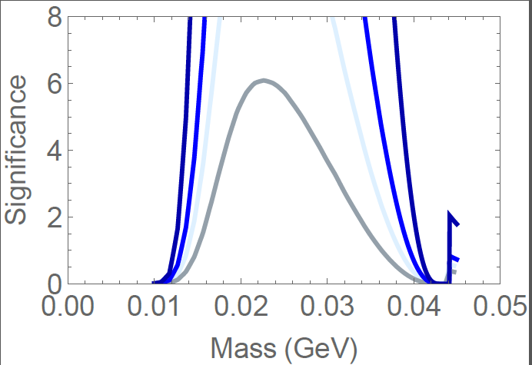
Significance vs Mass (1.1 GeV; ε=3x10⁻⁹) Matt’s Plots
PAC Days
3 days 15 mrad 3 days 25 mrad 7 days 15 mrad
14 days 15 mrad
Note: Signif ∝ Time
HPS could cover
25 – 34 MeV in 3 PAC days

Slide 15
