Slide 1

Welcome to HYP2018
Robert McKeown
HYP2018

Slide 2
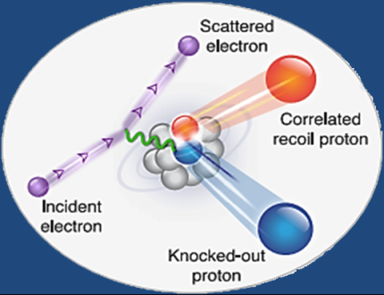

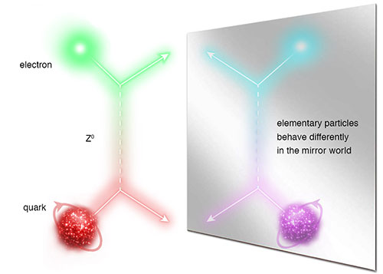
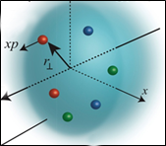
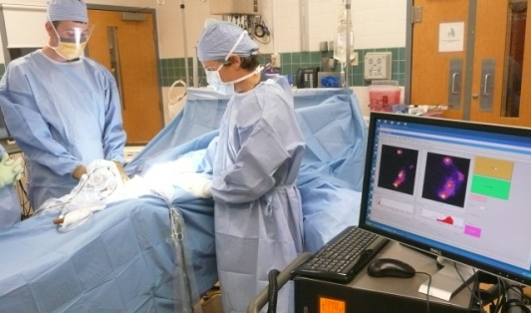
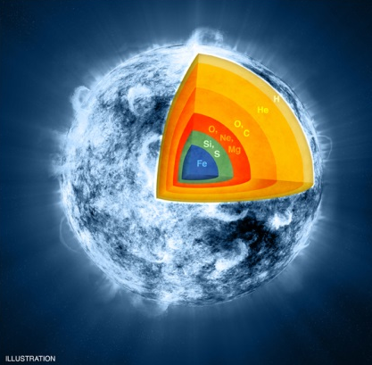
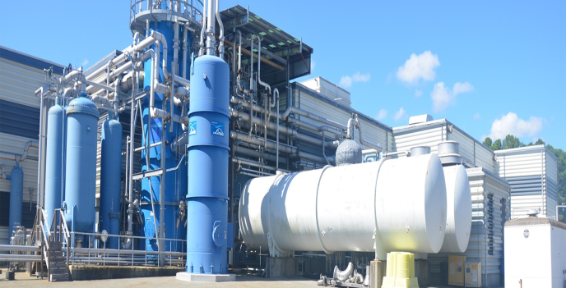
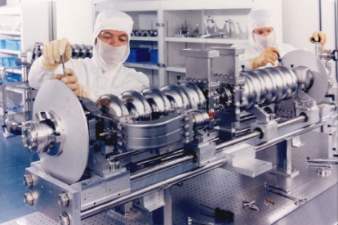

Jefferson Lab: A Laboratory For Nuclear Science
Z⁰
Nuclear Structure
Fundamental
Forces & Symmetries
Structure of Hadrons
Medical Imaging Technology
Nuclear Astrophysics
Cryogenics
Accelerator S&T
Theory & Computation

Slide 3

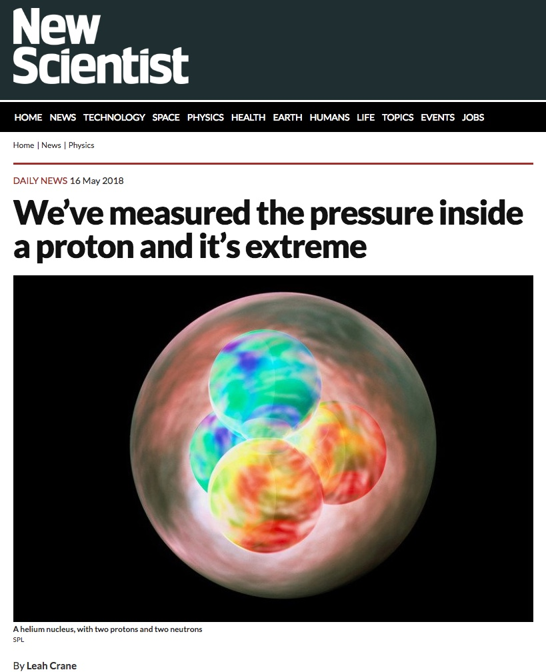
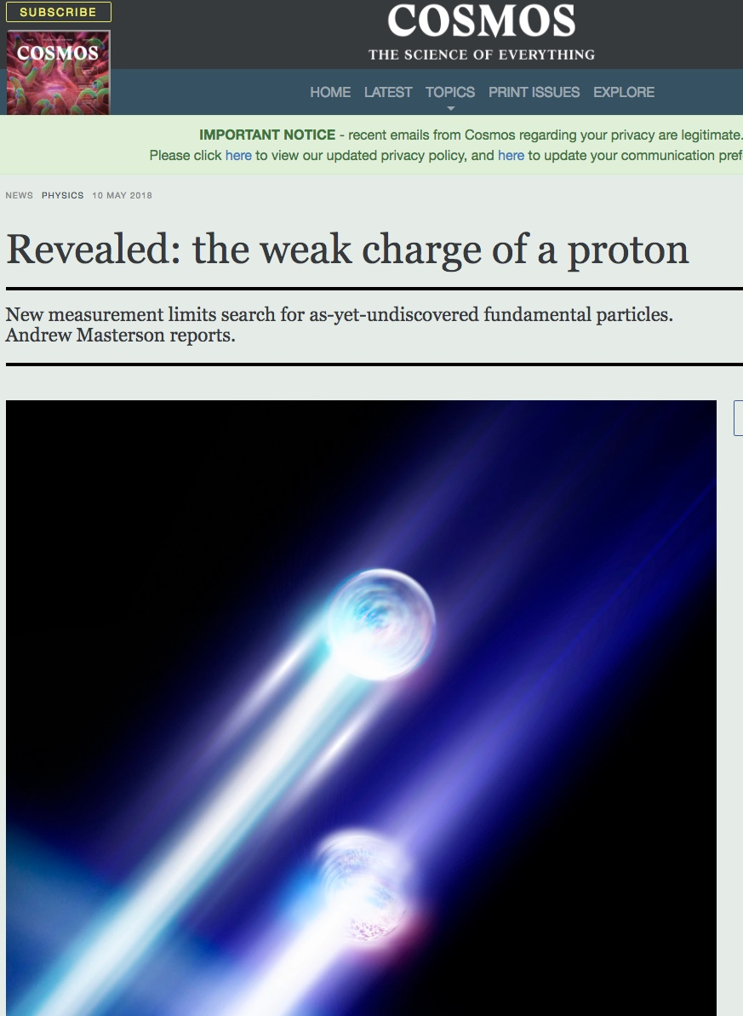
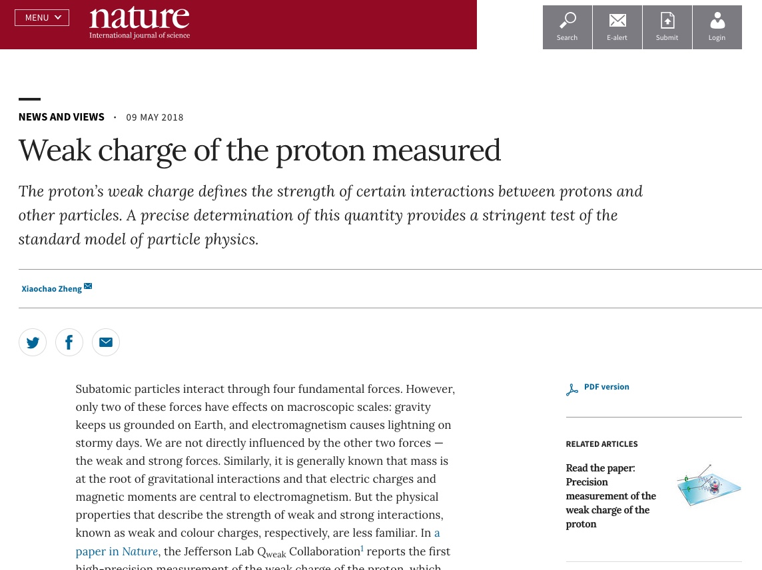
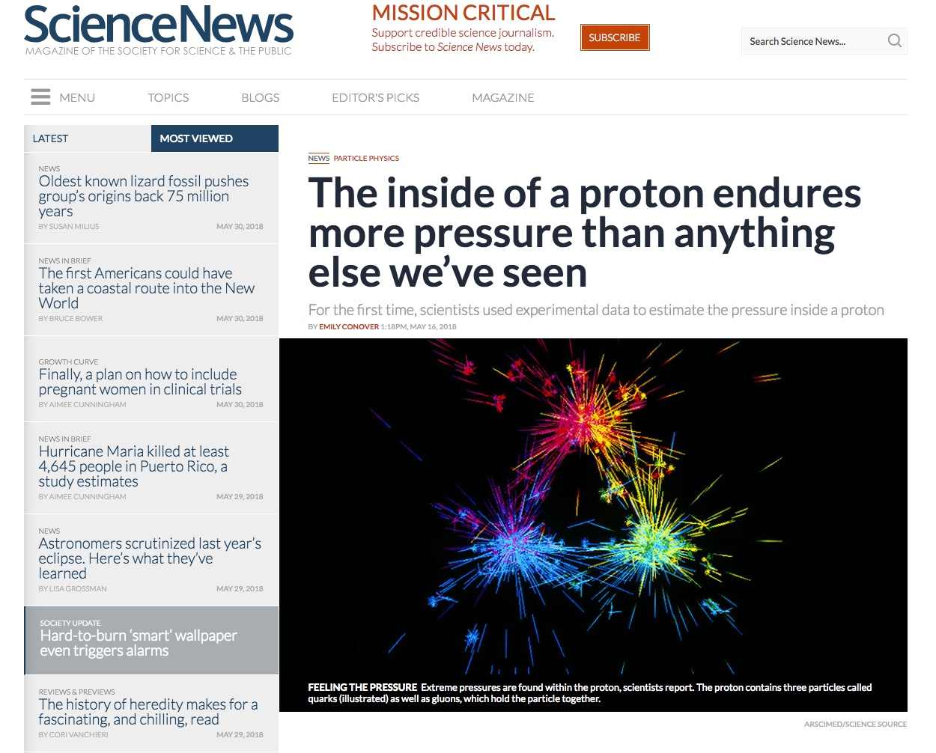
Results Accepted and/or Published in Nature
Precision measurement of the weak charge of the proton, Qweak collaboration,
Published: Nature 557, 207–211 (2018)
The pressure distribution inside the proton, Burkert, Elouadrhiri, Girod, Published: Nature 557 (2018) no.7705, 396-399
A per-cent-level determination of the nucleon axial coupling for quantum chromodynamics, Berkowitz et. al., Published: Nature 558, 91-94 (2018)
Ultrafast Nucleons in Asymmetric Nuclei, M. Duer et. al., CLAS Collaboration, accepted for publication
A glimpse of gluons through deeply virtual compton scattering on the proton, Dufurne et. al., Published: Nature Communications 8, 1408 (2017)
3

Slide 4
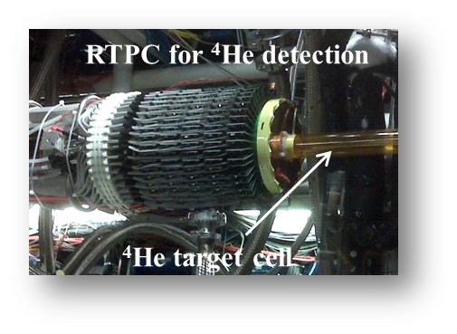

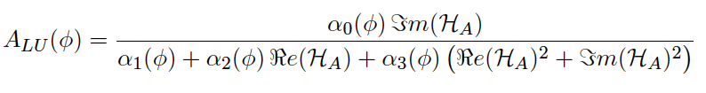
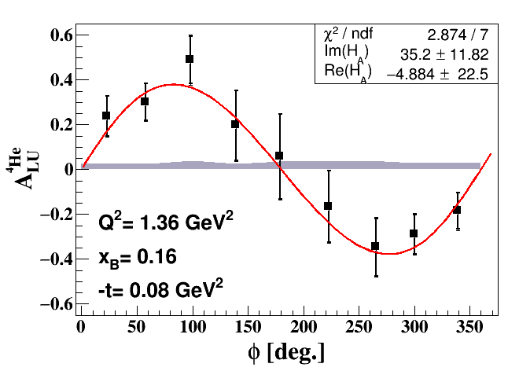
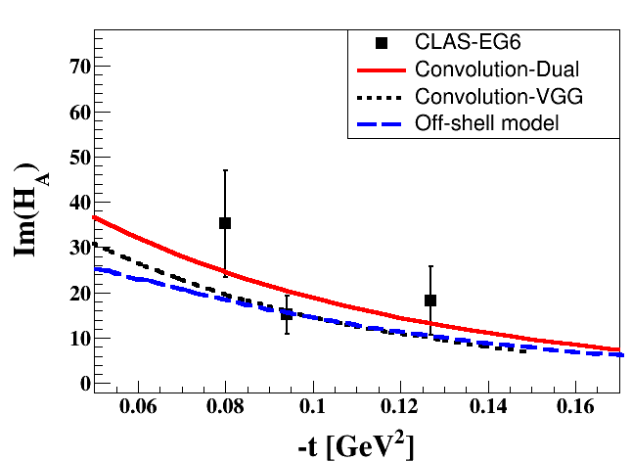
Other Recent 6 GeV Results
DVCS on ⁴He with CLAS; published in PRL: Phys. Rev. Lett. 119, 202004
Multiple nucleon resonances now confirmed; highlighted in Particle Data Group (PDG) tables.
Study the nuclear medium modifications in ⁴He:
one GPD (H_{A}(x,ξ,t)).
State N(mass)J^{P} | PDG pre 2012 | PDG 2018*
N(1710)1/2⁺ | *** | ****
N(1880)1/2⁺ |  | ***
N(1895)1/2⁻ |  | ****
N(1900)3/2⁺ | ** | ****
N(1875)3/2⁻ |  | ***
N(2120)3/2⁻ |  | **
N(2000)5/2⁺ | * | **
N(2060)5/2⁻ |  | **
Δ(2200)7/2⁻ | * | ***
Beam
Asymmetry
**** Existence is certain
*** Existence is very likely
** Evidence of existence is fair
* Evidence of existence is poor
First study of Nuclear GPD  3D Imaging

Slide 5
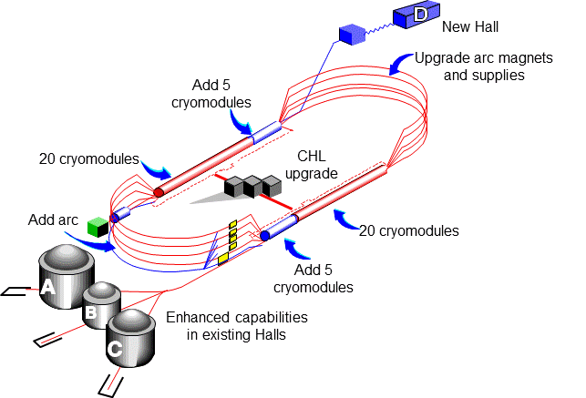
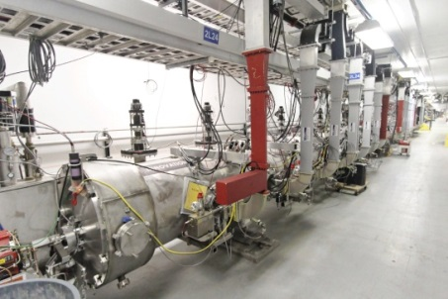
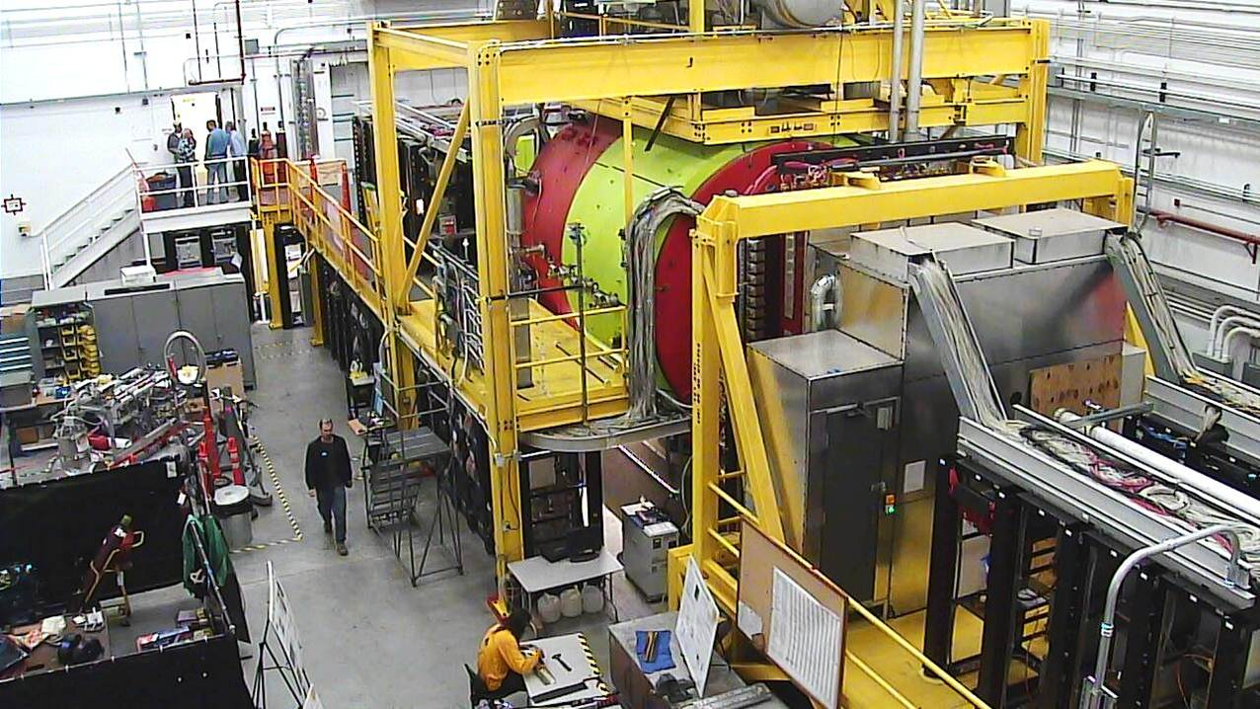
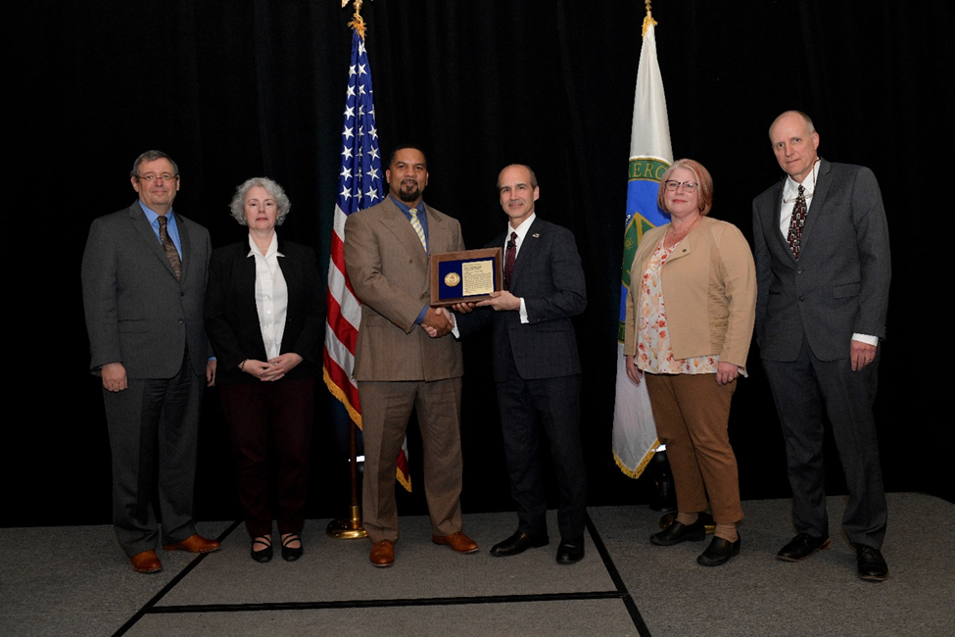
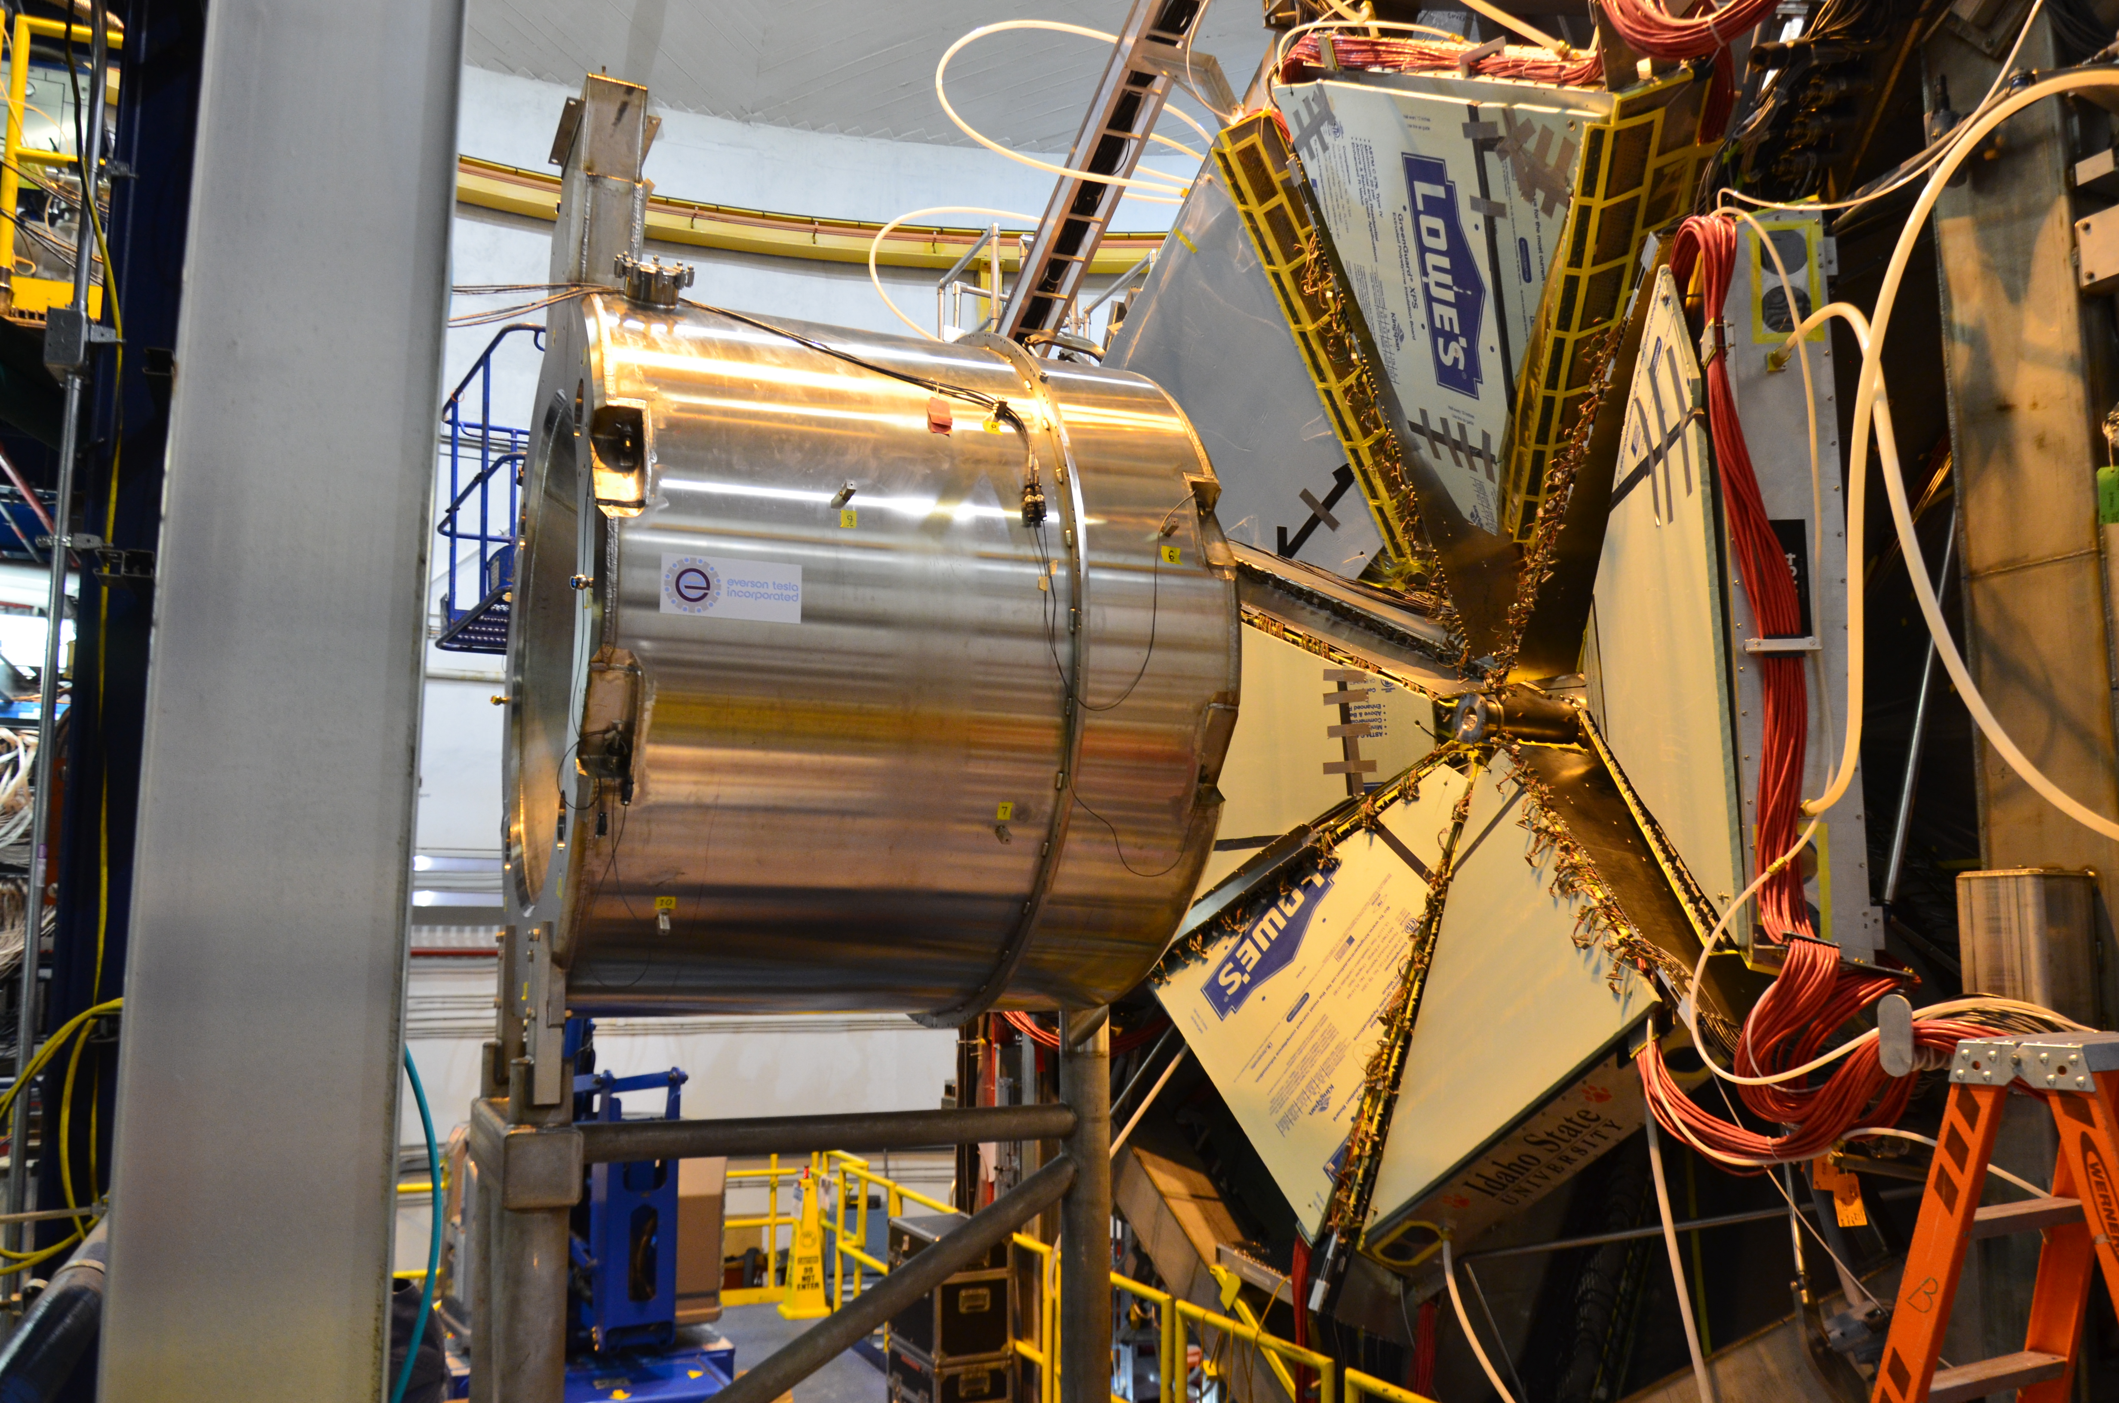
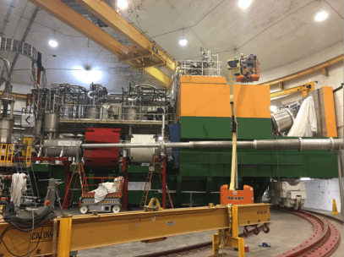
12 GeV CEBAF Upgrade Project Is Complete, On-time and On-Budget!
Secretary of Energy Project Management Achievement Award
Project Completion Approved September 27, 2017

Slide 6
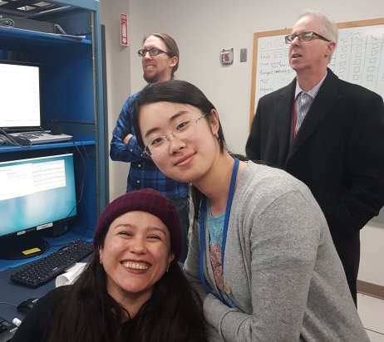
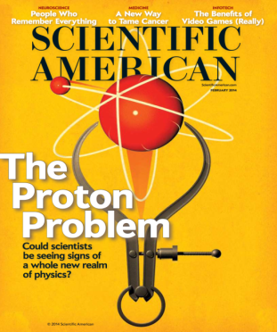
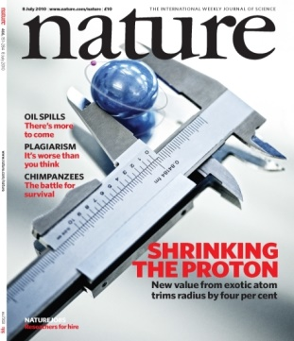
12 GeV Science Era is Here!
Hall A: In physics operations
  December 15, 2017: First Beam on Tritium Target!
  First 12 GeV era publications this year
Hall B: In physics operations
  Start of CLAS12 Physics in February
  Publications anticipated from Proton Radius and Heavy Photon Search experiments
Hall C: In physics operations
  Spectrometer engineering run completed
  Physics data-taking started January
  Initial measurements will lead to early publications.
Hall D: In physics operations (GlueX)
  Dozens of papers at 2016/2017 American Physical Soc. Div. Nuclear Physics meetings
  First 12 GeV era publication (April, 2017) Working on several other publications

Slide 7

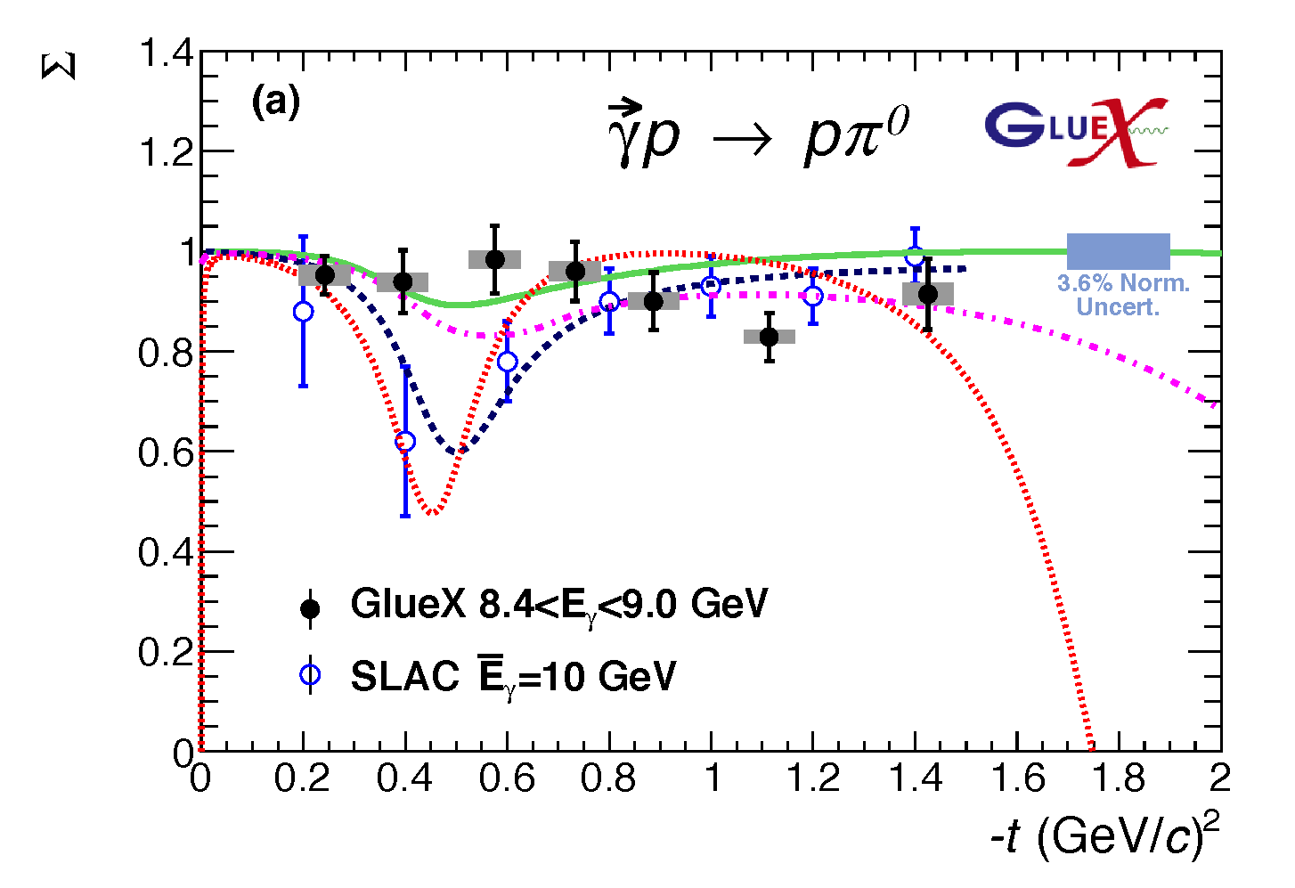

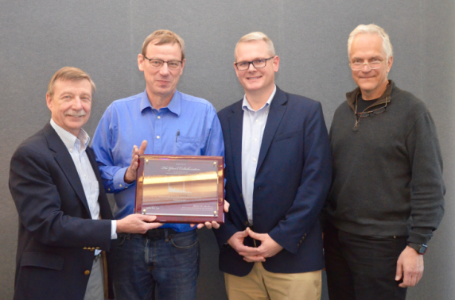
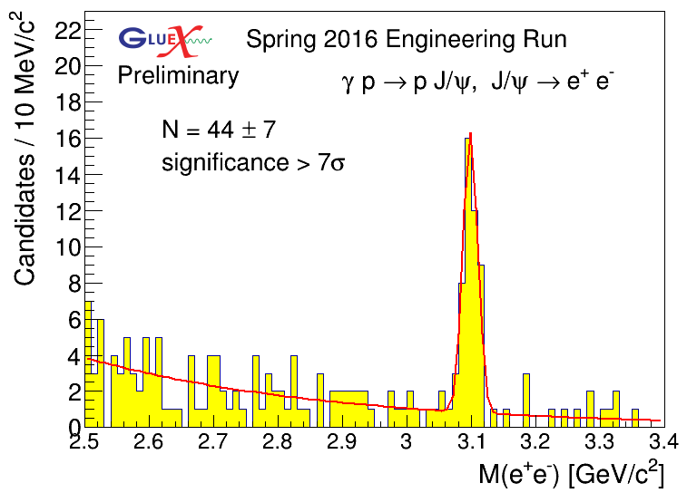
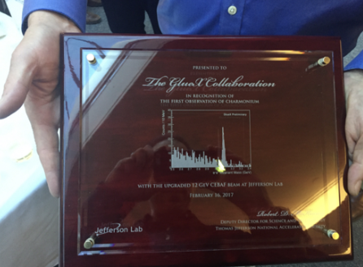
First Published Results from 12 GeV CEBAF
The first experimental results, from data collected in the GlueX engineering run, have been published in Phys. Rev. C.
The new GlueX results show:
• For neutral pions, the reaction mechanism is dominated by pure vector coupling.
• The first data for beam asymmetry for η production >3 GeV.
• The GlueX experiment in Hall D can produce timely results.
Σ
GlueX will search for hybrid mesons, particles in which the strong gluonic field contributes directly to their properties. From the spectrum of these particles, we can learn about the gluonic field in QCD.
Bonus:
First observation of charmonium at JLab!

Slide 8
Approved experiments
Topic | Hall A | Hall B | Hall C | Hall D | Other | Total
The Hadron spectra as probes of QCD | 0 | 3 | 1 | 3 | 0 | 7
The transverse structure of the hadrons | 6 | 4 | 3 | 1 | 0 | 14
The longitudinal structure of the hadrons | 2 | 3 | 6 | 0 | 0 | 11
The 3D structure of the hadrons | 5 | 9 | 6 | 0 | 0 | 20
Hadrons and cold nuclear matter | 8 | 4 | 7 | 0 | 1 | 20
Low-energy tests of the Standard Model and Fundamental Symmetries | 3 | 1 | 0 | 1 | 1 | 6
Total | 24 | 24 | 23 | 5 | 2 | 78
Total Experiments Completed | 4.6 | 2.7 | 2.1 | 0.8 | 0 | 10.2
Total Experiments Remaining | 19.4 | 21.3 | 20.9 | 4.2 | 2.0 | 67.8

Slide 9
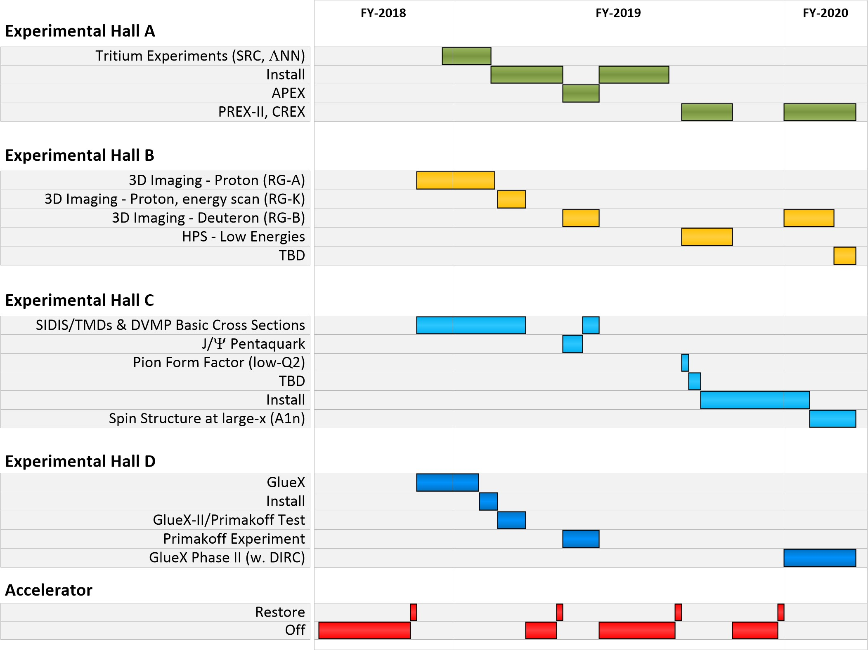
Near Term CEBAF Schedule
Note: 7 “High Impact” Experiments!

Slide 10
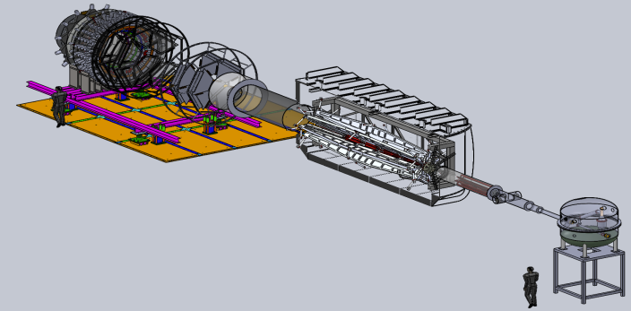

Future Projects
MOLLER experiment
(Possible MIE – FY19-23)
– Precision Standard Model Test
– DOE science review (Sept. 2014) – strong endorsement
– Director’s Cost, Schedule and Technical review held Dec. 2016
– CD-0 approved, Dec. 2016
(project paused due to budget)
– Awaiting green light to proceed
SoLID
– Large acceptance, high lumi
– SIDIS and PVDIS
– CLEO Solenoid 
– International collaboration
– Director’s review (Feb. 2015)
 new pre-CDR complete
– Awaiting science review from ONP

Slide 11
Center for Nuclear Femtography
Proposal to Commonwealth of VA
Consortium of VA universities
Theoretical physics, experimental physics, computation, statistics – broad involvement
Initial request of $.5M for pilot study, funding of ~$2M/year envisioned

Slide 12
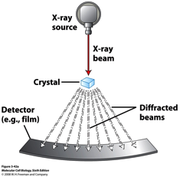
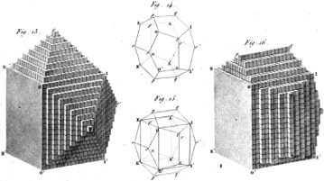
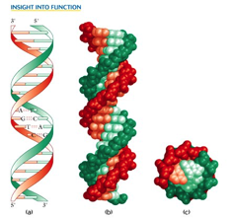
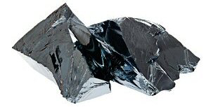
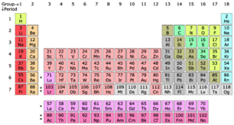
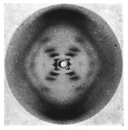


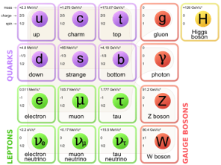
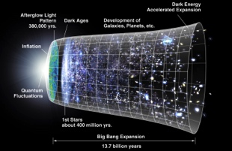
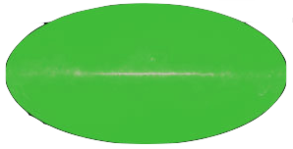
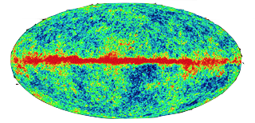
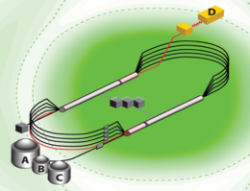
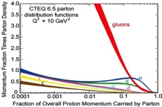


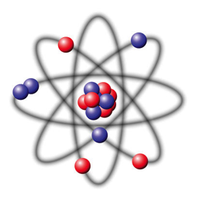



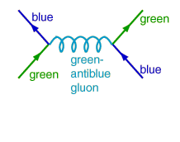

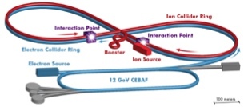
QCD: a New Frontier
Dynamical System | Fundamental Knowns | Unknowns | Breakthrough Structure Probes (Date) | New Sciences, New Frontiers
Solids
Electromagnetism
Atoms
Structure
X-ray Diffraction
(~1920)
Solid state physics
Molecular biology
1801
DNA
Universe
General Relativity
Standard Model
Quantum Gravity,
Dark matter, Dark
energy. Structure
Large Scale Surveys
CMB Probes
(~2000)
Precision
Observational
Cosmology
CMB 1965
Nuclei
and Nucleons
Perturbative QCD
Quarks and Gluons
Non-perturbative QCD
Structure
CEBAF12
(2018)
Structure & Dynamics in QCD
Electron-Ion Collider
(2025+)

Slide 13

Nsac long range plan
We recommend a high-energy high-luminosity polarized EIC as the highest priority for new facility construction following the completion of FRIB.

Slide 14

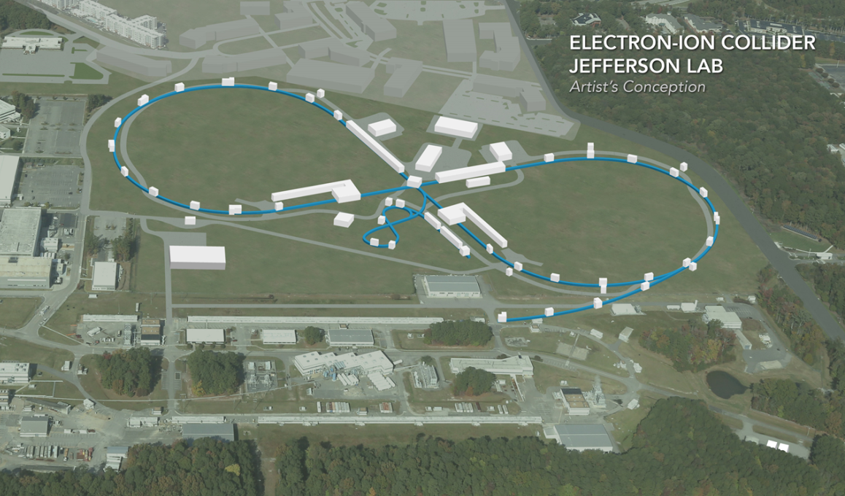
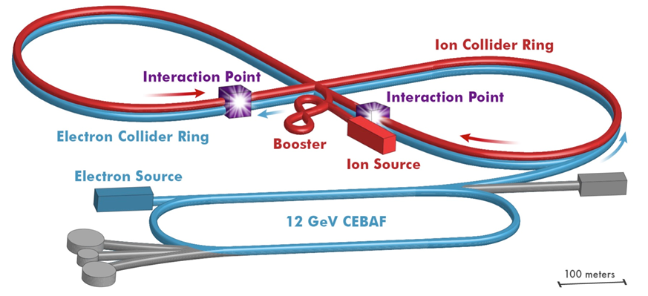
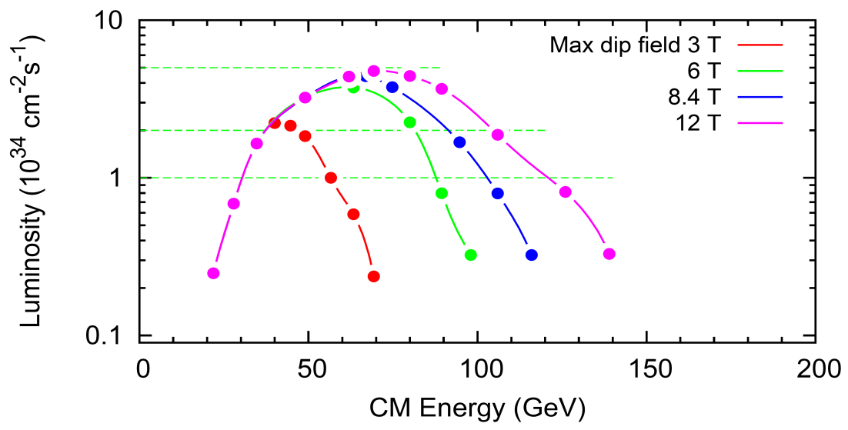
EIC at Jefferson Lab
JLab EIC Figure 8 Concept
    High Polarization
    High Luminosity
    Energy Range: √s : 20 to 65 - 140 GeV
    (magnet technology choice)
    Low technical risk
    Flexible timeframe for construction
    consistent w/running 12 GeV CEBAF
    Cost effective operations
    Fulfills White Paper Requirements
2015 NSAC recommendation
R&D collaboration with BNL
Collaborations with SLAC, LBNL, ANL
NAS Study underway
Next step would be DOE CD-0
10³⁵
LHC
(
10³⁴
10³³

Slide 15
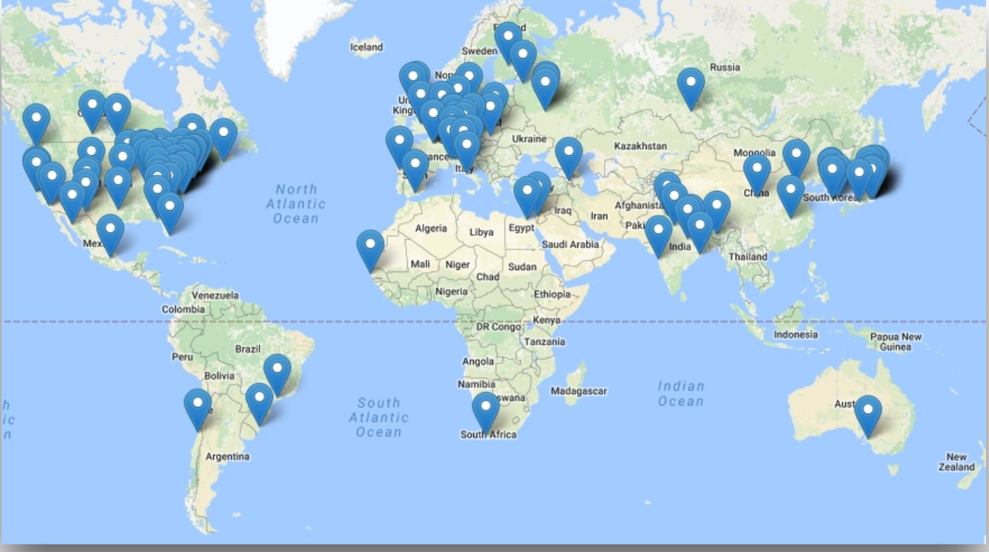
EIC Users Group and International Interest
Formed in fall 2015, currently: 788 members
169 institutions, 29 countries

Slide 16
Summary
12 GeV science program at JLab is underway
  4 Hall operation
  A broad program of 78 approved experiments with many opportunities for discovery is planned
  Initial science results are already being reported
Future Equipment projects
  MOLLER: CD0 – hope for FY20 start
  SoLID: Prepare for DOE science review
Future EIC project taking shape, much activity

Slide 17
Enjoy HYP2018!

