Slide 1
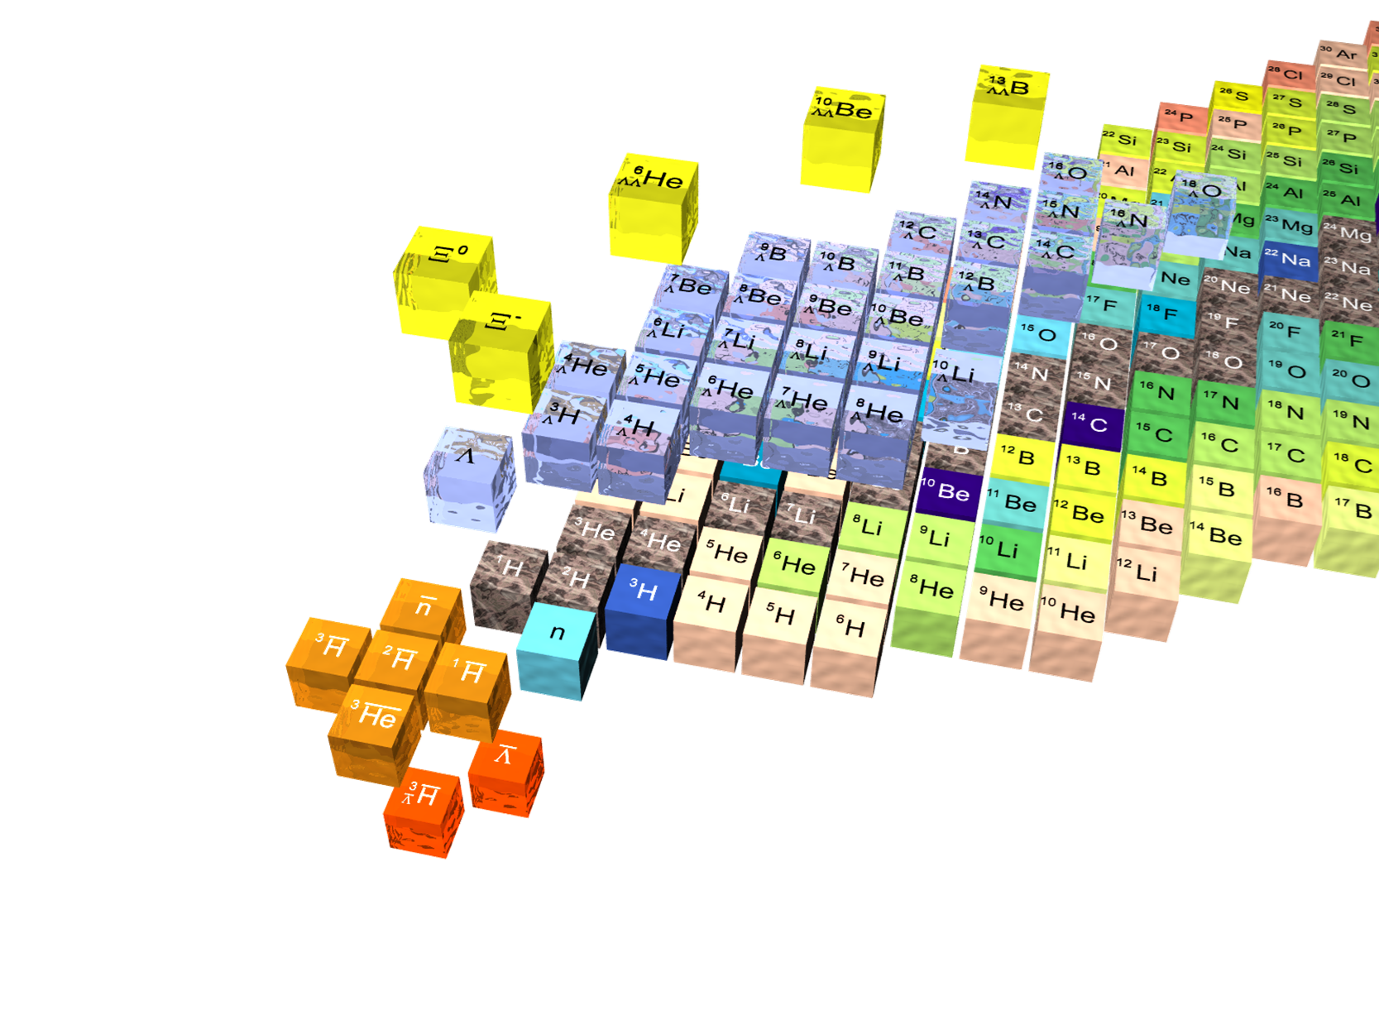
Josef Pochodzalla, HIM & Univ. Mainz, European Union
Introduction on neutral baryonic systems
Josef Pochodzalla
JGU Mainz & Helmholtz-Institut – Mainz – European Union

Slide 2
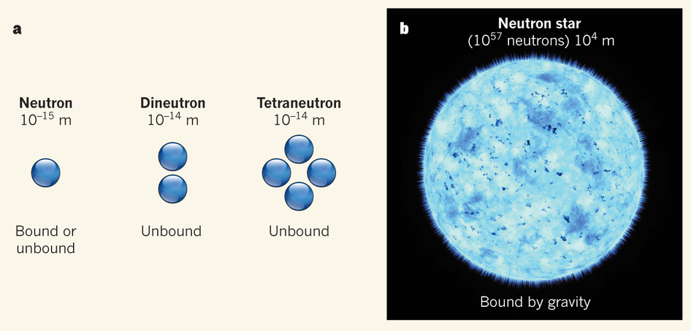
Carlos A. Bertulani and Vladimir Zelevinsky, Nature 532, 448–449 (28 April 2016)

Slide 3
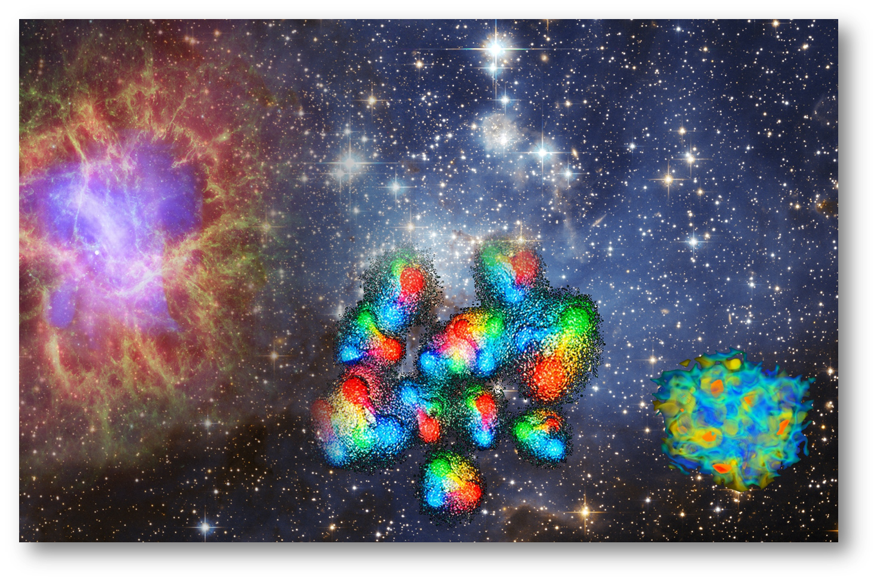
A=2
nn nΛ Σ⁻p ΛΛ ...

Slide 4
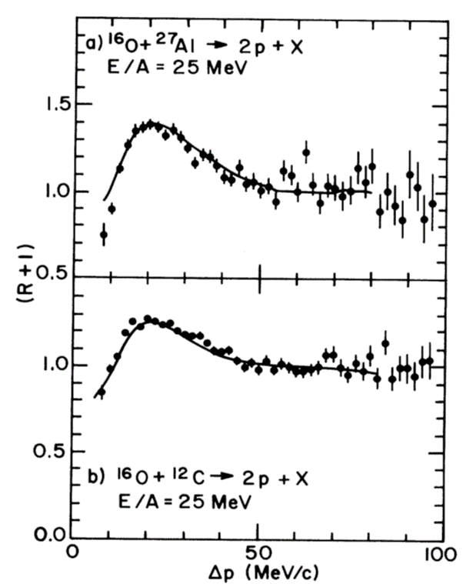
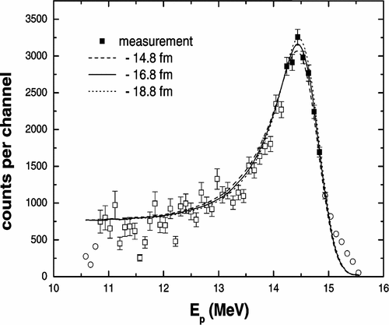
nn
Direct detection of neutral systems difficult F
final state interaction d(n,p)2n or p-p correlations in HI
  Problem: other hadrons present spoil the clear interpretation
The deuterium singlet state is the only bound state
The question of binding or not is small compared to total mass
Replacing a neutron by a Λ can produce bound states
W. von Witsch et al.,
Phys. Rev. C 74, 014001 (2006)
M.A. Bernstein et al.,
Phys. Rev. Lett. 54, 402 (1985)
STAR Collaboration, Nature 527, 345 (2015)
Notes:
The singlet s-wave scattering length (f0) and the effective range (d0) for the antiproton–antiproton interaction (red star) is plotted together with the s-wave scattering parameters for other nucleon–nucleon interactions. Here, statistical errors are represented by error bars, while the horizontal uncertainty for f0 is smaller than the symbol size, and systematic errors are represented by the box. Errors on other measurements29,30 are of the order of a few per cent, smaller than the symbol size.

Slide 5
nΛ and ΛΛ
FSI in d(e,e‘K⁺)
K⁺ capture on d (E91-016)
FSI in HI reactions
Future:
  Scattering experiments with Σ⁻ hyperons @ J-PARC, pΛ @ CLAS
  Tagged hyperons in a mini-pp collider at FAIR or JPARC ?
Talk by L. Fabiette
E91-016 (J. Reinhold)
L. Adamczyk et al.,
Phys. Rev. Lett. 114, 022301 (2015)
Notes:
Proceedings of the Sendai International Symposium: Strangeness in Nuclear ..

Slide 6
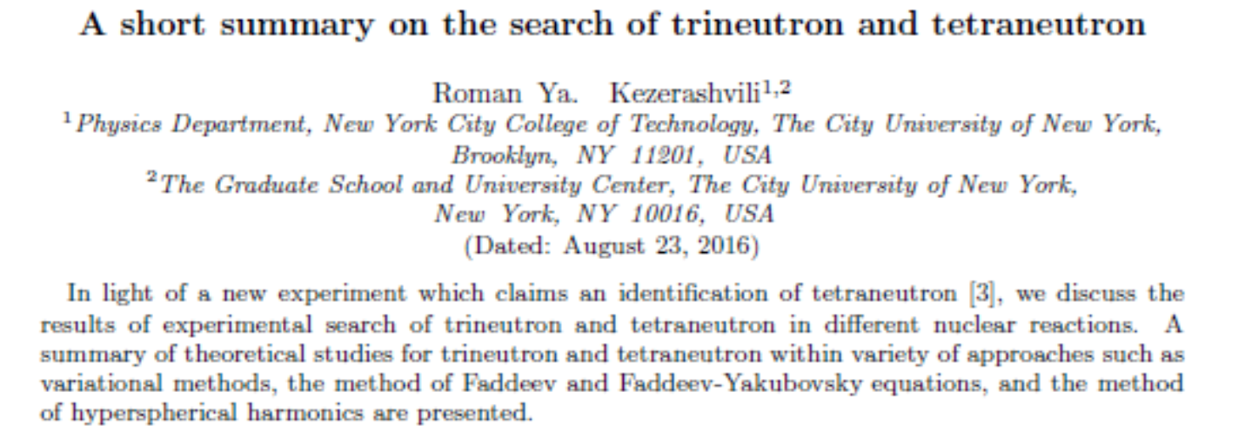
A=3
nnn nnΛ nΛΛ
See Talk by Humberto Garcilazo
arXiv:1608.00169v2

Slide 7
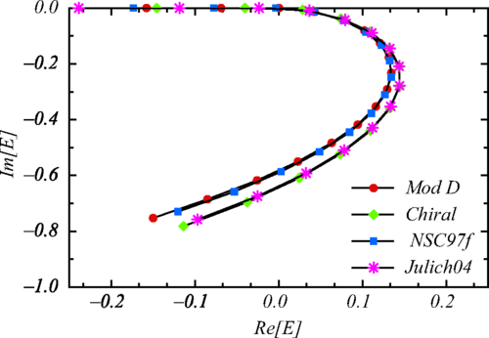
The nnΛ Puzzle
Such a state has been suggested by the HypHI collaboration
weak decay nnΛ→π-³H ⇒ bound state
Statistical Decay Model ⁶_{Λ}He* at E_{x}=40MeV
  Λ 30.7% nnΛ 17.3%
  ³_{Λ}H 13.9% ⁴_{Λ}H 29.2%
  ⁴_{Λ}He 3.9% ⁵_{Λ}He 4.8%
but: all modern state of the art ab initio theories do not allow a bound nnΛ state
Do we really understand the Λ−neutron interaction?
  N-N scattering: 4000 data
  Y-p scattering: 100 data
  Y-n scattering: 0 data
C. Rappold et al., Phys. Rev. C 88 , 041001(R) (2013)
>25% bound
5% real resonance
5% sub-threshold resonance
Iraj R. Afnan and Benjamin F. Gibson
Phys. Rev. C 92, 054608

Slide 8
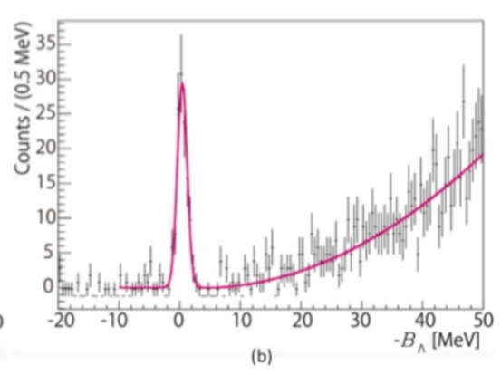
Approaching the nnΛ
See Talk by T. Saito on Friday
2018: J-Lab E12-17-003
  ³H(e,e‘K⁺)(nnΛ)
  missing mass experiment
  will measure mass and width
2019: FRS+WASA for S447
  ⁶Li+¹²C
  for d+π 2 better mass resolution
  8 times better S/BG ratio
  lifetime
The existence of this „femto-neutron star“ would require to re-think our understanding of three-body interactions
Next HYP conference we will know the answer!

Slide 9
A=4
nnnn nnΛΛ nnnΞ⁰
See Talk by Emiko Hiyama

Slide 10
⁴He(π⁻,π⁺) reaction
J.E. Ungar et al., Phys. Lett. 144B, 333 (1984)

Slide 11
Double charge exchange

Slide 12
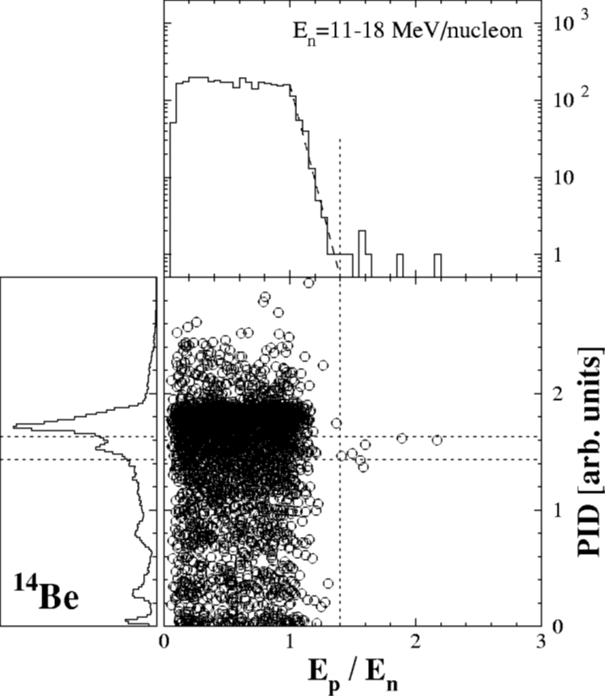
¹⁴Be breakup (2002)
…but bound tetraneutron is theoretically nearly impossible.
F.M. Marques et al., Phys. Rev. C 65, 044006 (2002)

Slide 13
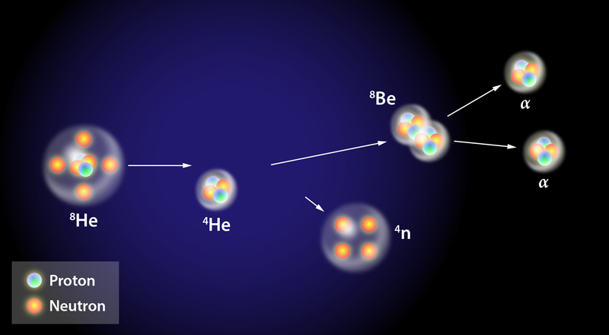
⁴He(⁸He,⁸Be)4n @ RIKEN
Double charge exchange reaction
186AMeV
K. Kisamori et al., Phys. Rev. Lett. 116, 052501 (2016)

Slide 14
arXiv:1608.00169v2

Slide 15
See Talk by
Jaume Carbonelle

Slide 16
…but…

Slide 17
PRL (in print)
Phys. Rev. Lett. 118, 232501 (2017)

Slide 18
Future
Improve statistics at RIKEN
Quasifree α know out
⁴He(π⁻,π⁺) reaction
See Talk by
Susum Shimoura
Hiroyuki Furoka et al.

Slide 19
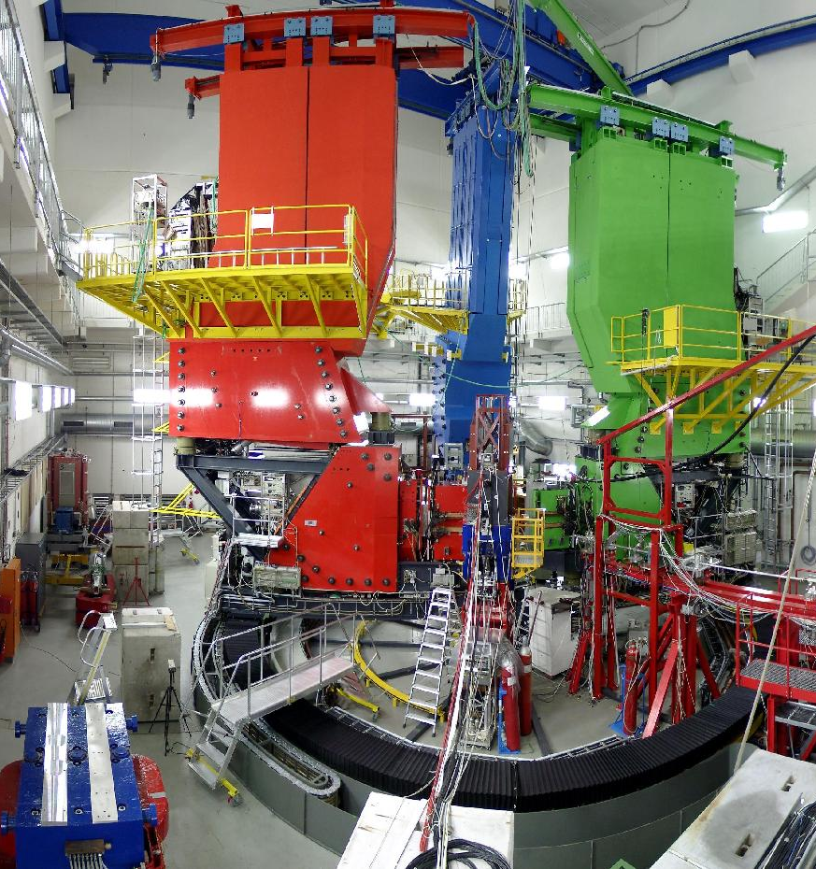
nnnn @ MAMI via missing mass
Double π⁺ production
What is needed
  Helium target ✓
  3 spectrometers ✓
  MAMI-C ✓
Short test experiment
Setting
  SPEK-B: e⁻ 600MeV/c θ=+15°
  SPEK-C: π⁺ 170MeV/c θ=+54°
  SPEK-A: π⁺ 590MeV/c θ= -23°

Slide 20
1 day test ¹²C(e,e‘π⁺π⁺)
Preliminary result
Not optimal/stable running conditions ⇒ calibration ?
Neutron background in ToF detectors
  relying only on particle ⇒ sizable background
  Tide timing cut removes also most of real tripple coincidences
preliminary
preliminary

Slide 21
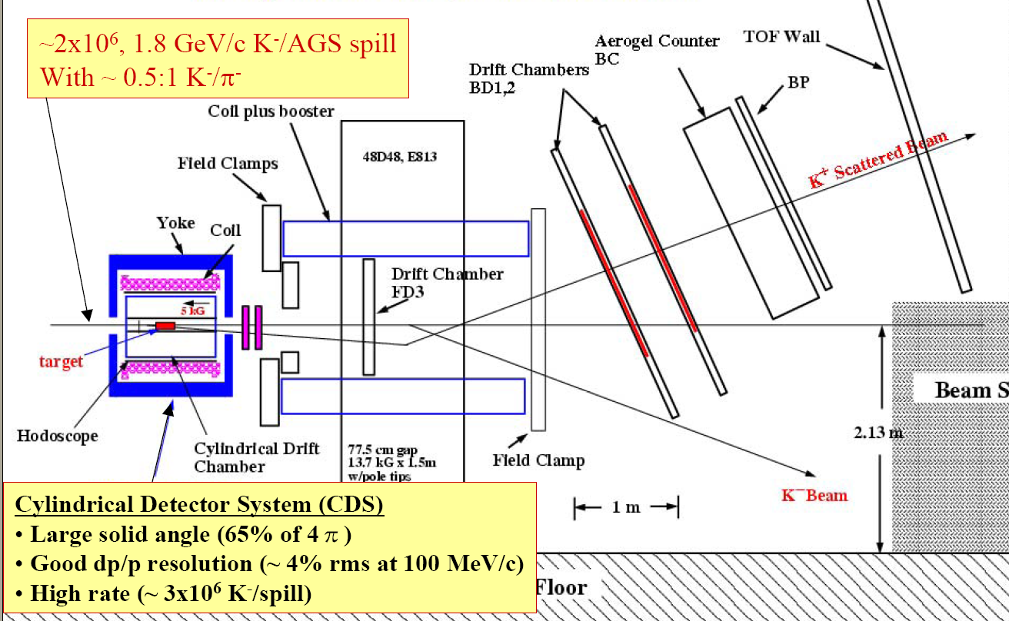
The E906: ⁹Be(K⁻,K⁺π-π-)
K⁺
K⁻
beam
dump

Slide 22
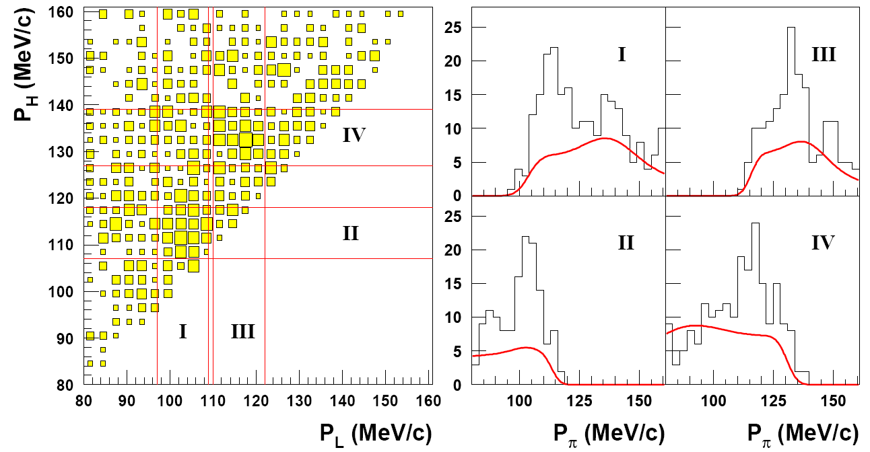
E906
consistent with single Λ hypernuclei
9·10¹¹ K⁻ on Be target
1.1·10⁵ trigger
twin hypernuclei
114 MeV/c
133 MeV/c
104 MeV/c
114 MeV/c
momentum of the pion with lower momentum
momentum of the pion with lower momentum

Slide 23
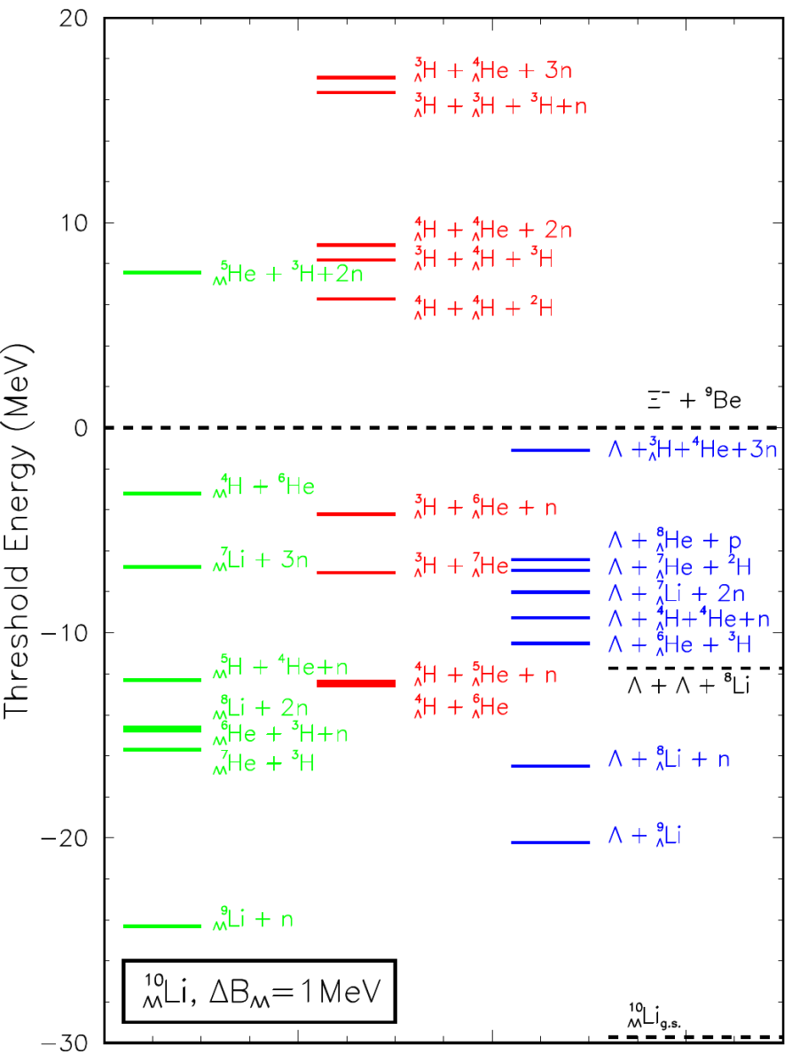

Slide 24
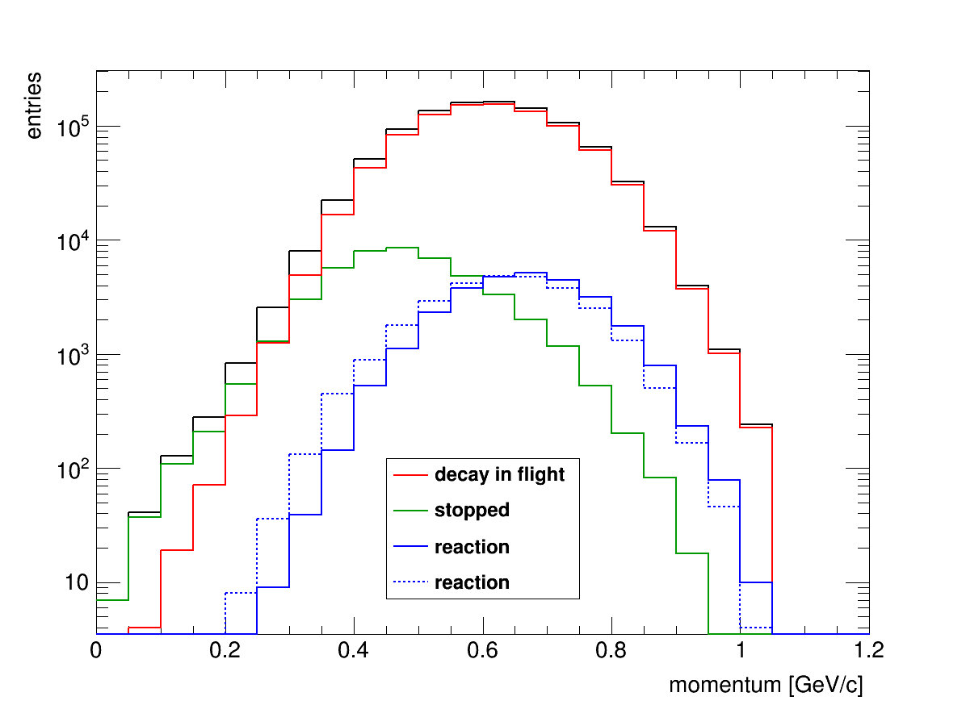
Scenario 2: Ξ⁻+⁹Be reaction in flight
GiBUU (T. Gaitanos) folded with momentum distribution of Ξ⁻ in ⁹Be target.
  Fujiwara Quark-Cluster model for Ξ+N--> Λ+Λ
  Similar results with Rijken OBE model for Ξ+N--> Λ+Λ
Ξ⁻ decay
Ξ⁻ stopped
4.65%
Ξ⁻ reaction
2.83%

Slide 25
 | Initial prob. [%] | Λ+Λ [%] | Λ+SH [%] | SH+SH [%] | DH [%] | ³_{Λ}H+⁴_{Λ}H [%]
SMM ¹⁰_{ΛΛ}Li* | 4.65 | 2.18 | 27.15 | 28.93 | 41.73 | 0
 | Ξ⁻→ΛΛ capture and conversion of 5%×4.65/2.83
SMM ¹⁰_{ΛΛ}Li* |  | 0.18 | 2.75 | 2.89 | 4.21 | 0
GiBUU Ξ⁻+⁹Be | 2.83 | 0.38 | 0.20 | 0.0009 | 0.03 | 0.0002
Capture of stopped Ξ- dominates hypernucleus production
Production of ³_{Λ}H+⁴_{Λ}H pairs is unlikely!

Slide 26
Can nnΛΛ solve the puzzle?
Gal, HYP2003
Hybrid emulsion experiment @ JPARC may help to clarify this question

Slide 27
…light neutral baryonic systems may be full of surprises and challenges

Slide 29
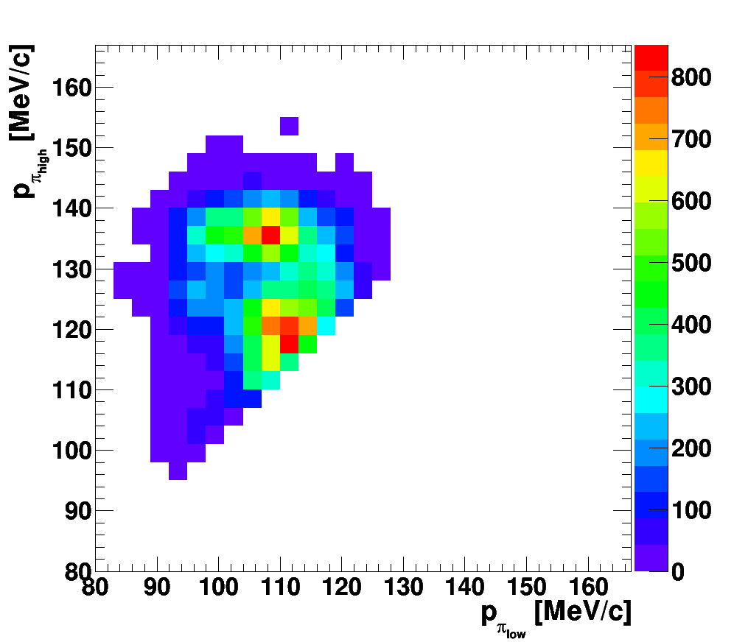

Slide 30
Are nΛΛ and nnΛΛ bound ?
ΛΛn possibly bound
nnΛΛ may be bound (particularly if nnΛ is bound)
  S=0, I=1, L=0
  No Pauli blocking
  Groundstate: J^{P}=0⁺
  calculation still rather schematic
If nΛΛ and nnΛΛ are bound, they might help to understand the E906 puzzle
J.-M. Richard, Q. Wang, and Q. Zhao, Phys. Rev. C 91, 014003 (2015)

Slide 31
nucleon-nucleon systems
The two-nucleon system consists of an isospin singlet state
and an isospin triplet
Simplified one-pion exchange gives rise to a term ~τ₁∙τ₂
Notes:
The reason is related to the strong interaction. The important parameters to describe the strong interaction between two particles are the scattering length (f0) and the effective range of the interaction (d0). The parameter f0 is related to the scattering cross section. The parameter d0 is related to the range of the potential. If a bound state can be formed, one needs an attractive potential and the maximum of the wave function inside the potential range. (check this paper "Measurements of momentum correlation and interaction parameters between antiprotons"). Put it in short, for a bound state to be formed, one needs an attractive potential and f0 ﹤ 0. For proton-proton, f0 = 7.78 fm, d0 = 2.78 fm; for n-n, f0 = 16.9 fm, d0 = 2.8 fm; and for pn singlet state, f0 = 23.75 fm, d0 = 2.75 fm. So you can't find the stable bound state for pp, nn, pn singlet in nature (All f0 > 0). And for pn triplet state, f0 = -5.4fm, d0 = 1.76fm (check this paper "Measurement of interaction between antiprotons"). So attractive potential and f0﹤0, you would have the pn triplet state bound state which is the deuteron.

Slide 32
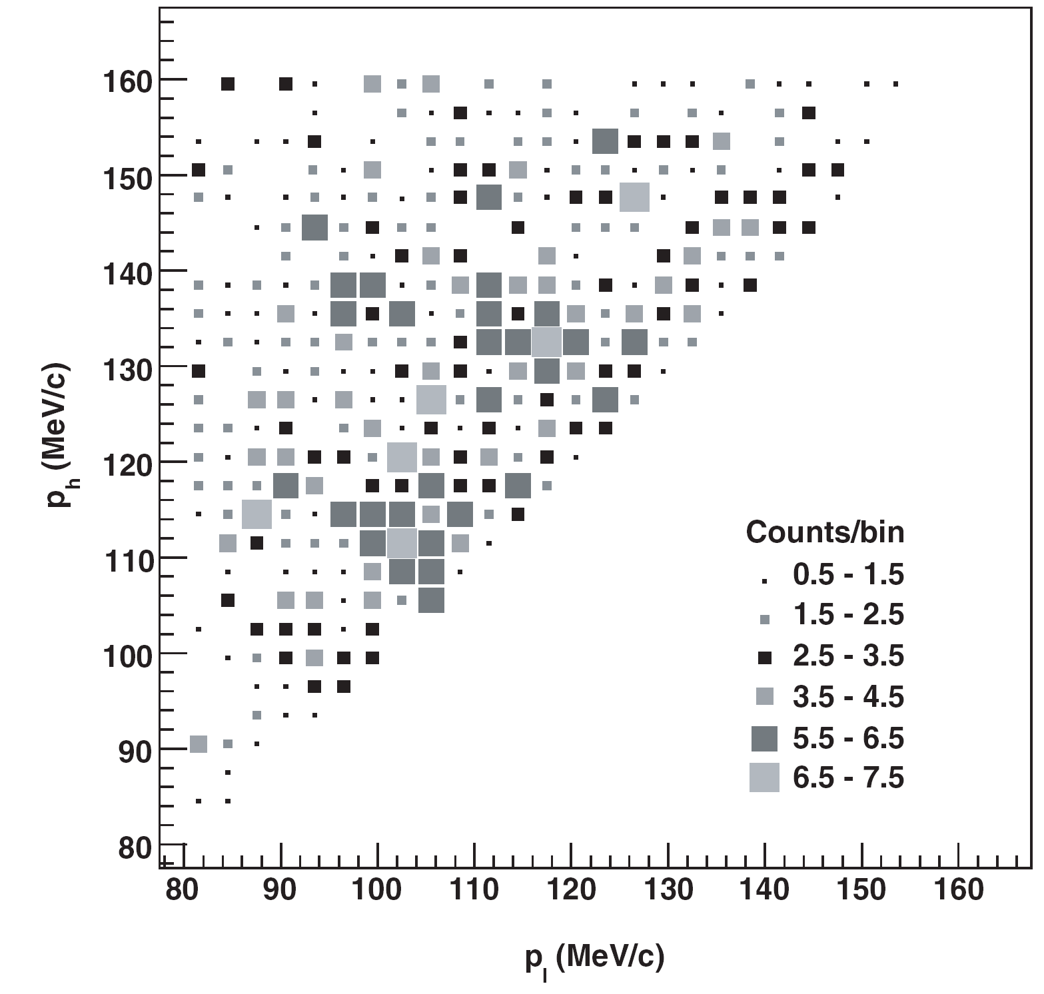

Slide 33
J-Lab E12-17-003 ³H(e,e‘K⁺)(nnΛ)
missing mass experiment
³H(e,e‘K⁺)(nnΛ)
will measure mass and width
approved , will run in November 2018

Slide 34
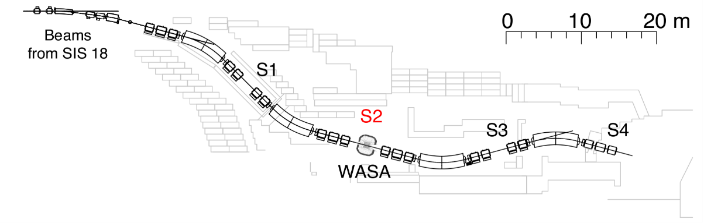
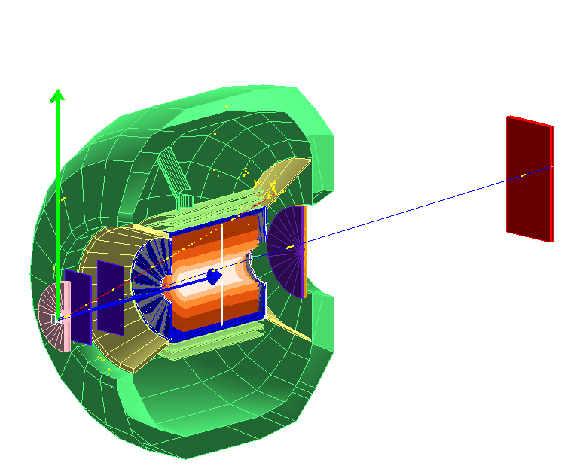
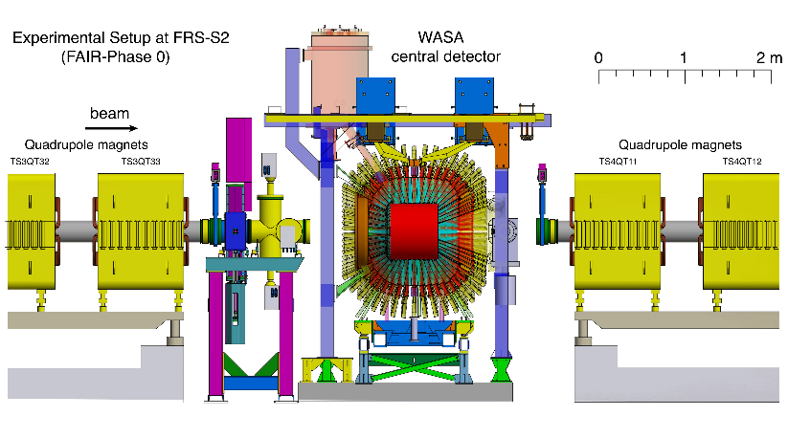
FRS+WASA for S447
See Talk by T. Saito on Friday
³_{Λ}H -> π⁻ + ³He
TOF barrel
TOF endcap
to S3-S4
π⁻
³He
Fiber trackers
Tracker+RPC
Fiber trackers
MDC (straw DC)
2019: for d+π
2 times better mass resolution
8 times better S/BG ratio

