Slide 1
Direct Measurement of The Lifetime of Medium-Heavy Hypernuclei: JLab E02-017 Experiment
L. Tang and X. Qiu
Hampton University/Jlab
Lanzhou University
Technique in detecting hypernuclear decay: Delayed Fissions
Technique in detecting fission fragments: Low-pressure MWPC
Lifetime measurement: Decay time spectrum
Puzzles to be investigated:
How the heavy hypernuclei decay?
Is the lifetime of heavy hypernuclei really short as ~145ps (COSY)?
HYP2018, June 24 – 29, 2018, Portsmouth-Norfolk, Virginia, U.S.A.

Slide 2
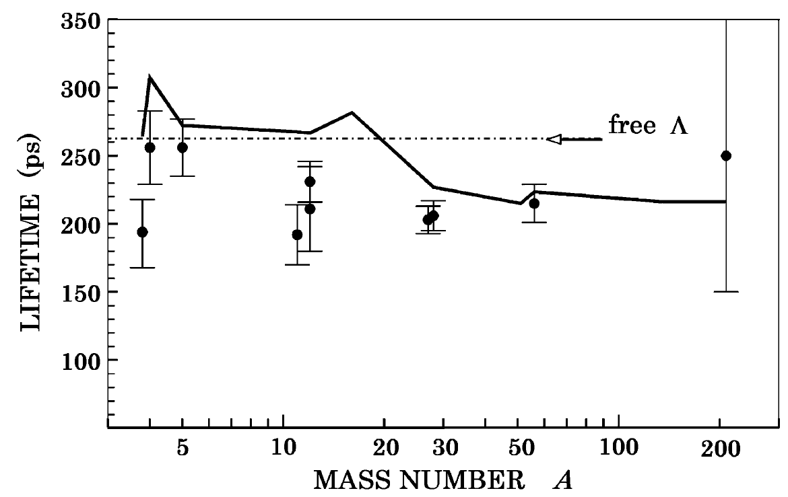
Lifetime of Hypernuclei Before The JLab Result
One of CERN results
from Bi target
~145ps
COSY result
From Bi target
Example from: K. Itonaga and T. Motoba, Progress of Theoretical Physics Supplement No. 185, 2010
Other papers: D. Jido, E. Oset and J.E. Palomar, Nucl. Phys. A 694, 525 (2001);
K. Sasaki, T. Inoue and M. Oka, Nucl. Phys. A 669, 331 (2000);
G. Garbarino, A. Parreño, A. Ramos, Phys. Rev. Lett. 91, 112501 (2003)

Slide 3
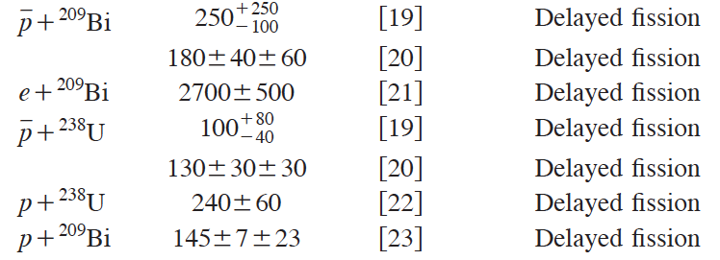
Conflicting Lifetime Results on Heavy Hypernuclei
19. J.P. Bocquet et al., Phys. Lett. B 192, 312 (1987)
T.A. Armstrong et al., Phys. Rev. C 47, 1957 (1993)
V.I. Noga et al., Sov. J. Nucl. Phys. 43, 856 (1986)
H. Ohm et al., Phys. Rev. C 55, 3062 (1997)
P. Kulessa et al., Nucl. Phys. A 639, 283c (1998); P. Kulessa et al., J. Phys. G, Nucl. Part. Phys. 28, 1715 (2002); W. Cassing et al., Eur. Phys. J. A 16, 549 (2003)

Slide 4
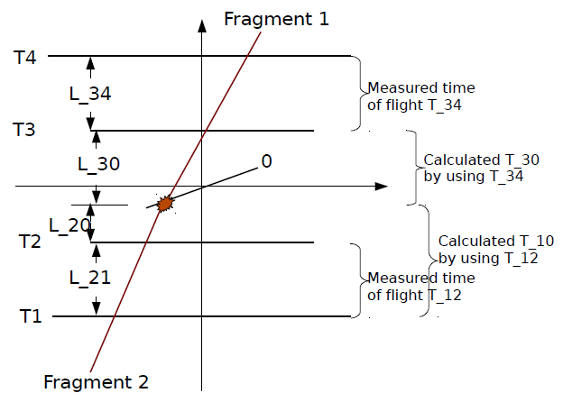
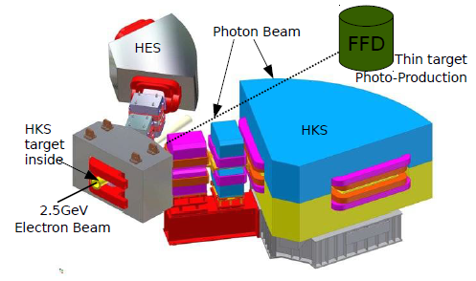
JLab E02-017: Experimental Technique and Layout
Fission Fragment Detector: FFD
4 MWPC’s operated under low-pressure (~3 Torr) heptane gas
Each MWPC measures 2-D coordinates and timing
They form 2 TOF pairs above and below the tilted target foil (~8° w.r.t. beam)
Two fragments were measured in coincidence
Time-zero of each fragment was reconstructed from TOF and geometry
Decay time spectrum was obtained from difference between the two time-zeros with resolution of ~60 ps
The target contains thin (~0.8 μm) Cu, Fe, Ag, and Bi strips and illuminated by Bremsstralungs generated from the thin target of HKS experiment

Slide 5
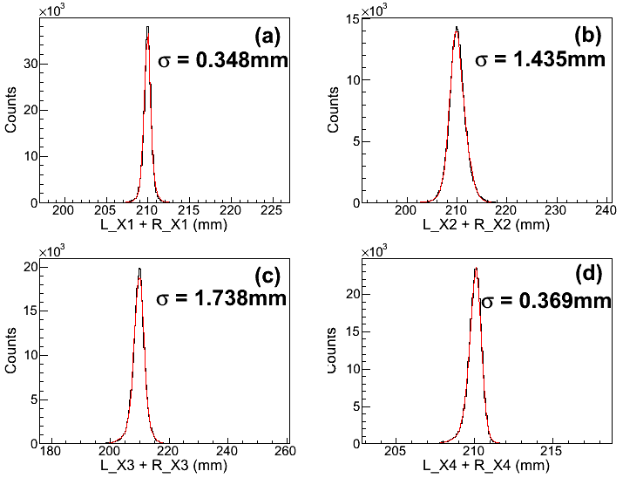
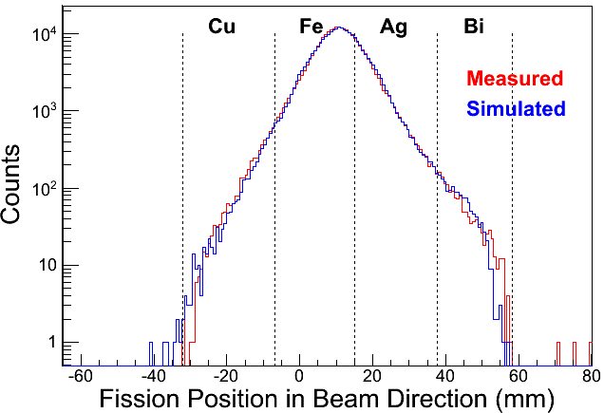
Features of Measurements
Position Resolution
(a) and (d) are the two outer MWPC’s with less effect from pile-up charges and good resolution
(b) and (c) are the two inner MWPC‘s very close to beam and their resolutions were affected by pile-up charges
Resolution of reconstructed fission position was dominated by the inner MWPC‘s
Measured and Simulated Beam Profile
Events were separated from 4 targets
Events mixing due to insufficient resolution was determined
Target Regions

Slide 6
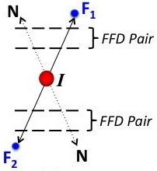
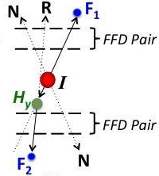
Fission Process Recognized By This Experiment
One-step Process
Should be dominated by photo-induced prompt fissions without “long” lifetime.
Fissions induced by non-mesonic weak decay of the ground or some low-lying states of photo-produced hypernuclei. Since both of the fragments came from the same time-zero, these events would appear to be “prompt” thus no-lifetime could be measured.
Two-step Process
1st step: Excited hypernuclei decay strongly by fission and Λ attached to one of the fragments producing hyper-fragments.
2nd step: Hyper-fragments fission or break-up via weak decay.
Thus one fragment has prompt time-zero while the other contains the character of lifetime of medium heavy-hypernuclei.

Slide 7
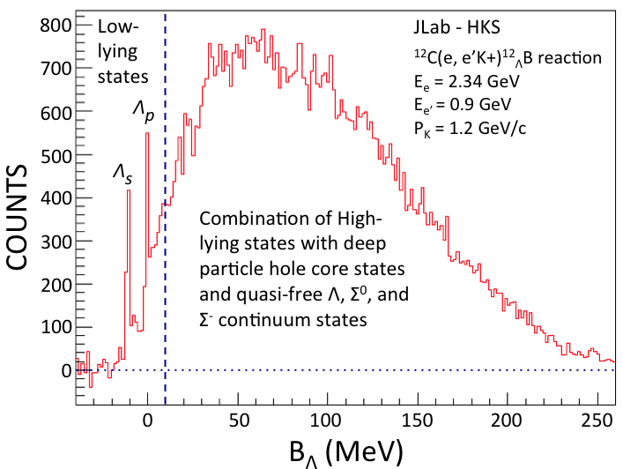
Which Process Should Dominate?
Using photo-produced ¹²_{Λ}B as example (q_{Λ} ≈ 350 MeV/c)
“Cold” hypernuclei
Λ at lower orbits coupled with nuclear core at ground or low excitation particle hole states
(Source for 1-step fission)
“Hot” hypernuclei
Λ at various orbits coupled with highly excited nuclear core at deep particle hole states
(Source for 2-step fission)

Slide 8
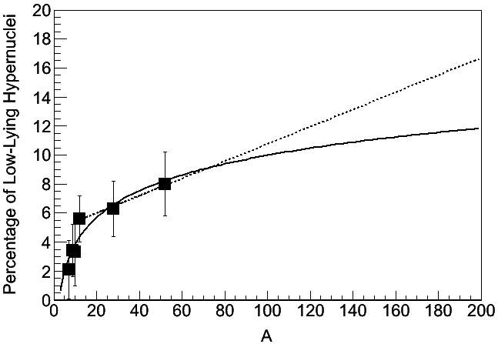
Which Process Should Dominate?
Ratio of “Cold”/”Hot” hypernuclei extracted from JLab HKS data
Arbitrary simple fits
⁵²_{Λ}V
²⁸_{Λ}Al
¹²_{Λ}B
Could be decreasing as # of deep hole states increase faster
¹⁰_{Λ}Be
⁷_{Λ}He
Hypernuclei recognized only by delayed fissions should be dominated by decay of hyper-fragments

Slide 9
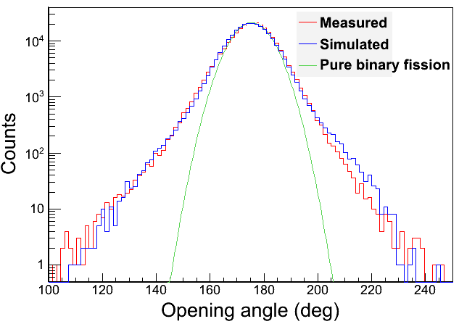
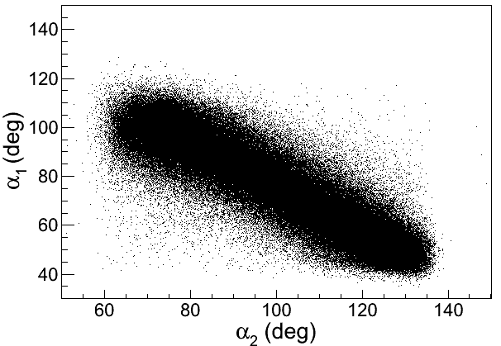
Opening Angle Of The Two Fragments
Measured angle correlation
Opening angle cannot be used as a “gate” to separate fissions from weak decay of “cold” or “hot” hypernuclei

Slide 10
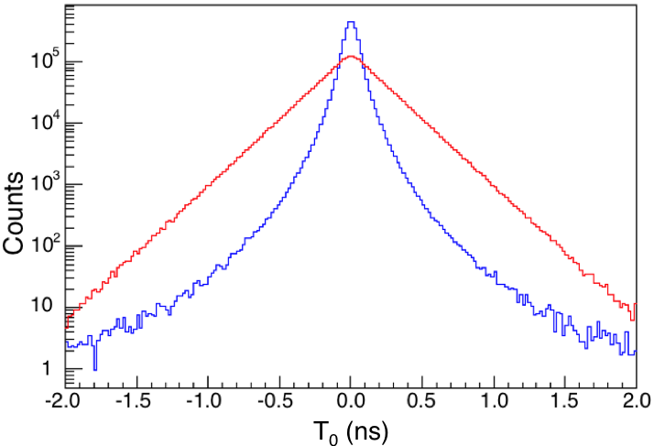
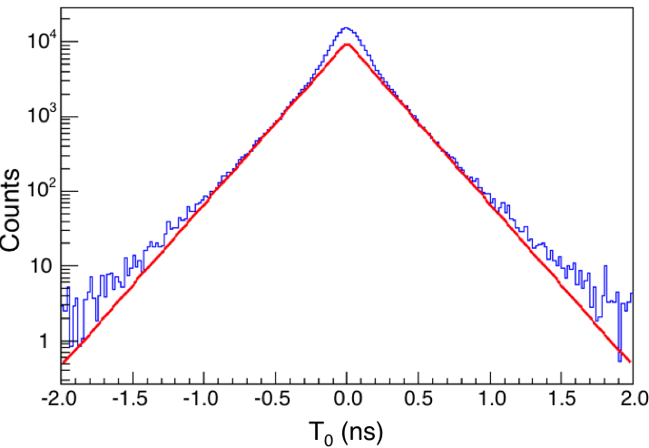
Decay Time Character of Hyper-fragments
Without energy loss in target
With energy loss in target
All stopped
All in-flight
If all decayed in-flight, no lifetime can be extracted, affected by velocity difference between hyper-fragment and fragment from decay.
This may indicate the clues of the conflicting CERN and COSY results, i.e. angular spread of fissioning projectiles.
Linear region would appear if there were sufficient amount of hyper-fragments decayed at stop.
The linear region should start beyond |T₀| > 300 ps.

Slide 11
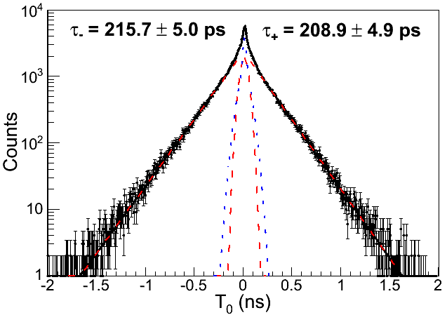
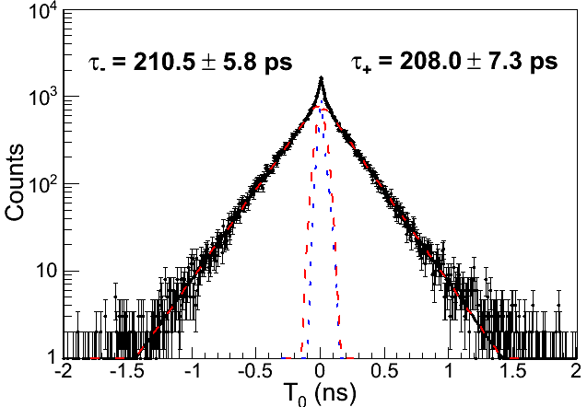
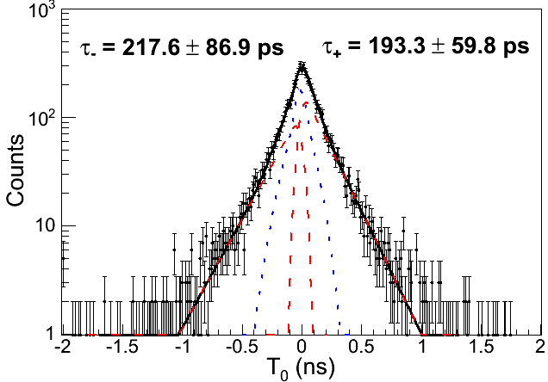
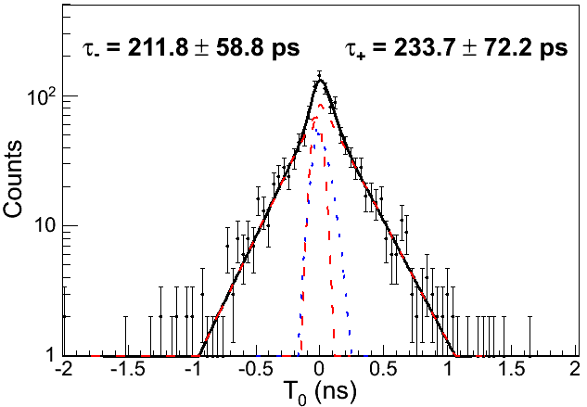
Decay Time Spectra and Fitting of Lifetimes
Fe Target
Ag Target
Cu Target
Bi Target

Slide 12
Characters of Decay and Lifetime of Heavy Hypernuclei
Bi fission is known dominated by binary mode with average of ~8 nucleons emitted, i.e. fragment mean mass is A ≈ 100 and σ_{A} ≈ 30.
The lifetime measured from the decays from Bi target events should be a statistical average of a range of medium mass hypernuclei (i.e. decay of hyper-fragments).
Fission from other targets, Ag, Cu, and Fe, are not well known. Assuming binary fission mode dominates, the extracted lifetimes are all averages at the mean mass, about 1/2 of the target masses.
Hyper-fragment rate from Ag, Cu, and Fe targets are much higher than expected. On the other hand, hyper-fragment rate from all targets are much higher than expected over that in the prompt region (one-step fission). This indicates that all lifetimes measured using delay fission technique without gating to a specific mass region are all averages around ~1/2 of the target mass.

Slide 13
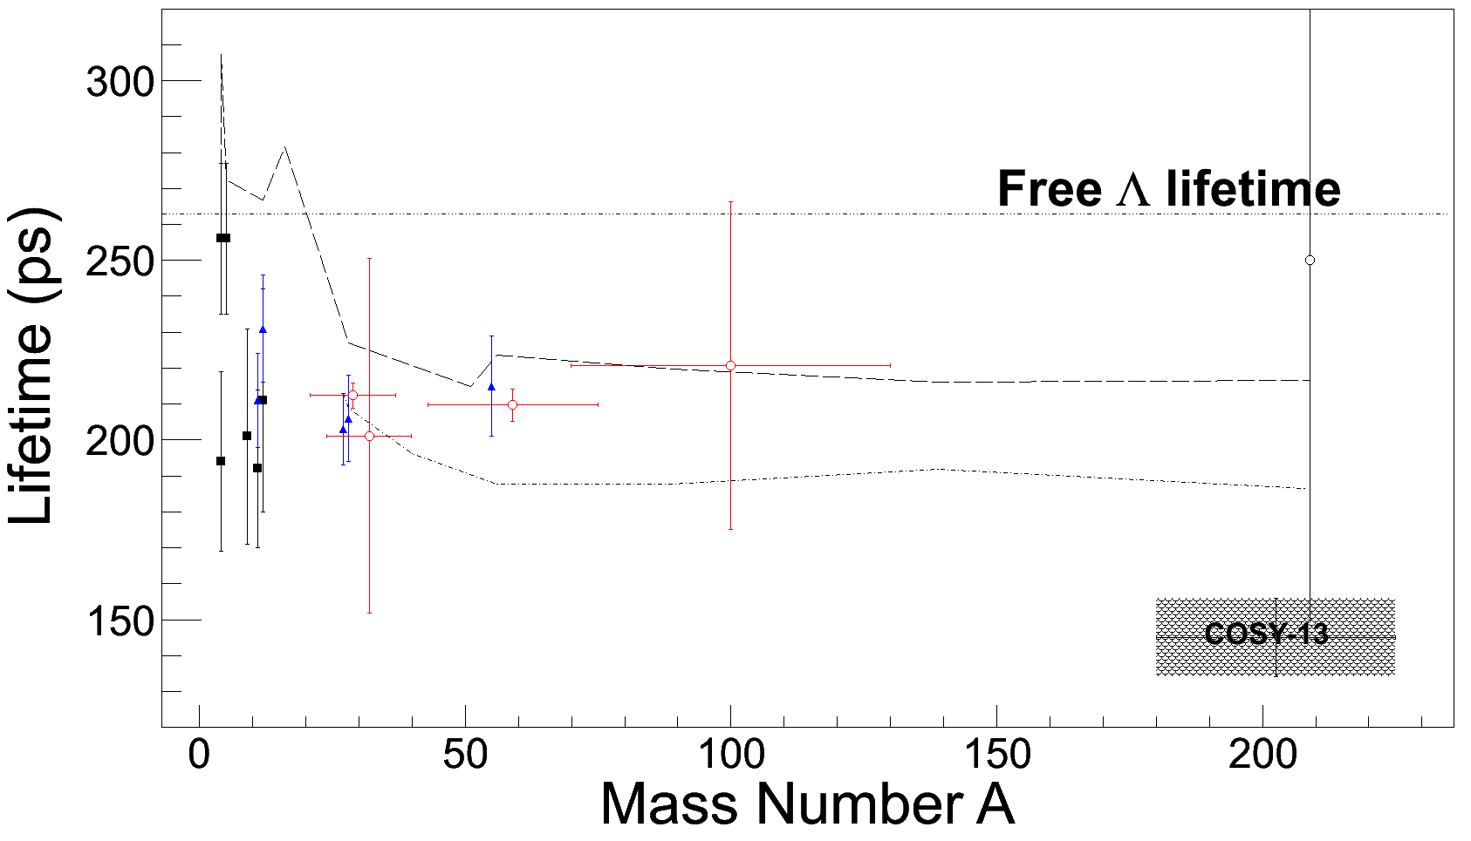
Summarized Lifetime of Hypernuclei WithJLab Result
K. Itonaga and T. Motoba, Progress of Theoretical Physics Supplement No. 185, 2010
E. Bauer, G. Garbarino, Phys. Rev. C 81 064315 (2010).

Slide 14
Summary
The JLab experiment made direct lifetime measurement from decay time spectra of hyper-fragments
The hyper-fragments should be produced by decays via fission of heavy hypernuclei at high excitation.
We believe that such hyper-fragment production and decay should be what were seen from all previous experiments using delayed fission technique.
Our result supports constant lifetime of ~200 ps for hypernuclei with medium-heavy mass and beyond.

