Slide 1


The constraining effect of isospin filtering processes in low energy meson-baryon interactions
Albert Feijoo, Volodymyr Magas, Àngels Ramos
HYP2018, Portsmouth, June 24 – 29, 2018

Slide 2

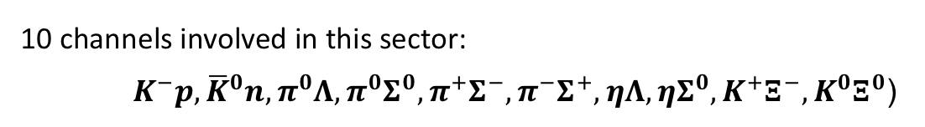





Aim: Describe the meson-baryon interaction in the S=-1 sector at low energies
Introduction (theoretical background and historical perspective)
10 channels involved in this sector:
${ K}^{−}p, {\overline{K}}^{0}n,π^{0}Λ, π^{0}Σ^{0}, π^{+}Σ^{−}, π^{−}Σ^{+}, ηΛ,ηΣ^{0}, K^{+}Ξ^{−}, K^{0}Ξ^{0}$)
1255 MeV
1810 MeV
$$πΛ$$
$$πΣ$$
$$\overline{K}N$$
$$ηΛ$$
$$ηΣ$$
$$KΞ$$
Framework:
QCD (the theory of the strong interaction among color charge carriers, quarks and gluons) is inefficient to treat low energy hadron interactions.
➔ Chiral Perturbation Theory (ChPT): effective theory with hadrons as degrees of freedom which respects the symmetries of QCD.
limited to a moderate range of energies above threshold
not applicable close to a resonance (singularity in the amplitude)

Slide 3


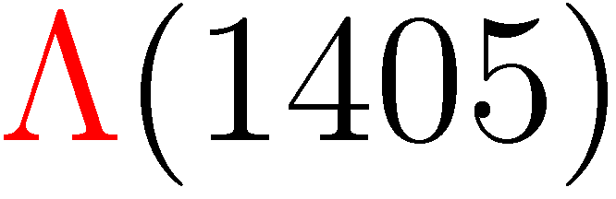
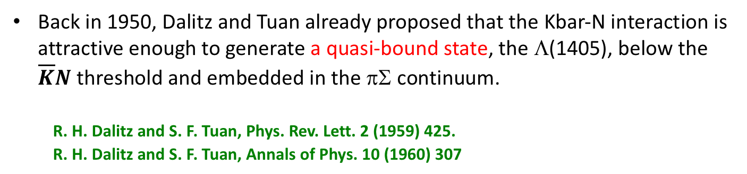
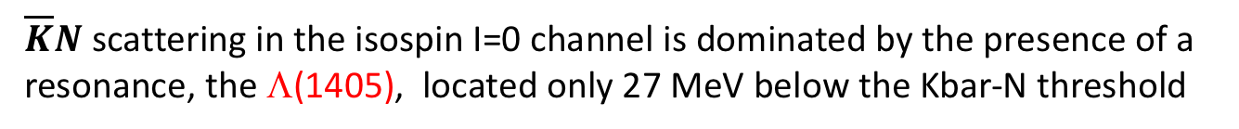
But…
$\overline{K}N$ scattering in the isospin I=0 channel is dominated by the presence of a resonance, the Λ(1405), located only 27 MeV below the Kbar-N threshold
→ A non-perturbative approach is mandatory !
Back in 1950, Dalitz and Tuan already proposed that the Kbar-N interaction is attractive enough to generate a quasi-bound state, the Λ(1405), below the $\overline{K}N$ threshold and embedded in the πΣ continuum.
R. H. Dalitz and S. F. Tuan, Phys. Rev. Lett. 2 (1959) 425.
R. H. Dalitz and S. F. Tuan, Annals of Phys. 10 (1960) 307

Slide 4
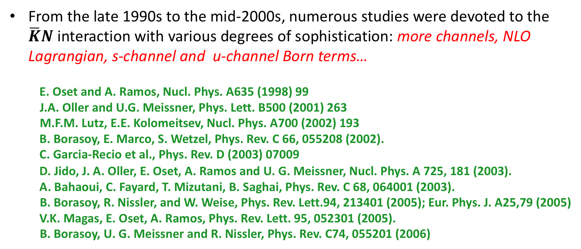
In 1995 Kaiser, Siegel and Weise reformulated the problem in terms of the
effective chiral unitary theory in coupled channels.
N. Kaiser, P. B. Siegel, and W. Weise, Nucl. Phys. A594 (1995) 325
From the late 1990s to the mid-2000s, numerous studies were devoted to the $\overline{K}N$ interaction with various degrees of sophistication: more channels, NLO Lagrangian, s-channel and u-channel Born terms…
E. Oset and A. Ramos, Nucl. Phys. A635 (1998) 99
J.A. Oller and U.G. Meissner, Phys. Lett. B500 (2001) 263
M.F.M. Lutz, E.E. Kolomeitsev, Nucl. Phys. A700 (2002) 193
B. Borasoy, E. Marco, S. Wetzel, Phys. Rev. C 66, 055208 (2002).
C. Garcia-Recio et al., Phys. Rev. D (2003) 07009
D. Jido, J. A. Oller, E. Oset, A. Ramos and U. G. Meissner, Nucl. Phys. A 725, 181 (2003).
A. Bahaoui, C. Fayard, T. Mizutani, B. Saghai, Phys. Rev. C 68, 064001 (2003).
B. Borasoy, R. Nissler, and W. Weise, Phys. Rev. Lett.94, 213401 (2005); Eur. Phys. J. A25,79 (2005)
V.K. Magas, E. Oset, A. Ramos, Phys. Rev. Lett. 95, 052301 (2005).
B. Borasoy, U. G. Meissner and R. Nissler, Phys. Rev. C74, 055201 (2006)
all of them obtaining in general similar features….

Slide 5
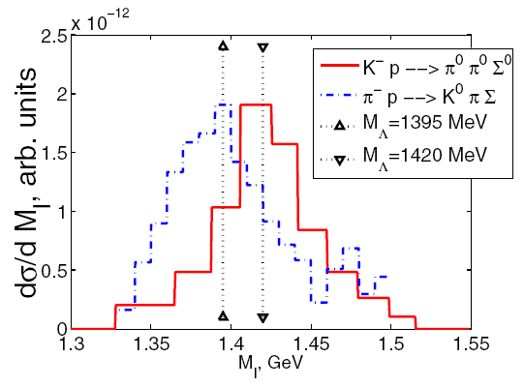
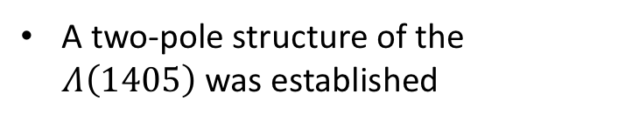
$\overline{K}N$ scattering data reproduced very satisfactorily
A two-pole structure of the $Λ\left(1405\right)$ was established
→ A success of the coupled-channel models!

Slide 6
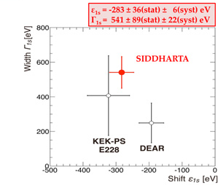
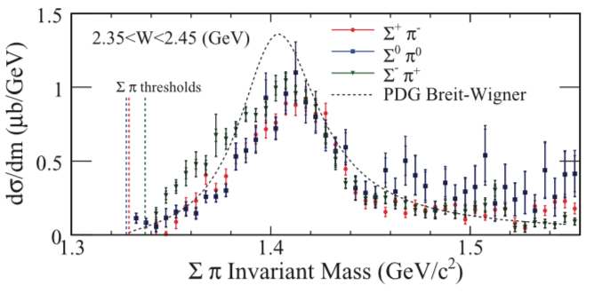
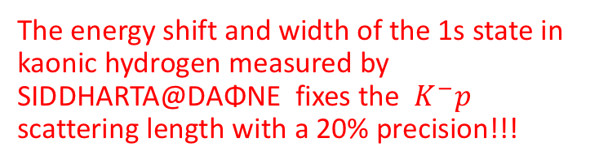

Recent experimental advances…
M. Bazzi et al., Phys. Lett. B 704, 113 (2011)
K. Moriya et al., Phys. Rev. C87, 035206(2013)
The energy shift and width of the 1s state in kaonic hydrogen measured by SIDDHARTA@DAΦNE fixes the $K^{−}p$ scattering length with a 20% precision!!!
Photoproduction $γp⟶K^{+}πΣ$ data by the CLAS@Jlab provided detailed line shape results of the Λ(1405)
→ These experiments injected a renewed interest in this topic… Precision era?
Y. Ikeda, T. Hyodo, W. Wiese, Nucl. Phys. A 881, 98 (2012).
A. Cieply and J. Smejkal, Nucl. Phys. A 881, 115 (2012).
Zhi-Hui Guo, J. A. Oller, Phys. Rev. C 87, 035202 (2013).
T. Mizutani, C. Fayard, B. Saghai and K. Tsushima, Phys. Rev. C 87, 035201 (2013).
L. Roca and E. Oset: Phys. Rev. C 87, 055201 (2013), Phys. Rev. C 88, 055206 (2013).
M. Mai and U. G. Meissner, Eur. Phys. J. A 51, 30 (2015).
A. Feijoo, V. K. Magas and A. Ramos, Phys. Rev. C 92, 015206 (2015).
A. Ramos, A. Feijoo and V. K. Magas, Nucl. Phys. A 954, 58 (2016).

Slide 7
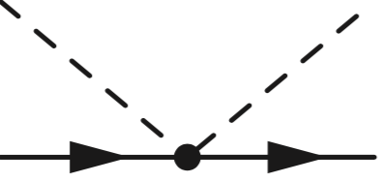


Chiral Unitary Effective Theory (brief description)
1. Lagrangian:
→ derive an interaction kernel V_{ij}
Leading order (LO)
Weinberg-Tomozawa term (WT)
Born terms:
Essentially p-wave contributions
(usually neglected)
Dominant contribution

Slide 8
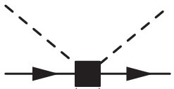
Next-to-leading order (NLO)
Meson-Baryon interaction potential:

Slide 9
2. Unitarization: e.g. via the Bethe-Salpeter equation with on-shell amplitudes
meson-baryon loop function
(dimensional regularitzation)
subtraction constants for the dimensional regularization scale $μ=1GeV$in all channels

Slide 10


Parameters of the model
meson decay constant: f
axial vector couplings of the Born terms: D and F
7 parameters of the NLO Lagrangian: b_{D}, b_{F}, b₀,d₁,d₂,d₃,d₄
- 6 subtraction constants (isospin symmetry):
$(partially constrained: 1.15f_{π}^{exp}≤f≤1.22 f_{π}^{exp}$, $f_{π}^{exp}$=93 MeV)
(we impose )

Slide 11
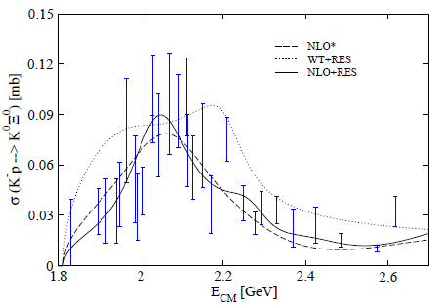
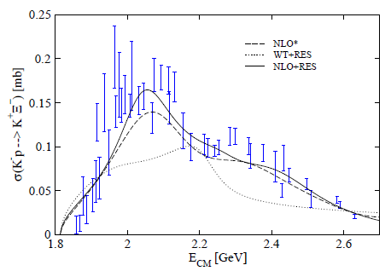
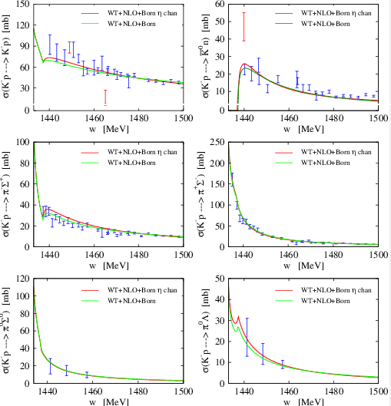

Our goals:
1. Find a more reliable set of parameters of the Chiral Effective Lagrangian,
paying special attention to the NLO coefficients
(fitting to existing data)
Energy shift and width of kaonic hydrogen
Threshold Branching ratios:
(New to other works: K⁻p → K⁰ Ξ⁰, K⁺ Ξ⁻ scattering data)
2. Give predictions for new/not measured observables

Slide 12
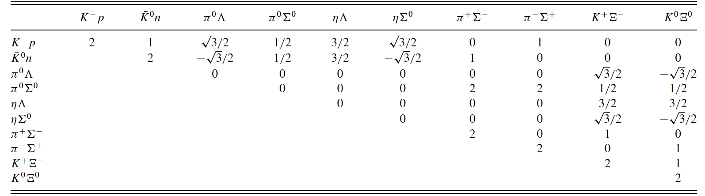
WT coefficients
assumed small
➔ The K⁻p → K⁰ Ξ⁰, K⁺ Ξ⁻ reactions are especially sensitive to NLO parameters !!

Slide 13
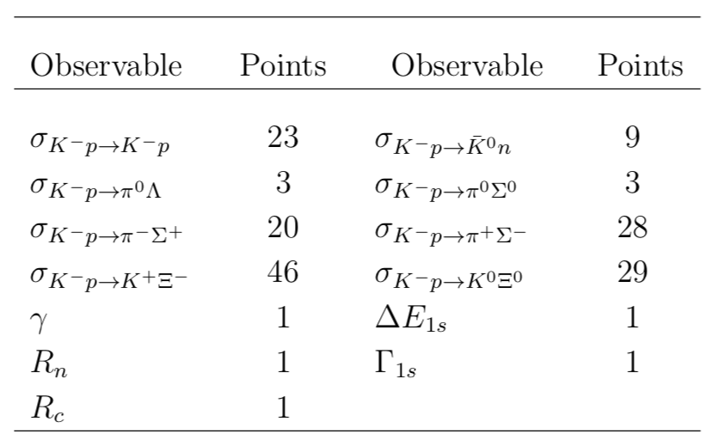
Results:
WT+NLO
(no Born terms)
A. Feijoo, V.K. Magas, A. Ramos, Phys. Rev. C92 (2015) 1, 015206
WT+Born+NLO
A. Ramos, A. Feijoo, V. Magas, Nucl. Phys. A 954, 58 (2016)
Experimental data employed in the fits
Born terms as important as NLO in
K⁻p → K⁰Ξ⁰, K⁺Ξ⁻ reactions
NLO coefficients dissimilar from WT+NLO fit
Naturally sized subtraction constants
x-sections traditionally employed
new x-sections considered

Slide 14
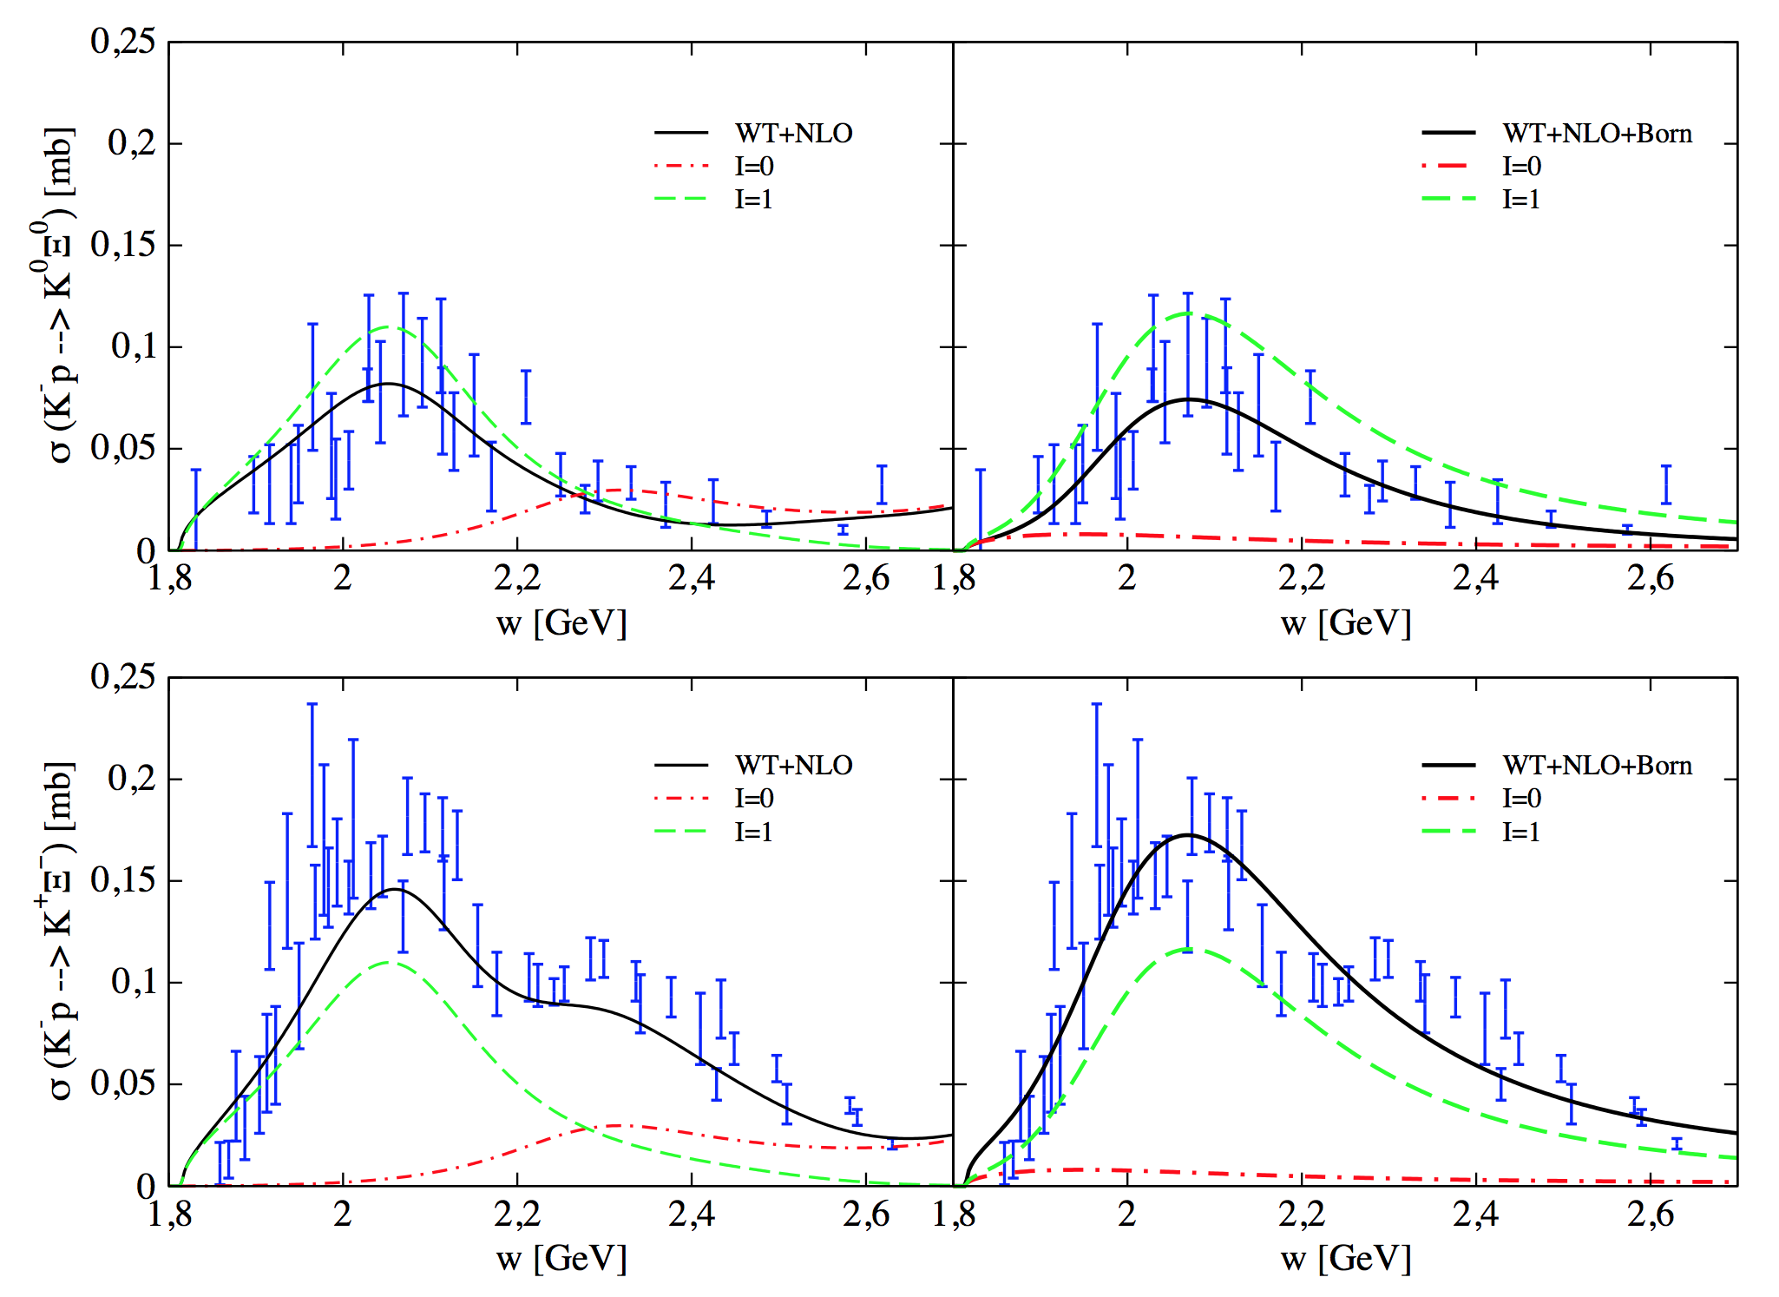
Isospin contributions
WT+NLO
WT+NLO+Born
The two models predict very different isospin contributions
➔ Isospin-filter observables are needed!

Slide 15
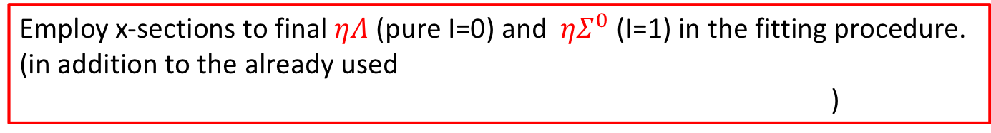
Isospin filtering processes
Processes which filter isospin will provide more constraints to obtain more reliable NLO coefficients.
Employ x-sections to final $ηΛ$ (pure I=0) and ${ηΣ}^{0}$ (I=1) in the fitting procedure.
(in addition to the already used
)

Slide 16
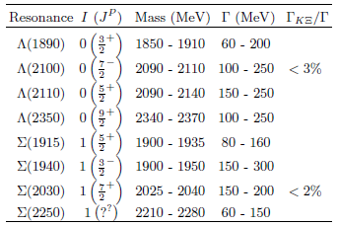

New fits:
WT+Born+NLO (new)
WT+Born+ NLO+RES
Unitarized scattering amplitude from Chiral Lagrangian complemented with explicit resonant contributions
Inclusion of high spin and high mass resonances allows us to study the stability of the NLO parameters ($b_{0}{, b}_{D},b_{F}, d_{1},d_{2}, d_{3},{ d}_{4}$).
It also simulates the contributions of higher angular momenta of the other channels via rescattering in the energy regime above $KΞ$ threshold.
Sharov, Korotkikh, Lanskoy, EPJA 47 (2011) 109
Jackson, Oh, Haberzettl and Nakayama, Phys. Rev. C 91, 065208 (2015)
Feijoo, Magas, Ramos, Phys. Rev. C 92,015206 (2015)

Slide 17










Inclusion of hyperonic resonances (WT+Born+NLO+RES model)
$\overline{K}N⟶Y⟶KΞ,ηΛ$
$$K^{−}\left(k^{μ}\right)$$
$K\left({k′}^{μ}\right)$, $η\left({k′}^{μ}\right)$
$$M_{Y},Γ_{Y}$$
$$g_{NY\overline{K}}$$
$$g_{ΞYK}, g_{ΛYη}$$
p$\left(p^{μ}\right)$
$Ξ\left(p^{′μ}\right)$, $Λ\left(p^{′μ}\right)$
Y=$Λ\left(1890\right)\left(J=\frac{3}{2}+\right),Σ\left(2030\right)\left(J=\frac{7}{2}+\right), Σ\left(2250\right) (J=\frac{5}{2}−)$
For $K^{−}p⟶KΞ$ transitions:
For $K^{−}p⟶ηΛ$ transitions:

Slide 18
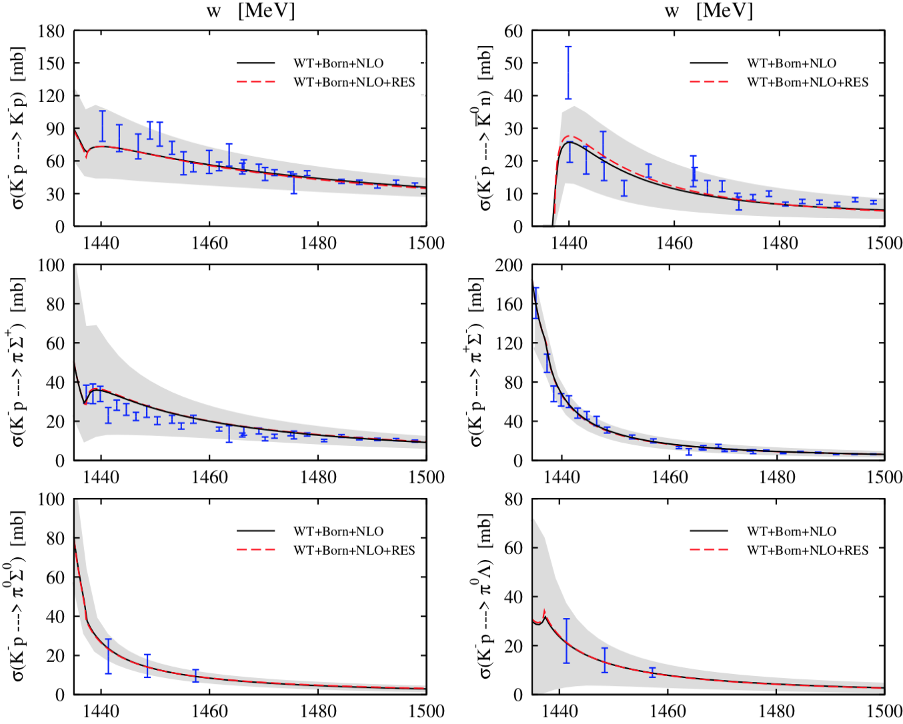
Total cross sections:

Slide 19
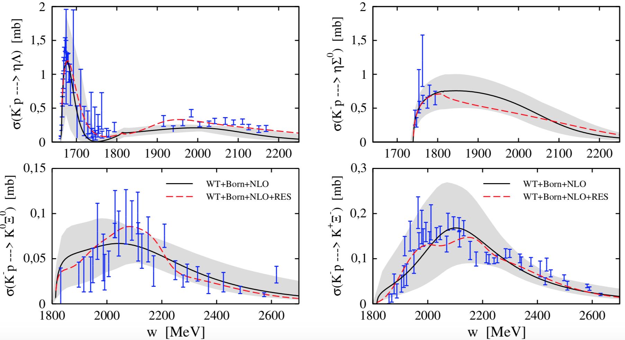
Total cross sections:

Slide 20
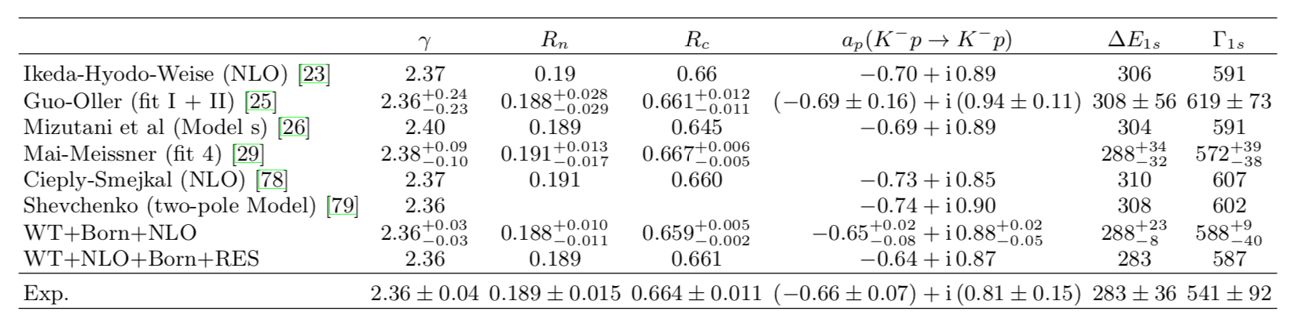
Threshold observables:

Slide 21
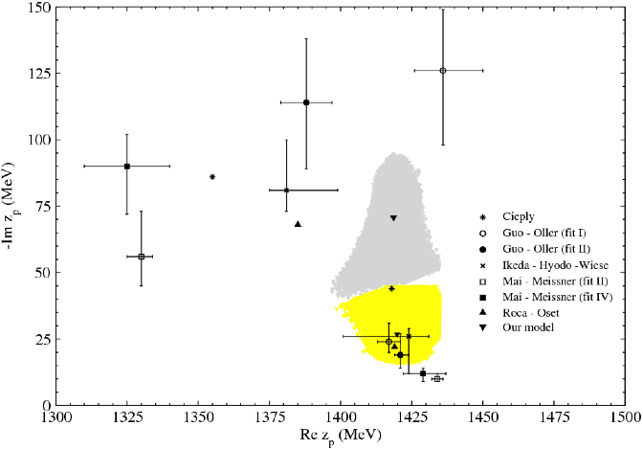
Pole content:

Slide 22
Parameters:
Naturally sized values
NLO coefficients:
homogeneous, accurate and stable
16% improvement on the goodness of the fit

Slide 23
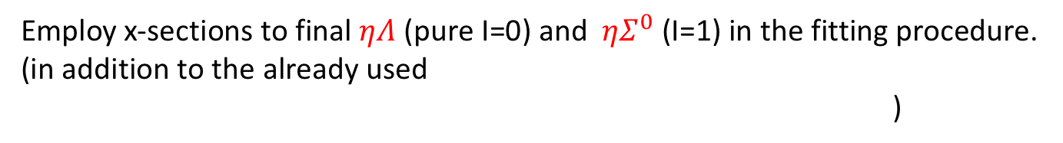

Isospin filtering processes
Processes which filter isospin will provide more constraints to obtain more reliable NLO coefficients.
✓
Employ x-sections to final $ηΛ$ (pure I=0) and ${ηΣ}^{0}$ (I=1) in the fitting procedure.
(in addition to the already used
)
Check our models against other isospin pure processes:
e.g. the ${ K}_{L}^{0}p⟶ K^{+}Ξ^{0}$reaction (I=1) that could be measured at J-Lab
employing the secondary $K_{L }$beam at J-Lab (proposal)

Slide 24
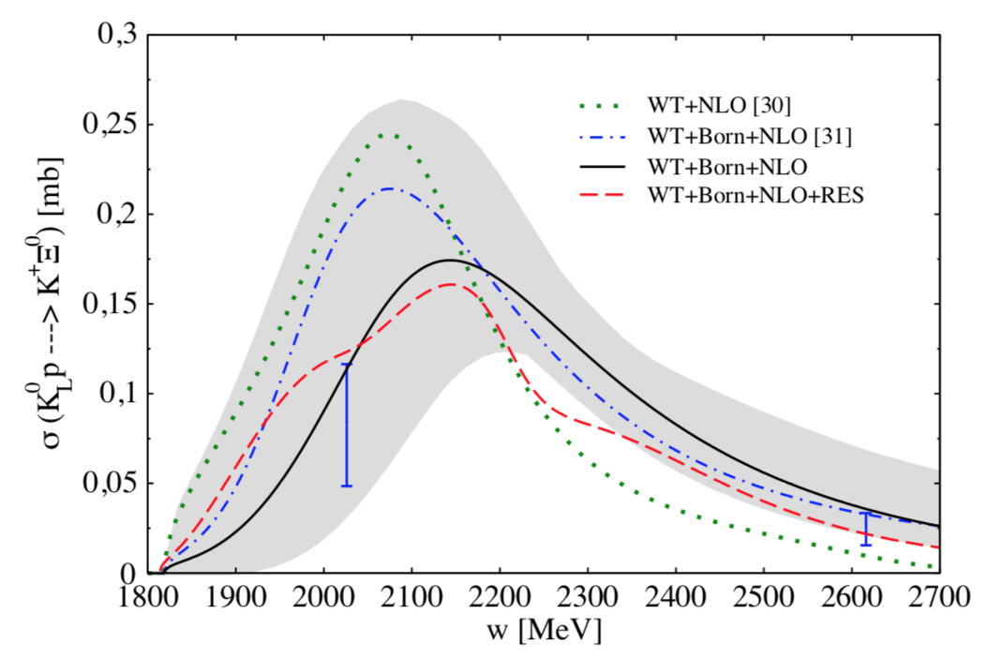

Prediction for $K_{L}^{0}p⟶K^{+}Ξ^{0}$ reaction
(S=-1, I=1)
It proceeds through the K⁰ component of the K⁰_{L}
_
J. P. Berge et al.
Phys. Rev. 147, 945 (1966)
(K⁻n ➔ K⁺Ξ⁰)
S.A.B.R.E. Collaboration,
J. C. Scheuer et al.
Nucl. Phys. B 33, 61 (1971)
(K⁻n ➔ K⁺Ξ⁰)
Data from the secondary K⁰_{L} beam at Jlab will be very valuable to constrain the models of the S=-1 meson-baryon interaction!
Notes:
.

Slide 25
Isospin filtering processes
Processes which filter isospin will provide more constraints to obtain more reliable NLO coefficients.
✓
Employ x-sections to final $ηΛ$ (pure I=0) and ${ηΣ}^{0}$ (I=1) in the fitting procedure.
(in addition to the already used
)
Check our models against other isospin pure processes:
e.g. the ${ K}_{L}^{0}p⟶ K^{+}Ξ^{0}$reaction (I=1) that could be measured at J-Lab
employing the secondary $K_{L }$beam at J-Lab (proposal)
or the recent determination of |T (K⁻n → π⁻Λ)| by Amadeus (also I=1)
K. Piscicchia et al.., Phys.Lett. B782 (2018) 339-345.

Slide 26
K. Piscicchia et al.., Phys.Lett. B782 (2018) 339-345.
AMADEUS collaboration, KLOE detector at DAΦNE

Slide 27
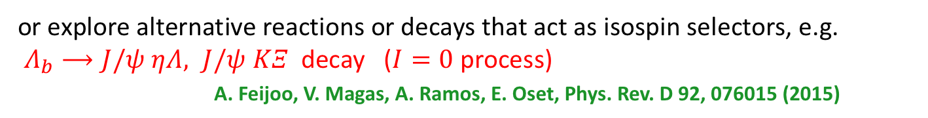
Isospin filtering processes
Processes which filter isospin will provide more constraints to obtain more reliable NLO coefficients.
✓
Employ x-sections to final $ηΛ$ (pure I=0) and ${ηΣ}^{0}$ (I=1) in the fitting procedure.
(in addition to the already used
)
✓
Check our models against other isospin pure processes:
e.g. the ${ K}_{L}^{0}p⟶ K^{+}Ξ^{0}$reaction (I=1) that could be measured at J-Lab
employing the secondary $K_{L }$beam at J-Lab (proposal)
or the recent determination of |T (K⁻n → π⁻Λ)| by Amadeus (also I=1)
K. Piscicchia et al.., Phys.Lett. B782 (2018) 339-345.
or explore alternative reactions or decays that act as isospin selectors, e.g.
$Λ_{b}⟶J/ψ ηΛ, J/ψ KΞ$ decay ($I=0$ process)
A. Feijoo, V. Magas, A. Ramos, E. Oset, Phys. Rev. D 92, 076015 (2015)

Slide 28
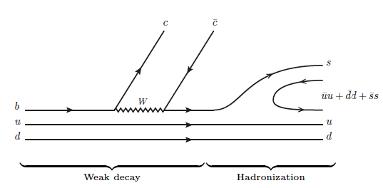

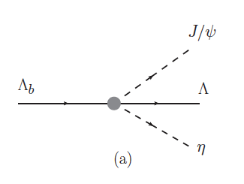
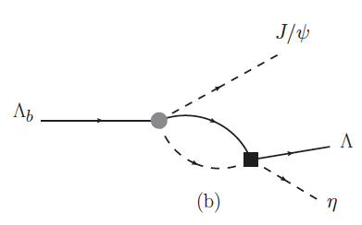


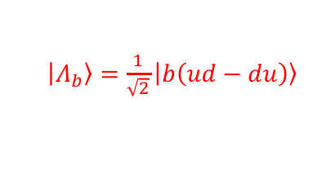
W. H. Liang and E. Oset, Phys. Lett. B 737, 70 (2014)
L. Roca, M. Mai, E. Oset and U. G. Meissner,
Eur. Phys. J. C75, 218 (2015)
$\left|\left.Λ_{b}\right\rangle \right.=\frac{1}{\sqrt{2}}\left|\left.b\left(ud−du\right)\right\rangle \right.$
Meson-Baryon in I=0 !
+

Slide 29
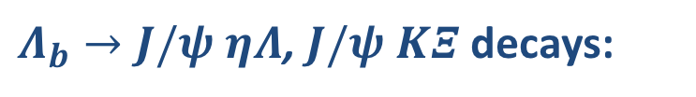
$Λ_{b}→J/ψ ηΛ$, $J/ψ KΞ$ decays:
Data from LHCb would be very useful to constrain our models!

Slide 30
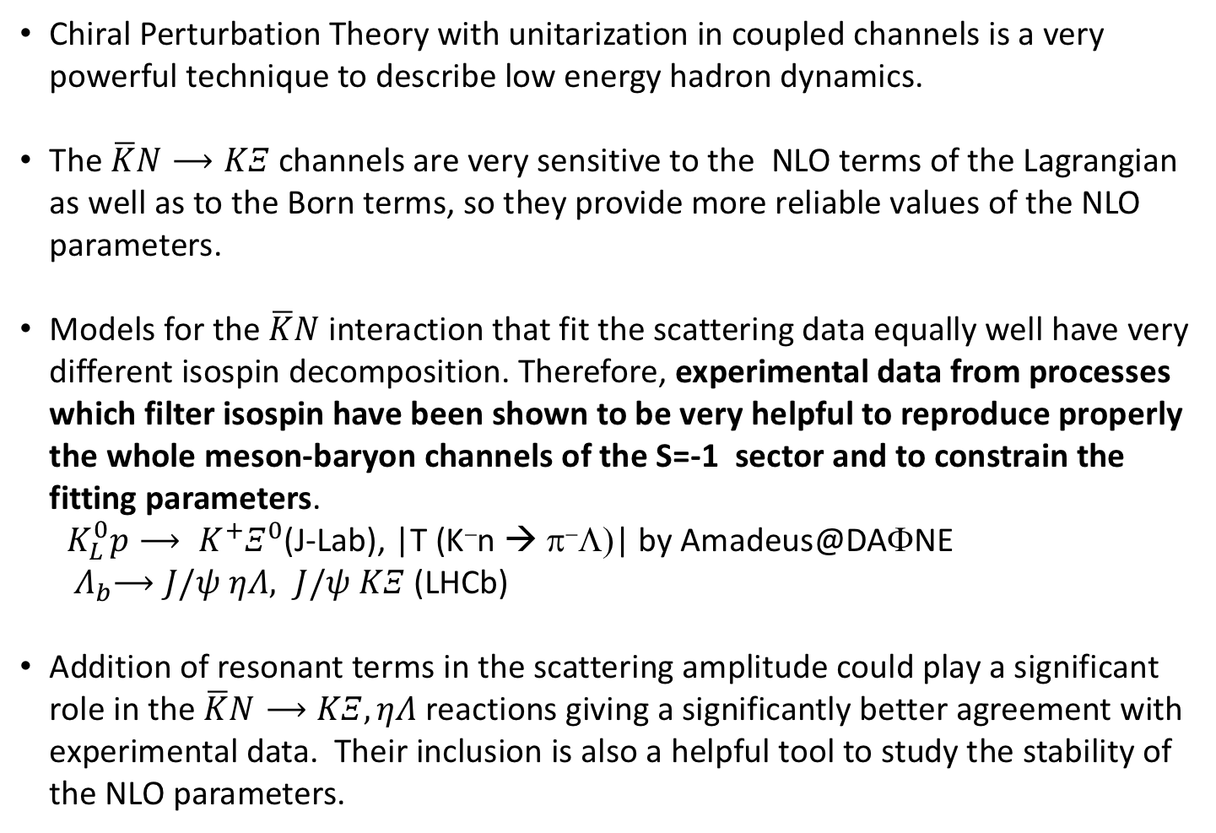
CONCLUSIONS:
Chiral Perturbation Theory with unitarization in coupled channels is a very powerful technique to describe low energy hadron dynamics.
The $\overline{K}N⟶KΞ$ channels are very sensitive to the NLO terms of the Lagrangian as well as to the Born terms, so they provide more reliable values of the NLO parameters.
Models for the $\overline{K}N$ interaction that fit the scattering data equally well have very different isospin decomposition. Therefore, experimental data from processes which filter isospin have been shown to be very helpful to reproduce properly the whole meson-baryon channels of the S=-1 sector and to constrain the fitting parameters.
${ K}_{L}^{0}p⟶ K^{+}Ξ^{0}$(J-Lab), |T (K⁻n → π⁻Λ)| by Amadeus@DAΦNE
${ Λ}_{b}⟶J/ψ ηΛ, J/ψ KΞ$ (LHCb)
Addition of resonant terms in the scattering amplitude could play a significant role in the $\overline{K}N⟶KΞ,ηΛ$ reactions giving a significantly better agreement with experimental data. Their inclusion is also a helpful tool to study the stability of the NLO parameters.

Slide 31
Thank you for your attention

Slide 32
Spare slides…

Slide 33
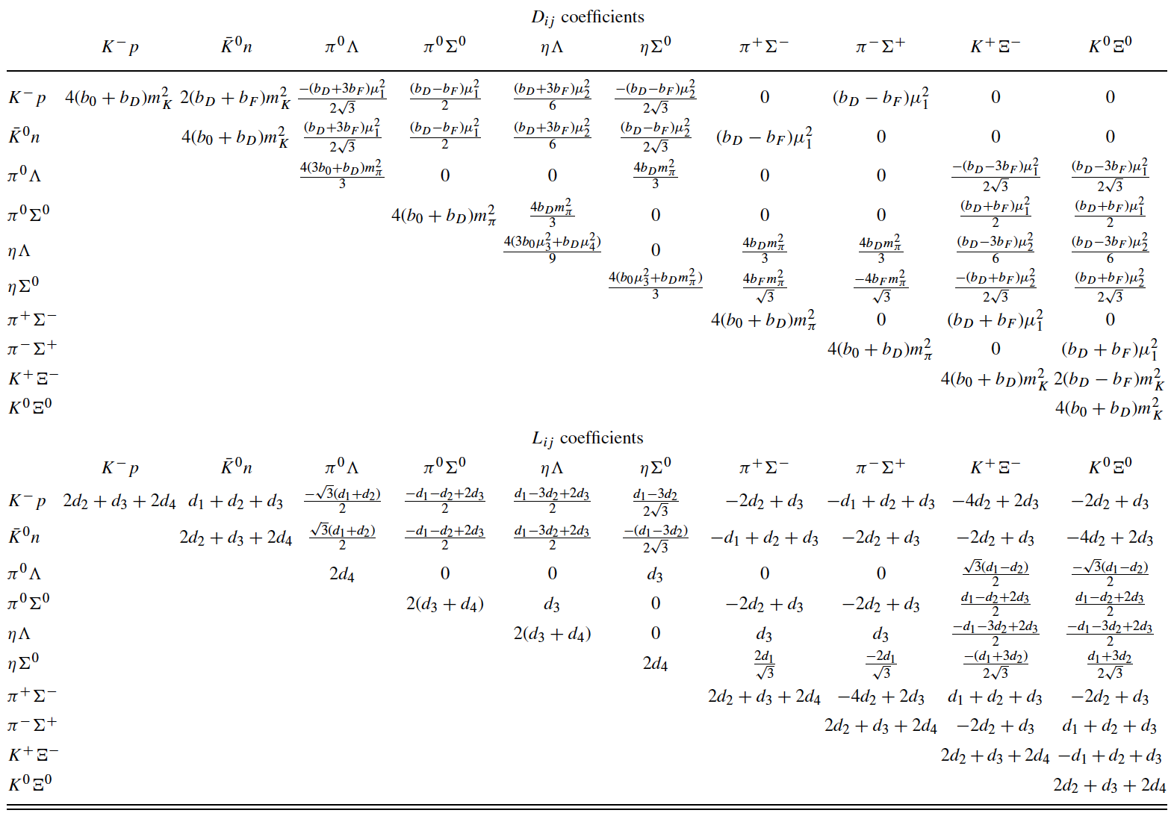
NLO coefficients

Slide 34










Inclusion of hyperonic resonances (WT+Born+NLO+RES model)
$$K^{−}\left(k^{μ}\right)$$
$K\left({k′}^{μ}\right)$, $η\left({k′}^{μ}\right)$
Only for $K^{−}p⟶KΞ$ reactions:
$$M_{Y},Γ_{Y}$$
$$g_{NY\overline{K}}$$
$$g_{ΞYK}, g_{ΛYη}$$
Only for $K^{−}p⟶ηΛ$ reaction:
p$\left(p^{μ}\right)$
$Ξ\left(p^{′μ}\right)$, $Λ\left(p^{′μ}\right)$
$\overline{K}N⟶Y⟶KΞ,ηΛ$
Y=$Λ\left(1890\right),Σ\left(2030\right)$, $Σ\left(2250\right)$
$Λ\left(1890\right)$, $J^{P}={\frac{3}{2}}^{+}$
$Σ\left(2030\right)$, $J^{P}={\frac{7}{2}}^{+}$
FORM FACTORS
$Σ\left(2250\right)$, $J^{P}={\frac{5}{2}}^{−}$
Sharov, Korotkikh, Lanskoy, EPJA 47 (2011) 109

