Slide 1

Mesons with charm and strangeness in nuclear matter
Philipp Gubler, JAEA
P. Gubler and K. Ohtani, Phys. Rev. D 90, 094002 (2014). P. Gubler and W. Weise, Phys. Lett. B 751, 396 (2015).
P. Gubler and W. Weise, Nucl. Phys. A 954, 125 (2016). A. Park, P. Gubler, M. Harada, S.H. Lee, C. Nonaka and W. Park, Phys. Rev. D 93, 054035 (2016).
K. Suzuki, P. Gubler and M. Oka, Phys. Rev. C 93, 045209 (2016).
Talk at HYP2018
Portsmouth, VA, USA
June 28, 2018

Slide 2




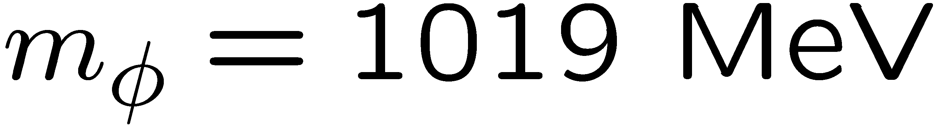
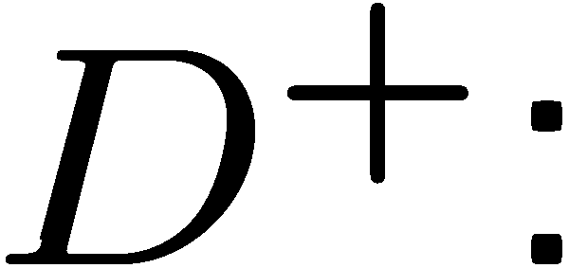


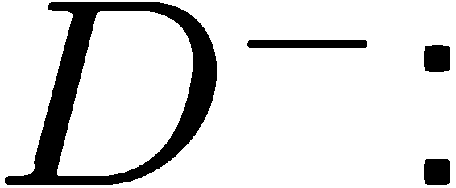

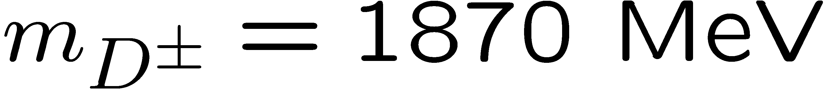
Introduction
φ meson
D mesons

Slide 3
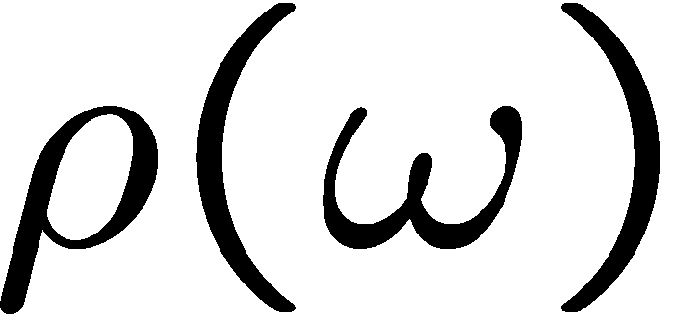

Introduction
Spectral functions at finite density
How is this complicated behavior related to the change of QCD condensates?
modification at finite density
coupling to nucleon resonances?
broadening?
mass/threshold shifts?

Slide 4

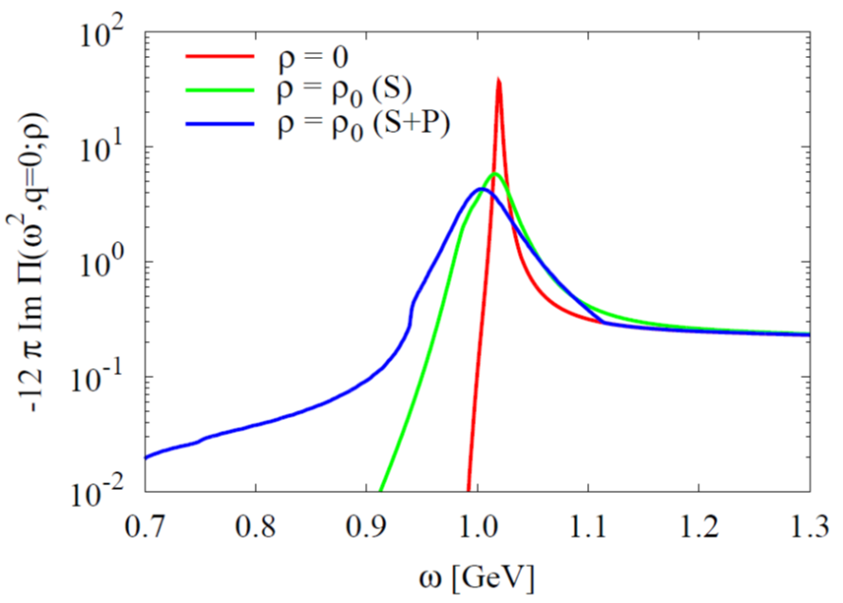
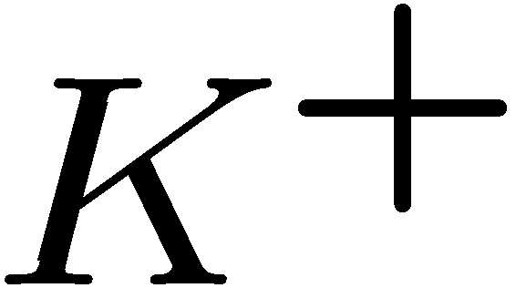
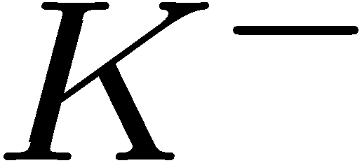
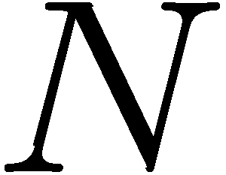
Recent theoretical works about the φ
based on hadronic models
P
N
N
P
Forward KN (or KN) scattering amplitude
P. Gubler and W. Weise, Phys. Lett. B 751, 396 (2015).
P. Gubler and W. Weise, Nucl. Phys. A 954, 125 (2016).

Slide 5
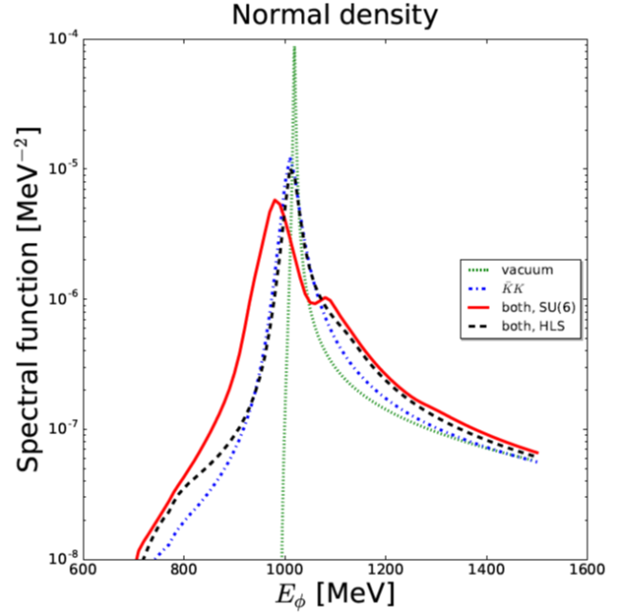
Recent theoretical works about the φ
based on hadronic models
large dependence on details of the model incorporating Baryon - Vector meson interaction
SU(6):
Spin-Flavor Symmetry extension of standard flavor SU(3)
HLS:
Hidden Local Symmetry
Common features:
strong broadening, small negative mass shift
See also:
D. Cabrera, A.N. Hiller Blin and M.J. Vicente Vacas, Phys. Rev. C 95, 015201 (2017).
D. Cabrera, A.N. Hiller Blin and M.J. Vicente Vacas, Phys. Rev. C 96, 034618 (2017).

Slide 6
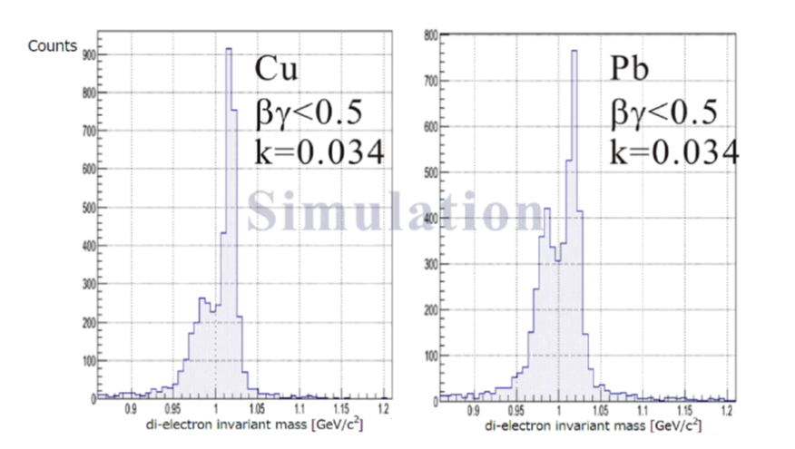
Experimental developments
The E325 Experiment (KEK)
Slowly moving φ mesons are produced in 12 GeV p+A reactions and are measured through di-leptons.
e
e
p
e
p
φ
φ
e
outside decay
inside decay
No effect (only vacuum)
Di-lepton spectrum reflects the modified φ-meson
Y. Morino et. al. (J-PARC E16 Collaboration), JPS Conf. Proc. 8, 022009 (2015).

Slide 7
Fitting Results
βγ<1.25 (Slow)
1.25<βγ<1.75
1.75<βγ (Fast)
Small Nucleus
Large Nucleus

Slide 8
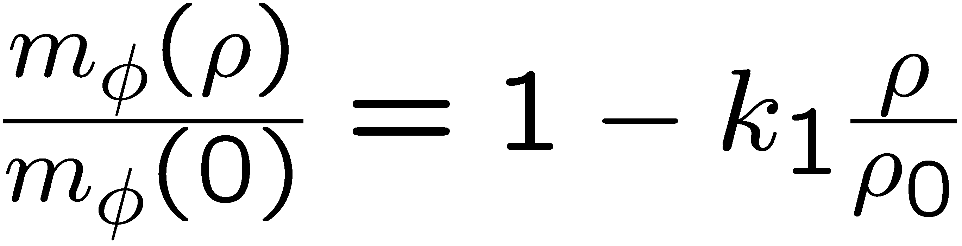
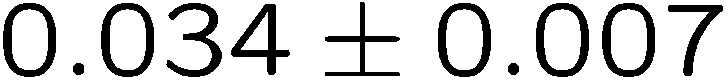
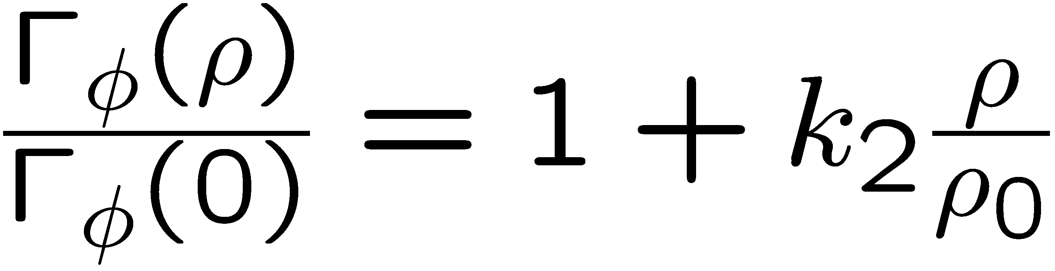
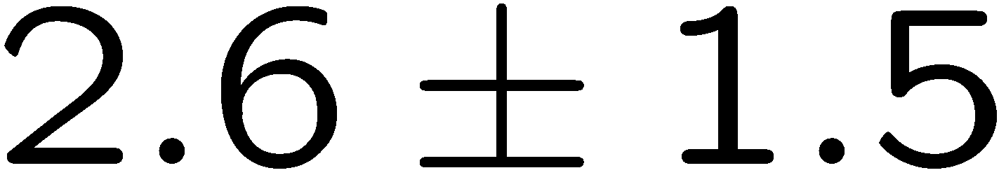
Experimental Conclusions
R. Muto et al, Phys. Rev. Lett. 98, 042501 (2007).
Pole mass:
35 MeV negative mass shift at normal nuclear matter density
Pole width:
Increased width to 15 MeV at normal nuclear matter density
Caution!
Fit to experimental data is performed with a simple Breit-Wigner parametrization
Too simple??

Slide 9
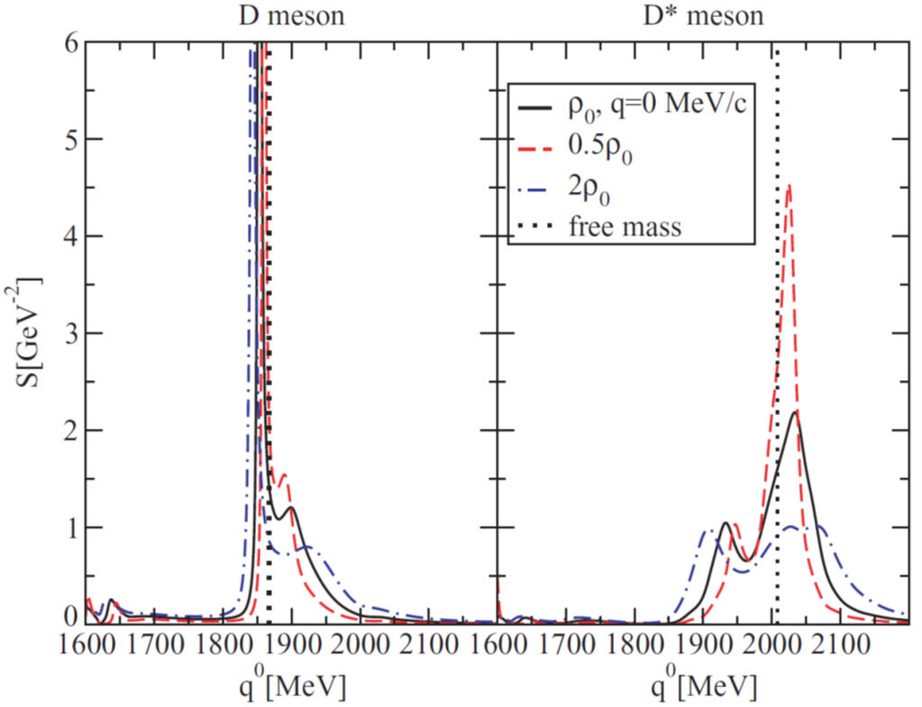
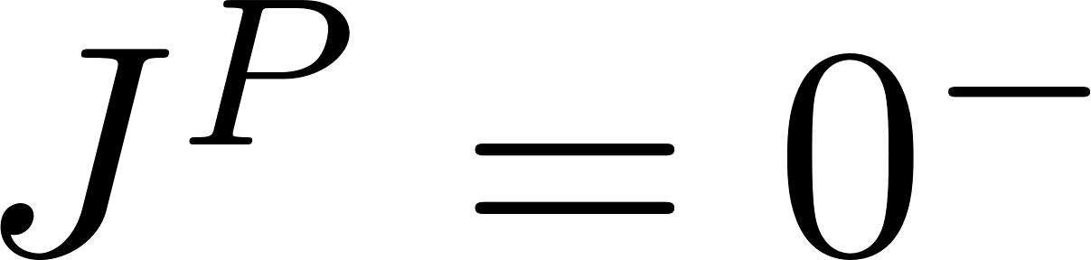
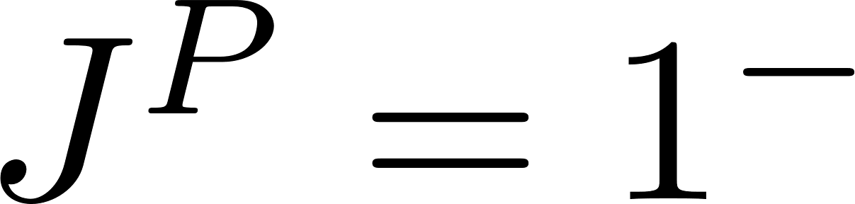
Recent theoretical works about the D
based on hadronic models
Self-consistent coupled-channel unitary approach
D: attractive
D*: repulsive
But:
strong broadening and additional structures appearing in the spectral function
L. Tolos, C. Garcia-Recio and J. Nieves, Phys. Rev. C 80, 065202 (2009).

Slide 10
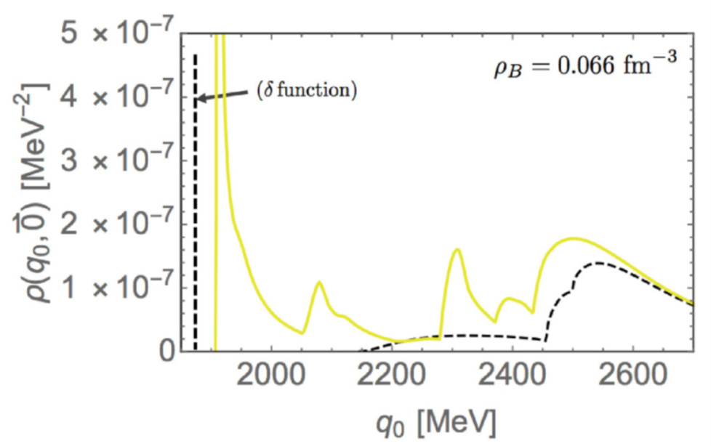
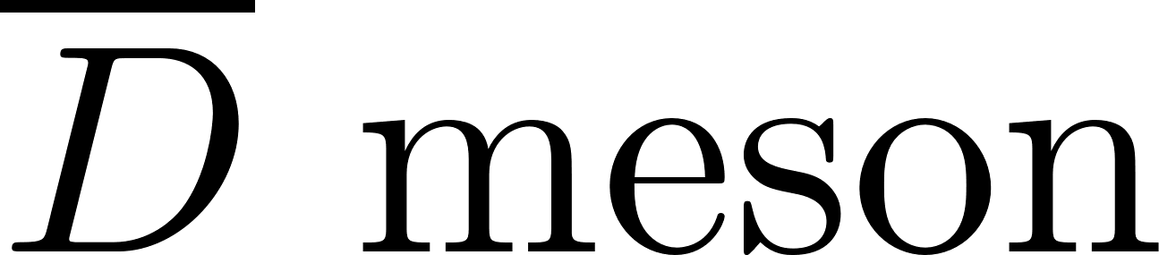
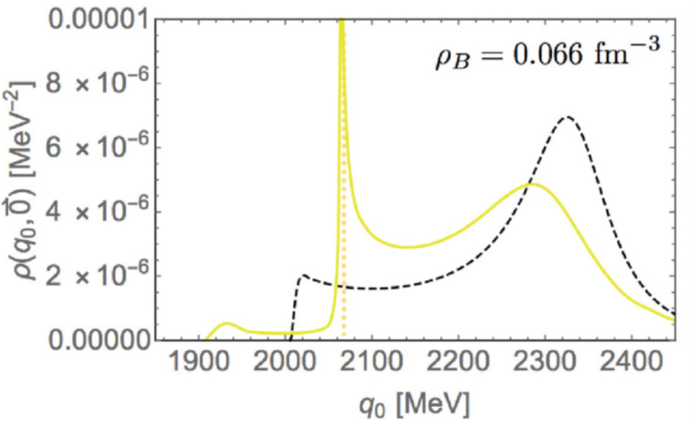
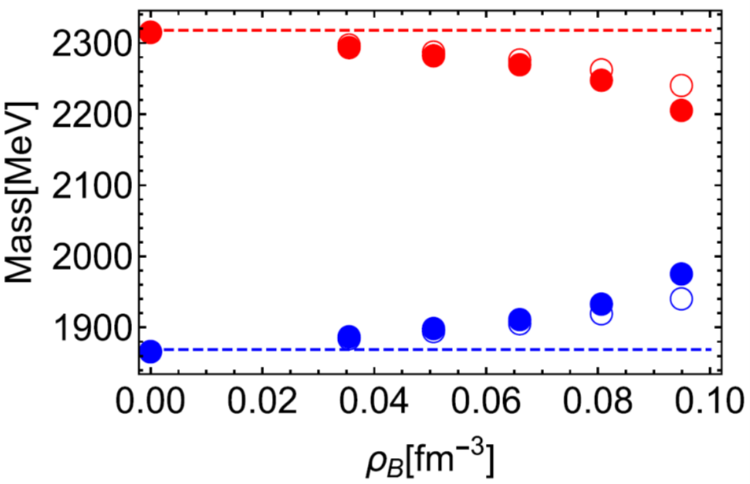
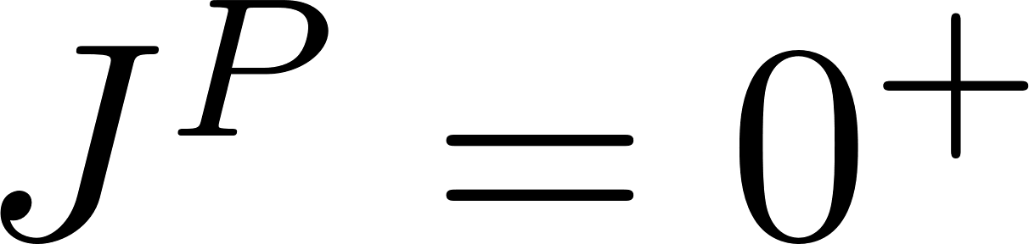
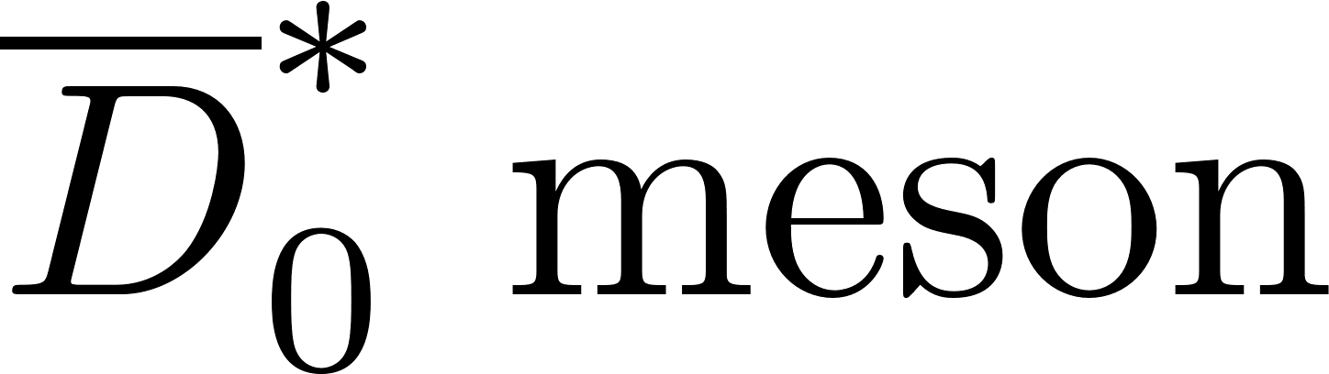
Recent theoretical works about the D
based on hadronic models
Analysis based on the linear sigma model
D: repulsive
should become degenerate for restored chiral symmetry
chiral partners
D*: attractive
0
D. Suenaga, S. Yasui and M. Harada, Phys. Rev. C 97, 015204 (2017).

Slide 11
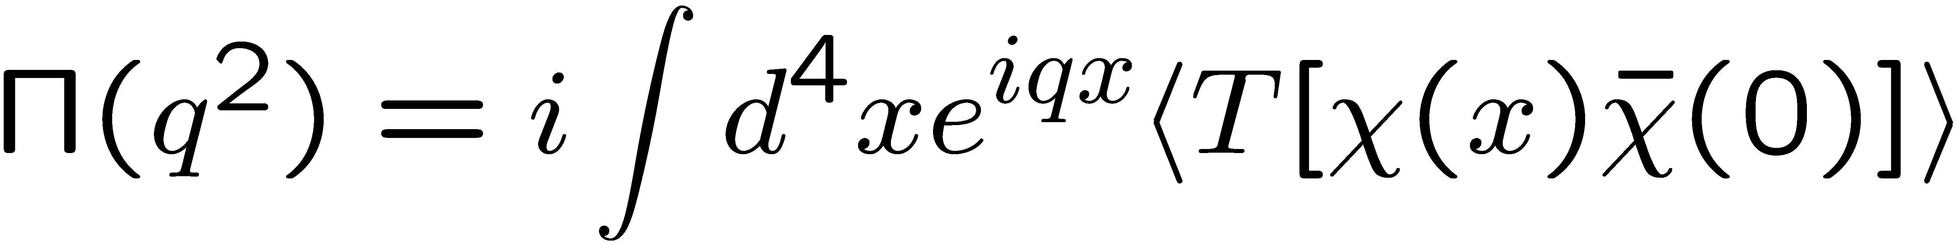
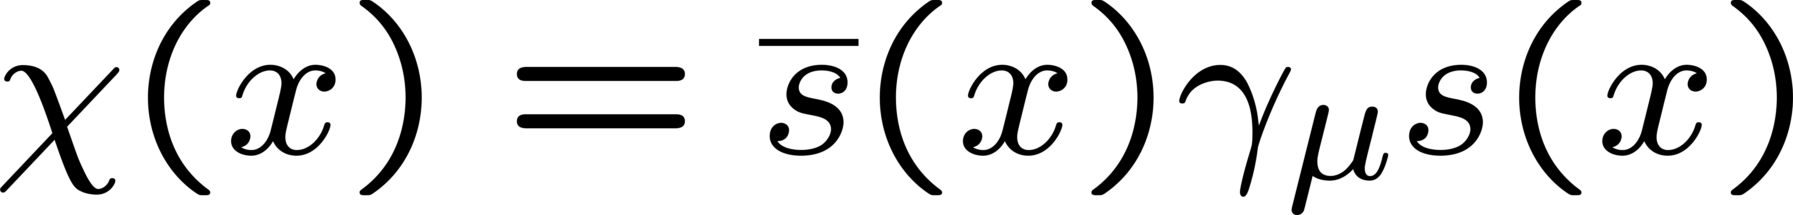
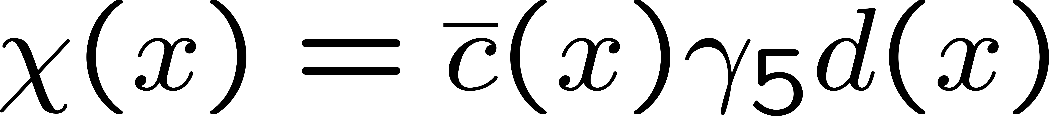
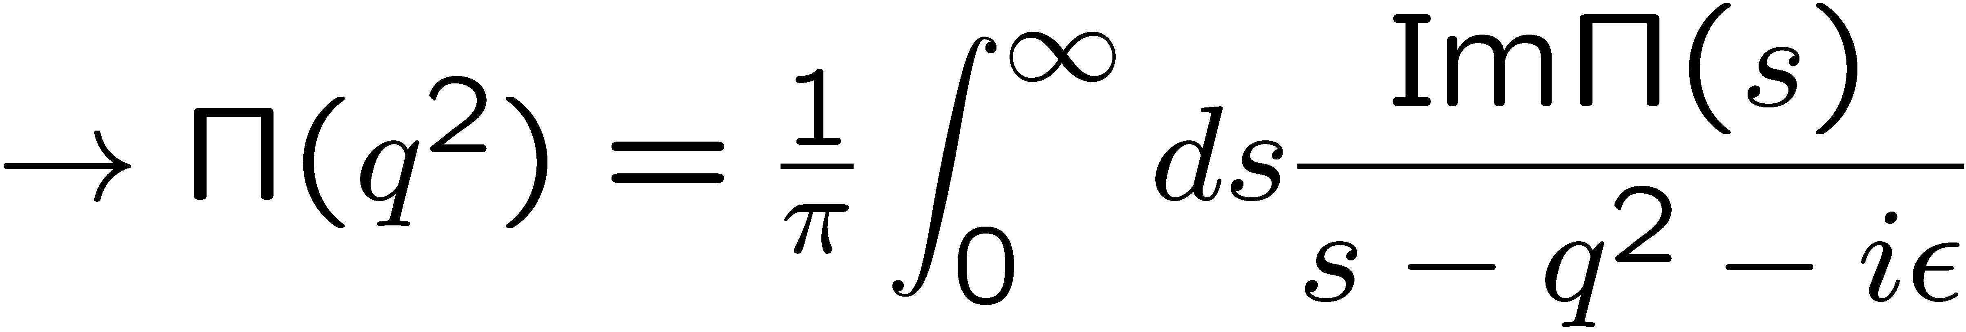
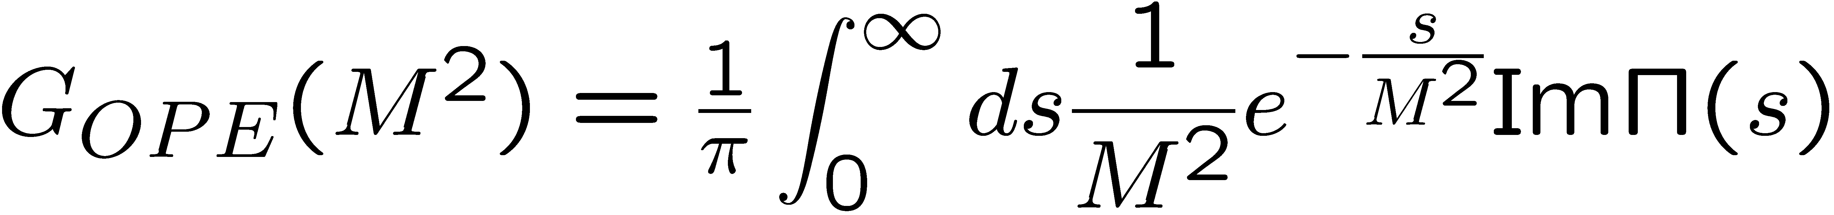
QCD sum rules
M.A. Shifman, A.I. Vainshtein and V.I. Zakharov, Nucl. Phys. B147, 385 (1979); B147, 448 (1979).
Makes use of the analytic properties of the correlation function:
q²
is calculated
“perturbatively”,
using OPE
spectral function
of the operator χ
After the Borel transformation:

Slide 12
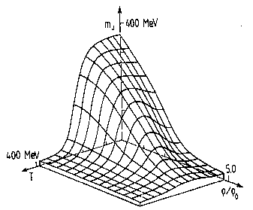
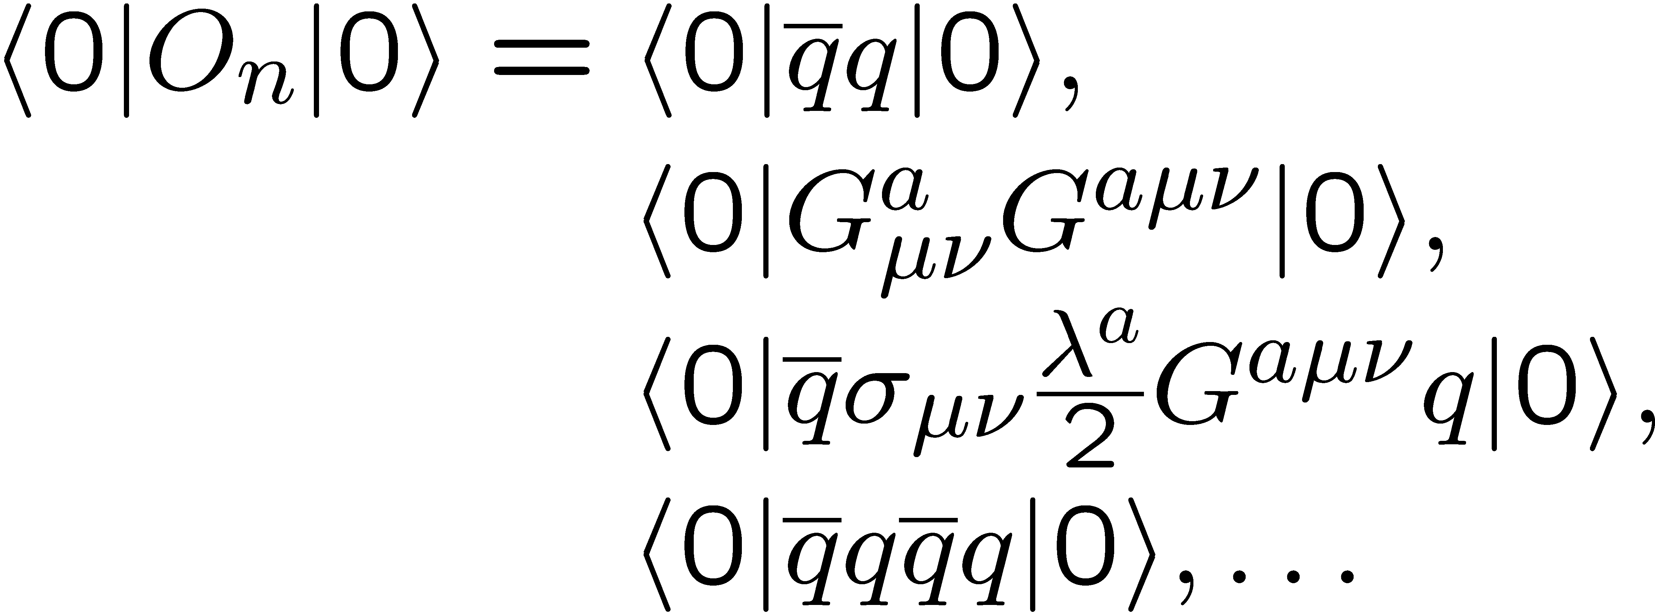
More on the operator product expansion (OPE)
non-perturbative condensates
perturbative Wilson coefficients
Change in hot or dense matter!

Slide 13
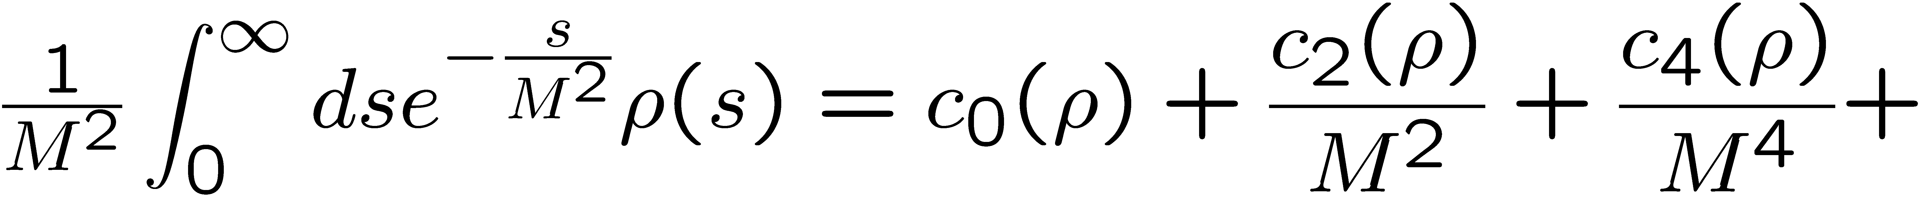
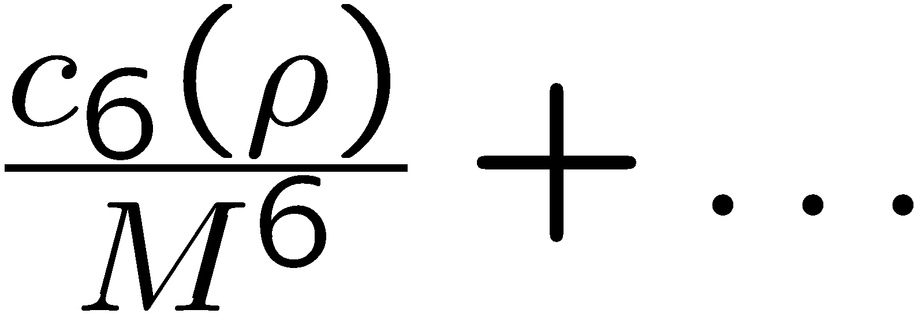
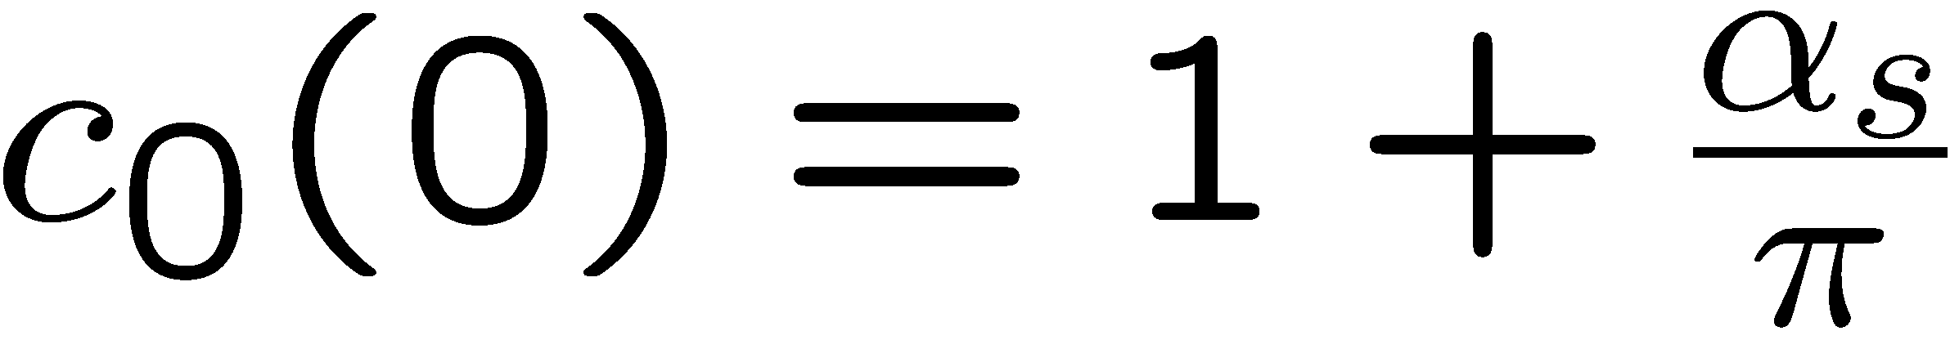
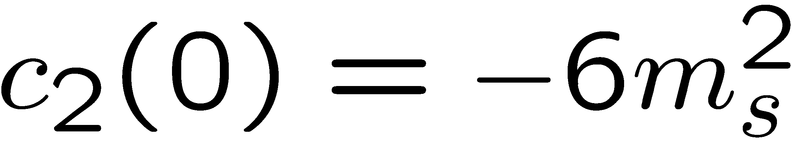
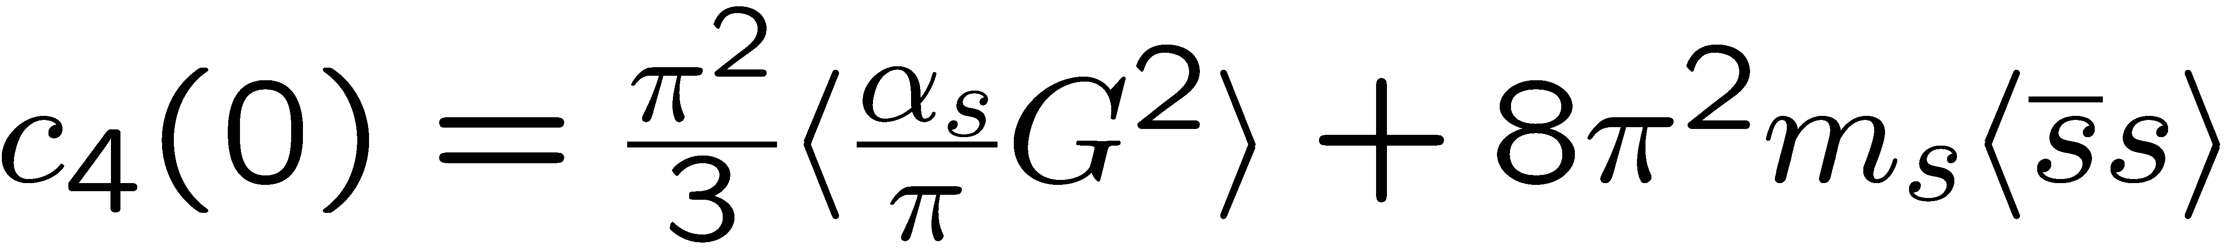
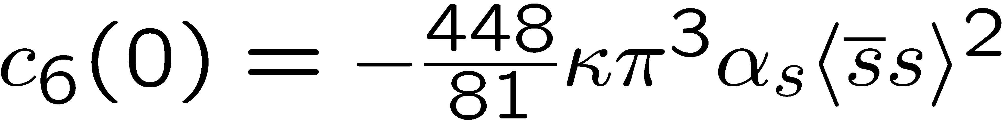
Structure of QCD sum rules for the phi meson
In Vacuum
Dim. 0:
Dim. 2:
Dim. 4:
Dim. 6:

Slide 14
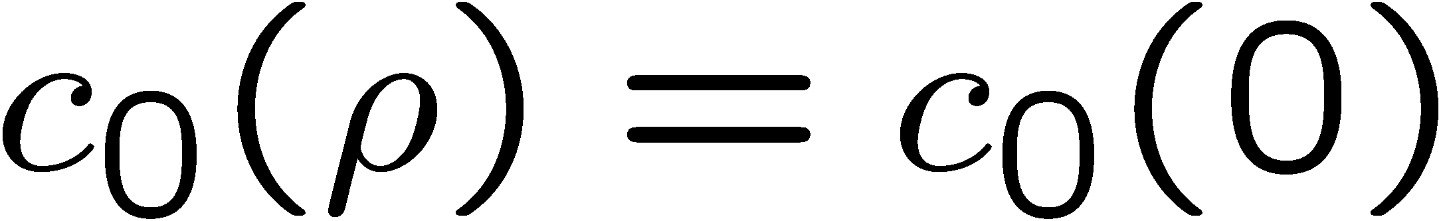
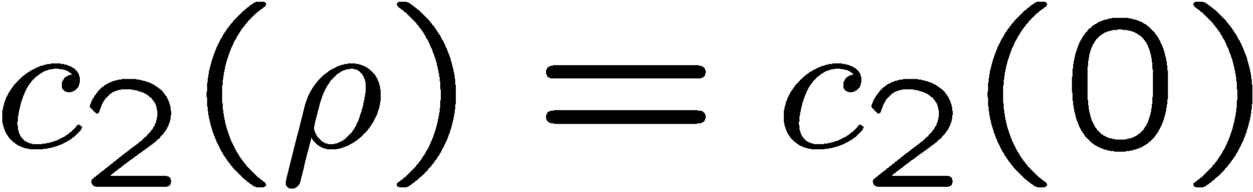
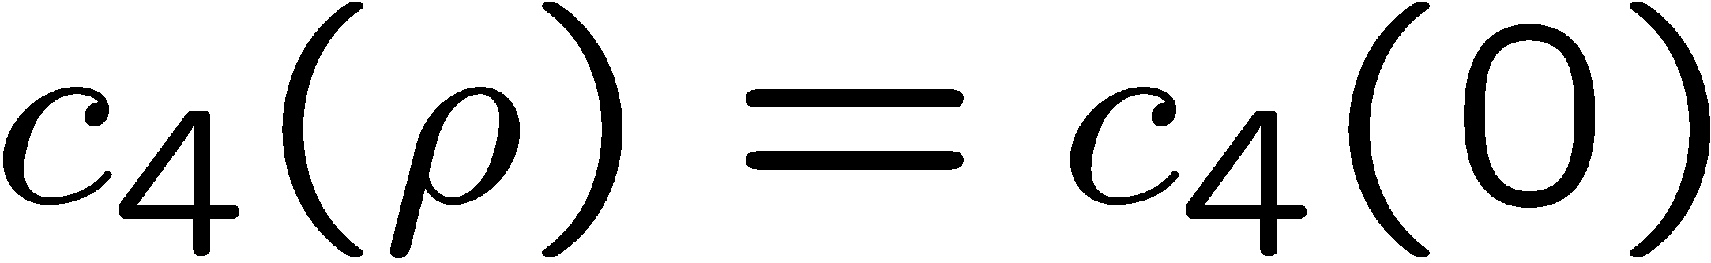
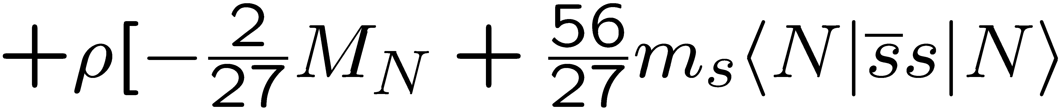
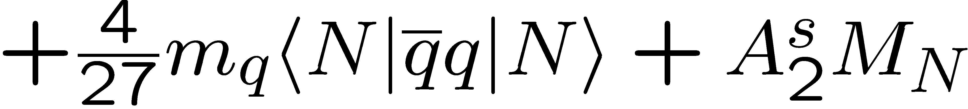
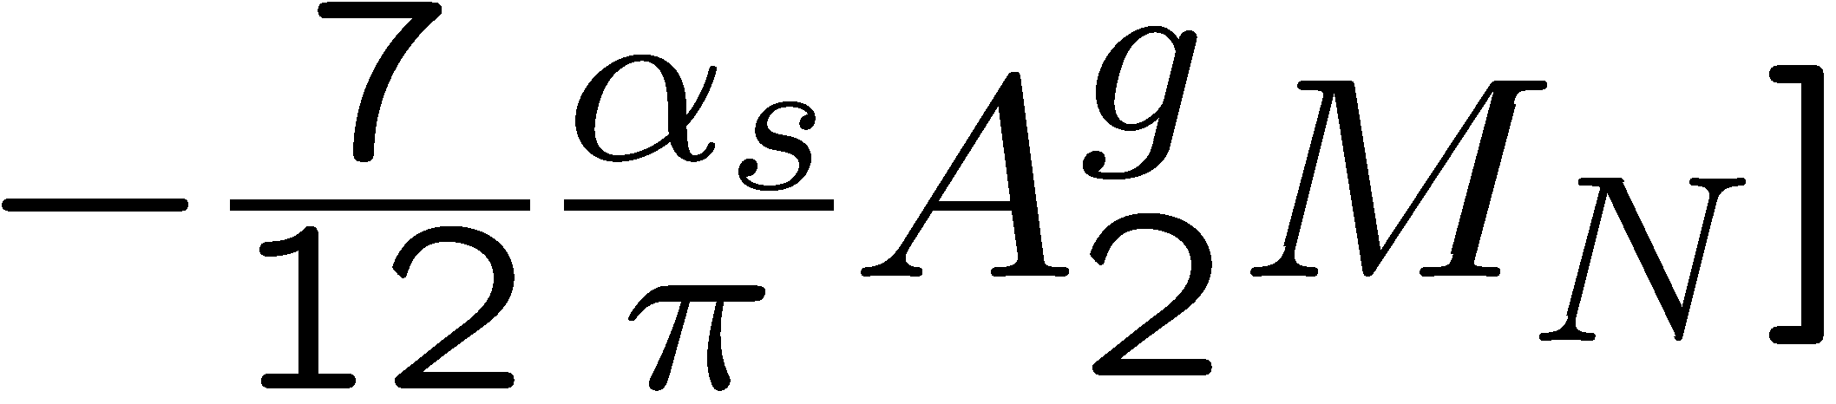
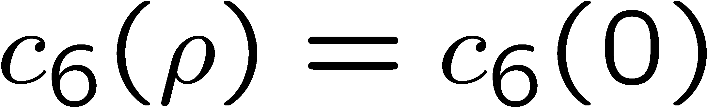
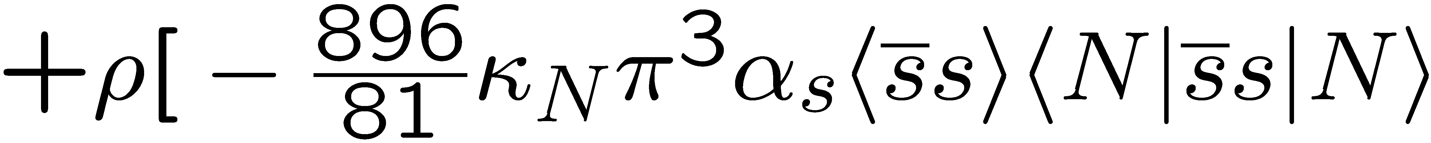
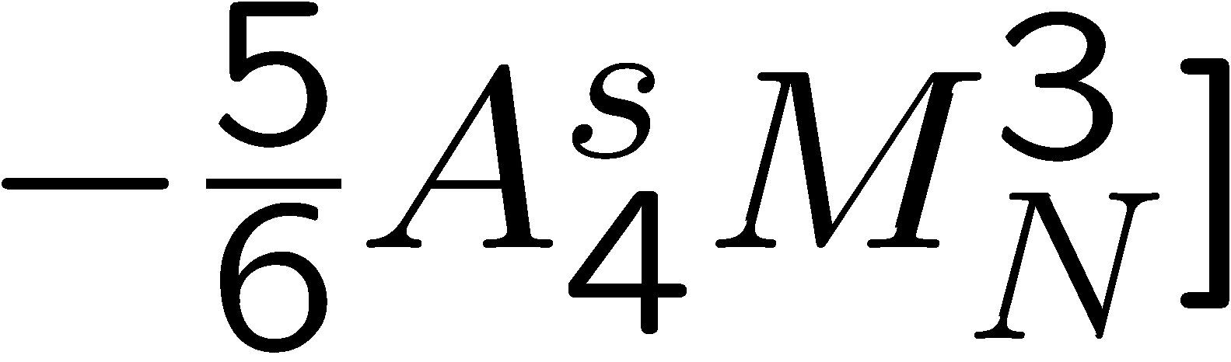
Structure of QCD sum rules for the phi meson
In Nuclear Matter
Dim. 0:
Dim. 2:
Dim. 4:
Dim. 6:

Slide 15
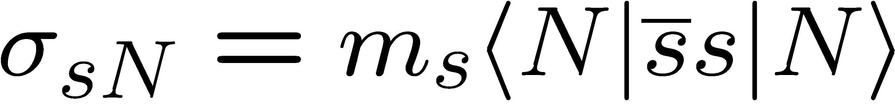
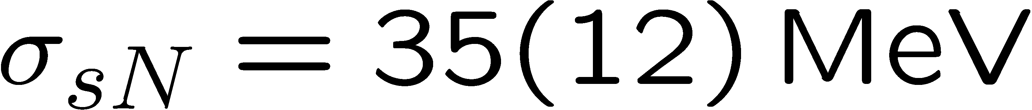
Recent results from lattice QCD
S. Durr et al. (BMW Collaboration), Phys. Rev. Lett. 116, 172001 (2016).
(Feynman-Hellmann)
Y.-B. Yang et al. (χQCD Collaboration), Phys. Rev. D 94, 054503 (2016).
(Direct)
A. Abdel-Rehim et al. (ETM Collaboration), Phys. Rev. Lett. 116, 252001 (2016).
(Direct)
G.S. Bali et al. (RQCD Collaboration), Phys. Rev. D 93, 094504 (2016).
(Direct)
N. Yamanaka et al. (JLQCD Collaboration), arXiv:1805.10507 [hep-lat].
(Direct)

Slide 16
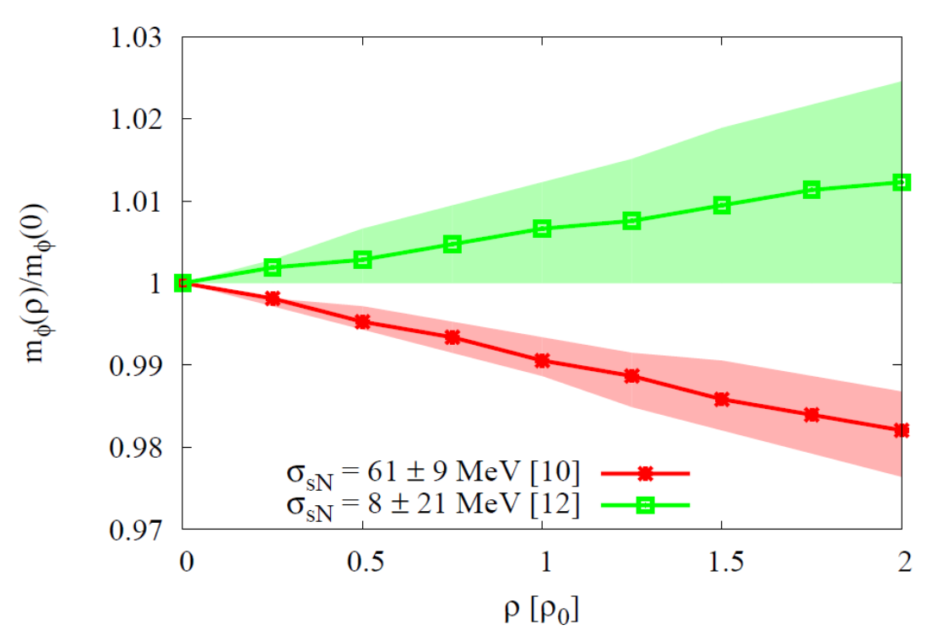
Results for the φ meson mass
Most important parameter, that
determines the behavior of the φ meson mass at finite density:
Strangeness content of the nucleon
P. Gubler and K. Ohtani, Phys. Rev. D 90, 094002 (2014).

Slide 17
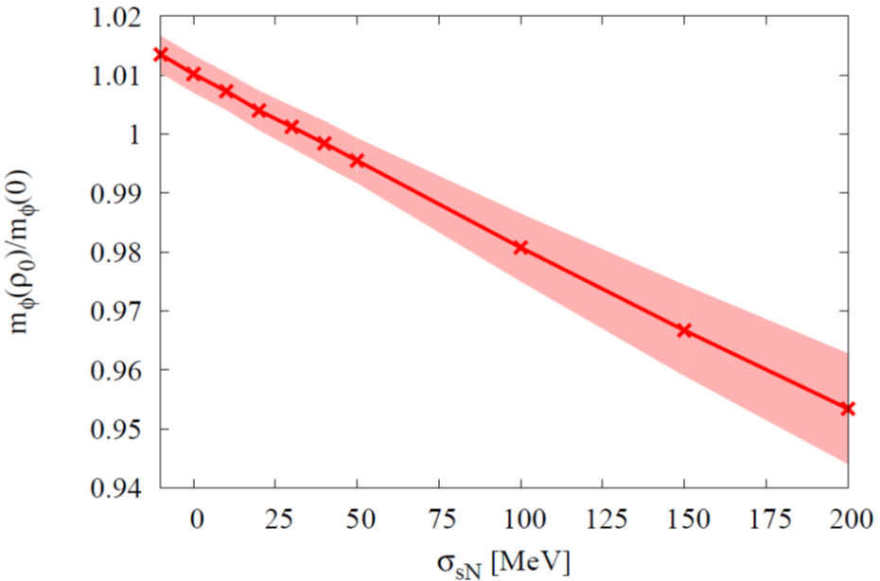

Compare Theory with Experiment
Sum Rules + Experiment
Not consistent?
Experiment
Lattice QCD
Will soon be measured again with better statistics at the E16 experiment at J-PARC!

Slide 18


What about the chiral condensate?
At finite density:
πN-σ term
Newest fit to πN scattering data
(value still not well known)
Recent lattice QCD determination at physical quark masses
M. Hoferichter, J. Ruiz de Elvira, B. Kubis and U.-G. Meißner,
Phys. Rev. Lett. 115, 092301 (2015).
S. Durr et al., (BMW Collaboration),
Phys. Rev. Lett. 116, 172001 (2016).
N. Yamanaka et al. (JLQCD Collaboration), arXiv:1805.10507 [hep-lat].

Slide 19






D-meson in nuclear matter
The sum rules we use:

Slide 20


Results
increase!
To be measured at the CBM (Compressed Baryon Matter) experiment at FAIR, GSI?
And/or at J-PARC??
K. Suzuki, P. Gubler and M. Oka, Phys. Rev. C 93, 045209 (2016).

Slide 21




Summary and Conclusions
In hadronic models, meson spectra are typically modified in a complicated manner:
broadening, mass shifts, additional peaks
The φ-meson mass shift in nuclear matter constrains the strangeness content of the nucleon:
  Increasing φ-meson mass in nuclear matter
  Decreasing φ-meson mass in nuclear matter
QCD sum rule calculations suggest that the D meson mass increases with increasing density:
most important parameter:

Slide 22
Backup slides

Slide 23


Recent theoretical works about the D
based on a non-relativistic quark model
replace r by 1/p and minimize E
Increasing mass for sufficiently small constituent quark masses!
A. Park, P. Gubler, M. Harada, S.H. Lee, C. Nonaka and W. Park, Phys. Rev. D 93, 054035 (2016).

Slide 24


Comparison with more accurate quark model calculation:
increase!
Wave function
A. Park, P. Gubler, M. Harada, S.H. Lee, C. Nonaka and W. Park, Phys. Rev. D 93, 054035 (2016).
Combined effect of chiral restauration and confinement!

Slide 25





Recent theoretical works about the φ
based on the quark-meson coupling model
Some φA bound states might exist, but they have a large width
J.J. Cobos-Martinez, K. Tsushima, G. Krein and A.W. Thomas, Phys. Lett. B 771, 113 (2017).
J.J. Cobos-Martinez, K. Tsushima, G. Krein and A.W. Thomas, Phys. Rev. C 96, 035201 (2017).
→ difficult to observe experimentally ?

Slide 26







Other experimental results
There are some more experimental results on the φ-meson width in nuclear matter, based on the measurement of the transparency ratio T:
Measured at SPring-8 (LEPS)
Measured at COSY-ANKE
Theoretical calculation:
V.K. Magas, L. Roca and E. Oset, Phys. Rev. C 71, 065202 (2005).
Theoretical calculation:
D. Cabrera, L. Roca, E. Oset , H. Toki and M.J. Vicente Vacas, Nucl. Phys. A733, 130 (2004).
Theoretical calculation:
E. Ya. Paryev, J. Phys. G 36, 015103 (2009).
T. Ishikawa et al, Phys. Lett. B 608, 215 (2005).
A. Polyanskiy et al, Phys. Lett. B 695, 74 (2011).

Slide 27






Starting point
Rewrite using hadronic degrees of freedom
(vector dominance model)
Kaon loops

Slide 28


Vacuum spectrum
(Vacuum)
How is this spectrum modified in nuclear matter?
Is the (modified) spectral function consistent with QCD sum rules?
P. Gubler and W. Weise, Phys. Lett. B 751, 396 (2015).
Data from
J.P. Lees et al. (BABAR Collaboration), Phys. Rev. D 88, 032013 (2013).

Slide 29
BMW version:
Sum Rules + Experiment
?
Experiment
Lattice QCD

Slide 30
χQCD version:
Sum Rules + Experiment
??
Experiment
Lattice QCD

Slide 31



The strangeness content of the nucleon: results from lattice QCD
Two methods
Direct measurement
Feynman-Hellmann theorem
A. Abdel-Rehim et al. (ETM Collaboration), Phys. Rev. Lett. 116, 252001 (2016).
S. Durr et al. (BMW Collaboration), Phys. Rev. Lett. 116, 172001 (2016).

Slide 32



The strangeness content of the nucleon:
Important parameter for dark-matter searches:
Neutralino: Linear superposition of the Super-partners of the Higgs, the photon and the Z-boson
Adapted from: W. Freeman and D. Toussaint (MILC Collaboration), Phys. Rev. D 88, 054503 (2013).
most important contribution
dominates
A. Bottino, F. Donato, N. Fornengo and S. Scopel, Asropart. Phys. 18, 205 (2002).

Slide 33

Problem at finite ρ: sign problem!
Dirac operator
mass matrix
chemical potential
The determinant is complex
Standard Monte-Carlo integration is essentially impossible

Slide 34



The basic problem to be solved
given
?
“Kernel”
(but only incomplete and with error)
This is an ill-posed problem.
But, one may have additional information on ρ(ω), which can help to constrain the problem:
- Positivity:
- Asymptotic values:

Slide 35



The Maximum Entropy Method
How can one include this additional information and find the most probable image of ρ(ω)?
→ Bayes’ Theorem
likelihood function
prior probability

Slide 36

Results of test-analysis (using MEM)
Peak position can be extracted, but not the width!
P. Gubler and K. Ohtani, Phys. Rev. D 90, 094002 (2014).

Slide 37






likelihood function
prior probability
Corresponds to ordinary χ²-fitting.
(Shannon-Jaynes entropy)
“default model”
M. Jarrel and J.E. Gubernatis, Phys. Rep. 269, 133 (1996).
M.Asakawa, T.Hatsuda and Y.Nakahara, Prog. Part. Nucl. Phys. 46, 459 (2001).

Slide 38
The traditional analysis method
The spectral function is approximated by a “pole + continuum” ansatz:
pert. QCD limit
m
s_{th}
Even though this ansatz is very crude, it works quite well in cases for which it is phenomenologically known to be close to reality.
e.g. -charmonium (J/ψ)

Slide 39

The strangeness content of the nucleon:
Important parameter for dark-matter searches:
Neutralino: Linear superposition of the Super-partners of the Higgs, the photon and the Z-boson
Adapted from: W. Freeman and D. Toussaint (MILC Collaboration), Phys. Rev. D 88, 054503 (2013).
most important contribution
dominates
A. Bottino, F. Donato, N. Fornengo and S. Scopel, Asropart. Phys. 18, 205 (2002).

Slide 40

In-nucleus decay fractions for E325 kinematics
Taken from: R.S. Hayano and T. Hatsuda, Rev. Mod. Phys. 82, 2949 (2010).

Slide 41







How can this result be understood?
Let us examine the OPE at finite density more closely:
Dimension 4 terms governs the behavior of the φ meson

Slide 42

More on the free KN and KN scattering amplitudes
For KN:
Approximate by a real constant (↔ repulsion)
T. Waas, N. Kaiser and W. Weise, Phys. Lett. B 379, 34 (1996).
For KN:
Use the latest fit based on SU(3) chiral effective field theory, coupled channels and recent experimental results (↔ attraction)
Y. Ikeda, T. Hyodo and W. Weise, Nucl. Phys. A 881, 98 (2012).
K⁻p scattering length obtained from kaonic hydrogen (SIDDHARTA Collaboration)

