Slide 1



Possibility of a new narrow Λ* resonance near the Λη threshold
Kiyoshi Tanida
(Japan Atomic Energy Agency)
for J-PARC E72 collaboration
@The 13th International Conference on
Hypernuclear and Strange Particle
Physics (HYP2018)
28 June 2018

Slide 2
Collaboration list – J-PARC E72
Japan Atomic Energy Agency: S. Hasegawa, T. Hashimoto,
Y. Ichikawa, K. Imai, H. Sako, S. Sato, K. Tanida
Ohio University: Taya Chetry, Gleb Fedotov, Ken Hicks, Joey Rowley, Utsav Shrestha
RCNP, Osaka University: H. Noumi, K. Shirotori, S.B. Yang
University of Connecticut: Kyungseon Joo, Nikolay Markov,
Andrey Kim, Stefan Diehl, David Riser, Brandon Clary,
Thomas O'Connell, Frank Cao, Kevin Wei
Florida International University: L. Guo
RIKEN: M. Iwasaki, S. Okada, F. Sakuma, H. Asano, Y. Ma
ELPH, Tohoku University: H. Ohnishi, A. Tokiyasu
Korea University: J.K. Ahn, S.W. Choi, W.S. Jung, B.M. Kang,
S.H. Kim, K.Y. Roh, H.M. Yang
INFN Frascati: Alberto Clozza, Catalina Curceanu,
Kristian Piscicchia, Alessandro Scordo
Kyoto University: M. Niiyama
Korea Research Institute of Standards and Science: S.H. Hwang

Slide 3


Dalitz plot: $Λ_{c}^{+}→pK^{−}π^{+}$
[S.B.Yang, K. Tanida, et al., PRL117.011801]
Κ∗(896)
Δ(1232)
What’s this?
Λ(1520)

Slide 4
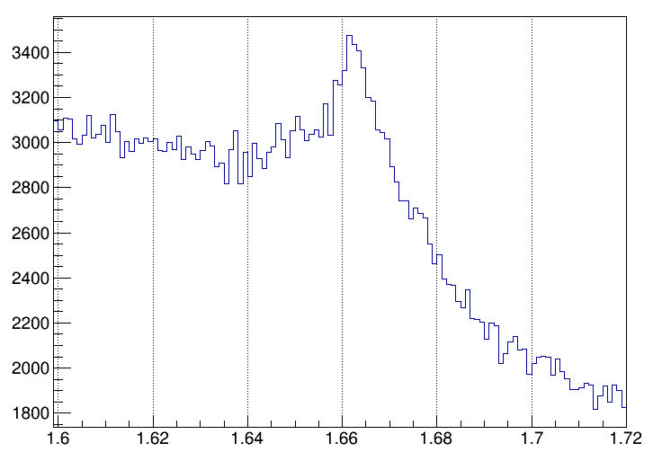
* $M\left(pK^{−}\right)$
■ 1D projection -- $M\left(pK^{−}\right)$
What’s this?
m～1663 MeV
Γ～10 MeV?
Counts / 1$MeV/c^{2}$
$$M\left(pK^{−}\right) [GeV/c^{2}]$$

Slide 5
What’s that?
The peak position is ~1663 MeV, near the Λη threshold (1663.5 MeV)
Width is ~10 MeV, significantly narrower than Λ, Σ resonances in this region
  Λ(1670): 25-50 MeV
  Σ(1660): 40-200 MeV
  Σ(1670): 40-80 MeV
  Λ(1690): ~60 MeV
No such narrow states are theoretically predicted in this region – exotic?

Slide 6
A new idea
2 independent groups claim there is a new narrow Λ* resonance at this energy with J=3/2
  Kamano et al. [PRC90.065204, PRC92.025205]
  J^{P}=3/2⁺ (P₀₃), M=1671+2-8 MeV, Γ=10+22-4 MeV
  Liu & Xie [PRC85.038201, PRC86.055202]
  J^{P}=3/2⁻ (D₀₃), M=1668.5±0.5 MeV, Γ=1.5±0.5 MeV
The reason is the same
  From K⁻p → Λη measurement near the threshold by Crystal Ball collaboration at BNL [PRC64.055205]
  Model independent

Slide 7
Crystall Ball data for K⁻p → Λη
Total cross section – this can be well explained by conventional Λ(1670)1/2⁻(S₀₁) resonance

Slide 8
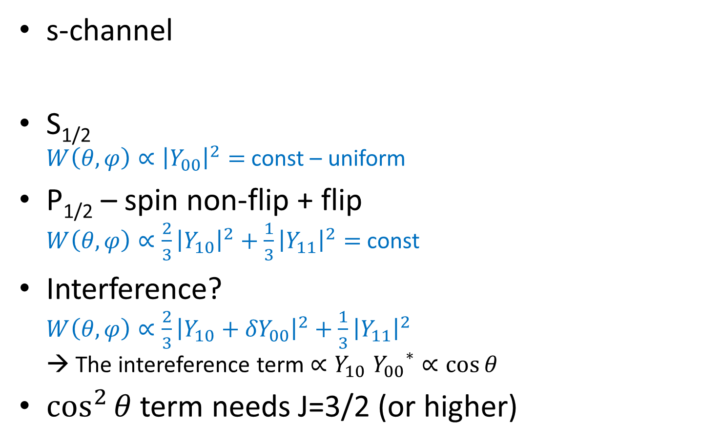
Differential cross section
(or angular distribution)
S_{1/2} P_{1/2,3/2}
D_{3/2,5/2} …
s-channel
S_{1/2}
$W\left(θ,φ\right)∝{\left|Y_{00}\right|}^{2}=$ const – uniform
P_{1/2} – spin non-flip + flip
$W\left(θ,φ\right)∝\frac{2}{3}{\left|Y_{10}\right|}^{2}+\frac{1}{3}{\left|Y_{11}\right|}^{2}=$ const
Interference?
$W\left(θ,φ\right)∝\frac{2}{3}{\left|Y_{10}+{δY}_{00}\right|}^{2}+\frac{1}{3}{\left|Y_{11}\right|}^{2}$
→ The intereference term ${∝Y}_{10}{Y_{00}}^{∗}∝\cos{θ}$
$\cos^{2}{θ}$ term needs J=3/2 (or higher)
K⁻
η
p
Λ

Slide 9
Differential cross sections (1)
flat
Quadratic
flat

Slide 10
Differential cross sections (2)
Flat near the threshold
  Expected for J=1/2 (S-wave)
Concave-up around p_{K}=734 MeV/c (√s=1669 MeV)
Flat again for p_{K} > 750 MeV/c
(√s=1677 MeV)
Quadratic shape requires J=3/2 amplitude
→ Narrow resonance; model independent

Slide 11
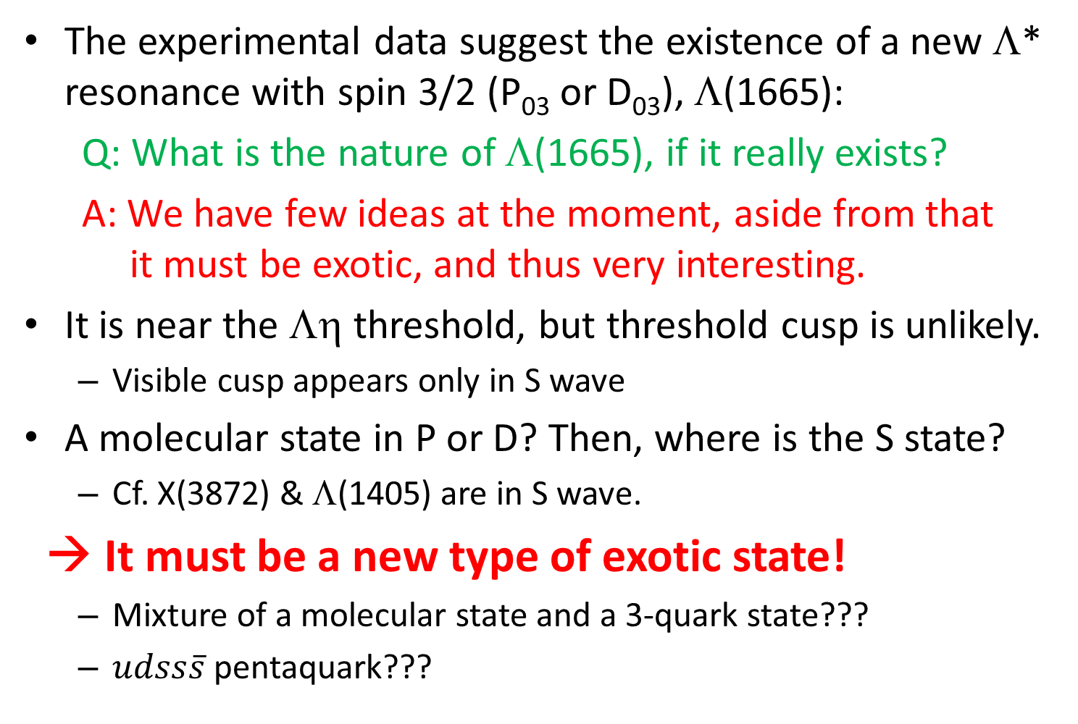
What can it be?
The experimental data suggest the existence of a new Λ* resonance with spin 3/2 (P₀₃ or D₀₃), Λ(1665):
Q: What is the nature of Λ(1665), if it really exists?
A: We have few ideas at the moment, aside from that
it must be exotic, and thus very interesting.
It is near the Λη threshold, but threshold cusp is unlikely.
  Visible cusp appears only in S wave
A molecular state in P or D? Then, where is the S state?
  Cf. X(3872) & Λ(1405) are in S wave.
→ It must be a new type of exotic state!
  Mixture of a molecular state and a 3-quark state???
  $udss\overline{s}$ pentaquark???

Slide 12
J-PARC E72
To establish Λ(1665) and determine its parity
Repeat the Kp → Λη experiment again with a large acceptance detector, i.e., TPC (HypTPC)
Principle:
  K beam momentum: 735 MeV/c (±2% FWHM)
  → K1.8BR (or K1.1 beamline)
  Momentum resolution: ～1.5 MeV/c
  → Can identify narrow resonance down to Γ∼1 MeV
  Detect Λ → pπ⁻, identify η by missing mass
  Both Λ and η go to forward direction

Slide 13
J-PARC K1.8BR beamline
Beam intensity (@50 kW)
~ 30 k/spill (2s/5.52s)
  π/K ~ 20
Momentum measurement by D5
  Resolution: 0.2% (1σ)
  (1.5 MeV/c)
Beam PID by Cherenkov counter (AC)
& TOF (BHD-T0, 7.7m)

Slide 14
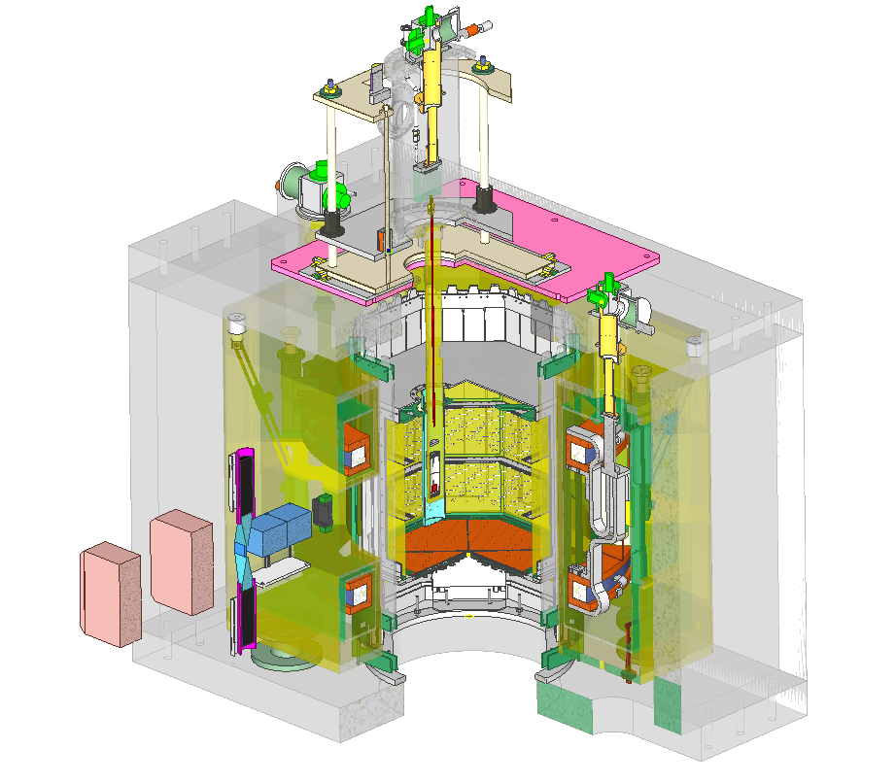
Hyperon Spectrometer
TPC Hodoscope
LH₂ Target
Helmholtz magnet
(B=0.6 T)
HypTPC
See also presentations by Prof. Ahn and Ms. ShinHyung Kim

Slide 15
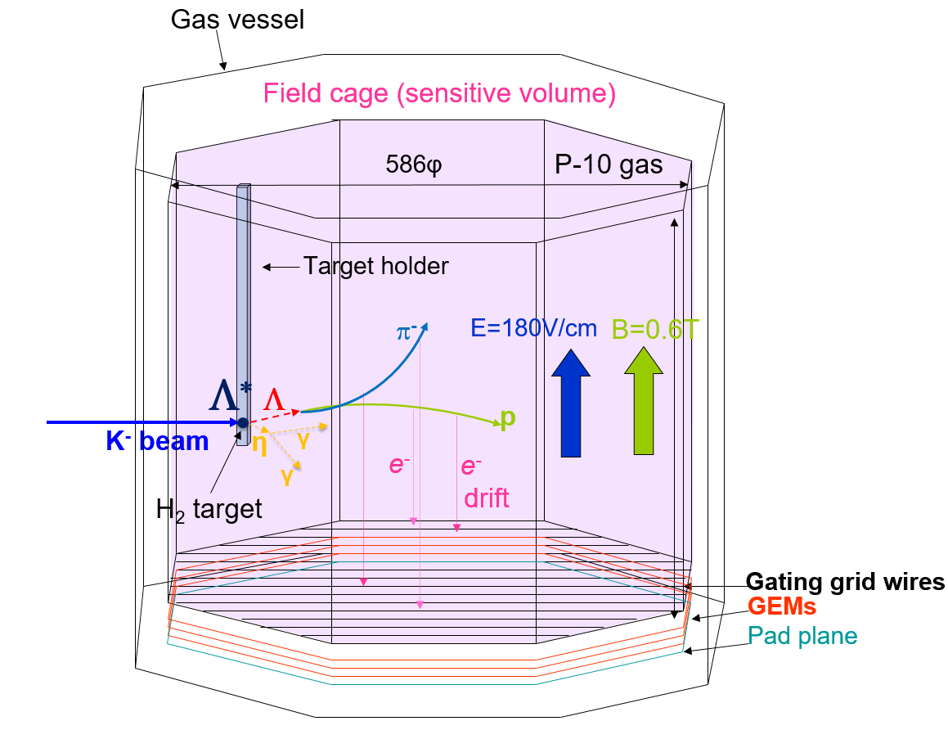
HypTPC
A new TPC for
H-dibaryon search
(J-PARC E42) &
baryon spectroscopy (E45)
Large (almost 4π) acceptance
Construction complete.
Under commissioning

Slide 16
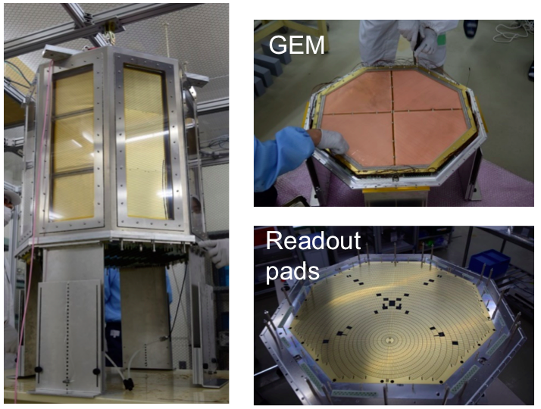
Pictures of hypTPC

Slide 17
Expected performance (@B=0.6T)
Momentum resolution (1σ)
  Proton (～400 MeV/c): 15 MeV/c
  Pion (～100 MeV/c): 2.5 MeV/c
Mass resolution
  Λ → pπ⁻ invariant mass: 2.5 MeV/c²
  η missing mass: 1 MeV/c² (mostly determined by beam momentum resolution)
Acceptance
  Proton: ~100%
  Pion: ~60-85% (~25% miss trigger hodoscope surrounding hypTPC, ~10% stop in the target and ~5% decay in volume)
  Reaction angle dependence is modest

Slide 18
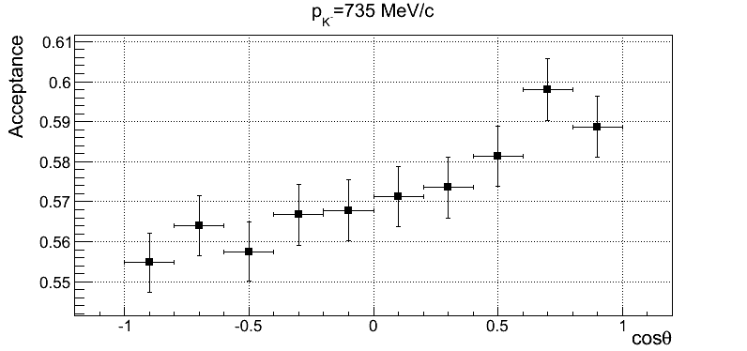
Acceptance curve
Most conservative case -- requiring both p and π⁻ pass through hypTPC and hit trigger hodoscope.
Reaction angle dependence is modest

Slide 19
Trigger
Interaction rate: 170/spill (for σ_{tot}=40 mb)
→ Strong trigger is not necessary
2 types of triggers:
  Type A: Two (or more) charged particles:
    Other reactions, such as Kp → ππΛ, can be also taken
    Loss of pion due to limited hodoscope acceptance (~25%)
  Type B: one proton with large energy deposit
    Protons hit forward segments only.
    Larger acceptance (~85%)
We will take OR of those two triggers
  Still, the estimated trigger rate is about 1k/spill (500 Hz)
  (> 90% DAQ efficiency)

Slide 20
Yield estimation
Beam intensity: 30 k/spill x 2/3
  about 1/3 miss the target
Target: Liq. H₂ 5 cm (0.35 g/cm², 2.1x10²³/cm²)
Reaction rate: 4.2/spill for 1 mb
Acceptance & efficiency: 0.3
  Λ → pπ⁻ branch: 0.64
  hypTPC acceptance: > 0.6
  Overall efficiency (DAQ, analysis): 0.8
Event rate: 900/h
→ 150k events in a week.
Cf. Crystal Ball: 2700 events in total

Slide 21
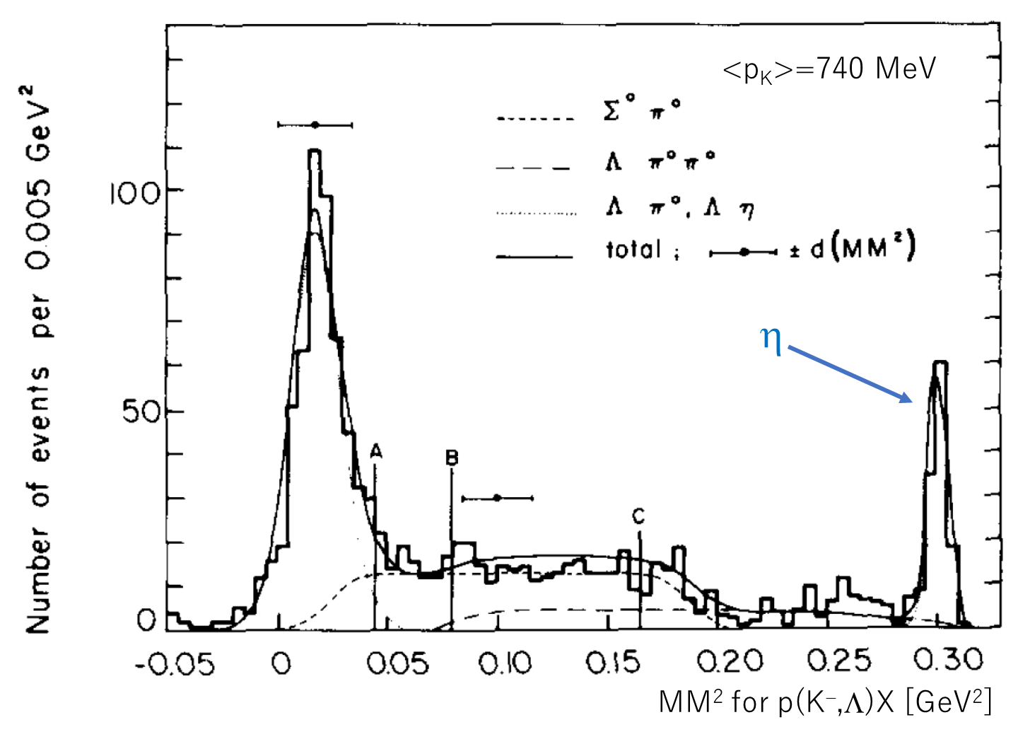
Background
Demonstrated to be small – old data [Nucl. Phys. B21, 15 (1970)]
  even better η missing mass resolution (3 → 1 MeV)

Slide 22
Parity determination
Angular distribution is the same for 3/2⁺ (P wave)
and 3/2⁻ (D wave)
  We need polarization of the final Λ
Crystal-Ball data is very poor for polarization
  Cannot conclude the existence of new resonance

Slide 23
Polarization – Parity in CB data
No new
resonance
New resonance
in 3/2⁺ (P₀₃)
Model calc. by
Kamano et al.
[PRC92.025205]
Crystal ball data is average of 722-750 MeV/c
& 750-770 MeV/c, not for each momentum.
⬄ Meanwhile, calculations are done on the points.

Slide 24
Calculation by Liu & Xie
[PRC86.055202]
New resonance in 3/2⁻ (D₀₃)
No new resonance
733 MeV/c
734 MeV/c
735 MeV/c

Slide 25
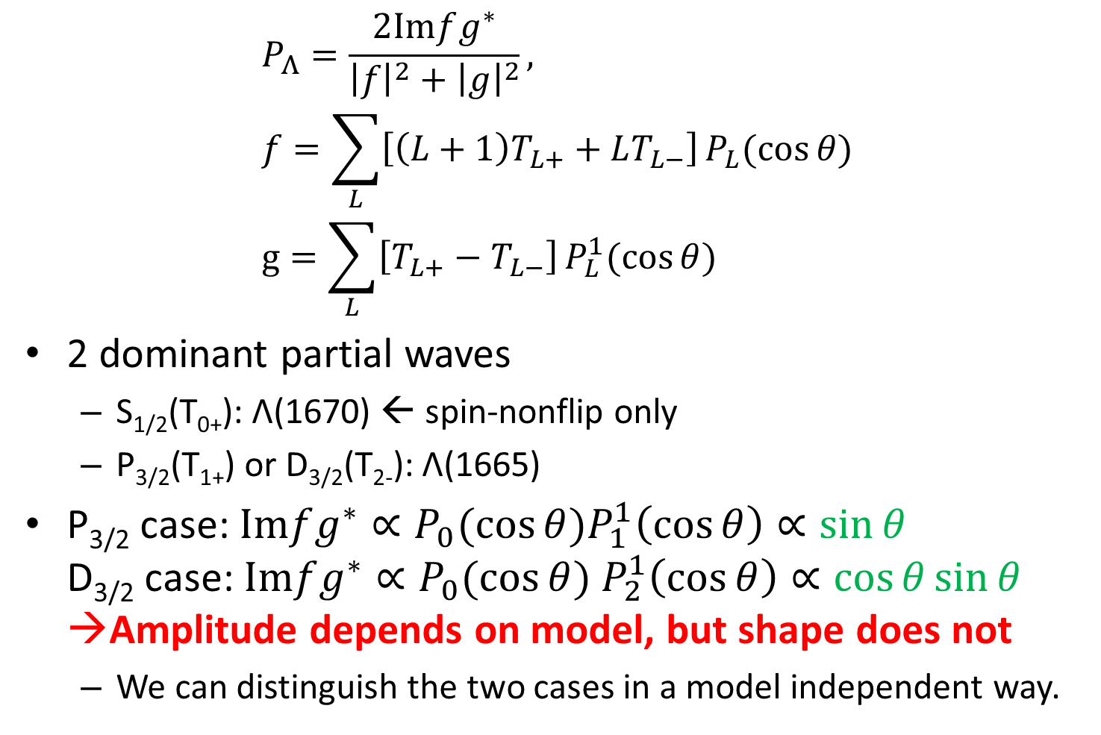
A simple calculation
$$P_{Λ}=\frac{2\text{Im}fg^{∗}}{{\left|f\right|}^{2}+{\left|g\right|}^{2}}, \\ f=\sum_{L}{\left[\left(L+1\right)T_{L+}+LT_{L−}\right]}P_{L}(\cos{θ}) \\ g=\sum_{L}{\left[T_{L+}−T_{L−}\right]}P_{L}^{1}(\cos{θ})$$
2 dominant partial waves
  S_{1/2}(T₀₊): Λ(1670) ← spin-nonflip only
  P_{3/2}(T₁₊) or D_{3/2}(T₂₋): Λ(1665)
P_{3/2} case: $\text{Im}fg^{∗}∝P_{0}(\cos{θ})P_{1}^{1}\left(\cos{θ}\right)∝\sin{θ}$
D_{3/2} case: ${\text{Im}fg^{∗}∝P_{0}(\cos{θ}) P}_{2}^{1}\left(\cos{θ}\right)∝\cos{θ}sin{θ}$
→Amplitude depends on model, but shape does not
  We can distinguish the two cases in a model independent way.
Notes:
分子：numerator (分母：denominator)

Slide 26
Parity determination
Angular distribution is the same for 3/2⁺ (P wave)
and 3/2⁻ (D wave)
  We need polarization of the final Λ
Crystal-Ball data is very poor for polarization
  Cannot conclude the existence of new resonance
How we can distinguish P&D?
  P wave – no node, D wave – node
We need δp~0.05 for each momentum/angle bin
→ Large (> 100 times) statistics needed
～16: δP 0.2 → 0.05
～10: binning 2 → 20
→ Need ~2 weeks of beamtime. Feasible!

Slide 27
Present status and prospects
Proposal was submitted to J-PARC in Dec. 2017
Stage-1 approval (Scientific approval) granted in the J-PARC PAC meeting in Jan. 2018.
We will try to get stage-2 approval (full approval) in the PAC meeting in Jan. 2019.
The whole detector system will be ready within 2019.
Hope to run in 2020.

Slide 28
Summary
Search for a new Λ∗ resonance around the Λη threshold
Hints seen in Belle & Crystall Ball
Does not fit in quark model or any other models
→ Must be an exotic
J-PARC E72@K1.8BR (or K1.1)
  Repeat the measurement of p(K⁻,Λ)η with x100 more statistics than Crystal Ball.
  Not only differential cross section, but Λ polarization
  → Parity can be determined
  Interpretation does not depend on theoretical models.
We hope to run in 2020
  Ready to run by Dec. 2019.

Slide 29
Backup

Slide 30
Measurement@Belle
The peak in the M(pK⁻) spectrum in Λ_{c} → pK⁻π⁺ decay is due to the new Λ* resonance?
If yes, key measurements are
  J=3/2 – angular distribution (correlation) between π⁺ and K⁻
  1+3cos²θ for pure J=3/2 amplitude
  flat for pure J=1/2 amplitude
  I=0, strongly couples to Λη channel
  → Important to see Λη channel
  Width
Parity is also important, but…
  Needs measurement of polarization of Λ in the Λη channel.
  In principle possible, but needs very high statistics
  Practically difficult @Belle, maybe possible at Belle2

Slide 31
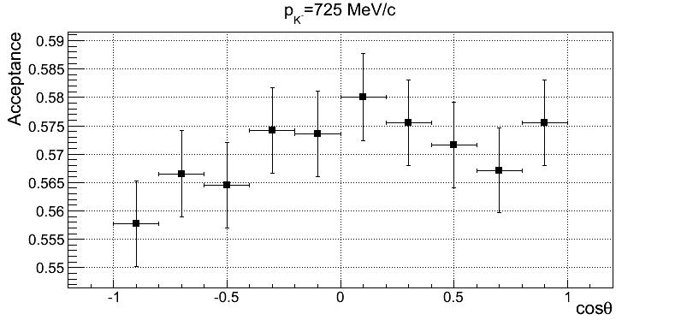
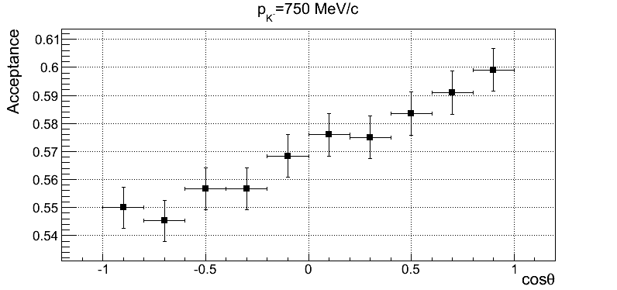
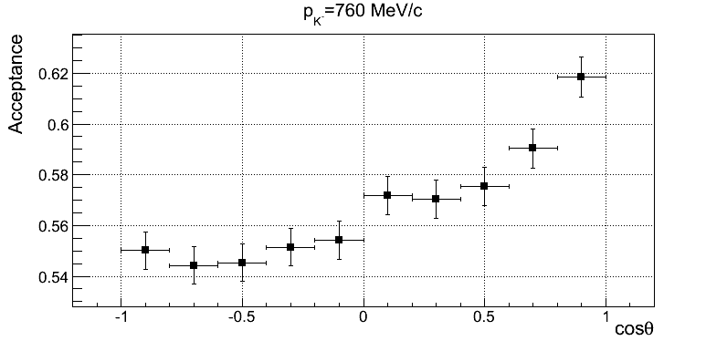
Acceptance curve

Slide 32
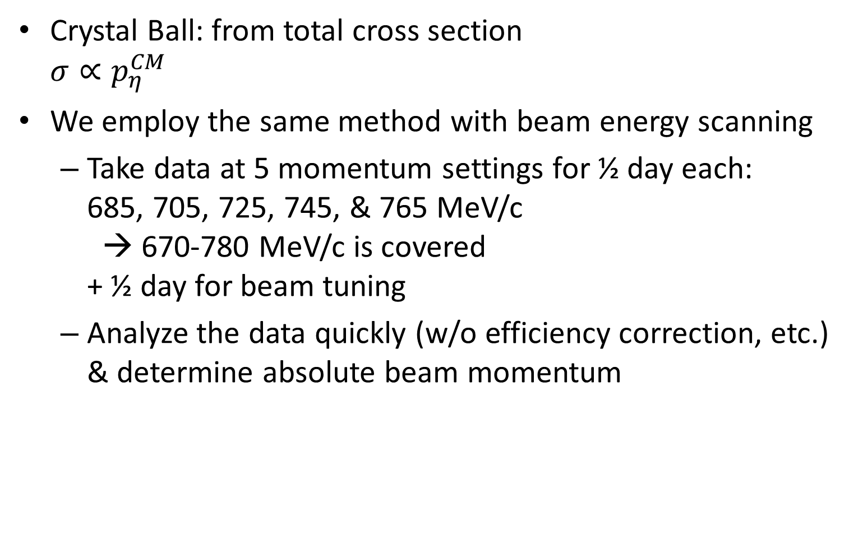
Energy calibration
Crystal Ball: from total cross section
$σ∝p_{η}^{CM}$
We employ the same method with beam energy scanning
  Take data at 5 momentum settings for ½ day each:
  685, 705, 725, 745, & 765 MeV/c
  → 670-780 MeV/c is covered
  + ½ day for beam tuning
  Analyze the data quickly (w/o efficiency correction, etc.)
  & determine absolute beam momentum

Slide 33
Magnetic field: 0.6T or higher?
Higher magnetic field
  Pros: Better momentum resolution
  Cons: Some of low momentum pions do not reach to the trigger hodoscope
0.6T: acceptance loss is negligible, while resolution is reasonable
  Optimized in conservative acceptance estimation
  Already good enough performance
Higher field may be better if we don’t require pion hits in trigger hodoscope (trigger B)
  Need detailed studies

Slide 34
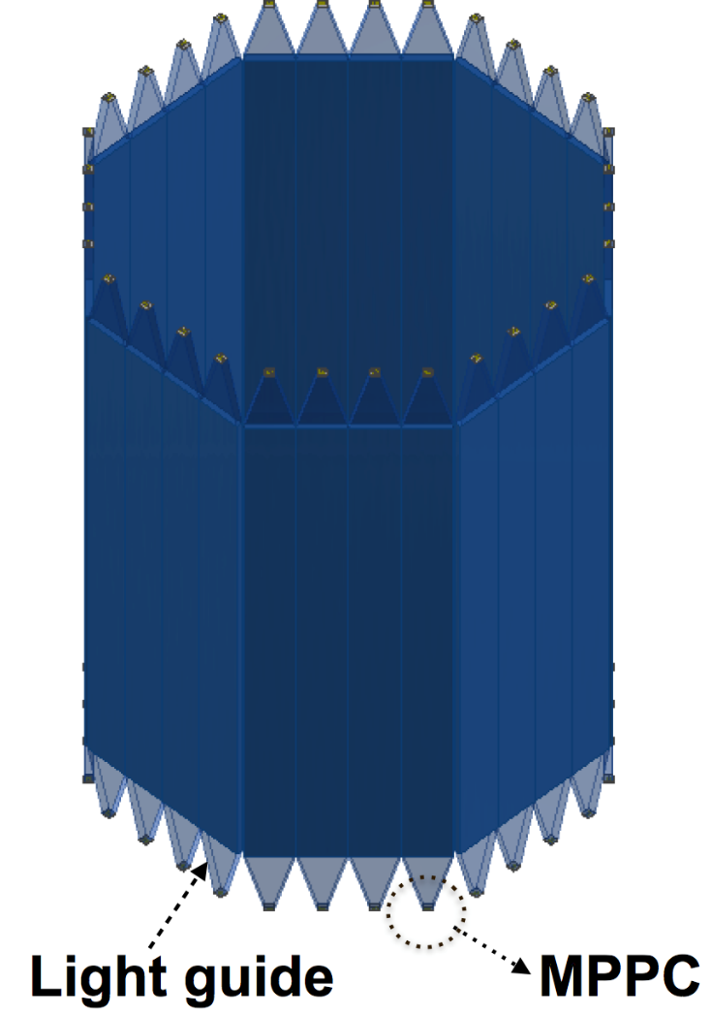
5. TPC hodoscope
Two-charged particle trigger
32 segments of plastic scintillator array.
MPPCs on both ends.

Slide 35
Hodoscope test with short counter
MPPC system is testing systematically
- MPPC number: 1, 2, 4,
- Over voltage: +3, +5, +7V
- Connection: Mixer (NIM), off-line sum,
Series
- MPPC : 3050(now), 3075, 6050, 6075
- Light guide: with (now), without
＠JAEA
MPPC
150 (real size = 800)
10
12
70
60°
PMT
PMT
MPPC: S13360-3050CS
PMT: H6612 (rising time 1.3ns)
PMT
PMT

Slide 36
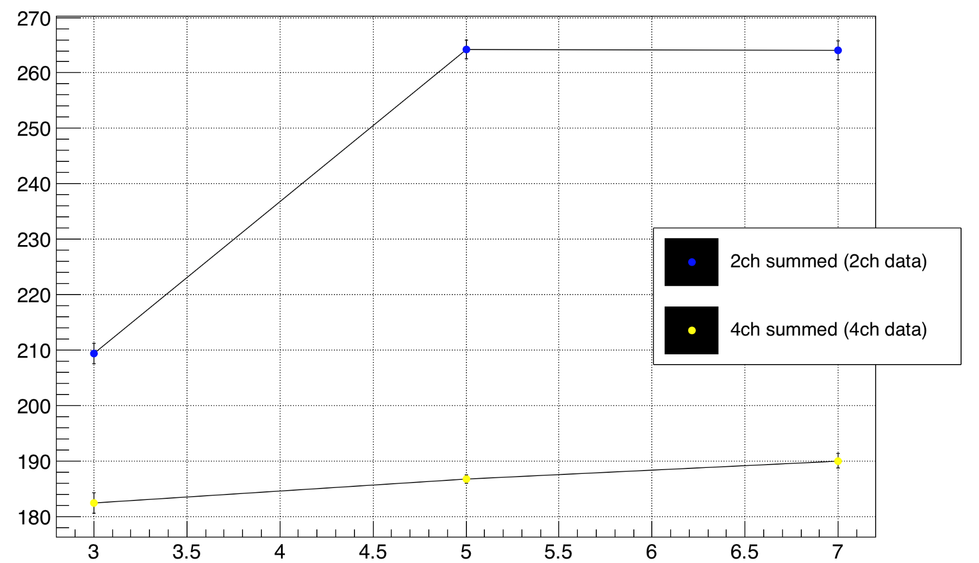
Preliminary result with short counter
We have achieved ~ 180ps resolution with 4ch read out system.
Test will continue to achieve better resolution and real size condition.
The results of NIM mixer connection
Time resolution (ps)
PMT‘s resolution ~ 100 ps
Over voltage (V)

Slide 37
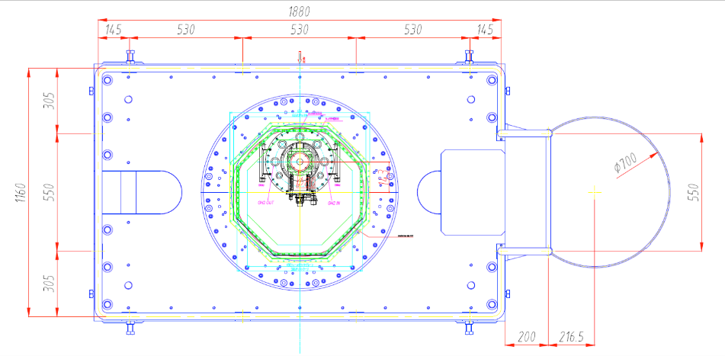
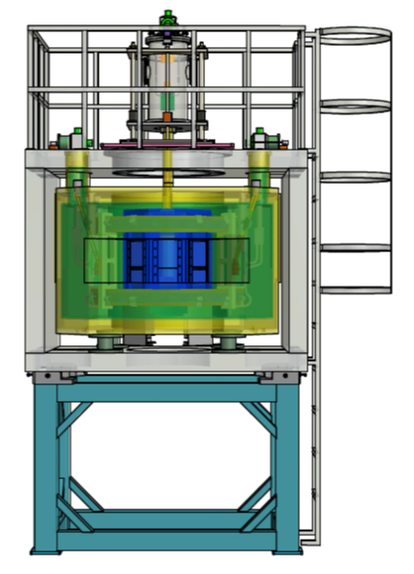
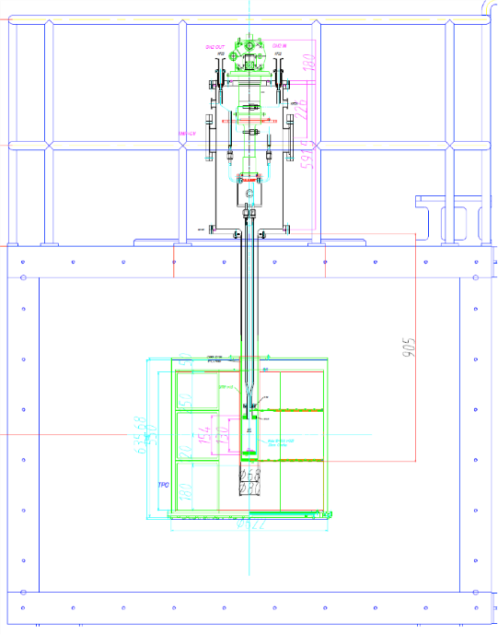
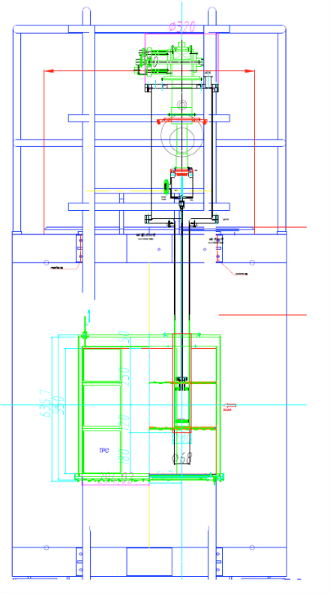
7. LH₂ target system
TPC and LH₂ system are independent
LH₂ cryostat + cylinder is fixed on the upper Yoke plate
Target cylinder inserted vertically down to TPC target holder
  Long target vacuum cylinder ~ 1m is required

Slide 38
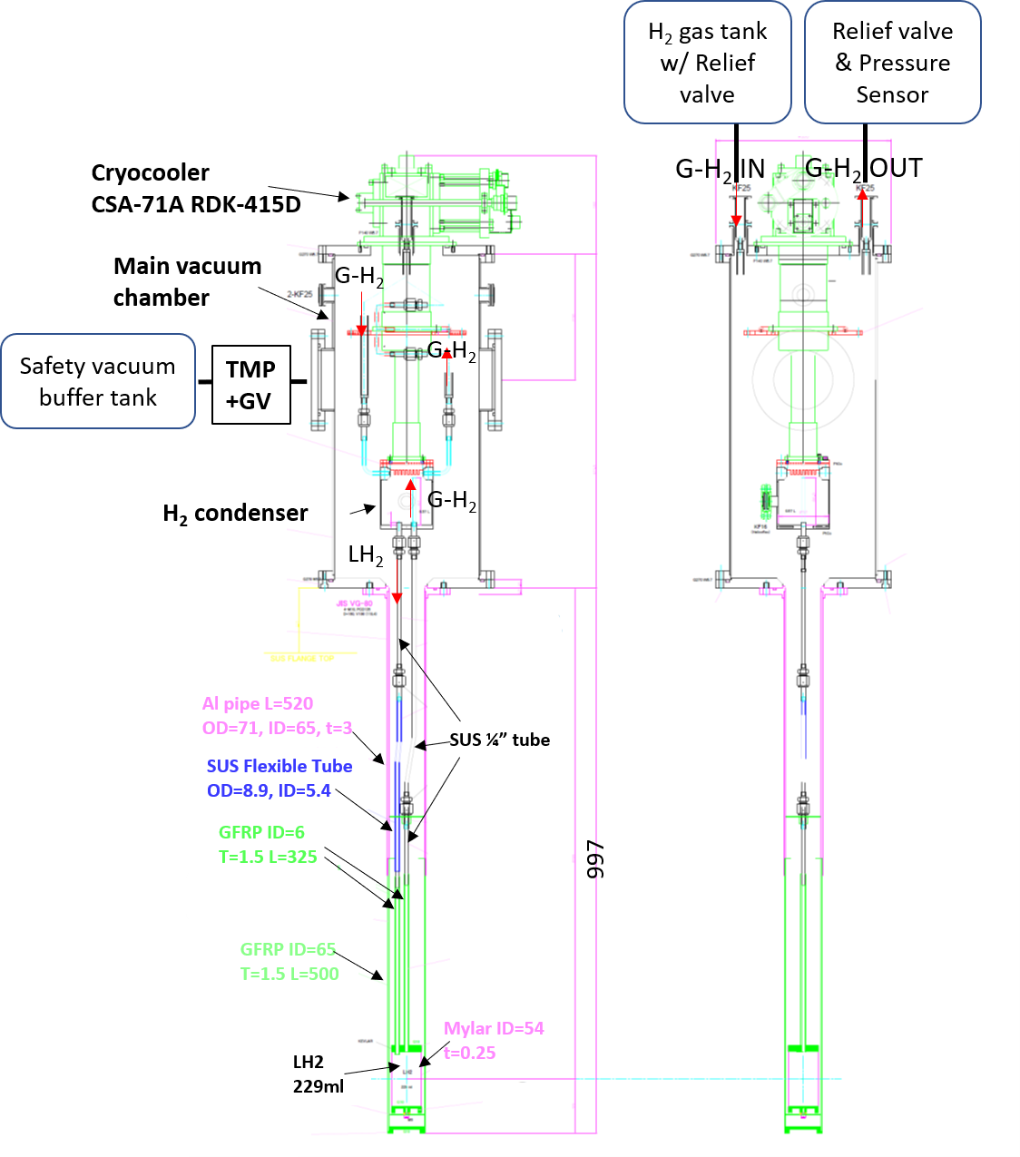
Liq-H₂ target
We design the target according to J-PARC liquid hydrogen target guideline
Based on E40 LH₂ target system with GM cryocooler
  E40 LH₂ was approved by FIFC
H₂ gas liquified in the condenser with the cryocooler
LH₂ flows to the target cell
H₂ gas from the target cell flows back to the condenser
Target vacuum chamber
Target cell

Slide 39
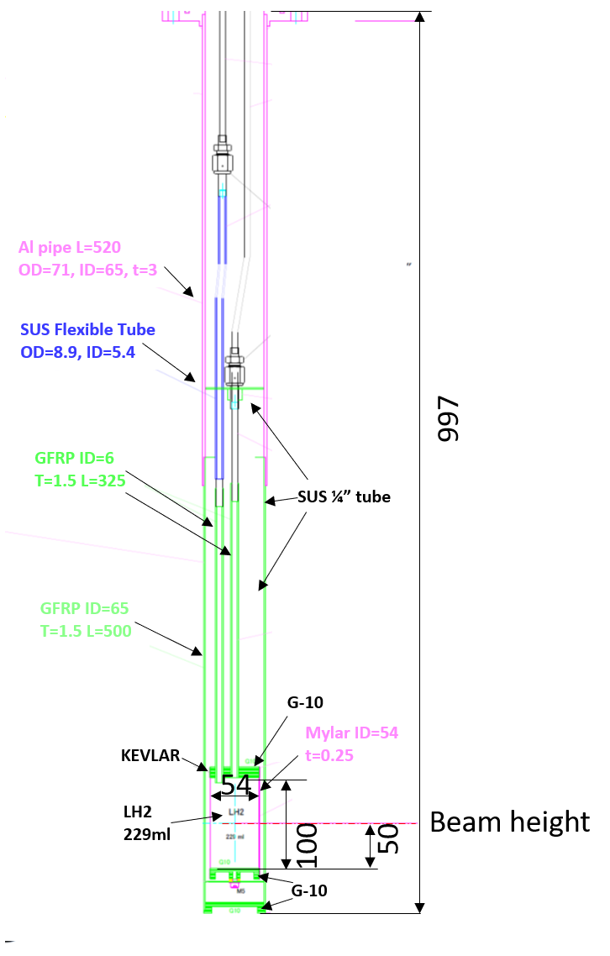
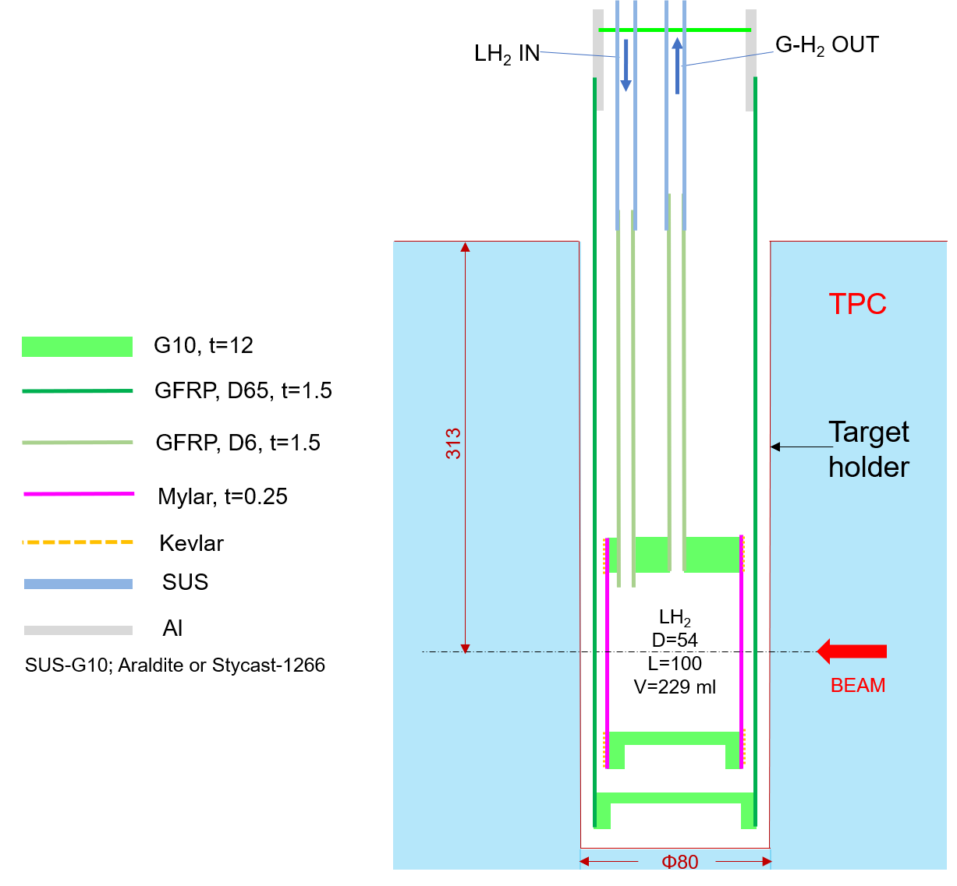
LH₂ target (detail)
Target size: 54φx100, 229ml
Insulator materials used inside the TPC to avoid E-field distortion

Slide 40
E45

Slide 41
E45

Slide 42
hypTPC commissioning run
We need additional commissioning time before the first experiment with hypTPC (E42, E45, or P72)
  +2 days, for commissioning of the hypTPC system.
  ~2 months before the first experiment starts, allowing analysis & tuning.
  LH₂ target is not necessary (CH₂ is enough)
  Either @K1.8 or K1.8BR – the same beamline as the first exp.
Notes:
どの実験を最初にするか、関連の質問が出てきたら見せる。

Slide 44
Run strategy & cost estimation
Requested beamtime: 14 days for physics run
+ 3 days for detector and target commissioning.
+ 3 days for beam energy calibration
+ 1 day for empty target run.
＝ 21 days in total
We are ready to run by Dec. 2019, when LH₂ target is ready
We share hypTPC with E42 & E45. These 3 experiments cannot run at the same time.
It costs ~12 Myen to complete the hypTPC system, but incremental hardware cost from E42/E45 is negligibly small (aside from usual running costs).

Slide 45
Toy model calculation with Lambda(1663)

Slide 46
Motivation – expected question
Peak at 1663 MeV in Λ_{c} → pK⁻π⁺ suggests there is a narrow resonance (Let’s call it Λ(1663)) at this energy
Meanwhile, Kp → Λη data suggests a narrow resonance around 1668 MeV.
Can those 2 data be explained by a single resonance at 1663 MeV?
Trying to explain both data with Λ(1663) in D_{3/2} and (conventional) Λ(1670) in S_{1/2}.

Slide 47
What we should explain?
Total and differential cross sections
cos²θ term appears only in a narrow region around 1668 MeV

Slide 48
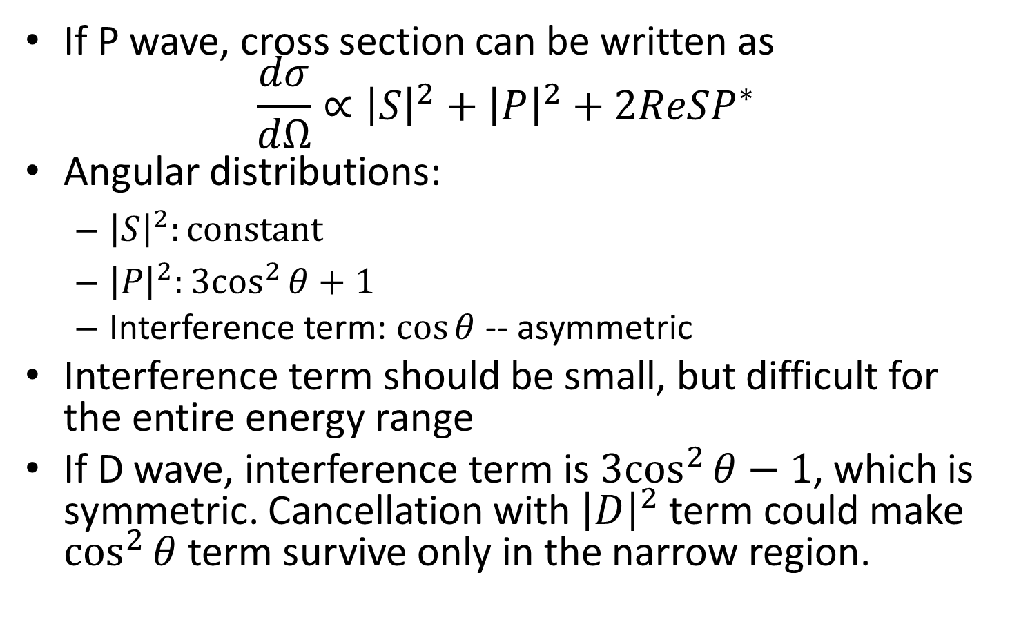
Why D_{3/2}, not P_{3/2}?
If P wave, cross section can be written as
$\frac{dσ}{dΩ}∝{\left|S\right|}^{2}+{\left|P\right|}^{2}+2ReSP^{∗}$
Angular distributions:
  ${\left|S\right|}^{2}:constant$
  ${\left|P\right|}^{2}:3\cos^{2}{θ}+1$
  Interference term: $\cos{θ}$ -- asymmetric
Interference term should be small, but difficult for the entire energy range
If D wave, interference term is ${3cos}^{2}{θ}−1$, which is symmetric. Cancellation with ${\left|D\right|}^{2}$ term could make $\cos^{2}{θ}$ term survive only in the narrow region.

Slide 49
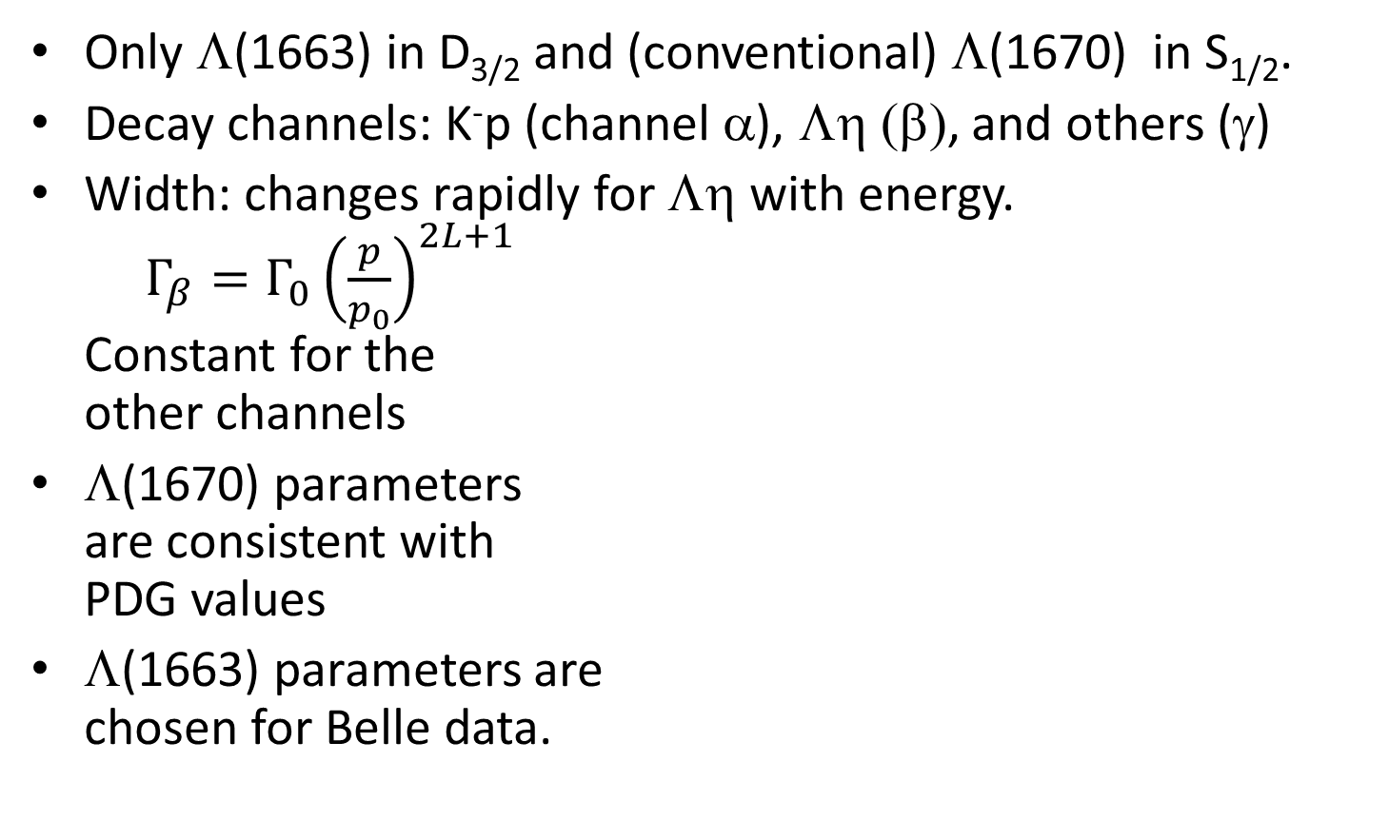
Model
Only Λ(1663) in D_{3/2} and (conventional) Λ(1670) in S_{1/2}.
Decay channels: K⁻p (channel α), Λη (β), and others (γ)
Width: changes rapidly for Λη with energy.
$Γ_{β}=Γ_{0}{\left(\frac{p}{p_{0}}\right)}^{2L+1}$
Constant for the
other channels
Λ(1670) parameters
are consistent with
PDG values
Λ(1663) parameters are
chosen for Belle data.
 | S_{1/2} | D_{3/2}
Resonance | Λ(1670) | Λ(1663)
Mass | 1670 | 1663
Γ_{α} | 4 | 1
Γ_{β} | 5@1670 | 4@1670
Γ_{γ} | 21 | 9

Slide 50
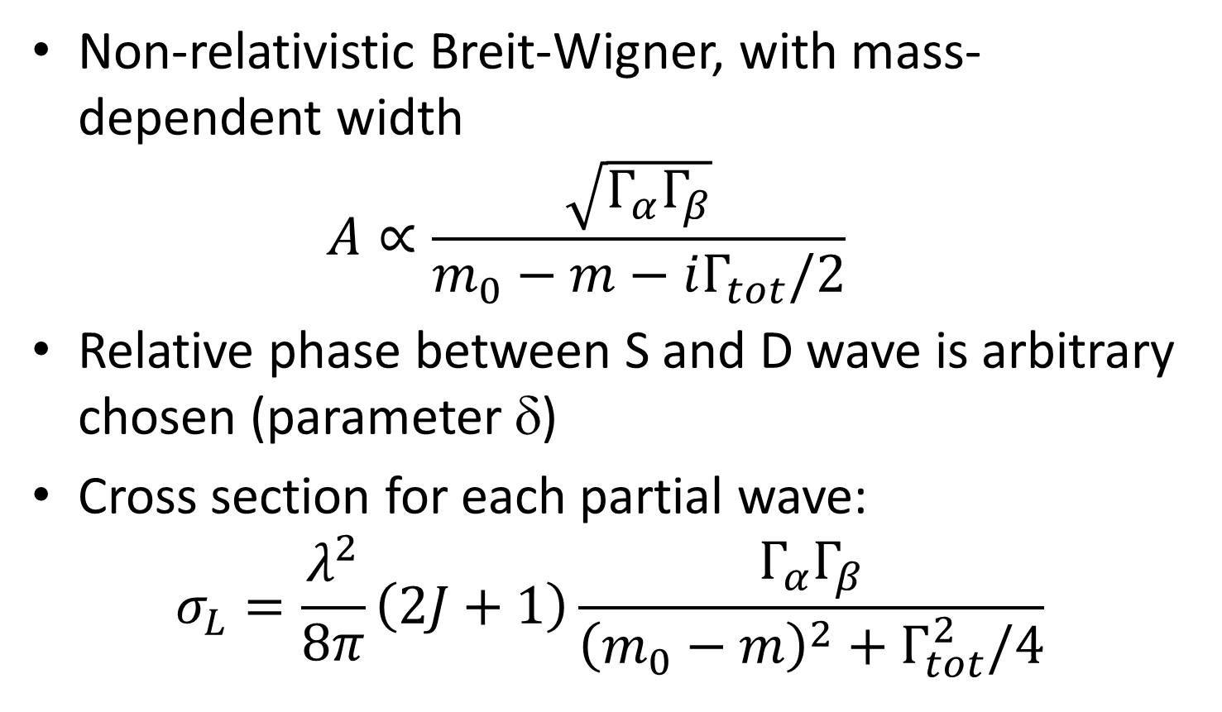
Amplitudes for Kp → Λη
Non-relativistic Breit-Wigner, with mass-dependent width
$A∝\frac{\sqrt{Γ_{α}Γ_{β}}}{m_{0}−m−iΓ_{tot}/2}$
Relative phase between S and D wave is arbitrary chosen (parameter δ)
Cross section for each partial wave:
$σ_{L}=\frac{λ^{2}}{8π}\left(2J+1\right)\frac{Γ_{α}Γ_{β}}{{\left(m_{0}−m\right)}^{2}+Γ_{tot}^{2}/4}$

Slide 51
Result – total cross section

Slide 52
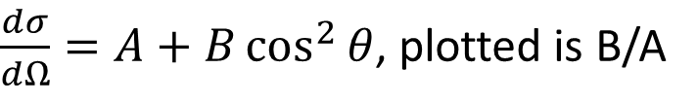
Angular distribution
$\frac{dσ}{dΩ}=A+B\cos^{2}{θ}$, plotted is B/A
δ=1.05 [rad]

Slide 53
Conclusion
Reasonable description is obtained for total cross section & angular distribution
  In order to explain the total cross section, coupling of Λ(1663) to K⁻p and/or Λη must be small.
Note: parameters are just chosen by hand, and are not optimized yet.

