Slide 1
Reflections on Charge Symmetry Breaking
Patrick Achenbach
U Mainz
June 2o18

Slide 2
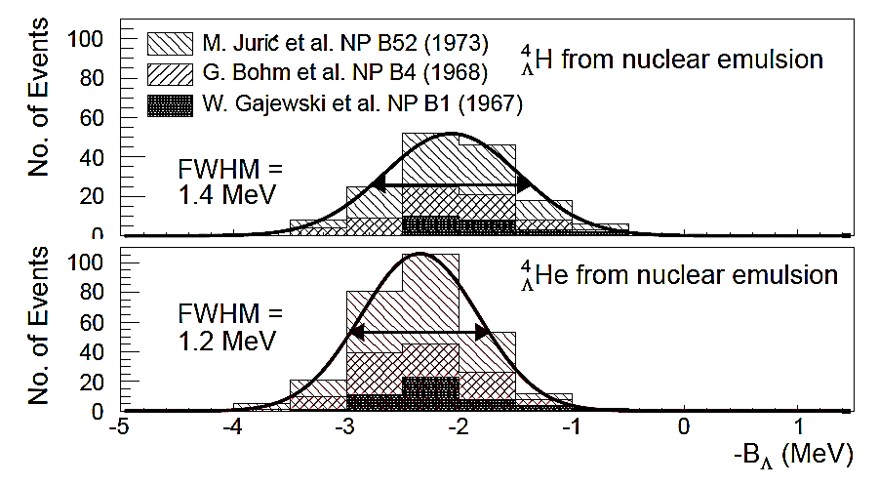
Reflections on Charge Symmetry Breaking
sizeable effect in A = 4 isospin mirror pair
large experimental uncertainties in A = 7, 8, 9, and 10 isomultiplets
what are the (quantitative and qualitative) limitations of the data?
ΔB_{Λ} = 0.35±0.06

Slide 3
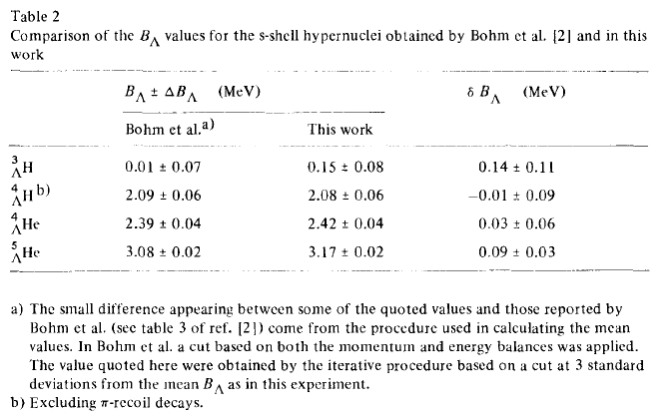
Use of Point Estimators
[M. Jurič et al., Nucl. Phys. B 52 (1973) 1]

Slide 4
CSB Database Issues (Personal Perspective)
do we have a complete set of statistical and systematic errors?
are all of the errors symmetric? is the data normal distributed?
are outliers of values treated consistently? (outliers can indicate a heavy-tailed distribution)
do we know all the cross-correlated errors when combining binding energies from different measurements?
are likelihood functions used to combine different experiments?
do we have a coherent and fully accepted database? (analogous to the PDG compilation)
No
No
No
No
No
No

Slide 5
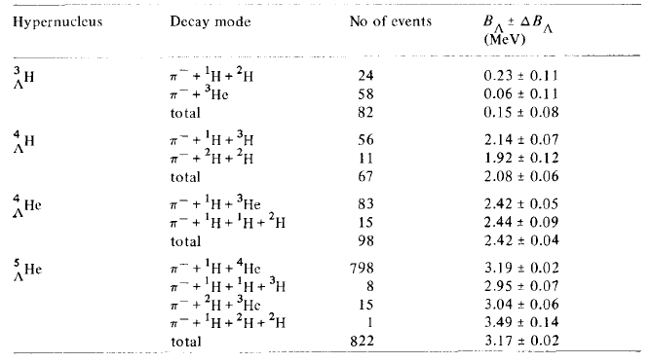
The CSB Database I
[M. Jurič et al., Nucl. Phys. B 52 (1973) 1]

Slide 6
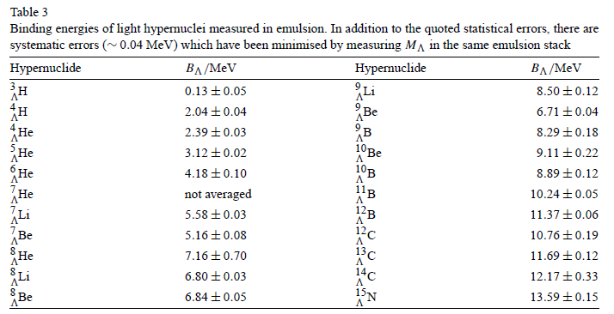
The CSB Database II
[D.H. Davis, Nucl. Phys. A 754 (2005) 3c]

Slide 7
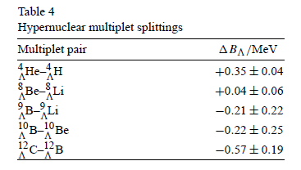
The CSB Database II
[D.H. Davis, Nucl. Phys. A 754 (2005) 3c]

Slide 8
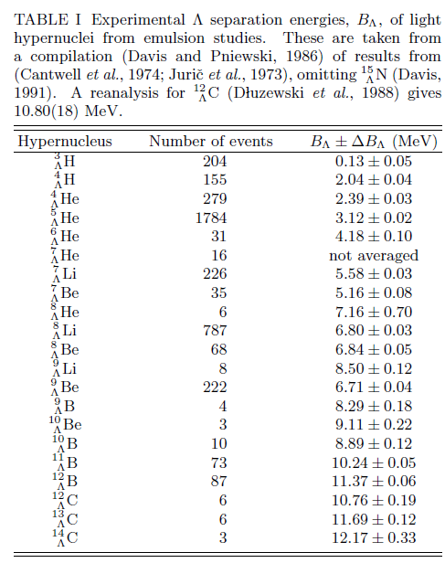
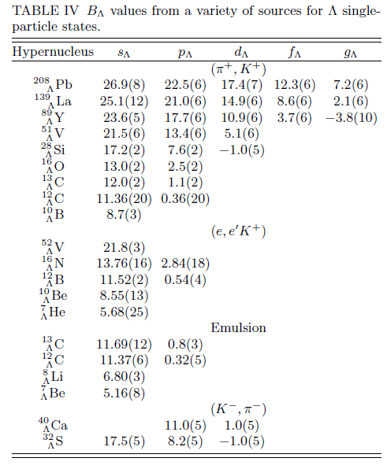
The CSB Database III
[A. Gal, E. V. Hungerford, D. J. Millener, Rev. Mod. Phys. 88 (2016) 035004]

Slide 9
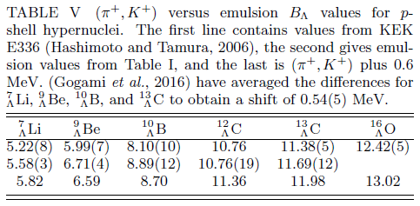
The CSB Database III
[A. Gal, E. V. Hungerford, D. J. Millener, Rev. Mod. Phys. 88 (2016) 035004]

Slide 10
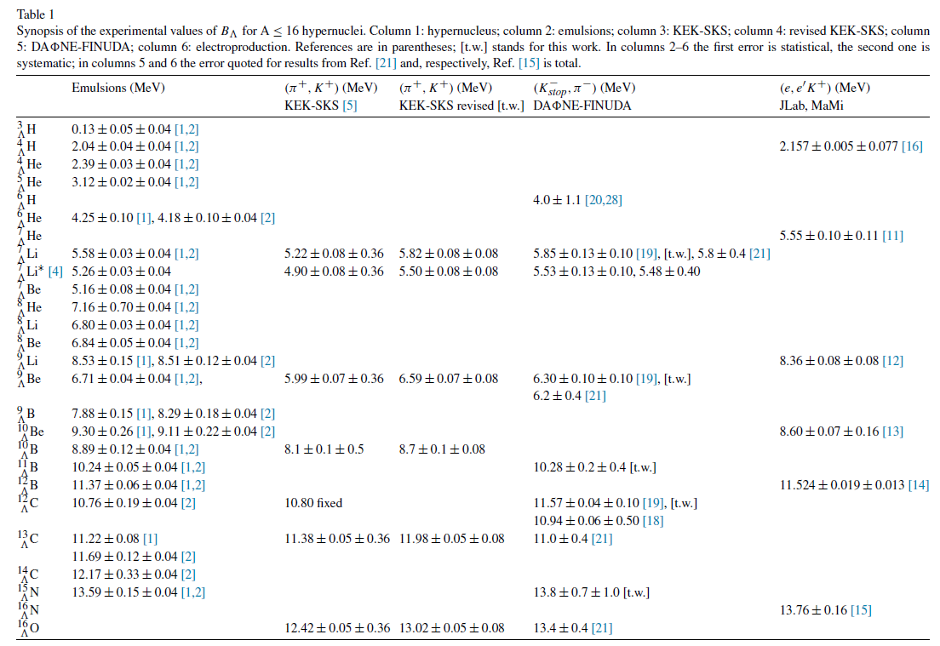
The CSB Database IV
[E. Botta, T. Bressani, A. Feliciello, Nucl. Phys. A 960 (2017) 165]

Slide 11
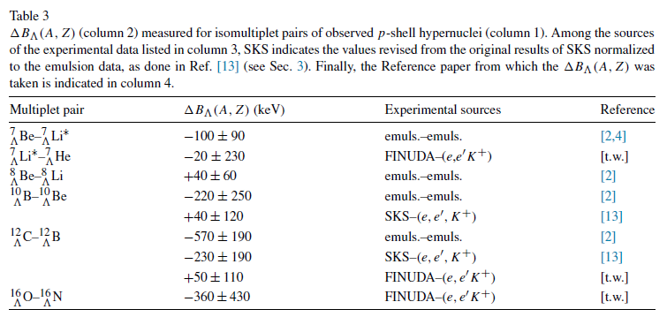
The CSB Database IV
[E. Botta, T. Bressani, A. Feliciello, Nucl. Phys. A 960 (2017) 165]

Slide 12
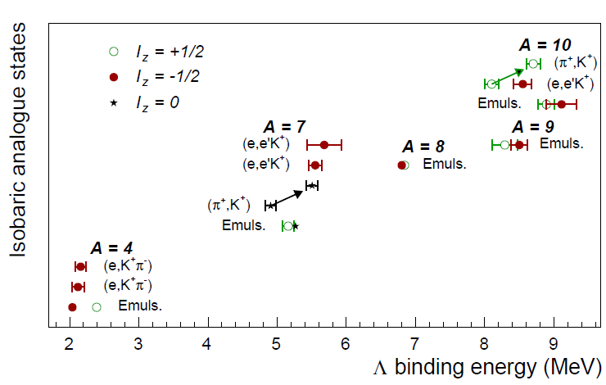
World data on A ≤ 10 systems
ΔB_{Λ}⁴
clearest signature of charge symmetry breaking in A = 4 system
weak indications of charge symmetry breaking in A ≠ 4 systems

Slide 13
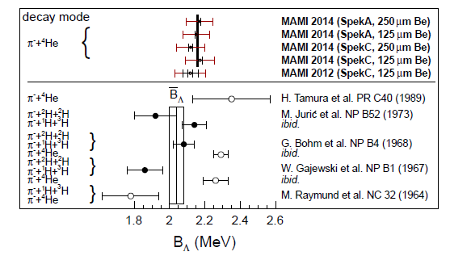
World data on ⁴_{Λ}H mass
outer error bars correlated from calibration
MAMI
emulsion
B_{Λ}(⁴_{Λ}H) (stat.) (syst.)
emulsion: 2.04 ± 0.04 ± 0.05 MeV [M. Juric et al. NP B52 (1973)]
MAMI 2012: 2.12 ± 0.01 ± 0.08 ± 0.03 MeV [A. Esser et al., PRL 114 (2015)]
MAMI 2014: 2.16 ± 0.01 ± 0.08 MeV [F. Schulz et al., NPA (2016)]

