Slide 1
Structure of light p-shell Ξ hypernuclei
Emiko Hiyama (Kyushu Univ./RIKEN)

Slide 2
The major goal of hypernuclear physics
1) To understand baryon-baryon interactions
Fundamental and important for the study
of nuclear physics
To understand the baryon-baryon interaction, two-body scattering experiment is most useful.
Total number of
Nucleon (N) -Nucleon (N) data: 4, 000
YN and YY potential models so far proposed
(ex. Nijmegen,
Julich, Kyoto-Niigata) have large ambiguity.
・ Total number of differential cross section
Hyperon (Y) -Nucleon (N) data: 40
・ NO YY scattering data

Slide 3
Therefore, as a substitute for the 2-body
limited YN and non-existent YY scattering data,
the systematic investigation of the
structure of light hypernuclei is essential.
Next step, it is important to extract information on ΞN interaction.

Slide 4
¹⁴N-Ξ-
0 MeV
-4.38 ± 0.25 ～-1.10 ± 0.25 MeV
Ξ⁻
¹⁴N
Kiso event
Furthermore, we observed bound Ξ hypernucleus, for the first time
in the world. Now, we understood that ΞN interaction should be attractive.
Also, it is important to interpret spin-parity to comparing theory and experimental data.

Slide 5
Ξ⁻
core
nucleus
For the study of ΞN interaction, it is important to study
the structure of Ξ hypernuclei.

Slide 6
Physical Review C 94, 064319 (2016)
Using RMF theory, we interpret that Kiso event is observation of ¹⁴N(g.s) +Ξ(0p) state.
Weak point: RMF theory focus on the only ground state of ¹⁴N, not the excited state of ¹⁴N.
It is planning to take into account of the excited state of ¹⁴N for further analysis of Kiso event
using α+α+α+d+Ξ 5-body cluster model.

Slide 7
“Spectroscopic study of Ξ-Hypernucleus, ¹²Be,
via the ¹²C(K⁻,K⁺) Reaction”
by Nagae and his collaborators
Ξ⁻
K⁺
K⁻
p
Ξ⁻
¹¹B
¹¹B
¹²C
Ξ hypernucleus
This experiment has been done, also.
The observed data will be reported by Prof. Nagae (next session).
Question: what kind of energy spectra do we have in this Ξ hypernucleus, theoretically?

Slide 8
¹²Be
For this purpose, it is requested to calculate energy spectra of .
Ξ⁻
Total isospin of ¹¹B : ½
Isospin of Ξ: ½
Total isospin of ¹¹B+Ξ: 1 and 0
K⁺
K⁻
p
Ξ⁻
T_{z} of ¹¹B: -1/2
Ξ-: -1/2
Total t_{z} of ¹¹B+Ξ：-1
Then, by the experiment, T=1 state
of ¹¹B+Ξ- can be produced.
¹¹B
¹¹B
¹²C
Ξ hypernucleus
But, first we want to know what are energy spectra in this system?

Slide 9

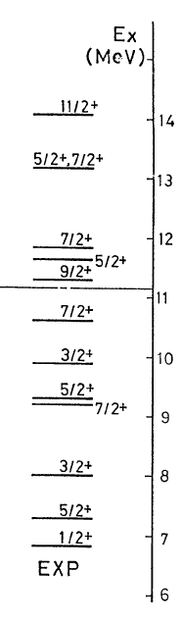
¹¹B
We have negative parities and positive parities.

Slide 10
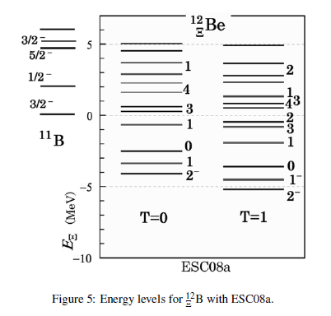
For the calculation of
¹²Be
Ξ⁻
Prof. Motoba calculated energy spectra
within the framework of shell model
using Nijmegen potential (ESC04d, ESC08a).
T. Motoba and S. Sugimoto,
NPA 835 (2010) 223
¹²Be
Now, it is important to sudy
energy spectra of
Ξ⁻
¹²Be
t
Ξ⁻
Ξ⁻
Within the framework of α+α+t+Ξ 4-body model.
α
α

Slide 11
Vαα: reproduce αα scattering phase shift
Vαt: reproduce low-lying properties of αt system
¹²Be
Ξ⁻
t
Ξ⁻
rules out the Pauli-forbidden states from the 5-body wave unction.
The Pauli-forbidden states (f ) are the 0S, 1S and 0D states of the α α relative motion, and the 0S, 1S, 0P and 0D states of the α t relative motion.
This method for the Pauli principle (Orthogonality-Condition Model) is often employed in the study of light nuclei using microscopic cluster models.
α
α
The energy spectra of ¹¹B are reproduced with the data.
VαΞ ： YNG ESC08c potential

Slide 12
Energy spectra
¹¹B+Ξ
¹¹B+Ξ
-1.75
1⁻
-1.27
1⁻
-2.116
2⁻
-1.61
2⁻
-3.30
0⁻
-4.06
2⁻
-4.45
0⁻
-4.99
Γ=0.38
1⁻
-5.44
1⁻
-6.02
2⁻
-7.35
Γ=0.58
2⁻
T=1
-8.69 MeV
Γ=0.65
1⁻
T=1 are lower than T=0.
Only T=1 spectra by the reaction by (K+,K-)
are produced.
In this way, we have many energy spectra by (K+.K-) reaction,
It is interesting to see what kind of states we produce by the reaction.
The data will be reported by Prof. Nagae.
The calculation using cluster wavefunction are next plan.
T=0

Slide 13
V_{ΞN} = V₀ + σ・σ V_{σ・σ} ＋ τ・τ V_{τ・τ}＋ (σ・σ)(τ・τ) V_{σ・σ τ・τ}
¹⁵_{Ξ}C
α
α
In this way, we are finding to have bound states in these systems and then we shall get information
that V_{ΞN} itself is attractive.
α
d
All of the terms contribute to binding energy of ¹²Be and ¹⁵_{Ξ}C ( ¹¹B and ¹⁴N is not spin-, isospin- saturated).
¹²Be
Ξ⁻
Ξ⁻
t
Ξ⁻
Next,
we want to know desirable strength of V_{0,} the spin-,isospin-independent term.
α
α

Slide 14
V_{ΞN} = V₀ + σ・σ V_{σ・σ} ＋ τ・τ V_{τ・τ}＋ (σ・σ)(τ・τ) V_{σ・σ τ・τ}
In order to obtain useful information about V₀,
the following systems are suited, because
the (σ・σ), (τ・τ) and
(σ・σ) (τ・τ) terms of
V_{ΞN} vanish
by folding them
into the α-cluster
wave function that are
spin-, isospin-satulated.
Ξ⁻
Ξ⁻
α
α
α
problem : there is NO target to produce them
by the (K⁻, K⁺) experiment .
Because, ・・・

Slide 15
To produce αΞ⁻ and ααΞ⁻ systems by (K⁻, K⁺) reaction,
target
K⁺
K⁻
These systems
are unbound.
Then, we
cannot use them as targets.
p
Ξ⁻
α
α
⁵H
⁵Li
Ξ-
K⁺
K⁻
p
Ξ⁻
α
α
α
α
⁹B
⁹Li
Ξ-

Slide 16
As the second best candidates to extract information about the spin-, isospin-independent term V₀, we propose to perform…
K⁺
K⁻
p
n
Ξ⁻
n
α
n
α
n
⁷Li (T=1/2)
⁷H
(T=3/2)
Why they are suited
for investigating V₀?
Ξ⁻
K⁺
K⁻
p
n
Ξ⁻
n
α
α
α
α
¹⁰B (T=0)
¹⁰Li (T=1)
Ξ⁻

Slide 17
(more realistic
illustration)
Core nucleus ⁶He is known to be halo
nucleus. Then, valence neutrons are located
far away from α particle.
n
n
α
Ξ⁻
Valence neutrons are located in p-orbit,
whereas Ξparticle is located in 0s-orbit.
Then, distance between Ξ and n
is much larger than the interaction range of
Ξ and n.
n
Ξ⁻
⁷H
(T=3/2)
Ξ⁻
n
α
α
Ξ⁻
Then, αΞ potential, in which only V₀ term
works, plays a dominant role in the binding
energies of these system.
¹⁰Li (T=1)
Ξ⁻

Slide 18
Before the experiments will be done,
we should predict whether these
hypernuclei will be observed as
bound states or not.
Namely, we calculate the binding energies
of these hypernuclei.
Ξ-
Ξ⁻
n
α
n
⁷H
(T=3/2)
Ξ⁻
Ξ⁻
n
α
α
¹⁰Li (T=1)
Ξ⁻

Slide 19
ΞN interaction
Only one experimental information about ΞN interaction
Y. Yamamoto, Gensikaku kenkyu 39, 23 (1996),
T. Fukuda et al. Phys. Rev. C58, 1306, (1998);
P.Khaustov et al., Phys. Rev. C61, 054603 (2000).
Well-depth of the potential between Ξ and ¹¹B: -14 MeV
Among all of the Nijmegen model,
ESC04 (Nijmegen soft core) and ND (Nijmegen Model D)
reproduce the experimental value.
OtherΞN interaction are repulsive or weak attractive.
We employ ESC04 and ND.
The properties of ESC04 and ND are quite different from each other.

Slide 20
Property of the spin- and isospin-components of ESC04 and ND
V(T,S)
ESC04
ND
T=0, S=1 strongly attractive
T=0, S=0
weakly attractive
T=1, S=1
T=1, S=0
(a bound state)
weakly repulsive
weakly attractive
weakly repulsive
Although the spin- and isospin-components of these two models are
very different between them (due to the different meson contributions),
we find that the spin- and isospin-averaged property,
V₀ = [ V(0,0) + 3V(0,1) + 3V(1,0) + 9V(1,1) ] / 16,
namely, strength of the V₀- term is similar to each other.

Slide 21
4-body calculation of
⁷H
E. Hiyama et al.,
PRC78 (2008) 054316
Ξ⁻
ESC04
MeV
ND
α+ n + n + Ξ⁻
1.71
MeV
α+ n + n + Ξ⁻
0.96
0.75
⁶He + Ξ⁻
0.39
(αΞ⁻ ) + n + n
0.0
0.0
(αΞ⁻ ) + n + n
⁶He + Ξ⁻
-1.35
1/2⁺
-1.56
Γ=0.27MeV
1/2⁺
⁷H
Γ=2.64MeV
⁷H
Ξ⁻
Ξ⁻
Ξ⁻
n
Similar binding
energies using ND and
ESC04.
α
In experiments,
we can expect
a bound state.
n
However, decay width is dependent on
on employed ΞN potential

Slide 22
4-body calculation of
¹⁰Li
E. Hiyama et al.,
PRC78 (2008) 054316
⁻Ξ
ESC04d
ND
MeV
α+ α+ n +Ξ⁻
5.17
MeV
⁹Be + Ξ⁻
α+ α + n +Ξ⁻
3.60
2.86
⁹Be + Ξ⁻
1.32
0.0
(ααΞ⁻ ) + n
(ααΞ⁻ ) + n
0.0
-2.96
2⁻
-3.18
2⁻
Γ=0.75MeV
Γ=5.87MeV
¹⁰Li
¹⁰Li
Similar binding
energies using ND and
ESC04d.
Ξ⁻
Ξ⁻
Ξ⁻
n
Independent on employed
ΞN potential
α
α
In experiments,
we can expect
a bound state.
But, decay width is dependent on employed
ΞN interaction.

Slide 23
In this way, the binding energies of Ξ hypernuclei with
A=7 and 10 are dominated by αΞ potential, namely,
spin-, and iso-spin independent ΞN interaction（Ｖ₀）.
Then, to get information about this part, we propose to perform
the (K⁻,K⁺) experiment by using ⁷Li and ¹⁰B targets
at J-PARC after the experiment with ¹²C target.
Also next, it is interesting to know
which partial contribution makes attractive for V_{ΞN} ?

Slide 24
ΞN interaction: T=0, S=0
T=0, S=1
T=1, S=0
T=1, S=1
Ξ
N
We want to know which partial wave is attractive or repulsive.
The suited systems to study are s-shell Ξ hypernuclei such as
NNΞ and NNNΞ systems.
N
N
N
N
Ξ
N
Ξ

Slide 25
N
N
N
N
Ξ
Ξ
N
I show my new results of these light systems.
NN interaction: AV8 potential
ΞN interaction :
Nijimegen extended soft core potential (ESC08c)
Realistic potential (only ΞN channel)
ΞN interaction by HAL collaboration (Lattice QCD calculation)
The potential was made by K. Sasaki and Miyamoto.

Slide 26
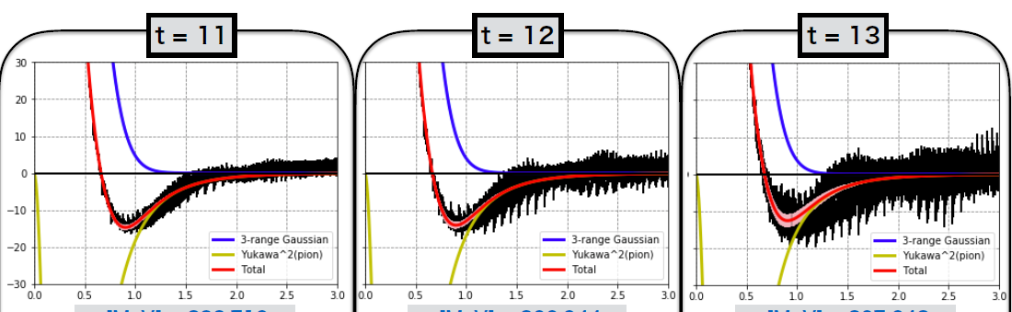
HAL potential
V_{ΞN}=V₀(r)+(σ_{Ξ}・σ_{N})V_{s}(r)+(τ_{Ξ}・τ_{N})V_{t}(r)+（σ_{Ξ}・σ_{N})(τ_{Ξ}・τ_{N})V_{ts}(r)
All terms are central parts only.
V₀(r)
In HAL potential , the statistical errors are NOT included.

Slide 27
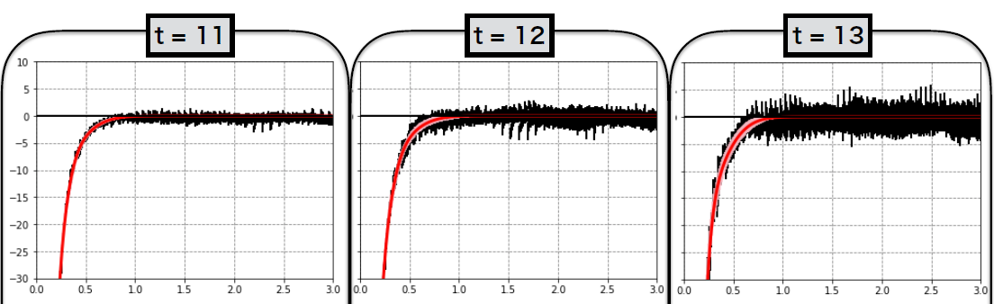
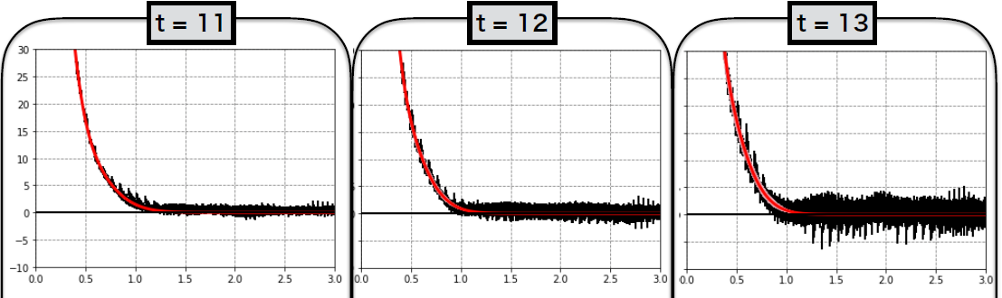
(σ_{Ξ}・σ_{N})V_{s}(r)
(τ_{Ξ}・τ_{N})V_{t}(r)

Slide 28
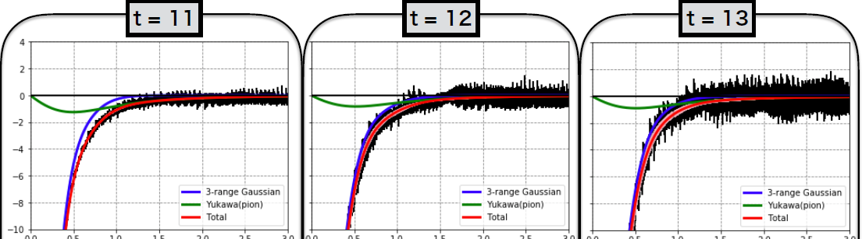
（σ_{Ξ}・σ_{N})(τ_{Ξ}・τ_{N})V_{ts}(r)

Slide 29
Property of the spin- and isospin-components of ESC08 and HAL
V(T,S)
ESC08c
HAL
T=0, S=1 strongly attractive
T=0, S=0
T=1, S=1
T=1, S=0
Weakly attractive
weakly repulsive
Strongly attractive
strong attractive
Weakly attractive
weakly repulsive
Weakly repulsive
Although the spin- and isospin-components of these two models are very different between them.
It is interesting to see the difference in the energy spectra in s-shell Ξ hypernuclei.

Slide 30
N
N
T=1/2, J=1/2⁺ and J=3/2⁺
Ξ
ESC08c
0 MeV
d+ Ξ
0 MeV
d+ Ξ
-2.07 MeV
J=1/2+
-2.57 MeV
J=3/2⁺
I used the different version of ESC08c (realistic force).
However, I also have two bound states in three-body system.

Slide 31
N
N
T=1/2, J=1/2⁺ and J=3/2⁺
Ξ
HAL potential
0 MeV
d+ Ξ
0 MeV
d+ Ξ
No bound state
J=1/2+
J=3/2⁺

Slide 32
N
N
N
Ξ
T=1 state
0 MeV
3N+Ξ
0 MeV
3N+Ξ
No bound state
-2.25MeV
0⁺
ESC08c
HAL potential

Slide 33
N
N
N
Ξ
In HAL potential , the statistical errors are NOT included.
T=0 state
0 MeV
3N+Ξ
0 MeV
3N+Ξ
1⁺
0.01 MeV～0.3 MeV
No bound state
Preliminary result
ESC08c
HAL potential

Slide 34
Summary
・Motivated by experiment of ¹²_{Ξ}Be, I calculated energy spectra of
This Ξ hypernclei using ESC08c potential.
We found there are many bound states and the ground state should be
T=0 when we use ESC08c. In the future, it is planned to calculate
reaction cross section using cluster model to compare with the data
by Prof. Nagae.
¹²Be
Ξ⁻
t
Ξ⁻
α
α

Slide 35
・To extract information on V₀ part, I would suggest to perform
search experiment of ⁷_{Ξ}H and ¹⁰_{Ξ}Li using ⁷Li and ¹⁰B target in
the future.
Ξ⁻
Ξ⁻
n
n
α
α
α
n
⁷H
(T=3/2)
¹⁰_{Ξ}Li
Ξ⁻

Slide 36
To investigate spin- isospin dependence on NNΞ and NNNΞ system, we calculated these systems using two types ΞN interactions, ESC08c and HAL potential.
The energies of these systems are strongly dependent on
the ΞN potential employed.
To investigate this fact, I suggest to produce these Ξ hypernuclei using ³He and ⁴He target by (K⁺,K⁻) reaction.
N
N
N
N
Ξ
N
Ξ

Slide 37
Thank you!

