Slide 1
Present and future hypernuclear spectroscopy with heavy ion beams
Take R. Saito
GSI Helmholtz Center for Heavy Ion Research, Germany
Helmholtz Institute Mainz, Germany
HYP2018, June 24th – 29th, Norfolk, USA

Slide 2
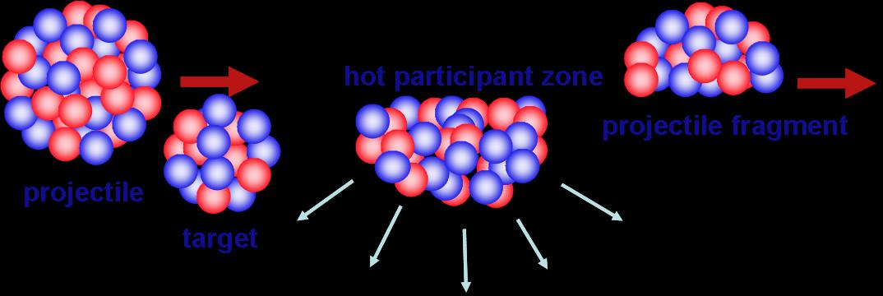
Production of Hypernuclei with HypHI
Projectile fragment
Hot participant zone
projectile
target

Slide 3
Production of Hypernuclei with HypHI
Projectile fragment
Hot participant zone
Λ
Hypernuclei
projectile
target
Coalescence of Λ in projectile fragments
NN -> ΛKN : Energy threshold ~ 1.6 GeV
  Heavy ion beams with E > 1.6 A GeV needed
    Stable heavy ion beam at GSI
    Stable heavy ion beam at FAIR
    RI-beam from FRS and super-FRS
Accessible to neutron- and proton rich hypernuclei

Slide 4
Relativistic hypernuclei
Projectile fragment
Hot participant zone
Λ
Hypernuclei
projectile
target
Large Lorentz factor γ (>3)
  Effective lifetime : Longer by the Lorentz factor
    200 ps -> 600 ps at GSI (ct ~ 20 cm)
    200 ps -> 4 ns at 20 A GeV
Hypernuclear separation and spin precession

Slide 5



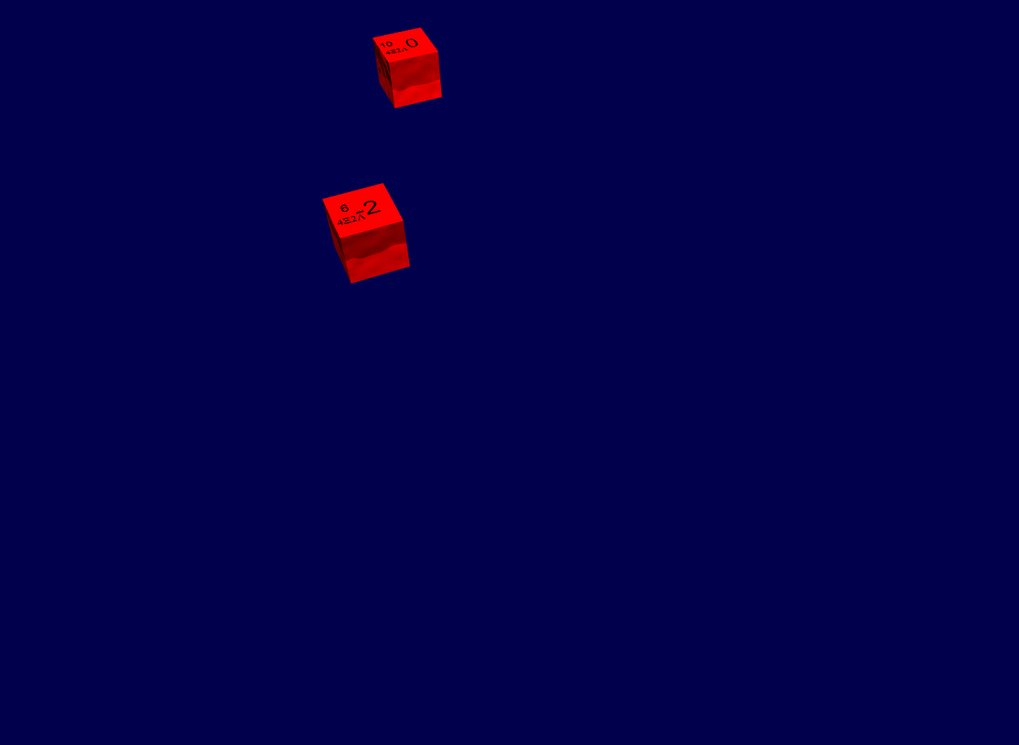
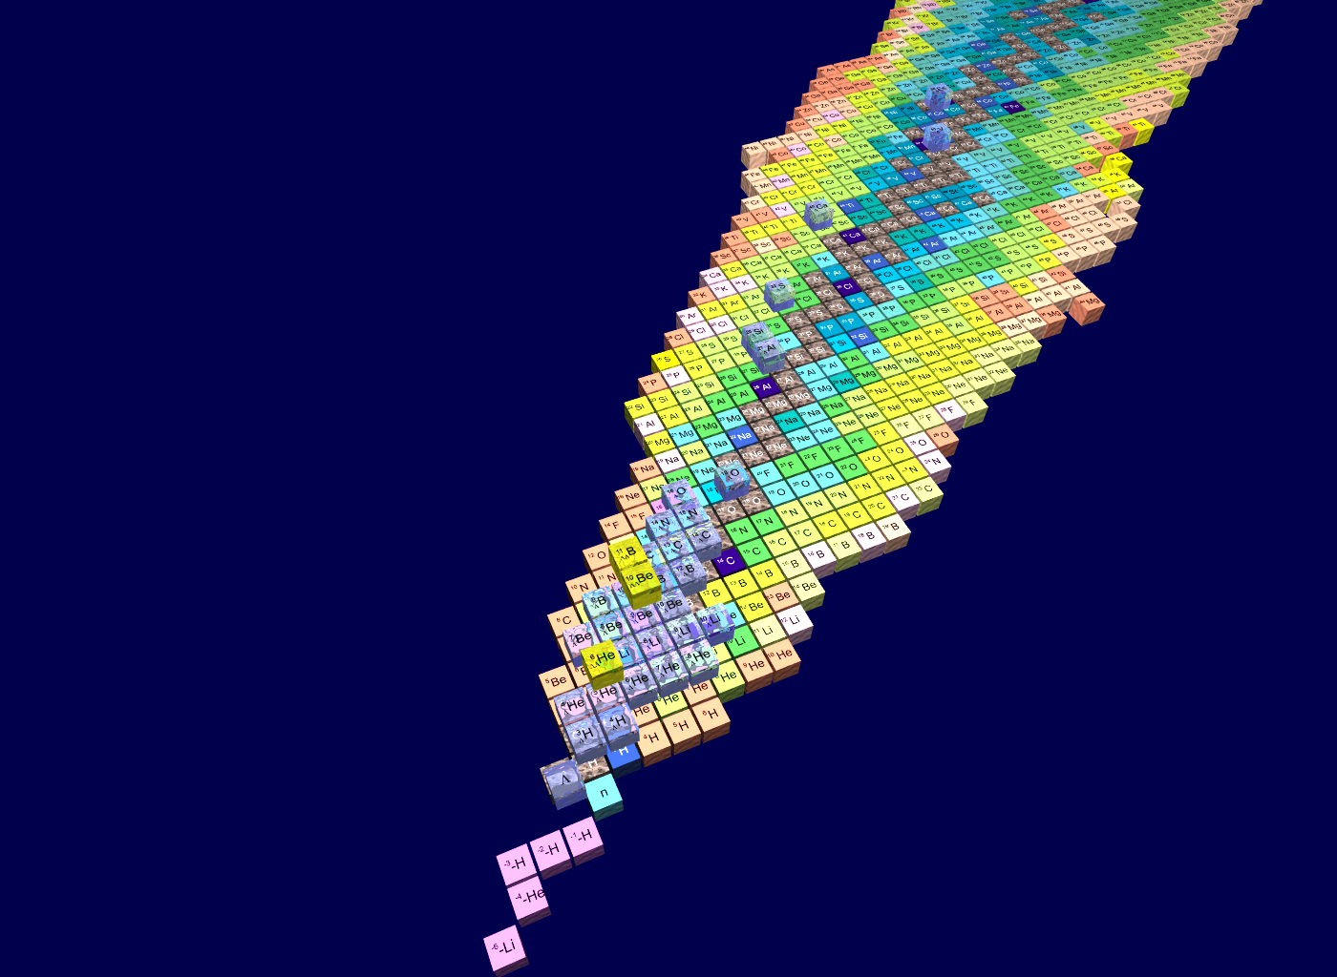
Nuclear matter with multiple-strangeness

Slide 6
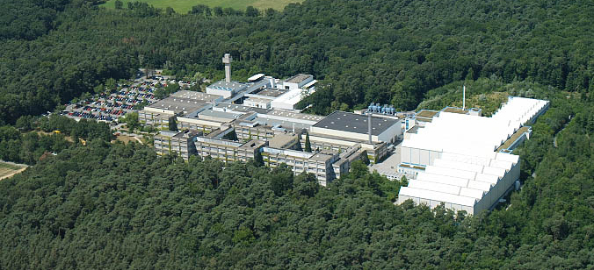
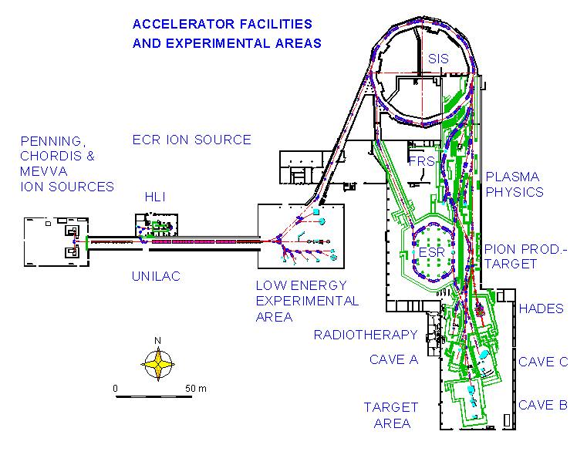
GSI Helmholtz Center for Heavy Ion Research

Slide 7
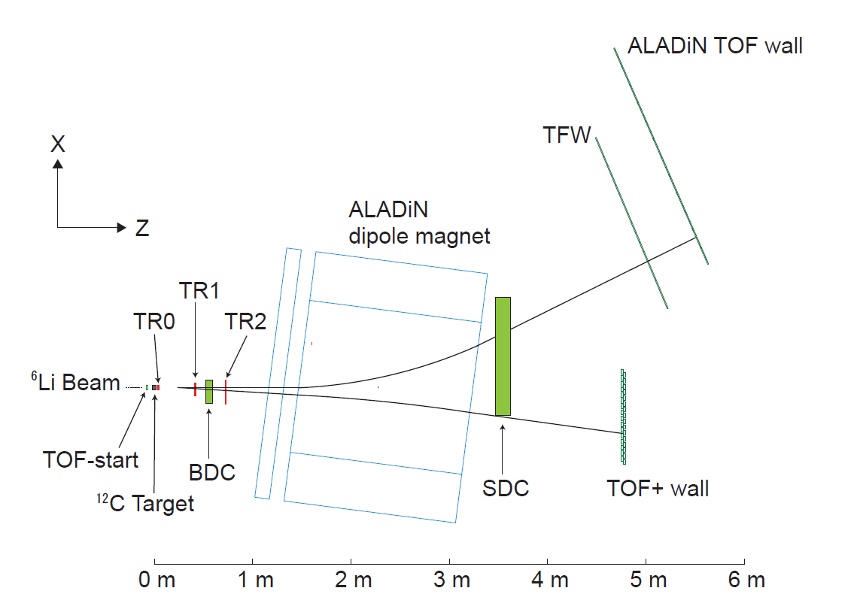
HypHI Phase 0 in October 2009
The goal of the Phase 0 experiments
  To demonstrate the feasibility of precise hypernuclear spectroscopy with ⁶Li primary beams at 2 A GeV :
  Mesonic decay Λ -> π⁻ + p
³_{Λ}H -> π⁻ + ³He
⁴_{Λ}H -> π⁻ + ⁴He
Funding
Helmholtz-University Young Investigators Group VH-NG-239, 2006-2012
DFG grant SA1696/1-1
2007-2009, TOF detectors

Slide 8
HypHI Phase 0 (2009), ⁶Li+¹²C at 2 A GeV
Example:
³_{Λ}H -> ³He + π⁻
Beam: ⁶Li at 2 A GeV, 3X10⁶ /s
Target: ¹²C, 8.8 g/cm²
Secondary decay-vertex finding
Invariant mass
4-momenta of π⁻
4-momenta of ³He

Slide 9
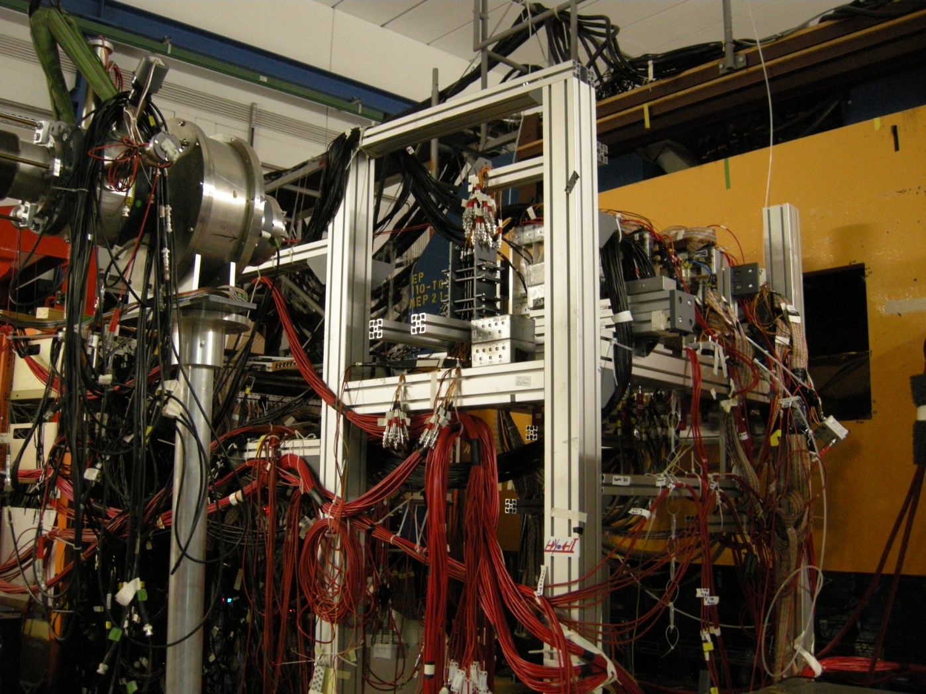
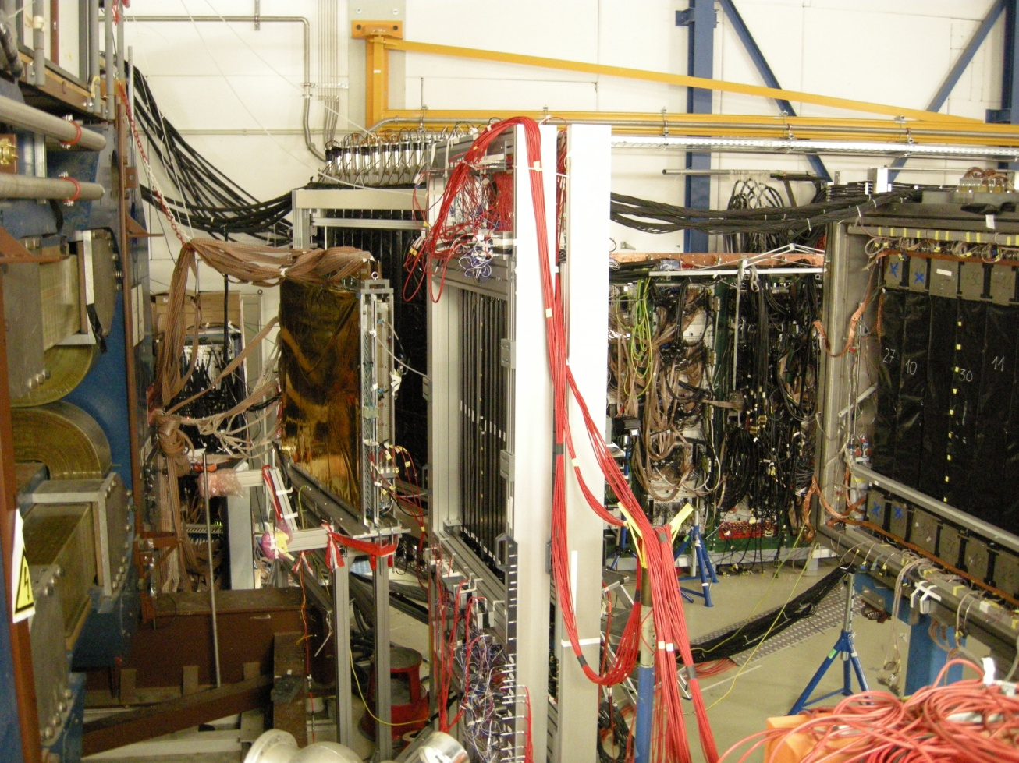
HypHI setup in 2009

Slide 10
HypHI Phase 0 and 0.5 collaboration
GSI Helmholtz-University Young Investigators Group VH-NG-239
  S. Bianchin
  O. Borodina (Mainz Univ.)
  V. Bozkurt (Nigde Univ.)
  E. Kim (Seoul Nat. Univ.)
  D. Nakajima (Tokyo Univ.)
  B. Özel-Tashnov
  C. Rappold (Strasbourg Univ.)
  K. Yoshida (Osaka Univ.)
  T.R. Saito (Spokes person)
Mainz University
  P. Achenbach, J. Pochodzalla
GSI HP2 and Mainz University
  D. Khaneft, Y. Ma, F. Maas
GSI HP1
  W. Trautmann
GSI EE department
  J. Hoffmann, K. Koch, N. Kurz, S. Minami, W. Ott, S. Voltz
GSI Nuclear reaction
  T. Aumann, C. Caeser, H. Simon
GSI Detector Lab.
  C. Schmidt
KEK
  T. Takahashi, Y. Sekimoto
KVI
  E. Guliev, M. Kavatsyuk, G.J. Tambave
Nigde University
  B. Goekuezuem, Z.S. Ketenci, S. Erturk
Osaka University
  S. Ajimura, A. Sakaguchi
Osaka Electro-Communication University
  T. Fukuda, Y. Mizoi
Seoul National University
  H. Bhang, M. Kim, S. Kim, C.J. Yoon
Tohoku University
  H. Tamura
Take Saito
t.saito@gsi.de
PhD thesis completed
PhD thesis in progress

Slide 11
Results of HypHI Phase 0
Observation of ³_{Λ}H, ⁴_{Λ}H and Λ-hyperon
  Nucl. Phys. A 913 (2013) 170
Short lifetime of ³_{Λ}H and ⁴_{Λ}H
  Nucl. Phys. A 913 (2013) 170
  Phys. Lett. B 728 (2014) 543
Observation of signals probably indicating nnΛ bound states
  Phys. Rev. C 88 (2013) 041001-1-6(R)
Production cross section of ³_{Λ}H, ⁴_{Λ}H and Λ-hyperon
  Phys. Lett. B 747 (2014) 129
Summary of the HypHI Phase 0 experiment
  Nucl. Phys. A 954 (2016) 199
5 Ph.D. and 1 Ph.D. in progress

Slide 12
HypHI Phase 0 (2009), ⁶Li+¹²C at 2 A GeV
Example:
³_{Λ}H -> ³He + π⁻
Δp/p ~ 5 %
Small acceptance
~ 20 %
4-momenta of π⁻
Δp/p ~ 5-10 %
4-momenta of ³He
Low efficiency of vertx trigger
~ 1 %

Slide 13
Novel technique with FRS at FAIR Phase 0 (GSI)

Slide 14
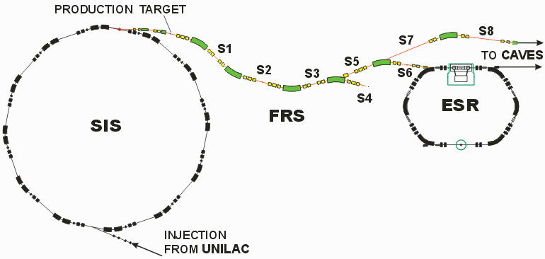
Accelerator complex and FRS at GSI
Larger acceptance for π⁻
Δp/p ~ a few %
Δp/p=10⁻³
³_{Λ}H -> π⁻ + ³He
⁴_{Λ}H -> π⁻ + ⁴He
nnΛ -> π⁻ + d + n

Slide 15
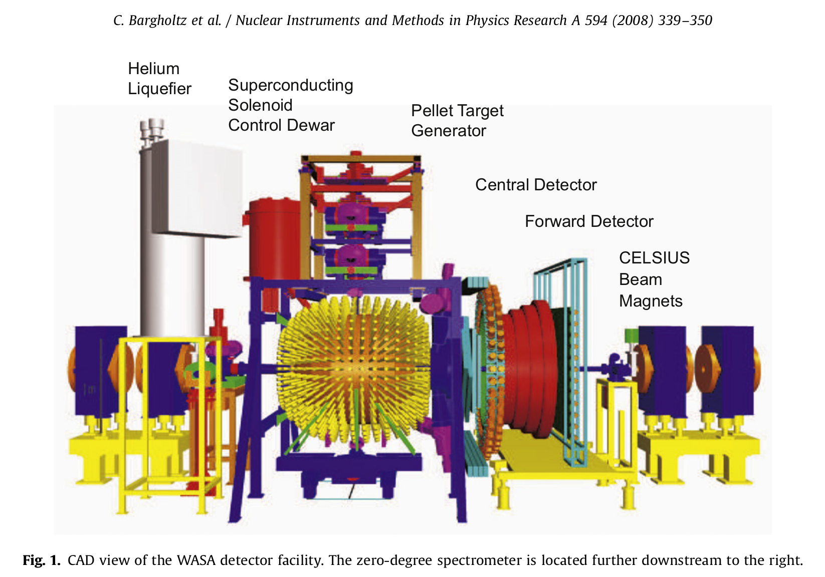
WASA at COSY in Juelich
GSI

Slide 16
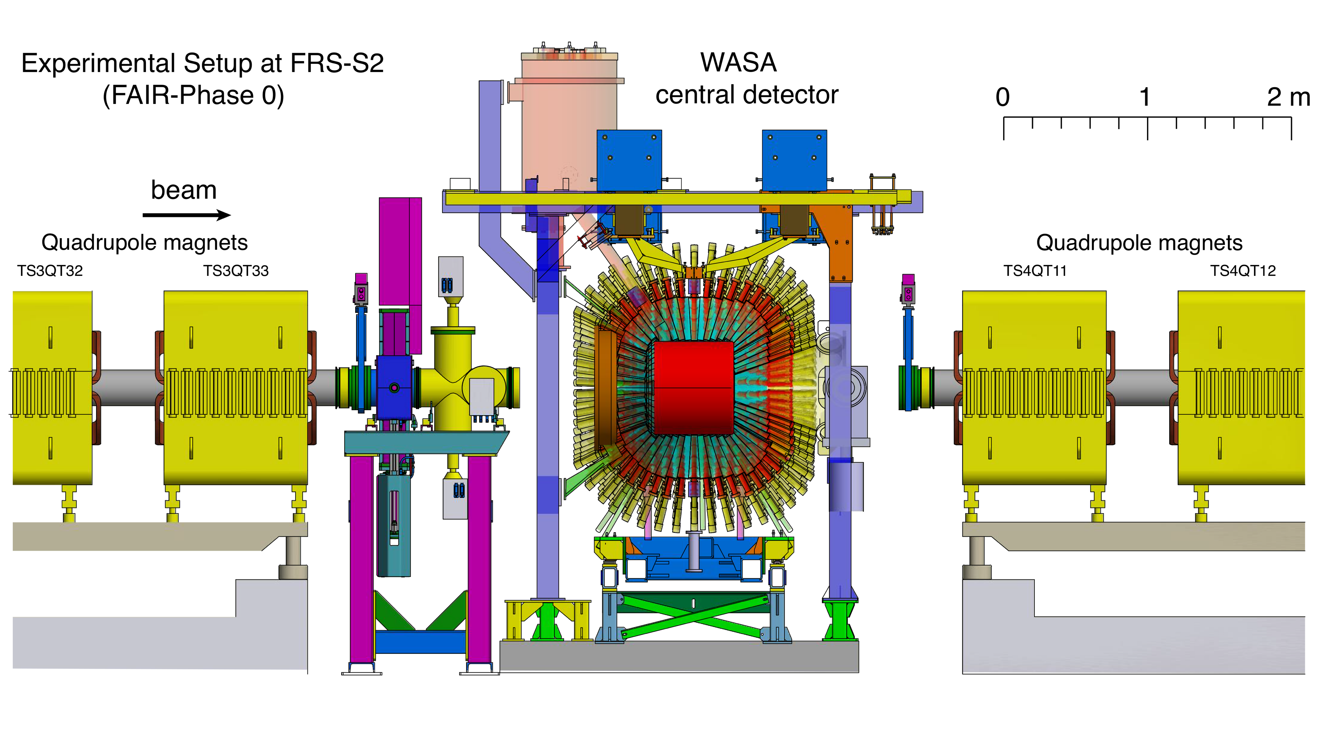
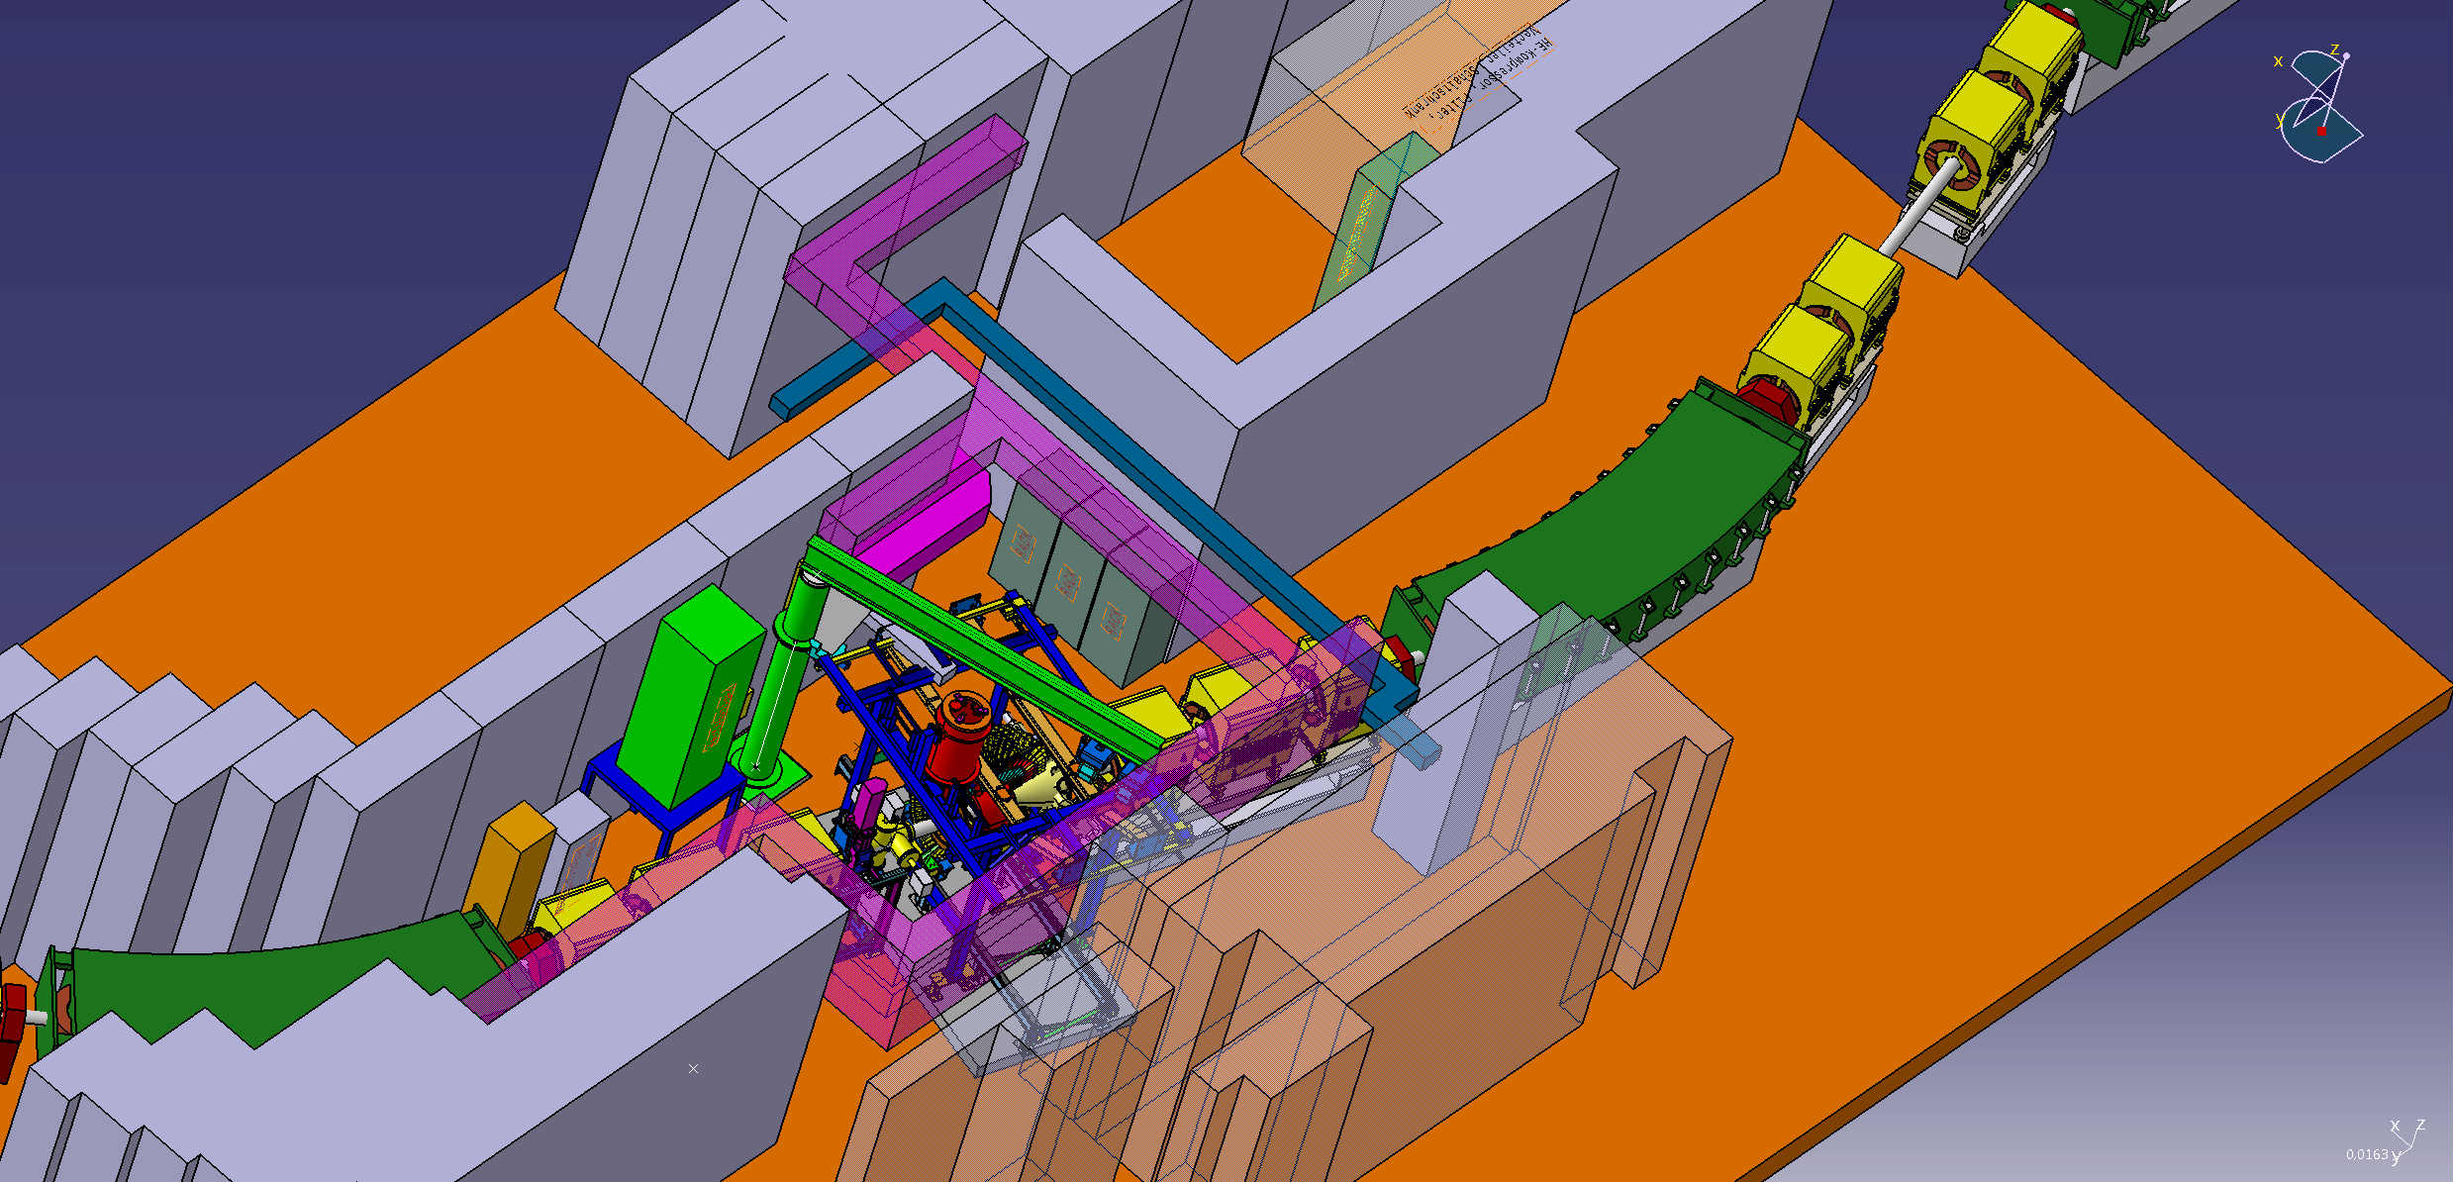
WASA at COSY to FRS at GSI
WASA-at-FRS collaboration
with Super-FRS Experiment Collaboration
Hypernuclei
η’-nucleus
Baryon resonances in exotic nuclei

Slide 17
Rate estimation and
Simulated invariant mass distribution
10 ~ 40 times more
If it exists
2-5 times better resolution

Slide 18
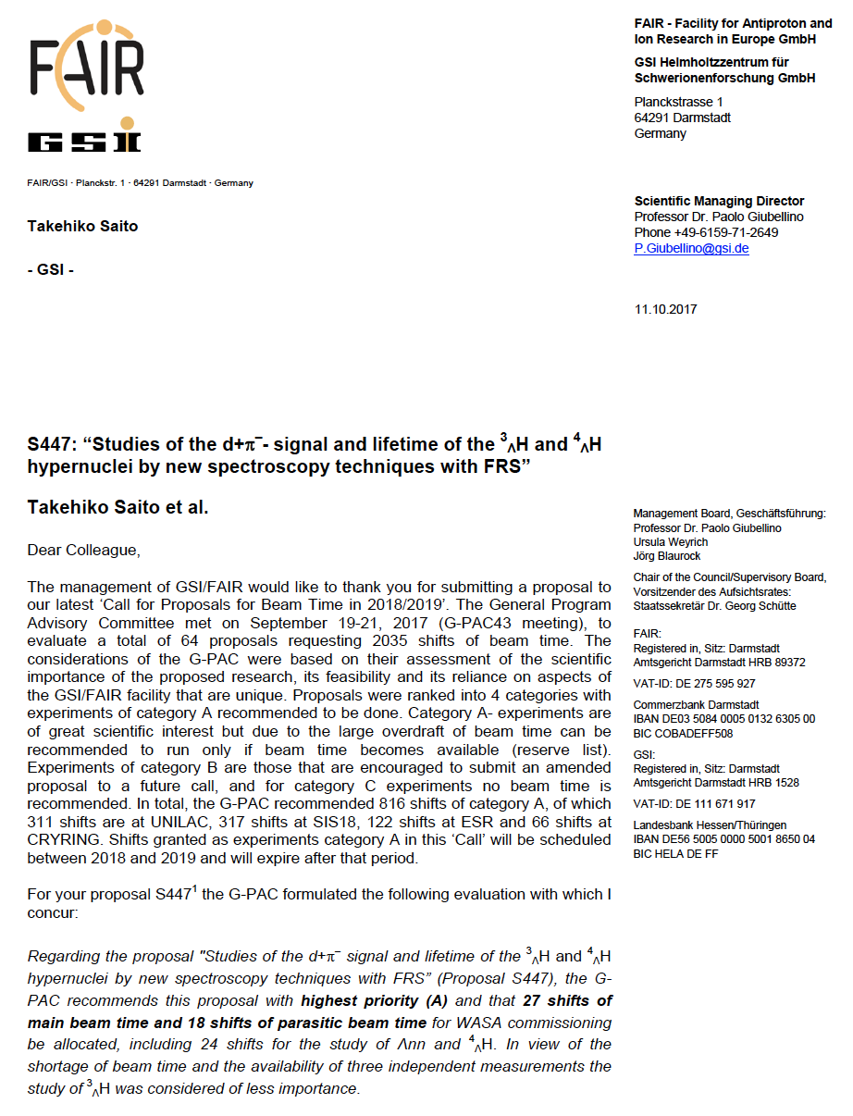
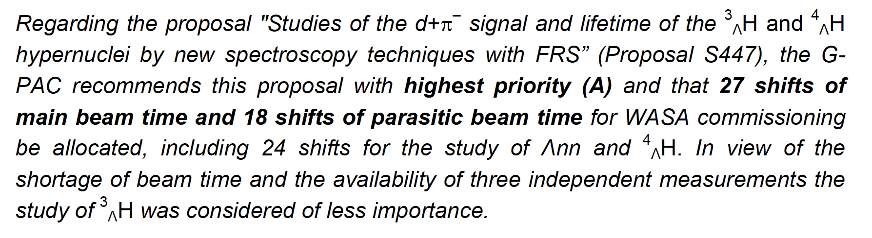
Approval by the GSI G-PAC in 2017
In 2019

Slide 19
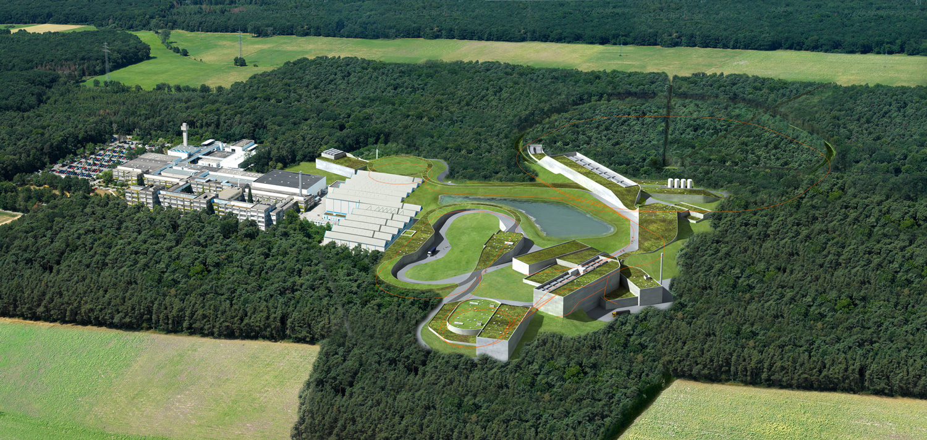
FAIR in Germany

Slide 20
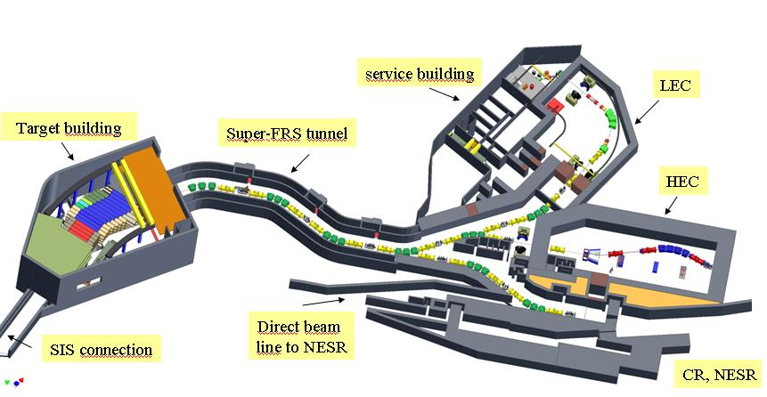
Super-FRS at FAIR
Precise hypernuclear spectroscopy with RI-beams

Slide 21
We can go further

Slide 22
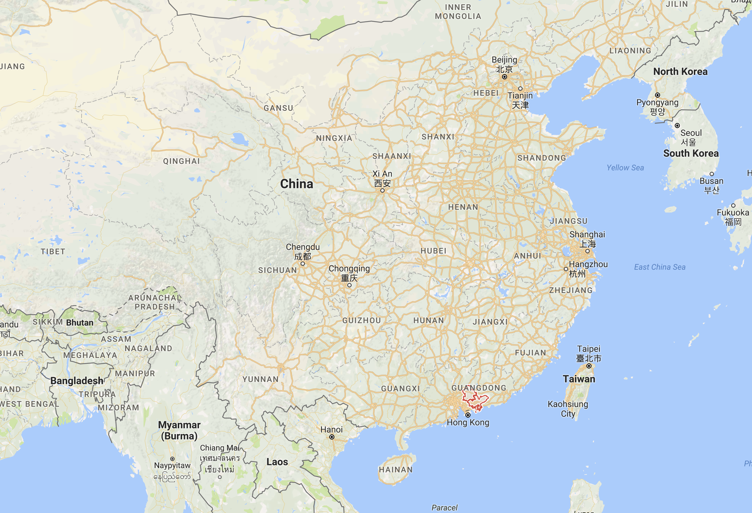
Huizhou

Slide 23
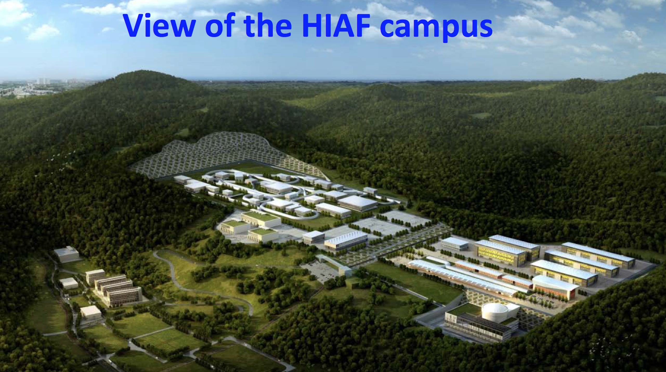
HIAF in Huizhou/China
High Intensity Heavy Ion Accelerator Facility
New Hypernuclear Project
  Spokesperson: Take Saito
@ 2024
Approved by Chinese government in December 2015
Under construction
Courtesy of Xinwen Ma

Slide 24
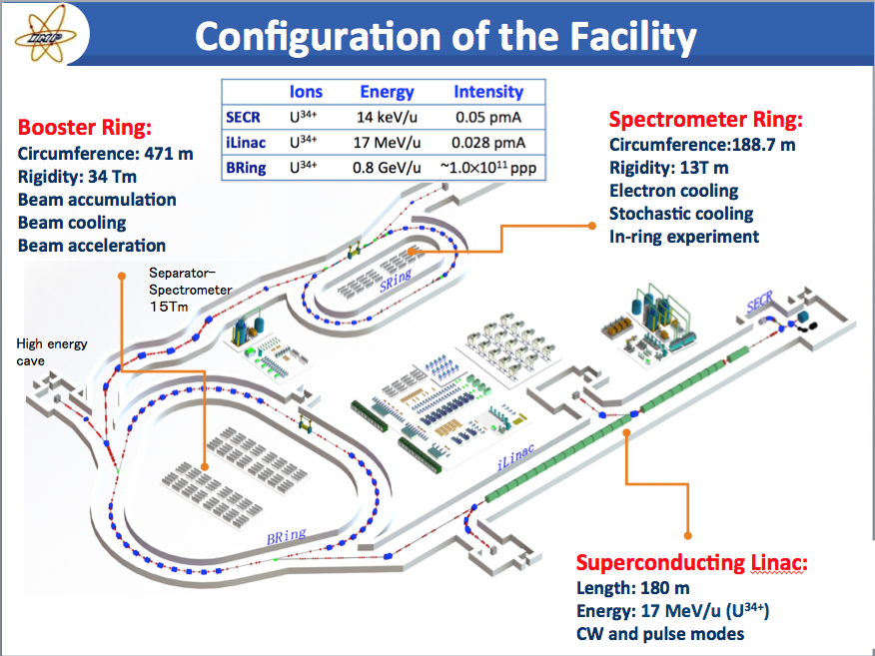
HIAF
4.25 A GeV for A/q=2

Slide 25
Production of double-Λ hypernuclei
d + Ξ⁻ -> nΛΛ
t + Ξ⁻ -> nnΛΛ
³He + Ξ⁻ -> ⁴_{ΛΛ}H
⁴He + Ξ⁻ -> ⁵_{ΛΛ}H
⁶Li + Ξ⁻ -> ⁷_{ΛΛ}He
⁷Li + Ξ⁻ -> ⁸_{ΛΛ}He
⁹Be + Ξ⁻ -> ¹⁰_{ΛΛ}Li
¹⁰Be + Ξ⁻ -> ¹¹_{ΛΛ}Li
¹⁰B + Ξ⁻ -> ¹¹_{ΛΛ}Be
¹¹B + Ξ⁻ -> ¹²_{ΛΛ}Be
Above threshold of Ξ—hyperon (dss) production: 3.747 A GeV
Ξ⁻p -> ΛΛ
Examples with only up to
Boron fragments
Projectile fragment
Hot participant zone
Ξ⁻
Double-Λ Hypernuclei
projectile
target

Slide 26
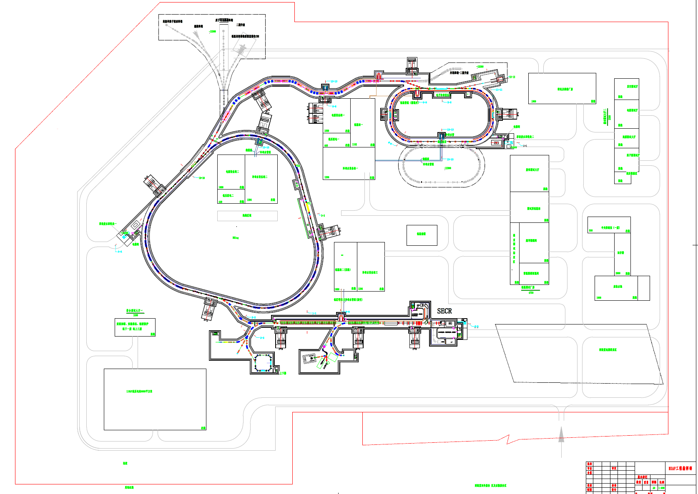

Slide 27
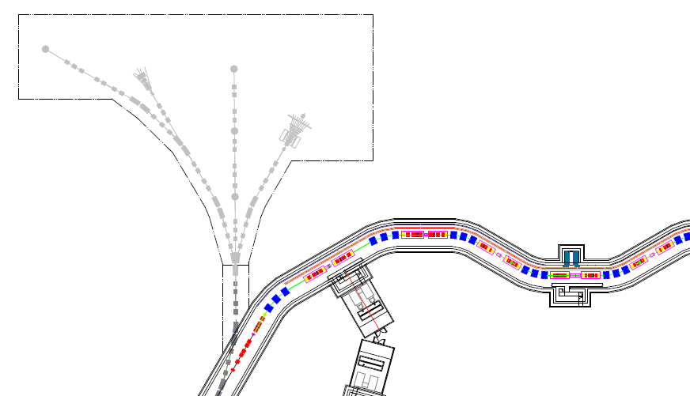
工程总体方案
终端-- 高能综合终端
Beamline for hypernuclei
质子照相终端
高能量密度
离子 | 离子数 ppp | 能量 （MeV/u）
²³⁸U³⁴⁺ | 1.0×10¹¹ | 800
¹²⁹Xe²⁷⁺ | 1.8×10¹¹ | 1400
⁷⁸Kr¹⁹⁺ | 3.0×10¹¹ | 1750
⁴⁰Ar¹²⁺ | 5.0×10¹¹ | 2300
¹⁸O⁶⁺ | 6.0×10¹¹ | 2600
p | 2.0×10¹² | 9300
超核终端
低温高密核
物质测量谱仪CEE
单粒子效应
研究终端

Slide 28
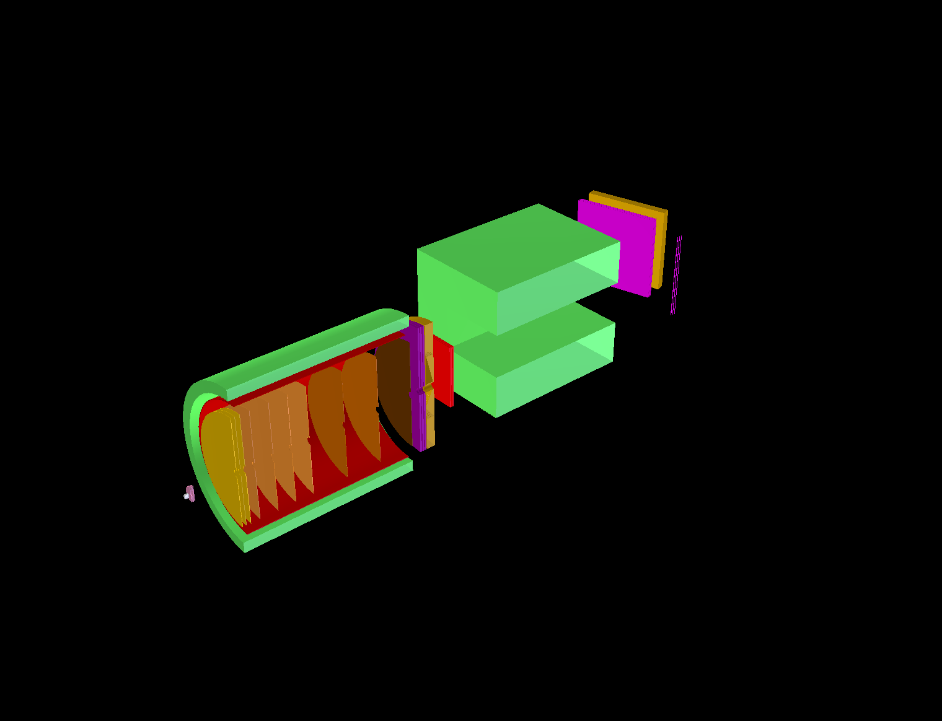
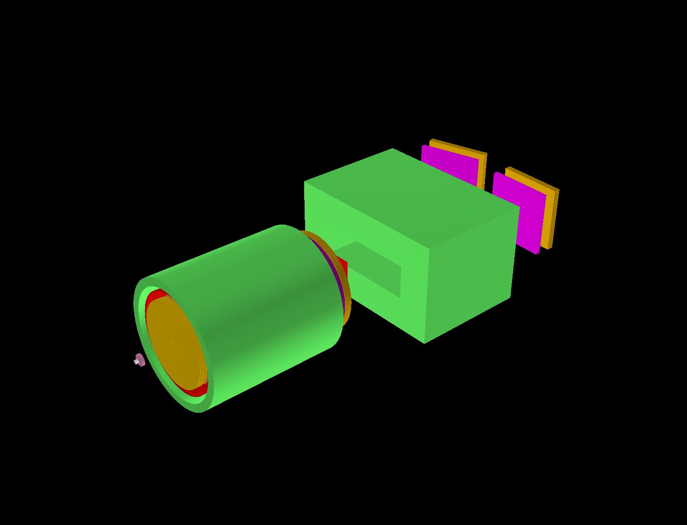
Current considerations for HIAF
Collaborations (so far):
GSI, IMP, Lanzhou Univ., Tsinghua Univ.,
USTC.
Hodoscopes
(RPC + Straw + Plastics)
Dipole magnet (ALADiN)
Superconducting solenoid magnet
TOF barrel
(Plastic + RPC)
Hodoscopes
(RPC + Straw + Plastics)
Stack of GEMs or Planer drift chamber
Vertex detectors (SSD + Fibers)
2 m

Slide 29
Expected reconstructed rate
²⁰Ne + ¹²C at 4.25 A GeV
Beam intensity: 10⁷ /s
Small Beam intensity
Independent to other complexes
Day-1 epxperiment at HIAF
Amount of observations
 | Single-Λ (Σ) hypernuclei | Double-Λ hypernuclei
per day | 8 X 10⁵ | 9 X 10¹
per week | 6 X 10⁶ | 6 X 10²
per month | 2 X 10⁷ | 3 X 10³
Unique opportunity
Hypernuclear scattering experiments with
Polarized target(H, HD) + TPC
Polarized projectiles
³_{Λ}H + p -> ³_{Λ}H’ + p’
³_{Λ}H + p -> Λd + p’
³_{Λ}H + p -> Λpn + p’

Slide 30
Neutron measurements
Construction of a large neutron detector (wall) at HIAF (TU Darmstadt)
Moving a part of the HIAF detector to R3B/FAIR
Cross section of the production of neutron rich hypernuclei
  Dependence of the neutron-hyperon interaction on the neutron density
HIAF
NuSTAR at FAIR

Slide 31
Precise measurements
Like WASA+FRS
HIAF
NuSTAR at FAIR

Slide 32
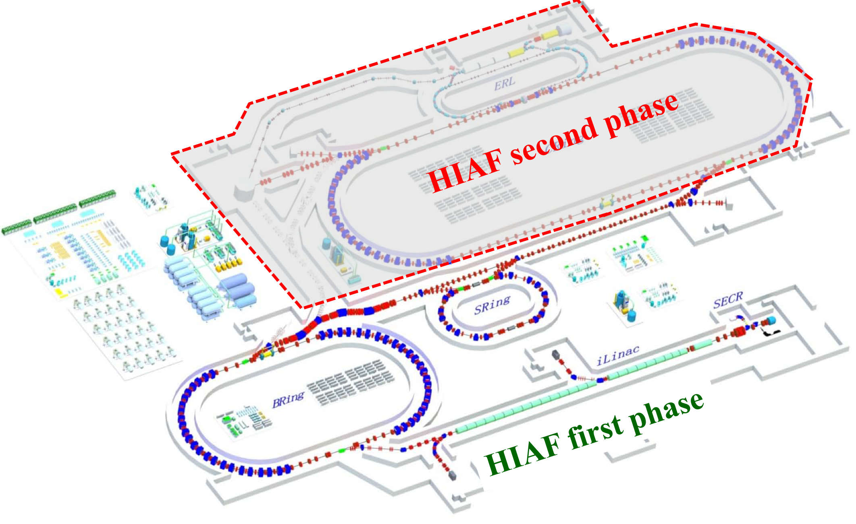
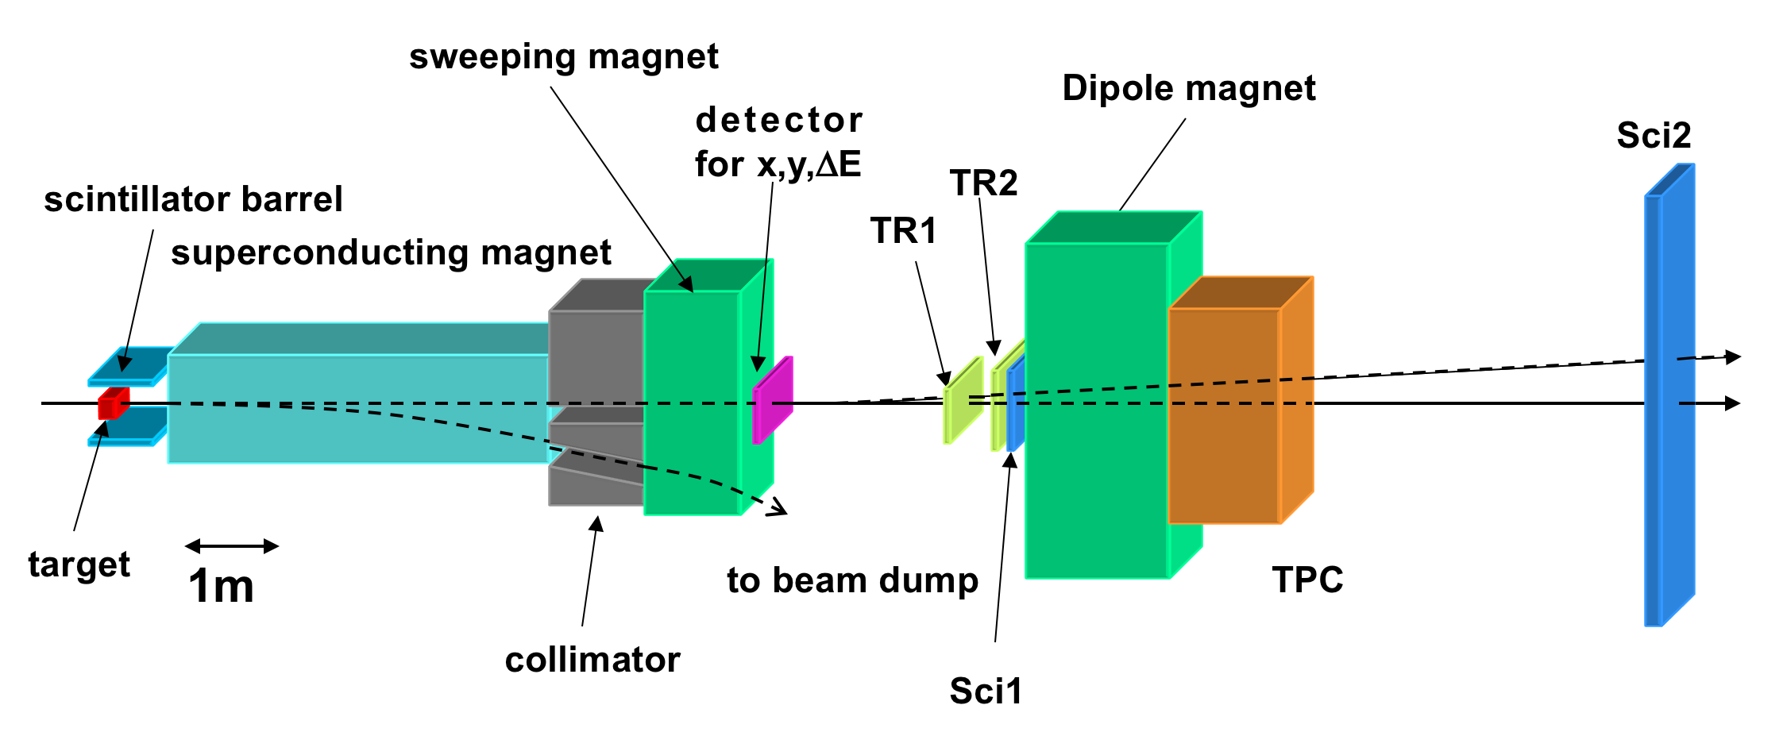
HIAF Phase 2
Energy upgrade
10 – 30 A GeV
Hypernuclear separator

Slide 33
Summary
Heavy ion beams and RI-beams
  Powerful tool also for hypernuclear physics
HypHI Phase 0 experiment
  Pioneering experiment
  nnΛ and short lifetime of hypertriton
FAIR Phase 0
  WASA-at-FRS experiment
    Exotic hypernuclei
    η’-nucleus
    Baryon resonances in exotic nuclei
  Similar technique at FAIR
Hypernuclear project at HAF in China
  Single- and double-strangeness hypernuclei
  Hypernuclear scattering
  Hypernuclear spectroscopy with neutron measurements
  Hypernuclear magnetic moments
  and much more…
t.saito@gsi.de

