Slide 1
High-resolution spectroscopy of ${}_{Λ}^{\text{4}}{\text{H}}$ hyperhydrogen at MAMI
Patrick Achenbach
U Mainz
May 2o14

Slide 2
Fundamental symmetries in light hypernuclei

Slide 3
The A = 4 isospin doublet
0 MeV
³He+Λ
0 MeV
³H+Λ
-1.00
-1.24
1⁺
1⁺
ΔB (He-H) = 0.24
-2.04±0.04
0⁺
-2.39±0.03
0⁺
ΔB (He-H) = 0.35±0.06
n
p
n
n
p
Λ
p
Λ
⁴He
⁴H
Λ
Λ
Nucleon-hyperon interaction can be studied by strange mirror pairs
Coulomb corrections are < 50 keV for the ⁴_{Λ}H - ⁴_{Λ}He pair
Energy differences of ⁴_{Λ}H - ⁴_{Λ}He pair much > than for ³H - ³He pair
Notes:
3
Among these calculation, Nogga and his collaborators investigated the charge symmetry breaking effect by sophisticated 4-body calculation using modern realistic YN and NN interactions. These are results using Nijmegen soft core ’97e model. The calculated energy difference in the ground state is 0.07 MeV. And this value in the excited state is -0.01 MeV. Both of energy difference in the ground state and the excited state are inconsistent with the data. At the present, there exist no YN interaction to reproduce the charge symmetry breaking effect.

Slide 4
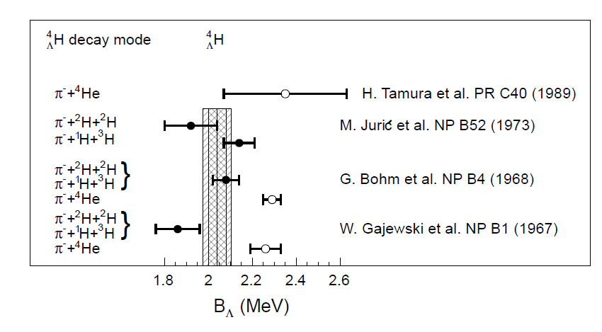
World data on _{Λ}⁴H
[M. Juric et al. NP B52 (1973)]:
⁴H
decay
→ π⁻+¹H+³H: B = 2.14 ±0.07 MeV
Λ
0.22 MeV difference
decay
⁴H
→ π⁻+²H+²H: B = 1.92 ±0.12 MeV
Λ
Total: B = 2.08 ±0.06 MeV

Slide 5
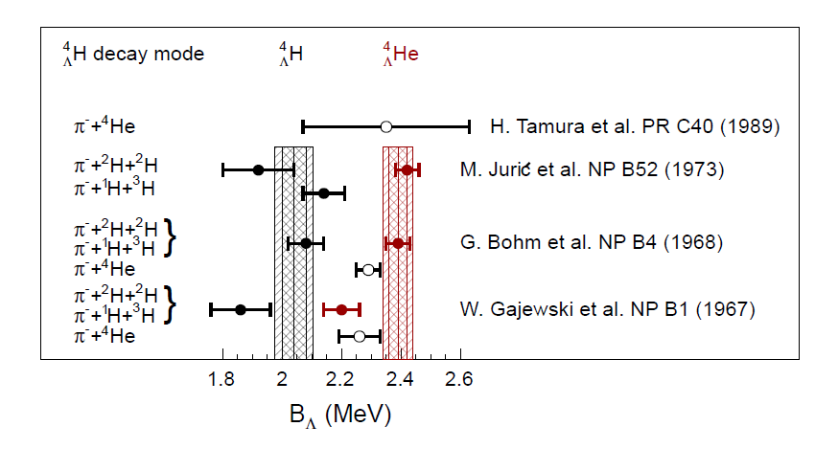
World data on A = 4 system
Λ
[M. Juric et al. NP B52 (1973)]:
⁴He
decay
→ π⁻+¹H+³He: B = 2.42 ±0.05 MeV
Λ
0.02 MeV difference
decay
→ π⁻+2¹H+²H: B = 2.44 ±0.09 MeV
⁴He
Λ
Total: B = 2.42 ±0.04 MeV

Slide 6
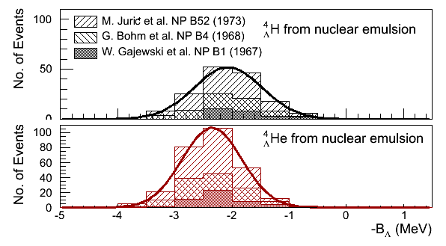
World data on A = 4 system
Only three-body decay modes used for hyperhydrogen
Systematic errors of > 0.04 MeV not included [D. Davis]
155 events for hyperhydrogen, 279 events for hyperhelium

Slide 7
Modern calculations on A = 4 system
Calculation | Interaction | ⁴_{Λ}H_{gs} | ⁴_{Λ}He_{gs} | Δ (He-H)
A. Nogga, H. Kamada and W. Gloeckle, PRL 88, 172501 (2002) | SC97e | 1.47 | 1.54 | 0.07
 | SC89 | 2.14 | 1.80 | 0.34
H. Nemura. Y. Akaishi and Y. Suzuki, PRL 89, 142504 (2002) | SC97d | 1.67 | 1.62 | -0.05
 | SC97e | 2.06 | 2.02 | -0.04
 | SC97f | 2.16 | 2.11 | -0.05
 | SC89 | 2.55 | 2.47 | -0.08
E. Hiyama, M. Kamimura, T. Motoba, T. Yamada and Y. Yama PRC 65, 011301 (R) (2001) | AV8 | 2.33 | 2.28 | -0.05
World data average |  | 2.04±0.04 | 2.39±0.03 | 0.35±0.06
With precise spectroscopy details of NY-interaction can be inferred

Slide 8
Experimental method

Slide 9
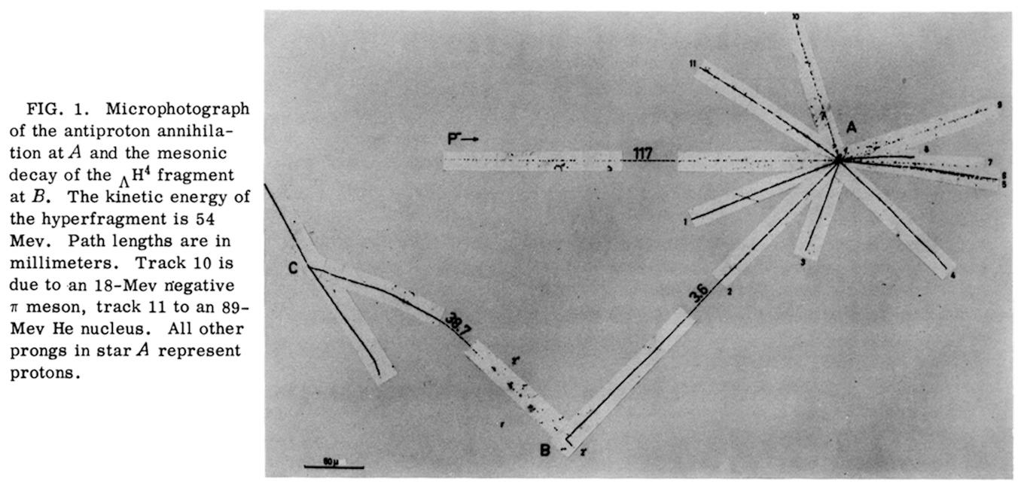
Hypernuclear decay-pion spectroscopy in emulsion
energy and momentum transfer to target nucleus
spectroscopy
3.6 mm
minimization
of energy-loss
stopping of hyperfragment
38.7 mm
Example _{Λ}⁴H event [Ekspong 1959]

Slide 10
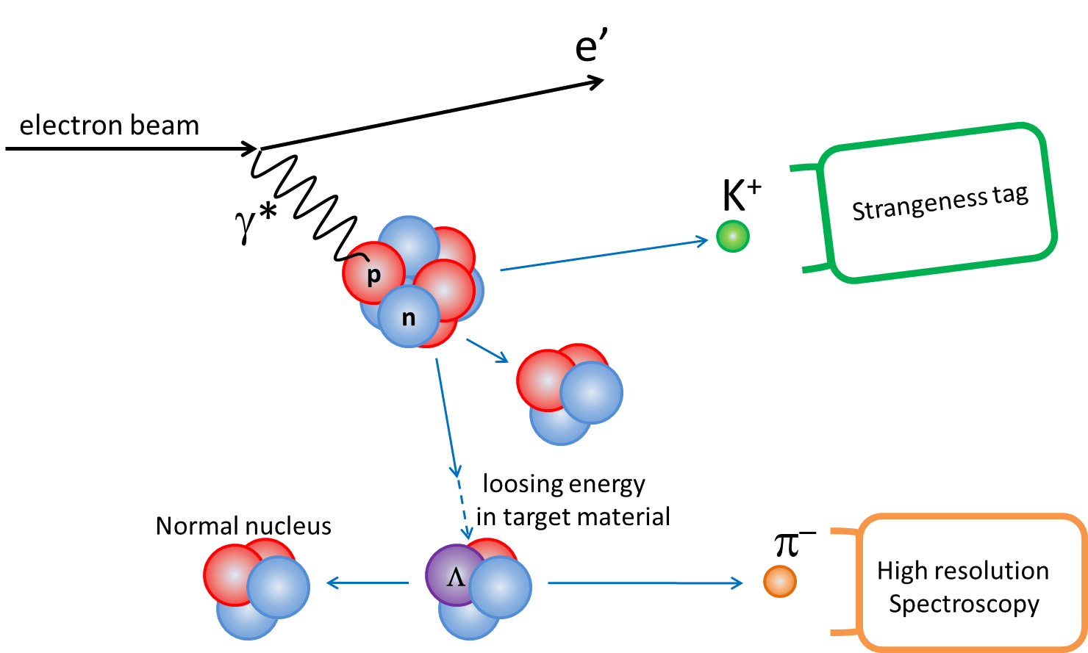
Hypernuclear decay-pion spectroscopy in counter experiments
energy and momentum transfer to target nucleus
Different possible fragmentation processes
stopping
minimization
of energy-loss
two-body decay at rest ⇒ mono-energetic pions

Slide 11
Goals of decay-pion spectroscopy
Measuring ground-state masses with high accuracy:
light hypernuclei ³_{Λ}H, ⁴_{Λ}H, …, ⁹_{Λ}Li
Determination of charge symmetry breaking (CSB) effects:
(⁴_{Λ}H ↔ ⁴_{Λ}He), (⁶_{Λ}He ↔ ⁶_{Λ}Li), (⁷_{Λ}He ↔ ⁷_{Λ}Li* ↔ ⁷_{Λ}Be), …
Search for hypernuclei near the neutron drip line:
important information for Λ−Σ coupling
⁶_{Λ}H: the “superheavy hyper-hydrogen – puzzle”
8 (9) accessible isotopes with ⁹Be
$${}_{Λ}^{6}{Li}$$
$${}_{Λ}^{7}{Li}$$
$${}_{Λ}^{8}{Li}$$
$${}_{Λ}^{9}{Li}$$
$${}_{Λ}^{4}{He}$$
$${}_{Λ}^{5}{He}$$
$${}_{Λ}^{6}{He}$$
$${}_{Λ}^{7}{He}$$
$${}_{Λ}^{8}{He}$$
pion momentum resolution ~ 100 keV/c
→ mass resolution ~100 keV/c² (FWMH)
→ accuracy of a few 10 keV/c²
$${}_{Λ}^{3}H$$
$${}_{Λ}^{4}H$$
$${}_{Λ}^{6}H$$
red: inaccessible by MM
gray: no two-body decay
Notes:
,

Slide 12
Experiments at Mainz Microtron

Slide 13
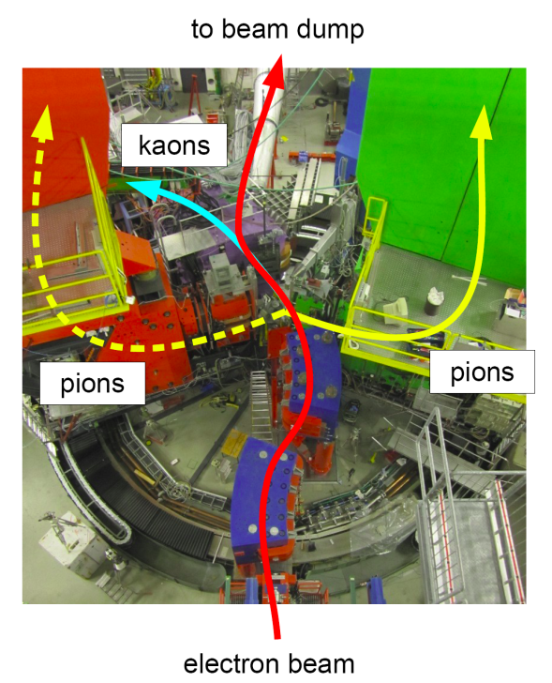
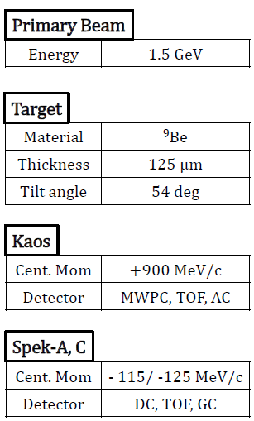
Decay-pion spectroscopy at MAMI

Slide 14
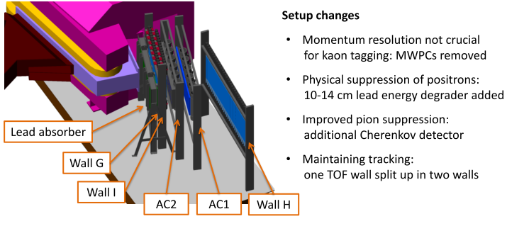
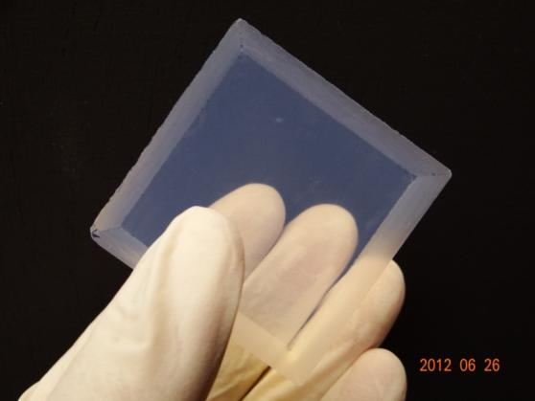
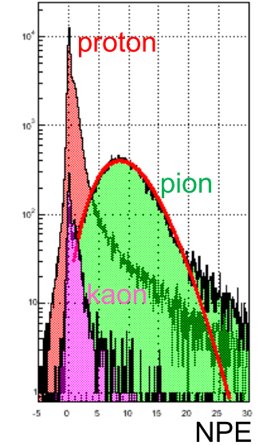
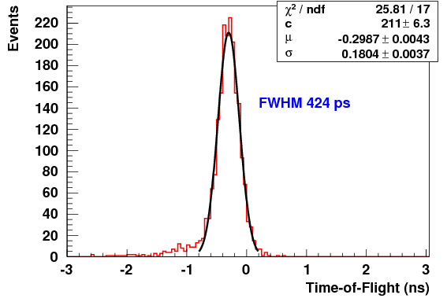
Particle detection system in KAOS
FWHM = 400 ps
time-of-flight reso-lution with TOF walls
pion detection ε > 95% by aerogel Cherenkov

Slide 15
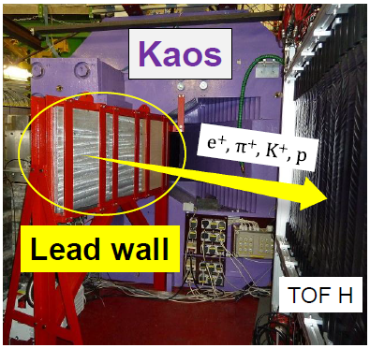
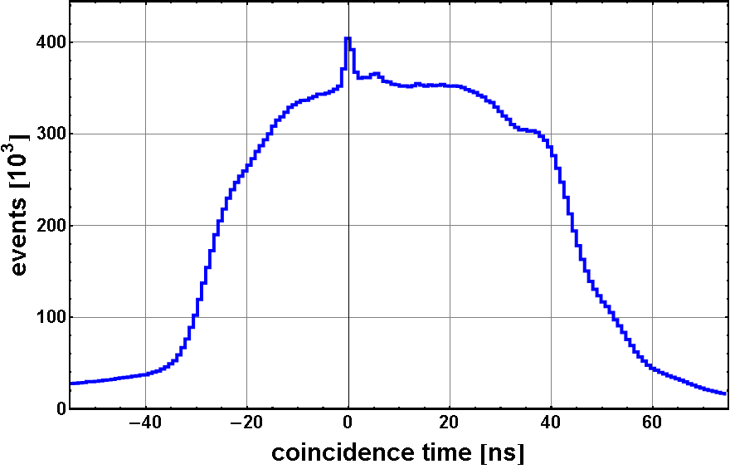
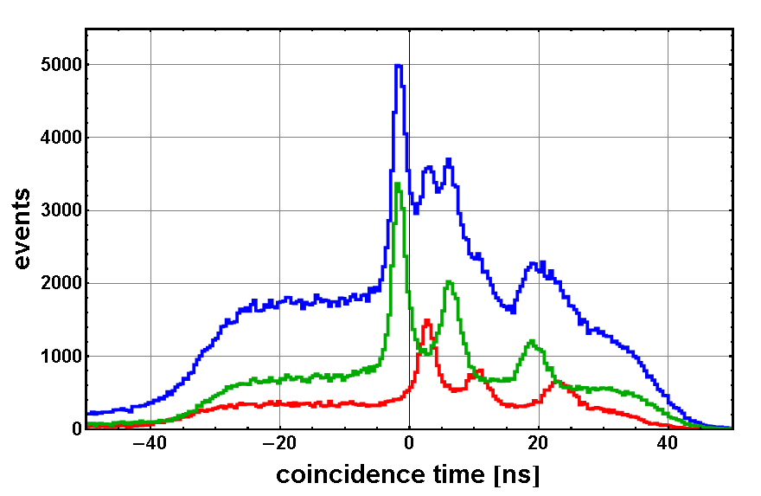
Kaos spectrometer changed into zero-degree tagger
without absorber
hadrons
positrons
with absorber
only
hadrons
Suppression of large positron flux
with 25 X₀ lead absorber wall
Much cleaner spectra for all hadrons

Slide 16
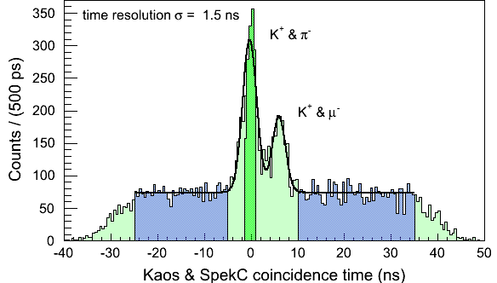
Reaction identification
with cut on gas Cherenkov signal for electron rejection
established clean tag on strangeness production at zero-degree
decay-pion detection with Spectrometer A & C (dp/p <10⁻⁴)
more than 1000 pion-kaon-coincidences from weak decays of hyperons

Slide 17
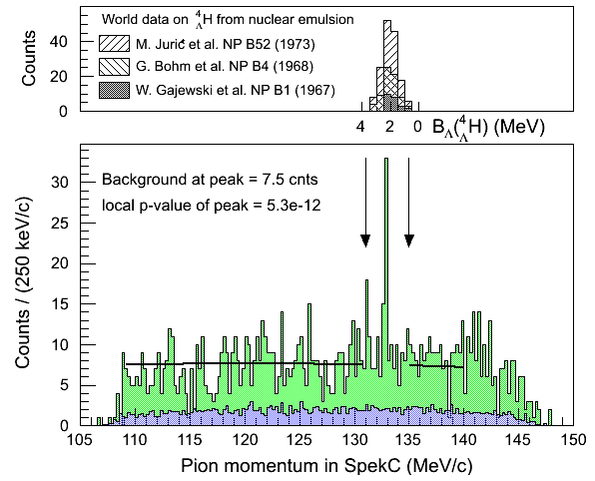
Hyperhydrogen peak search
Emulsion data
preliminary
MAMI data
local excess observed inside the hyperhydrogen search region

Slide 18
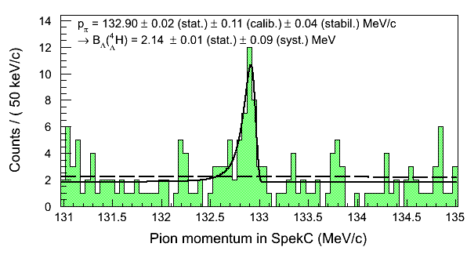
Binding energy extraction
preliminary
$S=\sqrt{−2\ln{\frac{L(BG)}{L(S+BG)}}}$=4.7

Slide 19
Systematic error evaluation
calibration errors:
uncertainty on beam energy
uncertainty on beam position
uncertainty on spectrometer angle
uncertainty on energy loss
stability errors:
magnetic field stability
linearity
→ ± 110 (calib.) ± 40 (stab.) keV/c

Slide 20
Discussion of results

Slide 21
World data on A = 4 system

Slide 22
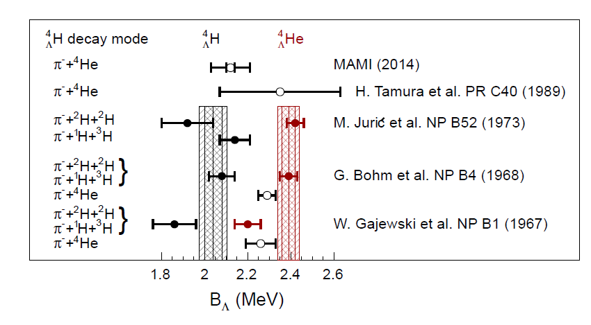
World data on A = 4 system
MAMI experiment confirmed Λ separation energy of _{Λ}⁴H

Slide 23
MAMI Experiment 2014
improved S/N ratio:
higher yield by longer beam time & higher beam intensity
better pion rejection by improved aerogel Cherenkov
suppression of background by improved shielding
suppression of background by trigger upgrade in SpekA & SpekC
suppression of background by beam-line upgrade
dedicated collimator for decay region
improved systematic uncertainties:
better control of magnet field variations
full overlap of SpekA and SpekC momentum acceptances
MAMI experiment starts tommorow morning and runs until 23 June !

Slide 24
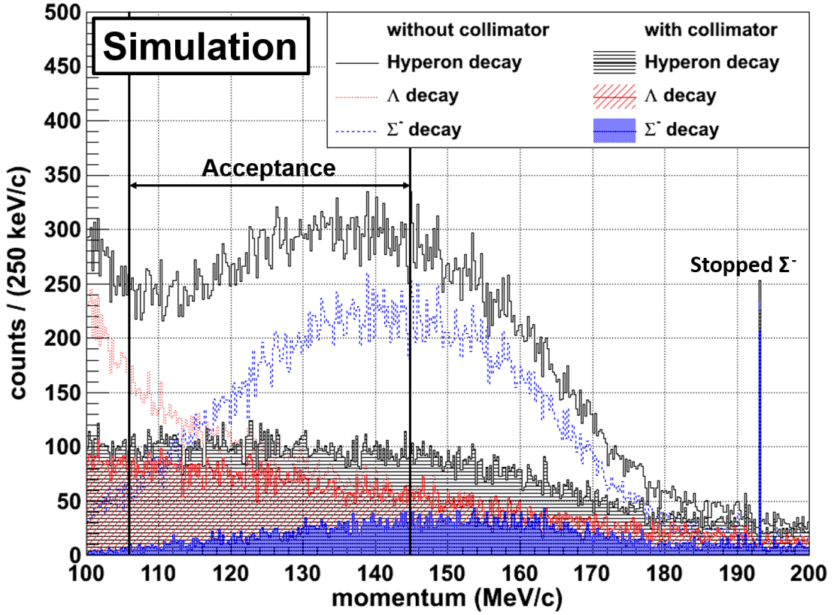
Decay region collimation
main background from decay of coincident quasi-free Σ⁻
Covering the region down-stream of the target with collimators
according to simulation this can reduce the background by more than a factor of 2
additional background of e± will be absorbed in Kaos and can be separated by A/C Cherenkov
Simulation by S. Nagao

Slide 25
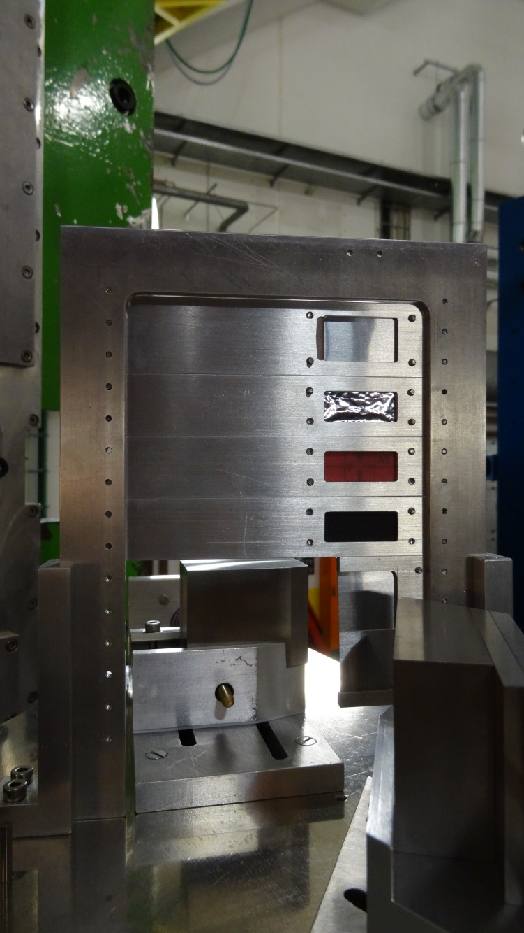
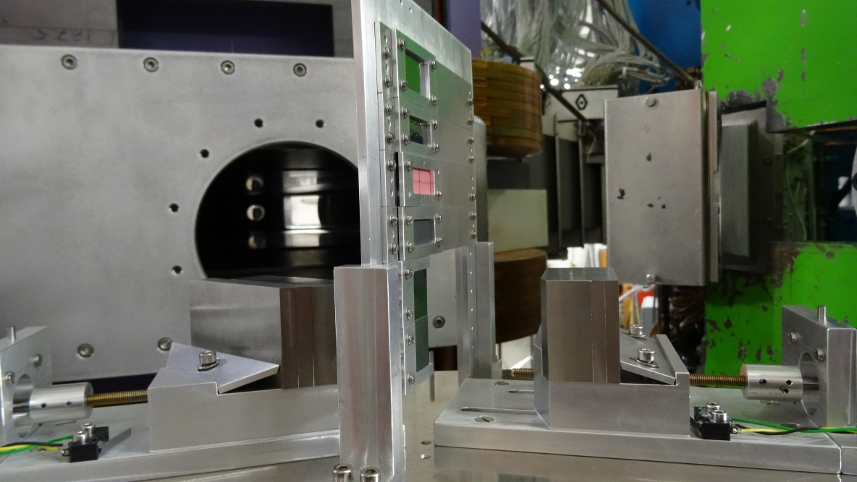
Decay region collimation
tungsten absorber
beam
beam
tungsten absorber

Slide 26
Conclusions
For the first time high-resolution spectroscopy of pionic decays of Λ-hypernuclei was successfully performed
MAMI experiment gave access to ground-state mass of one hyperisotope of the A = 4 system
One of the key experiments to get information about CSB:
Continuation with better control of systematics
with luminosity increase
How can we understand consistently the A = 4 and 7 systems?

Slide 27
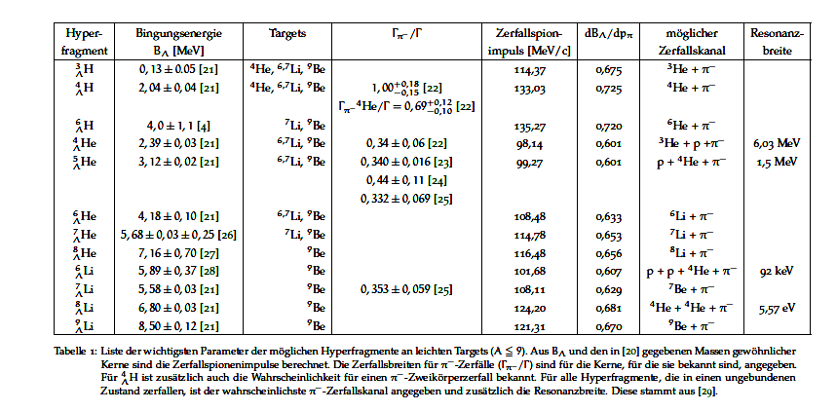
Light hyperisotopes

