Slide 1
(New) Results from FINUDA
Workshop on
Perspectives of high resolution
hypernuclear spectroscopy at JLab
Newport News, May 27-29, 2014
Tullio Bressani
Dipartimento di Fisica, Università di Torino (ITALY)
I.N.F.N. – Sezione di Torino (ITALY)

Slide 2
Outline
Introduction
A new analysis of the proton spectra from FINUDA
A (slightly) revised determination of Γ_{2N}
Determination of Γ_{p} for 8 Λ–Hypernuclei (p-shell)
Conclusions & what next?

Slide 3
Introduction (a brief reminder of the observables in Weak Decay of Λ–Hypernuclei)
MWD
NMWD
usually the Γ’s are given in units of Γ_{Λ},
for a correct comparison
of different Hypernuclei

Slide 4
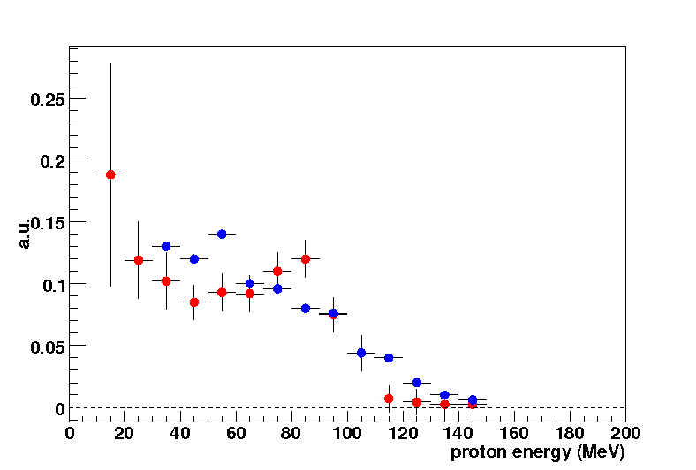
Introduction (cont’d)
Γ_{NMWD} very interesting (only tool to study the weak reaction ΛN → NN) but…
very difficult to measure since:
to identify Hypernuclei in their g.s.
to measure neutron and proton spectra in coincidence
Final State Interaction!!!
Following pioneering experiments (AGS, KEK) precise data from SKS (KEK) inclusive proton and neutron spectra for ⁵He_{Λ}, ¹²C_{Λ}, ⁸⁹Y_{Λ}:
FINUDA data followed for ⁵He_{Λ}, ⁷Li_{Λ}, ¹²C_{Λ}
⁵He_{Λ} spectra roughly agree
¹²C_{Λ} spectra in strong disagreement (bump at 80 MeV in FINUDA data, monotonic decrease in KEK ones)
Strong motivation for measuring proton spectra
for NMWD of ⁹Be_{Λ}, ¹¹B_{Λ}, ¹³C_{Λ}, ¹⁵N_{Λ} and ¹⁶O_{Λ}
low detection threshold = 15 MeV, ΔE = 1.6 MeV FWHM at 80 MeV
15 MeV threshold !
FINUDA NPA 804 (2008) 151
KEK E462/E508
PLB 597 (2004) 249

Slide 5
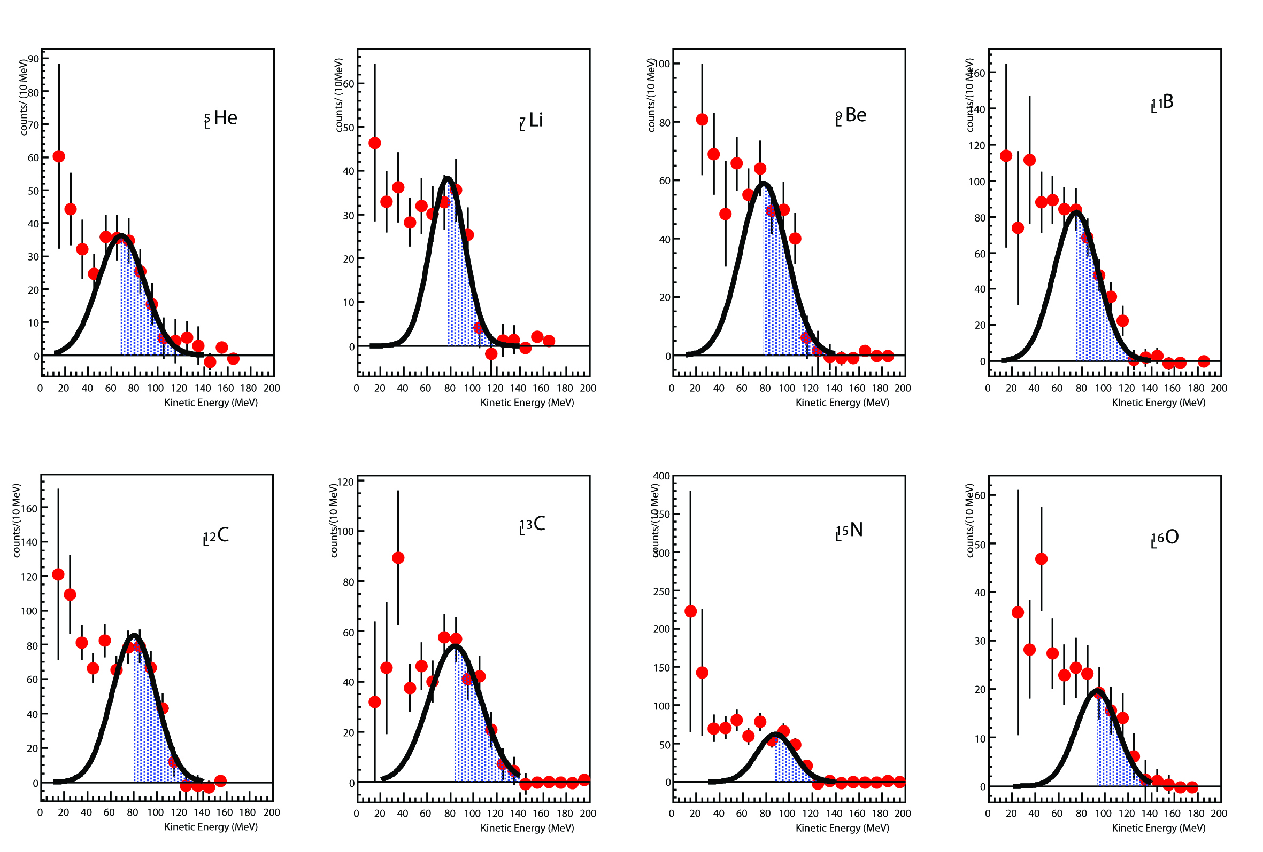
Introduction (cont’d)
M. Agnello et al., PLB 685 (2010) 247.

Slide 6
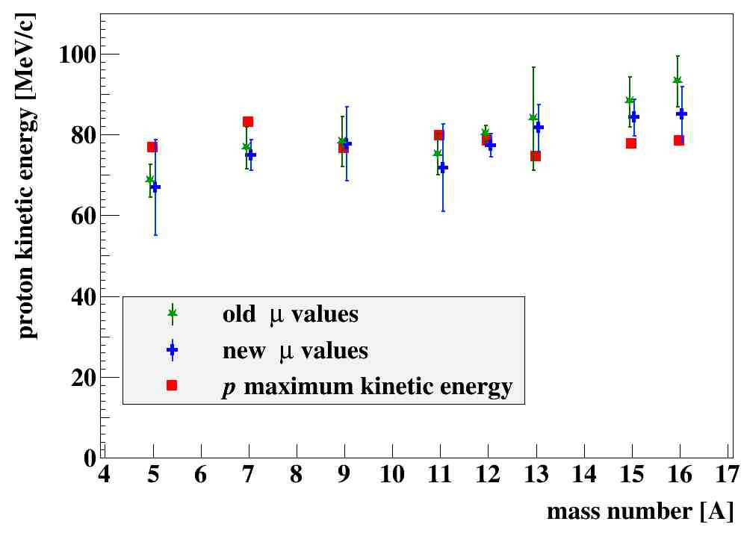
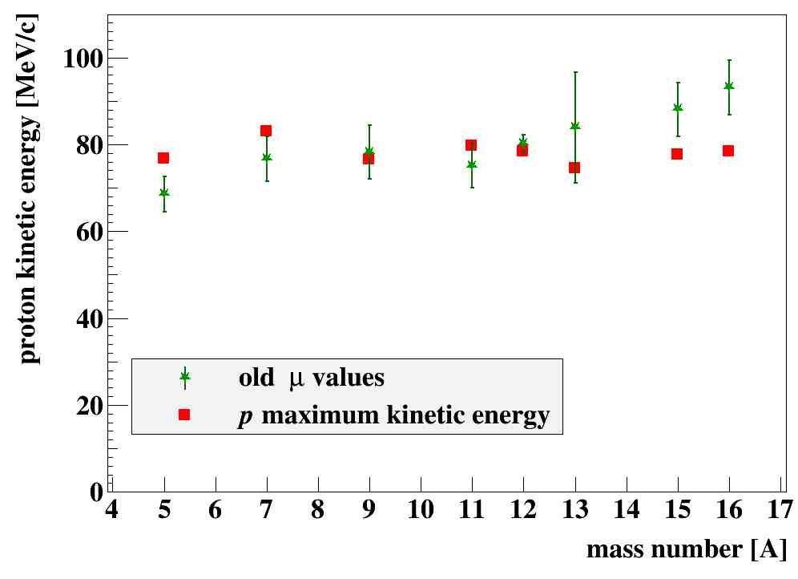
New analysis of the FINUDA proton spectra (cont’d)
fits to Gaussians of experimental proton spectra starting from 80 MeV,
with free centers (μ), widths and areas
disagreement of values of μ from whose expected from exact Q-values,
b-to-b kinematics and no-recoil of the residual nucleus, for ¹³C_{Λ} and, especially,
¹⁵N_{Λ} and ¹⁶O_{Λ}
M. Agnello et al., PLB 685 (2010) 247.

Slide 7
New analysis of the FINUDA proton spectra
Trials of improving the fits by lowering the starting points for the fits to 50, 60 and 70 MeV
Better value of χ²/n = 1.33 when choosing the start at 70 MeV

Slide 8
New analysis of the FINUDA proton spectra (cont’d)

Slide 9
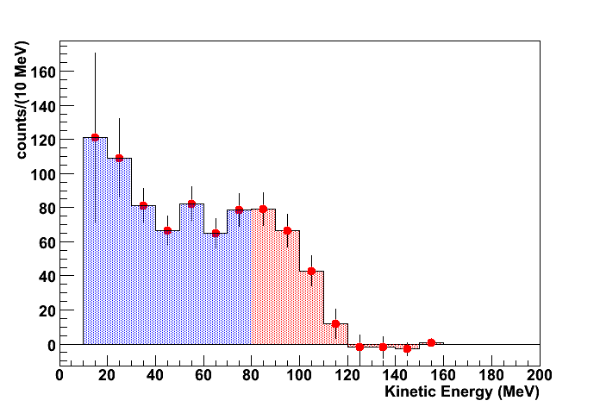
(Slightly) Revised determination of Γ_{2N}
The values of μ were used to divide the full area of the proton spectra into two regions,
A_{low} and A_{high.}
It was shown that from the expression:
A_{low}
A_{high}
the ratio Γ_{2N}/Γ_{p} can be obtained
(under the assumption that it is constant in the range A = 5 ÷ 16).
It was found:
Γ_{2N}/Γ_{p} = 0.43 ± 0.25 (Γ_{2N}/Γ_{NMWD} = 0.21 ± 0.10)
With the new values we find
Γ_{2N}/Γ_{p} = 0.50 ± 0.24 (Γ_{2N}/Γ_{NMWD} = 0.25 ± 0.12)
compatible with the previous one, within the errors.

Slide 10
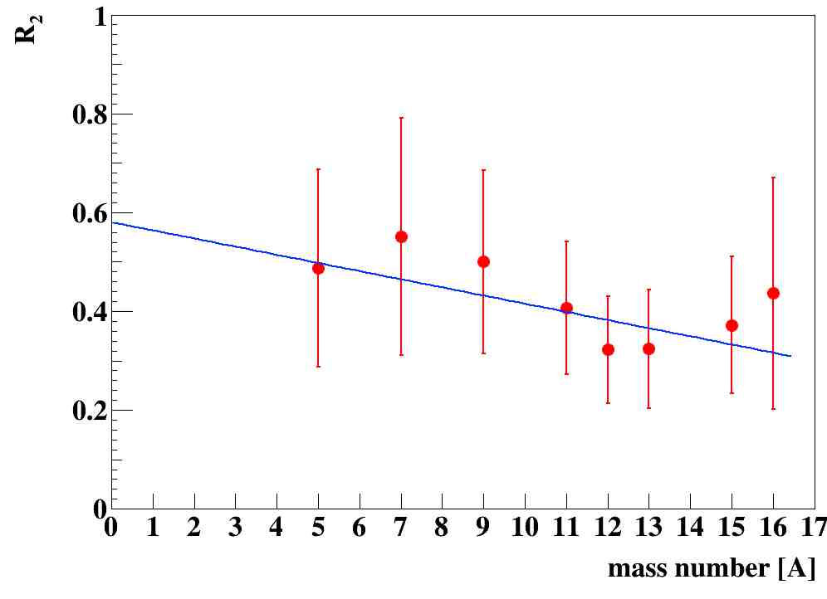
(Slightly) Revised determination of Γ_{2N} (cont’d)
Subsequently a more precise determination of Γ_{2N}/Γ_{p} was obtained,
by considering the (n,p) coincidence.
We defined the ratio

Slide 11
(Slightly) Revised determination of Γ_{2N} (cont’d)
and we found:
With the new μ values, we got:
fully compatible with the previous one, within the errors.

Slide 12
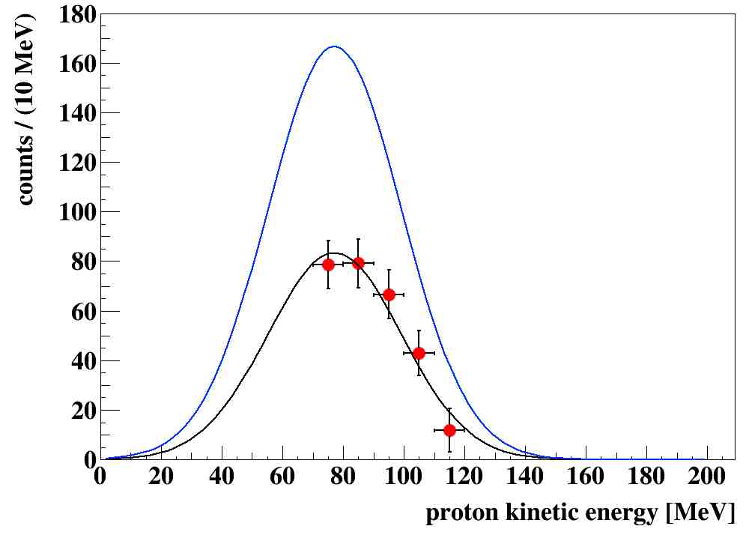
First determination of Γ_{p} for 8 Hypernuclei
Some information exists in the proton spectra, but
how it is possible to extract the “true” number of protons from NMWD.
Spectra are severely distorted by several FSI effects
At least 3 effects:
Number of primary proton from NMWD decreased by FSI
In a given region of the spectrum increase due to the FSI not only of higher energy protons, but of neutron as well
Quantum mechanical interference effect
In the upper part of the experimental spectrum b) and c) are negligible.
How to calculate a) without INC models, but only from experimental data?

Slide 13
First determination of Γ_{p} for 8 Hypernuclei (cont’d)
where α accounts for FSI
protons lost
on the basis of Γ’s experimental values from FINUDA and KEK
Γ_{2N}/Γ_{p} = 0.36 ± 0.14, Γ_{n}/Γ_{p} = 0.45 ± 0.10 (⁵He_{Λ}),
Γ_{n}/Γ_{p} = 0.51 ± 0.15 (¹²C_{Λ}), we got:
Γ_{p}/Γ_{Λ} = 0.223 ± 0.032 (⁵He_{Λ})
Γ_{p}/Γ_{Λ} = 0.494 ± 0.060 (¹²C_{Λ})
it is then possible to determine
α₅(5) = 1.154 ± 0.263
α₁₂(12) = 2.483 ± 0.463
under the hypothesis of a linear scaling with A:
α₅(12) = 1.035 ± 0.193 α₅ = 1.076 ± 0.156
α₁₂(5) = 2.770 ± 0.632 α₁₂ = 2.583 ± 0.373
general expression:
α(A) = (0.215 ± 0.031)A
preliminary

Slide 14
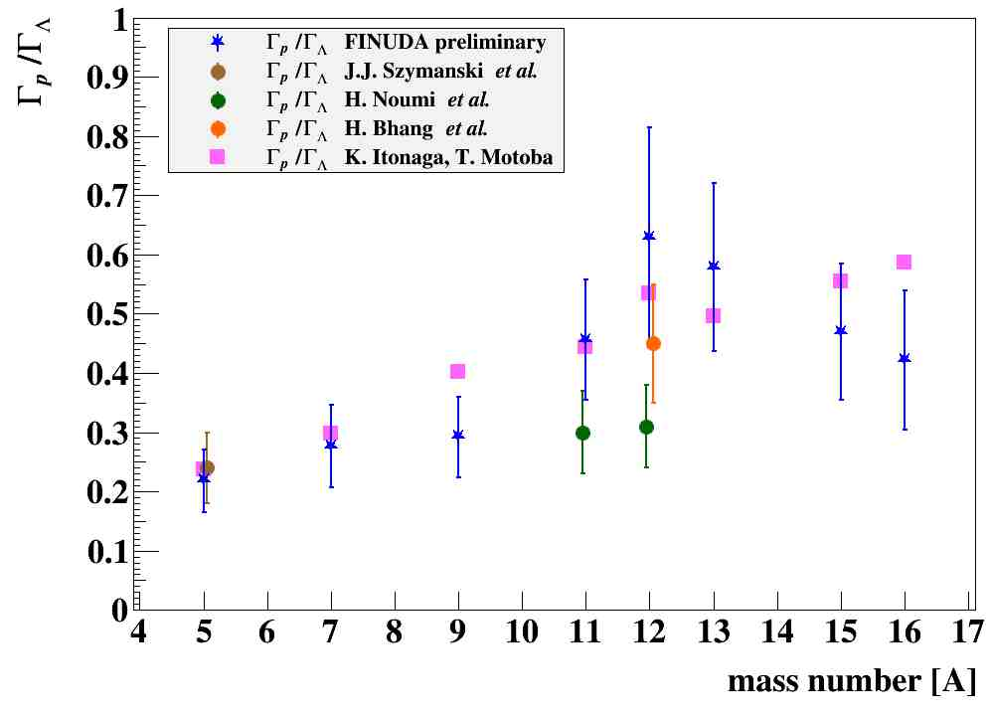
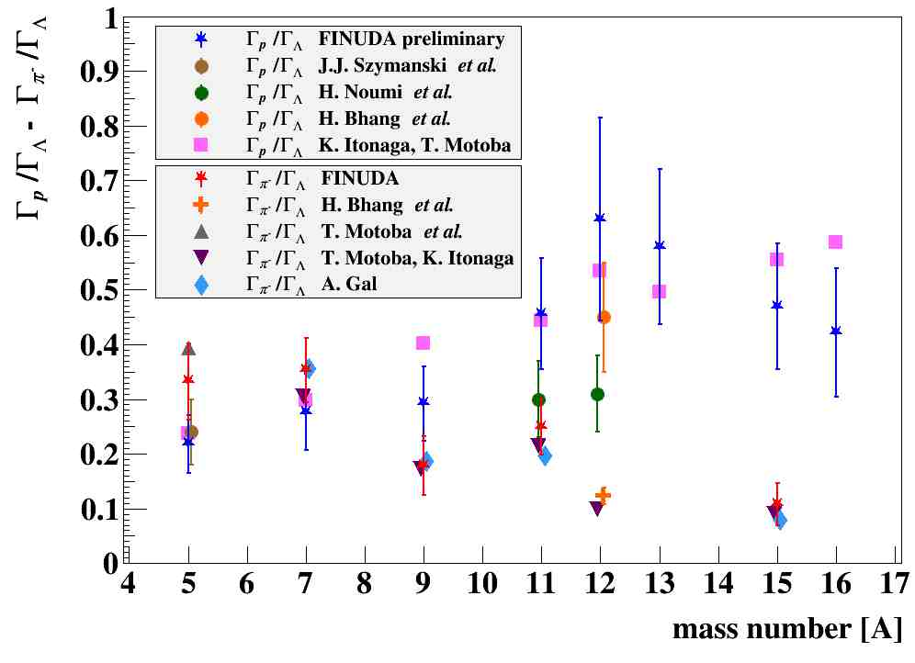
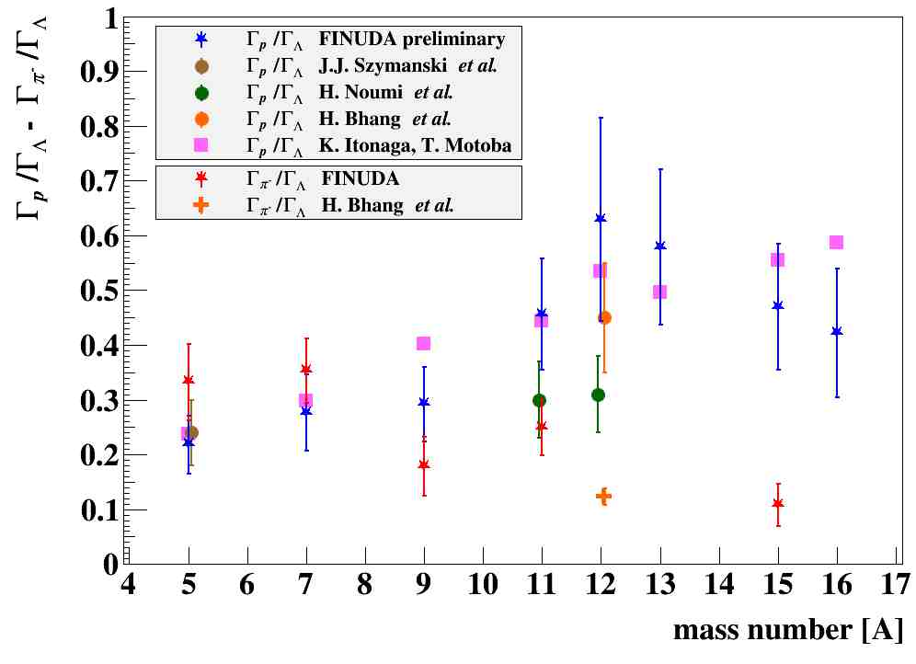
First determination of Γ_{p} for 8 Hypernuclei (cont’d)
K. Itonaga, T. Motoba, Progr. Theor. Phys. Suppl. 185 (2010) 252.
K. Itonaga, T. Motoba, Progr. Theor. Phys. Suppl. 185 (2010) 252.
K. Itonaga, T. Motoba, Progr. Theor. Phys. Suppl. 185 (2010) 252.
T. Motoba, K. Itonaga, Progr. Theor. Phys. Suppl. 117 (1994) 477.
T. Motoba et al., NPA 534 (1991) 597.
A. Gal, NPA 828 (2009) 72.
J.J. Szymansky et al., PRC 43 (1991) 849.
J.J. Szymansky et al., PRC 43 (1991) 849.
J.J. Szymansky et al., PRC 43 (1991) 849.
H. Noumi et al., PRC 534 (1995) 2936.
H. Noumi et al., PRC 534 (1995) 2936.
H. Noumi et al., PRC 534 (1995) 2936.
H. Bhang et al., JKPS 59 (2011) 1461.
H. Bhang et al., JKPS 59 (2011) 1461.
H. Bhang et al., JKPS 59 (2011) 1461.
M. Agnello et al., PLB 681 (2009) 139.
M. Agnello et al., PLB 681 (2009) 139.

Slide 15
First determination of Γ_{p} for 8 Hypernuclei (cont’d)
Remarks:
experimental data agree with the latest calculations by Itonaga & Motoba,
(even though the errors are quite large…)
First experimental verification of the complementary between MWD and NMWD,
at least for charged channels
K. Itonaga, T. Motoba, Progr. Theor. Phys. Suppl. 185 (2010) 252.

Slide 16
Conclusions & what next?
Good, qualitative agreement between expectations and experimental results
What about the “flag” of Hypernuclear Physics (ΛN → NN Weak Decay)?
Following the present amount of data, matrices of Γ’s for selected Hypernuclei at good precision (5-10%) must be performed. Theoretical guidance is needed
J-PARC is probably the best place for achieving such a goal (large production of Hypernuclei)
JLab, thank to its unprecedented records of resolution, may be essential for solving some particular puzzles in WD of Hypernuclei
Example:
τ_{Hyp} for ³H_{Λ}: recent experiments (STAR, ALICE, HypHi) reported very low values (≈ 180 ps) compared to previous, existing data (emulsions)
impossible to use ³H targets at J-PARC for production of ³H_{Λ}.
Possible at JLab: e⁻ + ³He → ³H_{Λ} + e′ + K⁺

Slide 17
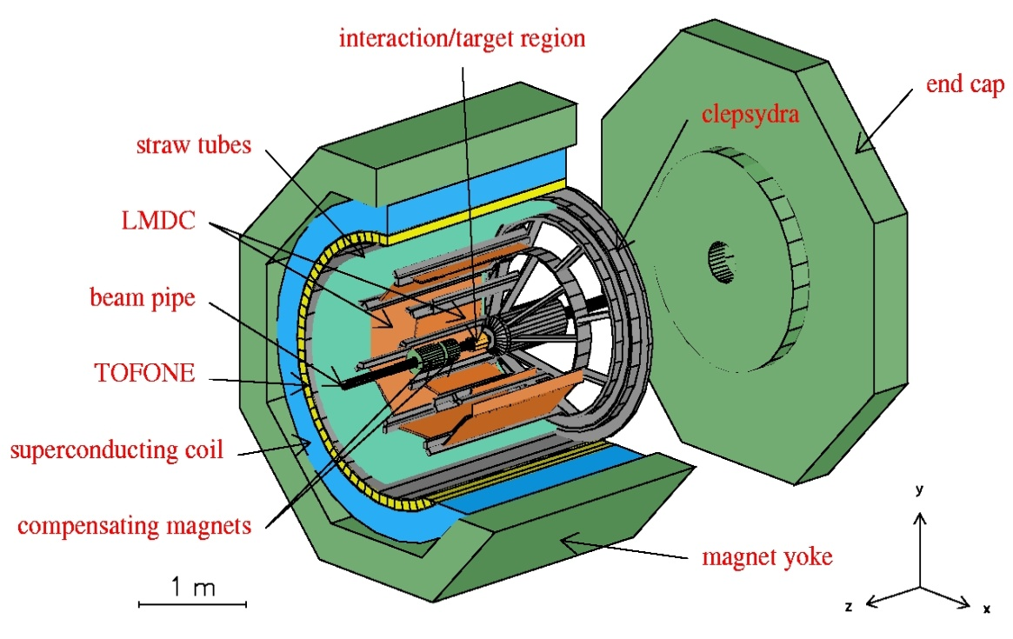
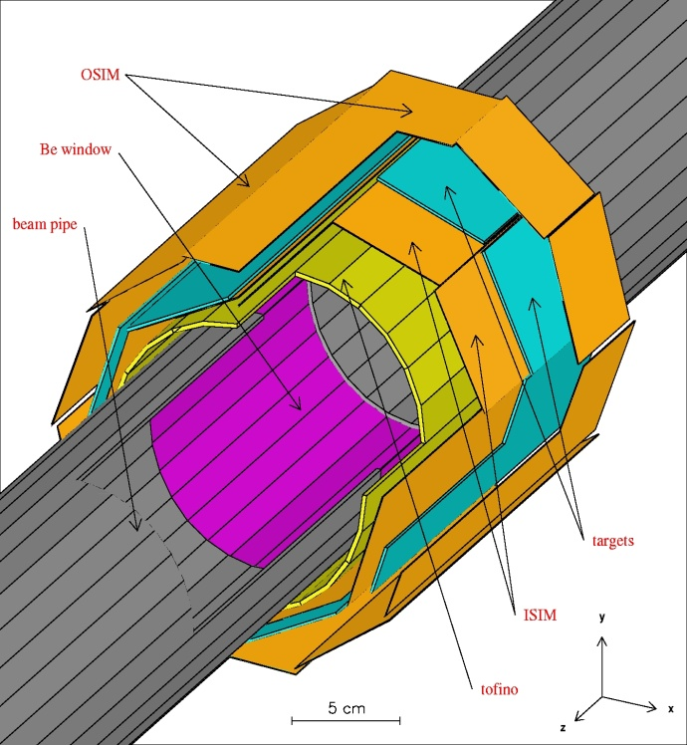
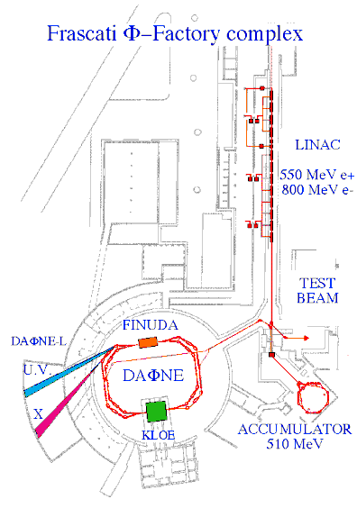
FINUDA @ DAΦNE
OSIM
Be window
beam pipe
energy | 510 MeV
luminosity | 5 10³² cm⁻² s⁻¹
σ_{x} (rms) | 2.11 mm
σ_{y} (rms) | 0.021 mm
σ_{z} (rms) | 35 mm
bunch length | 30 mm
crossing angle | 12.5 mrad
frequency (max) | 368.25 MHz
bunch/ring | up to 120
part./bunch | 8.9 10¹⁰
current/ring | 5.2 A (max)
targets
ISIM
tofino

Slide 18
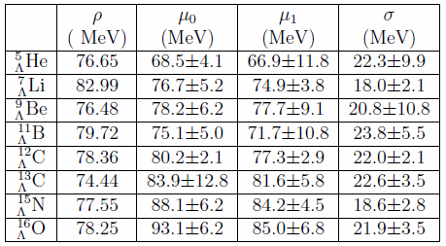
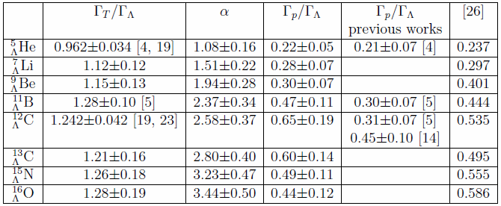

Slide 19
New analysis of the FINUDA proton spectra (cont’d)
M. Agnello et al., PLB 685 (2010) 247.

Slide 20
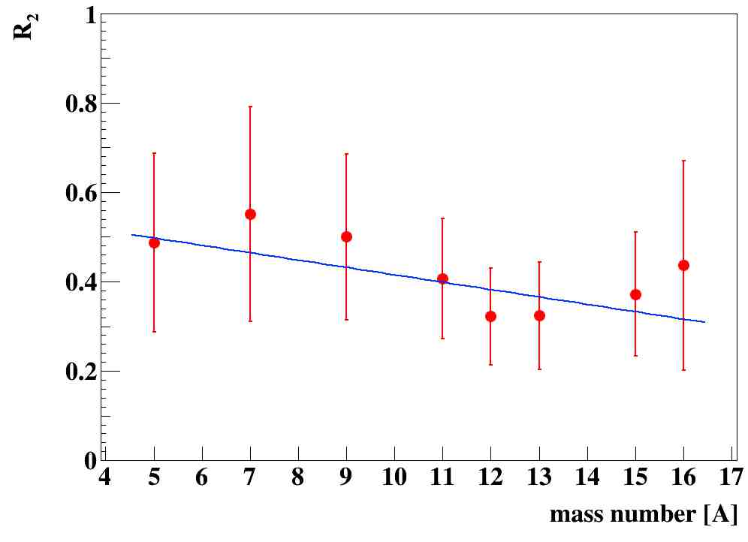
(Slightly) Revised determination of Γ_{2N} (cont’d)
With the new μ values, the behavior of R₂(A) looks like:
FINUDA Collaboration and G. Garbarino., PLB 701 (2011) 556.
systematics: all p-shell

Slide 21
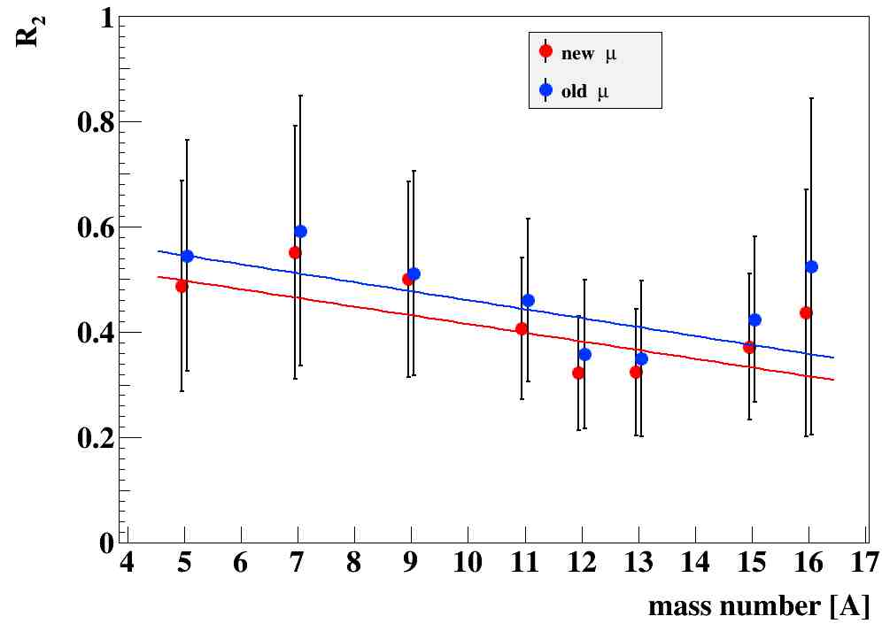
(Slightly) Revised determination of Γ_{2N} (cont’d)
With the new μ values, the behavior of R₂(A) looks like:
FINUDA Collaboration and G. Garbarino., PLB 701 (2011) 556.

Slide 22
First determination of Γ_{p} for 8 Hypernuclei (cont’d)
Γ_{p}/Γ_{Λ} was measured at KEK-PS for ¹²C: 0.45 ± 0.10
From FINUDA data
α₁₂ = 2.017 ± 0.448 (50% of primary protons lost by FSI)
We may find another determination of α and α₅ by using the experimental values of Γ_{n}/Γ_{p}
Γ_{2N}/Γ_{p} (FINUDA determination) and then Γ_{p}/Γ_{Λ} = 0.2304 ± 0.0315 for ⁵He_{Λ}
Then α₅ = 1.192 ± 0.270
Scaling linearly from α₁₂ : α₅ = 0.840 ± 0.187
Weighted average: α₅ = 1.016 ± 0.164
General formula for Hypernucleus A: α_{A} = (1.016 ± 0.164) (A/5)
preliminary

Slide 23
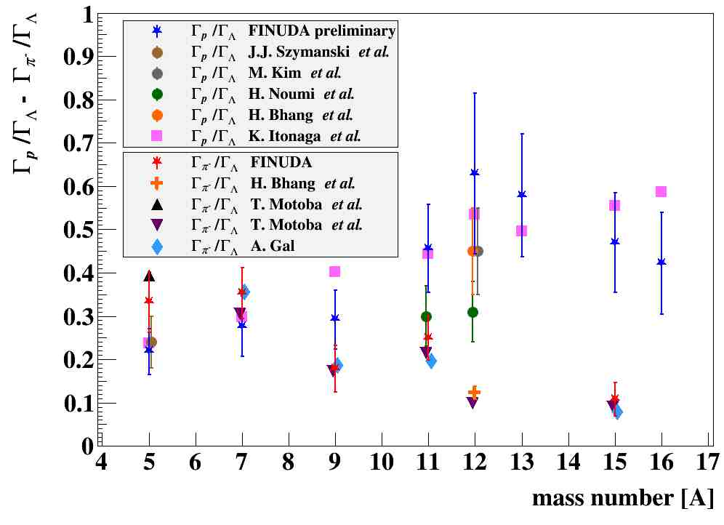
K. Itonaga, T. Motoba, Progr. Theor. Phys. Suppl. 185 (2010) 252.
T. Motoba, K. Itonaga, Progr. Theor. Phys. Suppl. 117 (1994) 477.
T. Motoba et al., NPA 534 (1991) 597.
A. Gal, NPA 828 (2009) 72.
M. Agnello et al., PLB 681 (2009) 139.
J.J. Szymansky et al., PRC 43 (1991) 849
H. Noumi et al., PRC 534 (1995) 2936.
M. Kim et al., PRL 103 (2009) 182502
H. Bhang et al., JKPS 59 (2011) 1461.

