Slide 1
Deformations of sd and pf shell Λ hypernuclei with antisymmetrized molecular dynamics
Masahiro Isaka (RIKEN)

Slide 2
Grand challenges of hypernuclear physics
2 body interaction between baryons (nucleon, hyperon)
hyperon-nucleon (YN)
hyperon-hyperon (YY)
Addition of hyperon(s) shows us new features of nuclear structure
Ex.) Structure change by hyperon(s)
No Pauli exclusion between N and Y
YN interaction is different from NN
Interaction: To understand baryon-baryon interaction
A major issue in hypernuclear physics
Structure: To understand many-body system of nucleons and hyperon
“Hyperon as an impurity in nuclei”
+
Λ hypernucleus
Normal nucleus
As an impurity
Today’s talk: deformation of Λ hypernuclei
Notes:
In my understanding, the grand challenges of hypernuclear physics are two fold.
The first is to understand interactions among baryons.
Another is to understand properties of many-body system composed of nucleons and hyperon.
In our study, we focus on the latter purpose.
Addition of a hyperon shows us new features of nuclear structure.
For example, nuclear structure may change by adding a Lambda particle.
Especially, we regard Lambda as an impurity in hypernuclei.
Today, we will focus on deformation of Lambda hypernuclei and their unique structure caused by L.

Slide 3
Recent achievements in (hyper)nuclear physics
Knowledge of ΛN effective interaction
Study of light (s, p-shell) Λ hypernuclei
Accurate solution of few-body problems ^{[1]}
ΛN G-matrix effective interactions ^{[2]}
Increases of experimental information ^{[3]}
Development of theoretical models
Through the study of unstable nuclei
Ex.: Antisymmetrized Molecular Dynamics (AMD)^{[4]}
AMD can describe dynamical changes of various structure
No assumption on clustering and deformation
Recent developments enable us to study structure of Λ hypernuclei
[1] E. Hiyama, NPA 805 (2008), 190c, [2] Y. Yamamoto, et al., PTP Suppl. 117 (1994), 361.,
[3] O. Hashimoto and H. Tamura, PPNP 57 (2006), 564., [4] Y. Kanada-En’yo et al., PTP 93 (1995), 115.
Notes:
So far hypernuclear studies are concentrated in s- and p-shell Lambda hypernuclei.
Through these studies, our knowledge of Lambda-nucleon interaction has been increased.
In nuclear structure study, theoretical model that describes nucleon many-body system has been developed in last two decades.
Antisymmetrized molecular dynamics is one of such models, and we adopted it in the present study.
Based on these recent developments, it becomes possible to study structure changes and structure of L hypernuclei itself.

Slide 4
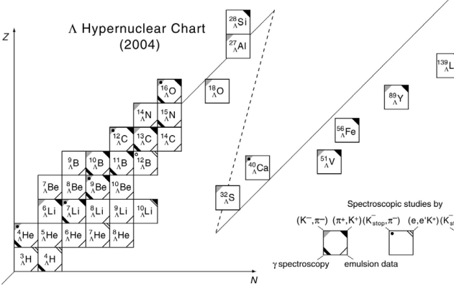
Toward heavier and exotic Λ hypernuclei
Experiments at JLab and J-PARC etc.
Hypernuclear chart will be extended to heavier regions
“Structure of hypernuclei”
Coexistence of
shell and cluster
p-sd shell region
sd-pf shell region
Today’s talk:
Various deformations
Light Λ hypernuclei
Coexistence of deformations
n-rich region
Developed cluster
Exotic cluster
⁴¹_{Λ}Ca, ³⁹_{Λ}Ar
Triaxial deformation
+
²⁵_{Λ}Mg
Taken from O. Hashimoto and H. Tamura, PPNP 57(2006),564.
Notes:
In near future, the forthcoming experiments at Jlab and J-PARC enables us to access heavier Lambda hypernuclei such as sd- and pf-shell Lambda hypernuclei.
From the point of view of structure, light Lambda hypernuclei have well developed cluster structure.
On the other hand, sd- and pf-shell normal nuclei with the mass number larger than about 20 have various deformations within the small excitation energies.
Therefore, it is expected that the corresponding deformed states will appear in sd- and pf-shell Lambda hypernuclei.
In this talk, we focus on coexistence of deformations and triaxial deformation.

Slide 5
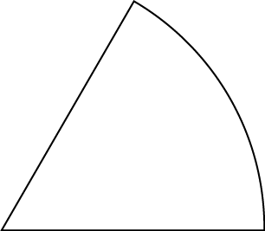
Deformation of nuclei
Many nuclei manifests various quadrupole deformation
Most of them are prolate or oblate deformed (axially symmetric)
(parameterized by quadrupole deformation parameters β and γ )
60◦
Middle
Long
γ
Short
γ = 60◦
γ ≈ 30◦
Triaxial
Oblate
(axially symmetric)
Today’s talk:
Various deformations
0
0◦
β
Coexistence of deformations
β = 0
γ = 0◦
Spherical
⁴¹_{Λ}Ca, ³⁹_{Λ}Ar
Prolate
Triaxial deformation
(axially symmetric)
+
²⁵_{Λ}Mg
Notes:
Here I will briefly explain nuclear deformations and how to describe it.
It is well known that many nuclei are deformed.
Their deformation are described by the quadrupole deformation parameters beta and gamma.
Here I am showing the beta-gamma plane.
Most of nuclei are prolately or oblately deformed.
Namely axially symmetric deformation.
On this plane, prolate and oblate deformations correspond to the regions with gamma = 0deg and 60 deg, respectively.
Triaxial deformation corresponds to the middle region with about 30deg of gamma.

Slide 6
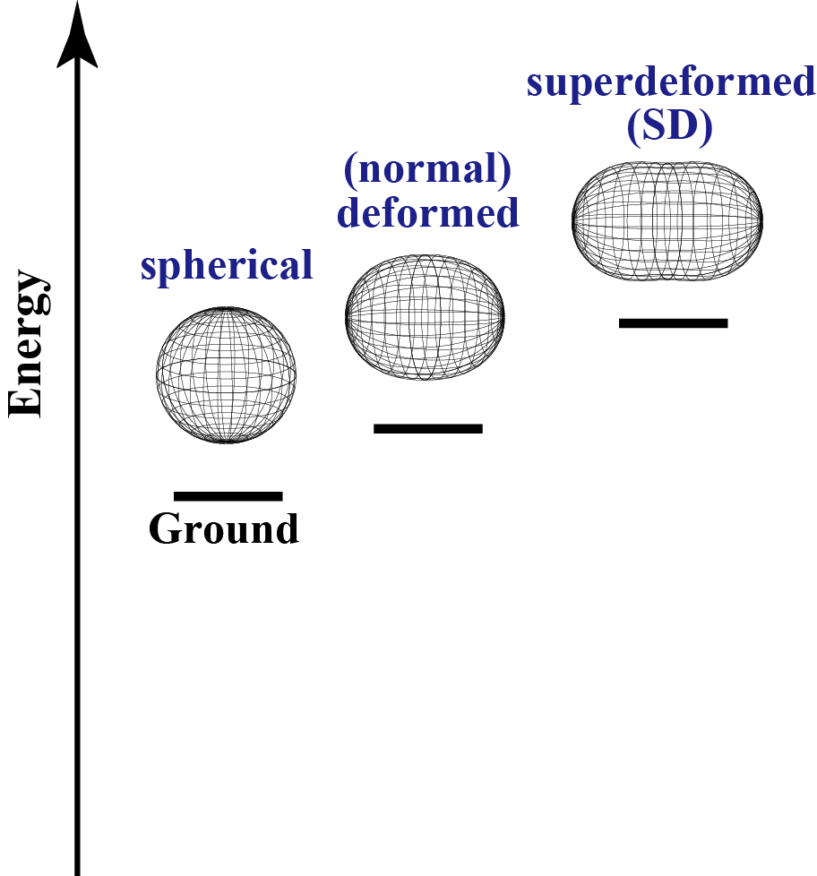
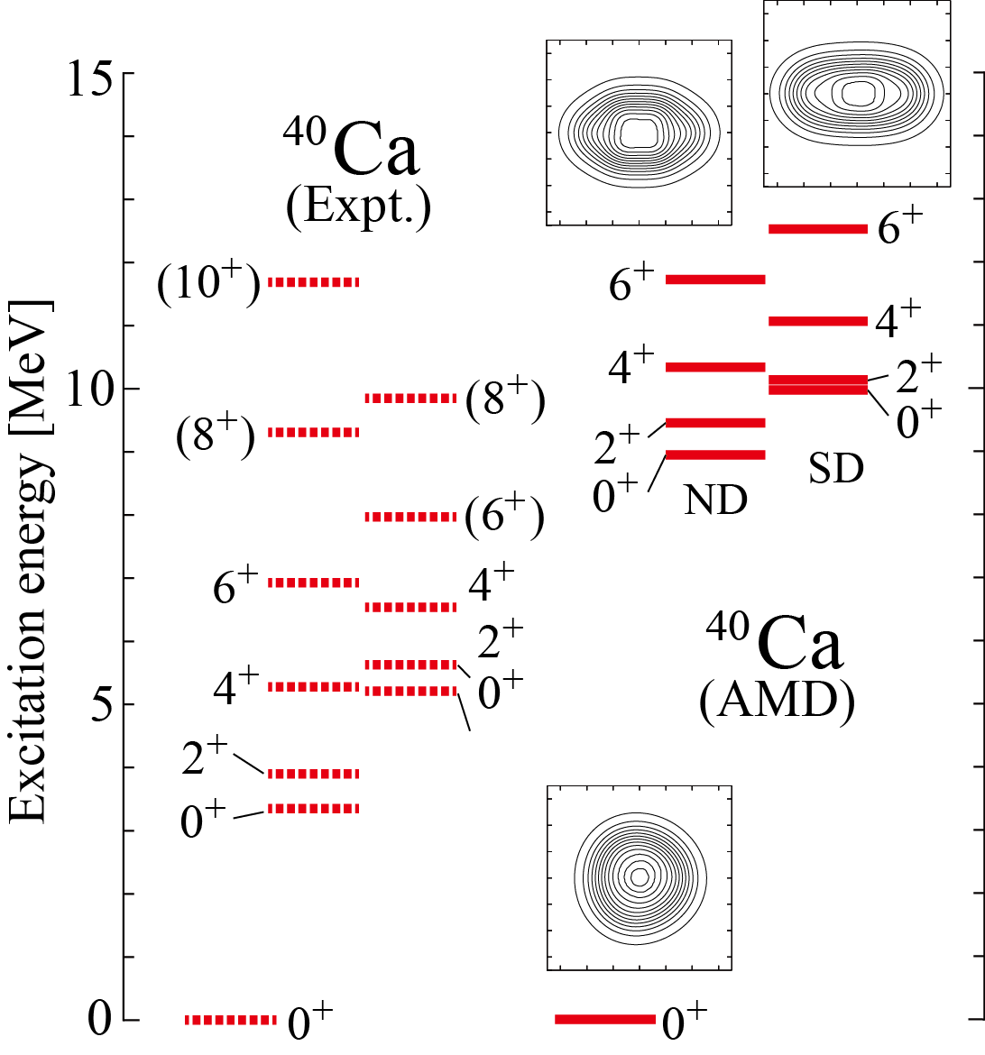
Topic 1: Coexistence of deformations in A≃40 nuclei
Different deformations could appear in the excited states in a nucleus
2
1
β ≃ 0.6
β ≃ 0.3
β ≃ 0.0
Superdeformed(SD) states
With 1:2 axis ratio of deformation
Observed in ⁴⁰Ca, ³⁶Ar and ⁴⁴Ti
Svensson et al., PRC63, 061301R (2001).
Ideguchi, et al., PRL 87, 222501 (2001)
O’Leary, et al., PRC61, 064314 (2000).
Various deformed states also appear in ³⁸Ar
If a Λ particle is added, what is happen?
Notes:
First, I will briefly mention about coexistence of deformations.
It is discussed that various deformations coexist within the small excitation energy in a nucleus with mass number around 40.
For example, Ca40 have deformed excited states such as superdeformed states, while the ground state is spherical due to the double closed shell structure.
Superdeformation is a largely deformed states with the 1:2 axis ratio of nuclear deformation.
In Ca40, existence of SD states were confirmed as well as normal deformed states.
Such coexistence aspects are expected to appear in the other nuclei. Ar38 is one of the candidates with the coexistence.
Here naïve question is, “if a L particle is added to these states with different deformations, what’s happen?”

Slide 7
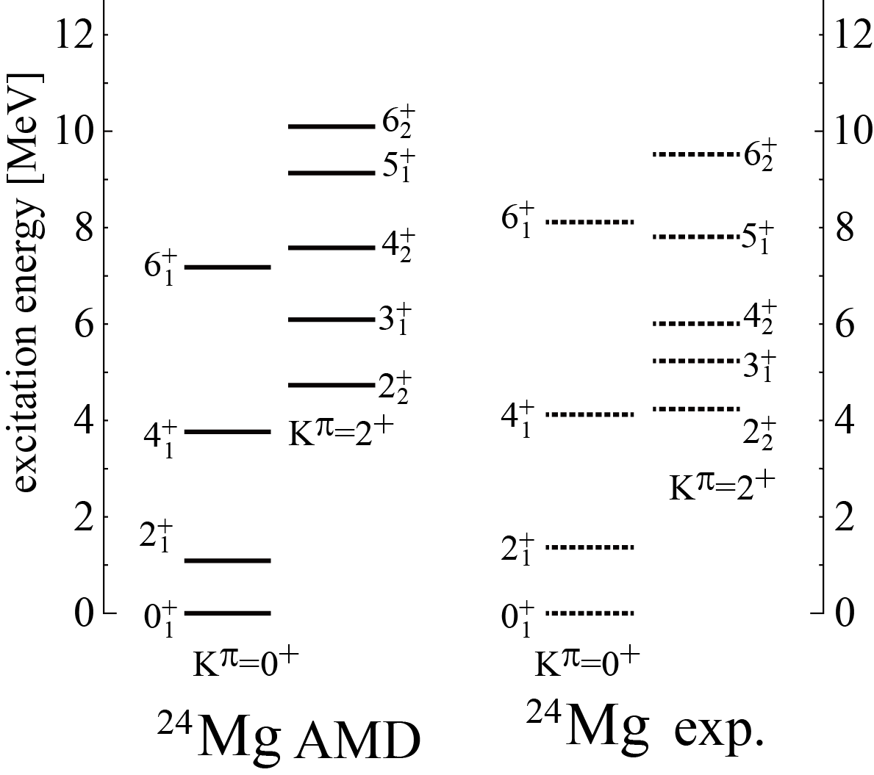
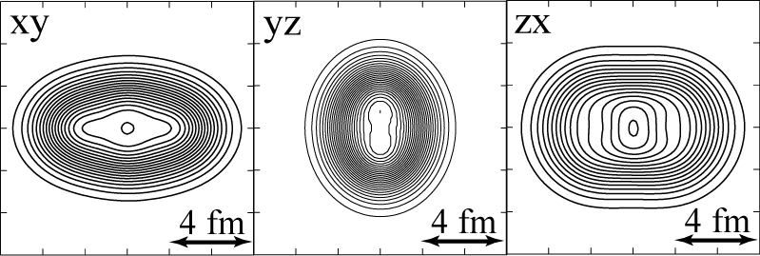
Topic 2: Triaxial deformation of nuclei
Triaxial deformed nuclei are not many, Mg isotopes are the candidates
Largely deformed
Low-lying 2nd 2⁺ indicates having the triaxial deformation
Ex.) ²⁴Mg
Identification of triaxial deformation is not easy
Our task: to identify triaxial deformation of ²⁴Mg by using Λ
Notes:
Another example of deformation in this mass region is triaxial deformation.
Mg isotopes are candidates of triaxially deformed nuclei.
For example, Mg24 is considered to have triaxial deformation due to the existence of low-lying 2nd 2+ state, because a rigid rotor model with triaxial deformation so called Davydov model predict the low-lying 2nd 2+ state.
However, its identification is not easy.
Here our task is to identify nuclear triaxial deformation of the core nucleus by using a L as a probe.

Slide 8
Theoretical Framework: HyperAMD
M.Isaka, et al., PRC83(2011) 044323
M. Isaka, et al., PRC83(2011) 054304
We extended the AMD to hypernuclei
HyperAMD (Antisymmetrized Molecular Dynamics for hypernuclei)
Hamiltonian
NN：Gogny D1S
ΛN：YNG interactions (NF, NSC97f)
Wave function
Nucleon part：Slater determinant
Spatial part of single particle w.f. is
described as Gaussian packet
Single-particle w.f. of Λ hyperon:
Superposition of Gaussian packets
Total w.f.：
Notes:
Here I will briefly explain the frame work.
We have extended AMD model to hypernuclei.
The Hamiltonian is given as follows.
We used the Gogny D1S force as NN effective interaction.
And we adopted the YNG interaction as Lambda-N effective interaction.
The wave function is defined as follows.
The nuclear part is defined by the Slater determinant.
The spatial part of single particle wave function is described by the Gaussian wave packets.
The single particle wave function of Lambda particle is defined by the superposition of the Gaussian wave packets.
Finally, the total wave function becomes as follows.

Slide 9
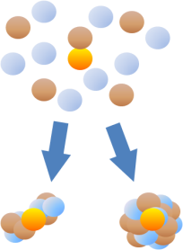
Theoretical Framework: HyperAMD
M.Isaka, et al., PRC83(2011) 044323
M. Isaka, et al., PRC83(2011) 054304
Procedure of the calculation
Variational Calculation
Imaginary time development method
Variational parameters:
Λ
Initial w.f.: randomly generated
Energy variation
Λ
Λ
Various deformations
and/or cluster structure

Slide 10
Theoretical Framework: HyperAMD
M.Isaka, et al., PRC83(2011) 044323
M. Isaka, et al., PRC83(2011) 054304
Procedure of the calculation
Variational Calculation
Imaginary time development method
Variational parameters:
Angular Momentum Projection
Generator Coordinate Method(GCM)
Superposition of the w.f. with different configuration
Diagonalization of and

Slide 11
1. Coexistence of deformations
Addition of Λ
1:2
SD
spherical
Various deformations
What is the difference in responses among deformations ?
Examples: ⁴¹_{Λ}Ca, ³⁹_{Λ}Ar
M.Isaka, M. Kimura, E. Hiyama, H. Sagawa, and Y. Yamamoto

Slide 12
Topic 1: Coexistence of deformations in A≃40 nuclei
Different deformations could appear in the excited states in a nucleus
Superdeformed(SD) states
With 1:2 axis ratio of deformation
Observed in ⁴⁰Ca, ³⁶Ar and ⁴⁴Ti
Svensson et al., PRC63, 061301R (2001).
Ideguchi, et al., PRL 87, 222501 (2001)
O’Leary, et al., PRC61, 064314 (2000).
Various deformed states also appear in ³⁸Ar
If a Λ particle is added, what is happen?
Notes:
Here we will focus on coexistence of deformations.
And we will discuss what is happen with Lambda in these deformed states.
As mentioned before, the coexistence of deformations is expected in Ar38.
Today, we focus on structure of Ar39L.

Slide 13
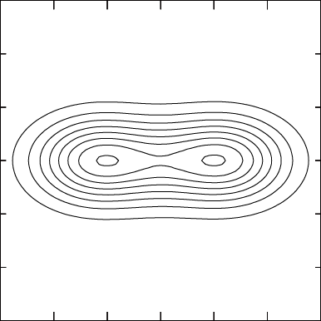
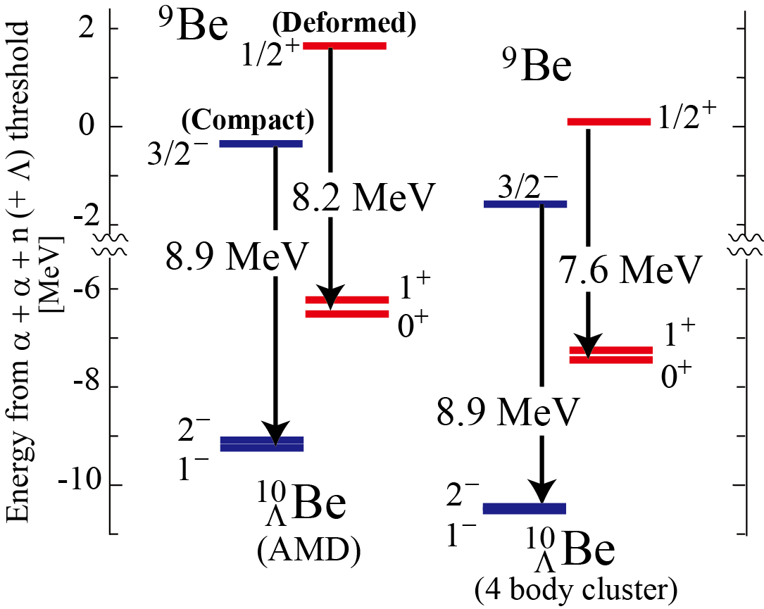
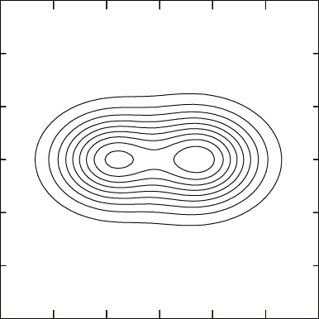
B_{Λ} with different deformations(structures)
Λ binging energy (B_{Λ}) in light Λ hypernuclei with cluster structure
Λ coupled to the compact state is more deeply bound
Changes of excitation spectra
1/2⁺
Ex.) ¹⁰_{Λ}Be (α + α + n + Λ)
β = 1.02
3/2⁻
⁸Be(0⁺) + n(s-orbit)
β = 0.73
⁸Be(0⁺) + n(p-orbit)
4 body calc.:
E. Hiyama and Y. Yamamoto,
PTP128(2012)105
Notes:
In p-shell Lambda hypernculei, it is discussed that the difference of deformations causes the difference of Lambda binding energy.
For example, in Be10L, difference of the Lambda binding energy BLmd was predicted.
Here BLmd is defined as the energy gain from the core state.
In Be9, the first excited state 1/2+ is deformed due to the well developed 2 alpha + n structure, while the ground state is more compact.
If a Lambda particle is added to these states, BLmd in the compact GS is larger than that in the deformed 1/2+ state.

Slide 14
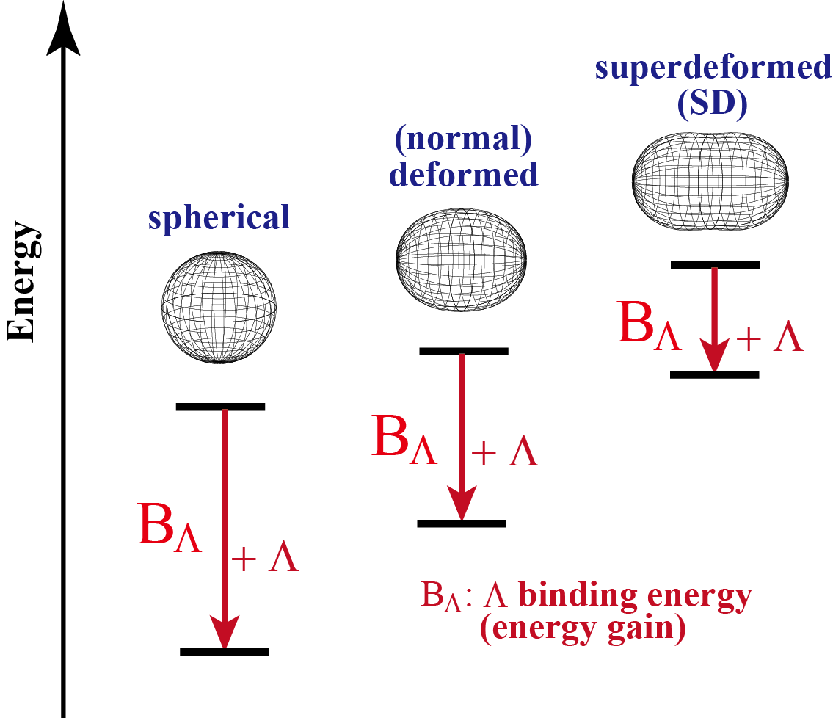
Expected difference of B_{Λ}
Which is the largest?
?
Examples: ⁴¹_{Λ}Ca (⁴⁰Ca + Λ), ³⁹_{Λ}Ar (³⁸Ar + Λ)
Purposes: to reveal difference of B_{Λ} depending on deformations
Notes:
Therefore, we can naively expected that BLmd is different depending on the deformations.
Especially, we expect BLmd in the largely deformed state is smaller than the spherical ground state.
In the present study, our purpose is to reveal the difference of BLmd and to reveal whether a Lambda particle modify these deformations.

Slide 15
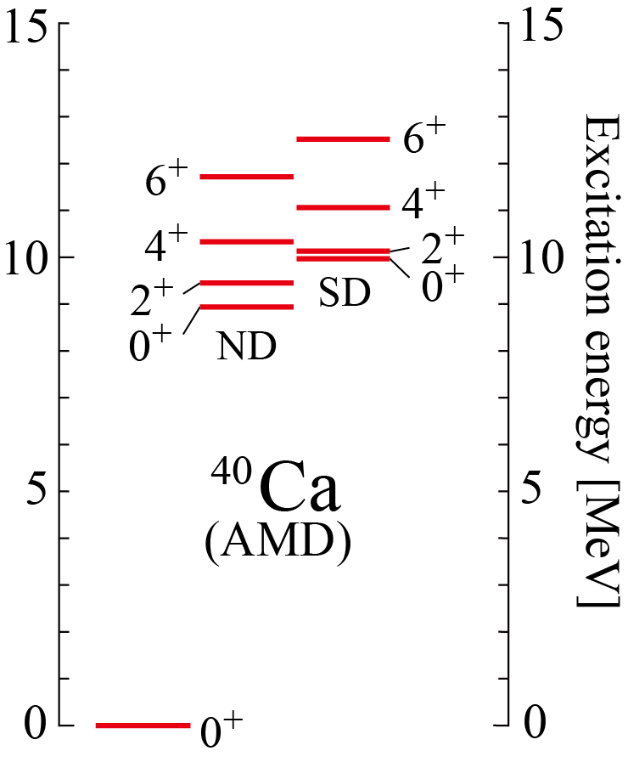
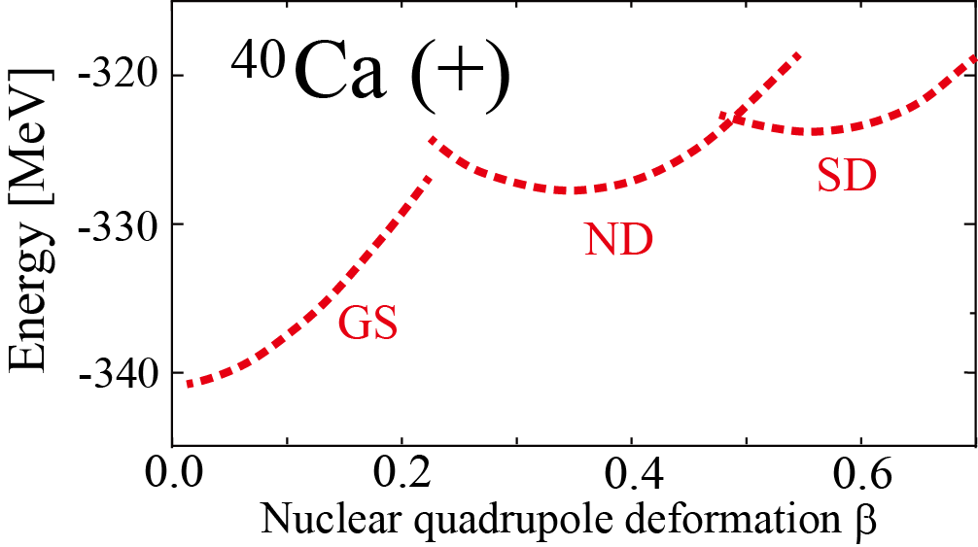
ND and SD states of ⁴⁰Ca
Ground, normal deformed and superdeformed states are obtained
Core nucleus ⁴⁰Ca:
basically same calculation as
Y. Taniguchi, et al., PRC 76, 044317 (2007)
1:2
spherical
β = 0.0
β ≃ 0.6
Notes:
First, I will briefly show you the results on the core nucleus Ca40.
We performed energy variation for Ca40, the core nucleus, basically following the Taniguchi-san’s work.
The left panel shows the energy curves as a function of nuclear quadrupole deformation parameter beta.
It shows that three energy minima are obtained, and they correspond to ground, ND and SD states of Ca40.

Slide 16
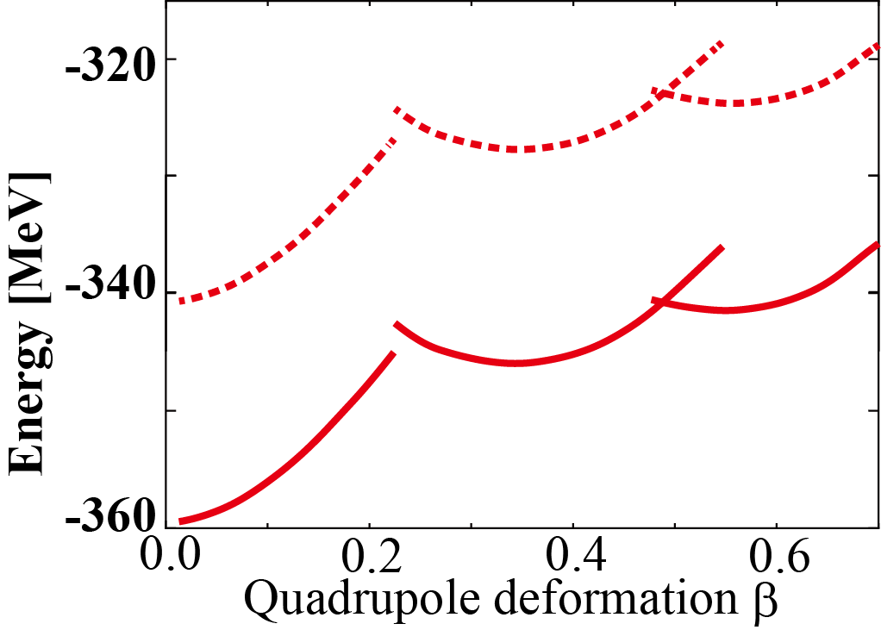
Results: Energy curves of ⁴¹_{Λ}Ca as a function of β
⁴¹Ca
“GS⊗Λ”, “ND ⊗Λ ” and “SD ⊗Λ ” curves are obtained
_{Λ}
SD states will appear in ⁴¹_{Λ}Ca
Energy (local) minima are almost unchanged
⁴⁰Ca
⁴⁰Ca
⁴⁰Ca
⁴⁰Ca(Pos)
spherical
SD
superdeformed
ND
GS
⁴¹Ca
_{Λ}
⁴¹Ca
⁴⁰Ca(Pos)⊗Λ(s)
_{Λ}
⁴¹Ca
_{Λ}
superdeformed
spherical
Notes:
By adding a Lambda particle to Ca40, we obtained the corresponding energy curves with three global and local energy minima. The curve corresponding to Ca41L is shown with solid curve. And open circles show the place of the energy minima.
We also show the density distributions at the minima corresponding to the ground and superdeformed states.
The contour lines show the density distribution of nucleons. The color plot shows the distributions of the Lambda hyperon.
From this figure, it is XXX変形の変化が小さい。

Slide 17
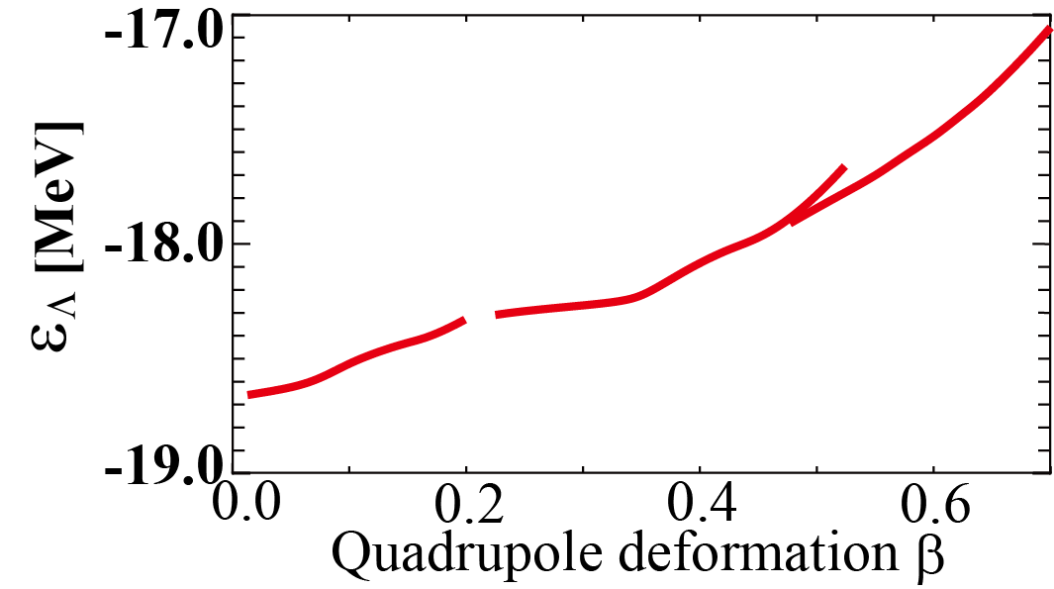
Results: Λ single particle energy
Definition:
General trend: ε_{Λ} changes within 1 - 2 MeV as β increases
Energy surface
Λ single particle energy
⁴⁰Ca
⁴⁰Ca(Pos)
⁴¹Ca
_{Λ}
ε_{Λ}
SD
ND
SD
ND
GS
GS
⁴⁰Ca(Pos)⊗Λ(s)
⁴⁰Ca(Pos)⊗Λ(s)
Notes:
To analyze how the binding energy of a Lambda hyperon changes depending on deformation, we calculate the Lambda single particle energy as a function of beta.
Here Lambda single particle energy epsilon_Lmd is defined as the energy difference between the energy curves.
And the resulting curve of Lmd single particle energy is shown in the right figure.
It shows that Lambda single particle energy becomes shallower as beta increases, and the energy change is within 2 MeV.

Slide 18
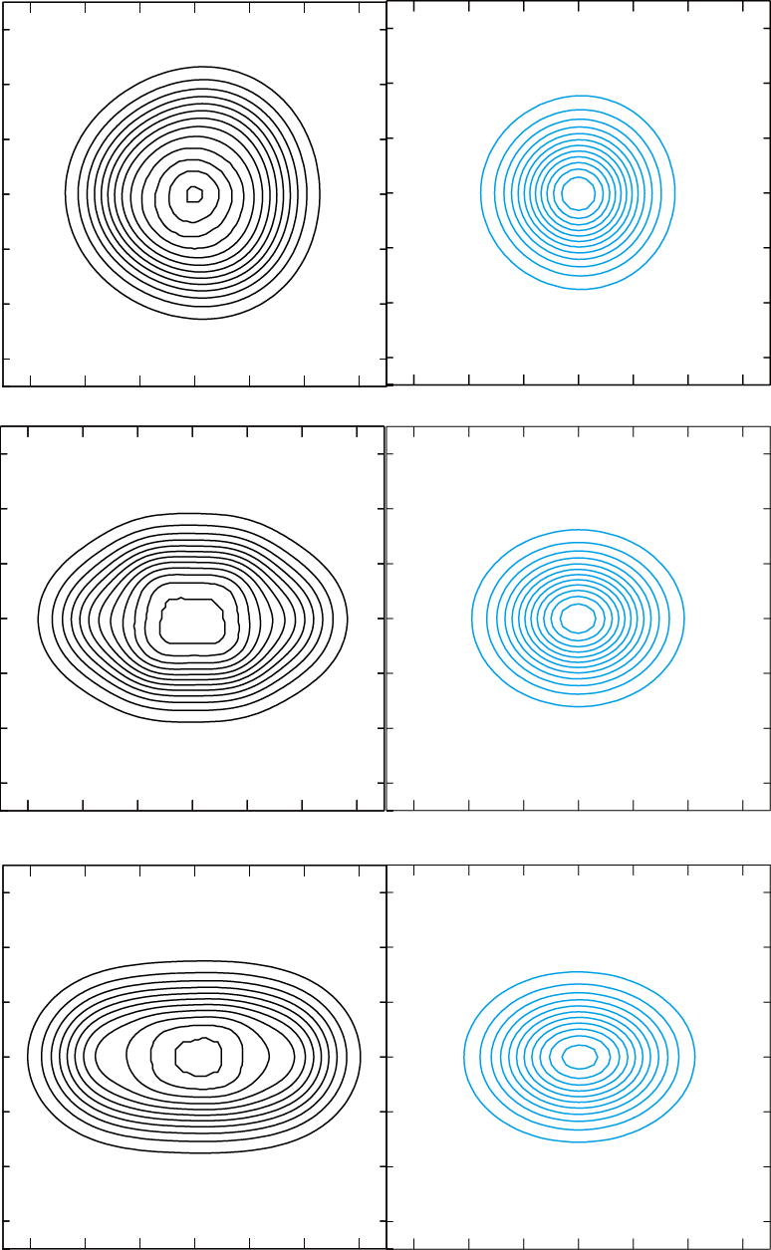
Results: Λ single particle energy
ε_{Λ} varies due to changes of spatial overlap between Λ and N
Deformation of Λ distribution is small, while nuclear part is deformed
matter
Λ
GS
β = 0.10
⁴¹Ca
_{Λ}
matter
Λ
ND
SD
GS
ND
⁴⁰Ca(Pos)⊗Λ(s)
β = 0.35
matter
Λ
SD
β = 0.58

Slide 19
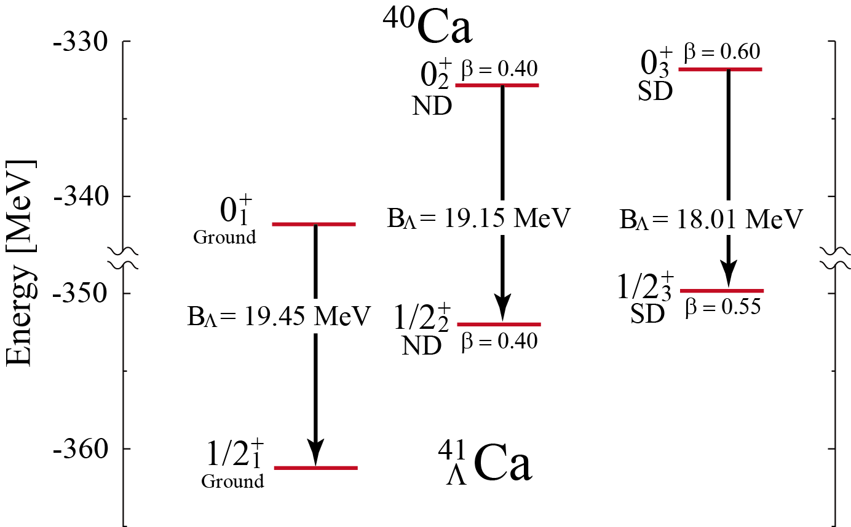
Results: Difference of Λ binding energy B_{Λ}
ND and SD states are predicted in ⁴¹_{Λ}Ca
B_{Λ} is different among ground, ND and SD states
⁴⁰Ca
Largest
⁴¹Ca
Λ

Slide 20
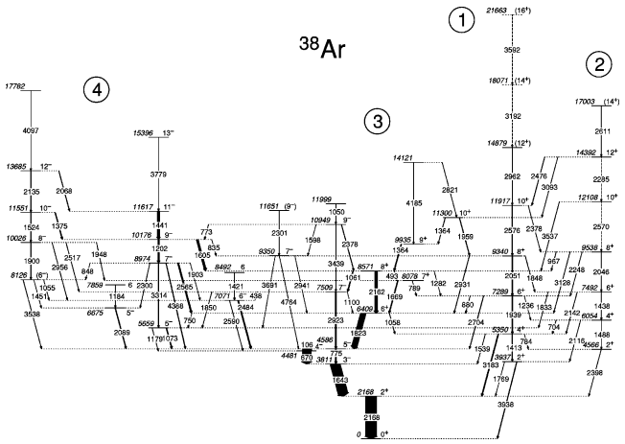
Many kinds of deformed states in ³⁸Ar
Several deformed rotational bands are observed
They have different deformations with different nucleon configurations
D. Rudolph, et al., Phys. Rev. C65. 034305 (2002)
Notes:
Today, we focus structure of Ar39L.
In the core nucleus Ar38, several deformed rotational bands are observed by experiments.
Here is an observed excitation spectra of Ar38.
Many excited states were observed. And some of them are classified into rotational bands.
It is considered that these bands have different beta and gamma deformations with different nucleon configurations.

Slide 21
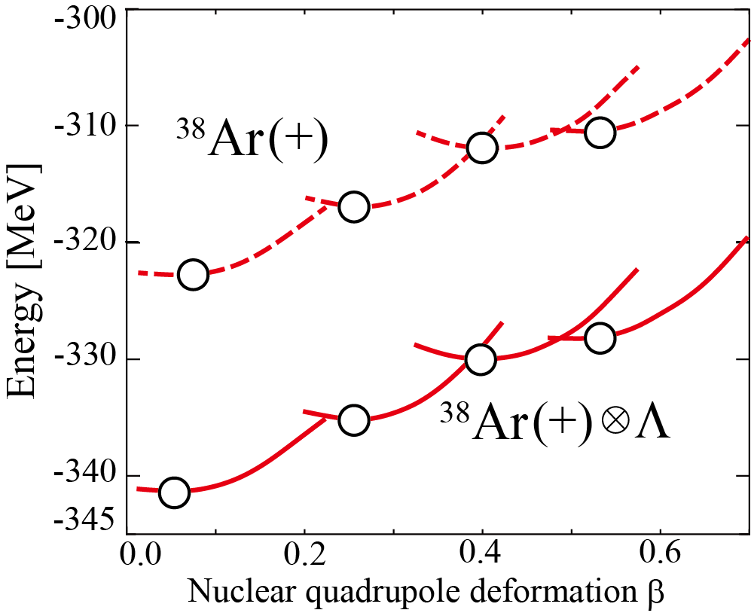
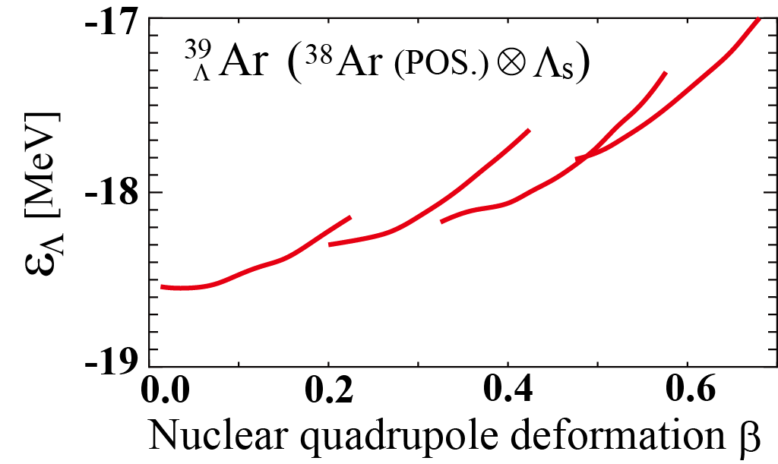
Results: Energy curve and Λ single particle energy
³⁸Ar
Energy (local) minima with different deformations appear
³⁹Ar
Energy (local) minima are almost unchanged
ε_{Λ} changes within 1 - 2 MeV as β increases
_{Λ}
Energy curve
Λ single particle energy ε_{Λ}
Notes:
By adding a

Slide 22
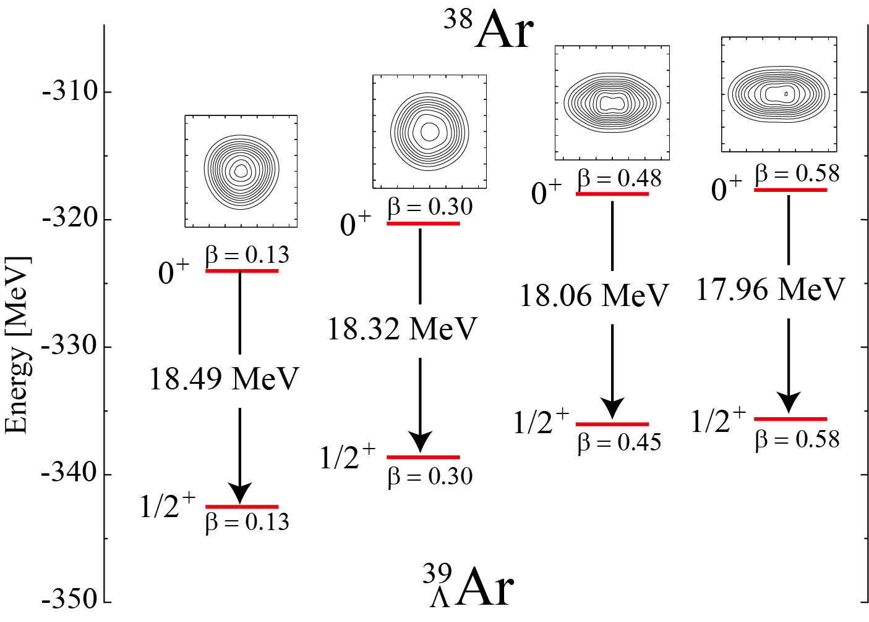
Results: Difference of B_{Λ}
Excited staes with different deformations are predicted in ³⁹_{Λ}Ar
B_{Λ} is different depending on deformations and consistent with ε_{Λ}(β)

Slide 23
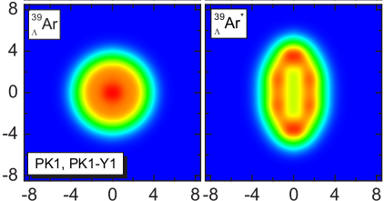
Other predictions of B_{Λ}
B_{Λ} is larger in the SD state in ³⁹_{Λ}Ar, etc.
Bing-Nan Lu, et al., Phys. Rev. C89, 044307(2014)
Localization of nucleons makes Λ deformed
Large spatial overlap between N and Λ
Large B_{Λ}
Large B_{Λ} in the SD state will give important information about localization
³⁸Ar
SD
ground
18.86 MeV
Matter density of ³⁹Ar
18.44 MeV
Λ
ground
SD
³⁹Ar
Λ
Notes:
XXX39ArLに直す。XXX

Slide 24
2. Triaxial deformation
To identify triaxial deformation by using Λ in p orbit
Examples: Mg
Based on
M.I., M. Kimura, A. Dote, and A. Ohnishi, PRC87, 021304(R) (2013)

Slide 25
Deformation of nuclei
Triaxial deformed nuclei are not many
Its identification is not easy
60◦
γ
Middle
γ = 60◦
Oblate
γ ≈ 30◦
Long
Short
Triaxial
0
0◦
Candidate: Mg isotope
β
γ = 0◦
Spherical
Prolate
“Λ in p orbit can be a probe to study nuclear (triaxial) deformation”

Slide 26
Triaxial deformation
If ²⁴Mg is triaxially deformed nuclei
p-states split into 3 different state
Triaxial deformation
Prolate deformation
cf. prolate deformation
Ex.) ⁹_{Λ}Be
Large overlap leads to deep binding
p orbit parallel to 2α (long axis)
Large overlap
Deeply bound
Middle
p orbit perpendicular to 2α (short axes)
Small overlap
Shallowly bound
Small overlap leads to shallow binding
Split corresponding to long/short axes
Notes:
In triaxial deformed nuclei, it is expected that the p-states split into three states with different spatial distribution of Lambda hyperon.
In axial deformed nuclei, there are two different axes, namely long and short axes.
In triaxially deformed nuclei, the length of three axes is different from each other.
Namely, there are long, middle, and short axes in triaxial deformed nuclei.
Therefore, the binding energy of the Lambda hyperon is different depending on the direction of each p-orbit, because the overlap between Lambda and nucleons are different for the p-orbits parallel to the long, middle, and short axes.

Slide 27
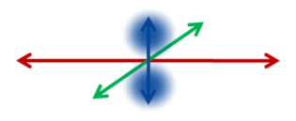
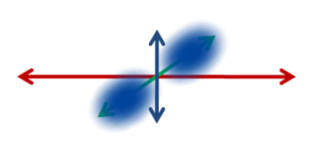
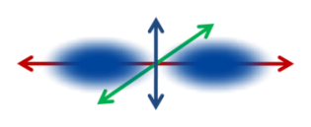
Triaxial deformation
If ²⁴Mg is triaxially deformed nuclei
p-states split into 3 different state
Triaxial deformation
Prolate deformation
²⁵_{Λ}Mg
Large overlap leads to deep binding
Excitation Energy
Split into 3 states?
Middle
²⁴Mg⊗Λ(p-orbit)
G.S.
²⁴Mg⊗Λ(s-orbit)
Small overlap leads to shallow binding
Observing the 3 different p-states is strong evidence of triaxial deformation
Our (first) task: To predict the level structure of the p-states in ²⁵_{Λ}Mg
Notes:
Therefore, we can naively expect that the p-states of Mg25L will spit into three different states.
By observing them, triaxial deformation of the Mg24 ground state will be confirmed by experiments directly.

Slide 28
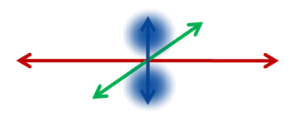
Results： Single particle energy of Λ hyperon
Λ single particle energy on (β, γ) plane
Single particle energy of Λ hyperon is different from each p state
This is due to the difference of overlap between Λ and nucleons
²⁵Mg (AMD, Λ in p orbit)
Λ
Lowest p state
2nd lowest p state
3rd lowest p state

Slide 29
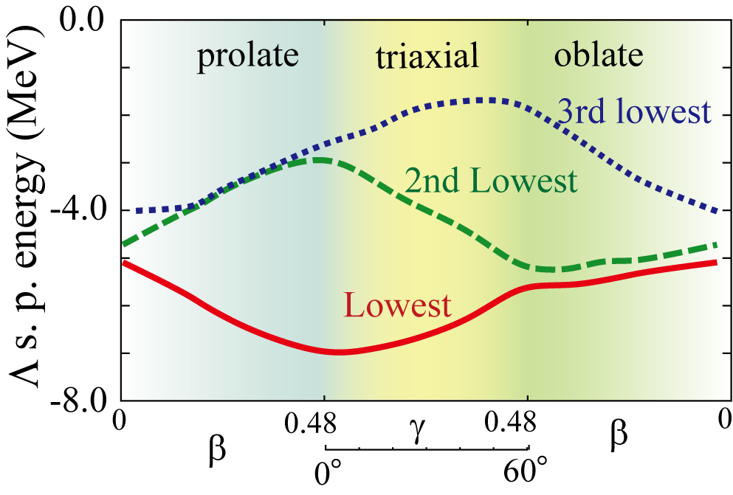
Results： Single particle energy of Λ hyperon ε_{Λ}
²⁵Mg (AMD)
Λ
3 p-states with different spatial distributions of Λ in p-orbit
Lowest
2nd Lowest
3rd Lowest
III
III
III
II
II
II
I
I
I
3rd lowest p state
(Parallel to short axis)
2nd lowest p state
(Parallel to middle axis)
I
II
III
Lowest p state
(Parallel to long axis)
Λ s. p. energy is different from each other with triaxial deformation

Slide 30
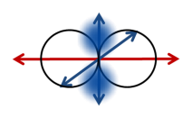
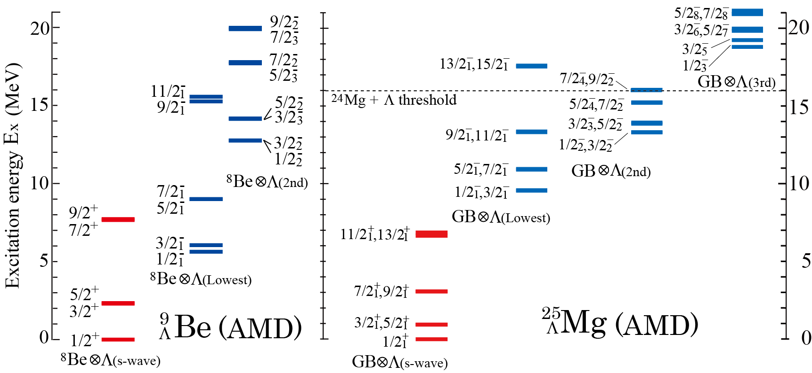
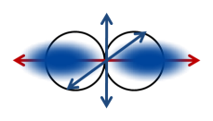
Results: Excitation spectra
3 bands are obtained by Λ hyperon in p-orbit
²⁴Mg⊗Λp(lowest), ²⁴Mg⊗Λp(2nd lowest), ²⁴Mg⊗Λp(3rd lowest)
Splitting of the p states
21
Λ
Ne +
Lowest threshold : in between 8.3 and 12.5 MeV
Λ

Slide 31
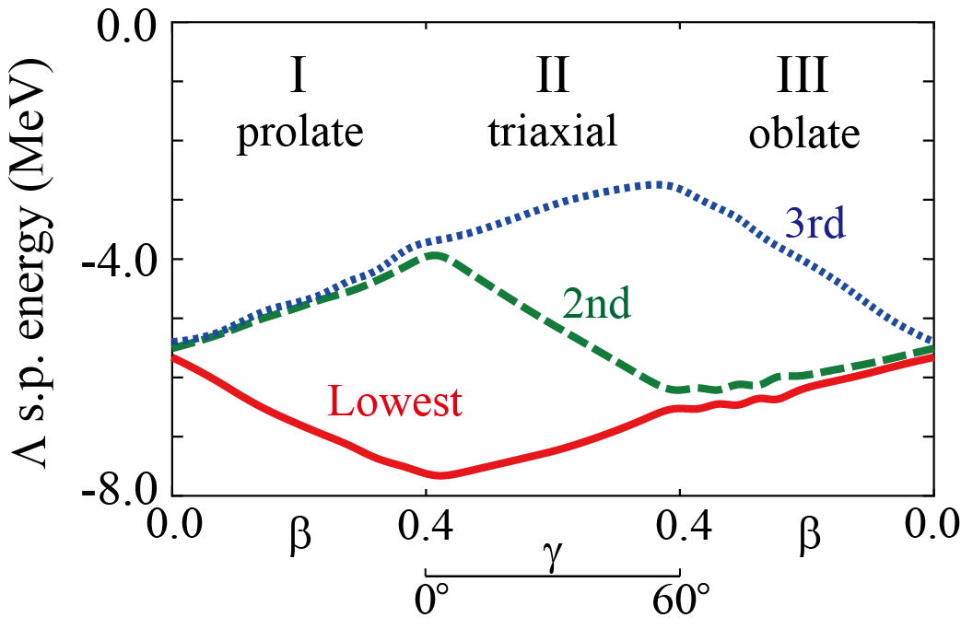
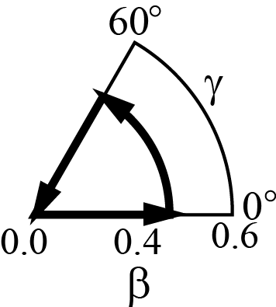
Triaxial deformation of ²⁶Mg: ²⁷_{Λ}Mg
Similar discussions can be possible in the other Mg isotopes
²⁶Mg (AMD)
²⁷_{Λ}Mg (AMD)
Energy surface (0⁺ state)

Slide 32
Summary
Summary
AMD + GCM was used to study deformations of sd-pf shell Λ hypernuclei
Λ added to various deformed states: ⁴¹_{Λ}Ca and ³⁹_{Λ}Ar
Various deformed states in Λ hypernuclei
Deformation is almost unchanged by Λ
B_{Λ} is different depending on deformations
Largest in the ground state
Smaller in the deformed state such as SD states
Λ as a probe to study triaxial deformation: ²⁵_{Λ}Mg
Λ in p-orbit generates three different p states in ²⁵_{Λ}Mg
This is due to the triaxial deformation of the core nucleus
Future plan
To predict the production cross sections
Comparison of B_{Λ} with cluster states: ¹³_{Λ}C (Hoyle + Λ)

Slide 34
Backup

Slide 35
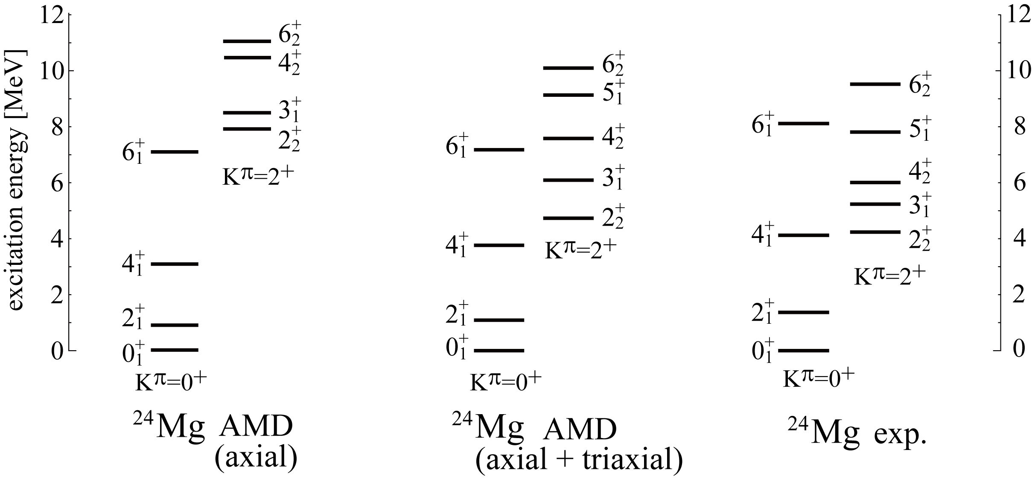
Structure of ²⁴Mg
Large deformation ・・・ Candidate of triaxial deformed nuclei
Excitation energy of K^{π}=2⁺ band depends on the triaxial deformation ^{[1,2]}
[1] M. Bender and P-H. Heenen, Phys. Rev. C78, 024309 (2008).
[2] M. Kimura, R. Yoshida and M.Isaka, Prog. Theor. Phys. 127 , 287(2011).

Slide 36
Structure of ²⁴Mg
Low lying K^{π}=2⁺ band: a sign of triaxial deformation
Excitation energy of K^{π}=2⁺ band depends on the triaxial deformation
M. Bender, P-H. Heenen, PRC78, 024309 (2008). , M. Kimura, R. Yoshida, M.I., PTP 127 , 287(2011).
Ex
Ex
Ex
K^{π} = 2⁺ band is rigid against the exclusion of the triaxial deformation
Does Λ particle change these two bands?

Slide 37
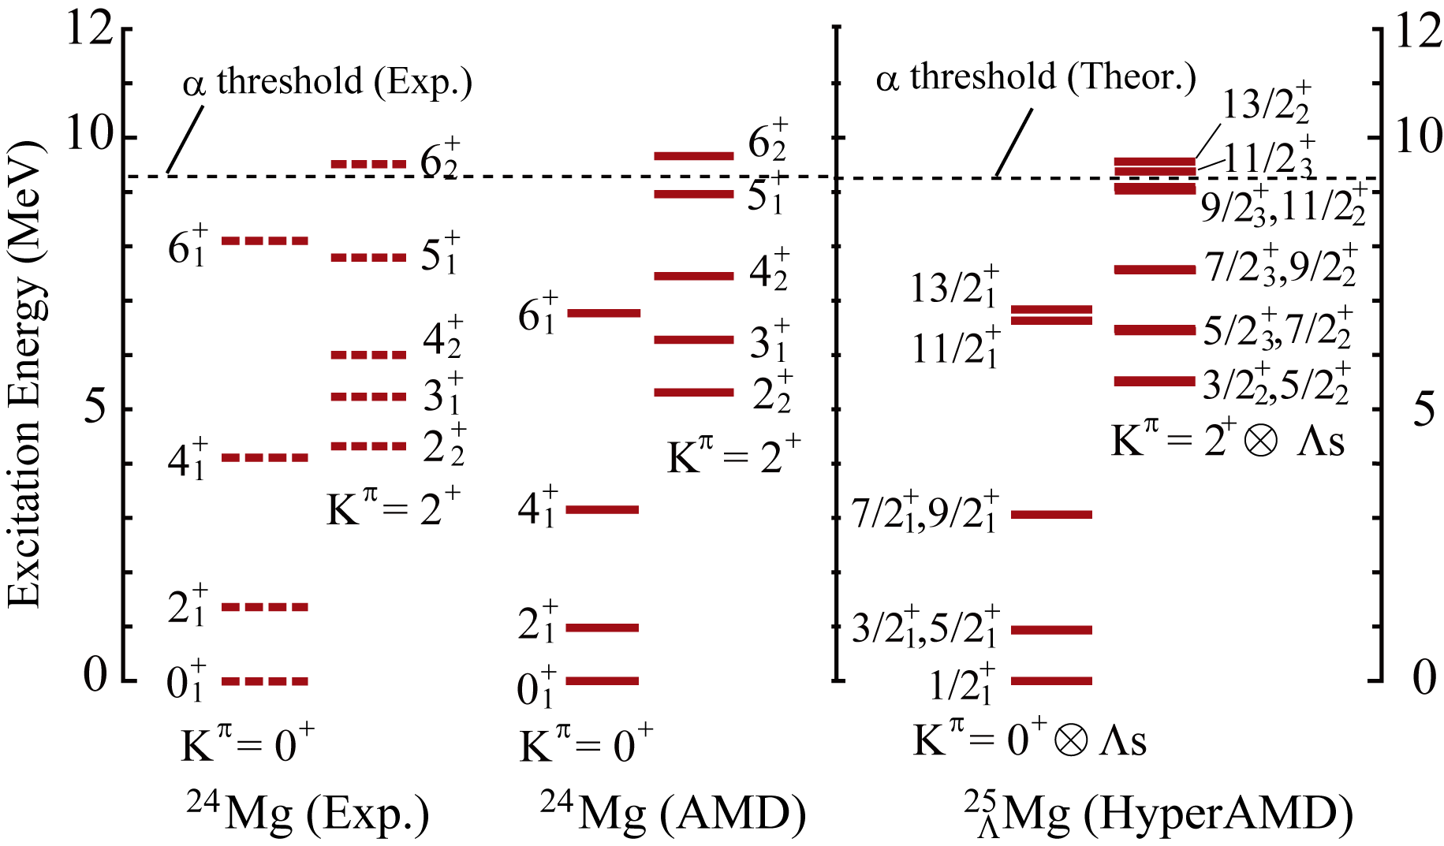
Results: Excitation spectra of ²⁵_{Λ}Mg
200keV
Excitation energy of K^{π}=2⁺⊗Λ_{s} band is shifted up by about 200 keV

Slide 38
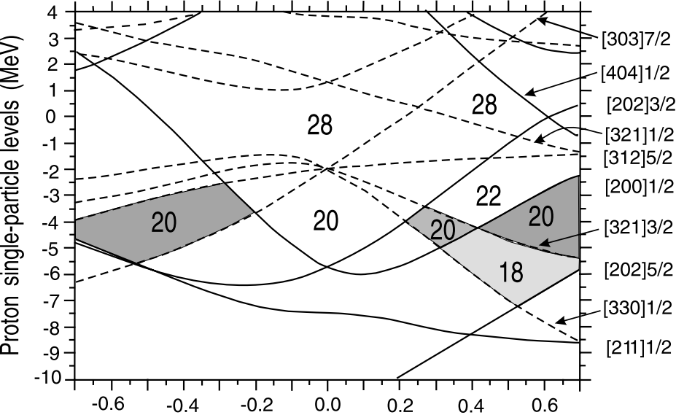
Back up: Superdeformation
SD is due to the large shell gap at certain deformations
Taken from E. Ideguchi, et al., PRL 87, 222501 (2011)

Slide 39
ND and SD states of ⁴⁰Ca
Ground, normal deformed and superdeformed states are obtained
Core nucleus ⁴⁰Ca:
basically same calculation as
Y. Taniguchi, et al., PRC 76, 044317 (2007)
1:2
spherical
β = 0.0
β ≃ 0.6
Notes:
First, I will briefly show you the results on the core nucleus Ca40.
We performed energy variation for Ca40, the core nucleus, basically following the Taniguchi-san’s work.
The left panel shows the energy curves as a function of nuclear quadrupole deformation parameter beta.
It shows that three energy minima are obtained, and they correspond to ground, ND and SD states of Ca40.

Slide 40
Energy curves of ⁴¹_{Λ}Ca as a function of β
⁴¹Ca
“GS⊗Λ”, “ND ⊗Λ ” and “SD ⊗Λ ” curves are obtained
_{Λ}
SD states will appear in ⁴¹_{Λ}Ca
Energy (local) minima are almost unchanged
⁴⁰Ca
⁴⁰Ca
⁴⁰Ca
⁴⁰Ca(Pos)
spherical
SD
superdeformed
ND
GS
⁴¹Ca
_{Λ}
⁴¹Ca
⁴⁰Ca(Pos)⊗Λ(s)
_{Λ}
⁴¹Ca
_{Λ}
superdeformed
spherical
Notes:
By adding a Lambda particle to Ca40, we obtained the corresponding energy curves with three global and local energy minima. The curve corresponding to Ca41L is shown with solid curve. And open circles show the place of the energy minima.
We also show the density distributions at the minima corresponding to the ground and superdeformed states.
The contour lines show the density distribution of nucleons. The color plot shows the distributions of the Lambda hyperon.
From this figure, it is XXX変形の変化が小さい。

Slide 41
Λ single particle energy
Definition:
General trend: ε_{Λ} changes within 1 - 2 MeV as β increases
Λ single particle energy
⁴¹Ca
Energy surface
_{Λ}
ND
SD
⁴⁰Ca
⁴⁰Ca(Pos)
GS
⁴⁰Ca(Pos)⊗Λ(s)
ε_{Λ}
SD
ND
GS
⁴⁰Ca(Pos)⊗Λ(s)
Notes:
To analyze how the binding energy of a Lambda hyperon changes depending on deformation, we calculate the Lambda single particle energy as a function of beta.
Here Lambda single particle energy epsilon_Lmd is defined as the energy difference between the energy curves.
And the resulting curve of Lmd single particle energy is shown in the right figure.
It shows that Lambda single particle energy becomes shallower as beta increases, and the energy change is within 2 MeV.

Slide 42
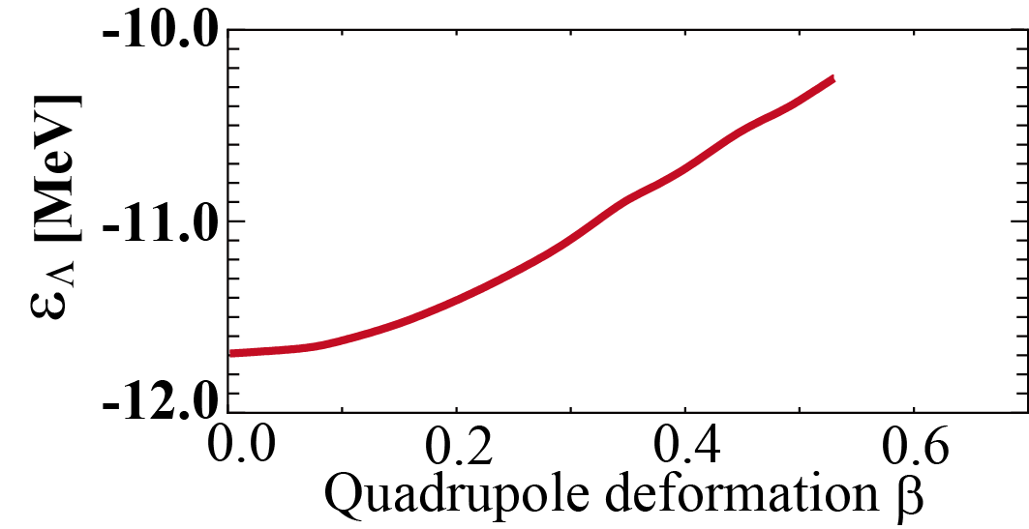
Λ single particle energy
Definition:
General trend: ε_{Λ} changes within 1 - 2 MeV as β increases
Similar to the p shell Λ hypernuclei
Λ single particle energy
⁴¹Ca
Energy surface
_{Λ}
ND
SD
⁴⁰Ca
⁴⁰Ca(Pos)
GS
⁴⁰Ca(Pos)⊗Λ(s)
ε_{Λ}
SD
ND
GS
¹³C
_{Λ}
⁴⁰Ca(Pos)⊗Λ(s)
¹³C(Pos)⊗Λ(s)
Notes:
This gross feature is similar to the p-shell Lambda hypernuclei such as C13L.

Slide 43
Difference of Λ binding energy B_{Λ}
ND and SD states are predicted in ⁴¹_{Λ}Ca
B_{Λ} is different among ground, ND and SD states
⁴⁰Ca
Largest
⁴¹Ca
Λ

Slide 44
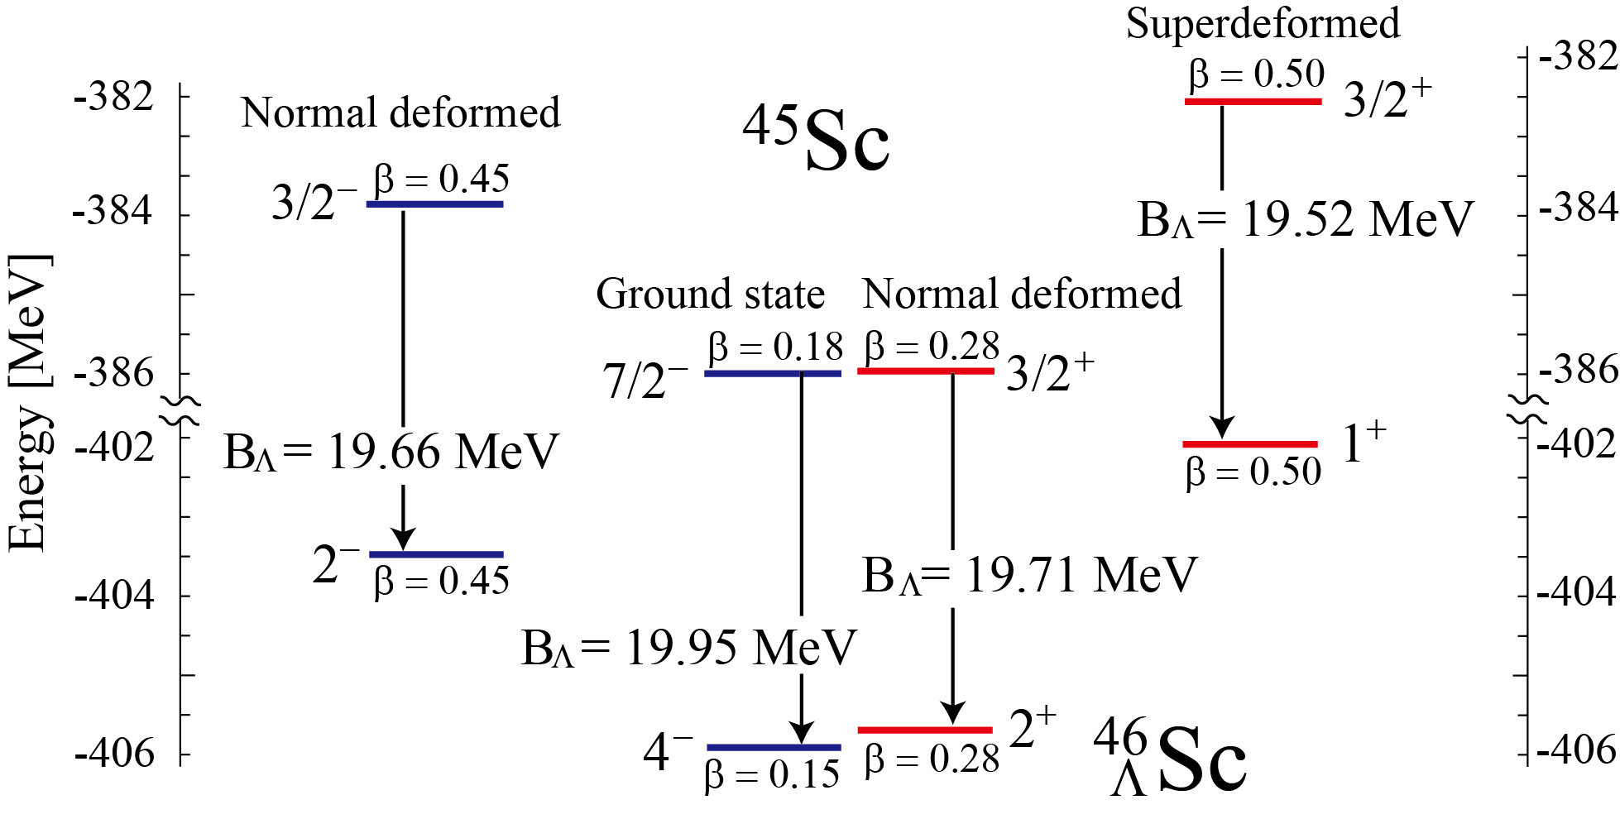
Superdeformed states in Sc hypernuclei
Examples: ⁴⁶_{Λ}Sc, ⁴⁸_{Λ}Sc
Core nuclei
(⁴⁵Sc, ⁴⁷Sc)
Various deformations coexist in the g.s. regions
We predict ND and SD states with mp-mh configuration
Difference of B_{Λ} depending on deformation by adding a Λ

Slide 45
Excitation spectra of ⁴⁶_{Λ}Sc and ⁴⁸_{Λ}Sc
Difference of B_{Λ} leads to the energy shift up of the deformed states
Similar phenomena in ⁴⁸_{Λ}Sc
Shifted up
Shifted up
Shifted up
We hope these states in Sc Λ hypernuclei are observed at JLab

Slide 46
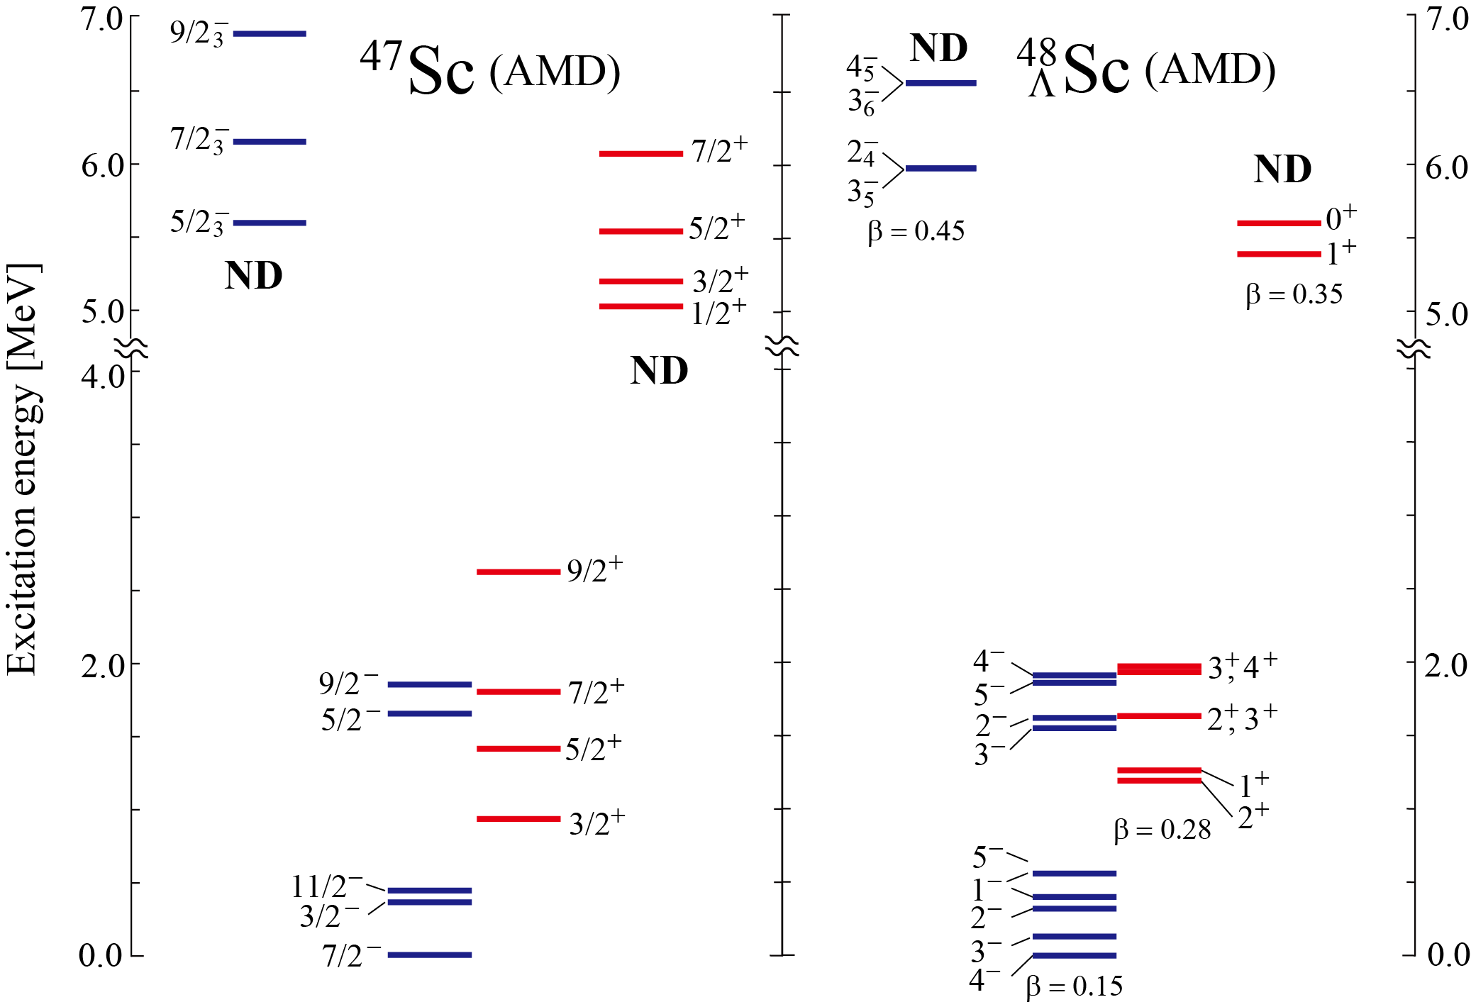
Changes of the excitation spectrum in ⁴⁸_{Λ}Sc
We predict mp-mh states with various deformations in ⁴⁷Sc
Difference of B_{Λ} and shift up of the deformed states in ⁴⁸_{Λ}Sc
Shifted up
Shifted up
Shifted up

Slide 47
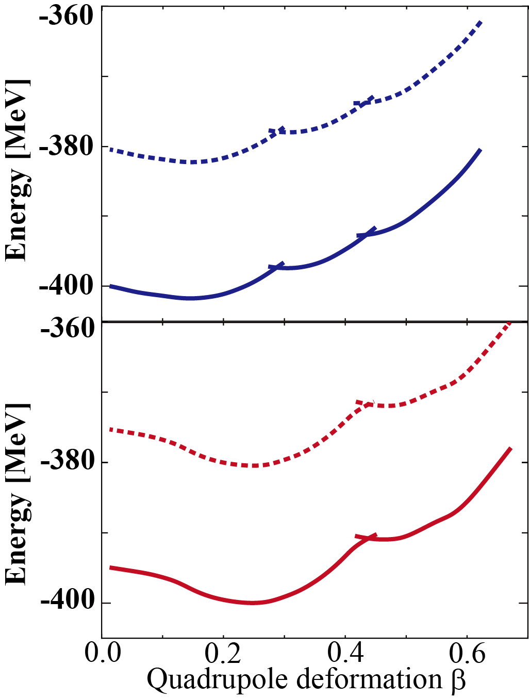
Energy surface as a function of β
Ground, normal deformed and superdeformed states are obtained
Energy (local) minima are almost unchanged
⁴⁵Sc
⁴⁵Sc(Neg)
ND
⁴⁰Ca
ND
⁴⁰Ca(Pos)
GS
SD
ND
⁴⁵Sc(Neg)⊗Λ(s)
GS
⁴⁵Sc
⁴⁰Ca(Pos)⊗Λ(s)
⁴⁵Sc(Pos)
SD
ND
⁴⁵Sc(Pos)⊗Λ(s)

Slide 48
Backup: Structure of the core nuclei
Examples:
⁴⁰Ca, ⁴⁵Sc, ⁴⁷Sc and corresponding Λ hypernuclei

Slide 49
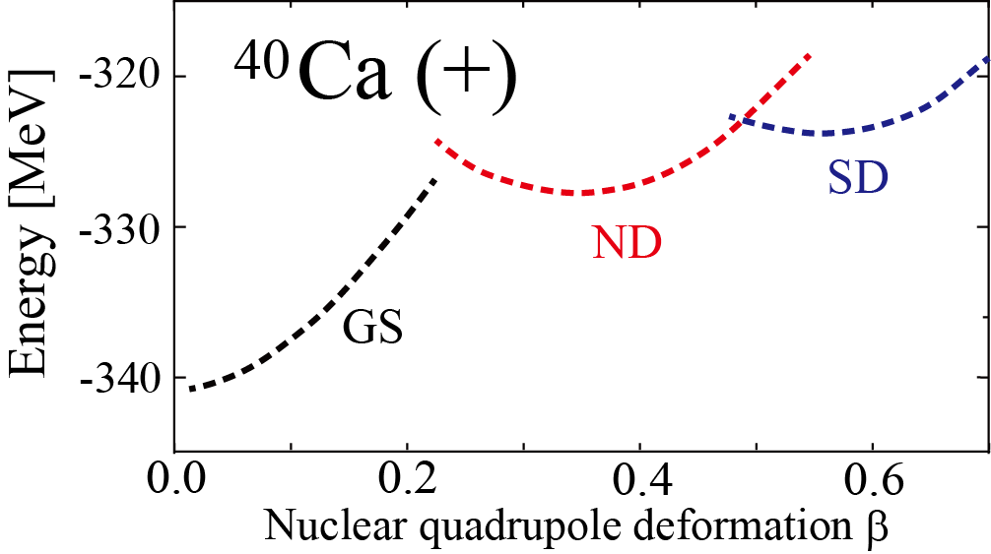
ND and SD states of ⁴⁰Ca
Ground, normal deformed and superdeformed states are obtained
Core nucleus ⁴⁰Ca:
basically same calculation as
Configuration
proton
neutron
Y. Taniguchi, et al., PRC 76, 044317 (2007)
pf
GS
sd
pf
ND
sd
pf
SD
sd

Slide 50
Configurations of nucleons
Number of the deformed harmonic oscillator quanta
proton
neutron
$$N^{p}\sim 30$$
$$N^{n}\sim 30$$
pf
GS
⁴⁰Ca (+)
sd
$$N^{p}\sim 32$$
$$N^{n}\sim 32$$
pf
ND
sd
GS
$$N^{p}\sim 34$$
$N^{n}\sim 3$4
pf
SD
sd

Slide 51
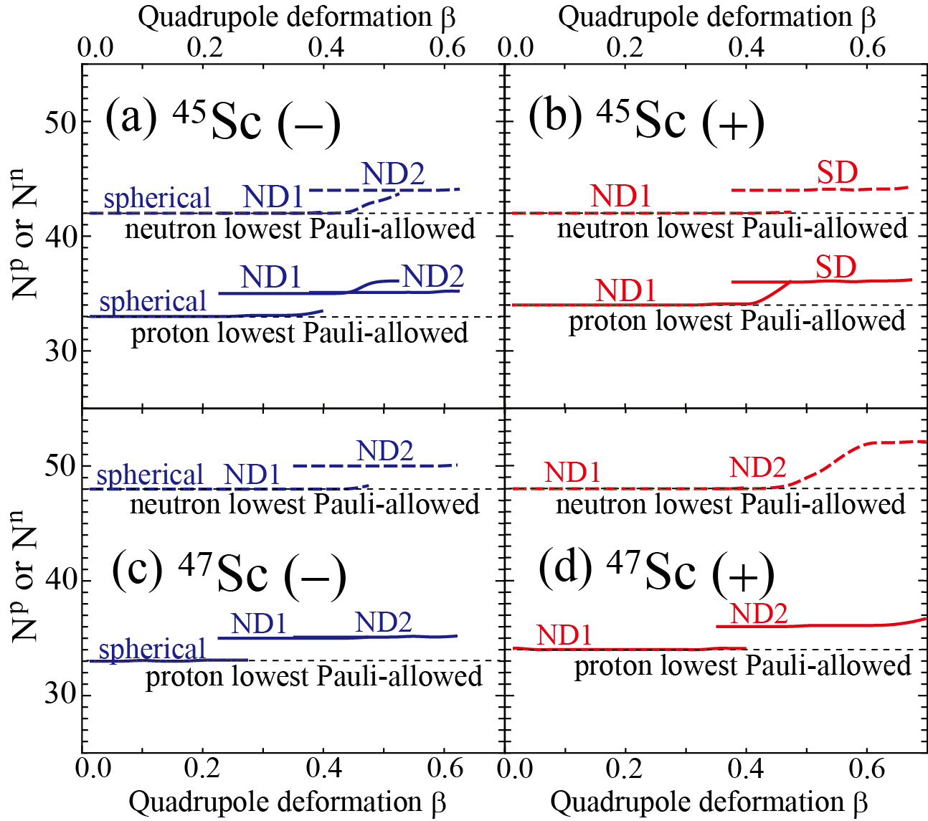
Configurations of nucleons

Slide 52
⁴⁵Sc: Configurations of nucleons
GS
proton
neutron
$N^{p}\sim 3$3
$$N^{n}\sim 42$$
pf
sd

Slide 53
⁴⁵Sc: Configurations of nucleons
GS
SD
proton
neutron
proton
neutron
$N^{p}\sim 3$3
$$N^{n}\sim 42$$
$N^{p}\sim 3$6
$$N^{n}\sim 44$$
pf
pf
sd
sd
protons: similar to SD states of ⁴⁰Ca

Slide 54
⁴⁷Sc: Configurations of nucleons
ND2
GS
proton
neutron
proton
neutron
$N^{n}\sim 4$8
$N^{p}\sim 3$6
$N^{p}\sim 3$3
$$N^{n}\sim 48$$
pf
pf
sd
sd
protons: similar to SD states of ⁴⁰Ca
neutrons: similar to the GS

Slide 55
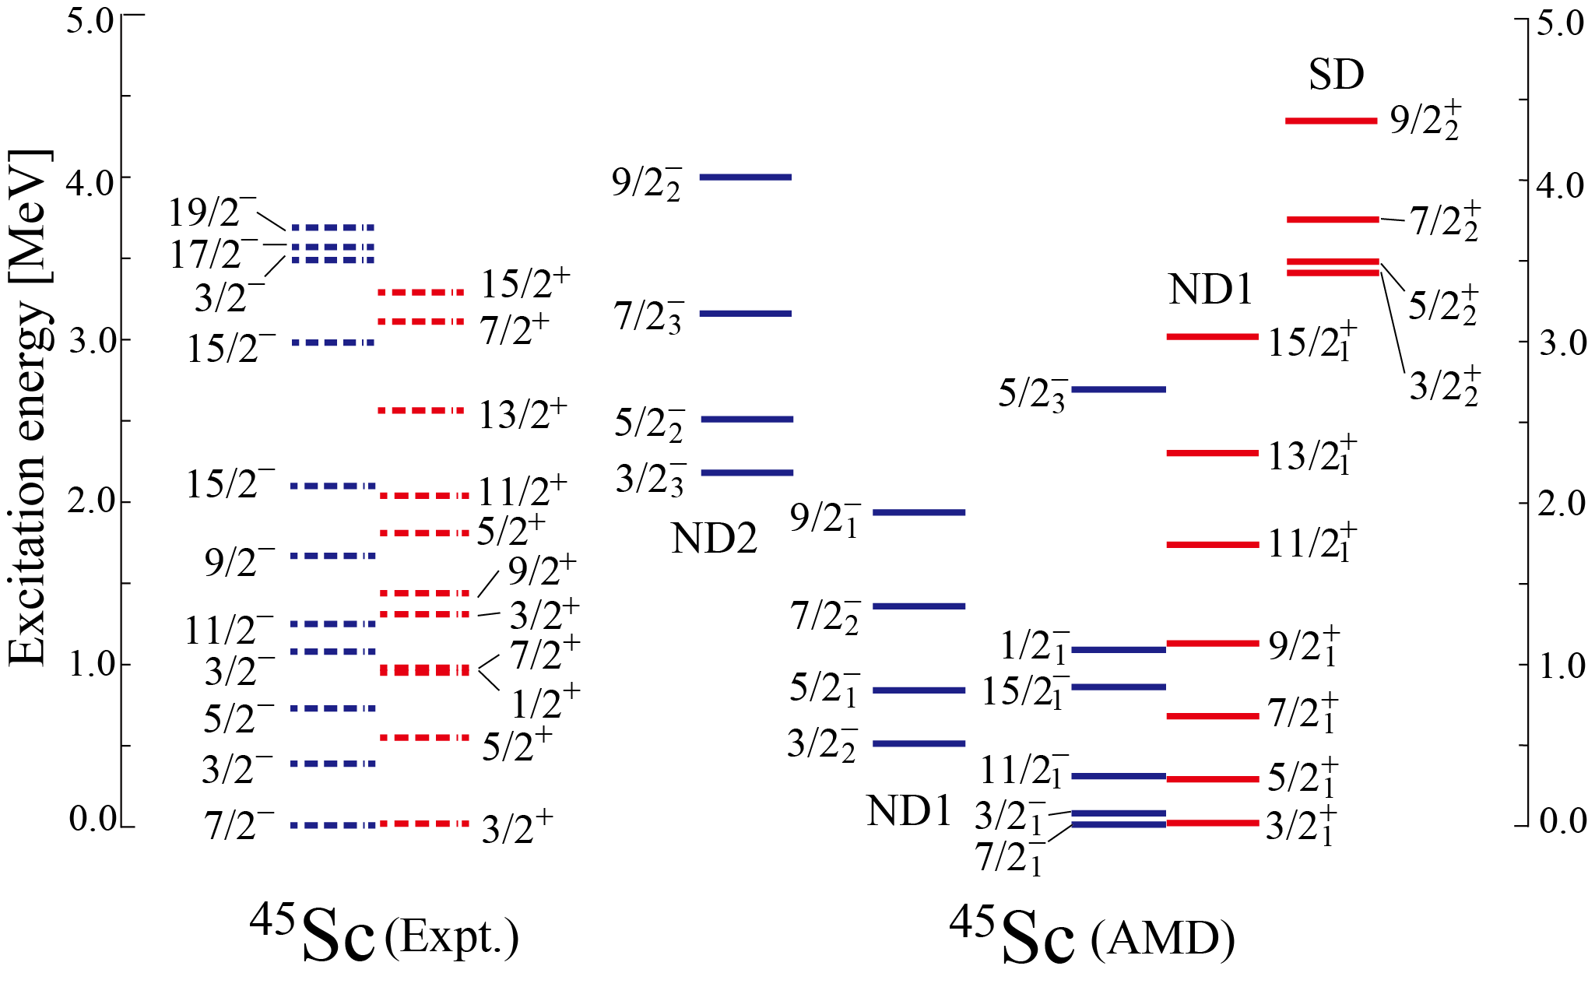
Excitation spectrum of ⁴⁵Sc
Various deformed states are predicted in ⁴⁵Sc including SD states
We hope SD band is observed by forthcoming experiment at RCNP
⁴⁵Sc (Expt.)
⁴⁵Sc (AMD)

Slide 56
Excitation spectrum of ⁴⁷Sc

Slide 57
Short summary
AMD + GCM framework has been applied to ⁴⁵Sc and ⁴⁷Sc to investigate deformed excited states.
Various deformed states with many-particle many-hole configurations
In ⁴⁵Sc, prediction of the SD states with proton 4p configuration
In ⁴⁷Sc, deformed states with 4p proton configuration,
but neutron configuration is the same as the GS.
SD in ⁴⁰Ca
SD in ⁴⁵Sc
⁴⁷Sc
proton
neutron
proton
neutron
proton
neutron
$$N^{p}\sim 34$$
$N^{n}\sim 3$4
$N^{p}\sim 3$6
$$N^{n}\sim 44$$
$N^{p}\sim 3$6
$N^{n}\sim 4$8
Increase of neutron number may affect neutron configuration?
Further investigations are required

Slide 58
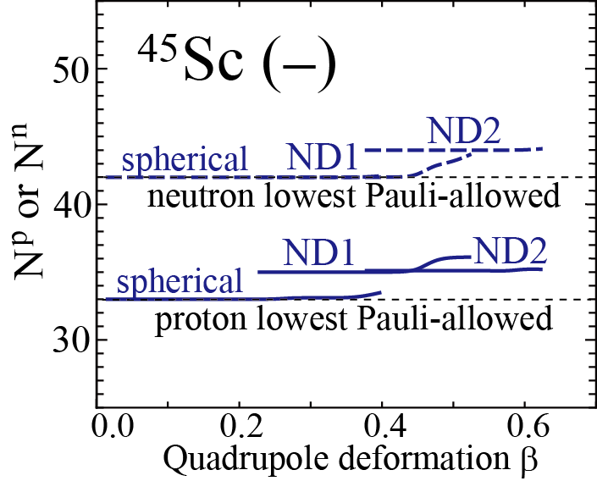
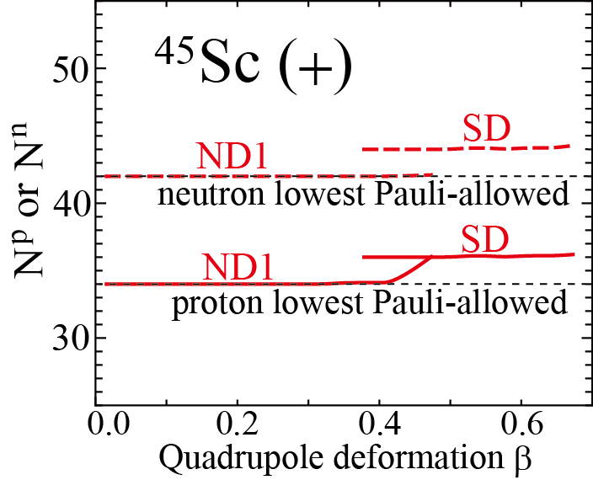
Backup: Configurations of nucleons
proton
neutron
Ground
pf
N^{p} = 33
sd
N^{n} = 42
ND2
pf
N^{p} = 35
sd
N^{n} = 42
ND2
pf
N^{p} = 35
sd
N^{n} = 44
ND1
pf
N^{p} = 34
sd
N^{n} = 42
SD
pf
N^{p} = 36
sd
N^{n} = 44

Slide 59
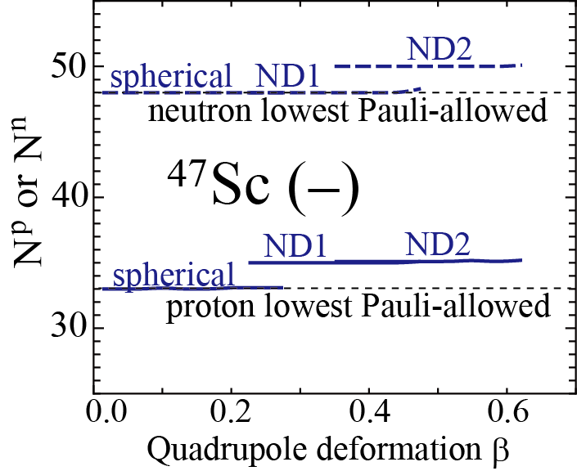
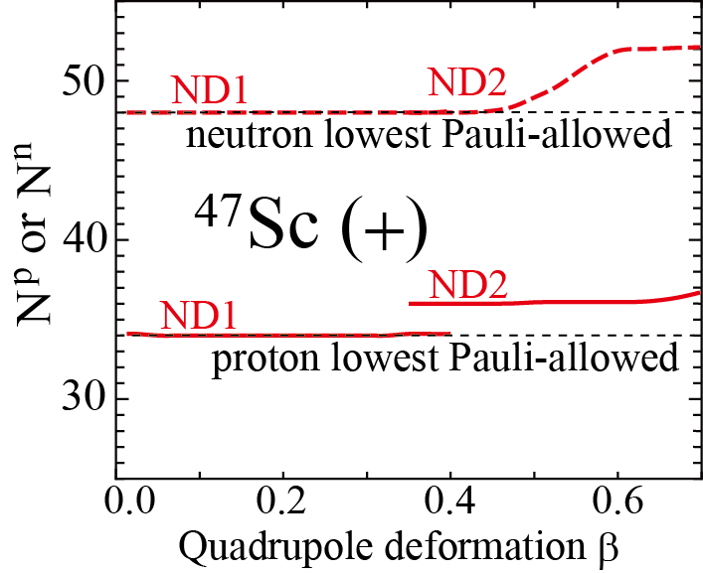
Backup: Configurations of nucleons
proton
neutron
Ground
pf
N^{p} = 33
sd
N^{n} = 48
ND1
pf
N^{p} = 35
sd
N^{n} = 48
ND2
pf
N^{p} = 35
sd
N^{n} = 50
ND1
pf
N^{p} = 34
sd
N^{n} = 48
ND2
pf
N^{p} = 36
sd
N^{n} = 48

Slide 60
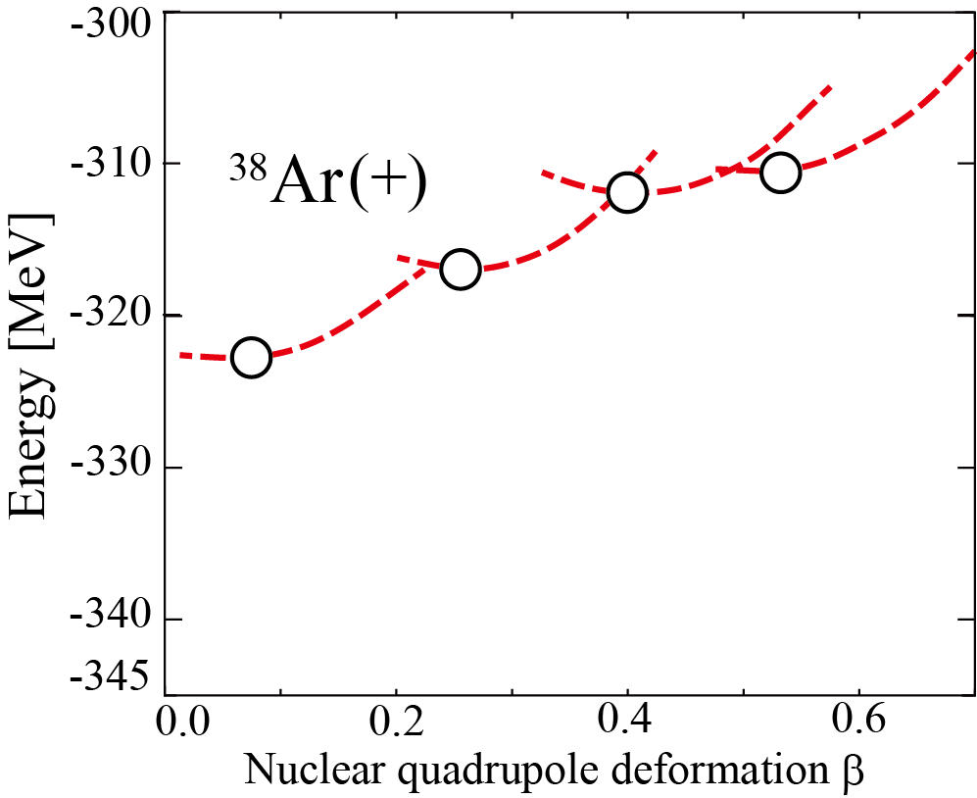
Results: Energy curve
³⁸Ar
Energy (local) minima with different deformations appear
Notes:
Let me go to the results.
Here I am showing the energy curve as a function of nuclear quadrupole deformation beta.
The horizontal axis show beta, while the vertical axis show the energy in MeV.
We obtain one absolute and three local energy minima.
It shows that these energy minima have different beta deformations.
The density distributions at each energy minima are also shown by the contour lines.

Slide 61
Results: Energy curve
³⁸Ar
Energy (local) minima with different deformations appear
³⁹Ar
“GS⊗Λ”, “ND ⊗Λ ” and “SD ⊗Λ ” curves are obtained
Energy (local) minima are almost unchanged
_{Λ}
Notes:
By adding a

Slide 62
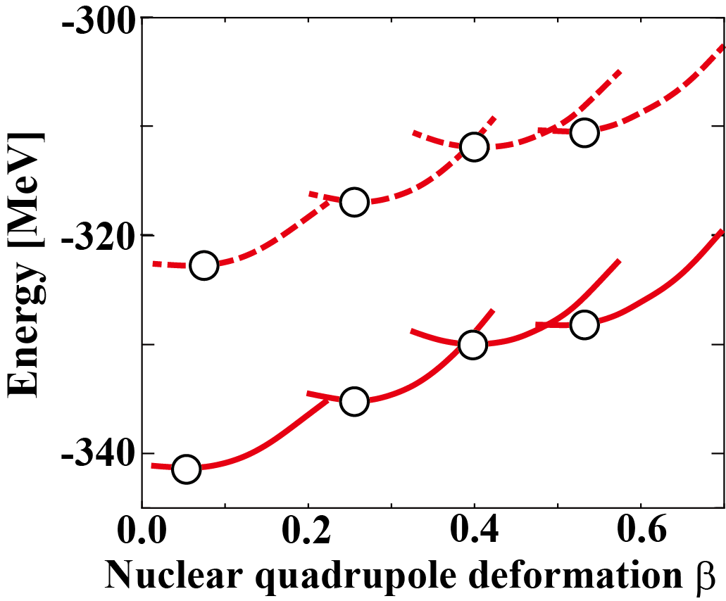
Results: Λ single particle energy
Definition:
General trend: ε_{Λ} changes within 1 - 2 MeV as β increases
Energy surface
Λ single particle energy
³⁸Ar(Pos)
ε_{Λ}
³⁸Ar(Pos)⊗Λ(s)

Slide 63
Results: Λ single particle energy
ε_{Λ} varies due to changes of spatial overlap
between Λ and N
Deformation of Λ distribution is small,
while nuclear part is deformed
β = 0.13
β = 0.30
β = 0.45
β = 0.58

Slide 64
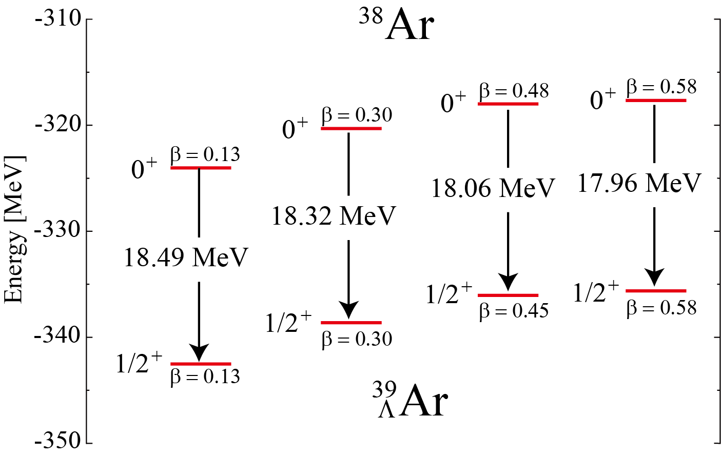
Results: Difference of B_{Λ}
Excited staes with different deformations are predicted in ³⁹_{Λ}Ar
B_{Λ} is different depending on deformations and consistent with ε_{Λ}(β)

Slide 65
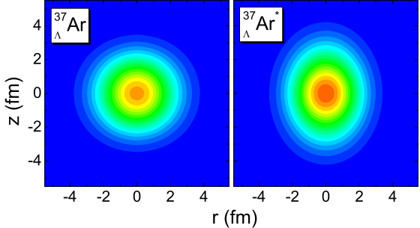
Other predictions of B_{Λ}
B_{Λ} is larger in the SD state in ³⁷_{Λ}Ar, etc.
Bing-Nan Lu, Emiko Hiyama, Hiroyuki Sagawa and Shan-Gui Zhou, arXiv:1403.5866v1
Localization of nucleons makes Λ deformed
Large spatial overlap between N and Λ
Large B_{Λ}
Large B_{Λ} in the SD state will give important information about localization
³⁶Ar
SD
ground
18.524 MeV
18.177 MeV
Matter density of ³⁷Ar
Distributions of Λ
Λ
ground
SD
ground
SD
³⁷Ar
Λ
Notes:
XXX39ArLに直す。XXX

