Slide 1
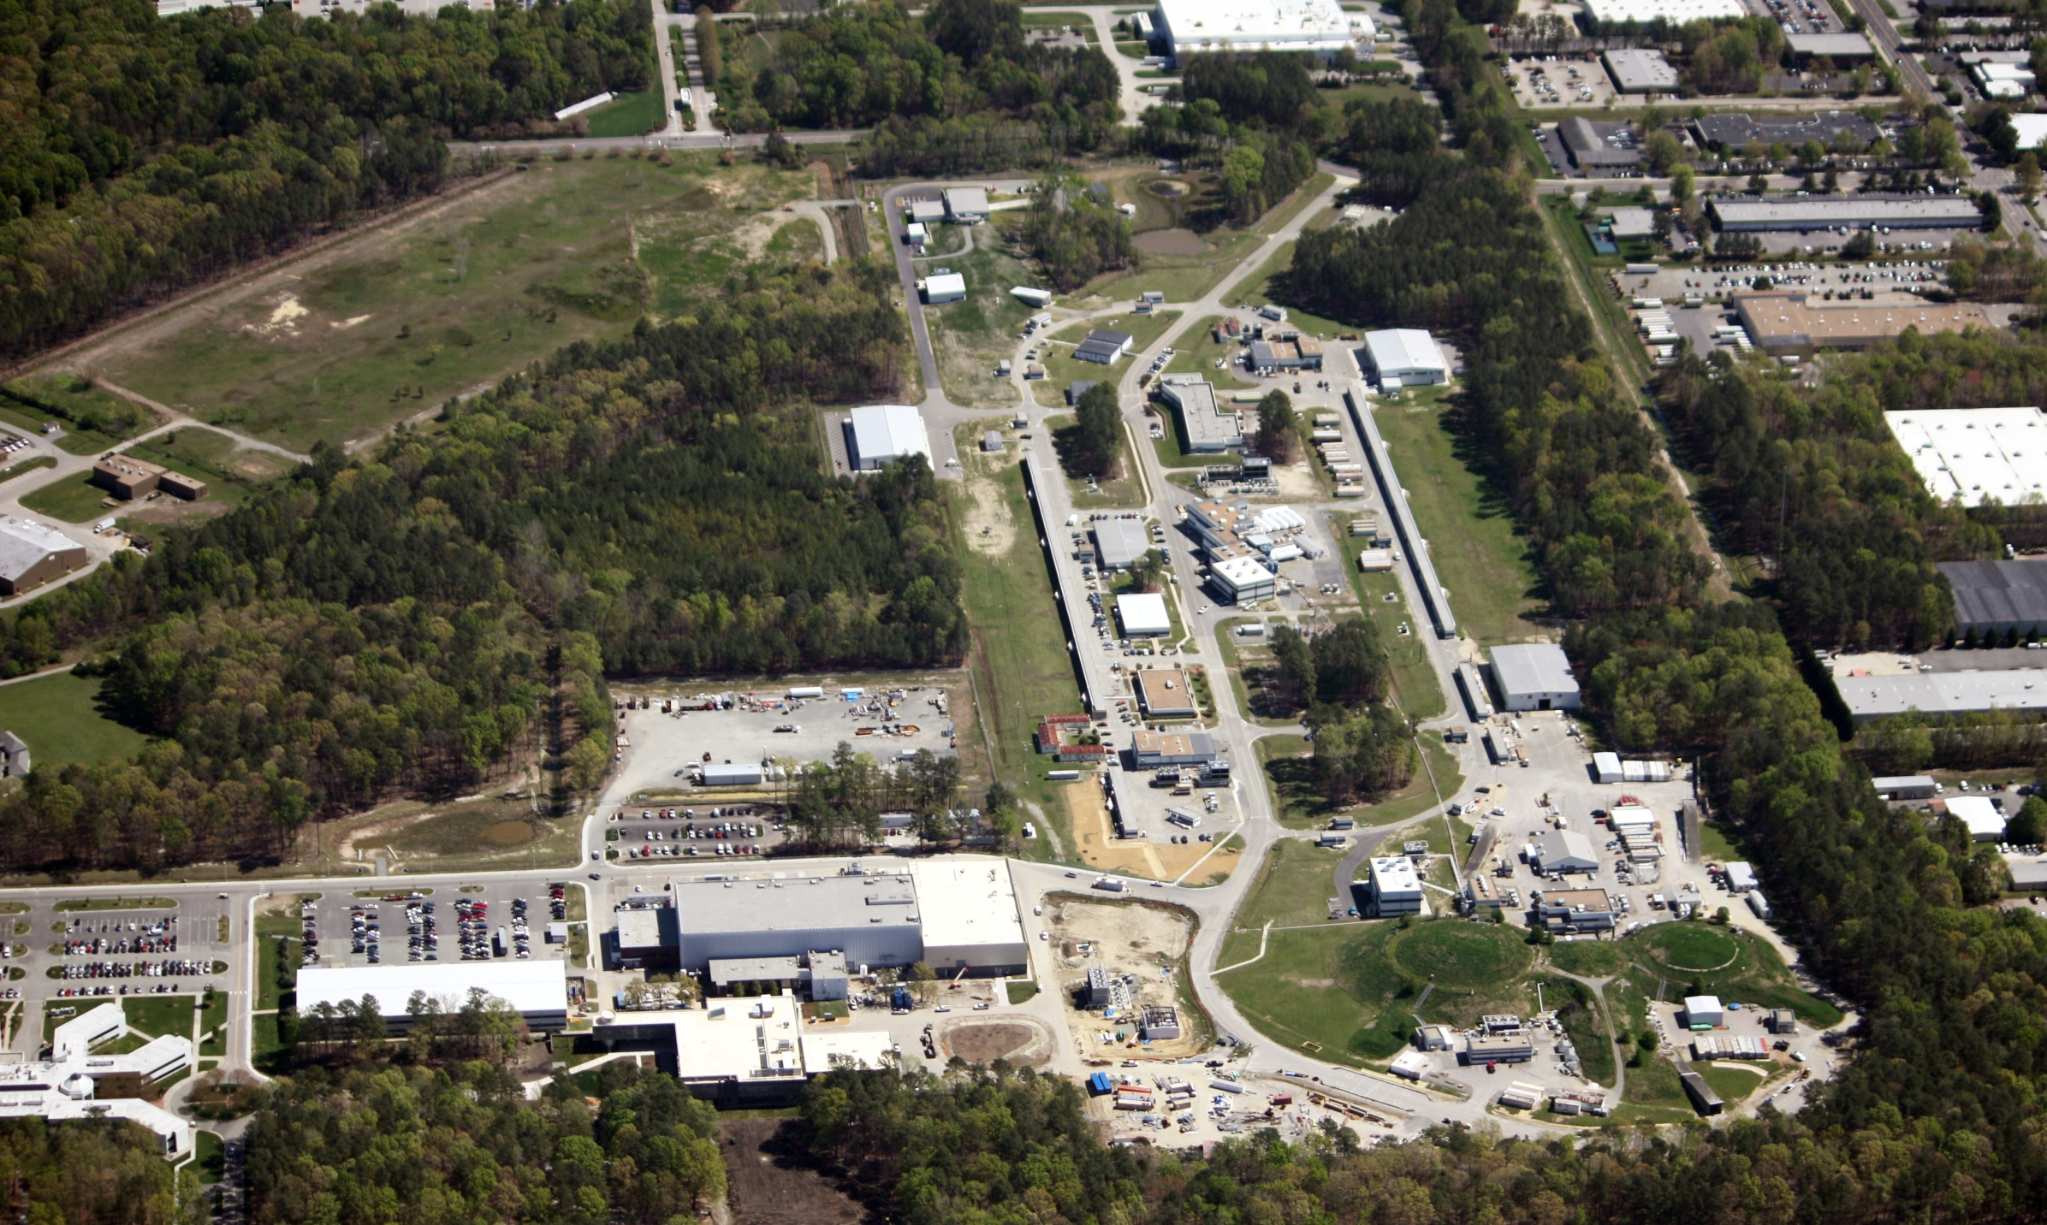
Welcome to Jefferson Lab
R. D. McKeown
Jefferson Lab
Hypernuclear Workshop
May 27, 2014

Slide 2
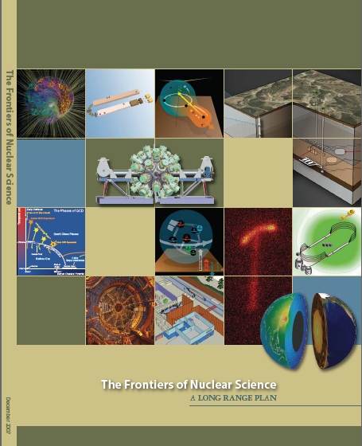
12 GeV Upgrade Project
Upgrade is designed to build on existing facility: vast majority of accelerator and experimental equipment have continued use
New Hall
Upgrade arc magnets
and supplies
Add 5 cryomodules
20 cryomodules
CHL upgrade
Maintain capability to deliver lower pass beam energies: 2.2, 4.4, 6.6….
Add arc
20 cryomodules
The completion of the
12 GeV Upgrade of CEBAF was ranked the highest priority in the 2007 NSAC Long Range Plan.
Add 5 cryomodules
Scope of the project includes:
Doubling the accelerator beam energy
New experimental Hall and beamline
Upgrades to existing Experimental Halls
Enhanced capabilities
in existing Halls

Slide 3
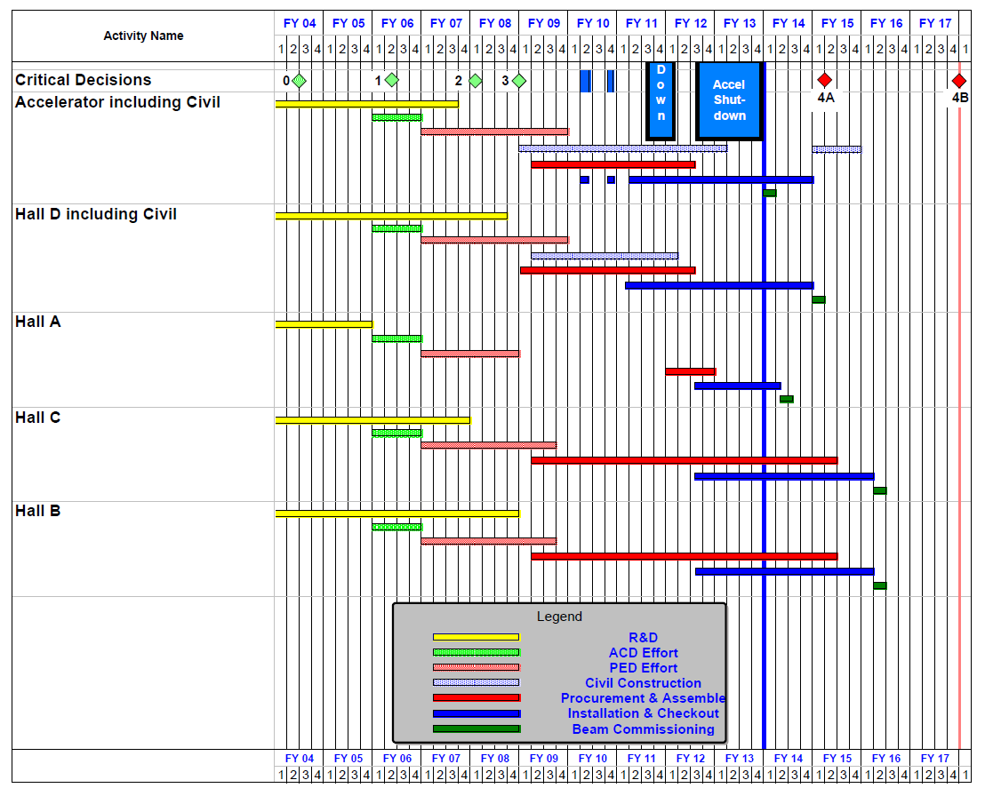
12 GeV Upgrade Project Schedule
16-month installation
May 2012 - Sept 2013
Accelerator commissioning start Oct 2013
Hall A commissioning start Feb 2014
Hall D commissioning start
Oct 2014
Halls B & C commissioning start Jan/Feb 2016
Project Completion September 2017
Re-baseline Approved
September 4, 2013

Slide 4
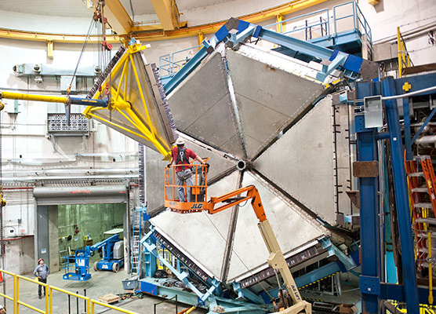
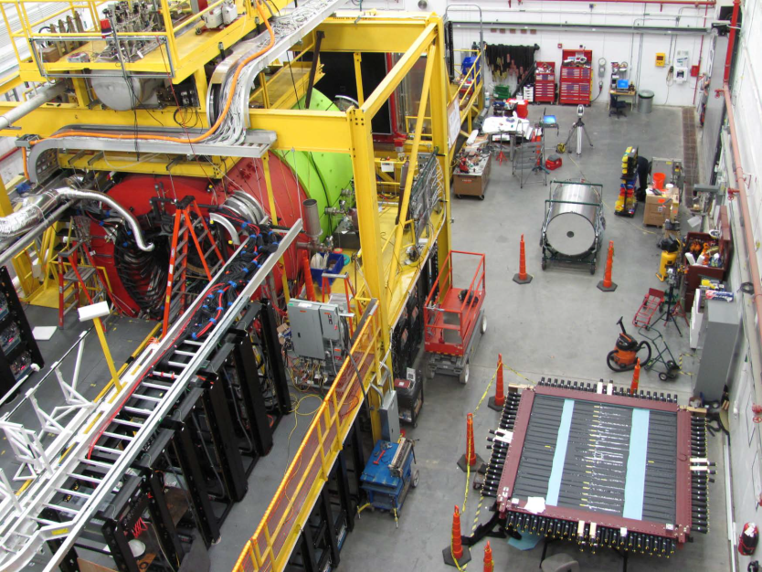
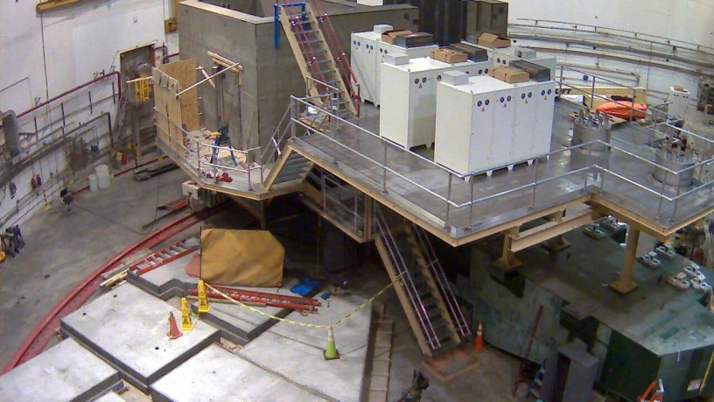
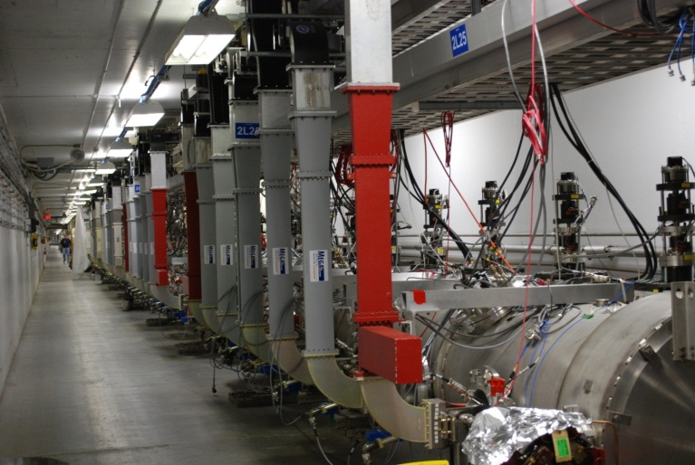
12 GeV Project Highlights
Hall D
Hall B
Hall C

Slide 5
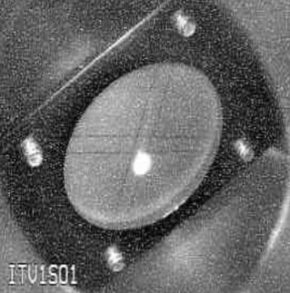
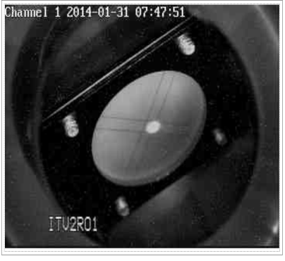
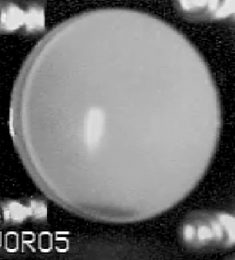
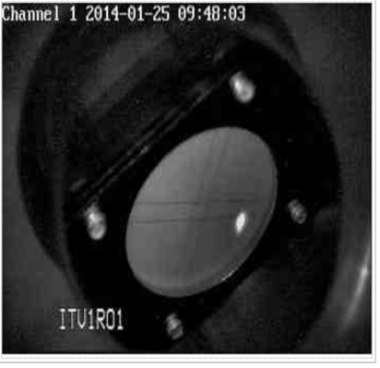
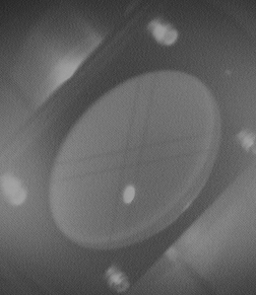
Accelerator Commissioning Progress
1S
2214 MeV
34 MeV
2R
0R
1124 MeV
CHL1, CHL2 operational
Linacs at 2K
North Linac – 1090 MeV
South LINAC – 1090 MeV
CEBAF 2.214 GeV
Optics, Magnets great
1R
2S
KPP: machine capable of 12 GeV
1 pass at 2.2 GeV/pass for 8 hours
with acceptable trip rate (50% uptime)

Slide 6
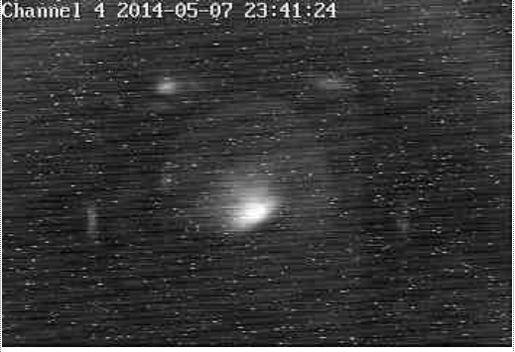
May 7, 2014
5.5 Passes
10.5 GeV
Transported to
Hall D Tagger Dumplet
Completes CD4a Project
milestone

Slide 7
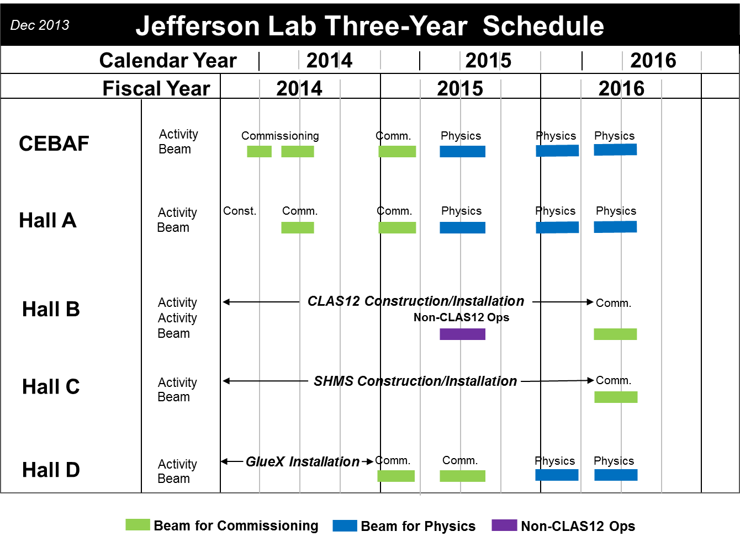
Three year plan

Slide 8
Future Hypernuclear Physics at JLab
A program of hypernuclear physics was proposed to the Jefferson Lab PAC40 in 2013. It was an extensive program that included measurements on:
• Elementary reaction p(*,K+)☹
• Few body systems (☹N, 4☹H)
• Medium mass nuclei (40Ca, 27Al,48Ti)
• Heavy nuclei: 208Pb

Slide 9
PAC Result
The PAC deferred on approving the proposal, stating:
“The beam time required for the full program constituted about 100 days. A significant setup time for this experiment requires both resources and significant planning. The PAC felt that the case had not yet been made for such a significant investment, and would encourage, as PAC39 had done, that the proponents work closely with the theory community to identify the most important cases for study. A future proposal should also clearly state the impact of measurements for our understanding of the ☹-N interactions. A careful analysis of how these sets of measurements and their uncertainties constrain nuclear theory would be of value. A dedicated Workshop focused on these questions could be very helpful. The PAC needs to see a sense of priority from the proponents.”

Slide 10
Charge to Panel Discussion
It would be helpful if the workshop could provide guidance to the proponents, specifically to
Identify the most important one or two key measurements to be pursued at JLab that would provide a substantial advance in our knowledge of hypernuclear physics. These measurements could form the initial program motivating the mounting of a more extensive hypernuclear physics program at JLab.

