Slide 1
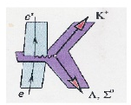
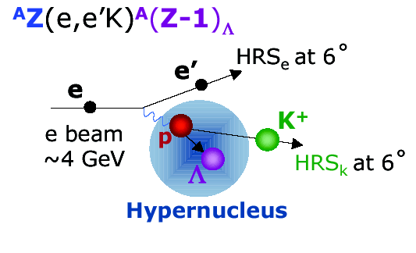
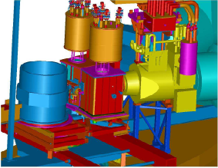
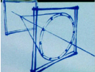
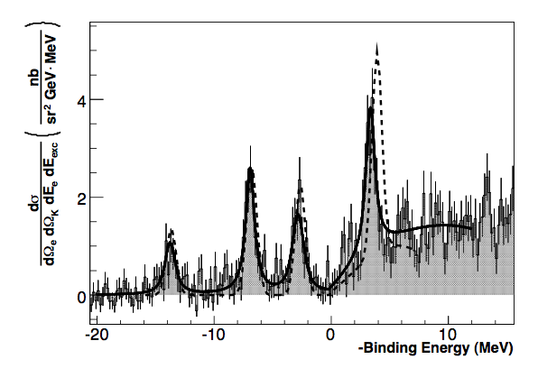
High-Resolution Hypernuclear Spectroscopy
JLab, Hall A Result
G. M. Urciuoli
Hypernuclear spectroscopy in Hall A
  ¹²C, ¹⁶O, ⁹Be, H
  E-07-012
Experimental issues
Results

Slide 2
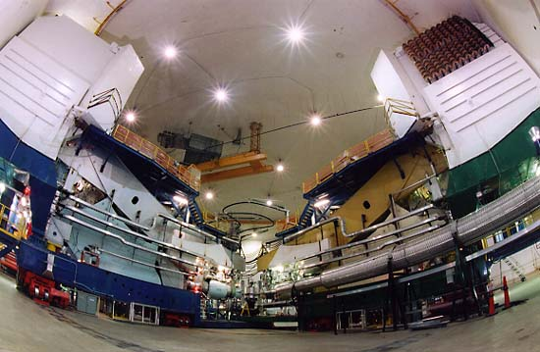

JLAB Hall A Experimental setup
The two High Resolution Spectrometer (HRS) in Hall A @ JLab
Beam energy: 3.7 GeV
σE/E : 2.5 10⁻⁵
Beam current: 100 μA
Targets : ¹²C, H₂O, ⁹Be, H
HRS – QQDQ main characteristics:
Momentum range: 0.3, 4.0 GeV/c
Δp/p (FWHM): 10⁻⁴
Momentum accept.: ± 5 %
Solid angle: 5 – 6 msr
Minimum Angle : 12.5°

Slide 3
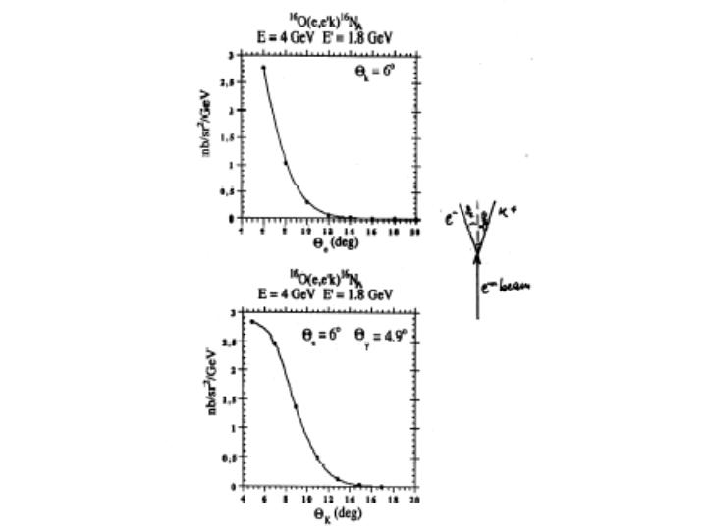
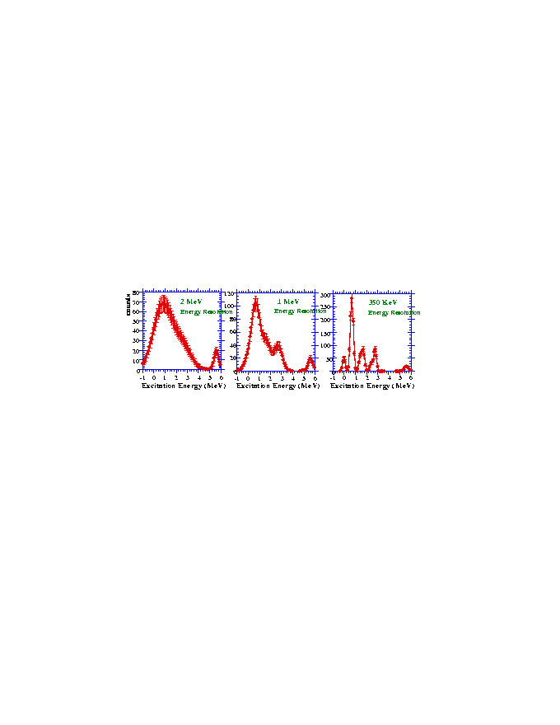
reasonable counting rates
forward angle
DE_{beam}/E : 2.5 x 10⁻⁵
2. DP/P : ~ 10⁻⁴
3. Straggling, energy loss…
septum magnets
~ 600 keV
good energy resolution
do not degrade HRS
minimize beam energy instability
“background free” spectrum
unambiguous K identification
High P_{k}/high E_{in} (Kaon survival)
RICH detector

Slide 4





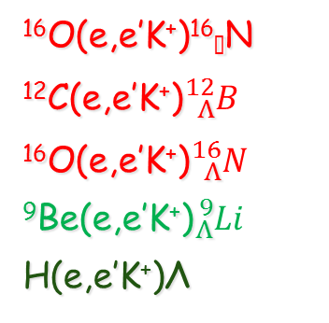
Kaon collaboration
JLAB Hall A Experiment E94-107
E94107 COLLABORATION
  A.Acha, H.Breuer, C.C.Chang, E.Cisbani, F.Cusanno, C.J.DeJager, R. De Leo, R.Feuerbach, S.Frullani, F.Garibaldi*, D.Higinbotham, M.Iodice, L.Lagamba, J.LeRose, P.Markowitz, S.Marrone, R.Michaels, Y.Qiang, B.Reitz, G.M.Urciuoli, B.Wojtsekhowski, and the Hall A Collaboration
  and Theorists: Petr Bydzovsky, John Millener, Miloslav Sotona
¹⁶O(e,e’K⁺)¹⁶☹N
¹²C(e,e’K⁺)${}_{Λ}^{12}B$
¹⁶O(e,e’K⁺)${}_{Λ}^{16}N$
⁹Be(e,e’K⁺)${}_{Λ}^{9}{Li}$
H(e,e’K⁺)Λ
E_{beam} = 4.016, 3.777, 3.656 GeV
P_{e}= 1.80, 1.57, 1.44 GeV/c P_{k}= 1.96 GeV/c
q_{e} = q_{K} = 6°
W  2.2 GeV Q² ~ 0.07 (GeV/c)²
Beam current : <100 mA Target thickness : ~100 mg/cm²
Counting Rates ~ 0.1 – 10 counts/peak/hour
E-98-108. Electroproduction of Kaons up to Q2=3(GeV/c)2 (P. Markowitz, M. Iodice, S. Frullani, G. Chang spokespersons)
E-07-012. The angular dependence of ¹⁶O(e,e’K⁺)¹⁶N and H(e,e’K⁺)L (F. Garibaldi, M.Iodice, J. LeRose, P. Markowitz spokespersons) (run : April-May 2012)

Slide 5
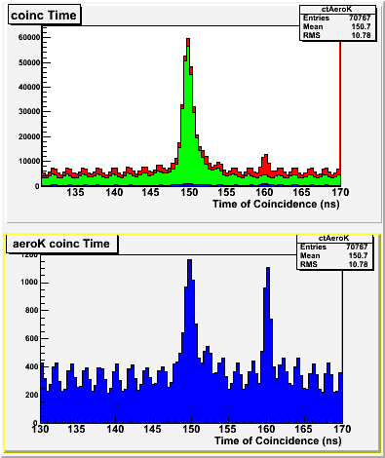
The PID Challenge
Very forward angle ---> high background of p and p
TOF and 2 aerogel in not sufficient for unambiguous K identification !
Kaon Identification through Aerogels
p_{h} = 1.7 : 2.5 GeV/c
π
π
All events
k
k
p
p
AERO1
n=1.015
AERO2
n=1.055
k
Pions = A1•A2
Kaons = A1•A2
Protons = A1•A2

Slide 6
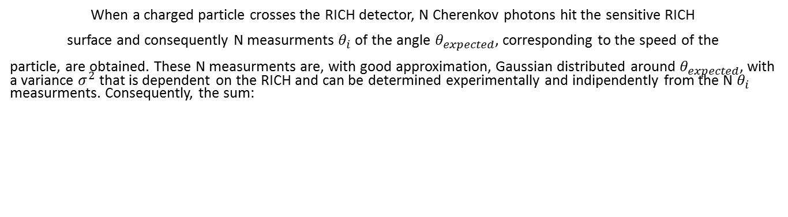

RICH Algorithm
(G.M. Urciuoli et al. NIMA 612, 56 (2009)
When a charged particle crosses the RICH detector, N Cherenkov photons hit the sensitive RICH
surface and consequently N measurments $θ_{i}$ of the angle $θ_{expected}$, corresponding to the speed of the
particle, are obtained. These N measurments are, with good approximation, Gaussian distributed around $θ_{expected}$, with a variance $σ^{2}$ that is dependent on the RICH and can be determined experimentally and indipendently from the N $θ_{i}$ measurments. Consequently, the sum:
Follows the $χ^{2}$ distribution with N degree of freedom.
Three particle hypotheses : Three possible $θ_{expected}$ values Three $χ^{2}$ tests
π $θ_{expected_π}$ $χ_{π}^{2}$
k $θ_{expected_k}$ $χ_{k}^{2}$
P $θ_{expected_p}$ $χ_{p}^{2}$
Usually only one of the three $χ^{2}$values acceptablle only one particle hypothesis valid

Slide 7
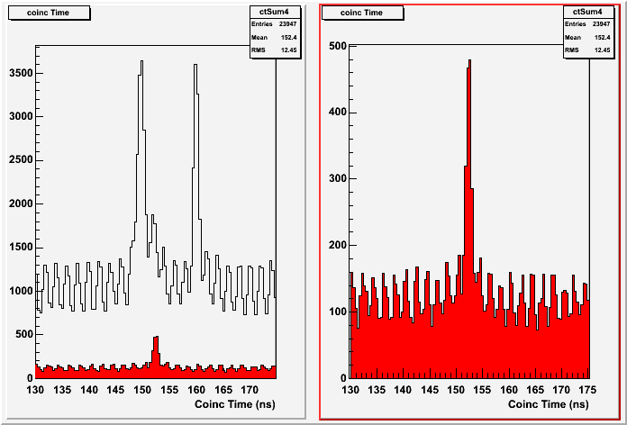
RICH – PID – Effect of ‘Kaon selection
Coincidence Time selecting kaons on Aerogels and on RICH
AERO K
AERO K && RICH K
p
P
K
Pion rejection factor ~ 1000

Slide 8
METHOD TO IMPROVE THE OPTIC DATA BASE:
An optical data base means a matrix T that transforms the focal plane coordinates in scattering coordinates:
To change a data base means to find a new matrix T’ that gives a new set of values:
:
Because:
this is perfectly equivalent to find a matrix
➔.
you work only with scattering coordinates.
From F you simply find T’ by:

Slide 9
METHOD TO IMPROVE THE OPTIC DATA BASE (II)
Expressing:
You have:
just consider as an example the change in the momentum DP because of the change in the data base:
with
a polynomial expression
Because of the change DP➔DP’ also the missing energy
will change:
In this way to optimize a data base you have just to find empirically a polynomial
in the scattering coordinates that added to the missing energy improves its resolution
:
and finally to calculate

Slide 10
A Data base cannot be improved if the missing energy does not show any unphysical dependence on scattering coordinates. In fact, in this case any change in the data base will be equivalent to an addition of a polynomial in the scattering coordinates to the missing mass value and will cause an unphysical dependence on scattering coordinates.
Vice versa, to check if the data base is the «best» one, a test has to be performed (for example with a «ROOT» profile) to investigate about unphysical dependence on scattering coordinates of the missing energy.

Slide 11
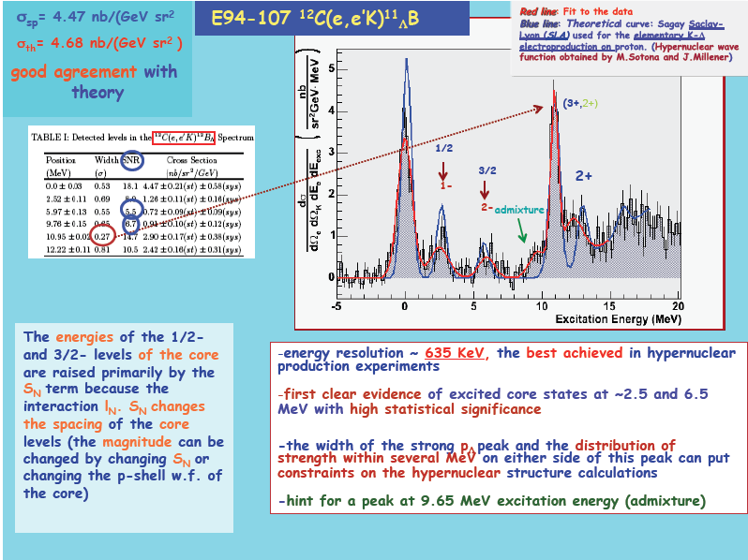

Slide 12
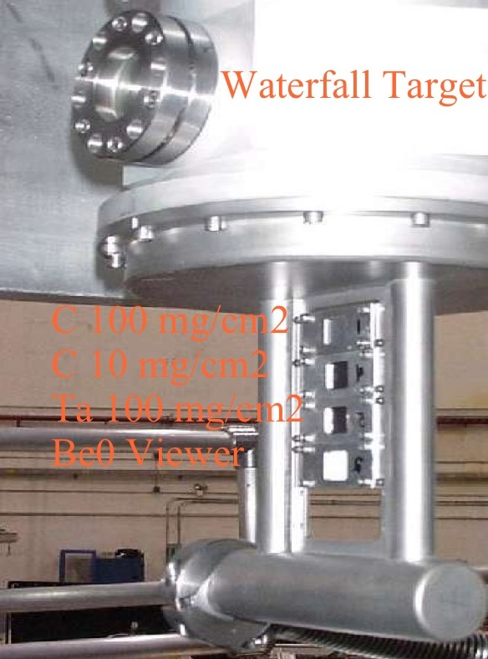
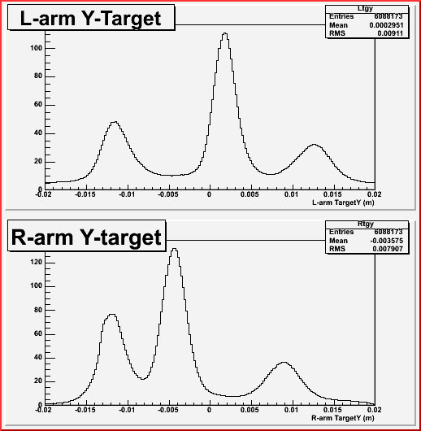
The WATERFALL target: reactions on ¹⁶O and ¹H nuclei
Be windows
H₂O “foil”
H₂O “foil”

Slide 13
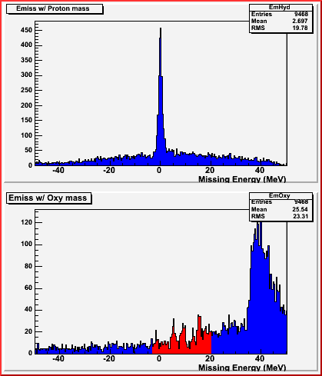
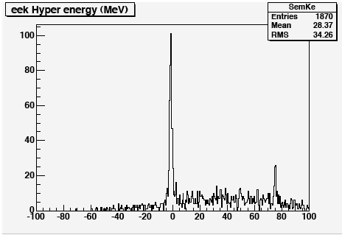
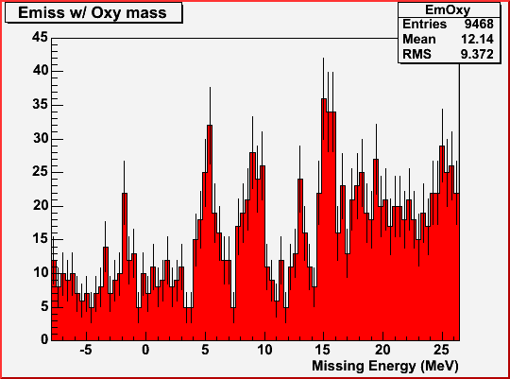
Results on the WATERFALL target - ¹⁶O and ¹H
¹H (e,e’K)L
¹H (e,e’K)L,S
L
Energy Calibration Run
S
¹⁶O(e,e’K)¹⁶N_{L}
Water thickness from elastic cross section on H
Precise determination of the particle momenta and beam energy
using the Lambda and Sigma peak reconstruction (energy scale calibration)

Slide 14
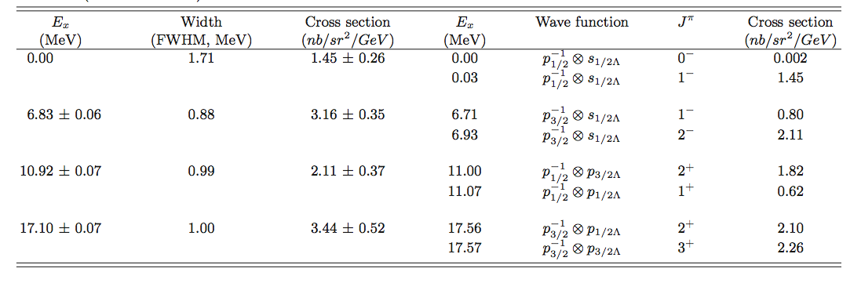
Results on ¹⁶O target – Hypernuclear Spectrum of ¹⁶N_{L}
Fit 4 regions with 4 Voigt functions
c²_{/ndf} = 1.19
Theoretical model based on :
SLA p(e,e’K⁺)Λ(elementary process)
¹⁶N interaction fixed parameters from KEK and BNL ¹⁶_{Λ}O spectra
Four peaks reproduced by theory
The fourth peak (Λ in p state) position disagrees with theory. This might be an indication of a large spin-orbit term S_{Λ}
0.0/13.760.16

Slide 15
Results on ¹⁶O target – Hypernuclear Spectrum of ¹⁶N_{L}
Fit 4 regions with 4 Voigt functions
c²_{/ndf} = 1.19
Binding Energy B_{L}=13.76±0.16 MeV
Measured for the first time with this level of accuracy
(ambiguous interpretation from emulsion data; interaction involving L production on n more difficult to normalize)
Within errors, the binding energy and the excited levels of the mirror hypernuclei ¹⁶O☹ and ¹⁶N☹ (this experiment) are in agreement, giving no strong evidence of charge-dependent effects
0.0/13.760.16

Slide 16
⁹Be(e,e’K)⁹Li_{L} (G.M. Urciuoli et al. Submitted to PHYS REV C)
Experimental excitation energy vs Monte Carlo Data
(red curve) and vs Monte Carlo data with radiative
Effects “turned off” (blue curve)
Radiative corrected experimental excitation energy vs theoretical data (thin green curve). Thick curve: four gaussian fits of the radiative corrected data

Slide 17
An elementary model for the (e,e′K+) reaction with a diﬀerent balance of spin-ﬂip and non-spin-ﬂip amplitudes might help to resolve the disagreement with theory of the relative strenght of the peaks in the doublets

Slide 18
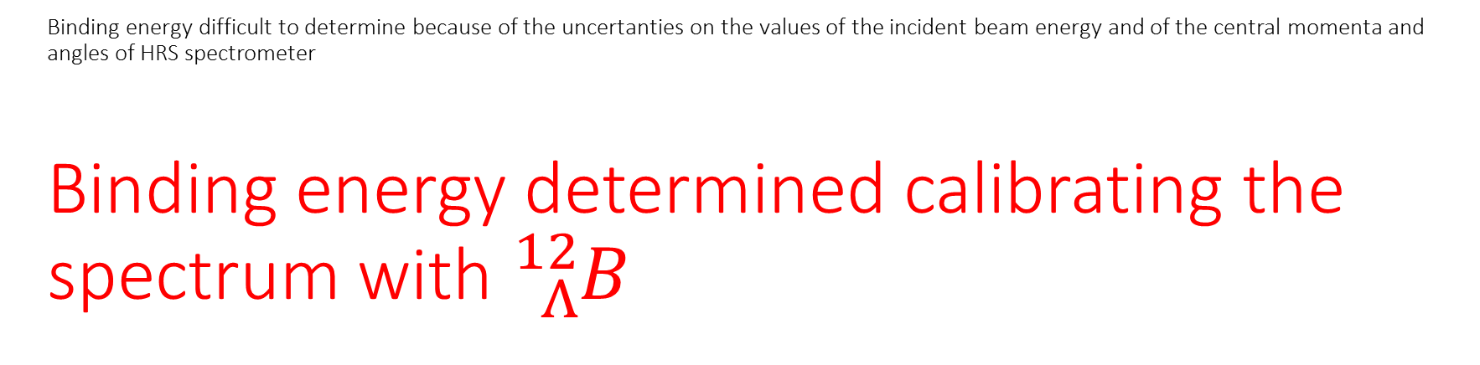
Binding energy difficult to determine because of the uncertanties on the values of the incident beam energy and of the central momenta and angles of HRS spectrometer
Binding energy determined calibrating the spectrum with ${}_{Λ}^{12}B$
Is equal to a shift that is equal for all the targets + a small term that depends unphysically on scattering coordinates

Slide 19
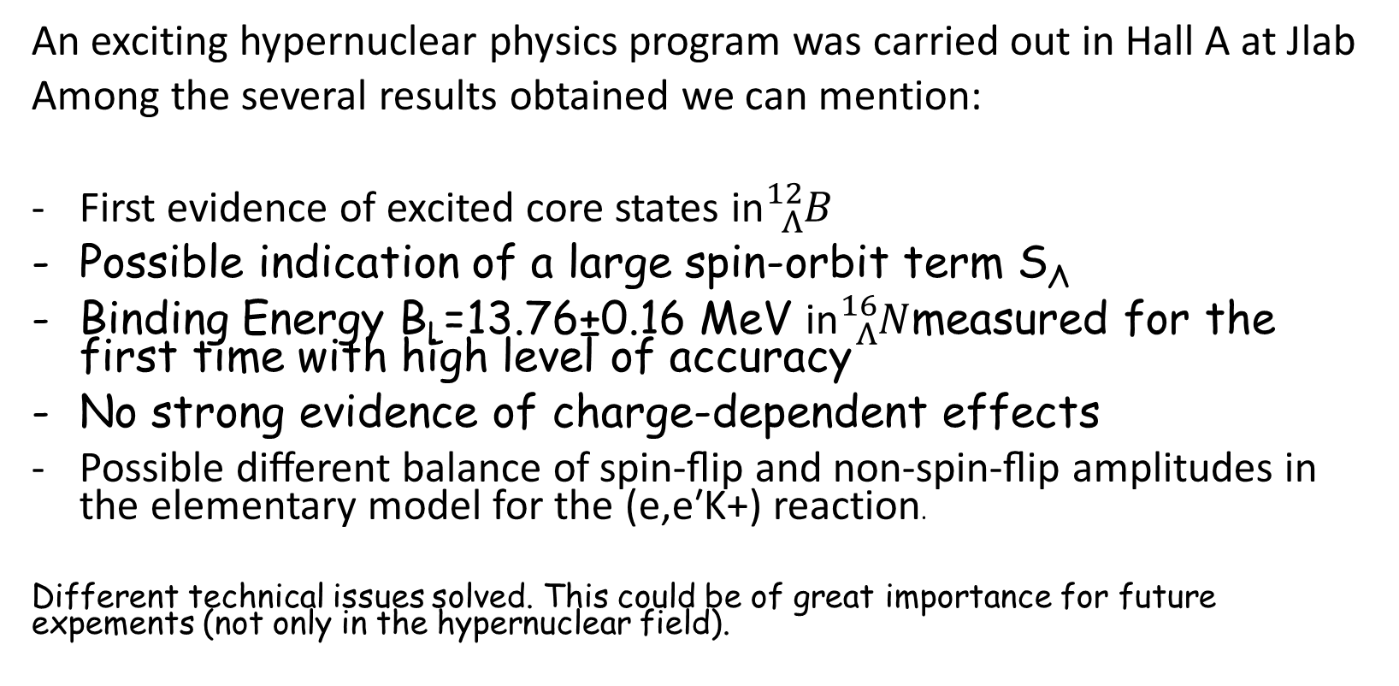
Conclusion
An exciting hypernuclear physics program was carried out in Hall A at Jlab
Among the several results obtained we can mention:
First evidence of excited core states in${}_{Λ}^{12}B$
Possible indication of a large spin-orbit term S_{Λ}
Binding Energy B_{L}=13.76±0.16 MeV in${}_{Λ}^{16}N$measured for the first time with high level of accuracy
No strong evidence of charge-dependent effects
Possible diﬀerent balance of spin-ﬂip and non-spin-ﬂip amplitudes in the elementary model for the (e,e′K+) reaction.
Different technical issues solved. This could be of great importance for future expements (not only in the hypernuclear field).

Slide 20
Spare

Slide 21

Single photon
Average
$χ^{2}$test

Slide 22
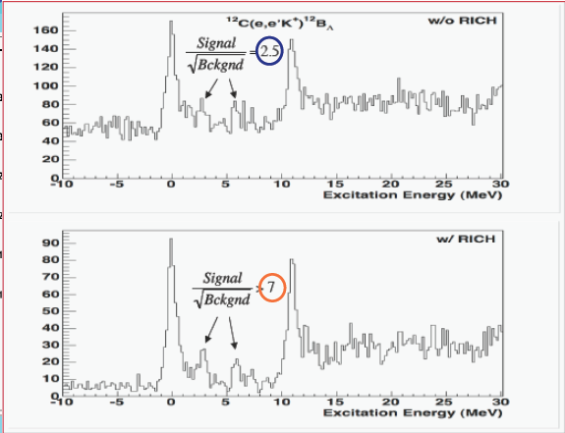
¹²C(e,e’K)¹²B_{L} M.Iodice et al., Phys. Rev. Lett. E052501, 99 (2007)

Slide 23

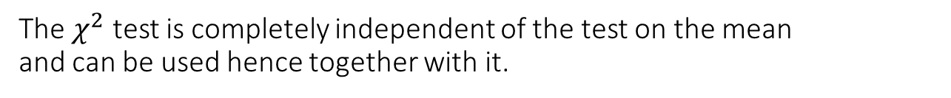
The $χ^{2}$ test is completely independent of the test on the mean and can be used hence together with it.
$χ^{2}$ test test on the variance of the distribution
Calculation of the average of the $θ_{i}$ test on the mean of the distribution
=
The $χ^{2}$ test always gives better rejection ratios than Maximum likelihood method

Slide 24
Radiative corrections do not depend on the hypothesis on the peak structure producing the experimental data
Non radiative corrected spectra
Radiative corrected spectra

